Slide 1

(WIMP) Dark Matter and the Nature of Neutrinos (part II)
Diego Gonzalez Diaz
9/01/2020, IGFAE retreat, Santiago

Slide 2

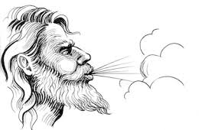





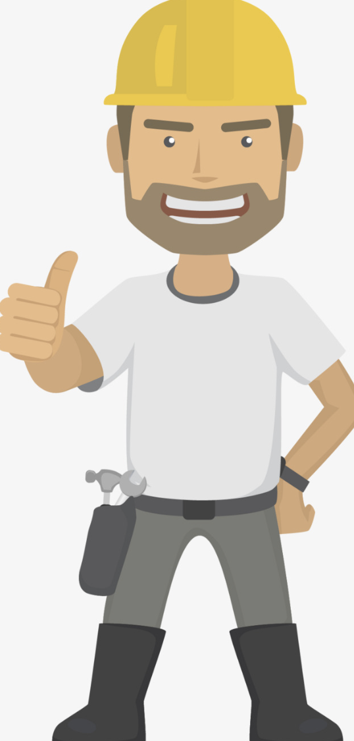

2019
Xunta (Fission
TPC)
CERN-RD51 (OTPCs)
FPA
(active targets)
FPA (NEXT)
Xunta (OTPCs
for Rare Event Searches)
group leaders
IPs
J. Saborido/A. Gallas (LHCb group)
B. Fernández/I. Durán (FICA group)
J. Benlliure (GENP group)
J. A. Hernando (LHCb group)
M. Caamaño (FICA group)
D. Gonzalez-Diaz (GENP group)
J. A. Garzón (LabCaF)
Faculty Dean
Institute Director
young researchers
Gonzalo
Junior (PhD)
Brais
(PhD)
Miguel
(PhD)
own the hangar
Enrique
(head engineer)
David
(technician)
Dani
(PhD)
Jose
(PostDoc)
Cris
(PostDoc)
Marwan
(PhD)
Gonzalo
Senior (PostDoc)

Slide 3
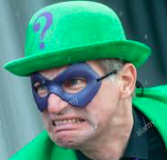
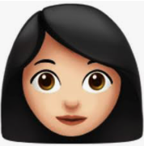
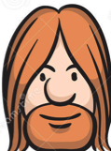
save the date: CERN-RD51 collaboration meeting
in June 22, 2020,
Santiago !
CERN-RD51
(cryogenic detectors)
new!
2020
IGNITE
(DUNE-ND)
new!
FPA (NEXT)
Xunta (OTPCs
for Rare Event Searches)
group leaders
IPs
J. Saborido/A. Gallas (LHCb group)
J. Benlliure (GENP group)
J. A. Hernando (LHCb group)
D. Gonzalez-Diaz (GENP group)
J. A. Garzón (LabCaF)
Faculty Dean
Institute Director
young researchers
Miguel
(PhD)
own the hangar
Enrique
(head engineer)
David
(technician)
(DUNE
PostDoc?)
A. Saa
(PostDoc)
P. Amedo
(PhD)

Slide 4
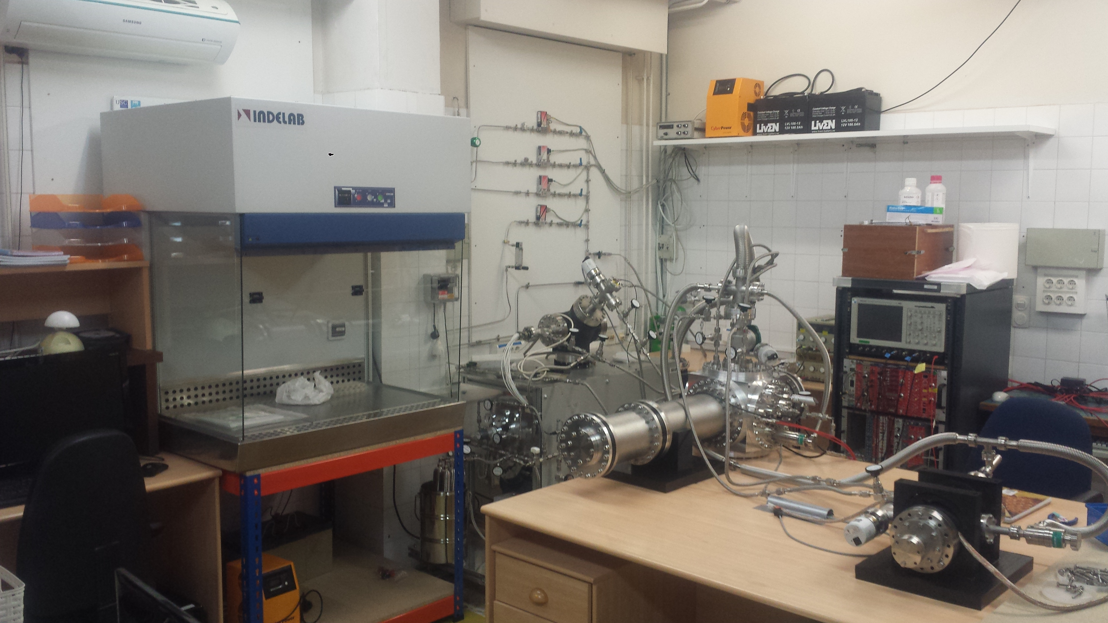
OTPC gaseous detector lab
Nausicaa0
(FAT-GEM studies)
Nausicaa1
(Optical TPC)
Nausicaa2
(R+D)
main results of 2019!

Slide 5
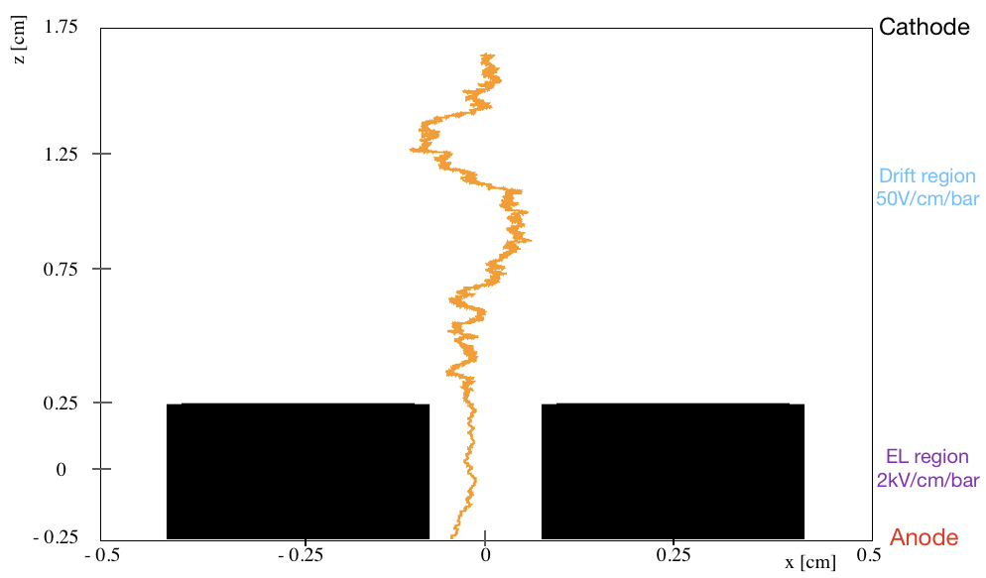
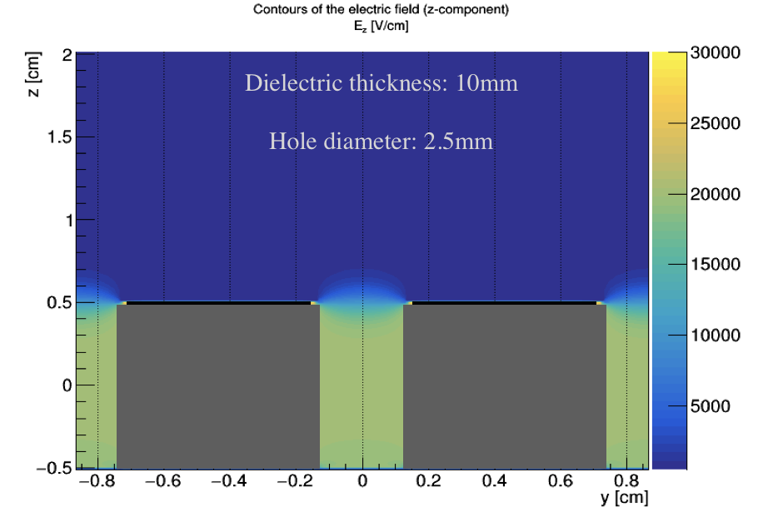
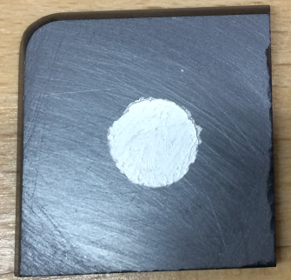
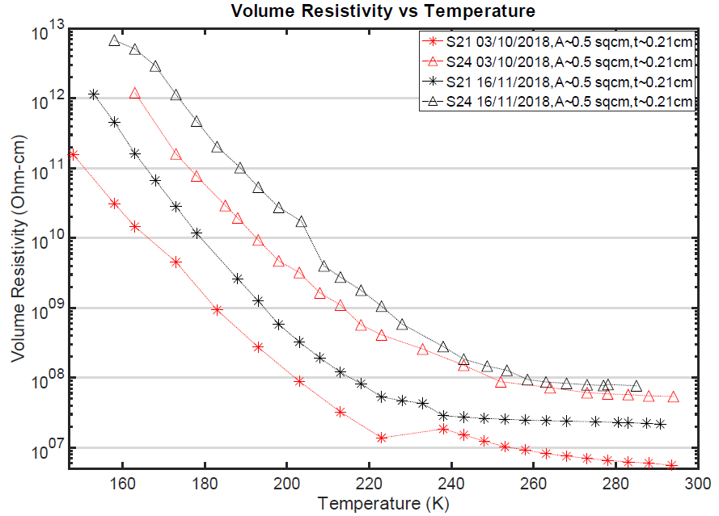
New amplification structures for pressurized time projection chambers (e.g., NEXT).
‘FAT-GEM’ (Field-Assisted Transparent Gaseous Electroluminescence Multiplier)
FAT-GEM: a ‘super-thick’ (5mm) acrylic-based GEM with semitransparent ‘gate’ plane
several geometries procured at the RD51 workshop
designed, tested, optimized at IGFAE
‘A new amplification structure for time projection chambers based on electroluminescence’, D. González-Díaz, M. Fontaíña, D. García Castro et al, arXiv:1907.03292 [physics.ins-det].
New amplification structures for cryogenic time projection chambers (e.g., XENON and DUNE).
G10 source Holder
RP-WELL (for cryogenic operation)
10 mm
standard thick-GEM coupled to a resistive electrode
Ne/CH₄
cathode/mesh
uncollimated ⁵⁵Fe source
5mm
0.6 mm FR4 single-sided THGEM
Fe Ceramic RP, 2 mm
measurements at Weizmann Institute (A. Roy)
conductive anode
developed by IGFAE in collaboration with ICMM
‘First results of Resistive Plate Well (RP-WELL) detector operation at 163K’, A. Roy, M. Morales et al, JINST 14 (2019) no.10, P10014.

Slide 6
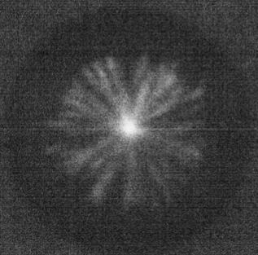
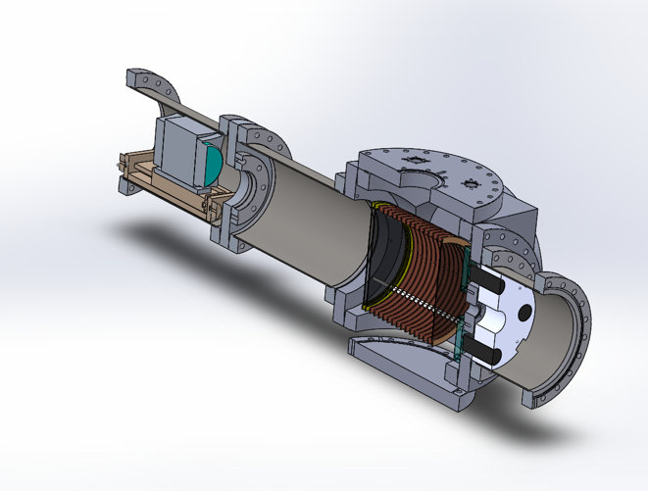
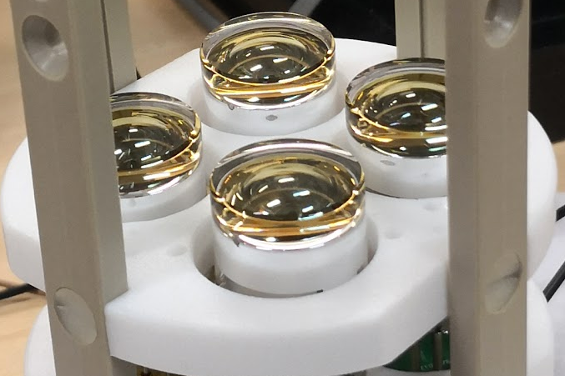
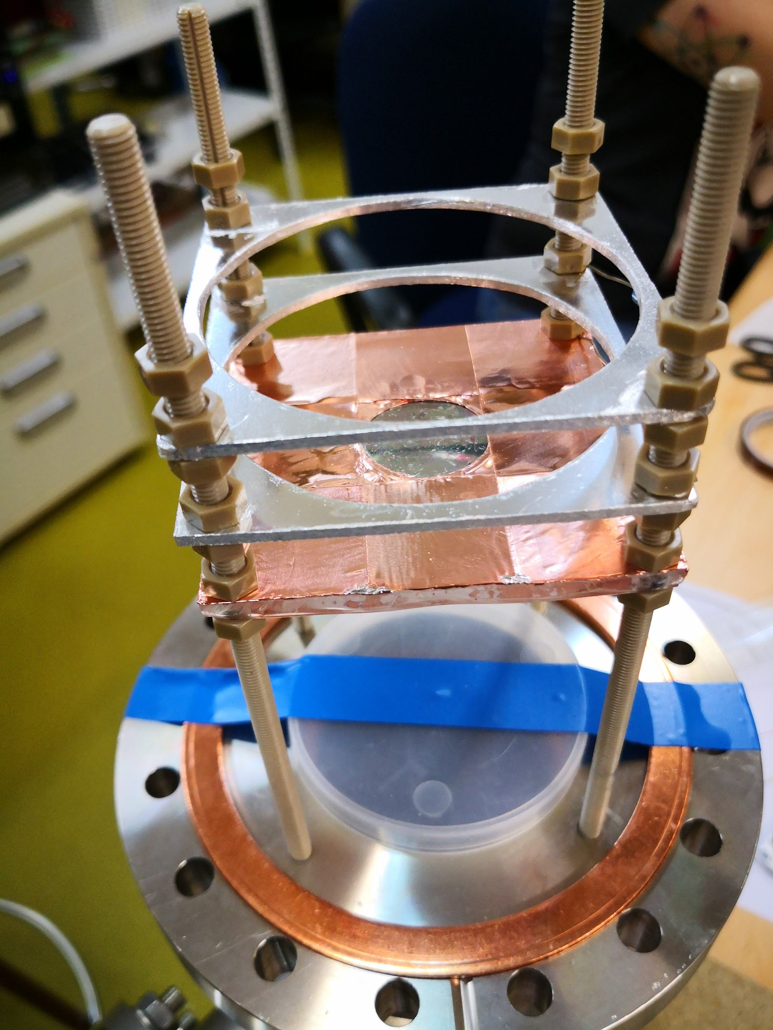
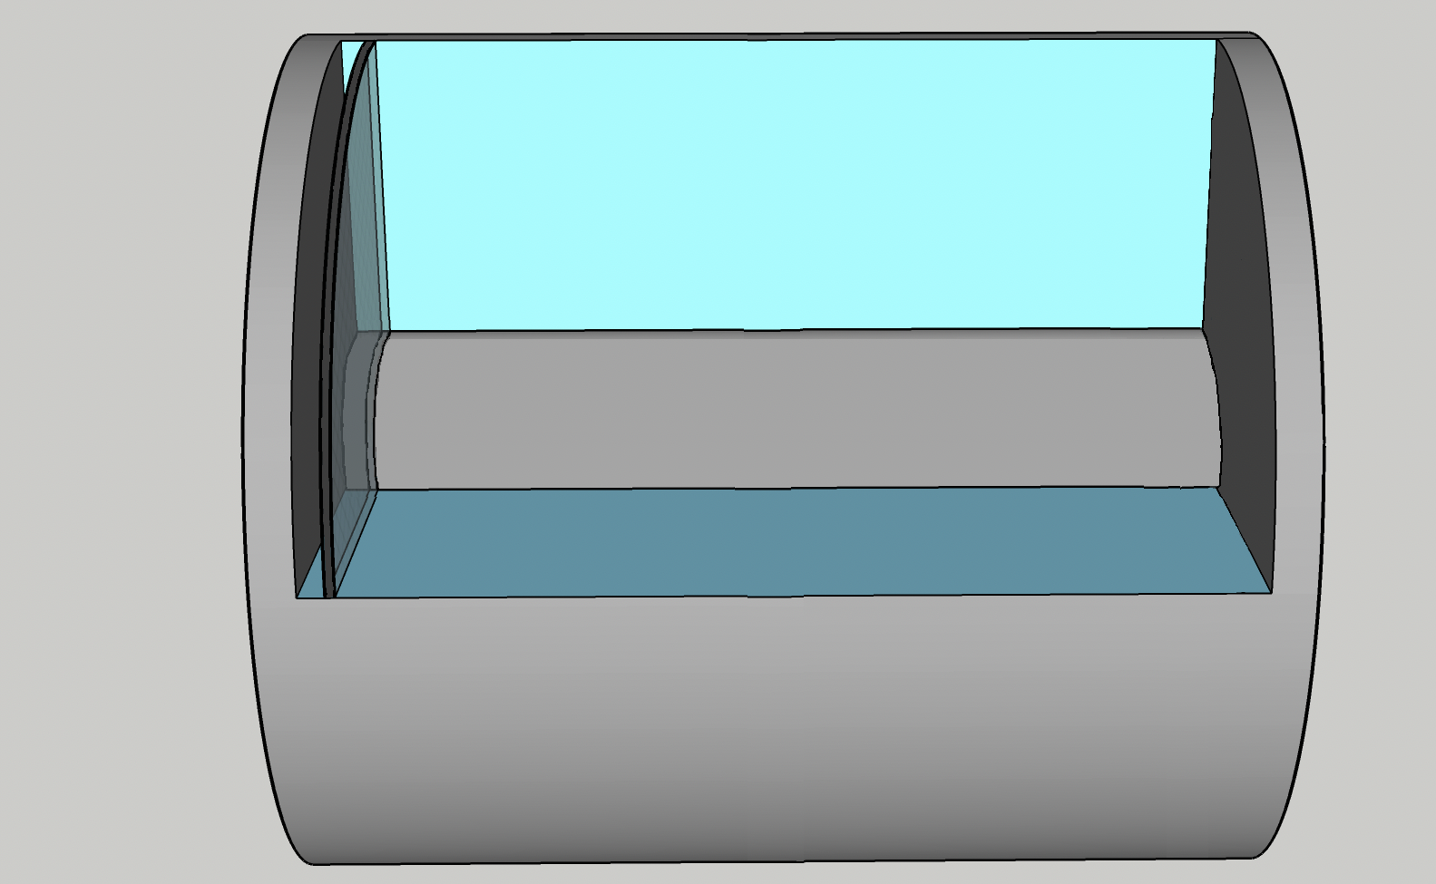
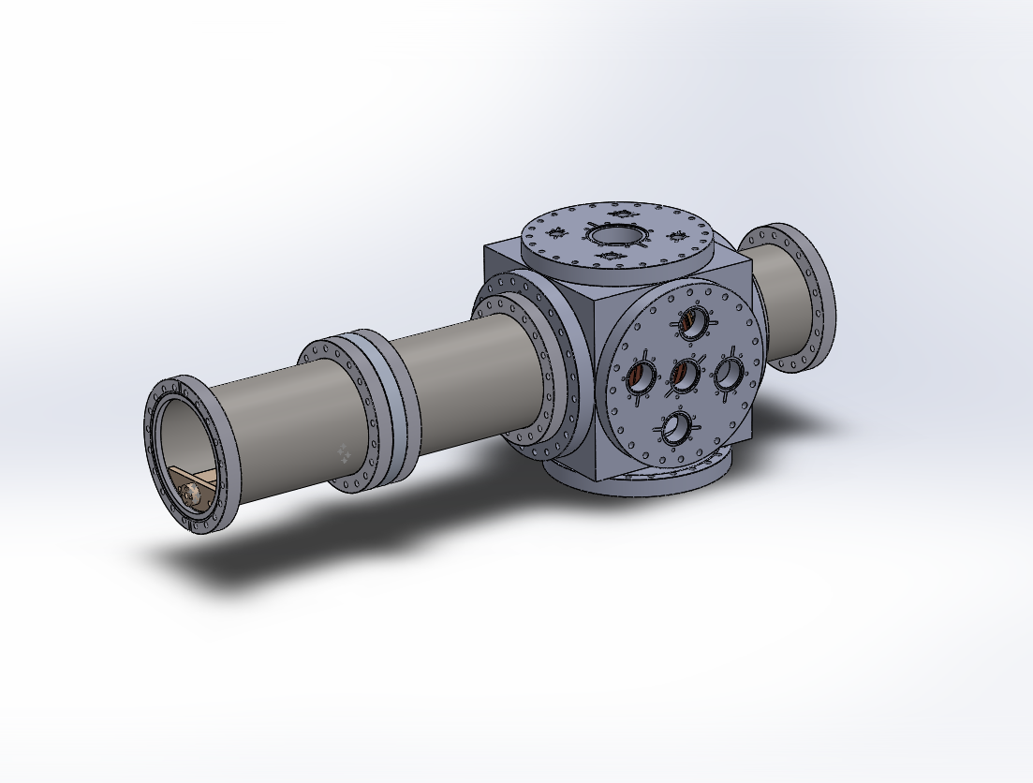
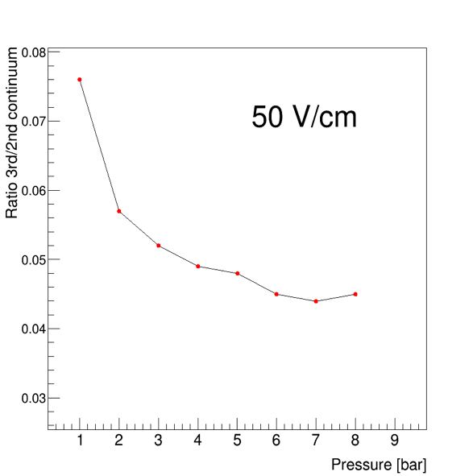
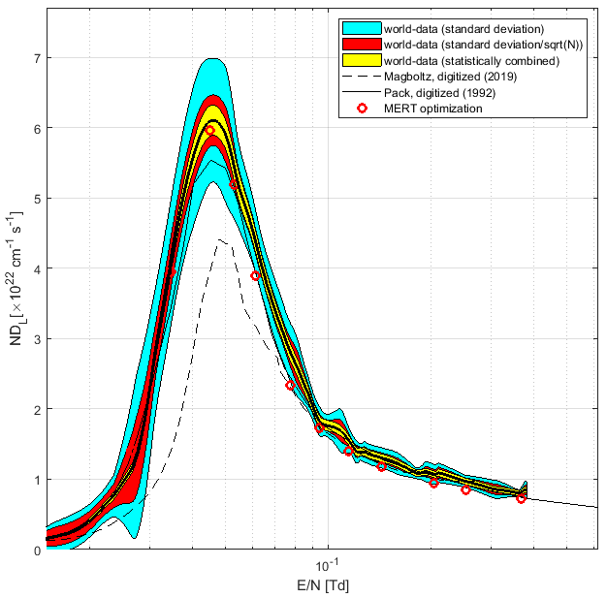
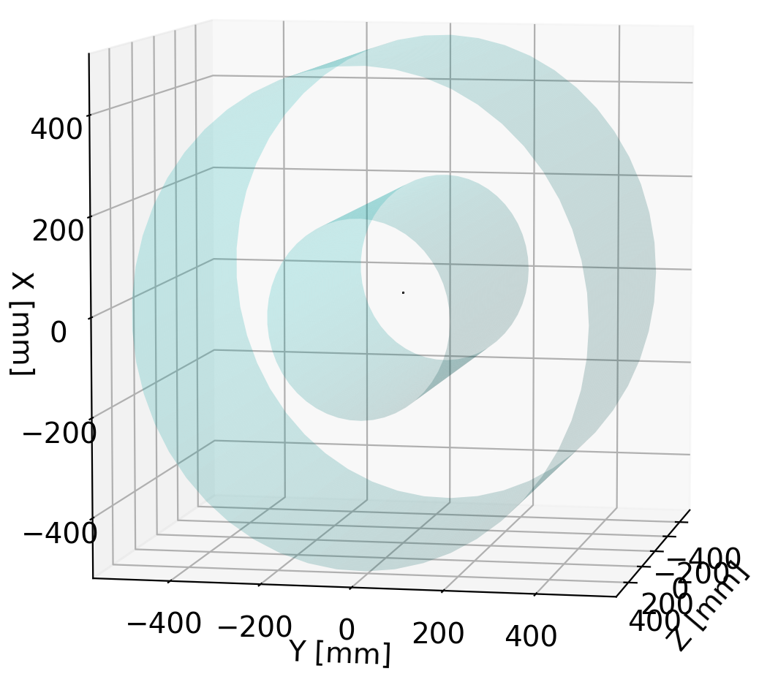
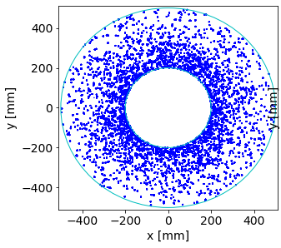
Refactorization of state of the art TPC simulation code from Fortran to Python.
‘Electron transport in gaseous detectors with a Python-based Monte Carlo Simulation Code’, B. Al Atoum, S. F. Biagi, D. González Díaz, B. J. P. Jones, A. D. McDonald, arXiv:1910.06983 [physics.ins-det].
Some teasers on ongoing activities towards next generation OTPCs.
𝛼-particles
OTPC
fundamentals of high-pressure xenon
applications
SiPM
plane
FAT-GEM
structure
cathode
e-
e-
hard X-rays
beamline
sample
y
z
x

Slide 7
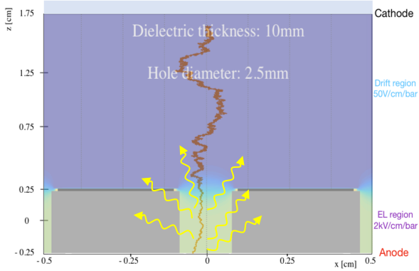
New amplification structures for pressurized time projection chambers (e.g., NEXT). Expanded…
NEXT concept for 𝛽𝛽0𝜈 searches
-28 kV
-7.9 kV
P = 10bar
E_{drift} = -53 kV/cm/bar
E_{EL} = -1.32 kV/cm/bar
☺
Unfortunately, electrostatic mesh/wire sagging limits the detector size!
Alternative:
develop rugged and versatile structures that can be customized at will.
☹
typical size of NEXT-100 (1m). NEXT-1T is at least 2m in size!.
stainless steel elastic limit: 700N/mm²
*JINST 13 (2018) no.10, P10002

Slide 8
New amplification structures for pressurized time projection chambers (e.g., NEXT). Expanded…
I. Design phase (IGFAE)
II. Fabrication (CERN workshops)
III. Characterization
(IGFAE)
IV. Data analysis (IGFAE)

Slide 9
New amplification structures for pressurized time projection chambers (e.g., NEXT). Expanded…
V. Some results
optical gain
energy resolution
First proof that this type of structure works at least as well as a conventional electroluminescence mesh in NEXT conditions!
Next steps:
Optimize the geometry (several patterns have been produced). At Santiago, several post-processing steps will be tried (wavelength shifting and resistive coating).
Scale-up the chosen design to at least 50cm x 50cm.

