Slide 1


Highlights 2019

Slide 2
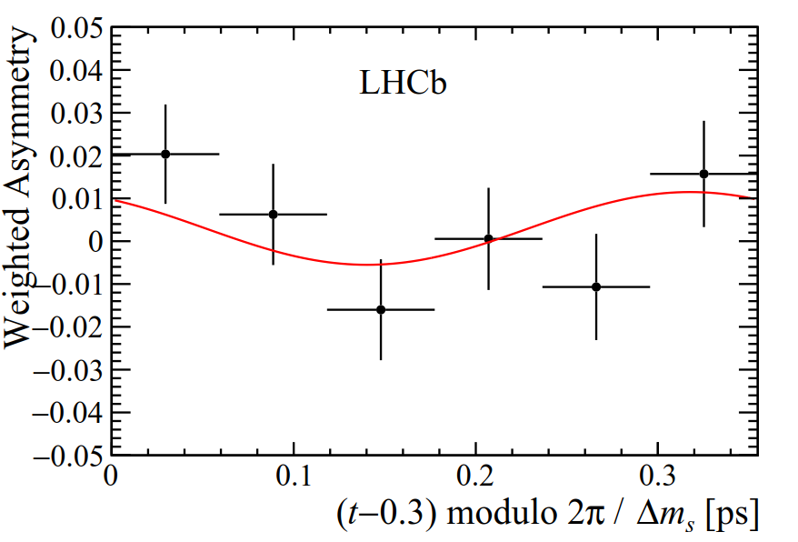




B_{s} oscillation
LHCb- PAPER-2019-013
Bs oscillation parameters and lifetime → One of LHCb’s main goals. Coordinated analysis between many countries (NL, GE, UK, US, CN...)
Crucial test for any model that predicts BSM in the Bs sector
Eg, B anomalies:
μ
Ζ’
W/A →
μ
b
Ζ’
s
SM : - 37  1 mrad
b
$$\overline{s}$$
s
$$\overline{b}$$
WG Convener: Veronika Chobanova
PhD thesis: Miriam Lucio (sup.: Diego Martinez & Veronika Chobanova)
Highlighted LHCb, RSEF

Slide 3

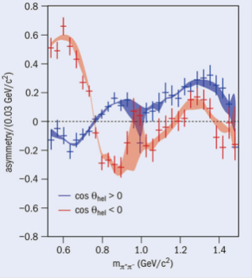
CP Asymmetry in B+ → 3π
Very large CPV (~60%) observed in B→3π decays in certain regions of the Dalitz plane
In principle it could be accommodated by QCD effects via ππ rescattering
Two papers:
* Accepted by PRD (editor suggestion)
* Accepted by PRL (editor suggestion)
Highlighted CERN courier July 2019
July 2019
J. Dalseno

Slide 4
Dark Photons searches
arxiv:1910.06926, accepted for publication in PRL
Update of dark photons with full Run 2 LHCb dataset
Make use of turbo data, i.e., reconstructed online (important achievement)
Look for displaced and prompt dark photons decaying to dimuons
No discovery, but world best result in large chunk of parameter space
X. Cid Vidal

Slide 5
K_{S}→μμ: The rarest detected decay?
LHCb-CONF-2019-002
Full LHCb dataset analyzed (9 fb⁻¹)
No evidence for signal (1.4σ)
New world best upper limit (improved by a factor ~4)
Nov 2019
BR(K_{S}→µµ) < 2.1x 10⁻¹⁰
@ 90% CL
If SM prediction (5e-12) is correct → 2 events in dataset → rarest decay ever recorded?
At 1σ:
Most precise BR @ the LHC !
Thesis Miguel Ramos Pernas about to finish
5

Slide 6
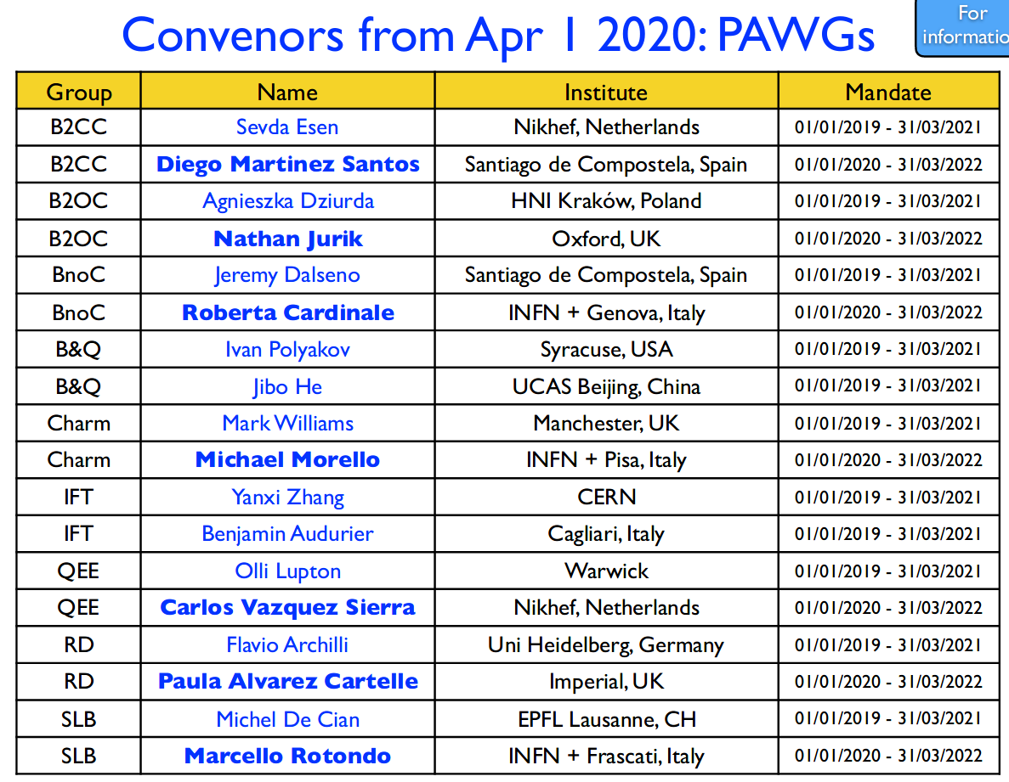

Slide 7
Trigger and reconstruction (now called RTA)
Expertise in tracking, trigger and particle identification
Trigger for low pt (~80 MeV) muons to make LHCb a leading experiment in strangeness physics (→ WP1 de ERC-StG)
PERIOD | Efficiency (K→μμ)
2011 | ~ 1%
2012 | ~2.4 %
Run-II (expected) | ~18 %
Full sw trigger | >~ 100%
Upgrade:
Muon reconstruction algorithms: under development
Spanish contribution to RTA (real time analysis) now settled, together with URL, IFIC & Daniel Campora (NIKHEF/Sevilla)
R&D in HLT architectures (basically GPU vs CPU):
TestBench : Installation of a gamer GPU farm with 20 RTX 2080Ti
(4% of the proposed full farm) . Budget 22k euros (50% USC –convenio Maru-ERC,
50% LPNHE)
We also use GPU’s for analysis: framework in pyCUDA to substitute ROOT/RooFit (arXiv:1706.01420v1 )

Slide 8
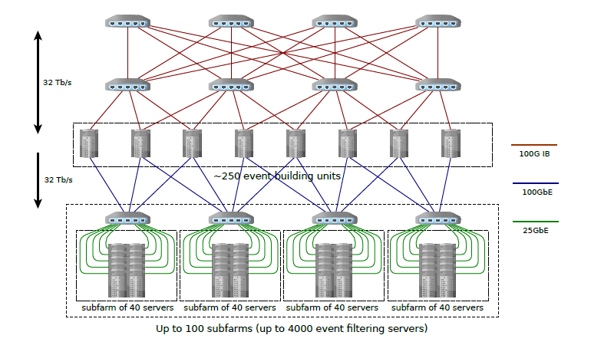
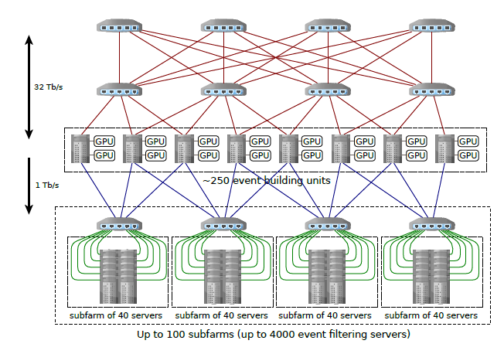
A GPU-based trigger?
LHCb has an ongoing proposal for a GPU based HLT1, called Allen
~5 PFLOPS
CPU paradigm (baseline):
* The CPU farm processes both HLT1 & HLT2
GPU paradigm :
* The GPU’s replace the event building units, and run HLT1
* CPU farm has to process only HLT2
* Mind also the cheaper network system → the cost reduction in network is already enough to pay the GPU farm!

Slide 9
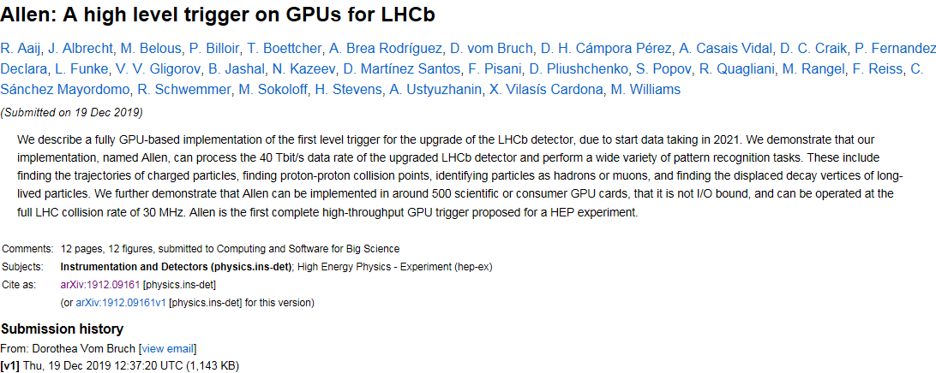
A GPU-based trigger: Status
submitted to “Computing and Software for Big Science”
https://arxiv.org/abs/1912.09161
Now:
Reconstruction thresholds lowered to 0 pT
Management requested to proceed to TDR → mid/end January

Slide 10
Publications, theses…
Publications 2019:
  7 LHCb PAPERS
  1 LHCb CONF (to become paper early 2020)
  2 LHCb trigger papers
  1 LHCb Hardware paper
  1 CodexB design paper
  7 Phenomenology (SUSY, B anomalies, Dark Matter, LLP’s, Axions, muonium, Charmless B decays …)
  2 Yellow reports (flavour, direct searches)
  Other (strangeness program, LLP community) : 2
Theses:
3 Theses presented in 2019 ( 2 of them cosupervised with members from the previous talk). Now they are postdocs at NIKHEF, Zurich and EPFL
Ongoing: 5 PhD theses, 5 master/bachelor theses

