Slide 1
Introduction
Process mediated by the weak interaction between two isobars
β⁻
( N , Z ) ---> ( N-1, Z+1 ) + e⁻ + ν
M(Z) - M(Z+1)= E_{β} + E_{ν} + Ex
β⁺ + EC
( N , Z ) ---> ( N+1, Z-1 ) + e⁺ + ν
M(Z) - M(Z-1)= E_{β}+ + E_{ν} + 1022+ Ex
EC
(N , Z)
β⁻
n
p
β⁺
1022 keV
E_{β}− _{max}
γ
Q_{β}
Q_{EC}
γ
E_{β}+ _{max}
E_{x}
S_{p}
E_{x}
γ
S_{n}
γ
(N-1 , Z+1)
(N + 1 , Z - 1)
daughter

Slide 2
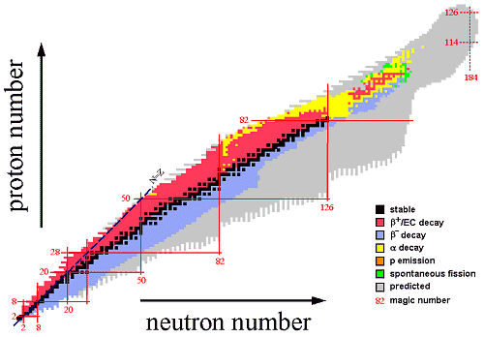
Beta Delayed Particle Emission
Beta decay is the preferred mode of desintegration
βdF
βp from Z = 8-73
βn from Z = 3-180
β2p
βα,βpα
Close to 400 nuclei emit delayed particles
Exotic decays
βd, βt
Near the drip lines
N

Slide 3
Planning and References
Beta delayed Particle emission
  Mechanisms of Breakup
  Analysis technique
  References:
“Particle Emission from Nuclei” Ed. D.N. Poenaru & M.S. Ivaçcu
CRD 1989 Vol I, II, III
B. Blank and M.J.G. Borge, Prog Part and Nuc. Phys 60 (2008) 403
M. Pfützner, L.V. Grigorenco, M. Karny & K. Riisager,
Rev. Mod. Phys,ArXiV:1111.0482
Euroschool on Exotic Beams, Lectures Notes:
“Decay Studies of N~Z Nuclei”, E. Roeckl,
École Joliot-Curie de Physique Nucleaire, 2002

Slide 4
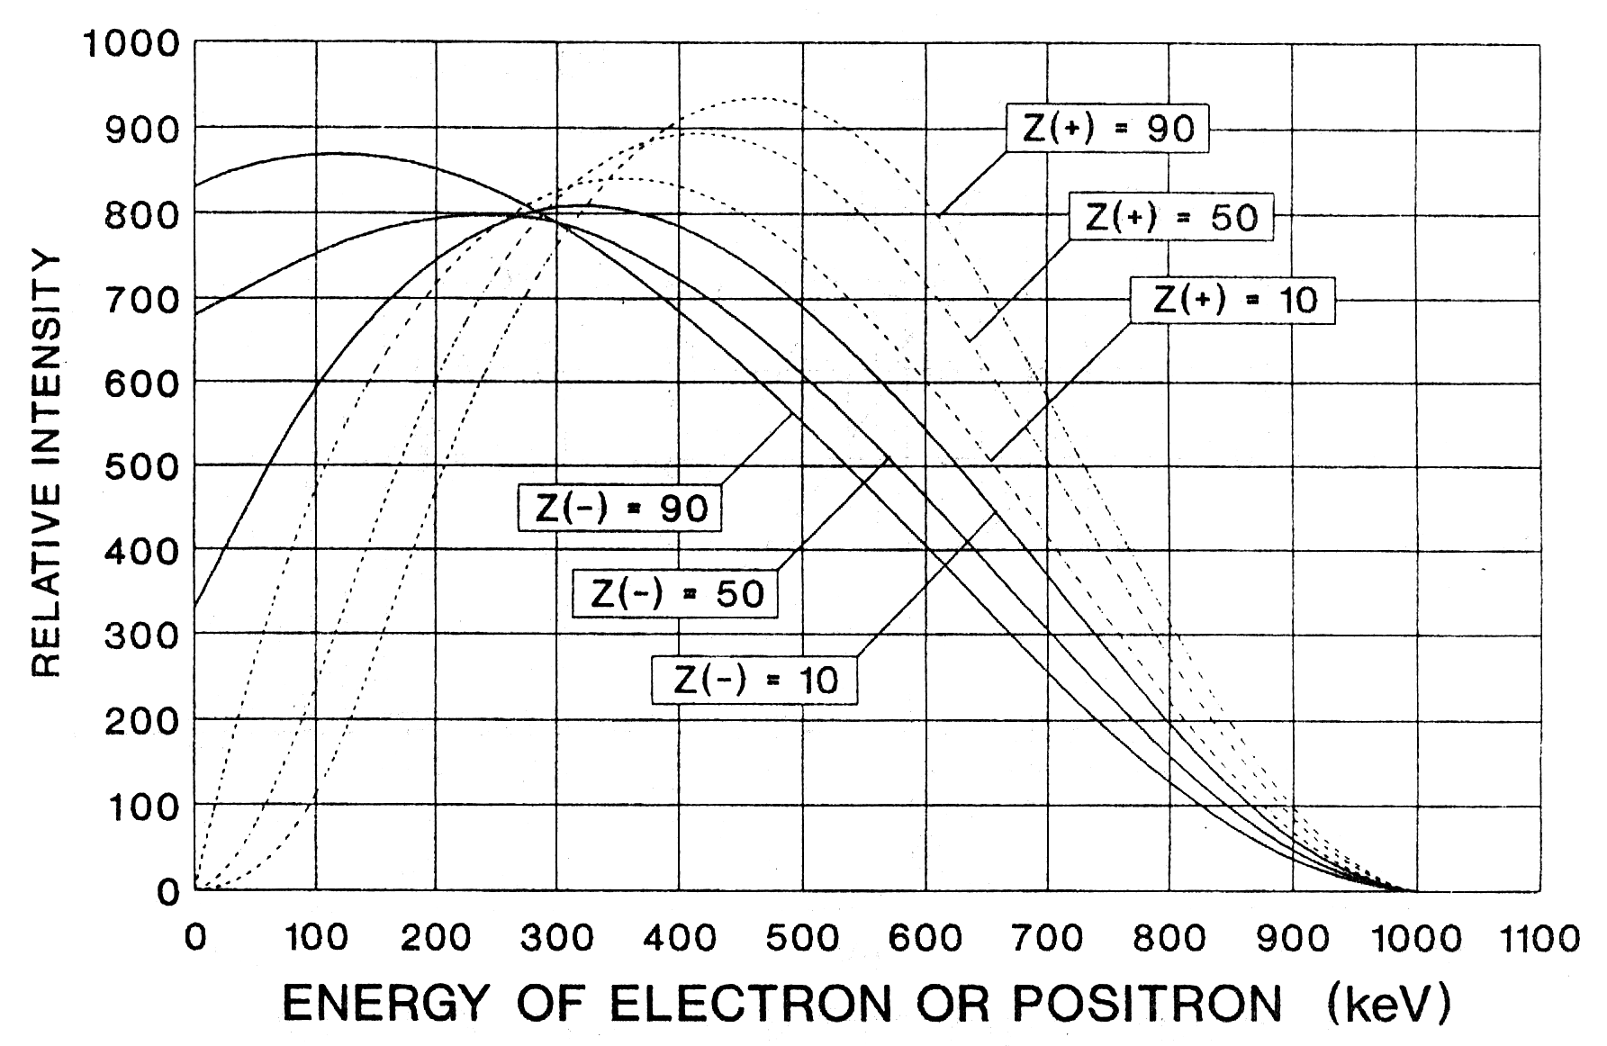
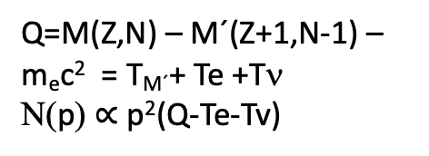
Reminder
Spectra β±
Expand in a large E-scale
E_{β}−= 2,6 keV (¹⁸⁷Re, β⁻)
E_{β}−= 22800 keV (²²N, β⁻)
Q=M(Z,N) – M´(Z+1,N-1) – m_{e}c² = T_{M´}+ Te +Tν
Ν(p) $∝$p²(Q-Te-Tv)
Half-life
³⁵ Na, T_{1/2} = 1,5 ms
T_{1/2} : ms --> 10¹⁵ years
⁵⁰V, T_{1/2} = 10¹⁷ y; (¹¹⁵In, 10¹⁴ y ; ¹¹³Cd, 10¹⁵ y)
Emission of delayed particles
β p, β2p, β3p, ...βn, β2n ...
P_{p} = 6 10⁻⁶ (¹⁵¹Lu) to 100 % (³¹Ar)
P_{n} = 5,5 10⁻⁴ (⁷⁹ Ge ) to 99 % (¹¹ Li)
Notes:
The three longest lived beta-decaying nuclei are given
The different in shape of the beta-spectrum of the electron and positrón are due to the influence of the nuclear Coulomb field on the electron/positrón plane wave function “repulsión for e+ and atraction for e-

Slide 5
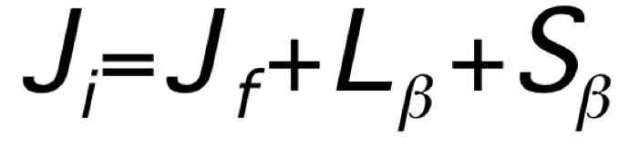

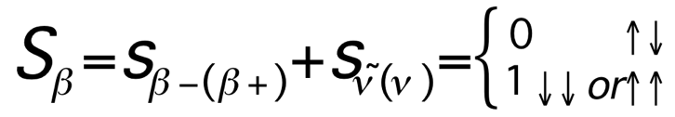
Classification of β-decay transitions
J_{i}π_{i}
Ε_{β}
J_{f}π_{f}
L_{β} = defines the degree of forbiddenness
allowed
forbidden
when L_{β}=0 and π_{i}π_{f}=+1
when the angular momentum conservation requires that
L_{β} >0 and/or π_{i}π_{f}=-1

Slide 6
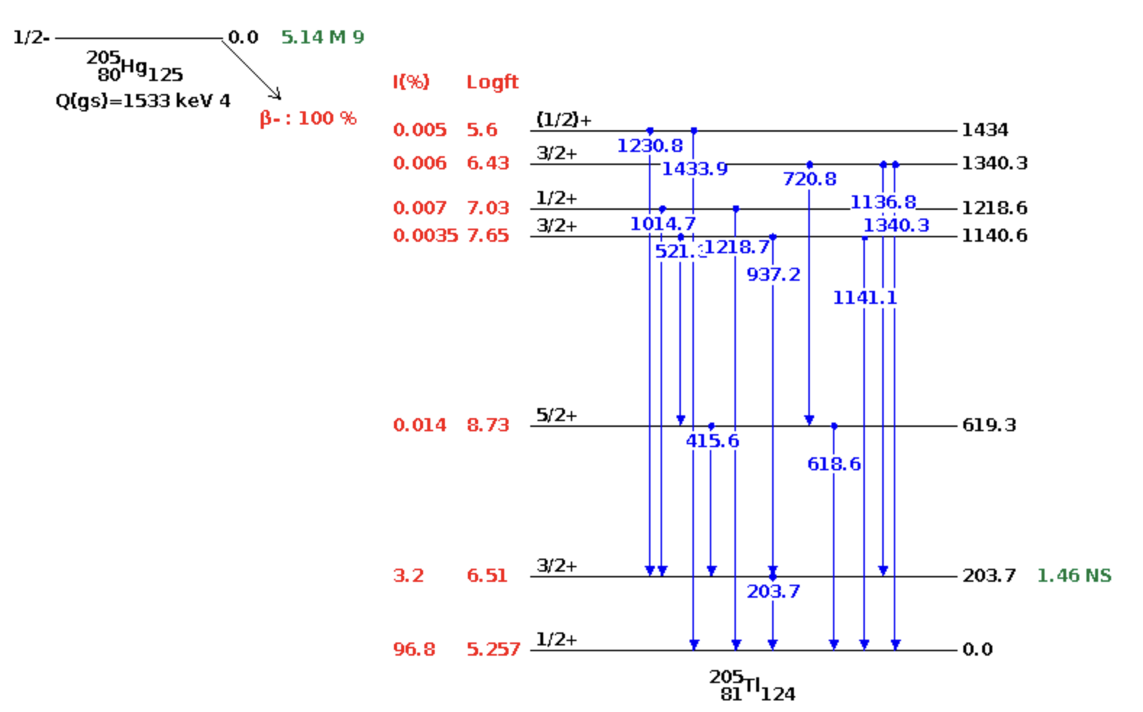
Practical example
What we want to know accurately
    T_{1/2}, I_{γ}, α_{T} & δ
In
Out
I(in) –I(out) [619,3 keV]= 0.69(10)

Slide 7
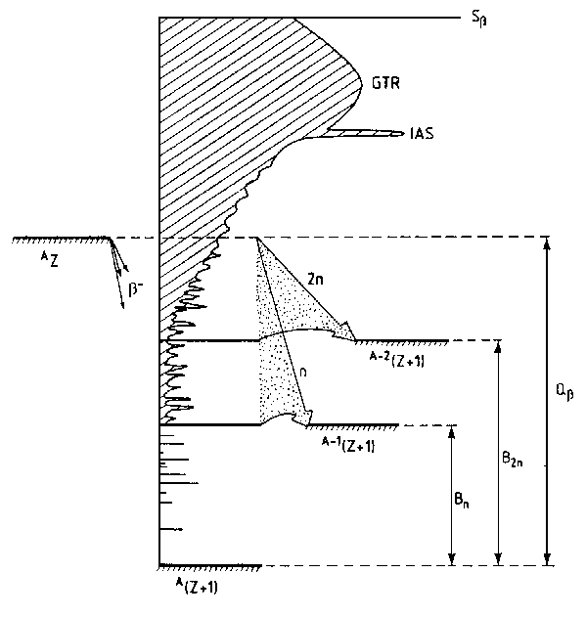
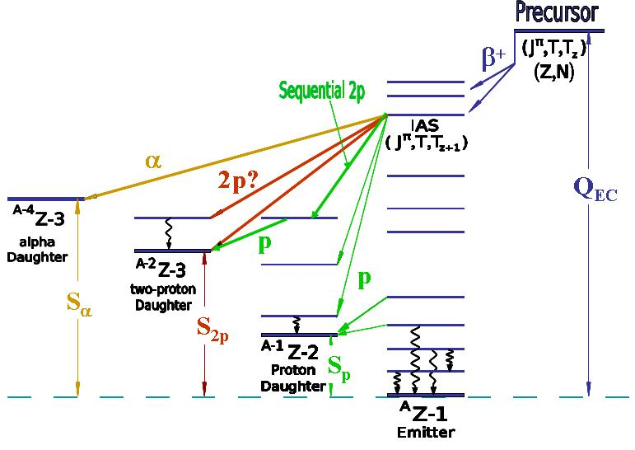

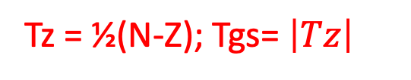
Beta Transitions
Tz = ½(N-Z); Tgs= $\left|Tz\right|$
β⁻ N > Z
β⁺ N < Z
β⁺ N > Z
T
T
T, IAS
IAS, T
T
T + 1
T - 1
T - 1
Neutron Rich
Neutron Defficient
Populated in Nuclear Reactions

Slide 8
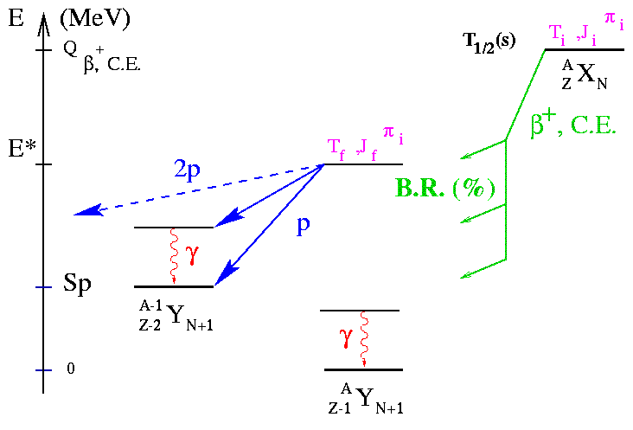
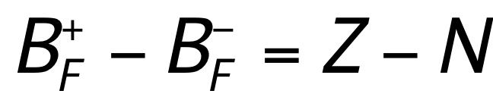
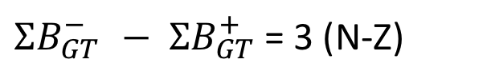
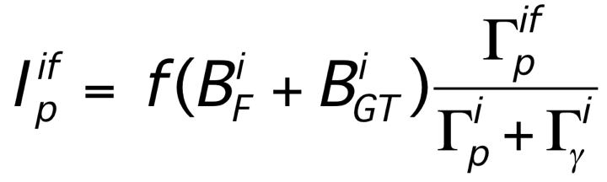
Decay properties of exotic nuclei
1916 Rutherford & Wood βα [Philos. Mag. 31 (1916) 379]
1963 Barton & Bell identified ²⁵Si as βp
Global properties
Short half-lives (∼ms)
High Q_{β} values
Low S_{p/n} values
β-delayed particle emission
Reduced transition probability:
K/G_{v}² = 6144(1) s = C and (G_{A}/G_{V})² = (-1,2695(29))²
Fermi Strength independent of Nuclear Structure
B_{F} = T(T+1)-T_{zi}T_{zf}
Gamow-Teller strength obeys the Ikeda sum Rule
E, Γ
Level density
Spin, Isospin
β-decay properties
$ΣB_{GT}^{− }− ΣB_{GT}^{+}$ = 3 (N-Z)

Slide 9
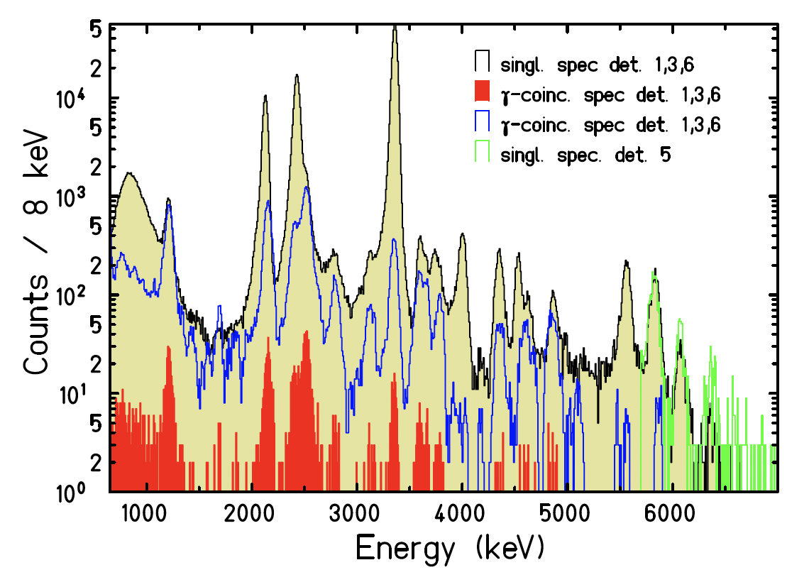
Beta-proton emitters
More than 160 precursors identified
For every element up to Z = 73 at least one proton precursor
The βp spectrum depends on the Z and A of the precursor and differs in the different mass region due to diferences in level density in the Q-Sp window
Properties of βp well understood → large variety of spectroscopic information
For light nuclei with Z ≥ 8, the IAS within the Q_{EC} window.
From βp energy of IAS ➔Q_{EC}-Sp deduced.
Test Isobaric Multiplet Mass eq.
M(A,T,T_{z}) = a + bT_{z} +cT_{z}² + δ(dT_{z}³+eT_{z}⁴)
If strength to IAS ≠ B_{F} ⇔ Isospin Mixing
If IAS in the middle of the Q_{EC} large part of the GTGR available => quenching factor deduced
Test of Mirror Symmetry
³²Ar
Blank et al, EPJA 57(2021)28

Slide 10
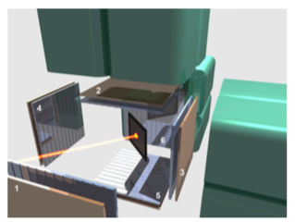
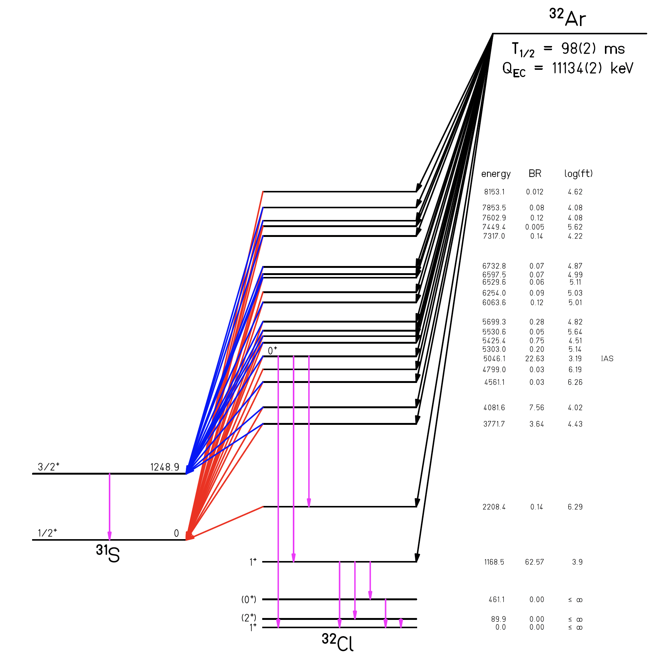
³²Ar(Z=18, N=14) → ³²Cl (Z=17, N=15)
0⁺
By βp → study up to 8153 keV →73% of energy window
22.6% feeding IAS→ logft = 3.19
Γ_{p} / Γ_{γ}(IAS) = 11.2(11)
= Γ_{p} + Γ_{γ} = 20(5) eV
The width of the IAS is very narrow as the proton emisión is isospín forbidden, facilitating the emisión of M1 transition of the 5.046 MeV IAS
B(F) = T(T+1)-T_{zi}T_{zf} = 2x3-(-2)(-1) = 6-2 = 4
Predicted mixing with 0⁺ T= 1 states →No strong feeding observed to states nearby.
Closest E = 5425 keV (ΔE = 379 keV)
T, Tz = 2,-2
IAS,
T, Tz = 2,-1
T, Tz = 1/2,-1/2
Sp =
T, Tz = 1,-1
Blank et al, EPJA 57(2021)28

Slide 11
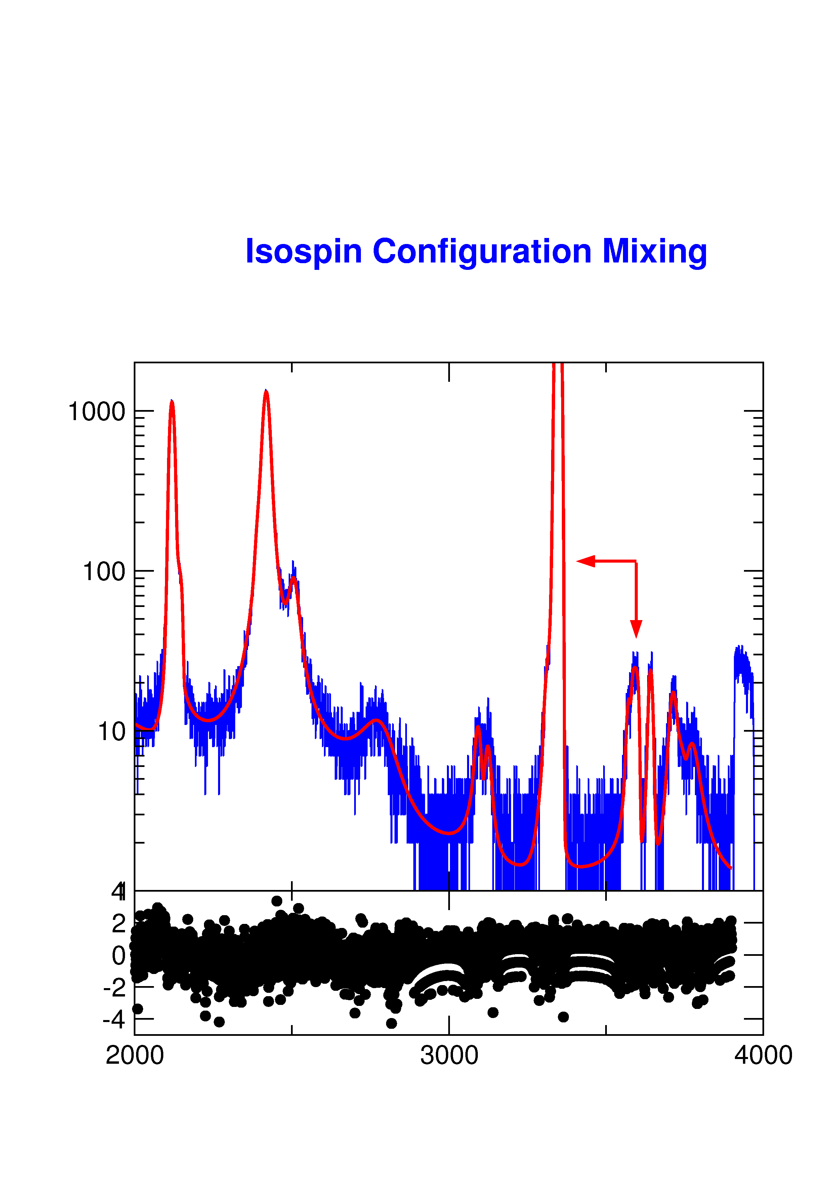
Electron-Neutrino Correlations (βp emitters)
βν correlation depends of the type of the transition
Important probe of the nature of weak interaction
The proton has info
about the ³²Cl recoil
(Doppler)
T_{1/2} = 98(2) ms
22.63%
³²Ar
E_{IAS} = 5046.1
Q_{EC} = 11134(2) keV
Instead of detecting
the neutrino
The V-A character of β-decay was determined by measuring the recoil energy spectrum of ⁶He
[Johnson et al, PR132(63)1149]
³¹S+p
³²Cl
Study of the proton line shape
Physics beyond the SM
Isospin mixing in Fermi decays
Configuration mixing
Level interferences
Spin assignment
Excitation energies
p
The delayed proton is a magnifing glass of the recoil energy
³²Ar
3.35 MeV
e⁺
5.1 MeV
³²Cl
³¹S
370 eV
ν
100 keV
0
Schardt & Riisager, Z. Phys. A 345 (1993) 265
Adelberger & Garcia, Hyp. Int 129 (2000) 237
2.5
E_{p} (MeV)
3.5

Slide 12
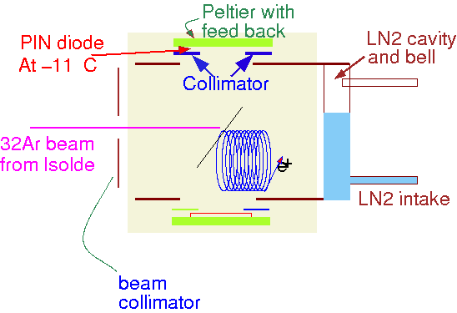
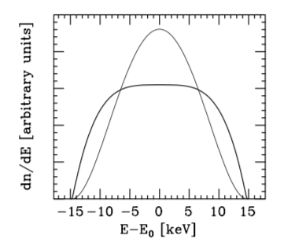
βν correlation studies: Search for New Physics
Set-up to avoid β-summing @ ISOLDE
³²Ar
0
2.5
E_{p} (MeV)
3.5
If βp emitter ⇒ measurement of e-ν correlation ⇒ F/GT nature of transition from the broadening of proton peak.
Limit for scalar component in beta decays
M_{S} ≥ 4.1 M_{W}
Adelberguer et al., PRL (1999)
GT
Fermi
Notes:
If βp emitter ⇒ e-ν correlation determined from the broadening of proton peak from IAS

Slide 13
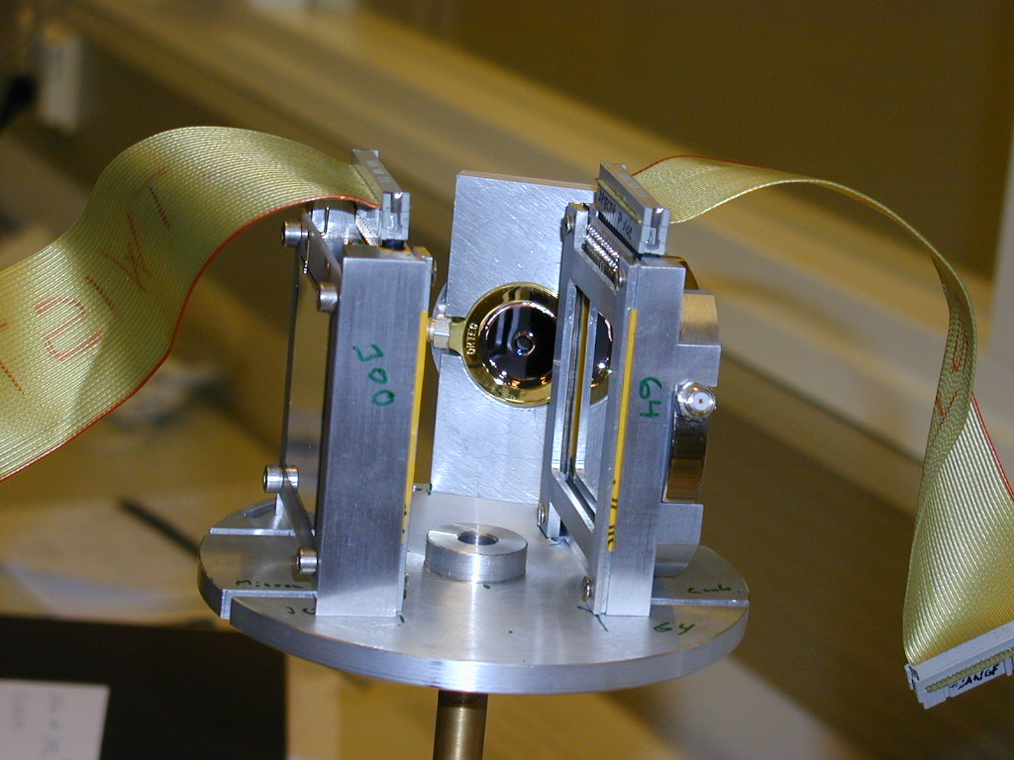
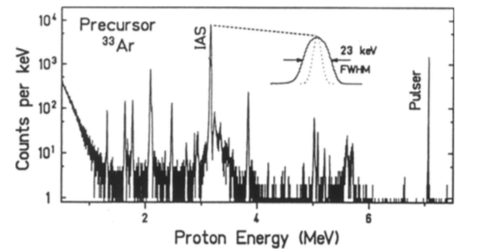
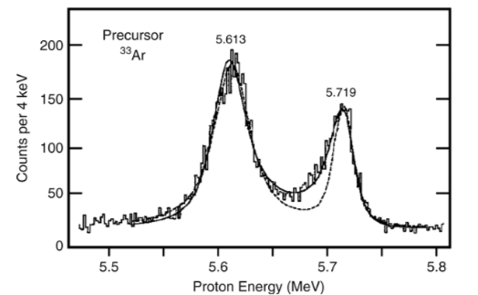
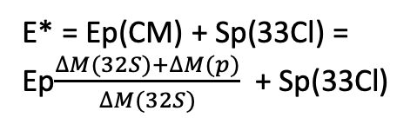
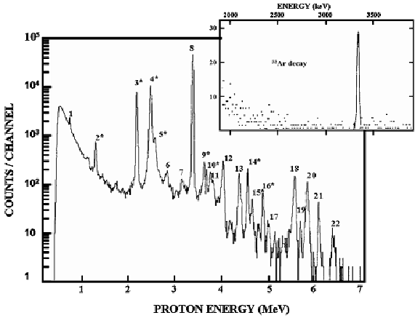
^{32,33}Ar – β decay
E-resolution = 8 keV
Angular correlations between e+ and ν in the Fermi and GT transitions → the Doppler effect larger recoil broadening of the proton lines for Fermi than for GT decay (Emission before the recoil daughter comes to rest)
Z. Phys. A 345, 265 (1993)
PRL39(77)792
³²Ar
VC-target
E* = Ep(CM) + Sp(33Cl) =
Ep$\frac{∆M(32S)+∆M(p)}{∆M(32S)}$ + Sp(33Cl)
³³Ar
T=2,-2
CaO-target
NPA443(85)283

Slide 14
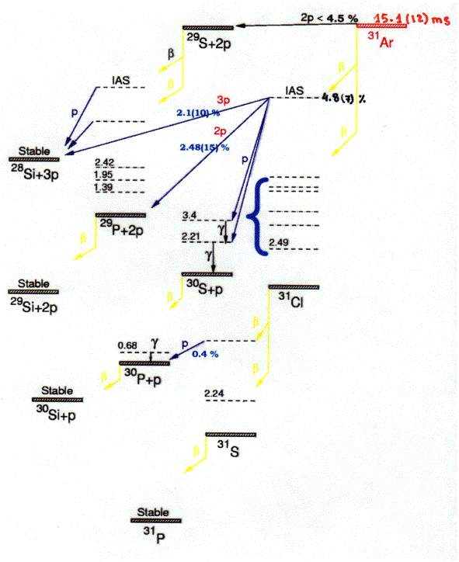
Q_{EC} = 18,36 MeV
The decay
of ³¹Ar
190 ms

Slide 15
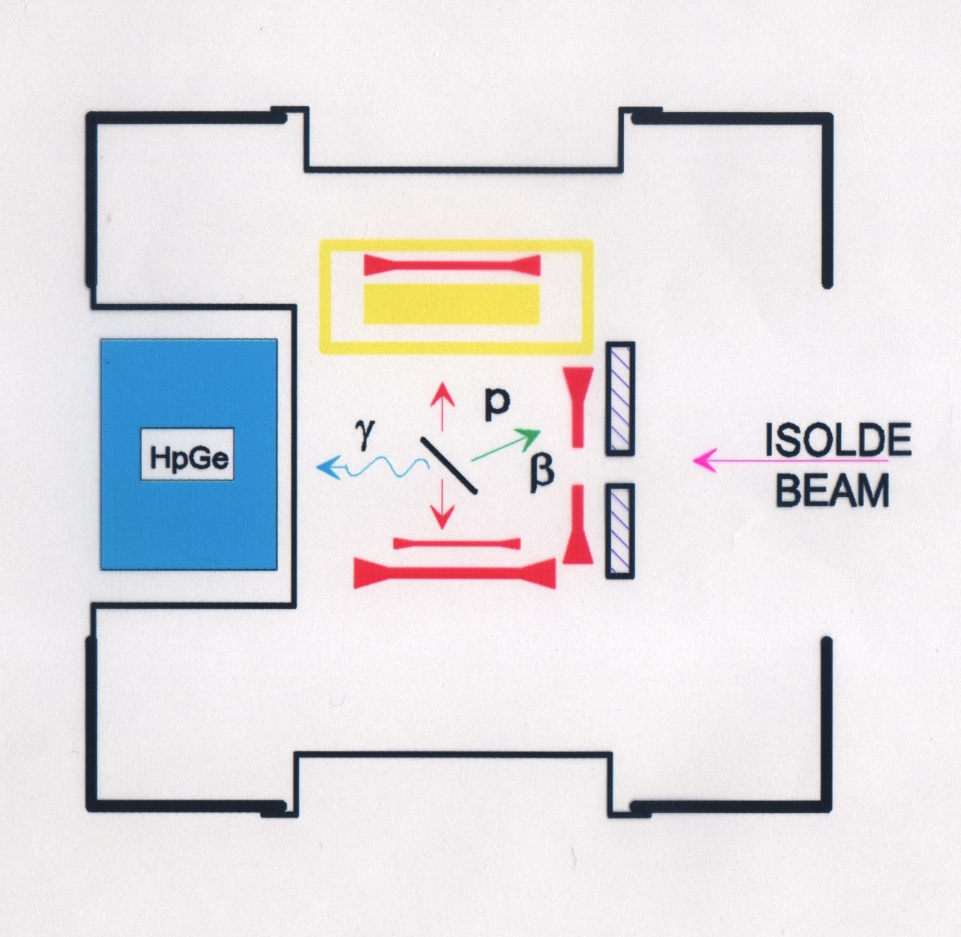
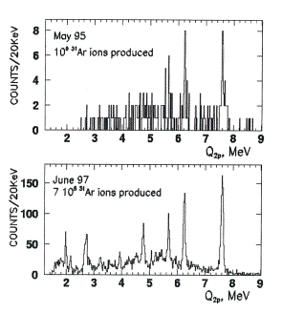
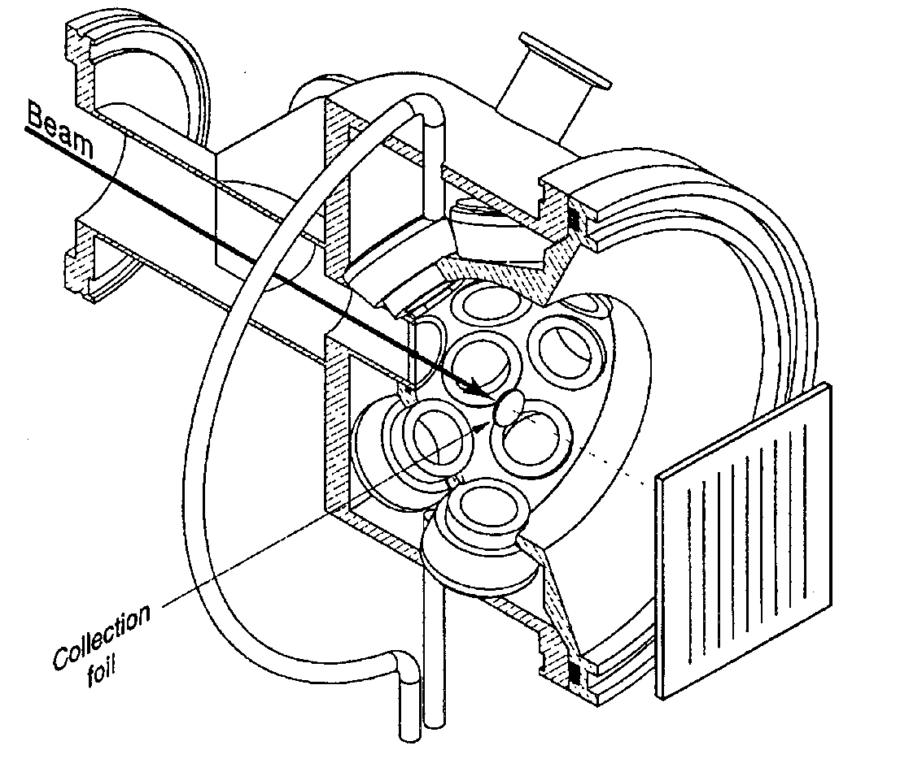
β-delayed 2p emission from ³¹Ar
Yield 2 atom/s
Solid angle 14 + 11 %
ε_{1p} 23.7 %
ε_{2p} 5.2 %
ε_{3p} 1.3 %
Granularity Increases Multiparticle Efficiency

Slide 16
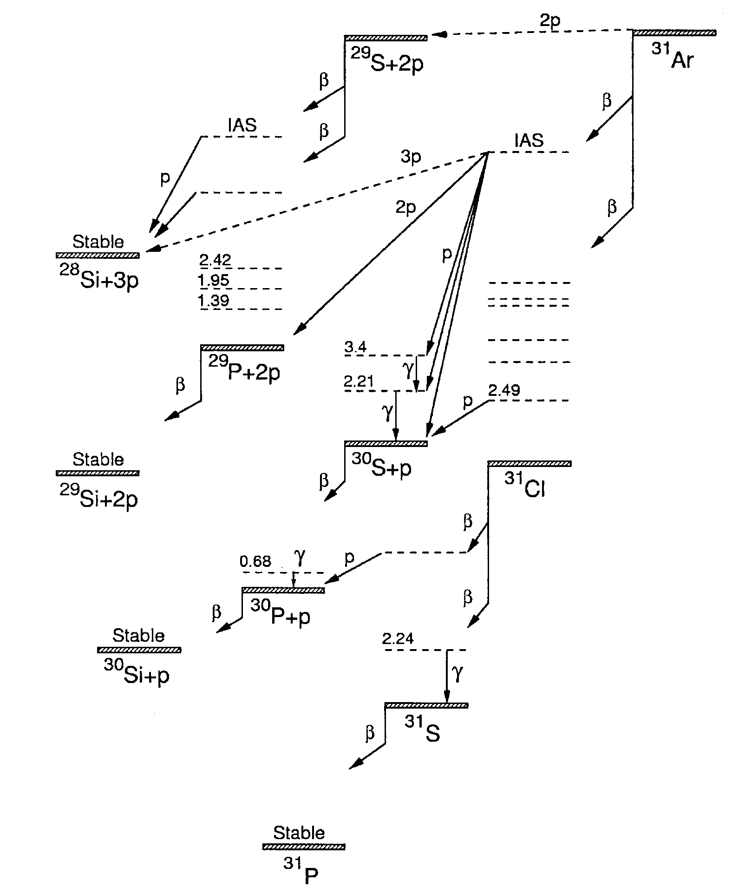
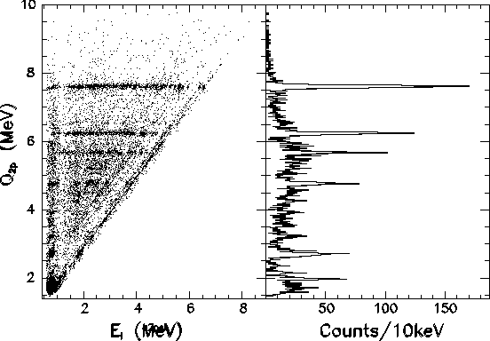
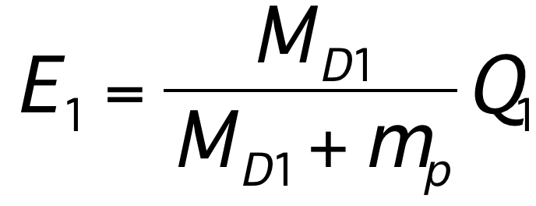
Diagonal from decays via single
intermediate state from many
initial states fed in beta-decay
M_{D1} = M(³⁰S)

Slide 17

2p emission from ³¹Ar IAS
a) Energy Conservation
b) Momentum Conservation
<10-4
62%
8,5%

Slide 18
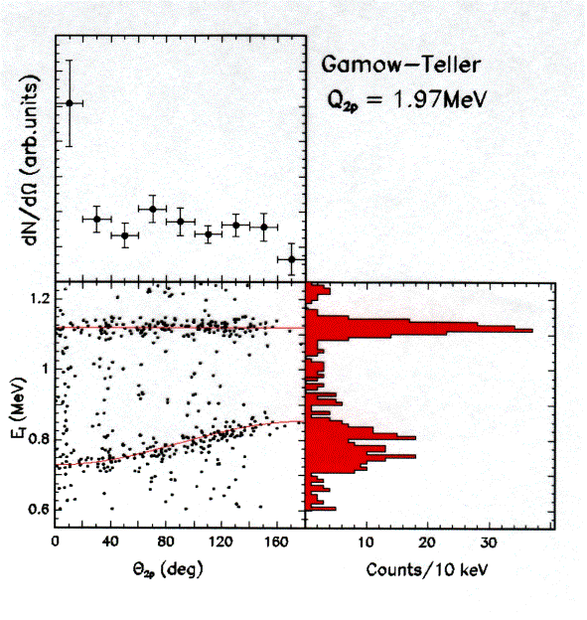
Individual proton projections from β2p in ³¹Ar
In sequential two-proton emission the energy of the first proton is
M_{D1} = M(³⁰S)

Slide 19
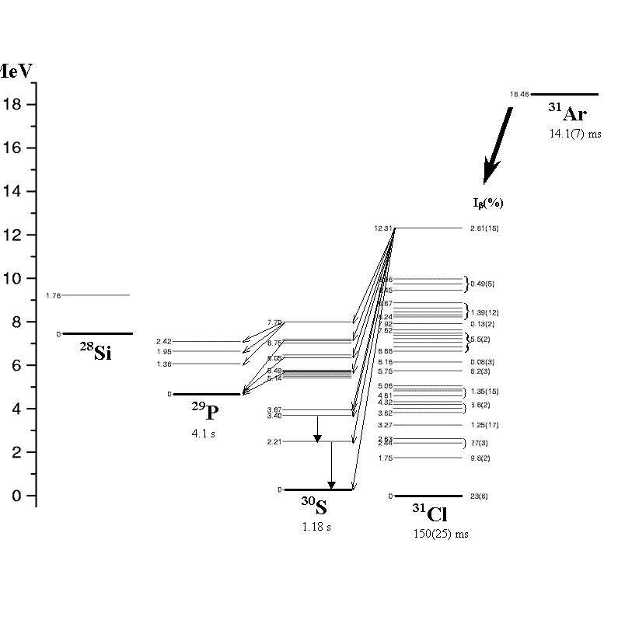
Decay of the IAS of ³¹Ar (Z =18,N=13)
E_{IAS} = 12322(2)(50) keV from Q2p
Q_{EC} = E_{IAS} + ΔEc - Δnp
ΔEc = 1448.8 [ZA^{-1/3}] – 1026.3 keV
Antony & Pape [ADNDT 34 (86) 279]
ΔEc =7045 keV
Leaving the coef. free and using exp. Coulomb energy shifts
between ^{32,33,34}Cl and ^{32,33,34}Ar
ΔEc =6950(90) keV ⇒ Q_{EC} = 18,49(11) MeV
f(E_{βIAS})t_{IAS} = 6145(4) s / [B(F) + B(GT)]
b.r.(IAS) = T_{1/2} / t_{IAS}
B(F) = [T(T+1)-T_{zi}T_{zf}]δ_{if}= 5
Expected b.r. (IAS) = 4.35(31)%
Experimentally: b.r. (IAS) = 4.25(30) %
IAS
β2p/β1p (IAS) ∼ 9
Fynbo et.al. NP A677(2000)38

Slide 20
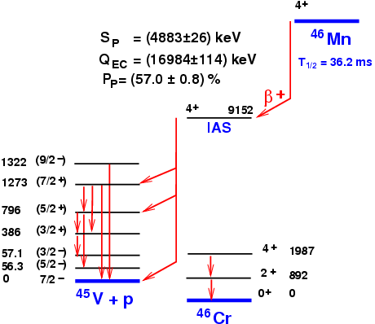
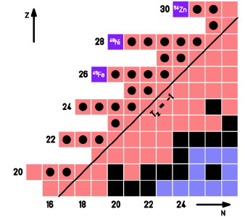
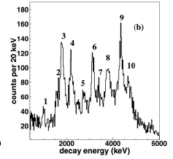
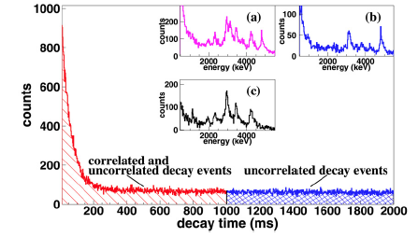
Mapping of Neutron Deficient nuclei 22 < Z < 28
Spectroscopy studies with β-p-γ, β-γ
23 isotopes Studied
Macroscopy Properties : T_{1/2}, P_{p}
Spectroscopy:
  Partial Decay scheme
  IAS Identification
  IMME
Dossat et al., NPA702 (2007) 18
⁴³Cr
β2p + β3p observed.
12 % feeding to bound states.
Pomorski PRC 83 (2011) 061303
β2p ?
⁴⁶Mn
P_{p} = (79.0 ± 2.7) %

Slide 21
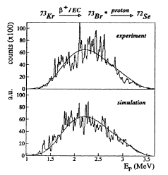
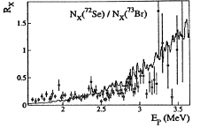
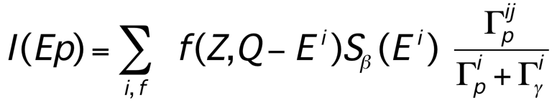
From peaks to continua (Hardy, Cargese, 1976)
βp explored high excitation energy in the daughter => individual transition are not longer resolved
^{(Z,N)}
Qβ⁺
(Z-2,N+1)+p
Q_{EC}
✔ To fit the proton spectrum average of the above quantities are considered.
Sp
^{(Z-1,N+1)}
βp + X-Ray ratio strongly constraint the level density distribution
Good estimate of proton and gamma widths for exotic nuclei of interest for nucleosynthesis
The Porter Thomas distribution accounts of the fluctuations observed in the spectrum
Giovinazzo et al, NPA674 (2000) 394

Slide 22
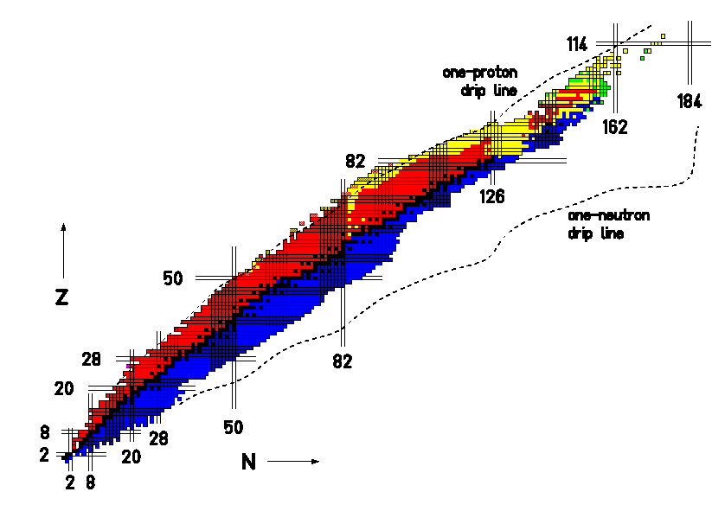
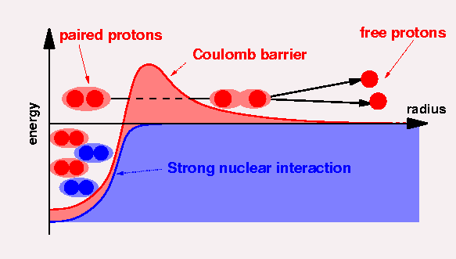
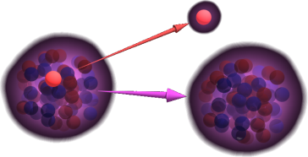
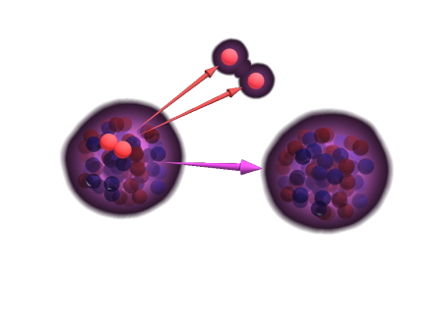
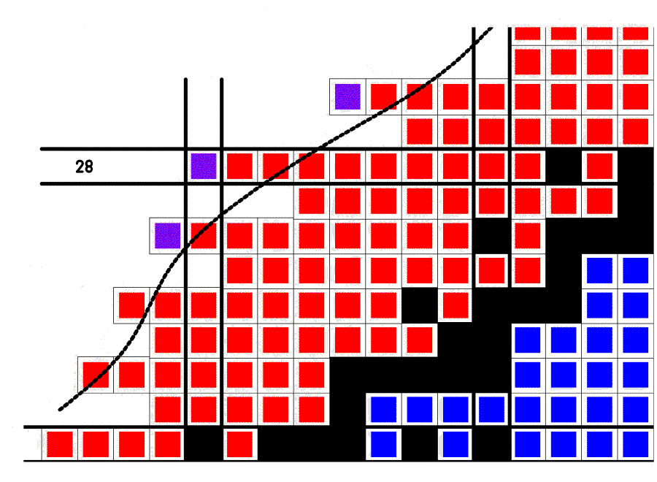
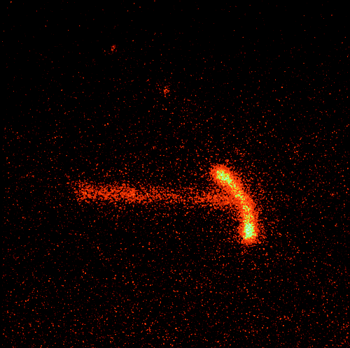
Exotic Radioactivities
1p-radioactivity
(Z,N) → p + (Z-1,N)
1981
2p-radioactivity
(Z,N) → 2p + (Z-2,N)
Zn
2002
Ni
Fe

Slide 23
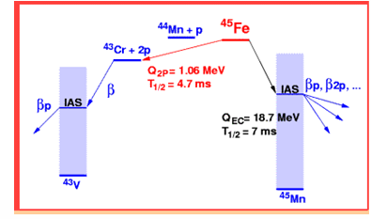
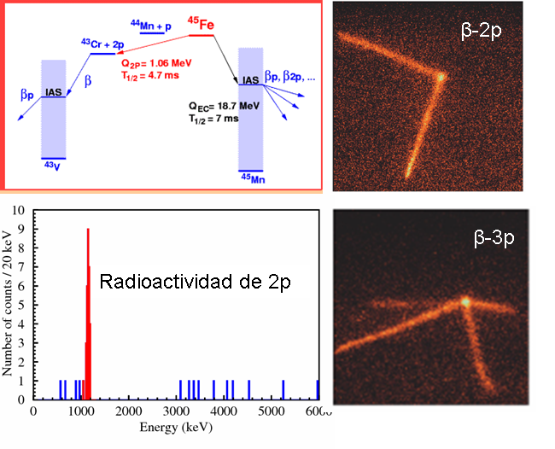
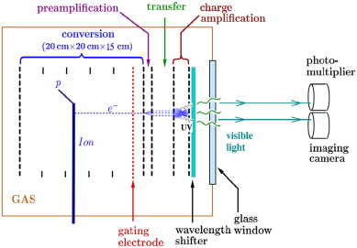
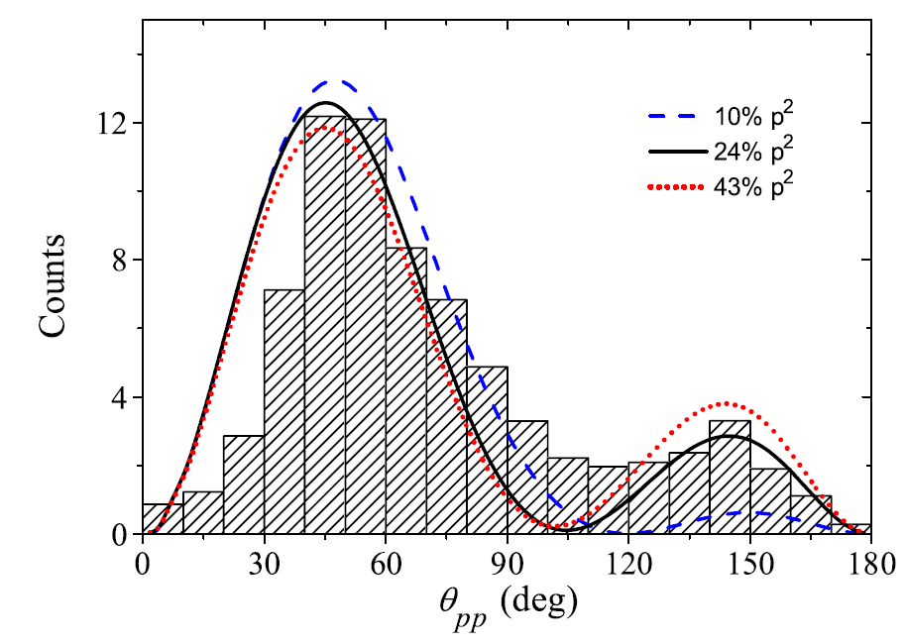
2p-correlation measured for first time in ⁴⁵Fe
Miernik et al,
NIM A 581 (2007) 194
PRL 99 (2007) 192501
PRC 76 (2007) 041304R
2p-radioactivity
Direct emission ⁴³Cr-p-p

Slide 24
Beta-delayed Neutron Emission
β⁻ N > Z
Neutron Rich
T
T
T - 1
Populated in Nuclear Reactions

Slide 25




Beta-delayed Neutron emitters
Compilation for fission products 26 < Z < 58, Pfeiffer, Kratz, Möller, Prog. Nucl. Energy 41(2002)39
Neutron Rich
Kratz-Hermann formula
P_{n}≈a[(Q_{β} –S_{n})/(Q_{β} – C)]^{b}
Where C is the parameter of pairing, depending of even or odd character of daughter nucleus
About 220 cases measured, Mainly T_{1/2} and P_{n}-values
Spectroscopy hampered by
Detection system.
a
b
regr
a
b
χ2

Slide 26
Measurement of Neutrons & βn
Long Counter: reduced energy to termal values by scattering in parafine.
Time-of-Flight, giving signals in plastic scintillator. Energy of neutron deduced.
βn can be deduce by obsevation of γ-ray transition in the beta-delayed neutron daughter.
Talk on Neutron deteccion by JL Tain

Slide 27


Beta decay of an exotic n-rich nuclei
2α + 3n
3/2⁻
20.6
β⁻
T_{1/2} = 8 ms
1983
1966
15.721
⁸Li+t
10.59
1980
8.82
1
8.982
1979
Identification of 2n & 3n by time correlations
Azuma et al., PLB 96 (1980) 31
7.315
2α+3n
⁹Be+2n
P_{3n} = 1.9 ± 0.2 %
P_{2n} = 4.1 ± 0.4 %
1974
Energías (MeV)
0.320
0.504
¹⁰Be+n
¹¹Be
P_{1n} = 84.9 ± 0.8 %

Slide 28

Beta delayed particle emitters
For β⁻-delayed x-neutron emission of ^{A}Z
BE(A,Z) = ZMpc² + NMnc² – M’(AZXN)c²
Using the Bethe-Weizsäcker mass equation for BE(A,Z)
M’(AZXN)c² = (ZMp + NMn)c² - a_{v}A + a_{s}A^{2/3} + a_{c}Z(Z-1)A^{-1/3} + a_{A}(A-2Z)²/A - a_{p}A^{-1/2}
Q_{βnx} = Q_{β} – S_{xn}(^{A}(Z+1)) = Q_{β} (^{A-x}Z) -S_{xn}
For β⁺-delayed x-proton emission of ^{A}Z Q_{β}- → Q_{EC}
B.Jonson & K. Riisager, NPA693 (2001) 77
Notes:
BE(A,Z) = ZMpc2 + NMnc2 – M’(AZXN)c2
Using the Bethe-Weizsäcker mass equation for BE(A,Z)
M’(AZXN)c2 = ZMpc2 + NMnc2 - avA + asA2/3 + acZ(Z-1)A-1/3+ aA(A-2Z)2/A - apA-1/2

Slide 29
Exotic decays
¹⁷Ne
Β, βp,βα
¹⁷F
β
¹⁸F
β
¹⁹F
stable
¹²O
2p
¹³O
β, βp
¹⁴O
β
¹⁵O
β
¹⁶O
stable
¹⁷O
stable
¹⁸O
stable
Z=8
¹⁰N
P?
¹¹N
p
¹²N
β,βα
¹³N
Β, noγ
¹⁴N
stable
¹⁵N
stable
¹⁶N
β, βα
¹⁷N
Β, βn,βα
¹⁸N
β,βn,βα
¹⁹N
β, βn
²⁰N
β, βn
⁸C
2p
⁹C
Β,βp,βα
¹⁰C
β
¹¹C
Β,noγ
¹²C
20.38 m
¹³C
20.38 m
¹⁴C
Β, noγ
¹⁵C
β, βn
¹⁶C
β, βn
¹⁷C
β, βn
¹⁸C
β, βn
¹⁹C
β, βn
⁷B
p
⁸B
Β,β2α
⁹B
p
¹⁰B
¹¹B
¹²B
Β, βα
¹³B
Β, βn
¹⁴B
β, βn
¹⁵B
β, βn
¹⁶B
unbound
¹⁷B
β, βn,β4n
¹⁸B
unbound
¹⁹B
β, βn,β2n
⁶Be
2p
⁷Be
β
⁸Be
α
⁹Be
¹⁰Be
β, noγ
¹¹Be
Β, βα
¹²Be
β, βn
¹³Be
unbound
¹⁴Be
4.35 ms
⁴Li
p
⁵Li
p
⁶Li
--
⁷Li
-d
⁸Li
β,β2α
⁹Li
β, βn, βα
¹⁰Li
unbound
¹¹Li
Β,β3n,βd,βt
Z=2
³He
--
⁴He
--
⁵He
unbound
⁶He
β, βd
⁷He
unbound
⁸He
β, βn, βt
⁹He
unbound
N=8
¹H
---
²H
--
³H
β
Q_{βd} = 3 – S_{2n} (MeV): ⁶He,¹¹Li, ¹⁴Be, ¹⁷B, ¹⁹B, ²²C
Q_{βt} = 9264-S_{3n} (MeV): ⁸He,¹¹Li, ¹⁴Be, ¹⁶B, ¹⁷B, ¹⁹C, ²⁰C
Qpα ó Qαp : ⁹C, ¹³0, ¹⁷Ne, ²¹Mg, ²³Si
n
10.25 m
N=2

Slide 30


Decay Scheme ➔ Structure Information (N= 20)
³³ Na
ISOLDE
fragmentation U (46g/cm²) 2000º
1,4 GeV protons 3 10¹³ / pulse (1,2s)
P_{n} = 47%
P_{2n} = 13%
³³ Na
2 at / s
Low threshold Neutron detectors
Detector 4πβ
Radioactive Beam
³³ Na
T_{1/2} = 8.0 (3) ms
HPGes
Detailed Level Scheme
exp. : coinc. β neutrons β.γ.n
inversion of 3/2⁺ 7/2⁻ orbits in ³³ Mg
M. Langevin et al NP A414 151 (1984)
S. Nummela et al PRC64 054313 (2001)

Slide 31





Intruder states & Effective interaction in sd-pf shell
Nummela et al.,
PRC63(2001)044316
T_{1/2} = 38.6 ms
Position of 3/2⁻ state in N = 21 isotones
Shell Model describe well by intruder states the Island of Inversion and the deformed region around ³²Mg.
Predicts vulnerability of N= 28 closure for ⁴⁴S, ⁴²Si and ⁴⁰Mg ⇒
confirmed for ⁴⁴S (Sohler, PRC66 (2002) 054302)).
Nummela et al., PRC63(2001)044316
Fix the single particle energy for the effective sd-pf interaction

Slide 32



βn from ^{133g}In(9/2⁺) and ^{133m}In(1/2⁻) → ¹³³Sn study
¹³³In is a key nucleus for
Astrophysics due to its placement on the r-process bottleneck regions in most scenarios.
its proximity to the doubly magic ¹³²Sn (50 protons and 82 neutrons) offers a uniquely simple β-decay system to validate nuclear theories.
β,γ,n,βn,βnγ measured @ ISOLDE
High resolution laser tuning allowed
Separate the contribution from gs and isomer ¹³³In
Neutron ToF Spectrum from VANDLE

Slide 33


Neutron Detection systems
4π Counter
With 40 ³He tubes embedded in parafine with 59 % efficiency.
Measured
P_{2n} = 0.060(9) %
TOF spectrometer: array of liquid scintillators
(BC501A)

Slide 34



Halo nuclei
Tanihata, 1985
Energy threshold effect
Highlight by nuclear reactions
Effects in beta decay

Slide 35



Beta-delayed deuterons
Q_{βd} = 3.007 – S_{2n} MeV
First case of β-decay to the continuum
BR ≈ 10⁻⁴
B.R. Of 10⁻⁶ Two Orders of Magnitude less than expected
B.R. = 1.65(10)x10⁻⁶
Exploring w.f. ∼ 10 fm
19 cm
B.R. 2.8(5) x 10⁻⁶
D. Baye et al., Prog. Th. Phys. 91 (1994) 271
Riisager et al., PLB235(90)30
Raabe, PRC (2009)

Slide 36

Beta decay of an exotic nuclei
20.6
β⁻
Even a neutron rich - nuclei emit charged particles
3/2⁻
1996
T_{1/2} = 8 ms
17.916
1983
⁹Li+d
1966
⁹Li
15.721
⁸Li+t
10.59
→p
1980
8.82
8.982
d
1979
7.315
2α+3n
⁹Be+2n
0.320
½⁻
1974
γ
Energías (MeV)
0.320
0.504
¹⁰Be+n
¹¹Be
½⁺
¹¹Be

Slide 37

¹¹Li, gamma rays
320 keV
½⁻
γ
½⁺
¹¹Be
M.J.G. Borge et al., PRC55 (97) R8
N. Aoi et al., NPA616 (97) 181c
D. Morrisey et al., NPA627 (97) 222
Q = 20.62 MeV, T _{1/2}= 8.2 ms
b(320) = 6.3(6) %
log ft = 5.73
(1s_{1/2})²/(0p_{1/2})² ~1

Slide 38




¹¹Li βd spectrum finally measured @ TRIUMF!!
Implantation of ¹¹Li beam on DSSSD Detector
Very precise B.R.
Low detection threshold
Low beta background
History of each decay
DSSSD 16x16 mm², 70μm thick
48x48 strips, 300 μm, 2304 pixels
J. Büscher et al., NIM B 266 (2008) 19
8 x 10⁷ ions implanted in 133 h
T₁
B.R = 1.30(13)x10-4
E_{cm} > 200 keV
Deuteron Spectrum
Decay to the continuum confirmed !
Raabe et al, PRL 101 (2008) 212501
T₂

Slide 39
Stringent test of Nuclear Models
Impressive reproduction of the B_{GT} distribution by Shell Model calculation
Quenching factor close to one, sensitive to the placement of the GTGR
Test Isobaric Multiplet Mass eq.
M(A,T,T_{z}) = a + bT_{z} +cT_{z}² + δ(dT_{z}³+eT_{z}⁴)
If 2-body forces responsible of charge dependence in nuclei IMME to T_{Z}²
B_{F} = T(T+1)-T_{Zi}T_{Zf}
If strength to IAS ≠ B_{F} ⇔ Mixing
³²Ar
³³Ar
theory
theory
Quintet test→ d = 0.89(11) keV
Notes:
Neutron defficient nuclei are a very good tool to study nuclear structure. In the absence of charge dependence forces the members of isobaric multiplet will have the same mass and wave function.

Slide 40




Kinematic identification of βt emission in ¹¹Li
Q_{βt} = ΔM(¹¹Li) - ΔM(⁸Li) - ΔM(t) = 4822(5) keV
Madurga et al., Eur. Phys. J A42 (2009)415
¹¹Li
Kinematics near 180º between charged particles.
⁹Li+d channel stopped, ⁹Li too low recoil energy.
The ⁸Li+t channel uniquely separated
θ
P₂

Slide 41




Viewing β-delayed triton emission
Mianowski et al, Acta Polonica 41(2010)449
Optical Time Projection Chamber
The strong βt branch allowed to identified feeding to a highly excited state in ⁸Li.
New branch βn from this state confirming the character of super-allowed transition

Slide 42





Beta-delayed Fission in the Pb-region
Discover in Dubna in ^{232,234}Am in 1966
Allows to study low energy fission properties at unusual N/Z ratios
Max energy of fissioning nucleus < Q_{EC} of precursor
Two region : 12 cases identified in the U-region
neutron defficient Pb-region
Shaughnessy, PRC65(2002)024612
Unexpected Asymetric Fission Fragments !
Q_{EC}-B_{f} = 0.65 MeV
Andreyev et al, PRL105(2010)252502

Slide 43
Beta-alpha emission
βα-Identified first in Natural radiactivity
βα favoured in light nuclei with Tz = -1: ⁸B, ¹²N, ²⁰Na…
In cases were both βα and βp are allowed =>βp dominates due to barrier penetrabilities
Branches of βα > 1% are only observed in nuclei A < 20 and ¹¹⁸I
Some of these states are of astrophysical relevance
  For instance the ¹⁶N(βα) helped to elucidate the ¹²C(α,γ)¹⁶0
βpα or βαp is a decay mode open for ⁹C, ¹³0, ¹⁷Ne, ²¹Mg and ²³Si
  Only identified ⁹C and ¹⁷Ne
    ⁹C special as the daughter is unbound to p-emission.
    Expectacular asymmetry in some of the mirror transitions with ⁹Li
    ¹⁷Ne astrophysical relevance to learn about the E2 capture rate in stellar ¹²C(α,γ)¹⁶0 reaction

Slide 44




Beta-decay of ¹⁷Ne
total
Q_{β}
p
α
p
IAS
α
α
p
γ
γ
Separation of βp, βα channels with ΔE-E and ToF techniques, allowing independent analysis of the two spectra.
Bp and Bα branches confimed previous values with higher precision.
Treatment of the full proton spectrum using R-Matrix.
Feeding to subthreshold ¹⁶0 states, study of their partial α-widths on progress.
S_{α}
γ
S_{p}
γ
Characterization of the α-width of the subthreshold states of ¹⁶0 at 6.9 and 7.1 MeV of interest for the ¹²C(α,γ)¹⁶0 capture rate.
R-matrix
½-
3/2-

Slide 45
Beta Delayed Particle Emission
βdF
βp from Z = 8-73
βn from Z = 3-57
β2p
βα,βpα
βd, βt
A wonderful Tool to pear into Nuclear Structure!!
N

Slide 47





βν correlation studies: peering into Nuclear Structure
The energy shift in the delayed particle averaged over the neutrino angles
If the decay is followed by particle emission, the recoil of the daughter shifts the energy of the delayed particle by about 10 keV that it is easy to measure.
First used to deduced the nature of the decay of ⁸Li β2α
{
GT
lp ≠0
Θτ ≠0
Spins: ³¹Ar
Fermi / GT character
Intrinsic widths of levels
Final state (gs/excited) of delayed particle
β – ν correlations allow to extract
Thaysen et al, Phys. Lett B 467 (1999) 194

Slide 48


¹¹Li (βd) @ ISOLDE
Complicated decay
B.R. of βd ∼ βt ∼ 10⁻⁴
Used of pulsed structure of ISOLDE beam
Identification of the βd branch by energy and time correlation
Time correlation
β-charged particles from ¹¹Li
Study of correlation between the Z = 1 particles (T < 0.06 ms) and delayed alphas between 0.15 < T < 0.9 s
B.R.(βd) ∼ 1x10⁻⁴
^{Mukha et al., PLB367 (96) 65}
β
d + t

