Slide 1
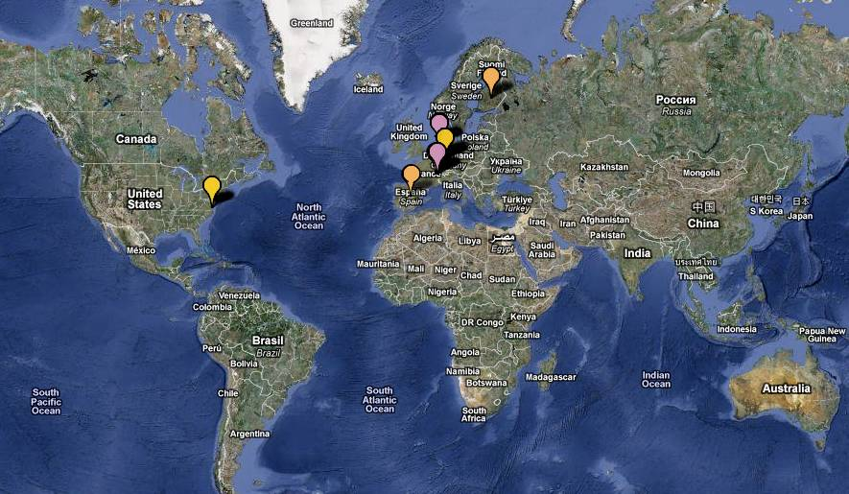

Production of Exotic Nuclei
JYFL
GANIL
GSI
TRIUMF
CERN - ISOLDE
FRIB
JLAB
LEGNARO
RIKEN
Raon
Máster Interuniversitario de FÍSICA NUCLEAR Curso 2024-2025

Slide 2
Exotic Nuclei and Radiactive Beams
Introduction
Exotic Nuclei :
    Production modes
    Separation
    Identification
Radioactive Beams
References:
“The why and how of Radioactive beam Research”, Mark Huyse,
“In-flight separation of projectile fragments”, David Morrisey and Brad Sherril
“Isotope separation on line and post-acceleration”, P. Van Duppen
http://www.euroschoolonexoticbeams.be/site/pages/lecture_notes

Slide 3

Open Questions in Nuclear Physics
What are the limits of nuclear stability?
¿ How does the complexity of nuclear structure arise from the interaction between nucleons?
How and where in the Universe are the
chemical elements produced?
Observables:
Basic ground state properties: mass, radius, moments J, μ, Q
Half-life y decay process
Transition probabilities
Cross sections
After Nuclear Physics Long Range Plan 2017
New LRP released Nov 2024
https://www.nupecc.org/lrp2024/Documents/nupecc_lrp2024.pdf

Slide 4
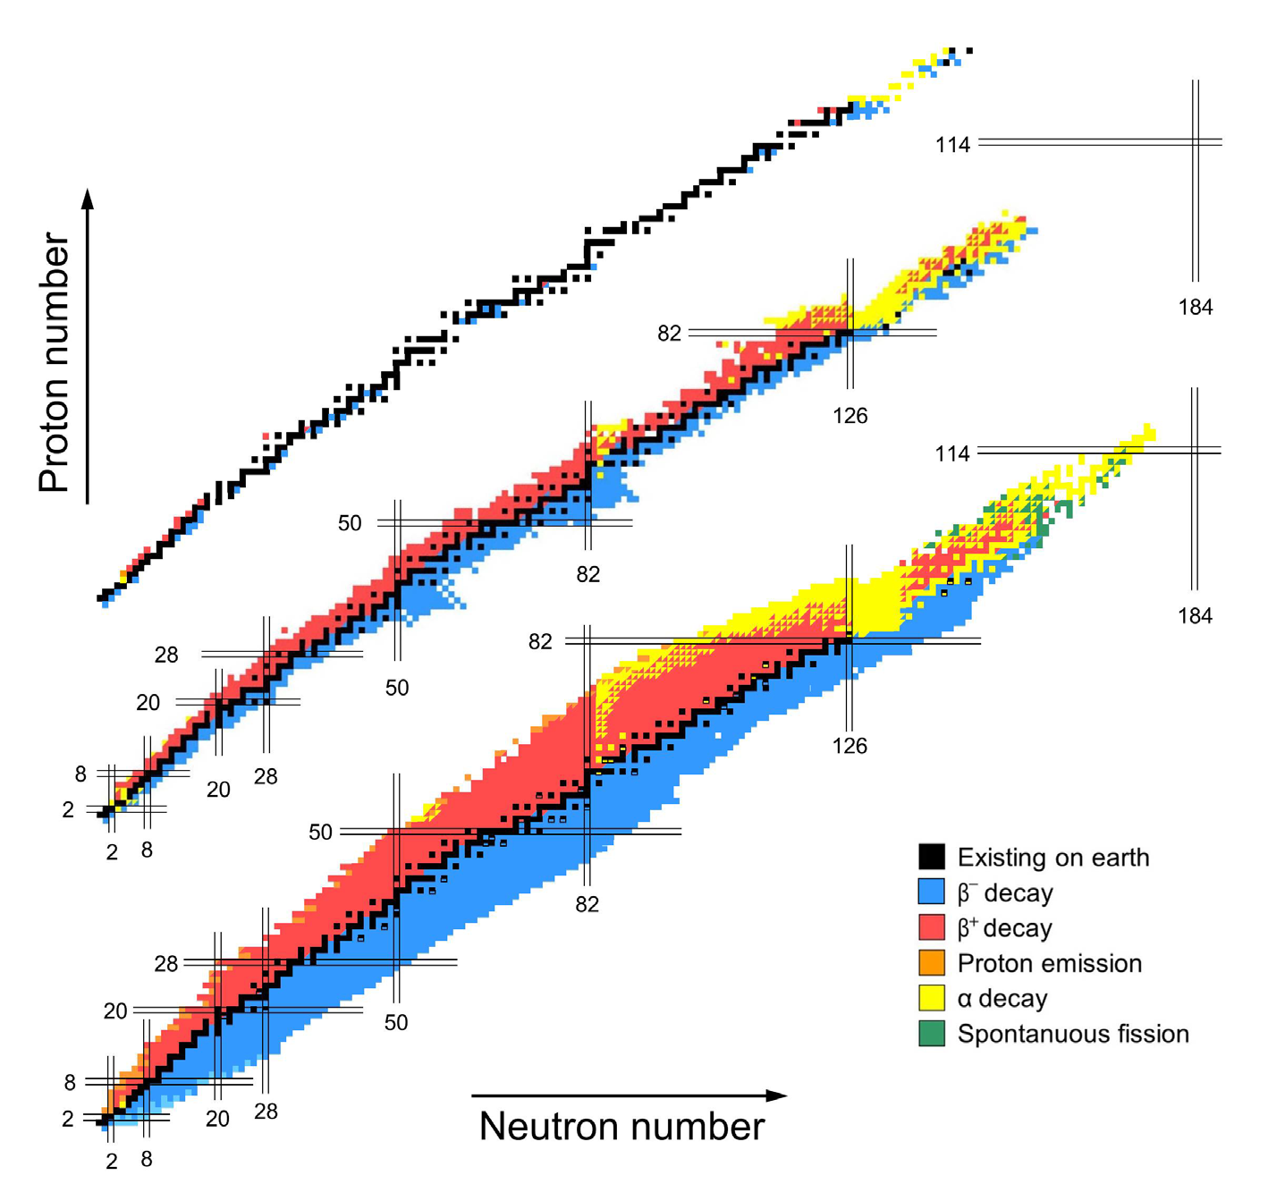
Evolution of the Table of Isotopes
1935, 90y!
1958
????
2015
10 years ago!

Slide 5
Production
The discovery of a new element/isotope depends of many factors:
Production method: various mechanism of nuclear reactions.
Efficent separation and transportation
Detection method

Slide 6
Yield Requirements
Rate
Access
~1/week
Existence
Z=107, 108, 109, … à GSI
Z < 40 GANIL, GSI, RIKEN, MSU
~10/day
Identification
Mass = Z+N
~100/day
β-decay gives
first information of a new isotope.
When the production is high
⇒ detailed structure information can be achieved.
~1/min
β (T_{1/2}, P_{xn})
1/sec
β-γ, β-n, β-p
100/sec
10⁴/sec
β-γ-γ, β-n-γ, β-p-γ

Slide 7
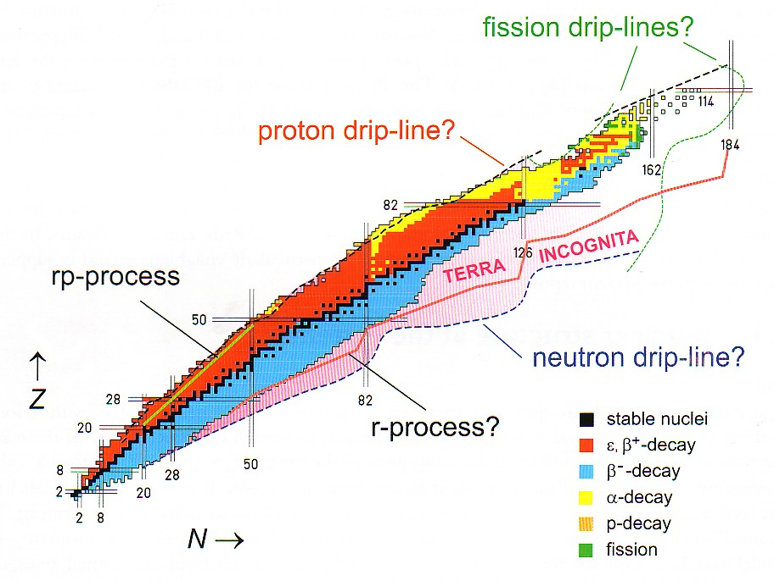
Situated far from the valley of Stability
Very different N/Z compare to the stable one
Close to the drip lines : B_{n} =0, B_{p} =0 at the frontier of discovery
Exotic Nuclei
13 isotopes discovered in 2023
Total= 3352 at Dec 2023

Slide 8
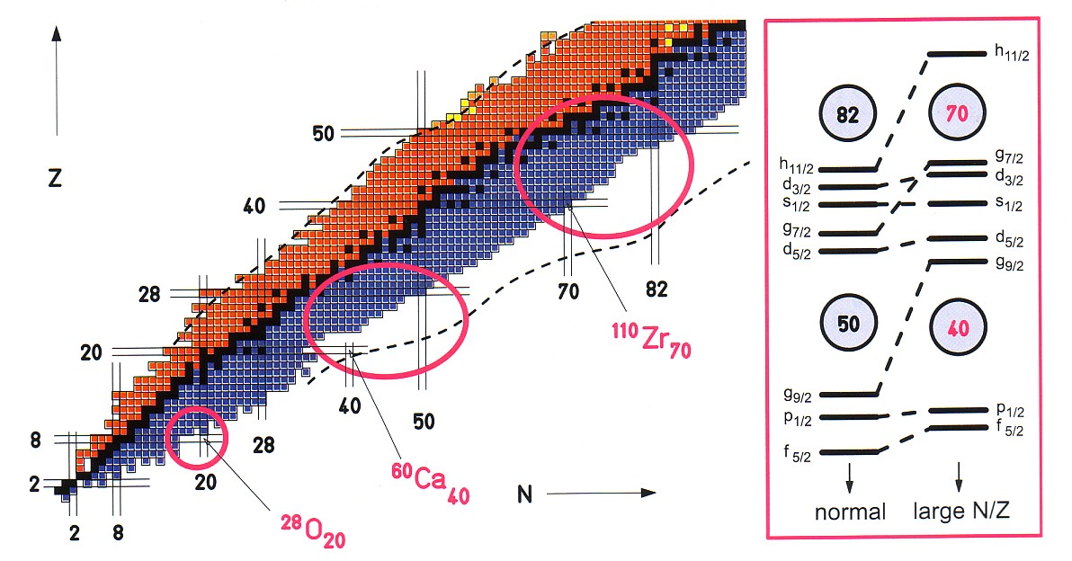
Why Study Exotic Nuclei?
Explore the different degrees of freedom of the system in
isospin, T,
in excitation energy, E_{x},
spin, J,
level density, ρ
Stringent test of Theoretical Models
Observation of new decay modes
Measurement of astrophysical interest
Halo structure
Evolution of shell structure

Slide 9
Physics interest?
Correlations: Pairs,
influence of collective modes (Giant Resonances)
Inflence of halo or skin of neutrons
Extension of rare phenomena in the space of Z, N, J, Ex, superdeformation,
Study of: Double magic nuclei
Semi-magic nuclei
Region of shape transtions
Nuclei with N~Z
Nuclei with N >> Z, halo nuclei
Nuclei very deformed
Nuclei of astrophysical interest

Slide 10
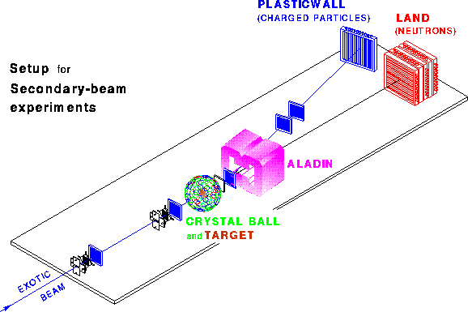
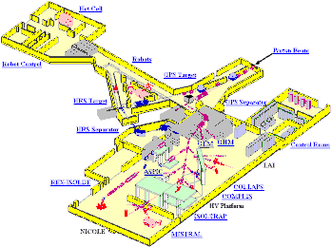
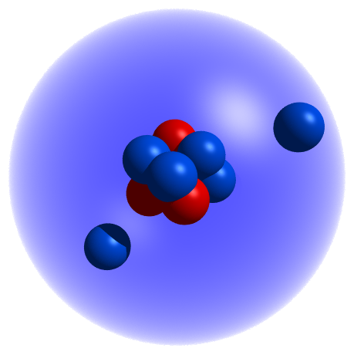
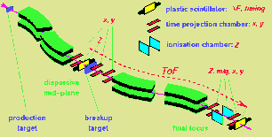
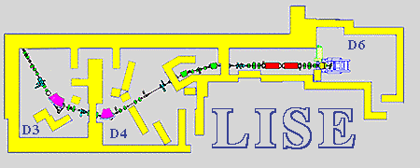
To explore a new phenomenon many different approaches are needed
GSI
Reacciones a E_{r}=700 MeV/u
Elastic
Scattering
Spins
Moments
ISOLDE
Desintegración beta E_{r}=0
Reaction
Cross Sections
Masses
Beta
Decay
Momentum
Distributions
GANIL
Reacciones a E_{r}=30-60 MeV/u
Unbound
Nuclei

Slide 11
Radiactive Beams: Possible Research Domains
masses
radius, shapes & moments
decay properties
astrophysics
Drip line phenomena
Structure and excitation modes
Transfer and spectroscopic factors
Heavy & Super-heavy nuclei
Nuclear Matter
de μeV à 100 keV
E < 1 MeV/u
de 1 à 10 MeV/u
E < 100 MeV/u

Slide 12
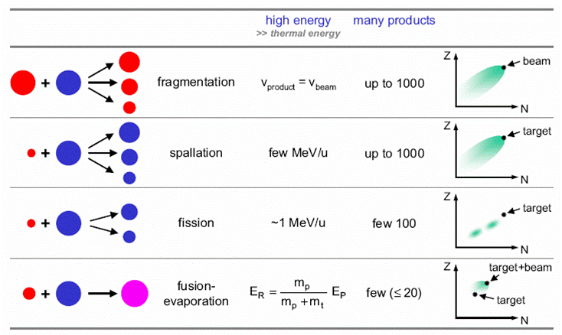
Production Methods
Beam → target → products
heavy ion
p
p/n
heavy ion

Slide 13
Production
N _{prod.} = σ φ N_{target} ε
efficiency
N of target nuclei/cm²
~ 1 - 100 g/cm²
Cross Section
Incoming particules/s
~ 10⁸ - 10¹² /s
fusion – evaporation, @ GSI ⁵⁴Cr(4,7MeV/u) + ²⁰⁹Bi → ²⁶³107 *…
¹²C + ⁵⁶Fe ou ¹⁶O + ⁵⁸Ni … nuclei N~Z at Tandem energies
spallation p + La or U ou TH or W → ¹¹⁵⁻¹³³Cs, rates of 1 à 10¹¹ at/s
transfer, 1 or several nucleons pick up, stripping…
inélastic ⁷⁶Ge (9 MeV/u) + Ta ou W → ⁶²Mn, ⁷¹⁻⁷³Cu
fragmentation of target or projectile
p drip line Z < 30 @ GANIL
N-rich A~65 GSI , A~45 GANIL
fission thermal ²³⁵U, ²³⁹Pu @ Grenoble ⁶⁸Fe, ⁷¹⁻⁷⁴Ni, ⁷⁹Cu, ⁶⁸⁻⁶⁹Co
relativistic ²³⁵U (750 MeV/u) + Pb → 50 products

Slide 14
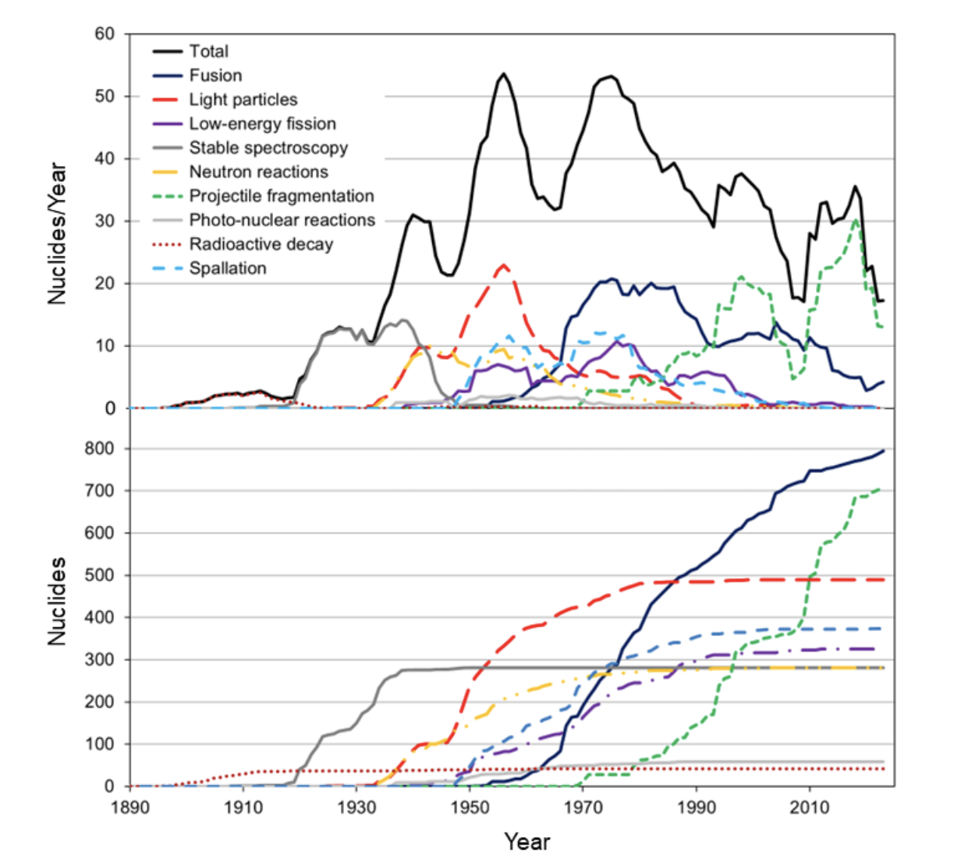

Slide 15
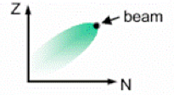
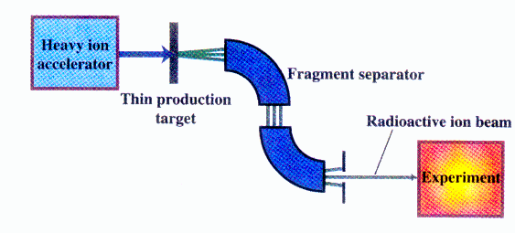

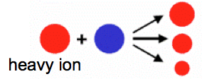
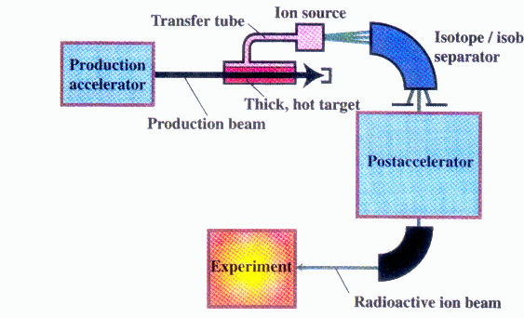
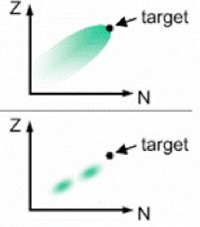
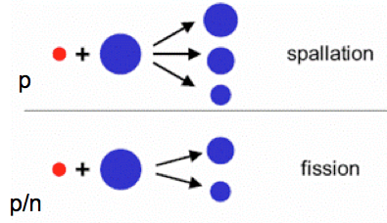
Production of Radioactive Beams
Energies of Outcoming beam
PROJECTILE FRAGMENTATION
FAIR
GSI
GANIL
SPIRAL
HIE –
ISOLDE
ISOLDE
1 GeV
400MeV/u
50MeV/u
14MeV/u
10MeV/u
0.06 MeV
High energy, large variety of species,
Short half-lives (μs), cocktail beam
ISOL
Variable energy, high intensity, good beam qualities

Slide 16
Production Methods
meV -100MeV/u
Good beam
From ms to s
High Temp
Thick Target
Ion source
Mass
Separator
Post-
Accelerator
Light & Heavy Ions
Spallation
Fusion
Fission
Fragmentation
Experiments
Detectors
Spectrometer
Driver Accelerator
Reactor
Gas Cell
Heavy Ions
Fusion
Fragmentation
GeV
Microseg
Ev. Slow down
Fragment
Separator
Storage
Ring
Thin Target

Slide 17
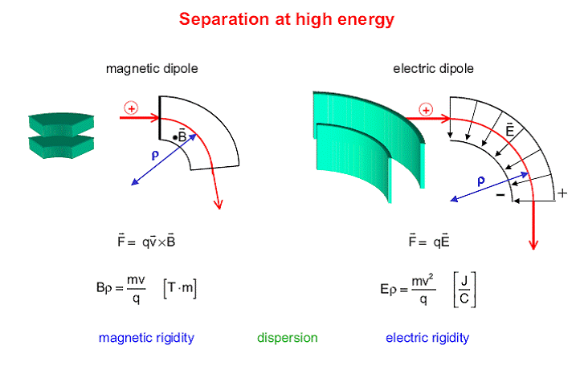
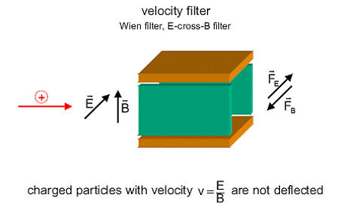
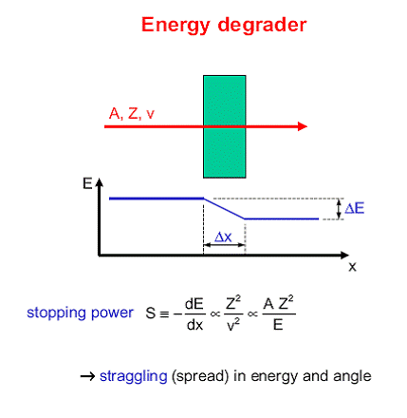
Separation at High Energy (See Talk by Teresa K)
Part with same charge, mass and v ➔same rigidity Bρ
Need Wien-vel-Filter to separate in velocity
Notes:
the magnetic analyser cannot distinguish between particles with equal charge and having the same mass-velocity product (same BR = p/q).
A simple way of resolving this degeneracy is to use a Wien velocity filter (WVF) in conjunction with the magnetic analysers.
The WVF uses the combined interaction of a magnetic and an electric filed in order to select the ions according to their velocity

Slide 18
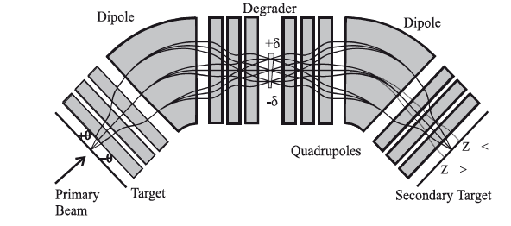
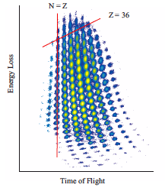

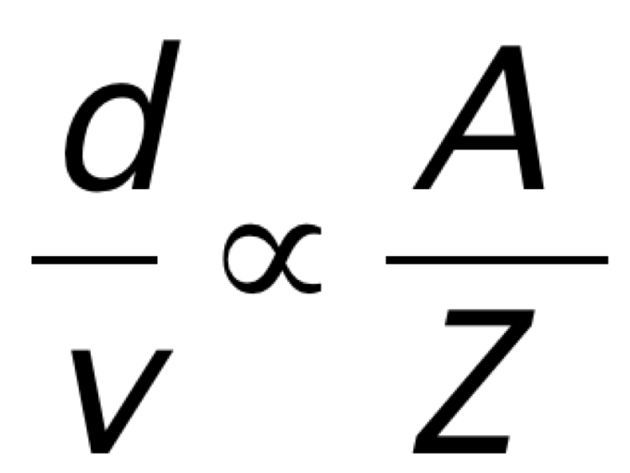
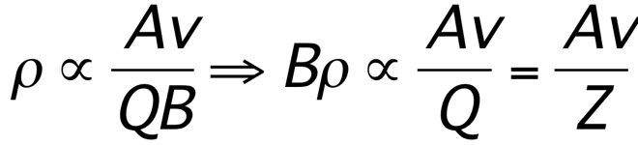
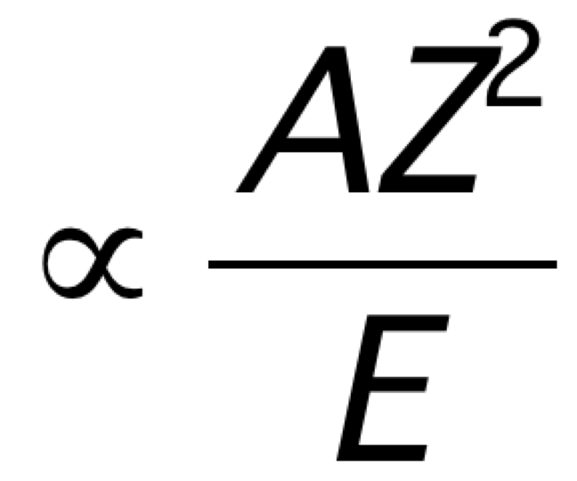
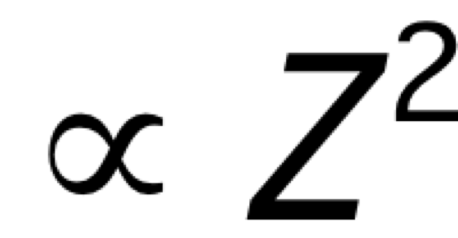
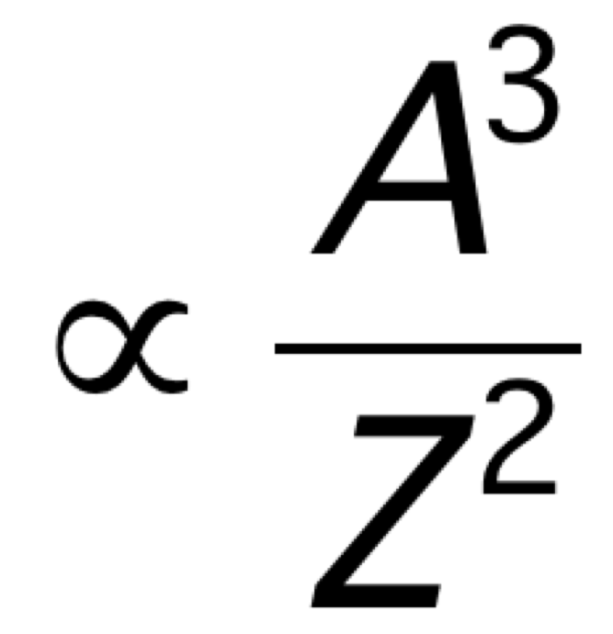
Fragment Separator - FRS
A/Z separation
Momentum Separation
DP1
DP2
Remove primary beam 10¹²➔ 10⁸
DP1
Degrader
Degrader + DP2
Reduction 10⁸ ➔ 10⁶
Energy loss
T_{vol} (Target - detector)=

Slide 19
In flight method
Higher energy
Targets
In the order of 1-4 g/cm²
Reaction products
Kinematically forward focused
extended detection scheme
& better resolution
Full-acceptance measurements
with moderate sized detectors
Possible study more exotic nuclei
efficient down to 1 ion/s, short lived

Slide 20
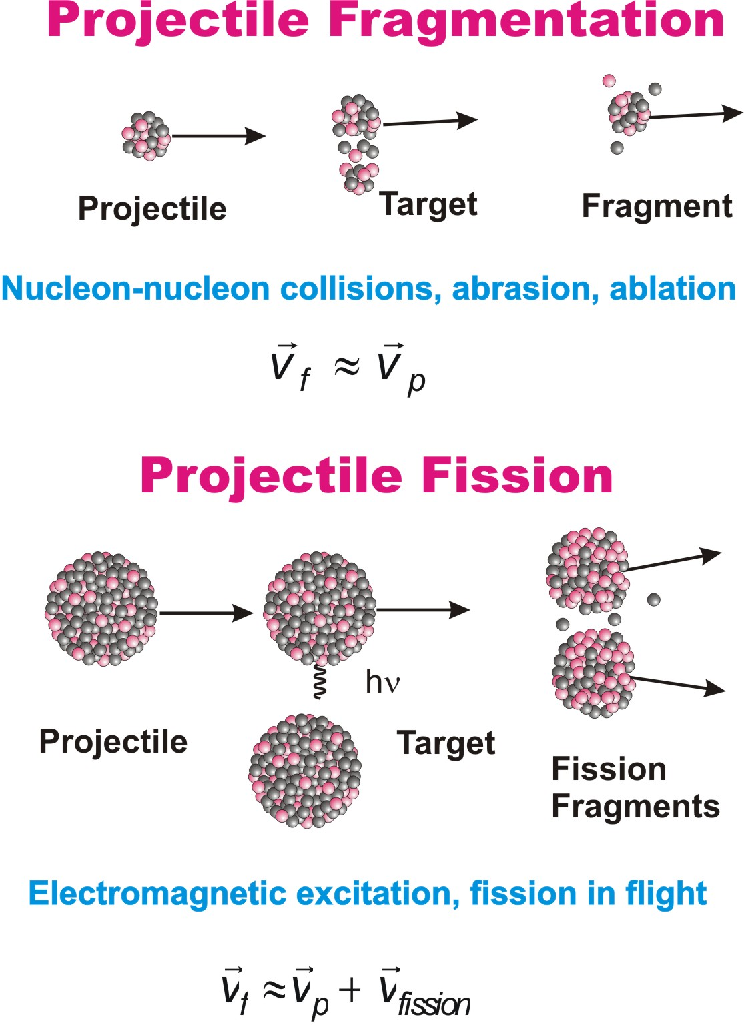
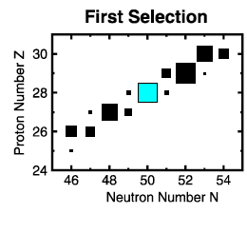

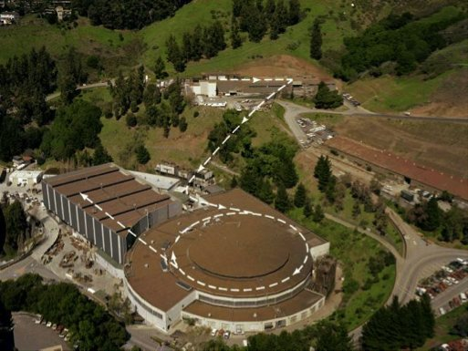
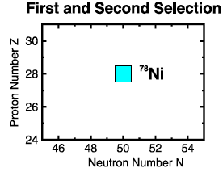
In-Flight Method (80’s)
Develop in the late 80’s
Production
Selection
HEAVY ION
ACCELERATOR
Thin target
Observation
Bevalac
Degrader
Phys.Rev. Lett. 43, 1859 (1979).
Magnetic
Separator
ΔE
Detector
Electronics
DAQ
Particle stability of 15 earlier unobserved nuclides from ²²N to ^{44,45}Cl.

Slide 21
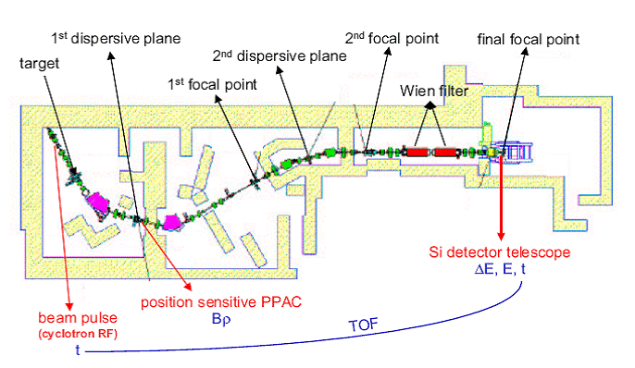
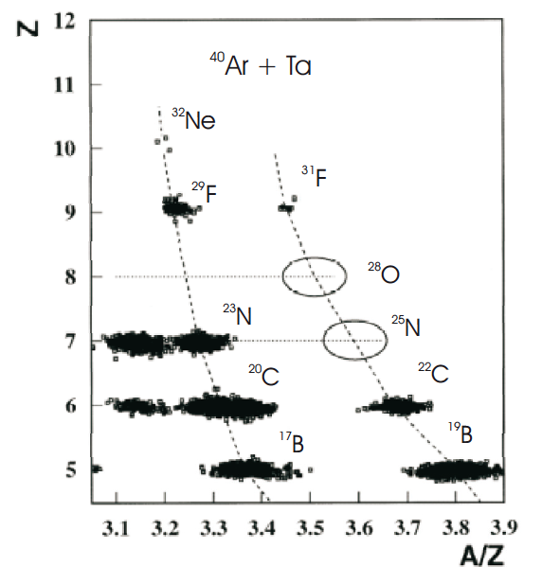
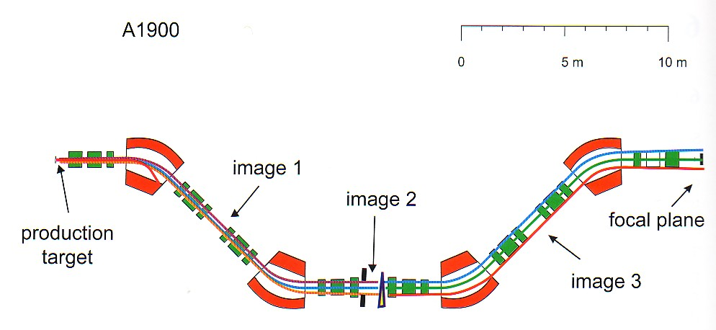
Different Spectrometer
Spectrometer LISE @ GANIL
GANIL
Spectrometer A1900 @ MSU
Talk of T. Kurtukian!

Slide 22
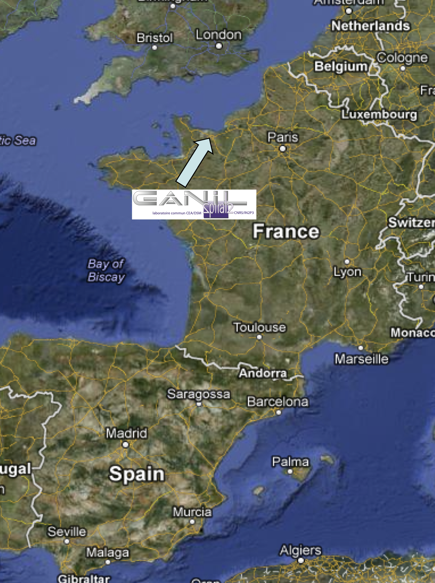
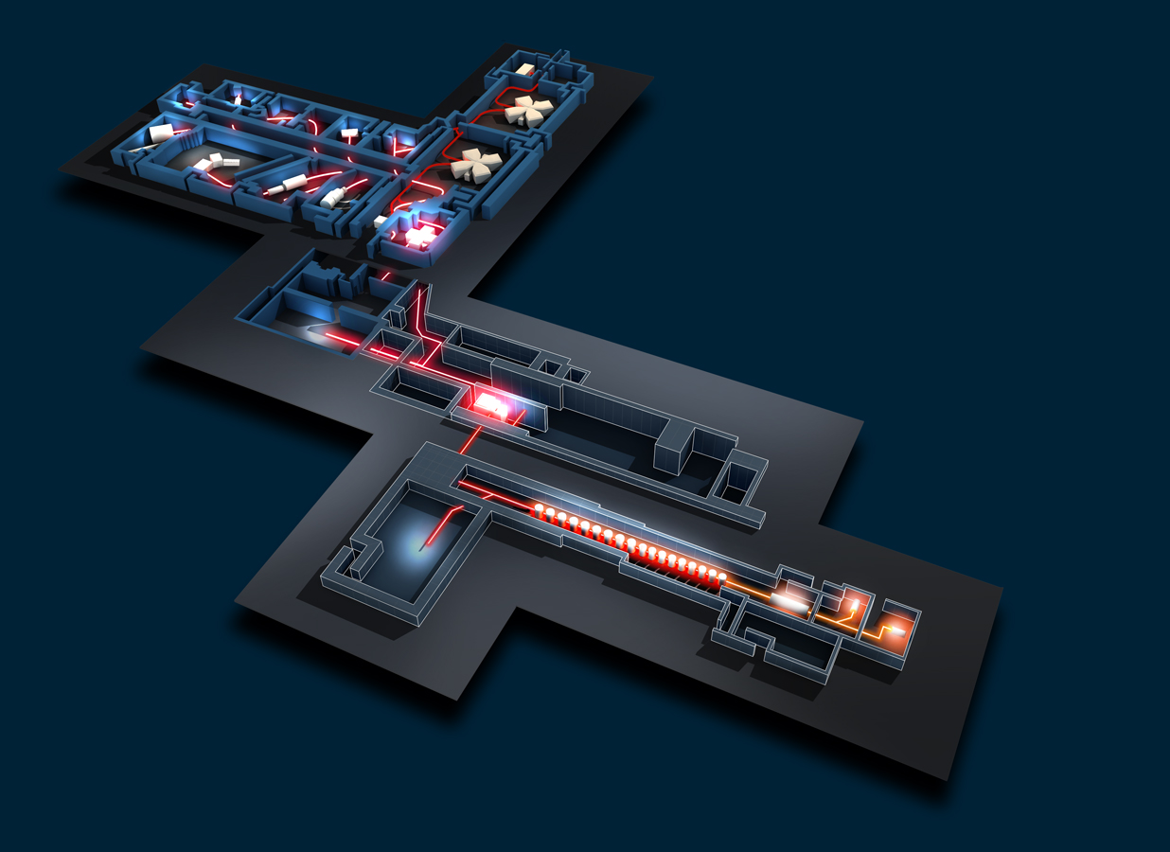
GANIL / SPIRAL 2
LISE
Existing GANIL facility
SISSI
CIME
LIRAT
Production building
DESIR
Low energy beams from
SPIRAL and SPIRAL2
Connected to S3
In construction
Operative 2026-27
S3
High-intensity stable beams on thin target
+ in-flight high-resolution separator
+ gas cell for stopping
First beams in November 2024
LINAG
(high intensity d and stable beams)
Notes:
GANIL(Grand Accelerateur National de Ion Lourds) produces beams of stable and exotic nuclei from a few eV from the ion source to 95 MeV/nucleon from Cyclotron. GANIL is composed of a set of cyclotrons that accelerate stable beams from 1MeV/u to 95 MeV/u. These stable beams are delivered either to the experimental areas or to a thin (SISSI) or thick carbon target (SPIRAL) to produce and accelerate exotic beams.
After the thick target there is a cyclotron CIME to accelerate the exotic beams to 25 MeV/u and then to the experimental areas. This has been SPIRAL (Système de production d’Ions Radioactifs Accelerés en Ligne) where essentially due the ionization procedure only nobel gases are produced.
Instruments: MUST= detect light recoil nuclei in studies of direct reactions, modular with 1000 channels and good energy and angular resolution.
Its version MUST-II can be couples to EXOGAM AND VAMOS.
TIARA= Detector for light charged particles . Together with EXOGAM AND VAMOS allow to identify the exit channels from collisions.
VAMOS = Spectrometer with large solid angle, icludes a velocity filter. Separation in A/q or rejection of beam for zero-degree measurements.
With SPIRAL the beams are limited to A < 80
The SPIRAL2 facility at GANIL broaden the range by using fission reactions produces isotopes from the lightest to very heavy elements beyond uranium. Fission can be caused by bombardment of fissile target by neutron flux. The number of fissions desired per second determines the neutron flux necessary. Neutron flux obtained by bombarding a C-target with a deuteron beam. The deuteron beams stop in the target which acts as deuteron-to-neutron converter the neutron scape the converter due to the incoming energy and irradiate an Uranium-target. The products are analysed and ionized before being accelerated in CIME.
Layout of the Existing GANIL in red → GANIL cyclotrons for fragmentation, CIME for post-acceleration (SPIRAL beams) → all send to exp. Areas (LISE, SPEG, VAMOS, …)
→ there is the option to send a few beams from the SPIRAL ion source accelerated by 30 keV to a low-energy beam line (LIRAT).
The new facility DESIR will exploit the low energy beams from SPIRAL and SPIRAL2. for that
Certain arrangements are needed to achieve a certain degree of purity ➔ the universal way to get isotopic pure beams
Is a high resolution mass separator.

Slide 23
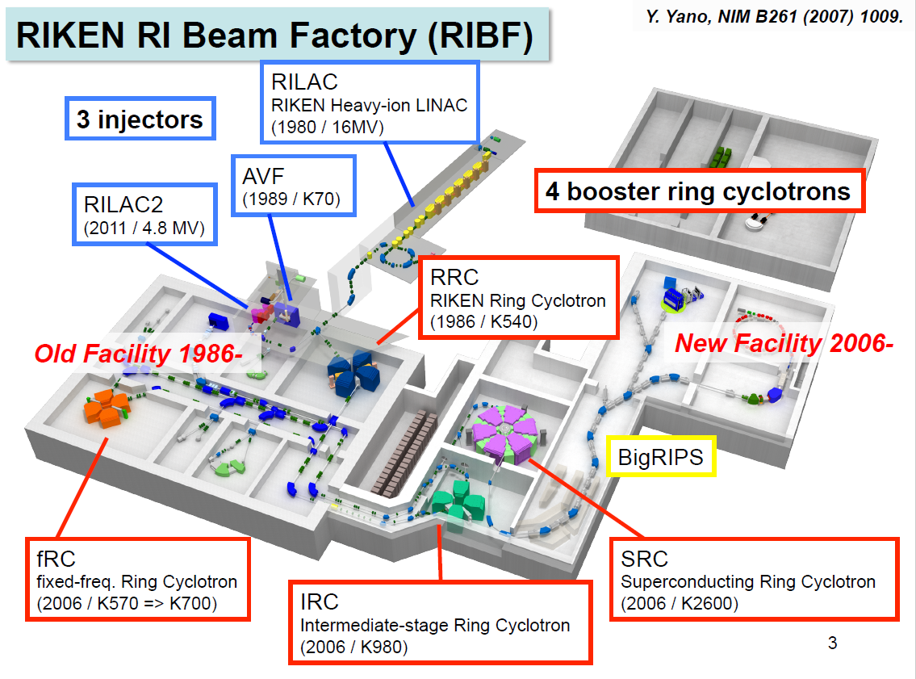

Slide 24
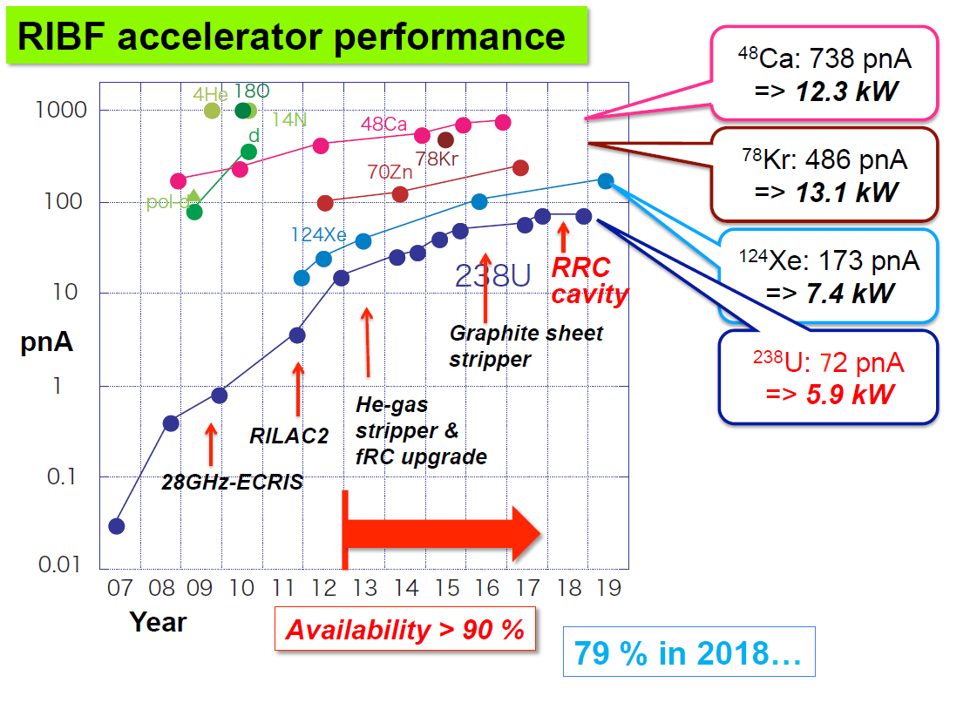
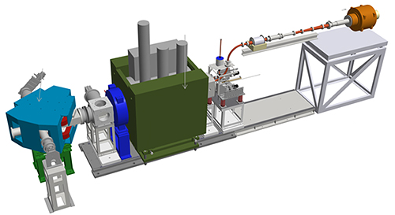
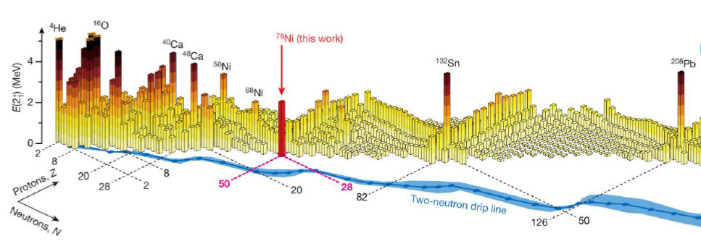
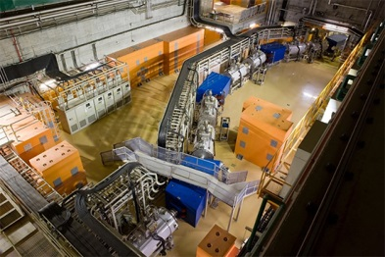
Steady increase of Beam Current @ RIKEN (Japan)
⁴⁰Mg (N=28) is largely deformed.
The origin is a mystery.
No theory can reproduces the data.
Quest for heavier super-heavies (Z=113)
Success in producing and accelerating high intensity vanadium beam
- Cleared the
way for
producing
element 119 –
(2017)
20
⁷⁸Ni (N=50) revealed as a doubly magic stronghold against nuclear deformation.
Taniuchi et al., Nature 569, 53 (2019)
Success in producing and accelerating high intensity vanadium beam
- Cleared the
way for
producing
element 119 –
(2017)
73 new isotopes discovered at RIKEN’s RI Beam Factory (2017)
Notes:
Increase due to improvement in Ion source and the strippe foils

Slide 25
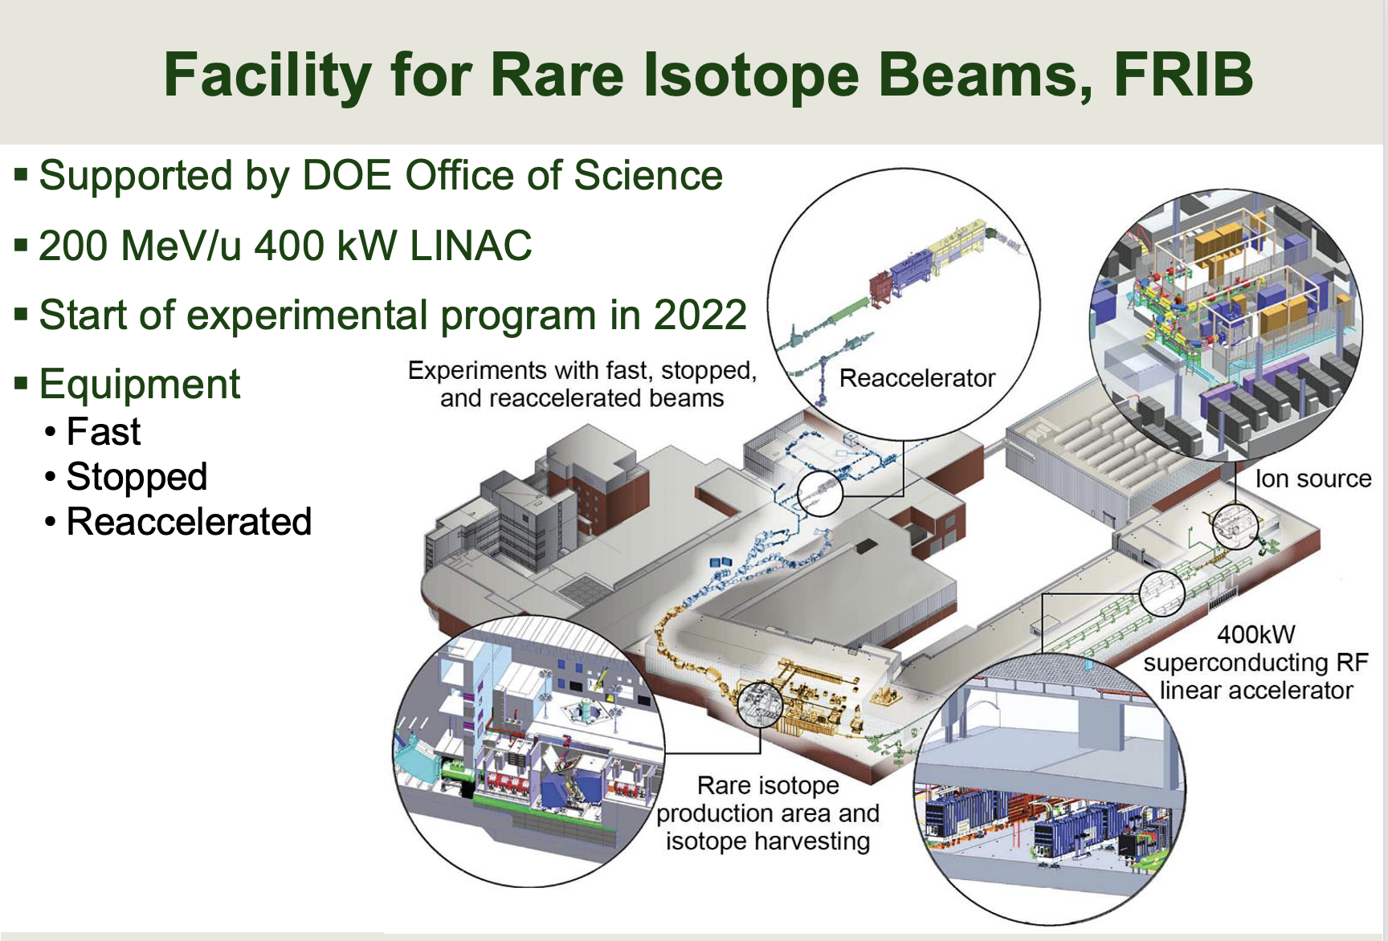


Slide 26


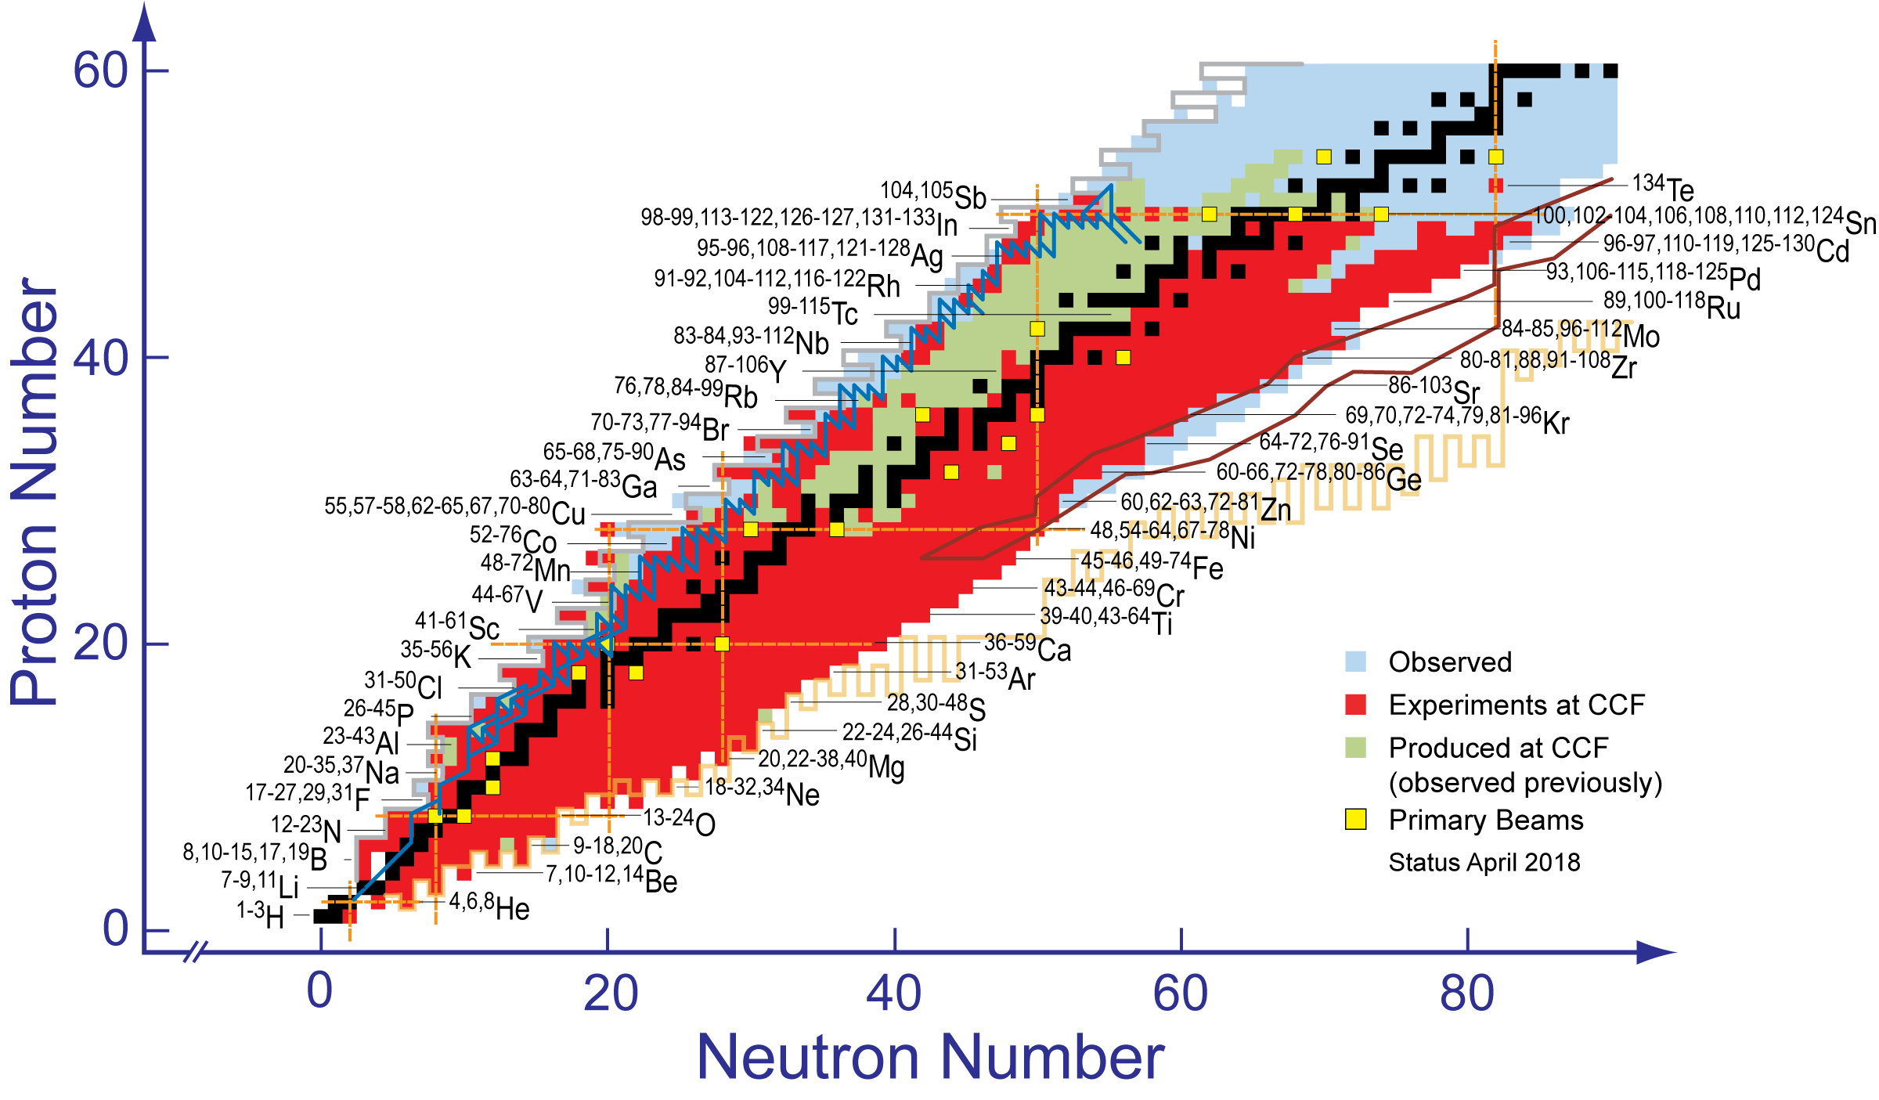


Physics Program
Properties of atomic nuclei
Develop a predictive model of nuclei and their interactions
Many-body quantum problem: intellectual overlap to mesoscopic science, quantum dots, atomic clusters, etc.
Astrophysics: What happens inside stars?
Origin of the elements in the cosmos
Explosive environments: novae, supernovae, X-ray bursts …
Properties of neutron stars
Tests of laws of nature
Effects of symmetry violations are amplified in certain nuclei
Societal applications and benefits
Medicine, energy, material sciences, national security

Slide 27
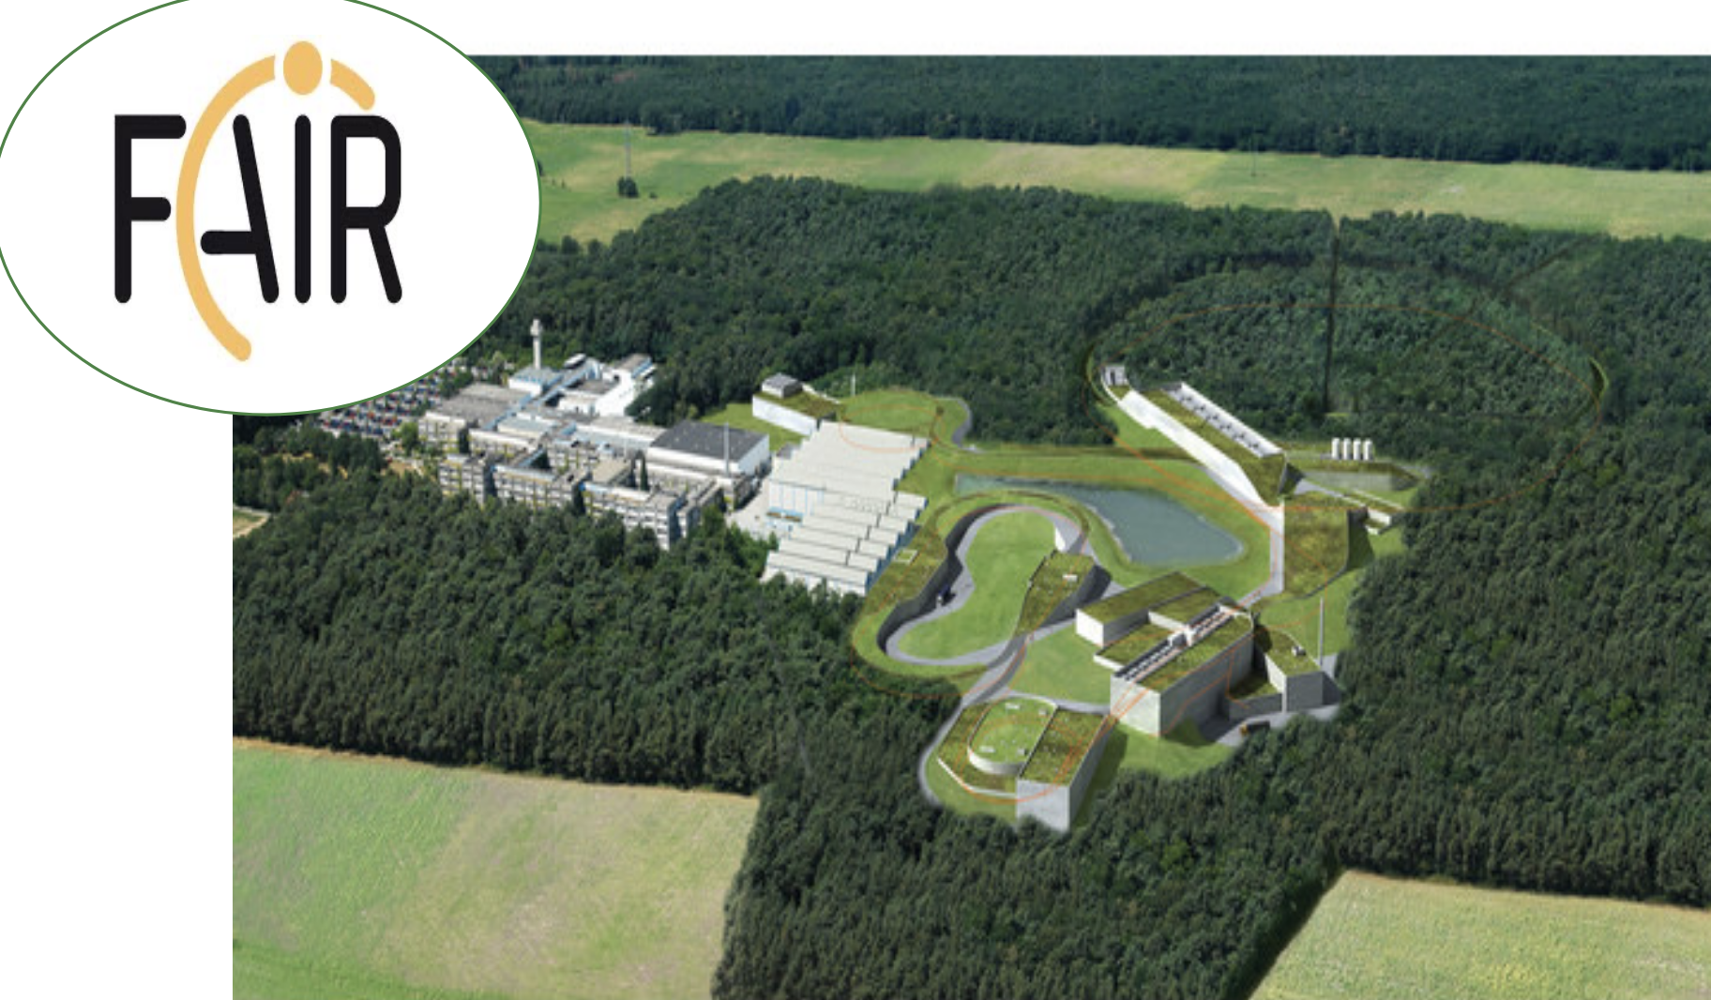
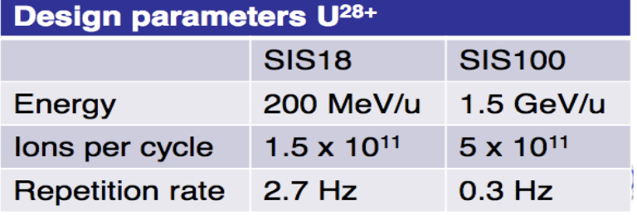
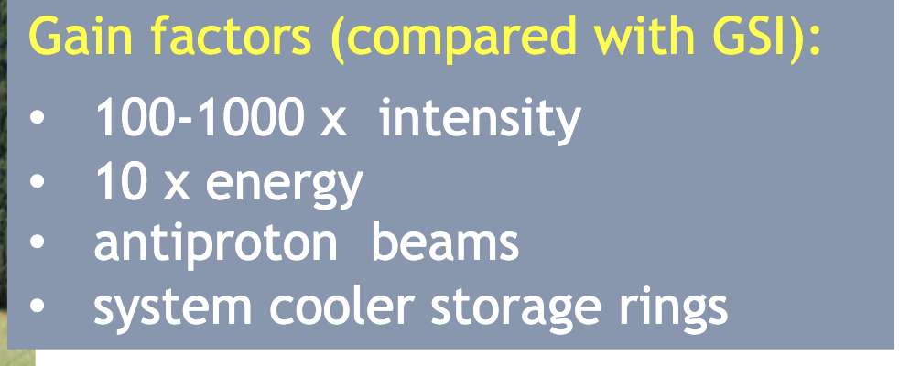
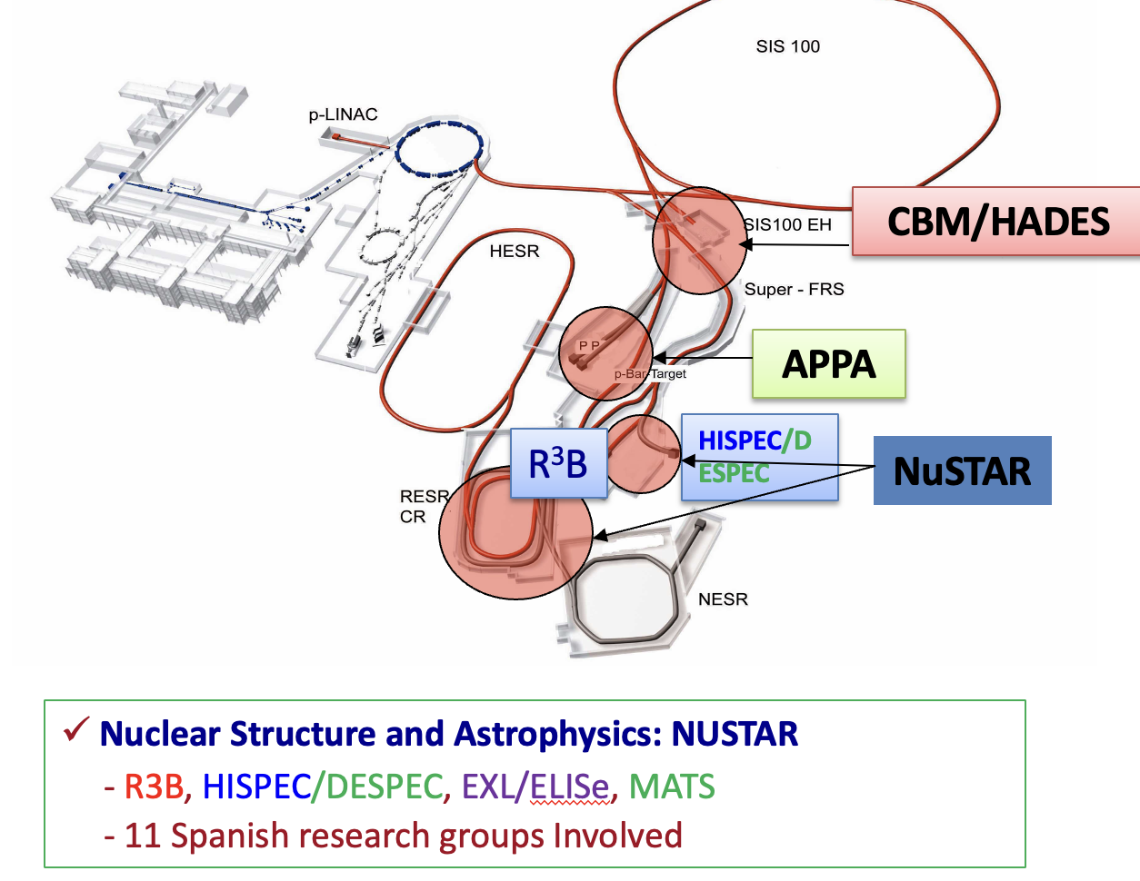
Talk by
Olof Tengblad

Slide 28
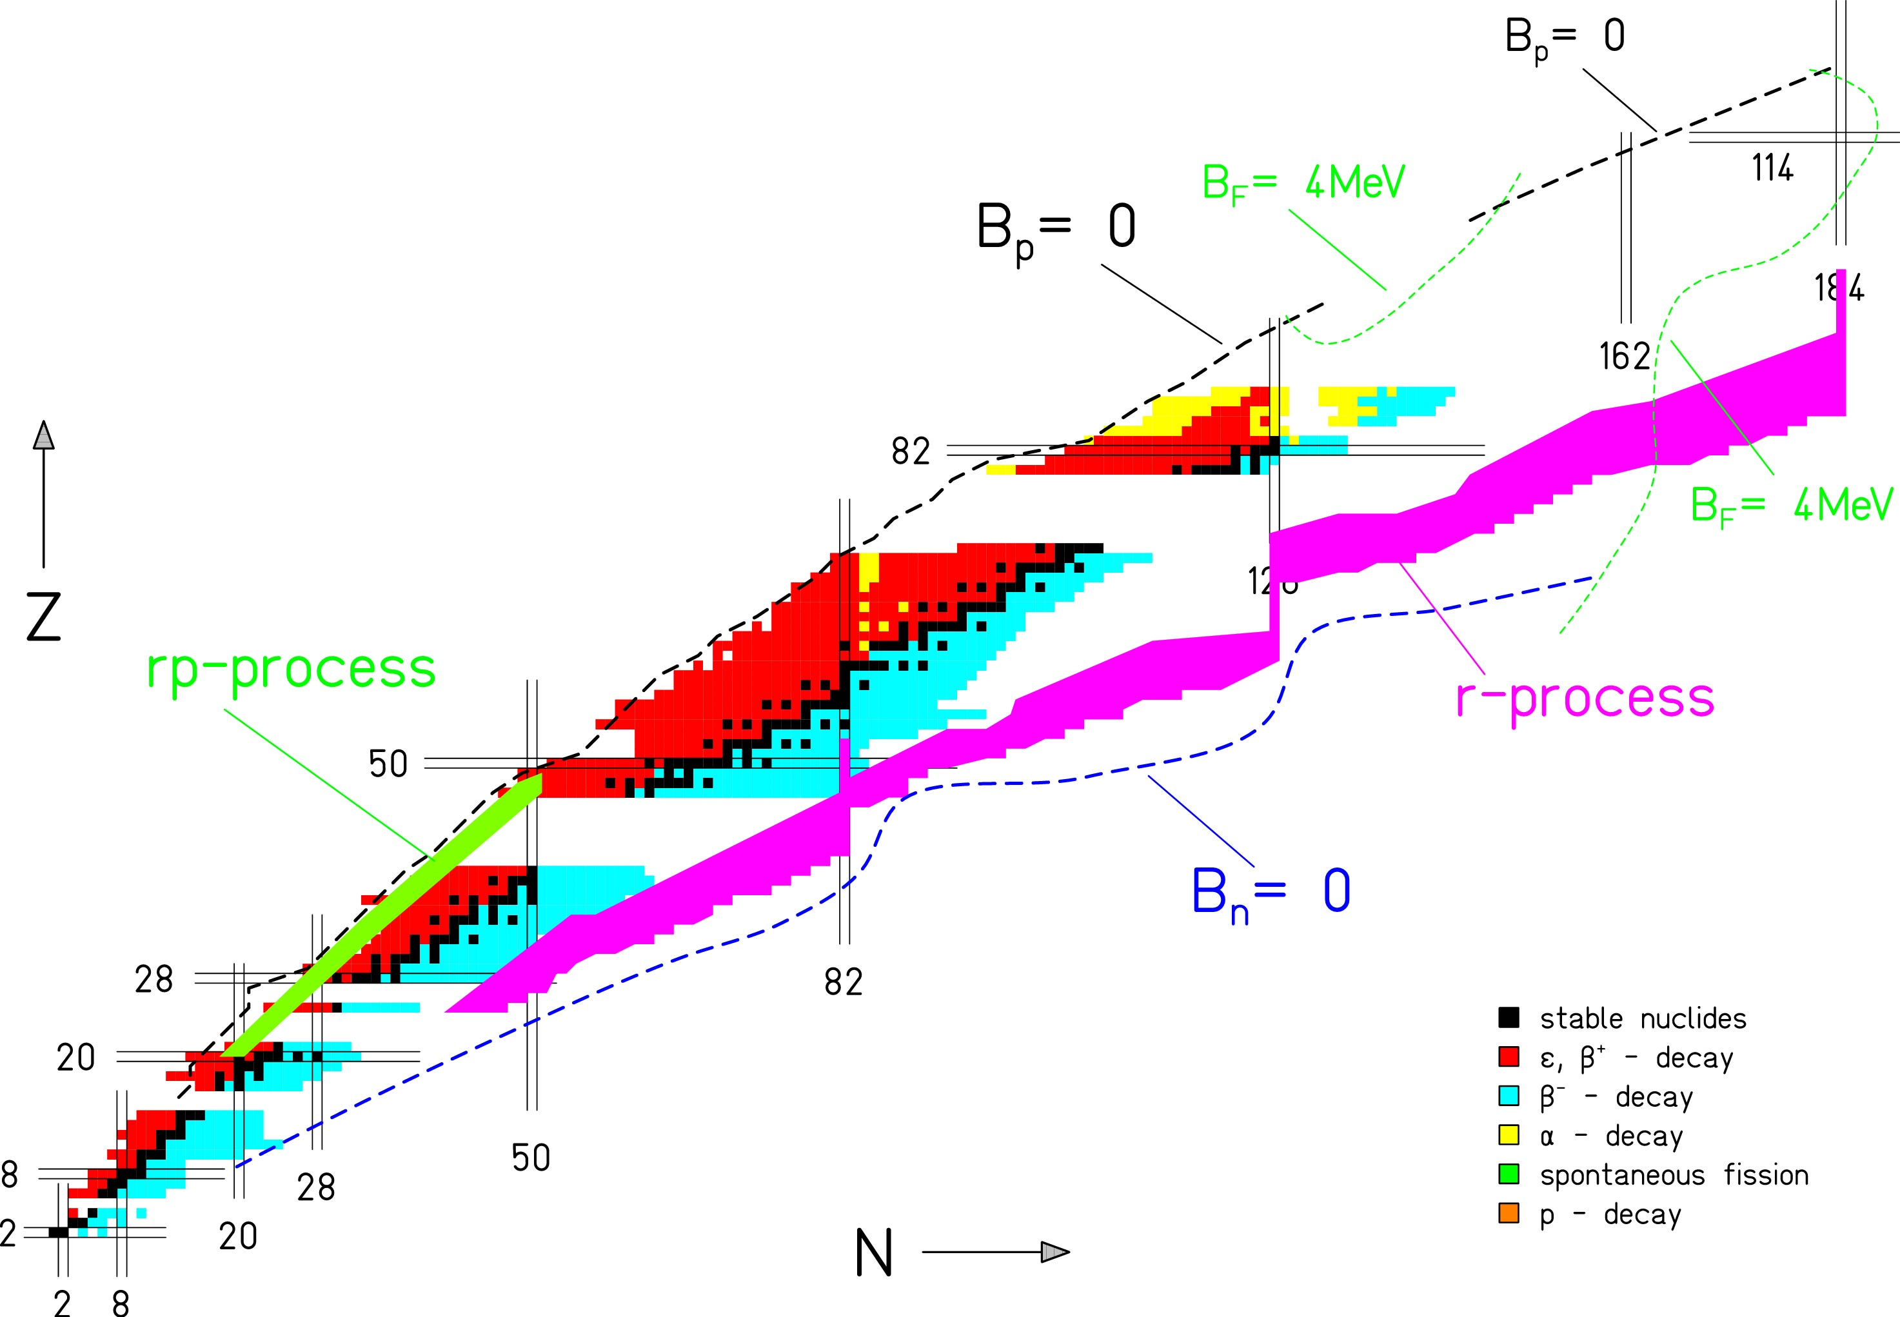
Isotope production
spalation
+
2
0
1
F
r
Nuclei chart @ ISOLDE
1 GeV p
fragmentation
+
+
2
3
8
U
1
1
L
i
X
fission
n
+
+
p
1
4
3
C
s
Y
Exotic ion production
Gaps
Long chain of isotopes

Slide 29
ISOLDE Isotope Separation On-Line
We need pure beams, free from isobaric contamination:
Low energy beam
Point like sources
Energy: 1.4 GeV (→ 2 GeV)
Pulse frequency: 1.2 s
Intensity: 3.2x10¹³ protons per pulse
I (average): 2 μA

Slide 30
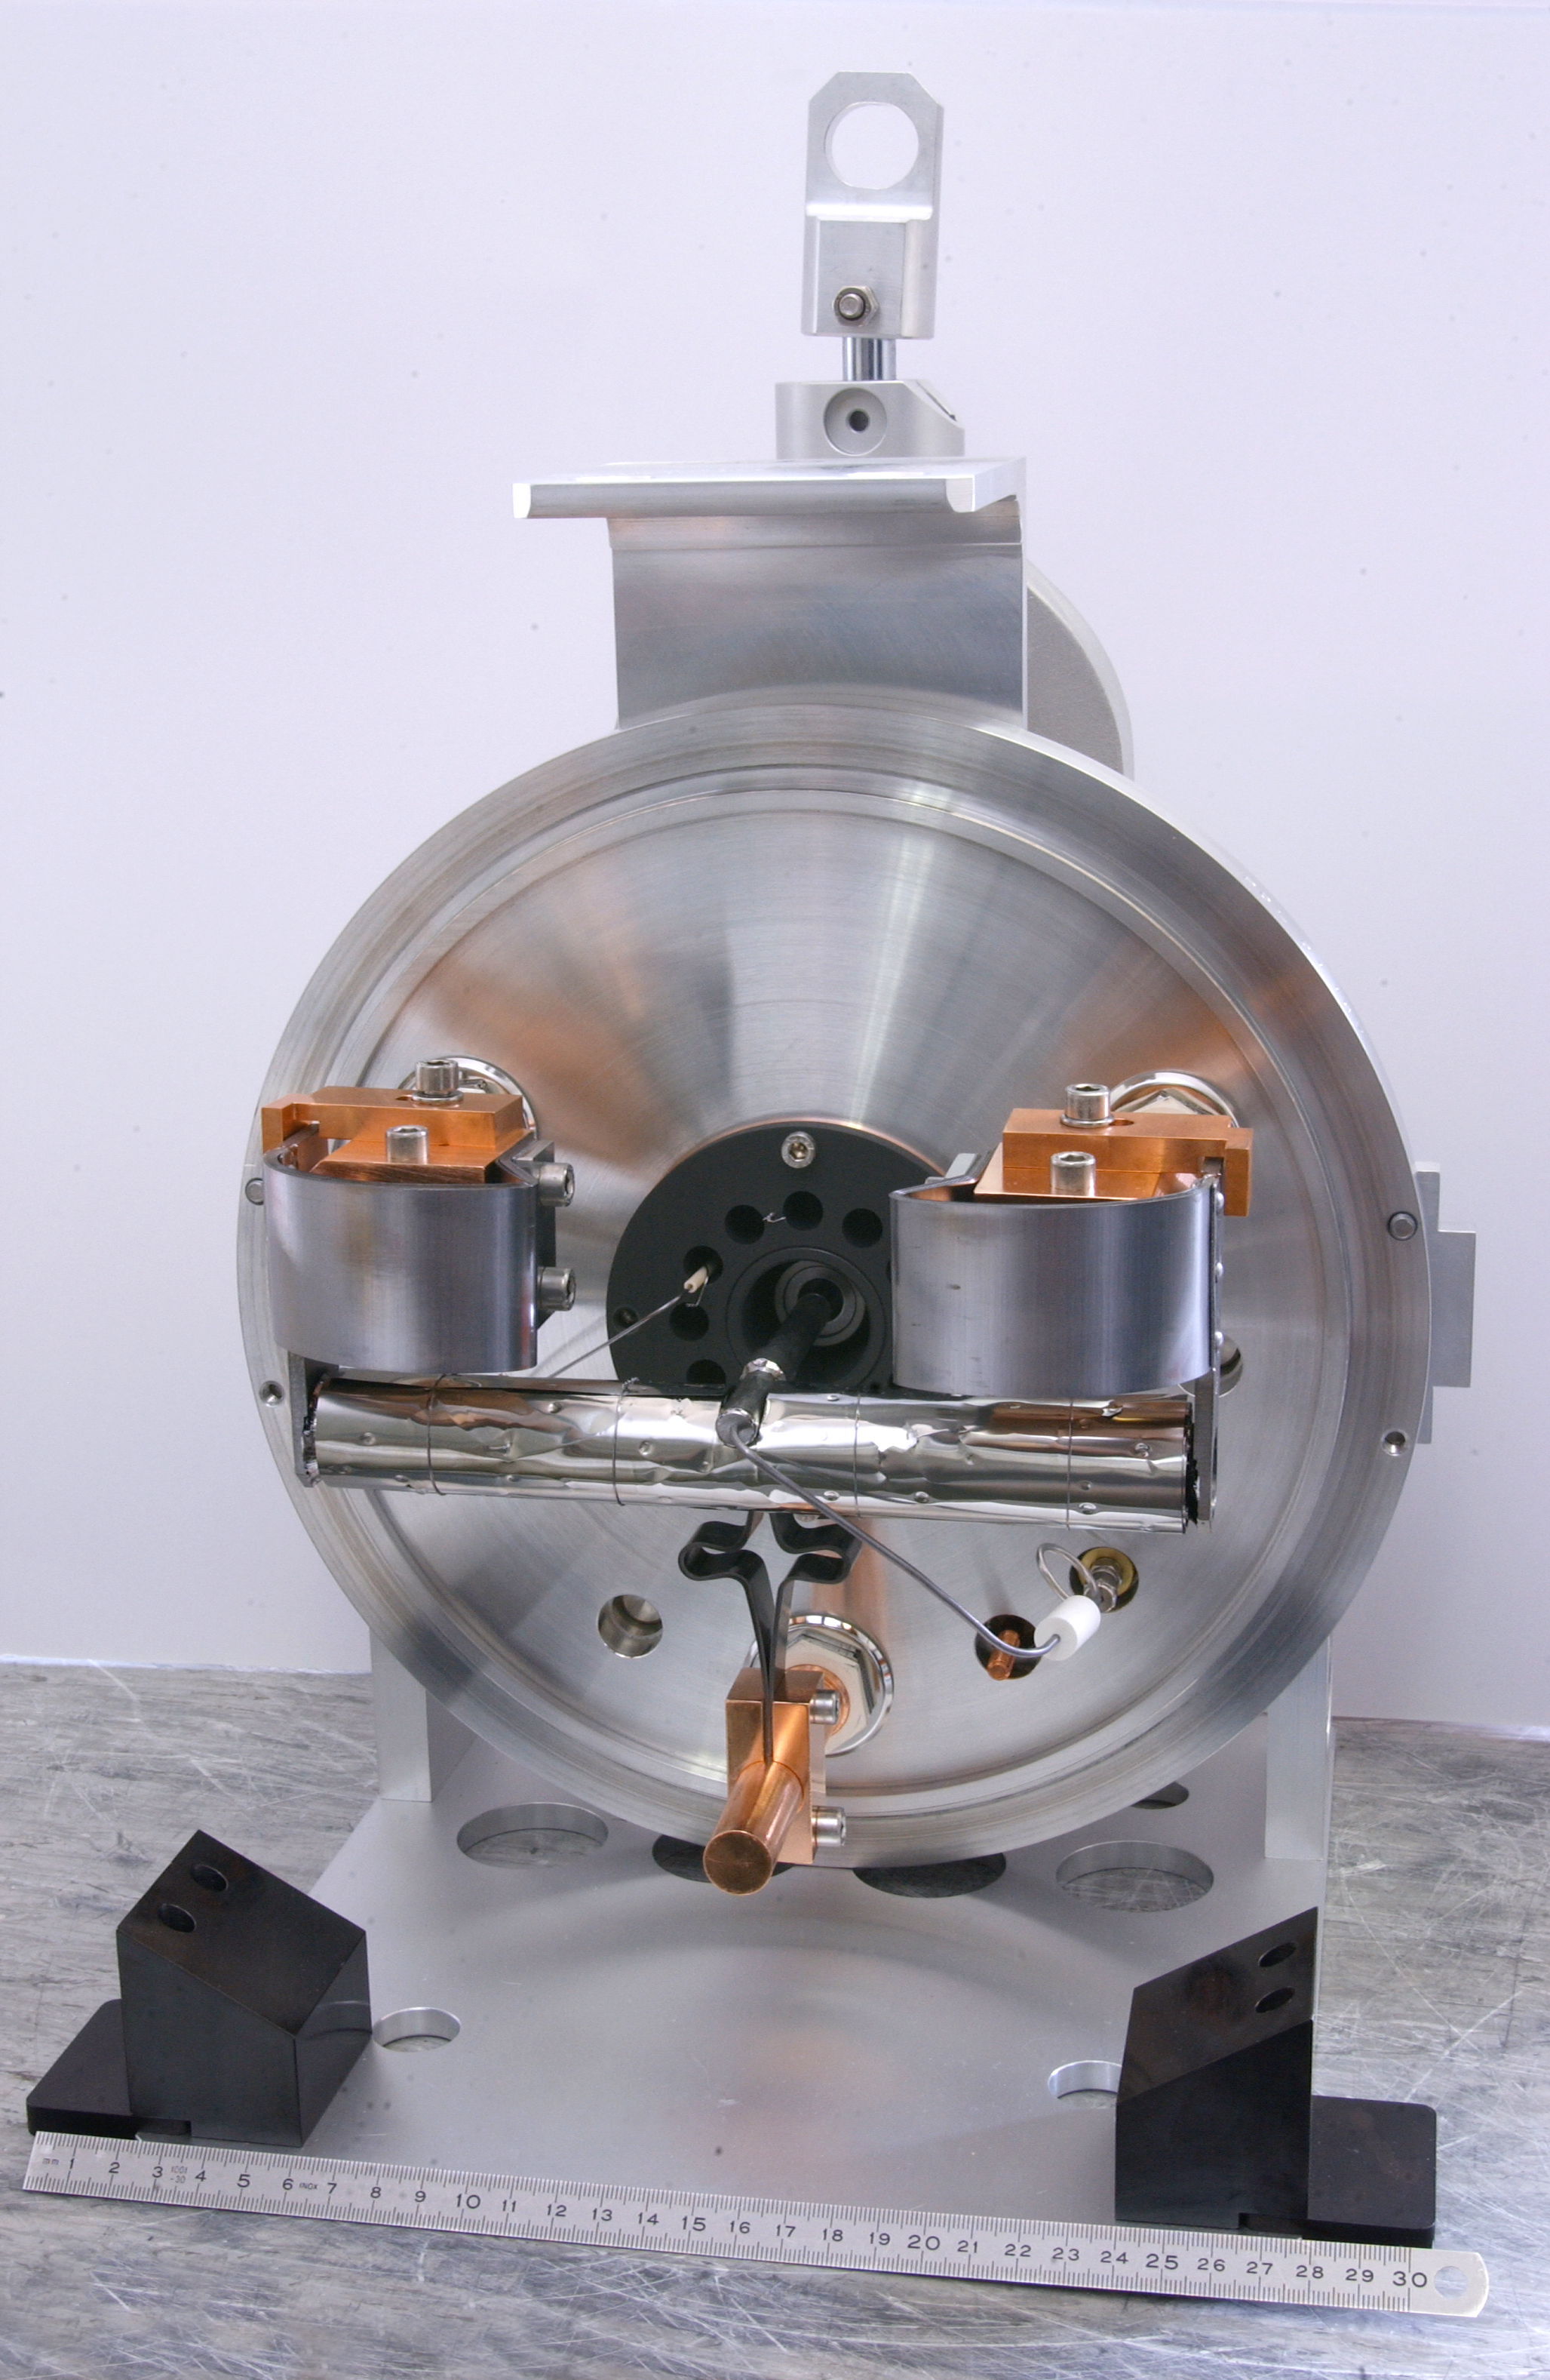
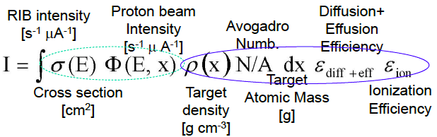


Target – Ion-source matrix: a chemical laboratory
^{Container:} ^{20 x 2 cm cylinder of Ta}
^{Material:}
  ^{Liquid La, Pb, Sn}
  ^{Metal foil/powder Nb, Ti,}
  ^{Oxides CaO, MgO}
  ^{Carbides SiC, UC, ThC}
^{Ion-source}
    ^{Surface}
    ^{Plasma}
    ^{Laser}
^{Fluorination CF4 or SF6}
Use in 2011 @ ISOLDE

Slide 31



ISOLDE Targets
Main challenge: extracting the 10⁻¹ – 10¹² nuclei produced in the reaction from the 10²³ nuclei in the target
Targets:
UCx, SiC, Ta, LaCx, CaO, ZrO….
The diffusion into the ion source is controlled by the target and transfer line temperature
31

Slide 32
Monte Carlo Simulation of ISOLDE production
Primary Nuclear Reaction
  Fragmentation:
  Fission
  Spallation
  Fluka Calculation
P beam on UC-Target
Spallation
fission
fragmentation
32

Slide 33
ISOLDE Main potential
Diffusion
Effusion
Production
700 isotopes
~75 elements
3 types of ion sources→ select pure beams
shape co-
existence
octupoles
shell
structure
n-p
pairing
rp-
process
Shell
structure
Over 20 target materials (carbides, oxides, solid metals, molten metals and molten salts) and ionizers, depending on beam of interest operated at high temperature
light
exotics

Slide 34




Surface & plasma ionization

Slide 35


Laser Ionization source
LASER – RILIS (Resonance Ionization Laser Ion Source)
    Used at ISOLDE since 1994
    Based on the selective ionization of a single atomic species
    It has allow for isomeric separation

Slide 36

Separation @ ISOL
Recoil Energy (fast)
Diffusion (slow)
The produced ions must leave the target:
Target + Ion source Unit
Separation of primary beam : Fragmentation in a thick target: ISOLDE
REX-ISOLDE
HRS
GPS
tape station

Slide 37


Mass separators @ ISOLDE
The radioactive ions are accelerated at 20 – 60 kV and sent to the separating magnets.
GPS (General Purpose)
  Magnetic dipole + electrostatic switchyard
  Can separate simultaneously 3 masses
  m/∆m = 1000
HRS (High Resolution)
  2 Magnetic dipoles
  Separation power
  m/∆m = 5000
∆m
37

Slide 38









Production and Selection @ ISOLDE
Very Efficient separation and production of the Nucleus of interest

Slide 39





Post-accelerator: REX-ISOLDE→ HIE-ISOLDE
REX-ISOLDE started in 2001
HIE-ISOLDE 2014
Total efficiency : 1 -10 %
Charge Breeding
1⁺ to A/Q = 2 – 4.5
1⁺ to A/Q = 2 – 4.5
ISOLDE
1 Nature, 12 PRL, 6 PLB…..
Primary
target
Protons
from PS
Heidelberg + GSI, Darmstadt
Stockholm
Mainz
Notes:
Ions are cold in the large aceptance rex-trap to effectively enter in the Electron beam ion source that produce a charge breeding between 3 al 4.5. last year the A/Q ratio 2 was successfully proved.
The 4-rod-RFQ is designed to accelerate radioactive ions with a charge-to-mass ratio larger than 1/4.5 from 5 keV/u to 300 keV/u . The RF Quadrupole field provides transverse focusing for the low energy ions while a modulation of the four rods performs a smooth bunching and acceleration of the injected 100 µs bunch.
The IH-Structure (IHS) [8] is a compact cavity containing separated regions of acceleration and focusing, including a triplet of quadrupoles and a section of drift tubes operating as a re-buncher, boosting the beam from 0.3 MeV/u to an energy value between 1.1 and 1.2 MeV/u, by providing an effective voltage of up to 4.2 MV. The whole structure has 20 gaps and a total length of 1.5 m.

Slide 40



The ISOLDE facility and set-ups
production
GPS
Target 2
RIB production
HRS
Target 1
REX-ISOLDE
RIB accelerator
Since 2001
2.8 MeV/u
TAS
+RILIS
HIE-ISOLDE RIB accelerator
2014-2018
Gradual increase to ~10 MeV/u
WISARD
VITO
Scattering
Chamber
MINIBALL
IDS
Solid State Physics
NICOLE
CRIS
ISOLTRAP
COLLAPS
ISS
High energy experiments
Low energy experiments
(~ 60 keV)
Travelling setups

Slide 41

Summary: Two production Methods
Primary Target
extraction
post-accelerator
ionisation
séparation
Secondary Target
spectroscopy
driver accelerator
driver accelerator
ions 100 MeV - 1 GeV/u
De-acceleration
fragmentation / fission
Secondary Target
Spectroscopie
Fragment Separator
Post-accelerator

Slide 42

SPIRAL2 Project

Slide 43
Reaction at High Energy @GSI → R3B @ FAIR
Reaction Mechanism :
Coulomb dissociation
Difraction
Absortion
Observables:
Momentum Distribution:
  neutron
  Charged fragment
Invariable Mass
Angular correlations
Experimental Variable:
beam energy 30 → 700 MeV/A
Secondary Target material: C → Pb
Secondary Beam ⁶He → ²²Ne

