Slide 1
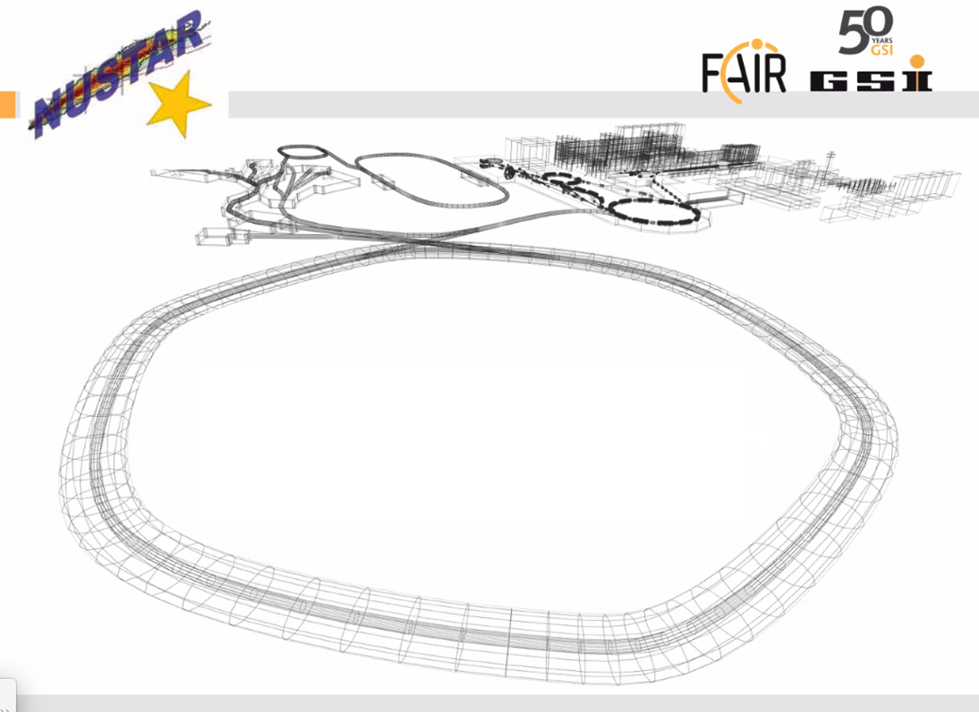

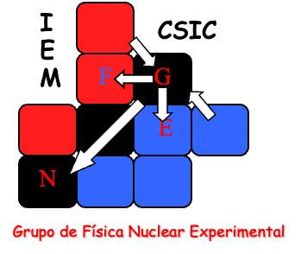

Slide 2
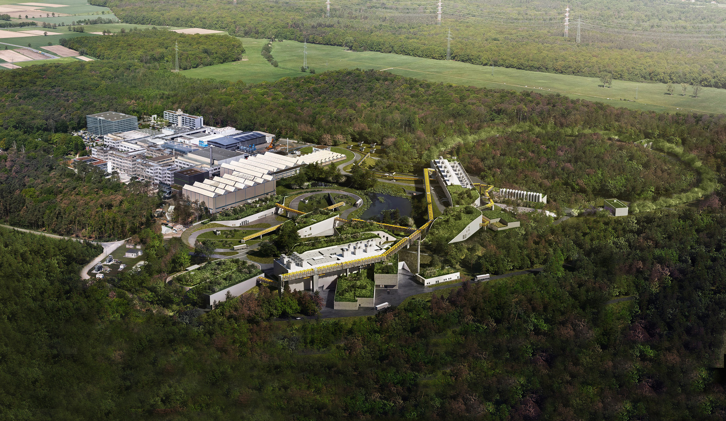
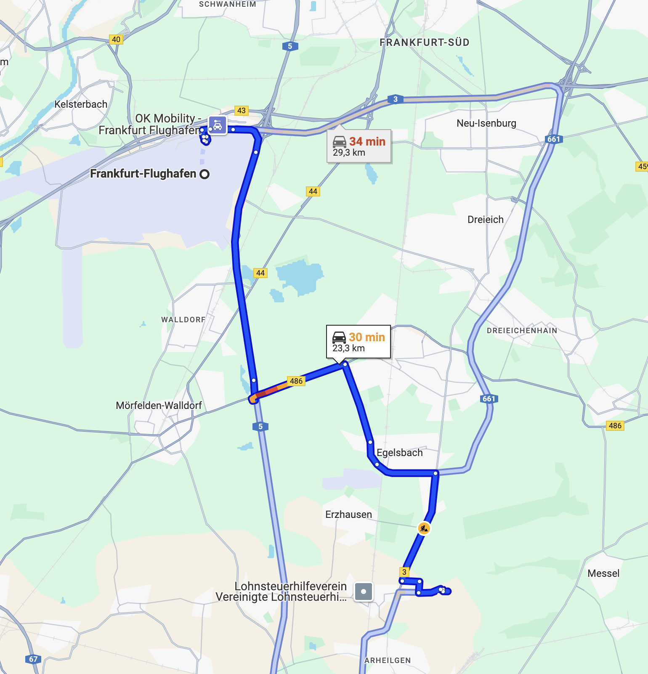
The Universe in the Laboratory
https://fair-center.eu/
FAIR- Facility for Antiproton & Ion Research
SIS100
Notes:
This is an artista view of how FAIR will look in a few years from know (2030?)
Upper left corner is the present GSI, and the rest is the future FAIR facility. (Berta showed you some photos on the status).
Inside this huge facility we have the NUSTAR facility

Slide 3
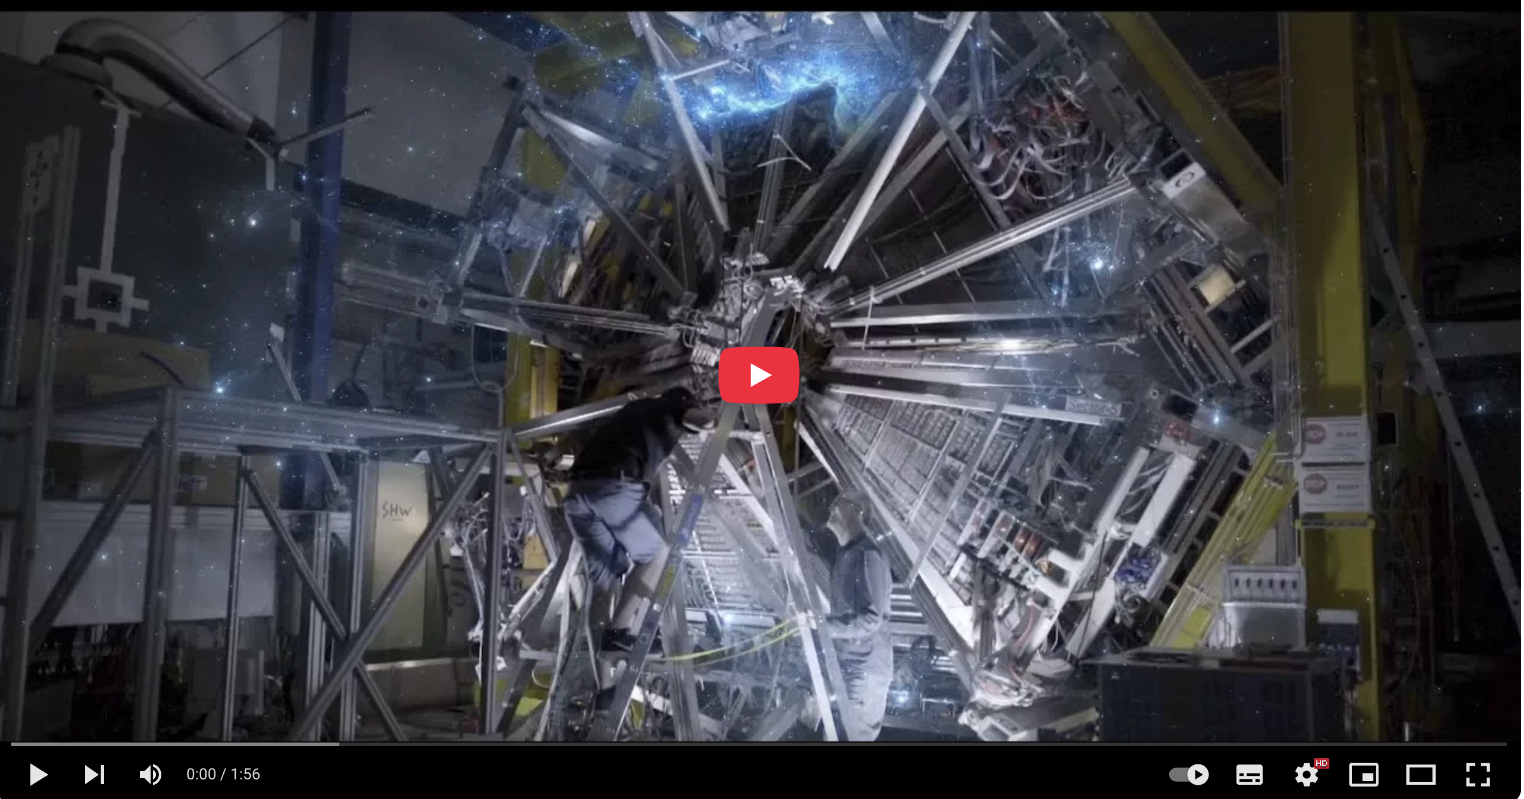
FAIR - The Universe in the Laboratory
Youtube movies
FAIR - The Universe in the Laboratory
https://www.youtube.com/watch?v=kbvK5AGg8oM
https://www.youtube.com/watch?v=wTCkZdeqI8I
NUSTAR
https://fair-center.eu/user/experiments/nustar/documents/technical-design-reports

Slide 4
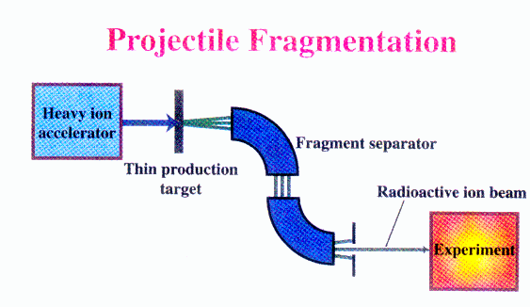
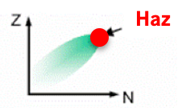

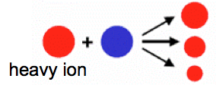
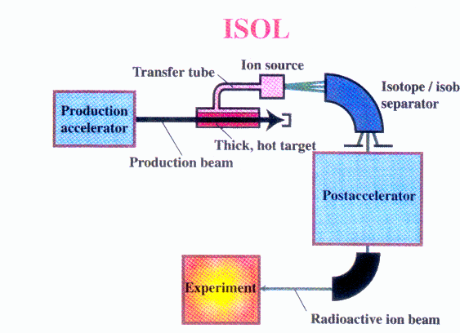
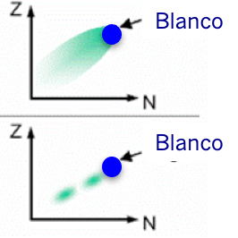
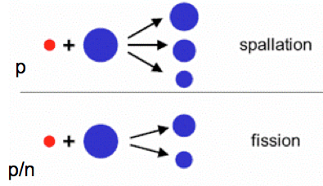
Radioactive Beam Production
Beam Fragmentation
FAIR
(2028)
GSI
GANIL
SPIRAL
HIE –
ISOLDE
ISOLDE
2 GeV
1 GeV
50 MeV
10 MeV
0.06 MeV
Haz
High energy, large variety of species,
Short half-lives (μs), cocktail beam
ISOL – Isotope Separation On Line
Blanco
Variable energy, high intensity, good beam qualities

Slide 5
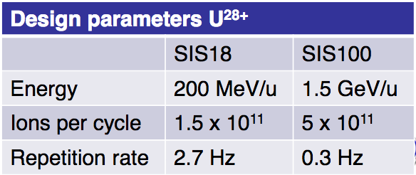
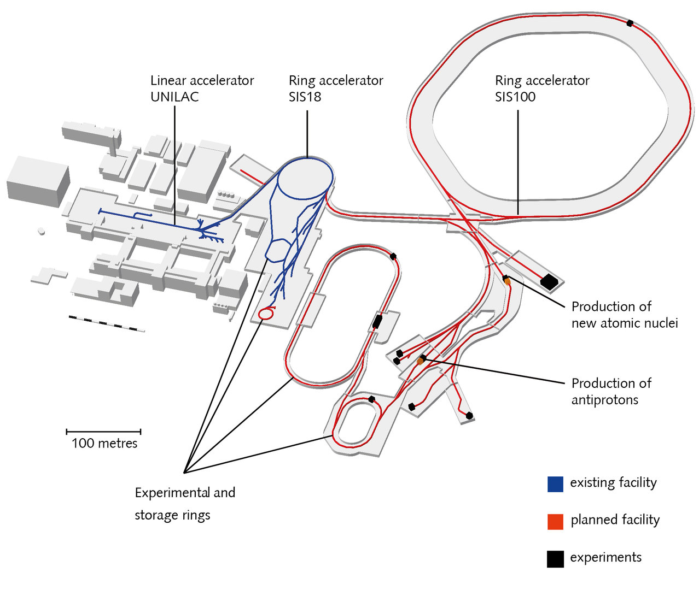
Cave C
R³B
2028
Existing
Not-too-far future
Experiment facilities

Slide 6
NUSTAR
The scientific user community of FAIR is organised in experimental collaborations, which are grouped in 4 scientific pillars:
APPA - Atomic, Plasma Physics and Applications
    BIOMAT - Biology and Material Science
    HED@FAIR - High Energy Density Science at FAIR
    SPARC - Stored Particles Atomic Research Collaboration
CBM - Compressed Baryonic Matter
NUSTAR - Nuclear Structure, Astrophysics and Reactions
    High Eenergy Branch R3B 2028
    Low Energy Branch HISPEC/DESPEC, MATS, LASPEC 2032
    Ring Branch ILIMA, ELISe, EXL 20xx
PANDA - Physics with High Energy Antiprotons
    Antiprotons produced by a primary proton beam → High Energy Storage Ring (HESR) → fixed target inside PANDA

Slide 7
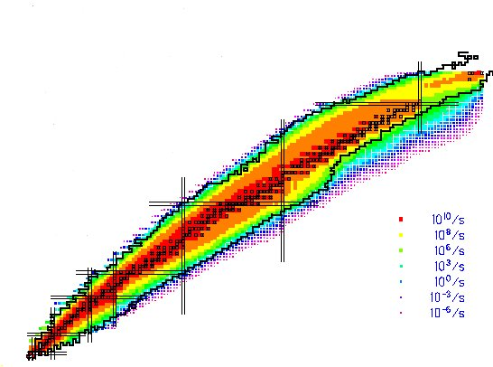
NUSTAR:
NUclear Structure, Astrophysics and Reactions
What are the limits for existence of nuclei?
  Where are the proton and neutron drip lines situated?
  Where does the nuclear chart end?
How does the nuclear force depend on varying proton-to-neutron ratios?
  What is the isospin dependence of the spin-orbit force?
  How does shell structure change far away from stability?
How to explain collective phenomena from individual motion?
  What are the phases, relevant degrees of freedom, and symmetries of the nuclear many-body system?
How are complex nuclei built from their basic constituents?
  What is the effective nucleon-nucleon interaction?
  How does QCD constrain its parameters?
Which are the nuclei relevant for astrophysical processes and their properties?
  What is the origin of the heavy elements?
Notes:
The Physics

Slide 8



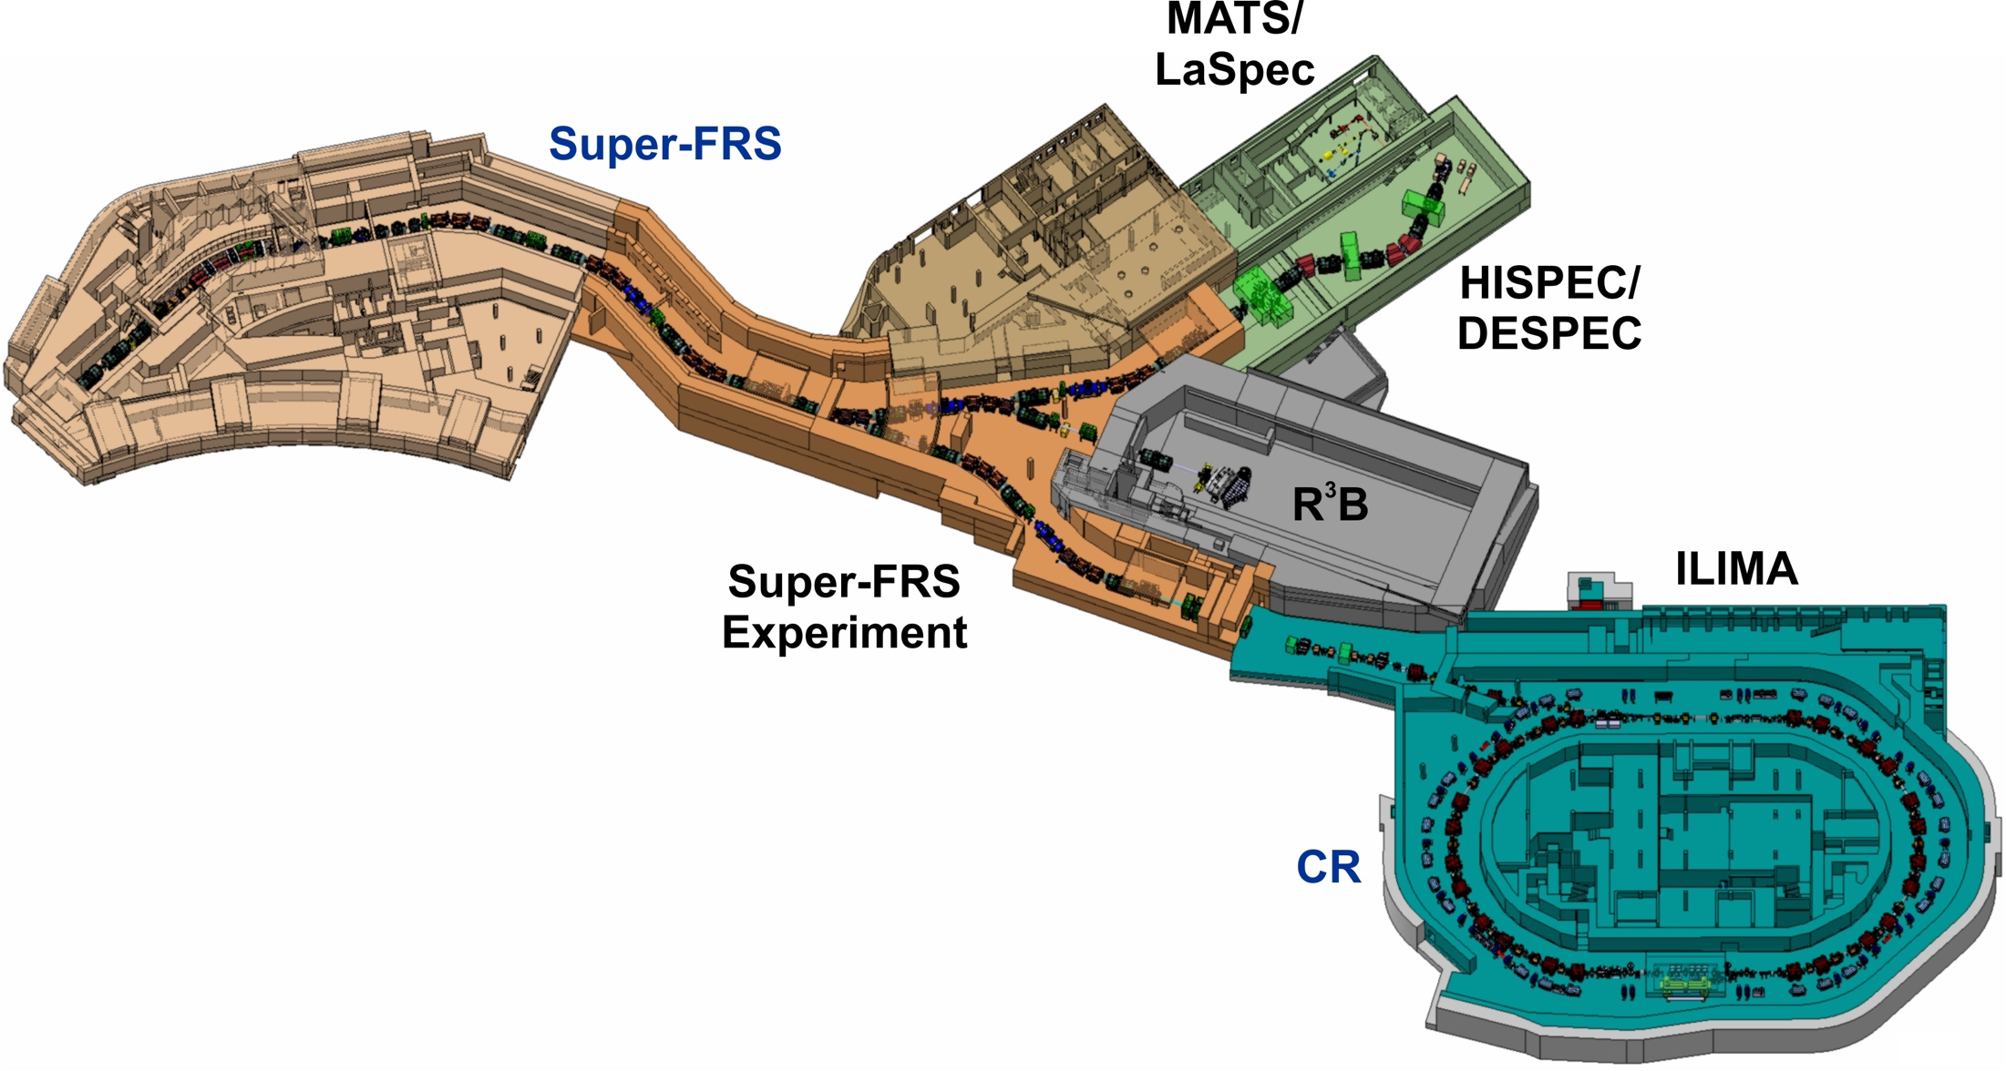




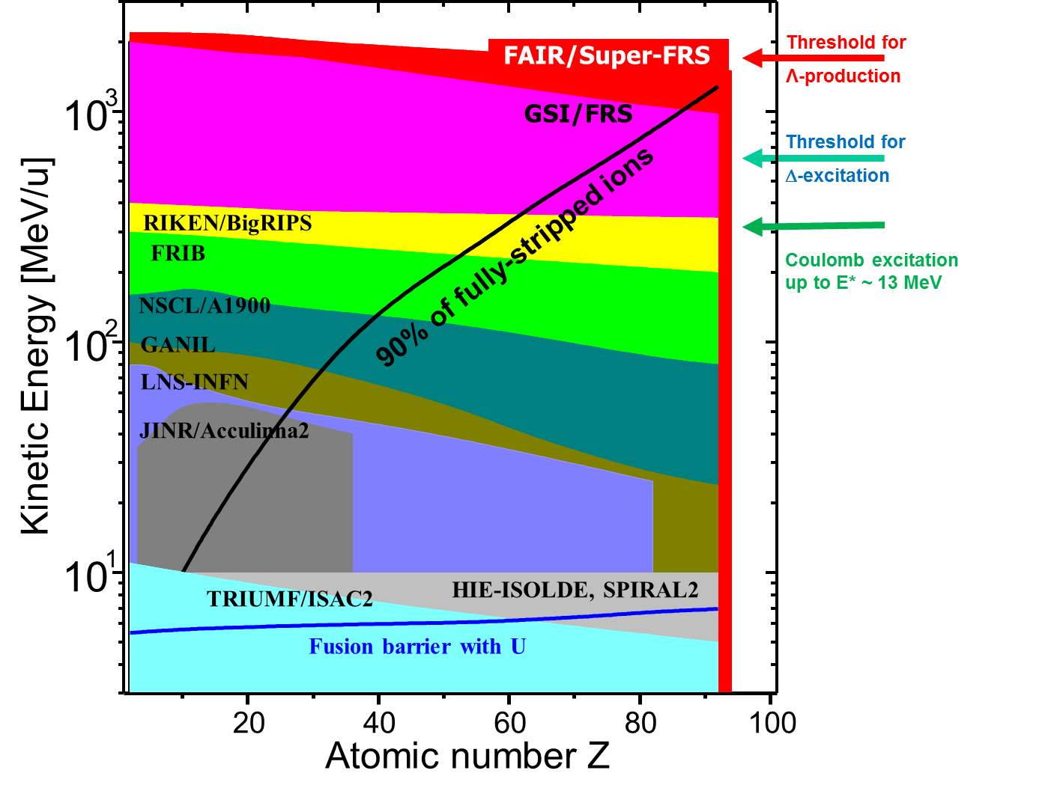
NUSTAR NUclear STructure & Astrophysis Research
Primary beam
from SIS100
Production of more than 4000 nuclear species
Olof TENGBLAD MASTER TEAFN
8
Notes:
NUSTAR NUclear STructure & Astrophysis Research: includes many sub-collaborations
Specially we divide into Low EnergyBranch, Ring Branch and High Energy Branch=R3B.
The aim is the same but the methods differs, we all want to produce exotic nuclei and understand their structure.
The heart and common part is the Super Fragment Separator SFRS

Slide 9
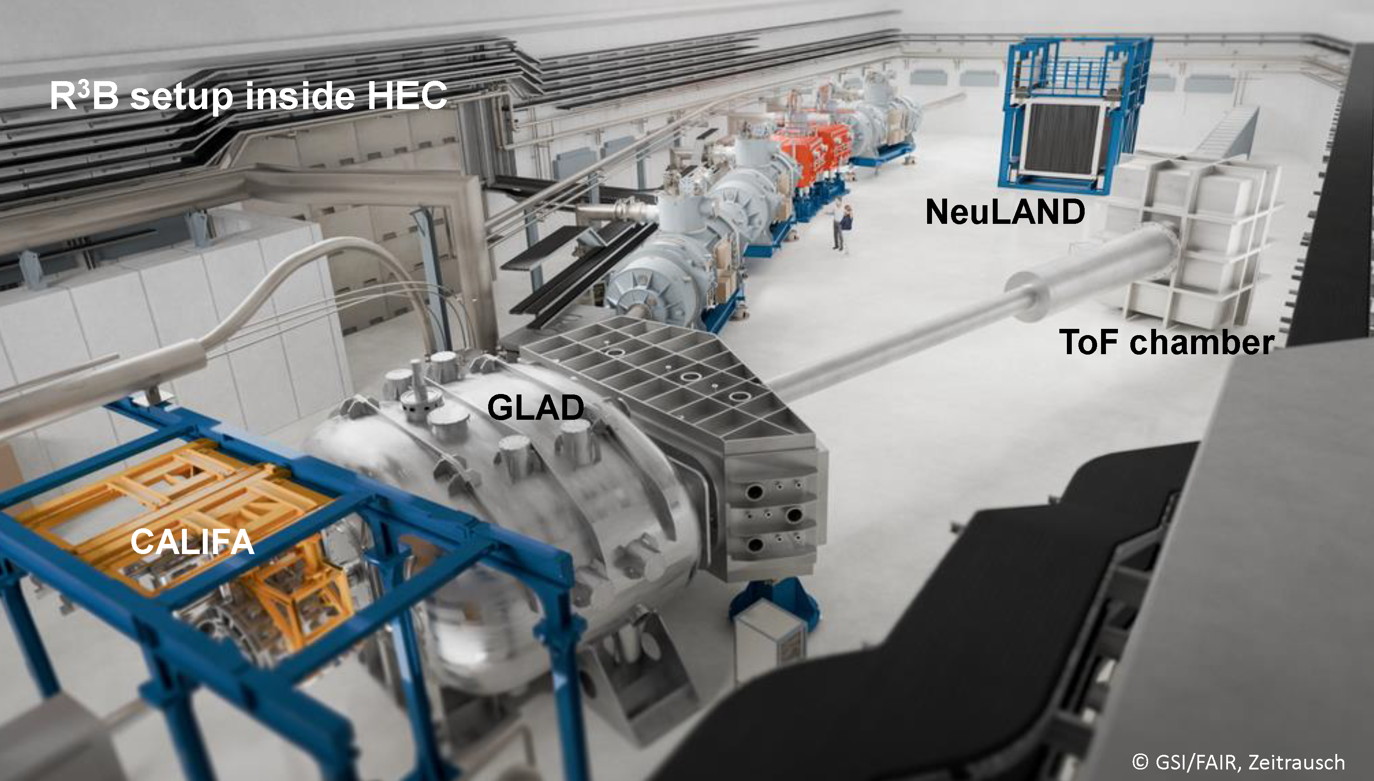
R³B: Reactions with Relativistic Radioactive Beams
CAD drawing of the new installation in High Energy Cave

Slide 10

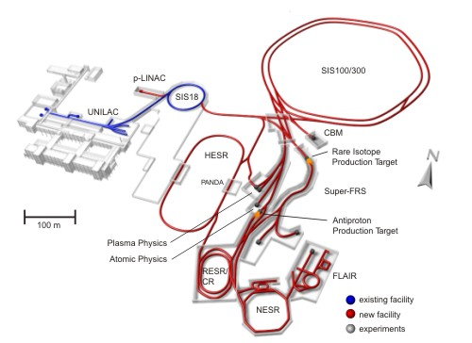
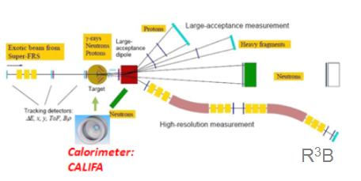
How does it work
FAIR (Facility for antiproton and ion research)
1. Accelerated beam impact on Production Target
2. Products are separated in SFRS
3. Separated isotopes directed to experiment
R³B
4. Isotope of interest impact on Reaction Target
p
n
n
p
H
5. Reaction fragments and gammas are detected
Notes:
This animation illustrates how these experiments are performed..

Slide 11
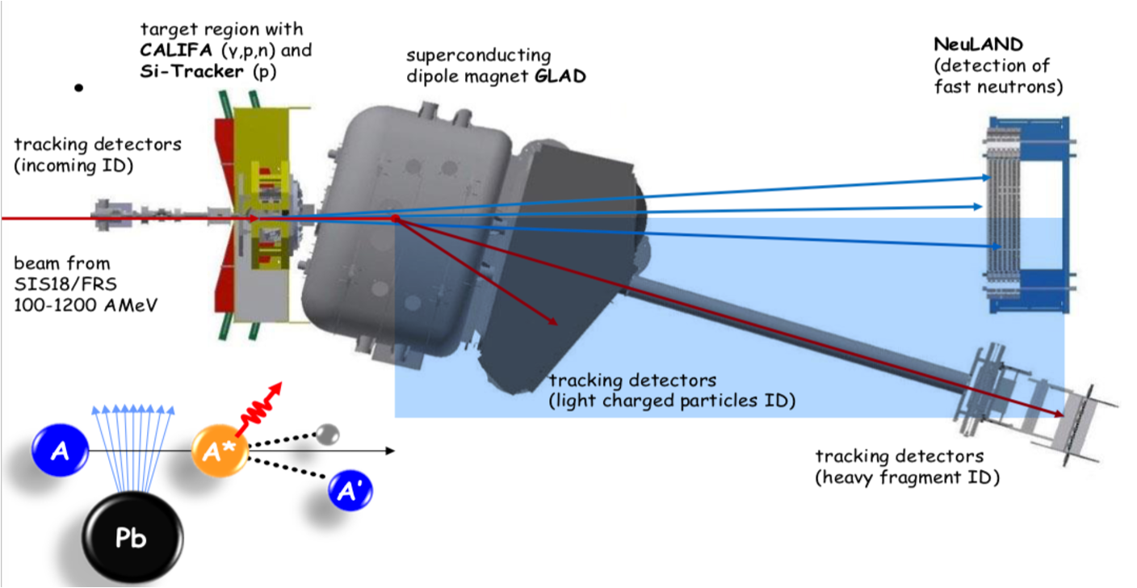
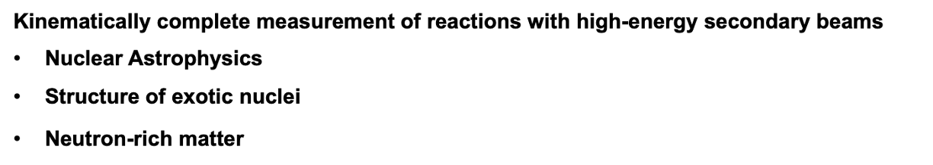
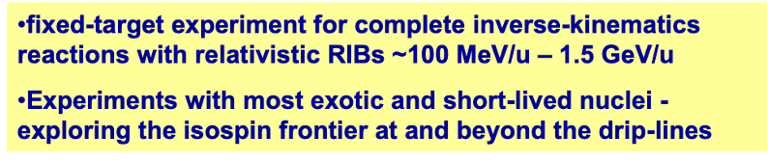
R³B: Reactions with Relativistic Radioactive Beams
Magnet
BEAM →
Neutrons →
γ p d
protons→
fragments →
Notes:
Along the talk you will see different layouts of the R3B experimental hall. This is not only due to historical advances but the equipment although big si moved arround optimizing for each campaign.
R3B is a universal fixed target experiment for complete inverse kinematic reactions with radioactive beams in the energy range 300-15000MeV/u.
The concept is build ont he existing ALADIN-LAND set-up at GSI.
We will adress Nuclear Astrophysics, study exotic nuclei or nuclei at the extreme

Slide 12
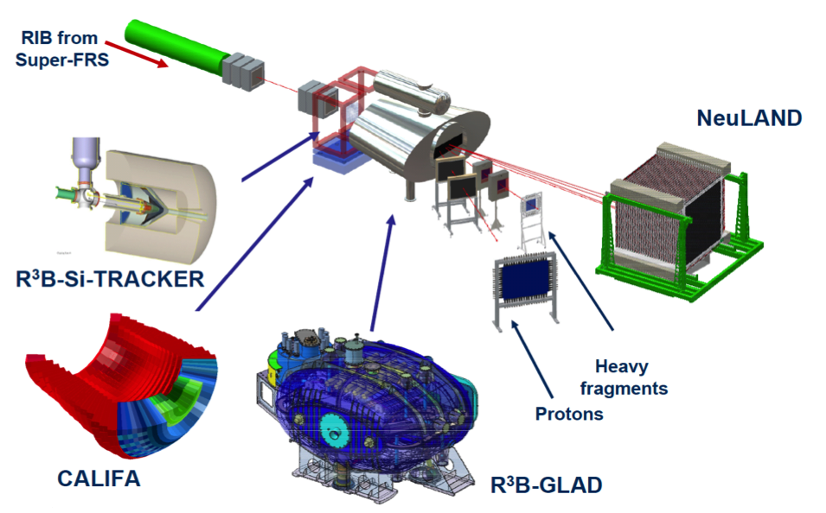
Key instrumentation
>20 meters
LH₂ target

Slide 13
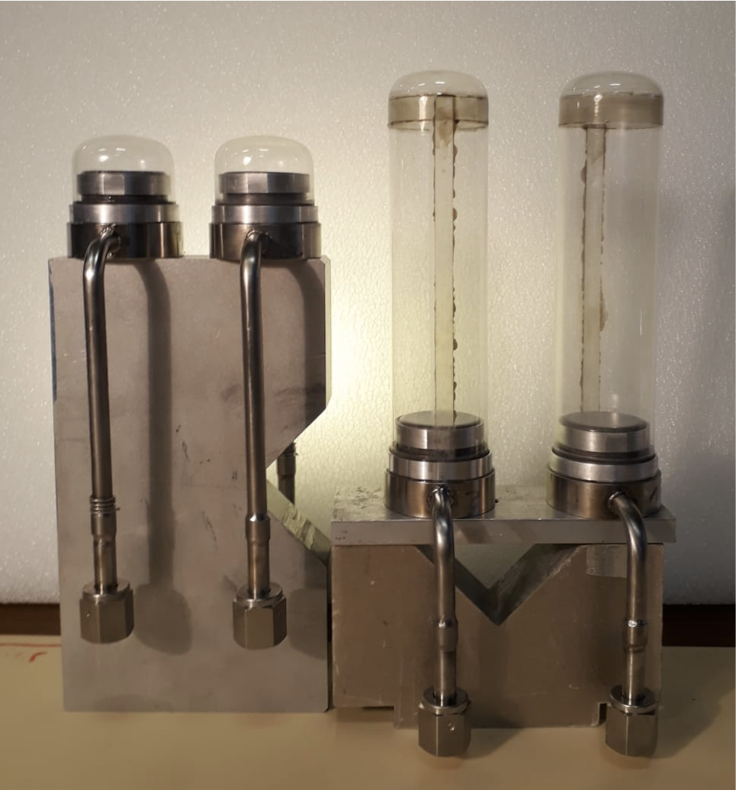
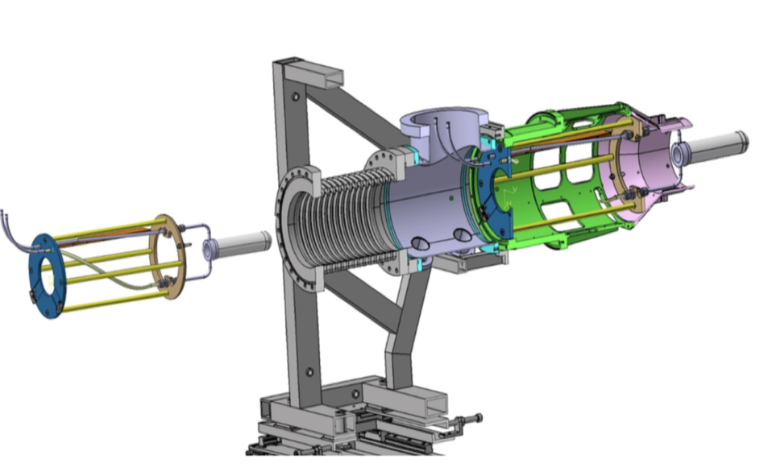
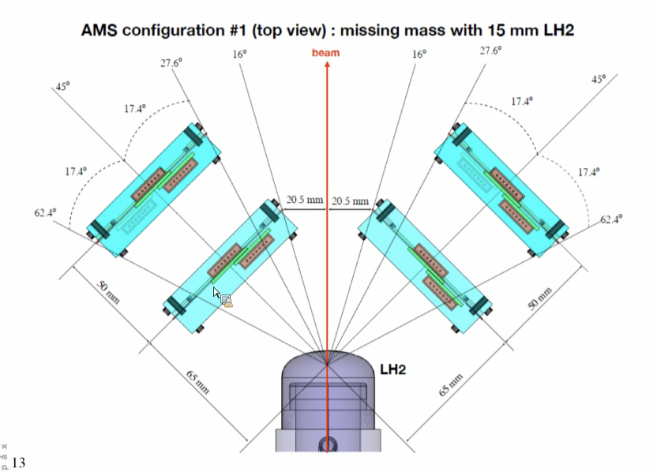
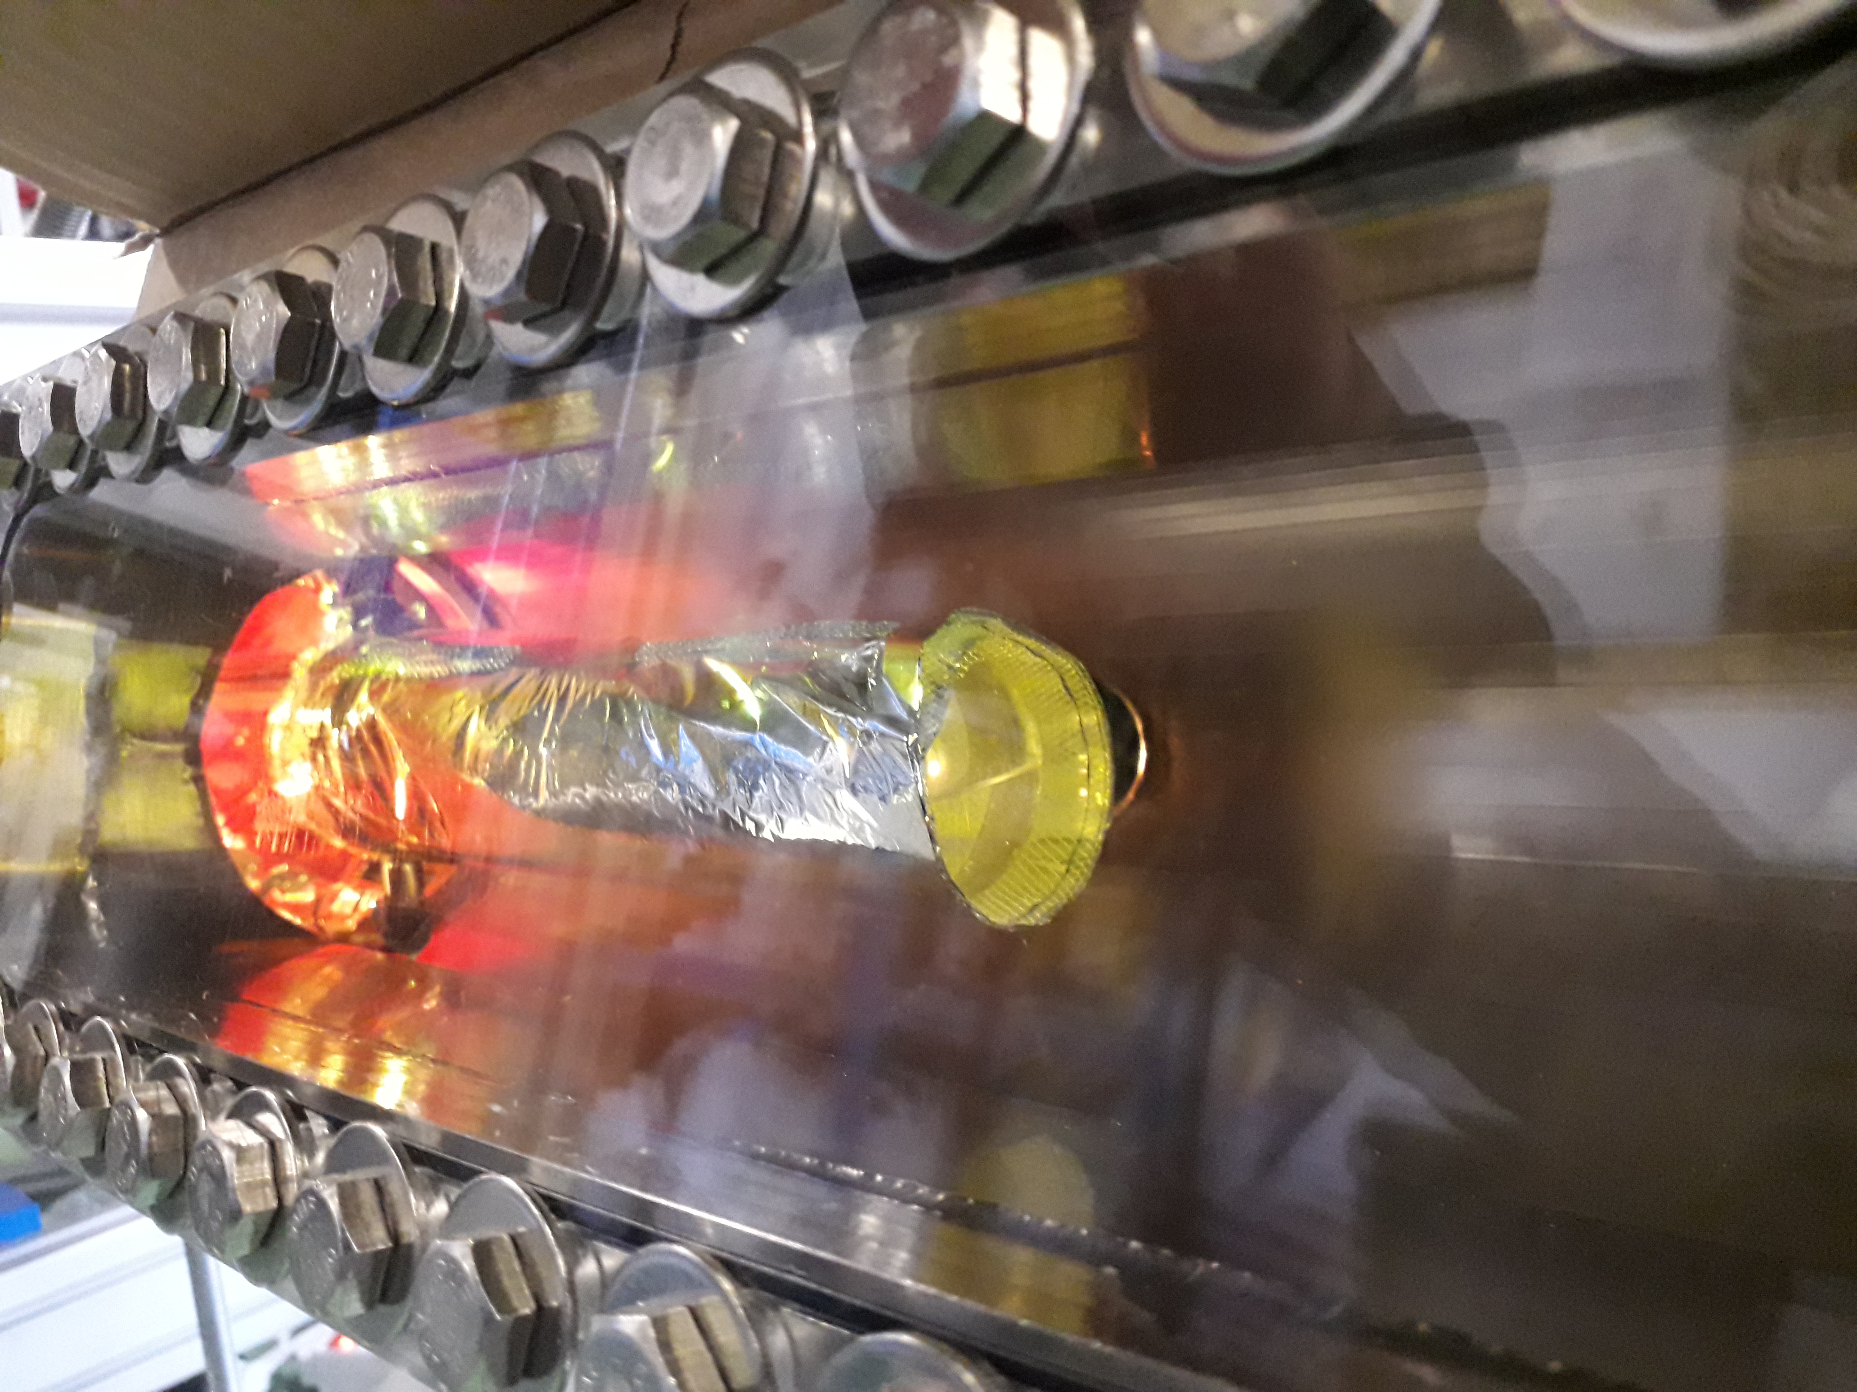
LH₂ target with Si-detector
1.5 cm 15 cm
The target cell made of Mylar
Target cell diameter 42 mm
Three target length 15, 50 and 150 mm.
The cryogenic system operates in a closed loop.
The target is connected to a storage tank.
The tank is filled with 800 l of hydrogen at room temp.
After liquefaction the target hydrogen is at 20.3 K and 1041 mbar.

Slide 14
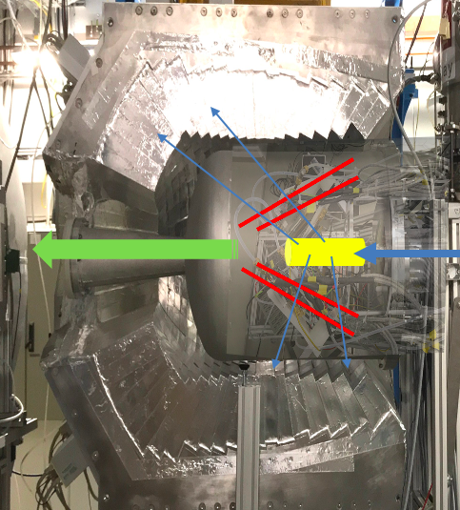

Reaction chamber: LH₂-target, p-tracker, γ-spec-calori-meter
Identify and track recoils emmitted at large angles
High angular resolution (better than 1 mrad) → very high segmentation
Low noise level → detection of MIP
Multi-layer sensors 50-100 μm for 1st layer → minimize multiple scattering or shadow γ rays
Low threshold 25 KeV
Multi-hit capability
Further:
Closed geometry around the extended target→ 4p vertex reconstruction
Spark protection against ionising particles hit
Operate in the proximity of strong magnetic fields and vacuum
Dedicated electronics

Slide 15
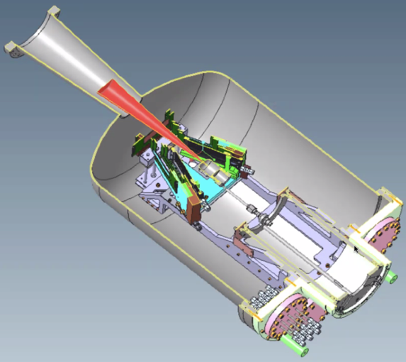
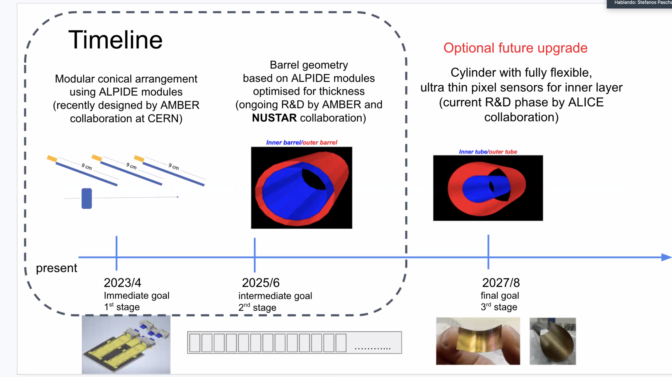
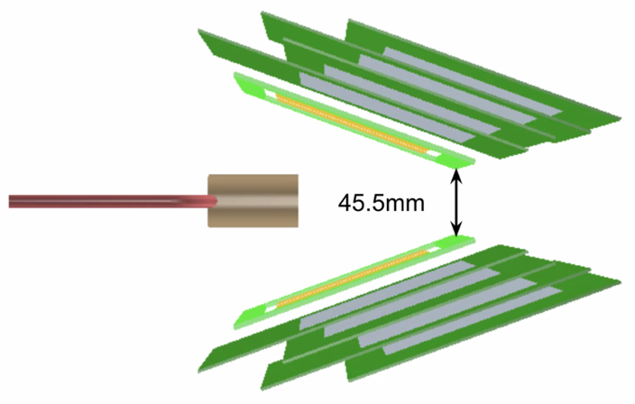
I+D para p-tracker → flexible pixelated Si-boards
2024/25
2026/27
2028/30
flexible boards

Slide 16

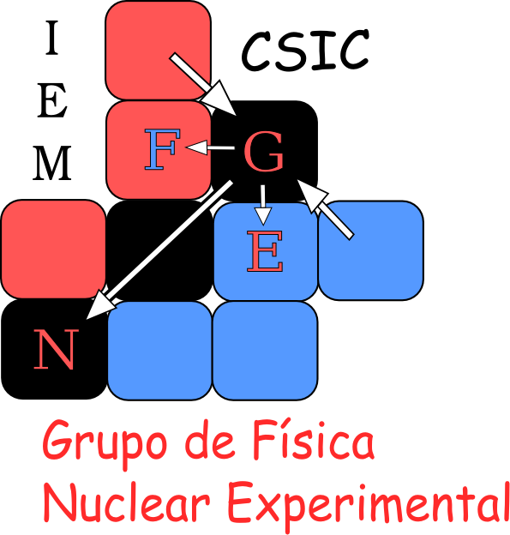


Hybrid γ/p spectrometer/calorimeter
Univ. Santiago de Compostela
TUDa - TUM – Lund

Slide 17
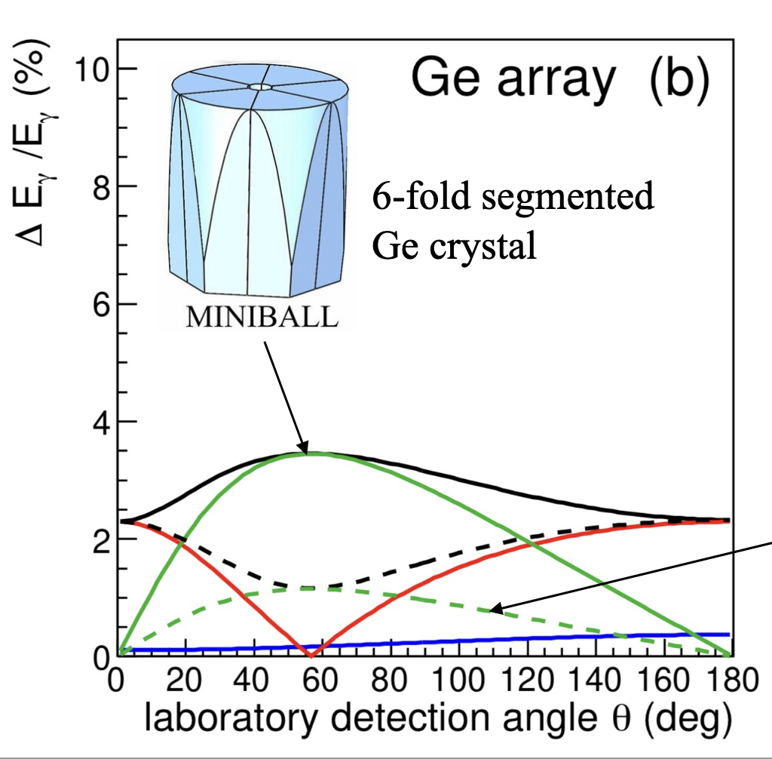
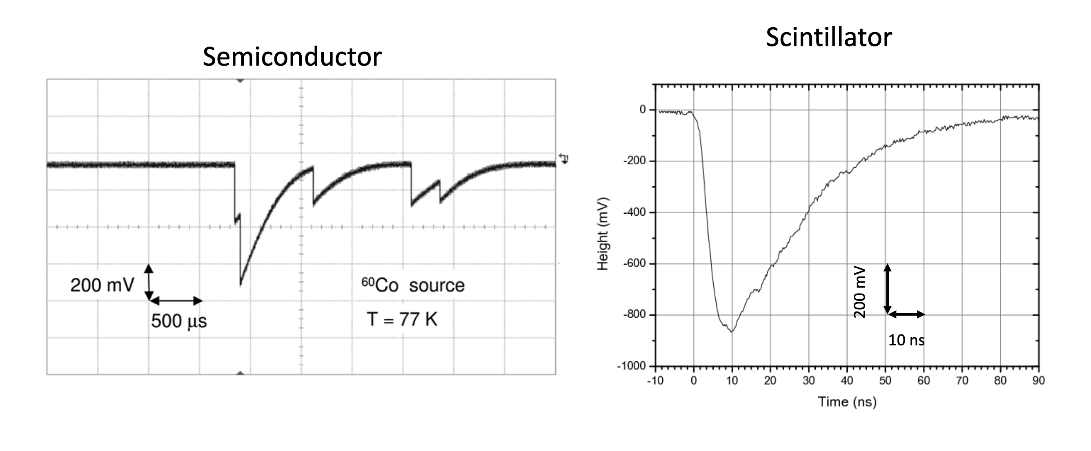
From the talks yesterday we learned
Design constrins
A. Jungclaus
  R³B β > 80% c
  the intrinsic resolution not so important.
  we can go for scintillator
  Doppler broadening → high segmentation
B. Olaizola
  Scintillators are fast (CsI 420ns) but some are faster (LaBr₃ 18ns!)
  → Forward endcap LaBr₃ to avoid the pile-up

Slide 18
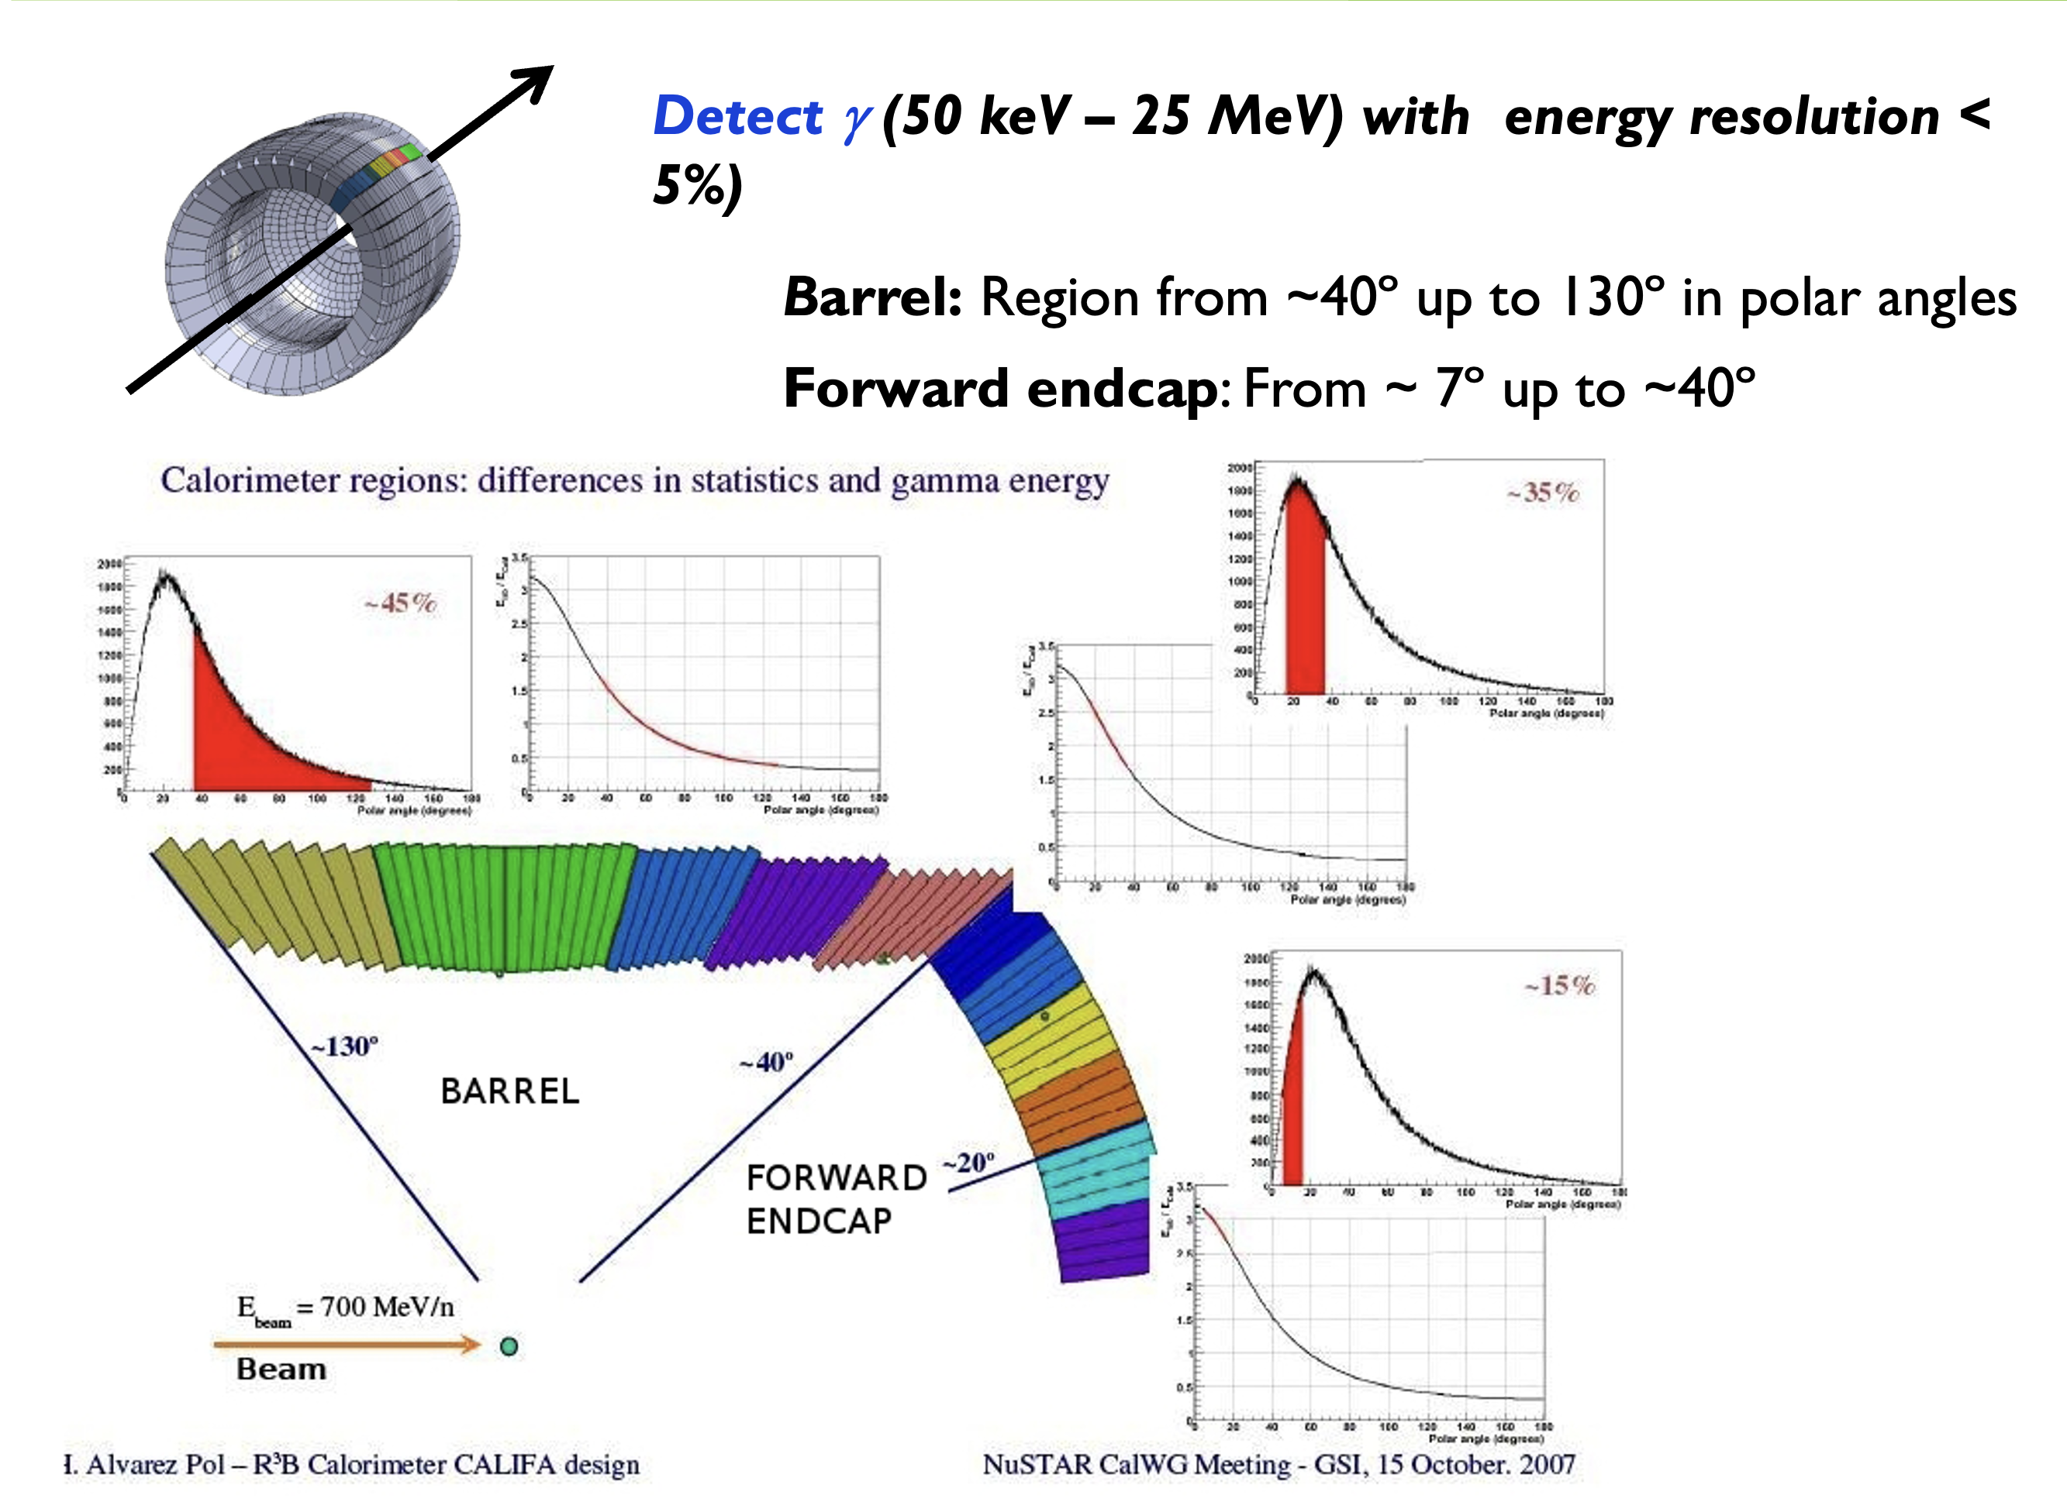
Hybrid γ/p spectrometer/calorimeter
Coverage
35%
Coverage
45%
Lorenz boost
0.5 – 1.5
Lorenz boost
1.5-2.5
Incoming beam @ 85% of c
→ Reaction very much forward → γ emitted in flight → Lorenz boost → at small angles γ boosted up to 3x
→ Highly segmented
15%
E_{beam}= 700 MeV/u
Lorenz boost
2.5 -3
β > 0.80

Slide 19
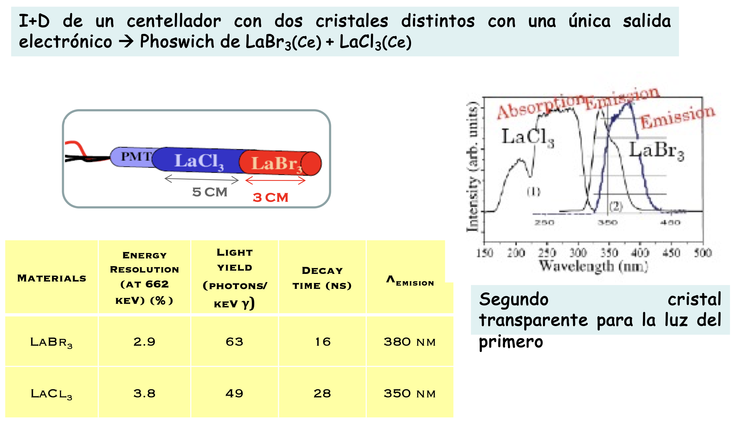
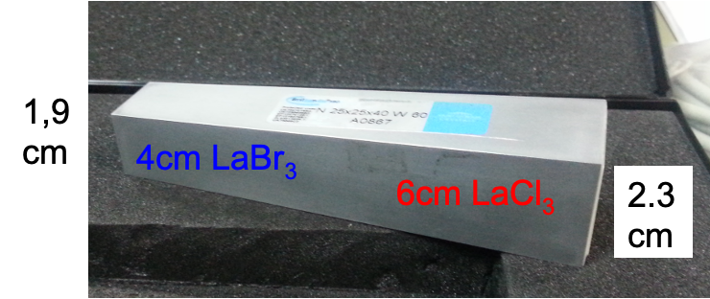
I+D para CALIFA

Slide 20


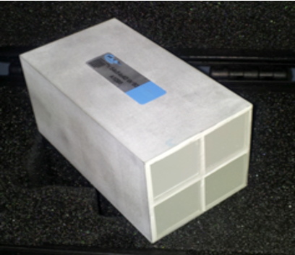
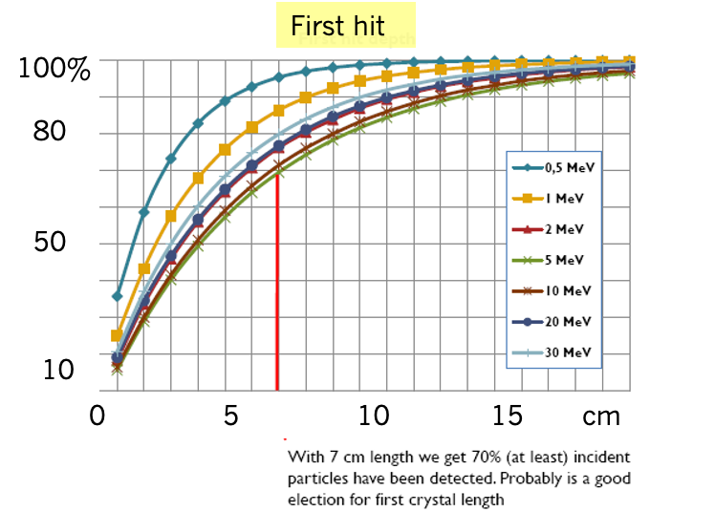
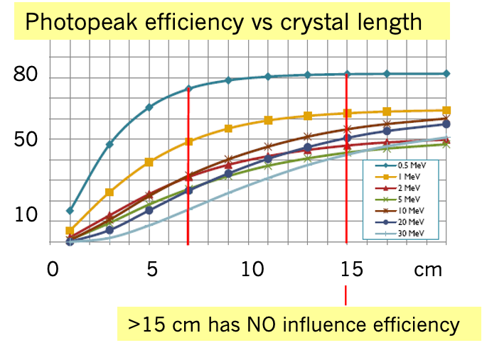
gammas in Phoswich
Question to be answered:
Depth of first interaction
Depth @ 90% photopeak efficiency
How many neighbouring crystals are being hit?
Simulation codes
SRIM --- GEANT4 --- MCNPX Monte Carlo N-Particle eXtended code
@7 cm 70 % of incident beam is detected

Slide 21
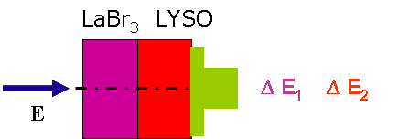
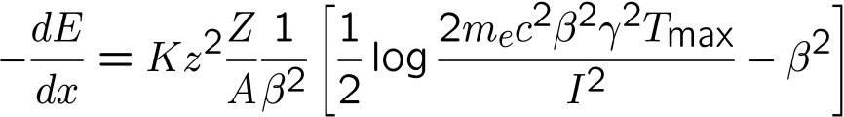
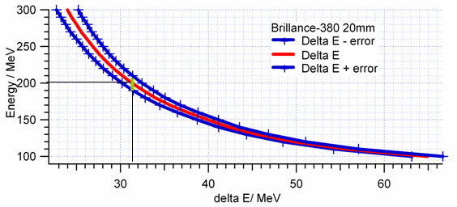
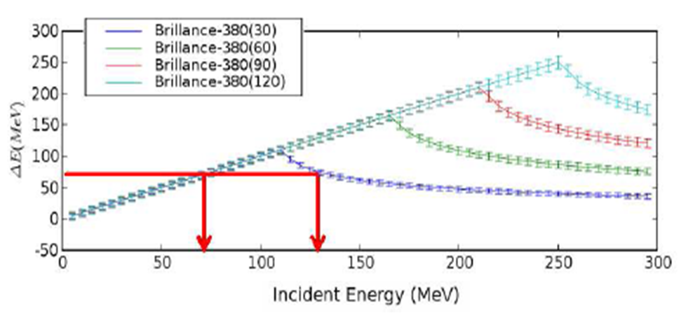
PROTONS in Phoswich: ΔE+ E
LaBr + LaCl
ΔE₁ ΔE₂
E = f( Δ E₁ ) + g( Δ E₂ )
Ep= 200MeV → 20 mm LaBr → ΔE = 31 ± 1 MeV
⇒200±10MeV
(σE/E=5%)
Protons: two ΔE-detectors one can determine the full proton energy with a resolution of <5%.
Gammas: Second detector placed to solve the ambiguity on the signal

Slide 22
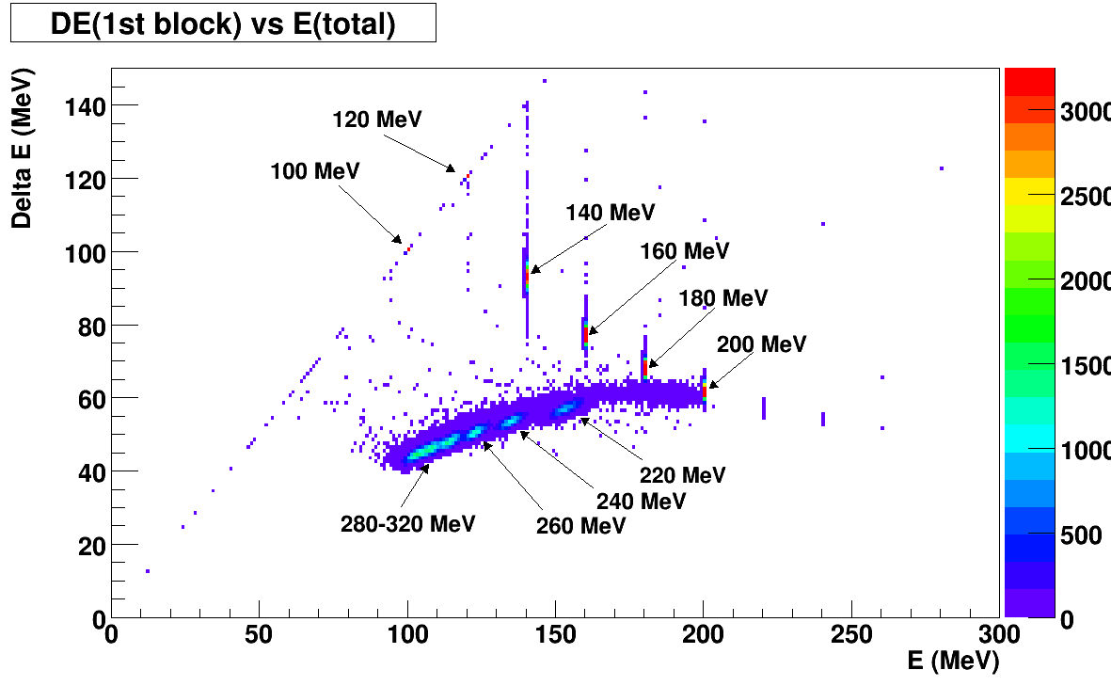
PROTONS in Phoswich: ΔE vs ΔE+ E
https://www.sciencedirect.com/science/article/pii/S0168900212014416
https://www.sciencedirect.com/science/article/pii/S0168583X19302228
ΔE
ΔE + E

Slide 23
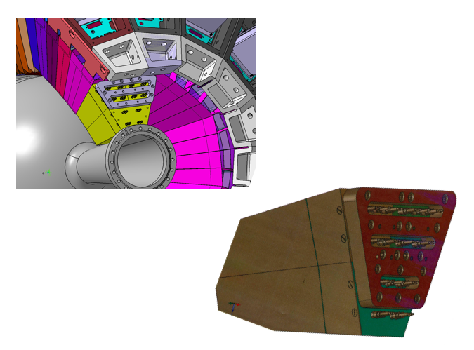
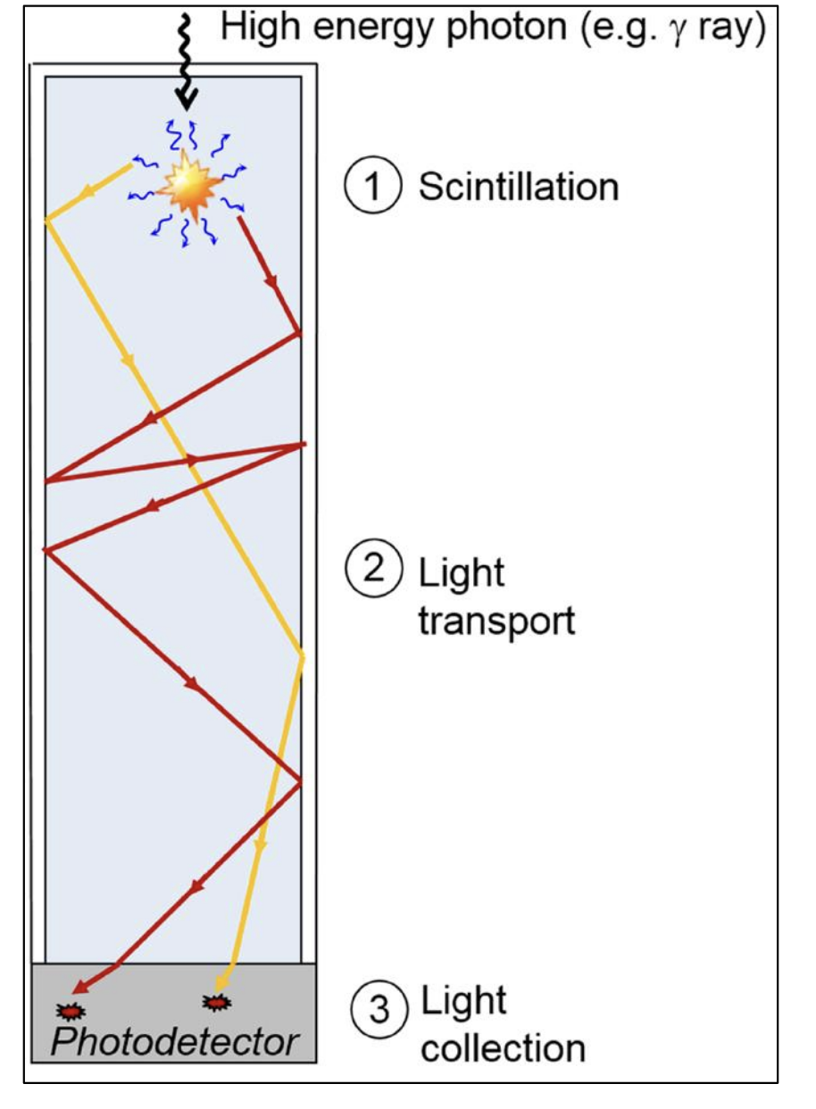
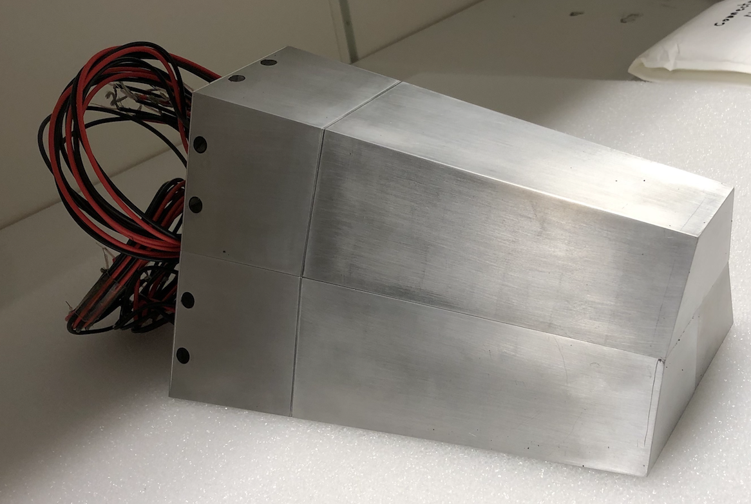
Endcap still in R&D!
As explained by Bruno
long funny shaped crystals
non-linear response
This is in CsI mitigated by LAPPING
In LaBr not easy…
8+7 cm
PM
LaCl₃
LaBr₃
3x4

Slide 24
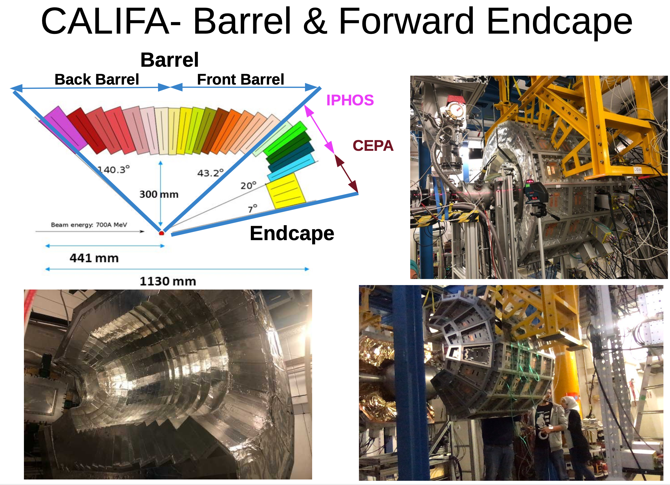
CALIFA: Highly segmented
Thick detection volume
Inner radius 50cm
Barrel: Crystal length 15-20 cm
1952 crystals = 2 Ton
EndCap: 680 crystals = 1 Ton
https://iopscience.iop.org/article/10.1088/1742-6596/1667/1/012006
CALIFA barrel and forward endcap
(gamma/particle calorimeter)
9

Slide 25
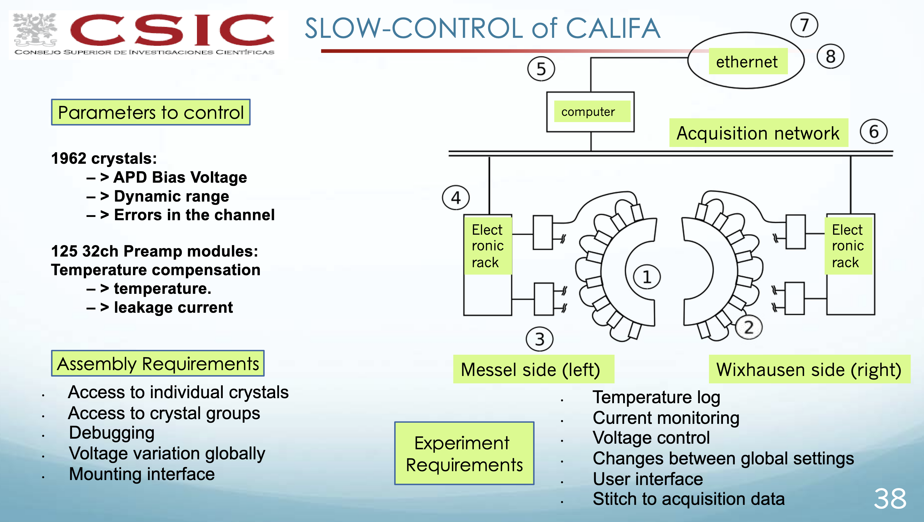




Slide 26



GLAD - Large-Acceptance superconductingDipole magnet https://www.gsi.de/work/forschung/nustarenna/nustarenna_divisions/kernreaktionen/r3b_project_group/glad
Weight: 50 t
This is now reduced
to a few days

Slide 27


NeuLAND - High-resolution neutron ToF spectrometer https://www.gsi.de/work/forschung/nustarenna/nustarenna_divisions/kernreaktionen/r3b_project_group/neuland
NeuLAND detector parameters:
full active detector using RP/BC408
face size 2.50x2.50 m²
active depth 3m (30 double-planes)
3000 scintillator bars
6000 PM / readout channels (both ends)
32 tons
x100 = one double-plane
2024: 17 DP installed
NeuLAND design goals:
>90% efficiency for 0.2-1.0 GeV neutrons
Multi-hit capability for up to 5n
invariant-mass resolution:
NeuLAND to target distance 35 m
∆E < 20 keV at 300 keV
2.5 m
https://www.sciencedirect.com/science/article/pii/S0168900221006860?via%3Dihub

Slide 28

For full kinematic reconstruction & reaction channel ID we need to know
for incoming and outgoing fragments, beam, gammas
Energy loss → Nuclear charge Z
Time of Flight → Mass identification
Trajectory → Momentum
R3B tracking system

Slide 29

Square fibers 0.2x0.2 mm²
Number of fibers ~ 10⁴ fibers
→ 60 μm resolution
Scintillating Fiber Tracker
4d Tracking at High Rate with High Dynamic Range
C. Caesar and D. Savran
Infrastructure upgrades

Slide 30
Many detectors, big distance, each with individual electronics and DAQ → But should work synchronized
R³B@FAIR
Notes:
Secondary Target. (especially LH₂ i.e. proton target)
CALIFA:m γ/p calorimeter-spectrometer Si-tracker: target recoil detector
GLAD: large acceptance dipole magnet tracking, DAQ, simulation, infrastructure
NeuLAND: neutron time-of-flight spectrometer
high-resolution spectrometer
I will go through some details in the following

Slide 31
General outline of electronics and DAQ
1 detector
1 channel
several detectors
Many channels
Many detectors many channels + many systems → how to synchronize

Slide 32

Synchronization and Coincidences to build event by event data →. GSI-FAIR wide Time reference:
The R3B experiment is composed by several separate detector components that are spatially extended, running independent DAQ → stitch together in MAIN-DAQ
For the coincidence timing at R3B we have to be in time-correlation with all the detector-systems, with FRS and with the Machine timing of GSI-FAIR
Bunch Timing System (BuTiS) distribute high precision clock train (100 kHz ident pulse, 10 MHz sine).
The distributed data acquisition system run in a time-synchronized distributed environment based on BuTiS and White Rabbit with timestamps of pico-second precision and 100 ps/km accuracy.
White Rabbit is a fully deterministic Ethernet-based network for general purpose data transfer and synchronization. It can synchronize over 1000 nodes with sub-ns accuracy over fiber lengths of up to 10 km.
Individual detector triggers are stitched together event by event in the MAIN DAQ before storage.

Slide 33

R3B Summary:
Schedule and first experiments @ GSI in Cave C
2020 50% NeuLAND and 50% CALIFA & Si-Tracker + tracking detector prototypes
  Liquid Hydrogen target (LH₂)
2019-25 Physics runs at GSI (Cave C) (phase 0)
2026 - 2027 Move to HEC- cave @FAIR
2028 1st R3B-NUSTAR experiment @FAIR
Experiments will make use of uniqueness of R3B:
Reactions at high beam energies up to 1 GeV/u
Tracking and identification capability for the heaviest ions
Multi-neutron tracking capability, high-efficiency calorimeter
Experiments possible for the first time:
4 neutron decays beyond the drip-line and for heavier n-rich isotopes
Kinematically complete measurements of quasi-free nucleon knockout reactions
Electric dipole and quadrupole response of Sn nuclei beyond N=82, and of neutron-rich Pb isotopes (polarizability, symmetry energy)
Fission barriers from (p,2p) reactions ( → r-process)

Slide 34

An example: S393 experiment
Study of light neutron-rich nuclei using kinematically complete measurements in inverse kinematics @ GSI
quasi-free scattering: ¹⁴B(p,2p)¹³Be
¹³B
17.3ms
¹⁴B
12.5ms
¹⁵B
9.93ms
¹⁶B
Unbound
¹⁷B
5.08ms
¹⁸B
Unbound
¹⁹B
2.92 ms
¹²Be
21.5 ms
¹³Be
Unbound
¹⁴Be
4.35ms
Study the precursor to the borromean nuclei ¹⁴Be
34
https://fnexp.iem.csic.es/reports/PhD_Theses/PhD-G_Ribeiro-2015.pdf

Slide 35



Quasi-Free Scattering: Knockout reaction
¹⁴B(p,2p)¹³Be
¹³B
17.3ms
¹⁴B
12.5ms
¹⁵B
9.93ms
¹⁶B
Unbound
¹⁷B
5.08ms
¹⁸B
Unbound
¹⁹B
2.92 ms
Direct Reaction: quick and direct from initial to final states without intermediate compound state.
If both outgoing particles have the same masses, in the lab system:
(p,2p), (p,np)
¹²Be
21.5 ms
¹³Be
Unbound
¹⁴Be
4.35ms
$$θA+θB≃ 81∘$$
35

Slide 36


Experiment:Cave C
¹⁴B(p,2p)¹³Be
Primary beam ⁴⁰Ar¹¹⁺ @ 490 MeV/u
Intensity 6·10¹⁰ ions/spill.
Production target Be 4 mg/cm²
Reaction target H, C, empty

Slide 37


Reaction channel Idenitifcation
Energy loss in the ToFW after the target → Identify the element after the reaction.
Identify the isotope from the ALADIN position deviation and beta of the fragment.
¹⁴B → ¹²Be + n
Incoming
Beam ¹⁴B
Incoming
Beam ¹⁴B
Fragments from ¹⁴B
Be Fragments from ¹⁴B
Be Fragments from ¹⁴B & Neutrons
Outgoing Be
Be +n
Charge identification from energy loss
¹²Be
Mass identification from ToF tracking
37

Slide 38



Relative Energy of ¹²Be + n:
https://journals.aps.org/prc/abstract/10.1103/PhysRevC.98.024603
Gamma Spectrum
E_{γ}=2 MeV
4
2
3
¹³Be
2´
1
1
2
2´
3
4

Slide 39

Experimentos de NUSTAR: pensar y recordar!
Acrónimos: FAIR NUSTAR SFRS R3B
Que método de producción se usa en experimentos de NUSTAR?
Cual es el haz primario, y de que origen normalmente?
Cual es el blanco de Producción?
Cual es el haz secundario? Cual es el blanco de Reacción?
Por que usamos varios blancos de reacción en el mismo experimento?
Por que cinemática inversa?
Que significa cinemática completa?
Como se selecciona el canal de reacción de interés del experimento?
Como se determina la carga, masa, la energía, el momento,
no olvides la importancia de medir las: γ & neutrónes!

Slide 40




250 Members
40 Institutes
15 Countries
Spokesperson: Lola Cortina IFIC
Technical Director 2014-24: O. Tengblad IEM

Slide 41

España
Lola Cortina
Pepe Benlliure
Enrique Nacher
Hector Alvarez Pol
Diego Gonzales
Univ. Santiago de Compostela
Saúl Beceiro Novo
Jose Luis Rodriguez Sanchez
Enrique Casarejos
Carlos Parrilla
Olof Tengblad
María Borge
Christoph Rappold

