Slide 1
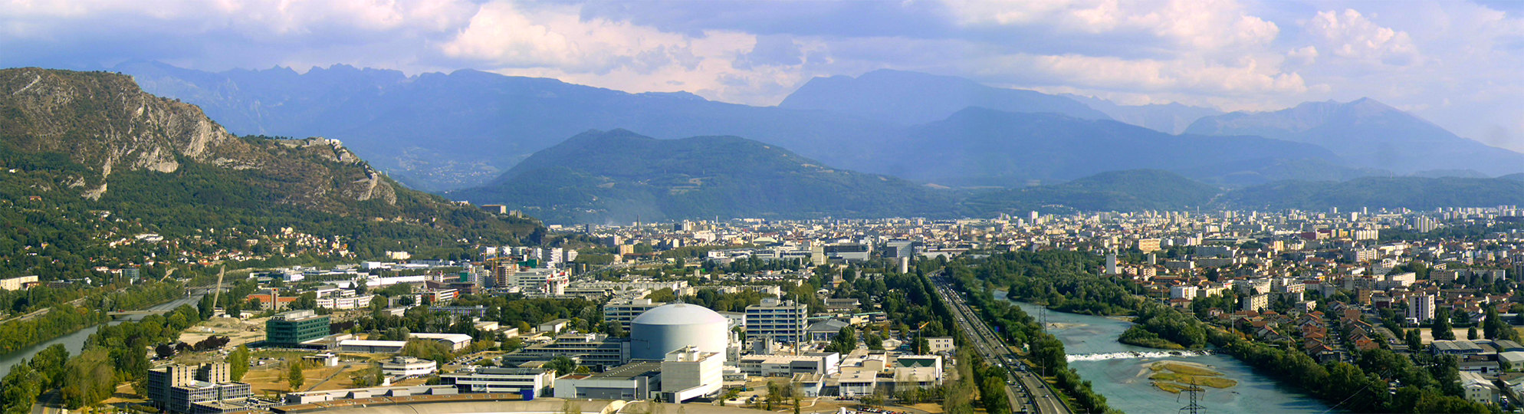
Nuclear Structure studies using
high-resolution techniques
Caterina Michelagnoli michelagnolic@ill.fr
26/01/2023
Master Interuniversitario IEM-CSIC

Slide 2
Table of contents
Introduction: main challenges in Nuclear Physics, why γ spectroscopy
→ Nuclear Structure and Astrophysics
Why high resolution and how
  → HPGe detectors and related technologies
  → Array of HPGe detectors, facilities (in-beam γ-ray spectroscopy)
  → Performance, back-ground reduction and selectivity
  → Angular correlations, polarization and lifetimes
Advanced γ-ray tracking
→ Basics
→ The AGATA project
Notes:
Table of Contents – Synthetic overview – I will go through, not necessarily ok order

Slide 3

(Main) bibliography of today’s lecture
G.F. Knoll "Radiation Detection and Measurement"
F. Recchia and C. Michelagnoli, in Lec. Notes in Phys. (Euroschool Vol. VI)
C. Michelagnoli, PhD Thesis, Univ. of Padova (2013) (and refs therein ☺ )

Slide 4
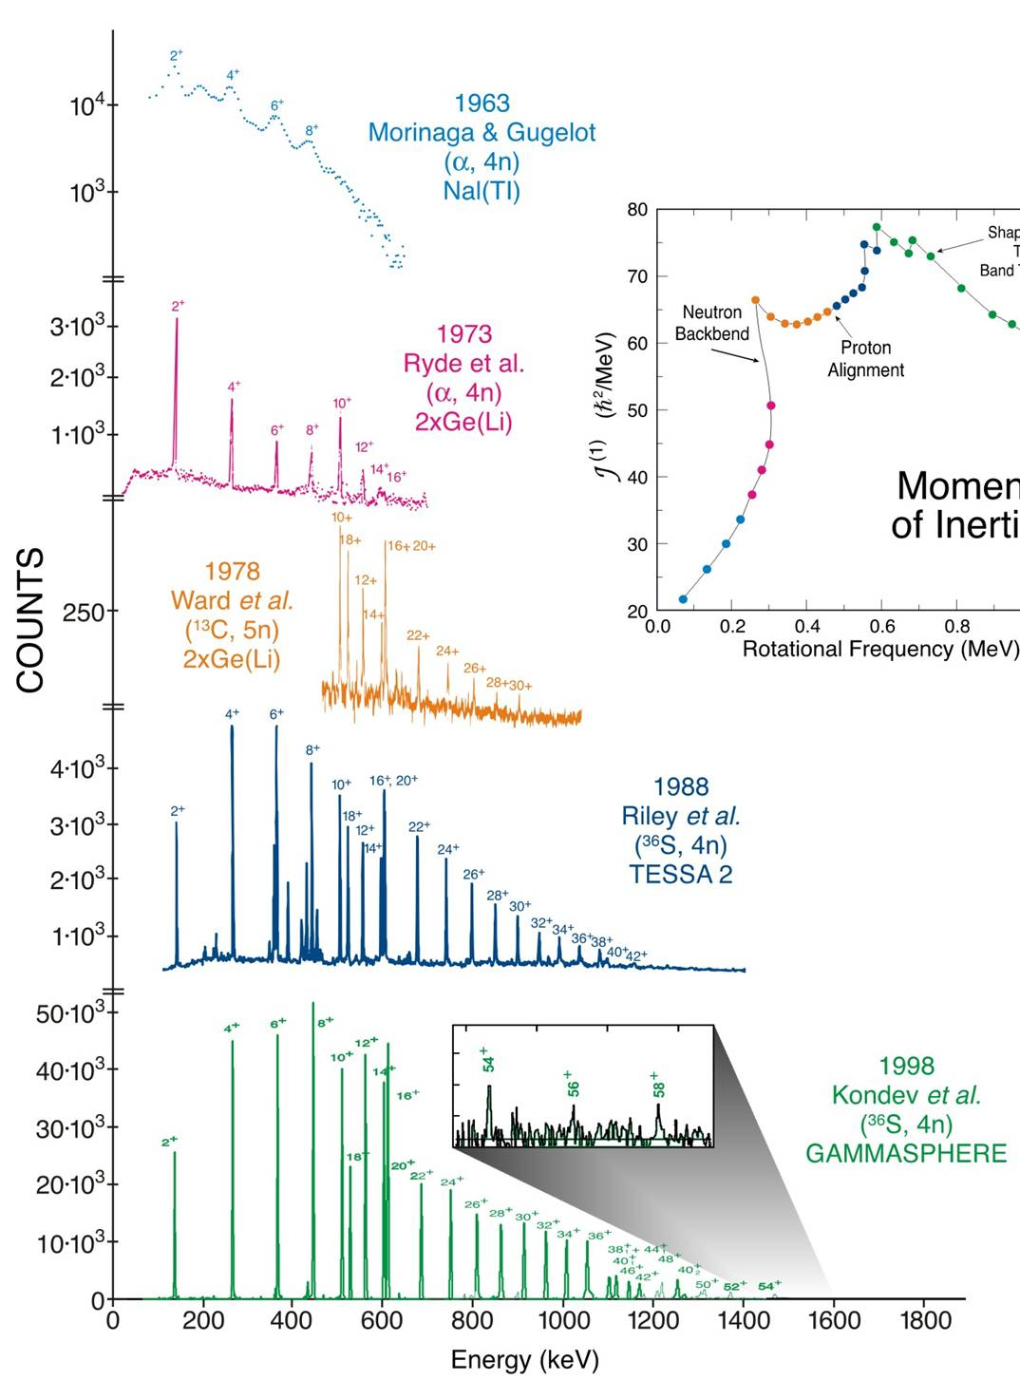
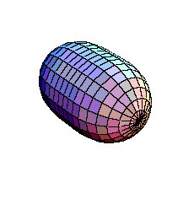
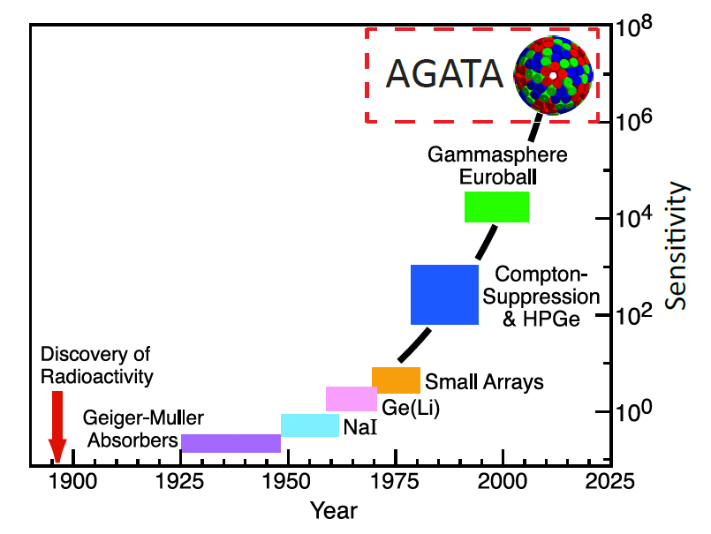
Advances in γ-ray spectroscopy
Sensitivity = inverse of the weakest channel reaction cross-section that can be measured over total cross-section
¹⁵⁶Dy
super-deformation in ¹⁵⁶Dy
major/minor axis = 2:1

Slide 5
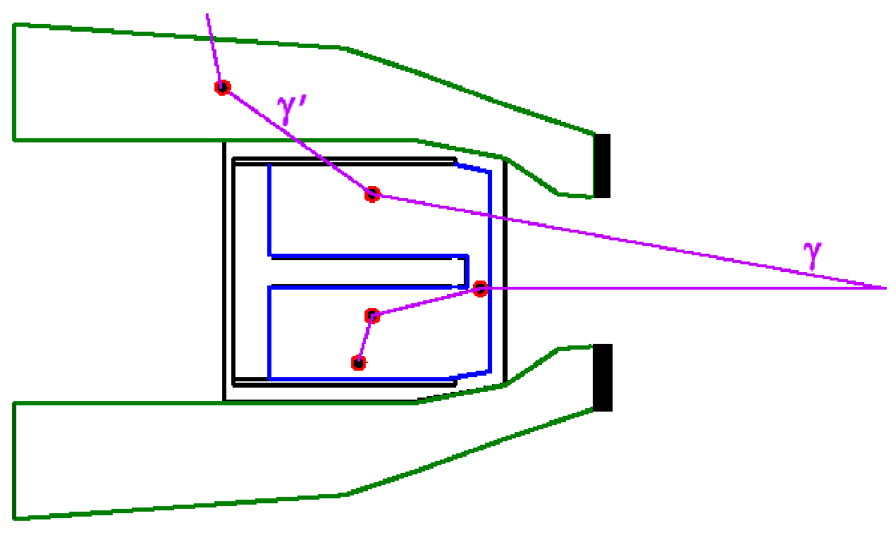
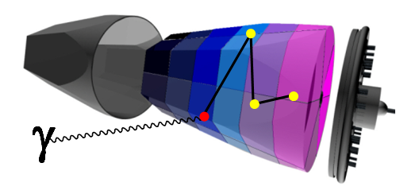
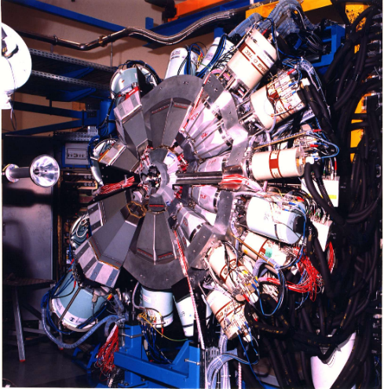
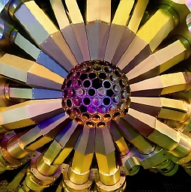
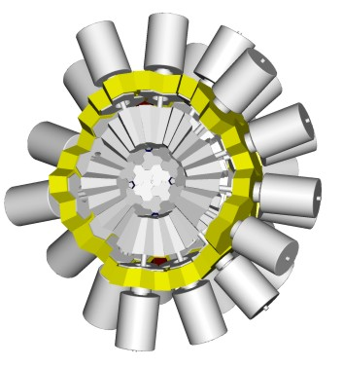
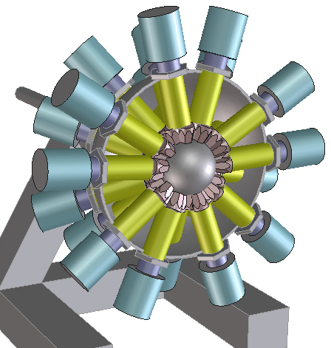
New generation HPGe arrays
Gamma Arrays based on Compton
Suppressed Spectrometers
Tracking Arrays based on
Position Sensitive Ge Detectors
EUROBALL
GAMMASPHERE
AGATA
GRETA
ε ∼ 10 — 5 %
( M_{γ}=1 — M_{γ}=30)
ε ∼ 50 — 25 %
( M_{γ}=1 — M_{γ}=30)

Slide 6
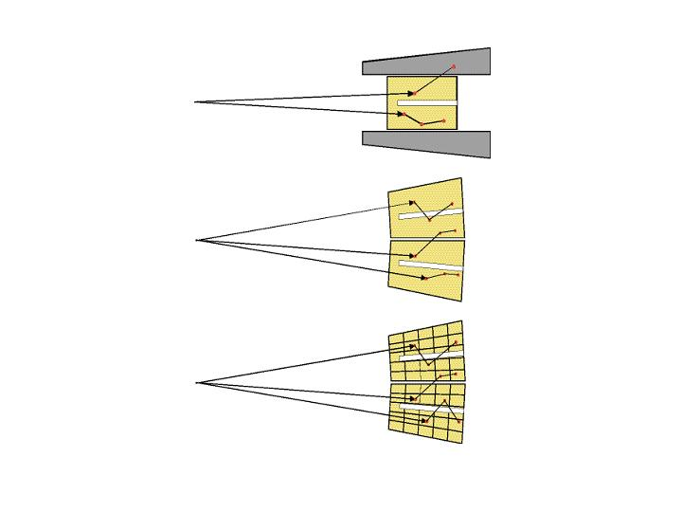
From conventional Ge to γ-ray tracking
Efficiency is lost due to the solid angle covered by the shield; poor energy resolution at high recoil velocity because of the large opening angle
Compton-shielded Ge
ε_{ph} ~ 10%
N_{det} ~ 100
θ ~ 8º
Ω ~40%
Using only conventional Ge detectors, too many detectors
are needed to avoid
summing effects and keep the resolution to good values
ε_{ph} ~ 50%
N_{det} ~ 1000
Ge sphere
θ ~ 3º
Ge tracking array
ε_{ph} ~ 50%
N_{det} ~ 100
Use detectors in a non-conventional way ☺
θ ~ 1º
Ω ~80%

Slide 7
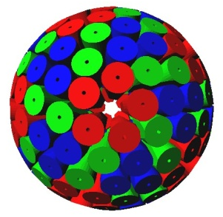
The γ spectroscopy dream
Cover the whole detection solid angle by germanium and track the path of the γ rays inside the detector medium
segmented detectors
digital electronics
timestamping of events
analysis of pulse shapes
tracking of γ rays
γ
source
Study of nuclei in extreme conditions of angular momentum and neutron/proton asymmetry
4 time more efficient than standard arrays, also for high γ multiplicity
(28 % M_{γ}=30)
High count rate capabilities
(100s KHz)
“perfect” Doppler correction
(6 keV @ 1 MeV, β=50%)
new accuracy and sensitivity for
nuclear level lifetimes
γ linear polarization
“continuous” angular distributions of the γ interaction points (θ~1º)

Slide 8
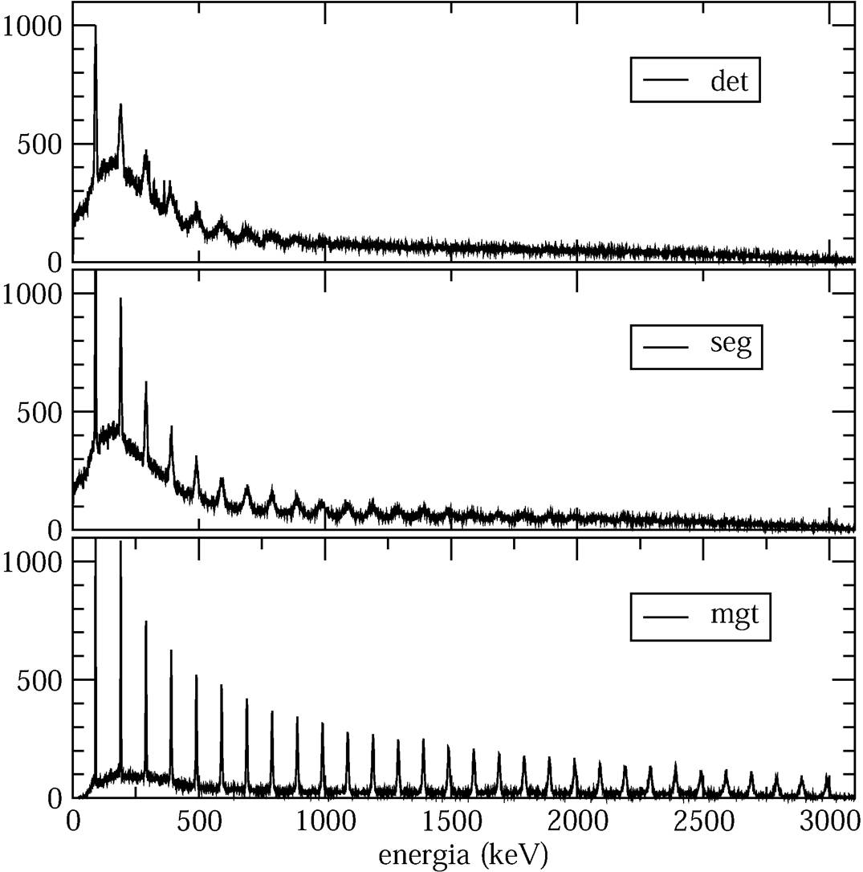
Position resolution used to limit Doppler broadening of gammas emitted in flight
v/c = 20 %
scarce
Detector
Doppler correction
capability
Segment
Definition of the
photon direction
Pulse shape
analysis
+
tracking γ
good
Energy (keV)

Slide 9
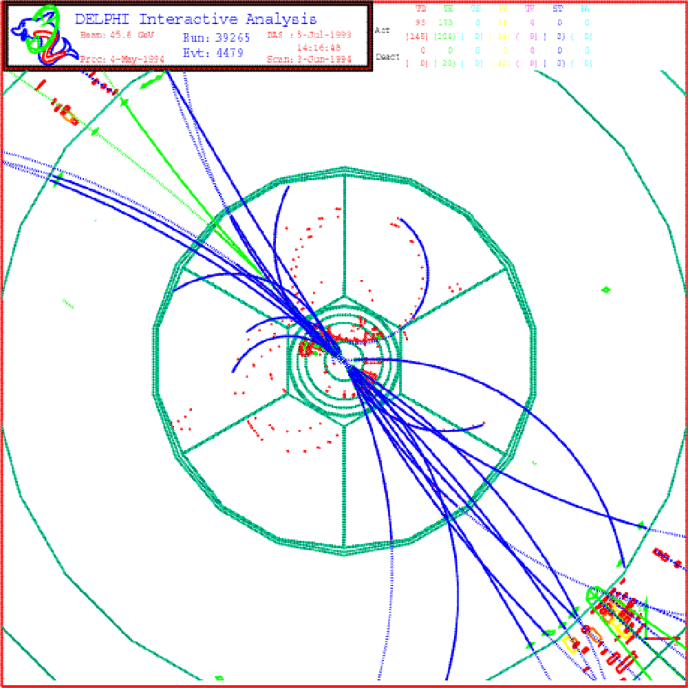
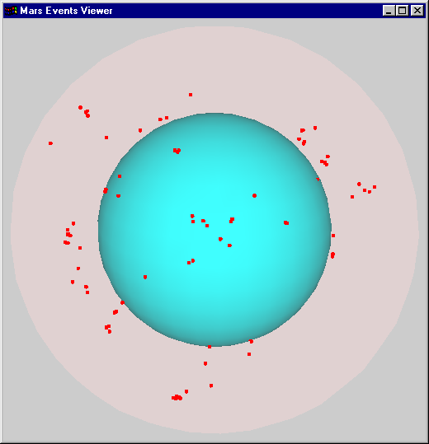
Tracking of radiation
in High Energy Physics
in Nuclear Spectroscopy
“continuous tracks” from very energetic particles
huge detectors for “one” experiment
Physics ← the study of “complete” events
“many” low energy
(0.01 -- 10 MeV) neutral transitions
with low density of energy deposition
“general-purpose” detectors for a large variety of experiments
Physics ← large number of incomplete events

Slide 10
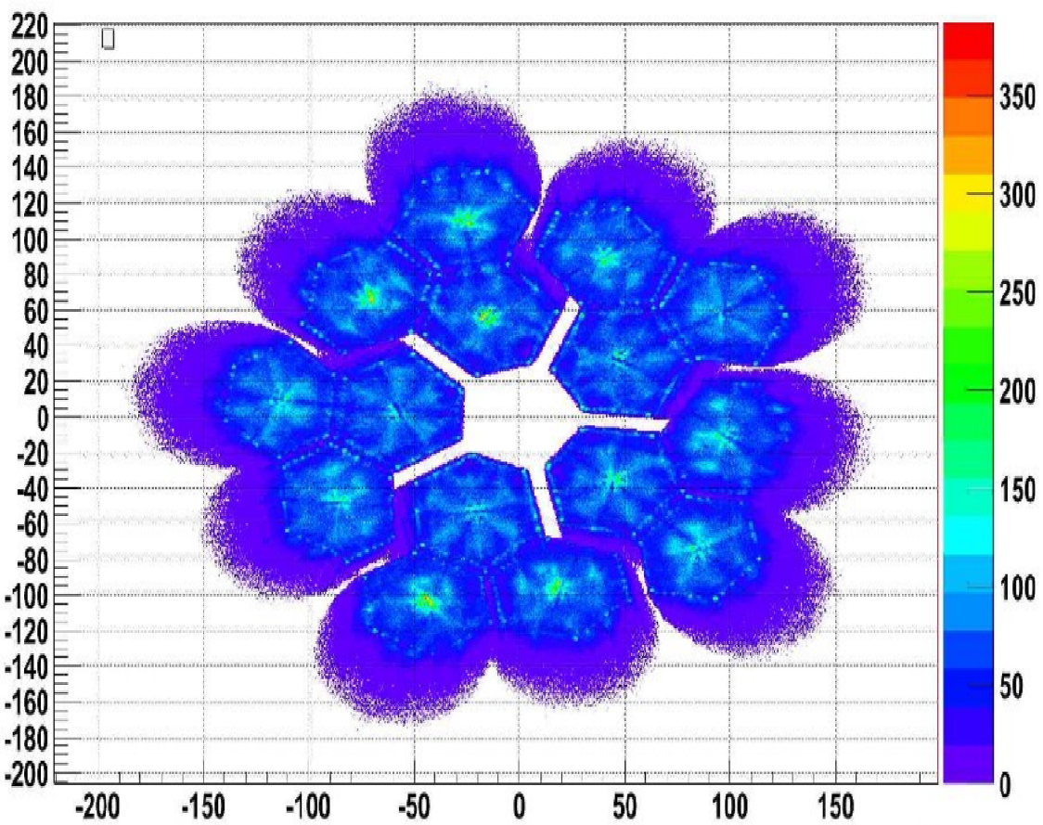
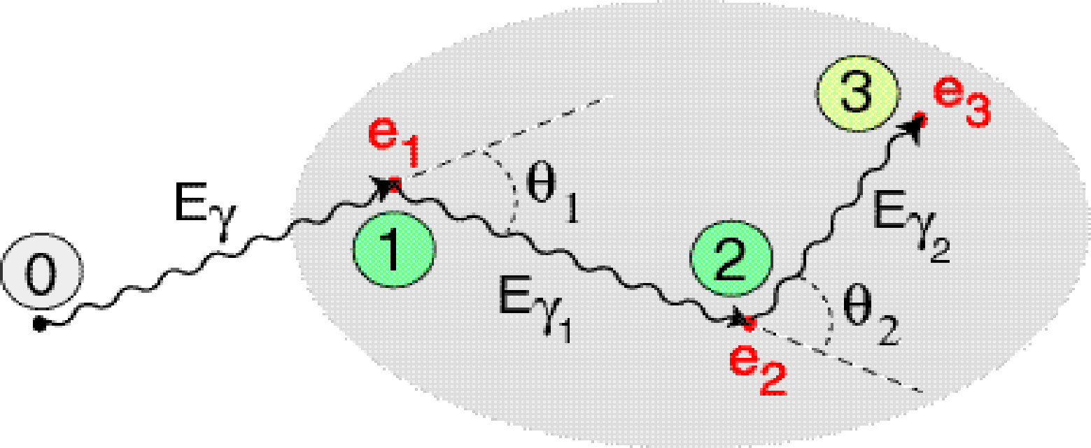
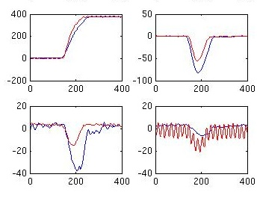
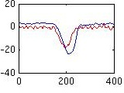
Position-sensitive operation mode and γ-ray tracking
highly segmented
HPGe detectors
Identified
interaction points
(hits)
(x,y,z,E,t)_{i}
reconstruction of
γ-rays from the hits
(tracking)
Pulse Shape Analysis
of the recorded waves
digital electronics to record sampled waveforms
Event by event:
how many gammas,
for each gamma: energy, first interaction point, path

Slide 11
Aim of γ-ray tracking
deposited energies and the positions of all the interactions points
of an event in the detector
reconstruct individual photon trajectories and write out photon energies,
incident and scattering directions
e₁, x₁, y₁,z₁
e₂, x₂, y₂,z₂
…………………..
e_{n}, x_{n}, y_{n},z_{n}
E₁, (θ,φ)_{inc,1},(θ,φ)_{sc,1}. …
E₂, (θ,φ)_{inc,2},(θ,φ)_{sc,2}. …
………………………………
E_{i}, (θ,φ)_{inc,i},(θ,φ)_{sc,i}
e₂
e₁
Doppler correction
discard events corresponding to incomplete energy release
Linear polarization

Slide 12
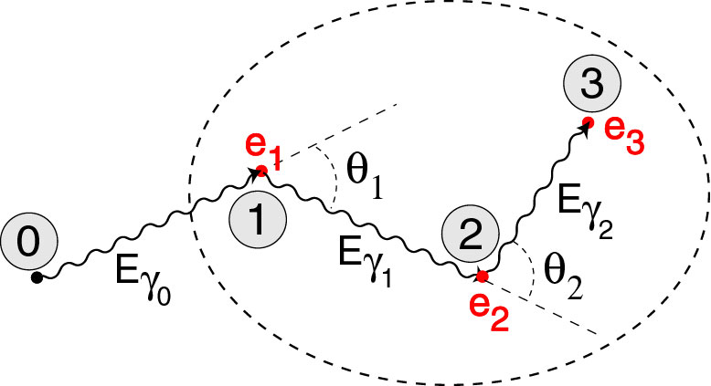
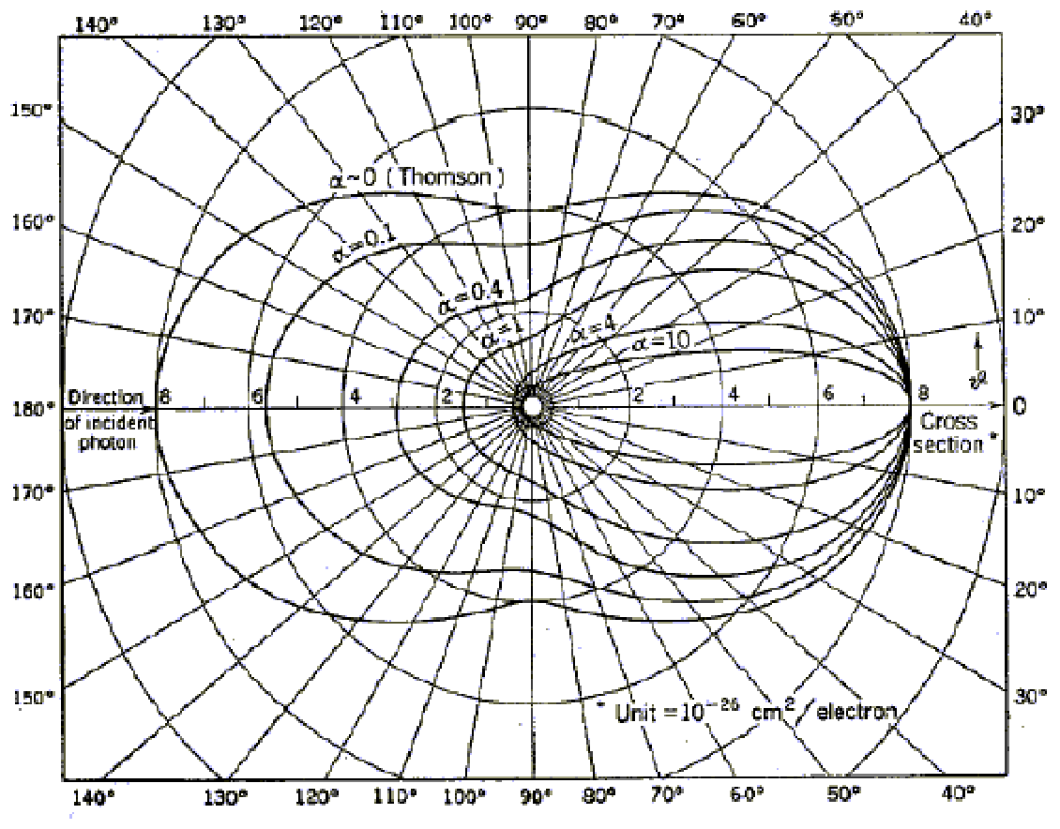
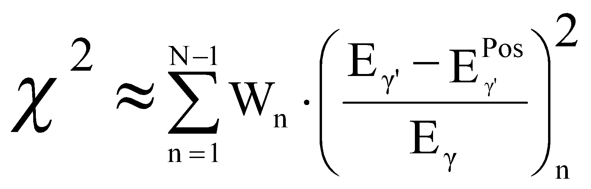

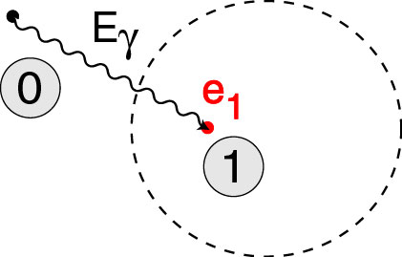
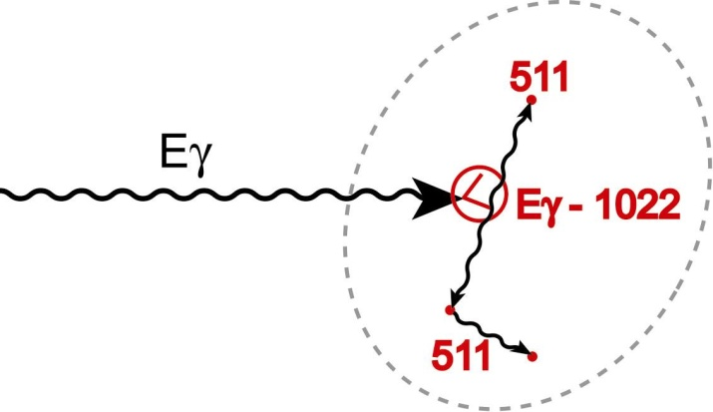
Forward tracking implemented for AGATA
Create cluster pool => for each cluster, E_{γ0} = ∑ depositions in the cluster
Find most probable sequence of interaction
points, test the 3 mechanisms
  do the interaction points satisfy
  the Compton scattering rules ?
  does the interaction satisfy
  photoelectric conditions
  (e₁,depth,distance to other points) ?
  do the interaction points correspond
  to a pair production event ?
  E_{1st} = E_{γ} – 2 m_{e}c²
3. Select clusters based on χ²
D.Bazzacco, Padova - A. Lopez-Martens, Orsay [NIMA 533 (2004) 454]

Slide 13
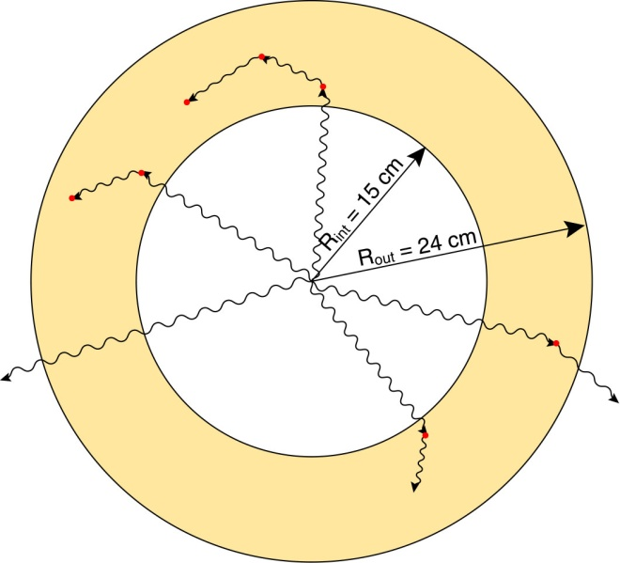
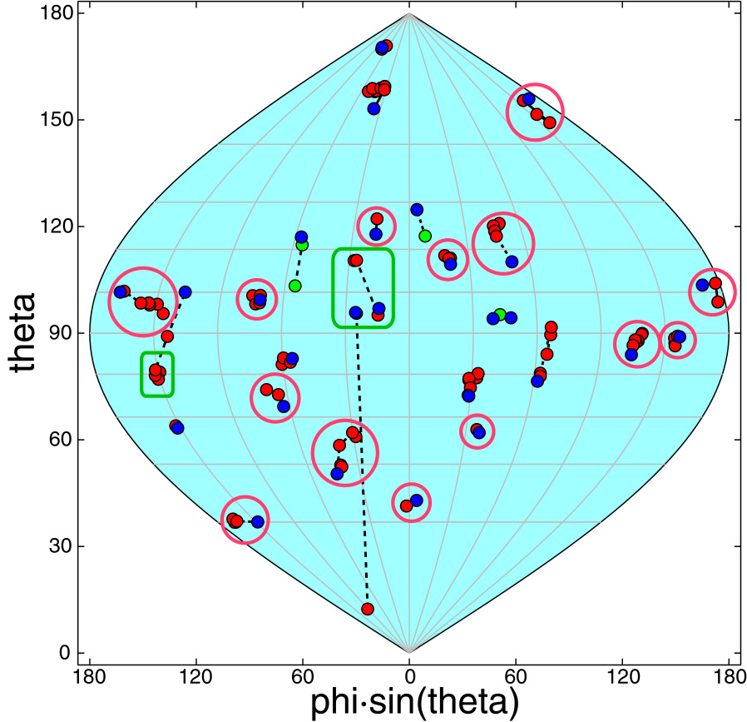

Performance of the Ge shell
Idealized configuration to determine
maximum attainable performance.
A high multiplicity event
E_{g} = 1.33 MeV
M_{g} = 30
1.33 MeV | M_{γ} = 1 | M_{γ} = 30
ε_{ph} (%) | 65 | 36
P/T(%) | 85 | 60
Reconstruction by Cluster-Tracking
Packing Distance: 5 mm
Position Resolution: 5 mm (at 100 keV)
27 gammas detected -- 23 in photopeak
16 reconstructed. -- 14 in photopeak

Slide 14
Fundamental Effects limiting the performance
Interaction position ≠ position of energy deposition
Bremsstrahlung
Rayleigh scattering ➔ change incident direction (relevant at low energy & end of track)
Momentum profile of electron ➔ change scattering direction (relevant at low energy & end of track)
γ
γ’
e⁻
γ_{br}
Fortunately (?) these effects are masked by the poor position resolution of practical Ge detectors

Slide 15
Practical Effects limiting the performance
uncertainty in position of interaction:
(position & energy dependent)
position resolution
energy threshold
energy resolution
dead materials ...
x
x
x
x
x
x
x

Slide 16
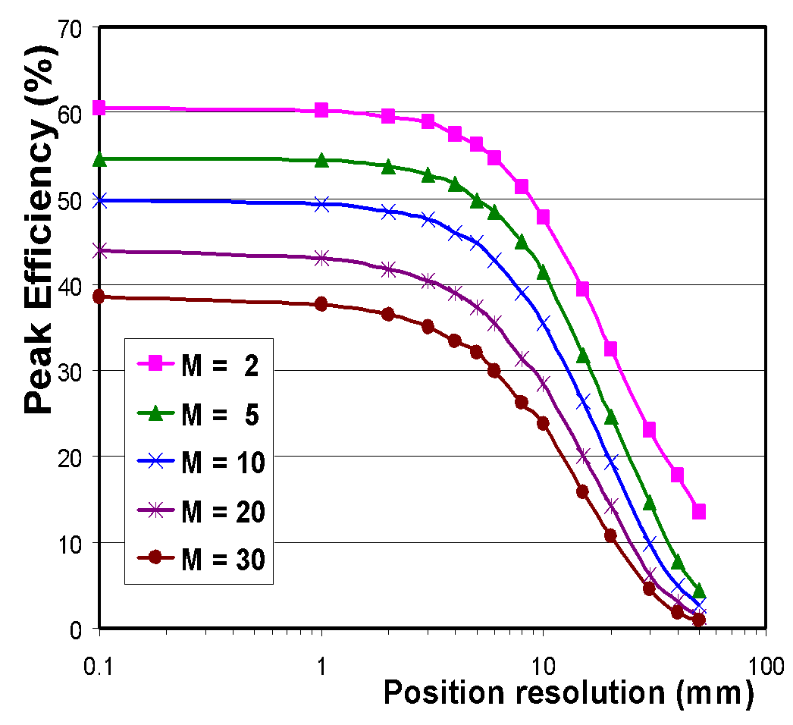
Efficiency of Ge shell vs position resolution and γ multiplicity
The biggest losses are due to multiplicity (mixing of points) not to bad position resolution
5 mm is the standard
“realistic” packing and smearing assumption
If positions inside segments are not known, performance
is a factor 2 worse
Standard shell; E_{γ} = 1.33 MeV; Packing=Smearing;
Energy independent smearing
Sub-segment position resolution is needed

Slide 17
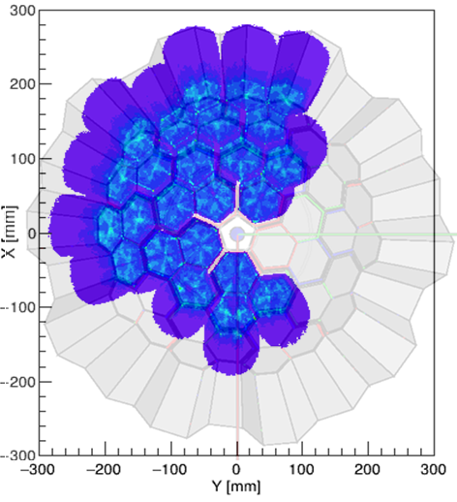
Pulse Shape Analysis (PSA)
8 AGATA Triple Clusters (24 detectors)
@ GANIL
“captured” during an experiment
Reconstruction of the interaction points (hits)

Slide 18
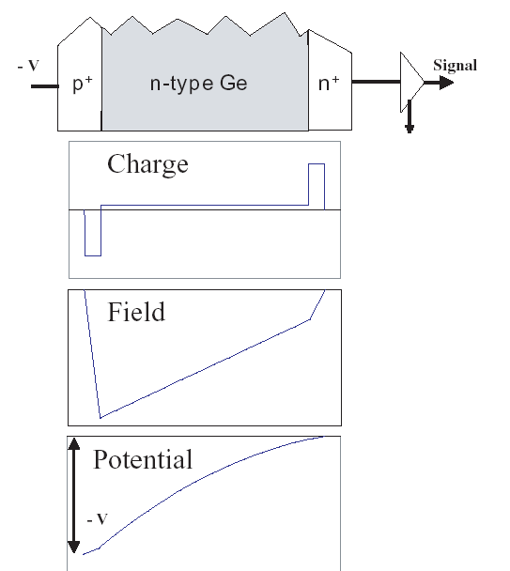
Detector = p-i-n diode
-HV
h
e
Near intrinsic bulk (N_{D}~10¹⁰cm⁻³)
Highly doped thin contacts
N_{A} ~ 10¹⁸cm⁻³ N_{D} ~ 10¹⁸cm⁻³
B ~ 3 mm Li ~ 0.5 mm
Reverse bias (-HV on p⁺ contact)
depletes bulk
generates high electric filed
Radiation creates carriers in bulk
Carriers swept out by field → signal

Slide 19
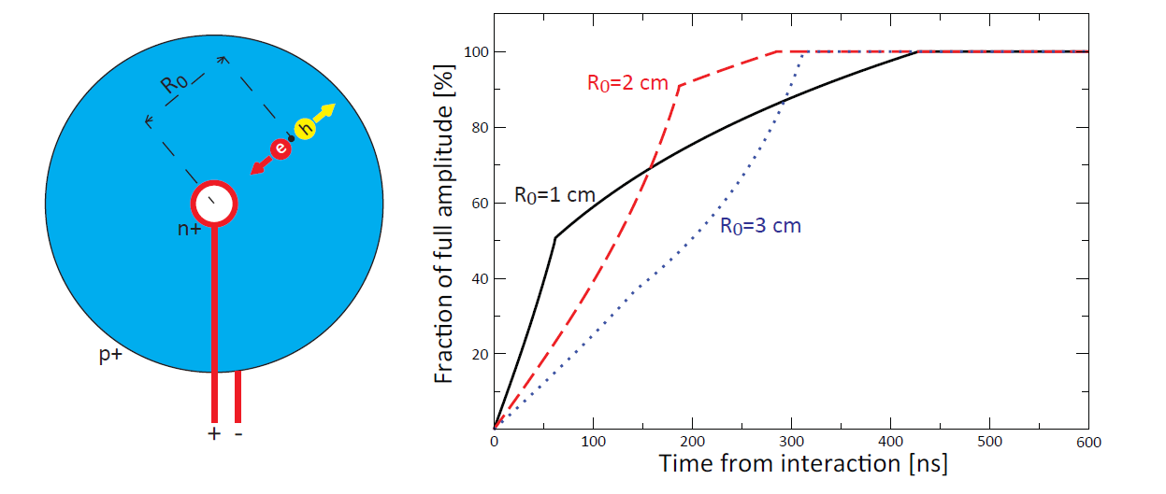
Pulse shapes in a co-axial HPGe
On “true” coaxial detectors, the shape depends on initial radius

Slide 20
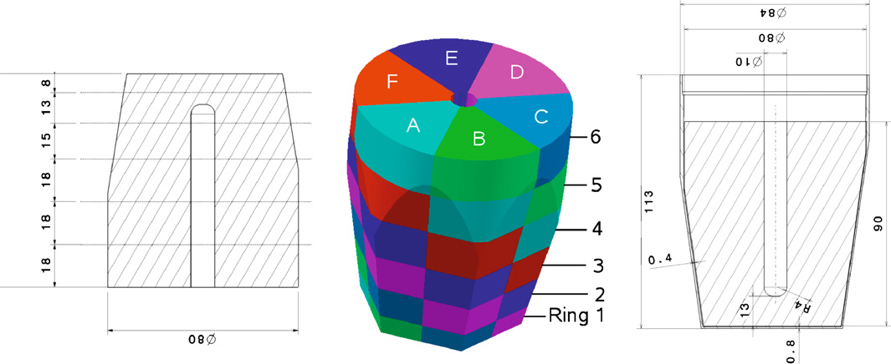
Segmented detectors
When one of the electrodes is (electrically) segmented, the motion of charges within one segment induces a transient signal also in the neighboring electrodes
Contrary to the segment where the interaction takes place (the charge is released), the total collected charge in the neighboring electrodes is null
The amplitude of the induced transient signals provides a convenient way to locate the interaction with sub-segment precision
Segmentation of an AGATA detector

Slide 21
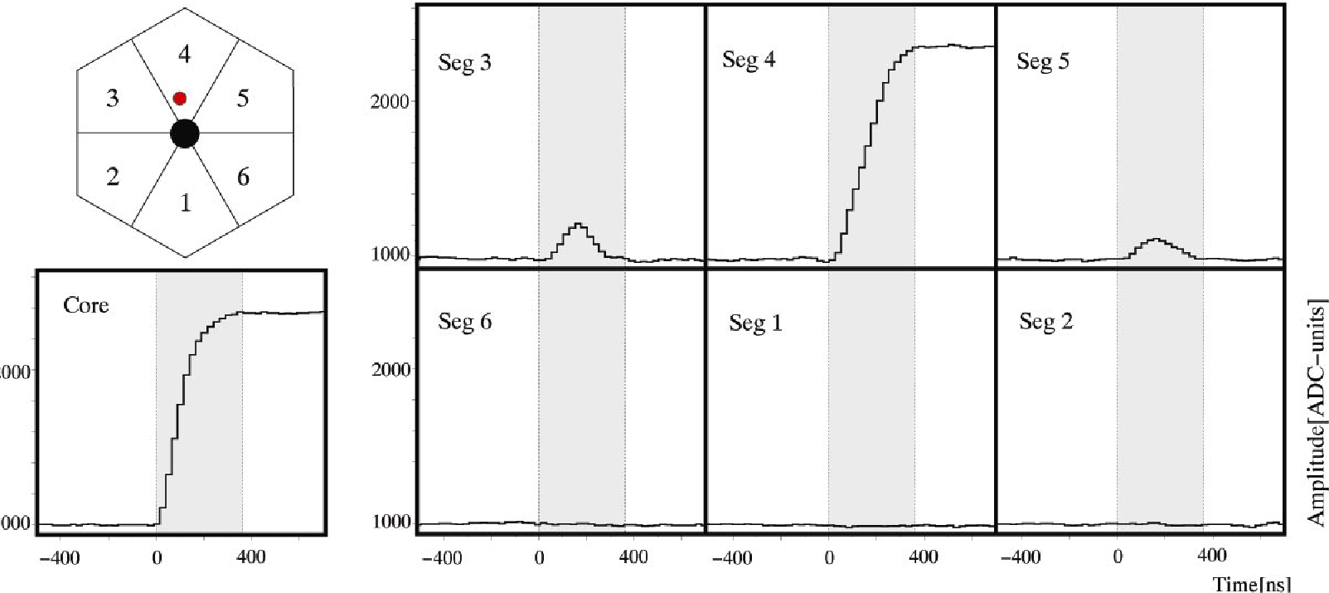
Pulse Shape Analysis concept
Interaction occurred in segment 4
(net charge signal)
Interaction is closer to segment 3 (larger amplitude than segment 5)
Sub-segment precision … but not enough to efficiently perform tracking!
➔ Pulse Shape Analysis

Slide 22
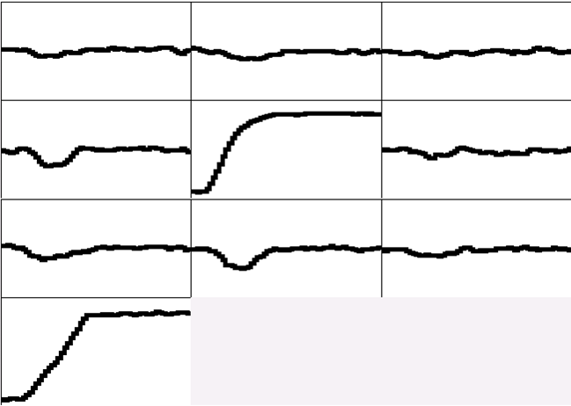
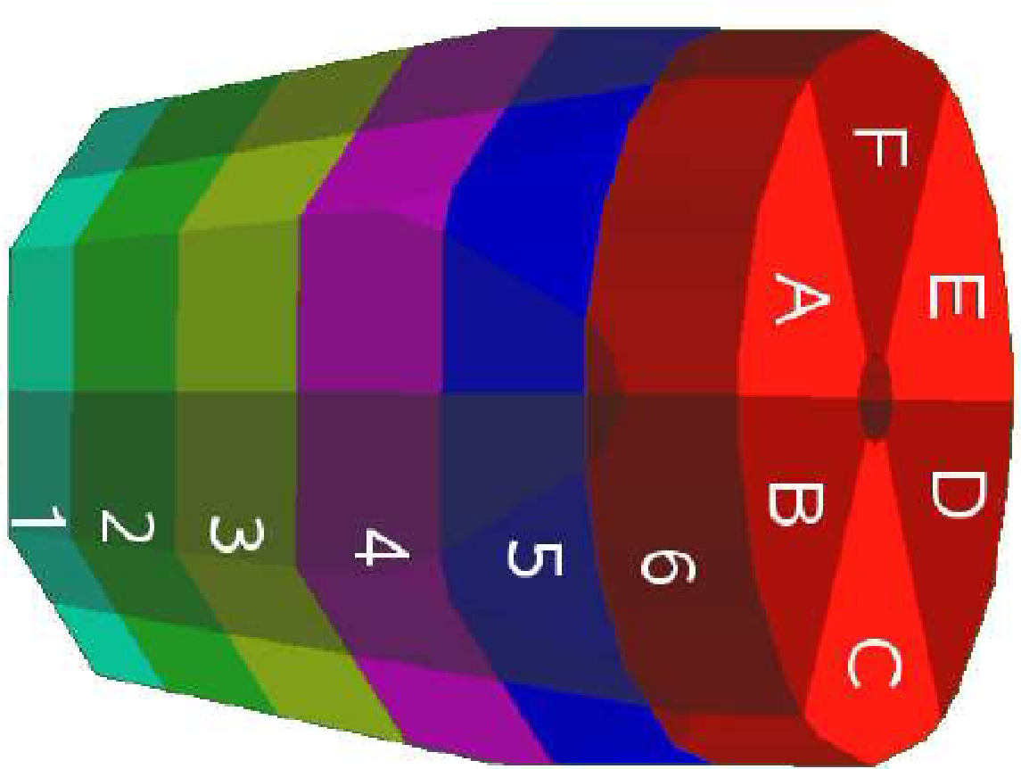
Pulse Shape Analysis concept
A3
A4
A5
B3
B4
B5
C3
C4
C5
CORE
measured
791 keV deposited in segment B4

Slide 23
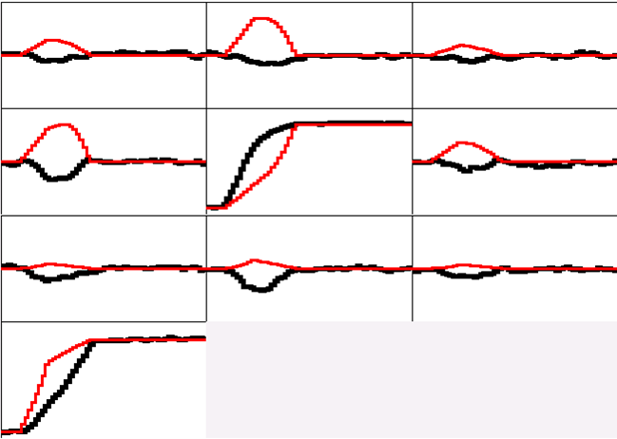
Pulse Shape Analysis concept
A3
A4
A5
B3
B4
B5
(10,10,46)
C3
C4
C5
y
CORE
C4
B4
measured
calculated
D4
A4
x
791 keV deposited in segment B4
E4
F4
z = 46 mm

Slide 24
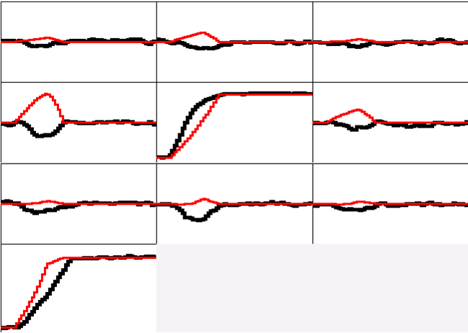
Pulse Shape Analysis concept
A3
A4
A5
B3
B4
B5
(10,15,46)
C3
C4
C5
y
CORE
C4
B4
measured
calculated
D4
A4
x
791 keV deposited in segment B4
E4
F4
z = 46 mm

Slide 25
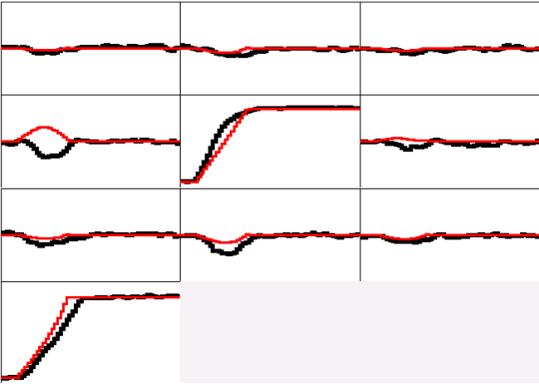
Pulse Shape Analysis concept
A3
A4
A5
B3
B4
B5
(10,20,46)
C3
C4
C5
y
CORE
C4
B4
measured
calculated
D4
A4
x
791 keV deposited in segment B4
E4
F4
z = 46 mm

Slide 26
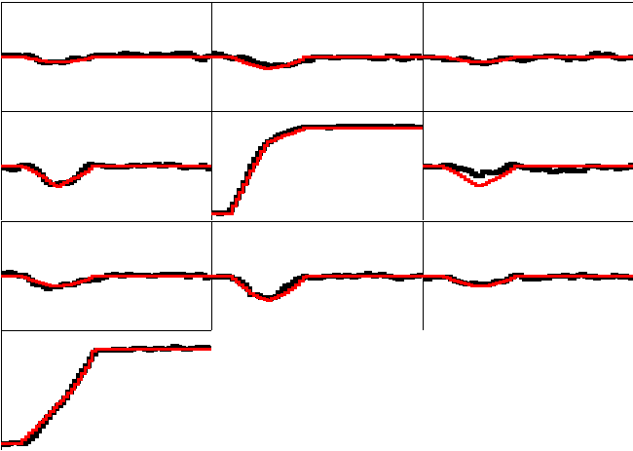
Pulse Shape Analysis concept
A3
A4
A5
B3
B4
B5
(10,25,46)
C3
C4
C5
y
CORE
C4
B4
measured
calculated
D4
A4
x
791 keV deposited in segment B4
E4
F4
z = 46 mm

Slide 27
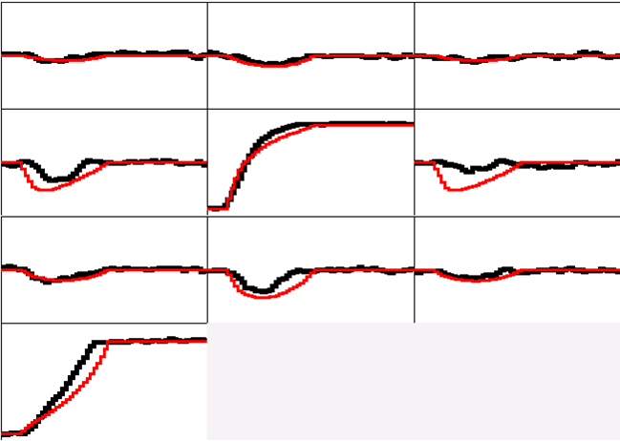
Pulse Shape Analysis concept
A3
A4
A5
B3
B4
B5
(10,30,46)
C3
C4
C5
y
CORE
C4
B4
measured
calculated
D4
A4
x
791 keV deposited in segment B4
E4
F4
z = 46 mm

Slide 28
Pulse Shape Analysis concept
A3
A4
A5
Result of
Grid Search
Algorithm
B3
B4
B5
(10,25,46)
C3
C4
C5
y
CORE
C4
B4
measured
calculated
D4
A4
x
791 keV deposited in segment B4
E4
F4
z = 46 mm

Slide 29
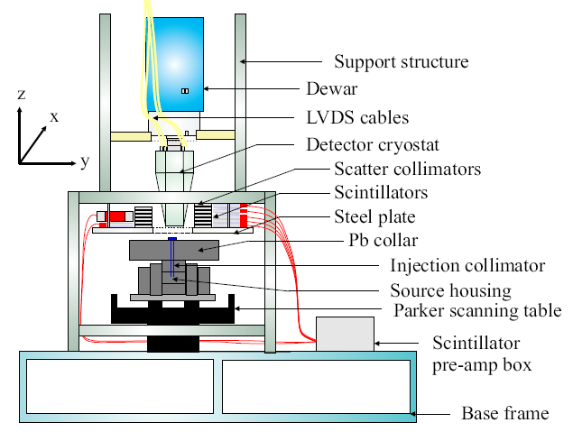
Scan setup
The interaction point is located by requesting a coincidence between the germanium detector and a second, narrowly collimated detector
Scanning the whole crystal is a time-consuming procedure!

Slide 30
Signal Formation
Signal is due to the motion of charge carriers inside the detector volume.
Calculations based on the weighting field method derived by Ramo’s theorem, which is based on
Green’s reciprocity theorem that says: given two systems consisting of a distribution of charges and electrodes, charges and voltages are related by

Slide 31
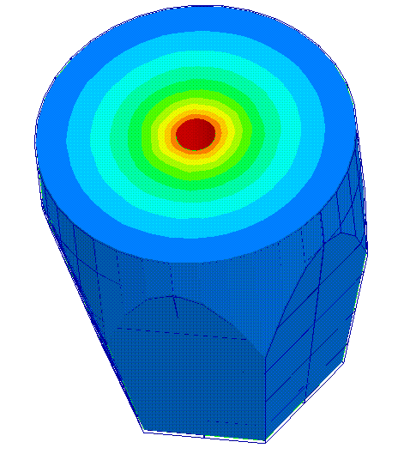
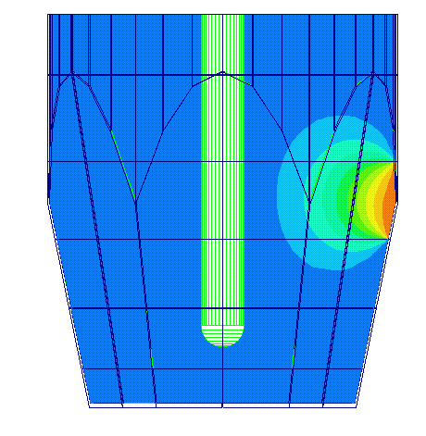
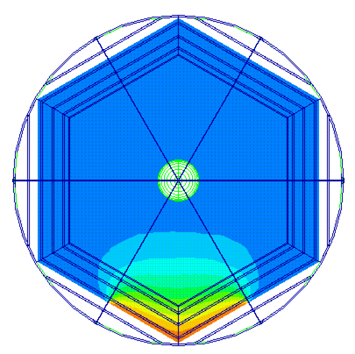
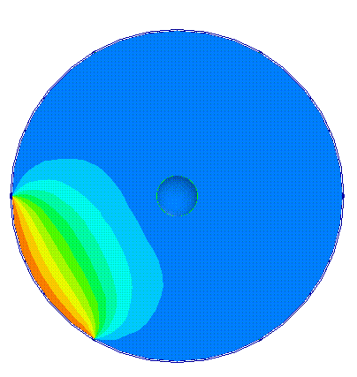
Real potential
Weighting potential
4000 V
2000 V
0 V
1 V
0.5 V
0 V
(1)
(2)
Current of electrode k
Weighting potential
Weighting potential is calculated by applying 1 V on the segment collecting the charge and 0 V to all the others (Ramo’s Theorem).
It measures the electrostatic coupling (induced charge) between the moving charge and the sensing contact.

Slide 32
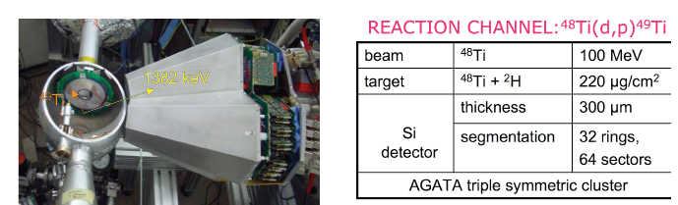
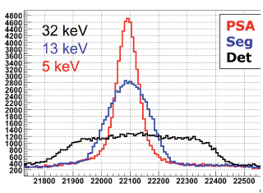
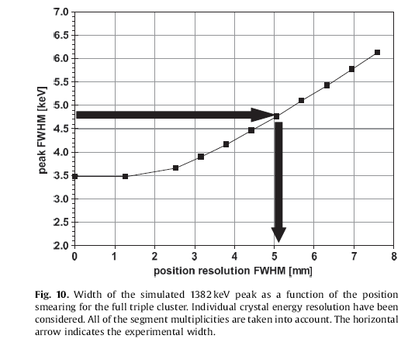
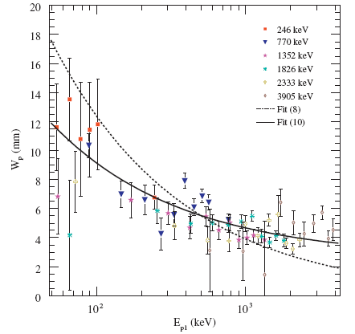


Position resolution for AGATA
Method = Doppler correction capability in an in-beam experiment
F. Recchia et al., NIMA 604 (2009) 555
P-A. Soederstroem et al., NIMA 638 (2011) 96
Energy [channel]
Simulation of reaction + detector response
F. Recchia et al., NIMA 604 (2009) 555

Slide 33
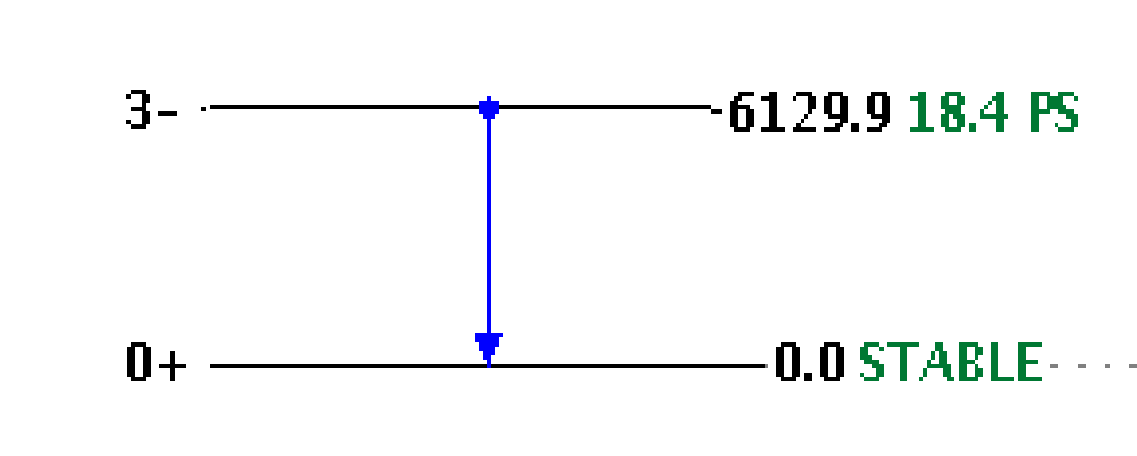
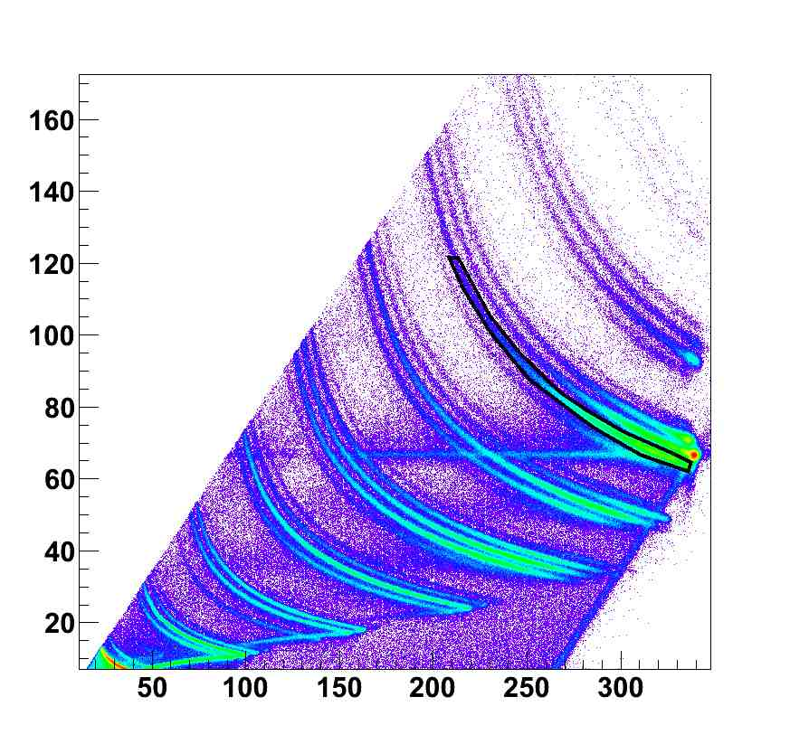

Doppler correction capabilities
AGATA Demonstrator at LNL
Inelastic scattering
¹⁷O @ 20 MeV/u on ²⁰⁸Pb
¹⁶O
No Dopp Corr
Crystal Centers
Segment Centers
PSA+Tracking
F
O
N
C
dE (MeV)
B
Be
Li
α
TKE (MeV)
F.Crespi, Milano
46

Slide 34







AGATA as a big (and expensive) Compton camera
Far Field Backprojection
All 9 detectors
One detector
Near Field Backprojection
All 9 detectors
One detector
Source at 51 cm ➔Dx ~Dy ~2 mm Dz ~2 cm
F. Recchia et al., NIMA 604 (2009) 60

Slide 35



AGATA
(Advanced-GAmma-Tracking-Array)
the “γ-ray spectroscopy dream”
High efficiency.
Good position resolution on the individual γ interactions.
Capability to stand a high counting rate.
High granularity.
Capability to measure the Compton scattering angles of the γ-rays within the detectors.
Coupling to ancillary devices for added selectivity.
180 hexagonal crystals 3 shapes
60 triple clusters all equal
inner radius 24 cm
amount of germanium 374 kg
solid angle coverage 79 %
6480 segments
efficiency at 1MeV: 39% (M_{g}=1), 25% (M_{g}=30)
Peak/Total: 53% (M_{g}=1), 46% (M_{g}=30)
Geant4 Montecarlo simulations
E. Farnea, NIMA 621 (2010) 331
Notes:
Ultimate dream
Full coverage, no spaces
All hits recorded

Slide 36


GRETA vs. AGATA
Ge crystals size:
Length 90 mm
Diameter 80 mm
120 hexagonal crystals 2 shapes
30 quadruple-clusters all equal
Inner radius (Ge) 18.5 cm
Amount of germanium 237 kg
Solid angle coverage 81 %
4320 segments
Efficiency: 41% (M_{γ}=1) 25% (M_{γ}=30)
Peak/Total: 57% (M_{γ}=1) 47% (M_{γ}=30)
180 hexagonal crystals 3 shapes
60 triple-clusters all equal
Inner radius (Ge) 23.5 cm
Amount of germanium 362 kg
Solid angle coverage 82 %
6480 segments
Efficiency: 43% (M_{γ}=1) 28% (M_{γ}=30)
Peak/Total: 58% (M_{γ}=1) 49% (M_{γ}=30)

Slide 37






“realization of the dream”:
AGATA the nomadic detector
Demonstrator at the Legnaro National Lab.,
Italy
2009-2012
AGATA@GANIL,
2014-2020
AGATA @ GSI
Germany
2012-2014
22

Slide 38


AGATA is today at LNL

Slide 39





AGATA Crystals
80 mm
90 mm
Volume ~370 cc Weight ~2 kg
(the 3 shapes are volume-equalized to 1%)
6x6 segmented cathode

Slide 40

Asymmetric AGATA Triple Cryostat
- integration of 111 high resolution
spectroscopy channels
- cold FET technology for all signals
Challenges:
- mechanical precision
- heat development, LN2 consumption
- microphonics
- noise, high frequencies
A. Wiens et al. NIM A 618 (2010) 223–233
D. Lersch et al. NIM A 640(2011) 133-138
Courtesy P. Reiter

Slide 41

Analogue vs Digital Electronics
Standard Arrays
Shaping Amplifier
E
ADC
Detector
(Germanium)
t
DAQ
CFD
TDC
Notes:
1/26/23 10:36 AM
© 2007 Microsoft Corporation. All rights reserved. Microsoft, Windows, Windows Vista and other product names are or may be registered trademarks and/or trademarks in the U.S. and/or other countries.
The information herein is for informational purposes only and represents the current view of Microsoft Corporation as of the date of this presentation. Because Microsoft must respond to changing market conditions, it should not be interpreted to be a commitment on the part of Microsoft, and Microsoft cannot guarantee the accuracy of any information provided after the date of this presentation.
MICROSOFT MAKES NO WARRANTIES, EXPRESS, IMPLIED OR STATUTORY, AS TO THE INFORMATION IN THIS PRESENTATION.
41

Slide 42

Analogue vs Digital Electronics
AGATA
E
E
MWD
E
Detector
(Germanium)
t
t
FADC
DCFD
PSA
Tracking
DAQ
t
x,y,z
Filters
Segment
Detector
Array
Performance comparable to
best analog electronics.
Higher count rate capabilities

Slide 43




Digital processing of signals
The energy is obtained via trapezoidal filter (or Moving Window Deconvolution, MWD)
A.Georgiev and W. Gast, IEEE Trans. Nucl. Sci., 40(1993)770
V.T.Jordanov and G.F.Knoll, Nucl.Instr.Meth., A353(1994)261
1)
Signal amplitude = value at the top –
value of the baseline
2)
3)

Slide 44

Signal processing at high counting rates
30 kHz "nominal"
(front) segment
core
time [10ns]

Slide 45


Signal processing at high counting rates
30 kHz "nominal"
core
time [10ns]
MWD amplitude:
risetime 5us
risetime 2.5us

Slide 46


Singles rates and shaping time
6 different rates x 4 trapezoid risetimes x 6 BLR lengths
⁶⁰Co - fixed
¹³⁷Cs – 6 positions
F. Recchia

Slide 47

Singles rates and shaping time
⁶⁰Co - fixed
¹³⁷Cs – 6 positions

Slide 48

Structure of Data Processing
Local Level Processing

Slide 49

Structure of Data Processing
Global Level Processing
Ancillary Producer/Filter
(Merger)

Slide 50

Data preparation to the PSA: energy calibrations
Calibration of traces: from calibrations of amplitudes and MWD parameters

Slide 51



Data preparation to the PSA:
cross-talk correction
Generate strong energy shifts proportional to the segment fold
Sum of segment energy vs fold
segment id
segment id
Before correction
After correction
Notes:
Present in any segmented detector,

Slide 52

Data preparation to the PSA: recovery of missing segment
45

Slide 53



Neutron-damage correction
April 2010
July 2010
→ corrected
CC
r=15mm
SG
r=15mm
CC
r=15mm
SG
r=15mm
The 1332 keV peak as a function of crystal
depth (z) for interactions at r = 15mm
Charge loss due to neutron damage →
proportional to the path length to the electrodes
Use PSA interaction points and modeling
of charge trapping to correct the effect
B.Bruyneel et al, Eur. Phys. J. A 49 (2013) 61

Slide 54

Effect of the correction on energy resolution
corrected
Sum of segments: 5.9 keV ➔ 2.9 keV
uncorrected

Slide 55

The nucleus is always full of surprises
Instrumentation advances ⇔ New Science

