Slide 1
SPECTROMETERS
1st Lecture: 24/01/2023, 12:00 - 13:00
Definitions; Formalism; Main ion-optical elements
2nd Lecture: 25/01/2023, 10:30 - 11:30
Higher Orders ; Exemples
Teresa Kurtukian Nieto
kurtukia@lp2ib.in2p3.fr
LP2i Bordeaux
CNRS/IN2P3 Université de Bordeaux

Slide 2
Literature
• Optics of Charged Particles, Hermann Wollnik, Academic Press, Orlando, 1987.
• The Optics of Charged Particle Beams, David.C Carey, Harwood Academic Publishers, New York 1987.
• A First- and Second-Order Matrix Theory for the Design of Beam Transport Systems and Charged Particle Spectrometers. Karl L. Brown. SLAC Report-75. June 1982
https://cds.cern.ch/record/283218/files/SLAC-75.pdf
Computing Codes:
• COSY INFINITY 10.0 Beam Physics Manual https://www.bmtdynamics.org/cosy/manual/COSYBeamMan100.pdf
• GICOSY Manual https://web-docs.gsi.de/~weick/gicosy/
• TRANSPORT http://aea.web.psi.ch/Urs_Rohrer/MyWeb/trans.htm
Thanks B. Jacquot and Franck Varenne/ GANIL for some material used in this course

Slide 3
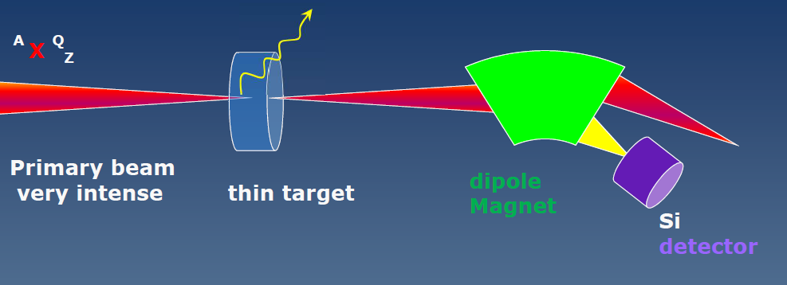
What is a Spectrometer?
In the broadest sense a spectrometer is any instrument that is used to measure the variation of a physical characteristic over a given range.
A dipole magnet is the simplest electromagnetic spectrometer to scan on mass-to-charge ratio (m/q)
Focal plane

Slide 4
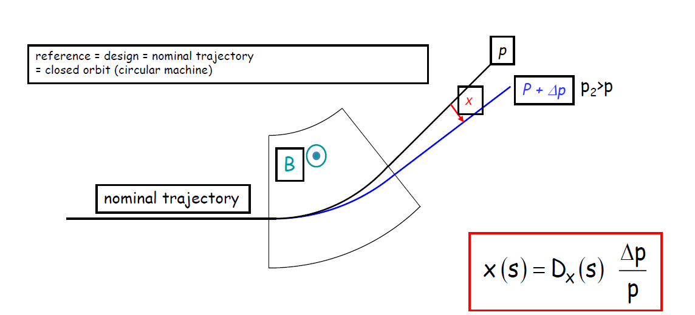
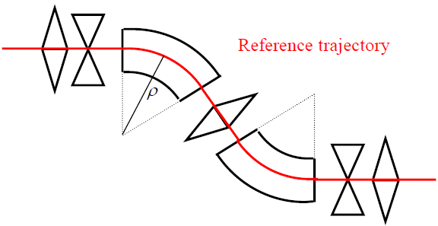
Dispersion

Slide 5
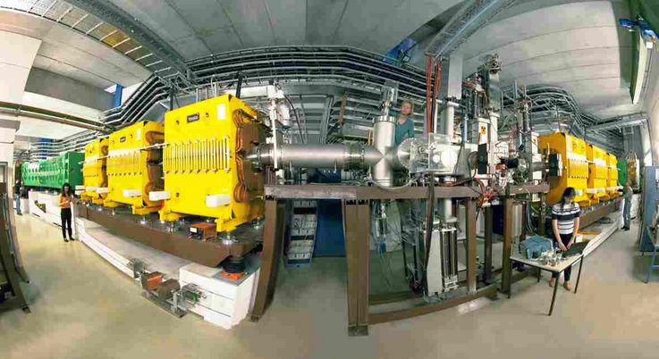
GSI FRS Germany

Slide 6
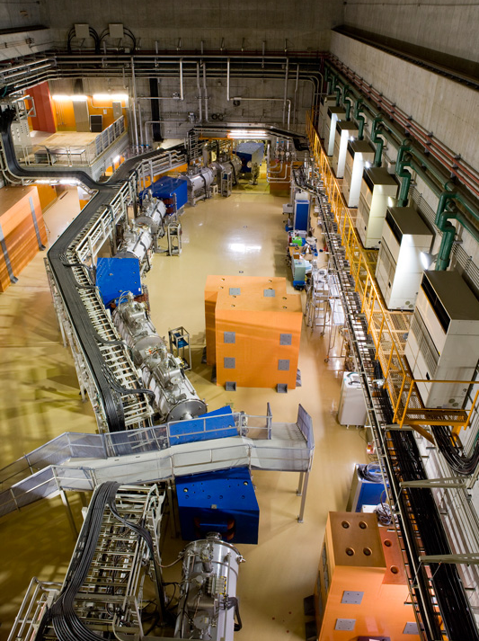
BIGRIPS RIKEN Japan

Slide 7
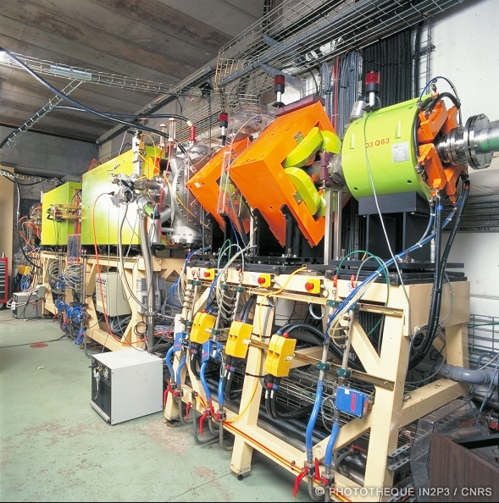
LISE (wien filter)
GANIL, France

Slide 8
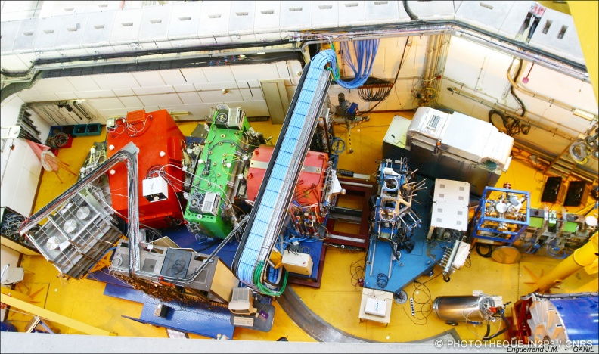
VAMOS
GANIL, France

Slide 9
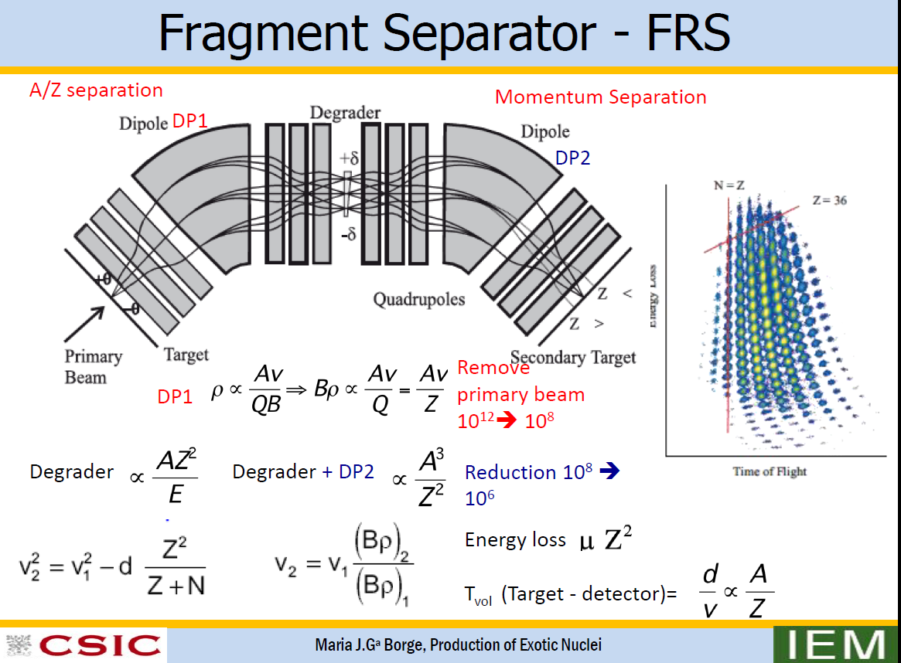

Slide 10
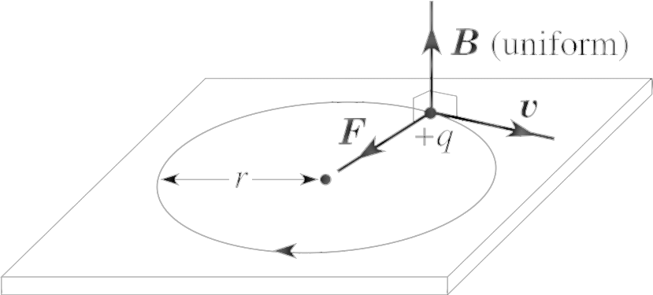



Why it works?
Thanks to the Lorentz force F and Newton’s second law
1. Lorentz force: A charged particle moving in an electromagnetic field experiences a force.
$$\frac{dp}{dt}=F=q(E+v ×B)$$
Electic Magnetic
Force Force
This force causes a centripetal acceleration and consequently a circular motion of the particle in the medium based on the equations described below.
2. Newton’s second law
$$F=m a$$
$$Fcentripetal=\frac{mv^{2}}{r}$$
Radius r → ρ

Slide 11
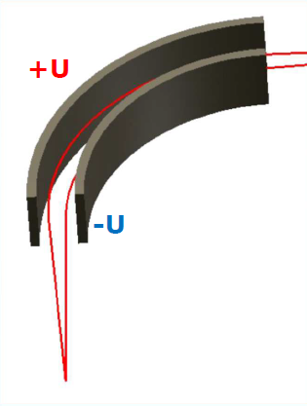

Electrostatic selection :
F= q E
F_{Electic} = F_{centripetal}
E$ρ=\frac{mv^{2}}{q}$
Difficult to bend energetic particles with
raisonnable E field due to sparking
Most used for low energy particles keV

Slide 12
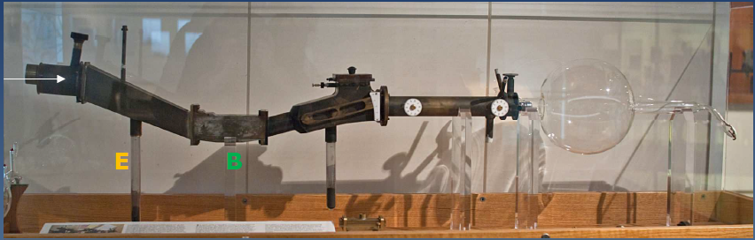
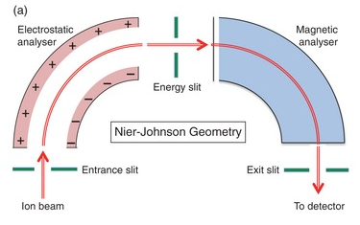
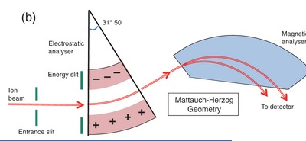
Aston Nobel price (1919) : E+ B selection with a « mass spectrograph »
  identification Stable isotopes : ²⁰⁻²²Ne; ³⁵⁻³⁷Cl & mass measurement

Slide 13

Magnetic Separation:
F_{Magnetic} = F_{centripetal}
F_{magnetic} = q v B
$Bρ=\frac{mv}{q}$, → Magnetic Rigidity
Beam rigidity quantifies how difficult it is to bend the beam and is given by the total momentum divided by the total charge
Wien Filter: F_{electic} = F_{magnetic}
v = E/B with E ⊥ Β
m/$q=\frac{2Ek}{qv^{2}}$

Slide 14
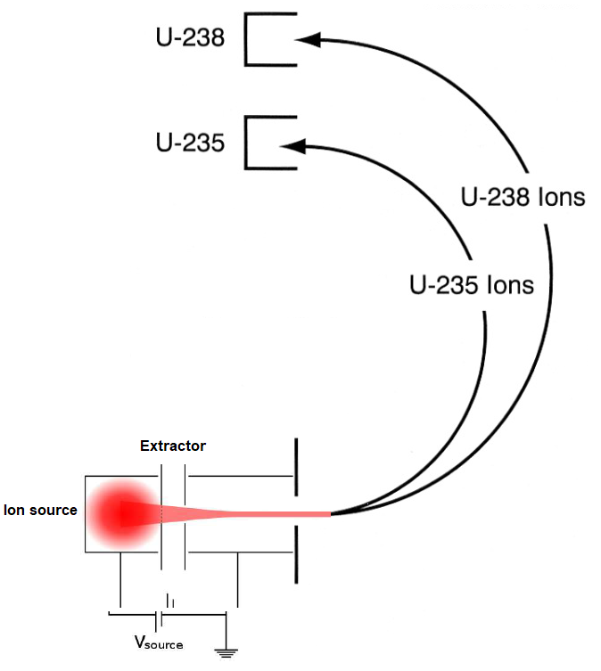
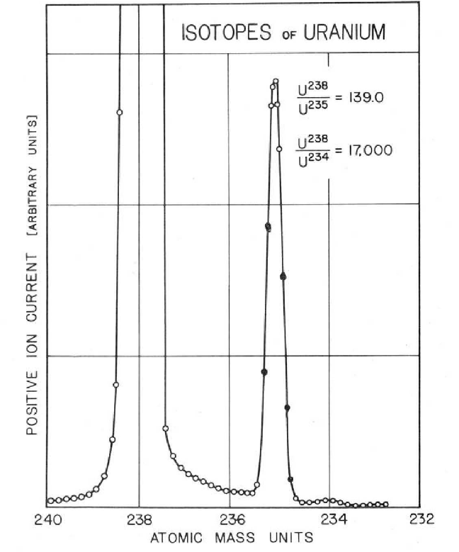
The simplest m/q magnetic spectrometer : 1 dipole magnet
40’s: Manhattan project U-235/U-238 enrichment (B selection)
Dipole →mass dispersion

Slide 15
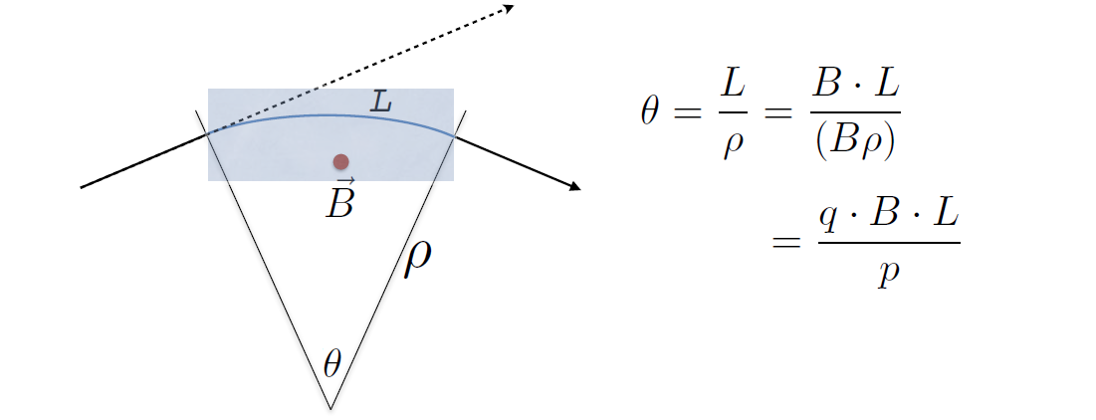
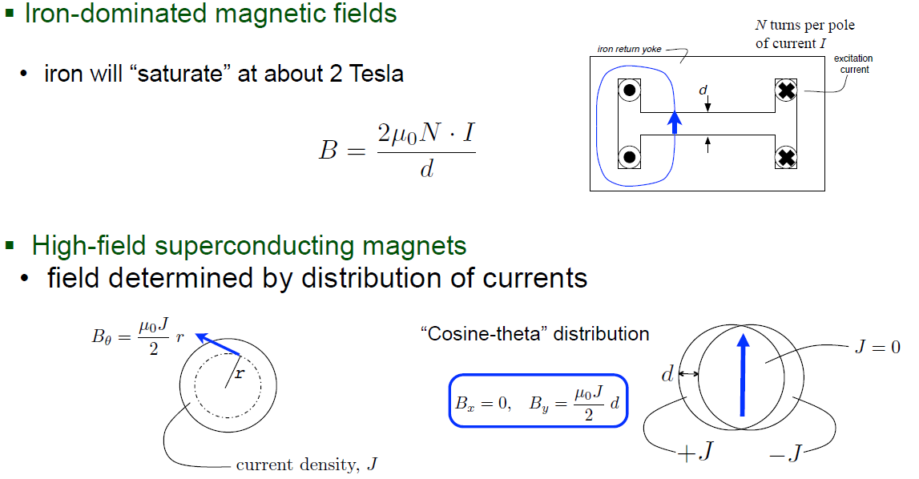
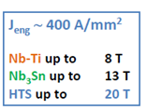
Bending through Dipole Field

Slide 16
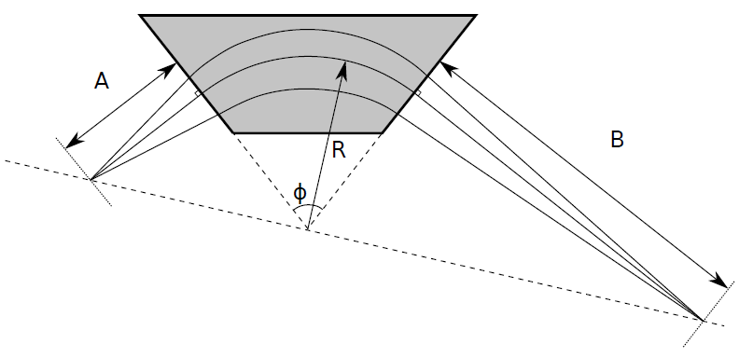
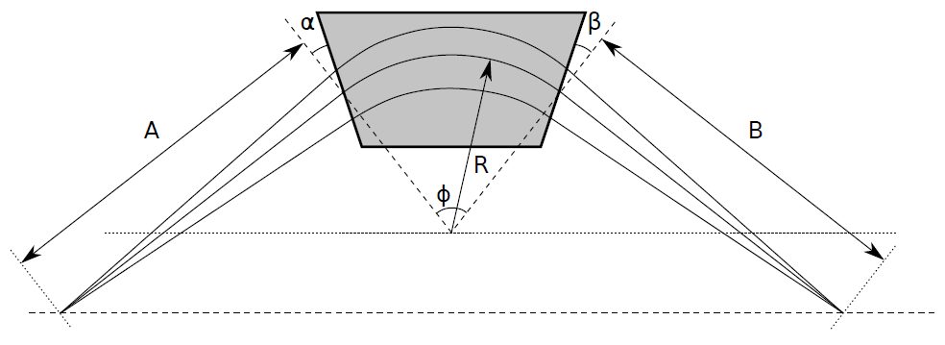
The dipole elements also have focusing/defocusing properties.
With edges perpendicular to the optical axis (edge angle 0◦) focuses the beam in the
bending plane (x). There is no focusing action in the y direction.
If the magnet edge angles deviate from 90◦, the focusing power in the x direction can be
adjusted. If the edge angle is made positive (as shown), there is weaker focusing
in the x direction. If the angle is negative, there is stronger focusing in the x direction.

Slide 17
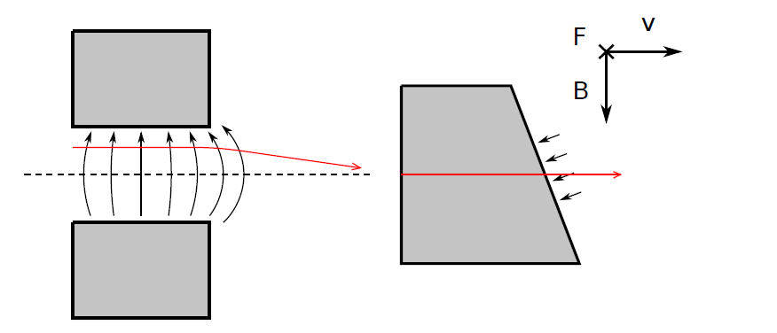
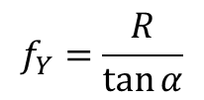
Changing the edge angle also has an important effect in the y direction:
if the angles are positive, the fringing field of the magnet will focus the beam in the y direction
Overall, this means that the focusing in the x direction can be traded for y focusing.
The focal length from the edge focusing is given by.
$$f_{Y}=\frac{R}{\tan{α}}$$

Slide 19
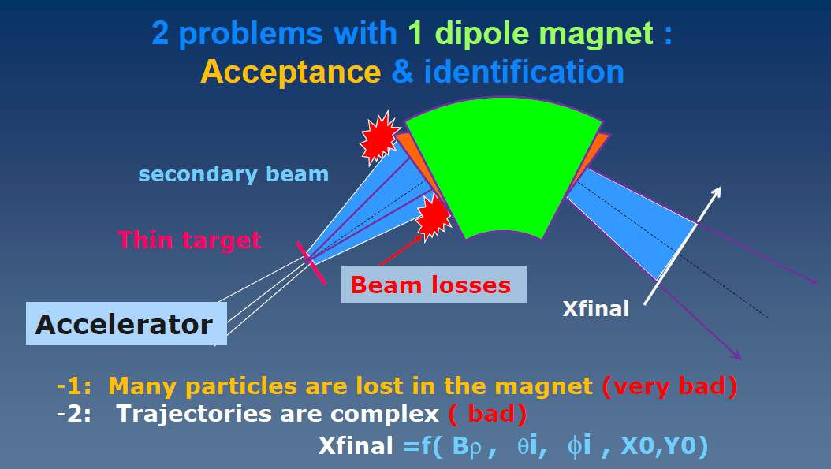
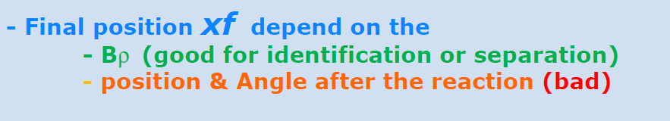
Focal plane

Slide 20
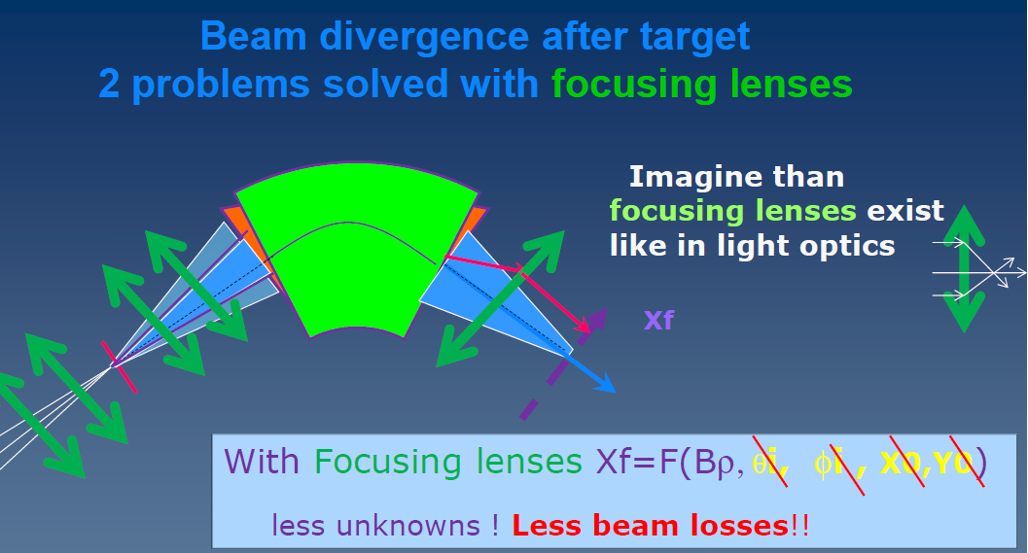
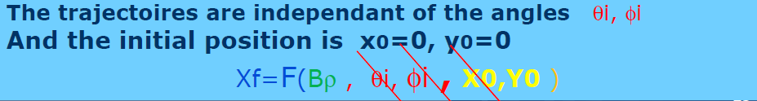
Focal plane

Slide 21
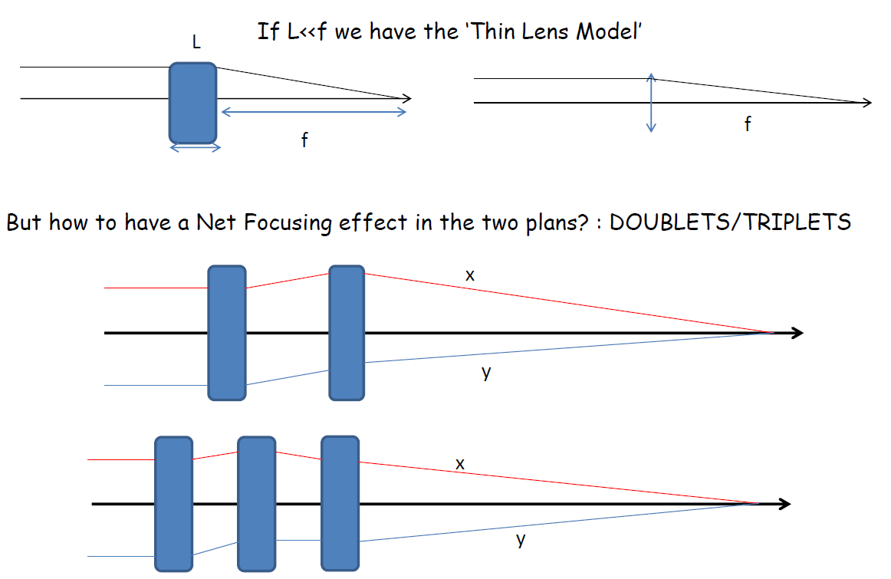
Focusing in both planes : doublets, triplets

Slide 22
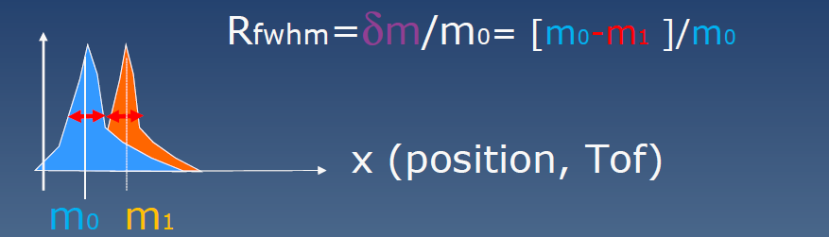
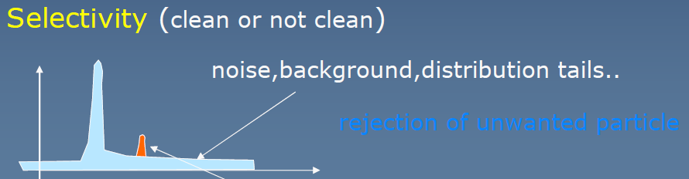
Resolving power
The term resolving power is the ability of a spectrometer to resolve adjacent peaks in a mass spectrum and is often used interchangeably with resolution. The separation of peaks for singly charged ions can be expressed as a mass difference δm

Slide 23
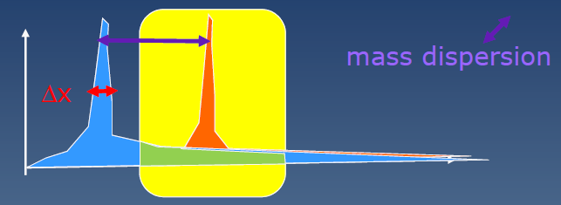
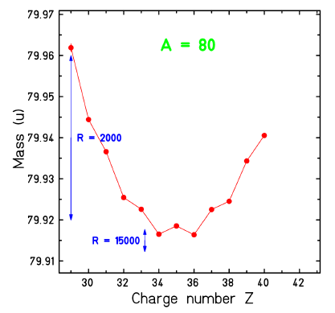

Resolution = Δx_{FWHM} / dx/dm, Resolving power = 1/Resolution
Mass dispersion usually expressed in meters (m) (SI):
cm/% (centimeters per 100%) ;
mm/‰
Notation :
D_{m}
dx/dm, physical meaning
Matricial notation (see later)
(x|δ) Wollnik
R16, T16, M16
Resolving power R = $\frac{(x|δ)}{∆x (FWHM)}$

Slide 24
Exercise 1:
Imagine a spectrometer with a dispersion of 30 cm/%
and beam width of 1 mm FWHM on the focal plan detector.
What is the resolving power R ?
30
30000
1500

Slide 25
Beam optics (basics)
Already seen:
Dispersion and focalisation with dipoles
Focalisation with quadrupoles
Resolution
Next concepts:
Particles coordinates
Beam emittance
Optical Matrices following Taylor expansion
Angular Acceptance
Bρ Acceptance

Slide 26
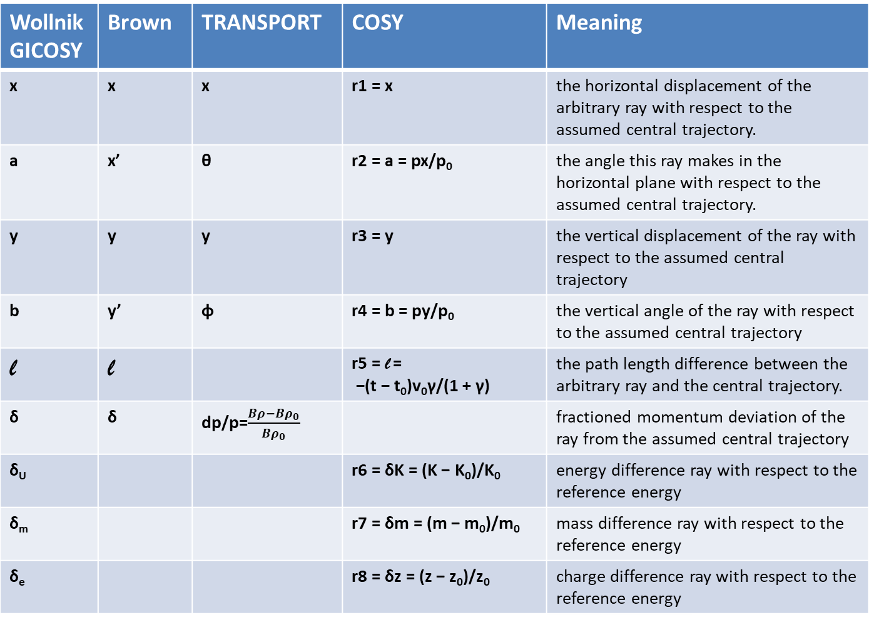
The Coordinates
Notations in the Literature is not consistent!
Wollnik GICOSY | Brown | TRANSPORT | COSY | Meaning
x | x | x | r1 = x | the horizontal displacement of the arbitrary ray with respect to the assumed central trajectory.
a | x’ | θ | r2 = a = px/p₀ | the angle this ray makes in the horizontal plane with respect to the assumed central trajectory.
y | y | y | r3 = y | the vertical displacement of the ray with respect to the assumed central trajectory
b | y’ | φ | r4 = b = py/p₀ | the vertical angle of the ray with respect to the assumed central trajectory
l | l |  | r5 = l = −(t − t₀)v₀γ/(1 + γ) | the path length difference between the arbitrary ray and the central trajectory.
δ | δ | dp/p=$\frac{Bρ−{Bρ}_{0}}{{Bρ}_{0}}$ |  | fractioned momentum deviation of the ray from the assumed central trajectory
δ_{U} |  |  | r6 = δK = (K − K₀)/K₀ | energy difference ray with respect to the reference energy
δ_{m} |  |  | r7 = δm = (m − m₀)/m₀ | mass difference ray with respect to the reference energy
δ_{e} |  |  | r8 = δz = (z − z₀)/z₀ | charge difference ray with respect to the reference energy

Slide 27
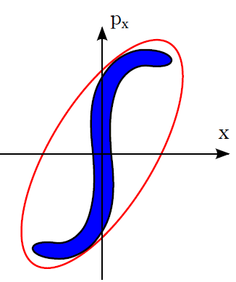
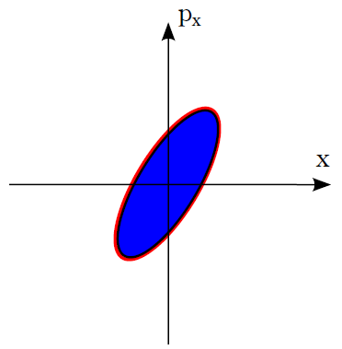
Beam emittance
The emittance is defined as the six-dimensional volume limited by a contour
of constant particle density in the (x, px, y, py, z, pz) phase space. This volume obeys the Liouville theorem and is constant in conservative fields
optical system
The area of the particle distribution is conserved but the area of the elliptical envelope increases.

Slide 28
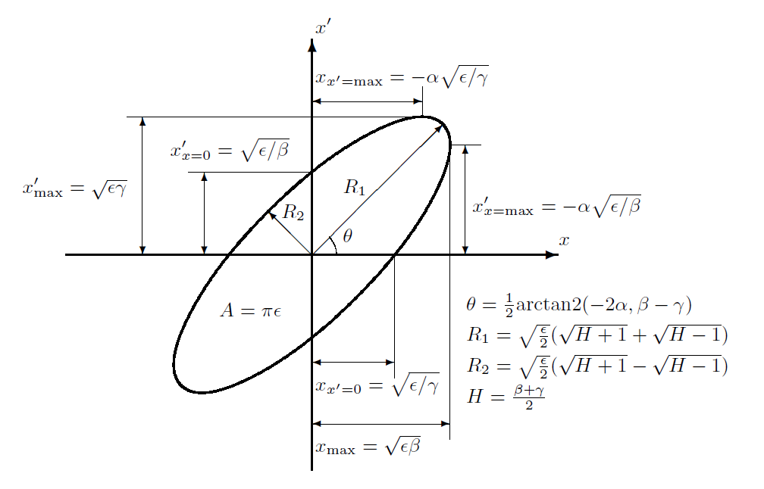



Beam emittance
$$γx^{2}+2αxx^{′}+β{x′}^{2}=ε$$
$$βγ− α^{2}=1$$
$$A=πε=πR_{1}R_{2}$$
ε is the two-dimensional transverse emittance, and α, β and γ are known
as the Twiss parameters

Slide 29
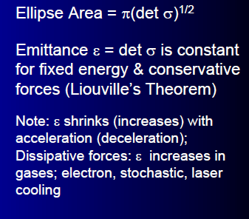
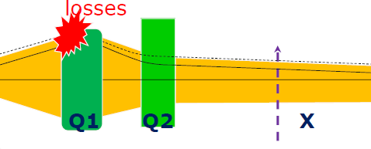
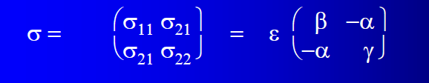
The beam size : important for the design

Slide 30

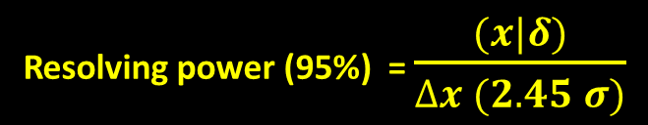
The percentage of bivariate normally distributed data covered by an ellipse whose axes have a length of numberOfSigmas · σ can be obtained by integration of the probability distribution function over an elliptical area.
percentage = (1 - exp (-numberOfSigmas²/2)) · 100%,
This results in the following equation,
(x/σ_{x})² + (y/σ_{y})² = numberOfSigmas².
where the numberOfSigmas is the radius of the "ellipse":
the numberOfSigmas =1 ellipse covers 39.3% of the data,
the numberOfSigmas =2 ellipse 86.5%,
and the numberOfSigmas =3 ellipse 98.9%.
From the formula above we can show that if we want to cover p percent of the data,
we have to chose numberOfSigmas as
numberOfSigmas = √(-2 ln(1-p/100)).
For covering 95% of the data we calculate numberOfSigmas = 2.45.
Resolving power (95%) = $\frac{(x|δ)}{∆x (2.45 σ)}$

Slide 31
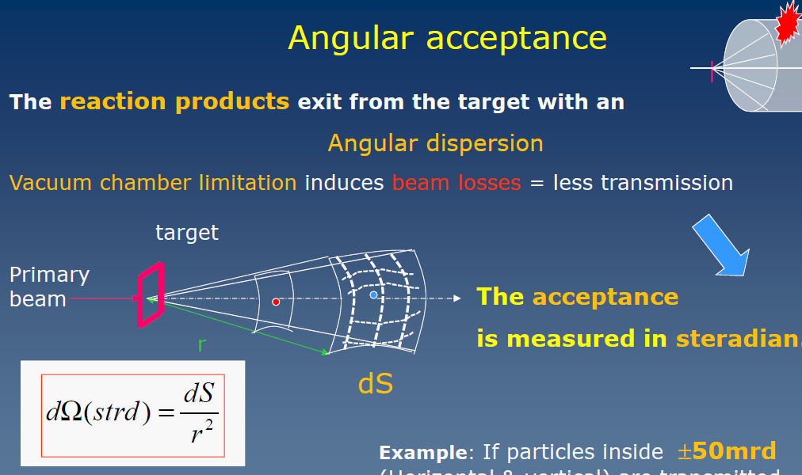
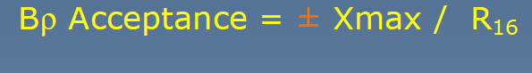

Slide 32
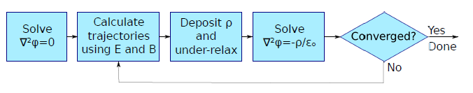
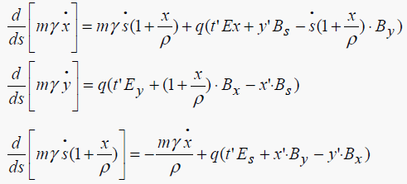

Modelling of ion optical transport lines
1. Trajectories : exact equations
integrate the particle equation of motion using mesh based maps for E and B fields [field map 3D]
$$\frac{dp}{dt}=F=q(E+v ×B)$$
Examples of codes : ZGOUBY
But generally we can do simpler : Matrix approach

Slide 33



Modelling of ion optical transport lines
Taylor expansion in x, a, y, b and δ
$x_{1}=\left(x\right|x) x_{0}$+ $\left(x\right|a) a_{0}+\left(x\right|δ)δ$ $+\left(x\right|x^{2})x_{0}^{2}\text{+ }\left(x\right|xa) x_{0}a_{0}\text{+}\left(x\right|a^{2})a_{0}^{2}$
$\left(x\right|xδ) x_{0}\text{+}\left(x\right|aδ) a_{0}δ$+ $\left(x\right|δ^{2})δ_{}^{2}\text{+}\left(x\right|y^{2})y_{0}^{2}\text{+}\left(x\right|yb) y_{0}b_{0}+\left(x\right|b^{2})b_{0}^{2}$ $\text{+} \text{higher} \text{orders}$
First order
$\left(x\right| …)$= $\frac{∂}{∂x}$
$$Higher orders :e.g. \left(x | a^{2}\right)=\frac{∂x}{∂a∂a}=T_{122}$$

Slide 34

Transfer matrix formalism
6x6 Matrix
representing first optic element
(usually a Drift)
$$x_{n}=T_{n}T_{n−1}…T_{0}x_{0}$$
Ray at final
Location n
Ray at initial
Location 0
(e.g. a target
or slits)
Complete system is represented in first order by one Matrix Rsystem = T_{n} T_{n-1} … T₀

Slide 35


Transfer matrix formalism
Most crucial parameters :
$$T=\left(\begin{matrix}(x|x) & (x|a) & (x|y) & (x|b) & (x|l) & (x|δ) \\ (a|x) & (a|a) & (a|y) & (a|b) & (x|l) & (a|δ) \\ (y|x) & (y|a) & (y|y) & (y|b) & (x|l) & (y|δ) \\ (b|x) & (b|a) & (b|y) & (b|b) & (x|l) & (a|δ) \\ (l|x) & (l|a) & (l|y) & (l|b) & (x|l) & (l|δ) \\ (δ|x) & (δ|a) & (δ|y) & (δ|b) & (x|l) & (δ|δ)\end{matrix}\right)$$
$$T_{11}=magnification in horizontal$$
$$T_{16}=dispersion in momentun=dispersion in Bρ$$
$$T_{33}=magnification in vertical$$
$$T_{12}=angular dependance in horizontal$$
$$T_{34}=angular dependance in vertical$$

Slide 37
Exercise 2:
For covering 95% of the beam ellipse data which value of sigma in ΔX we should use for calculating the resolving power?
1 𝛔
2.35 𝛔 (FWHM)
2.45 𝛔

Slide 38
Supplemental slides

Slide 39
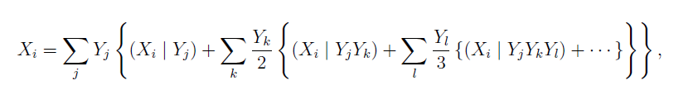
Transfer matrix formalism
Following Taylor expansion the trajectory component Xi after propagation through an ion optical element can be calculated from
where Yi are the components of the trajectory before the ion optical element, and
(Xi | Yj), (Xi | YjYk), (Xi | YjYkYl), . . . are the first-order, second-order, third-order, . . . transfer coefficients
This can be described as matrix–vector multiplication with :
6 × 6 matrix in first order
6 × 6² matrix in second order,
6 × 6³ matrix in third order, etc.

Slide 40


Transfer matrix formalism
$$\left[\begin{matrix}x \\ x′ \\ y \\ y′ \\ l \\ δ\end{matrix}\right]=\left(\begin{matrix}T_{11} & T_{12} & T_{13} & T_{14} & T_{15} & T_{16} \\ T_{21} & T_{22} & T_{23} & T_{24} & T_{25} & T_{26} \\ T_{31} & T_{32} & T_{33} & T_{34} & T_{35} & T_{36} \\ T_{41} & T_{42} & T_{43} & T_{44} & T_{45} & T_{46} \\ T_{51} & T_{52} & T_{53} & T_{54} & T_{55} & T_{56} \\ T_{61} & T_{62} & T_{63} & T_{64} & T_{65} & T_{66}\end{matrix}\right)\left[\begin{matrix}x0 \\ x^{′}0 \\ y0 \\ y^{′}0 \\ l0 \\ δ0\end{matrix}\right]$$
$$T=\left(\begin{matrix}(x|x) & (x|a) & (x|y) & (x|b) & (x|l) & (x|δ) \\ (a|x) & (a|a) & (a|y) & (a|b) & (x|l) & (a|δ) \\ (y|x) & (y|a) & (y|y) & (y|b) & (x|l) & (y|δ) \\ (b|x) & (b|a) & (b|y) & (b|b) & (x|l) & (a|δ) \\ (l|x) & (l|a) & (l|y) & (l|b) & (x|l) & (l|δ) \\ (δ|x) & (δ|a) & (δ|y) & (δ|b) & (x|l) & (δ|δ)\end{matrix}\right)$$

