Slide 1
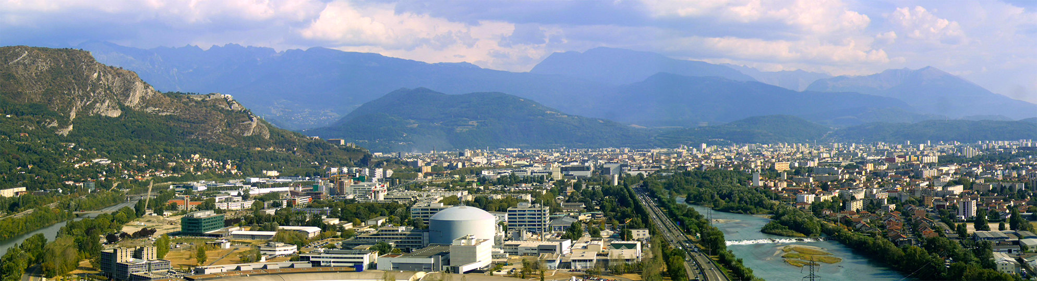
Nuclear Structure studies using
high-resolution techniques
Caterina Michelagnoli
20/01/2023
Master Interuniversitario IEM-CSIC

Slide 2
Table of contents
Introduction: main challenges in Nuclear Physics, why γ spectroscopy
→ Nuclear Structure and Astrophysics
Why high resolution and how
  → HPGe detectors and related technologies
  → Array of HPGe detectors, facilities (in-beam γ-ray spectroscopy)
  → Performance, back-ground reduction and selectivity
  → Angular correlations, polarization and lifetimes
Advanced γ-ray tracking
→ Basics
→ The AGATA project
Notes:
Table of Contents – Synthetic overview – I will go through, not necessarily ok order

Slide 3
(Main) bibliography of today’s lecture
P. Ring and P. Schuck "The Nuclear Many Body problem"
P. J. Nolan and J. F. Sharpey-Schafer, Rep. Prog. Phys. 42, 1 (1979)
"The measurement of the lifetimes of excited nuclear states"
J. Suhonen "From Nucleons to Nucleus: Concepts of Microscopic Nuclear Theory"
L.W. Fagg and SS. Hanna, Rew. Mod. Phys. 31, 711 (1959)
"Polarization measurements on nuclear γ rays"
J.K. Smith et al., Nucl. Instr. Meth. A922 (2019) 47
"γγ angular correlation analysis techniques with the GRIFFIN spectrometer"
D. Reygadas, PhD Thesis, Univ. Grenoble-Alps, 2021
G. Bocchi, PhD Thesis, Univ. Milano, 2015

Slide 4
Introducing my lectures…
Scope : showing you (main) challenges and technologies in high-resolution Nuclear Structure, from and experimentalist point of view...
… through a “personal taste and experience”-biased selection of examples

Slide 5
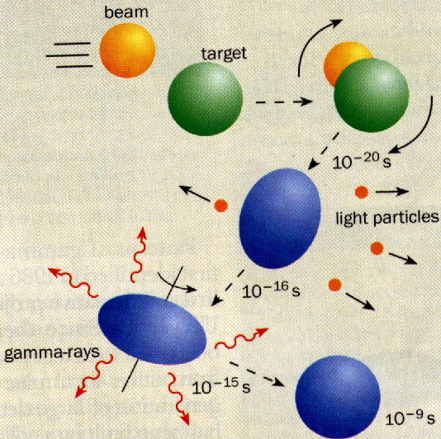
In-beam γ-ray spectroscopy
The “check-list” of detection requirements, Eg ~ 10keV – 10MeV
Energy resolution,
to disentangle complex spectra → germanium detectors
Peak-to-Total ratio,
to maximize “good events” → Compton background suppression
Doppler-correction capabilities,
to compensate the Doppler broadening (emitting nucleus in motion)
Good solid angle coverage,
to maximize the efficiency
Good granularity,
to reduce multiple hits on the detectors, measure angular distributions/correlations

Slide 6
In-beam γ-ray spectroscopy
The “check-list” of detection requirements, Eg ~ 10keV – 10MeV
Avoid dead materials,
to avoid radiation absorbtion and preserve low energies
High counting rate capability,
often the channel of interest is (much!) less strong than the bakground
Time resolution,
for prompt events selection, lifetime measurements
Possibility to couple with ancillary devices,
to improve selectivity, determine velocity vector, …

Slide 7
The structure of the nucleus
Low-energy (<~10-15MeV) nuclear states
Observables:
energy levels (E_{i})
spin (J_{i})
parity (π_{i})
lifetime
(transition probabilities) (τ_{i})
nuclear moments (g-factors)
Measuring γ-ray:
energy
angular distribution
linear polarization
energy Doppler shift
(for example)
angular distribution vs t
Energy
E_{i} J_{i} π_{i}
ground state
populate in excited state(s) and
observe γ-ray de-excitation radiation
γ-ray spectroscopy is an approach
for the study of nuclear structure
systematics (e.g. shape transitions)
benchmarks for nuclear models
(e.g. Nuclear Shell Model)

Slide 8
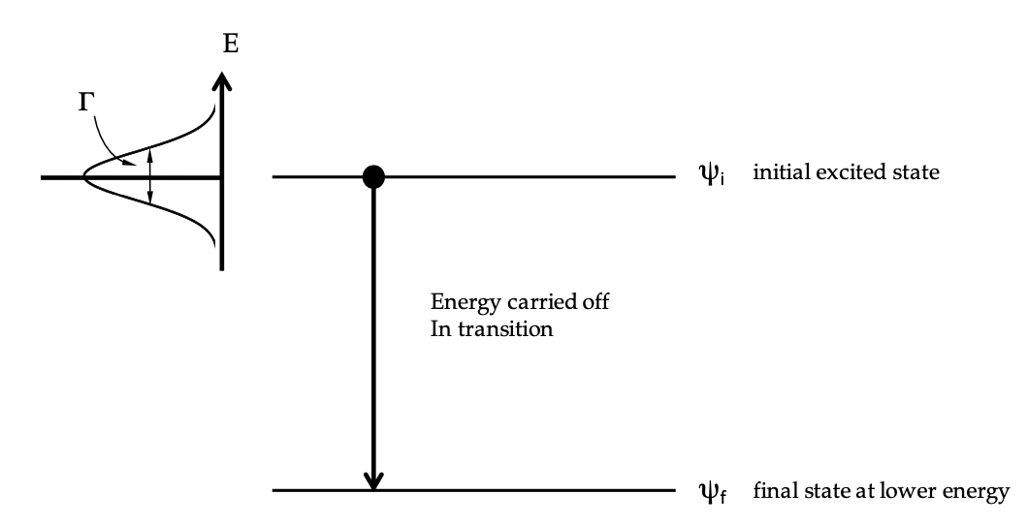


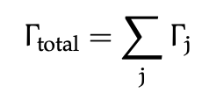
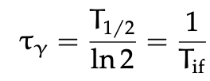

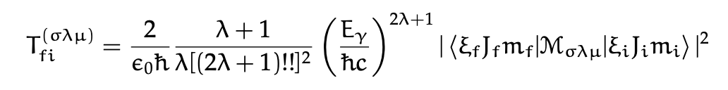
Transition probability and multipolarity
If different decay modes (j):
transition probability (per unit time):
Iγ= intensity of the transition with given multipolarity λ
E or M transition probability ("golden rule"):
|J_{f}-J_{i}|< λ < |J_{i}+J_{f}|
-λ < μ < λ
π_{f} = (-1)^{λ} π_{i} σ = E
σ = E, M μ = magnetic substate
π_{f} = (-1)^{λ+1} π_{i} σ = M
J_{f}=J_{i} ➔ E0 (internal conversion)

Slide 9
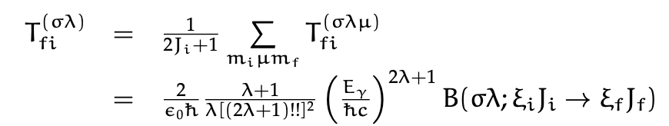
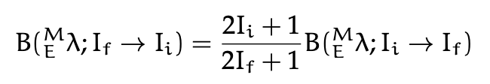

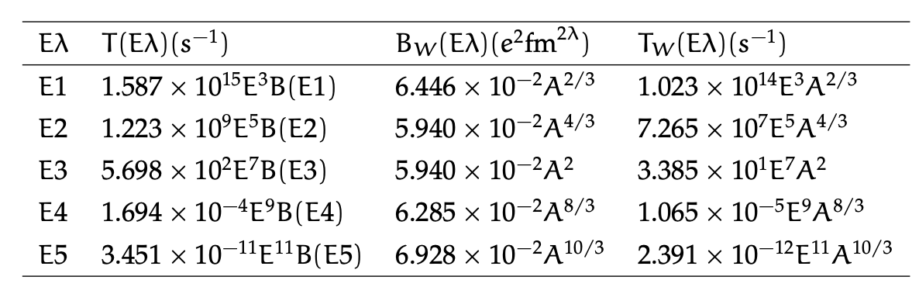
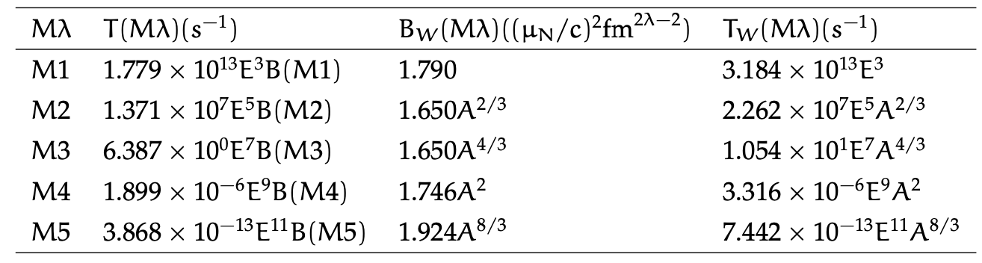
Reduced transition probabilities
Averaging on initial magnetic substates and summing over all final ones :
Reduced transition probability
Weisskopf estimates (J_{i}>J_{f}) – single particle probabilities (Energies in MeV):

Slide 10
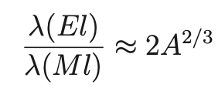
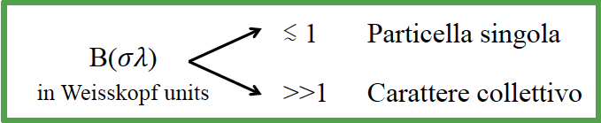
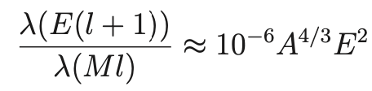
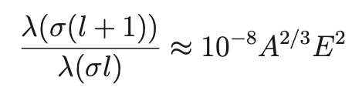
Weisskopf estimates of transition rates
When the details of the wave function are not known – single particle probabilities
for a given λ, electric transition always dominates
T(Eλ)/T(Mλ)
Single Particle
for large A and Eγ, E2 can compete with M1, E3 with M2, …
T(Eλ+1)/T(Mλ)
Collective
as L increases, T decreases quite "dramatically"
T(σλ+1)/T(σλ)
Of course not for same transition in same nucleus :) just to have a general idea in given mass region

Slide 11
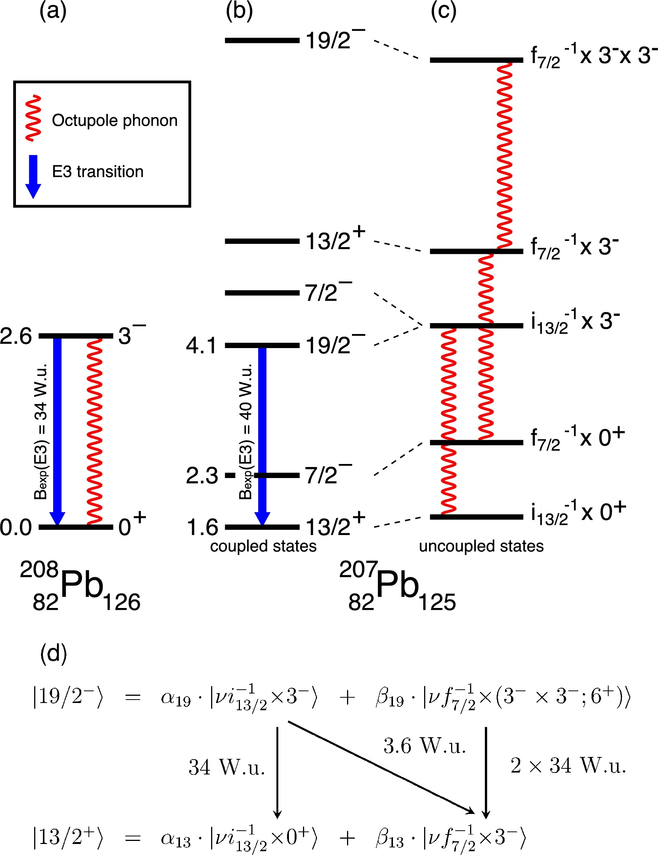
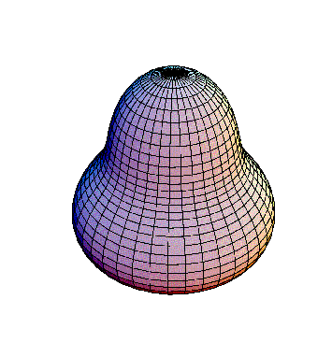
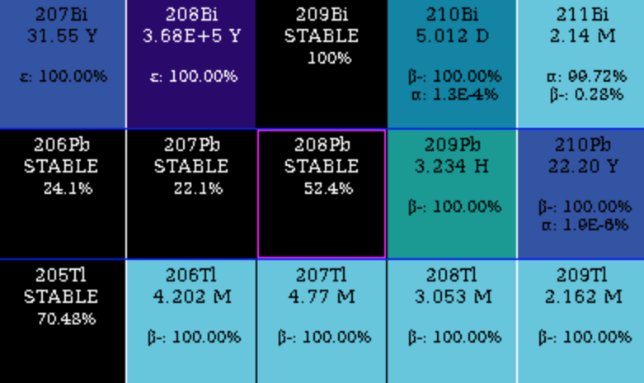
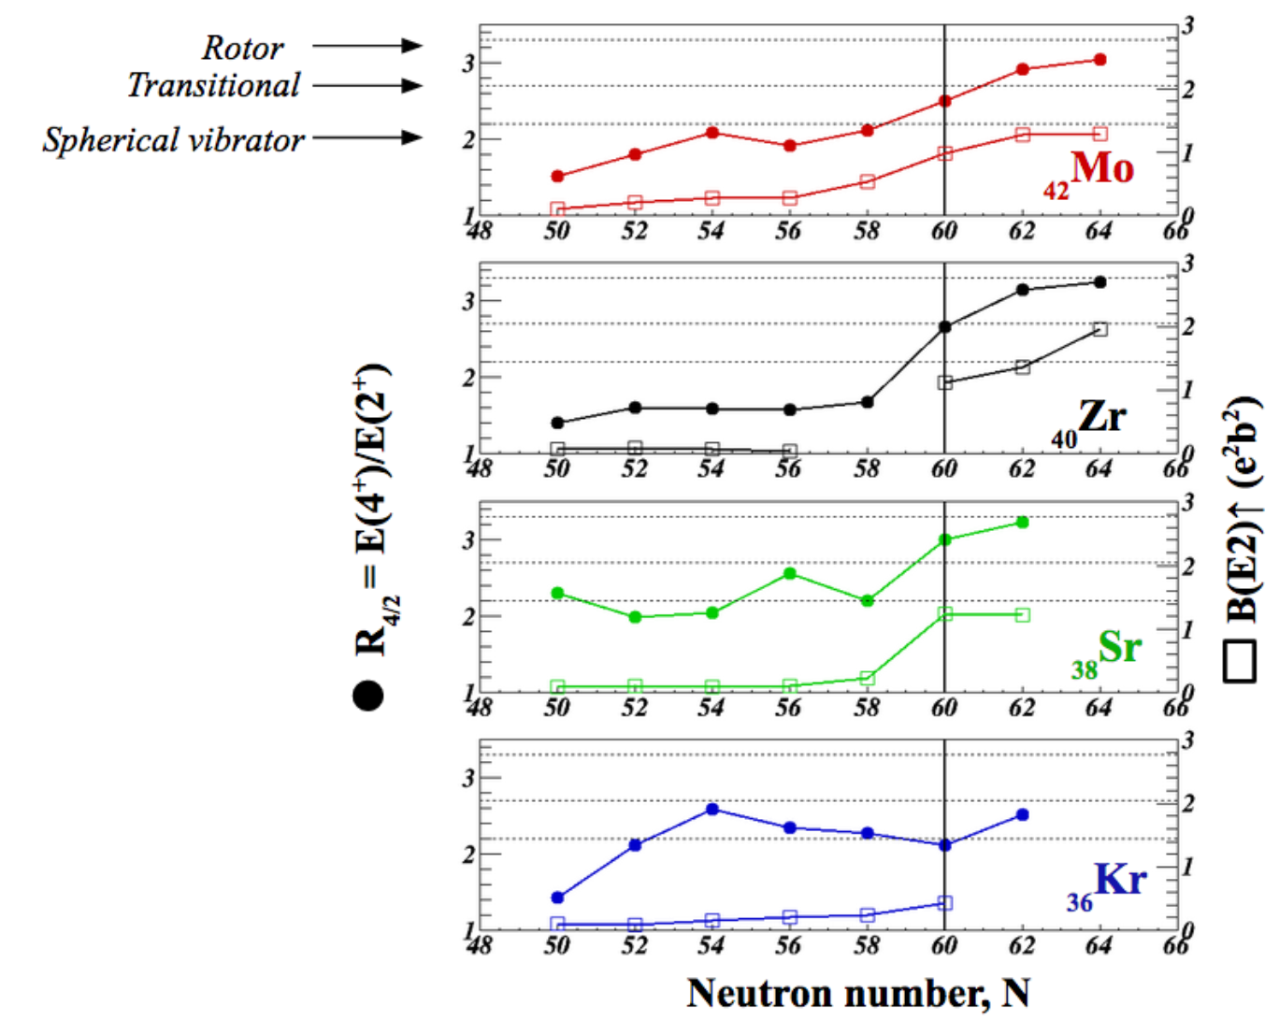
Collectivity and nuclear shapes
83
E(3⁻) = 2.6 MeV
B(E3, 3⁻ → 0⁺) = 34.0(5) W.u.
82
# protons
81
R.H. Spear et al. PLB128 (1983) 29
124
125
126
127
128
Octupole (collective) vibration
# neutrons
D. Ralet et al, PLB 797 (2019) 134797
Single particle (hole)
+ phonon states
B(σλ; ξ_{i}J_{i} ξ_{f}J_{f})  1/τ
need to measure λ, σ, τ
Shape transitions in
n-rich nuclei A~100
D. Reygadas, PhD Thesis, UGA 2021

Slide 12
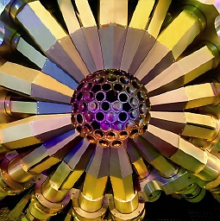
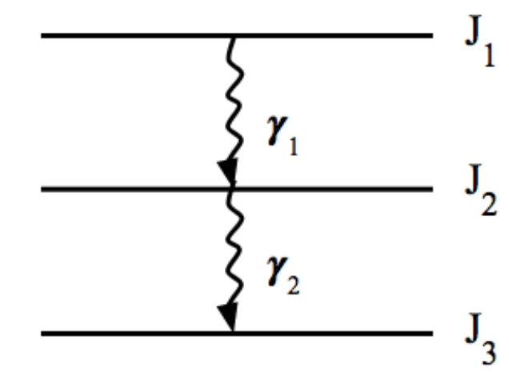
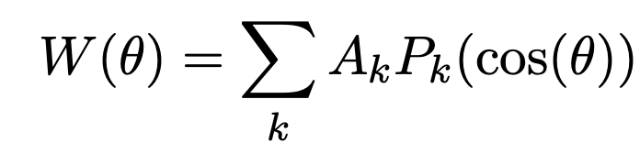


Angular distributions (correlations)
Measurement of the multipole order of the transition (λ, eventually mixed)
γ₁
γ₁
✪
θ
I_{γ}(θ) = I
γ₂
(in case of ε(θ)=ε)
A_{k} ➔ Theory
P_{k}(cos(θ)) ➔ Legendre polinomials
k integer up to min{2J₂, λ₁, λ₂}
"sources" of alignement : magnetic field
nuclear reactions (heavy ion reactions)
Or set a direction by coincidence on a gamma on the cascade : angular correlations
If max multipolarity = 2 :

Slide 13
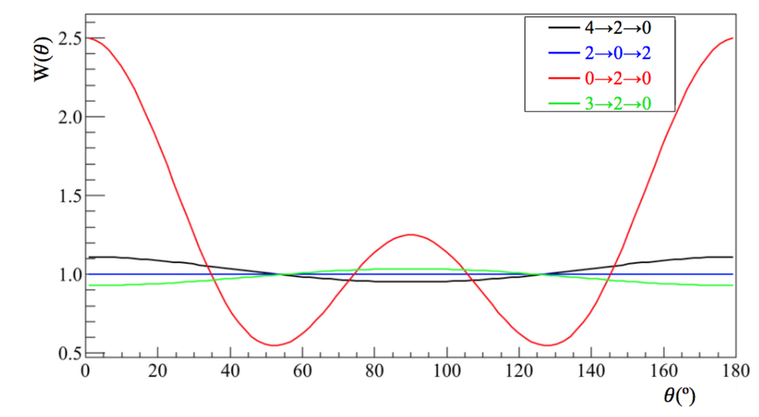
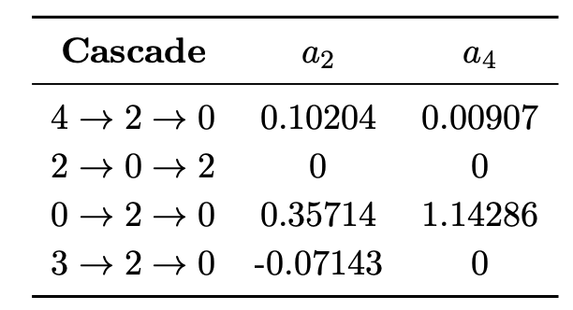
Examples of theoretical angular correlation functions
Real life:
a_{k} = q_{k} a_{th}
q_{k ←→} response function of the gamma array used
Data from https://griffincollaboration.github.io/AngularCorrelationUtility/

Slide 14
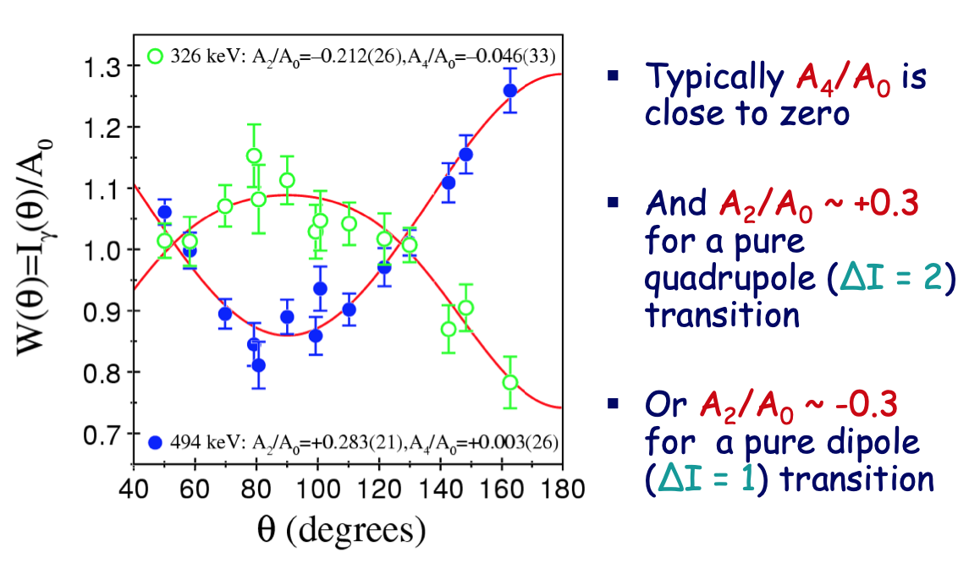
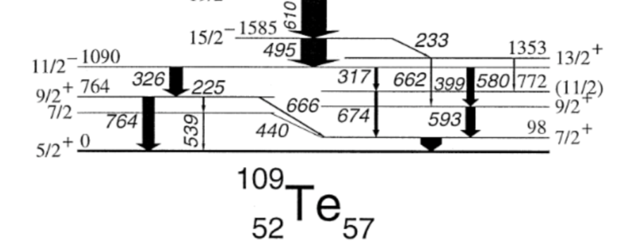
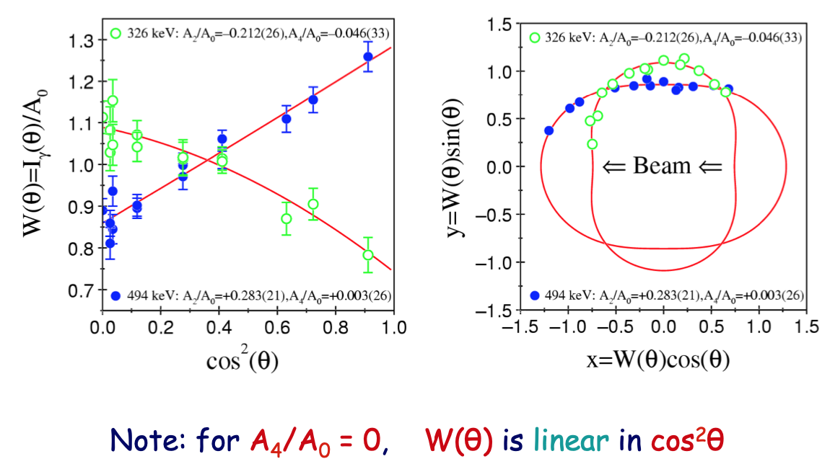
¹⁰⁹Te from fusion-evaporation reactions
A₄/A₀ ~ 0
A2/A0 ~ +0.3 pure quadrupole transition
A2/A0 ~ -0.3 pure dipole transition
A₄/A₀ ~ 0 ➔ W(θ) linear in cos²θ
https://ns.ph.liv.ac.uk/~ajb/summerschool/files/ESP-Lecture4.pdf

Slide 15
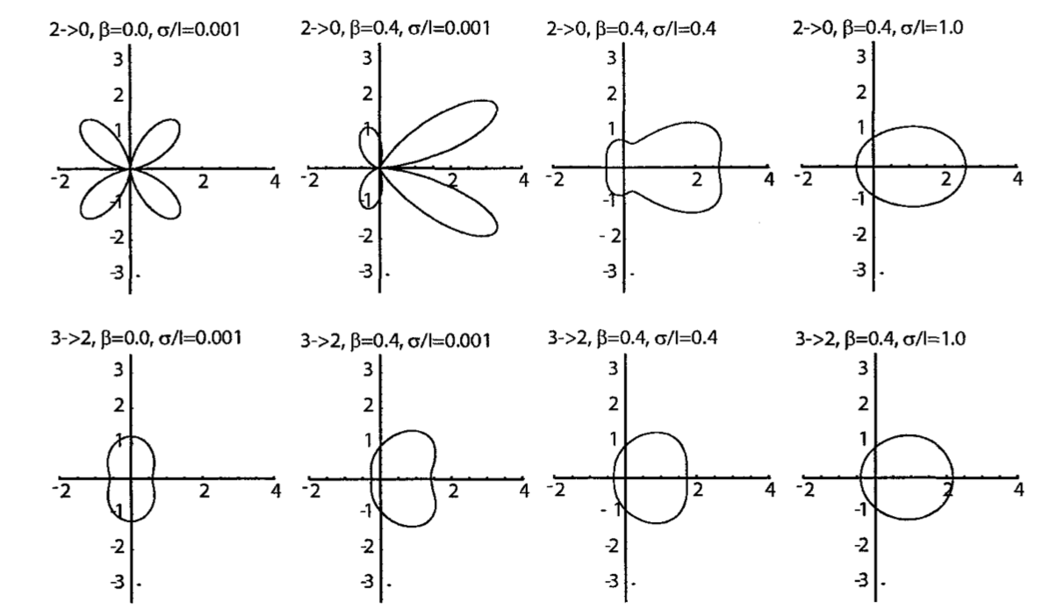
Polar plots as a function of beam velocity β
In the lab. frame
σ/l = width of the gaussian m-state distribution
θ
Beam direction
Mueller al, Nucl. Instrum. Methods 466,492 (2001).

Slide 16
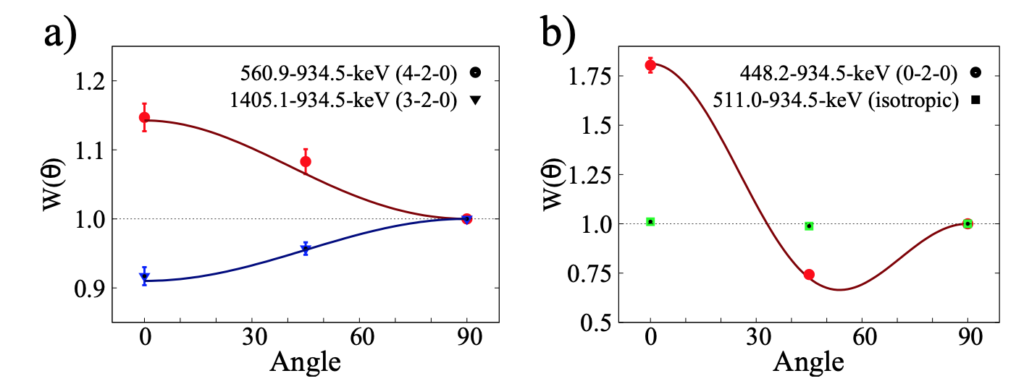
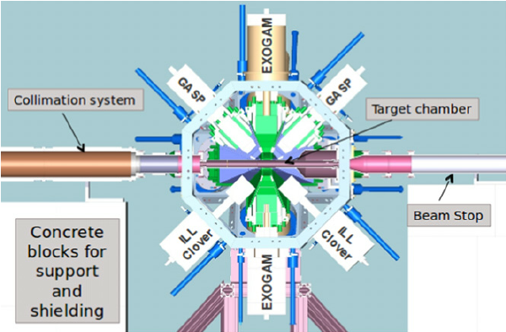
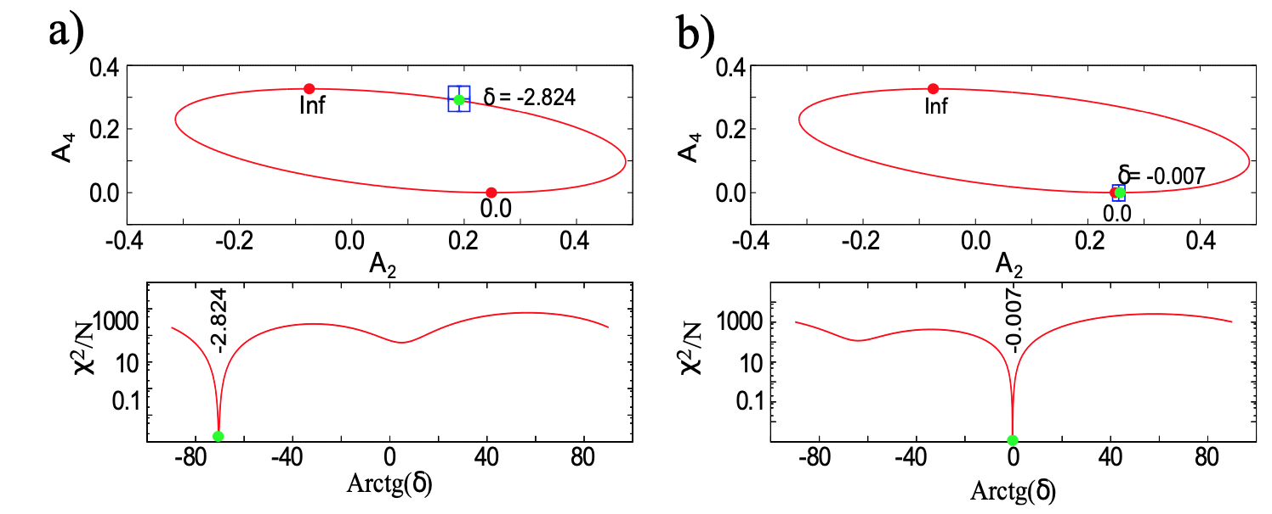
Examples of angular correlations
thermal n
⁹¹Zr
⁹²Zr*
M. Jentschel et al., JINST 12 (2017) P11003

Slide 17

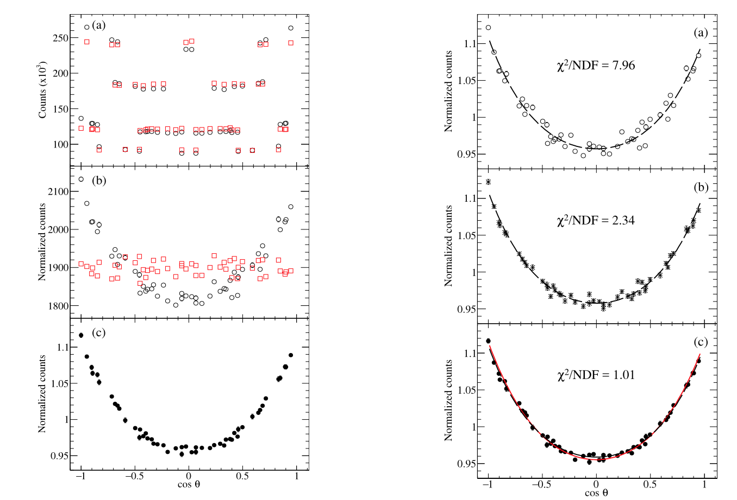
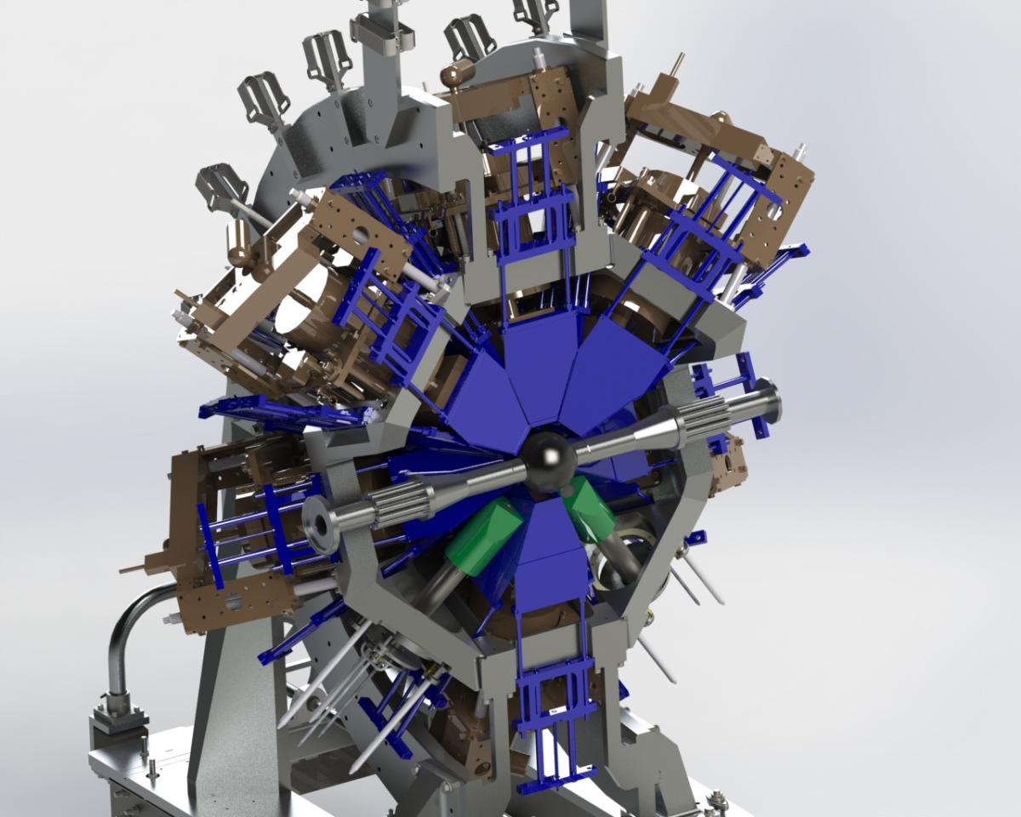
Angular Correlations: normalization
4⁺ 2⁺ 0⁺
norm = # of crys pairs
⁶⁰Ni
coincidences
event-mixed coincidences
norm = # of crys pairs +effi
divided by
# of crystal pairs at each angle
GRIFFIN @ TRIUMF
norm = event mixing
The intensities at each angle are normalized using the EVENT MIXING technique
final ang corr
J.K. Smith et al., Nucl. Instr. Meth. A922 (2019) 47

Slide 18
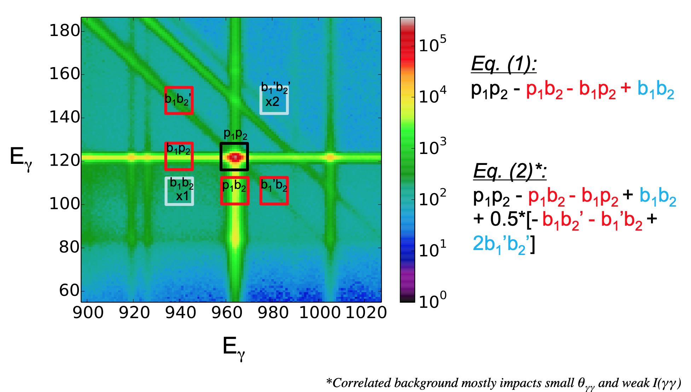
Angular Correlations: bg subtraction
Correlated background must be properly subctrated (often ignored in a "simple" 1D analysis… !)
Courtesy of JM Allmond (GRETA collaboration)

Slide 19
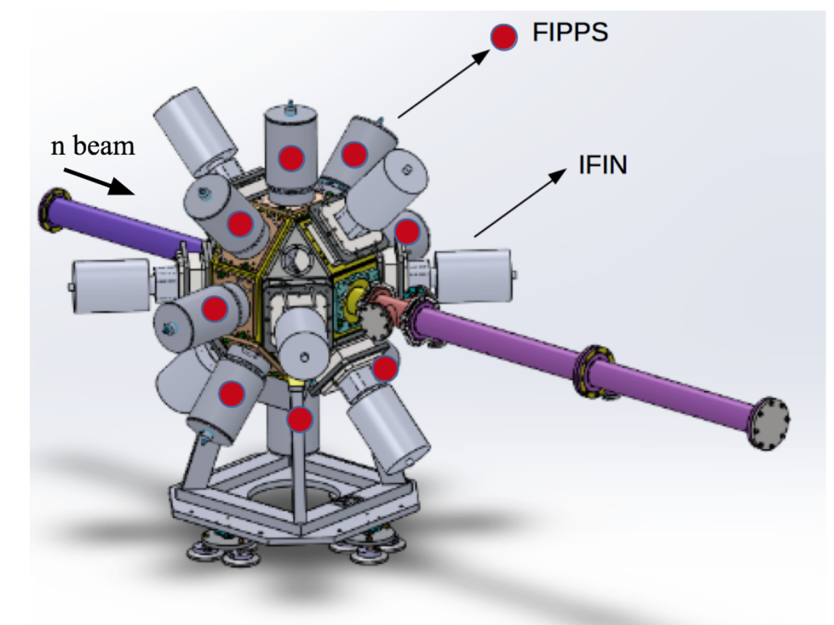
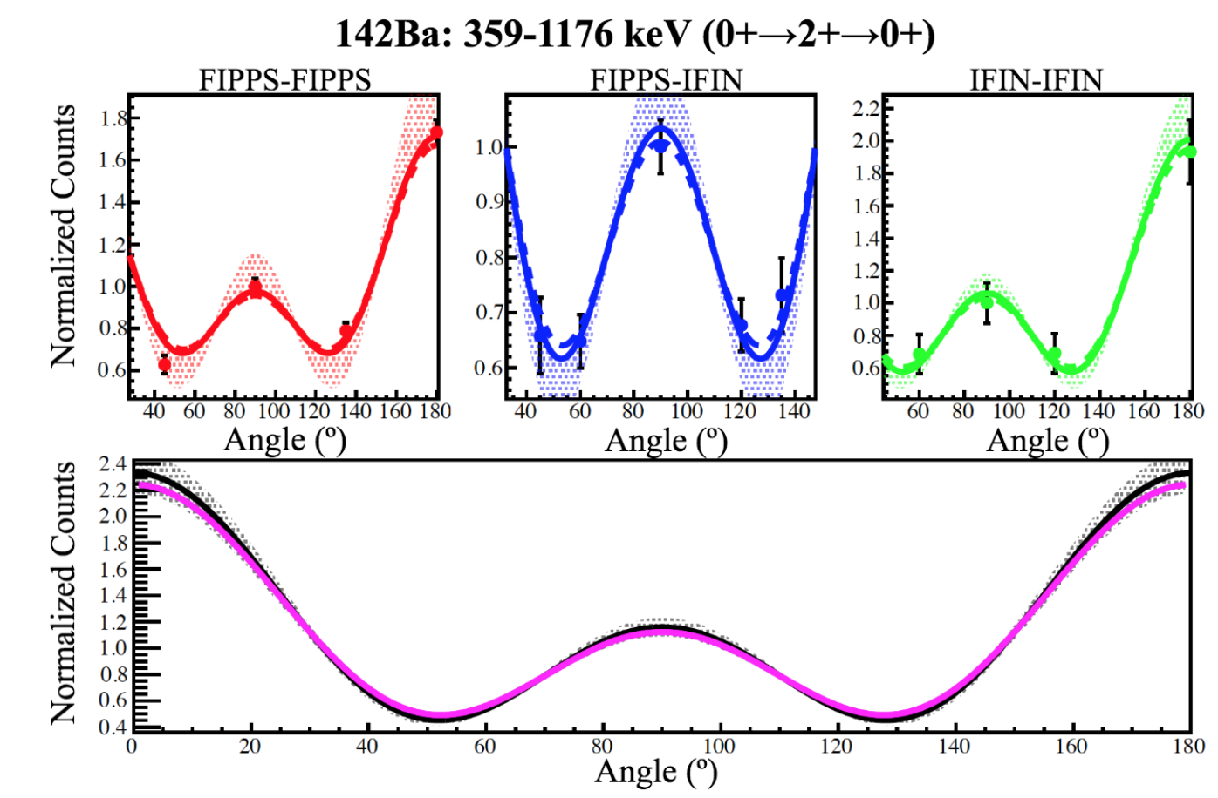
Angular correlations with hybrid detector setup
Hybrid detector setup!
Simultaneous fit of all type of combinations

Slide 20
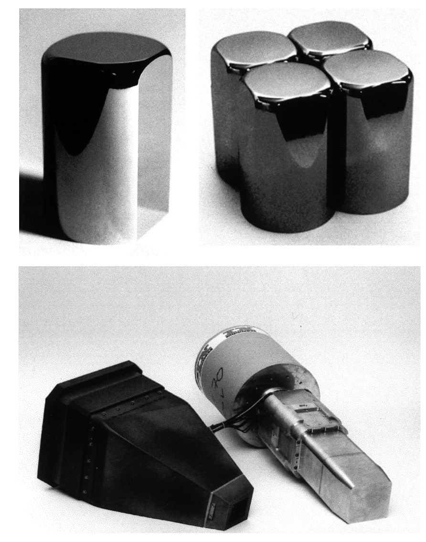
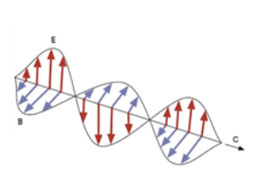
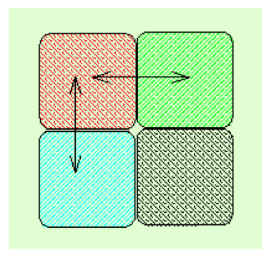
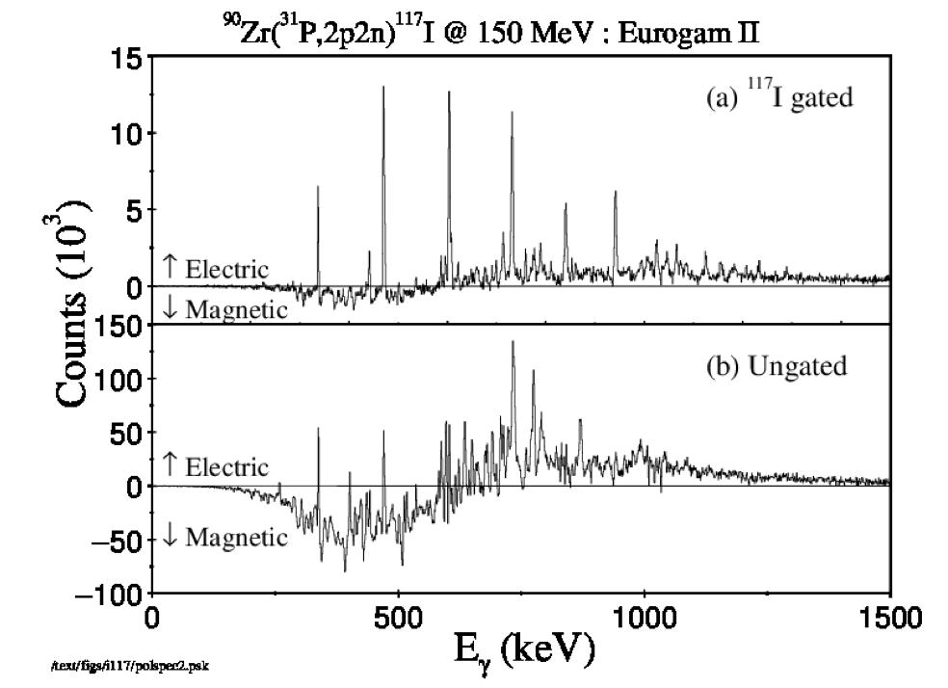
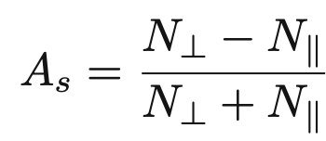
E/M character of γ transitions
Parity of nuclear states
Compton scattering can be used to measure the γ-ray linear polarisation – the direction of the electric vector with respect to the beam-detector plane
Clover detectors are ideal
P = A/Q
Q =polarization sensitivity (as a function of the energy)
Streched E2 : P>0; Streched M1 : P<0

Slide 21
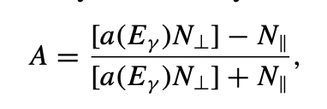

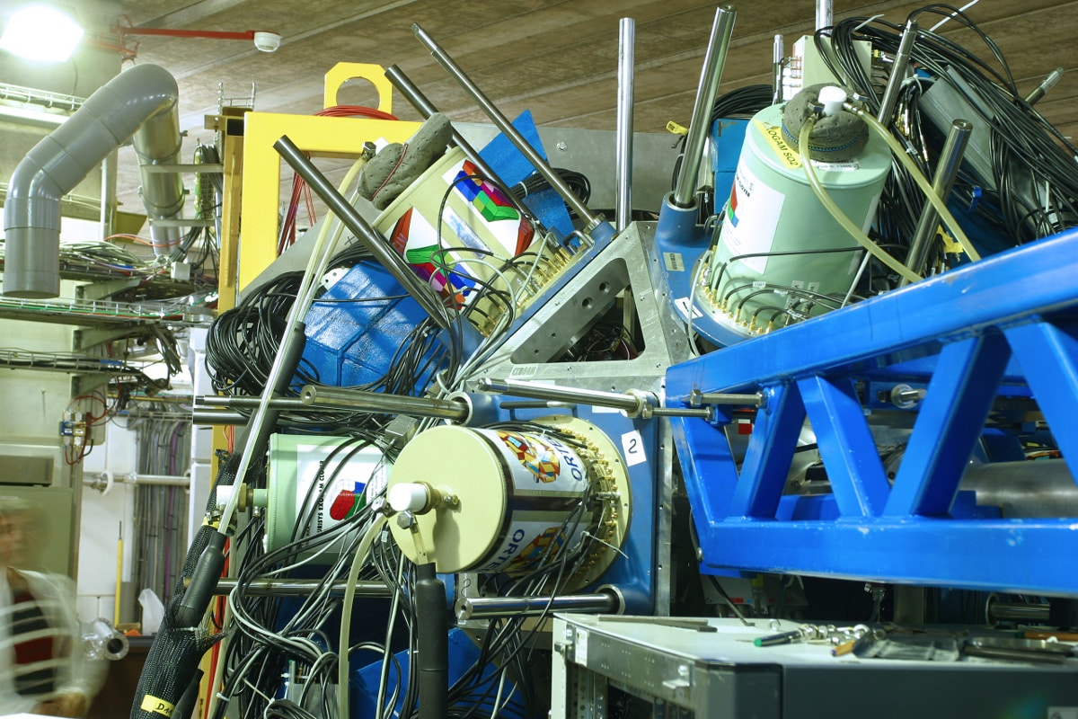
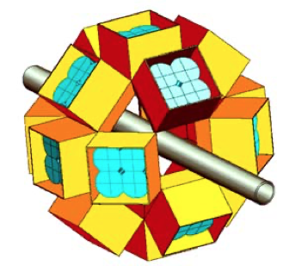
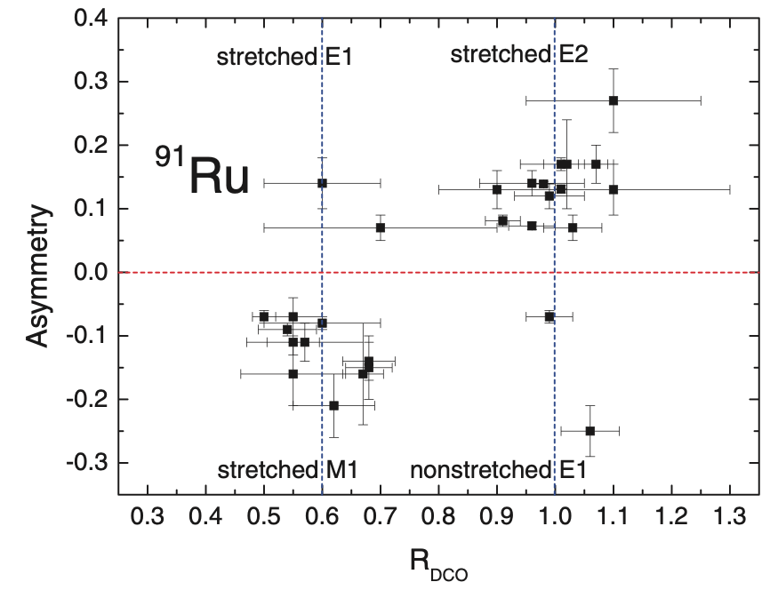
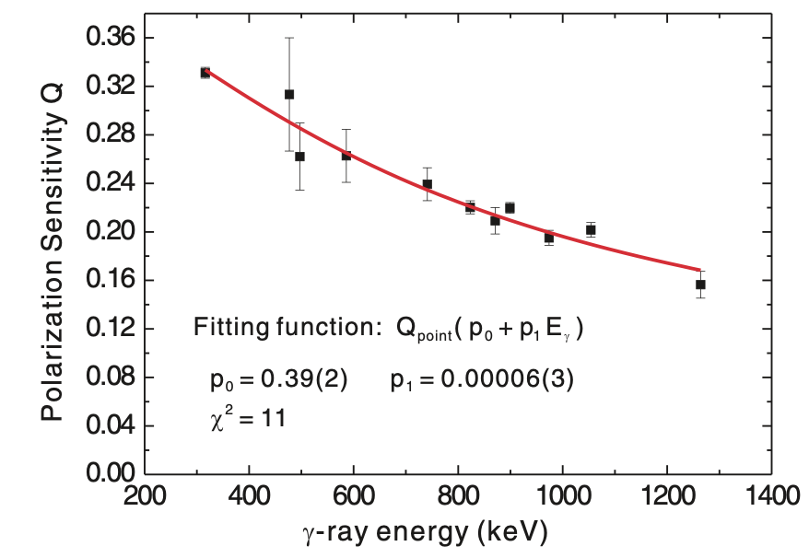
An example
Y. Zheng, PHYSICAL REVIEW C 87, 044328 (2013)

Slide 22

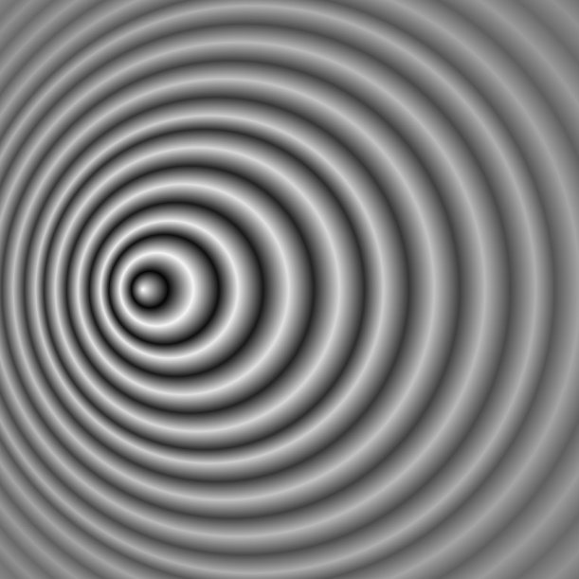
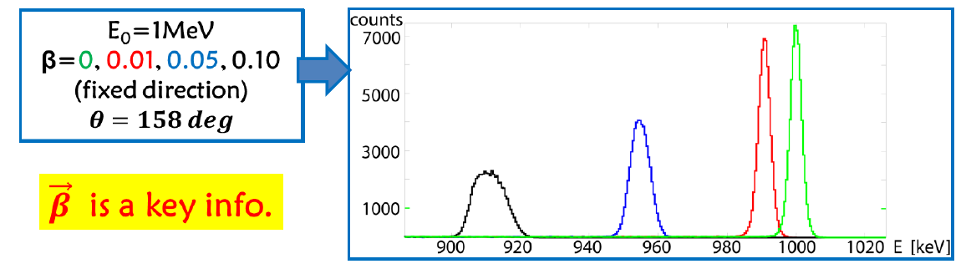
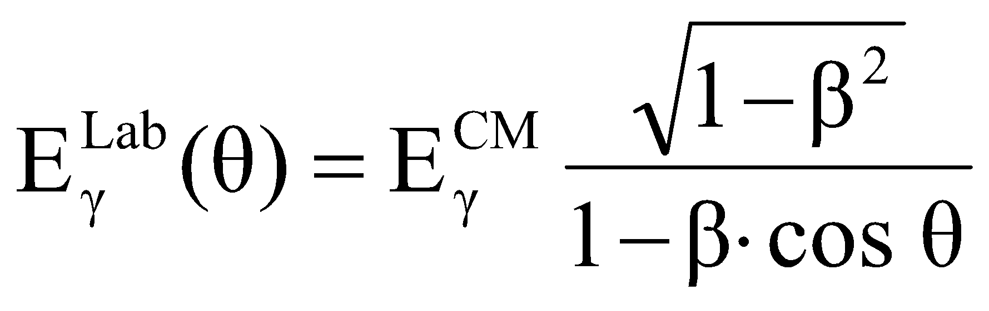
Lifetime measurements using Doppler techniques
Reminder from last Lecture:
θ
Source at rest → intrinsic energy
resolution
v

Slide 23
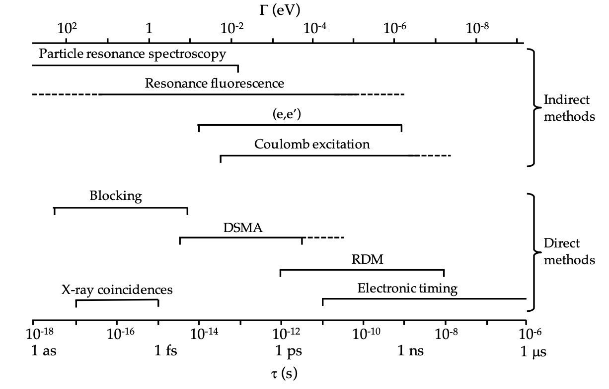
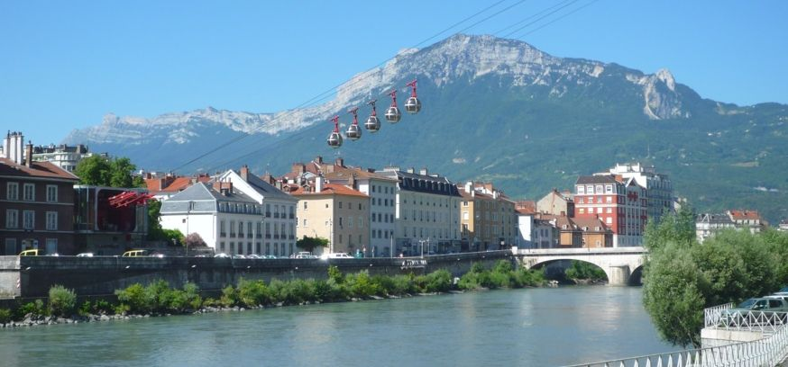

Direct vs Indirect methods for measuring lifetimes
water flow in Isere in the month of June
~ 10⁻¹²
bottle of wine

Slide 24


A very simple starting point…

Slide 25


Recoil Distance Doppler Shift Techniques
SPECTROMETER
SPECTROMETER

Slide 26


Doppler Shift Attenuation Method (DSAM)
Nowadays: full Geant4 simulations

Slide 27

Doppler shift techniques
Some remarks

Slide 28



Lifetime measurements in ²⁰⁷Pb
²⁰⁸Pb beam @ 6.25A MeV on enriched 1.9 mg/cm²-thick ¹⁰⁰Mo target
2 mg/cm²-thick Ni degrader
Beam-like reaction products detected and identified on an event-by-event basis in the large-acceptance VAMOS++ spectrometer
D. Ralet et al, PLB 797 (2019) 134797

Slide 29

There’s not a nuclear model that explains everything!
A challenge for both theory and
nuclear instrumentation

