Slide 1



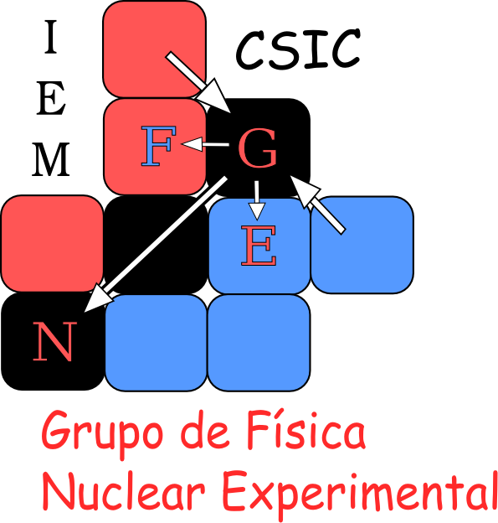
R³B a setup for kinematical complete measurements
@
FAIR- Facility for Antiproton & Ion Research
O. Tengblad
Instituto de Estructura de la Materia,
IEM – CSIC, Serrano 113 bis, ES-28006 Madrid
Notes:
I will tell you some details on the R3B setup at GSI-FAIR.
I will not go much into the physics details, but mainly give an idea how it Works.
What are we looking for, how can we obtain the results.
To work in experimental physics involves a lot of machinery! Many different detectors
have to be built, big collaborations imposible to put your hands everywhere! You have to have a multitasking interest partly in the equipment, partly the running, the analysis
And of course an interest in the physics

Slide 2
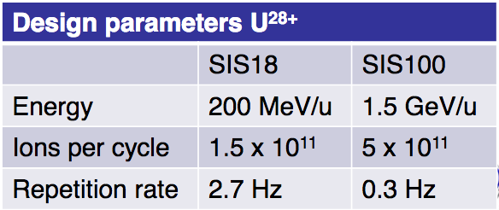
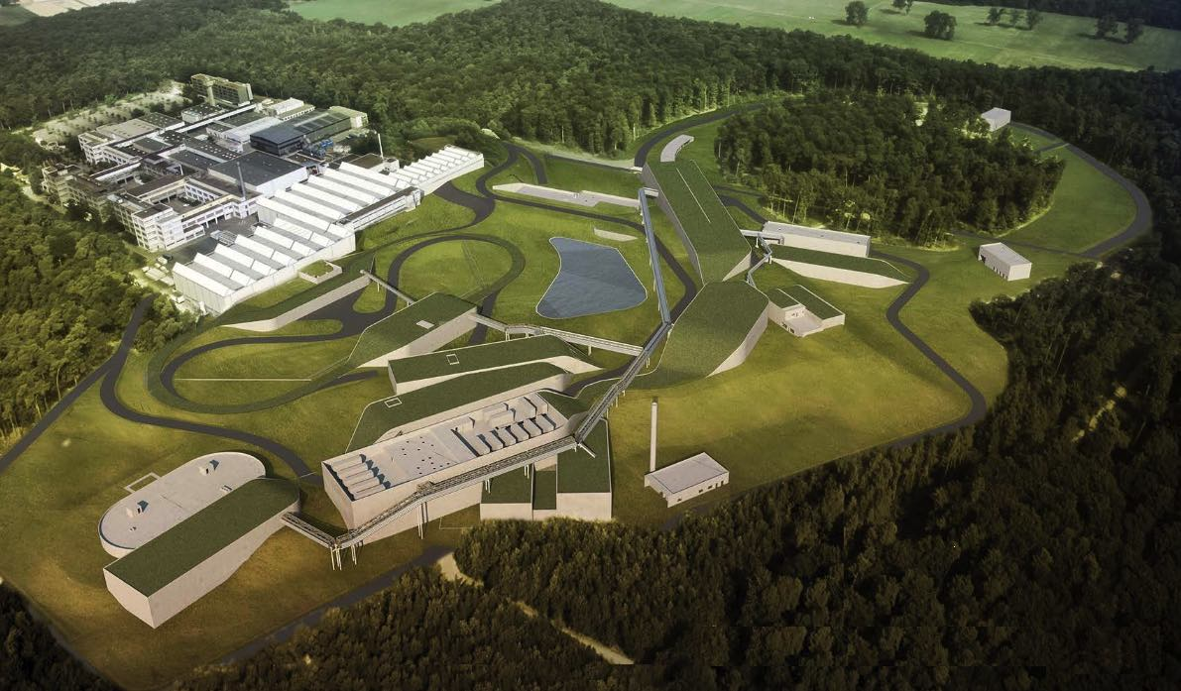
en un futuro no muy lejano
SIS100
Notes:
This is an artista view of how FAIR will look in a few years from know (2030?)
Upper left corner is the present GSI, and the rest is the future FAIR facility. (Berta showed you some photos on the status).
Inside this huge facility we have the NUSTAR facility

Slide 3
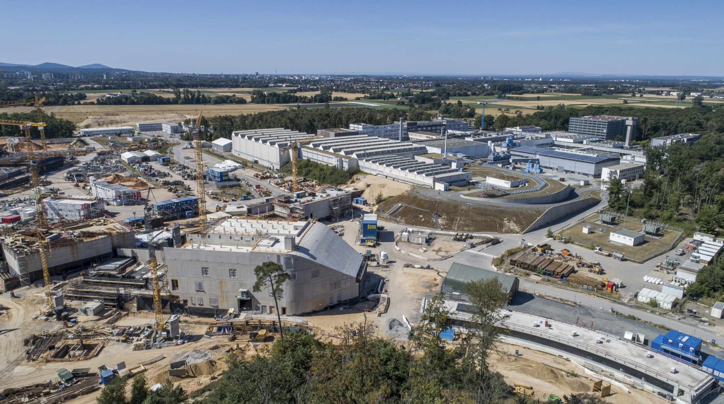
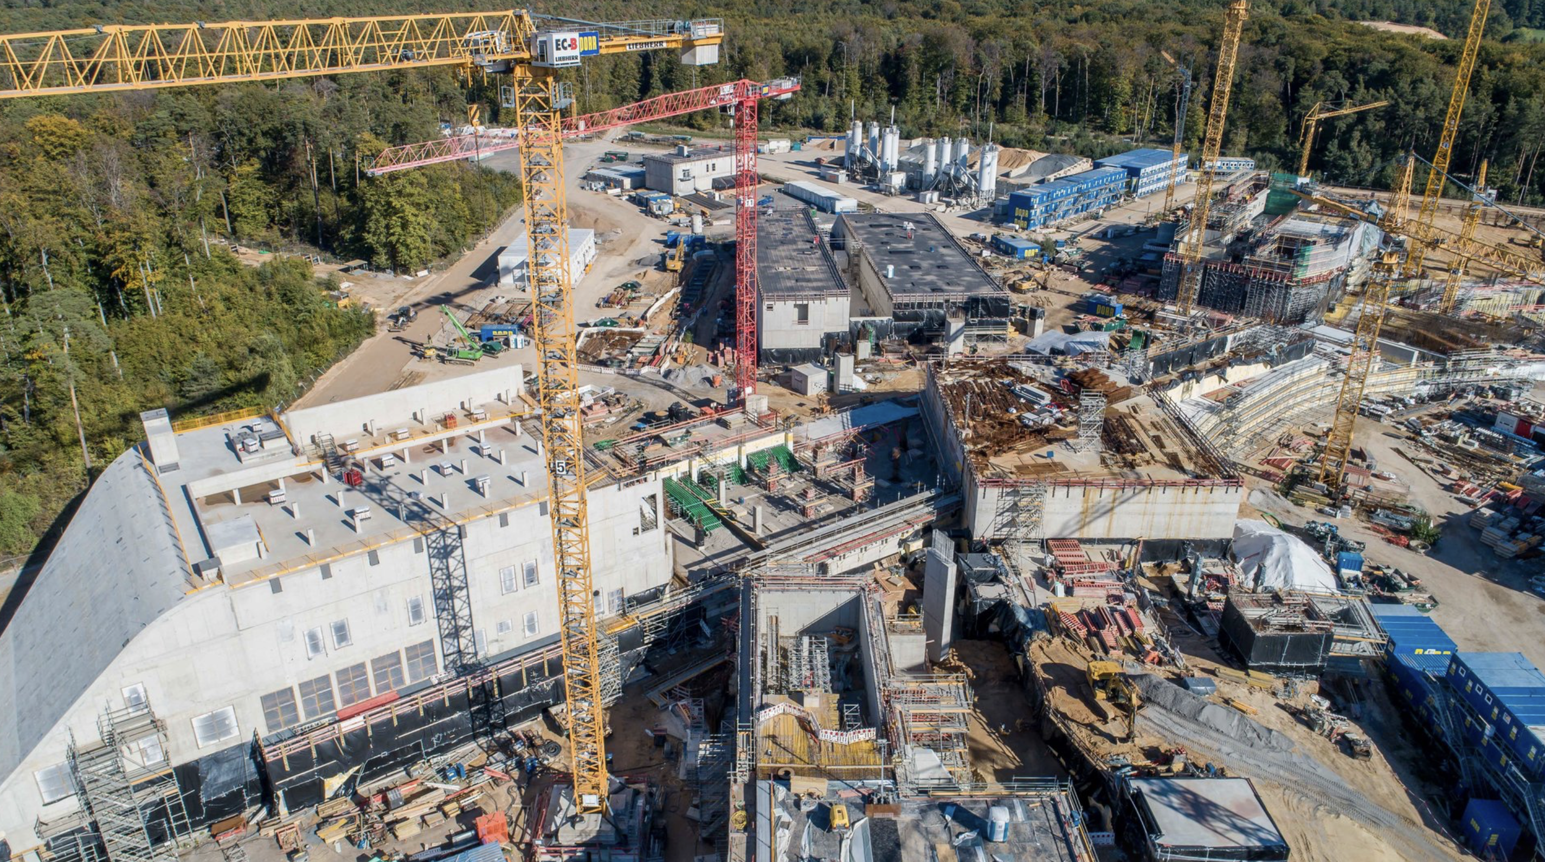

Slide 4
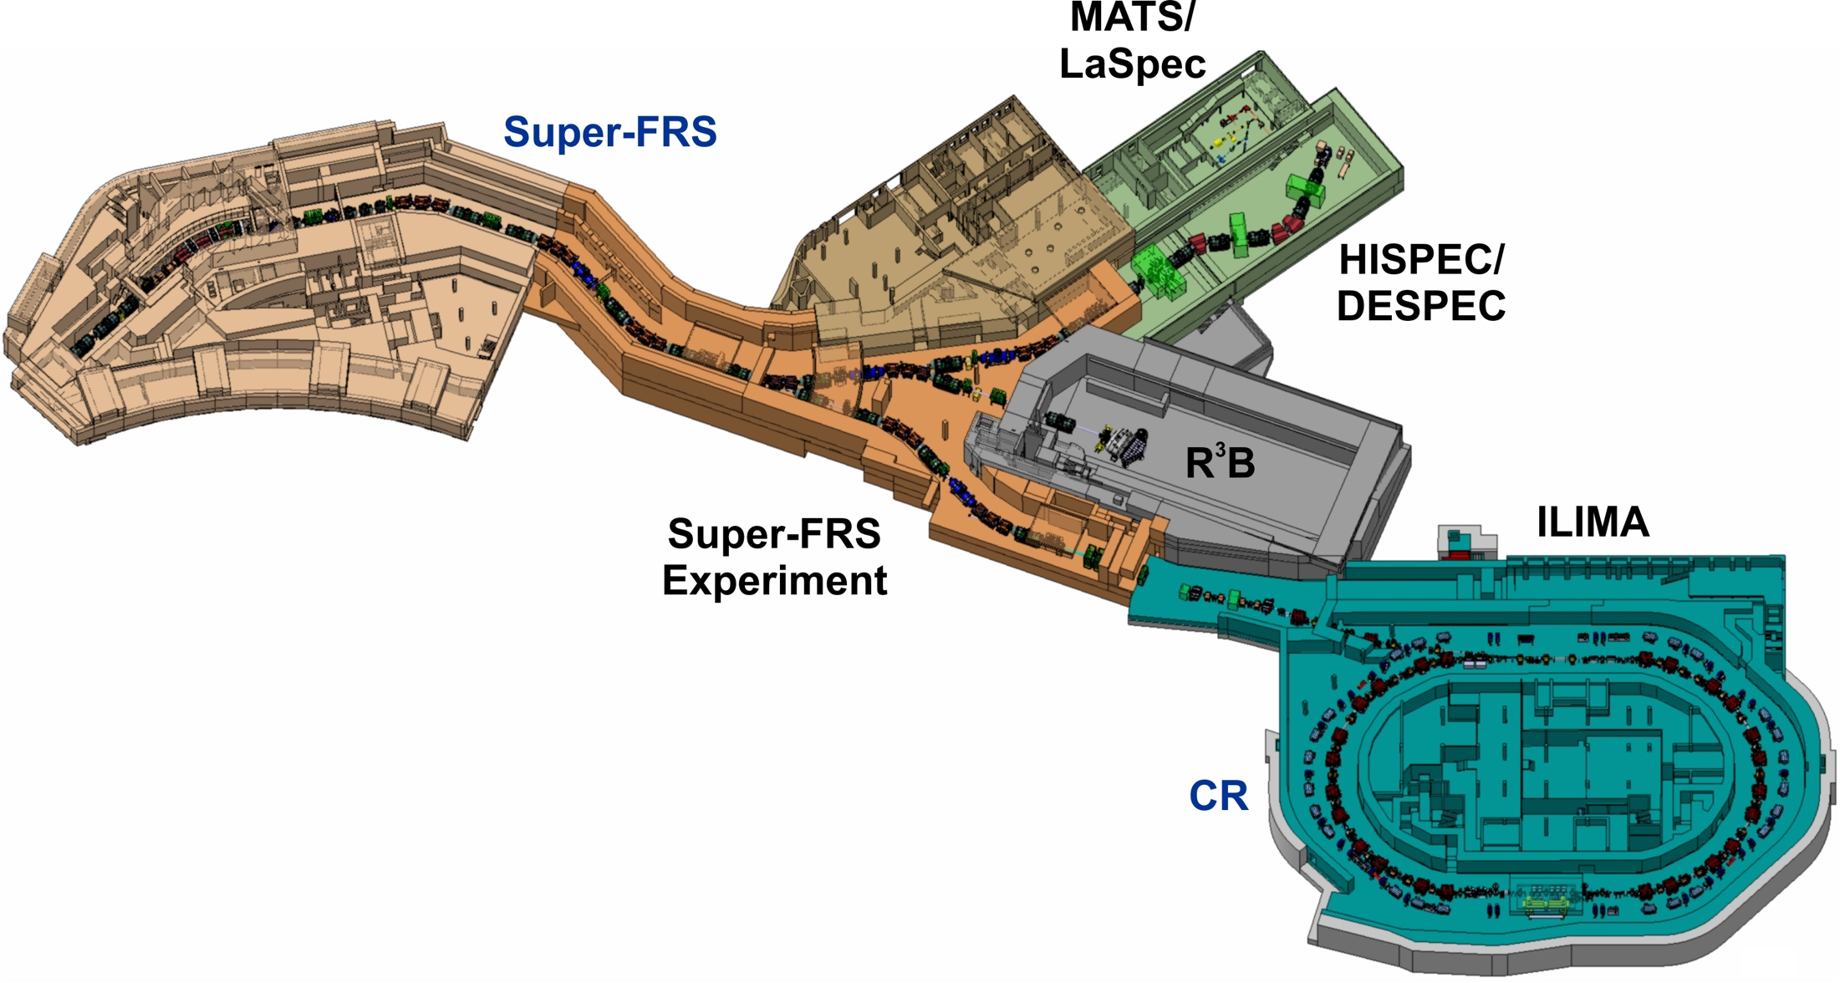
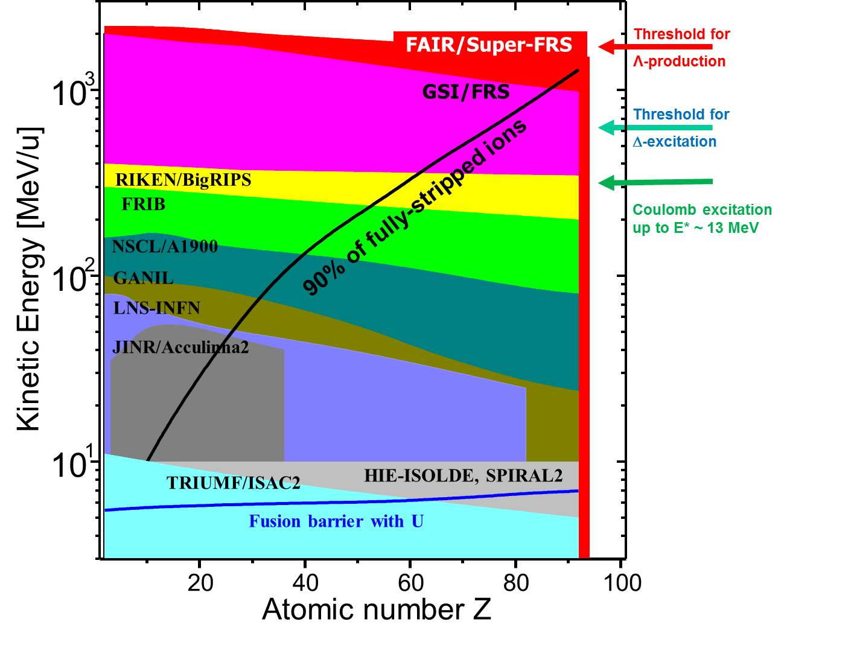
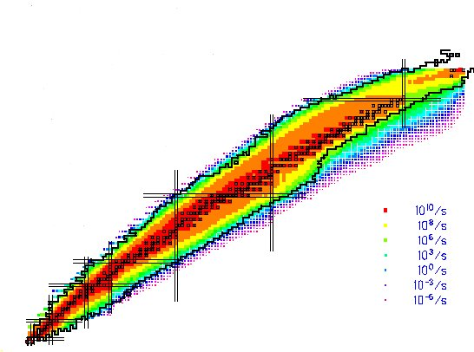
NUSTAR NUclear STructure & Astrophysis Research
Haces de
SIS100
Producción de mas de 4000 especies nucleares
Dolores Cortina Gil
Notes:
NUSTAR NUclear STructure & Astrophysis Research: includes many sub-collaborations
Specially we divide into Low EnergyBranch, Ring Branch and High Energy Branch=R3B.
The aim is the same but the methods differs, we all want to produce exotic nuclei and understand their structure.
The heart and common part is the Super Fragment Separator SFRS

Slide 5
NUSTAR:
NUclear Structure, Astrophysics and Reactions
What are the limits for existence of nuclei?
  Where are the proton and neutron drip lines situated?
  Where does the nuclear chart end?
How does the nuclear force depend on varying proton-to-neutron ratios?
  What is the isospin dependence of the spin-orbit force?
  How does shell structure change far away from stability?
How to explain collective phenomena from individual motion?
  What are the phases, relevant degrees of freedom, and symmetries of the nuclear many-body system?
How are complex nuclei built from their basic constituents?
  What is the effective nucleon-nucleon interaction?
  How does QCD constrain its parameters?
Which are the nuclei relevant for astrophysical processes and what are their properties?
  What is the origin of the heavy elements?
Notes:
The Physics

Slide 6
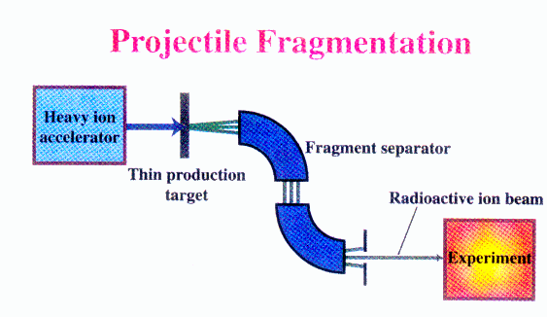
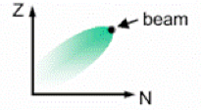

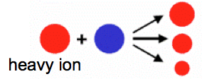
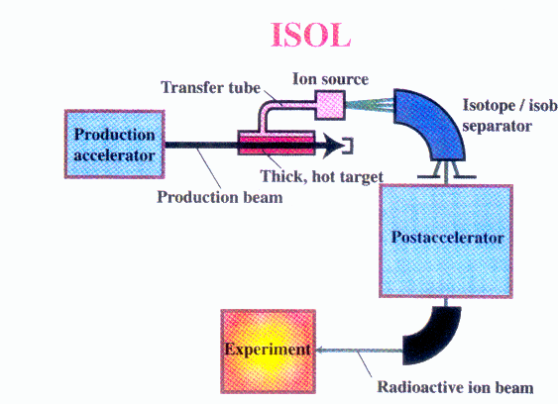
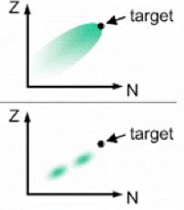
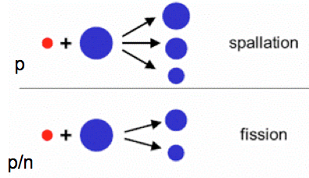
Producción de Haces Radioactivas
Fragmentación del Haz
Haz
FAIR
(2021)
GSI
GANIL
SPIRAL
HIE –
ISOLDE
ISOLDE
1 GeV
400 MeV
50 MeV
10 MeV
0.06 MeV
High energy, large variety of species,
Short half-lives (μs), cocktail beam
Haz
ISOL – Isotope Separation On Line
Blanco
Blanco
Blanco
Variable energy, high intensity, good beam qualities

Slide 7
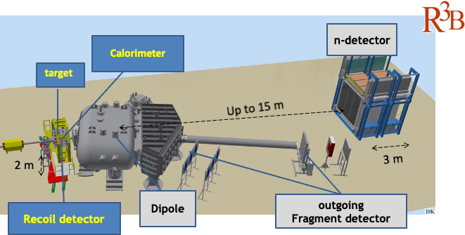
R³B: Reactions with Relativistic Radioactive Beams
Kinematically complete measurement of reactions with high-energy secondary beams
Nuclear Astrophysics
Structure of exotic nuclei
Neutron-rich matter
fixed-target experiment for complete inverse-kinematics reactions with relativistic RIBs ~100 MeV/u – 1.5 GeV/u
Experiments with the most exotic (<1 ion/s) and short-lived nuclei - exploring the isospin frontier at and beyond the drip-lines
Notes:
Along the talk you will see different layouts of the R3B experimental hall. This is not only due to historical advances but the equipment although big is moved arround optimizing for each campaign.
R3B is a universal fixed target experiment for complete inverse kinematic reactions with radioactive beams in the energy range 300-15000MeV/u.
We will adress Nuclear Astrophysics, study exotic nuclei or nuclei at the extreme
This is a very big experiment in size 30x10m incuding many different detectors. But this is not CERN, although the detectors are very big they are being moved around and exchanged for
For other depending on the needs in each sub-experiment.

Slide 8
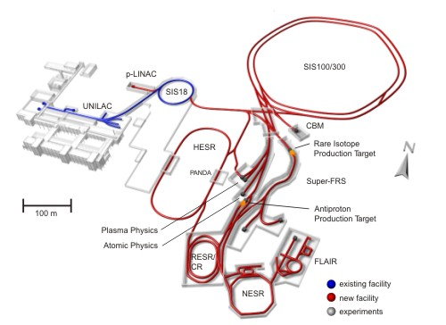
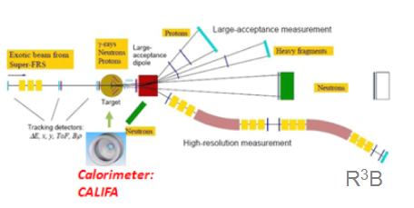
How does it work
FAIR (Facility for antiproton and ion research)
1. Accelerated beam impact on Production Target
2. Products are separated in FRS
3. Separated isotopes directed to experiment
R³B
4. Isotope of interest impact on Reaction Target
p
n
n
p
H
5. Reaction fragments and gammas are detected
Notes:
This animation illustrates how these experiments are performed..

Slide 9
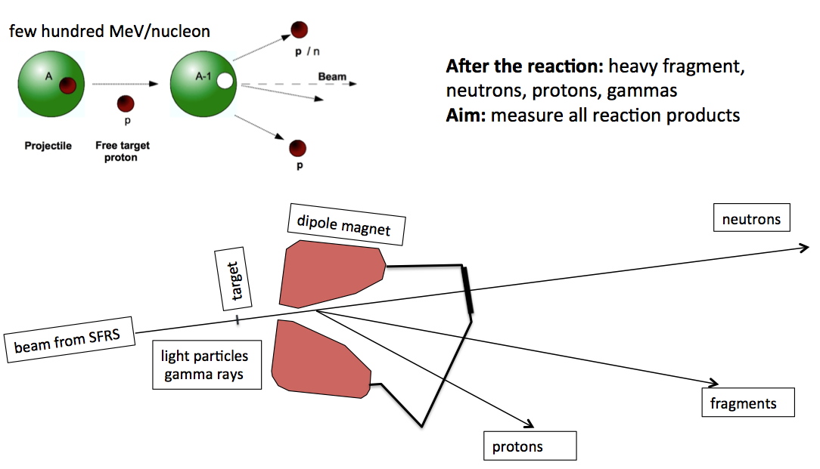
R3B Concept
Cinemática completa!!
Incoming
Cocktail beam
Outgoinging
fragments
Notes:
The R3B concept is as told: in event by event identify the incoming fragment (usually from a cocktail beam)
Let it interact with different targets. Light heav and empty each in order to separate out direct reaction, Coulomb break-up and back-ground
All outgoing fragments, nucleons and gammas are detected for a ful momentum reconstruction,

Slide 10
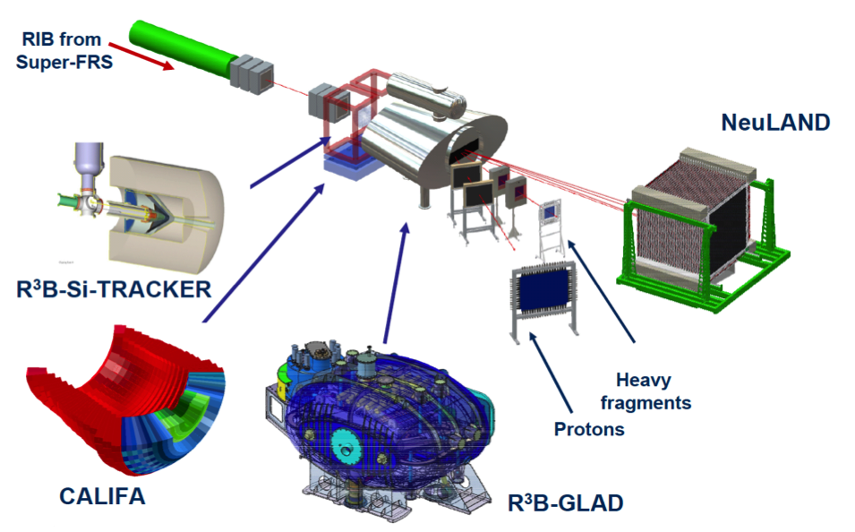
R3B: (Key) Components
R³B@FAIR
Notes:
Secondary Target. (especially LH₂ i.e. proton target)
CALIFA:m γ/p calorimeter-spectrometer Si-tracker: target recoil detector
GLAD: large acceptance dipole magnet tracking, DAQ, simulation, infrastructure
NeuLAND: neutron time-of-flight spectrometer
high-resolution spectrometer
I will go through some details in the following

Slide 11
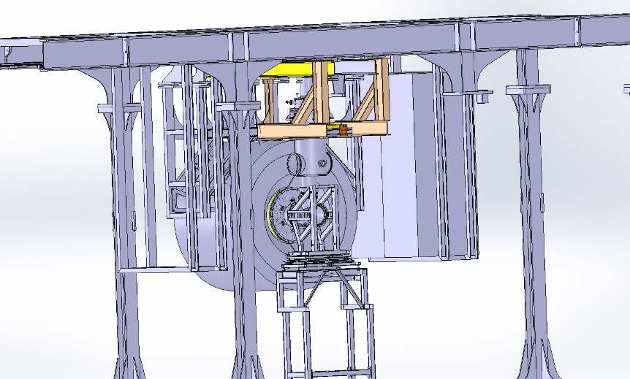
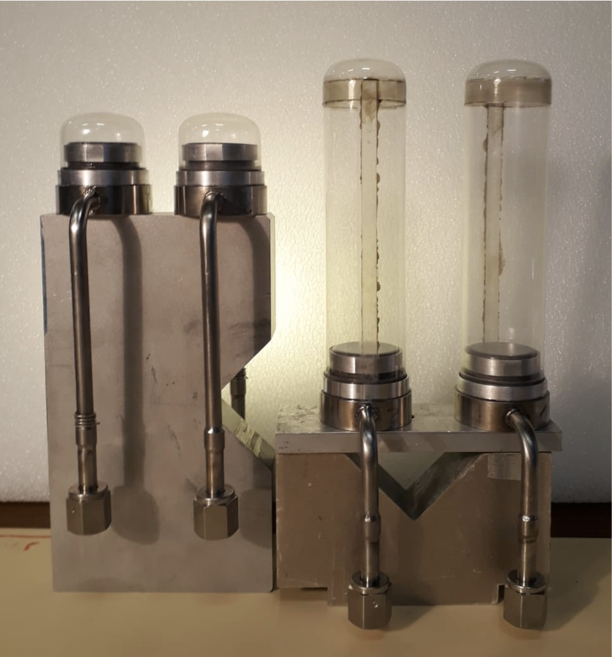
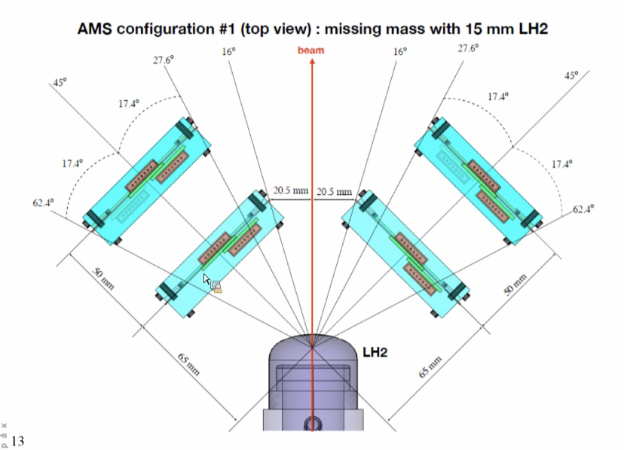
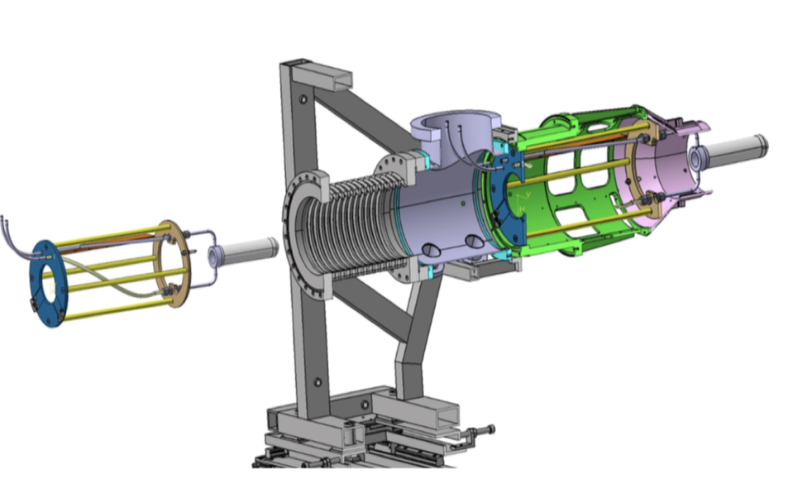
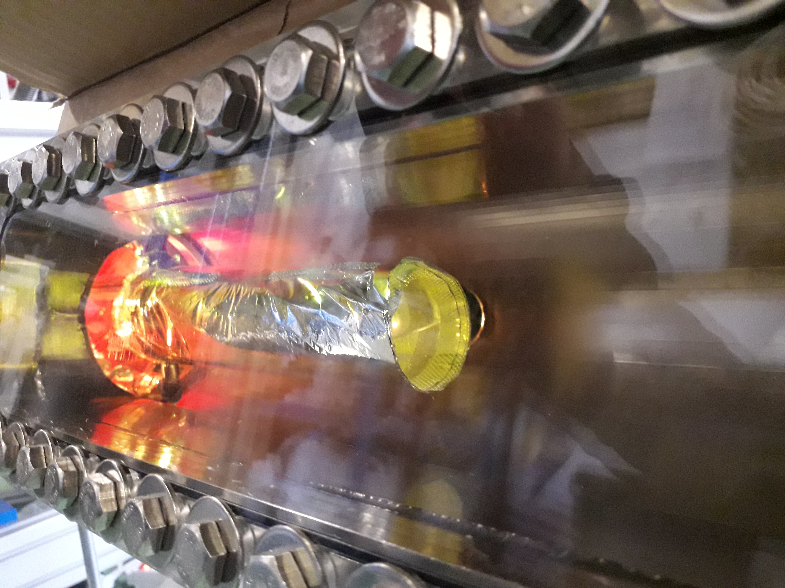
LH₂ target with Si-detector
1.5 cm 15 cm
The target cell diameter is 42 mm,. Three target length of 15, 50 and 150 mm.
The cryogenic system operates in a closed loop. The target is connected to a 852 l storage tank. The tank is filled with 800 l of hydrogen at room temperature. After liquefaction the hydrogen is at 20.3 K and 1041 mbar.
The target cell is made of Mylar

Slide 12
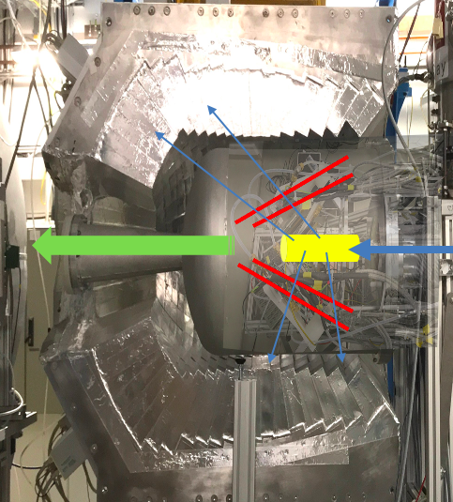
Reaction chamber: LH₂-target, p-tracker, γ-spec-calori-meter
Identify and track recoils emmitted at large angles
High angular resolution (better than 1 mrad) → very high segmentation
Low noise level → detection of MIP
Multi-layer sensors 50-100 μm for 1st layer → minimize multiple scattering or shadow γ rays
Low threshold 25 KeV
Multi-hit capability
Further:
Closed geometry around the extended target→ 4p vertex reconstruction
Spark protection against ionising particles hit
Operate in the proximity of strong magnetic fields and vacuum
Dedicated electronics

Slide 13
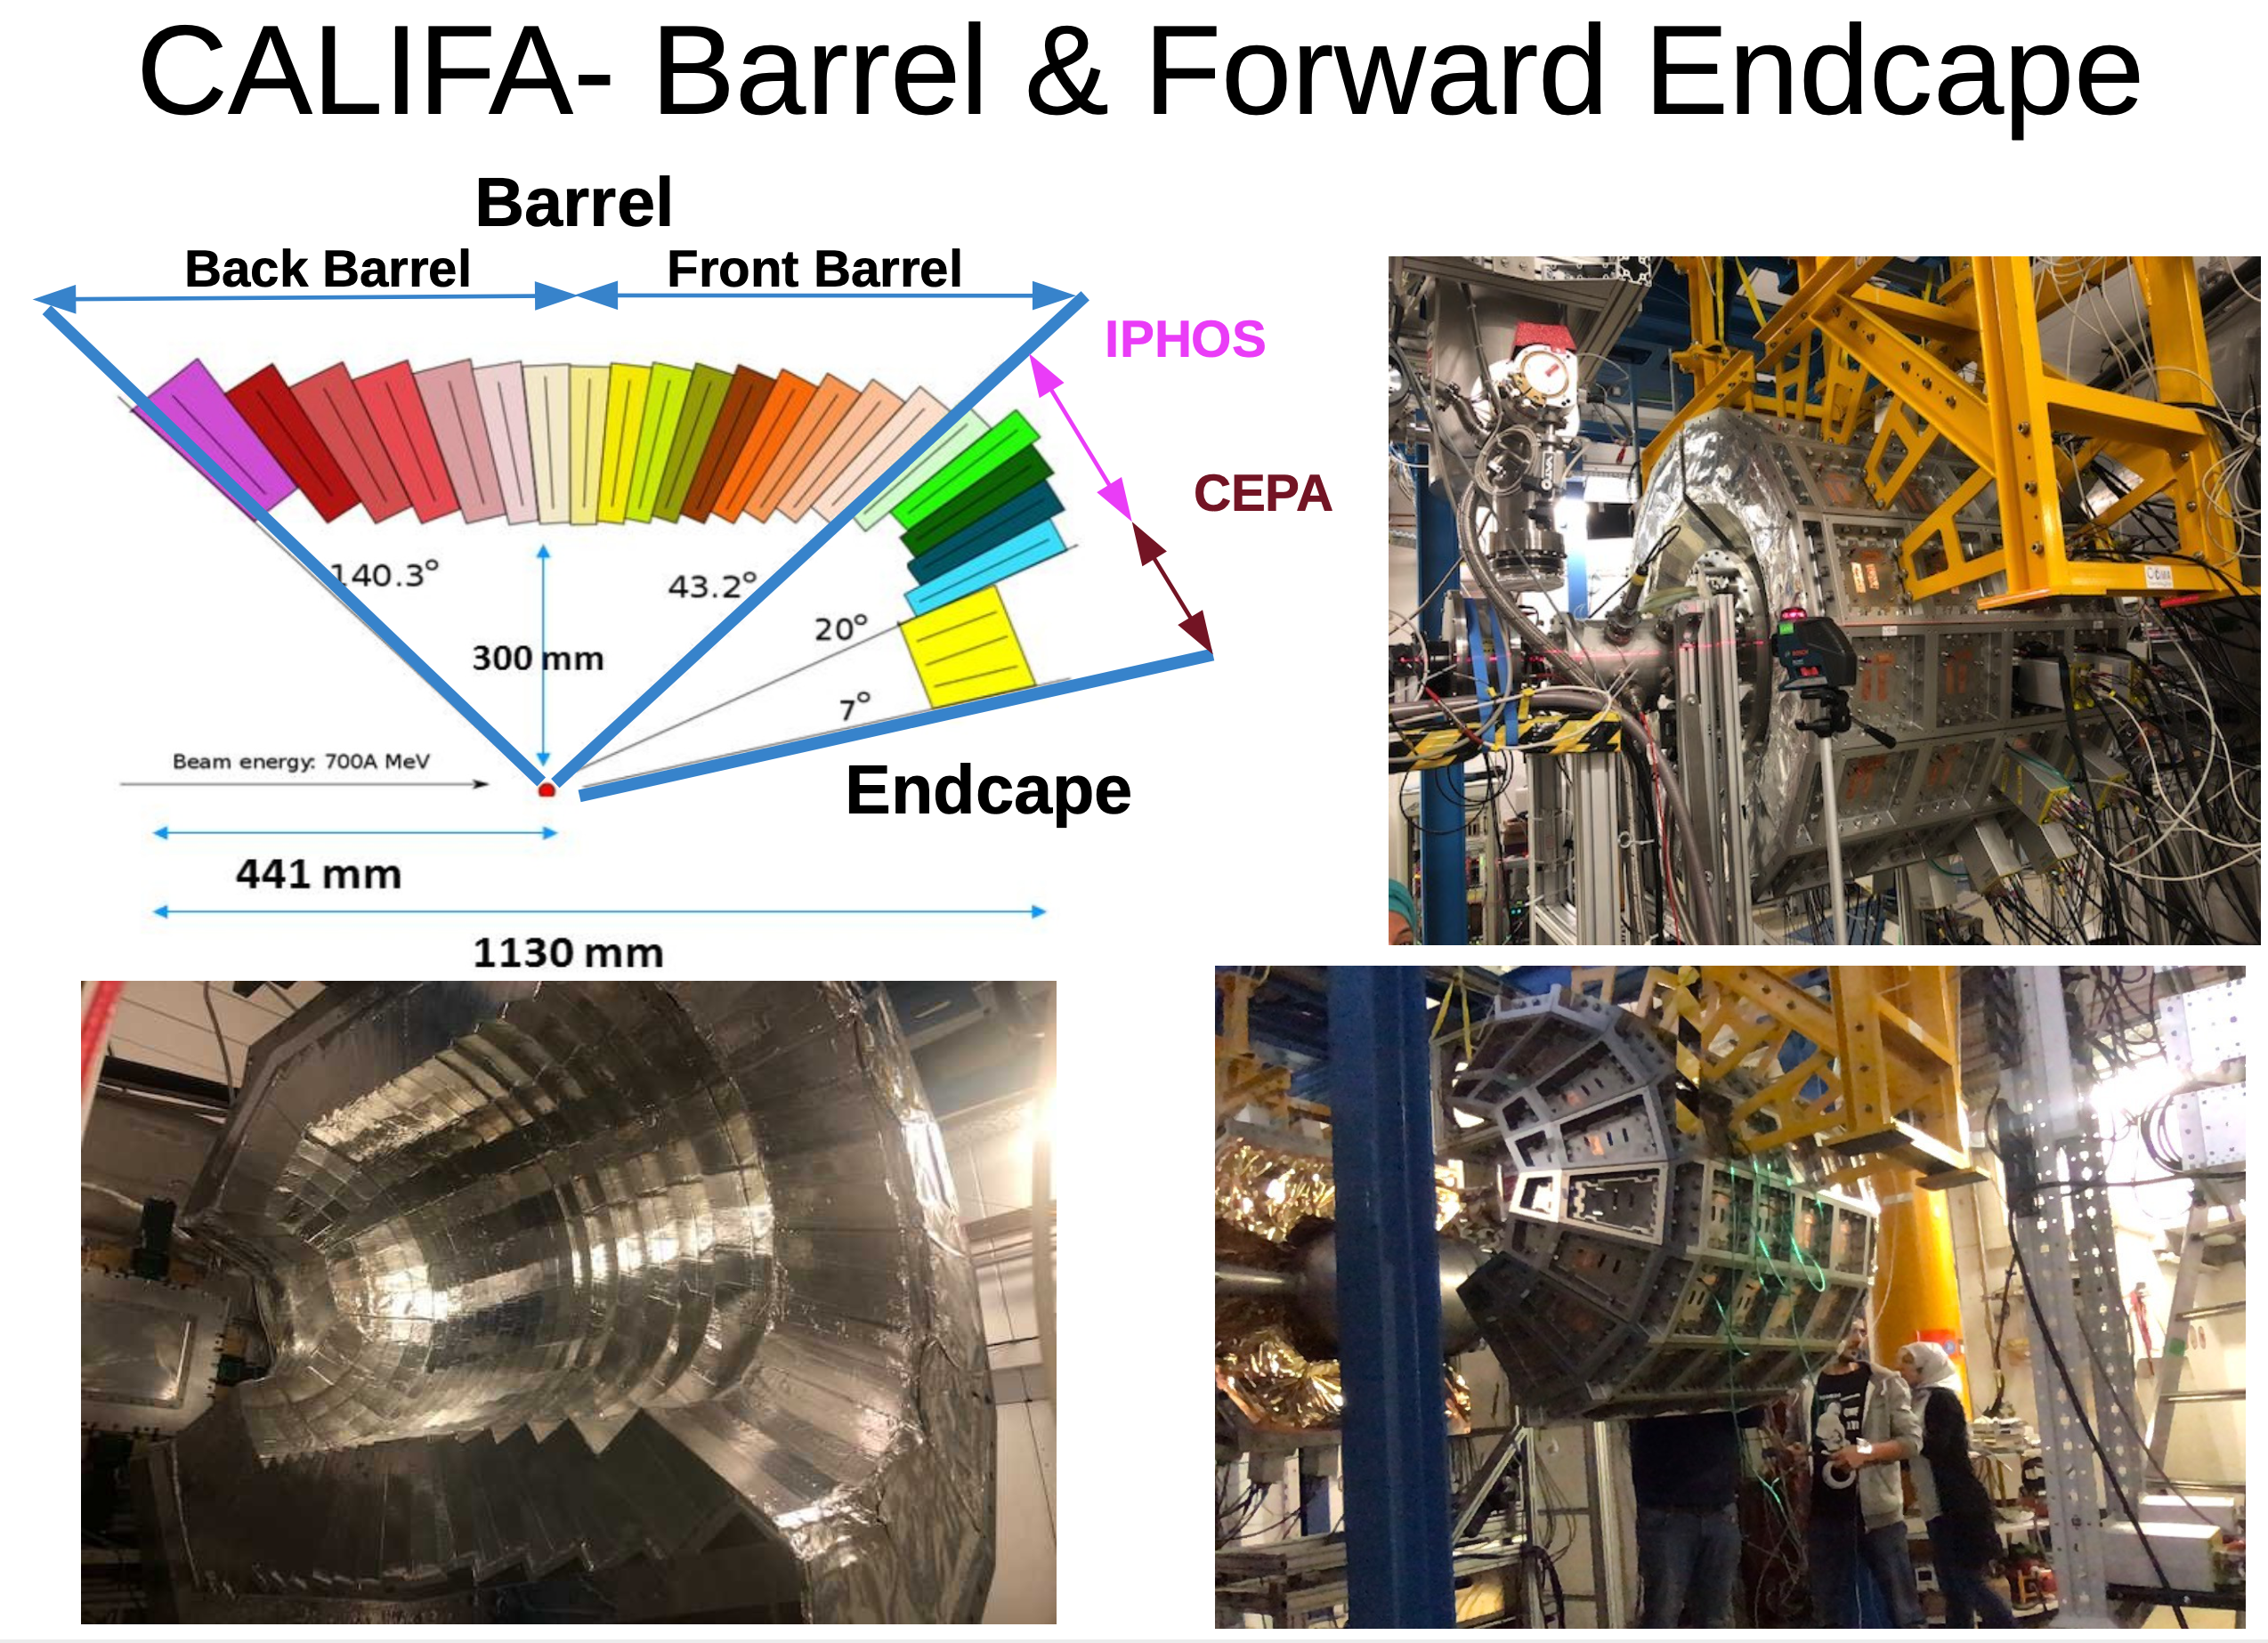
CALIFA: Highly segmented
Thick detection volume
Inner radius 50cm
Barrel: Crystal length 15-20 cm
1952 crystals = 2 Ton
EndCap: 680 crystals = 1 Ton
https://igfae.usc.es/igfae/es/califa-instalado-fair/
CALIFA barrel and forward endcap
(gamma/particle calorimeter)
9

Slide 14
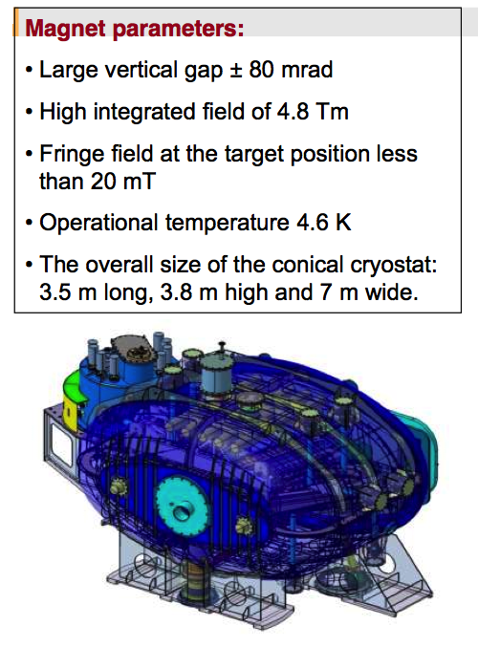
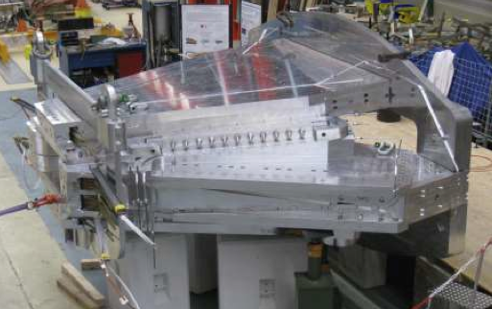
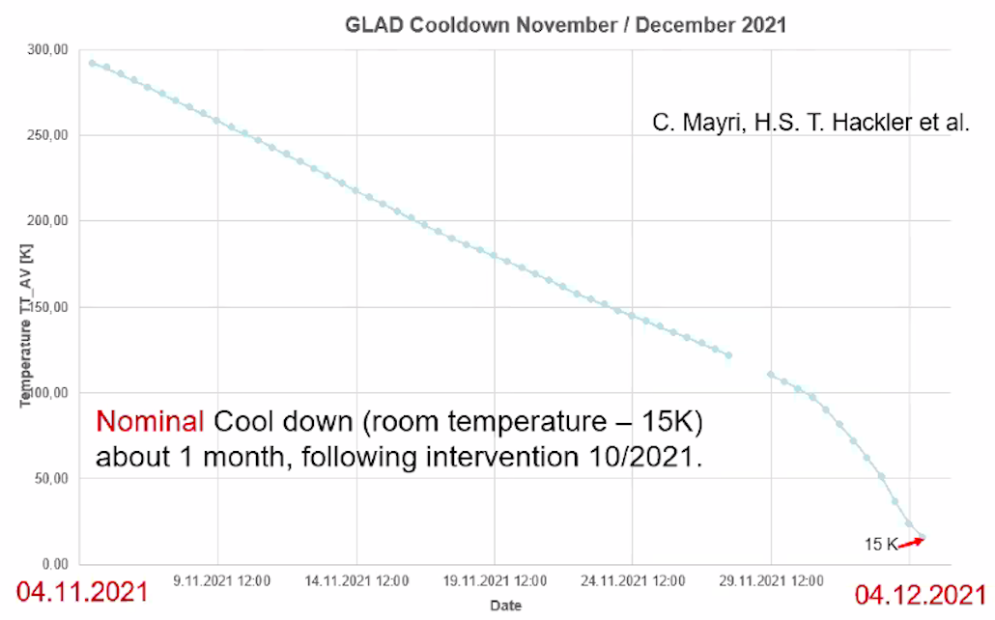
GLAD - Large-acceptance superconductingdipole magnet http://fpsalmon.usc.es/r3b/reports/R3B-Glad_MT20_Preprint_IEEEref-PID488807.pdf
Weight: 50 t

Slide 15
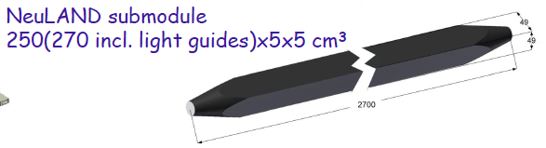
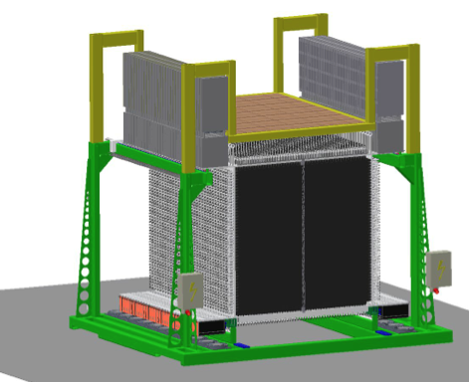
NeuLAND - High-resolution neutron ToF spectrometer https://www.gsi.de/work/forschung/nustarenna/nustarenna_divisions/kernreaktionen/r3b_project_group/neuland
NeuLAND detector parameters:
full active detector using RP/BC408
face size 2.50x2.50 m²
active depth 3m (30 double-planes)
3000 scintillator bars
6000 PM / readout channels (both ends)
32 tons
x100 = one double-plane
2022: 15 DP installed
NeuLAND design goals:
>90% efficiency for 0.2-1.0 GeV neutrons
Multi-hit capability for up to 5n
invariant-mass resolution:
NeuLAND to target distance 35 m
∆E < 20 keV at 300 keV
2.5 m

Slide 16
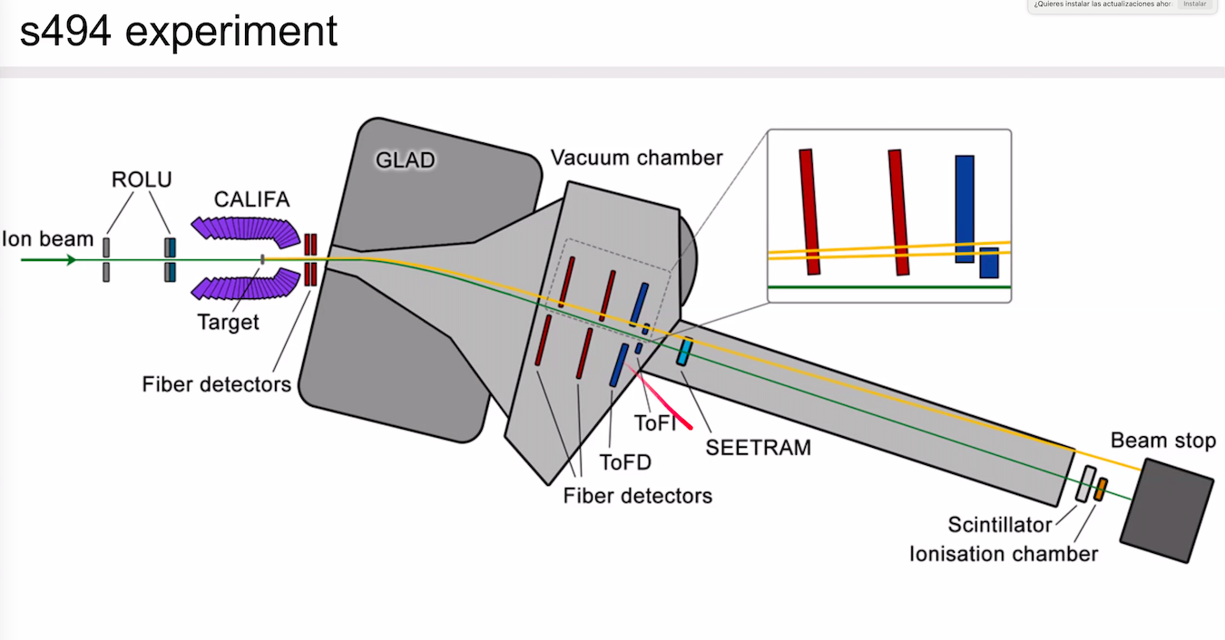
For full kinematic reconstruction & reaction channel ID we need to know
for incoming and outgoing fragments, beam, gammas
Energy loss → Nuclear charge Z
Time of Flight → Mass identification
Trajectory → Momentum
R3B tracking system

Slide 17
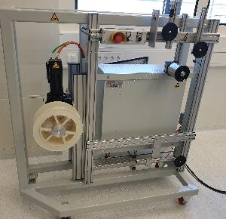
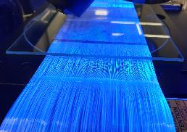
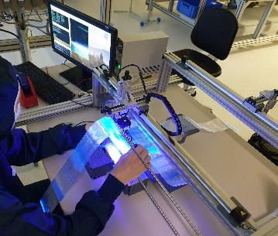
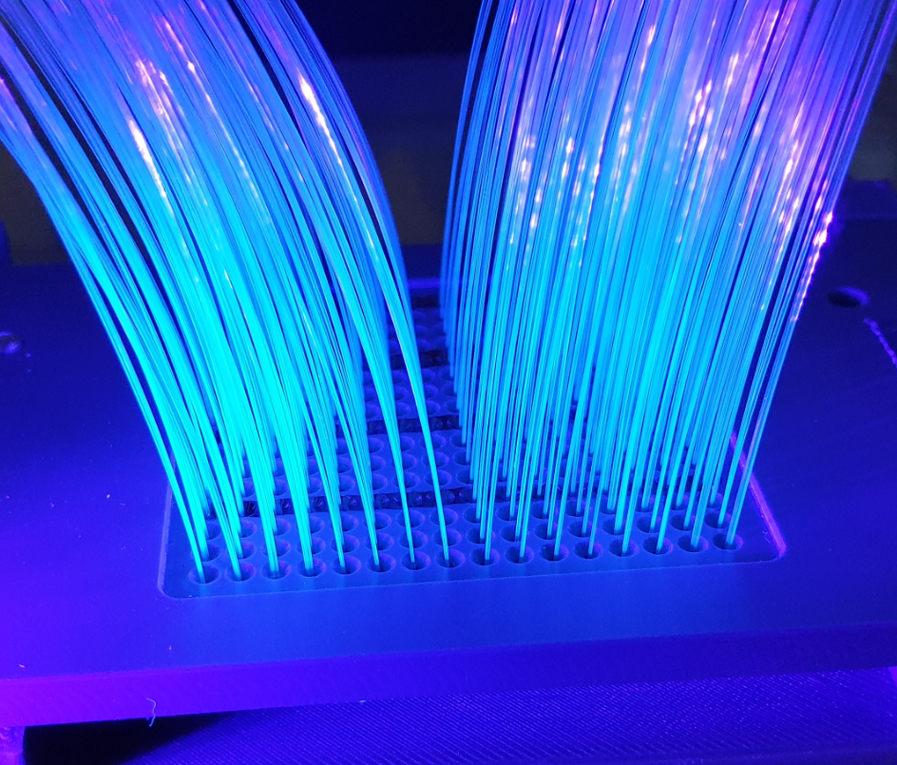
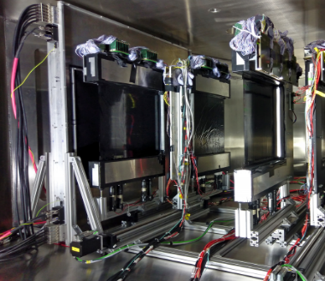
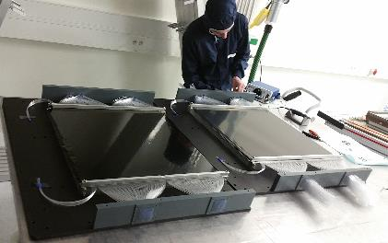
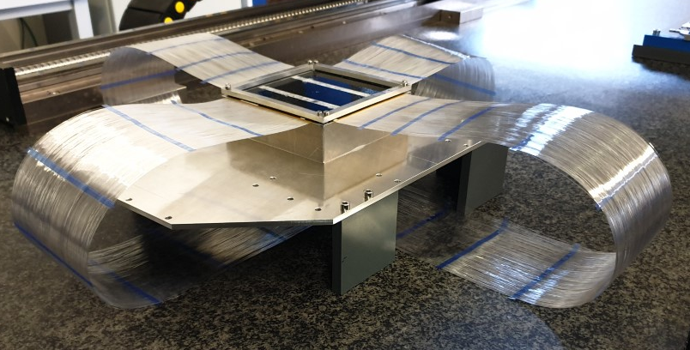
Square fibers 0.2x0.2 mm²
Number of fibers ~ 10⁴ fibers
→ 60 μm resolution
Scintillating Fiber Tracker
4d Tracking at High Rate with High Dynamic Range
C. Caesar and D. Savran
Infrastructure upgrades
Upgraded winding machine
speed/tension control
New infrastructure for sorting fibres into a mask
Fiber readout mask
Inspecting with microscope
200 um
Double layer 10x10 cm2
3 mm hole in the middle
Large fiber trackers
inside the vacuum chamber (s454)
Manufacturing process
Small fiber detector for S494
7

Slide 18
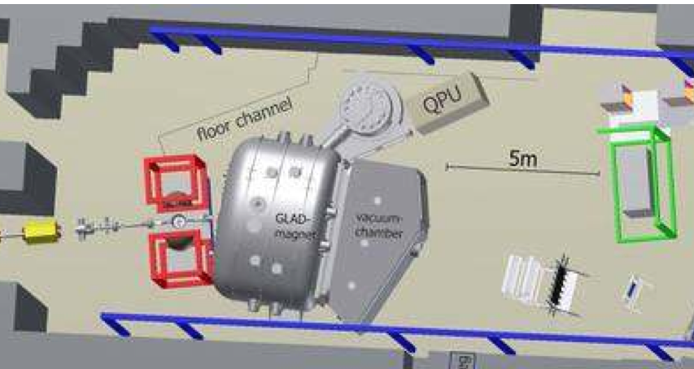
R3B Summary:
Schedule and first experiments @ GSI in Cave C
2020 50% NeuLAND and 50% CALIFA & Si-Tracker + tracking detector prototypes
  Liquid Hydrogen target (LH₂)
2019-23 Physics runs at GSI (Cave C) (phase 0)
2024 - 2025? Move to HEC- cave @FAIR
Experiments will make use of uniqueness of R3B:
Reactions at high beam energies up to 1 GeV/u
Tracking and identification capability for the heaviest ions
Multi-neutron tracking capability, high-efficiency calorimeter
Experiments possible for the first time:
4 neutron decays beyond the drip-line and for heavier n-rich isotopes
Kinematically complete measurements of quasi-free nucleon knockout reactions
Electric dipole and quadrupole response of Sn nuclei beyond N=82, and of neutron-rich Pb isotopes (polarizability, symmetry energy)
Fission barriers from (p,2p) reactions ( → r-process)

Slide 19
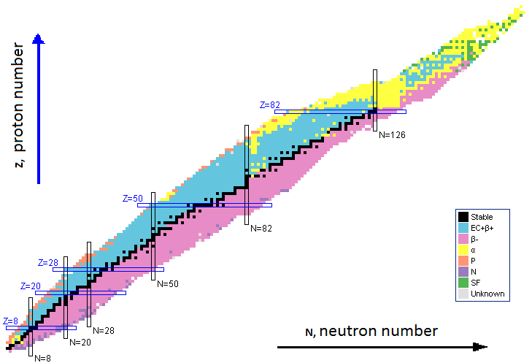
S393 experiment
Study of light neutro-rich nuclei using kinematically complete measurements in inverse kinematics @ GSI
quasi-free scattering: ¹⁴B(p,2p)¹³Be
G. Ribeiro
¹³B
17.3ms
¹⁴B
12.5ms
¹⁵B
9.93ms
¹⁶B
Unbound
¹⁷B
5.08ms
¹⁸B
Unbound
¹⁹B
2.92 ms
¹²Be
21.5 ms
¹³Be
Unbound
¹⁴Be
4.35ms
Study the precursor to the borromean nuclei ¹⁴Be
19

Slide 20
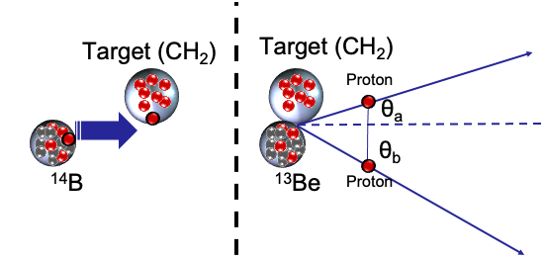
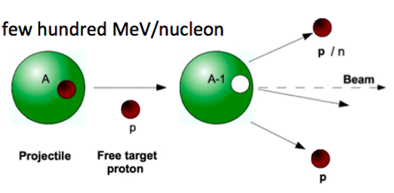

Quasi-Free Scattering: Knockout reaction
¹⁴B(p,2p)¹³Be
¹³B
17.3ms
¹⁴B
12.5ms
¹⁵B
9.93ms
¹⁶B
Unbound
¹⁷B
5.08ms
¹⁸B
Unbound
¹⁹B
2.92 ms
Direct Reaction: quick and direct from initial to final states without intermediate compound state.
If both outgoing particles have the same masses, in the lab system:
(p,2p), (p,np)
¹²Be
21.5 ms
¹³Be
Unbound
¹⁴Be
4.35ms
$$θA+θB≃ 81∘$$
20

Slide 21
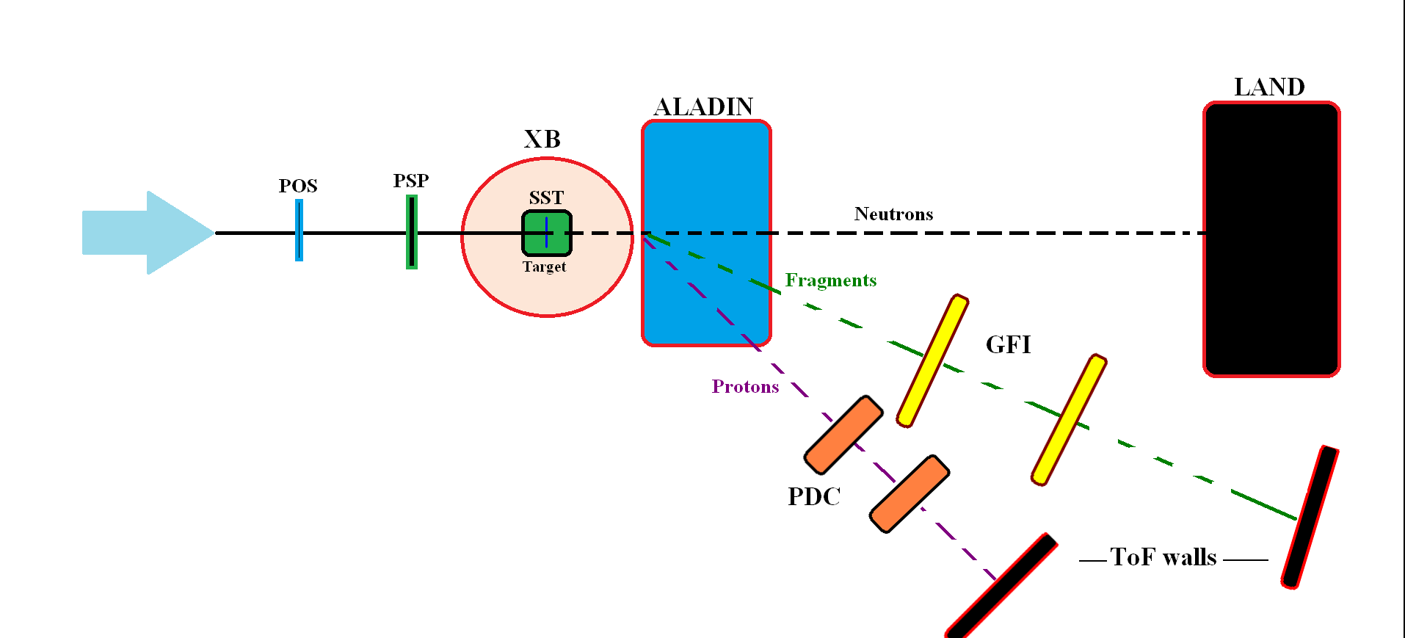
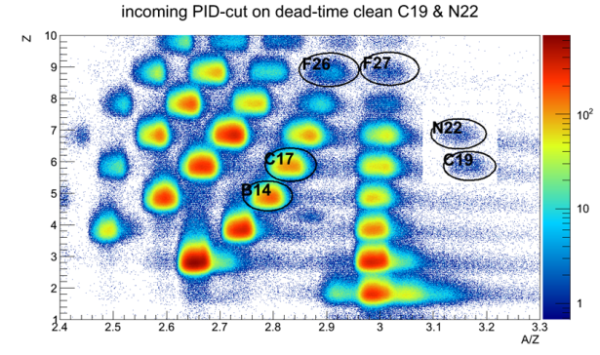
Experiment:Cave C
¹⁴B(p,2p)¹³Be
Primary beam ⁴⁰Ar¹¹⁺ @ 490 MeV/u
Intensity 6·10¹⁰ ions/spill.
Production target Be 4 mg/cm²
Reaction target H, C, empty

Slide 22
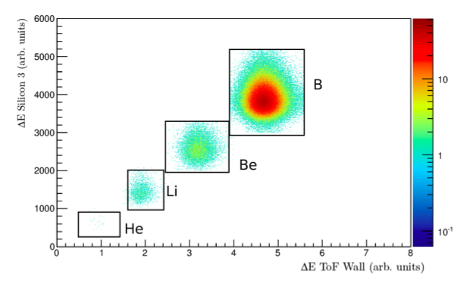
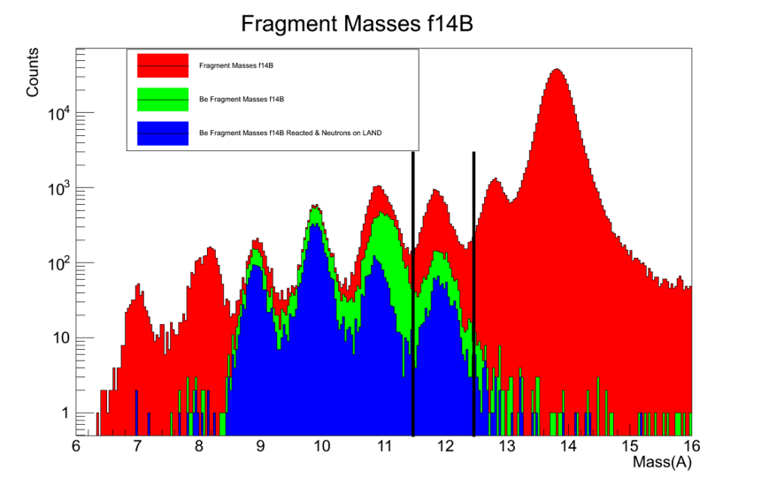
Reaction channel Idenitifcation
Energy loss in the ToFW after the target → Identify the element after the reaction.
Identify the isotope from the ALADIN position deviation and beta of the fragment.
¹⁴B → ¹²Be + n
Incoming
Beam ¹⁴B
Fragments from ¹⁴B
Be Fragments from ¹⁴B
Be Fragments from ¹⁴B & Neutrons
Outgoing Be
Be +n
Charge identification from energy loss
¹²Be
Mass identification from ToF tracking
22

Slide 23
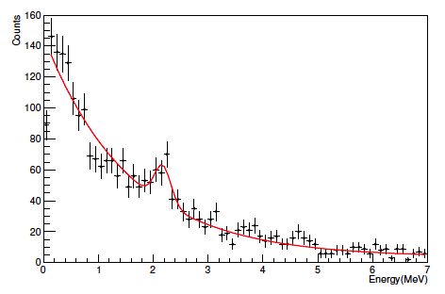
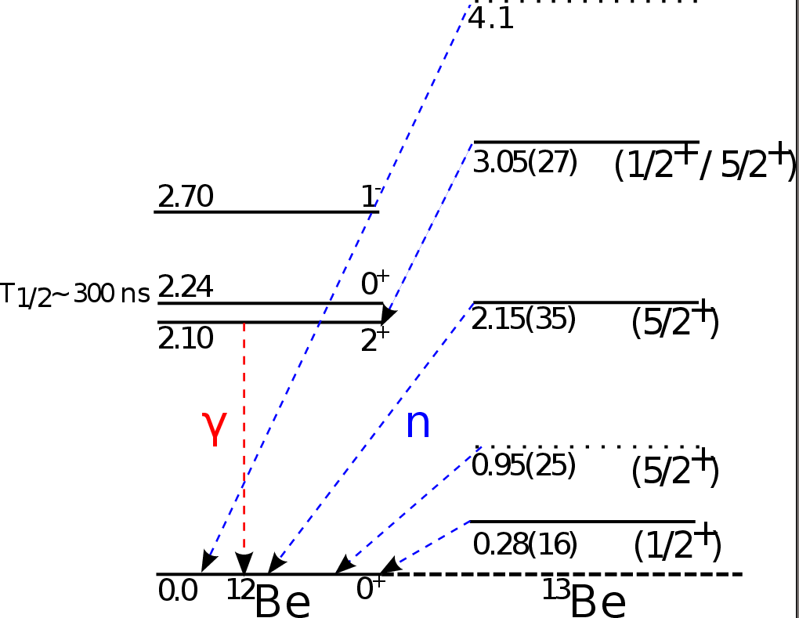
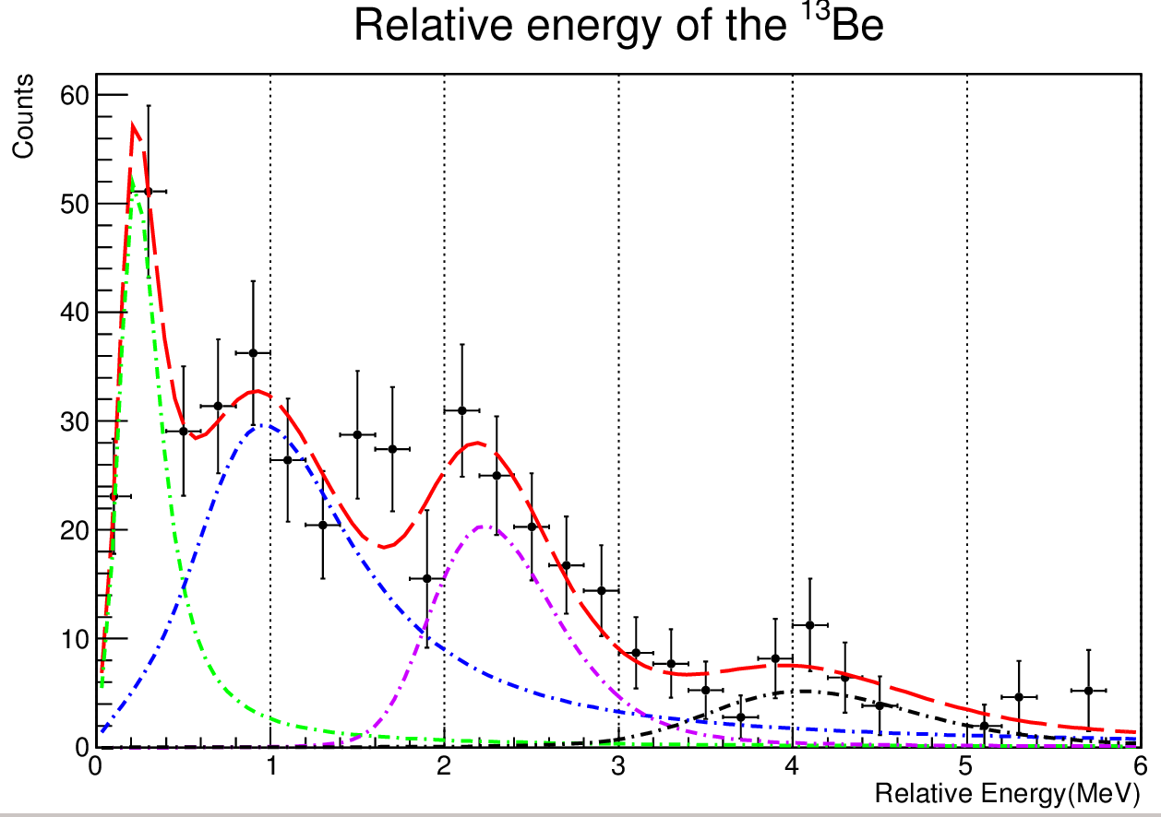
Relative Energy of ¹²Be + n:
Gamma Spectrum
E_{γ}=2 MeV
4
2
3
¹³Be
2´
1
1
2
2´
3
4

Slide 24





Can we settle this problem via the two-neutron transfer reaction,
¹¹Be(t,p)¹³Be @ HIE-ISOLDE
Complementary Experiment
Miniball + T-REX
¹¹Be(t, p) ¹³Be

Slide 25

Experimentos de NUSTAR: pensar y recordar!
Acrónimos: FAIR NUSTAR SFRS R3B
Que método de producción se usa en experimentos de NUSTAR?
Cual es el haz primario, y de que origen normalmente?
Cual es el blanco de Producción?
Cual es el haz secundario? Cual es el blanco de Reacción?
Por que usamos varios blancos de reacción en el mismo experimento?
Por que cinemática inversa?
Que significa cinemática completa?
Como se selecciona el canal de reacción de interés del experimento?
Como se determina la carga, masa, la energía, el momento,
Y no olvides la importancia de medir las: γ y neutróns!

Slide 26




250 Members
40 Institutes
15 Countries
Spokesperson: Lola Cortina USC
Technical Director: Olof Tengblad CSIC

Slide 27






España
Pepe Benlliure
Lola Cortina
Hector Alvarez Pol
Diego Gonzales
Jose Luis Rodriguez Sanchez
Univ. Santiago de Compostela
Enrique Casarejos
Carlos Parrilla
Olof Tengblad
María Borge
Christoph Rappold
Enrique Nacher (IFIC)
Angel Perea

