Slide 1
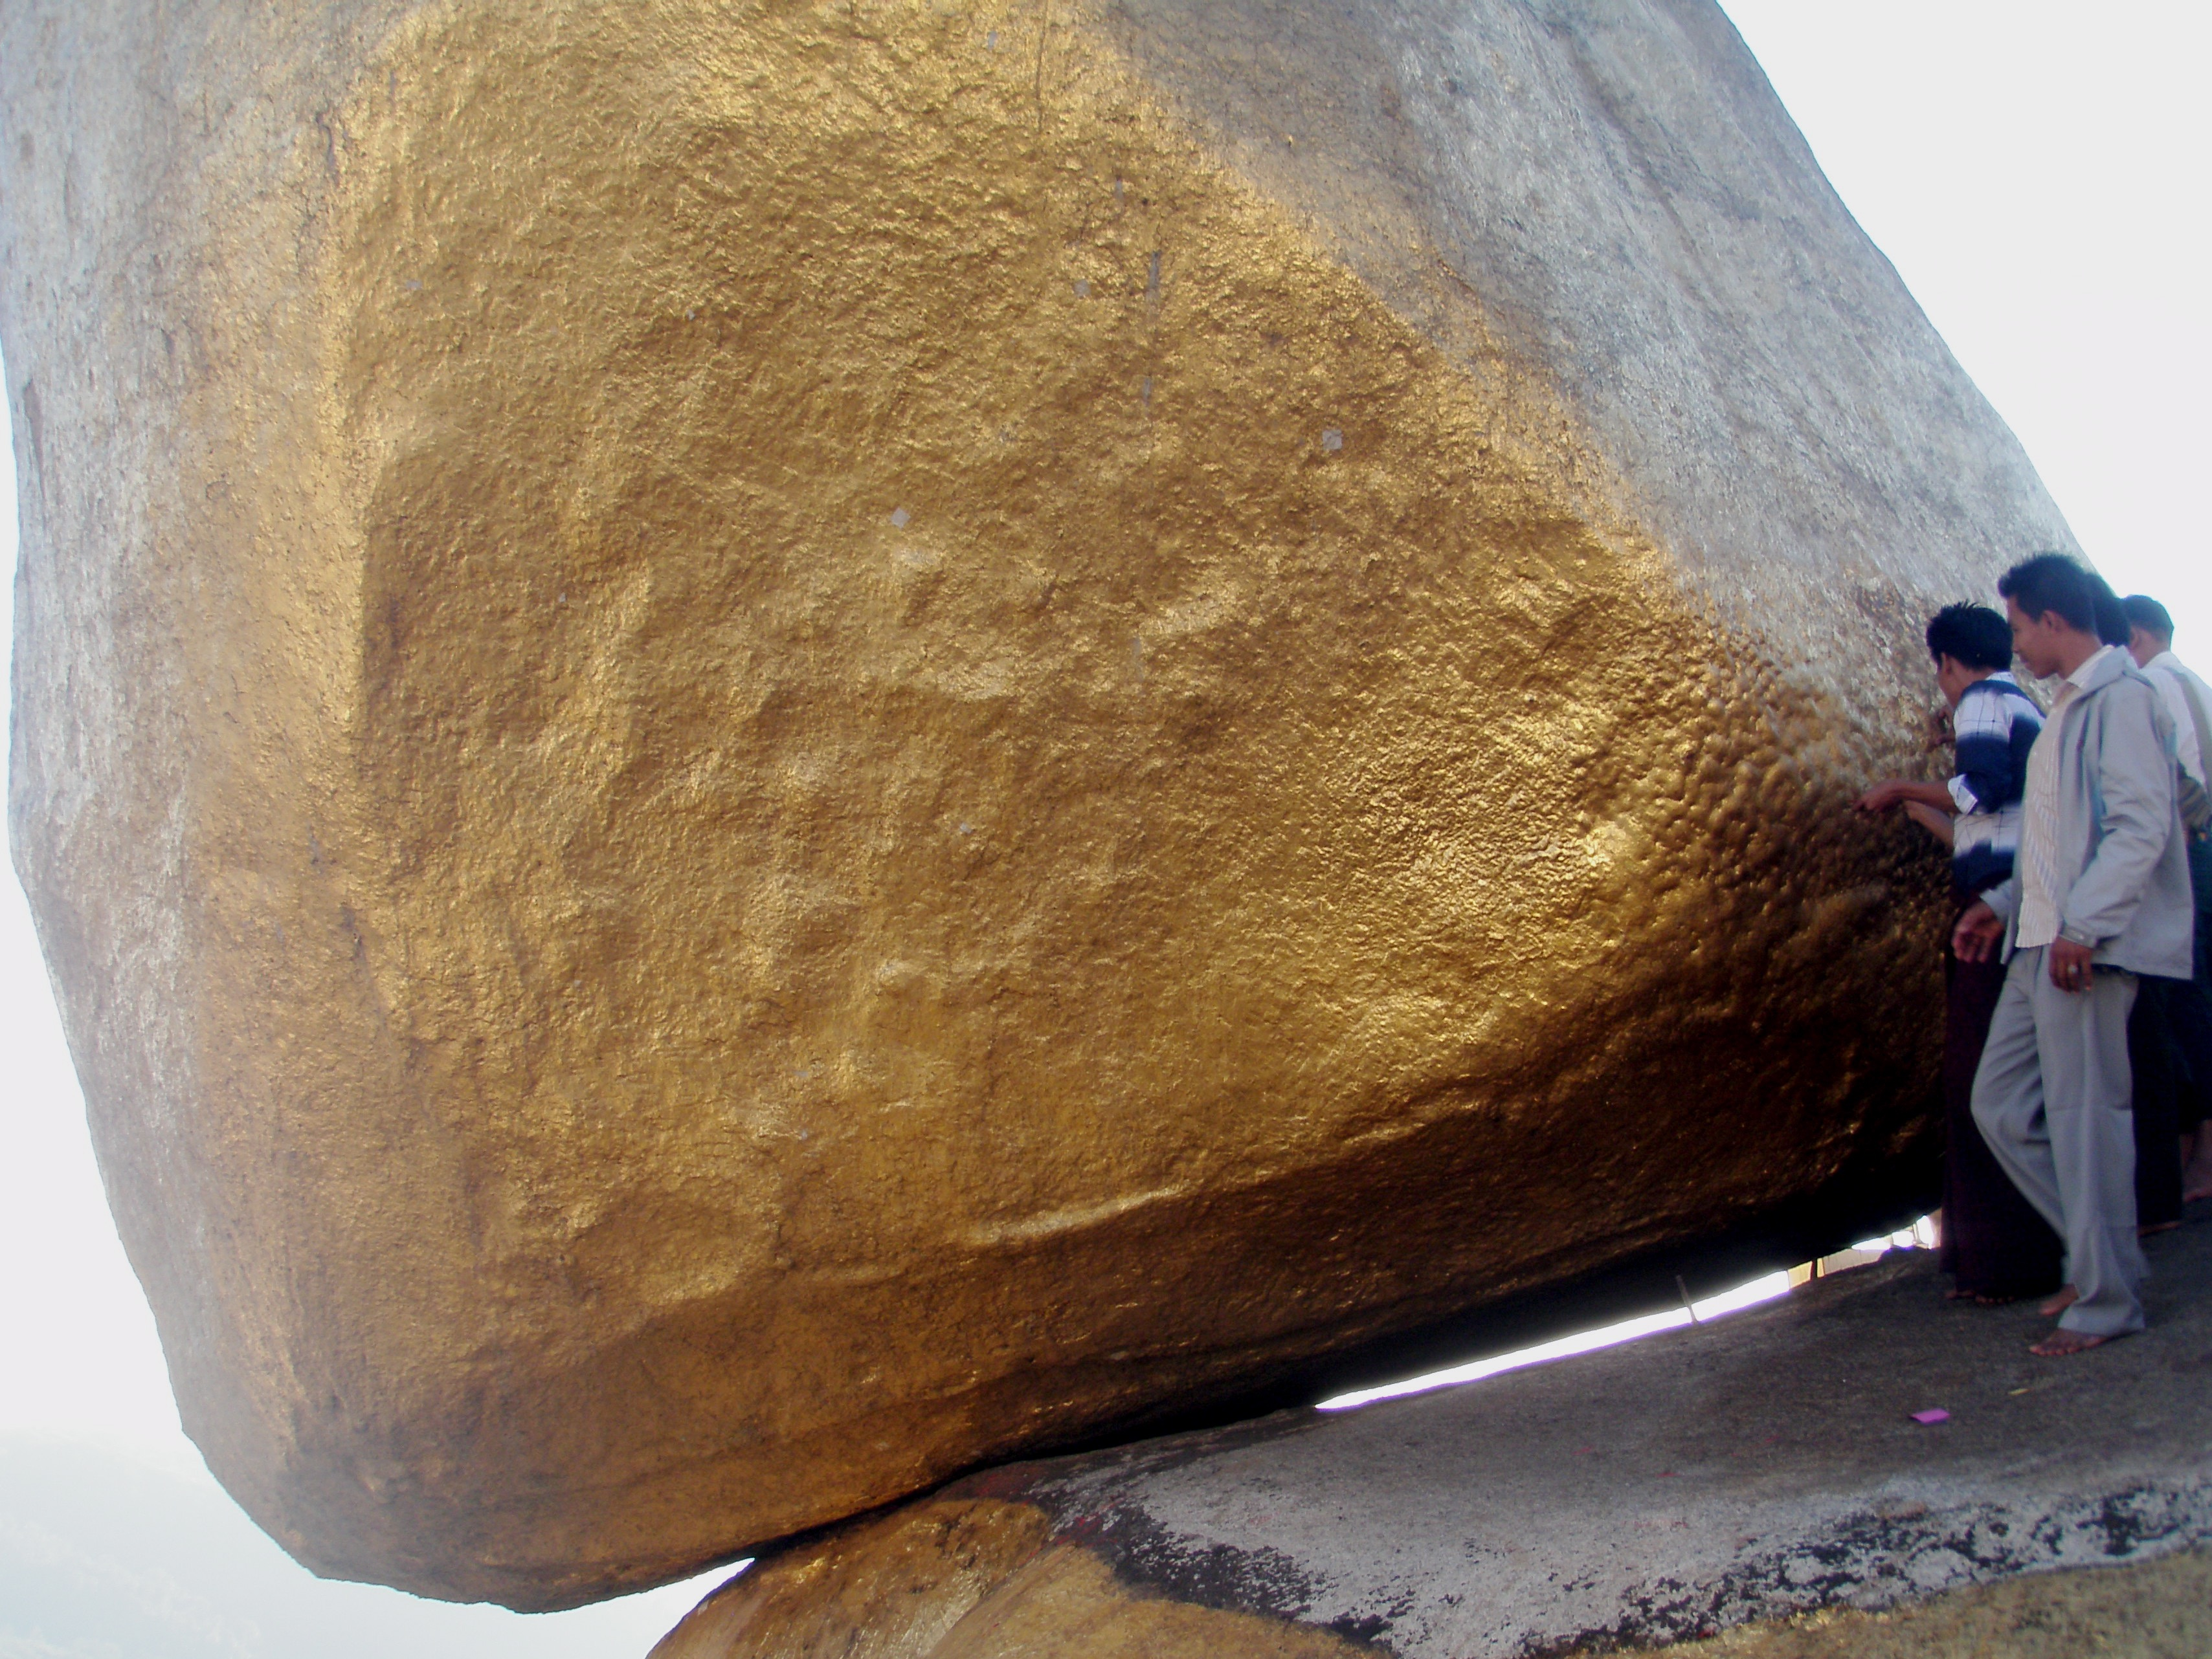
Gamma Factory
New research opportunities for CERN
JENAS EoI, 16.07.2020
Kyaik-Tiyo, Myanmar(Burma)
JENAS Symposium 2022, Madrid 4.05.2022
Mieczyslaw Witold Krasny, Gamma Factory group
LPNHE, CNRS and University Paris Sorbonne and CERN, BE-ABP

Slide 2
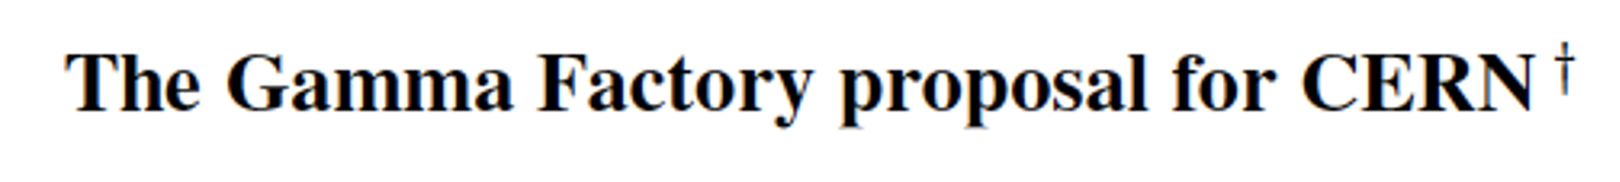
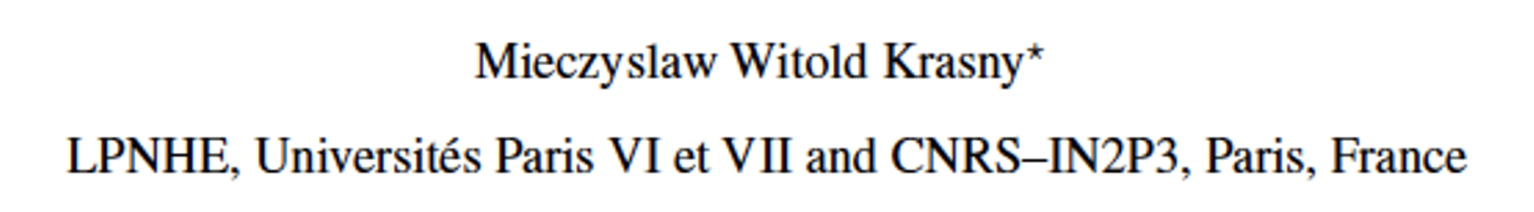

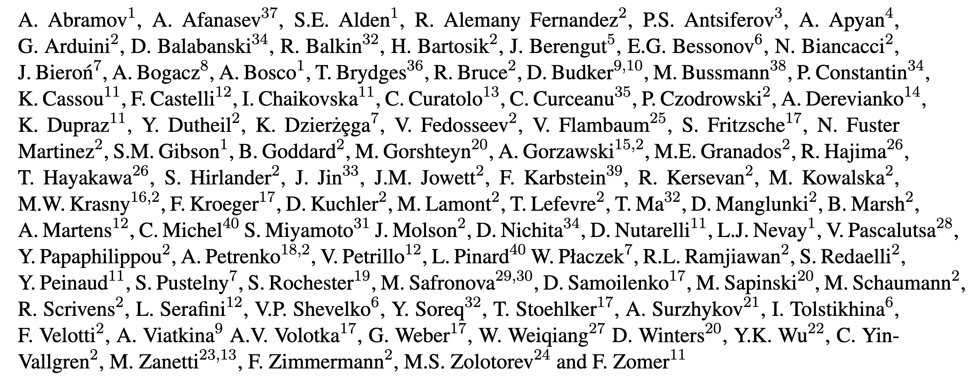
“Gamma Factory” proposal and studies
Gamma Factory studies are anchored, and supported by the CERN Physics Beyond Colliders (PBC) framework.
More info on the GF group activities:
  https://indico.cern.ch/category/10874
We acknowledge the crucial role of the CERN PBC framework in bringing our accelerator tests, GF-PoP experiment design, software development and physics studies to their present stage!
~ 100 physicists form 40 institutions have contributed so far to the Gamma Factory studies

Slide 3
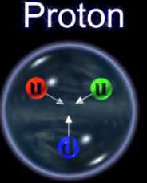
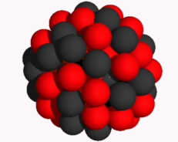
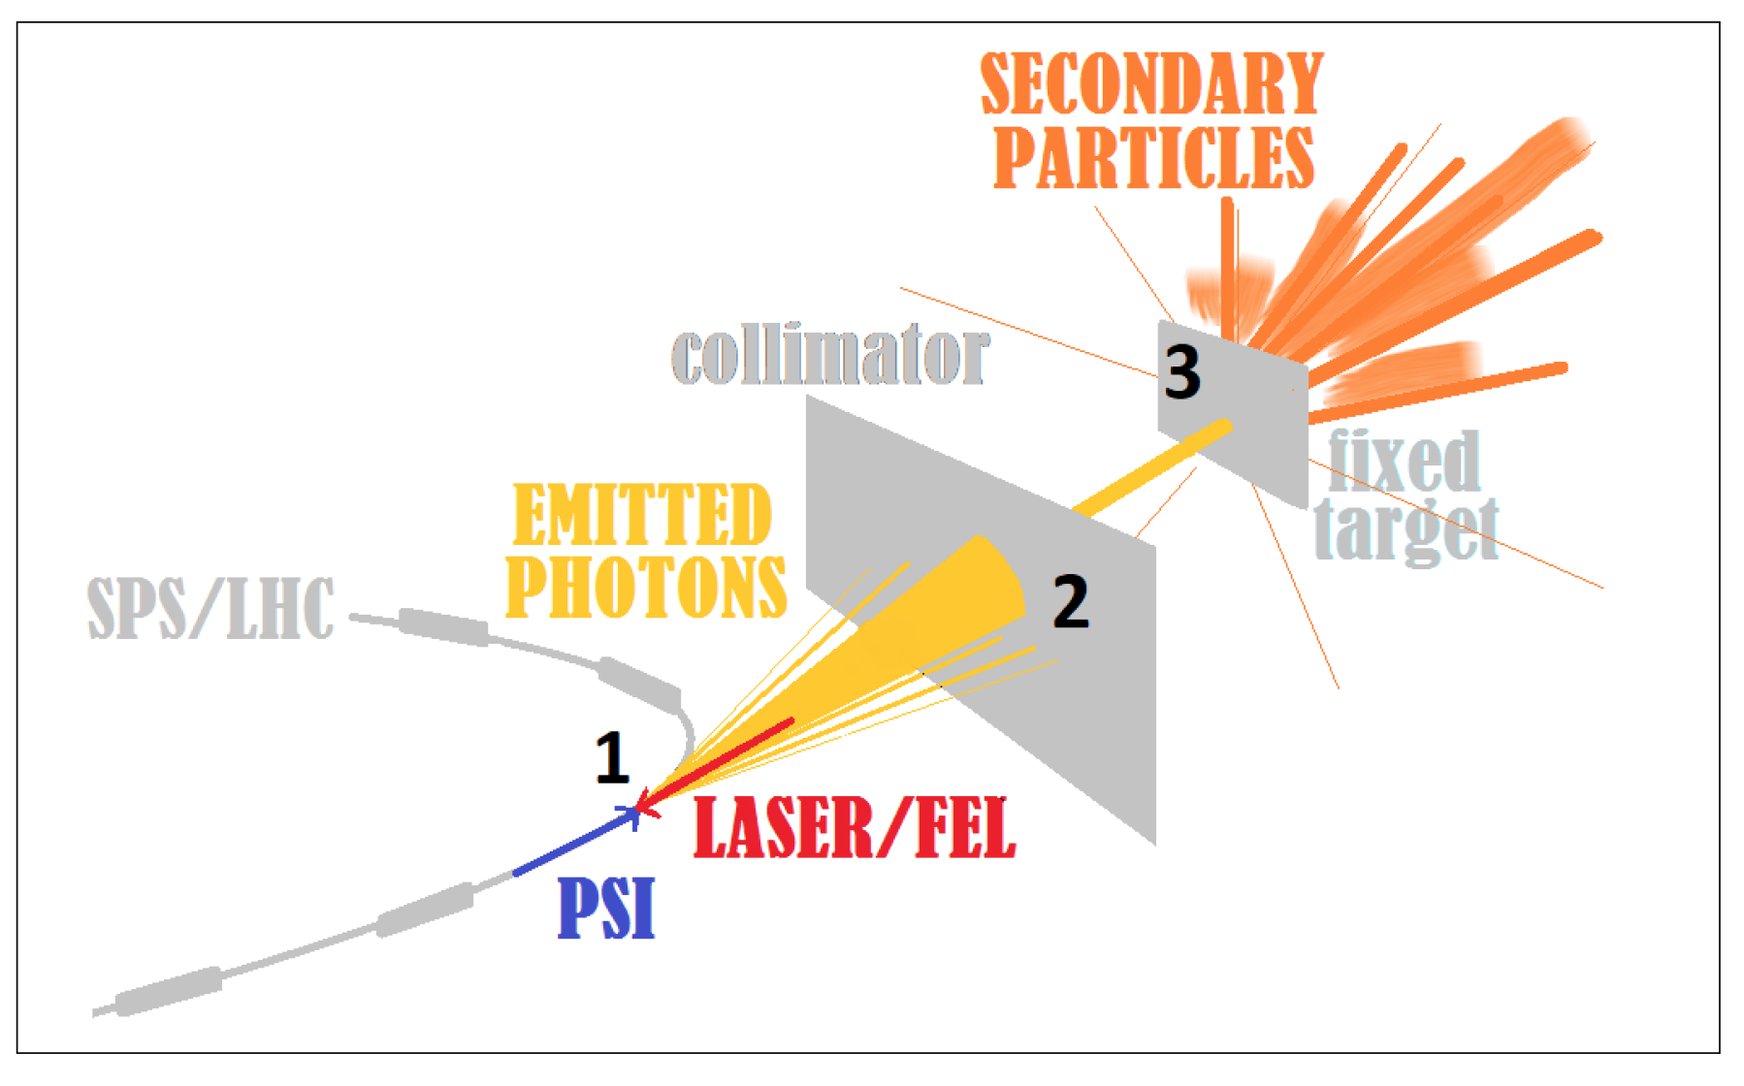

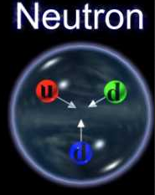
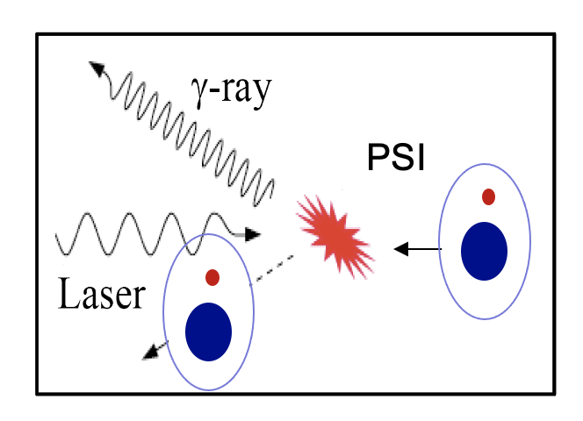
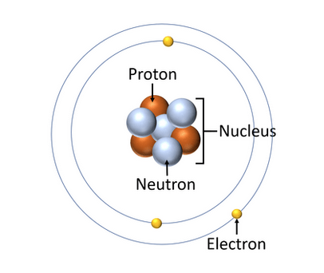
Gamma Factory: novel use of existing CERN’s storage rings
LHC beams
Store atomic beams of partially stripped ions in the LHC
Collide them with laser pulses (circulating in Fabry-Pérot resonators)
PSI – Partially stripped Ions

Slide 4
Principal Gamma Factory research tools
  Atomic traps of highly charged, cold atoms
  High intensity photon(γ)-beams
  Laser-light based cooling methods of high-energy hadronic beams
  High-intensity beams of polarised electrons, polarised positrons, polarised muons, neutrinos, neutrons and radioactive ions
  Electron beam for ep collisions in the LHC interaction points
  Low emittance beams and electron source for plasma Wakefield acceleration

Slide 5
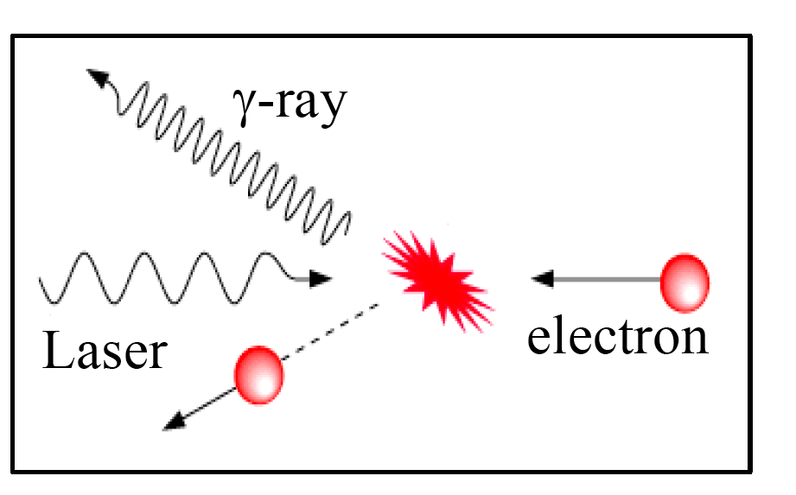
Gamma Factory photon beam
c τ
E=0
E=0
E=0
E_{laser}
E _{γ-ray}
n=2
n=2
n=2
n=1
n=1
n=1
Gigabarn cross section
High energy atomic beams play the role of high-stability light-frequency converters:
ν^{max} (4 γ_{L}²) ν_{Laser}
for photons emitted in the direction if incoming atoms, γ_{L} = E/M is the Lorentz factor for the ion beam
Notes:
5

Slide 6
GF photon beams
1. Point-like, small divergence
Δz ~ l_{PSI-bunch}, Δx,Δy ~ σ^{PSI}_{x}, ^{PSI}_{y} , Δ(θ_{x}), Δ(θ_{y})~ 1/γ_{L} < 1 mrad
2. Huge jump in intensity:
6–8 orders of magnitude w.r.t. existing (being constructed) γ-sources
3.Very wide range of tuneable energy photon beam :
10 keV – 400 MeV -- extending, by a factor of ~1000, the energy range of the FEL photon sources
4. Tuneable polarisation:
γ−polarisation transmission from laser photons to γ-beams of up to 99%
5. Unprecedented plug power efficiency (energy footprint):
LHC RF power can be converted to the photon beam power. Wall-plug power efficiency of the GF photon source is by a factor of ~300 better than that of the DESY-XFEL!
(assuming power consumption of 200 MW - CERN and 19 MW - DESY)
Notes:
6

Slide 7
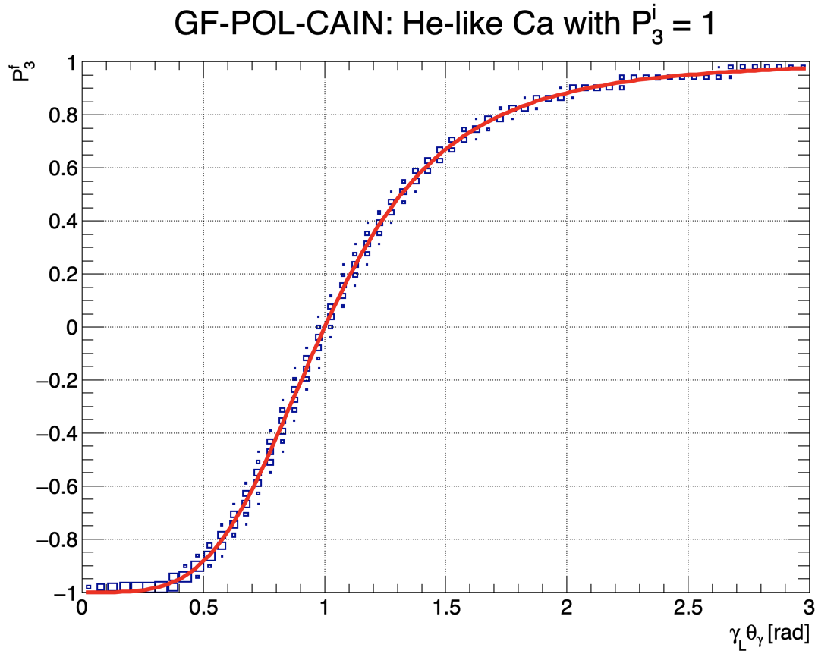
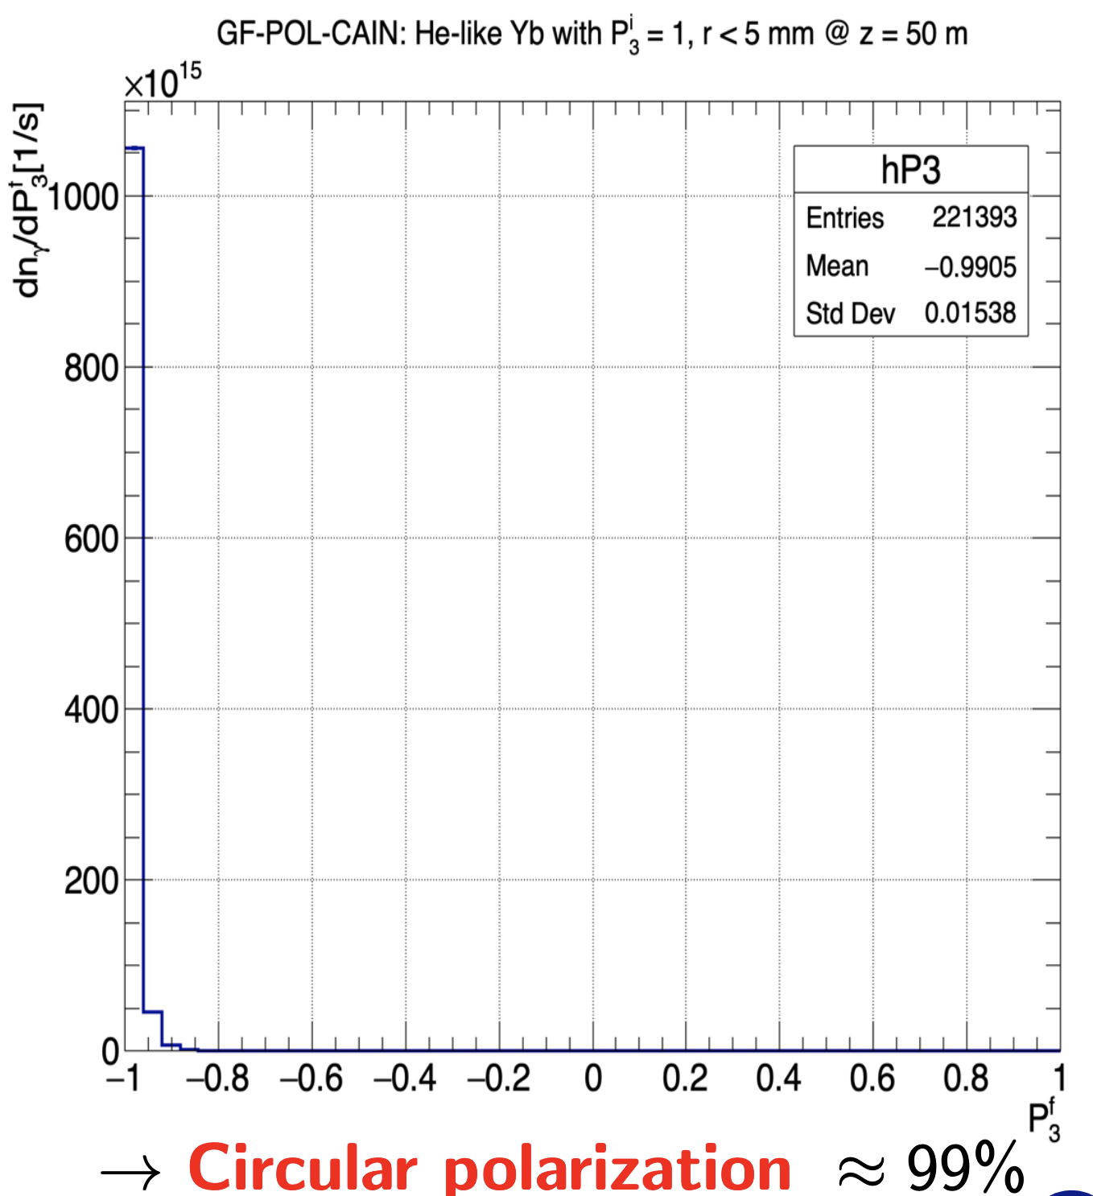
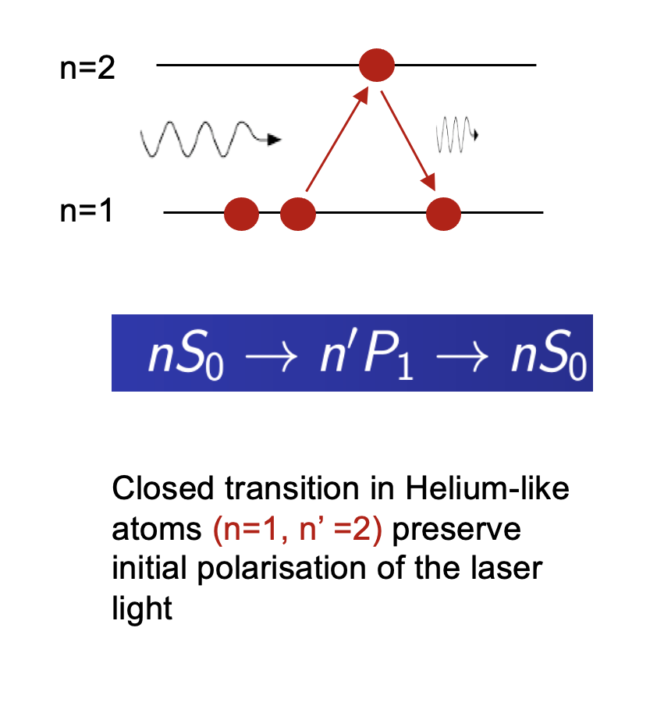
Polarised beams in GF – example: He-like, Calcium beam, Er:glass laser (1522 nm)
A trick: 1s² 1S₀→ 1s¹ 2p¹ ¹P₁ transition in He-like atoms
Radial collimation:
R<5 mm@z=50 m
For more details see presentations at our recent, November 2021,
Gamma Factory workshop: https://indico.cern.ch/event/1076086/

Slide 8
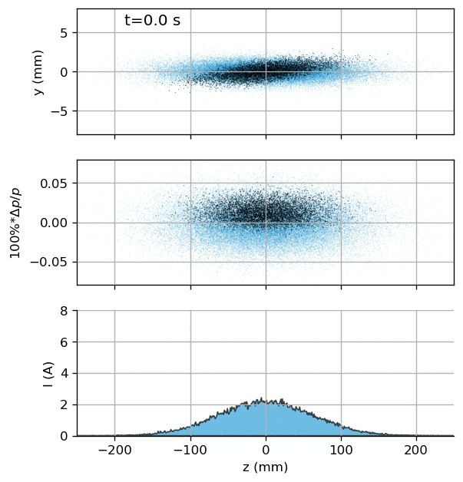
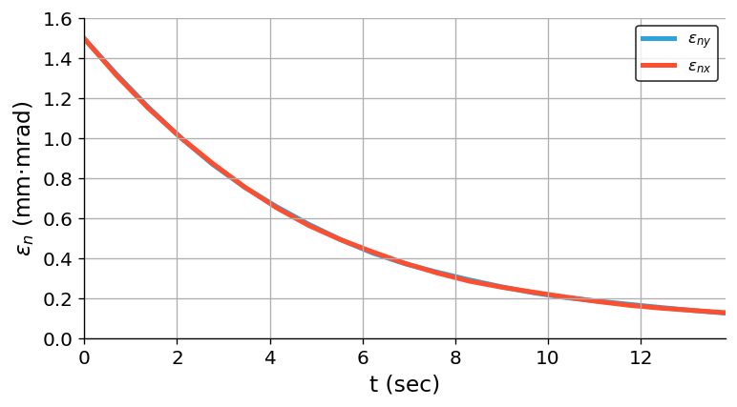
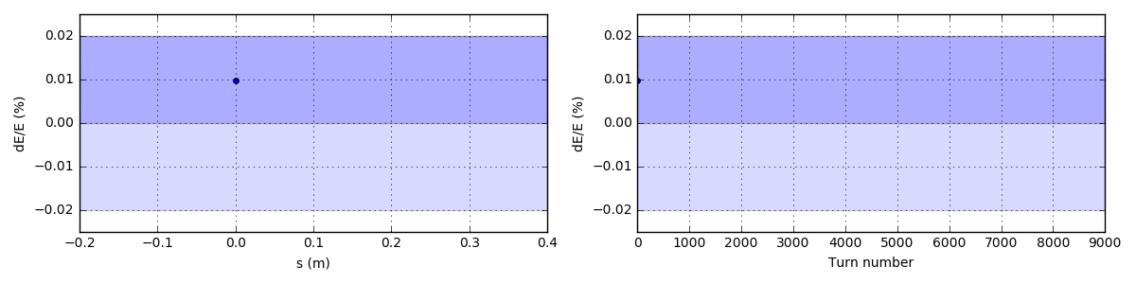
Laser cooling of high-energy hadronic beams
Beam cooling:
the laser wavelength band is chosen such that only the ions moving in the laser pulse direction (in the bunch rest frame) can resonantly absorb photons.
Opens a possibility of forming at CERN high-energy hadronic bunches of the required longitudinal and transverse emittances and population, (bunch merge + cooling) within a seconds-long time scale.
Laser pulse
A. .Petrenko
σ_{x} = 0.8 mm, σ_{y} = 0.57 mm
σ_{z} = 10 cm, t_{pulse} = 2 ps
Θ_{coll} = 1.3 deg, Dx = 2.44 m
W = 2 mJ Ti:Sa laser pulses
4.0 scatterings
per ion per turn
A. .Petrenko
A. .Petrenko
Simulation of laser cooling of the lithium-like Ca(+17) bunches in the SPS: transverse emittance evolution.

Slide 9
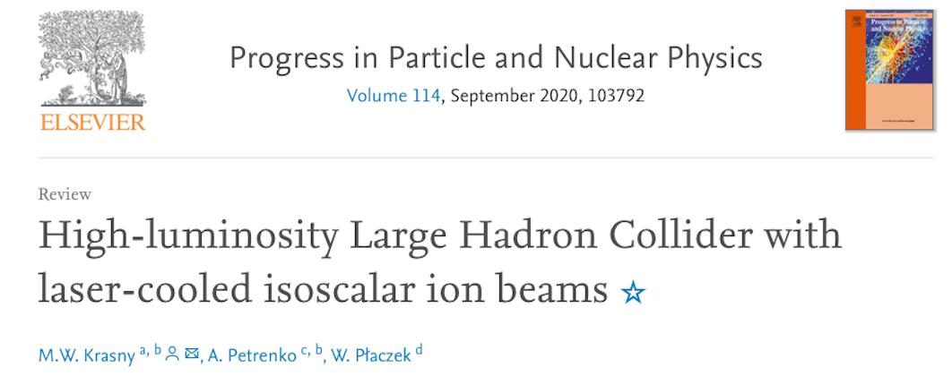
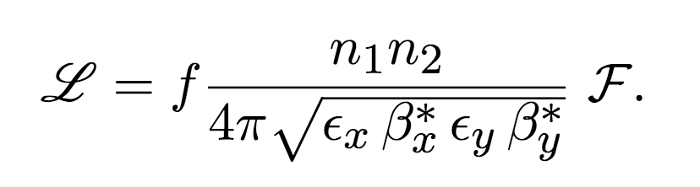
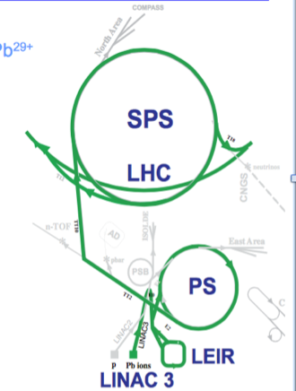
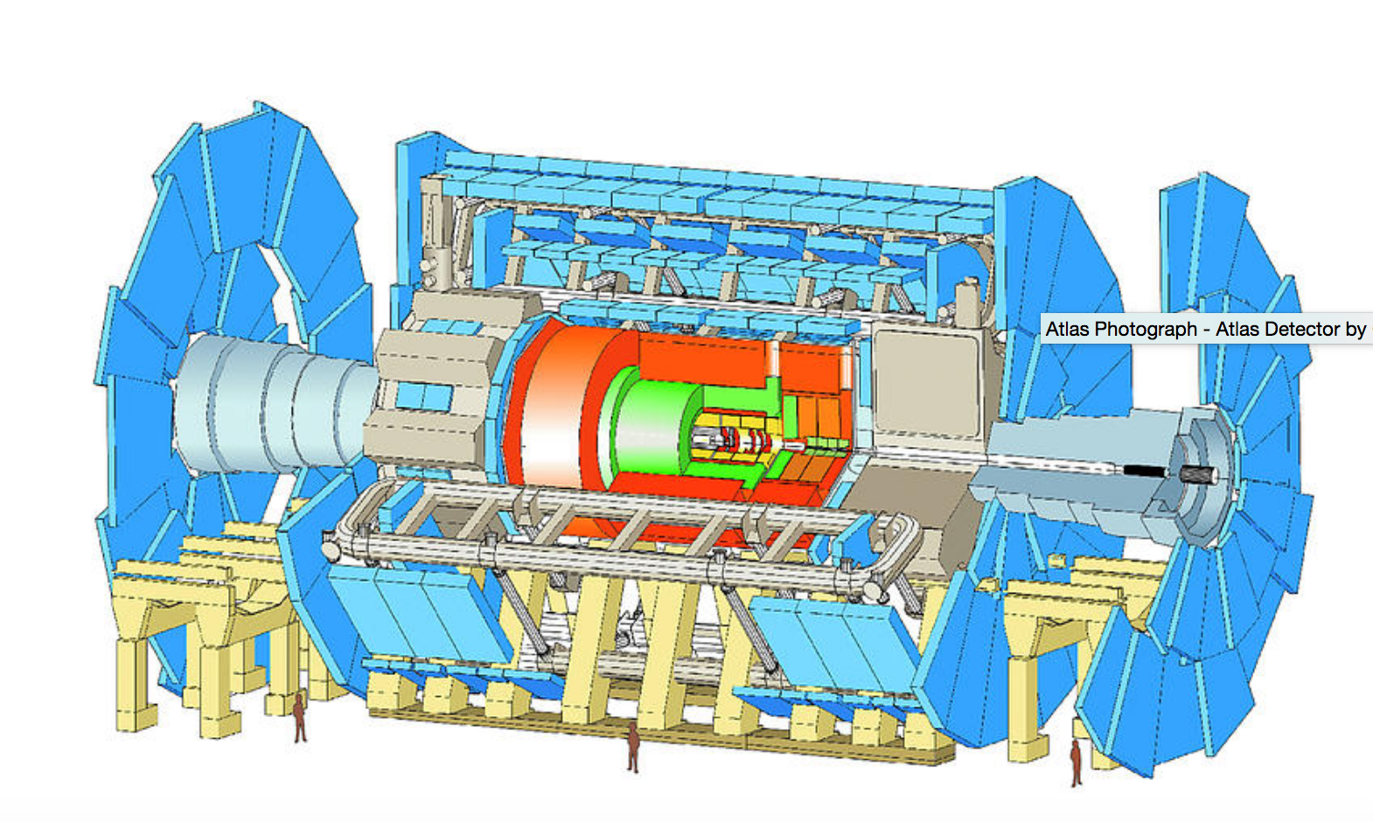
Gamma Factory (complementary) path to HL-LHC:
Studies of the implementation scheme with laser-cooled isoscalar Ca beams
The merits of cold isoscalar beams
higher precision in measuring SM parameters (M_{W,} sin²θ_{W,} …) in CaCa than in pp collisions,
Possible unique access to exclusive Higgs boson production in photon–photon collisions,
Lower pileup background at equivalent nucleon-nucleon (partonic) luminosity,
New research opportunities for the EW symmetry breaking sector.
Two complementary ways to increase collider luminosity
for fixed n₁,n₂,and f :
reduce β_{x}∗ and β_{y}∗
reduce ε_{x} and ε_{y}
LHC: fully stripped Calcium –Ca(+20)
Laser cooling
(2s—>3p)_{1/2}
SPS
Stripper
SPS: Lithium-like Calcium - Ca(+17)
Stripper
LHC
HL-LHC – β* reduction by a factor of 3.7 (new inner triplet)
Ion Source + Linac: charge state after stripping: Ca(+17)
Reduction of the transverse x,y, emittances by a factor of 5 can be achieved in 9 seconds (top SPS energy)
If necessary: add optical stochastic cooling time for the Ca beam at the LHC top energy t_{cool} ~1.5 hours (V. Lebedev)

Slide 10
Technical Proof of Principle

Slide 11
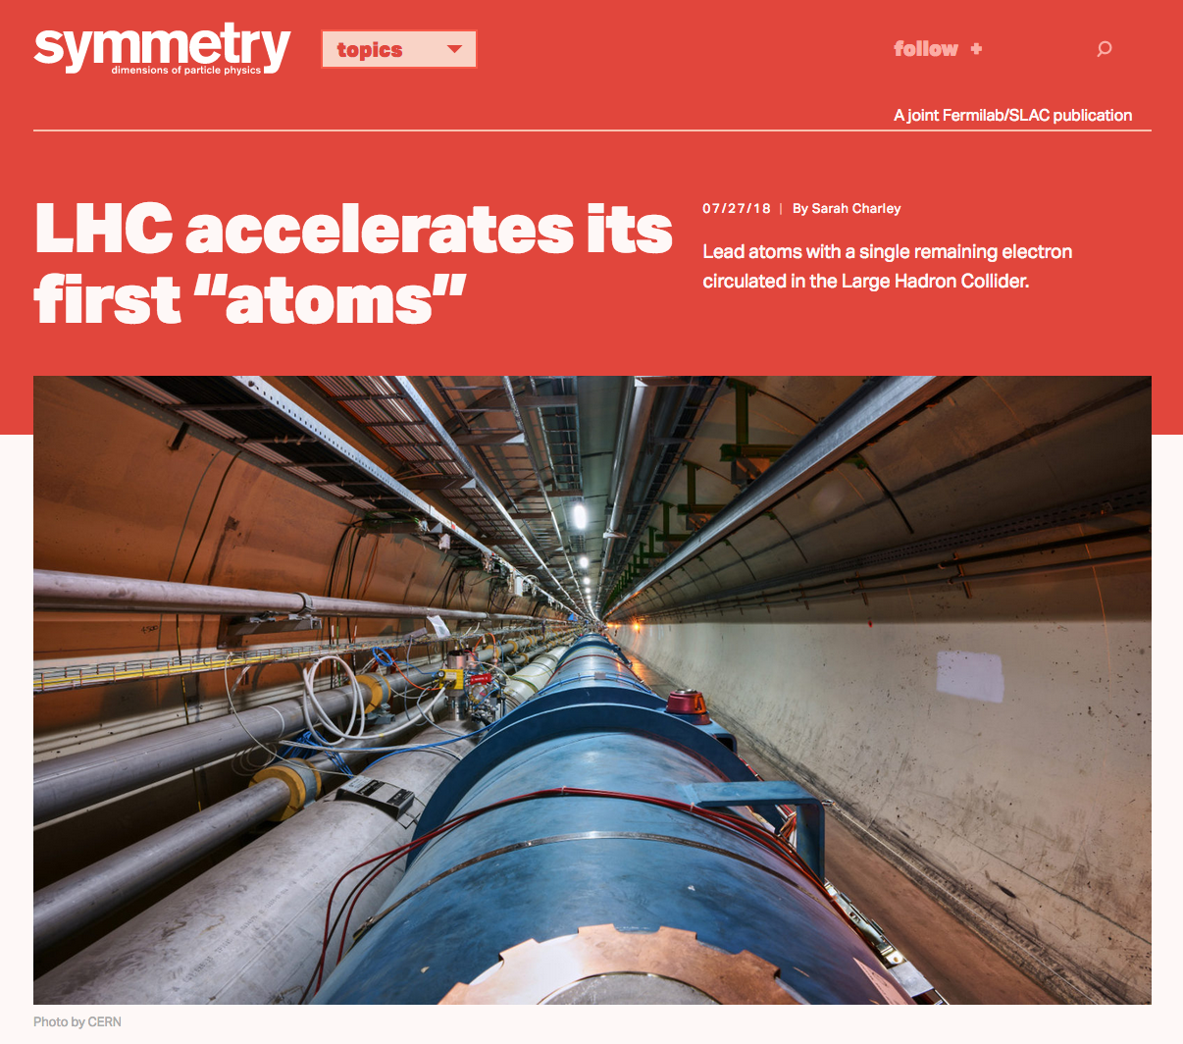
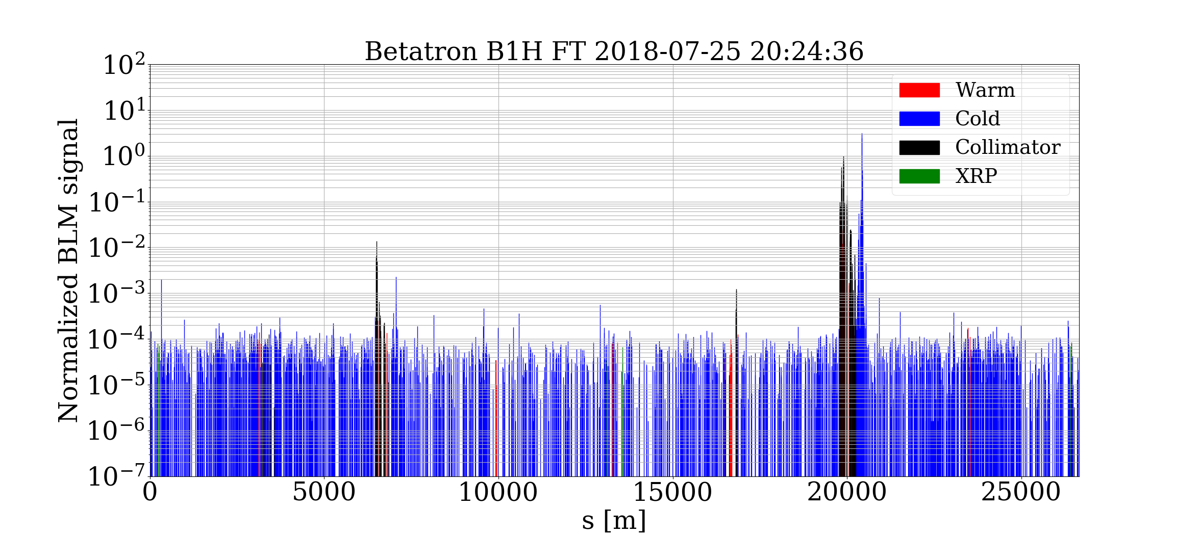
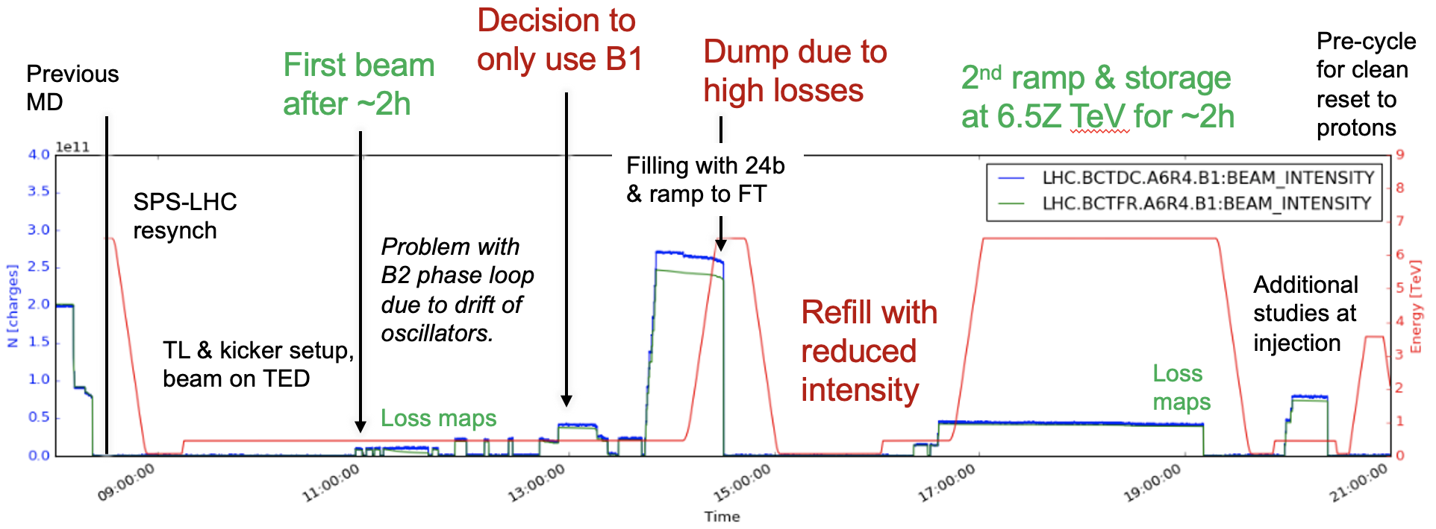
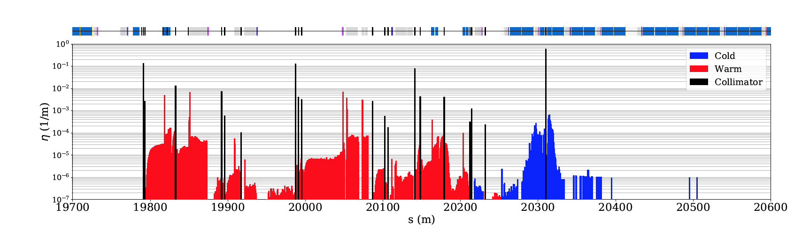
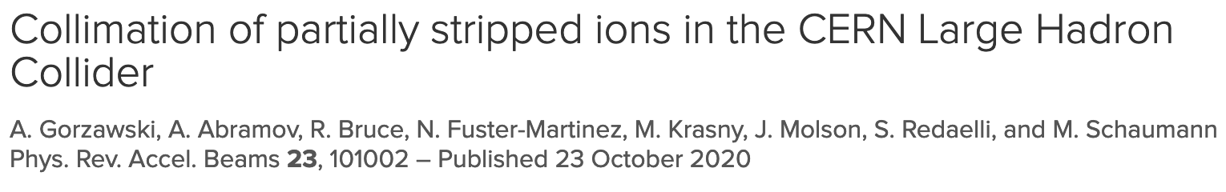
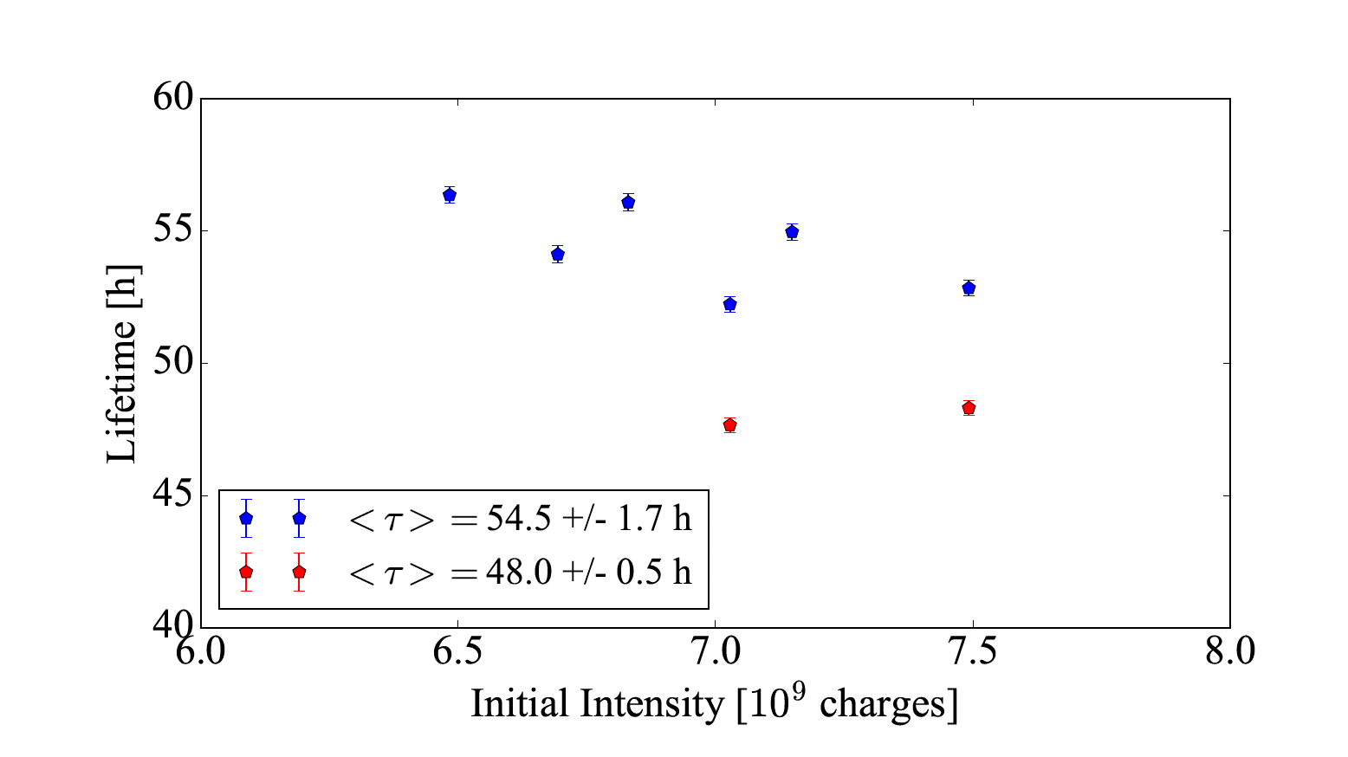
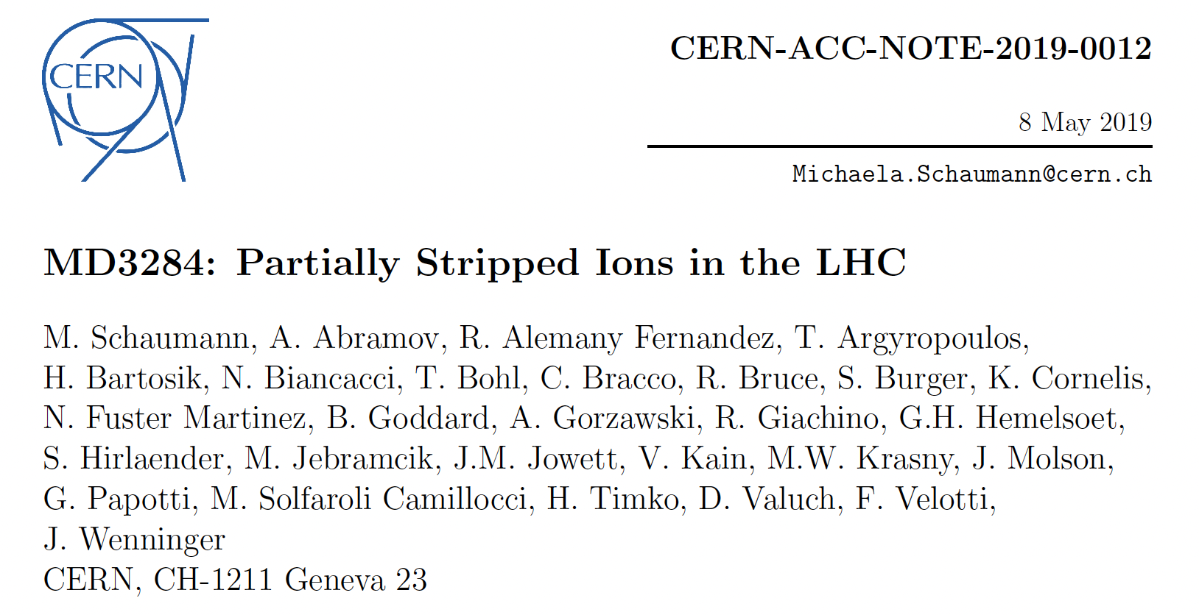
Mitigation strategies:
1. Dispersion suppressor collimator (TCLD)
2. Crystal collimation
3. Laser collimation
Atomic beams in the LHC (Hydrogen-like Lead )
The beam intensity limit is determined by
the beam collimation efficiency in IR7
s = 20430 m
IR7
zoom
Simulation
studies
Lifetime of PSI bunches ~ 50h
A dedicated LHC MD with crystal collimation of the PSI (H-like Pb) beam will be the next step…

Slide 12
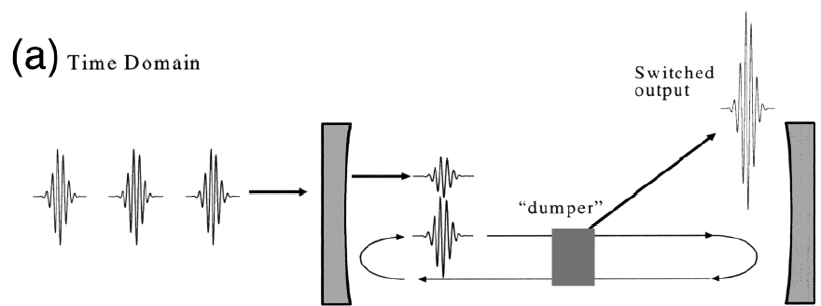
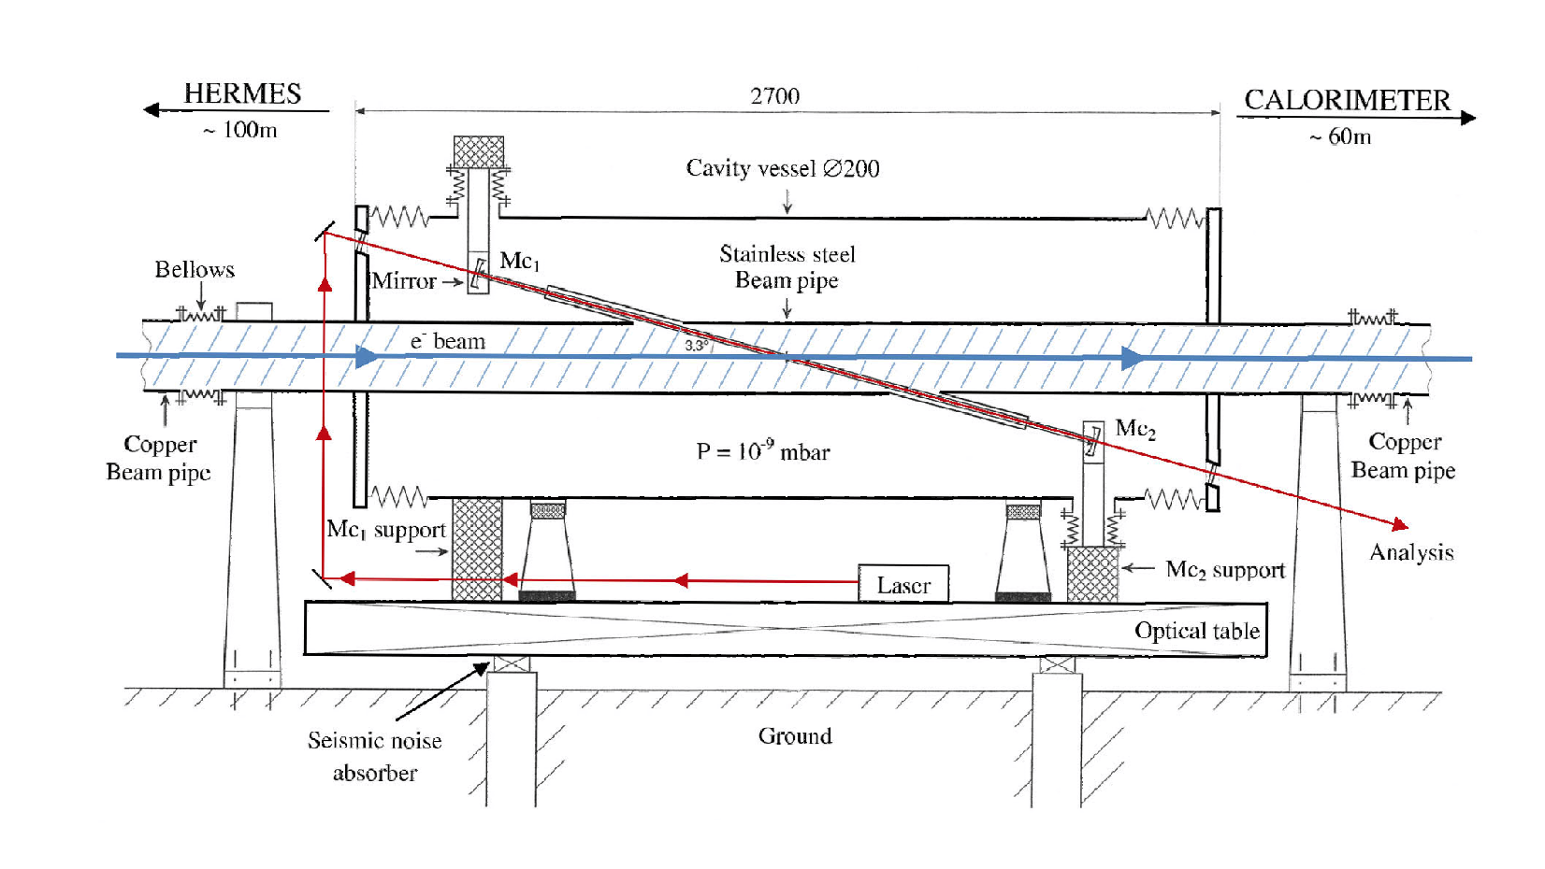
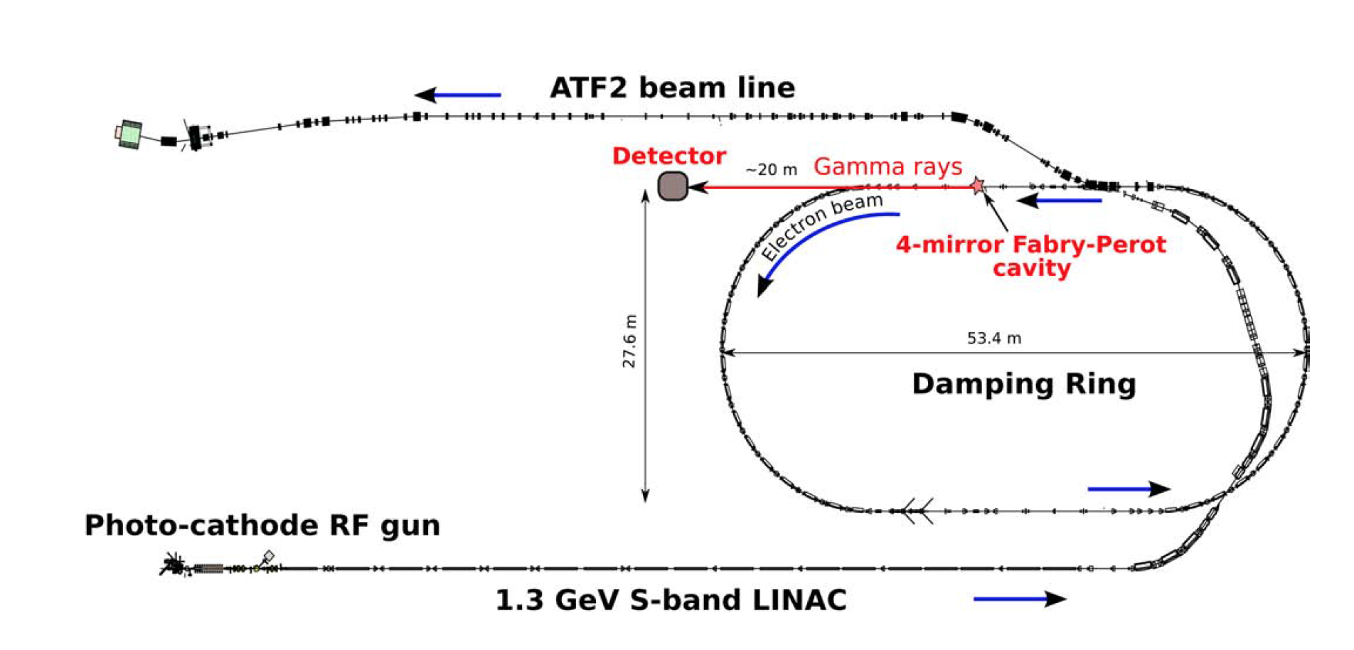
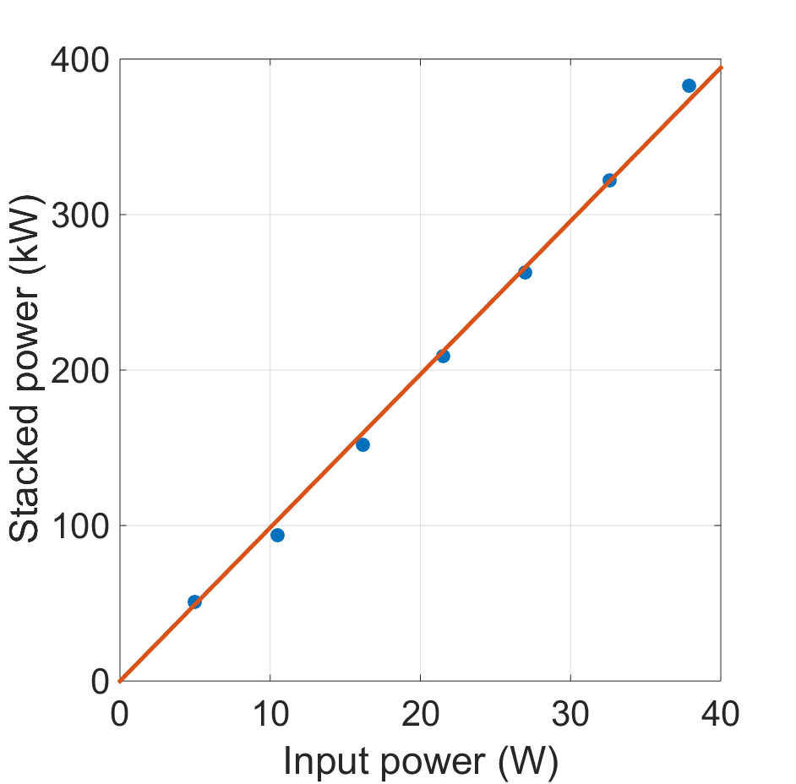
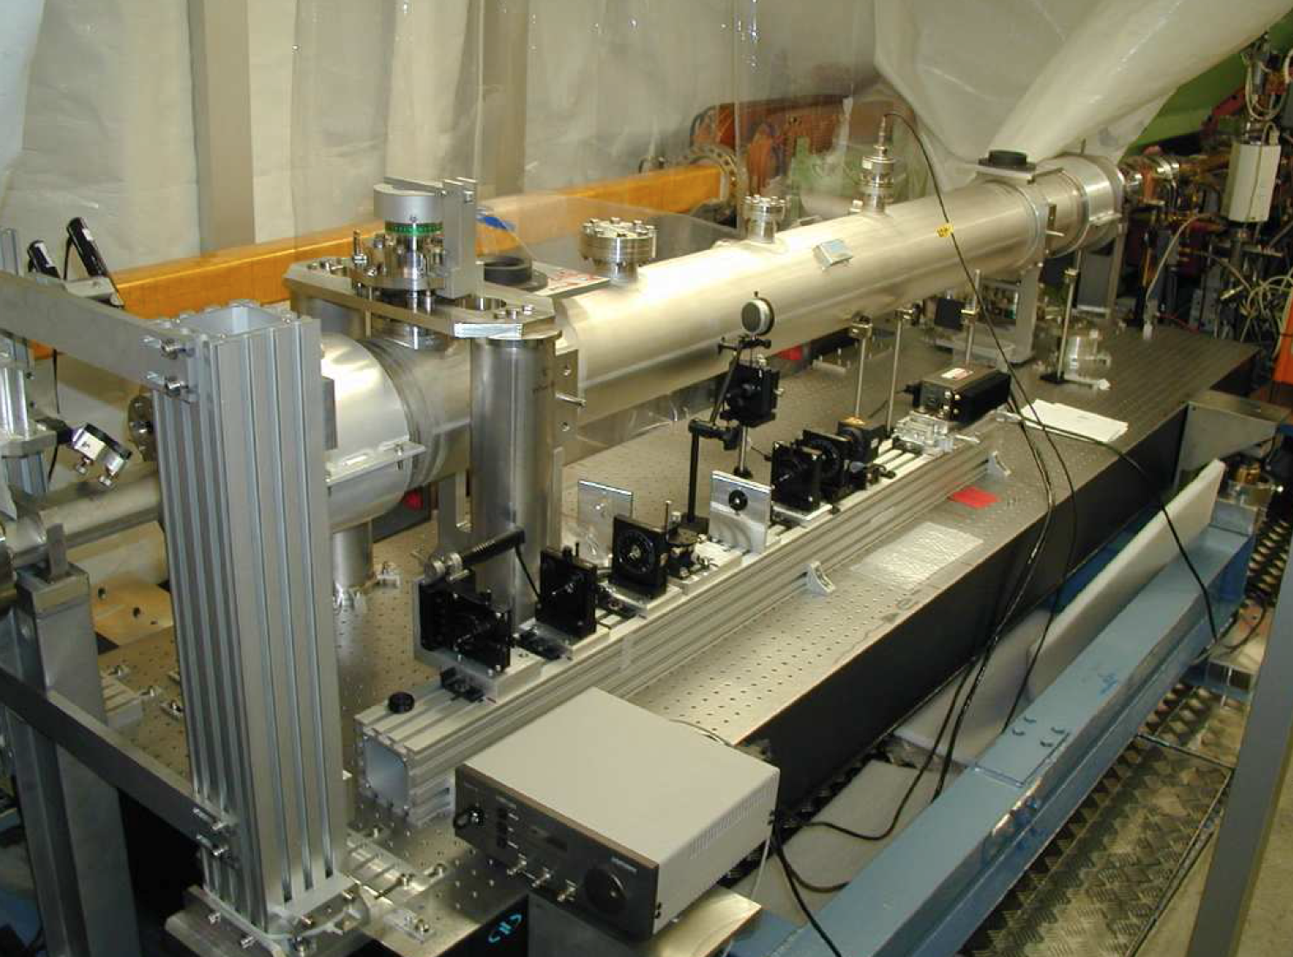
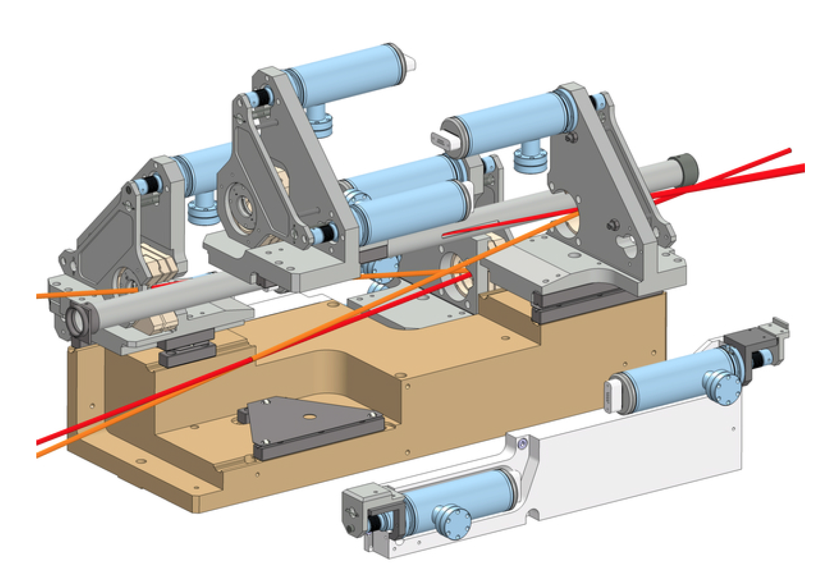
Fabry-Pérot resonator
Fabry-Pérot (FP) resonators
and their integration in the electron storage rings
HERA storage ring
KEK – ATF ring
mirror
mirror
~10¹⁶ ph/bunch
Laser pulses
Amoudry L. et al., Applied Optics 59(2020)116
100W amplifiers are
commercial systems
GF requirement:
< 5mJ pulses @ 40MHz, (200kW photon beam)
Towards the first integration of the FP resonator in the hadron storage ring →

Slide 13
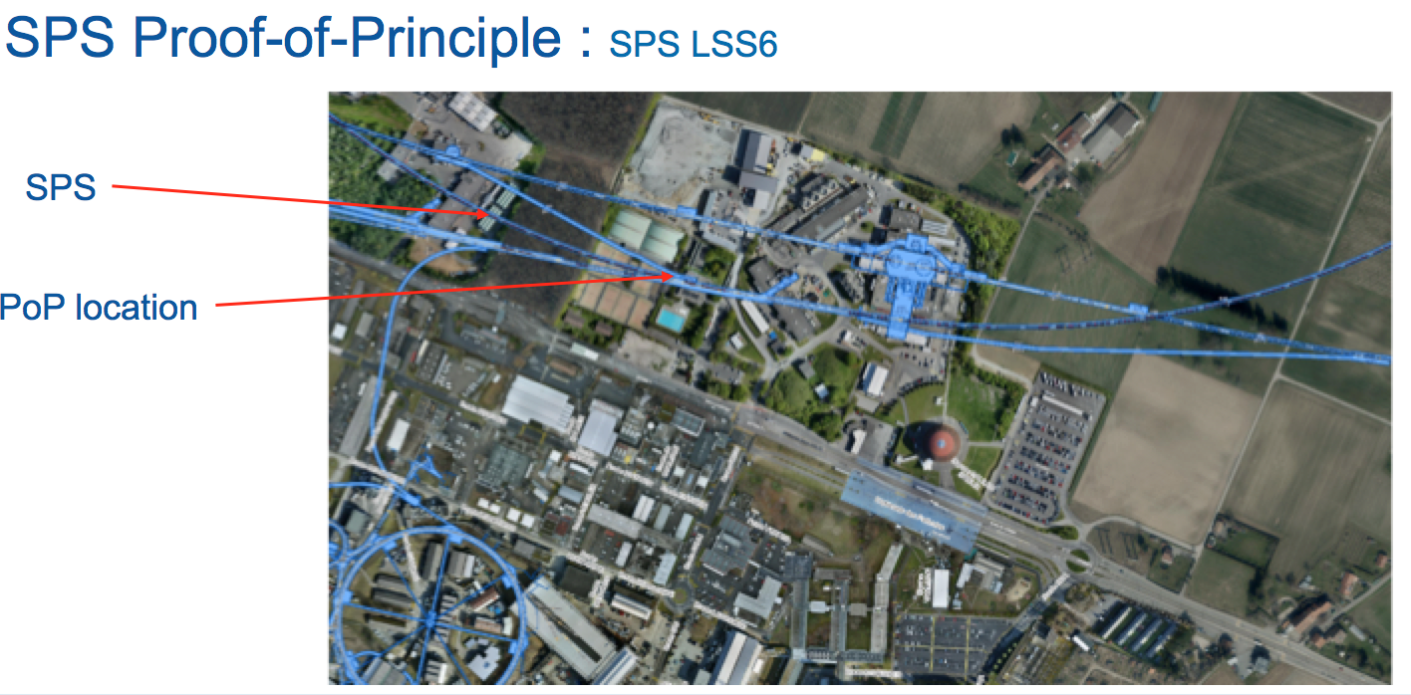
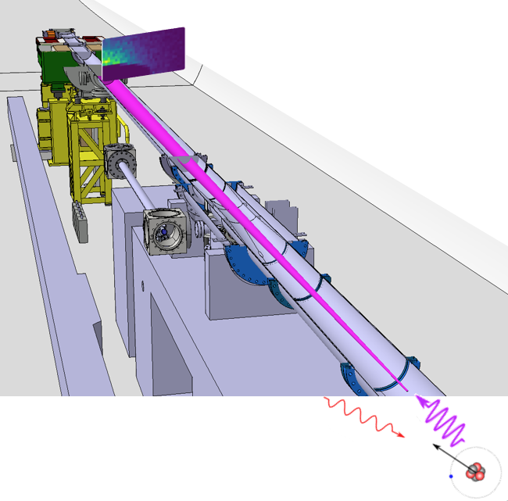
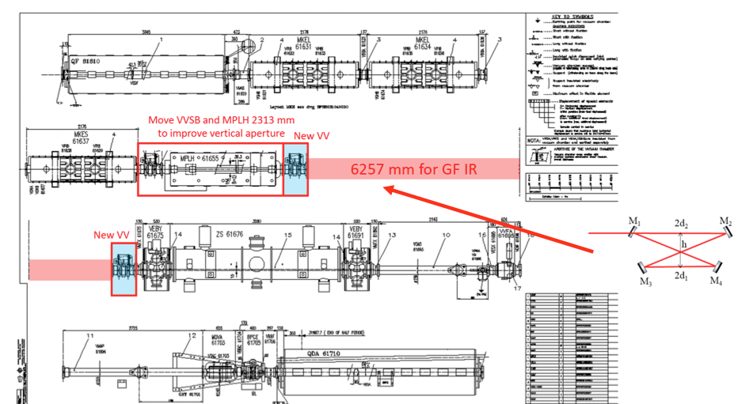
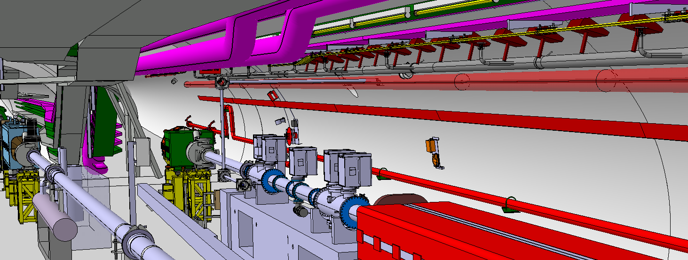
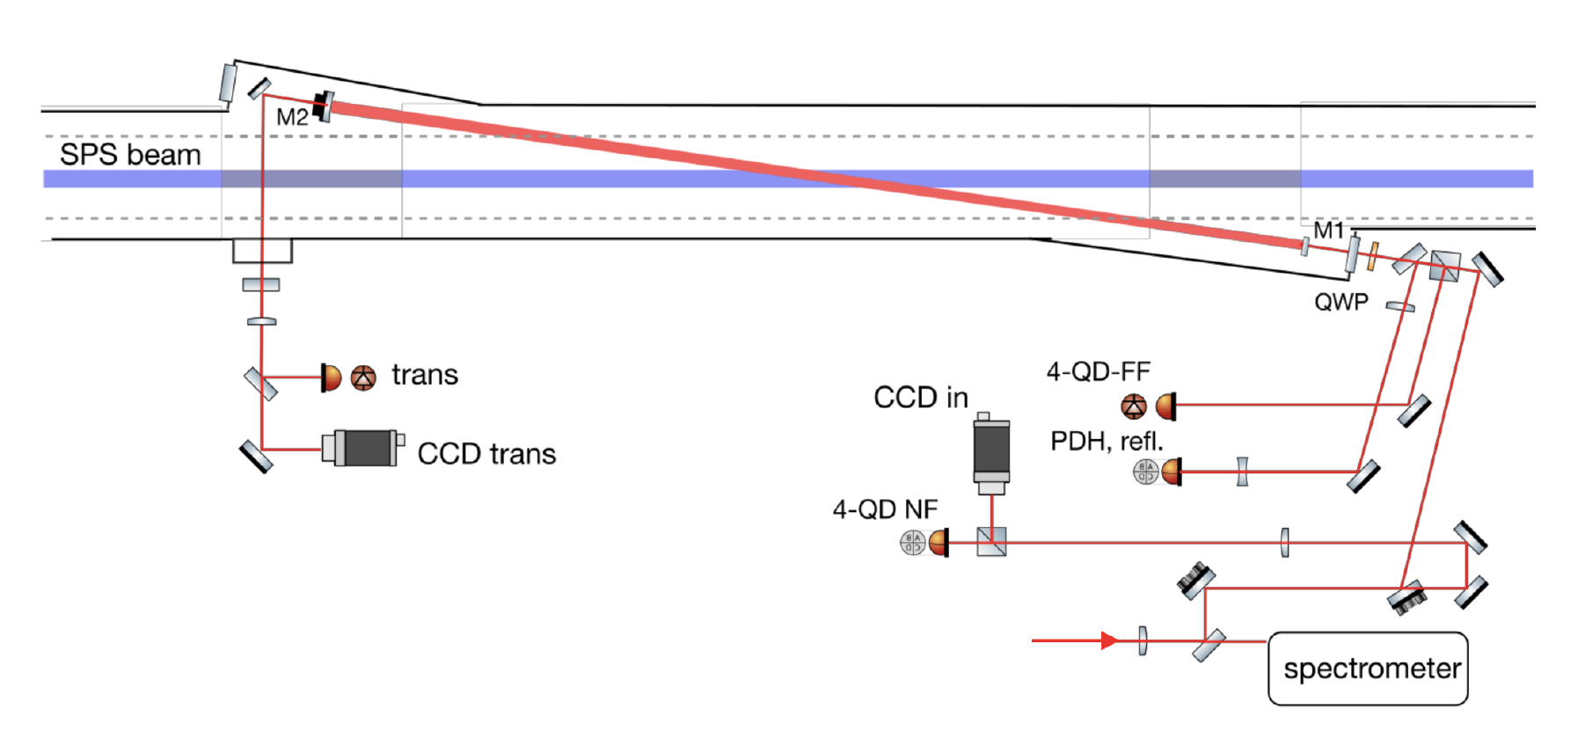
Gamma Factory Proof-of-Principle (PoP) SPS experiment
Detection of produced
X-rays in resonant
excitation of the
(2s—>2p)_{1/2}
transition
Lithium-like lead ion bunches in the SPS
SPS half-cell 621 with side tunnel TI18
LSS6 zone
F-P cavity – “in beam” position
F-P cavity
F-P cavity length – 3.75 m -- vertically tilted by 2..6 deg

Slide 14
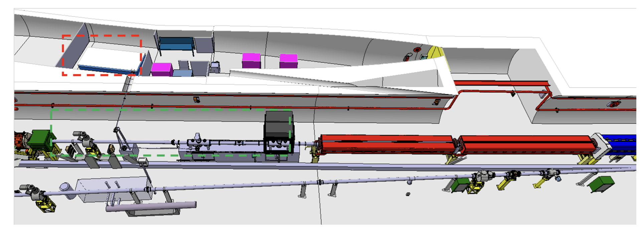
PoP experiment – location of laser room
SPS half-cell 621 with side tunnel TI18

Slide 15
The purpose of the GF SPS PoP experiment
1
5
Demonstrate ion beam cooling: longitudinal and then transverse
6
Atomic physics measurements
4
2
3
Demonstrate stable and repeatable operation
Confront data and simulations
Demonstrate that an adequate laser system (5mJ@40MHz) can be (remotely) operated in the high radiation field of the SPS.
Demonstrate that very high rates of photons are produced : almost all PSI’s are excited in single collision of the PSI bunch with the laser pulse
Estimated cost of the experiment 2.5 MCHF

Slide 16
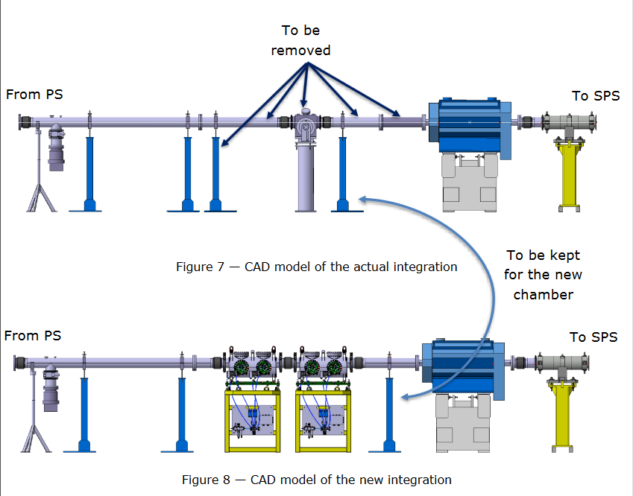
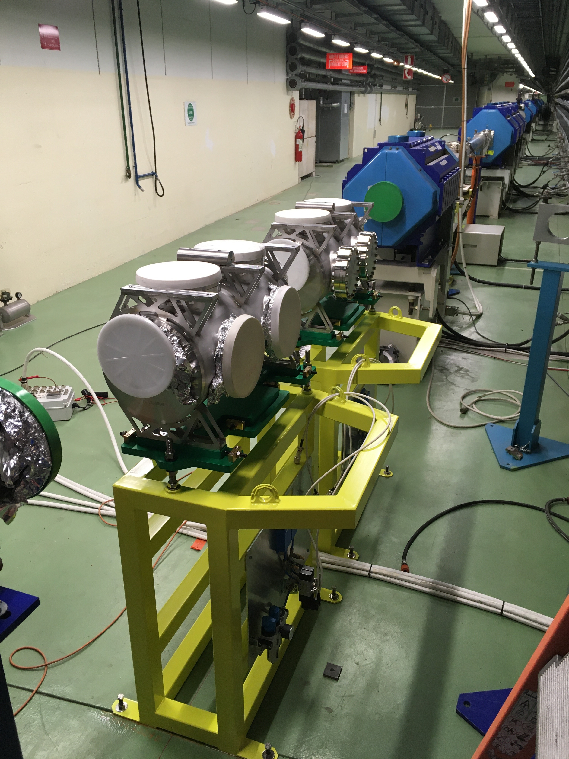
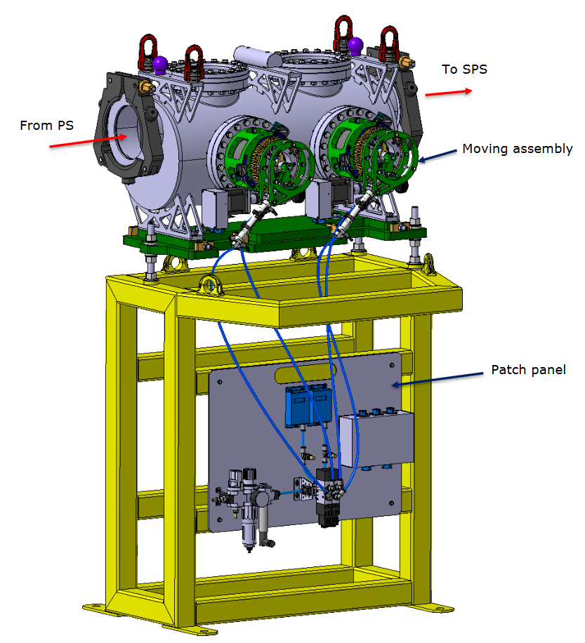
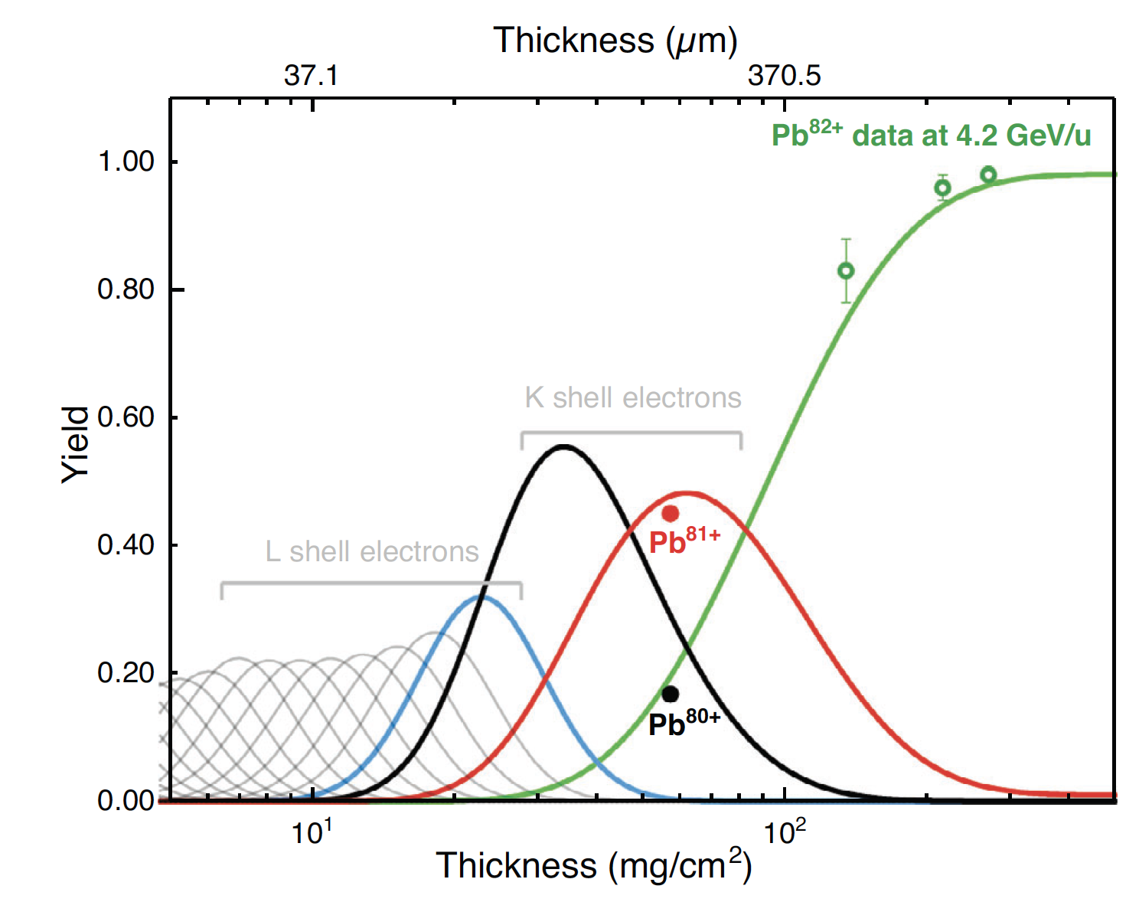
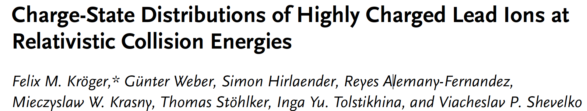
Very recent technical developments: new TT2 stripper system
Stripping of Pb+54 ions in the TT2 PS-→ SPS transfer line
PoP experiment
Pb+79
R. Alemany-Fernandez (BE.OP), E. Grenier-Boley and D. Baillard (SY.STI)
The two tanks of the new stripper system have been installed during YETS 2021-2022. The first of them is already one is equipped with two stripper foil mechanisms. The second will house additional two foil mechanism (installation in YETS 2022-20023)

Slide 17
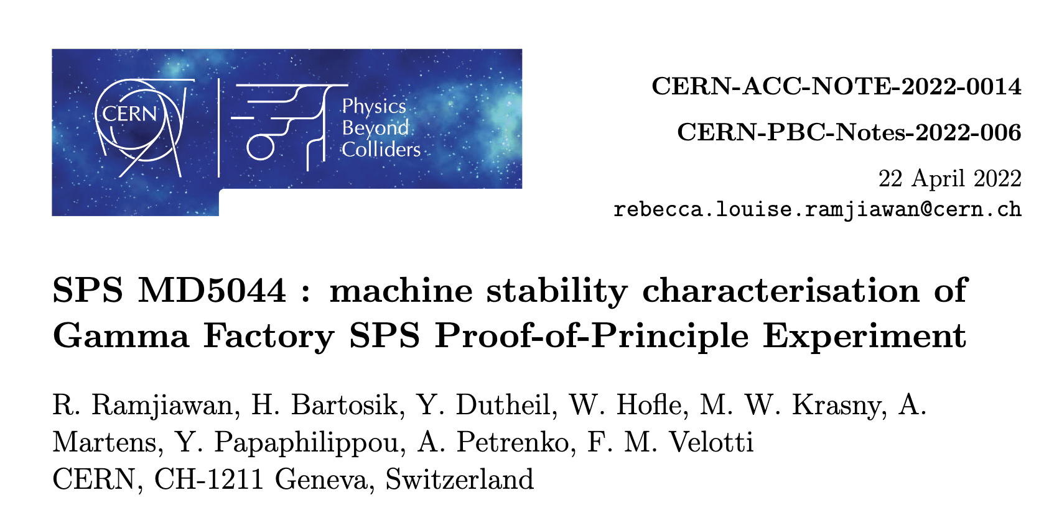
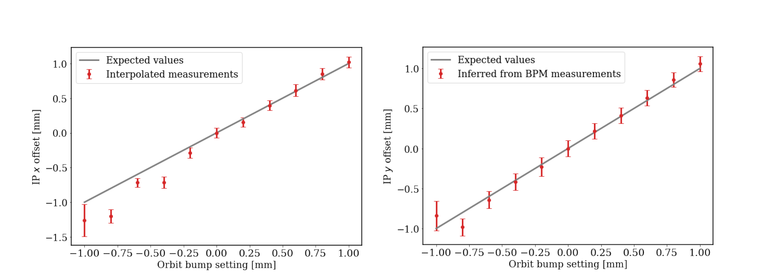
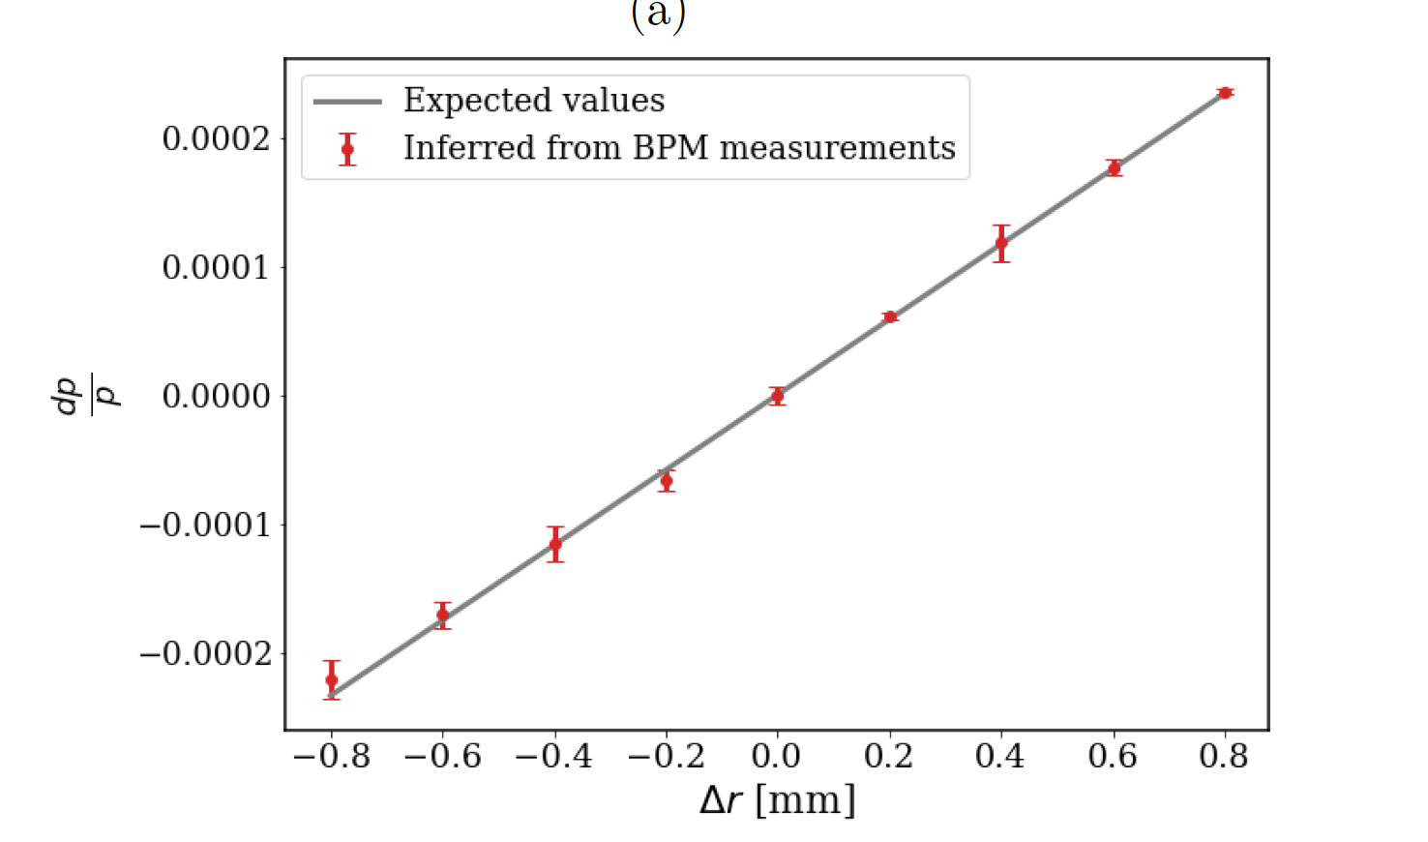
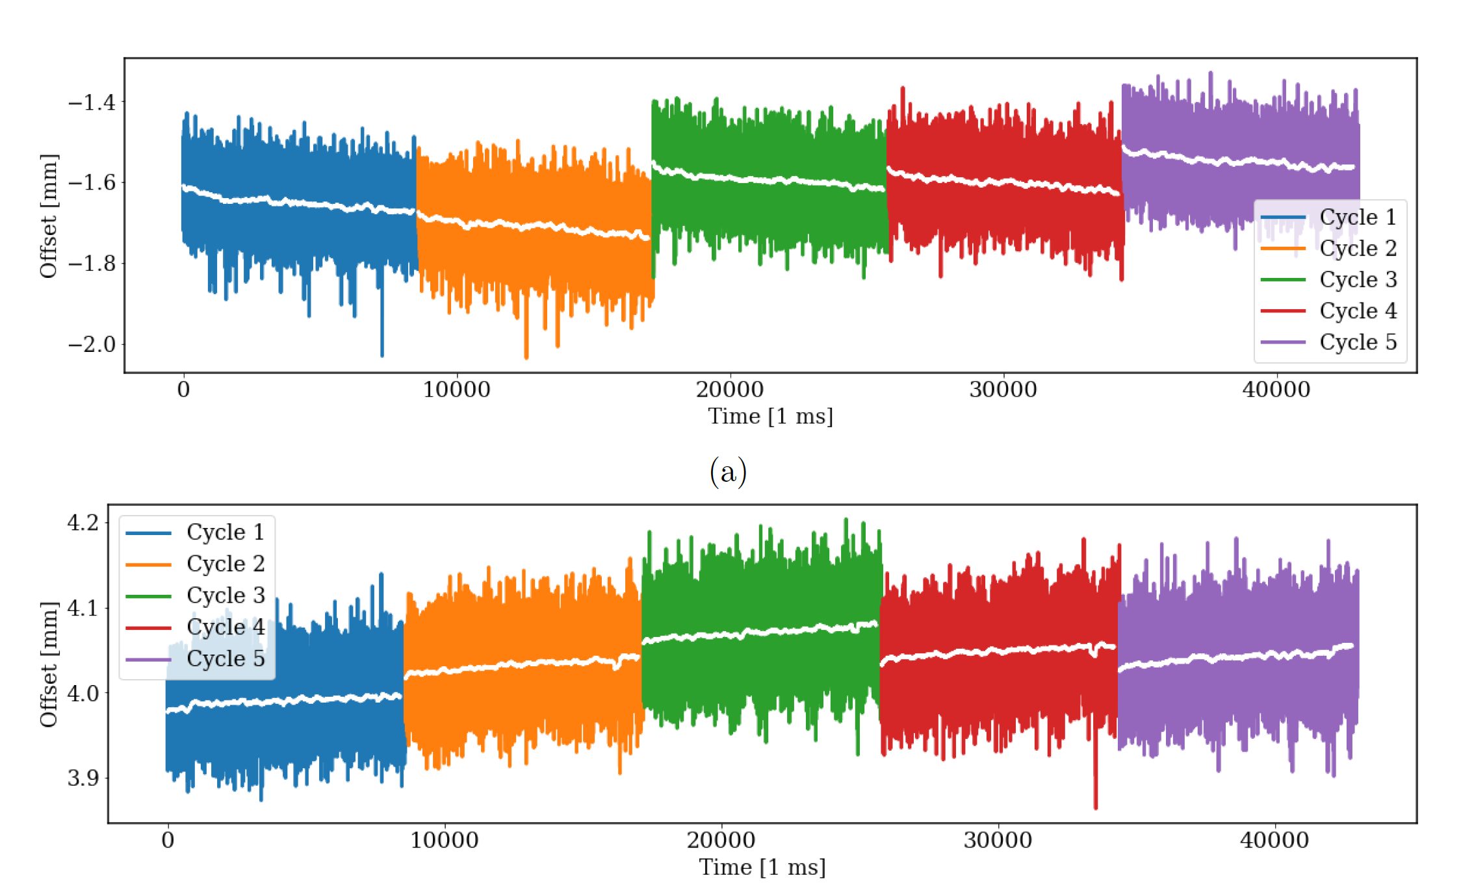
Very recent technical developments: Beam orbit and beam momentum stability tests at the SPS
Control of the beam position and momentum in the PoP IP
Main result of the beam tests:
The beam position at the IP and beam momentum can be controlled with the requisite precision. The measured beam trajectory followed closely the predictions from simulations.

Slide 18
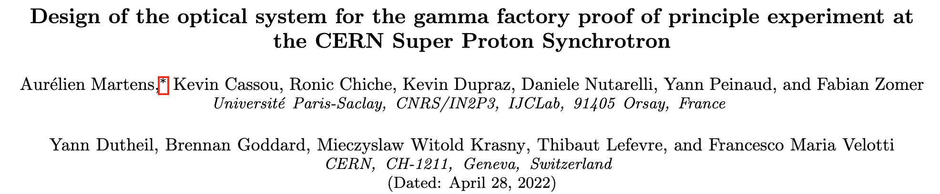



Very recent technical developments: final design of the GF optical system
… submitted last week to Phys.Rev.
Choice of the laser oscillator –
phase noise measurements
Choice of the radius of the
hemispherical mirrors
Dumping of non-gaussian
modes in the FP cavity
Final choice: R=7.65 m
Laser 2 fulfils the requisite phase-stability
criteria for the 40 Mhz, 10000 finesse FP cavity

Slide 19

GF-PoP experiment status
As received from the SPSC referees on Oct. 20th 2020
« The SPSC recognizes the Gamma Factory's potential to create a novel research tool, which may open the prospects for new research opportunities in a broad domain of basic and applied science at the LHC. »
We have recently finalised the final specification of the Laser and FP system for the GF-PoP experiment, made the requisite SPS beam-stability tests and finalised the technical specification of the stripper
In parallel, we are finalizing a detailed estimation of the CERN (Accelerator Sector), and participating labs, resources needed to construct the PoP experiment in the SPS tunnel with the plan to submit an EU funding request
We are in the process of signing the GF-PoP-MoU by collaborating institutes
Full experiment specifications have been finalised.
Target Installation time : LS3 -- what we (only) need is to find 2.5 MCHF to cover the cost of the experiment and to assure the requisite CERN FTE resources (experiment infrastructure)…

Slide 20
Opening new possibilities

Slide 21


























GF papers published since JENAS EoI submission (2020)

Slide 22
Examples of potential applications domains of
the Gamma Factory research tools
particle physics (precision QED and EW studies, vacuum birefringence, Higgs physics in γγ collision mode, rare muon decays, precision neutrino physics, QCD-confinement studies, …);
nuclear physics ( nuclear spectroscopy, cross-talk of nuclear and atomic processes, GDR, nuclear photo-physics, photo-fission research, gamma polarimetry, physics of rare radioactive nuclides,… );
astrophysics (dark matter searches, gravitational waves detection, gravitational effects of cold particle beams, ¹⁶O(γ,α)¹²C reaction and S-factors…);
fundamental physics (studies of the basic symmetries of the universe, atomic interferometry,…);
atomic physics (APV in highly charged atoms, electronic and muonic atoms, pionic atoms);
accelerator physics (beam cooling techniques, low emittance hadronic beams, plasma wake field acceleration, high intensity polarised positron and muon sources, beams of radioactive ions and neutrons, very narrow band, and flavour-tagged neutrino beams, neutron sources…);
atomic physics (highly charged atoms, electronic and muonic atoms, pionic and kaonic atoms);
applied physics (accelerator driven energy sources, fusion research, medical isotopes’ and isomers’ production).

Slide 23

Visions for the future requirements for physics research
Mieczyslaw Witold Krasny
LPNHE, CNRS and University Paris Sorbonne and CERN, BE-ABP
https://indico.cern.ch/event/1133593/timetable/?print=1&view=standard

Slide 24
Four examples
particle physics
astrophysics
atomic physics
nuclear/applied physics

Slide 25









Particle Physics: GF low-emittance, high-intensity muon source
Existing and future muon sources
Gamma-Factory muon source
A.Apyan, M.W.Krasny, W. Placzek, to be published
acceleration to
10 GeV over 2.5 m

Slide 26




Astrophysics: Dark matter searches
GF: ALP discovery potential
GF: dark photon discovery potential
Significant discovery potential for Dark Matter particles with GF photon beams!

Slide 27

Atomic physics: muonium

Slide 28






Nuclear/applied physics: GF photon-beam-driven energy source
Nature:
TR = transmuted/loaded
Photon beam
SR = transmuted/produced
Can we produce rather than buy the plug-power necessary for the next generation of high-energy, high-current new accelerators locally, in situ, in our HEP research centers?

Slide 29
Conclusions

Slide 30
A potential place of the Gamma Factory (GF) in the future CERN research programme
The next CERN high-energy frontier project (if ever constructed) may take long time to be approved, built and become operational, … unlikely before 2050-ties
The present LHC research programme will certainly reach earlier (late 2030-ties?) its discovery saturation (L_{int} ~ 0.5L_{goal}) -- little physics gain by a simple extending its pp/pA/AA running time
A strong need will certainly arise for a novel multidisciplinary programme which could re-use (“co-use”) the existing CERN facilities (including LHC) in ways and at levels that were not necessarily thought of when the machines were designed, by a broad scientific communities
The Gamma Factory research programme could fulfil such a role. It can exploit the existing world unique opportunities offered by the CERN accelerator complex and CERN’s scientific infrastructure (not available elsewhere) to conduct new, diverse, and vibrant research in particle, nuclear, atomic, fundamental, applied physics, and astrophysics with novel research tools

Slide 31





  Concepts and tools

Slide 32

  A vision of the LHC operation mode in in the post-HL-LHC phase

