Slide 1
















HOW TO LIMIT THE ENVIRONMENTAL IMPACT
Mar Capeans
2nd Joint ECFA-NuPECC-ApPEC JENAS-Seminar
May 2022 Madrid, Spain
EDMS 2735914

Slide 2

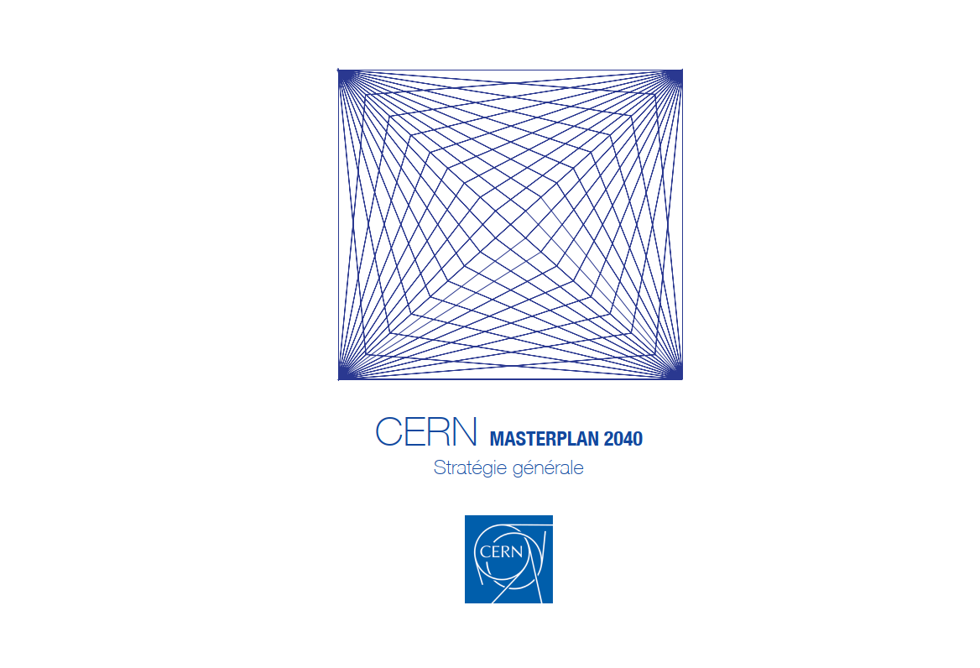
OUTLINE
Environmental protection at CERN
Reporting
Targets
Actions
CERN Environmental Reports
CERN Masterplan 2040
Site development
Future
Outlook
ACKNOWLEDGEMENTS
B. Delille and S. Kleiner, CERN Health, Safety and Environmental Unit, E. Cennini, CERN Industry, Procurement and Knowledge Transfer, N. Bellegarde and S. Claudet, CERN Accelerator & Technology Sector, FCC team, CLIC team, CERN Site and Civil Engineering Department team

Slide 3
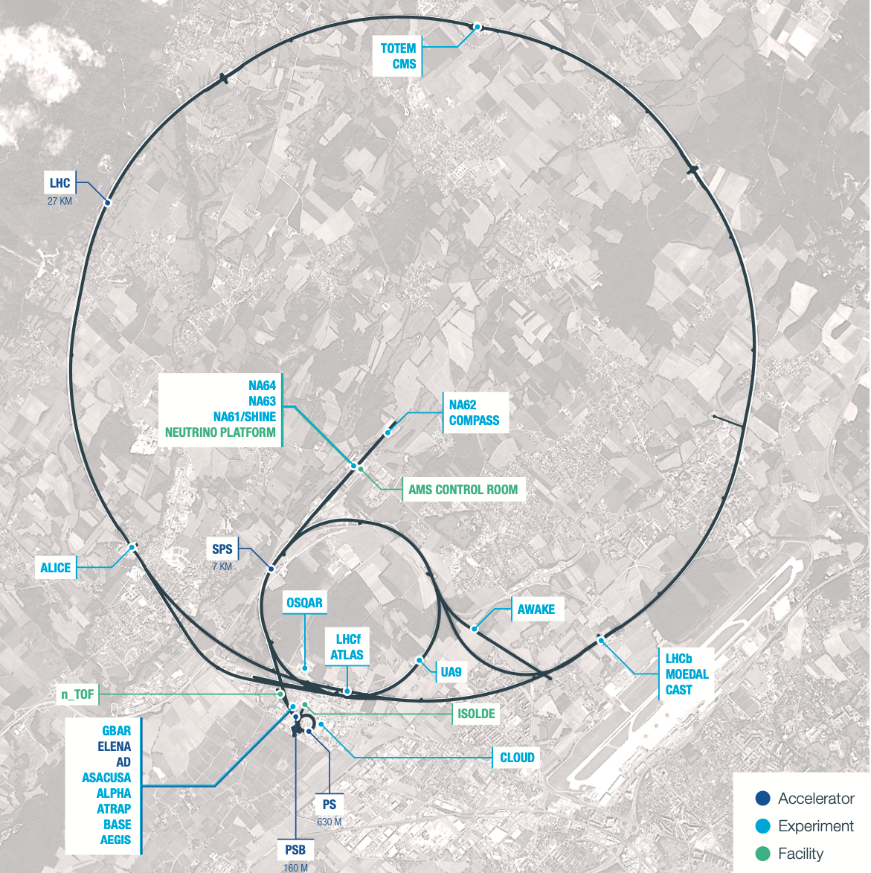
CERN
23 Member States
3600 employees
12’500 scientists (110 nationalities) using the Laboratory’s facilities
35 Non-Member States with Co-operation agreements with CERN
1200 MCHF annual budget

Slide 4
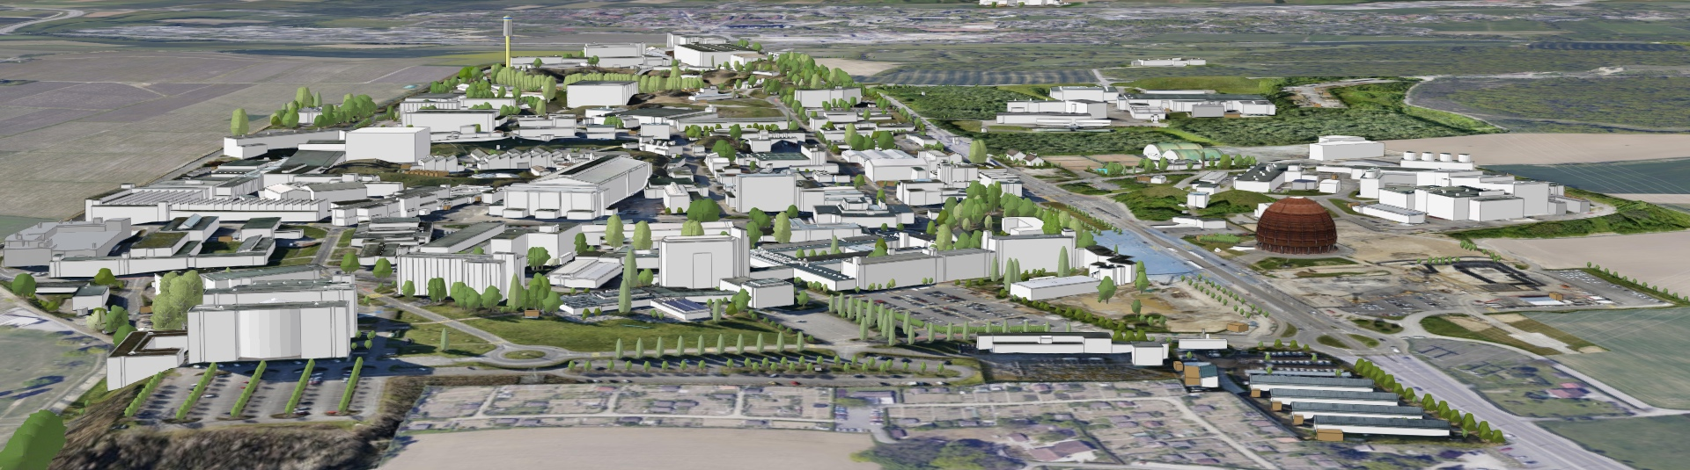
KEY FIGURES
590 ha (220 fenced)
2 main sites and 15 satellite sites
670 buildings from 10 m² to 20.000 m²
65% built before the 70’s
70 km tunnels and 80 caverns
30 km roads
1000 km technical galleries and trenches
9000 persons/daily
490 hostel rooms
8500 working places
4300 parking places in Meyrin, 1400 in Prévessin
25000 daily movements to- and inter-sites
Public transport links in CH, not in FR

Slide 5
STRATEGY
Involving the entire organization
  Environment included in CERN’s main objectives for 21-25
  Strong strategic direction from the DG, endorsed by Council and supported by enthusiastic efforts throughout the organization
  Increasing accountability and governance
Generating transparent and reliable reporting
  Materiality assessment and stakeholder review
  Reporting on GHG emissions since 2019, Global Reporting Guidelines (GRI)
Acting
  Setting targets
  Global strategy with objectives and measures that take up the framework objectives and translate them into operational prioritized measures

Slide 6

STRATEGIC ACTIONS
2016 | 2017 | 2018 | 2019 | 2020 | 2021 | 2022 | 2023 | 2024 | 2025
Energy Management Panel
Baseline year
2017-2018
Environment Report
2023-2024 Environment Report
Environmental Protection Steering Board
Materiality analysis
Environmental Noise policy
2021-2022 Environment Report
Environmentally Responsible Procurement Policy
2019-2020 Environment Report
Energy Performance plan
Environmental Responsible Procurement Policy Project
ISO50001 certification
Green Village
Innovation Programme on Environmental Applications
Masterplan2040

Slide 7
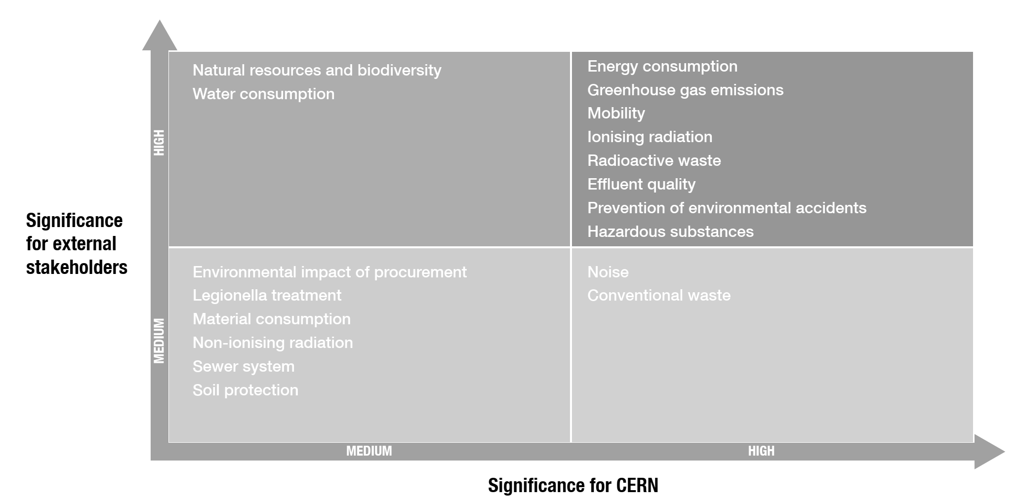
MATERIALITY

Slide 8











SCOPE 1
Direct
SCOPE 2
Indirect
SCOPE 3
Indirect
Particle Detectors
Accelerators
Purchased electricity
Waste treatment
Water purification
Business Travel
Vehicles
Employee Commuting
Catering
Procurement
Assets

Slide 9
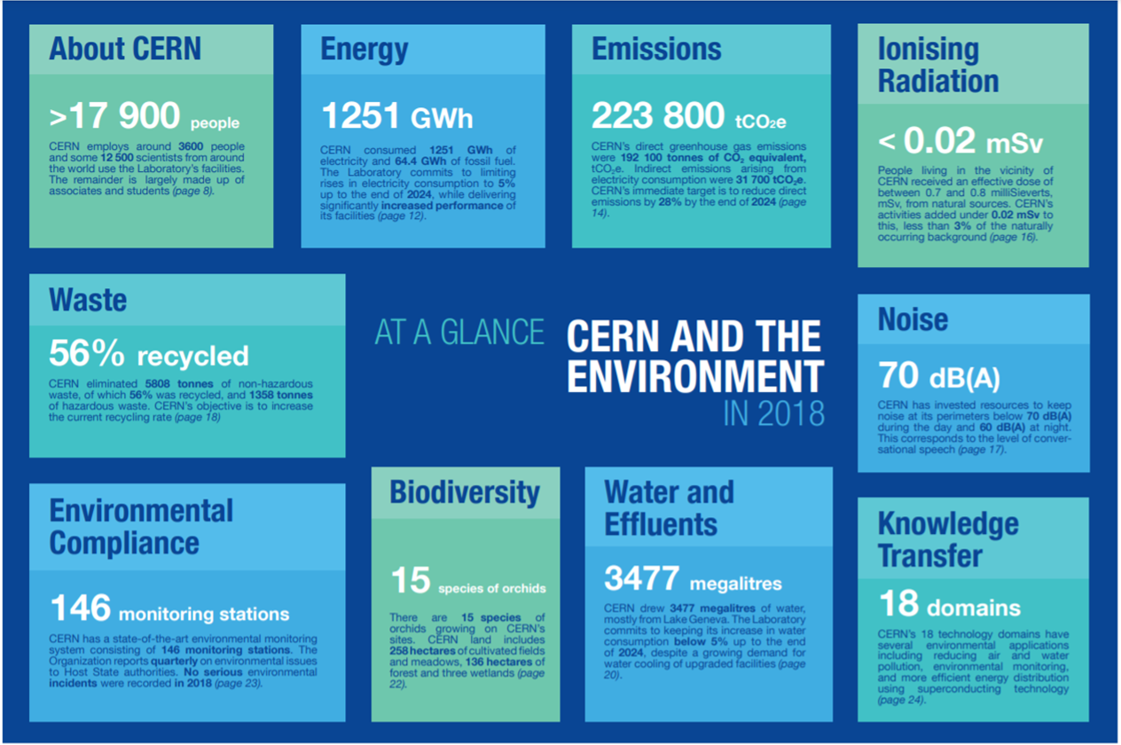

Slide 10
TARGETS 2025
ENGAGEMENTS
GHG Emissions
Reduction by 28%
Waste
Increase recycling rate
Noise
Restrict
Energy Consumption
Limit raise by 5%
Commuting
Constant
Water Consumption
Limit raise by 5%
Biodiversity
Protect

Slide 11
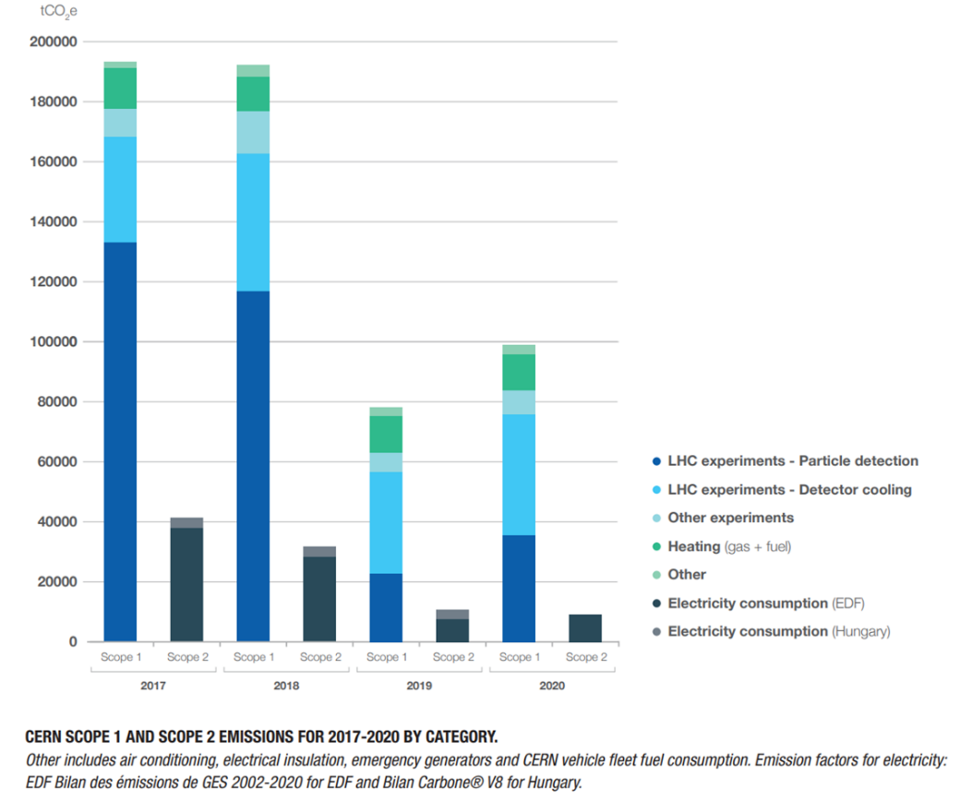
GHG EMISSIONS
Detector cooling
Systems using F-gases will be stopped by end of Run3 and replaced by CO₂ cooling for Run4
Forecasted reduction ~40’000 tCO₂e/year
Particle detection (gases)
Reduction target ~13’000 tCO₂e/year

Slide 12
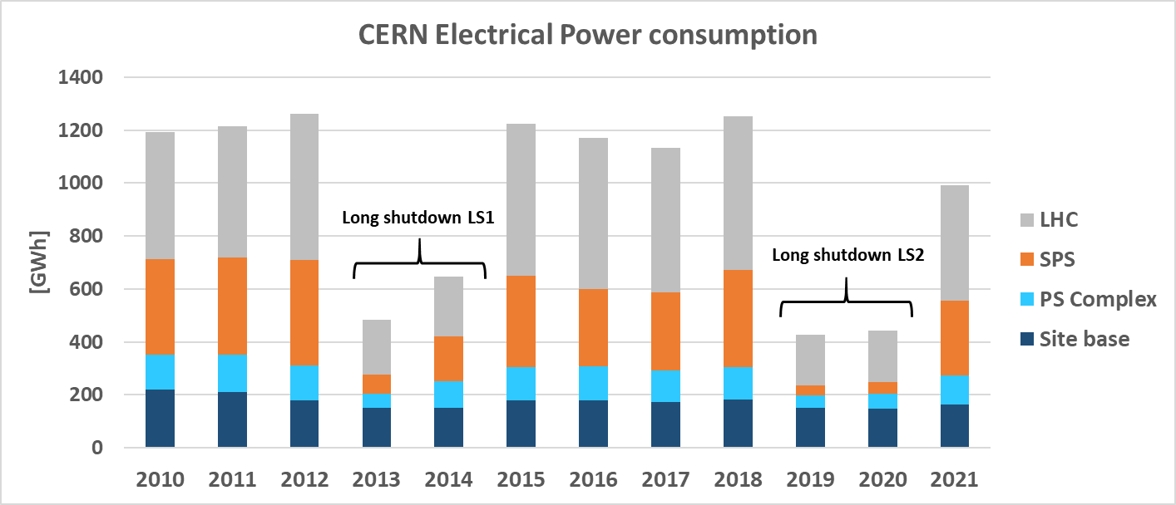
SCOPE 2: INDIRECT EMISSIONS

Slide 13
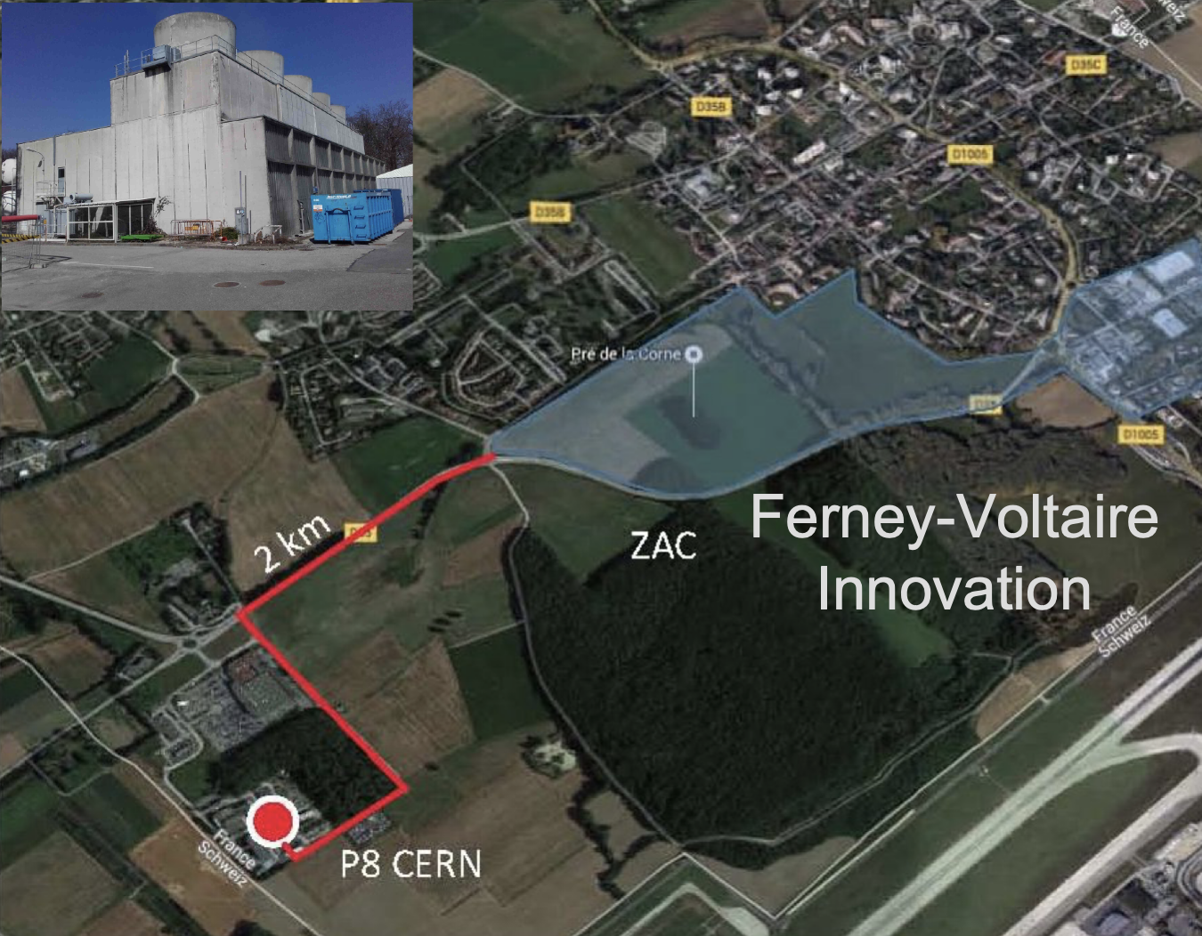
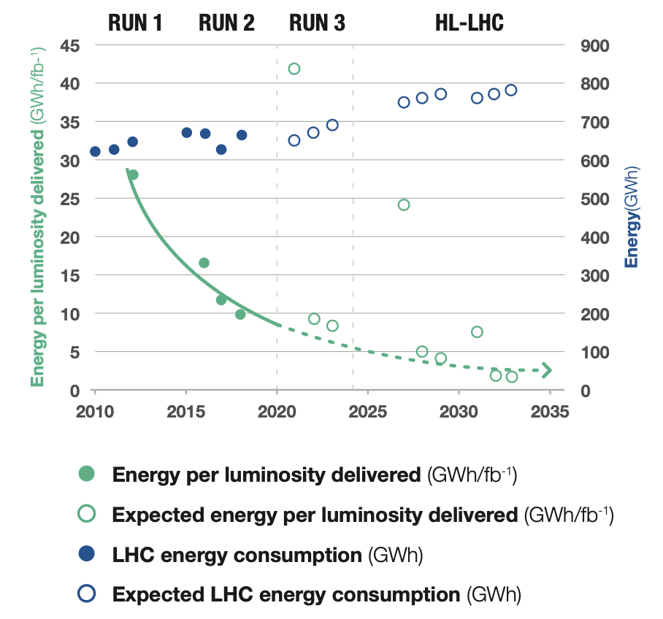
SCOPE 2: ACTIONS ON ENERGY CONSUMPTION
INCREASE EFFICIENCY
USE LESS
RECOVER
Savings up to ~100 GWh/y since 2010
LHC high availability at ~constant energy consumption
Technology: PS East area power converters designed to supply the magnets on a cyclical basis, with an energy-recovery stage between each cycle resulting into 90% electricity consumption reduction: (11 to 0.6 GWh/y)
Campus: Building Global renovations for reduction of losses (energy, water, gas, cooling), densifying occupation
Annual Virtual Energy Bills
Energy performance plan & ISO50001
Hot water from LHC cooling system (P8, 2 x 5 MW heat exchangers) to heat up a residential area (20 GWh/y at peak).
PCC to heat Prevessin CERN site (3-4 MW)
LHC Cooling towers at P1 to heat Meyrin CERN site (5-10 MW)

Slide 14
SCOPE 3: INDIRECT EMISSIONS
21/03/2022

Slide 15
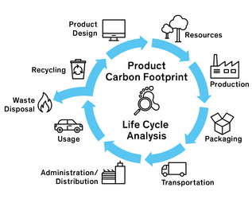

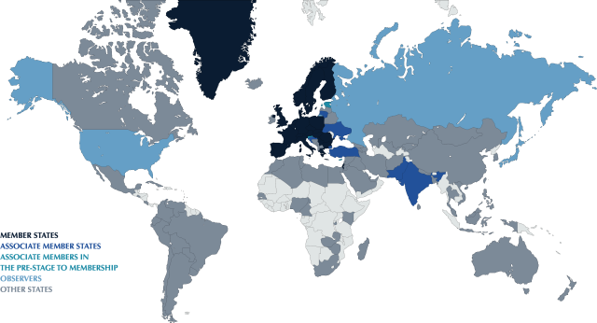
Challenge the need!
SCOPE 3: ACTIONS
As user/owner?
Functional approach
KPIs e.g. % recycled
Buy/Partner/Make
CERN Environmental Responsible Procurement Policy Project (2021)
Courtesy E. Cennini
WHY BUYING
HOW DO WE BUY
Fair competition
Payment deadline
WHAT DO WE BUY
Reasoned negotiation
Suppliers’ performance
Respect of commitments
Polluting materials?
Carbon footprint?
Social impact?
Eco-design/Life Cycle Analysis
Resource optimization (water/energy)
Total Cost of Ownership (TCO)
WHO WE BUY FROM
Countries/people exposed
Duty of vigilance/Compliance
(Very) Poorly balanced Countries
Labels/Certification
Local purchase/Diversity

Slide 16
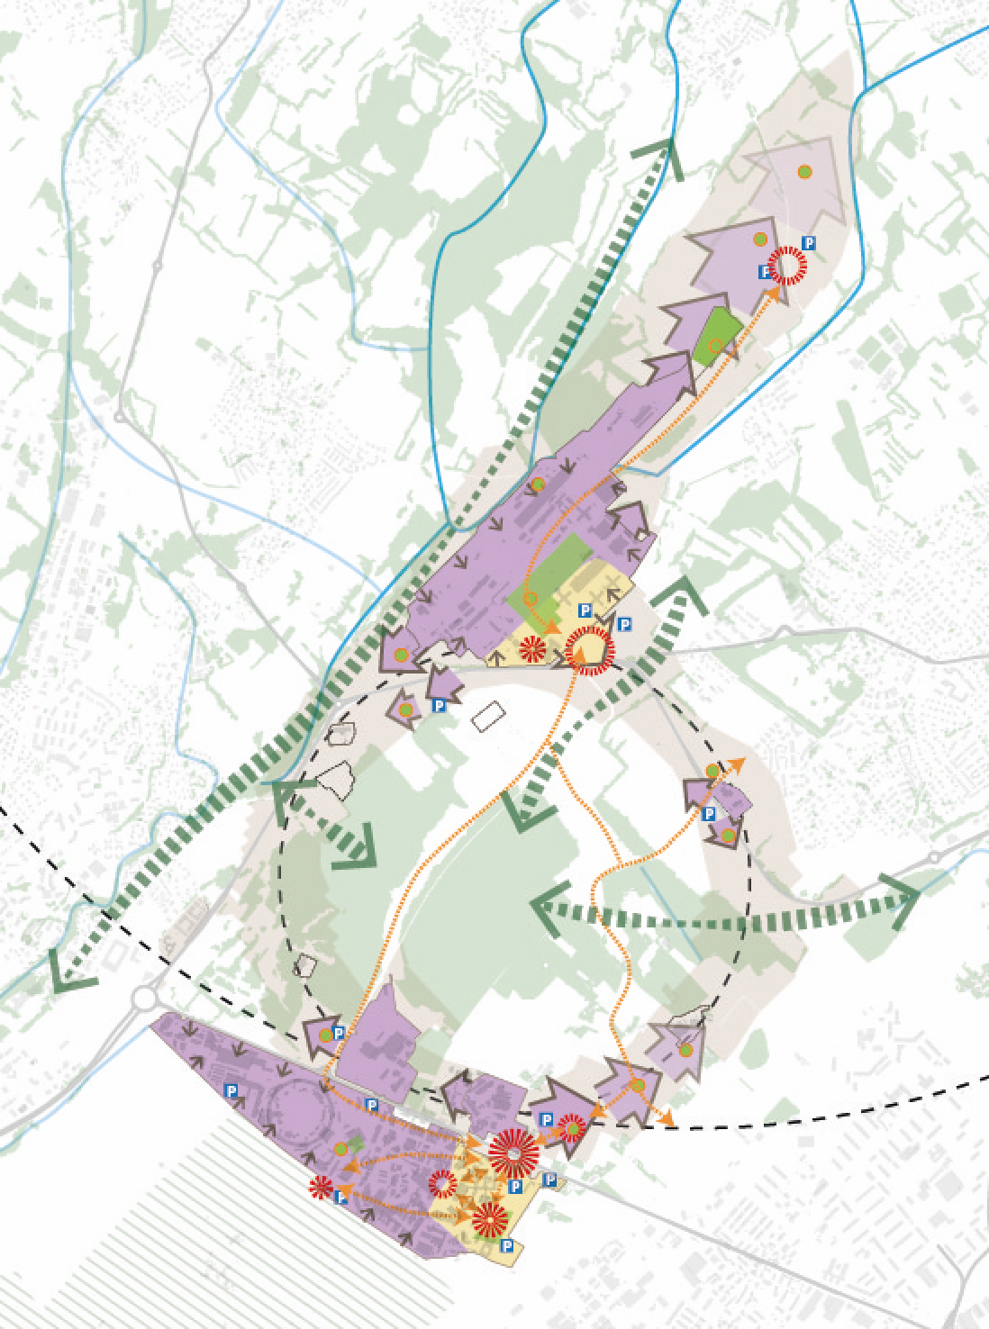
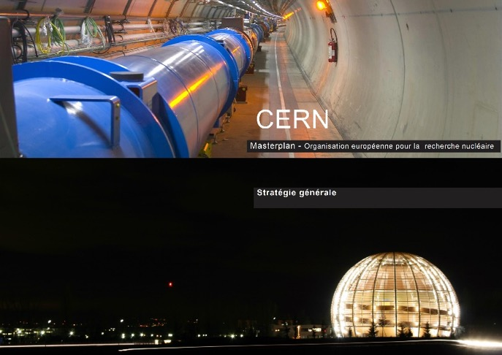

CERN MASTERPLAN2040
Integration of the latest projects
Integration of SPS land and LHC points
Integration of the Development Guide (CH)
Integration of sustainable development

Slide 17
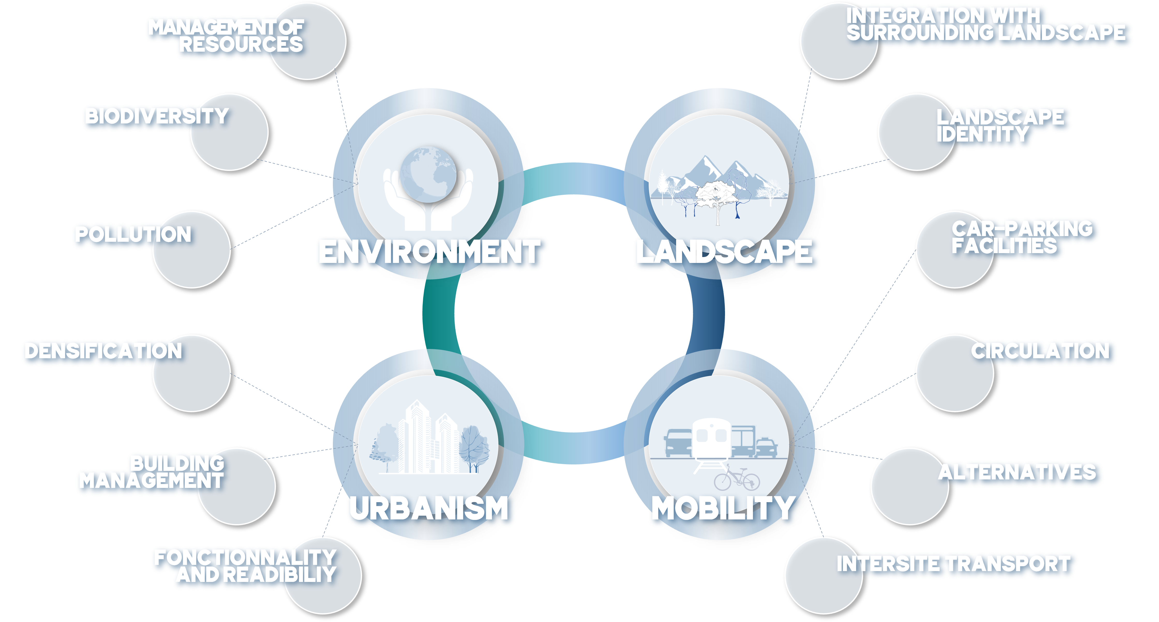

MASTERPLAN2040
Framework objectives and measures

Slide 18
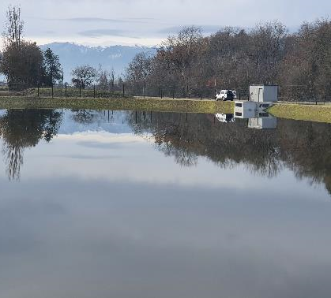

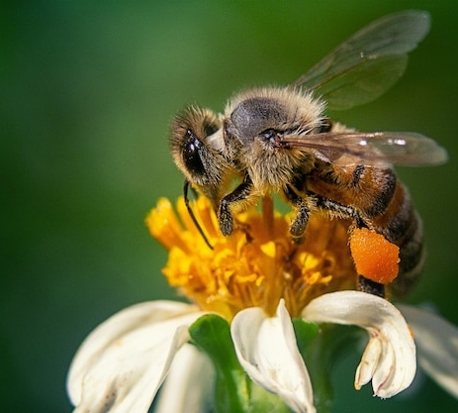
MASTERPLAN2040
MANAGEMENT OF
RESSOURCES
Control the resource requirements for the operation of tertiary infrastructures:
Improve energy consumption and reduce greenhouse gas emissions
Promote new energy-generation technologies
Limit the increase in water consumption.
BIODIVERSITY
Initiate an action plan in favour of biodiversity, green spaces and protected species:
Continue to implement the rainwater management strategy at CERN
Draw up an inventory of the existing biodiversity, protected species and green spaces
Continue the development of the ecological continuity of environments and wildlife corridors.
POLLUTION
ENVIRONMENT
Control and mitigate CERN's environmental pollution:
Limit noise pollution
Increase the recycling rate and reduce waste production

Slide 19
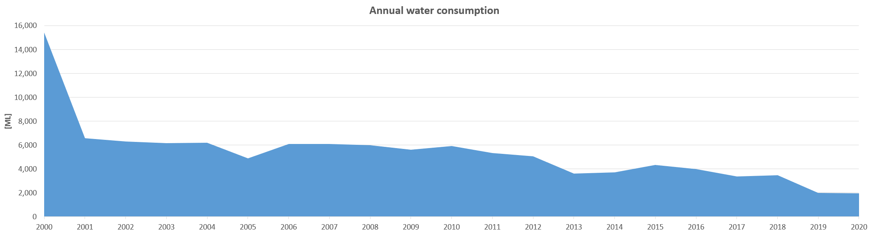
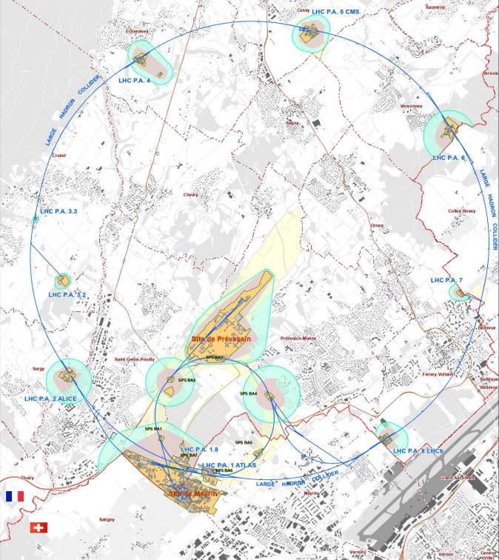
MASTERPLAN 2040: Environment
WATER
NOISE

Slide 20
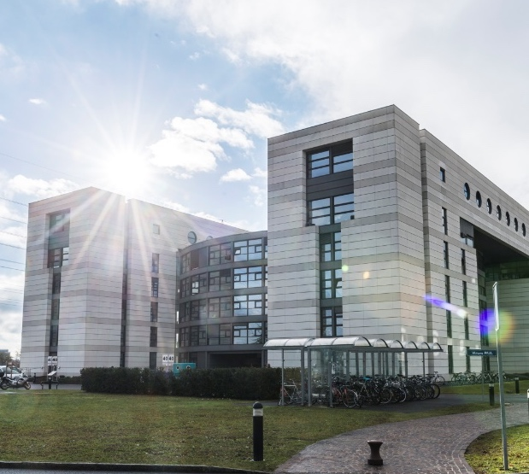

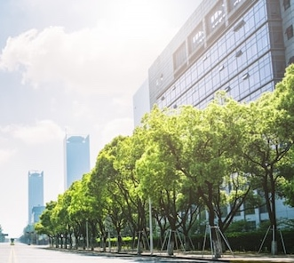
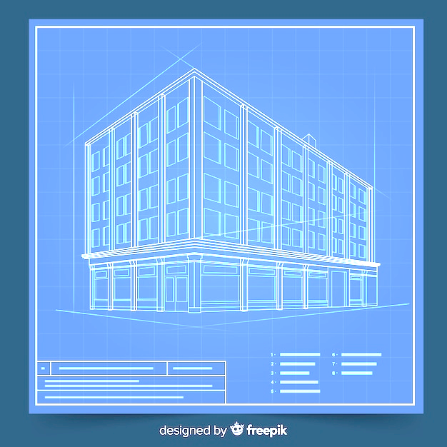
MASTERPLAN2040
DENSIFICATION
Densify land occupation by ensuring flexibility of use
Identify the areas set aside for development and define priorities
Continue to monitor CERN’s development
Draw up a land improvement plan
Favour taller buildings where site conditions and building use so permit
BUILDING MANAGEMENT
Standardise the use of built-up areas:
Develop a policy for the management of built-up areas with a specific strategy for each purpose
Continue monitoring existing buildings
Continue the renovation programme
URBANISM
FUNCTIONALITY & READABILTY
Consolidate the functionality of the Meyrin and Prévessin sites and the experiment sites, and make the Prévessin site autonomous :
Enhance the organisation and coherence of the sites by creating specific zones: visitor, academic, scientific–technological .
Create one or more decentralised service hubs on the existing and future sites, notably bringing together amenities, restaurants, public spaces, lawns, gathering areas, etc

Slide 21


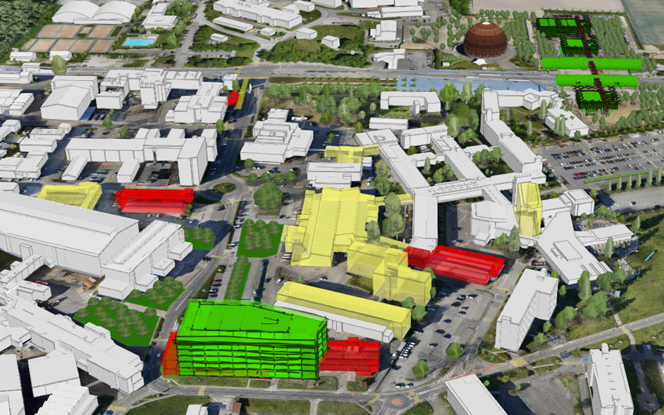
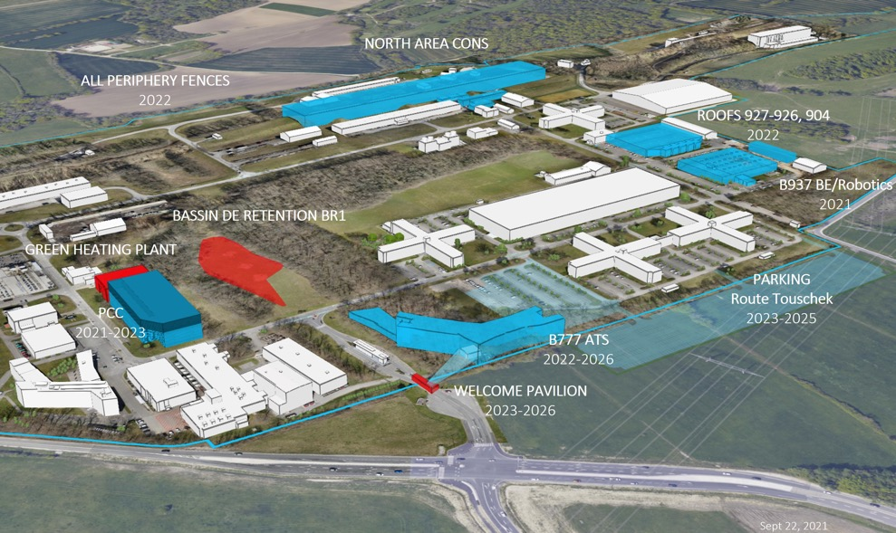
2021 - 2026 PLAN
New construction
Planned and funded
Renovation
Planned, not yet funded
Demolition

Slide 22
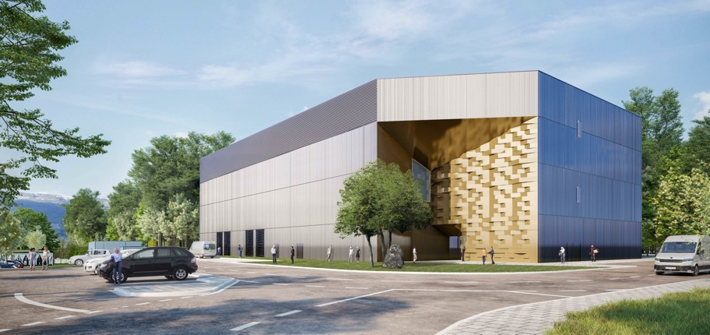
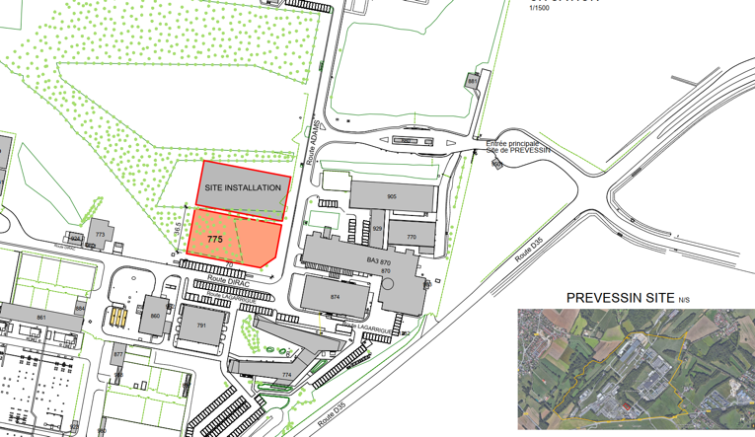
PREVESSIN COMPUTING CENTER
Initial capacity of 4 MW available for IT equipment with stepwise future increases to 12 MW.
To meet CERN's environmental goals the project incorporates the following considerations :
Designed to be energy efficient with a target PUE (Power Usage Efficiency) of 1.10 (1.15 contractual)
Optimised water consumption via a recirculation system lowering consumption in hot periods
All cleared vegetation will be reconsolidated
The acoustic study used for design of the building follows CERN commitments
A heat recovery system is foreseen for up to 25% of power produced to be recovered
Green terrace on the roof

Slide 23
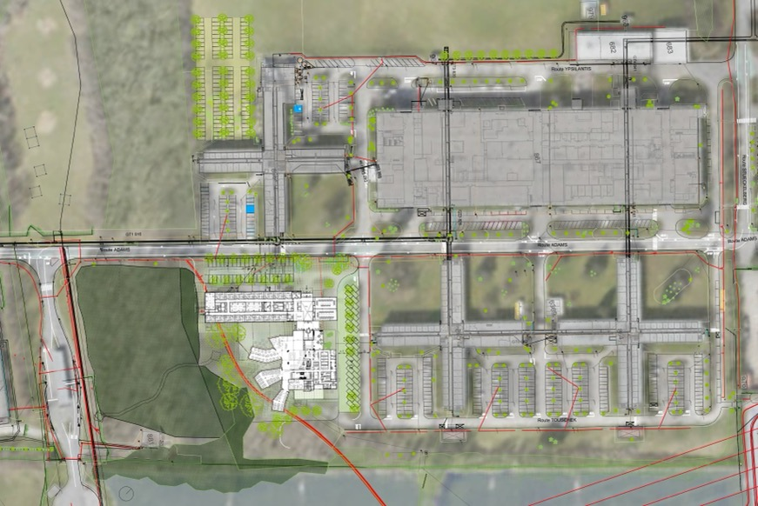
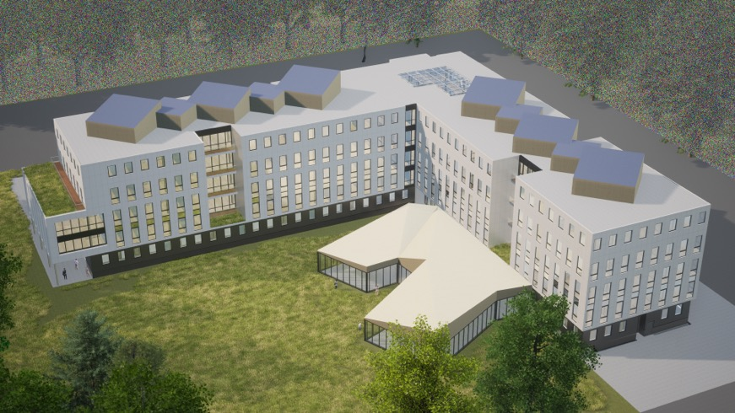
PREVESSIN OFFICE CENTER
Key design information:
Tertiary building (475 p.) + new restaurant (500 s.) + Parking
Compliance Master Plan 2040
Compliance RE 2020 (environmental regulation) ;
Low embodied energy (mass timber structure)
Preservation of near by forest
Integrate soft mobility ;
2026 : end of works
Reference Design

Slide 24
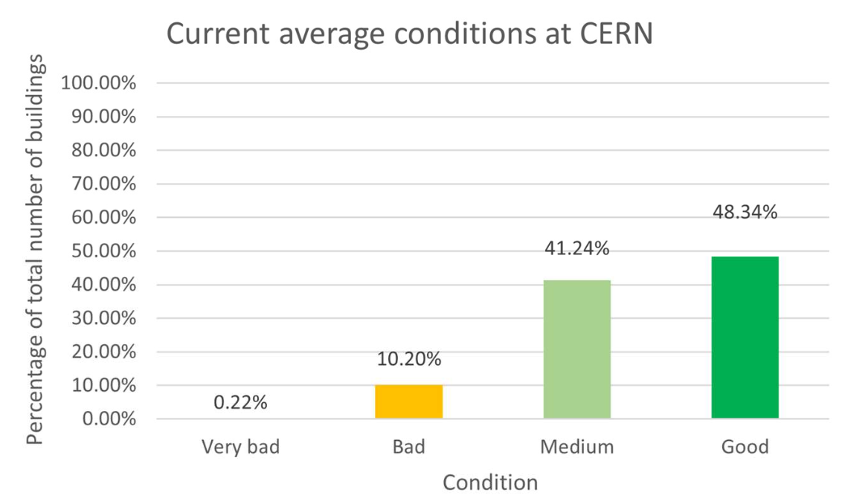
SITECONSOLIDATION
PRIORITIES
PROCESS
SPECIFICATIONS
Safety
Strategic value wrt scientific goals
Sustainability: durability, environmental impact, energy performance
Data-driven decisions
Standardization of requirements definition according to Masterplan objectives and approval process for execution
5-year view
Global renovations
Regulations compliance
Energy efficiency improvement: > 60%
Monitoring heating, electrical and lighting consumption
Operation of HVAC, Heating and lighting consumption according to the outdoor temperature, occupation of the premises, eco-mode
Favor centralized networks
AMBITIONS
Global renovation of up to 2 buildings/y
Densify consolidated space
New space management policy
Demolish depreciated space

Slide 25
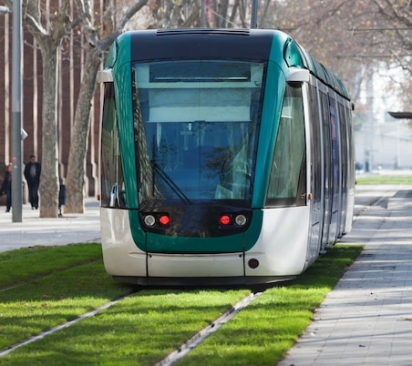
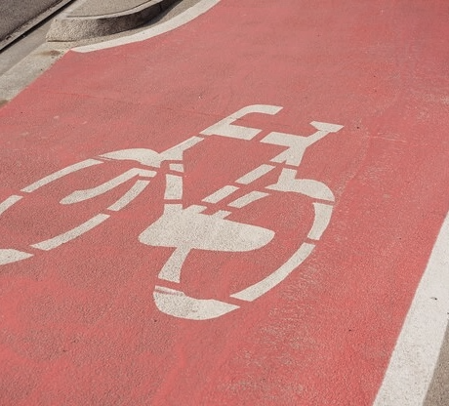

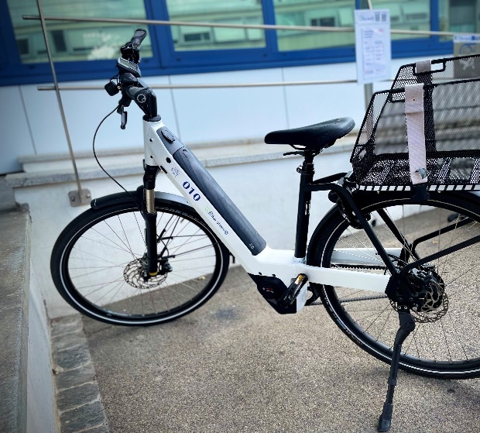
PARKING
MASTERPLAN2040
Optimise the car-parking facilities and their management :
  Limit car parking
  Privilege car parks close to the main road network
  Continue the development of facilities for soft-mobility
  Develop communication promoting a reduction of the impact of people’s mobility at CERN
CIRCULATION
Promote efficient and fluid access to and circulation on the CERN sites :
  Optimise the fluidity of access to the CERN sites.
  Improve the hierarchy of the road network.
  Continue developing accessible facilities for people with reduced mobility.
ALTERNATIVES
MOBILITY
Encourage alternatives to individual motorised transport for commuting :
  Encourage car sharing.
  Improve the continuity, safety and comfort of soft-mobility routes and provide parking for bicycles.
INTERSITE TRANSPORT
Promote alternatives for travelling between the CERN sites :
  Continue developing facilities associated with collective transport on site.
  Optimise the management and supply of CERN vehicles.
  Expand and diversify CERN’s bicycle fleet.
  Continue developing the network of foot and cycle paths on site.

Slide 26
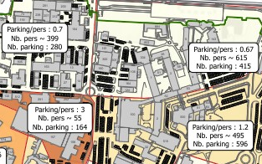
MOBILITY
STRATEGIC PRINCIPLES
ROADMAP
ACTIONS
Focus on people needs
Integrate transport modes
Adaptable to the future needs of the organization
Sustainable and eco-responsible
Communicate, cooperate with local actors, and involve the community
Data driven
Targets
KPIs
Eliminate abandoned vehicles (2021)
10 km Cycle paths (2020)
+40% Bike parkings (2022)
2 E-charging stations (2022)
80 E-bikes (2021)
Increased car-sharing (2022)
Optimization of the car fleet (2023)
Modal points at < 5min walk
Mobility Report (2022 and yearly)

Slide 27
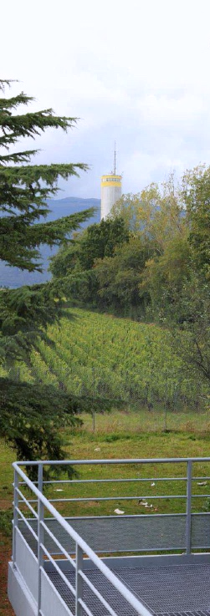

MASTERPLAN2040
INTEGRATION WITH SURROUNDING LANDSCAPE
Integrate the CERN sites with the surrounding landscape :
Integrate sites harmoniously with the existing features of the overall landscape and with the views onto that landscape
Enhance the CERN site perimeters by planting diverse hedgerows that will contribute to the overall ecological network
Implement an architectural strategy to enhance the image of CERN’s buildings and emblematic public areas
LANDSCAPE IDENTITY
Develop a landscape identity :
Harmonise and enhance the attractiveness of the landscape developments and gathering areas, and create a furniture and signage catalogue
Reduce islands of heat and plant trees and shrubs close to existing and future paved or tarmacked spaces, car parks and roads
LANDSCAPE

Slide 28
TECHNOLOGY & ENVIRONMENT
INNOVATION PROGRAMME ON ENVIROMENTAL APPLICATIONS
GREEN
VILLAGE
FROM SOCIETY TO CERN TO SOCIETY
Enabling rapid access to CERN campus as a test site for technologies linked to environment and sustainability
Accelerating the commercialization of ideas, technologies and prototypes
Involving Young Innovators (new ideas for unforeseen applications)
Challenges: waste management, mobility, energy efficiency for tertiary activities on campus, space management, IoT, Zero-waste, urban analytics, …
FROM CERN TO SOCIETY
CIPEA: Developing advanced technologies linked to environment and sustainability
E.g. solar thermal panels derived from vacuum technology; CO₂ cooling technology; superconductive power transmission lines and current leads

Slide 29
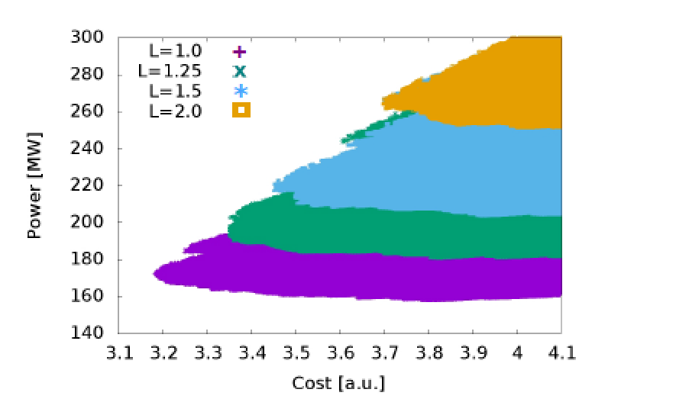
FUTURE STUDIES & ENVIRONMENT
FCC
CLIC
Integration of an “Eco-design” from the first conceptual design phase onwards, balancing Scientific excellence, Territorial compatibility, Implementation and operation
The environmental evaluation process follows “Avoid-Reduce-Compensate”; includes geology, urbanism, society health and safety, technical development and risks…
Iterative co-development with the Host State partners on high-priority topics such as:
  Consumption of resources: land, soil, water
  Limitation of impacts, e.g. re-use of excavated materials, reduction of surface footprints, energy efficient designs, reduction of traffic and nuisances during construction
  Creation of added value, e.g. supply of waste heat, sharing of technical infrastructures (e.g. electricity, telecommunications, water supply and treatment)
Approaches to increase sustainability:
Overall system design
  Compact (short) accelerator -> high gradient
  Energy efficient -> low losses
  Effective -> small beam sizes
Subsystem and component design, e.g.
  High-efficiency klystrons, permanent magnets
  Heat-recovery in tunnel linings
Sustainable operation concepts
  Recycle energy (heat recovery)
  Adapt to regenerative power availability, Exploit energy buffering potential

Slide 30











SUMMARIZED AMBITIONS
Reduce direct emissions by 28%
ENERGY: limiting rises in electricity consumption to 5%
WATER: increase in water consumption below 5%
Control water effluents (CH)
Closed/loop and recycling of cooling water from Cooling towers
2021
2022
2023
2024
2025
2026
2027
2028
2029
2030
Reduce professional travel
Control water effluents (FR)
100% Inventory of CERN areas of biological interests
40’000 m² new Green Space
40’000 m² Renovated buildings
CO2-based detector cooling
Potential reduction ~40’000 tCO₂e/y
Reduce car fleet
Potential reduction ~ 500 tCO2e/y
Sustainable heating plants
Heat recovery from data centre in Prévessin and cooling towers at LHC PA1
Potential reduction ~1’900 tCO₂e/y and ~6’000tCO₂e/y
Particle detection (gases)
Reduction target ~13’000 tCO₂e/y

Slide 31

OUTLOOK
CERN’s strategy with respect to environment and sustainability is based on three lines of action:
  Reduce the laboratory’s impact on the environment with comprehensive CO₂ footprint evaluation and commitment to decrease it
  Reduce energy consumption and increase energy recovery
  Develop technologies that can help society to preserve the planet.
Actions to reduce environmental impact require long planning, often long-lead execution
and RoI; ambition and long-term planning with short-term actions are crucial.
A selection of programs for improving existing infrastructures is a way to put into practice the good intentions, and to acquire expertise.
Scientific/research organizations are often ‘special’ but their environment and sustainability challenges are similar; knowledge exchange on carbon accountings and sharing experiences on reduction actions is important.
Future large-scale science projects will need to carefully address energy management and sustainability, e.g. energy efficiency, energy recovery and carbon accounting; at all levels, from design decisions through construction to operation and decommissioning plans.
31

