Slide 1
Calorimetry
JENAS-2022
2nd Joint
ECFA-NuPECC-APPEC
Symposion
20220503-06
Madrid
H. Simon ● GSI Darmstadt

Slide 2
Calorimetry
Wealth of different systems (APPEC, NuPECC, EFGA)
Discuss enabling techniques, from a nuclear (structure) physicist point of view.
Cross fertilization (also into commercial sector) – but the similarities are within our communities
Idea: typical demands are defined, e.g. in roadmap documents
Go through specific examples where synergies where explored
Calorimetry, is accompanied by different methods in order to clarify interaction points and, subsequetly, allow for tracking of interactions in the absorptive material.
Example to be used: Target Calorimeter for ‚high‘ energy
nuclear physics, where interaction point is key

Slide 3
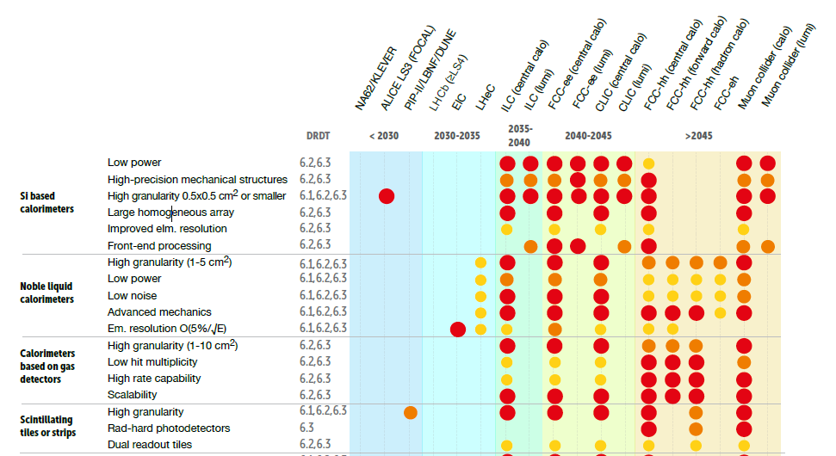
Key technologies - Calorimetry
(from the EFCA Detector Roadmap – 2021)

Slide 4
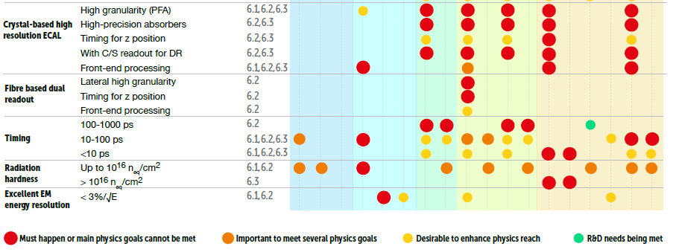
Key technologies - Calorimetry
(from the EFCA Detector Roadmap – 2021)

Slide 5
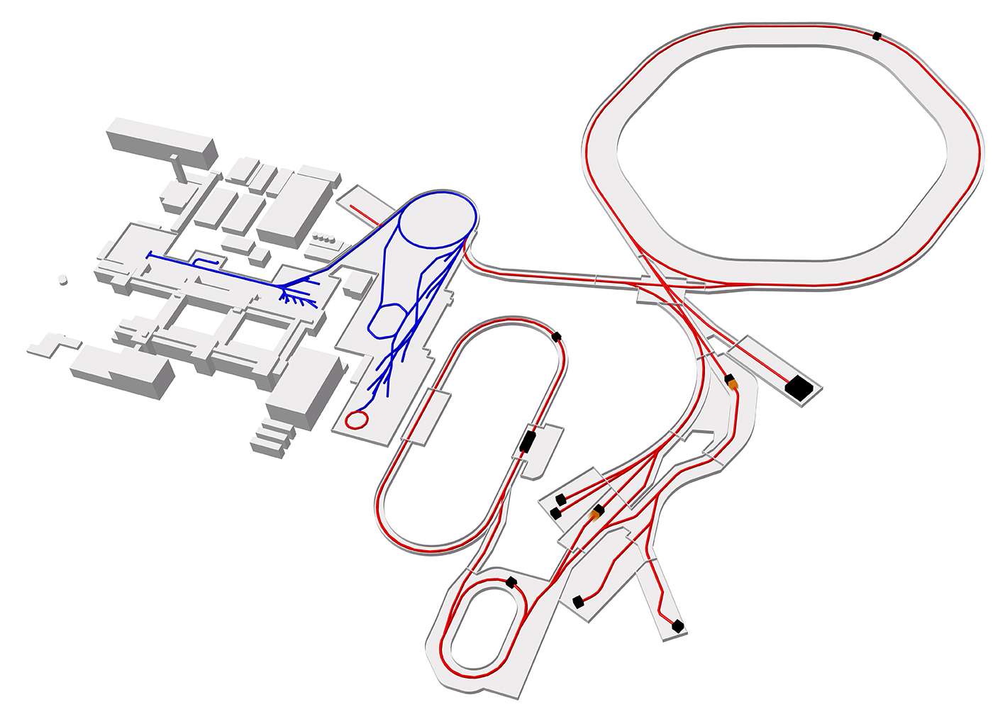
FAIR – The Facility in view of
Nuclear Physics
SIS100
Ion Sources
pLinac
SIS18
Linear- accelerator
UNILAC
APPA
CBM:
Relativistic nuclear collision
Production of
Antiprotons
HESR
CBM
100 Meter
PANDA
APPA
SuperFRS
Production of secondary beams
PANDA:
Antiproton beams
High Energy and Storage Ring
pBar
NUSTAR:
Radioactive ion beams
CR
NUSTAR R3B
Existing Facility
APPA:
Ions, antiprotons
NUSTAR LEB
FAIR Facility
Experiment- and
Collectorring
Intense secondary beams
Primary beams p..U from SIS100
with high intensity
Matched Super-Fragment
Separator (SuperFRS) with large
apperture and rate capability
Experiments
5

Slide 6
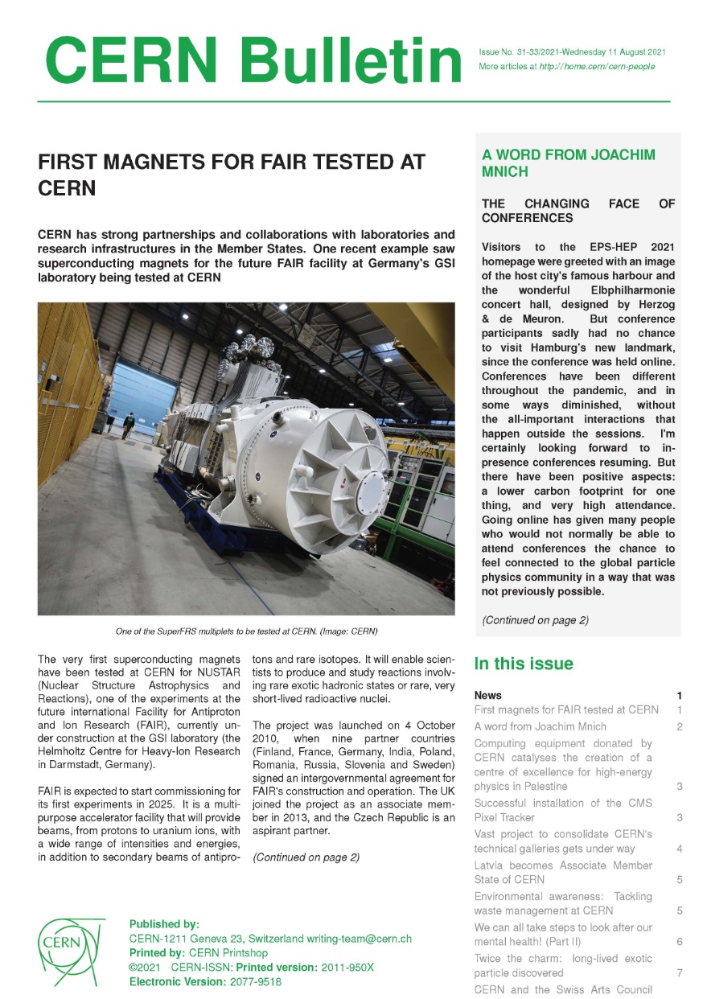
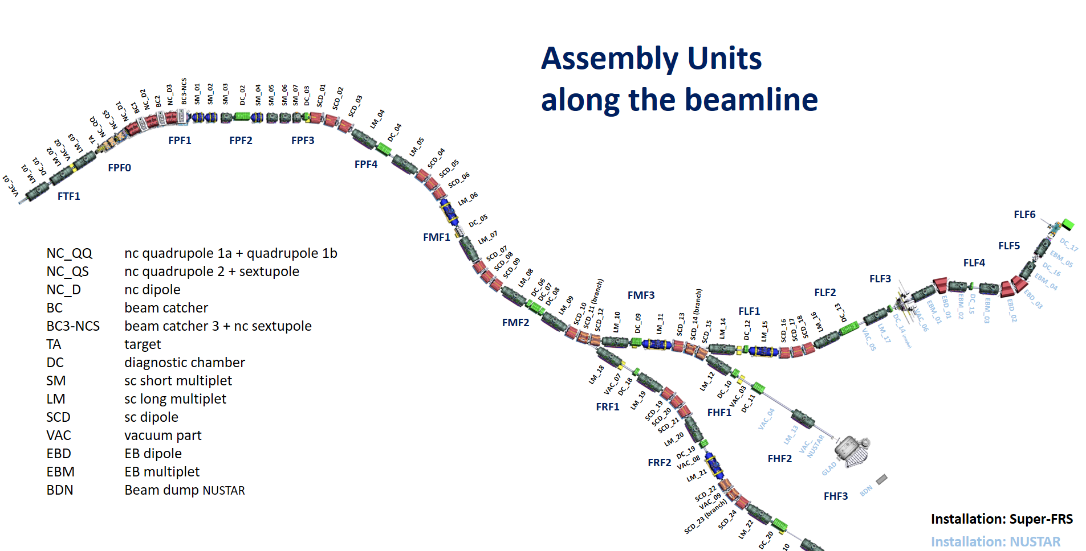


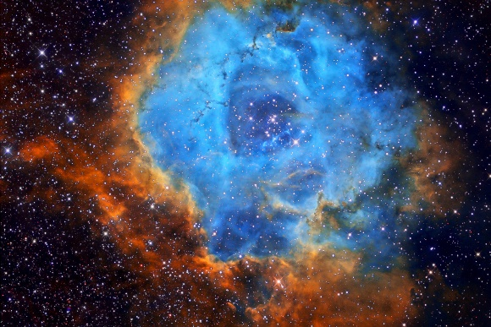
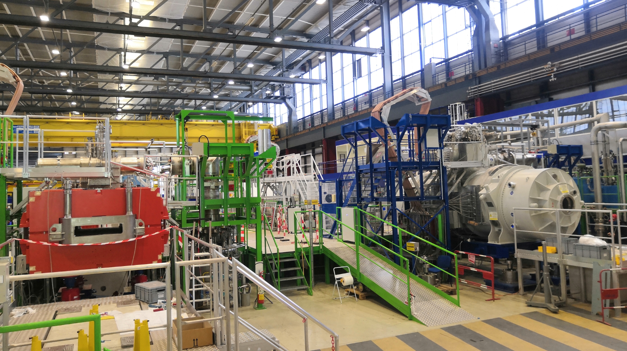
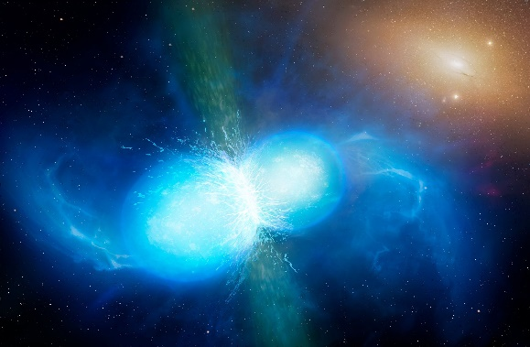
Super-FRS workhorse for
Nuclear- and Astro- Physics with Reactions
(NUSTAR), e.g.
Powerful
separator
for exotic
nuclei
Testing@CERN : All sc Magnets
6

Slide 7


Physics Example: Quasi Free Scattering (p,2p)
at relativistic beam energy in inverse kinematics
(k₀,T₀)
(k_{A-1},T_{A-1})
evaporate n,p,d,t
A
A-1
p
de-excite via γ radiation
Bound proton
Momentum transfer q
(k₁,T₁)
p
Tracking: A, A-1
Correlated protons
180 deg in φ
∼ 90 deg in θ
➔ tracking into calorimeter
θ₁
p
θ₂
target proton
(k₂,T₂)
~ 700 A MeV
p
θ (deg) | E_{p} (MeV) | CsI(Tl) range (cm) | Efficiency (%)
7 | 686 | 71,8 | 15%
20 | 592 | 59,7 | …
40 | 356 | 26,4 | 50%
Physics imposes the scientific requirements
Huge dynamic range
100keV γ-rays – 700 AMeV charged particles
high efficiency, good resolution
high granularity → Doppler correction
particle identification
D. Cortina, NN 2015, Catania
7
Notes:
7
7
7
7
7
7
7

Slide 8
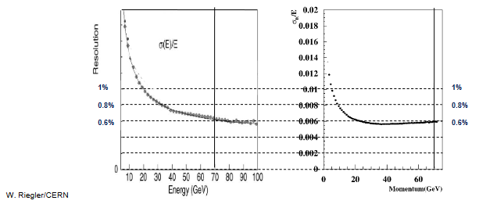
Requirements (from scientific aim)
Spectroscopic properties
Calorimetric properties
Intrinsic photopeak efficiency | 40% (up to Eγ=15 MeV projectile frame)
Gamma sum energy resolution D(E_{γ}sum)/<(E_{γ}sum)> | < 10% for 5 γ rays of 3 MeV
Calorimeter for high energy Light charged particles | 200-700 MeV in lab system
Gamma energy resolution | ~5-6% (FWHM at Eγ=1 MeV) ~ 3% for very forward angles
Light charged particles resolution | ~2% (stopped particles) ~ 5% (punch through particles)
Proton-γ ray separation | For 1 to 30 MeV
NA48/KTeV
However:
Beam momenta are different
B
NA48 Experiment at CERN and KTeV Experiment at Fermilab,
Homogenous calorimeters with Liquid Krypton (NA48) and CsI (KTeV). Excellent and very similar resolution.
(Compilation W.Riegler/CERN)
8
Notes:
8
8
8
8
8
8
8

Slide 9

GEM TPC for high rate tracking (Super-FRS)
- Anything in common with the panda EMC ?
Beam Particle ID
→ Bρ-ΔE-TOF method:
Requirements
Bρ=A/Z・β・γ
A/Z, P
TOF=L/β
ΔE～Z²/β²
Z
Pos res. σ ≤ 1 mm
Timing res.
σ: 50 ps
ΔE resolution σ: 1-2 %
p…U: large dynamic range
Rate capability some MHz ➔ Timestamped readout
high rate also required for calorimetry with gas detectors
9

Slide 10
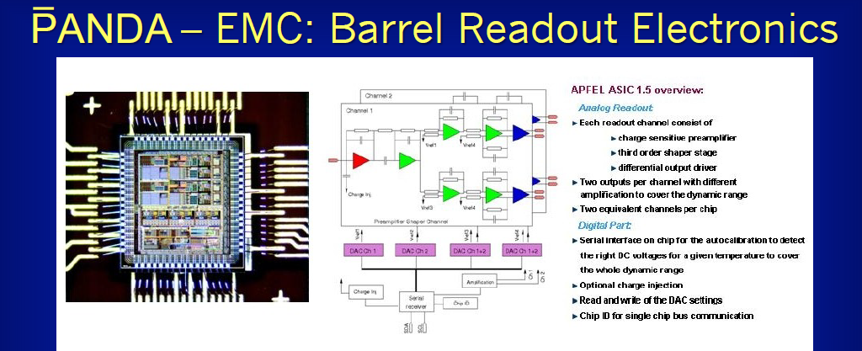
GEM TPC for high rate tracking
- Anything in common with the panda EMC ?
K. Brinkmann/U. Thoma – ASIC:
P. Wieczorek and H. Flemming, IEEE Nucl. Sci. Sym. & Med. Imag. Conf. (2010) 1319
APFEL ASIC (0,35µm AMS): 2 outputs with different GAIN
Digital interface for configuration
Rate/ch. ~350kHz ➔ Similar Demands for GEM-TPC
Power <= 50 mW/ch (22k Ch.)
10

Slide 11
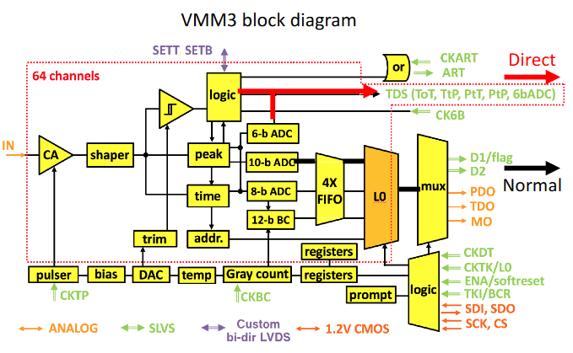
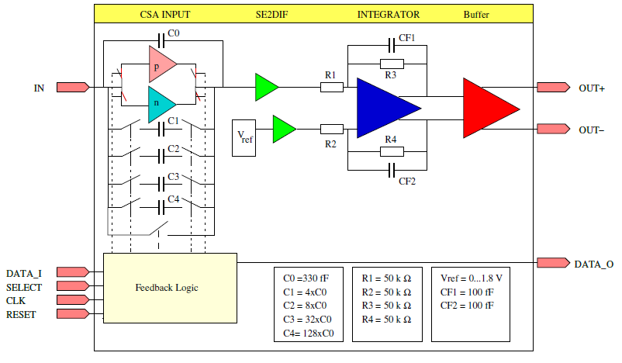
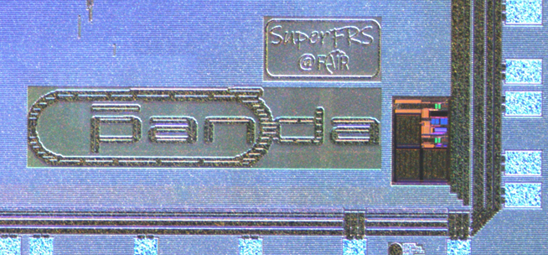
GEM TPC for high rate tracking
- Competition of solutions
AWAGS ASIC
P. Wieczorek, H. Deppe, H. Flemming,
Low noise amplifier with adaptive gain setting (AWAGS),
accepted from JINST as TWEPP2021 proceeding.
ASIC with adaptive gain;
- very large dynamic range (71pC)
AWAGS
build. blck.
for panda
trans, rec.
VMM3a: „Swiss army knife“ ASIC (HEP)
ATLAS small wheel (µMEGAS)
Perfect fit for GEM readout ?
Availability of building blocks allows
for optomized solutions.
11

Slide 12
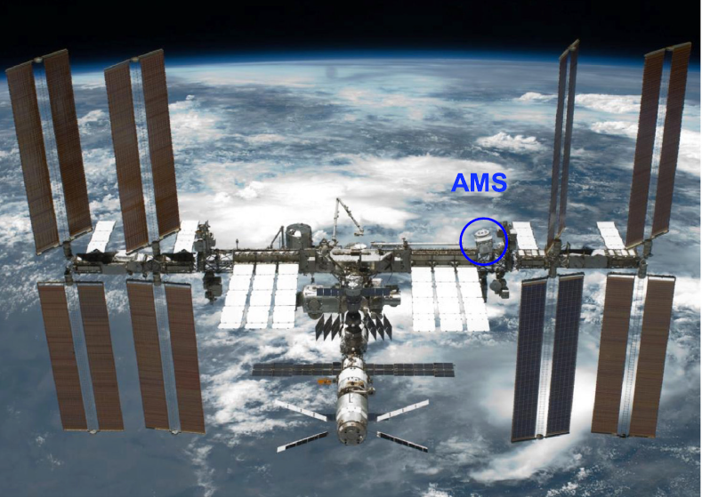
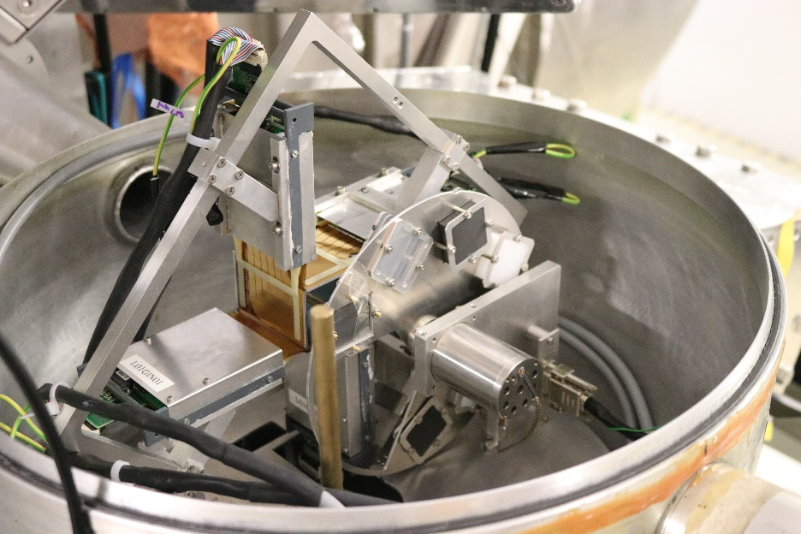
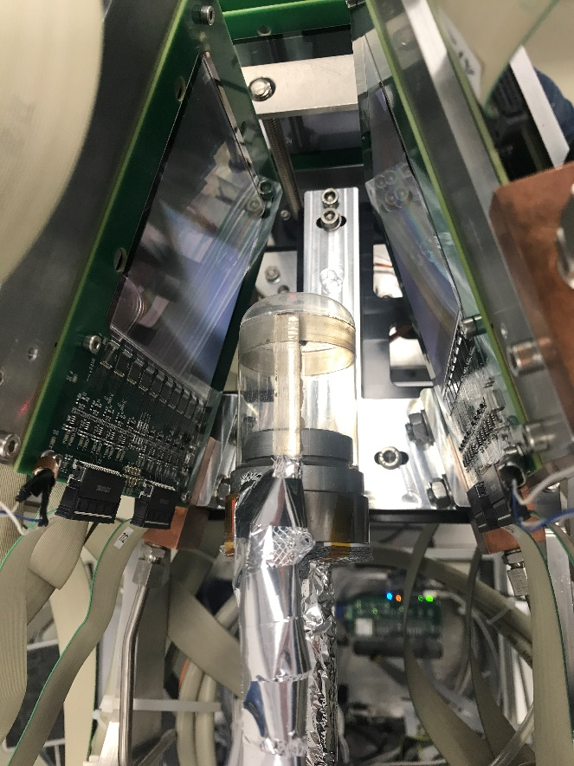
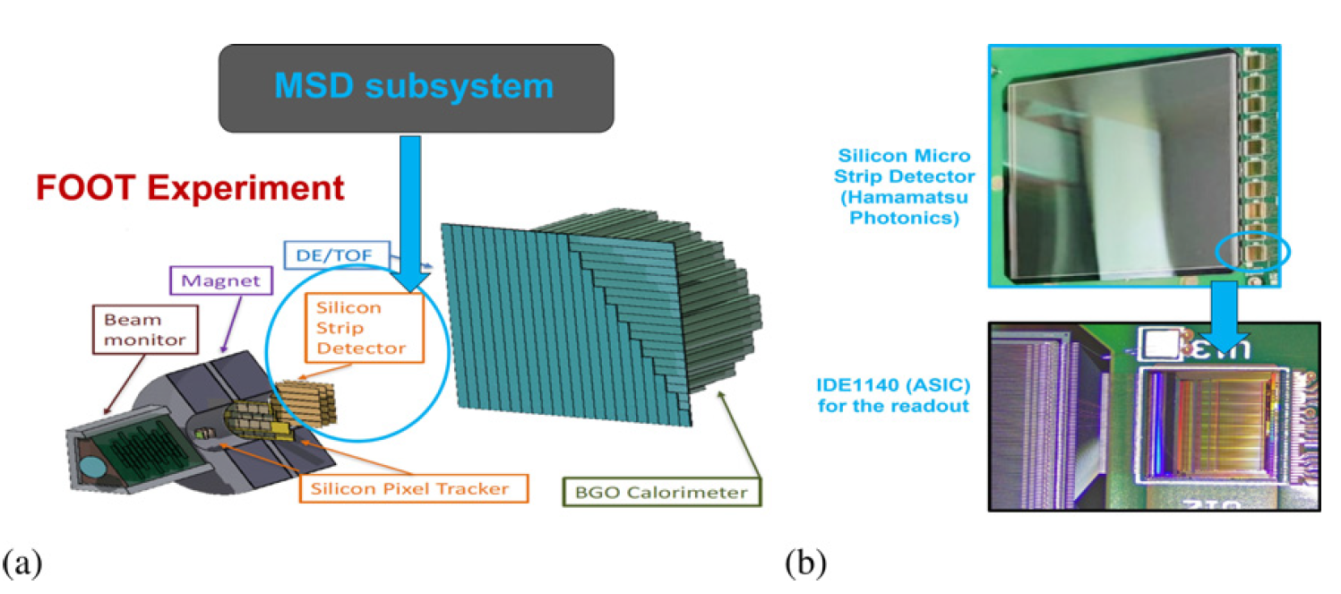
Enabling technologies
- from Space to medical applications
AMS-02
Detectors in Vacuum
low power (!)
Box geometry
CH2 target
https://ams02.space/
detector/silicon-tracker
Physics Reports 894 (2021)
1-116
VA64.hdr
Cocotier LH2 target with
FOOT Si-trackers
as subsystem of the
CALIFA calorimeter
K. Kanxheri et al 2022 JINST 17 C03035
IDE1140
12

Slide 13
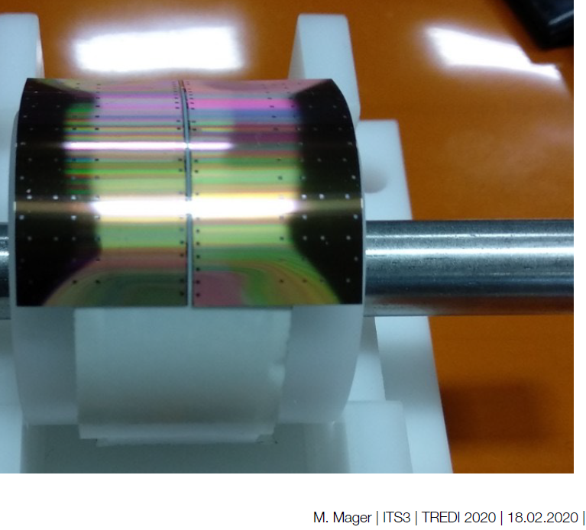
Enabling technologies
- ALICE Alpide
Test system at GSI
Geometry adaptation to the limit (‚surrounding the target‘)
Pixel detectors
  suppression of delta rays
  noise environment / noise reduction & selective trigger/selection schemes
  option for inner tracker in front of Calorimeter
13

Slide 14
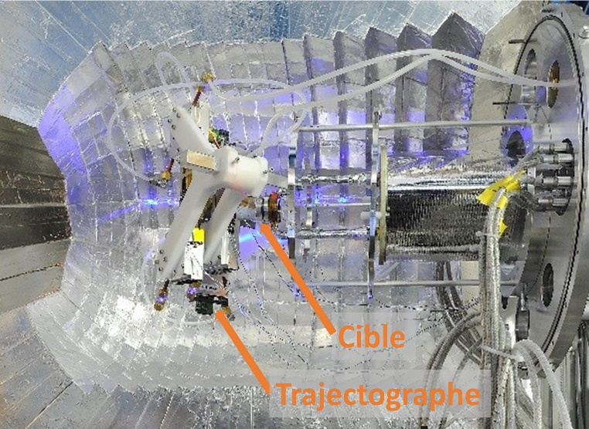
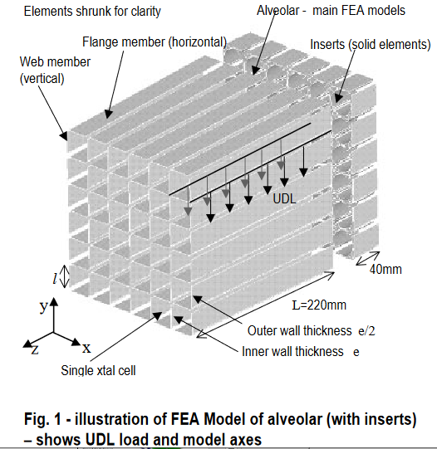
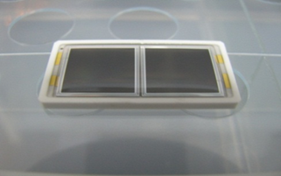
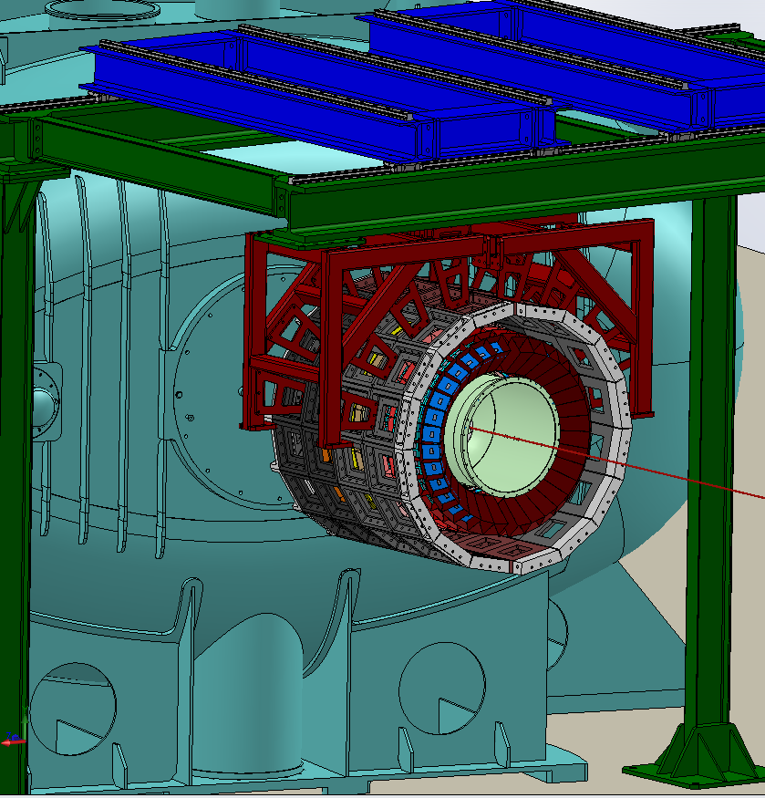
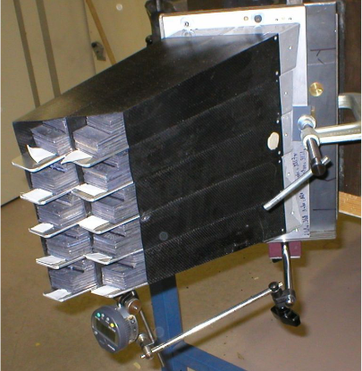
Enabling technologies
- close geometry / magnetic field / mechanics
APD readout:
- Hamamatsu / CMS - APD S8664-55
- Hamamatsu / panda - APD S8664-1010 PbWO₄
→ Characterized to be suitable
for Califa CsI readout → APD-S8664-SPC1010 (2CH)
CMS Ecal - CMS NOTE 2000/048
Carbon fiber
Alveoli (panda)
Carbon fiber alveoli
+ APD readout
14

Slide 15
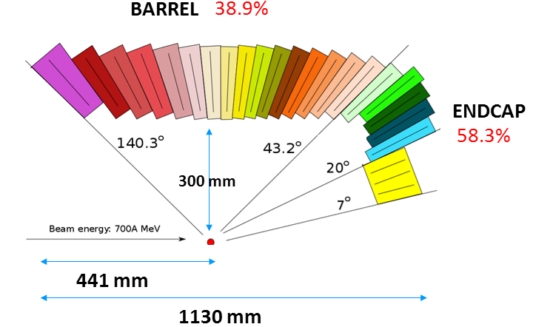
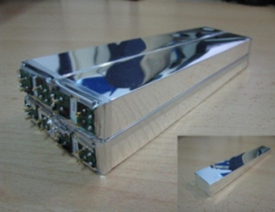
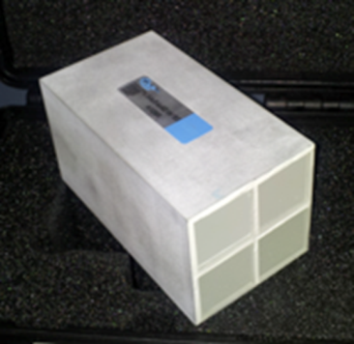
CALIFA
- External structure 3.5 x 4 m
- Detector volume ~ 1.3 m³
- Detector weight ~ 2.5 t
- 2528 detection units
 | Barrel | Endcap
 |  | iPhos | CEPA
Scintillator | CsI(Tl) | CsI(Tl) | LaBr/LaCl
Geom. | 11 | 16 | 6
Crys. Len (cm) | 15-22 | 22 | 4/7
Polar cov. | 7-20º | 20-43º | 43-140º
Read-out | LAAPD | LAAPD | PM/SiPM
Dete.chan. | 1952 | 480 | 96
Elec. chan. | 1952 | 960 | 96 x2
Weight (Kg) | ~ 1500 | ~ 550 | ~ 50
Volume (cm³) | 285.000 | 90.000 | 11.000
D. Cortina-Gil et al. Nuclear Data Sheet 120(2014) 99-101
15

Slide 16
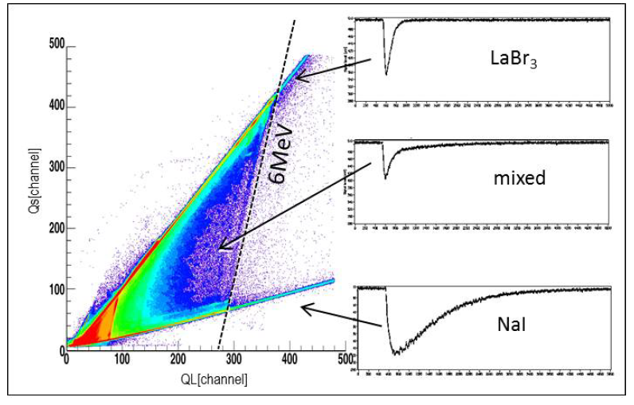
Enabling technologies
- Phoswitch/IPHOS (Dual Readout)
CEPA: 4x 4cm LaBr₃(Ce) + 6cm LaCl₃(Ce)
?
PARIS White Book – 03/2021
HERMES nano satellites
(Gamme ray burst detection)
GAGG:Ce
IPHOS
CsI(Tl) light at
600 ns / 3.5 μs
3U platform
Available Payload volume:
  97 x 97 x 150 mm
Available Mass:
  0.5 to 1.5 kg
Data rate in the air:
  up to 150 Mbps
arXiv:2101.03945v1
GAGG:Ce (Cerium-doped Gadolinium Aluminium Gallium Garnet)
12C(p.p´) 12C* @ 21 MeV MLL
16

Slide 17
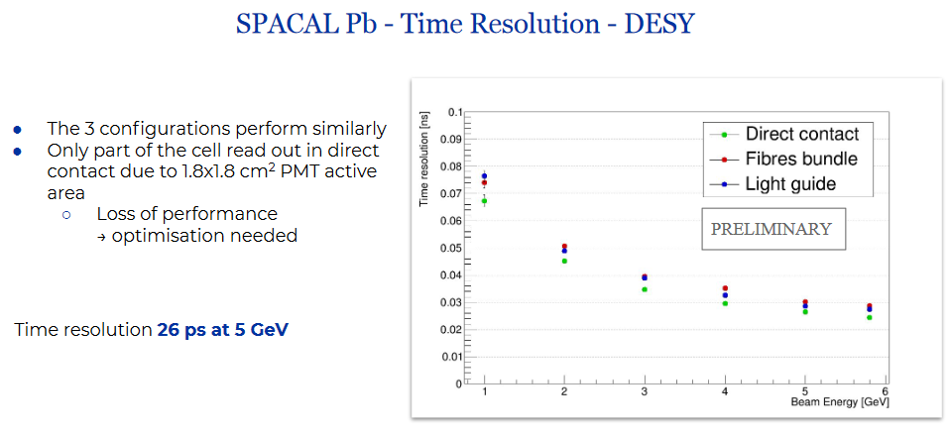
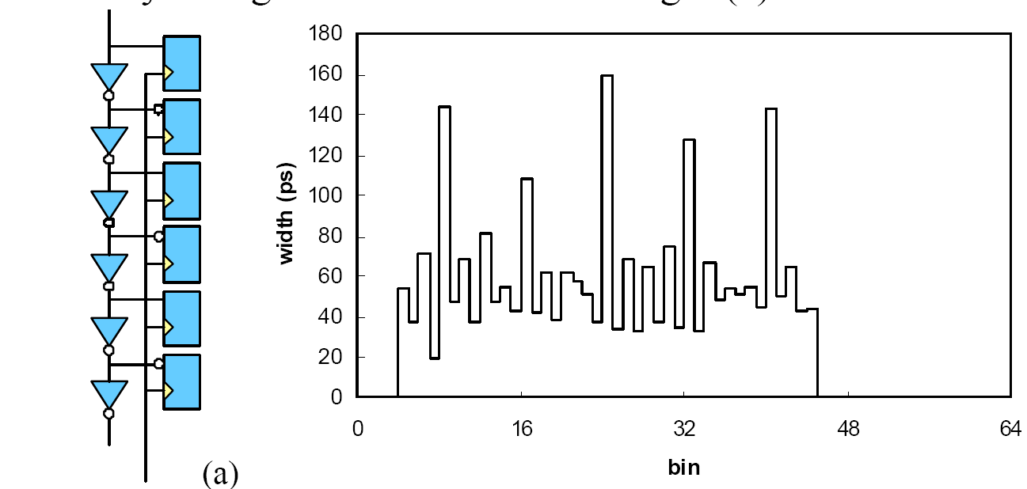
Enabling technologies
- Precision timing (few...100 ps)
Light coupling
Materials
Geometry
…
The 10-ps Wave Union TDC:
Improving FPGA TDC Resolution
beyond Its Cell Delay
Jinyuan Wu and Zonghan Shi
IEEE Nucl. Sci. Symp. Conf. Rec. (2008)
LHCb R&D
Time distribution systems
- e.g. Based on WR network (… KM3NeT)
- https://white-rabbit.web.cern.ch/
- CAMPUS wide (e,g, ToF: Separator – Exp.)
FPGA TDCs down to 7ps resolution
Precise position measurement
Amplitude information via time over threshold
E.g. ToF Wall based on plastic scintillator
σ_{t}=14ps, σ_{E}/E=1%
17

Slide 18
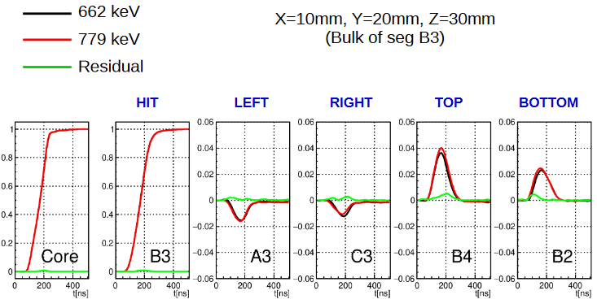
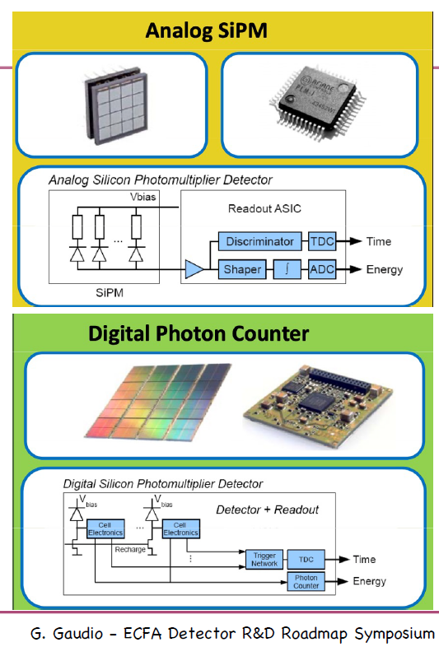
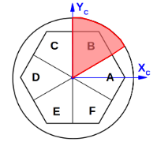
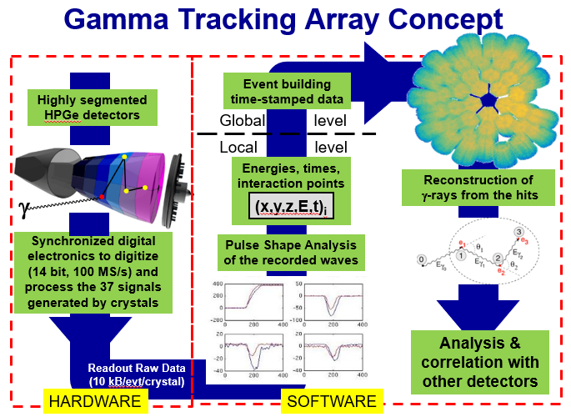
Enabling technologies
- Fully digital electronics
B. De Canditiis
AGATA Week – 2021
@ system
level
@ sensor level
P. Reiter
18

Slide 19
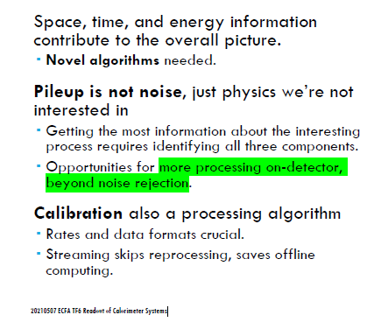
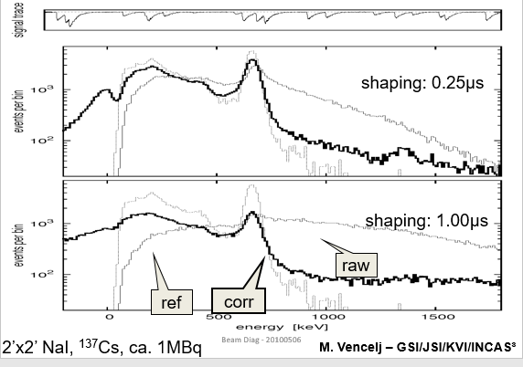
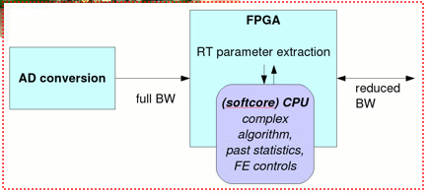
Ultimately 5D readout: x,y,z,t,E
A. David (CERN)
EFCA TF-6 2021
Online pile up correction in
FPGA (deconvolution, 2010)
Use: t - information
Key: Online processing of incoming channel data
19

Slide 20
Summary (form a nuclear physicists perspective)
Enabling technologies presented
Hardware focus
Common needs can be easily identified
Nuclear physics applications require often large dynamic range
- requirements resemble calorimetric
Processing in frontends is possible
- software methods can be later (partially) implemented
- Machine learning results to a certain extend also
The availability of sample systems for testing are key for common
applications → open access, documentation and awareness
Example: WR time distribution system (open hard & software)
- e.g. used at german stock market
- … and KM3Net
- … replaced „home made“ BuTiS in our lab.
Machine learning
20

Slide 21
Summary
Similarly: Detector samples (with or w/o readout sysytem) for testing
- for external collaboration key
A lot of processing in frontends is technologically possible
  - software methods can be later (partially) implemented
  - Machine learning results to a certain extend also
  - Quality monitor/Many channels
Thank you for your attention !
Special thanks:
Martin Aleksa, David Barney, Roberto Ferrari, Thomas Peitzmann, Frank Simon, Ulrike Thoma
21

