Slide 1
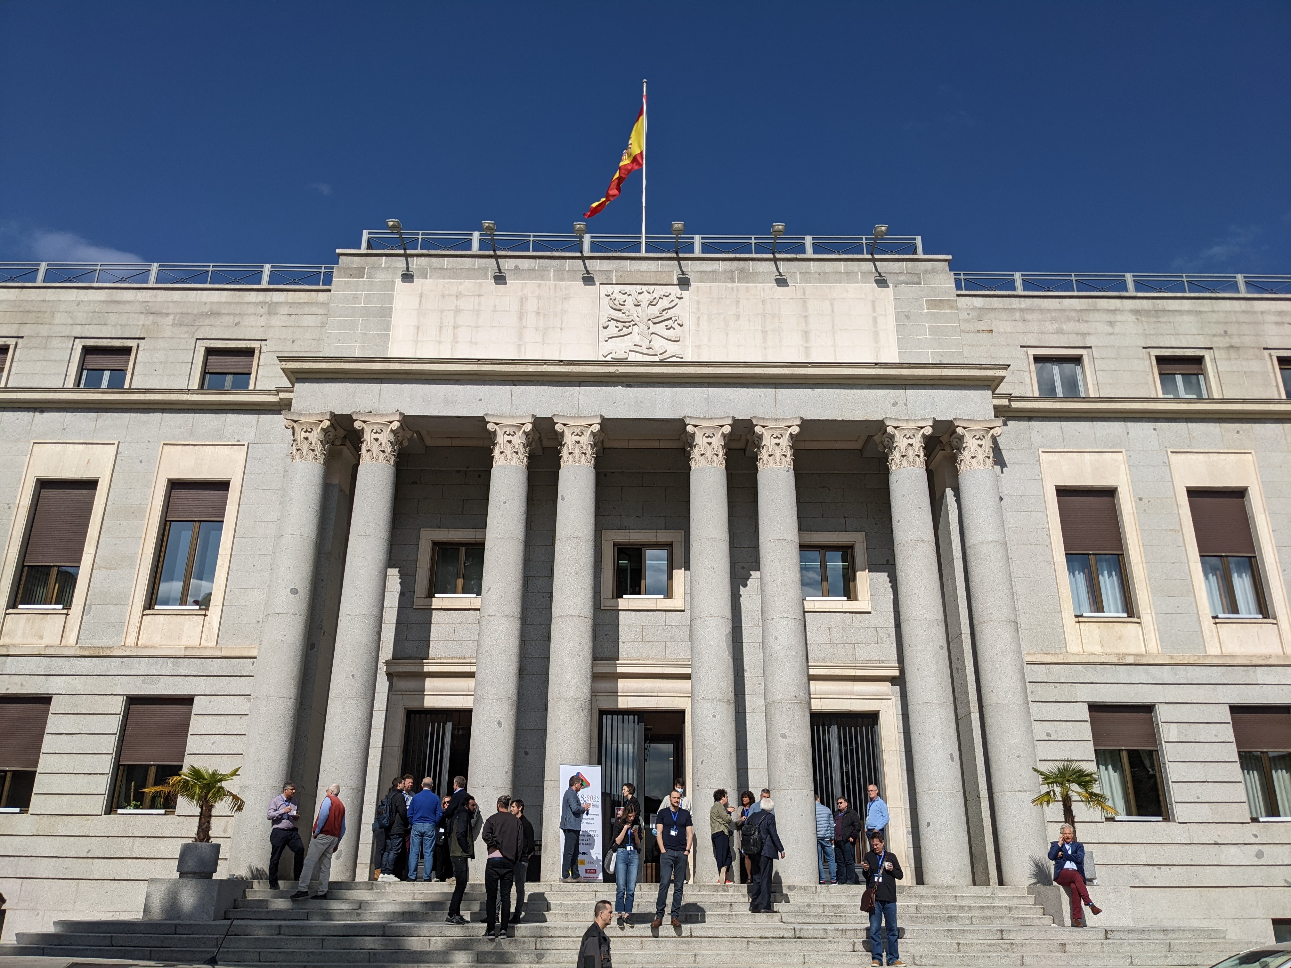


Sustainability and Future of Software Frameworks
Graeme Stewart, CERN EP-SFT & HSF
JENAS Symposium, Madrid, 2022-05-05

Slide 2



Caveat Emptor
I will speak about some specific software in High-Energy Physics
  Which has a significant overlap with nuclear physics
  And I can’t mention all projects
Generally, the arguments made here are applicable to other scientific software domains
  Astro-particle observatories and projects face many of the same issues
    Particularly as data rates and volumes rise
  Despite domain specific matters, many of the development trends and solutions will be very similar
  We all, in common, face the problem of training, recruitment and retention of excellent people who can write and maintain scientific software
Notes:
Also cannot mention all possible projects – forgive me my personal selection!

Slide 3
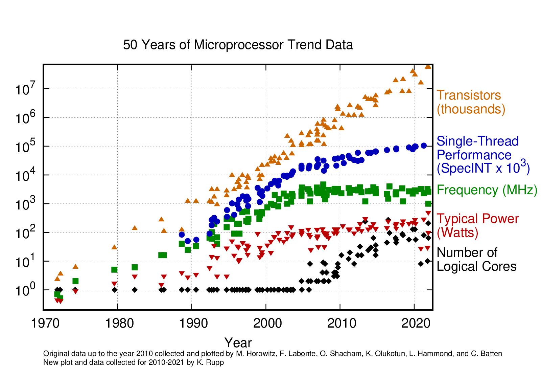
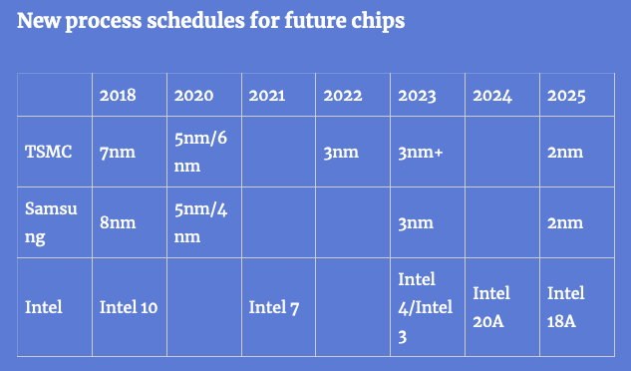
Technology Context
Once we move away from the detectors all software and computing is being done mostly commodity off-the-shelf hardware (COTS)*
The evolution of this technology over the last decades has continued to follow Moore’s Law
  We still get more transistors with each processor generation
  But clock speed has been stalled now for many years
  This limits the throughput of any serial codes
    We have to adopt parallel processing paradigms
Karl Rupp
* Data centre GPUs, FPGAs, tape systems would be the exceptions

Slide 4
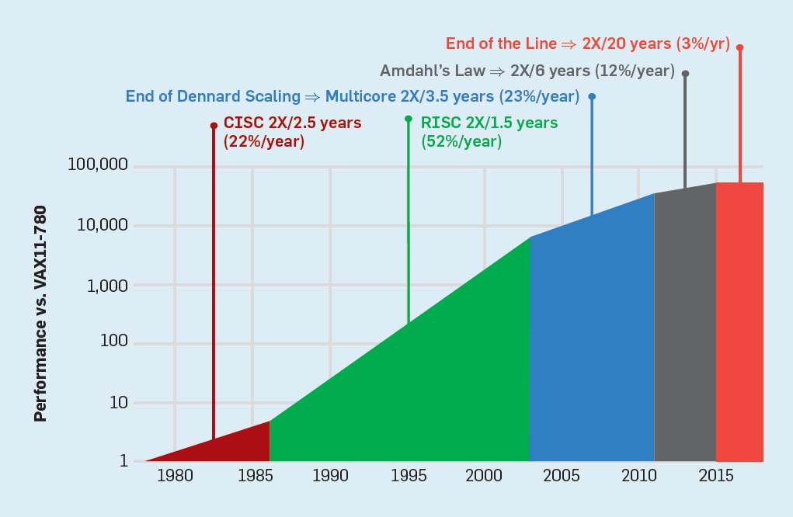
Alternative Processor
Architectures
Traditional CPU architectures are no longer the optimal choice for many problems
  Albeit that there is innovation here, e.g., ARM processors such as Apple M1, Fujitsu A64FX; AMD x86 CPUs. (CPU has a SIMD model, a.k.a. vectorisation)
By devoting more transistors to arithmetic operations, GPUs can achieve a higher computational throughput
  Single instruction multiple thread model (SIMT)
  Albeit with significantly more work from the software developer
  GPUs are not the only option either: FPGAs, TPUs, etc.
Data intensive codes have to work hard to mitigate data movement costs
  On the CPU as well as the GPU
  Poor memory access patterns will destroy performance
A New Golden Age for Computer Architecture, Hennessy, Patterson 2019
Efficient use of these computing architectures significantly lowers energy costs – Green Computing

Slide 5
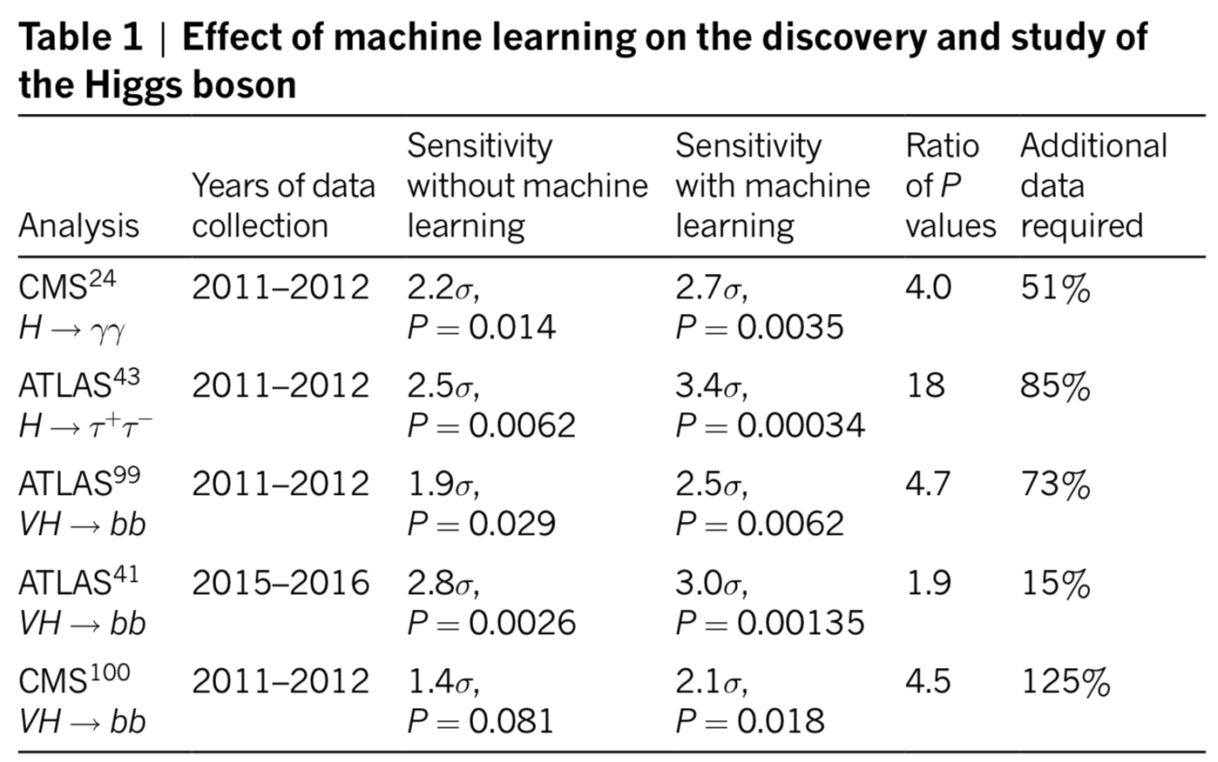
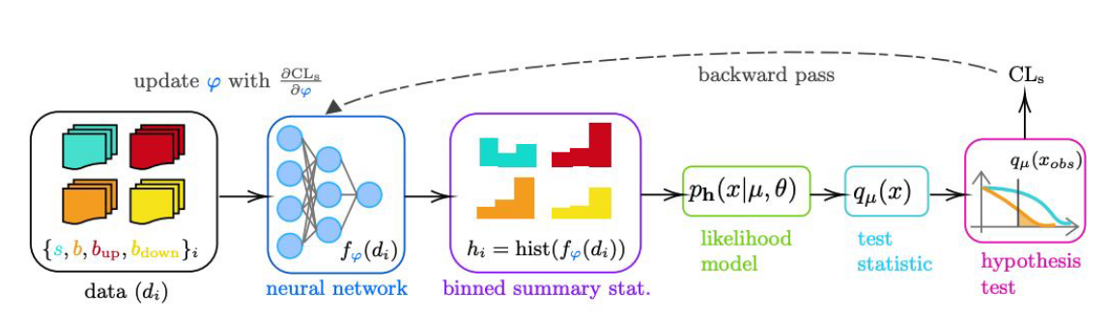

Machine Learning and Other Technologies
Machine Learning
  Used in HEP for a long time
  Discrimination, classification, anomaly detection are all in use in HEP
  Centre of cutting edge software outside HEP, developed and supported by industry
    Our models are generally very simple, cf. GPT-3 (autoregressive language generator) that has
    175 billion parameters
Auto-differentiation
  Neural networks (amongst other things) are differentiable
  Can evaluate the relationship between underlying calculations and observables in
  both directions
    Requires the development of surrogate models for non-differentiable parts
  But with this could do an end-to-end optimisation of everything from analysis to
  experiment design (MODE talk, Pietro Vischia)
Quantum Computing
  Definitely a very hot topic (see previous talk from Philippe Chomaz)
  Some models now appearing for HEP applications, many training NNs
  Remains to be seen if this will really be a revolution for software (and on what timescale)
    Doing theory calculations directly on a quantum computer would be really exciting!
Radovic et al., [10.1038/s41586-018-0361-2]
Auto-differentiation adds a backwards pass to optimise an analysis, Simpson and Heinrich [2203.05570]

Slide 6
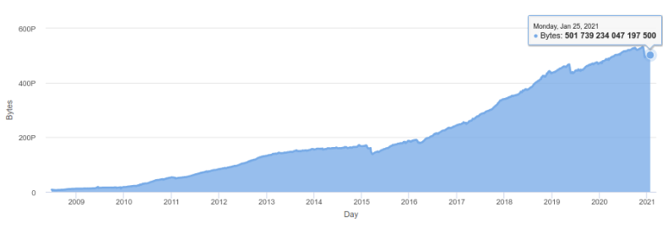
End-to-End Data Storage and Networks
For the LHC storage is actually the dominant capital cost
Hierarchical storage is necessary to control this cost and adapt to technology changes
  Tape systems offer the highest capacity per unit cost and highest data safety
  Spinning hard disk drives are still the
  best choice for bulk online storage
    Even if the consumer market has gone
    to SSDs, this technology does not go away
    HAMR drives offer even greater capacity,
    up to 20TB
  SSDs become faster (NVMe2) and larger capacity
    But for now remain more costly than HDDs
Network capacity has grown enormously
  This has significantly changed how we manage
  data and computing for big experiments
ATLAS Data managed by Rucio, more than 500PB

Slide 7
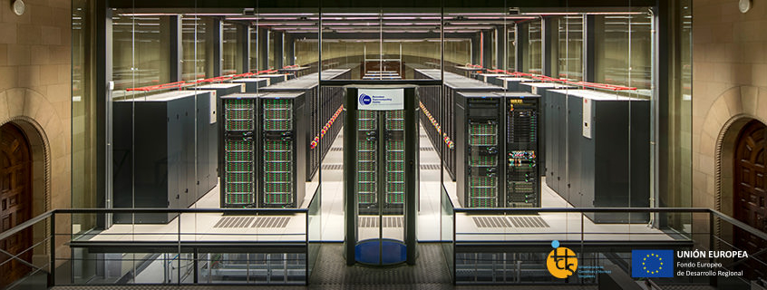
Resource scaling and computing
Covered in detail by Gonzalo Merino’s talk, Challenges in computing and software for our Big Data
Data intensive sciences use significant computing resources
  The number of high data-rate experiments and projects is only growing
  ESCAPE has helped to bring considerable harmony in the data management area
Computer centres serve multiple communities and provide resources that match their integrated needs
  E.g., now commonly including GPUs (which handle ML tasks very well)
  Larger centres in the future, but more diverse hardware probable
High-performance computing centres (HPCs) are funded and used in many regions now
  Our software needs to adapt to these resources
    GPUs are very prevalent now – in multiple flavours
    Non x86 CPUs
  Large scale heterogeneous computing is the new
  model

Slide 8
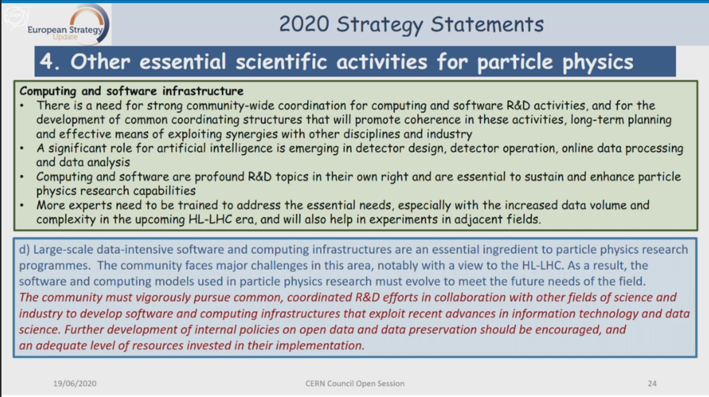
European Strategy Update 2020

Slide 9

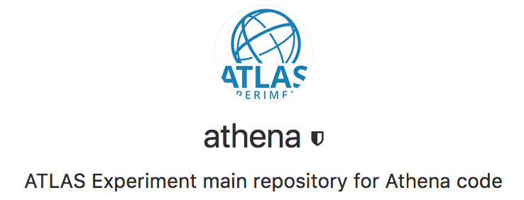
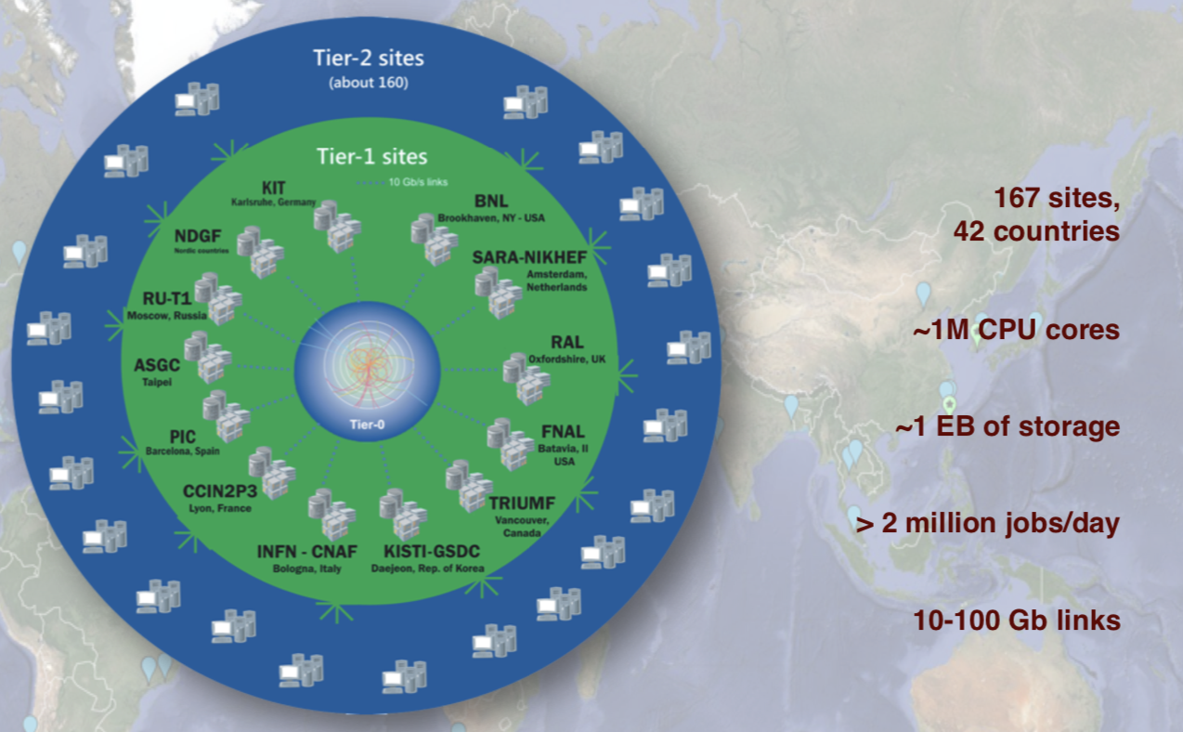



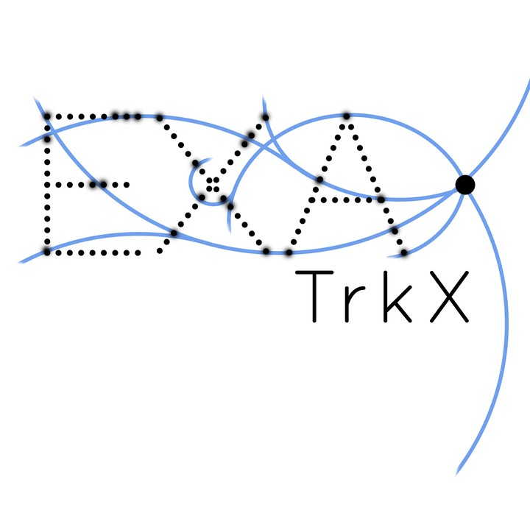
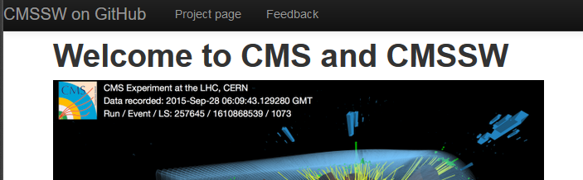


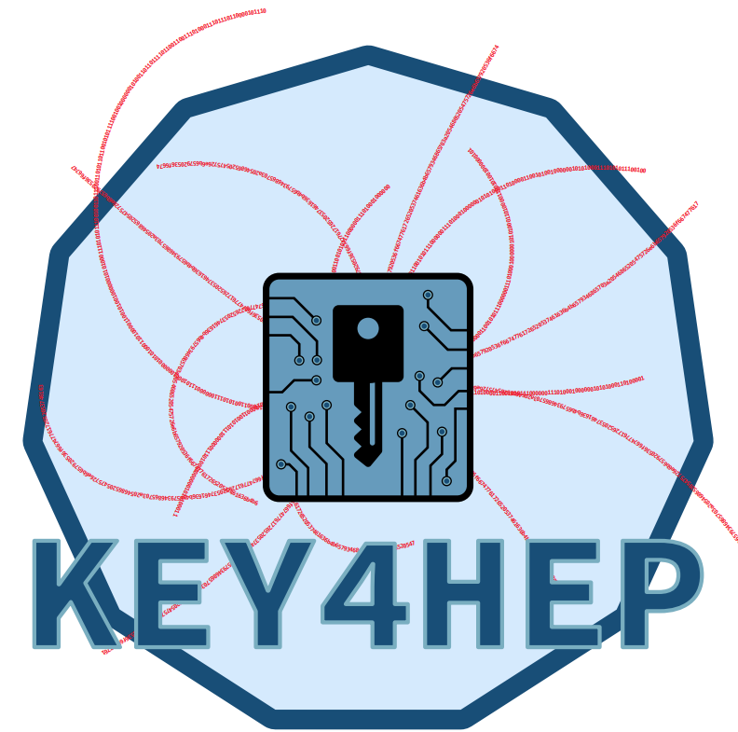




HEP Software Frameworks in a nutshell…
Gaudi
Software is involved at every
level
  Event generation
  Detector Simulation
  DAQ and Triggers
  Reconstruction
  Analysis
Resource consumption implied can be massive, e.g., for the LHC experiments now with DUNE on the horizon
  Use of exabytes of storage and millions of CPU cores
Balance of consumption in each step can vary from
experiment to experiment
  Guide optimisation by total cost (e.g., EM calorimeter simulation)
>50M lines of code
Allen

Slide 10
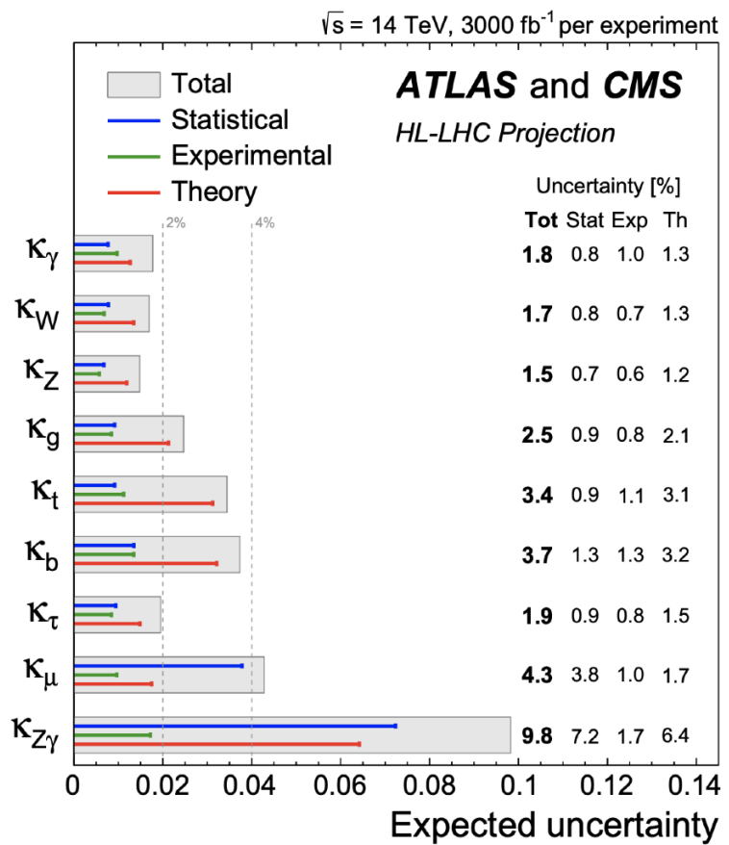
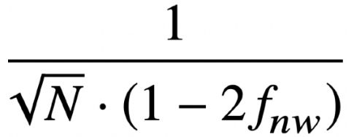
Event Generation Challenges
Expected uncertainties in κ formulation for HL-LHC, from EPPSU
High luminosity LHC will require a very good control over uncertainties
  Theory errors are very significant
  Need to move from LO calculations to NLO and even NNLO
  These calculations are inherently more demanding
    And introduce problems of negative weight events from MC@NLO matching
    Dilutes statistical power and also computationally heavy as negative probability events need to be simulated and reconstructed as well
Generally there is a mismatch between the incentives for the theory community and the needs of the experimental community
  Work in the HSF and SWIFT-HEP is helping to bridge this gap

Slide 11
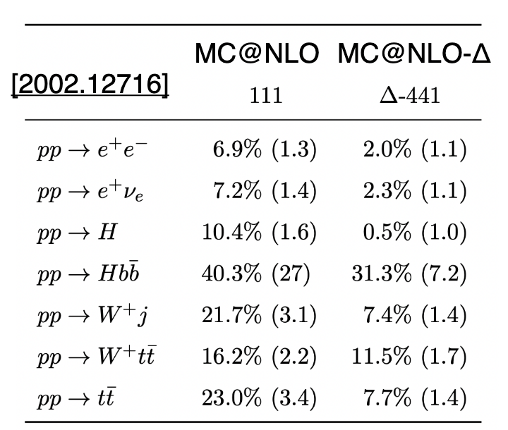
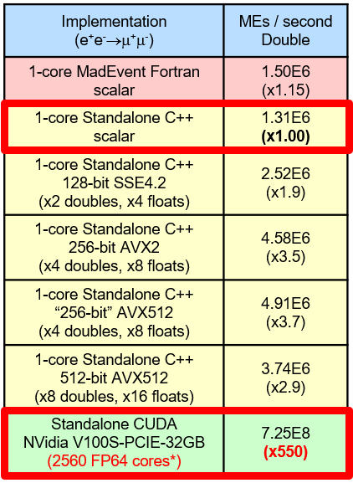
Event Generator Improvements
Negative weights
  New NLO matching schemes proposed that reduce negative weight fraction [2002.12716], MC@NLO-Delta
  Resampling before further processing reduces CPU “wasted” (positive resampling [2002.12716], NN-based resampling [2002.12716])
  Efforts from the experiments to improve the sampling schemes to reduce CPU costs and increase statistical precision [2112.09588 - x2 cost reduction with better accuracy for V+jets event in Sherpa]
Porting to alternative architectures
  Matrix element calculations are quite suitable for GPUs and CPU SIMD - many repetitive and independent calculations on multiple phases space points
  Early results from porting limited set of processes of MG5+aMC to GPUs are promising
  Work also going on in Sherpa team [2106.06507] showing several factor speedups
Also excellent results on vectorised CPUs, x3.5 on avx2

Slide 12
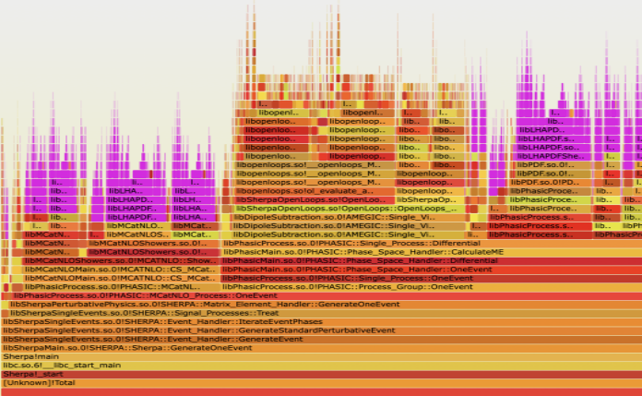
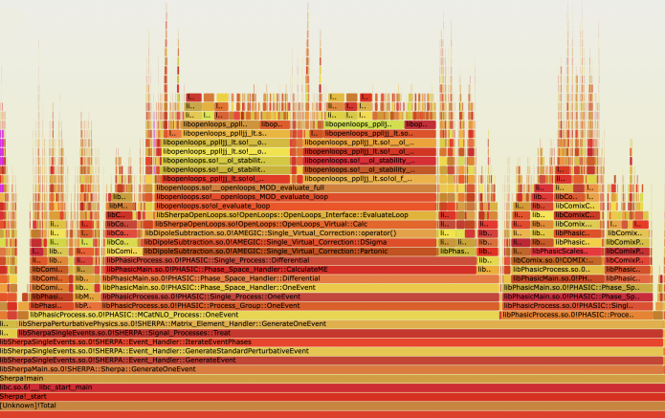
Further Event Generator Improvements
SWIFT-HEP profiling 2 years ago showed a suspicious amount of LHAPDF CPU
  60-70% of CPU time used when generating multi-jet events
  in Sherpa+OpenLoops for ll+0,1,2@NLO+3,4,5@LO
How to optimise this?
  Make LHAPDF faster (optimise interpolation and transcendental calls)
    Restructured LHAPDF calls to improve interpolation code, 30% speed-up
  Call LHAPDF less – do a minimum generation for the event, up to unweighting
    Then only calculate the full event when it is accepted (rewind RNG state to do this)
  Use analytic one-loop amplitudes, when available

Slide 13
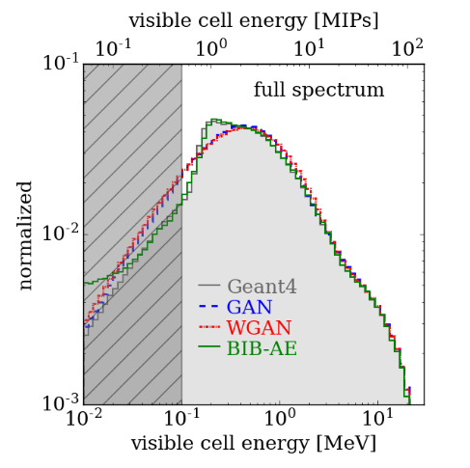
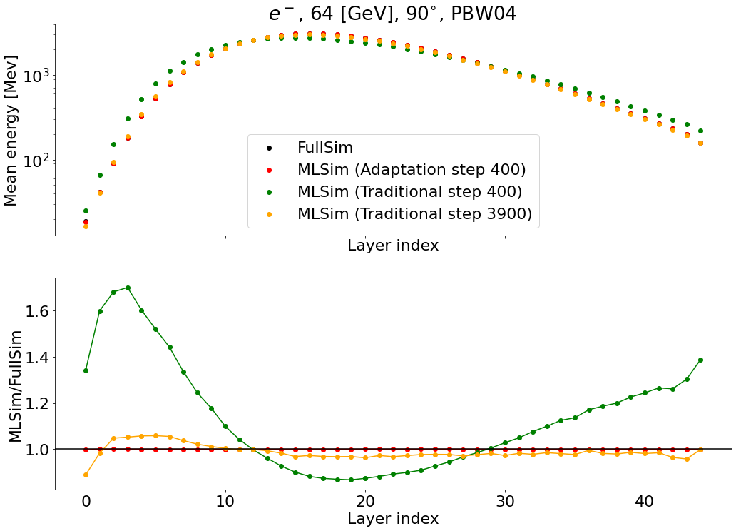
Detector Simulation –
Machine Learning
Performance of different ML architectures for photons in ILC Calorimeter, S Diefenbacher et al.
A major consumer of LHC grid resources today
  Experiments with higher data rates will need more simulation
  Simulation will also need to be more accurate (e.g., recent Geant4 improvements in release 11.0)
Faster simulation, with minimal loss of accuracy, is the goal
  Range of techniques have been used successfully for a long time (frozen showers,
  parametric response)
Recent LPCC workshop on fast simulation provides a good overview
  Machine learning lends itself to problems like this
    Calorimeter simulations usually targeted, due to their high resource consumption
  Variational Autoencoders (VAEs) and Generative Adversarial Networks (GANs), but also other architectures used (BIB-AE)
  This is not as easy as we thought - traditional parametric approaches are hard to beat, but can be done [10.1007/s41781-021-00056-0]
  Retrainable networks allow faster adaption to new layouts, e.g., a different calorimeter geometry
Hybrid models are also an option, e.g., ATLAS AtlFast3, combining parametric and ML approaches [2109.02551]
Meta Learning allows for fast adaption of a model from one calorimeter to another, Salamini & Zabrowska

Slide 14
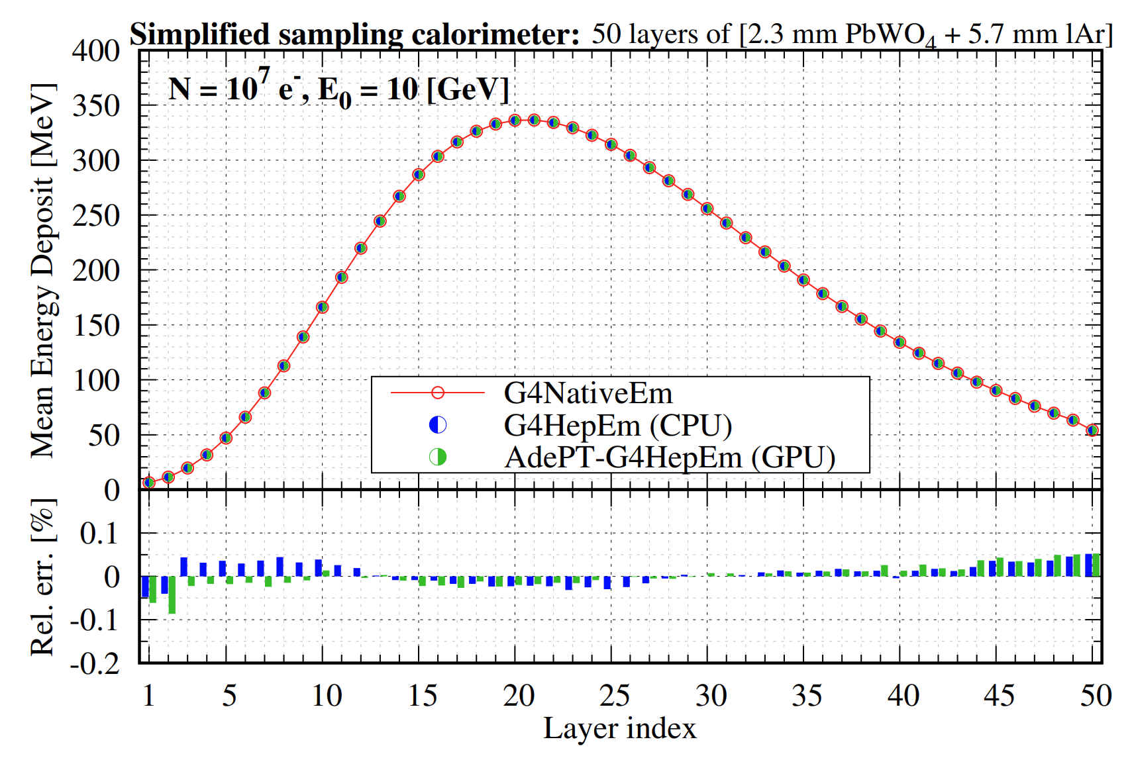
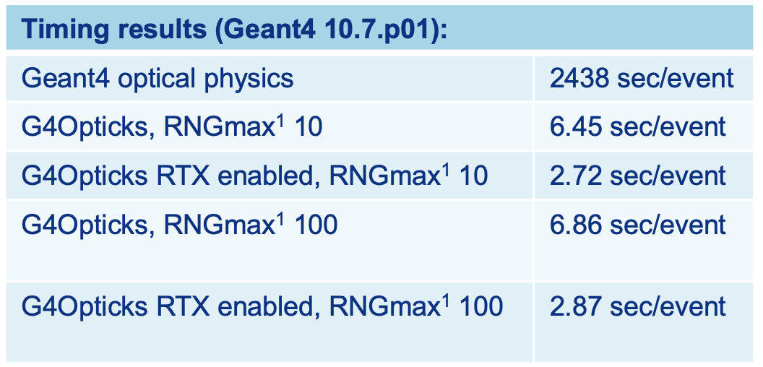
Detector Simulation on GPUs
Physics results with G4HepEm library running on CPU and GPU, cf. Geant4
Particle tracking on GPUs is very challenging, but work has started
  Naively there is a lot of parallelism in the problem, but stochastic simulation naturally introduces divergence
  As for fast simulation, calorimeters are a first target
  AdePT demonstrator (CERN EP-SFT and SWIFT-HEP) & Celeritas (DOE)
    HSF Community Meeting this week to review progress
      Can duplicate HEP EM physics extremely well cf. Geant4
      Can beat the speed of a multi-core CPU on a GPU in a simple geometry
      Complex geometry currently is a significant bottleneck
Opticks, using ray tracing on GPUs for optical photons, takes advantage of native ray tracing on GPUs
  Developed for JUNO (Simon Blyth, 10.1051/epjconf/202125103009) and integrated into Geant4 for DUNE (w. Hans Wenzel)
Speedup in optical photon simulation in LAr with GPU (x378) and ray tracing GPU (x900) cf. Geant4 on single CPU core

Slide 15
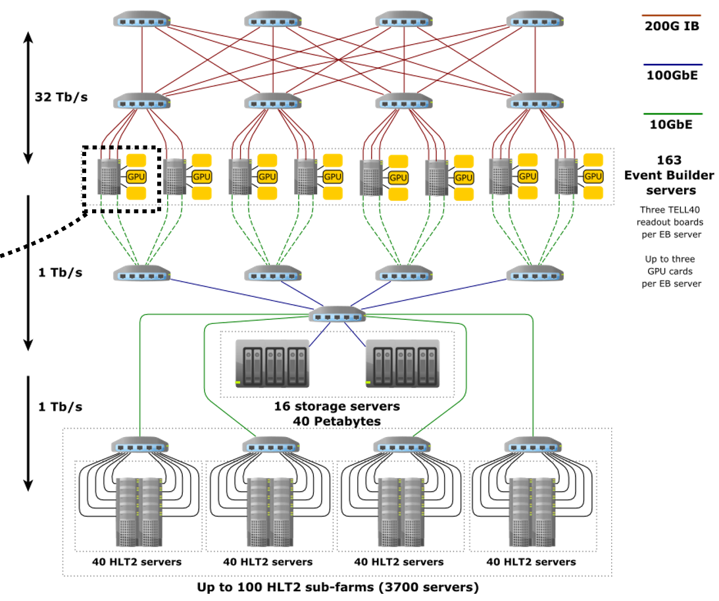
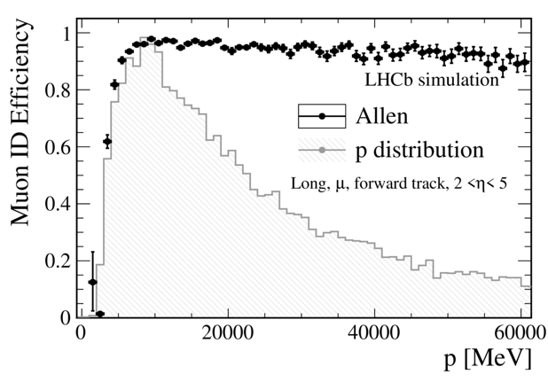
Reconstruction
New detectors are optimised for high-rate data acquisition
  Physics needs require high quality selection at close to beam-crossing rates – software triggers
  This is drinking from the fire-hose at 30MHz (LHCb have MHz rates of charm and beauty)
Break with the past and rewrite software targeting GPU architectures
  Pioneered by ALICE in Run 2, now revamped for Run 3; being introduced by CMS too (Patatrack project)
  LHCb have a new implementation of their HLT1 running on GPU, the Allen framework
    GPUs integrated into event builder nodes, up to 3 GPUs per server
  Lessons learned: keep data model simple, bulk data, be asynchronous, minimise data transfers
    Most work is in re-thinking algorithms and data flow, not in cross-architecture portability
Allows for real-time analysis
  Keep partial event information for many more events recorded
Allen

Slide 16
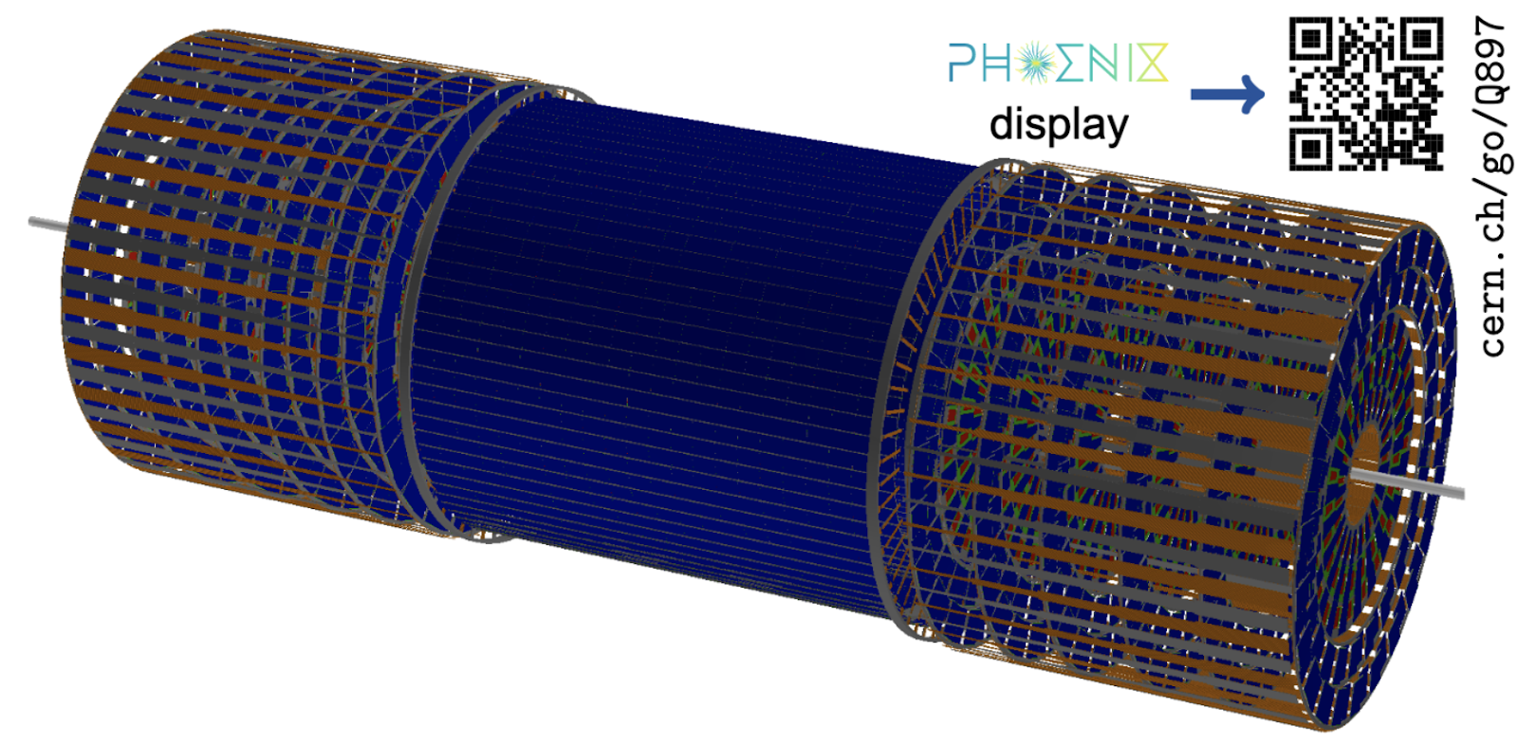
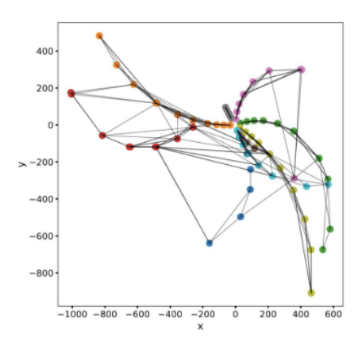
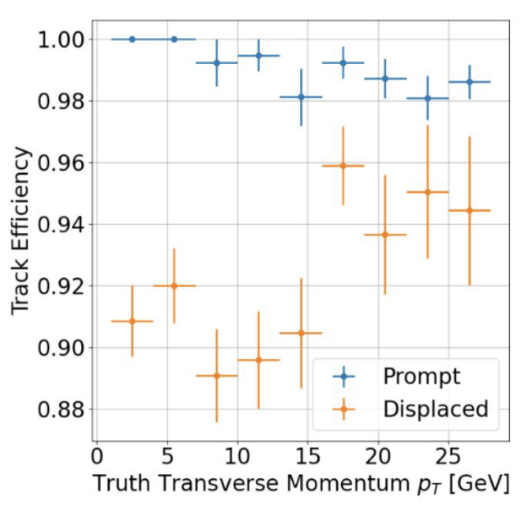
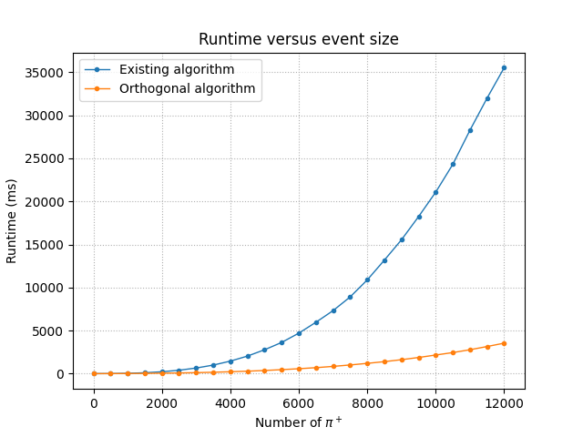
Reconstruction
Traditionally reconstruction software has been rather experiment specific
  Grimy details of sub-detectors, calibrations and specific geometries drove specific implementations…
The problems of efficient solutions on challenging hardware drive in the opposite direction - towards common solutions that can adapt to different experiments
  One example is the ACTS Tracking Project [2106.13593]
Drives developments in parallelisation, compute accelerator implementations and machine learning
  Development of the Open Data Detector (developed from TrackML) provides an open platform for development and comparison of different approaches
  Graph neural network approach [1, 2], also explored by Exa.TrkX project [3]
    Now incorporated into Acts stack
  Impressive parallelisation results from ‘ground up’ thread safety
New seed finding strategy on based of KD-trees,
achieving very similar tracking performance

Slide 17
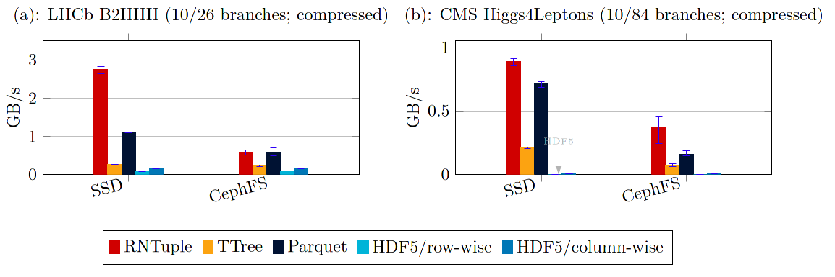
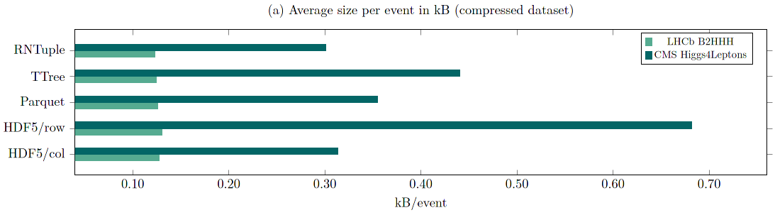
HEP Data Analysis
Scaling for analysis level data also a huge challenge for experiments
  Data must also be kept readable and accessible for decades afterwards (FAIR principles)
    Nothing is sustainable if we can’t read our data!
  Re-inventing data formats for modern devices is a key piece of re-engineering by ROOT to scale up in speed (and down in size!)
  New RNTuple format is smaller on disk and faster to read than older formats or industry alternatives
    Adapted for modern object stores systems
    Comes with a ‘lifetime guarantee’ to be supported
Reducing volume of data needed helps
hugely
  CMS ~1kB nanoAOD [10.1051/epjconf/201921406021] makes a vast difference to analysis efficiency and “papers per petabyte”
Read speeds comparing new ROOT RNTuple with older HEP TTree format and other industry formats [Gomez, Blomer] (note y-axis is log10 scale)
On disk serialised sizes comparing new ROOT RNTuple with older HEP TTree format and other industry formats [Gomez, Blomer]

Slide 18
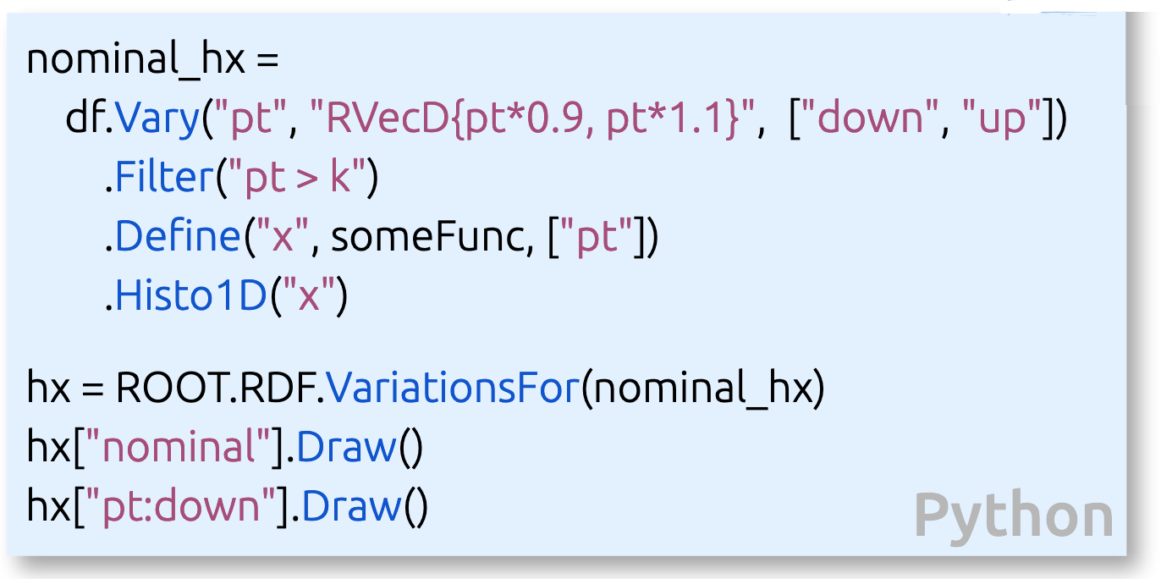
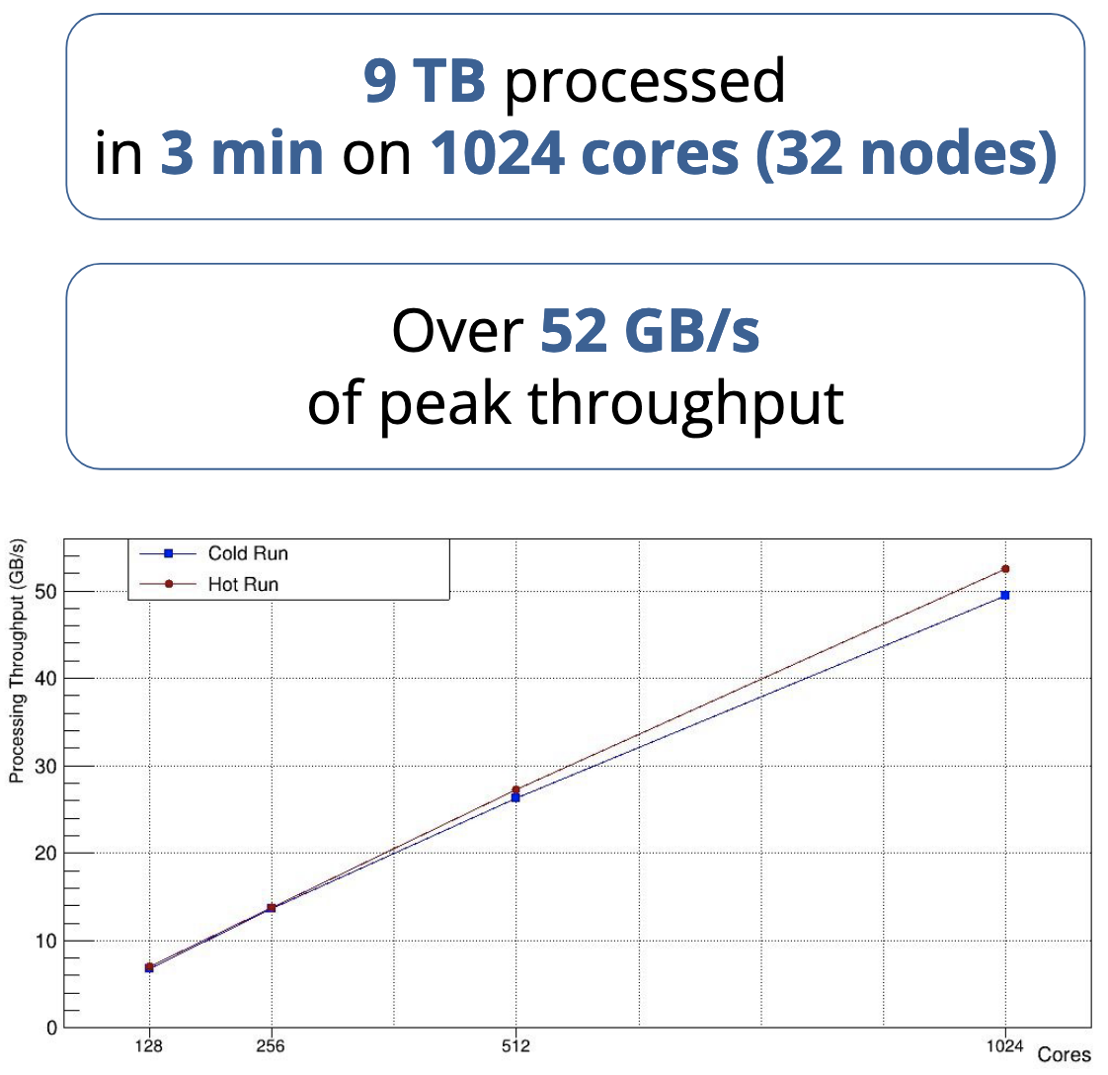
Analysis Ergonomics and Scaling
Improving how analysis is done increases productivity
  Rise of declarative models
    E.g., ROOT’s RDataFrame, Coffea
  Say what, not how and let the backend optimise
    More natural treatment of the problem
    No event loop!
  E.g. split and merge, GPU execution, cluster-wide distribution, systematics
Front end is increasingly Python, C++ optimised behind
  This gives an excellent avenue into the Python Data Science tools ecosystem
  Many new HEP specific Python packages are contributing to exploiting this area and addressing HEP specific needs
    Fitting, histogramming, statistics, …
  Very active field, 1300 registrants at last PyHEP workshop
Declarative approach to systematics with RDataFrame in ROOT
RDataFrame analysis parallelised with Dask backend

Slide 19

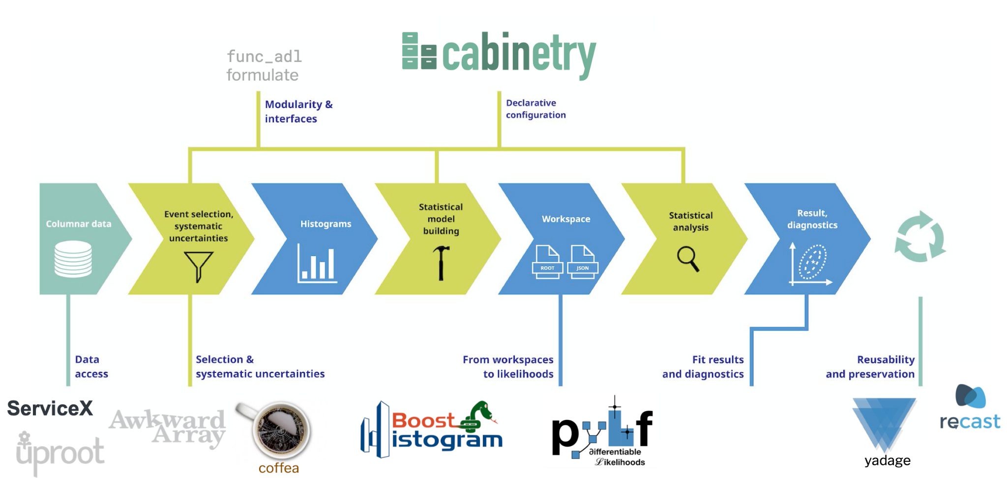
Analysis Ecosystem
Analysis facilities may offer specialist solutions to the different working point of analysis vs. other workflows
  coffea-casa prototype with columnar backend
  SWAN with EOS backed storage
  Here notebooks are commonly used as interfaces for the analyst
Standard candle analysis benchmarks help compare approaches and Analysis Grand Challenges (IRIS-HEP) test solutions end-to-end
Upcoming Analysis Ecosystems Workshop 2 (HSF, IRIS-HEP) will discuss all of this
Analysis Grand Challenge incorporates many software elements into a full workflow, from source data access to analysis preservation

Slide 20

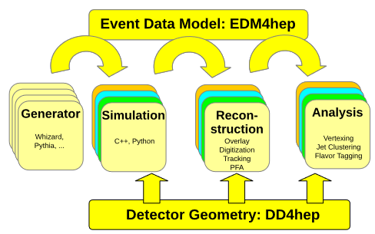
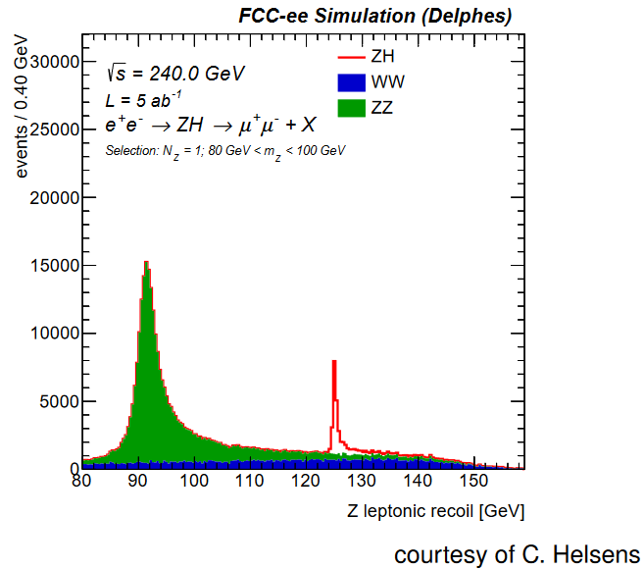
HEP Software Stacks – Key4hep
HEP software stacks are wide and deep - many dependencies
Want to be able to run full chains for detector design studies easily and in a validated setup
Key4hep ingredients
  Event data model, EDM4hep based on LCIO and FCC-EDM
  DD4hep for geometry
  Gaudi event processing framework
  Packaged and deployed using Spack
  Fast (Delphes) and full (Geant4) simulation available
Developed in AIDAinnova and EP R&D; contributions from ILC, CLIC, FCC and CEPC communities
Deployed via CVMFS to resources worldwide
  This also is a stepping stone to preservation

Slide 21


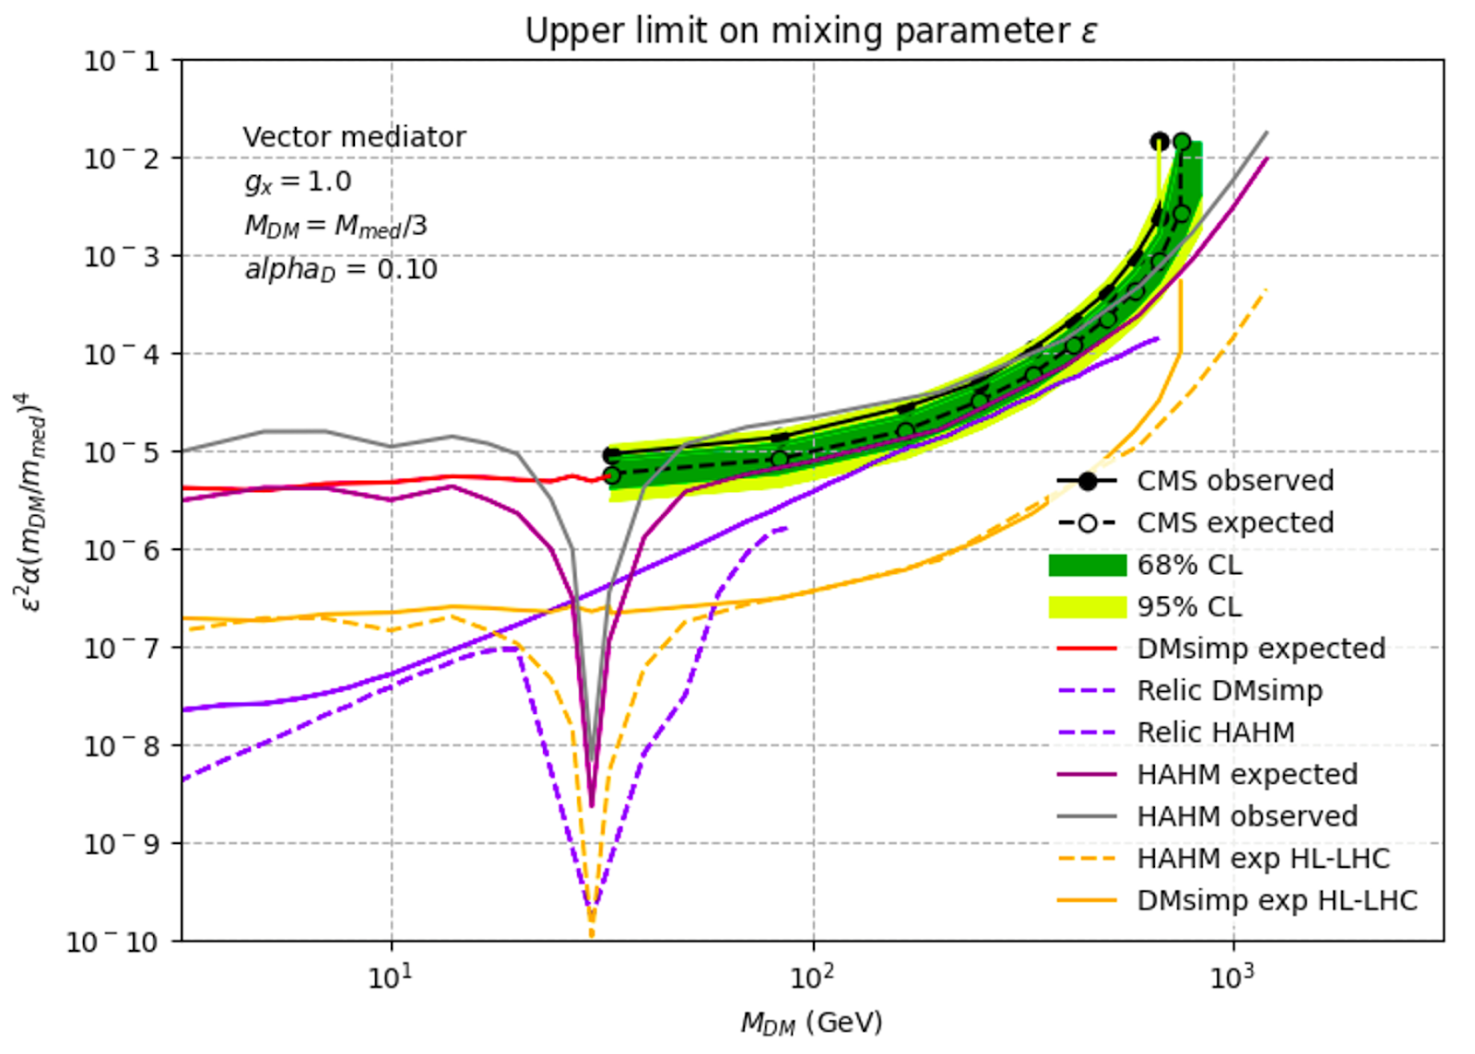
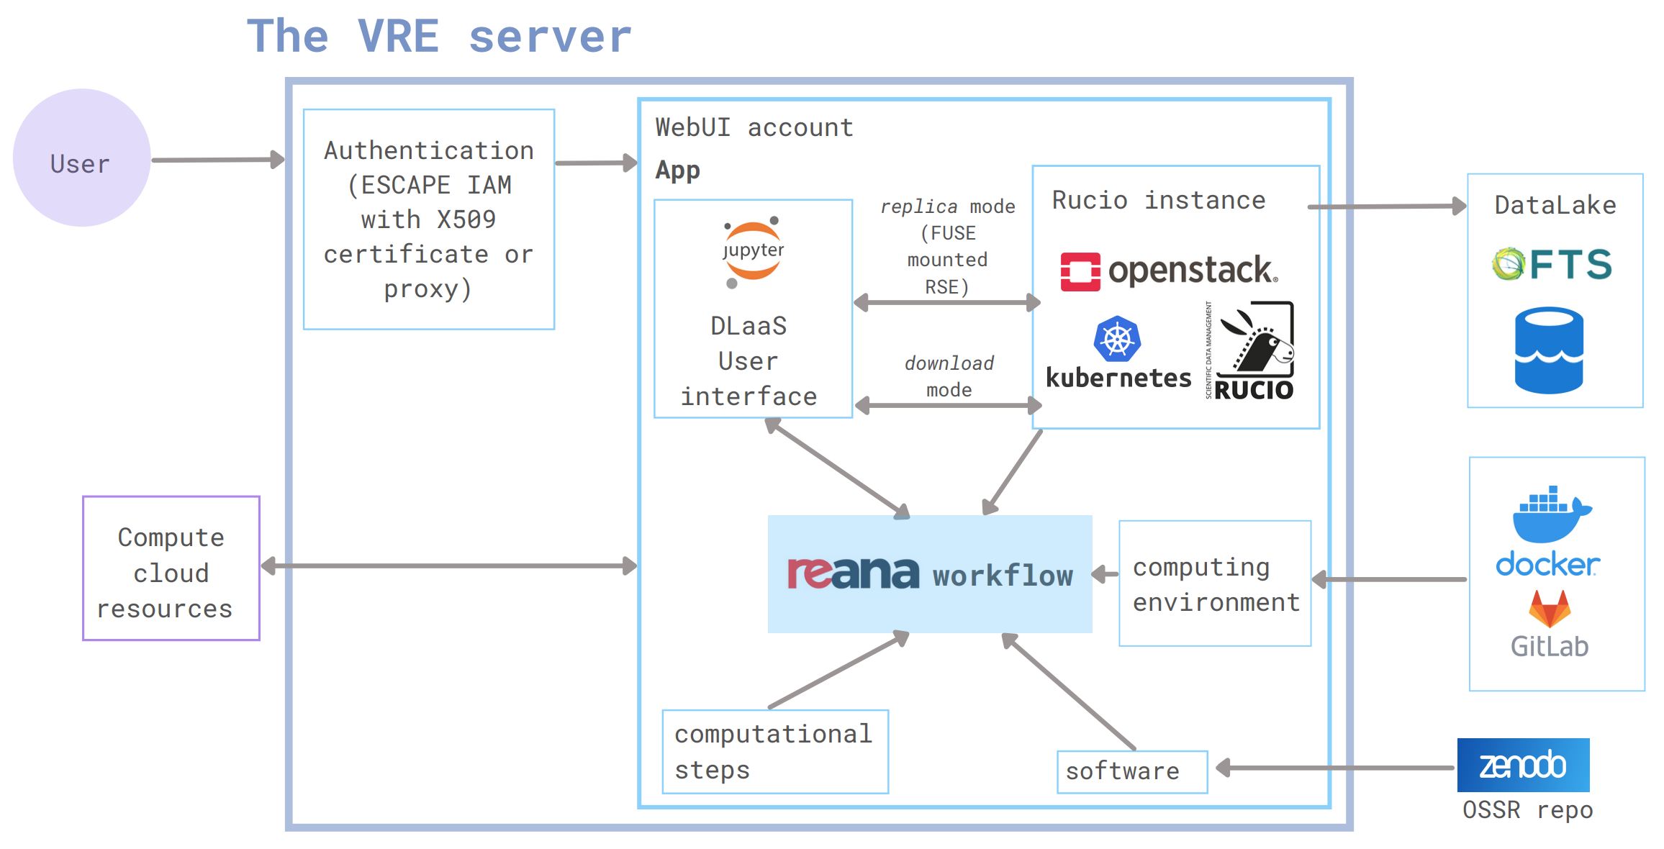
EOSC-Future Test Science Projects
For an example of the physics cases and VRE usage, see posters by J. Greaves and J. Little
Two test science projects (see also G. Lamanna’s ESCAPE talk)
  Extreme Universe
  Dark Matter
Test science projects will connect resources and enable scientific analysis at scale
  Prototyping use of the European Open Science Cloud
Use/develop a Virtual Resource Environment
  Experimental data (detector and simulation)
    Ambition to starting from different data formats
    (raw/derived/likelihood level)
  Software for analysis
  Computing resources
  Workflow management
  Demonstrate end-to-end analysis
    With preservation ‘built-in’
E. Gazzarrini

Slide 22
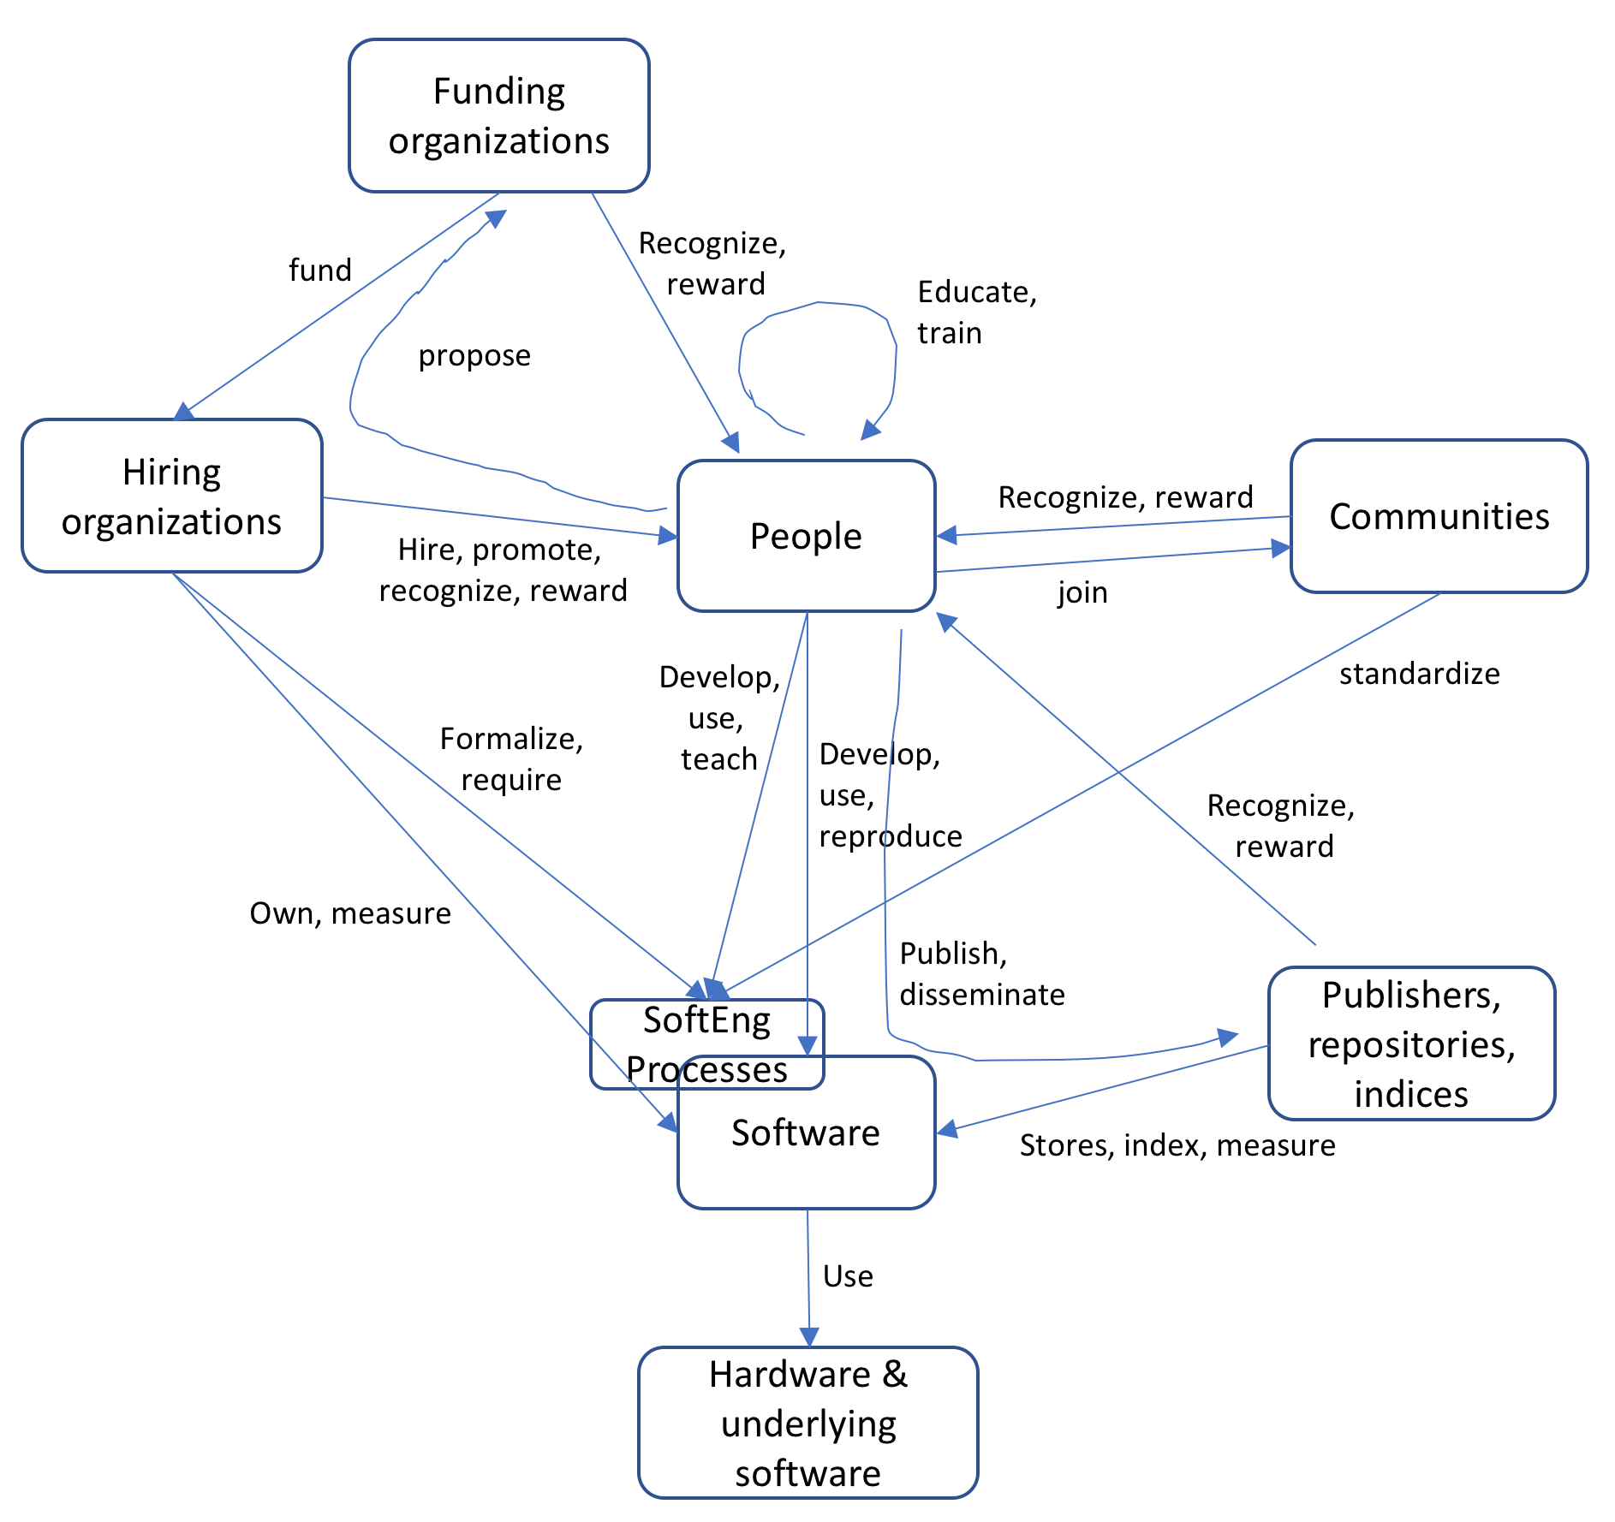
Software Sustainability
Sustainability is a complex matter, with interactions between many parties
  Funding agencies, funded projects, software engineers and developers, resource providers, …
Key pieces
  Software Engineering
    Good code, built with best practices
    Even existing code needs to be maintained (new compilers, platforms, library versions)
  Community
    People feel involved in the projects and between projects
    Open source and welcoming – lower barriers to entry
  Training
    Equipping developers with the skills they need
    Recognising that scientific software is developed by many people at different expertise levels (domain knowledge is critical!)
  Policy
    Is software recognised and funded?
    Are there career paths for those at the heart of our software projects?
      Research software engineer model is a step forward
Mapping the research software sustainability space, Druskat and Katz https://doi.org/10.1109/eScience.2018.00014

Slide 23

Software and Workflow Sustainability
Sustainability requires commitment
  There is often a chicken and egg problem…
    I won’t use your software because it’s not maintained long term – Experiment computing coordinator
    I won’t fund your software long term because it’s not used by the experiments – Funding agency
Projects that have staff on long-term/permanent positions can make firmer commitments into the future
  E.g. ROOT and Geant4 supported by CERN (and others!)
  From these core commitments communities are certainly easier to sustain long term
    Communities develop: User ➔ Contributor ➔ Developer ➔ Leader (reduce friction along this path)
  These projects are critical for the long term health of the field – stability here matters!
We need also to promote innovation and allow projects to take risks
  But with credible paths to sustainable outcomes
Just sustaining software isn’t enough, we also need to preserve data and
analysis workflows – for many decades
  Requires support for (open) data, support infrastructure (e.g., REANA) and
  documentation

Slide 24
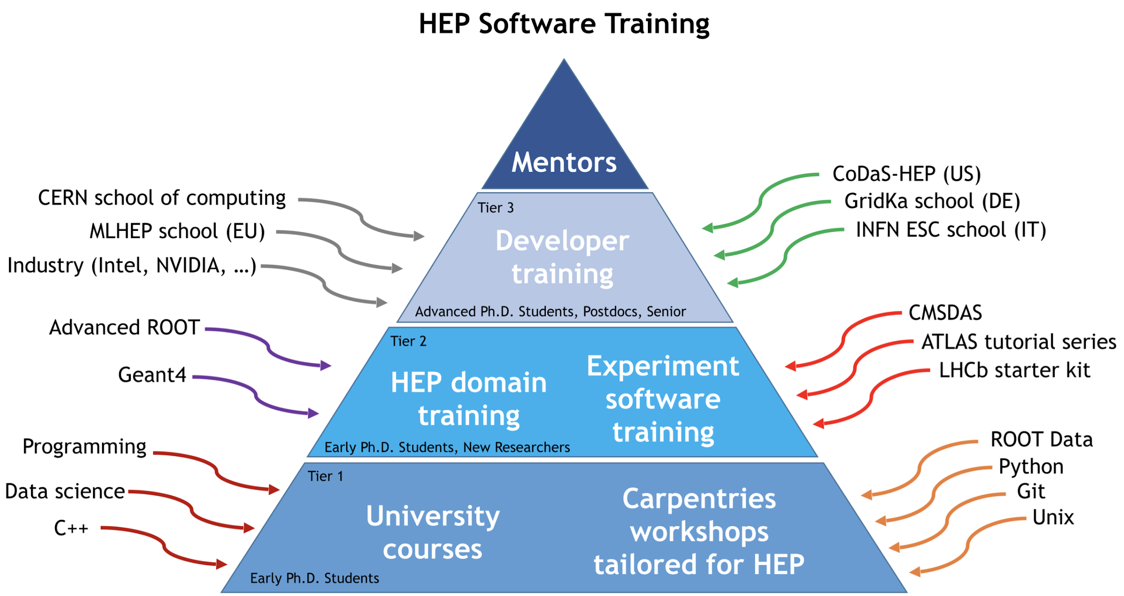
Training
Many new skills are needed for today’s
software developers and users
Base has relatively uniform demands
  Any common components help us
HSF Training Group runs Software Carpentries and other tutorials (co-organised between the HSF and IRIS-HEP, with key projects like ROOT)
Highly successful C++ training courses (from SIDIS and HSF)
  Inspires continued curriculum development and sharing material
Assembling a complete curriculum for training in HEP, using Carpentries templates as part of addressing this need [10.1007/s41781-021-00069-9]

Slide 25


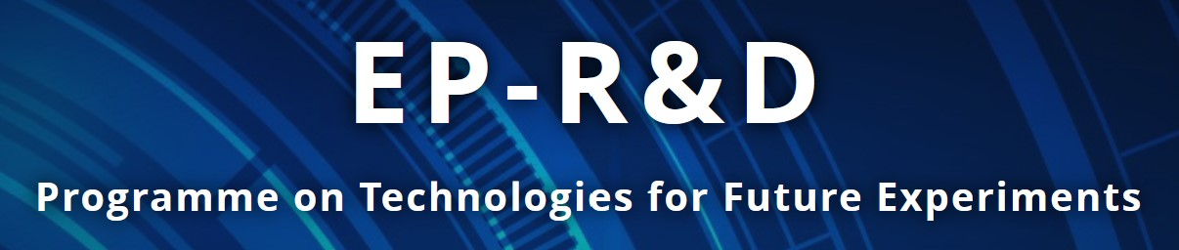

HSF and Software Projects
Since the publication of the Community White Paper in 2018 [10.1007/s41781-018-0018-8] there has been growing awareness of the need to invest in software for the future
  A number of important projects have been funded
    IRIS-HEP, NSF
    SWIFT-HEP, STFC
    HEP-CCE, DOE
    EP R&D Software, CERN
    AIDAinnova, EU
These projects are having a significant positive impact on software for HEP
  The sustainability of the software and people they develop needs to be addressed
HSF provides a meeting point for exchange of information and interaction between these activities, through working groups, fora and workshops
  Our key objective is to form a community for HEP software

Slide 26
Conclusions
HEP has a huge investment in software
  Our science just wouldn’t be possible without it
We face challenges from
  Ambitious physics programmes, with higher data rates and more stringent requirements
  Technology evolution towards parallel architectures, particularly GPUs
  This is common across disciplines
Important software projects have been funded in recent years
  In combination with the experiments and the existing projects these are helping our software to advance
  The HSF, though largely unfunded, has become a place to help build the community and share knowledge
Sustainability requires a commitment to people more than anything
  We will take care of the technical matters, but there is a real need to find people sustainable careers

