Slide 1
From OPEN DATA to OPEN RESEARCH
(new paradigms, challenges and opportunities)
Giovanni Lamanna
LAPP, Laboratoire d’Annecy de Physique des Particules, CNRS-IN2P3
JENAS Symposium – 5 May 2022

Slide 2
Preamble and outline
@ JENAS 1st Symposium (October 2019) ESCAPE was presented and discussions brought to an important evolution of our work plan: Open Test Science Projects […]
  ESCAPE builds an Open Research Environment: current status
The European Open Science Cloud (EOSC) and the current evolution of the EU Research ecosystem acknowledges the contributions from the Science Clusters and their mutual cooperation
  Science Cluster scheme as “coordinating structure” for Open Science and operationalising the European Research Area (ERA).
Committing JENA++ scientific communities at large in the Horizon Europe work programme for enabling an operational open science, large cooperative schemes and for Research Infrastructure consolidation
  The new ESCAPE Open Collaboration and its work plan
https://indico.ijclab.in2p3.fr/event/5418/contributions/17542/
https://projectescape.eu
https://indico.in2p3.fr/event/24327/
2

Slide 3






























The ESCAPE H2020 CONSORTIUM
31 partners including 2 SMEs
10 ESFRI projects & landmarks: CTA, EST, FAIR, HL-LHC, KM3NeT, SKA, LSST, VIRGO, ESO, JIVE
2 pan-European International Organizations: CERN, ESO with their world-class established infrastructures, experiments and observatories
2 European Research Infrastructures: EGO and JIV-ERIC
1 involved initiative/infrastructure: EURO-VO
4 supporting European consortia: APPEC, ASTRONET, ECFA and NuPECC
Budget: 15.98 M€
Started: 1/2/2019
Duration: 48 months (end date 31/1/2023)
Coordinator: CNRS-LAPP
3

Slide 4
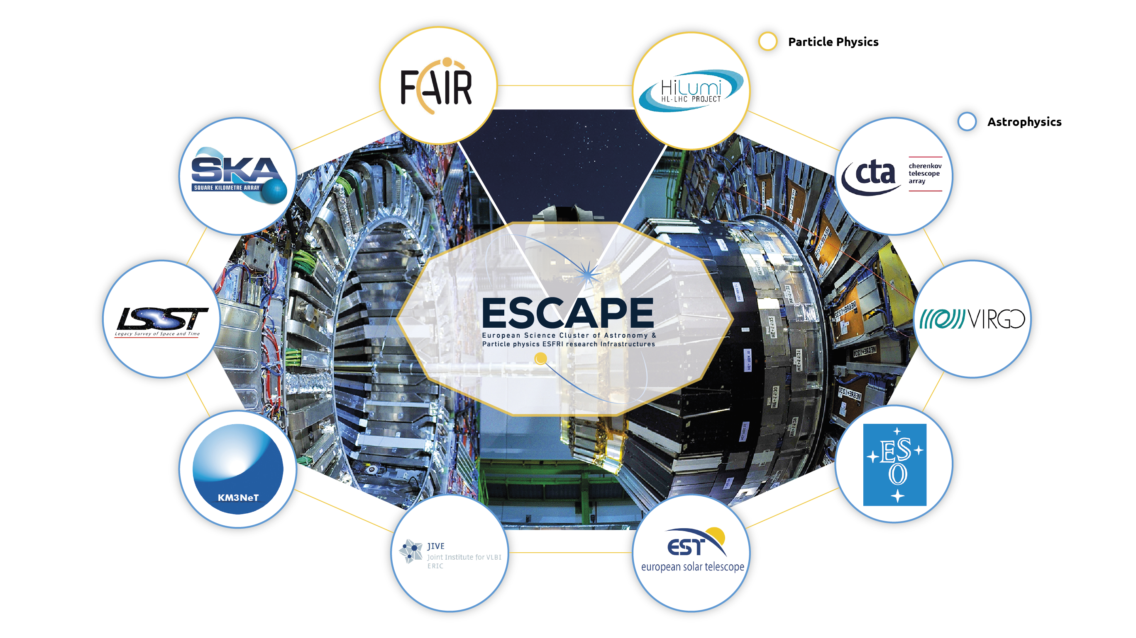
(ESFRI) and other RI PARTNERS
/ Nuclear Physics
/ Astroparticle Physics
4

Slide 5
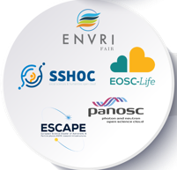

The five Science Clusters
ESCAPE is one of the five Science-Cluster projects that resulted from the H2020 topic call INFRAEOSC-04-2018: “Connecting ESFRI infrastructures through Cluster projects”.
Other Science Clusters: ENVRI-FAIR (Environment and Earth Sciences), EOSC-LIFE (Biomedical Science), PANOSC (Neutron and light sources facilities) and SSHOC (Social Science and Humanities).
Expected impact:
Improve access to data and tools leading to new insights and innovation
Facilitate access of researchers to data and resources for data driven science.
Create a cross-border open innovation environment.
Rise the efficiency and productivity of researchers through open data services and infrastructures for discovering, accessing, and reusing data.
Foster the establishment of global standards.
Develop synergies and complementarity between involved research infrastructures.
Adopt common approaches to the data management for economies of scale.
Working together making data and scientific research FAIR …
Five Science Clusters
More than 80% of ESFRI RIs,
plus other world-class RIs and new emerging ones.
5

Slide 6
ESCAPE: Astronomy, Nuclear and Particle Physics ESFRIs
Background analysis for the uptake of “Open Science” and “Data FAIRness”
Builds on communities’ complementary excellences in data stewardship:
  Astronomy Virtual Observatory infrastructure
  HE-NP expertise in Exabyte-scale data management and large-scale distributed computing
Builds on existing inter-RI synergies, intersections.
Recognises that ESCAPE communities will be Exascale data generators,
early adopters of ICT and data management innovations, push state-of-the-art.
Both Observatory- and Facility- operations require global, open access to data,
long term curation, and sustainability.
Concerned by connecting the ESFRIs to EOSC - European Open Science Cloud (at the early stage when EOSC was just a concept and EU shared policy)
6

Slide 7
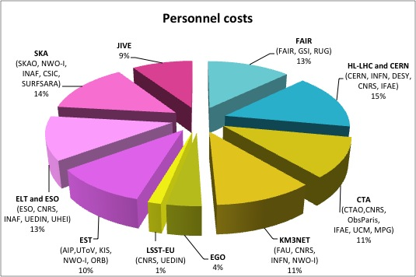
ESCAPE consortium
As per H2020 INFRAEOSC-04-2018 call - CLUSTER MEMBERSHIP and PARTNERSHIP:
The EC funding contributions proportional to the number of pan-European research infrastructures (ESFRI project/landmark) that the science cluster connects to the EOSC.
Each RI legal entity commits
together with a sub-set of
associated national institutes.
Furthermore:
The Director of each ESFRI RI is a member of the
ESCAPE Supervisory Committee (E-SC)
APPEC, ASTRONET, ECFA, NuPPEC chairs
and ESA representative form the
ESCAPE External Advisory Board (E-EAB)
Distribution of personnel costs among partners grouped by RI
7

Slide 8
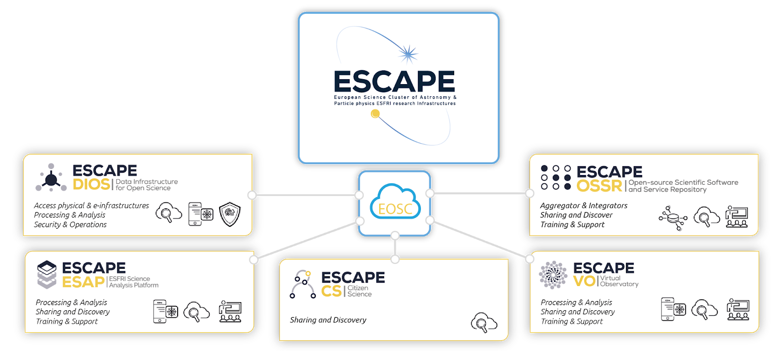
WORK PROGRAMME
Data Lake:
Build a scalable, federated, data infrastructure as the basis of open science for the ESFRI projects within ESCAPE.
Software Repository:
Repository of "scientific software" as a major component of the “data” to be curated in EOSC.
Science Platforms:
Flexible science platforms to enable the open data analysis tailored by and for each facility as well as a global one for transversal workflows.
Virtual Observatory:
Extend the VO FAIR standards, methods and to a broader scientific context; prepare the VO to interface the large data volumes of next facilities.
Citizen Science:
Open gateway for citizen science on ESCAPE data archives and ESFRI community
8

Slide 9
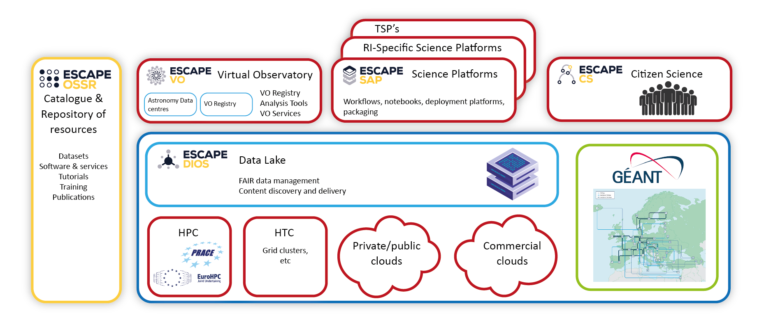
Our domain-based “EOSC CELL”
9

Slide 10
Overview progress: implementing the EOSC-cell
From preliminary plans or first prototypes
to operational components of the ESCAPE EOSC-cell for open science:
10

Slide 11
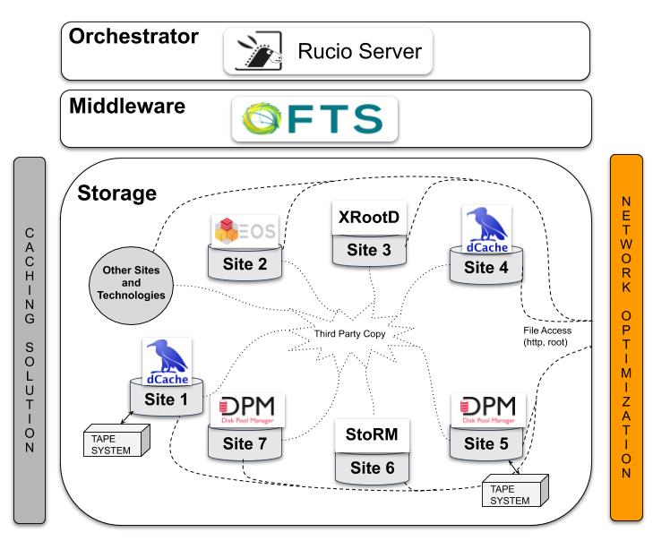


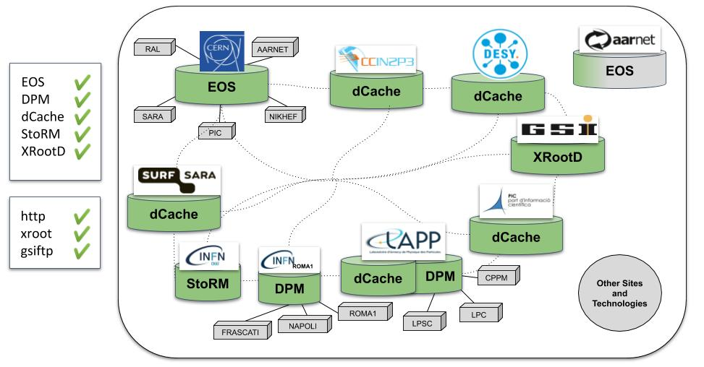
The ESCAPE Data Infrastructure for Open Science (DIOS)
The main Data Lake (DL) building blocks are deployed and operated by the ESCAPE partner institutes.
Petabyte scale storage harnessing capacity provided at DESY, SURF-SARA, IN2P3-CC, CERN, IFAE-PIC, LAPP, GSI and INFN (CNAF, ROMA and Napoli)
Data management and storage orchestration layer provided by Rucio (framework developed in ATLAS/LHC)
File transfer and data movement services provided by FTS (developed in WLCG/CERN) and enabling different transfer and access protocols: http, gridftp, xrootd and swift/S3
Global Data Lake Information System: endpoints, protocols, ports provided by CRIC (from ATLAS/LHC)
Common Auth/Authz/IM (AAI) - the ESCAPE IAM, from INDIGO-DATACLOUD, AARC/AARC2 and FIM4R projects, deployed and operated in INFN/CNAF
Xavier Espinal - CERN
11

Slide 12
Overview progress: implementing the EOSC-cell
  A functional Data Lake implemented (by all RIs and for their requirements)
The ESCAPE pilot Data Lake (DL), after design and deployment was recently assessed, culminating in a joint exercise labelled as Full Dress Rehearsal (FDR20):
  - a 24h production-like window where ESFRI’s executed relevant workloads.
Followed by a full scale Data and Analysis Challenge (DAC21) performing production-like Data Management, Processing and Analysis workloads including interplay possibilities using large scale resources (batch systems and clouds) and user-analysis oriented platforms (online notebooks and analysis platforms).
12

Slide 13
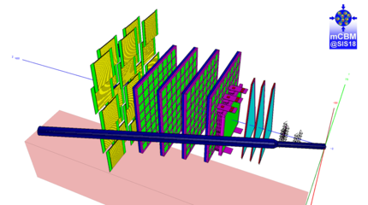


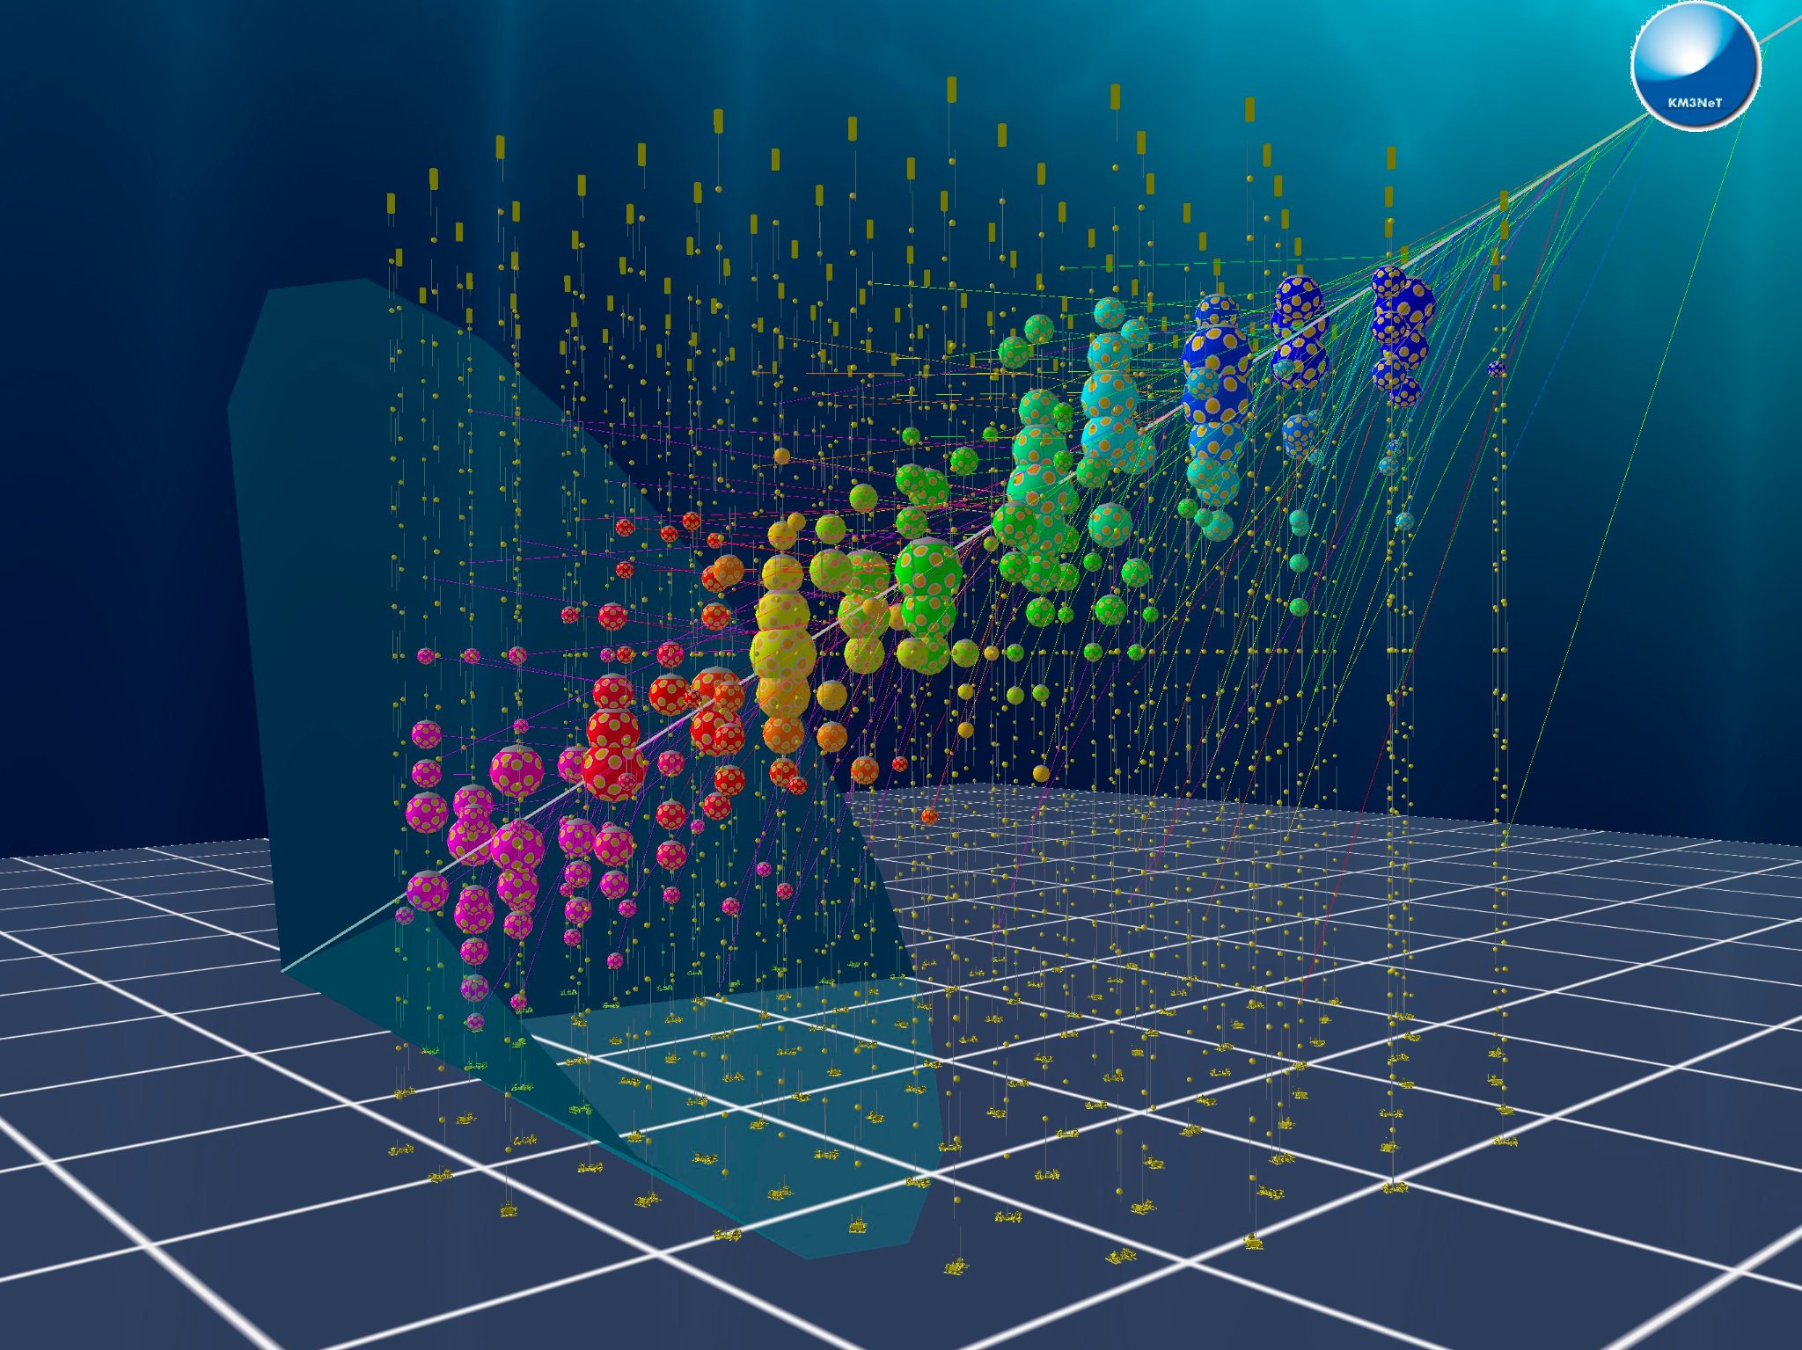
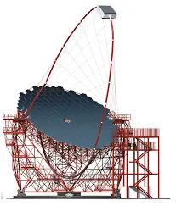

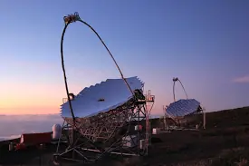

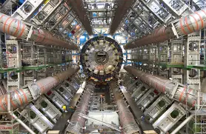

The ESCAPE Data Infrastructure for Open Science (DIOS)
Raw data injected, stored and preserved in the DL. Data processed by users, results are stored back in the DL.
Offload data from the storage buffer in the coast, replicate across sites, run data calibration, store back. Data product ready for user consumption
Distributed data re-processing taken at remote locations (La Palma)
Large experiment demonstrating open data capabilities (with ad-hoc ATLAS open-data software)
Xavier Espinal - CERN
13

Slide 14

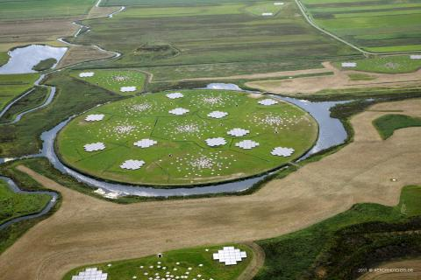
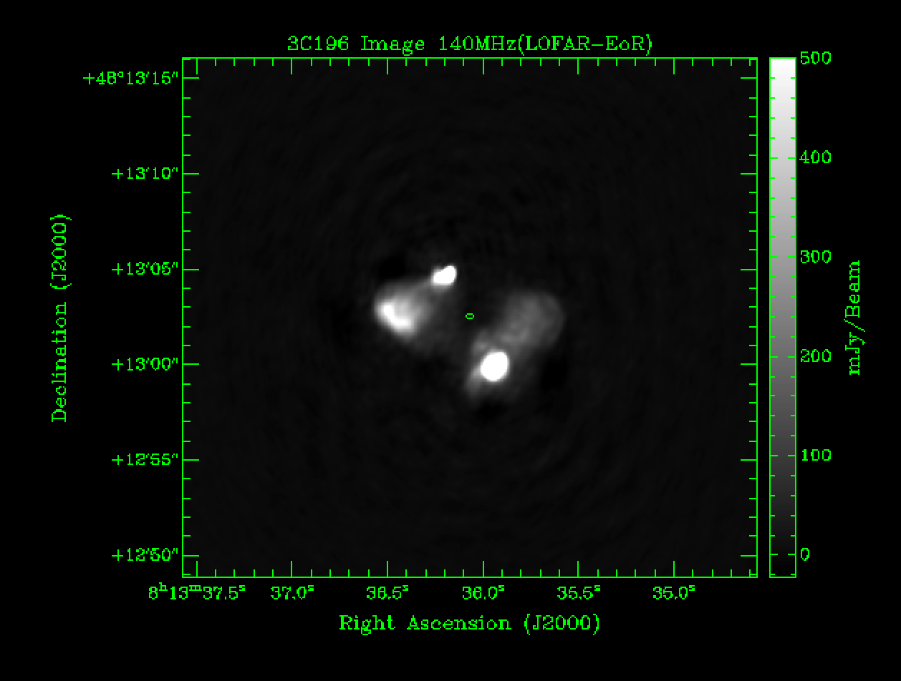
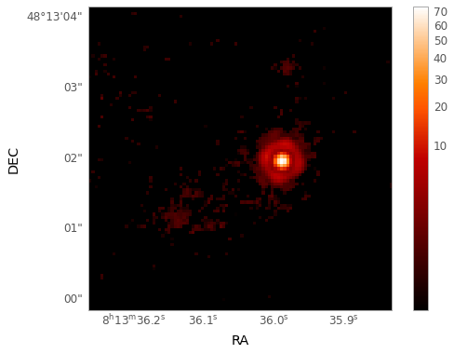
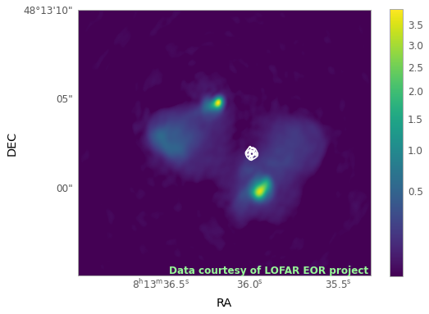
The ESCAPE Data Infrastructure for Open Science (DIOS)
Full-cycle scientific data management and data processing
1. Data injected to the DL from three radio source observations
in external locations
2. User in external
location download
the data, process and store results back to the DL
3. User interested in combining results
stored with other public data to cover also visible spectrum
5. Optical and radio data aggregate in via the ESAP (WP5), combined analysis done. Results uploaded back to the DL.
4. Combined optical data from the Hubble
located via the VO (WP4)
From left to right: Radio image, Optical image and the Combined image (LOFAR with optical contours)
Xavier Espinal - CERN
14

Slide 15
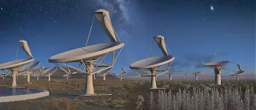

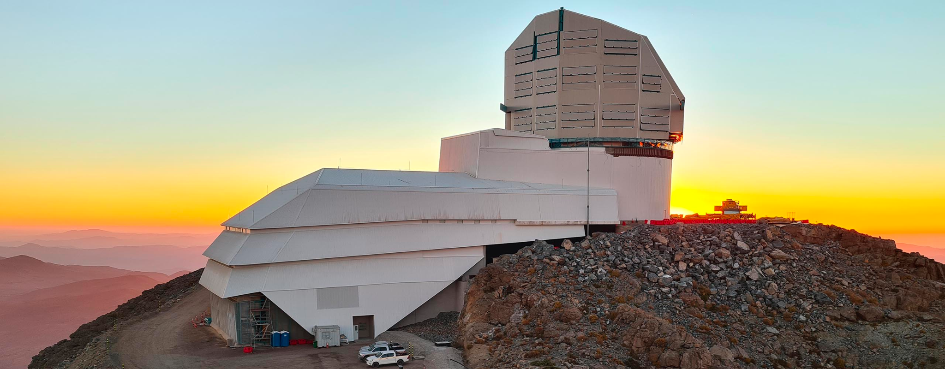


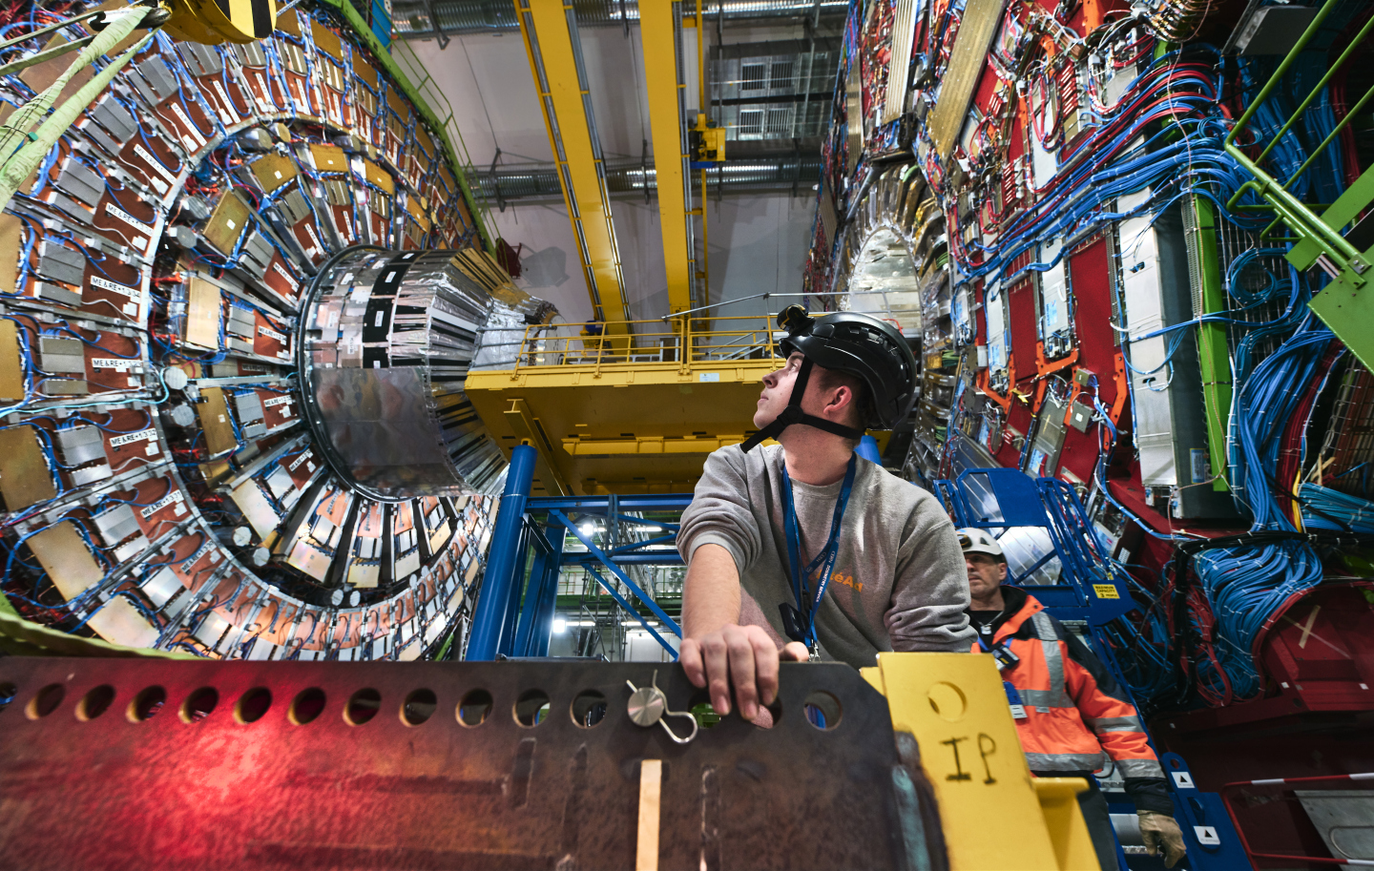

The ESCAPE Data Infrastructure for Open Science (DIOS)
Full-cycle scientific data management and data processing
Global-scale (Australia, South-Africa and Northern hemisphere sites )Data Management
Simulate observations and leverage telescope local storage data replication to fulfil daily data management cycles (incorporating SLAC in the data replication chain)
DL interface with local and heterogeneous resources (HPC), control access, caching and analysis
Xavier Espinal - CERN
15

Slide 16
Overview progress: implementing the EOSC-cell
  Deployment of the Open-source ESCAPE catalogue of resources (data and software)
Shared domain-based open science software and services based on FAIR principles
Objectives:
  Facilitate and support continuous development, deployment, exposure and preservation of partners’ software/tools/services
  Foster interoperability, software re-use and cross-fertilisation between ESFRIs (e.g. simulation)
  Offer an open innovation environment for open standards (e.g. workflows, data-formats), common regulations and shared (novel) software for multi-messenger & multi-probe data
eOSSR library https://gitlab.in2p3.fr/escape2020/wp3/eossr
  incorporates all OSSR developments, based on the commonly defined practices and standards
  python-based
  OSSR API : send request to the OSSR, find and filter software and services, upload new entries, update existing entries
  CI : automated upload / update using gitlab CI
  Metadata : schema definition, crosswalk between CodeMeta and Zenodo, generator and validator available
16

Slide 17






ESCAPE OSSR Workflow
publishes source code
(updates your existing record with new versions)
long term archived
findable
citable
publishes
image
develop/maintain software
tag a version(release)
add metadata
let the CI do the rest
registers
image
integrates into ESCAPE EOSC cell
builds a
container image
17

Slide 18
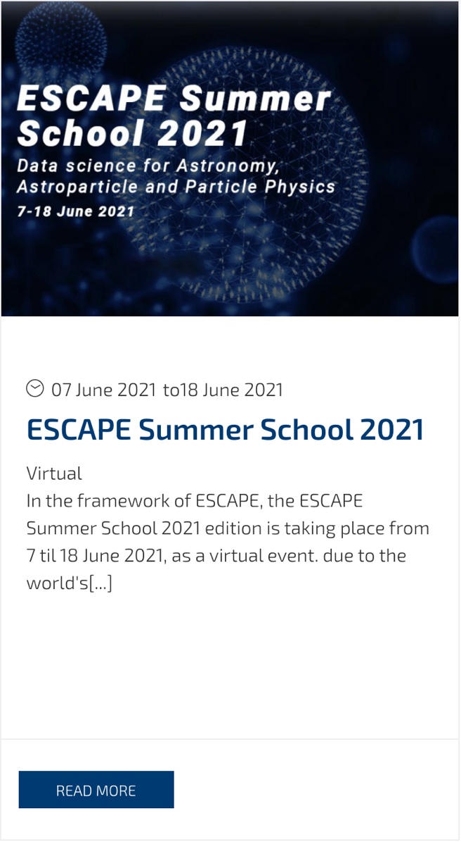
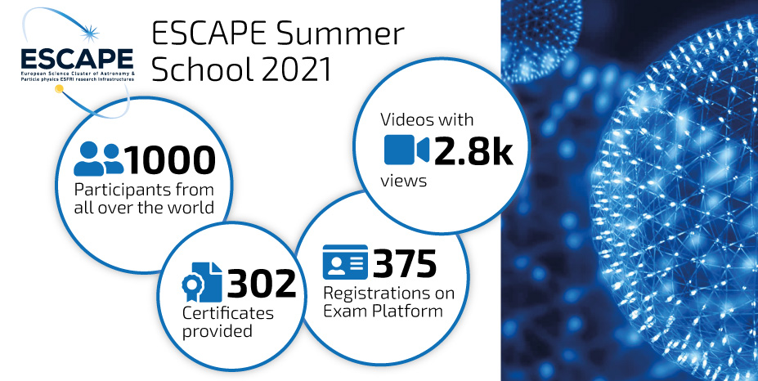
OSSR training
Software as first class EOSC citizen
Enable software custodians
All lectures/materials online:
https://escape2020.github.io/school2021/
https://indico.in2p3.fr/event/26913/

Slide 19
Overview progress: implementing the EOSC-cell
Development of the ESFRI Science Analysis Platform: a toolkit for building platforms through which users can discover and interact with the data products, software tools, workflows, and services that are made available through ESCAPE.
Preparing ESFRI services, data products, and tools for integration with ESAP and their subsequent use within ESCAPE and EOSC.
19

Slide 20
Overview progress: implementing the EOSC-cell
Demo system
https://sdc-dev.astron.nl/esap-gui

Slide 21
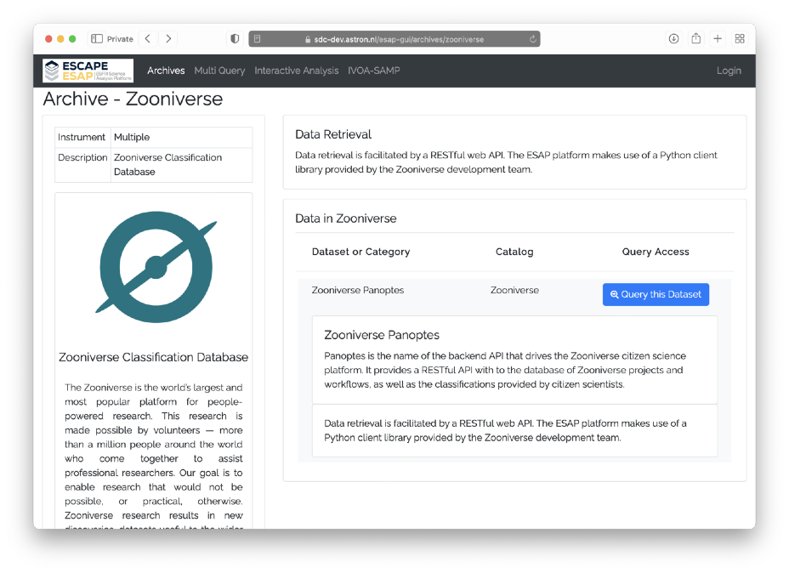
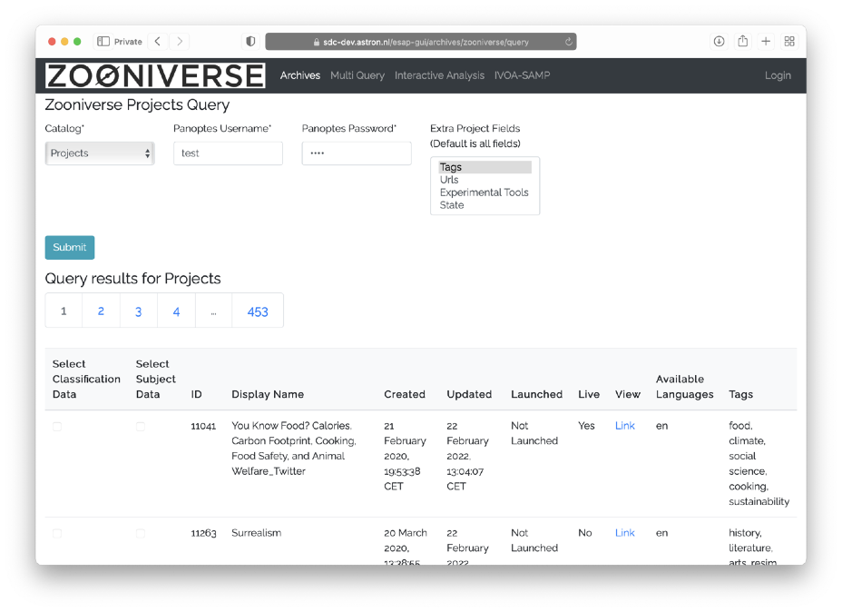
Overview progress: implementing the EOSC-cell
Full integration of ESAP with the ESCAPE Zooniverse “Panoptes” system.
21

Slide 22
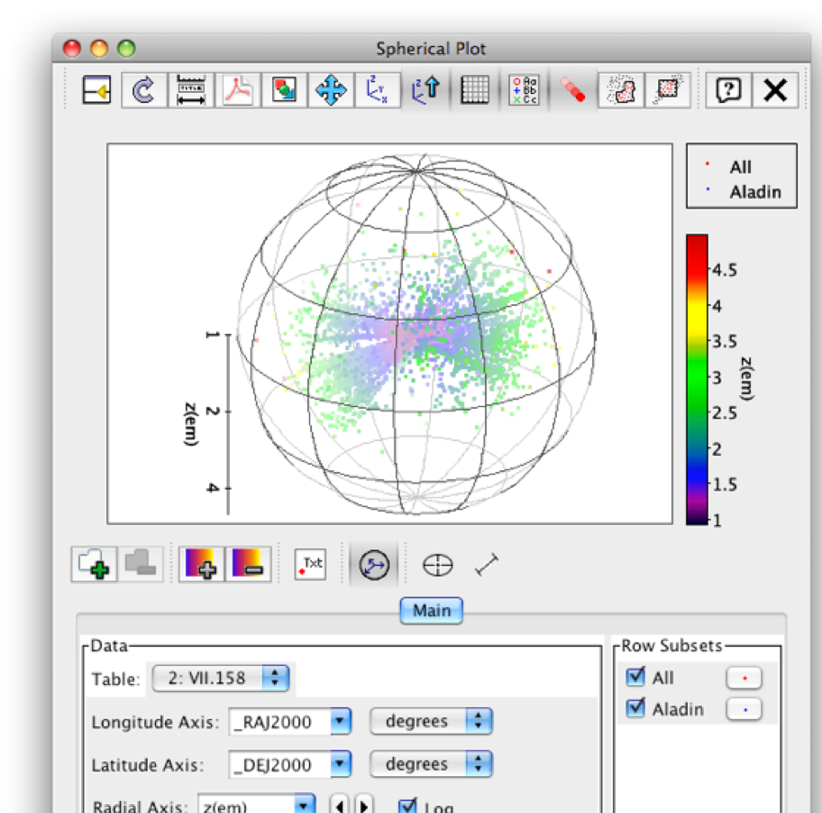
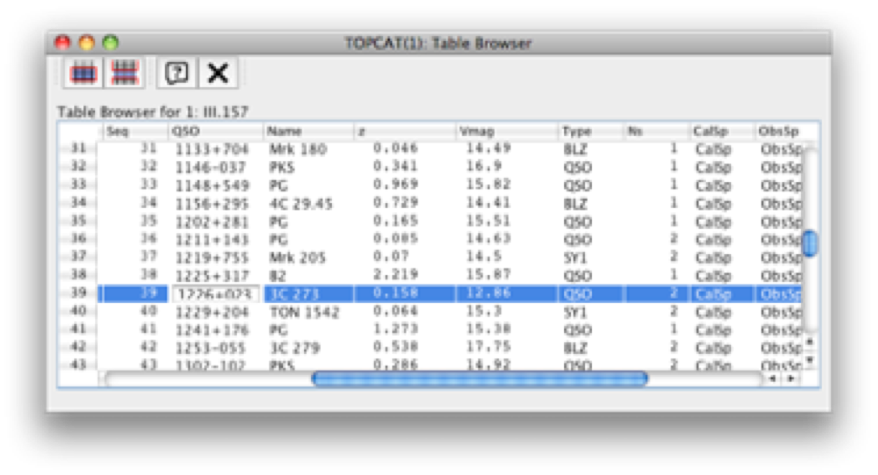
Overview progress: implementing the EOSC-cell
Enables a Virtual Research Environment of interoperable tools and services based on IVOA standards, including ESO Science Archive and ESO Science Portal
22

Slide 23
Implementing the ESCAPE disciplinary EOSC-cell
The ESCAPE EOSC-cell for a three-fold impact:
  a FAIR digital environment dedicated to scientists at large to interoperate data and workflows for fundamental science;
  data management solutions mutually adopted by a large fraction of RIs and potentially extendible to further disciplines;
  the “EOSC Web of FAIR Data and Services for Science” for our disciplines
A Virtual Research Environment (VRE): thematic collaborative digital environment used by scientists, which enables FAIR community-based scientific research, training, innovation, cross-fertilisation and open science.
Evolving practices on the assessment of research giving increasing value to open science contributions and outputs beyond publications. A wide range of digital objects beyond publications, including data, software, code, workflows, and processes, such as open peer-reviews (requiring an enhanced traceability, coherent and comprehensive metrics and FAIRness of a wide range of digital objects). Digital content added in order to :
Perform analysis
Explore analysis
Repeat analysis
Modify analysis
Upload analysis
Publish new results
Rewarding scientists
The ESCAPE Virtual Research Environment prototype
to host the Test Science Projects
(and part of the EOSC Future project […])
23

Slide 24
Enhancing participation in EOSC
(Test) Science Projects – (T)SPs
  Originally part of the ESCAPE work programme, proposed to validate ESCAPE services for Open Science at the end of the project.
  The ESCAPE-TSP concept finds consensus and evolves for a larger impact.
    Stimulating and/or cooperating with Joint ECFA, NuPPEC, APPEC Activities (JENAA)
    TSP “bench” concept aiming at enhancing researchers participation in open science and cross-domain scientific research (and guiding the EOSC architecture).
    Included in the new H2020 EOSC Future project
24

Slide 25
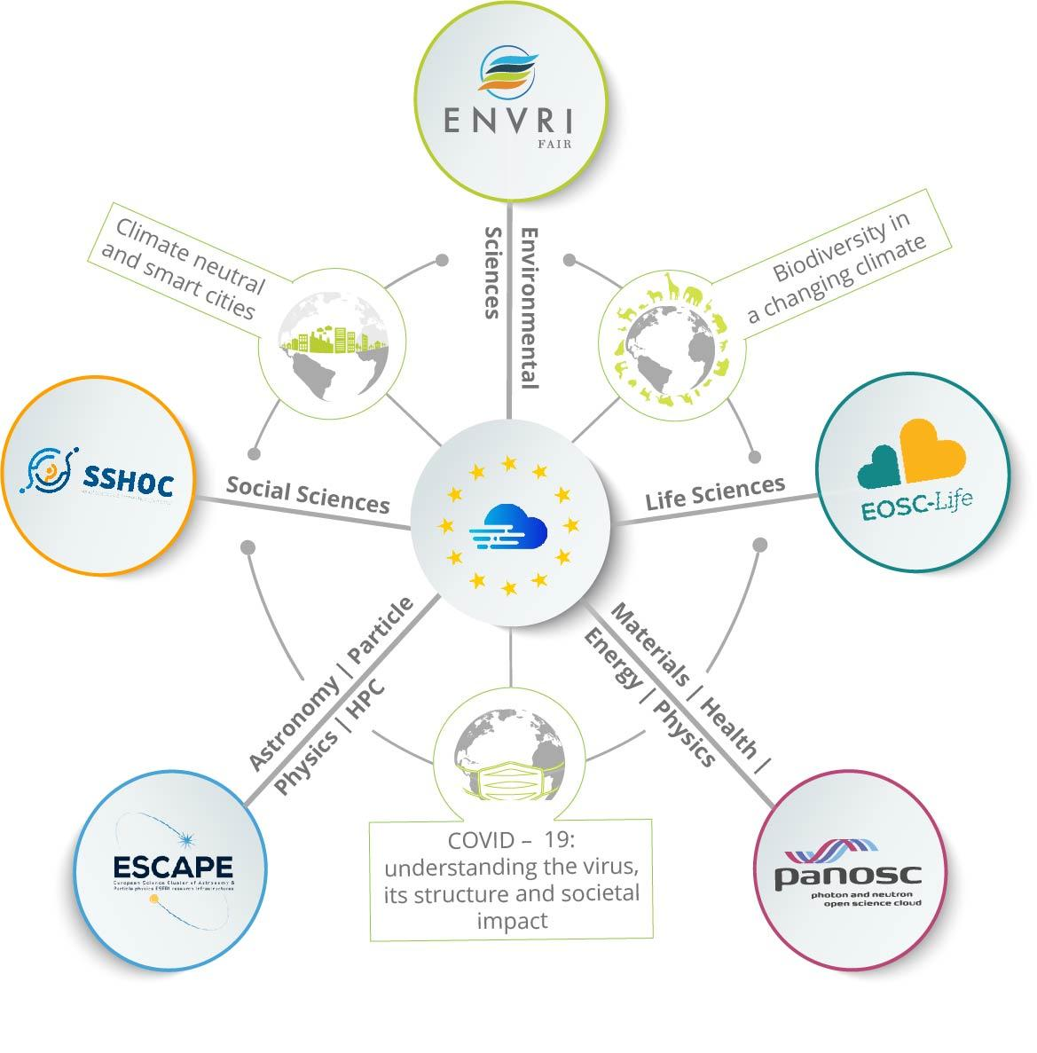






TSPs and synergies in EOSC Future
Synergy between
Clusters & e- infrastructures
EOSC Service Delivery
Innovation capacity and procurement
Architecture and Interoperability
Design and Development of Portal Layers
Training and Skills
Integration of Community Services and Products
25

Slide 26
Enhancing participation in EOSC
TSPs are proposed to demonstrate multi-domain science integration across ESCAPE
  demonstrate new cutting edge open science capabilities, making use of the services implemented within ESCAPE
  feedback on the capabilities delivered by ESCAPE
  benefit real science goals in exploring synergies between the ESFRIs and largely among three scientific communities Astrophysics/Astroparticle, accelerator-based Particle and Nuclear Physics (supported by consortia of EU member states research agencies and institutes within JENAA)
1. Dark Matter Science Project
2. Extreme Universe (& Gravitational waves) Science Project
A top-down endorsement for a bottom-up approach based on Expression of Interests (EoI) subscribed by researchers
Linked to two corresponding JENAA EoIs
(with already about 1000 subscribed scientists)
26

Slide 27
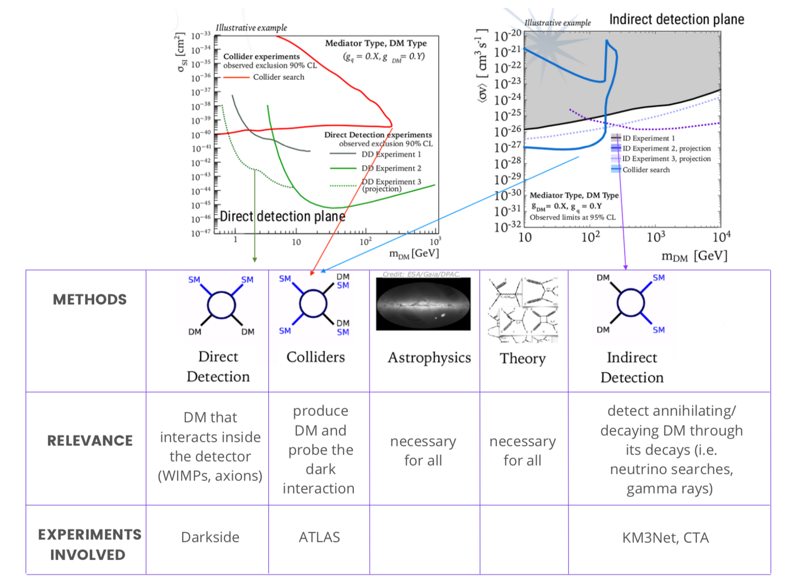
Dark Matter Science Project
Open Science Pilots within “Dark Matter” as focus / scientific question
Primary goal of TSP: produce summary plots for different hypotheses (starting from WIMP hypothesis) using fully reproducible workflows on the EOSC, using ESCAPE services
Starting for now from RIs in ESCAPE partners (LHC, CTA, KM3Net, Darkside …) , will open up to others once the first workflows are up
Bottom-up effort: start from the individual science inputs and make tools + digital objects (data) shareable and sustainable
Additional goal of TSP: share software methods that can be useful to other communities (e.g. ML algorithms)
Slides by E. Gazzarrini and DM Science Project organizers (F. Calore, C. Doglioni, L. Heinrich)
Notes:
The goal is to produce dark matter summary plots from

Slide 28
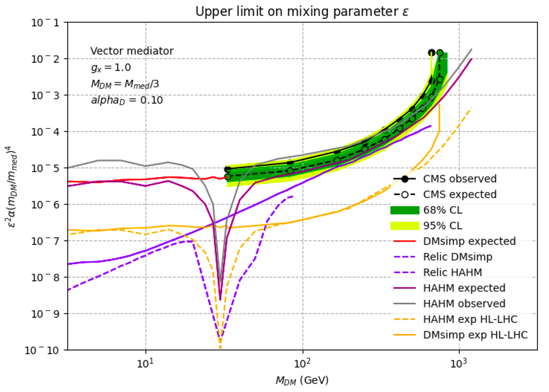
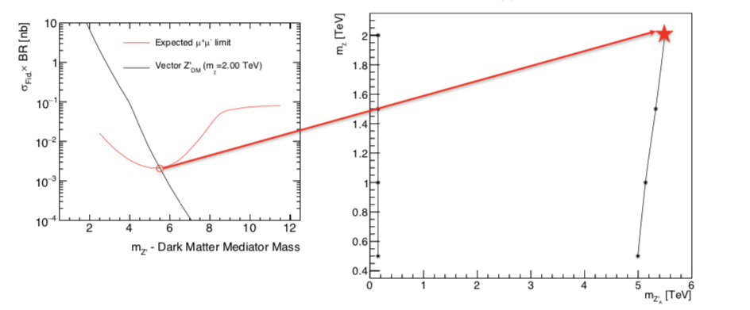
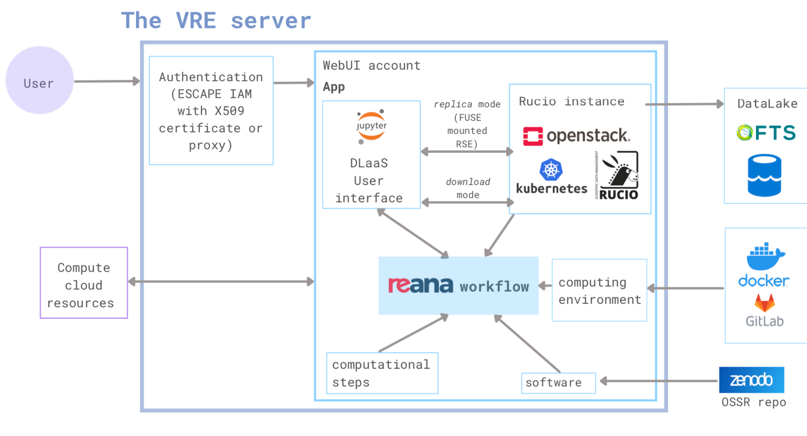
Dark Matter Science Project
J. Greaves (with P. Harris and C. Doglioni): reinterpreting ATLAS DM results to connect to accelerator DM searches
J. Little (with T. Hryn’ova): making DM summary plots using ATLAS High Luminosity projections, withinthe ESCAPE VRE
Ex. LHC. Work in progress on:
Individual DM analyses (science cases)
  For examples from colliders: see Jared Little and Josh Greaves’s JENAS posters
Preparing and onboarding software, discussing data access
Virtual Research Environment (VRE)
  Building the core of the project
  where the workflows will run
Understanding computing resource needs
First full data analysis results expected for October 2022
E. Gazzarrini, E. Garcia
Slides by E. Gazzarrini and DM Science Project organizers (F. Calore, C. Doglioni, L. Heinrich)

Slide 29
Extreme Universe Science Project
A series of pilots focused on violent phenomena in the Universe with Astrophyiscal as well as fundamental implications (e.g. Dark Matter)
Main Research Area | Objects/sources | Messengers | ESF/RI involved | ESCAPE services EOSC-Future integrations | Data Analysis tools (AI,ML) | Pilot project(s) | Computing resources required
Compact objects | Pulsars, FRBs, Off-nuclear AGN | radio, optical, X-ray, … | LOFAR... | Multiwavelength platform/Software catalogue,VO tools | Data science, Machine Learning | 1) Radio astronomy: FRBs, pulsars, plerions, off-nuclear AGN | Compute cluster, Jupyter hub, Rucio Data lake
High energy Astrophysics | GRBs, jets, AGN, BNS, CCSN | neutrinos, gamma-ray, radio,X-ray, GW,... | CTA, Virgo, KM3NeT, SKA,LSST | Multimessenger platform/Software catalogue,... Virtual Observatory tools | Model comparison, Machine Learning | 1)GRB/neutrino/GW analysis, 2) Blazar MWL/neutrino | GPU cluster Jupyter hub
Fundamental physics | Dark matter, GR, Primordial Universe | GW, | Virgo, Einstein Telescope | Template banks, generation software,... | Machine learning approach | 1) DM template bank and ML analysis pipeline | GPU cluster Jupyter hub
Collecting requirements
for VRE.
Understanding services, computing resource needs and technical challenges.
First full data analysis results expected for October 2022
29

Slide 30
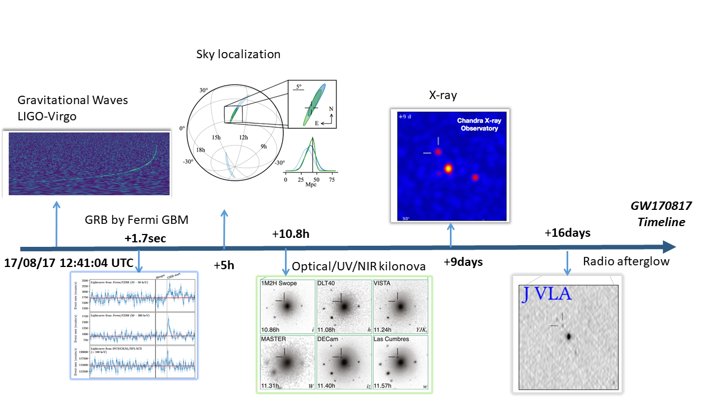
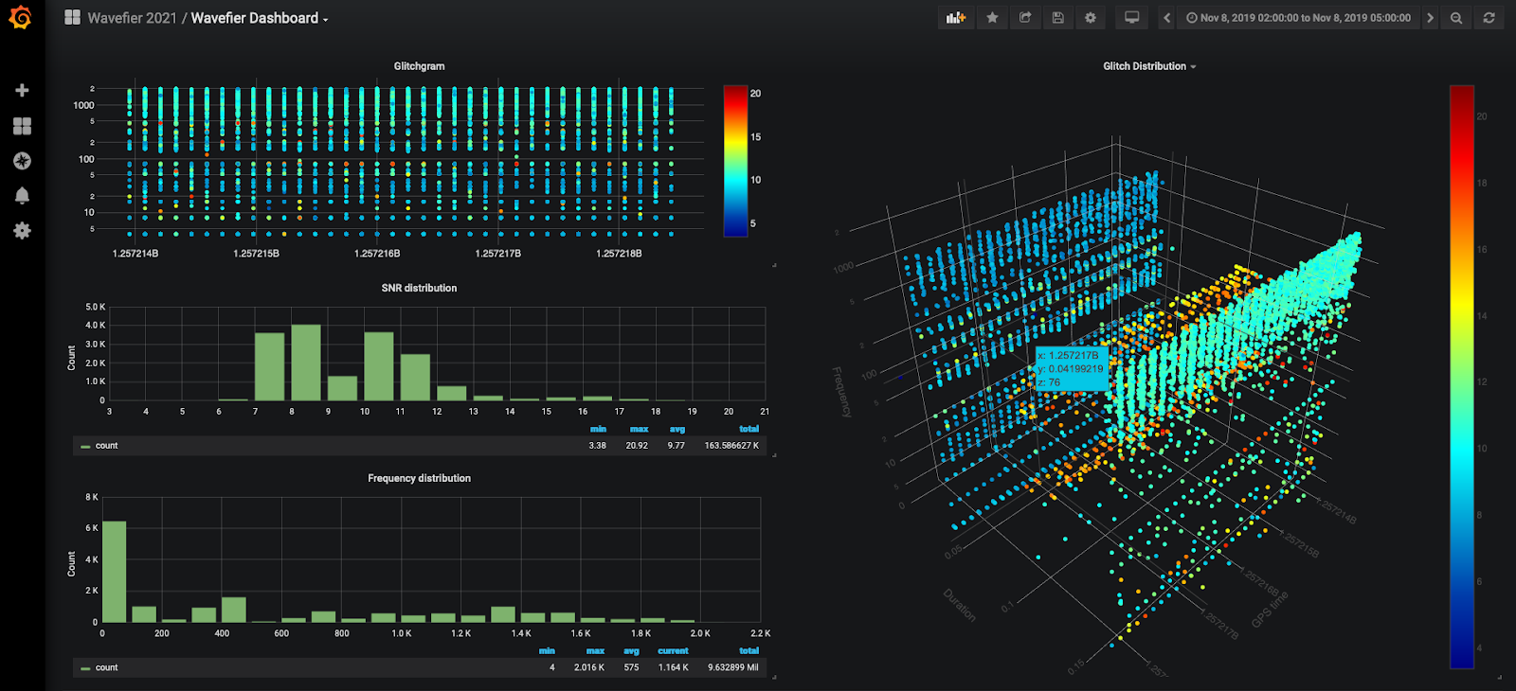
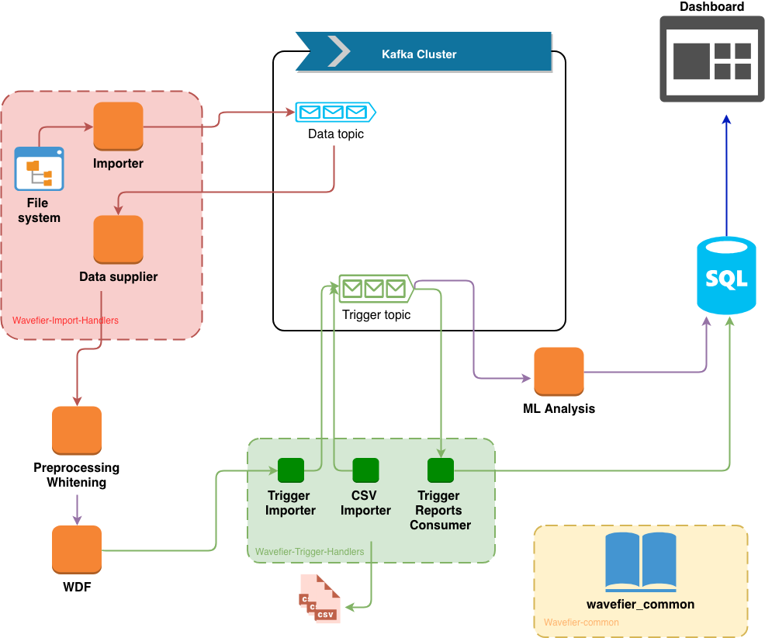
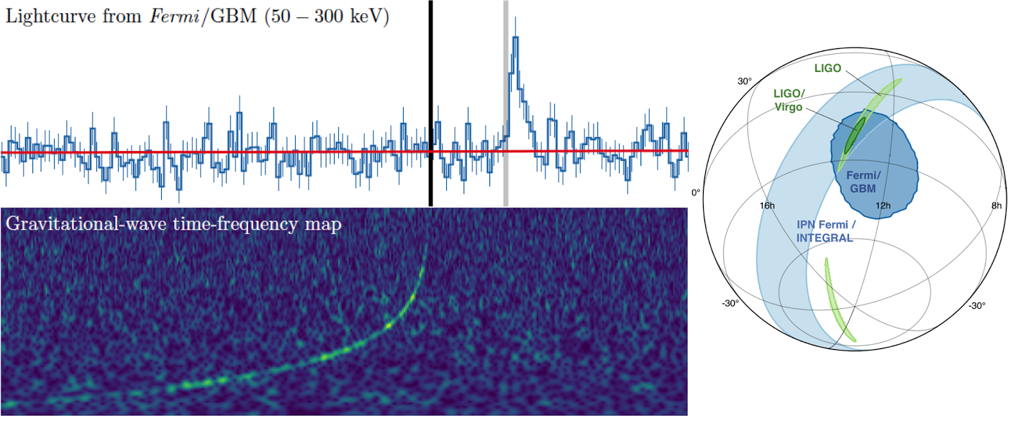
Extreme Universe Science Project
Multi-Messenger Astrophysics
Analyzing Multimessenger signals within ESCAPE/EOSC framework with a real time transient signal classifier
Wavefier: A prototype for Real time analysis
Multimessenger platform/Software catalogue
GRB/neutrino/GW analysis
EOSC implementation of real time classifier
GW data
neutrino data
GRB data
Machine Learning Analysis
Data analysis pipelines:
Abbott et al. 2017
Elena Cuoco
30

Slide 31
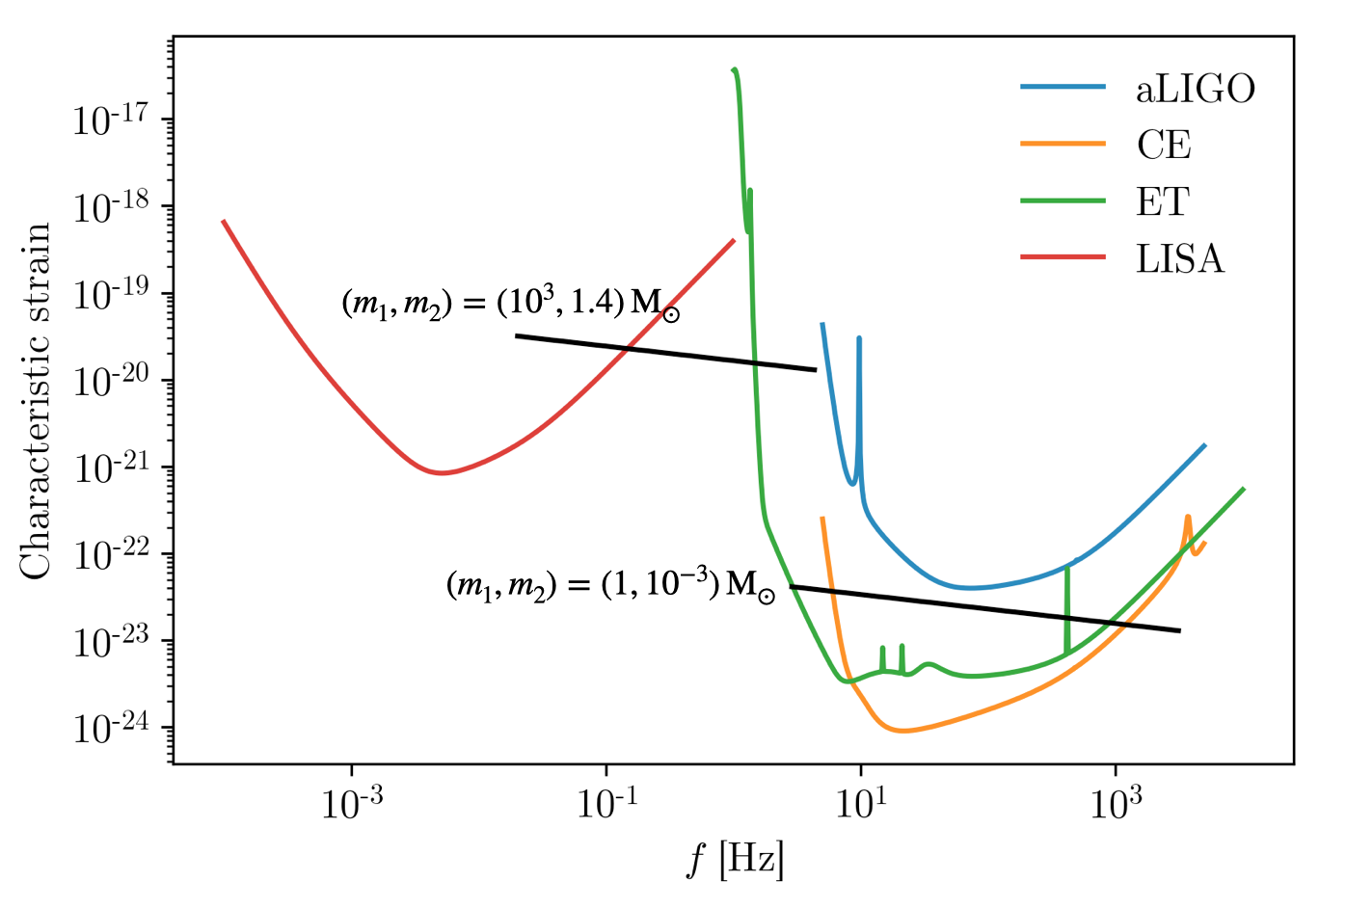
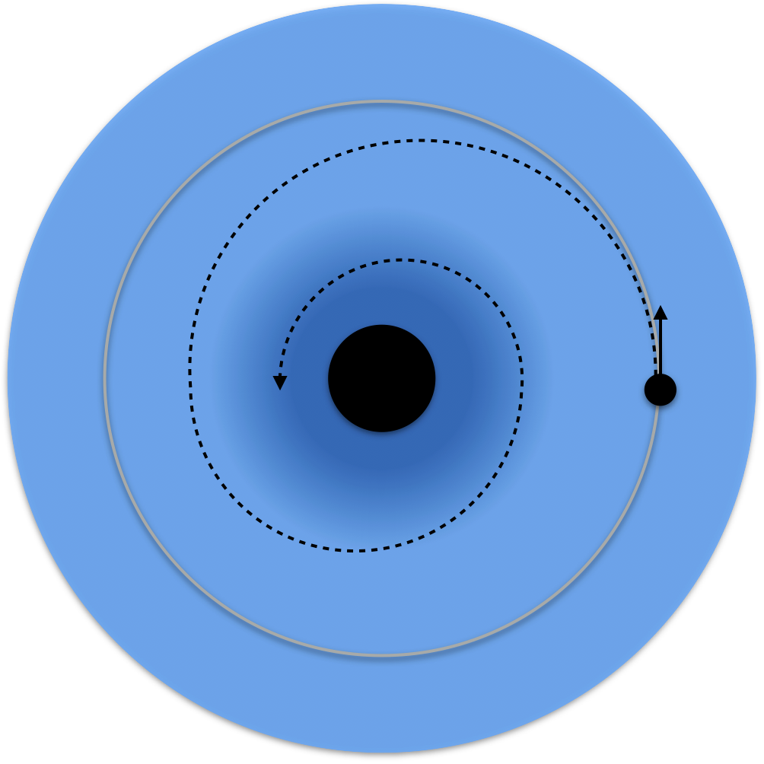
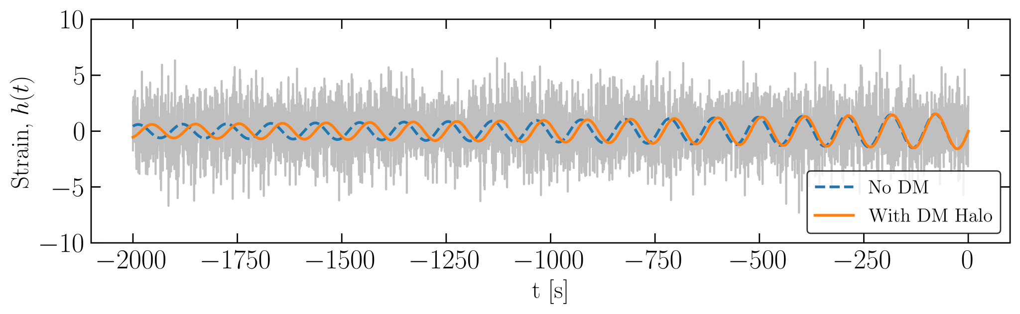
Extreme Universe Science Project
Fundamental physics (.. again Dark Matter) by emerging topics (e.g. Einstein Telescope perpsectives)
Template banks, generation software
DM template bank and ML analysis pipeline
Distinguish DM matter presence with GW detection and waveform classification
  Possibility to detect and constrain dense DM ‘spikes’ with just a few cycles of GW ‘dephasing’ → but these subtle differences can be hard to detect!
Frequency band of ET means that most
promising target would be solar and
sub-solar mass binaries
Primordial black holes (PBHs) could
form such binaries, and must be surrounded by a
dense spike of particle DM
Currently developing an ET pipeline to search for ‘de-phased’ GW waveforms due to DM around PBHs, using machine learning
Waveform generation & search pipeline will all be public → implementation in virtual research environment will allow easy access and re-use
Kavanagh et al., https://arxiv.org/abs/2002.12811
Coogan et al., https://arxiv.org/abs/2002.12811
31

Slide 32

Science Cluster synergies and outlook for the future
https://www.projectescape.eu/sites/default/files/Escape_position_statement_web.pdf
https://zenodo.org/record/3675081 - .X2R2PJNLhTY
https://zenodo.org/record/4889503
32

Slide 33

Science Cluster synergies and outlook for the future
The Science Clusters occupy a unique position between EOSC, ESFRI RIs and scientific communities.
Three momenta mark the success of the Science Clusters -> We all want to keep on them for the future.
Top-Down: The (ESFRI) RIs legal entities joining efforts together
Bottom-Up: The concerned scientists willing to pursue the cross-fertilization in science and innovation
Horizontally: The Universities and Institutes leveraging the inter-domain potential… to be fully exploited
around new academic/training schemes based on data-research
  The five Science Clusters have debated and positioned their own community-based expectations in the Horizon Europe perspective.
  -> they are moving towards sustained platforms/collaborations
https://indico.in2p3.fr/event/24327/

Slide 34
New ESCAPE Collaboration Agreement
  ESCAPE will become a sustained “Community Platform”.
  Its (ESF)RIs core partners as Parties in a new Collaboration Agreement
  to operate Open Science as well as cooperating in order to address new topics in ERA.
[…]
Giovanni Lamanna

Slide 35
New ESCAPE Collaboration Agreement
ESCAPE collaboration preliminary Work Plan:
For EOSC destination and European Research Area (ERA) operational
Data Lake
Data interoperability
Software catalogue, methods and training
Open Science Research Projects
Virtual Research Environments
European Virtual Software Institute for Research
Low Latency data analysis
Sector Data Spaces […]
Technological dev. and innovation (e.g. quantum)
Citizen Science
Researchers’ rewarding
Inter-cluster projects for society
Curiosity driven RIs’ synergies
5/5/2022

Slide 36

The ESCAPE collaboration work plan in Horizon Europe
Advancing frontier knowledge of our RIs
Community-based scientific software development and preservation
Build on the Science Clusters approach to ensure the uptake of EOSC
VRE for assessing scientific knowledge production
Future shared development of RI technologies and services
Matching the five Science Clusters expectations as well as the new ESCAPE work plan

Slide 37
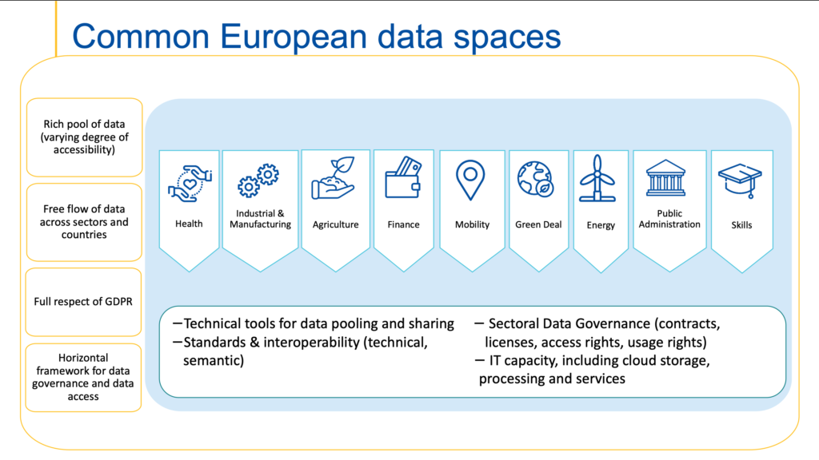
Last outlook: sector data space
European Data Spaces: “…The European strategy for data aims at creating a single market for data that will ensure Europe’s global competitiveness and data sovereignty.
Common European data spaces will ensure that more data becomes available for use in the economy and society, while keeping companies and individuals who generate the data in control.
Data is an essential resource for economic growth, competitiveness, innovation, job creation and societal progress in general…”

Slide 38
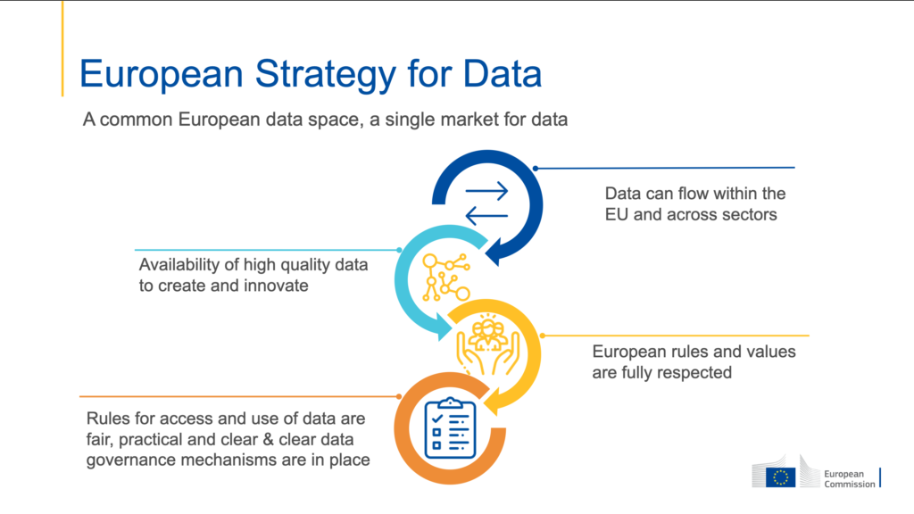
Last outlook: sector data space
…The ESCAPE Big-Science RIs (as well as all other Science Clusters) are concerned by the European Data Strategy…
ESFRI facilities to support EU’s industry; as well as global coordination for innovation, e.g. Quantum Computing as a service and for tech. R&D; algorithms and standards for Industry 4.0; AI; HPC.
Aligning Innovation programmes and technology R&D with environmental implications.
Cross-sector sharing of data for an unifying, forward-looking approach of any Big Science facility for energy efficiency, water management, etc.
Science Data to reduce the skills mismatches between the education and training systems and the labour market needs.
Data and experience to improve accountability of public spending for research; management and sustainability of Big Science RIs through socio-economic impact model analyses.
Health data essential for EOSC-Life advances but also link with particle/nuclear physics facilities applied to healthcare

Slide 39

Conclusions
“OPEN DATA and OPEN RESEARCH”, a change of the global paradigm.
ESCAPE and other Science Clusters position:
Expectation:
Accelerate the discoveries and increase scientific value
Enable opportunities offered by the digital revolution
Commitment:
Shape and operate platforms for data interoperability
Sustain the federation of RIs for excellence science
Widen impacts of Open (Data) Science
Cooperation:
EOSC Association and EC
Inter-domain and cross-disciplines
SMEs for co-developments
Society at large
Inclusiveness:
Attracting more thematic and emerging RIs
Lead a regional as well as international alliance in Science
Universities, Institutes and citizens

Slide 40

THANK YOU!
40

