Slide 1
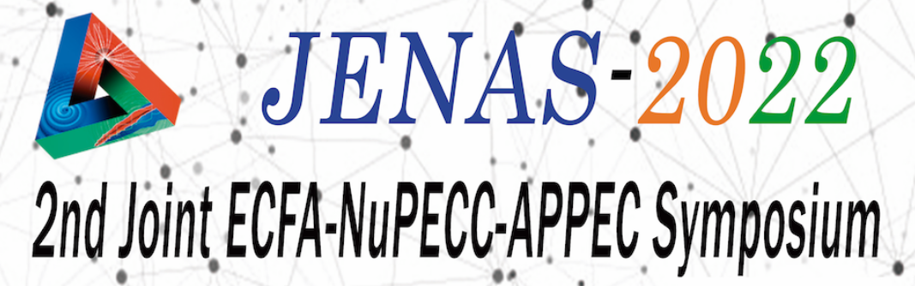


Knowledge Transfer (KT) between Academia/Research and Industry, Best Practices Round Table (RT), JENAS 2022, CSIC, Madrid, 3-6 May 2022
Agenda
Purpose/aims of the KT RT session, introduce the KT experts [3 min]
Panel 1st round: Speakers (each 3 min) views on KT and selected issues [12 min]
Comments/questions from the audience and short replies by KT experts [5 min]
Panel 2nd round: Speakers (each 3 min) views on KT and selected issues [12 min]
Comments/questions from the audience and short replies by KT experts [5 min]
Conclusions, follow-up [3 min]
total/max = 40 min

Slide 2
Knowledge Transfer (KT) between Academia/Research and Industry, Best Practices Round Table (RT), JENAS 2022, CSIC, Madrid, 3-6 May 2022
Expert speakers
Benjamin Frish, CERN’s KT Group. Since 2018 supports the transfer of CERN technologies towards societal and industrial applications. Coordinates the healthcare and quantum applications, manages the accelerator technology portfolio. Over 15 y experience in technological developments. PhD from the TU Vienna, Thesis on PET at CERN. Conducted research in medical robotics and interventional imaging at TU Munich. Provided regulatory and clinical affairs consultancy for medical device manufacturers.
Erik Fernandez, General Manager of INEUSTAR, the Spanish Science Industry Association. Erik is Telecommunications Engineer from the University of Navarra and holds a PhD in Telecommunications Engineering from the same university. During his career has held various positions in research Institutes, creating and leading research teams in the field of Nondestructive Testing of materials and being the Corporate Development Manager of CEIT. Associate professor at the school of engineering of the University of Navarra
Ezio Previtali, Director of the Gran Sasso Nat. Lab. LGNS INFN, prof. Nuclear and Subnuclear Physics at Milano Bicocca Univ. Involved in particle physics experiments, neutrino physics, development of particle physics detectors, e.g. bolometric detector CUORE. Spokesperson of the CUPID experiment. Until end 2020 coordinator of the INFN nat. committee on Technology Transfer. Responsible of KT project Open-INFN to implement best approaches to maximize KT processes from research to industries and identify best approaches for KT processes. Produced 4 patents registered in Europe and US. Developed 3 projects licensed to industry.
Gaston Garcia Lopez, Director of CMAM UAM, Centro de Micro-Análisis de Materiales, ion beam accelerator center at the Universidad Autonoma de Madrid, multidisciplinary research in Materials science, Nuclear Physics and Biomedical applications. Engaged in accelerator based research infrastructures, technology applications, deputy director of ALBA synchrotron till end 2019. Involved in the League of European Accelerator-based Photon Sources LEAPS (coordination board chair), ESRF council (Spanish delegation scientific advisor), European Physics Journal Plus (editor in chief).

Slide 3





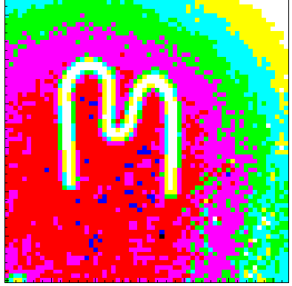


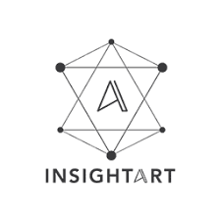

Knowledge Transfer (KT) between Academia/Research and Industry, Best Practices Round Table (RT), JENAS 2022, CSIC, Madrid, 3-6 May 2022
Expert contacts, KT groups
Benjamin Frish, CERN’s KT Group, KT Officer, benjamin.frisch@cern.ch
  CERN Knowledge Transfer Group: https://kt.cern/
Erik Fernandez, INEUSTAR, General Manager, efernandez@ineustar.com
  INEUSTAR, the Spanish Science Industry Association: https://www.ineustar.com
Ezio Previtali, Gran Sasso National Laboratory INFN, Director, ezio.previtali@lngs.infn.it
  LNGS INFN, https://www.lngs.infn.it
Gaston Garcia Lopez, CMAM, Director, gaston.garcia@uam.es
  CMAM, Centre for Micro Analysis of Materials: https://www.cmam.uam.es
KT spin-offs, start-ups
Carlos Granja, Advacam, carlos.granja@advacam.com
  Advacam, start-up of IEAP CTU Prague and CERN Medipix Collaboration: https://advacam.com
  InsigthART, spin-off of Advacam and the European Space Agency ESA incubator: https://insightart.eu
  Radalytica, spin-off of Advacam, https://www.radalytica.com
3

Slide 4
Knowledge Transfer (KT) between Academia/Research and Industry, Best Practices Round Table (RT), JENAS 2022, CSIC, Madrid, 3-6 May 2022
Key issues/challenges
Importance, significance of KT among researchers and in the public
Technology push versus market pull: HEP institutes are traditionally very tech push oriented. How do we make sure we’re aligned with the market and bring more market pull into our approach?
Fundamental difference between industry and academia: we operate along different timelines, might pursue different goals, use different vocabulary – how do we bridge the gaps?
Getting ourselves known: HEP institutes are rarely seen as know-how and tech providers by industry – how can we spread the news about our capabilities?
Motivating our researchers: how do we motivate researchers that concentrate on “pure” research to collaborate on more applied projects with industry?
Lessons learned, what are/what should be the priorities/conditions for successful KT? e.g., focus on the market/society needs, or more of a balance of ingredients? Short- and long-term impact
Strong points of successful KT, expand, support further, build on them
Weak points and barriers hindering KT, how to address, suppress, remove them
How to foster KT, changes needed – at all levels (individual, institution, society – e.g. increase awareness, tax credits, effective support)

