Slide 1
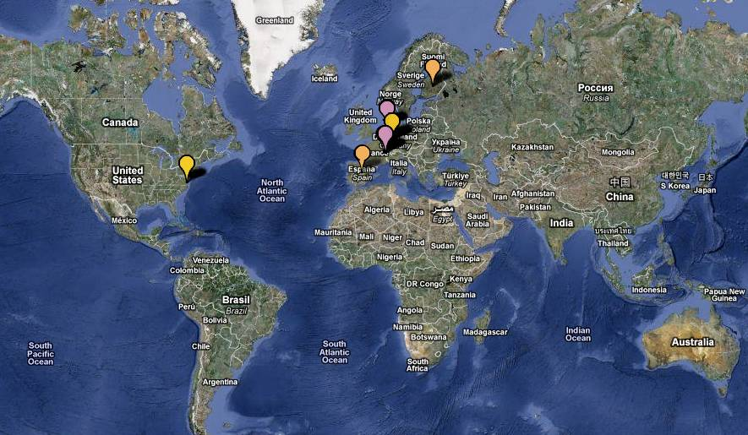

Production of Exotic Nuclei
JYFL
GANIL
GSI
TRIUMF
CERN - ISOLDE
JLAB
LEGNARO
RIKEN
Máster Interuniversitario de FÍSICA NUCLEAR Curso 2020-2021

Slide 2
Exotic Nuclei and Radiactive Beams
Introduction
Exotic Nuclei :
    Production modes
    Separation
    Identification
Radioactive Beams
References:
“The why and how of Radioactive beam Research”, Mark Huyse,
“In-flight separation of projectile fragments”, David Morrisey and Brad Sherril
“Isotope separation on line and post-acceleration”, P. Van Duppen
http://www.euroschoolonexoticbeams.be/site/pages/lecture_notes

Slide 3
Open Questions in Nuclear Physics
What are the limits of nuclear stability?
¿ How does the complexity of nuclear structure arise from the interaction between nucleons?
How and where in the Universe are the
chemical elements produced?
Observables:
Basic ground state properties: mass, radius, moments J, μ, Q
Half-life y decay process
Transition probabilities
Cross sections

Slide 4
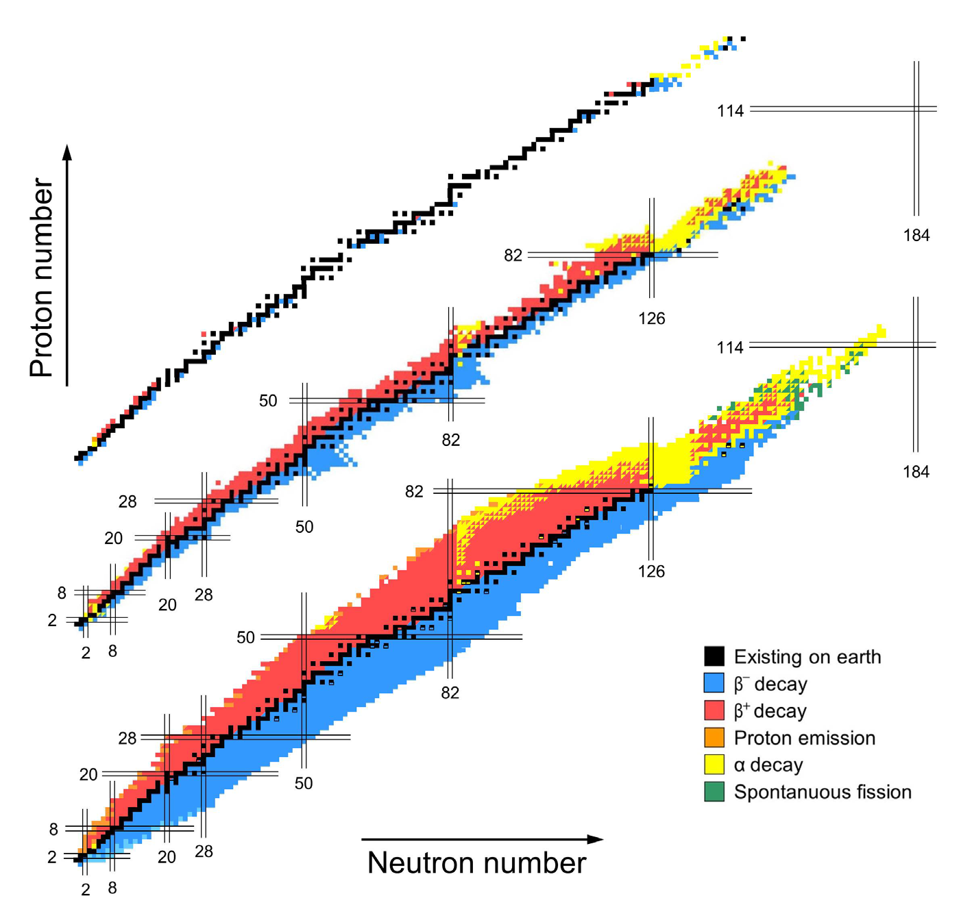
Evolution of the Table of Isotopes
1935
1958
2015

Slide 5
Production
The discovery of a new element/isotope depends of many factors:
Production method: various mechanism of nuclear reactions.
Efficent separation and transportation
Detection method

Slide 6
Yield Requirements
Rate
Access
~1/week
Existence
Z=107, 108, 109, … à GSI
Z < 40 GANIL, GSI, RIKEN, MSU
~10/day
Identification
Mass
~100/day
β-decay gives
first information of a new isotope.
When the production is high
⇒ detailed structure information can be achieved.
~1/min
β (T_{1/2}, P_{xn})
1/sec
β-γ, β-n, β-p
100/sec
10⁴/sec
β-γ-γ, β-n-γ, β-p-γ

Slide 7
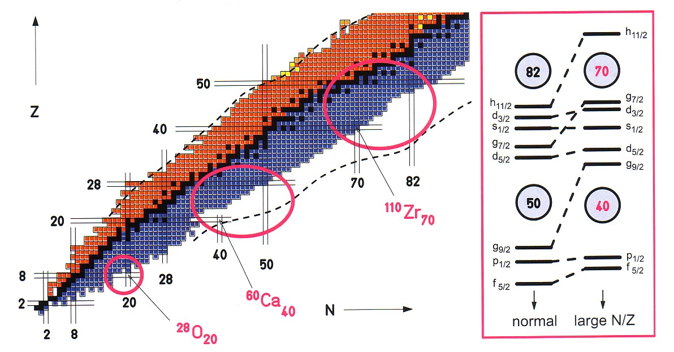
Why Study Exotic Nuclei?
Explore the different degrees of freedom of the system in
isospin, T,
in excitation energy, E_{x},
spin, J,
level density, ρ
Stringent test of Theoretical Models
Observation of new decay modes
Measurement of astrophysical interest
Halo structure
Evolution of shell structure

Slide 8
Physics interest?
Correlations: Pairs,
influence of collective modes (Giant Resonances)
Inflence of halo or skin of neutrons
Extension of rare phenomena in the space of Z, N, J, Ex, superdeformation,
Study of: Double magic nuclei
Semi-magic nuclei
Region of shape transtions
Nuclei with N~Z
Nuclei with N >> Z, halo nuclei
Nuclei very deformed
Nuclei of astrophysical interest

Slide 9
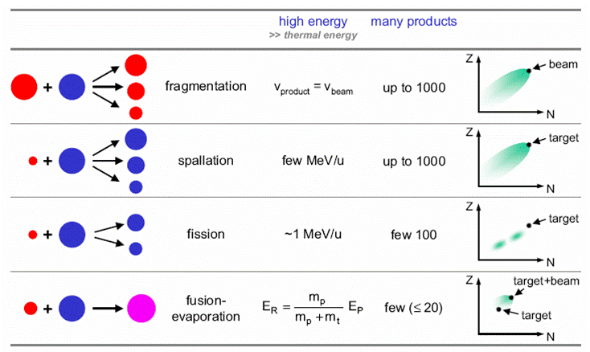
Production Methods
Beam → target → products
heavy ion
p
p/n
heavy ion

Slide 10
Production
N _{prod.} = σ φ N_{target} ε
efficiency
N of target nuclei/cm²
~ 1 - 100 g/cm²
Cross Section
Incoming particules/s
~ 10⁸ - 10¹² /s
fusion – evaporation, @ GSI ⁵⁴Cr(4,7MeV/u) + ²⁰⁹Bi → ²⁶³107 *…
¹²C + ⁵⁶Fe ou ¹⁶O + ⁵⁸Ni … nuclei N~Z at Tandem energies
spallation p + La or U ou TH or W → ¹¹⁵⁻¹³³Cs, A~20, 70 rates of 1 à 10¹¹ at/s
transfer, 1 or several nucleons pick up, stripping…
inélastique ⁷⁶Ge (9 MeV/u) + Ta ou W → ⁶²Mn, ⁷¹⁻⁷³Cu
fragmentation of target or projectile
p drip line Z < 30 @ GANIL
N-rich A~65 GSI , A~45 GANIL
fission thermal ²³⁵U, ²³⁹Pu @ Grenoble ⁶⁸Fe, ⁷¹⁻⁷⁴Ni, ⁷⁹Cu, ⁶⁸⁻⁶⁹Co
relativistic ²³⁵U (750 MeV/u) + Pb → 50 NE products

Slide 11
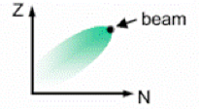
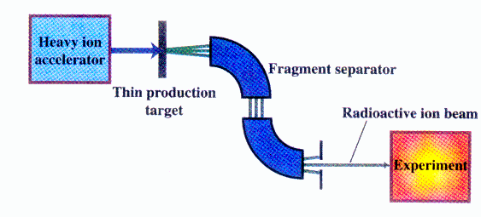

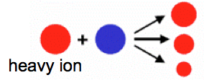
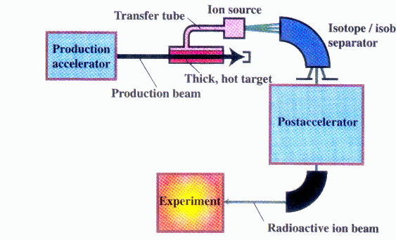
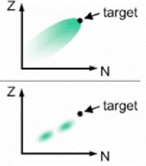
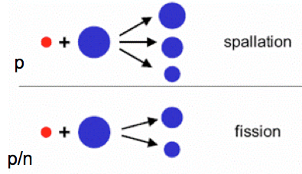
Production of Radioactive Beams
PROJECTILE FRAGMENTATION
FAIR
GSI
GANIL
SPIRAL
HIE –
ISOLDE
ISOLDE
1 GeV
400MeV/u
50MeV/u
14MeV/u
10MeV/u
0.06 MeV
High energy, large variety of species,
Short half-lives (μs), cocktail beam
ISOL
Variable energy, high intensity, good beam qualities

Slide 12
Production Methods
meV -100MeV/u
Good beam
From ms to s
High Temp
Thick Target
Ion source
Mass
Separator
Post-
Accelerator
Light & Heavy Ions
Spallation
Fusion
Fission
Fragmentation
Experiments
Detectors
Spectrometer
Driver Accelerator
Reactor
Gas Cell
Heavy Ions
Fusion
Fragmentation
GeV
Microseg
Ev. Slow down
Fragment
Separator
Storage
Ring
Thin Target

Slide 13
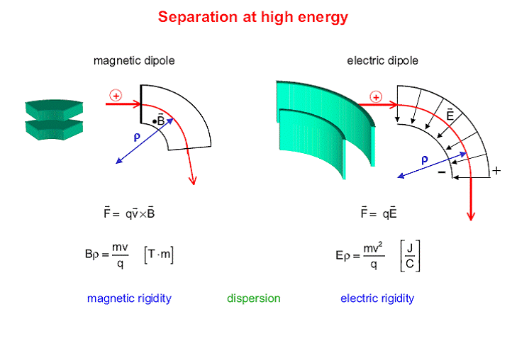
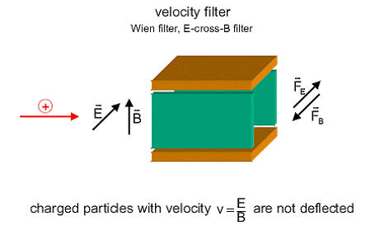
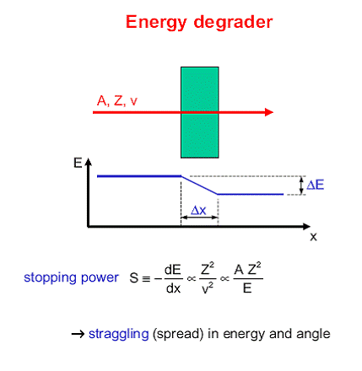
Separation at High Energy
Part with same charge, mass and v ➔same rigidity Bρ
Need Wien-vel-Filter to separate in velocity
Notes:
the magnetic analyser cannot distinguish between particles with equal charge and having the same mass-velocity product (same BR = p/q).
A simple way of resolving this degeneracy is to use a Wien velocity filter (WVF) in conjunction with the magnetic analysers.
The WVF uses the combined interaction of a magnetic and an electric filed in order to select the ions according to their velocity

Slide 14
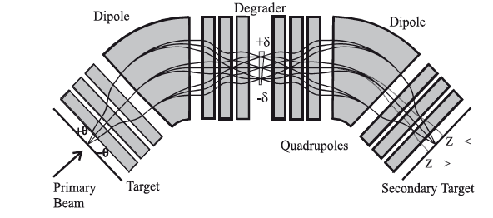
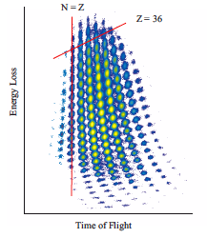

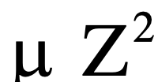
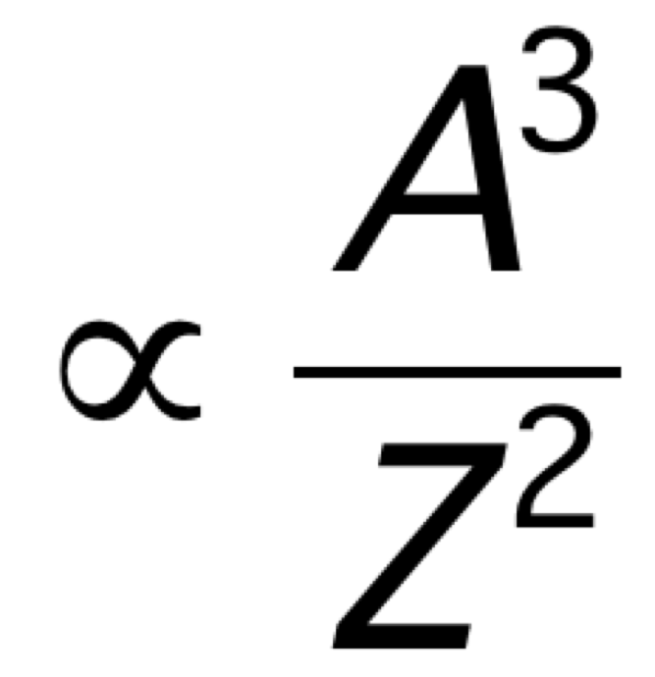
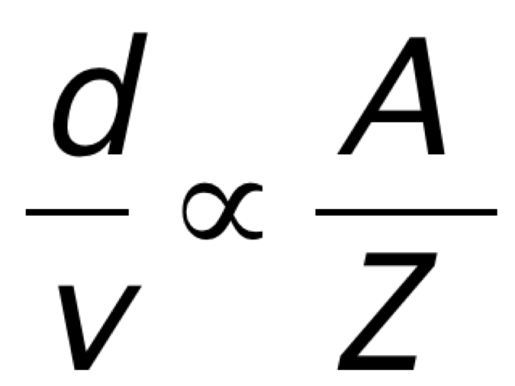
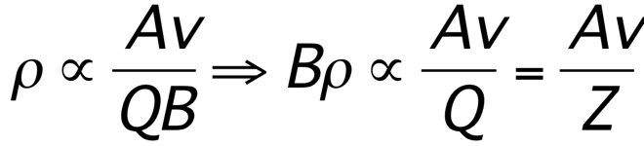
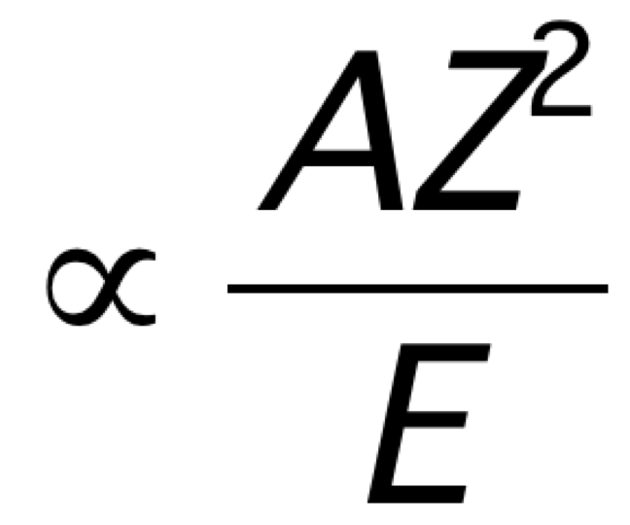
Fragment Separator - FRS
A/Z separation
Momentum Separation
DP1
DP2
Remove primary beam 10¹²➔ 10⁸
DP1
Degrader
Degrader + DP2
Reduction 10⁸ ➔ 10⁶
Energy loss
T_{vol} (Target - detector)=

Slide 15
In flight method
Higher energy
Thicker targets
can be used
In the order of 1 g/cm²
Reaction products
Kinematically forward focused
extended detection scheme
& better resolution
Full-acceptance measurements
with moderate sized detectors
Possible study more exotic nuclei
efficient down to 1 ion/s, short lived

Slide 16
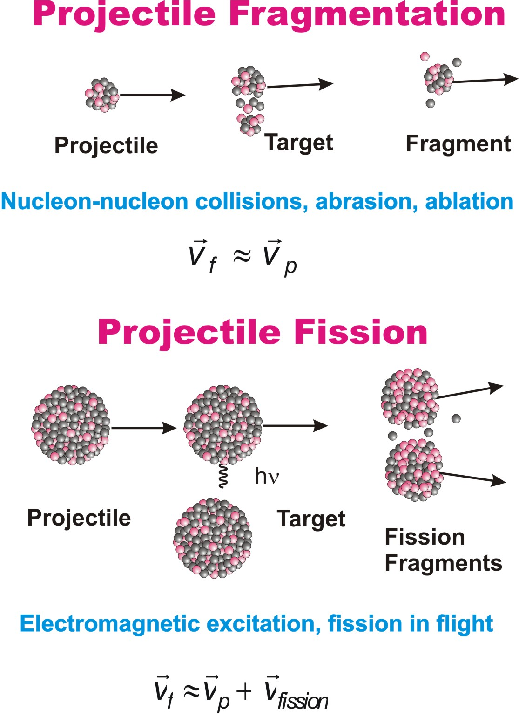
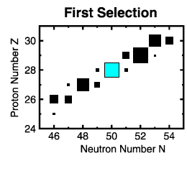

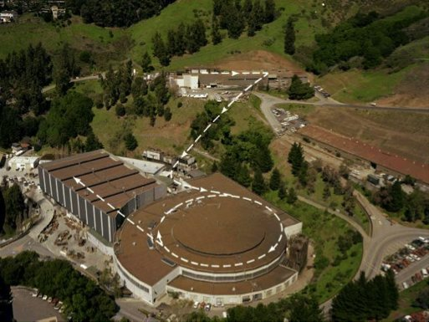
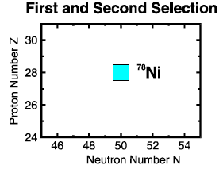
In-Flight Method (80’s)
Develop in the late 80’s
Production
Selection
HEAVY ION
ACCELERATOR
Thin target
Observation
Bevalac
Degrader
Phys.Rev. Lett. 43, 1859 (1979).
Magnetic
Separator
ΔE
Detector
Electronics
DAQ
Particle stability of 15 earlier unobserved nuclides from ²²N to ^{44,45}Cl.

Slide 17
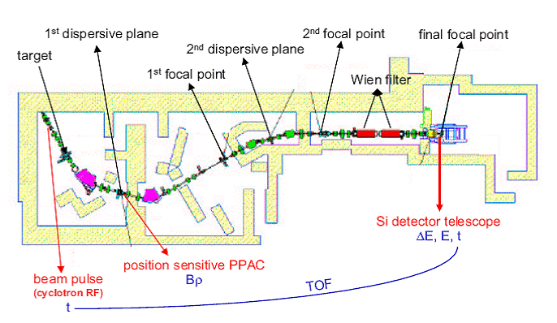
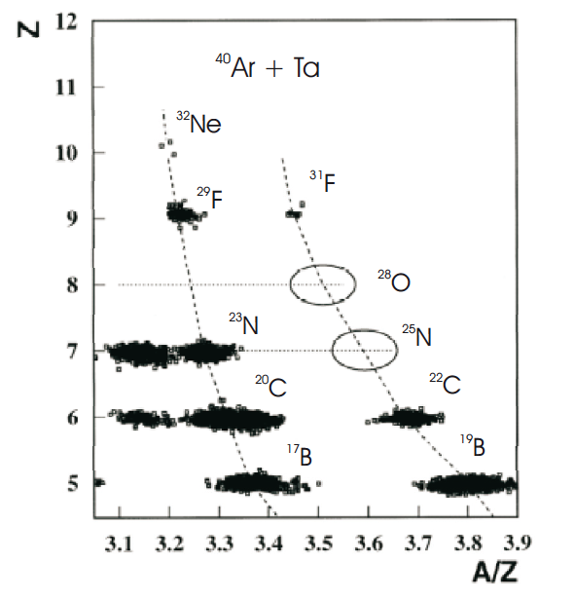
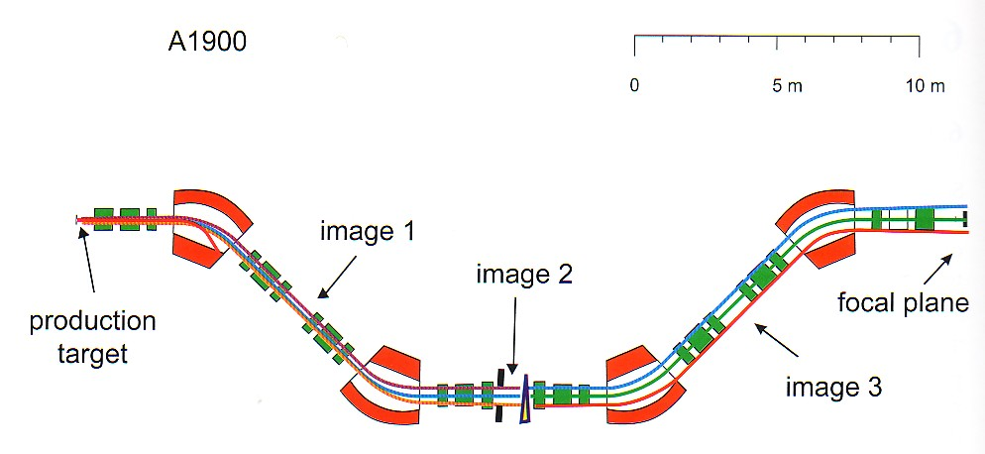
Different Spectrometer
Spectrometer LISE @ GANIL
GANIL
Spectrometer A1900 @ MSU

Slide 18
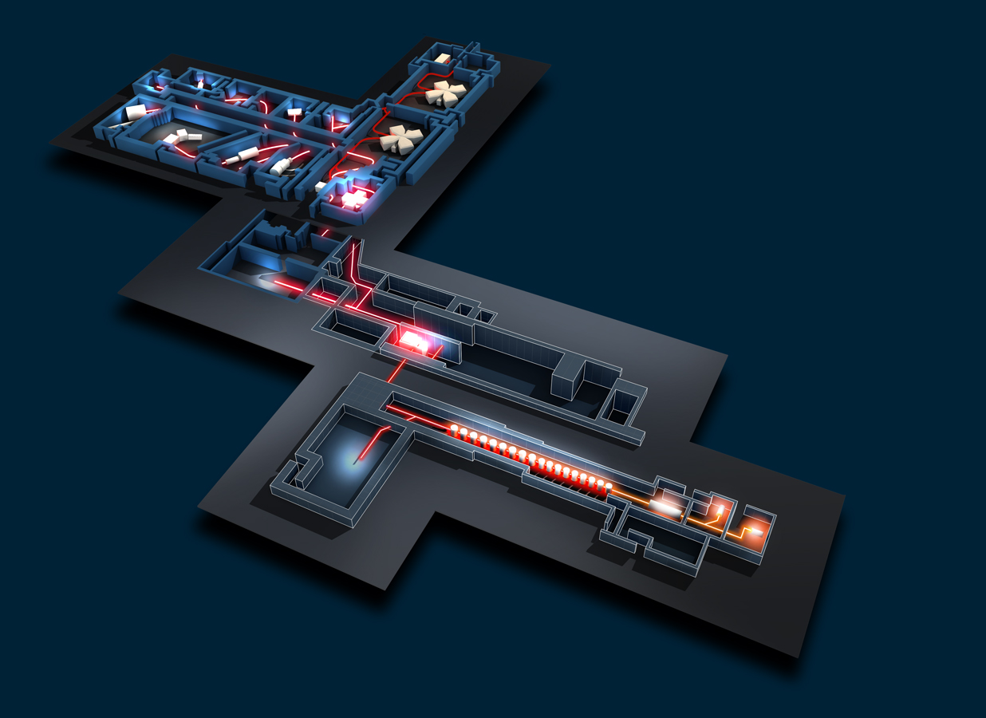
GANIL / SPIRAL 2
LISE
Existing GANIL facility
SISSI
CIME
LIRAT
Production building
DESIR
Low energy beams from
SPIRAL and SPIRAL2
(and S3 ?)
S3
High-intensity stable beams on thin target
+ in-flight high-resolution separator
+ gas cell for stopping
+ ??
LINAG
(high intensity d and stable beams)
Notes:
GANIL(Grand Accelerateur National de Ion Lourds) produces beams of stable and exotic nuclei from a few eV from the ion source to 95 MeV/nucleon from Cyclotron. GANIL is composed of a set of cyclotrons that accelerate stable beams from 1MeV/u to 95 MeV/u. These stable beams are delivered either to the experimental areas or to a thin (SISSI) or thick carbon target (SPIRAL) to produce and accelerate exotic beams.
After the thick target there is a cyclotron CIME to accelerate the exotic beams to 25 MeV/u and then to the experimental areas. This has been SPIRAL (Système de production d’Ions Radioactifs Accelerés en Ligne) where essentially due the ionization procedure only nobel gases are produced.
Instruments: MUST= detect light recoil nuclei in studies of direct reactions, modular with 1000 channels and good energy and angular resolution.
Its version MUST-II can be couples to EXOGAM AND VAMOS.
TIARA= Detector for light charged particles . Together with EXOGAM AND VAMOS allow to identify the exit channels from collisions.
VAMOS = Spectrometer with large solid angle, icludes a velocity filter. Separation in A/q or rejection of beam for zero-degree measurements.
With SPIRAL the beams are limited to A < 80
The SPIRAL2 facility at GANIL broaden the range by using fission reactions produces isotopes from the lightest to very heavy elements beyond uranium. Fission can be caused by bombardment of fissile target by neutron flux. The number of fissions desired per second determines the neutron flux necessary. Neutron flux obtained by bombarding a C-target with a deuteron beam. The deuteron beams stop in the target which acts as deuteron-to-neutron converter the neutron scape the converter due to the incoming energy and irradiate an Uranium-target. The products are analysed and ionized before being accelerated in CIME.
Layout of the Existing GANIL in red → GANIL cyclotrons for fragmentation, CIME for post-acceleration (SPIRAL beams) → all send to exp. Areas (LISE, SPEG, VAMOS, …)
→ there is the option to send a few beams from the SPIRAL ion source accelerated by 30 keV to a low-energy beam line (LIRAT).
The new facility DESIR will exploit the low energy beams from SPIRAL and SPIRAL2. for that
Certain arrangements are needed to achieve a certain degree of purity ➔ the universal way to get isotopic pure beams
Is a high resolution mass separator.

Slide 19
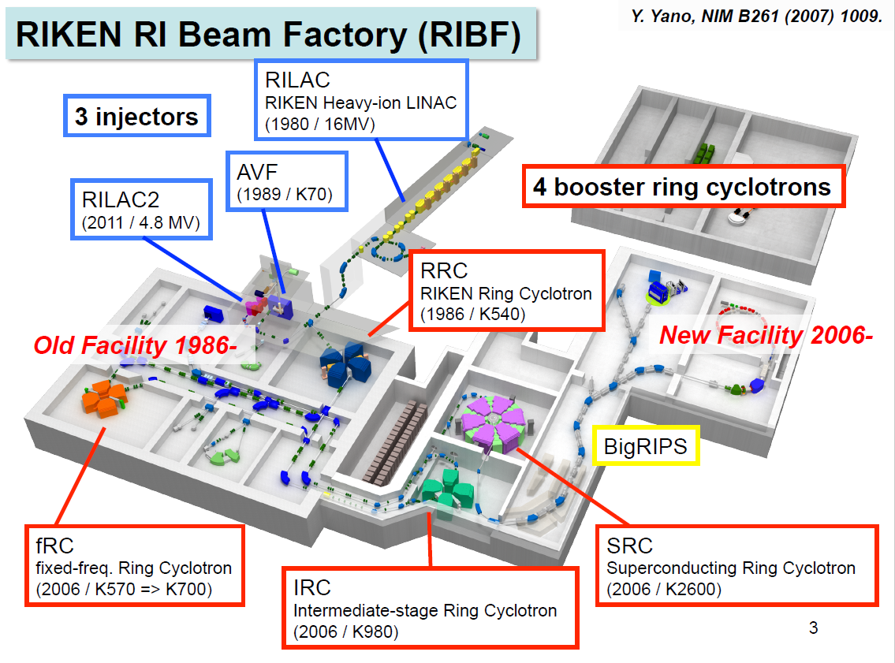

Slide 20
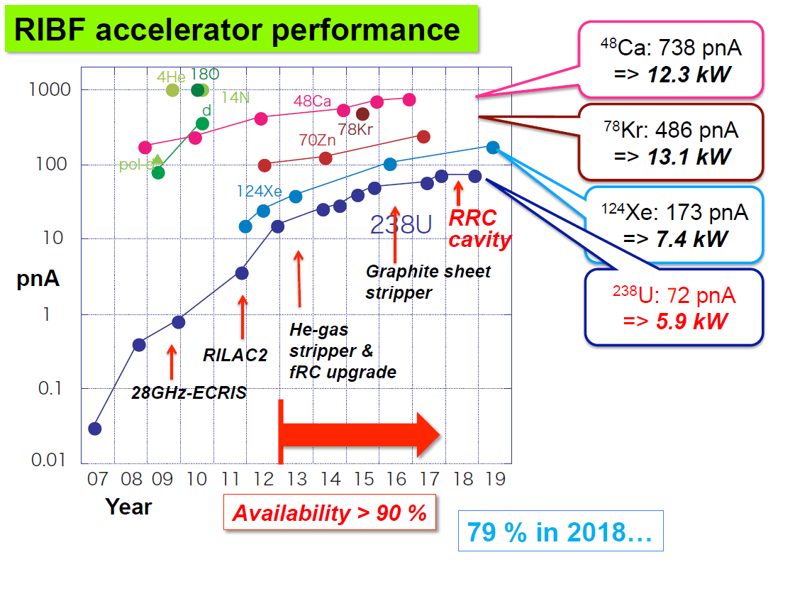
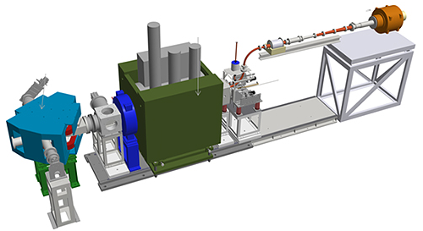
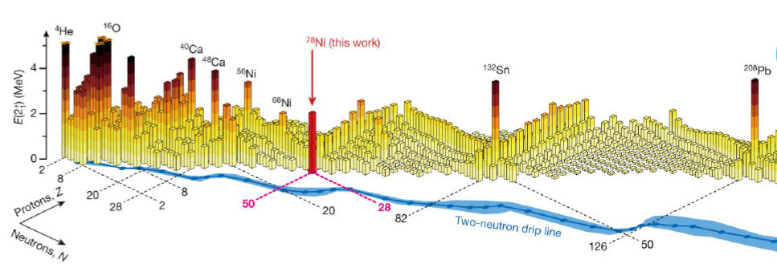
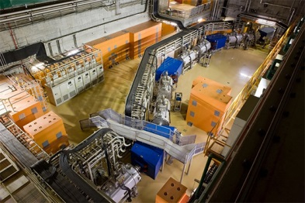
Steady increase of Beam Current @ RIKEN (japan)
⁴⁰Mg (N=28) is largely deformed.
The origin is a mystery.
No theory can reproduces the data.
Quest for heavier super-heavies (Z=113)
Success in producing and accelerating high intensity vanadium beam
- Cleared the
way for
producing
element 119 –
(2017)
⁷⁸Ni (N=50) revealed as a doubly magic stronghold against nuclear deformation.
Taniuchi et al., Nature 569, 53 (2019)
Success in producing and accelerating high intensity vanadium beam
- Cleared the
way for
producing
element 119 –
(2017)
73 new isotopes discovered at RIKEN’s RI Beam Factory (2017)
Notes:
Increase due to improvement in Ion source and the strippe foils

Slide 21
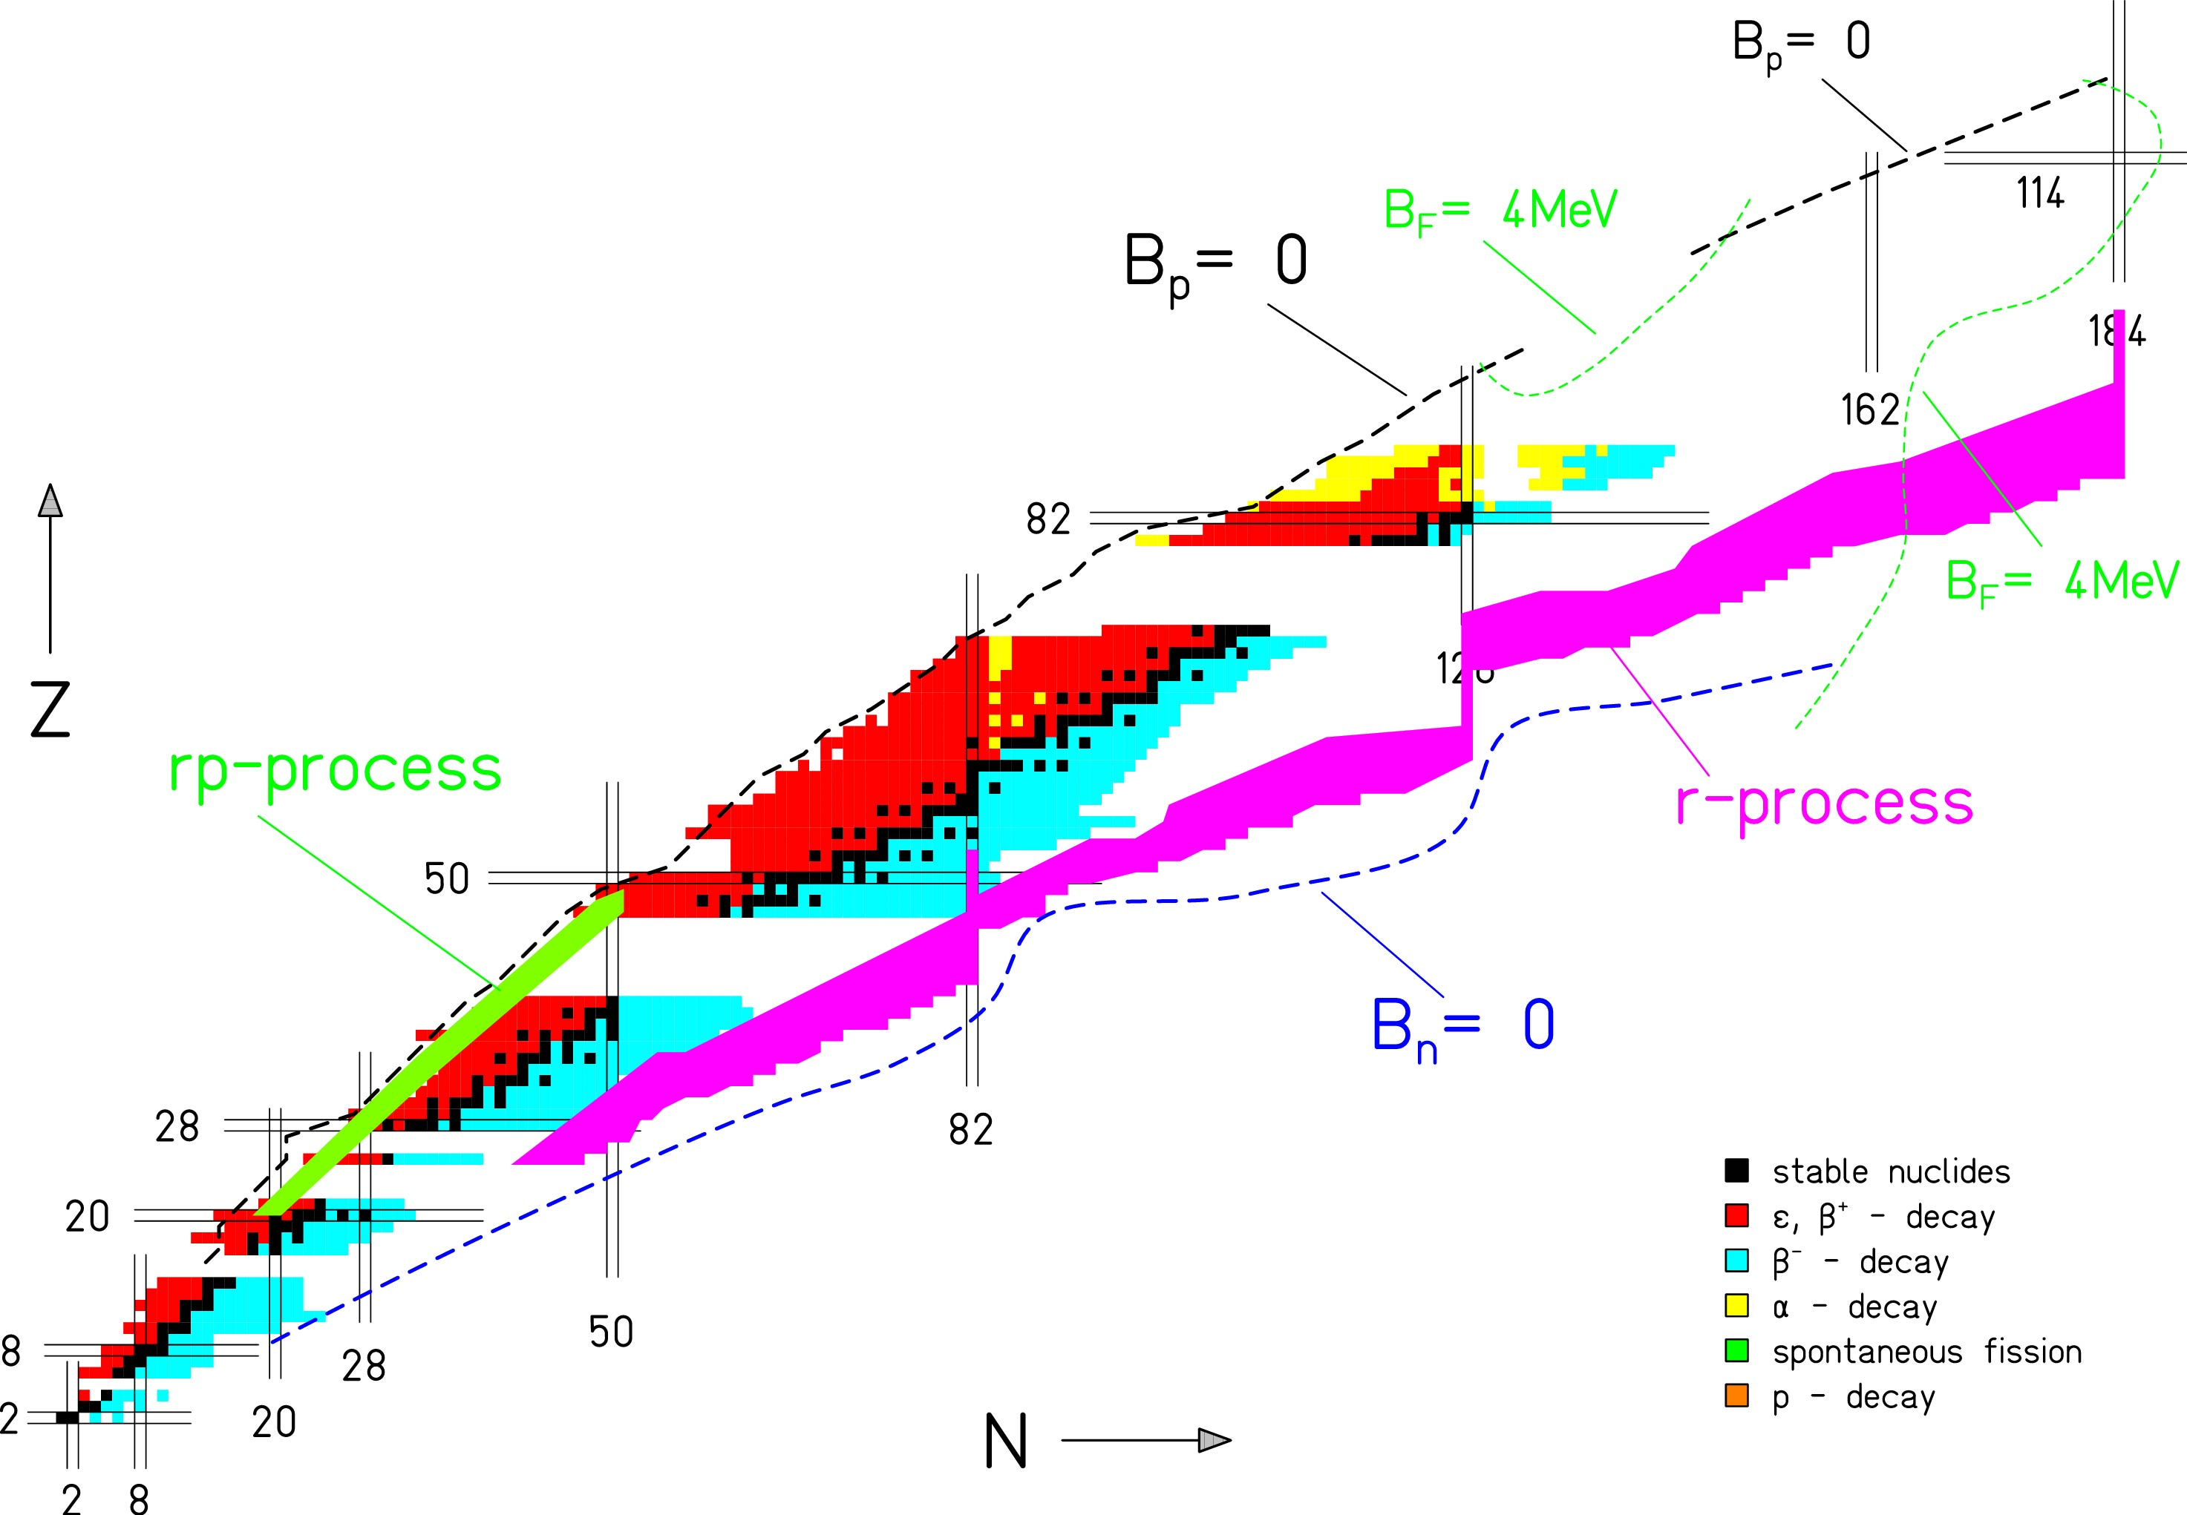
Isotope production
spalation
+
2
0
1
F
r
Nuclei chart @ ISOLDE
1 GeV p
fragmentation
+
+
2
3
8
U
1
1
L
i
X
fission
n
+
+
p
1
4
3
C
s
Y
Exotic ion production

Slide 22
ISOLDE Isotope Separation On-Line
We need pure beams, free from isobaric contamination:
Low energy beam
Point like sources
Energy: 1 GeV (1.4 GeV)
Pulse frequency: 1.2 s
Intensity: 3.2x10¹³ protons per pulse
I (average): 2 μA

Slide 23
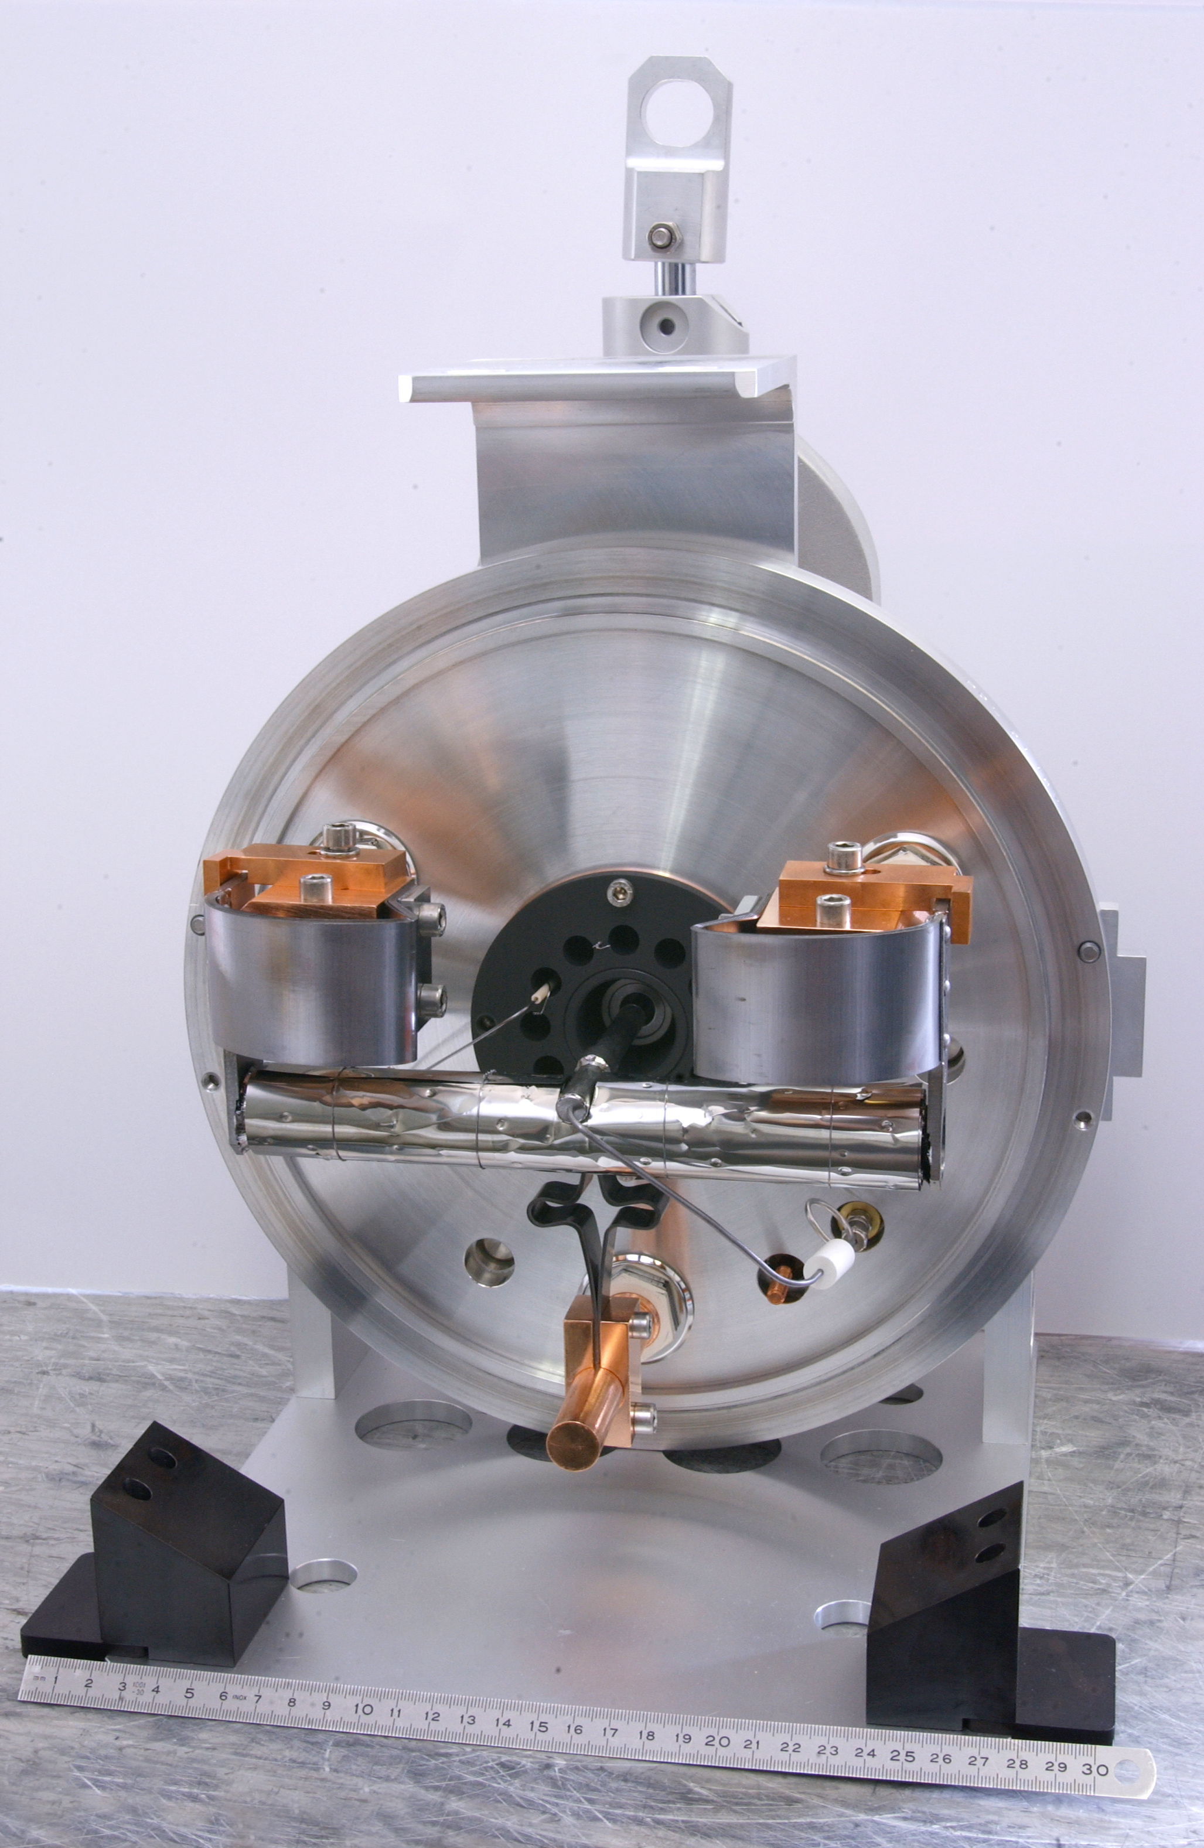
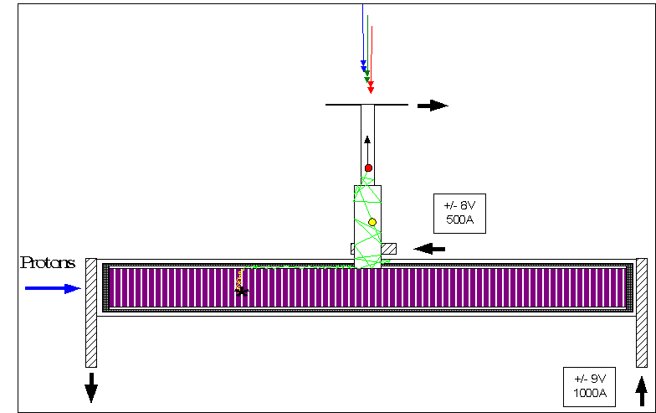
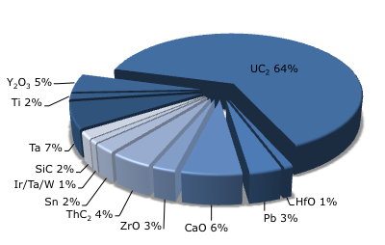
Target – Ion-source matrix: a chemical laboratory
^{Container:} ^{20 x 2 cm cylinder of Ta}
^{Material:}
  ^{Liquid La, Pb, Sn}
  ^{Metal foil/powder Nb, Ti,}
  ^{Oxides CaO, MgO}
  ^{Carbides SiC, UC, ThC}
^{Ion-source}
    ^{Surface}
    ^{Plasma}
    ^{Laser}
^{Fluorination CF4 or SF6}
Use in 2011 @ ISOLDE

Slide 24
ISOLDE Main potential
Diffusion
Effusion
Production
700 isotopes
~75 elements
3 types of ion sources→ select pure beams
shape co-
existence
octupoles
shell
structure
n-p
pairing
rp-
process
Shell
structure
light
exotics

Slide 25
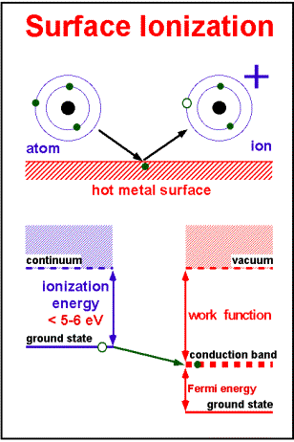
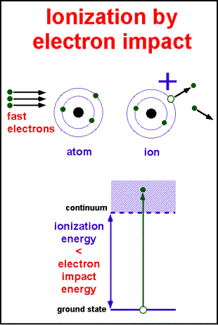
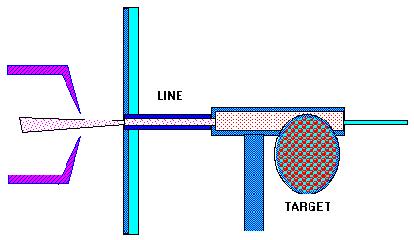
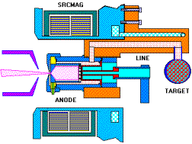
Surface & plasma ionization

Slide 26
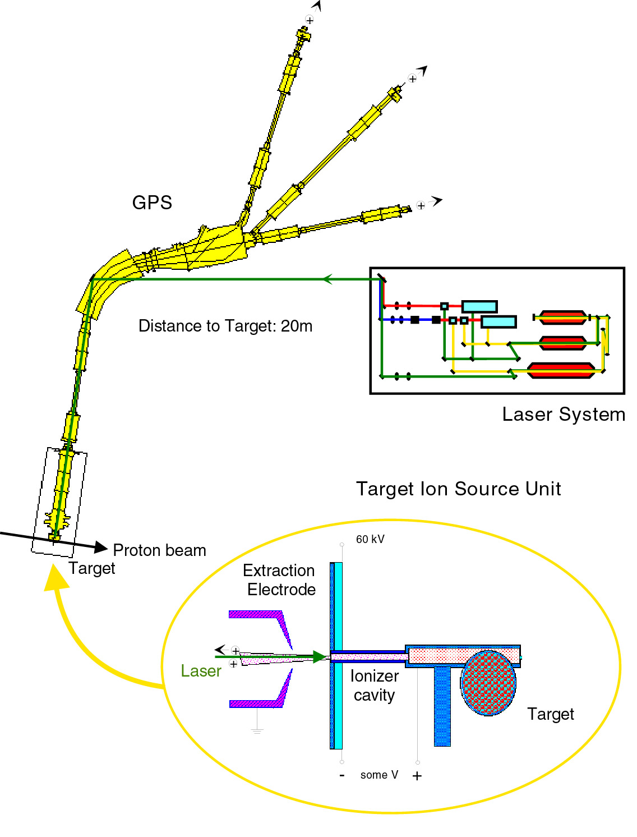
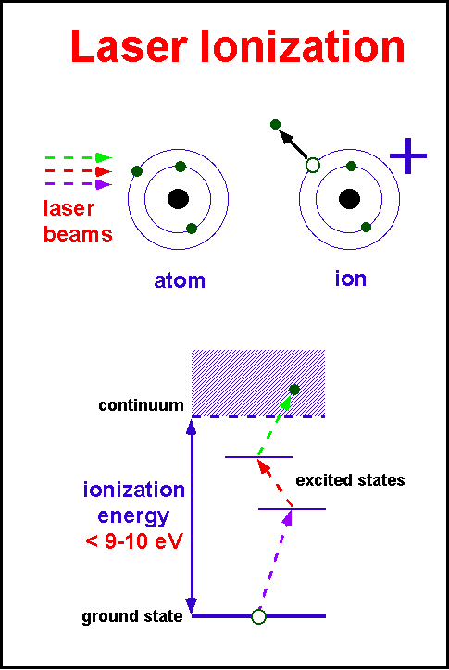
Laser Ionization source

Slide 27
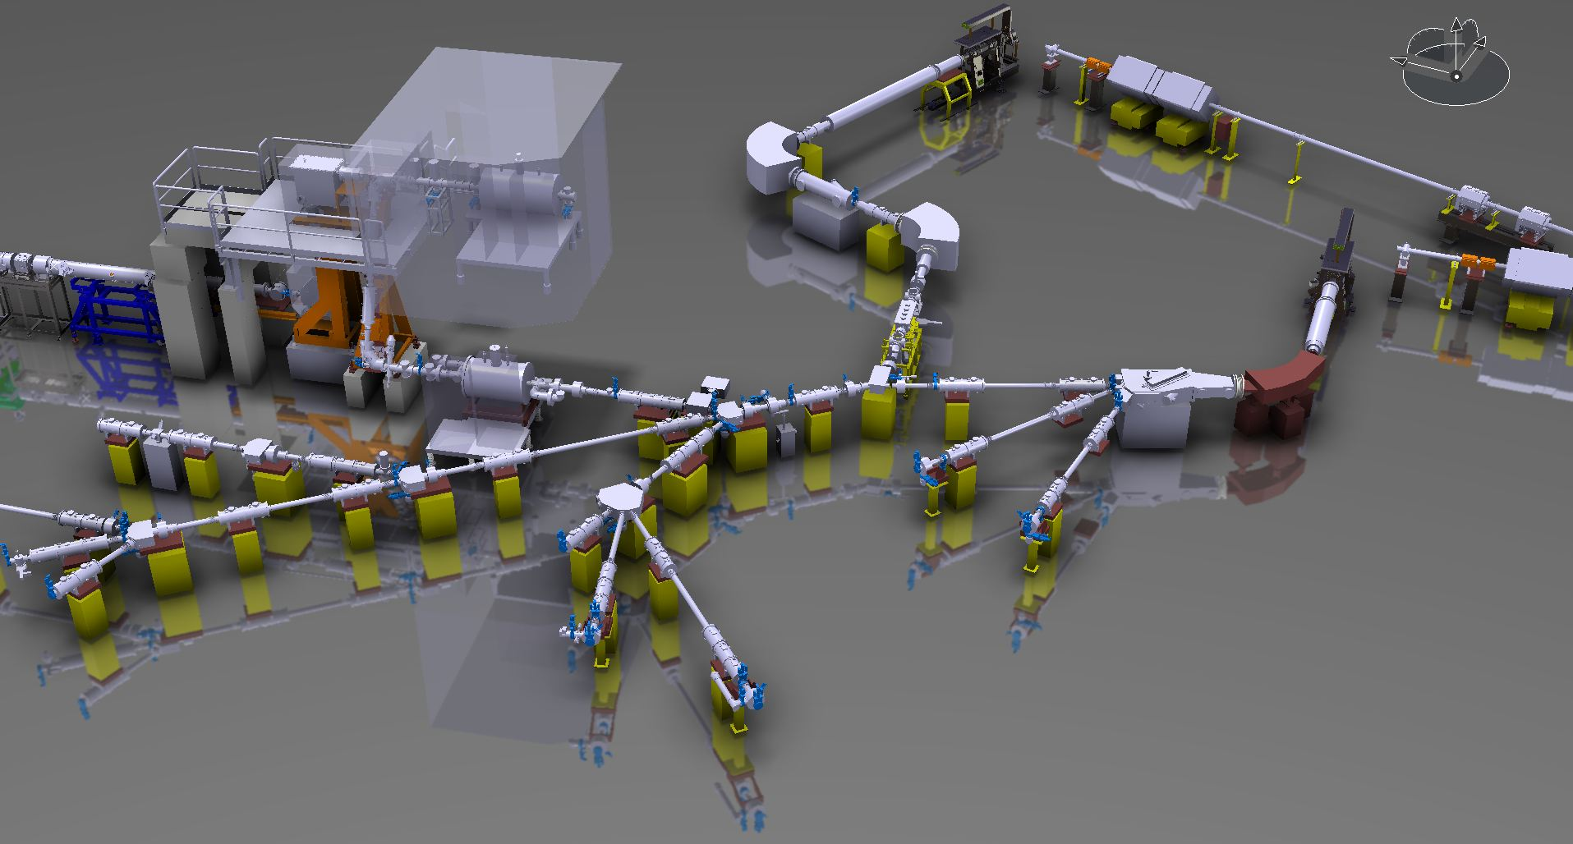
Separation @ ISOL
Recoil Energy (fast)
Diffusion (slow)
The produced ions must leave the target:
Target + Ion source Unit
Separation of primary beam : Fragmentation in a thick target: ISOLDE
REX-ISOLDE
HRS
GPS
tape station

Slide 28
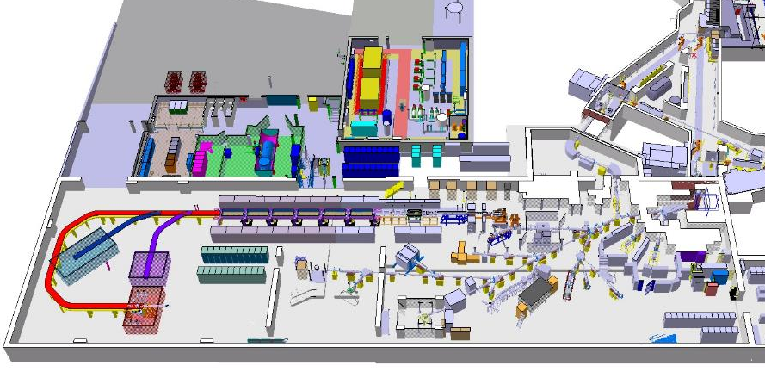
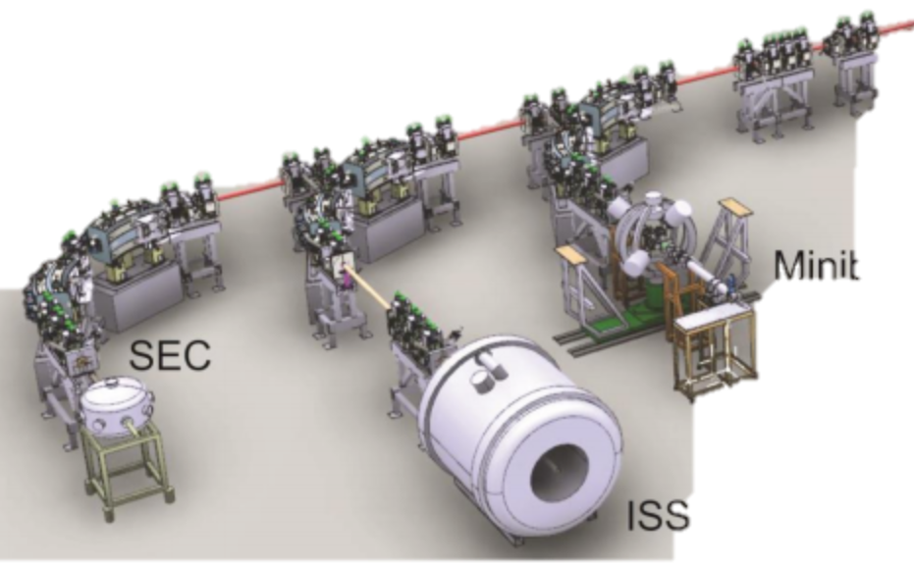

The ISOLDE facility and set-ups
production
GPS
Target 2
RIB production
HRS
Target 1
REX-ISOLDE
RIB accelerator
Since 2001
2.8 MeV/u
TAS
+RILIS
HIE-ISOLDE RIB accelerator
2014-2018
Gradual increase to ~10 MeV/u
WISARD
VITO
Scattering
Chamber
MINIBALL
IDS
Solid State Physics
NICOLE
CRIS
ISOLTRAP
COLLAPS
ISS
High energy experiments
Low energy experiments
(~ 60 keV)
Travelling setups

Slide 29
Radiactive Beams: Possible Research domains
masses
radius, shapes & moments
decay properties
astrophysics
Drip line phenomena
Structure and excitation modes
Tranfer and spectroscopic factors
Heavy & Seper-heavy nuclei
Nuclear Matter
de μeV à 100 keV
E < 1 MeV/u
de 1 à 10 MeV/u
E < 100 MeV/u
Some reactions :
fusion – evaporation, ¹⁴O + ⁴⁰Ca, ³⁰S + ⁴⁰Ca, ⁶⁴Ge + ⁴⁰Ca…
Super heavy
²⁴⁸Cm(²⁰O,4n)²⁶⁴Rf …
Coulomb Excitation, Neutron rich Nuclei
transfert, of 1 or several nucleons for neutron rich nuclei
Astrophysics
H(¹⁹Ne, ²⁰Ne)γ
⁴He(¹⁵O, ¹⁹Ne)γ …

Slide 30
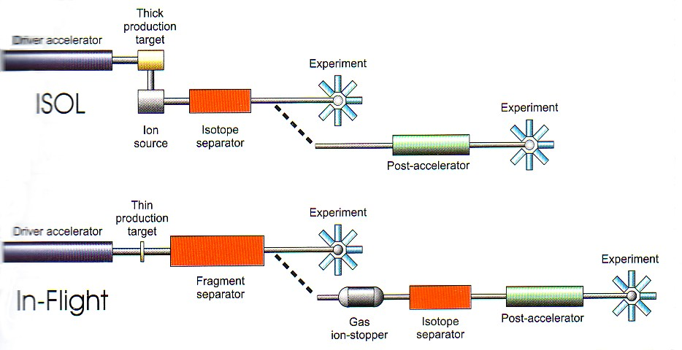
Summary: Two production Methods
Primary Target
extraction
post-accelerator
ionisation
séparation
Secondary Target
spectroscopy
driver accelerator
driver accelerator
ions 100 MeV - 1 GeV/u
De-acceleration
fragmentation / fission
Secondary Target
Spectroscopie
Fragment Separator
Post-accelerator

Slide 31

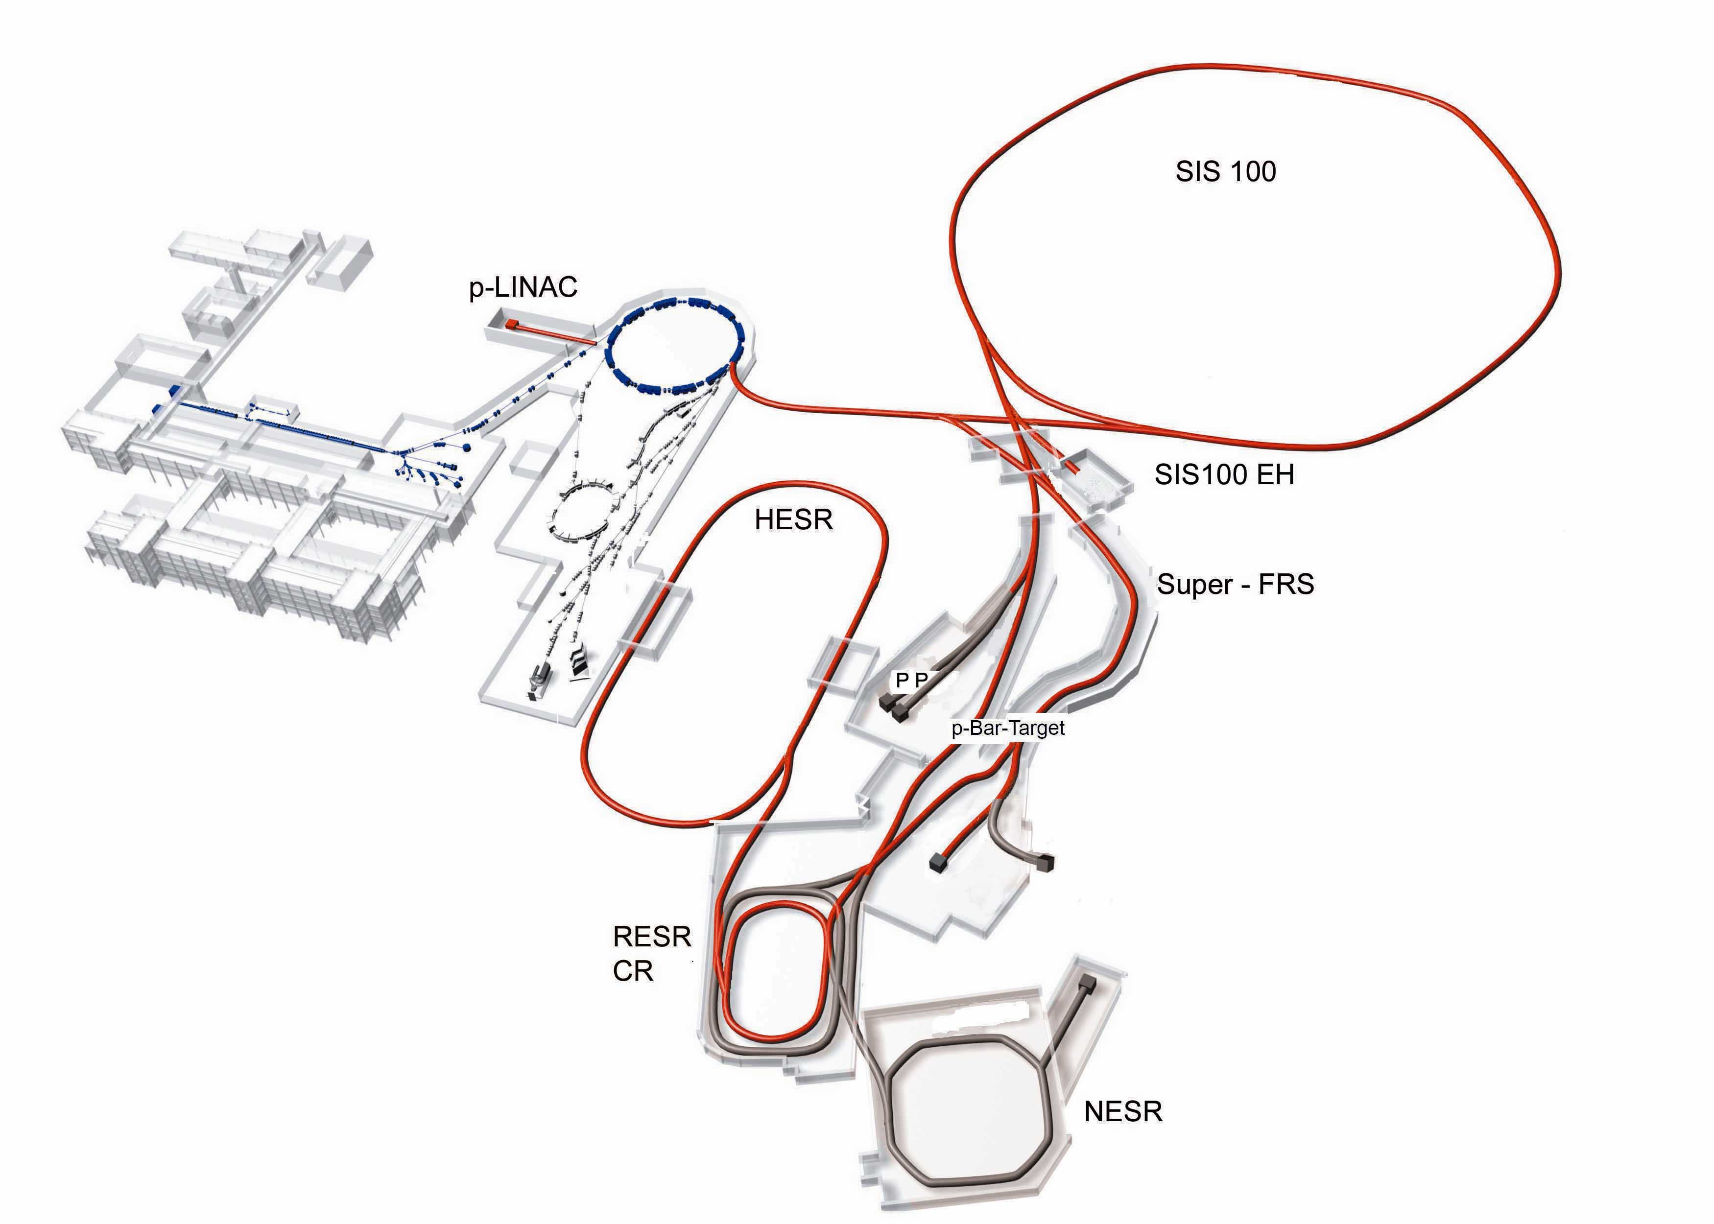
















Fair : Facility of Antiprotons and Ion Research
Present
Operative in 2018
All the Spanish experimental groups participate in the project
CBM/HADES
The company FAIR started 4th October 2010
APPA
PANDA
R³B
HISPEC/DESPEC
NuSTAR
- CIEMAT
- IEM (CSIC)‏
- IFIC (CSIC)‏
- Universidad Complutense de Madrid
- Universidad de Granada
- Universidad de Huelva
- Universidad Politécnica de Cataluña
Universidad de Salamanca
- Universidad de Santiago de Compostela
Universidad de Sevilla
-Universidad de Vigo
Nuclear Structure and Astrophysics: NUSTAR
- R3B, HISPEC/DESPEC, EXL/ELISe, MATS
- 11 research groups
Austria
China
Finland
France
Germany
Greece
India
Italy
Poland
Romania
Russia
Slovakia
Slovenia
Spain
Sweden
U K
Notes:
Reactions at relativistic energies in the order of 1000 MeV/u
20 Tm corresponds to energies up to 1500 MeV/u for U ions

Slide 32


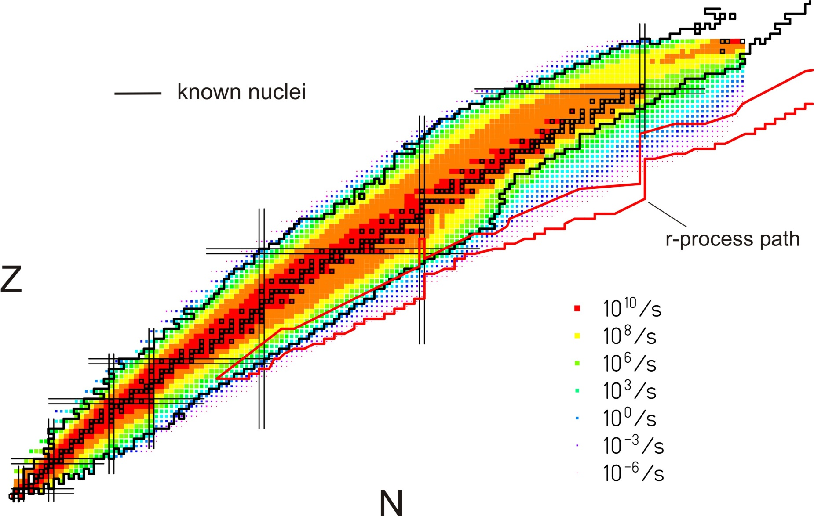
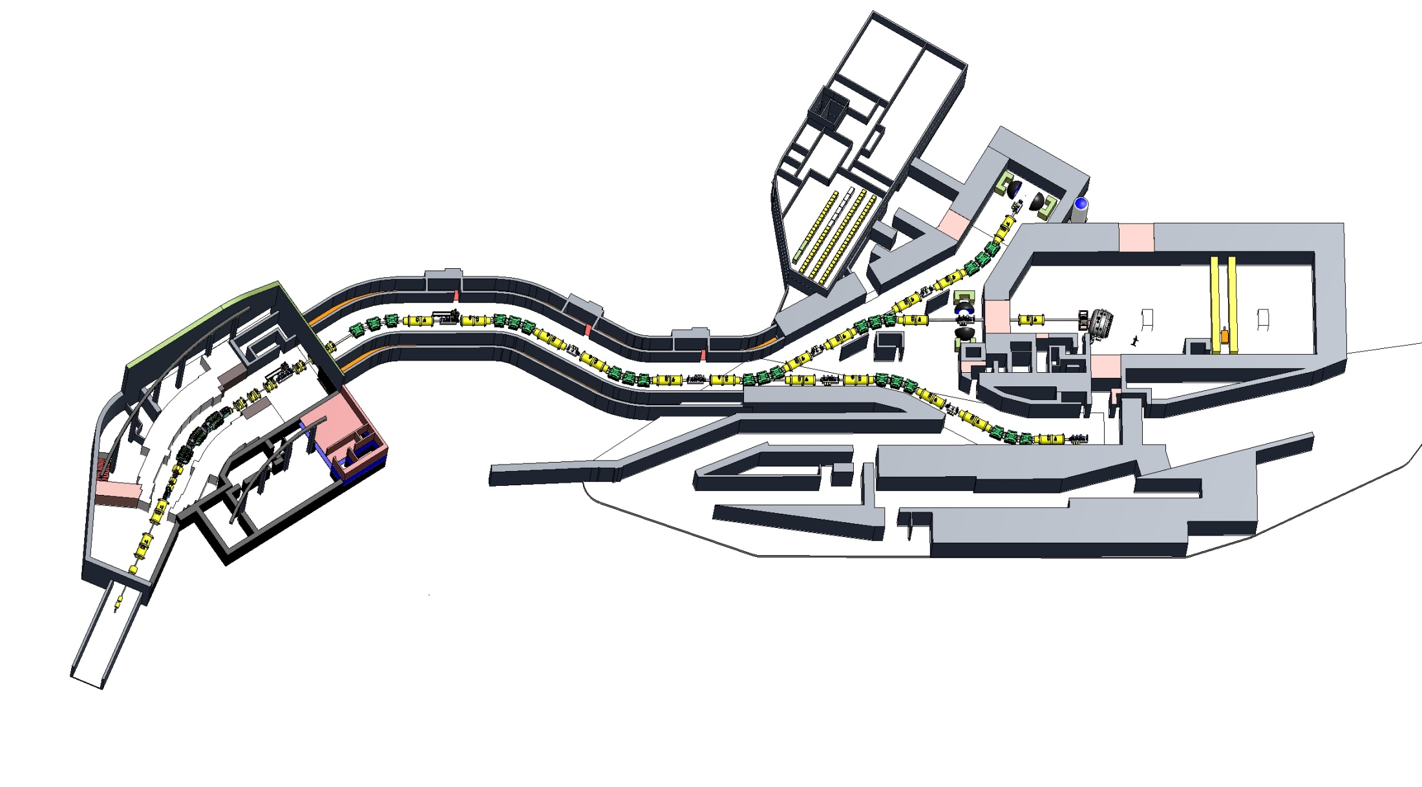




Central Topics for NuSTAR at FAIR
Quest for the limits of existence
Halos, Open Quantum Systems, Few Body Correlations
Changing shell structure far away from stability
Skins, new collective modes, nuclear matter, neutron stars
Phases and symmetries of the nuclear many body system
Origin of the elements
➔ unified theory (ab-initio, density functional, shell model)
DESPEC
HISPEC
Neutron Skins
Pygmy Resonance
Neutron stars
Super-FRS
Halos
EOS
32
Notes:
32

Slide 33





HISPEC & DESPEC @ FAIR
Precision Mass Measurements (MATS)
UGR
HISPEC:
High-resolution in-flight spectroscopy of exotic nuclei using Super-FRS RIB beams at 3 – 200 A·MeV
- Coulex, knock-out, fragmentation at relativistic energies and at direct reactions, fusion barrier energies.
Decay spectroscopy (DESPEC): IFIC, CIEMAT, UCM, UPC
UHU, USE
DESPEC:
First glance to nuclear structure at the extreme: mass, β-decay, βn, βγ….
IEM, IFIC, USAL

Slide 34


The HIE-ISOLDE Project
Intensity Upgrade:
Design Study of target Area and beam lines
Energy Upgrade:
Construction of SC Linac
& cryogenics building

Slide 35


The neutron detectors for DESPEC
CIEMAT is the coordinator of the neutron detector working group of the DESPEC experiment and exploiting all possible international synergies (SPIRAL-2).
Design and construction of a demonstrator
CIEMAT: design and partial construction
TOF spectrometer: array of liquid scintillators
(BC501A)

Slide 36




Identification and Measurement of fragments
EXOGAM
Recoil Spectrometer RITU Jyväskilä
VAMOS GANIL
Mass Spectrometer DRAGON
Vancouver CANADA

Slide 38

Production of nuclei @ GANIL
Production target
Fragment separation
(fragmentation)
magnetic dipoles
velocity filter
target
degrader (⁹Be)
Detection set-up
ion source
Accelerator
³⁶Ar¹⁸⁺ @ 95 MeV/u

Slide 39

Reaction at High Energy @GSI → R3B @ FAIR
Reaction Mechanism :
Coulomb dissociation
Difraction
Absortion
Observables:
Momentum Distribution:
  neutron
  Charged fragment
Invariable Mass
Angular correlations
Experimental Variable:
beam energy 30 → 700 MeV/A
Secondary Target material: C → Pb
Secondary Beam ⁶He → ²²Ne

