Slide 1
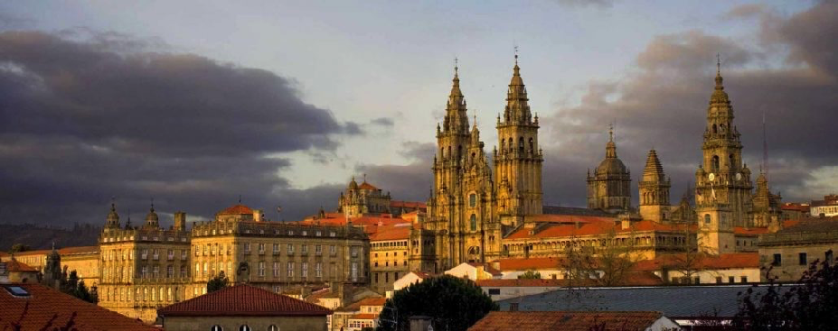

Summary Talk
Takashi Nakamura
Tokyo Institute of Technology
The 11th International Conference on Direct Reactions with Exotic Beams (DREB2022)
@ Santiago de Compostela, Spain, 26 June-1 July, 2022

Slide 2
Remarks
I would like to congratulate all the speakers and poster presenters in DREB2022
Please allow me to select some of the talks among all the great talks in all the sessions in DREB2022
This selection is biased, and somewhat affected by my preferences
I tend to pick up more experimental talks
I also tend not to pick up the very preliminary results
I may not be politically correct
Note: My nickname is “Bogen” (I tend to say something which is uncomfortable to you, unknowingly)

Slide 3

From Matsue to Santiago de Compostela
Felomena-san,
Please correct it!
DREB2018: June, 2018, Matsue, Japan
→DREB2022: June-July, 2022, Santiago de Compostela
"Looking back, Looking forward"

Slide 4
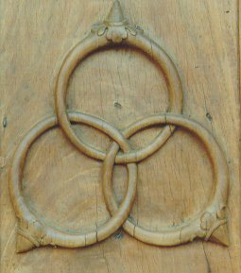
Trinity
Nuclear Reactions
(Direct Reactions)
Elastic scattering
Inelastic scattering
Quasi free scattering
/Knockout reaction
(p,pa), (p,pp), (p,pn),
(p,3p),
Breakup Reactions
Transfer reactions
(d,p),(t,p),(p,t),(p,³He)
Shell Structure
(Shell Evolutions,
Magic numbers)
Cluster
Halo
Resonance
²n,⁴n,⁶n…
Driplines
Continuum
Short Range Correlation
QCD, Chiral EFT
NN, NNN, NNNN
Effective interactions
(Optical Potential)
Nuclear
Structure
Interactions

Slide 5
Exoticness
Unstable Nuclei (RI)
T.Otsuka et al., Rev. Mod. Phys. 92, 015002 (2020).

Slide 6
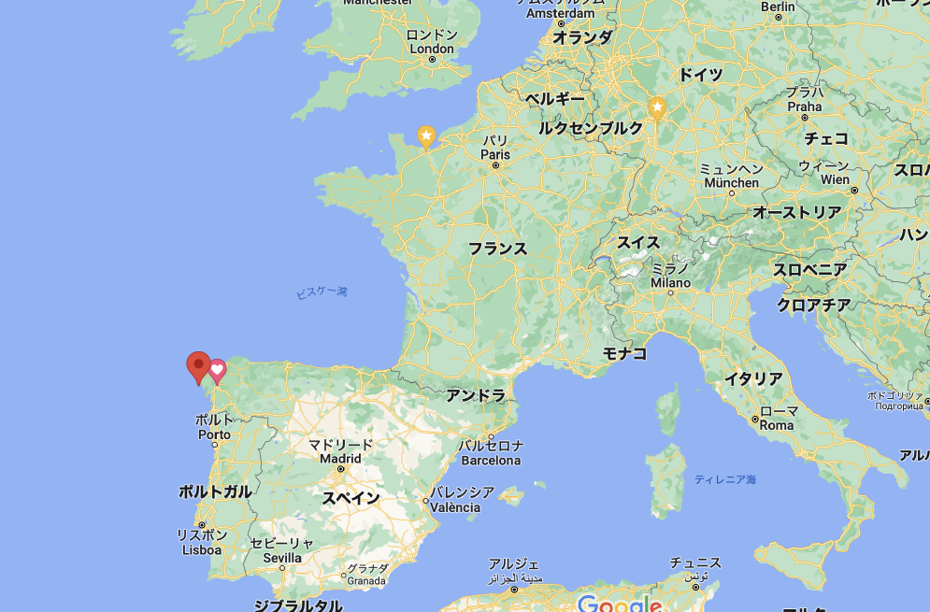
Exoticness → Edges
Superheavy
Proton dripline
Fisterra
(The end of the Earth)
Neutron dripline
T.Otsuka et al., Rev. Mod. Phys. 92, 015002 (2020).

Slide 7
Exoticness
Ordinary
Exotic
Stable Nuclei
Valley of Stability
Deeply bound nuclei
Nucleus made of nucleons
Independent Particle Model
Nuclei below ²³⁸U
Magic numbers 2,8,20,28,50,82,126
Unstable Nuclei
Driplines
Weakly bound nuclei/Unbound nuclei
Nucleus made of quarks
Nucleus made of alphas, dineutrons
Short range correlations/ Correlations
Superheavy
Magic numbers 6,14,16,32,34,…
Edges/Boundaries

Slide 8
Edges: Closed or Open?
Otsuka, Mittig, Volya
Closed system Open system
Normal Nuclei: Bound and Isolated system→ Closed quantum system
Exotic nuclei at driplines, Highly excited states → Open quantum system
Unbound States Continuum
E=0
Bound States
Bound States
“Nuclear Reaction (open)”& “Exotic Nuclear Structure (closed-open)”
Boundary between “open” and “closed”
→ Novel phenomena and features in Nuclear Structures and Reactions
“Reaction” and “Structure” on equal footing?

Slide 9


Edges: Boundary of open/closed quantum systems
Quark
Hadron
Atom
Open Quantum System
E_{x}
E_{x}
E_{x}
Hadron Molecule
α cluster
Λ(1405)
Hoyle State
Feshbach Molecule
N+$\overline{K}$
α
1/ka→0
3α
+
N
α
α
E_{x}
E_{x}
E_{x}
Λ
u
Nucleus
d
s
Molecule
Hadron
¹²C(gs)
Closed Quantum System

Slide 10


Edges: Boundary of open/closed quantum systems
Neutron Matter
Ex→Larger
A=const. N/Z→Larger
Hadron
Hadron
N/Z$≫∞$
Open Quantum System
E_{x}
E
α cluster
dineutron cluster
Hoyle State
Neutron Halo
α
⁹Li+2n
n
3α
α
α
N/Z>2
n
¹¹Li(3p+8n)
E_{x}
E
Nucleus
N/Z$\sim 1$
Nucleus
¹²C(gs)
¹¹B(5p+6n)
Closed Quantum System
Edges (near threshold): Relevant to Stellar Nuclear Reactions

Slide 11
Edges of open/closed systems:
Driplines:
Beyond neutron dripline
Halo Nuclei
Neutron clusters (dineutron/tetraneutron)

Slide 12
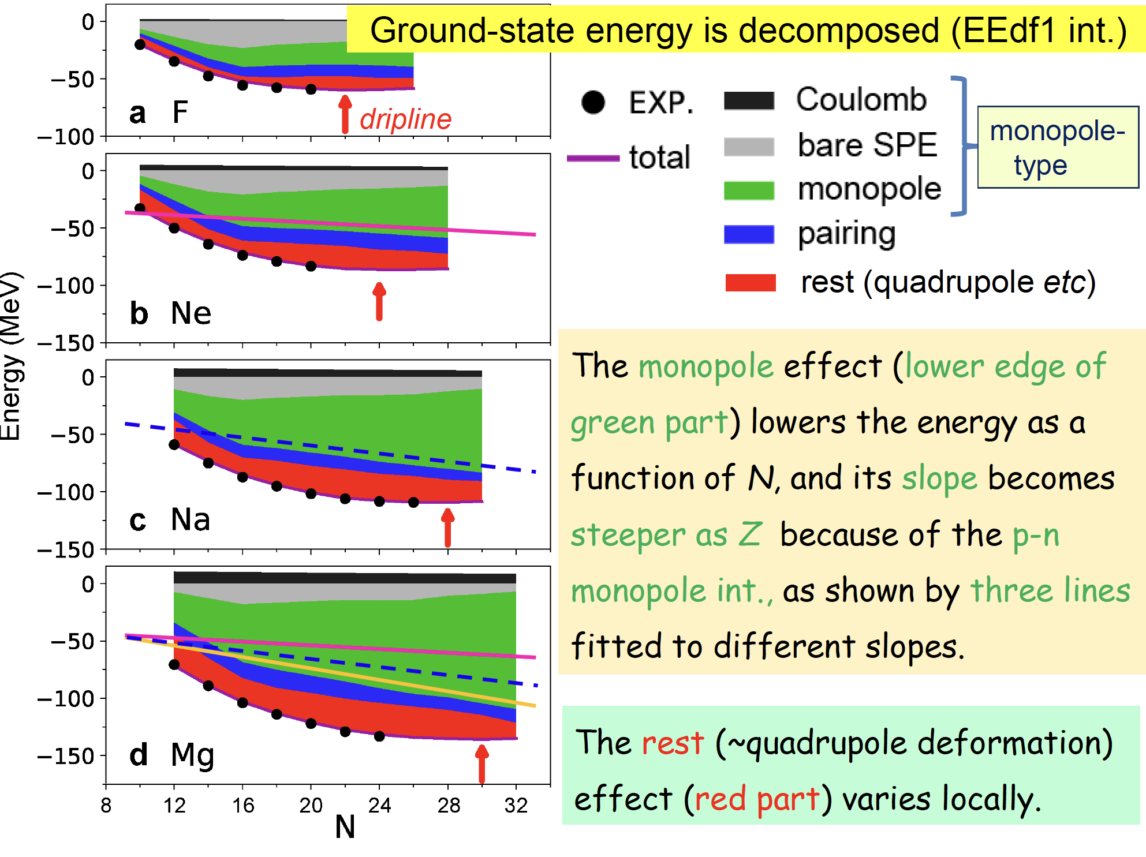
What locates neutron driplines?
Taka Otsuka
Neutron dripline:
Monopole←→Deformation
Balance

Slide 13
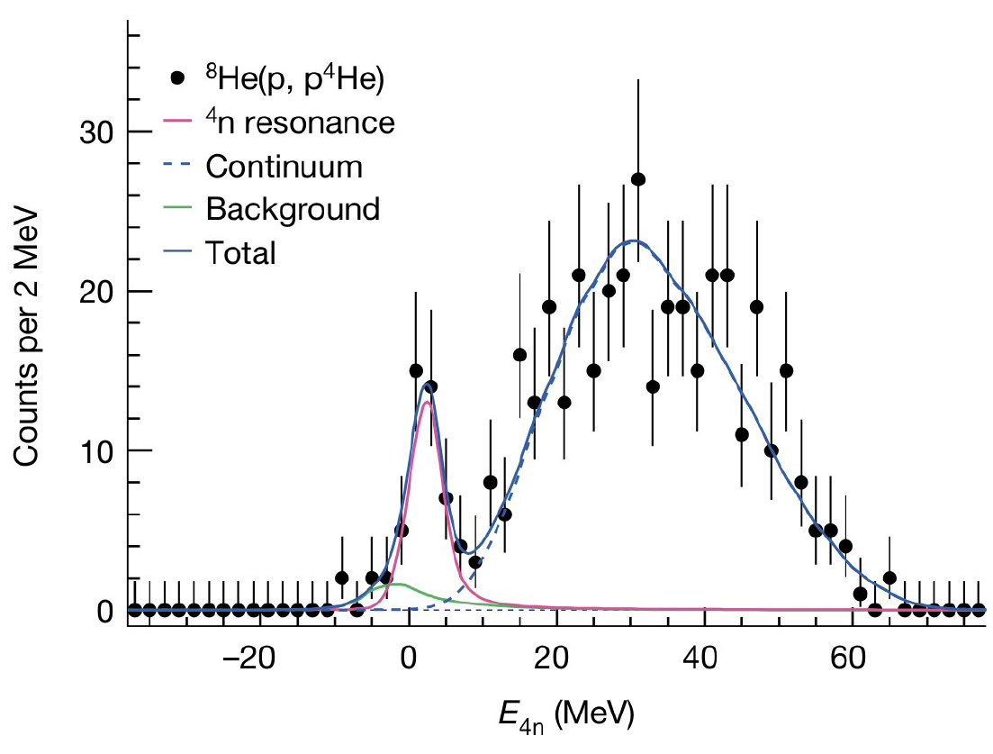
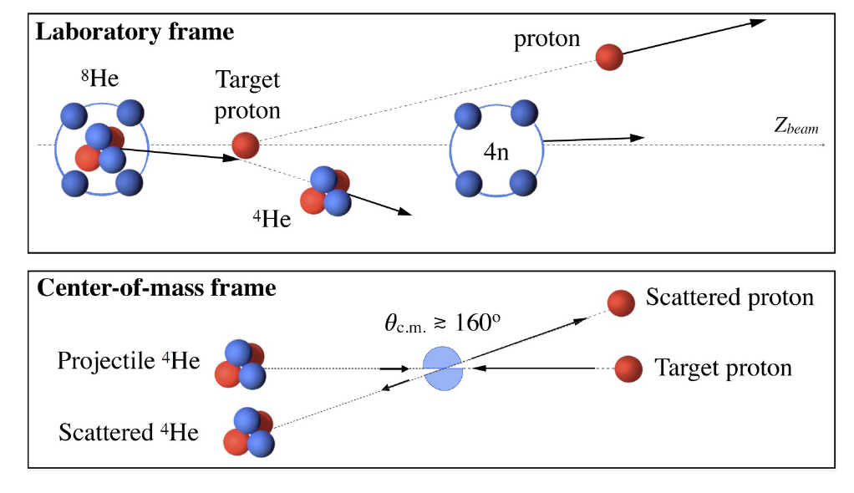
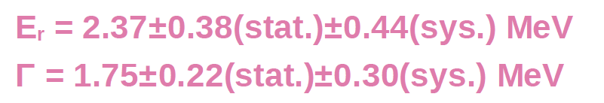
Tetra Neutron
Maytal Duer
@SAMURAI-RIBF
(p,pα) at backward kinematics (@156MeV/u)
M. Duer et al., Nature 606, 678 (2022).

Slide 14
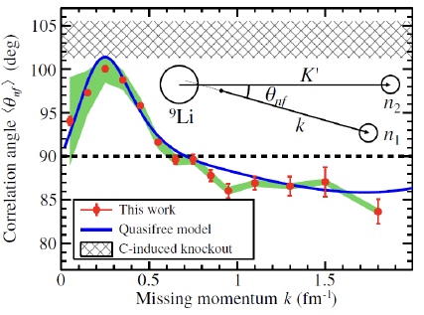
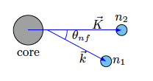

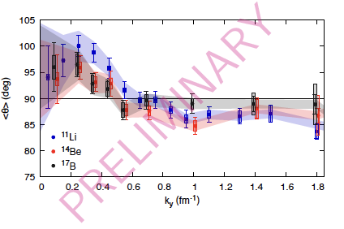
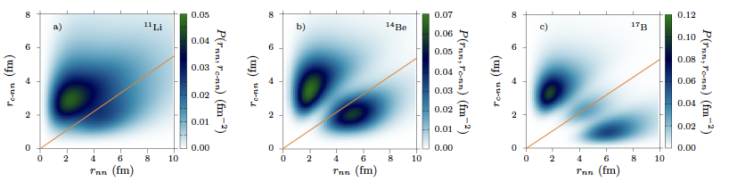
Locating dineutron in 2n halo by (p,pn)
Jésus Casal
¹¹Li(p,pn)¹⁰Li
Y.Kubota et al.,PRL125, 252501 (2020).
Eikonal Sudden Approximation+ three-body model
Dineutron in a limited region of surface
→Common feature?
A.Corsi et al., submitted

Slide 15
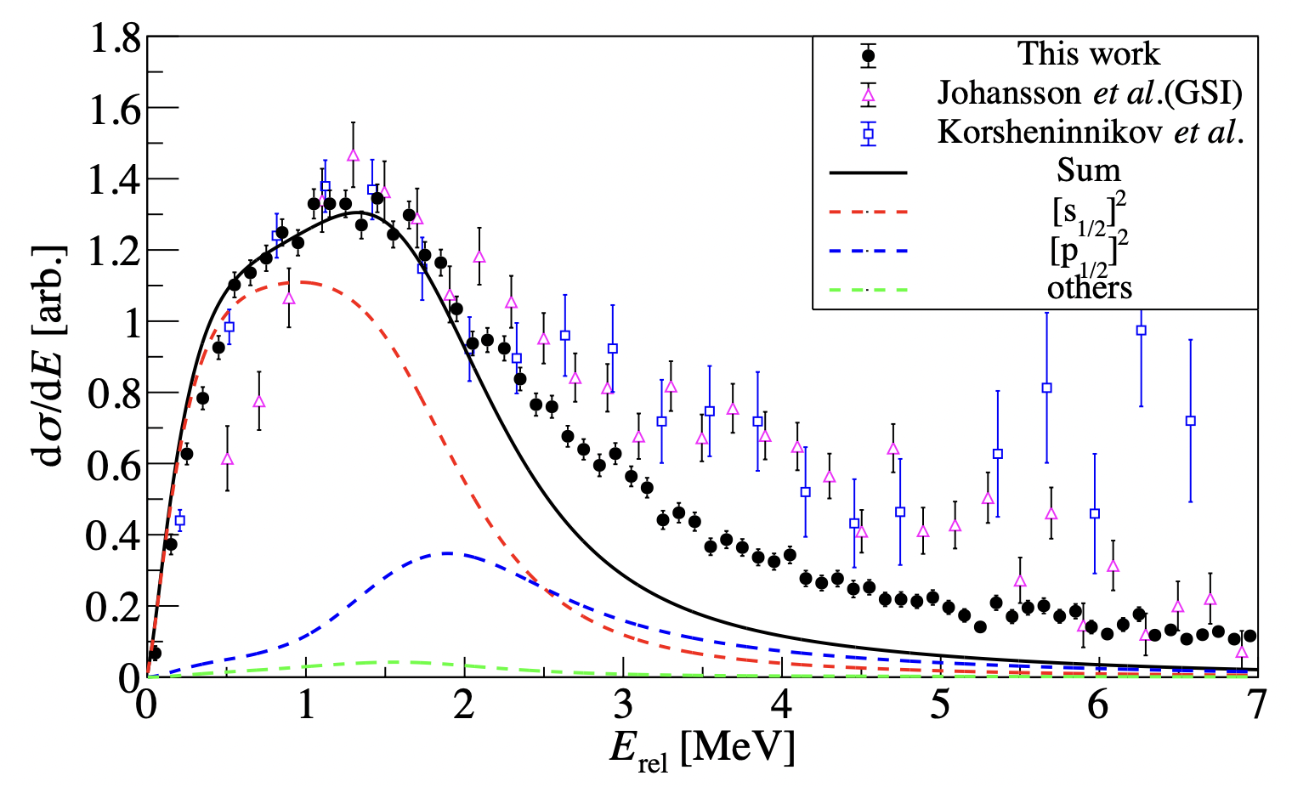
¹⁰He from ¹¹Li(p,2p)
Yelei Sun
253 MeV/u SAMURAI@RIBF
Two components:
E~1 MeV, ~2 MeV
⁸He-n interaction based on current ¹⁰He spectrum
s-wave scattering length -3.45 fm (close to recent ⁹He results)
Three-body Virtual States?
Dineutrons at E_{x}>2 MeV?

Slide 16
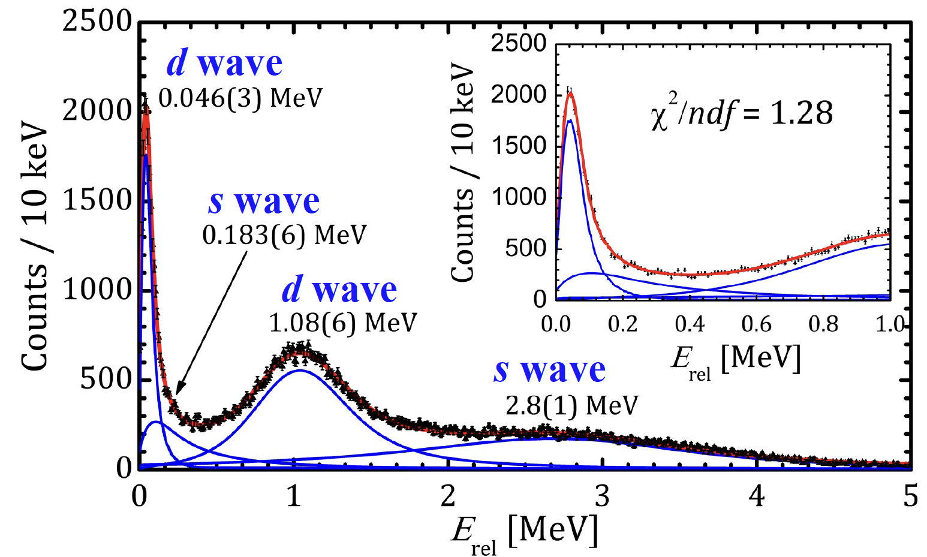
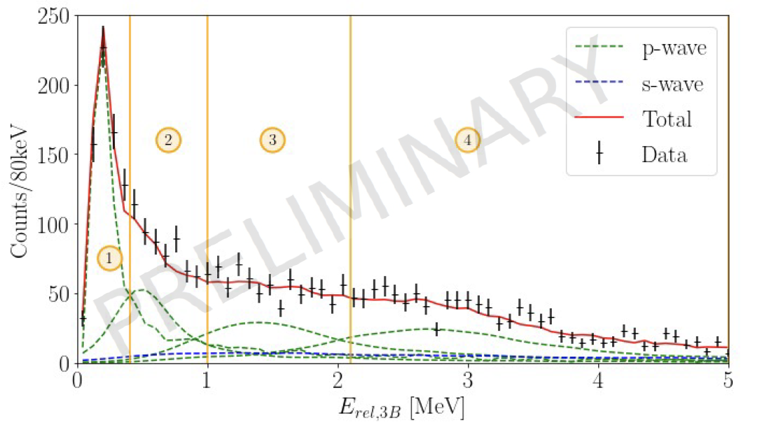
More dripline nuclei with (p,2p)
@SAMURAI-RIBF
¹⁷B(p,2p)¹⁶B
Zaihong Yang
¹⁴Be(p,2p)¹³Li
Paul André
¹⁷B: valence neutrons: d-dominant
Z.Yang et al., PRL126, 082501 (2021).
⁷H, ⁷He Siwei Huang

Slide 17
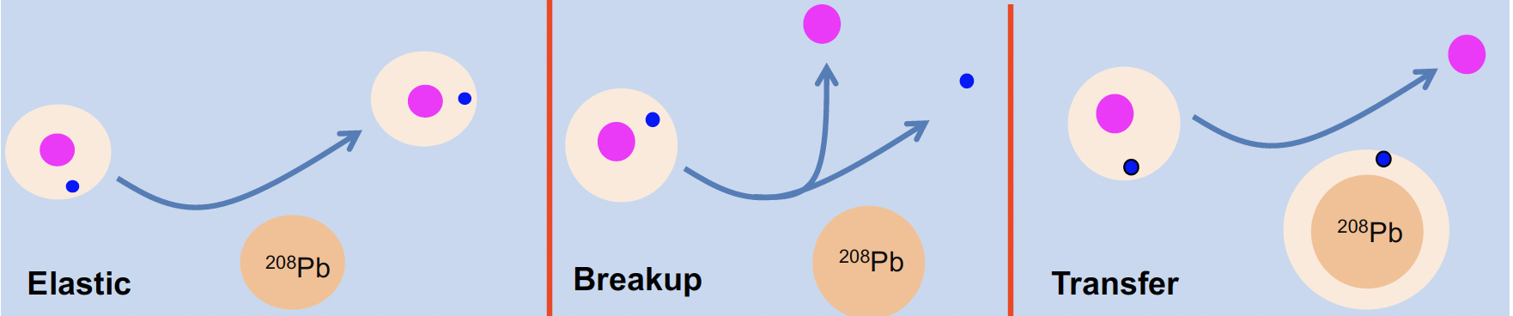
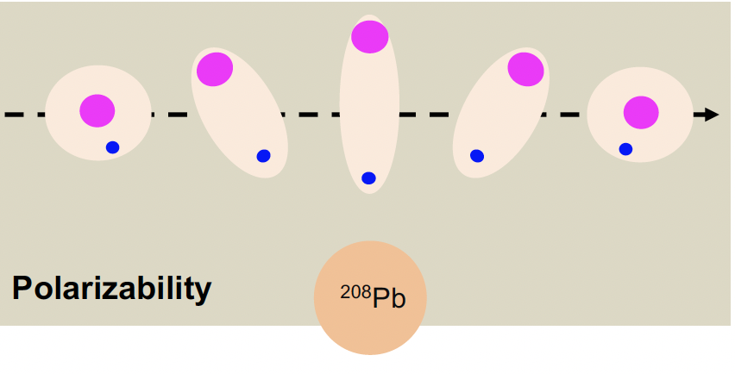
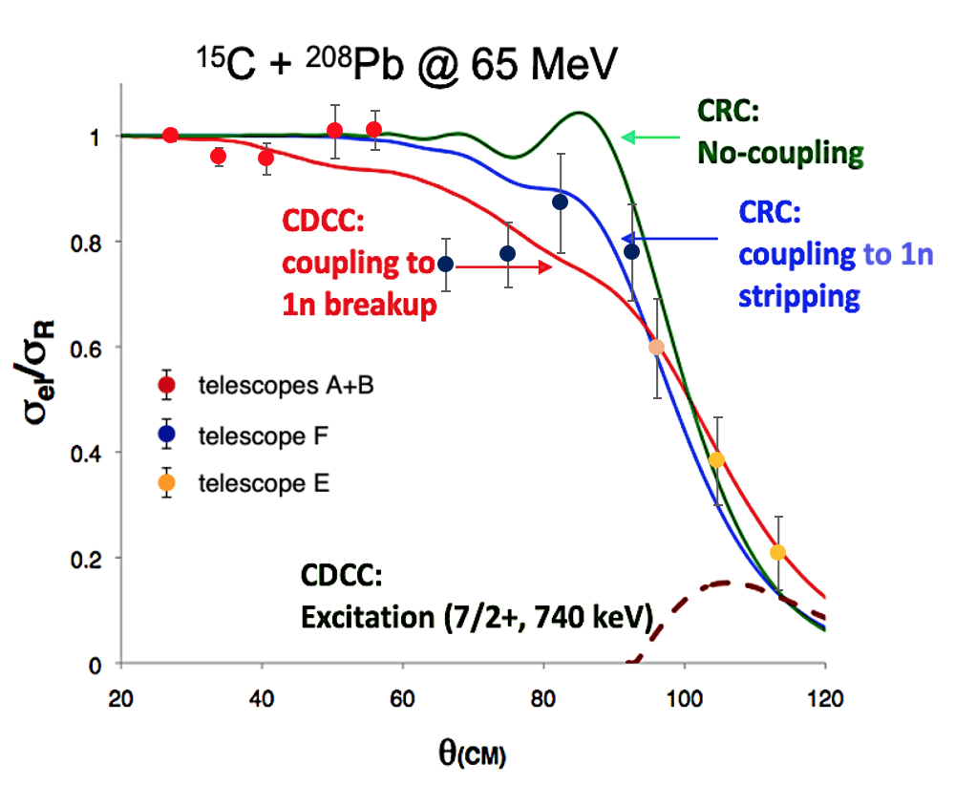
Reactions of halo nuclei near Coulomb Barrier
María José García Borge
@HIE ISOLDE CERN
Theory: Keenly PRC2007
CDCC, CRC
Elastic Scattering of ¹⁵C
Near Coulomb Barrier
Experiment-Theory-Collaboration

Slide 18
Edges of open/closed systems:
α, d, t Clusters

Slide 19
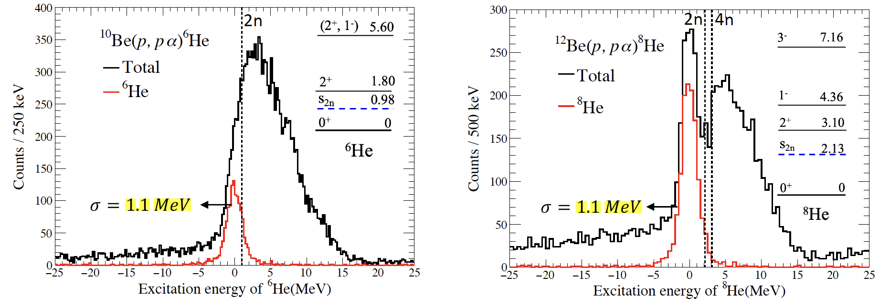
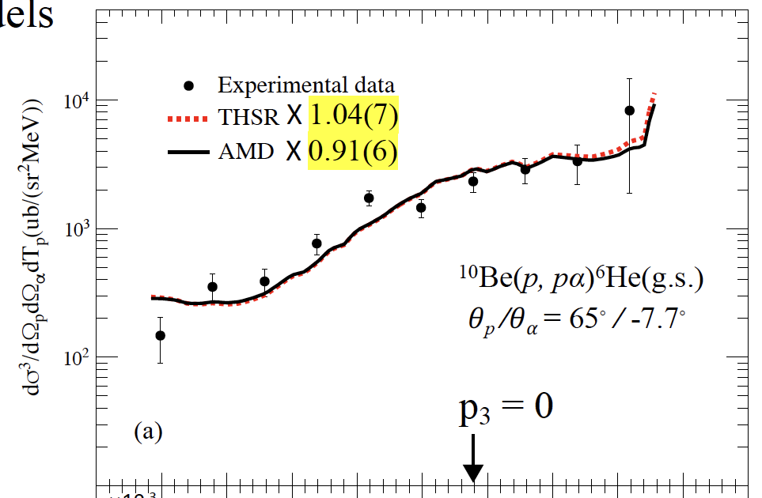
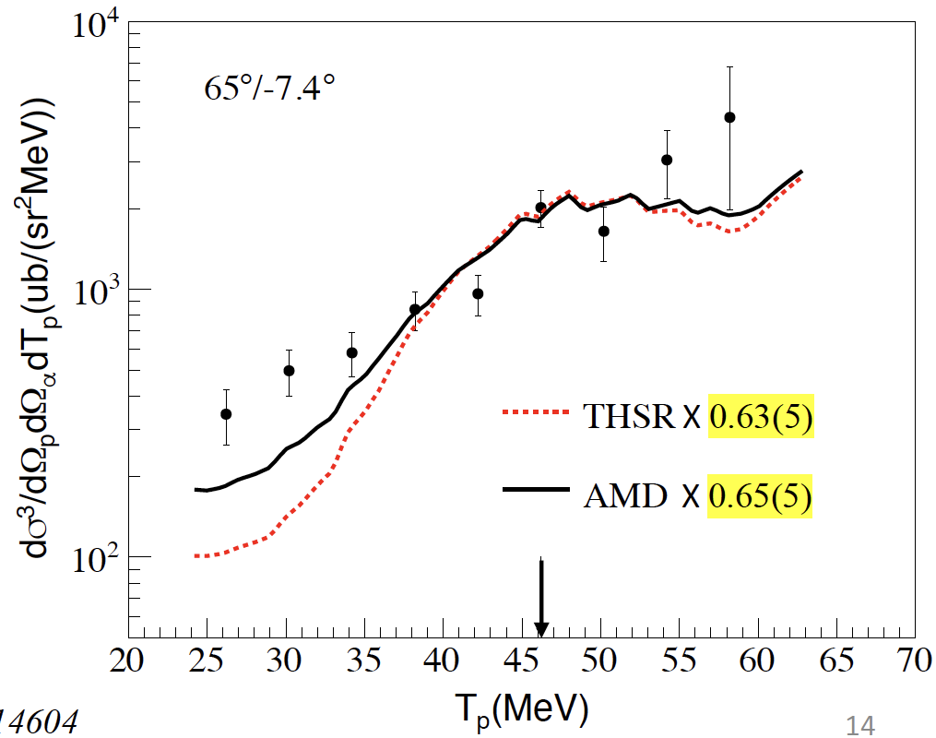
(p,pα) for alpha clustering
Pengijn Lee
¹⁰Be(p,pα)⁶He
150MeV/u
¹²Be(p,pα)⁸He
150MeV/u
@SAMURAI-RIBF
(p,pα)
Excellent probe
for alpha cluster
E_{x}(⁶He) (MeV)
E_{x}(⁸He) (MeV)
¹⁰Be: alpha cluster ~1
¹²Be: alpha cluster ~0.6
Triple Differential
Crosssection
T_{p} (MeV)
T_{p} (MeV)

Slide 20
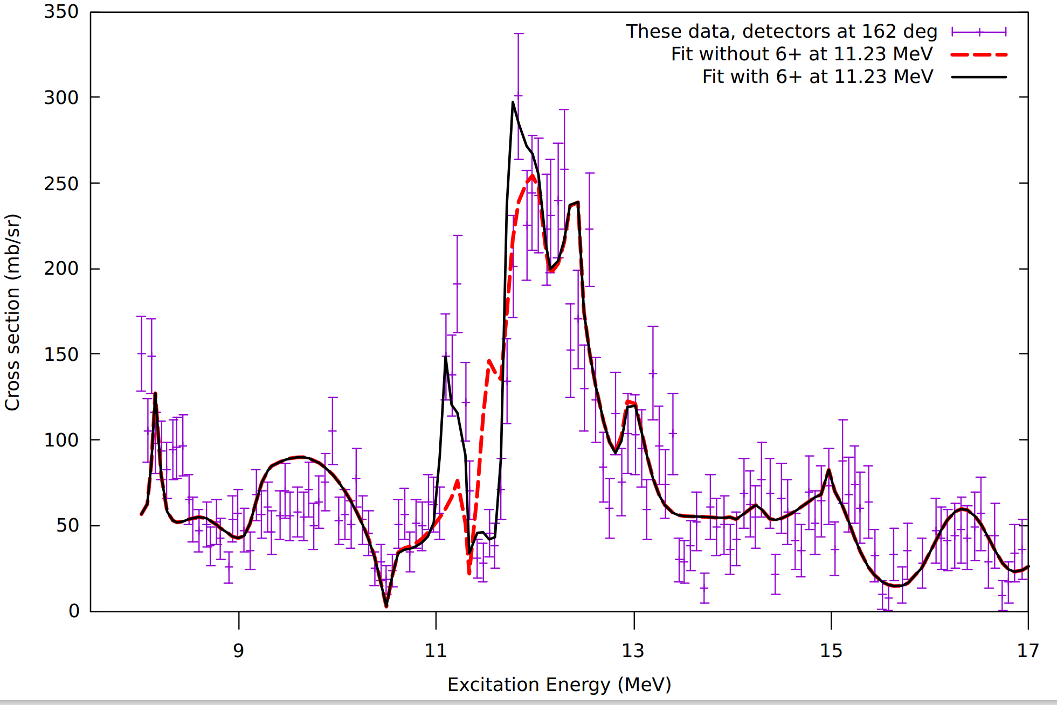
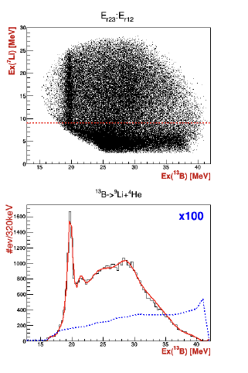
α-cluster states using a variety of reactions
Marina Barbui
Nikola Vukman
Active target at Texas A&M: ¹⁸Ne: ¹⁴O+α
TRIUMF ¹³B,^{12,11}Be: (⁶He,α clusters)
⁹Li(75 MeV) +⁷Li →¹³B,^{12,10}Be
⁴He, triton transfer etc.
E_{x}(⁷Li)
¹³B
→⁹Li+⁴He
E_{x}(¹³B) [MeV]
E_{x}(¹³B) [MeV]

Slide 21
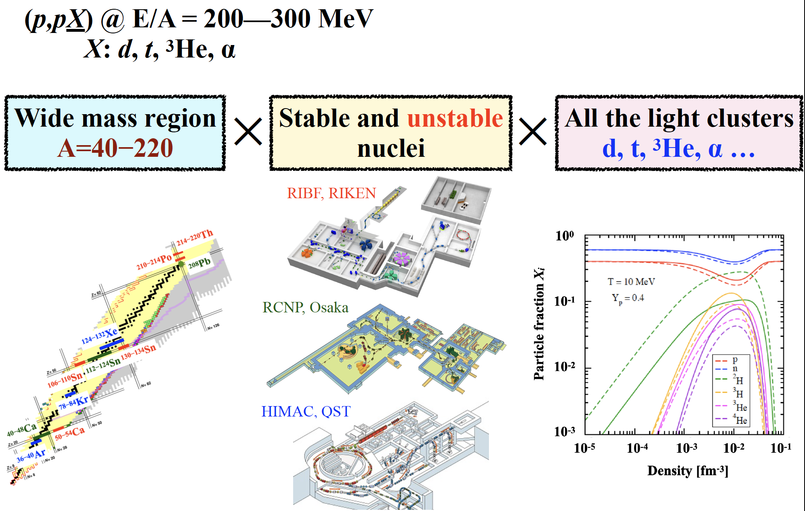
Knockout Reaction for clusters
Tomo Uesaka

Slide 22
Edges of open/closed systems:
Excited states near thresholds

Slide 23
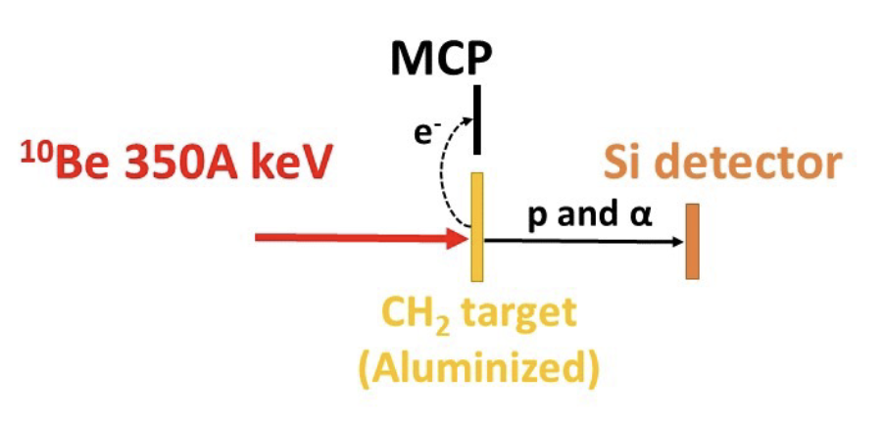
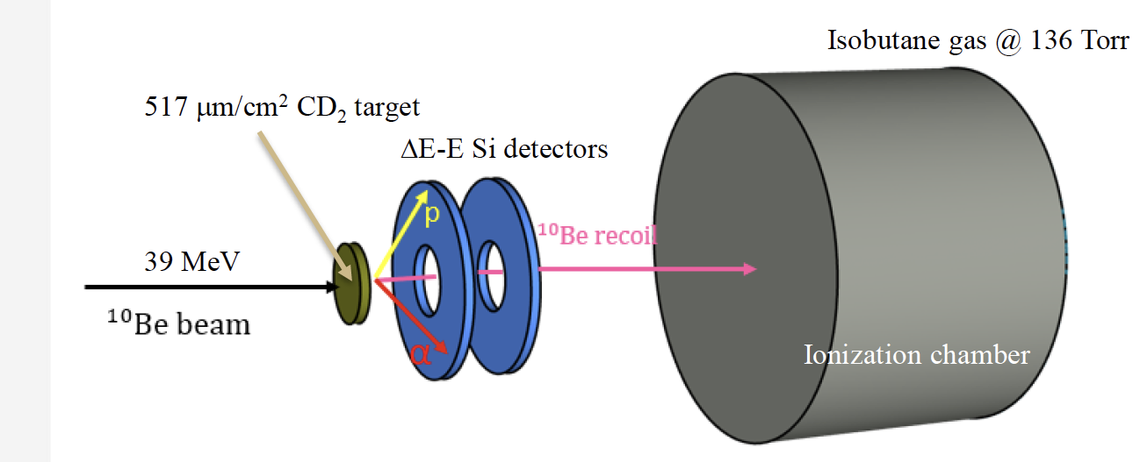
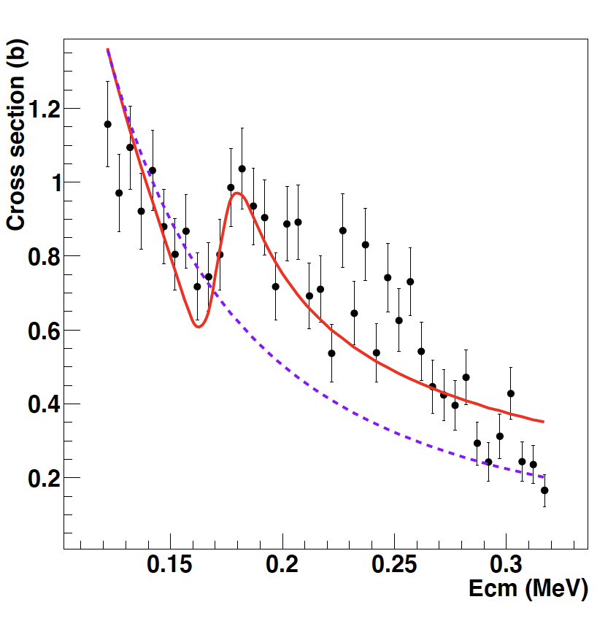
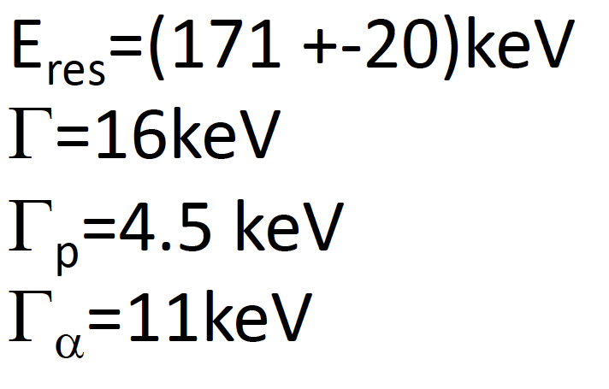
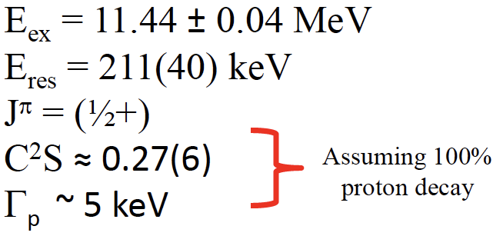
Enhanced Resonance near threshold
Wolfgang Mittig
Sergio Almaraz-Calderon
Y.Ayyad,W.Mittig et al. PRL2022
E. Lopez-Saavedra et al., PRL2022
¹⁰Be(39MeV)+d→¹⁰Be+p
Florida State U.
ReA3@NSCL
11.45 MeV ½+
¹⁰Be+p
¹¹B
S-wave resonance
Enhanced at the threshold?

Slide 24
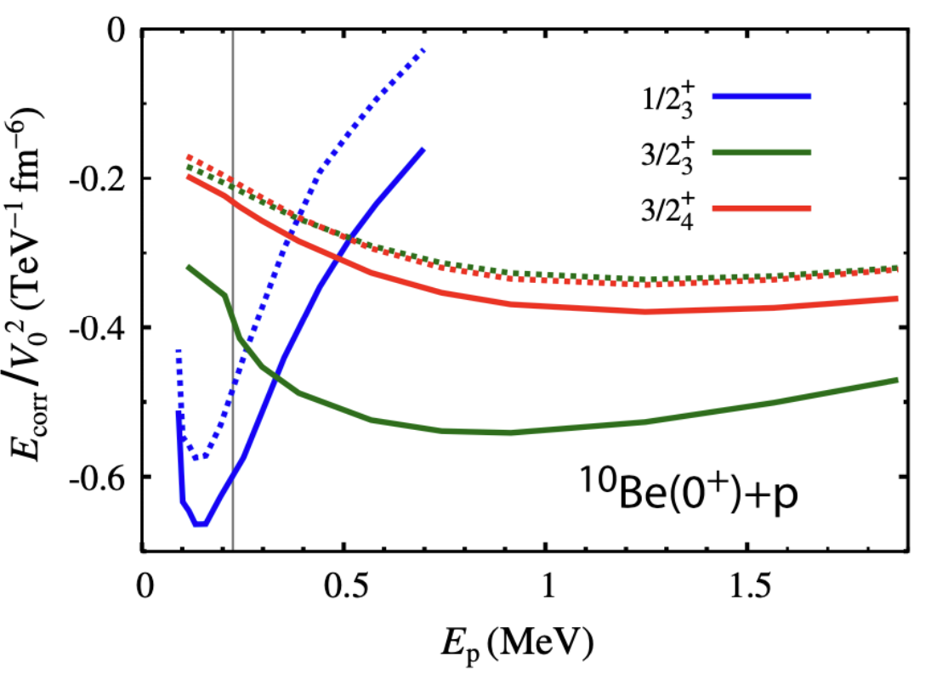
Enhanced Resonance near threshold
11.45 MeV ½+
S-wave proton resonance
Enhanced at the threshold due to coupling to the continuum?
¹⁰Be+p
¹¹B
Alexandre Volya
Wolfi Mittig
Is this universal?
Superradiant?
Relevance to alpha clusters?
Minch-Loc Bui
Petr Navratil

Slide 25
Beyond the mean field
Short Range Correlations

Slide 26
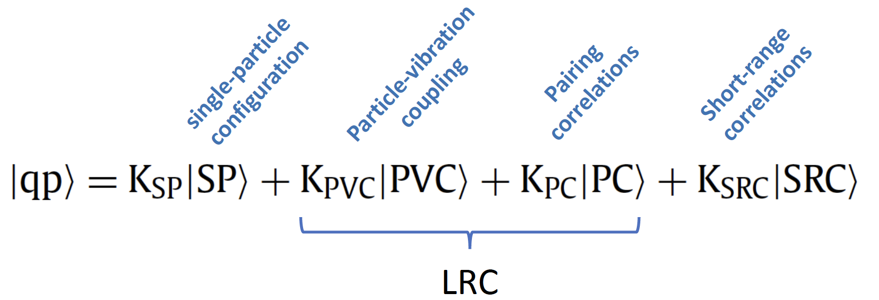
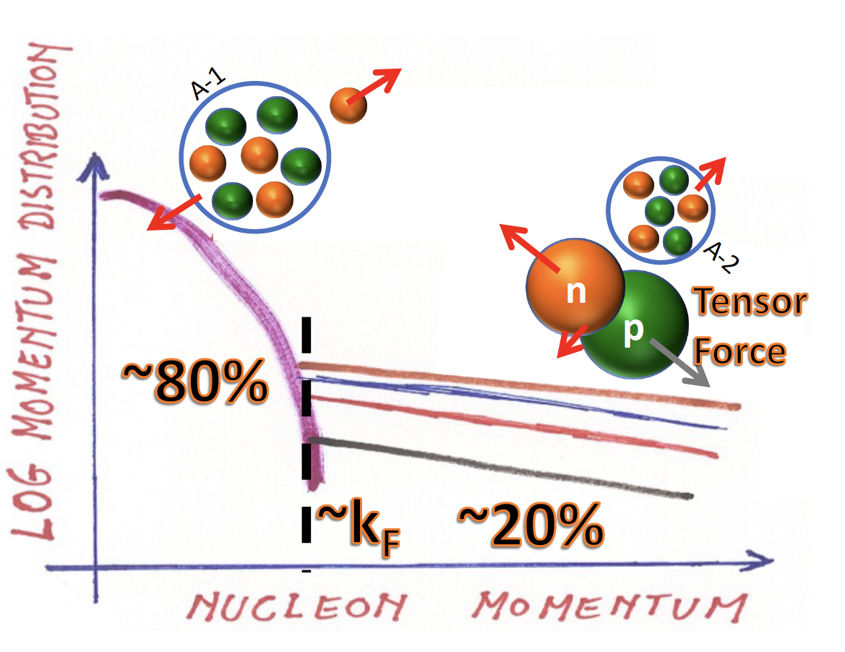
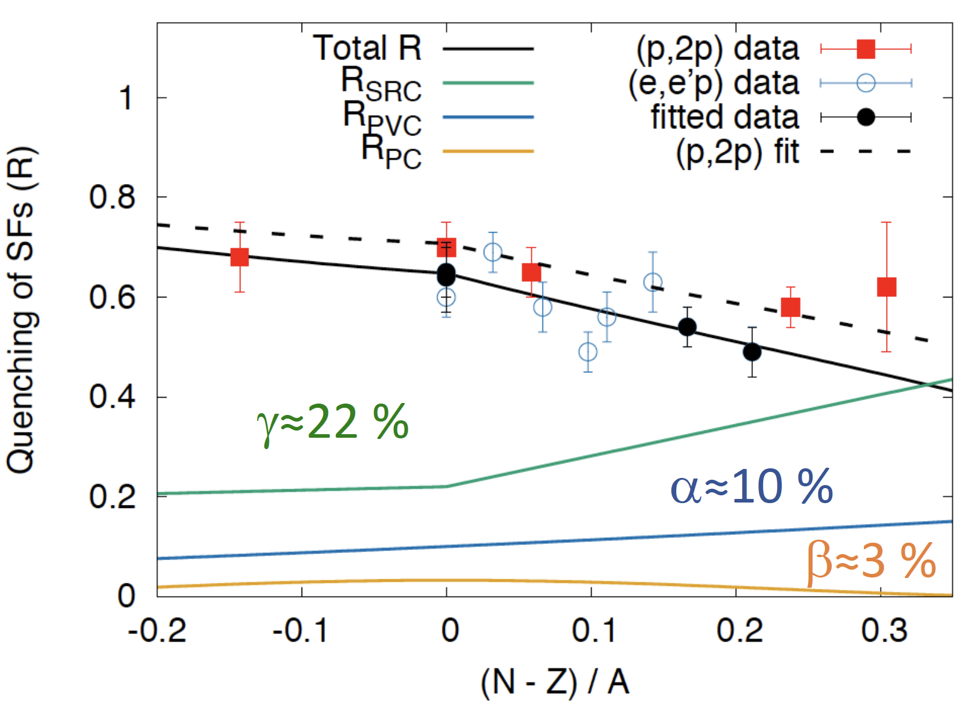
Short Range Correlation
Marina Petri
J-Lab Experiments by
Hen, Korover, Duer, Cohen…
Short Range Correlation
Isospin Dependence?
S. Paschalis, M. Petri, et al., PLB800, 135110, (2020).

Slide 27
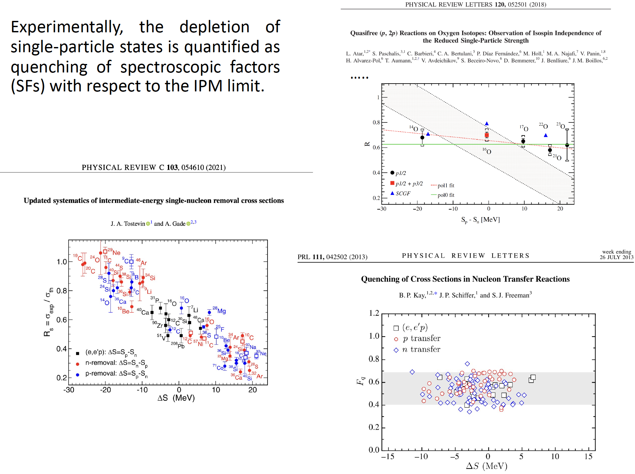
Reduction-factor issue continues
←Slides by Marina Petri
A number of speakers discussed this in this conference
→
SRC?
Reaction Mechanism?
Other effects?
Also see T.Aumann et al., PPNP118, 103847 (2021)

Slide 28
Shell Evolution near ⁷⁸Ni

Slide 29
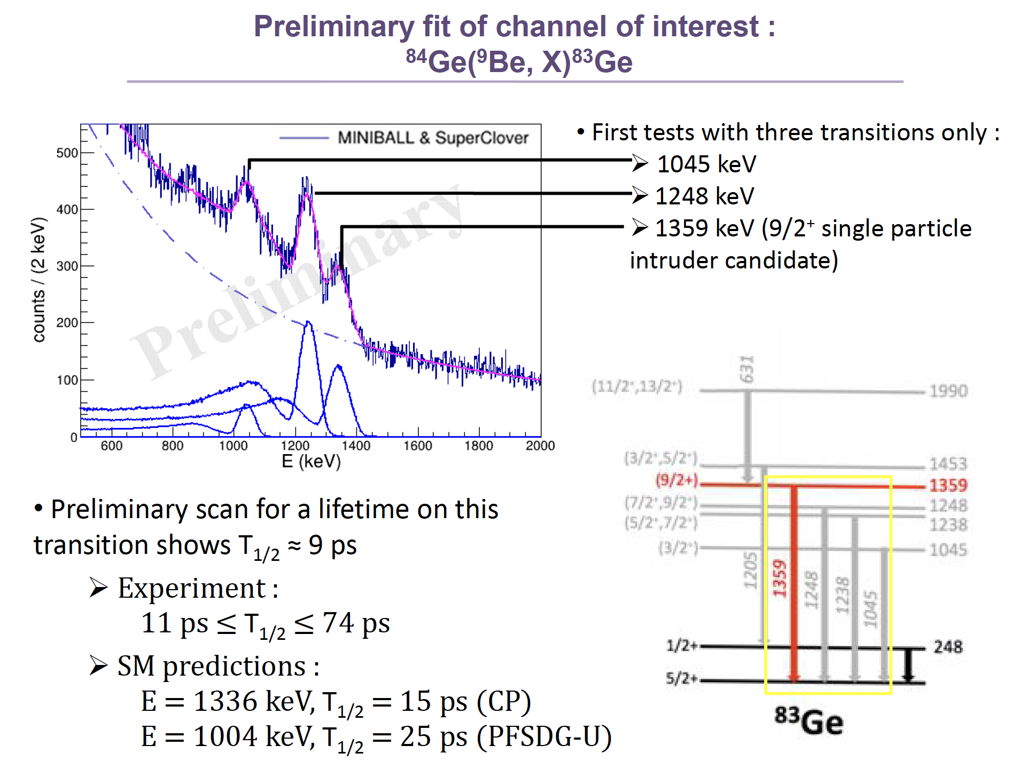
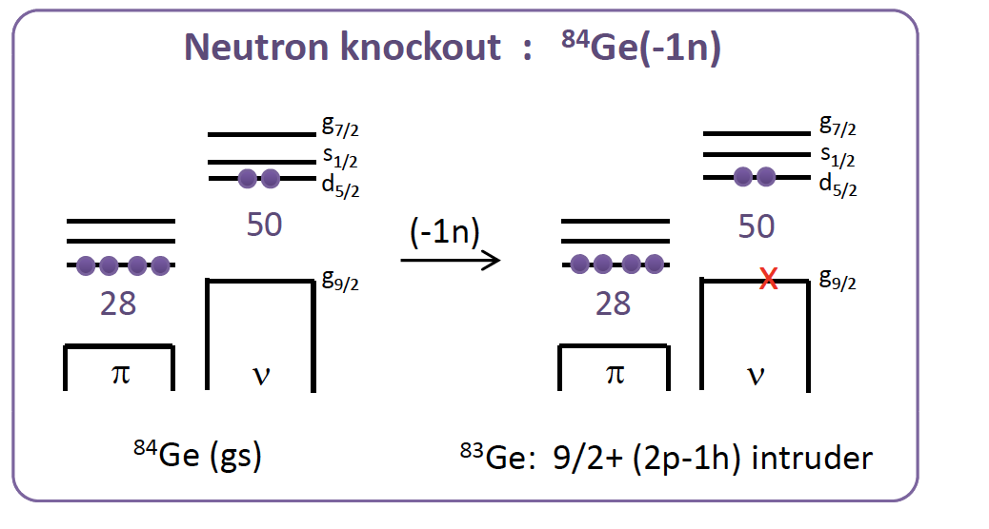
Intruder state ?
Léo Plagnol
1n Reomval from N=50 ⁸⁴Ge
@HiCARI-RIBF
(Z=32,N=51)

Slide 30
Exotic reactions

Slide 31
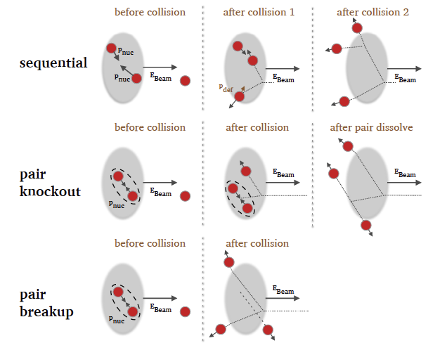
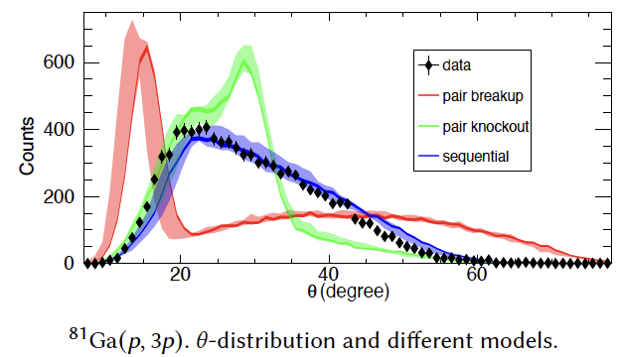
Exotic Reactions-(p,3p)
Axel Frotscher
@ZDS-RIBF
Sequential Dominant
How (p,3p) can be used for spectroscopy?
Hongna Liu (future exp.)

Slide 32
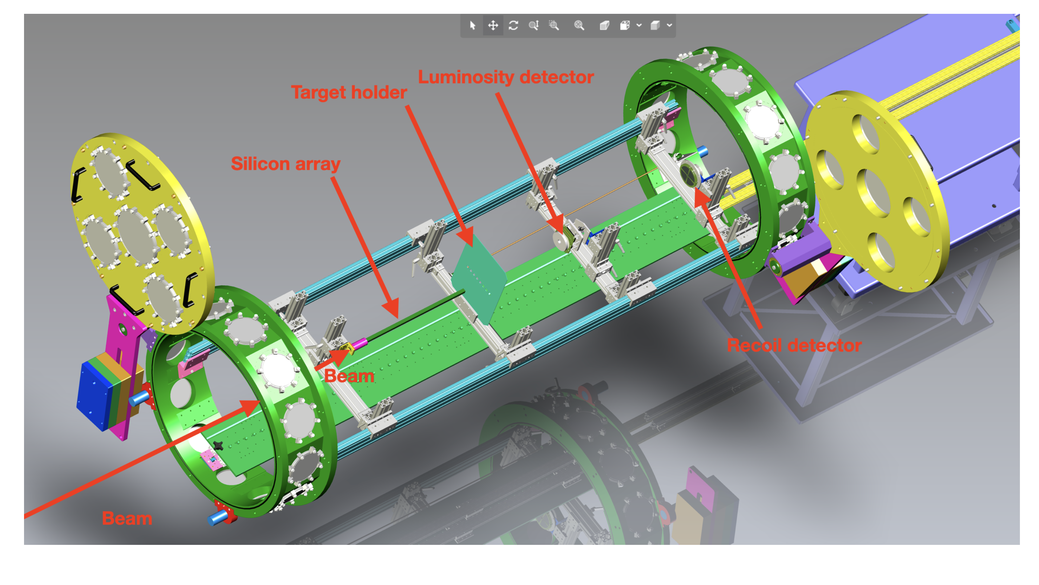
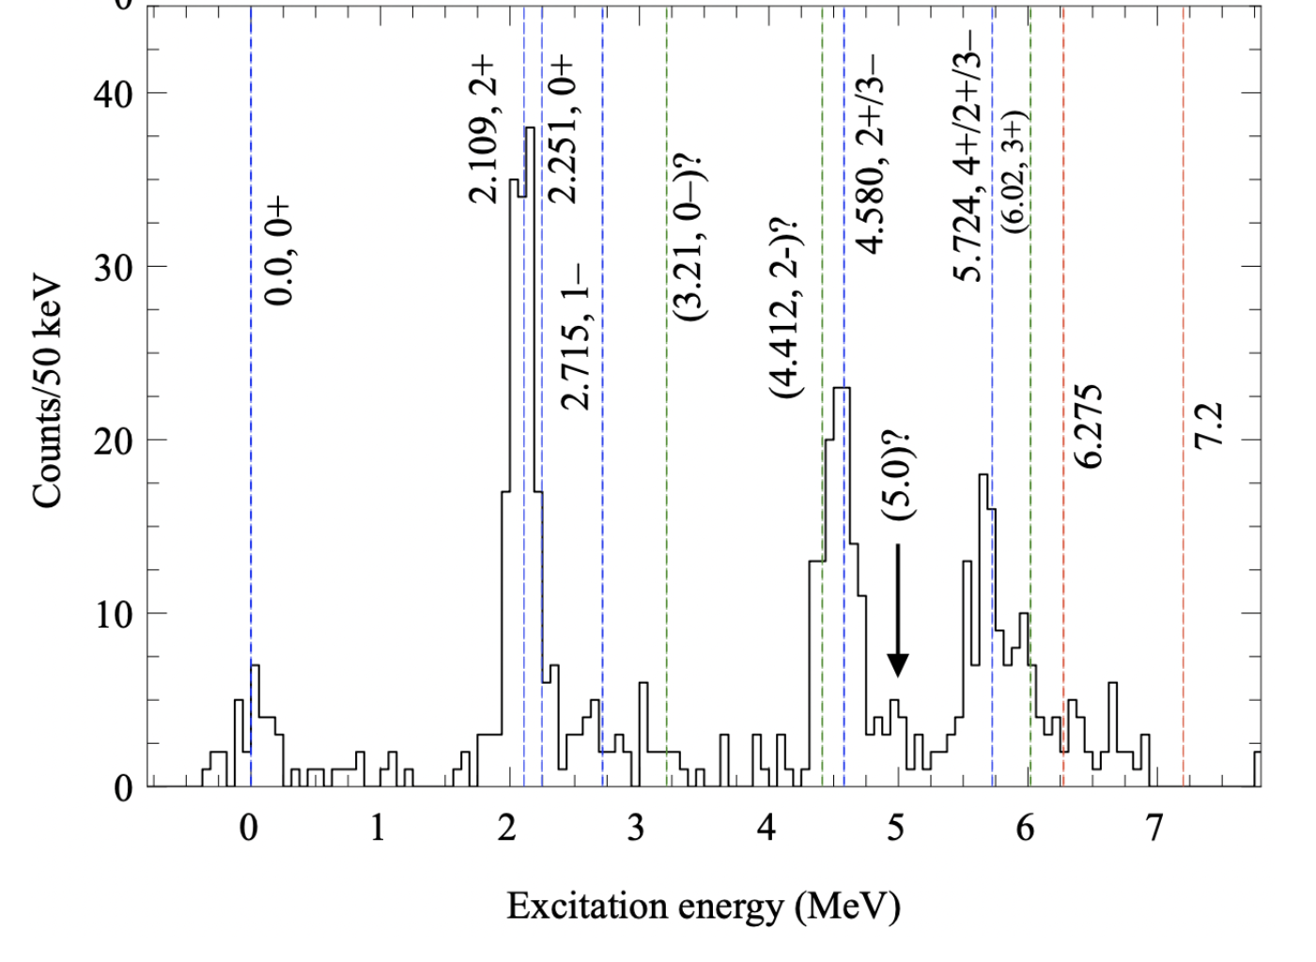
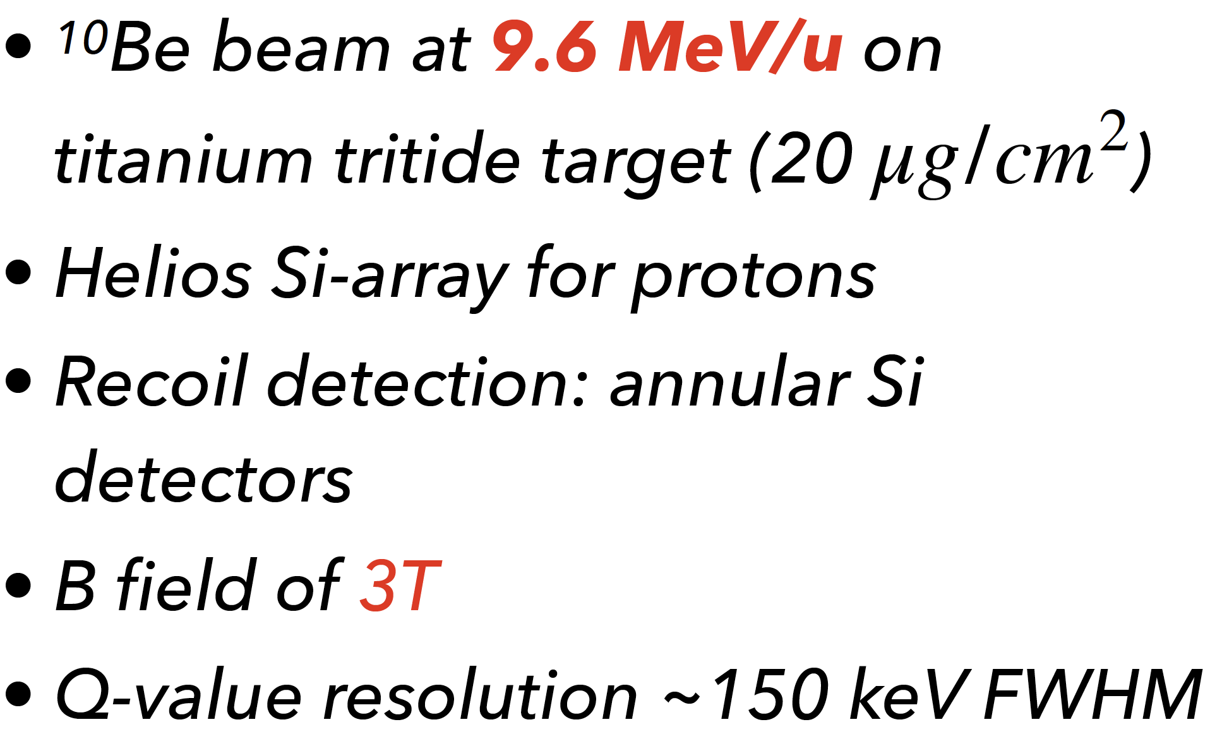
Exotic Reactions-(t,p) reaction
Alicia Muñoz-Ramos
NSCL-ReA3-SOLARIS
¹⁰Be(t,p)¹²Be*
Assign spin-parity of the observed states
by the angular distribution

Slide 33
2N transfer reactions --Theories
Stefano Burrello
⁹Li(p,t)¹¹Li
José Antonio Lay
^{A-2}Sm(t,p)^{A}Sm
Quantum Phase Transition
Enrico Vigezzi
¹²C(¹⁸O,¹⁶O)¹⁴C
Giant Paring Vibration?
Seems sensitive to “pairing correlation”
How experimentalists can make better use of it?

Slide 34
Experimental Developments

Slide 35
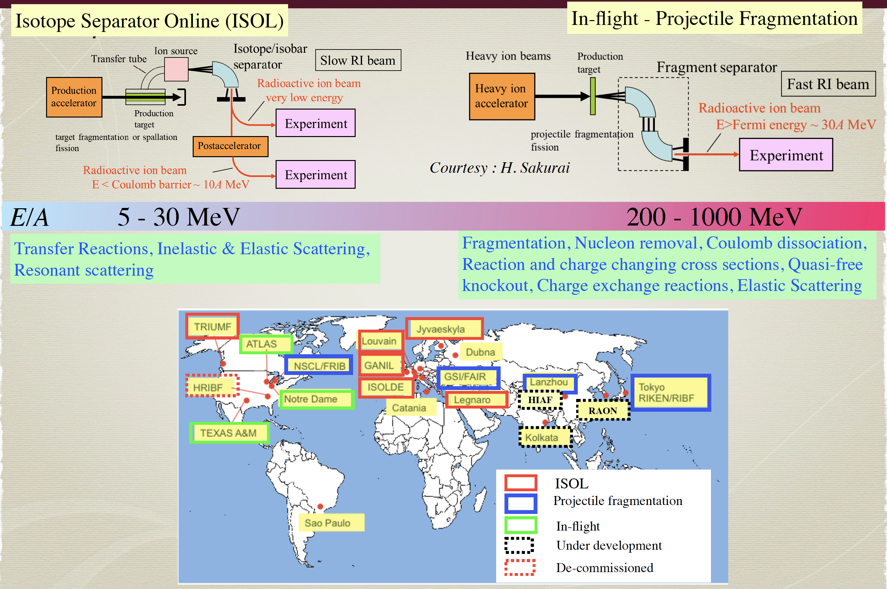
FRIB has started!
Slide
by Ritu Kanungo

Slide 36
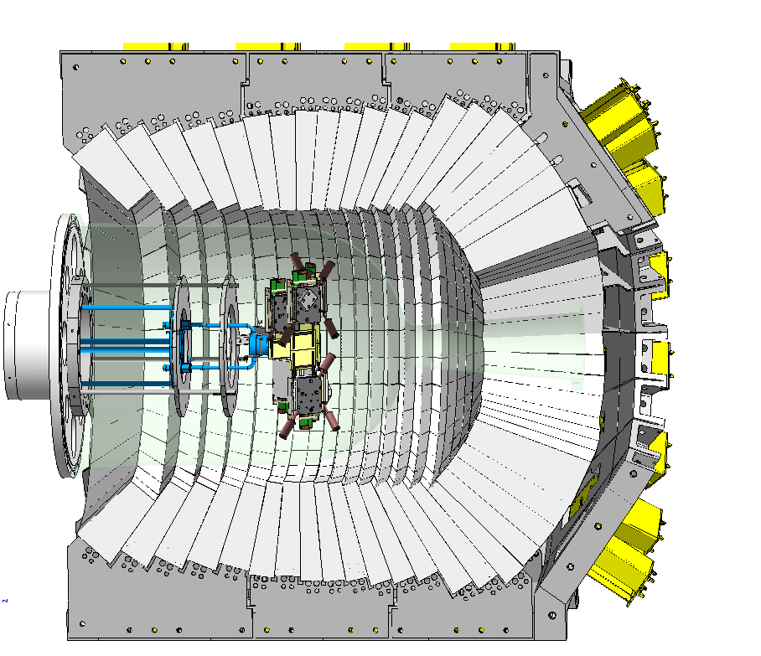
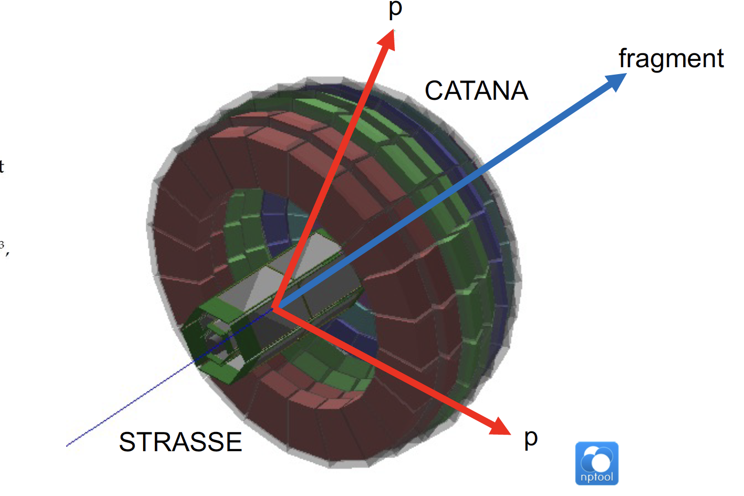
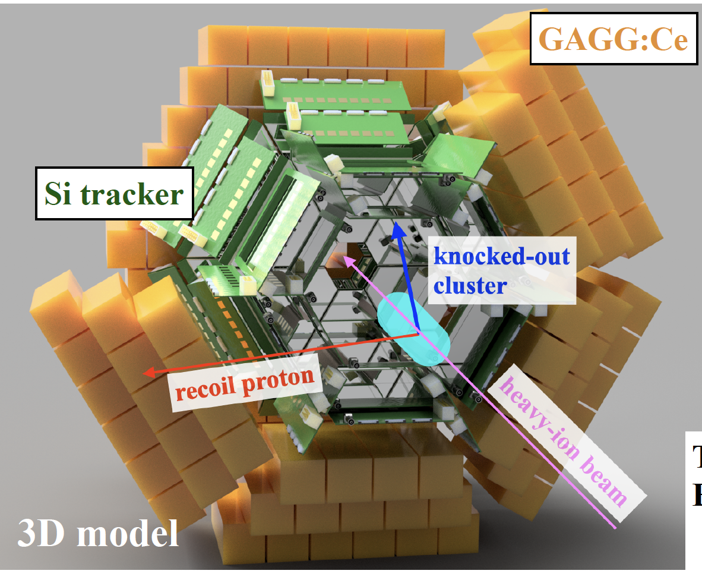
Devices for missing mass spectroscopy
(p,2p),(p,2pγ),(p,3p),(p,pd),(p,pα)
@200- GeV/u
TOGAXSI@RIBF
STRASSE/CATANA@RIBF
T. Jenegger
A.Graña Gonzalez
T. Uesaka
V. Alcindor
CALIFA/Si Tracker
R³B@GSI/FAIR

Slide 37
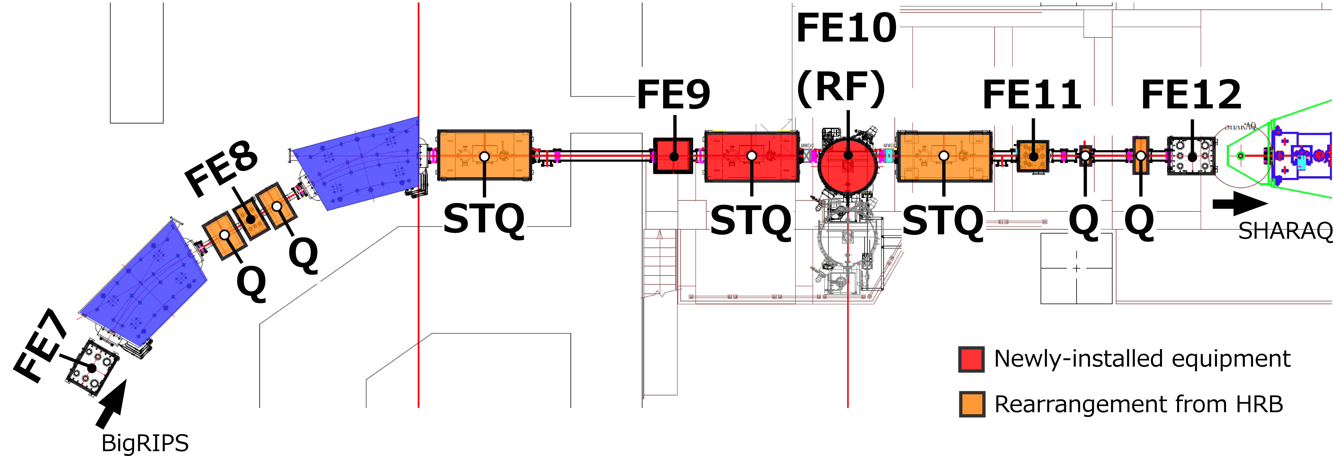
Slowing down for transfer reactions
OEDO@RIBF
Susumu Shimoura
Transfer Reactions : 10-50 MeV/nucleon
(Higher for ISOL, Lower for Fragment Separators)
Mono-energetic degrader
+ RF Deflector
Dipole magnet
Energy degrader
RF Deflector
10-50 MeV/u
90% Transmission
Fast Collection!
(d,p)(t,p)…
δp>0
δt<0
δp<0
δt>0

Slide 38
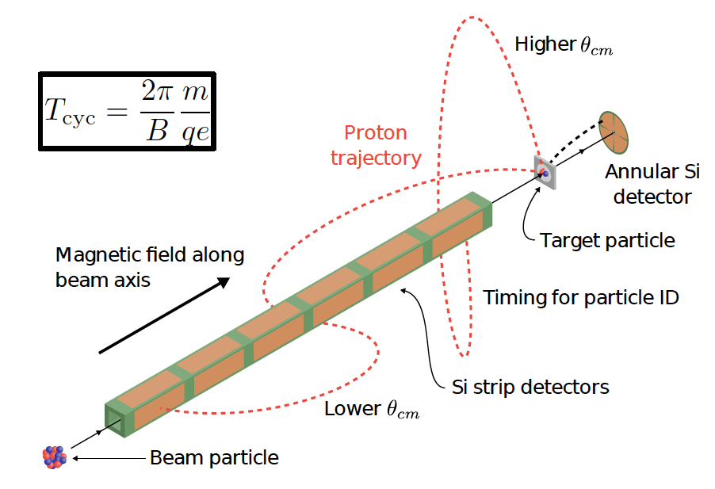
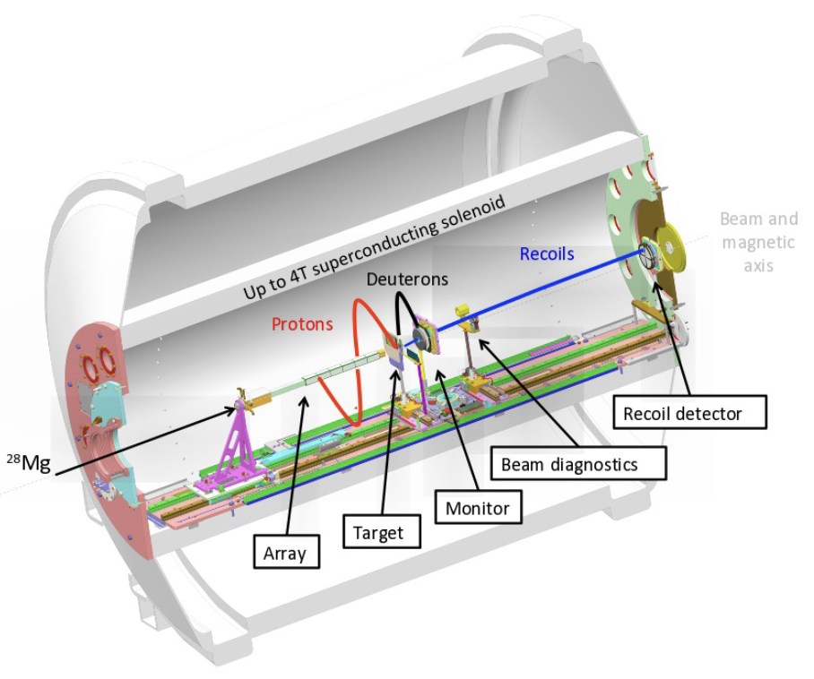
Direct Reactions with a Solenoid
David K. Sharp
ISS at HI-ISOLDE

Slide 39
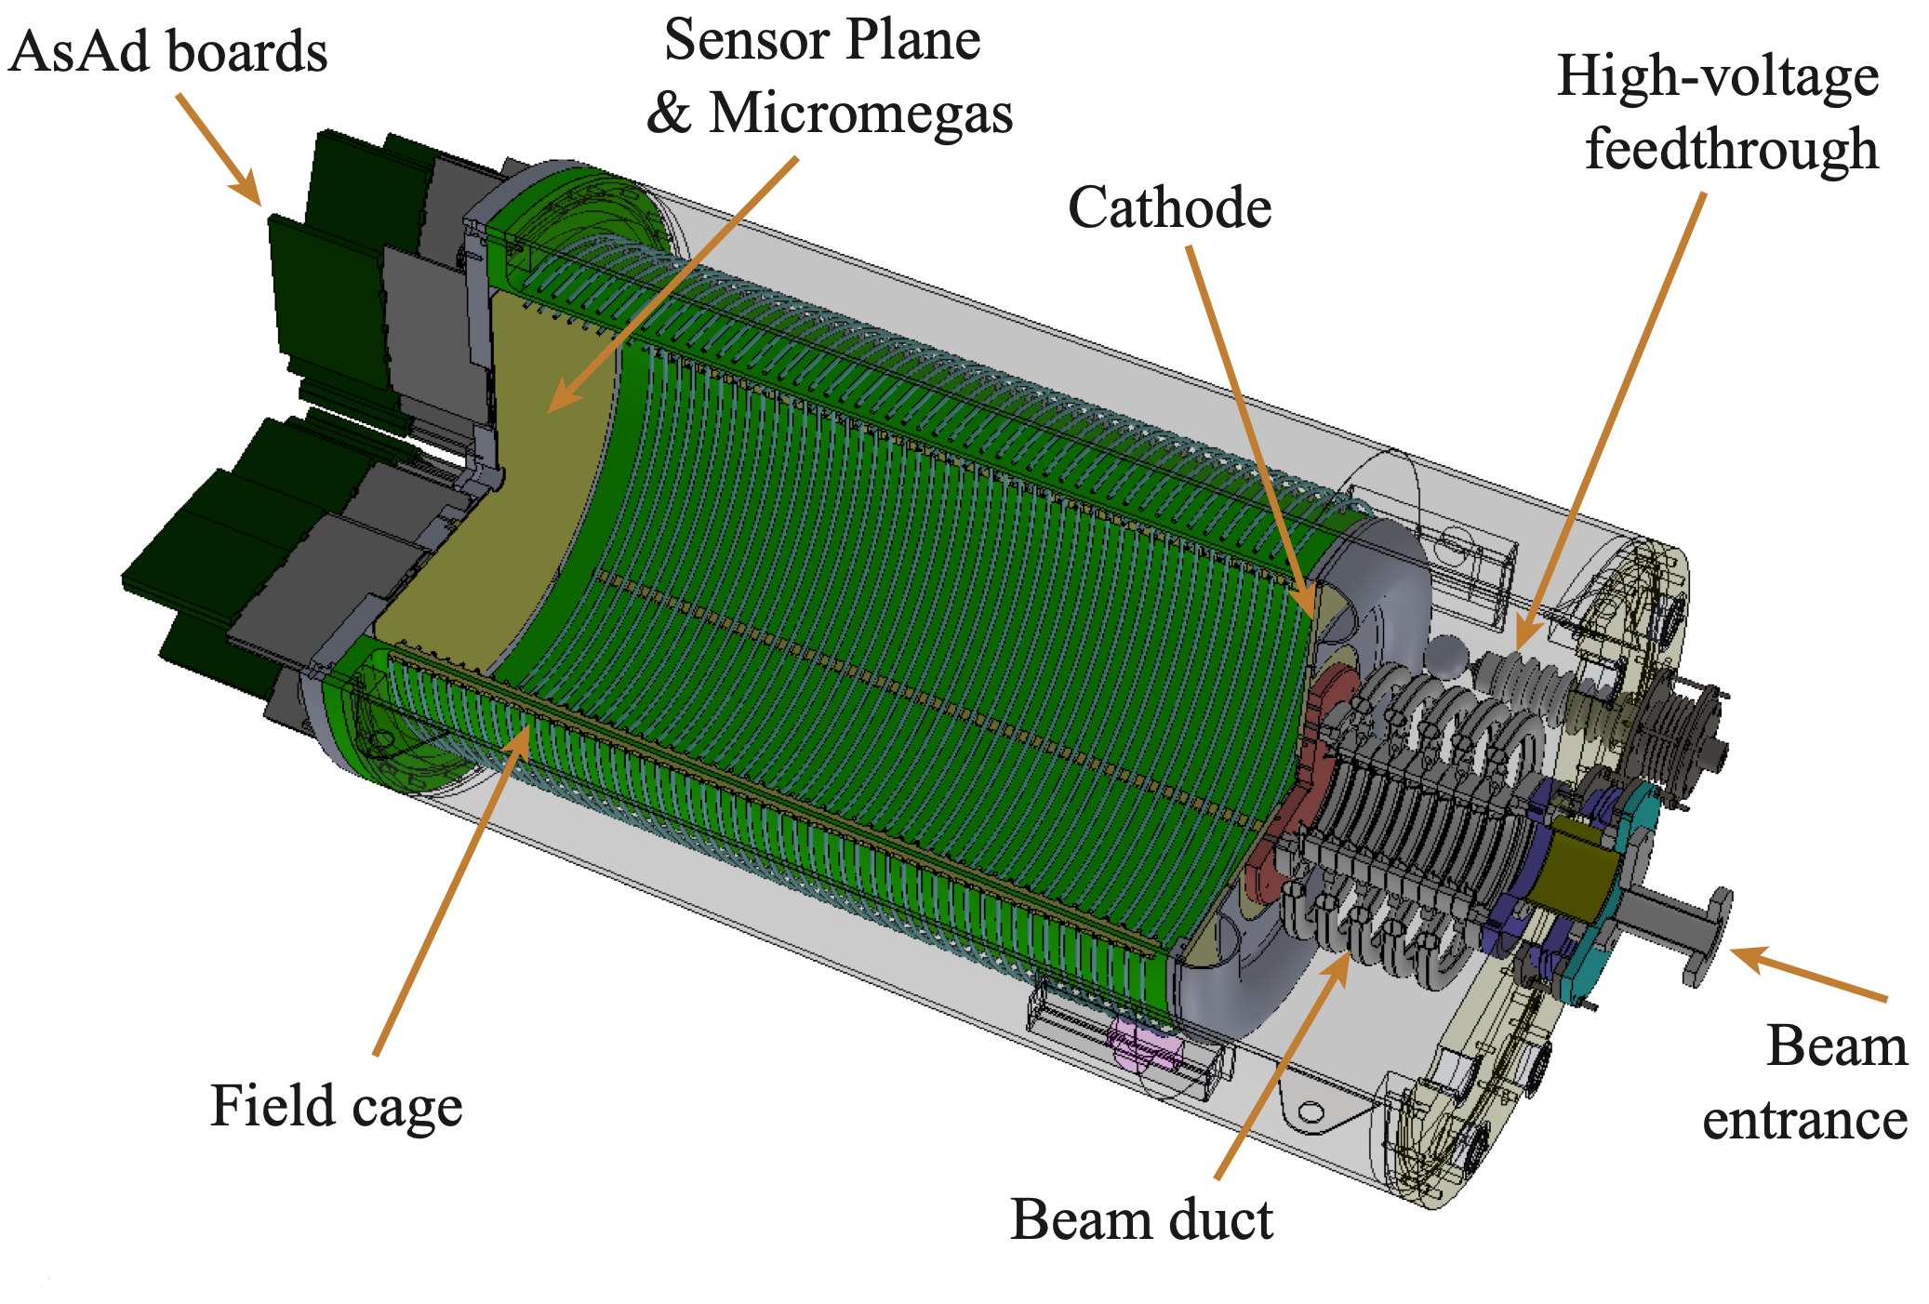
Direct Reactions with Solenoid & Active Target
Daniel Bazin
SOLARIS+ATTPC at FRIB(NSCL)
(t,p) (d,p) (d²He)
CINAMON ROLL
SQUID

Slide 40
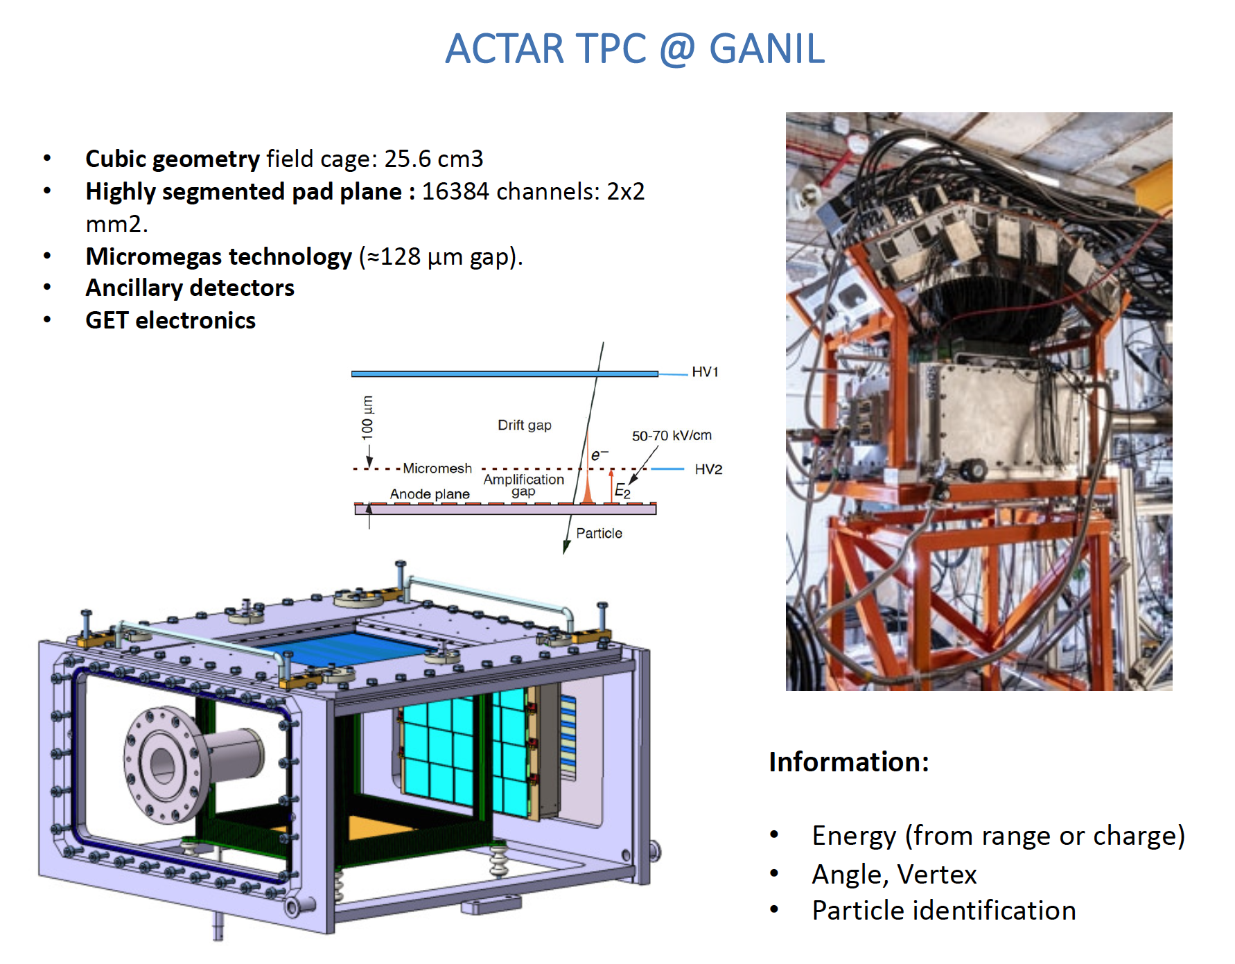
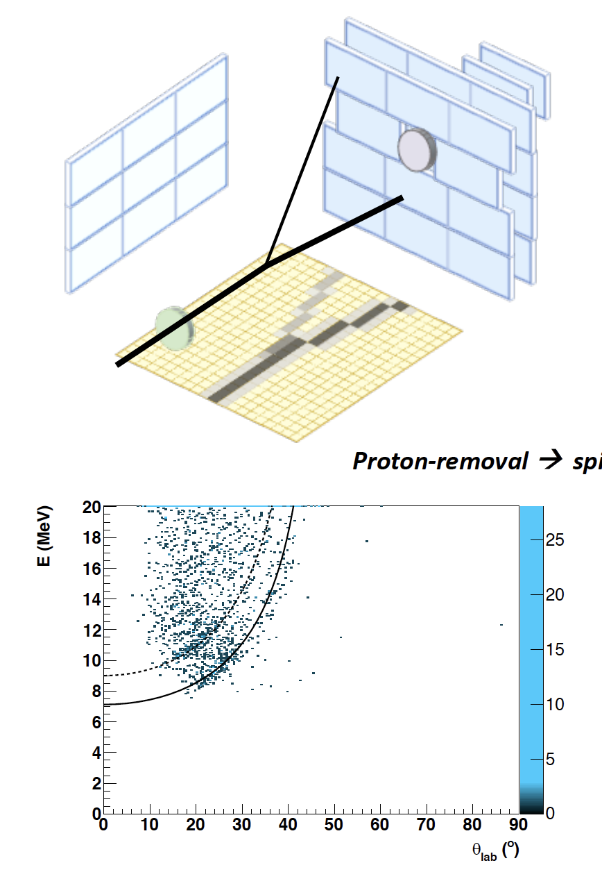
Active Target at GANIL
Beatriz Fernández-Domínguez
Elastic/Inelastic/Transfer reactions
e.g. (d,³He)

Slide 41
Theoretical Developments

Slide 42

Time-dependent Approach
Laura Moschini
Moschini et al.
PRC103, 014604 (2021)
Time dependent approach: Very Promising
→3D Treatment Necessary

Slide 43
Theory-Experiment
Collaborations with theoreticians (both in reaction theory and structure theory) in any experimental papers are getting more and more important and imperative!

Slide 44
Special Thanks to
Special Thanks to Local Organizing Committee:
M.J.G. Borge
D. Cortina
A.M. Moro
H. Alvarez-Pol
Y. Ayyad
J. Benlliure
O.Tengblad
J.L. Rodriguez
Muchas Gracias

Slide 45

Thanks a lot for making such a nice program
Muchas Gracias

Slide 46

Special Thanks to
All the Sponsors
Especially EPJA
Muchas Gracias

Slide 47

Thanks a lot for making the conference so enjoyable!
To All the participants: Speakers, Poster presenters
Muchas
Gracias

Slide 48

From Santiago de Compostela to Wiesbaden
"Looking forward"
Auf Wiedersehen in Wiesbaden in 2024!

Slide 49
Backup

Slide 50

Tetra neutron at SAMURAI@RIBF
Maytal Duer

Slide 51

Clusters may appear in surface (low-dense region)
T. Uesaka

