Slide 1
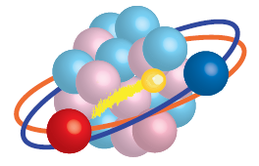



DREB2022
Santiago de Compostela
June 27 (27-1), 2022
What locates neutron driplines ?
Takaharu Otsuka
N. Tsunoda, T. Takayanagi, N. Shimizu, T. Suzuki, Y. Utsuno, H. Ueno
U. Tokyo, CNS, Sophia U., JAEA, RIKEN, Nihon U.
This work was supported also by MEXT as “Program for Promoting Researches on the
Supercomputer Fugaku” (Simulation for basic science: from fundamental laws of particles to
creation of nuclei) and “Priority Issue on post-K computer” (Elucidation of the Fundamental
Laws and Evolution of the Universe), and by JICFuS.

Slide 2
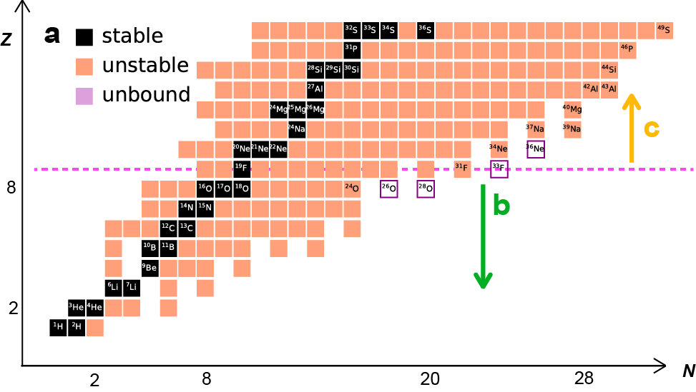
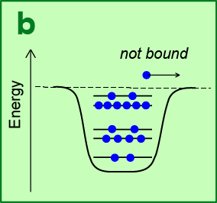
Neutron driplines : traditional and new(?) views
Z > 8
What happens
here ?
Z ≦ 8
¹¹L
traditional view with
single-particle origin
Neutron halo appears, if last neutrons are extremely loosely bound.
¹¹Li: Tanihata et al. PRL 55 (1985)

Slide 3
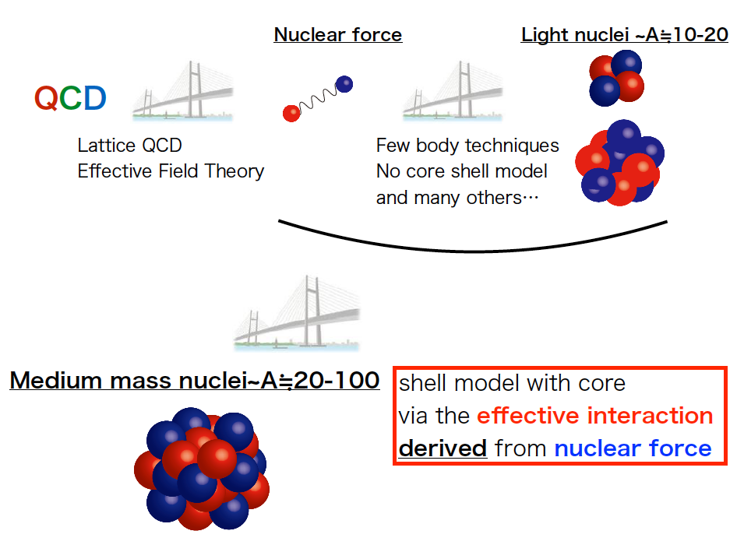
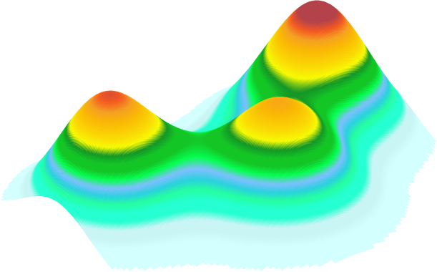
Example: ¹²C
TO et al. Nature Com.
13, 2234 (2022)
Hoyle state
Courtesy from N. Tsunoda

Slide 4
Chiral EFT NN int. + Fujita-Miyazawa 3N int. with averaging
(to be replaced by EFT N2LO 3N int.)
V _{low k} : treatment of high-momentum components
EKK : in-medium correction (core polarization)
(conventional MBPT may diverge in two major shells)
Krenciglwa and Kuo (1971) -> Extended KK (by Takayanagi)
ab initio effective interaction : EEdf1
Shell model (or Configuration Interaction; CI) calculation
by the conventional matrix diagonalization
or by the Monte Carlo Shell Model
Energy levels, electromagnetic matrix elements
(diagonalization of Hamiltonian matrix)

Slide 5
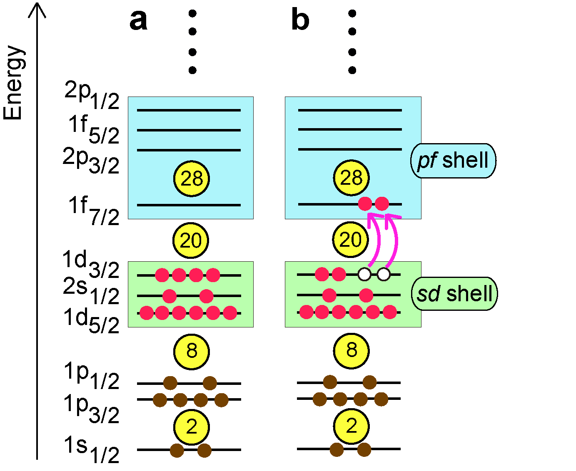
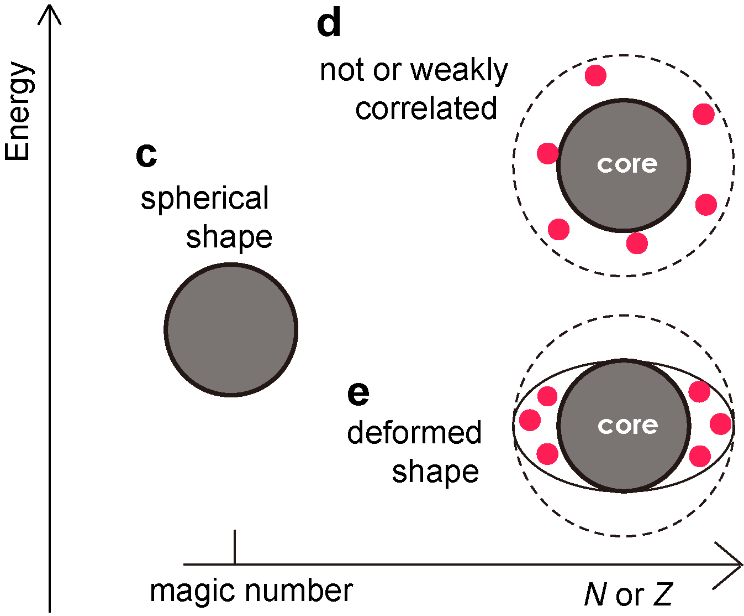
Relation to the magic number N=20 and the present valence shell
The valence shell in the present work
normal
state
intruder
state
If magic number
works,
If magic number
is broken,

Slide 6
Anomaly in energy levels : not expected from the N=20 magicity
³²₁₂Mg₂₀
20 : magic number
low-lying 2⁺

Slide 7
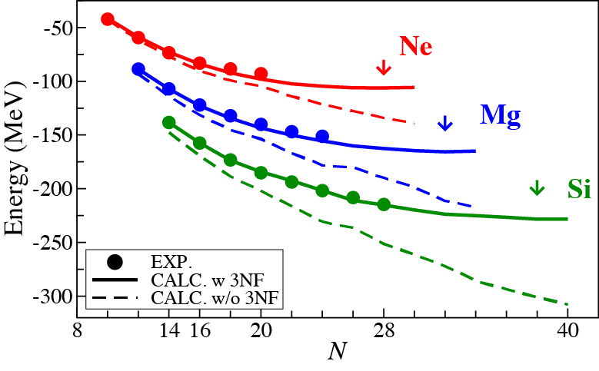
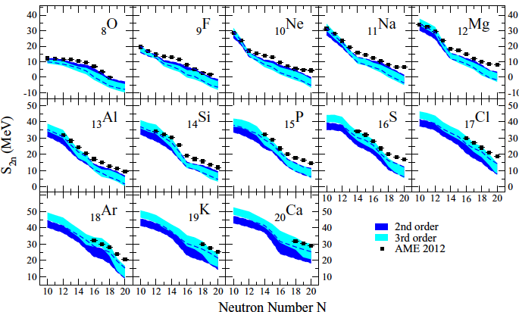
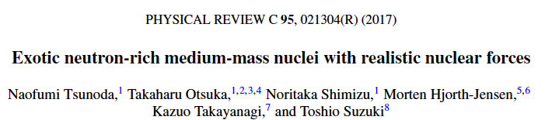

ground-state energies
Earlier (2017 PRC) work by EEdf1
Earlier work
Calculations with full sd + pf shell
Simonis et al.
PRC 93, 011302(R) (2016)

Slide 8
Recent ab initio calculation (IM-SRG)
Large deformation seems to be
a challenge.

Slide 9
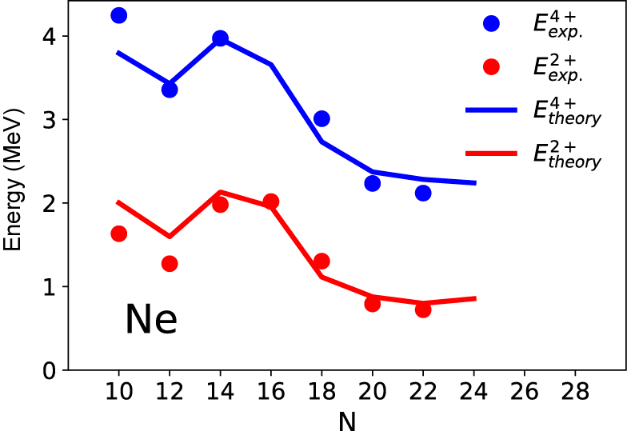
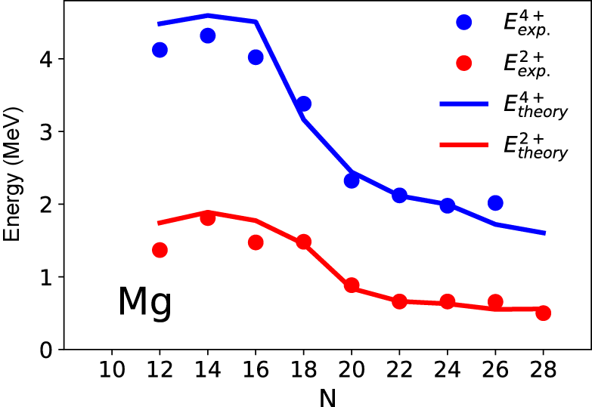
Ne and Mg systematics
The EEdf1 Hamiltonian appears
to be reasonable up to N~28
for Z=9-12.
Levels may not exist as bound
states, because their energies
are above the threshold
of neutron emission.
/18
Notes:
action, action
gamma softness

Slide 10
Dripline mechanism
Driplines known for F and Ne, and most likely for Na.

Slide 11
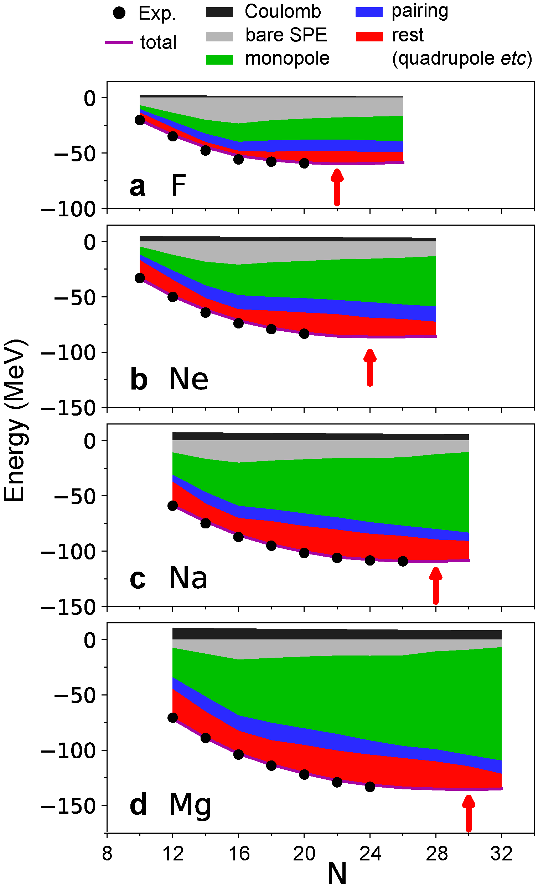
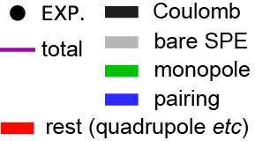
Ground-state energy is decomposed (EEdf1 int.)
dripline
monopole-
type
rest (quadrupole etc)
The monopole effect (lower edge of green part) lowers the energy as a function of N, and its slope becomes steeper as Z because of the p-n monopole int., as shown by three lines fitted to different slopes.
The rest (~quadrupole deformation)
effect (red part) varies locally.
Notes:
action, action
gamma softness

Slide 12

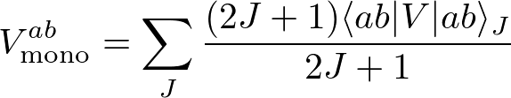
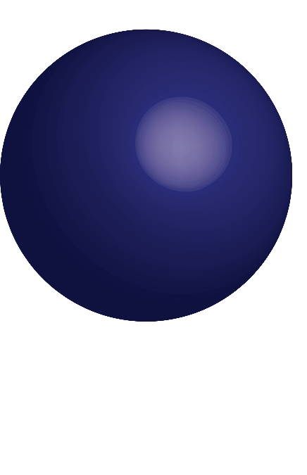
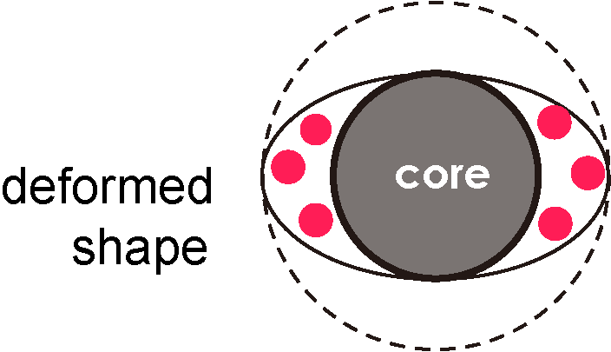
Decomposition of the Hamiltonian
monopole part
bare SPE
monopole
monopole: shift of SPE
multipole part
pairing
J=0 nn + pp
pairing correlations
correlation
rest
quadrupole deformation, etc
/18
Notes:
\begin{align*}
H = H_\mathrm{mono} + H_\mathrm{multi}
\end{align*}
\begin{align*}
H_\mathrm{mono} = \sum \epsilon_i a_i^{+}a_i + \sum_{i,j} V_\mathrm{mono}^{ab} a_i^{+} a_j^{+} a_j a_i
\end{align*}
\begin{align*}
V_\mathrm{mono}^{ab} = \sum_J
\frac{(2J+1)\langle ab\lvert V \rvert ab \rangle_{J} }{2J+1}
\end{align*}

Slide 13
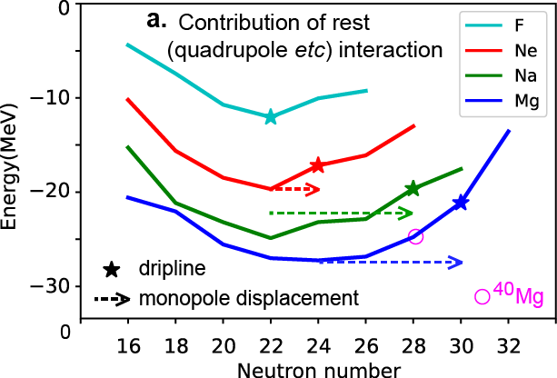
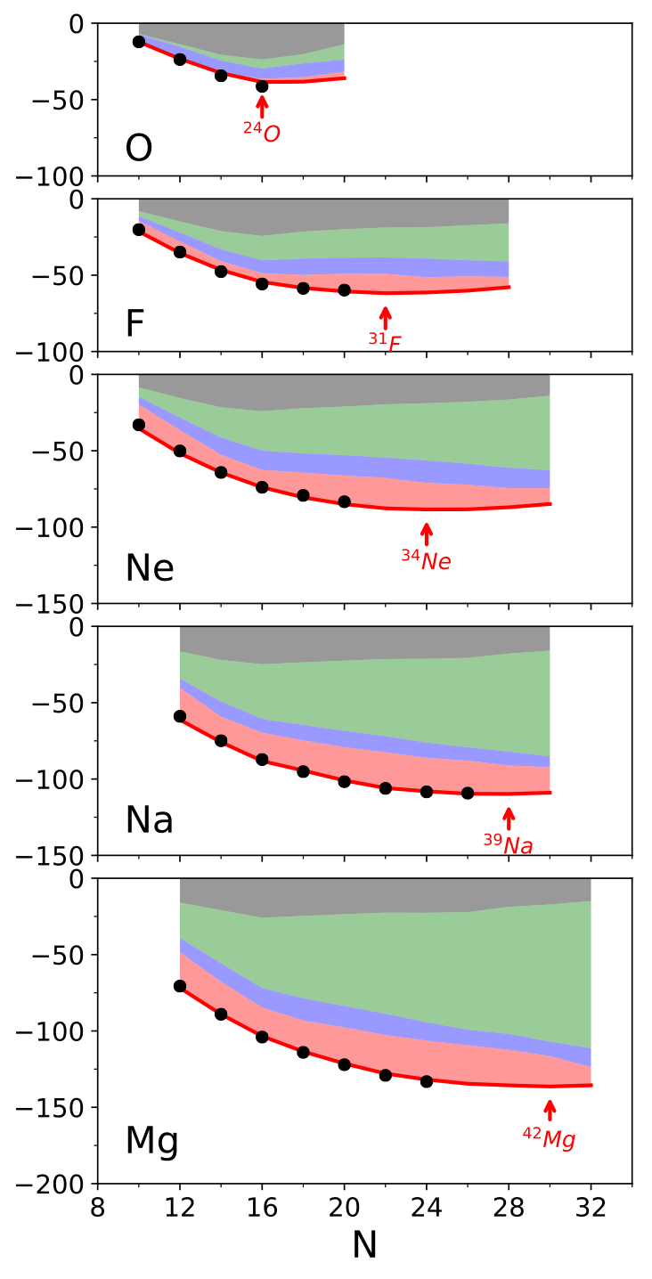
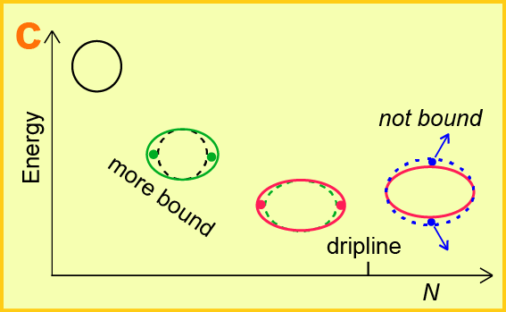
Two driving forces: example from Mg isotopes
monopole part
~6 MeV / neutron
~3 MeV / neutron
still substantial
The rest (mainly deformation
energy) part is saturated at N=24.
The monopole effects
compensate it, and pushes
the dripline away
(dashed arrows).
Notes:
action, action
gamma softness

Slide 14
structure evolution towards the dripline
Dripline of F isotopes
16
20
Neutron number
N
Monopole effect (edge of green part) becomes weaker for N > 16 in F isotopes. It even decreases (see gray edge).
If there were no “rest” (~ quadrupole deformation) effect (red part), the dripline would be at N = 16, which is the same as oxygen isotopes.
Loose binding phenomena may be seen, in contrast to Ne, Na or Mg.
Notes:
action, action
gamma softness

Slide 15
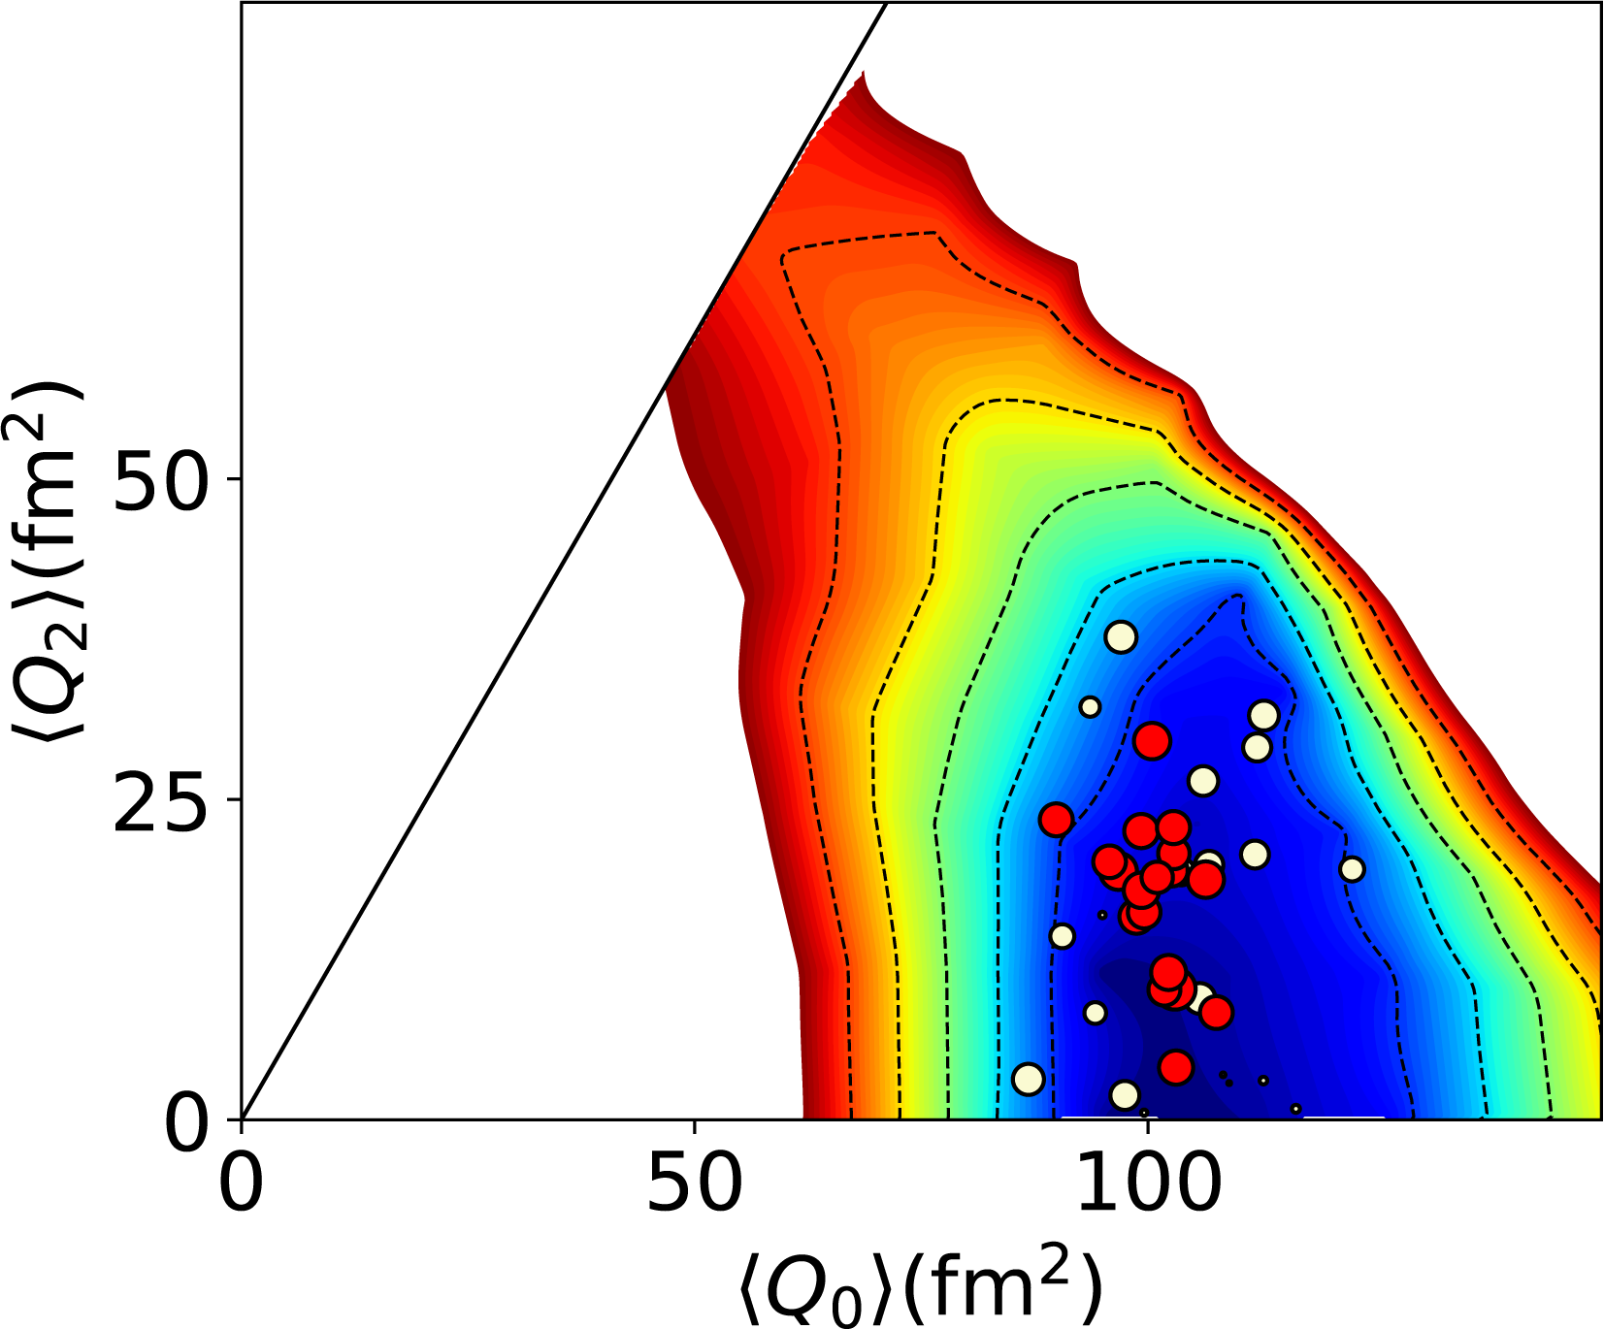
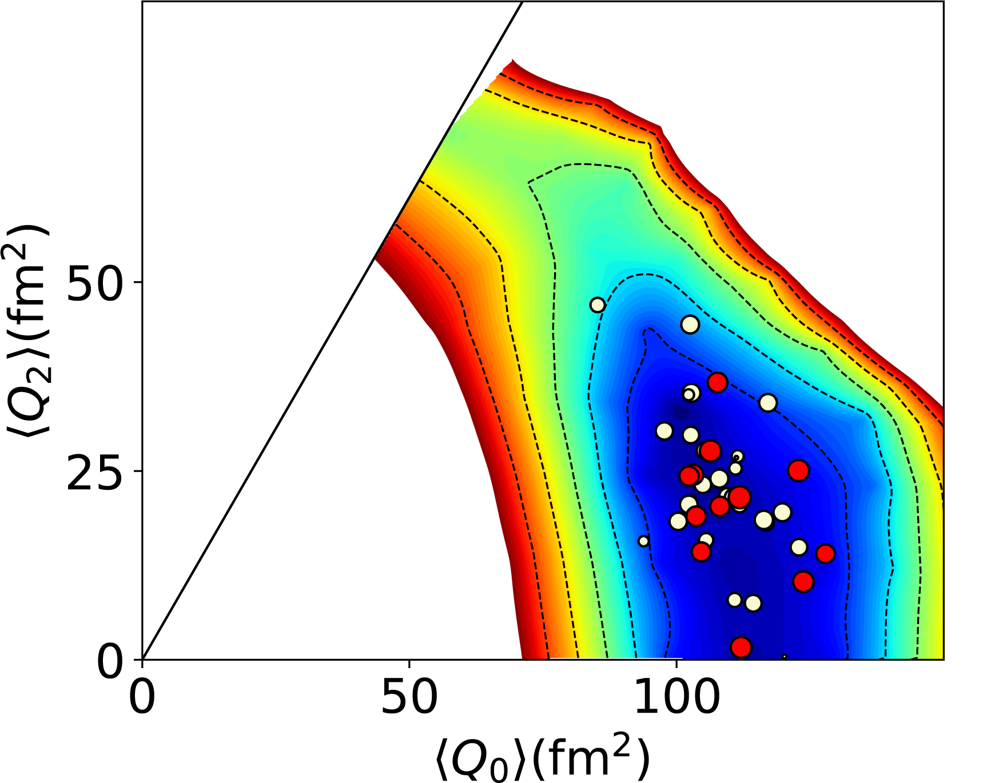
Prevailing triaxiality in nuclei near driplines
T-plots on the PES
²⁷Na
³¹Na
³⁹Na
⁴¹Na
dripline
²⁸Mg
³²Mg
⁴²Mg
⁴⁴Mg
predicted
dripline
³⁴Mg
³⁶Mg
max def. energy

Slide 16

Deformation parameters extracted from T-plot
increased triaxiality
maximum deformation
γ (degrees)
Na
Mg
12
16
20
24
28
32
Neutron number (N)
Neutron number (N)
Na
driplines
Mg

Slide 17
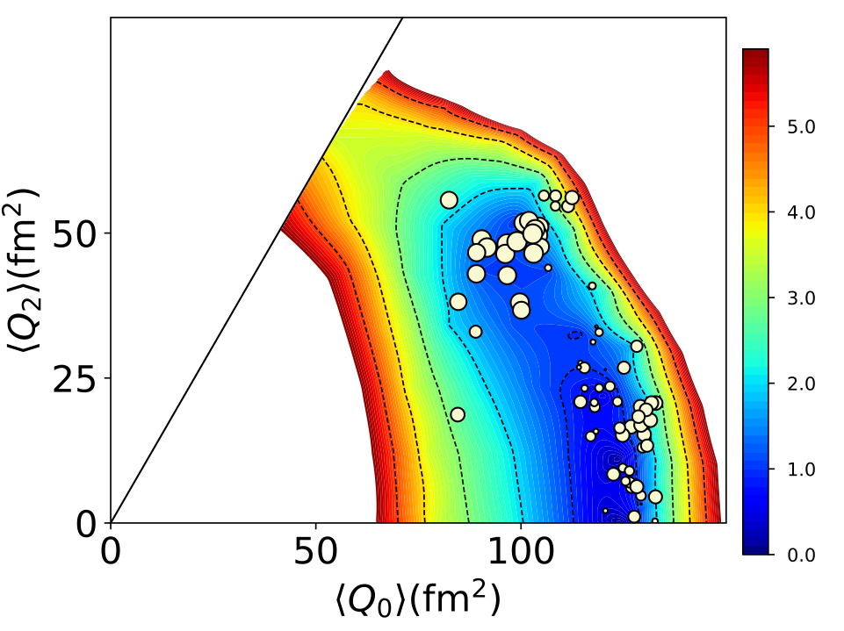

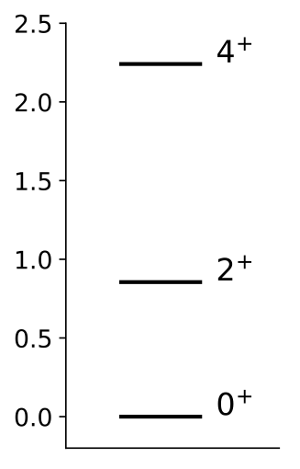
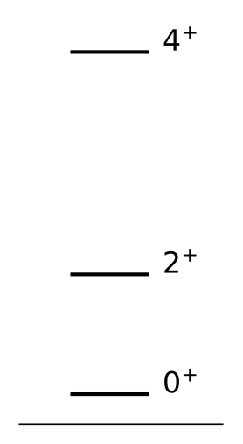
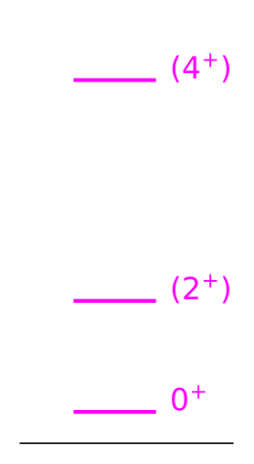
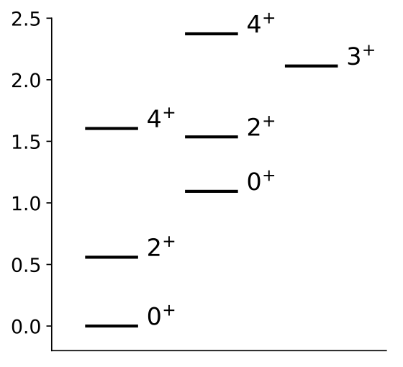
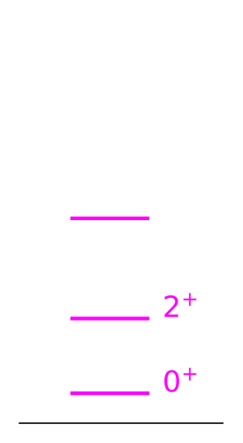
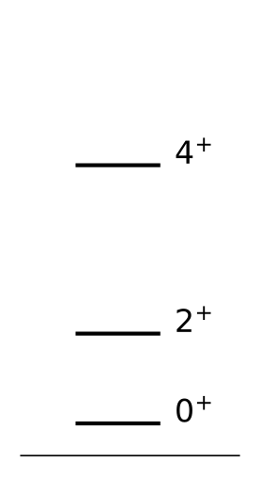
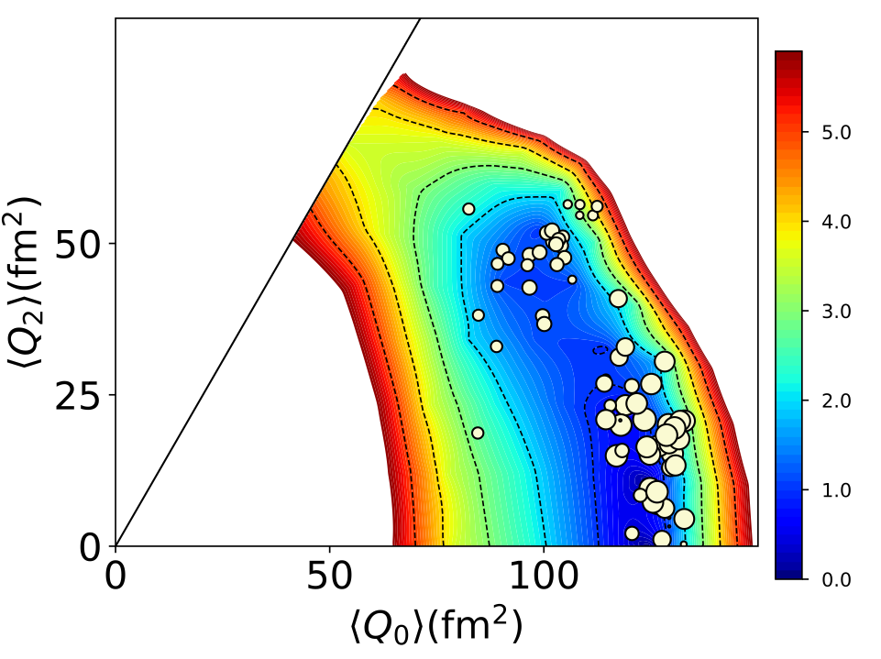
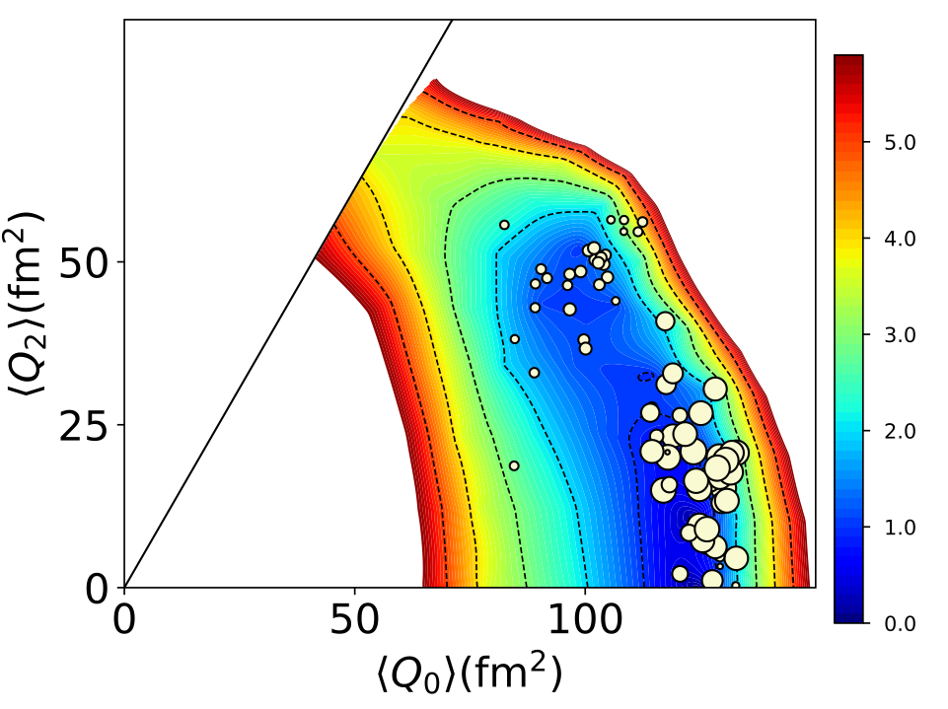
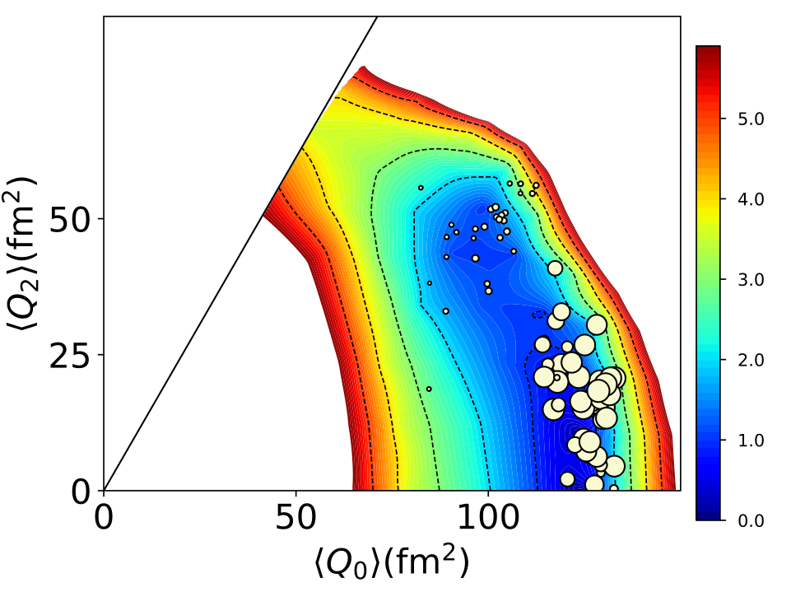
Shape coexistence near dripline
Crawford et al.,
PRL 122, 052501
(2019)
02⁺
22⁺
³⁴Ne
³²Ne
⁴⁰Mg
⁴⁰Mg
⁴²Mg
EEdf1
EEdf1
EXP.
EEdf1
EXP.
EEdf1
01⁺
21⁺
41⁺
N=28 gap is
not working
Notes:
action, action
gamma softness

Slide 18
Summary
0. Correlation energies can be crucial to driplines.
There are, at least, two dripline mechanisms:
one with a single-particle origin, while the other due to the interplay
between the monopole and quadrupole (deformation) effects.
2. The driplines of F, Ne, Na and Mg isotopes follow the new mechanism.
Two mechanisms may appear alternatively as Z increases further.
3. Those isotopes are described well by the EEdf1 interaction derived in
an ab initio way.
4. These isotopes remain deformed up to dripline.
Neutrons are still well bound as single particles (except for F isotopes).
The magnitude of the deformation energy decreases around driplines.
Monopole compensation per ΔN depends on # of valence protons:
~ 0 MeV for F, …, -3 MeV for Mg, near driplines.
It is stressed that this variation is a fully ab initio consequence.
5. Prevailing and developing triaxial shapes in nuclei towards driplines.

Slide 19
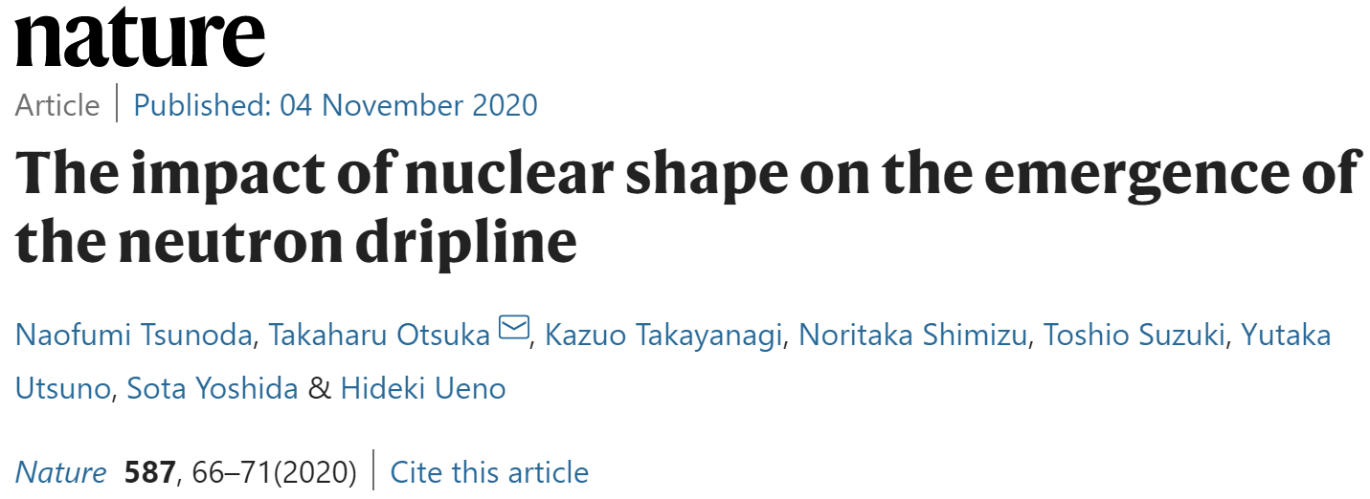
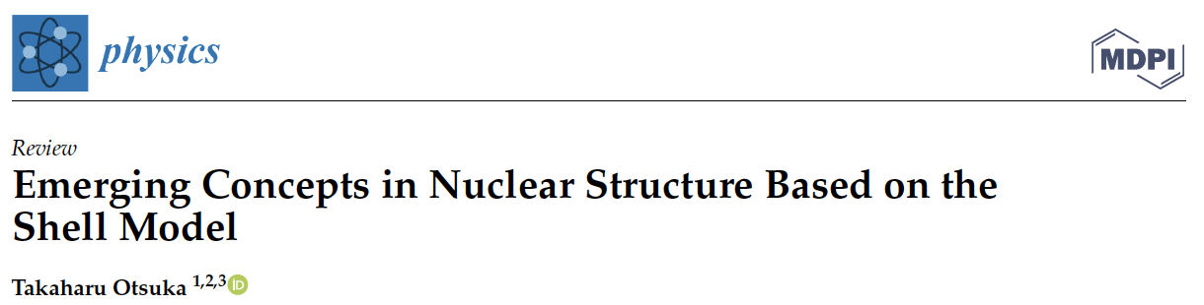
This talk is mainly based on
“Moments and radii of exotic Na and Mg isotopes”
TO, N. Shimizu and Y. Tsunoda
Phys. Rev. C, 105, 014319 (2022)
From a global view point, this mechanism can be interpreted :
Physics 2022, 4, 258–285.
https://doi.org/10.3390/physics4010018

Slide 20
THANK YOU

Slide 21
A development starting from chiral EFT
EKK method* to handle consistently
two (or more) major shells
-> Effective shell-model interaction
(i) without fit of two-body m. e.,
(ii) applicable to broken magicity, or
merging two shells,
both are crucial for exotic nuclei.
*) Extended Krenciglwa-Kuo method is a magic by Takayanagi
K. Takayanagi, Nucl. Phys. A 852, 61 (2011).
N. Tsunoda, K. Takayanagi, M. Hjorth-Jensen, and T. Otsuka, Phys. Rev. C 89, 024313 (2014).
K. Takayanagi, Annals of Physics 350, 501 (2014).

Slide 22
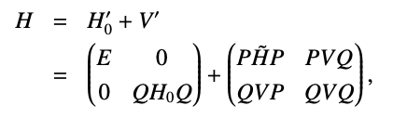
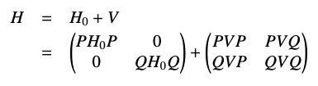

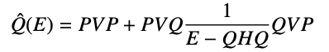
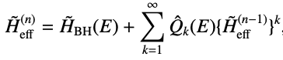


Extended KK method and conventional KK method
EKK method
KK method (conventional)
New parameter E (arbitrary parameter)
Krenciglwa and Kuo (1971)
Divergence problem in multi-shell
EKK method enables us to construct effective interaction for multi-major shell
N. Tsunoda, K. Takayanagi, M. Hjorth-Jensen, and T. Otsuka, Phys. Rev. C 89, 024313 (2014).
K. Takayanagi, Annals of Physics 350, 501 (2014).
K. Takayanagi, Nucl. Phys. A 852, 61 (2011).
/18
Notes:
Taylor 展開とのanalogy

Slide 23
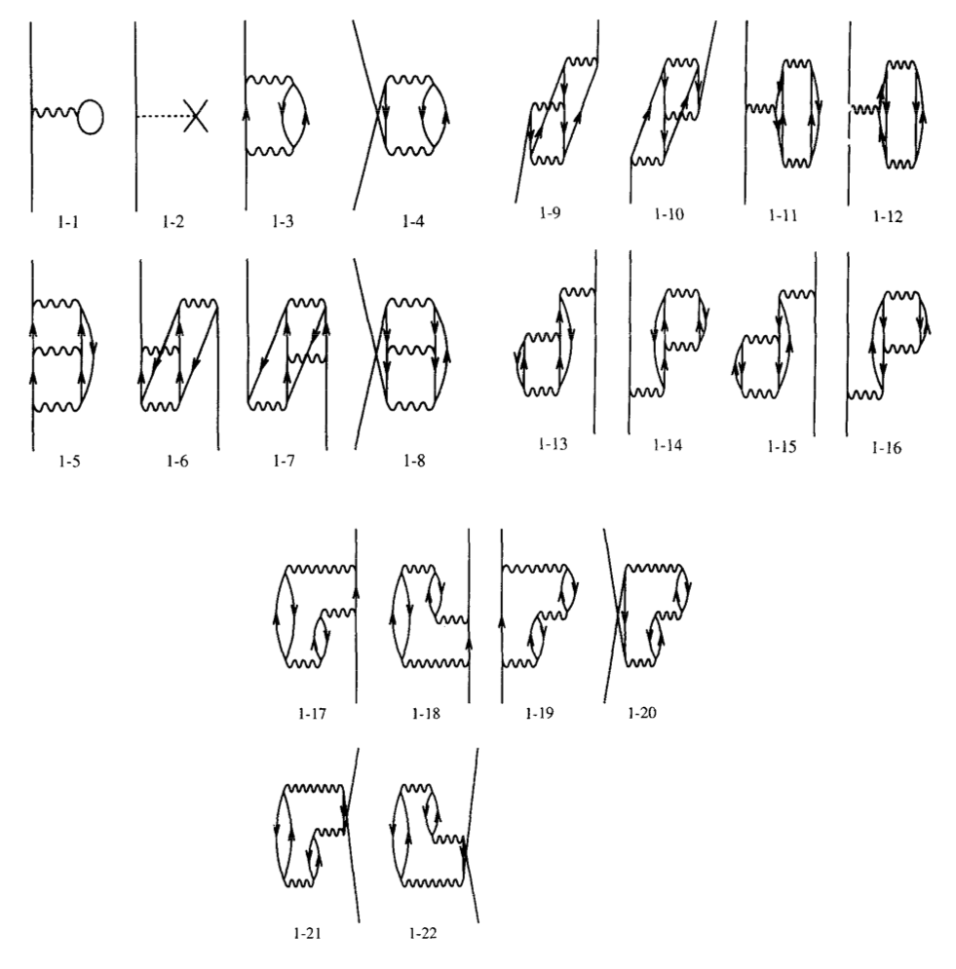
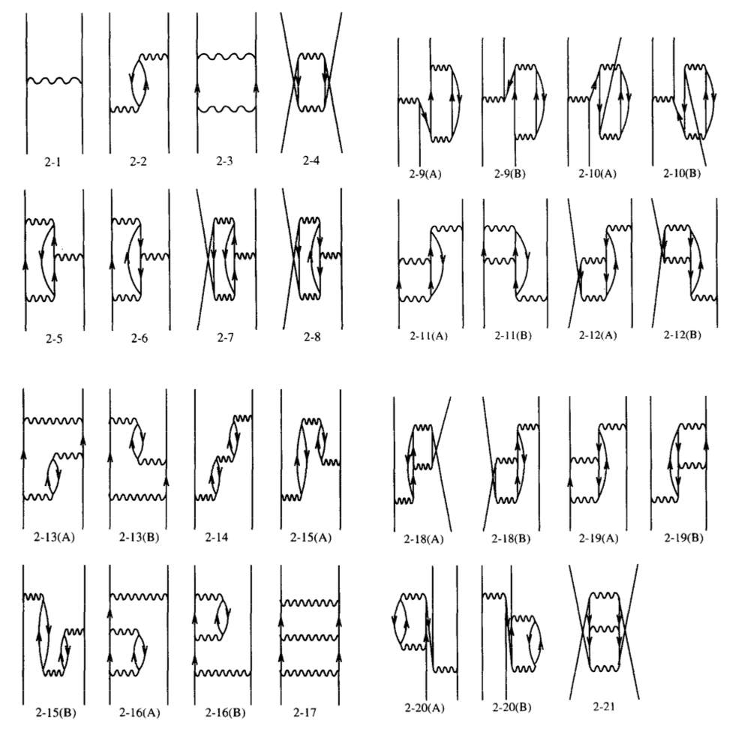
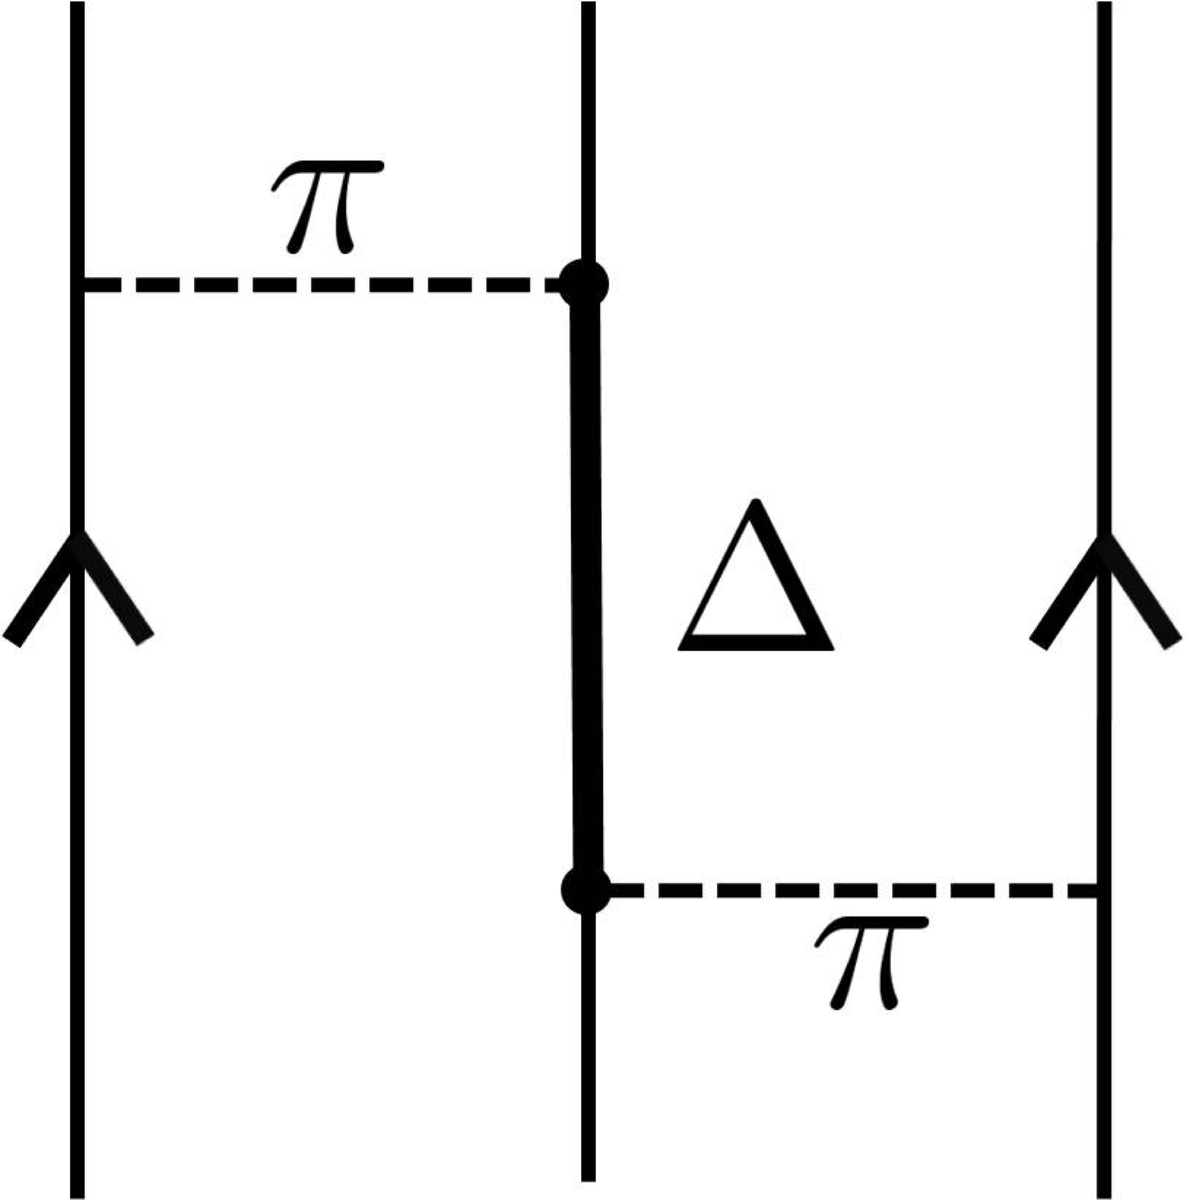
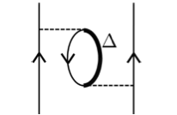
Many-body perturbation theory
M.H-Jensen physics report (1995)
summation with hole state
Fujita-Miyazawa type
3N interaction
Effective
2N interaction
/18

Slide 24

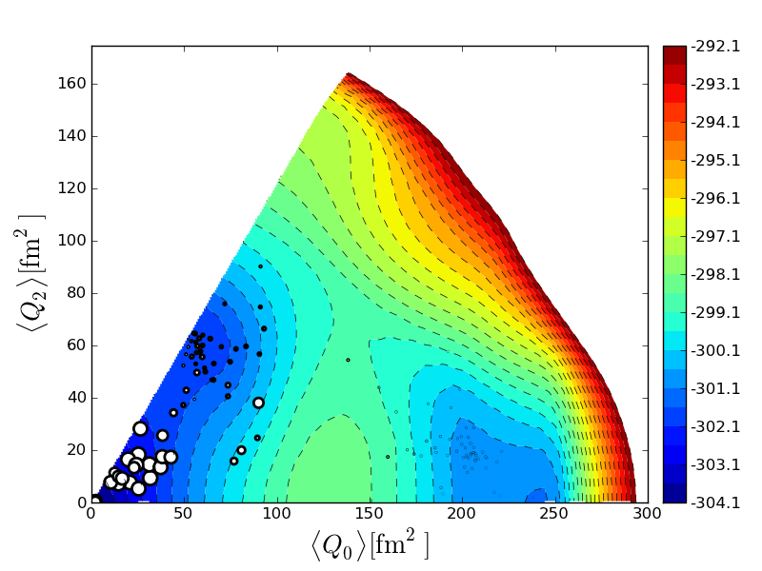

T-plot : visualization of MCSM eigenvector on Potential Energy Surface
eigenstate
stochastically deformed Slater determinant
→ intrinsic shape
amplitude
projection onto J^{π}
0⁺₁ state of ⁶⁸Ni
PES is calculated
by CHF for the shell-model Hamiltonian
Location of circle : quadrupole deformation of unprojected MCSM basis vectors
Area of circle :
overlap probability
between each
projected basis and
eigen wave function
oblate
triaxial
spherical
prolate
Y. Tsunoda, et al.
PRC 89, 031301 (R) (2014)

