Slide 1


Reaching interesting reactions cross-sections by measuring radioactive recoils with AMS technique: the successful cases of ¹⁰Be, ¹⁴C and ²⁶Al.
Luis Acosta
Instituto de Física
Universidad Nacional Autóma de México

Slide 2
Introduction
Accelerator Mass Spectrometry is a technique commonly used to approach low concentrations of certain long half-life radioisotopes.
The most important contribution of the technique is the accurate measure of organic sample ages, by separating masses 12,13 and 14 in the case of carbon allocated in such a samples.
However, the reach of AMS could cover many other scientific scopes, due to it can give us a precise measure of a very small concentration of a radioisotope.
On this direction, AMS can be used to approach reactions of interest for astrophysics, if we spot a specific radioisotope which concentration can be measured with such a technique.
Starting with this, we have selected specific reactions produced either with low neutrons at a reactor, or positive ions at an accelerator. The chosen reactions are important in astrophysics processes.

Slide 3
Rough Procedure
Search a reaction involving certain radioisotope as a product (product has to be an AMS radioisotope)
produce such reaction (either with a thermal neutrons from a reactor or with ion beams at an accelerator).
Counting the radioisotope using AMS technique. This number is directly related to the reaction cross section.
Radiochemical separation of the molecular compound which contains the radioisotope (examples: BeO, Al₂O₃)

Slide 4
Radioisotope “candidates”
It is important to choose radioisotopes which could be well measured by using AMS.
  ¹⁰Be (1.39 × 10⁶ years)
  ¹³C (stable)
  ¹⁴C (half-life 5730 years)
  ²⁶Al (7.17×10⁵ years)

Slide 5
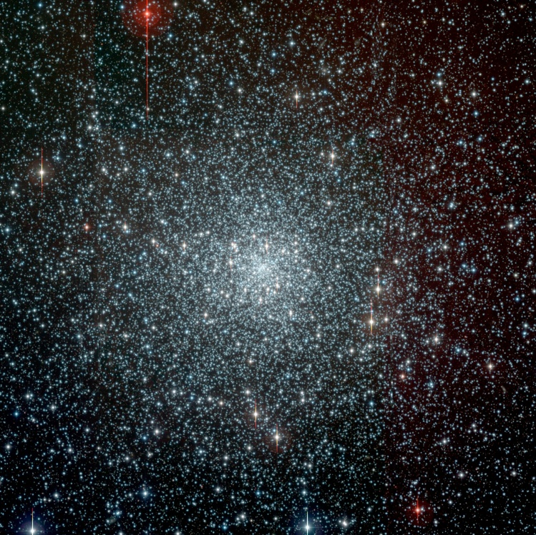
Which reactions and why?
Thermal neutron capture reactions, important to understand both stellar and primordial nucleosynthesis:
  ⁹Be(n,γ)¹⁰Be
    It had been indirectly measured and calculated by different methods, but there is not a general agreement about its precise value.
    It is needed (beyond models and calculations), to complete the picture of the primordial and star synthesis of light elements.

Slide 6
Which reactions and why?
Thermal neutron capture reactions, important to understand both stellar and primordial nucleosynthesis:
  ¹⁴N(n,p)¹⁴C
    It has a capture cross section for thermal neutrons that is very large, so much that it stands as the most important neutron poison in stellar nucleosynthesis.
    It has been measured with great accuracy and therefore it can be used as a benchmark to validate our experimental protocol.
  ¹³C(n,γ)¹⁴C
    importance in the s process.

Slide 7
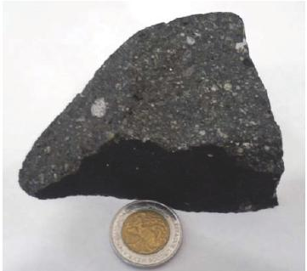
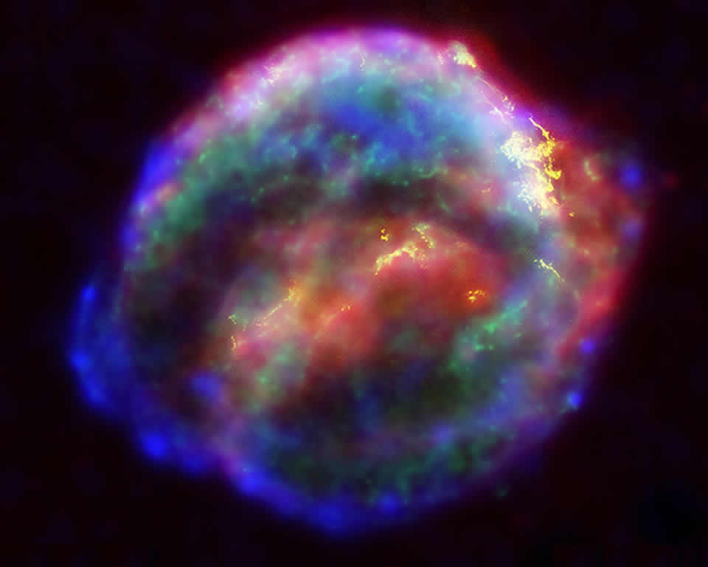
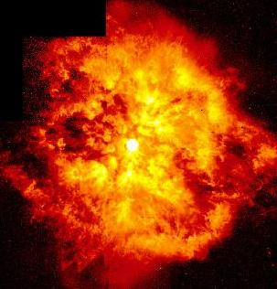
Which reactions and why?
Though many studies regarding ²⁶Al has been carried out, still exist some discrepancies about its production in the interstellar medium.
  ²⁸Si(d,α)²⁶Al
    could contribute to explain the fraction of ²⁶Mg found in meteorites, considering that not all ²⁶Mg found, for instance in Allende meteorite, may be related to the previous presence of ²⁶Al.
  ²⁵Mg(p,γ)²⁶Al
    It is not totally known which starts make the most important contribution (W-R, novae, AGB, supernovae explosion, etc.).
7

Slide 8
1st part: Reaction Production

Slide 9
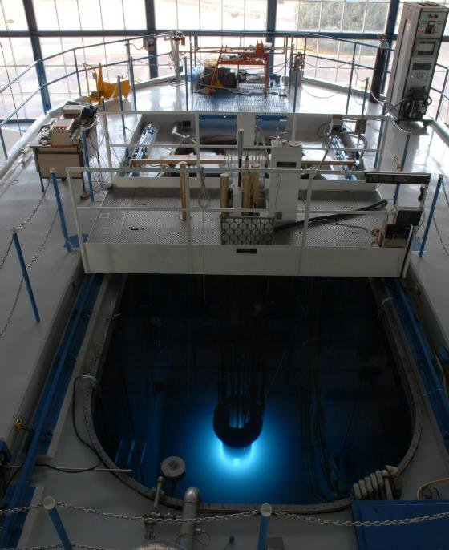
Neutron capture reactions
National Institute for Nuclear Research (ININ).
  The 1 MW TRIGA MARK III reactor is a pool-type research reactor with a movable core, cooled and moderated with light water.
  Neutrons are moderated with the maximum at 25 meV for a temperature of 290 K; thermal neutrons.
  The structure of the core is a circular arrangement of fuel, control rods, and graphite elements.
  Thermal neutron fluxes of up to 3.3 × 10⁻¹³ n/cm²s can be reached in stationary mode.

Slide 10
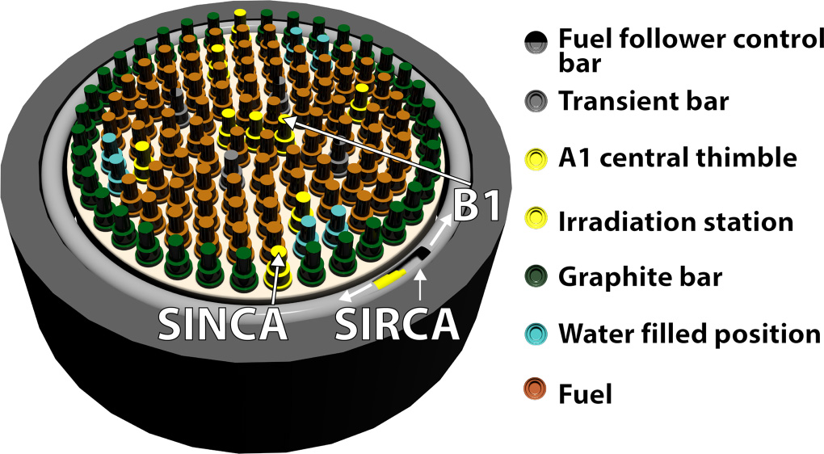
Targets and irradiation
Beryllium oxide.
  Samples of pure BeO were chemically extracted from 8 ml of Be standard solution [Beryllium ICP Standard Solution, Be₄O(C₂H₃O₂)₆, 1000 mg/l Be Merck],which is currently used as carrier and blank in AMS.
Graphite and uracil.
  For ¹⁴N(n,p)¹⁴C reaction. we used uracil (C₄H₄N₂O₂).
  For the attempt to measure ¹³C(n,γ)¹⁴C reaction cross section, we used natural graphite (98.9% of ¹²C and 1.1% of ¹³C).
BeO. SIRCA port: neutron flux of 2.26 x 10¹¹ n/cm²s (30 min/sample and 120 min/sample).
Uracil. SINCA port: neutron flux of 4.42 x 10¹² n/cm²s (20 s/sample) .
Graphite. B1 port. neutron flux of 2.3 × 10¹³ n/cm²s (10 h/sample and 2 h/sample (Cd container)).
Notes:
SINCA (Pneumatic Capsule-Irradiation
System). SIRCA (Rotary Capsule-Irradiation System),

Slide 11
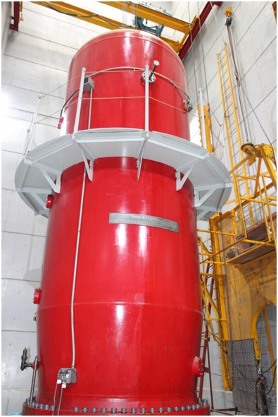
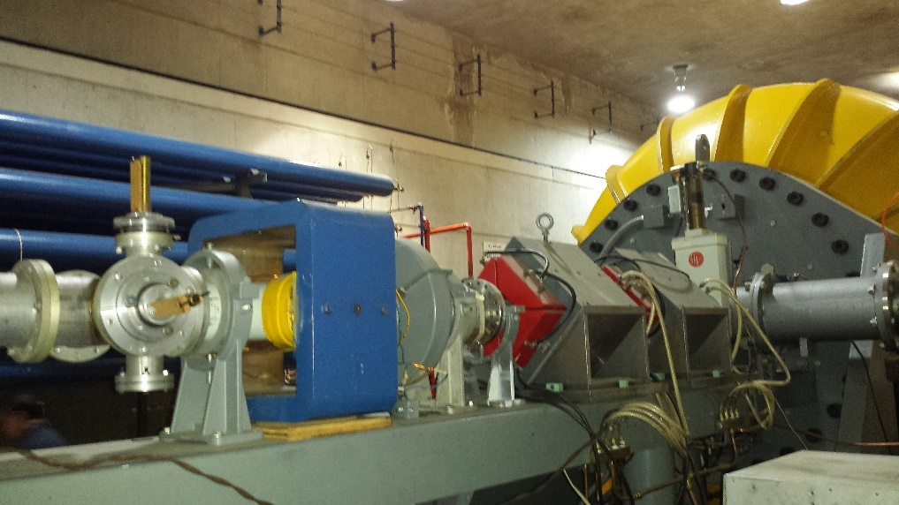
²⁸Si(d,α)²⁶Al reaction.
Two measurements using two different facilities:
  Van der Graaff 5.5 MV, (Lab. CGF @ IFUNAM, Mexico City)
  CN-Tandem 6 MV, (ININ, Ocoyoacac Edo. Mex.).
  Both facilities can produce deuterium beams of (1-2 MeV 1 - 4 MeV, respectively ~ 1 μA)

Slide 12

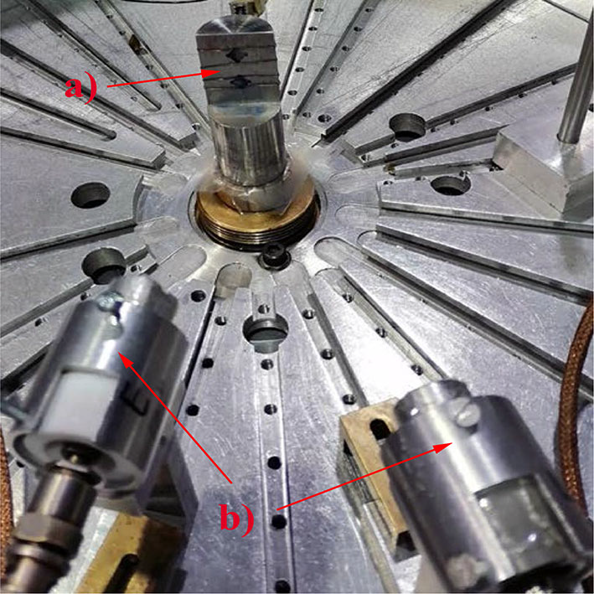
²⁸Si(d,α)²⁶Al reaction experimental setup
Silicon wafers were chosen as targets:
  wide enough to allow proper alignment with the beam, which is 2 mm diameter,
  thick enough to stop the beam and
  small enough to facilitate the digestion in the radio-chemistry laboratory Chemical separation of Al from Si targets tested before the experiment (attaining finally Al₂O₃).
New target-holder and Si waffles.
Silicon detectors (500 μm thickness)

Slide 13
2nd part: AMS measurement

Slide 14
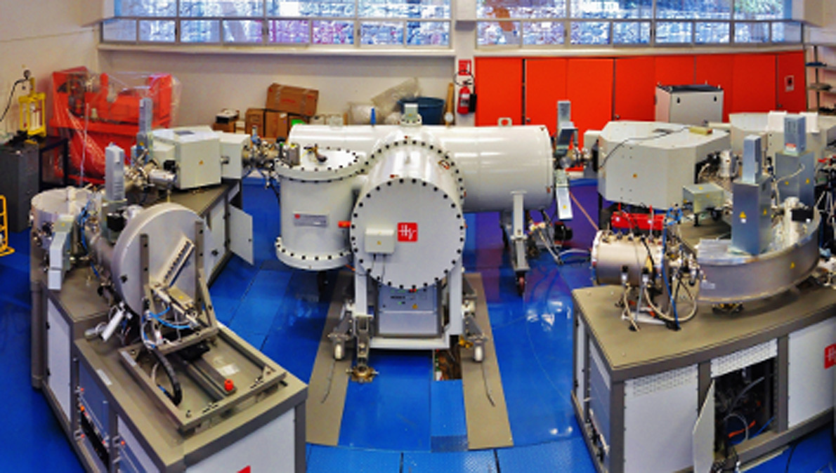
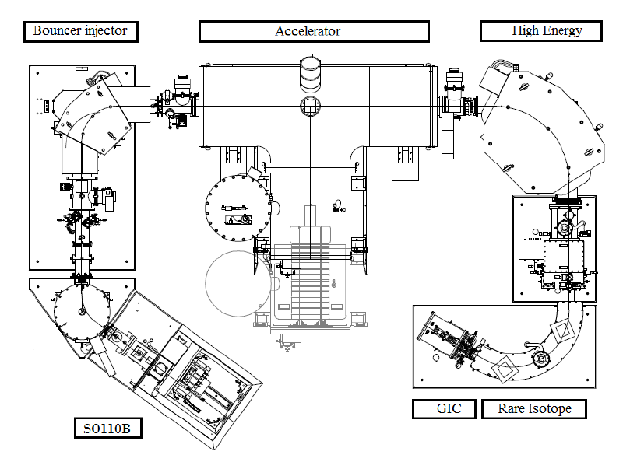
The LEMA facility.
The National Laboratory of Accelerator Mass Spectrometry (LEMA-IFUNAM) was commissioned in 2013.
A tandetron of 1 MV (HVEE) equipped with peripheral laboratories:
  for the cleaning and chemical samples preparation;
  Graphitization of carbon samples.
Sequential injection makes possible the measurement of isotopes present in concentration ratios from 10⁻¹⁰ to 10⁻¹⁵.
LEMA was calibrated to measured concentrations of ¹⁰Be, ¹⁴C, ²⁶Al, ¹²⁹I and Pu isotopes.
14

Slide 15
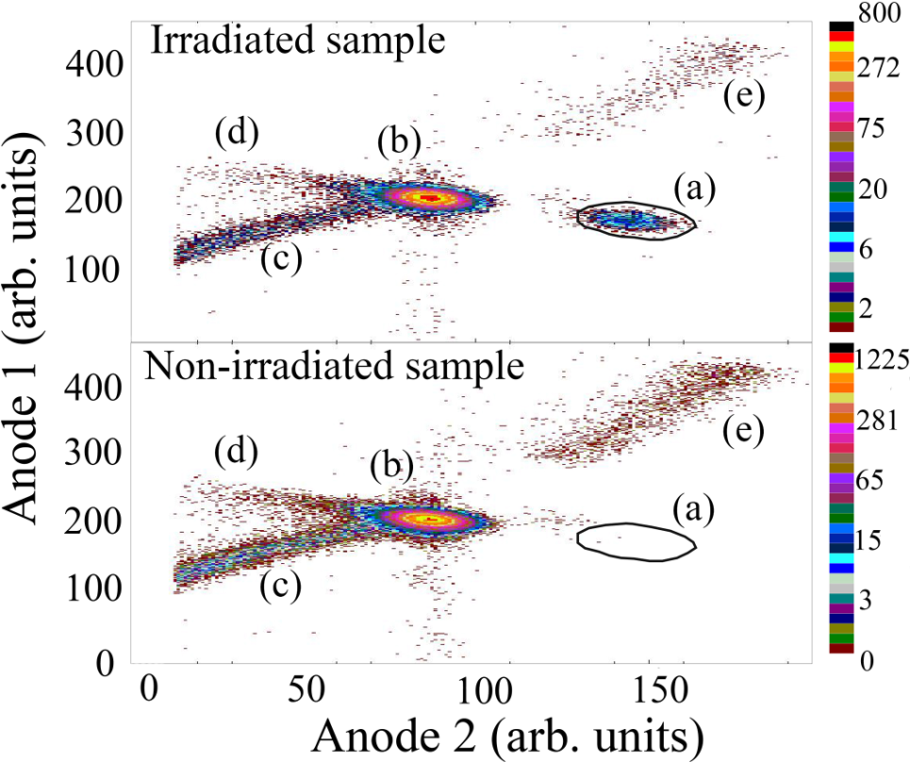
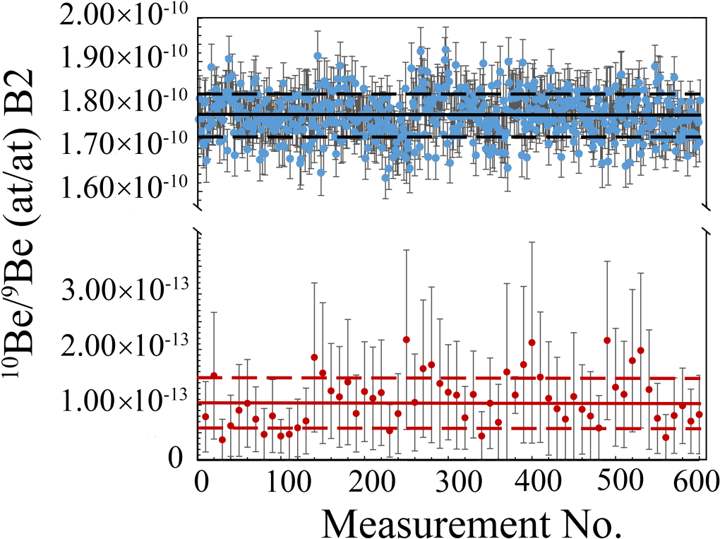
Results for neutron capture reactions.
BeO samples.
ΔE-E spectra from gas detector of LEMA system.
Events enclosed in black polygon are ¹⁰Be counts.
Data from irradiated (blue dots) and non-irradiated (red dots, averaged over ten values) samples.
The continuous and dashed
lines show the average and the standard deviation, respectively.

Slide 16
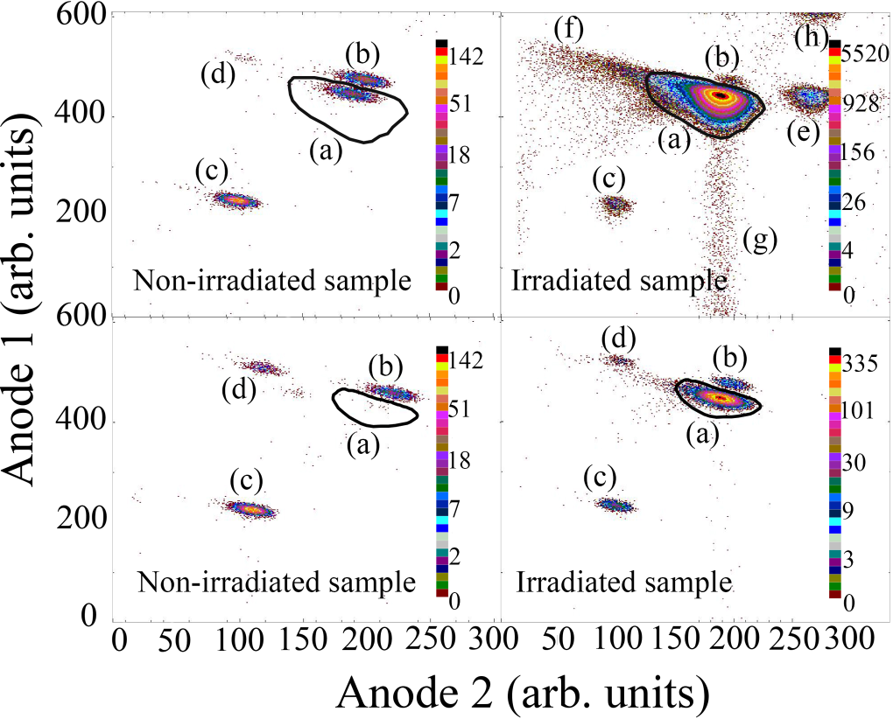
Results for neutron capture reactions.
Graphite and uracil samples.
Graphite
Uracil
ΔE-E spectra from gas detector of LEMA system.
Events enclosed in black polygon are ¹⁴C counts.

Slide 17
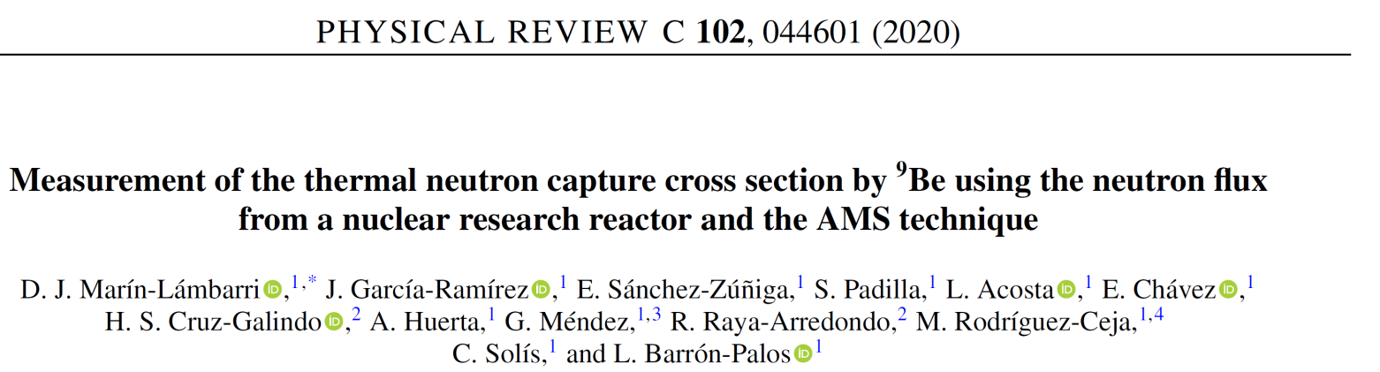
Reaction cross sections
Reaction | σ_{LEMA} [b] | σ_{NIST} [b] | σ_{IAEA} [b] | σ_{ANR} [b]
¹⁴N(n,p)¹⁴C | 2.07 ± 0.37 | 1.91 | - | 1.86 ± 0.03
¹³C(n,γ)¹⁴C | 0.18 ± 0.03 | 0.00137 ± 0.00004 | - | 0.00137 ± 0.00004
⁹Be(n,ɣ)¹⁰Be | 0.0097 ± 0.0005 | 0.0076 ± 0.0008 | 0.0087 | -
Cross section found for ¹⁴N(n,p)¹⁴C reaction is in agreement with the previous measured values.
  Cross section found for ¹³C(n,γ)¹⁴C it is far from the values reported in the literature. The discrepancy could be related to the production of ¹⁴C by neutron reactions in Nitrogen, which is part of the sample and no simple to quantify.
Cross section found for ⁹Be(n,ɣ)¹⁰Be is the first direct measurement reported. It is in good agreement with the indirect measurements previously reported.

Slide 18
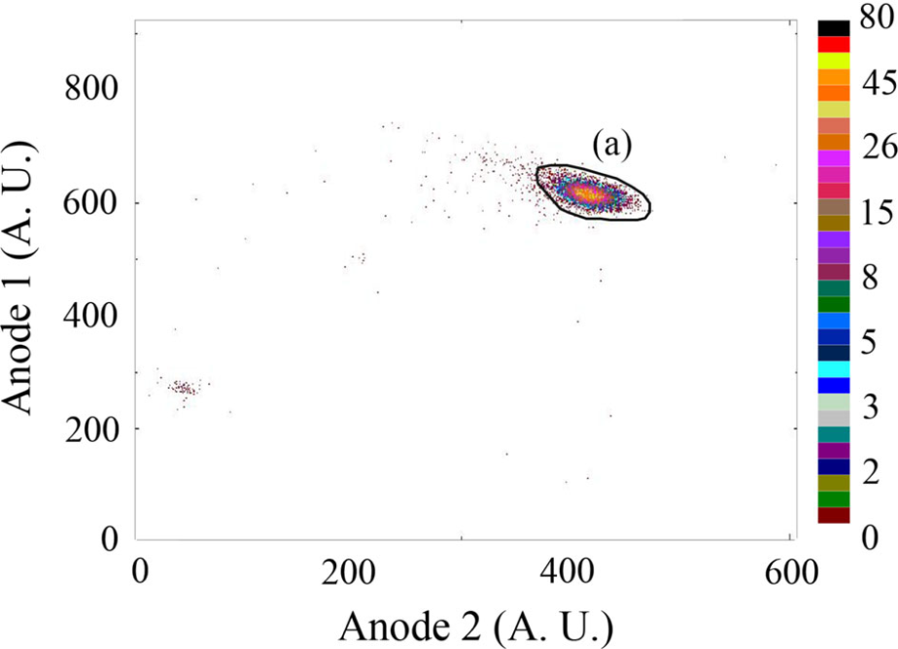
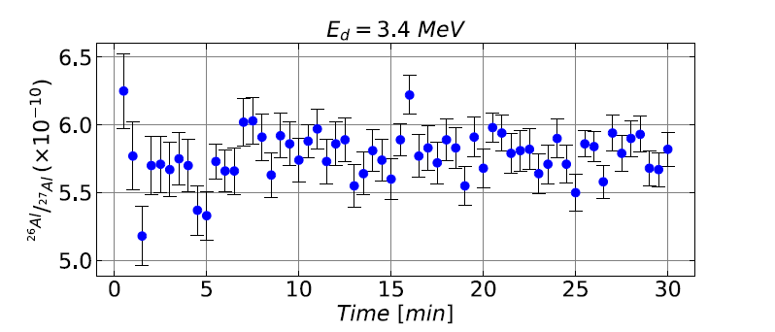
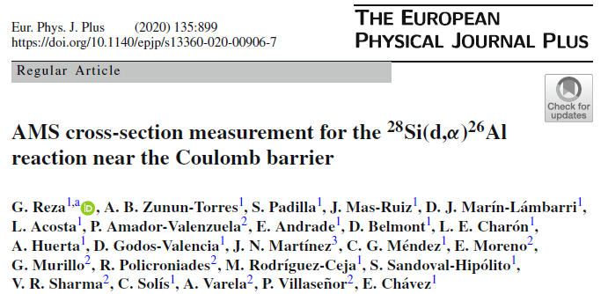
²⁸Si(d,α)²⁶Al results.
Al₂O₃ samples
Data from irradiated samples.
ΔE-E spectra from gas detector of LEMA system.
Events enclosed in black polygon are ²⁶Al counts.
Still necessary improves the precision in the measurement of deuterium flux.

Slide 19
Summary and conclusions
The combination of reaction production + AMS technique was probed, founding a good alternative for the direct measurement of interesting cross section.
Thermal neutrons produced from a small reactor as well as low energy beams from small accelerators (ININ and IFUNAM machines) are good options to produce the reactions.
Radioisotope concentrations can later be measured using an AMS system (as LEMA).
Neutron capture reactions for Beryllium and Nitrogen targets (for the ¹⁴C and ¹⁰B production respectively) were well measured, showing the effectiveness of the method.
Particularly for ⁹Be(n,ɣ)¹⁰Be reaction, we achieve the first direct measurement of the total cross section, which agrees with previous indirect measurements.
(d,α)²⁶Al was also studied, founding promising results for a further measurement of the total cross section in a wide low energy range.
Thank to the new LEMA beam-line, these studies will be able to extend to other reactions as the (p,γ)²⁶Al at 400 keV, which is crucial for the understanding of the ²⁶Al production on stellar nucleosynthesis.

Slide 20
Thank you for your attention
Collaboration:
L. Acosta, D. J. Marín-Lámbarri , J. García-Ramírez , E. Sánchez-Zúñiga, S. Padilla, E. Chávez , H. S. Cruz-Galindo , A. Huerta, G. Méndez, R. Raya-Arredondo, M. Rodríguez-Ceja, C. Solís, L. Barrón-Palos, G. Reza, A. B. Zunun-Torres, J. Mas-Ruiz, P. Amador-Valenzuela, E. Andrade, D. Belmont, L. E. Charón, D. Godos-Valencia, J. N. Martínez, E. Moreno, G. Murillo, R. Policroniades, S. Sandoval-Hipólito, V. R. Sharma, A. Varela, P. Villaseñor and V.Araujo-Escalona.
Instituto de Física, Universidad Nacional Autónoma de México, Mexico.
Instituto Nacional de Investigaciones Nucleares, Mexico.
GRANTS: CONACYT 271802, 280760, 299073, 299186, 294537 and DGAPA-UNAM IN107820, IN109120 , AG101120, IG100619 and IG101016.

Slide 23
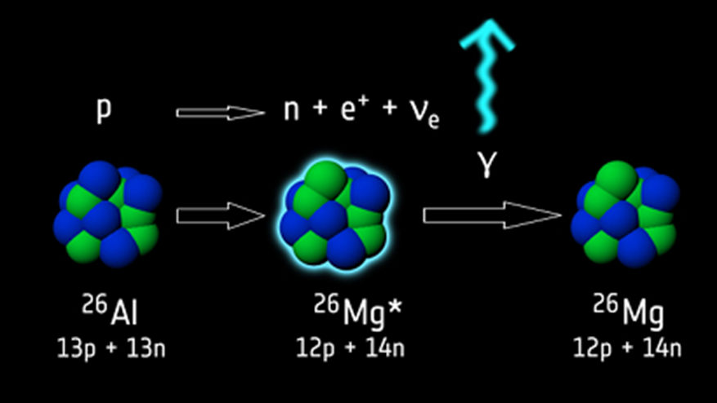
Which reactions and why?
The ²⁶Al is a long-live radioisotope (T_{1/2} = 0.716 Ma).
Its γ-decay (E_{γ}=1.809 MeV) is transparent in the interstellar medium, allowing to be measured and gives evidence of presently active nucleosynthesis.
  The measure of this decay allows to quantify the ²⁶Al production in the space, giving a good contribution to the existing nucleosynthesis models.

Slide 24
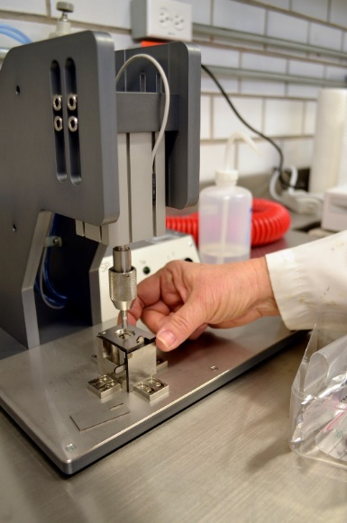
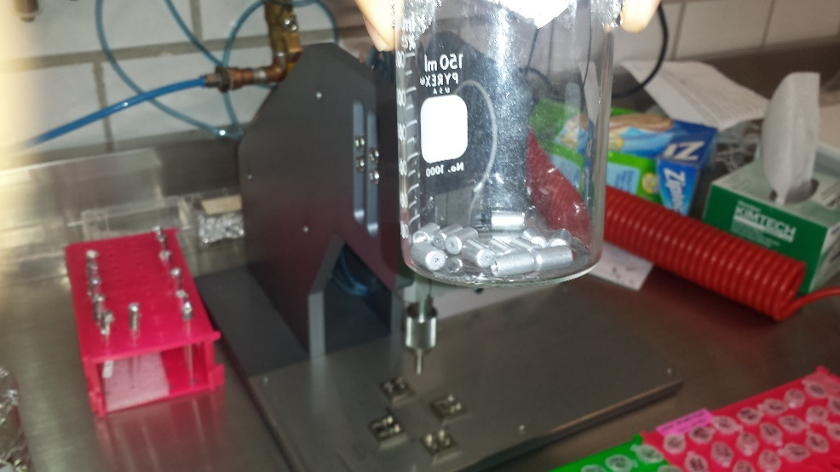
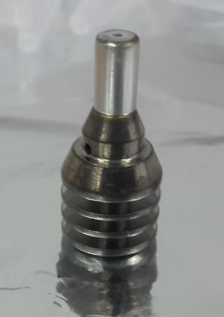
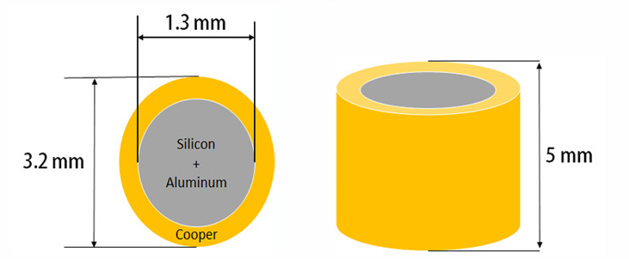
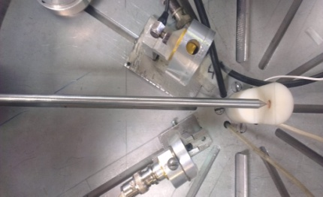
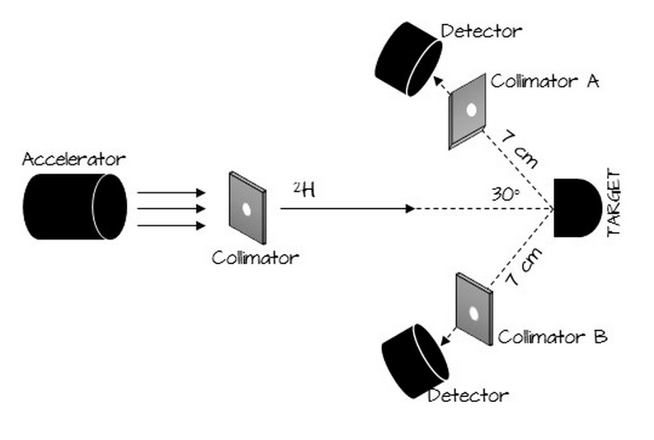
First attempt to measure ²⁸Si(d,α)²⁶Al reaction
Using a combination of 50-50 Si/Al (3 mg Al + 3 mg Si) compressed inside a cathode for AMS system.
Target/cathode
beam
PIPS detectors

Slide 25
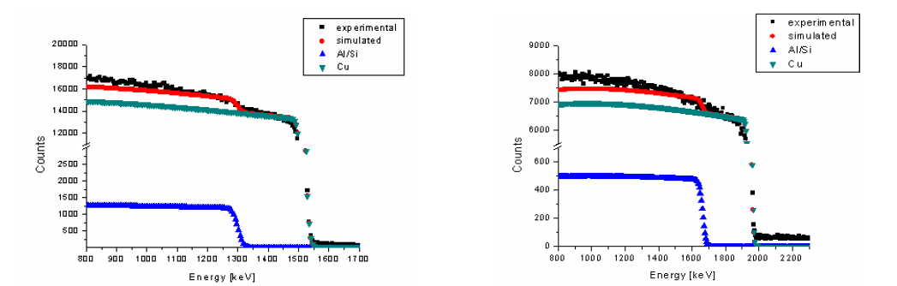
First attempt to measure ²⁸Si(d,α)²⁶Al reaction
However, due to the small size of the sample, most of the beam (till 80%) was impinging the cooper container (cathode).
The consequences were ²⁶Al cross section of 3.9(4) μb (1.1 MeV), 1.5(2) μb (1.5 MeV) and 1.3(1) μb (1.8 MeV).
V. Araujo-Escalona, et. al., J. Phys. CS 730, 012003 (2016)
V. Araujo-Escalona, et. al., Phys. Procedia 90, 421–428 (2017)
L. Acosta et al., Eur. Phys. J. W. C 165, 01001 (2017)

Slide 26
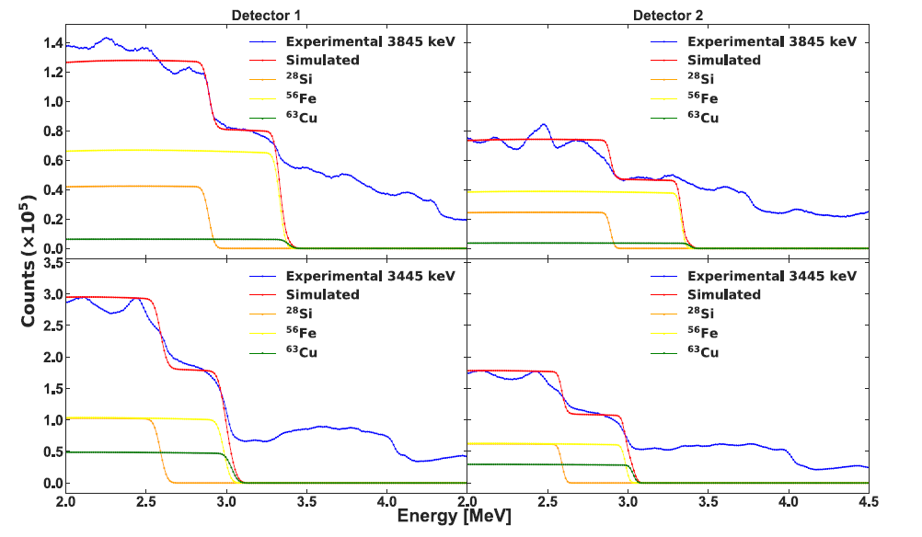
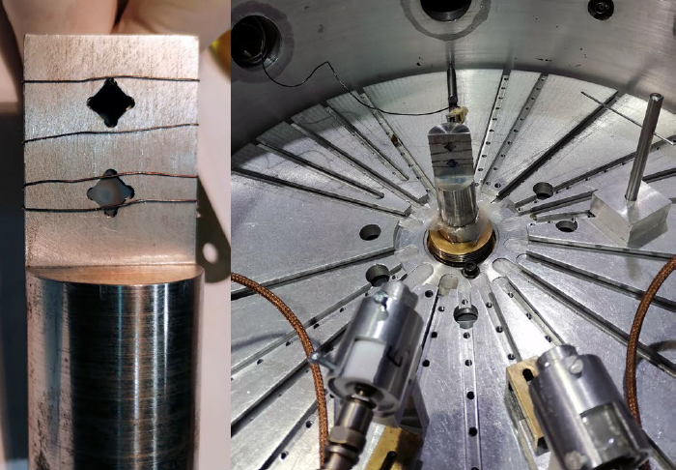
²⁸Si(d,α)²⁶Al results.
RBS analysis of deuterons scattered at 165º by Si target and other elements.
For this 2nd attempt, the beam on Si target for all the measured energies was ~ 70% (most of the beam was on Si).

Slide 27
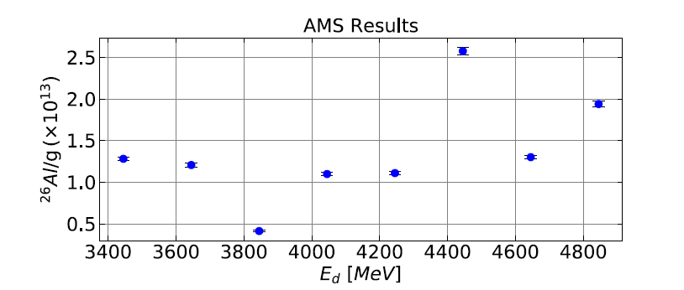
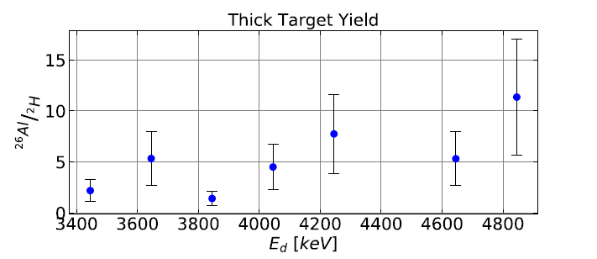
Measure of the ²⁶Al concentrations
²⁶Al concentrations can be well measured with AMS. The uncertainties grows noticeably when ²⁶Al events are normalized with the thick target.
Larger uncertainties may come from the poor determination of the deuteron flux.

Slide 28
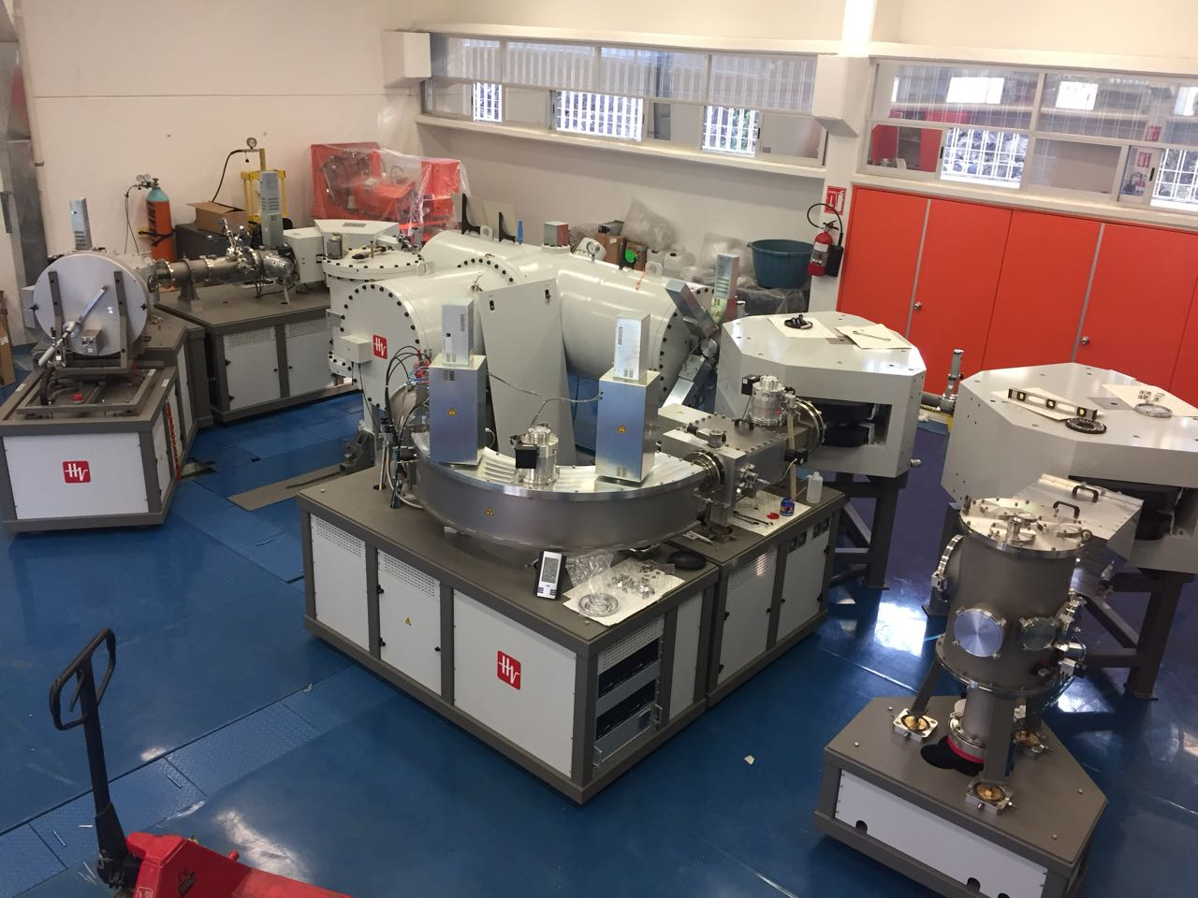
Improvements and further ²⁶Al measurements.
To achieve the total cross section for (d,α) reaction:
  a tighter collimation of the deuteron beams to have a more robust determination of the beam spot on target,
  particle identification using a telescope (ΔE-E) of the back-scattered particles detected,
  add a very thin (20 nm) gold layer to the silicon slabs to monitor on the elastic scattering on gold and not on silicon.
The (p,γ) reaction at 400 keV (in the new LEMA beam-line is the next to measure. Natural Mg targets are under chemical test.

