Slide 1

Scattering of ¹⁵C on ²⁰⁸Pb at energies near the Coulomb barrier
María José García Borge
(on behalf of J. D. Ovejas, V. G Távora)

Slide 2
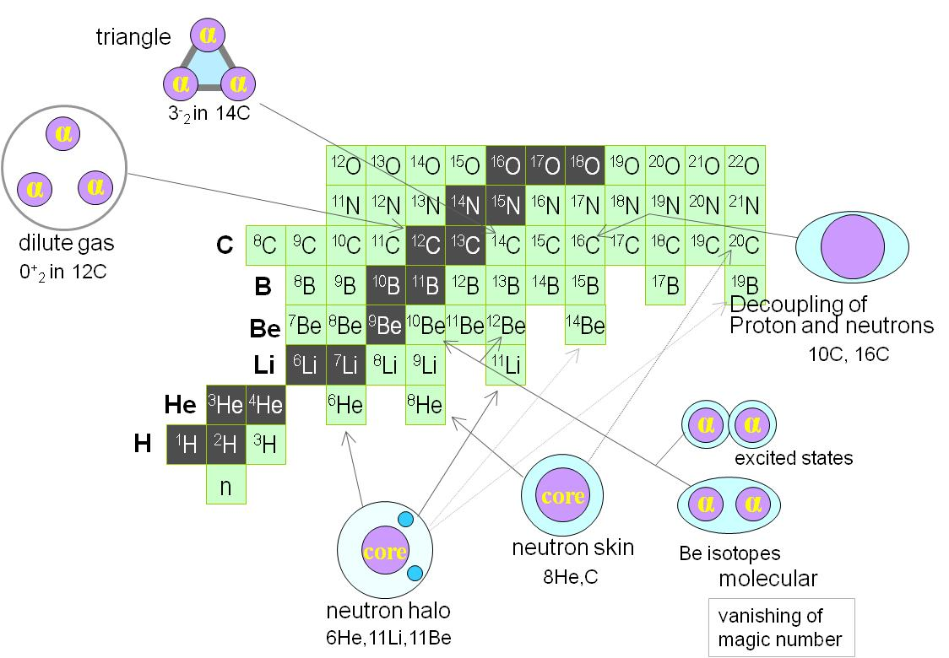
Light Nuclei
Courtesy Kanada-En’yo
Light nuclei: a quantum mechanics laboratory
Quantum mechanics plays a role in creating peculiar structures in ground states of light nuclei: nuclear skins and/or nuclear halos, nuclear clusters, nuclear molecules, gas condensate ….
Theoretical understanding of the structure of light drip-line nuclei is challenging → Ab-Initio calculations are reaching good description of structure of light nuclei.
In order to handle new observables and exotic structures → New theoretical models needs to be able to describe reaction dynamics

Slide 3
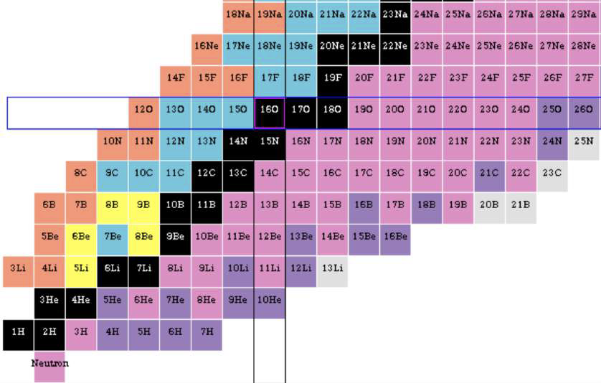
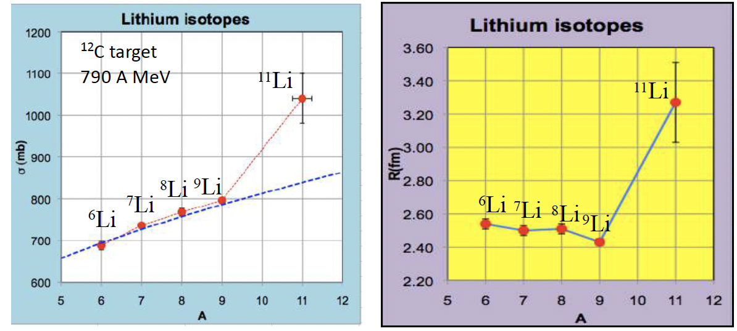

Halo Nuclei
The nuclear halo is a threshold effect arising from the very weak binding energy (0.1-1 MeV) of the outer nucleon(s)
Extended mass distribution
Large rms radius
Large reaction cross section
Narrow momentum distribution following fast fragmentation
Concentration of B(E1) close to BU threshold
1p
1n
4n
2p
2n
G. Sawhney et al, J. Phys G Nuc part Phys 41 (2014) 055101
Neutron Haloes
Provide an ideal test bench to study few-body correlations by measuring elastic, nucleon transfer and breakup
Tanihata, PRL 55 (1985)2676

Slide 4
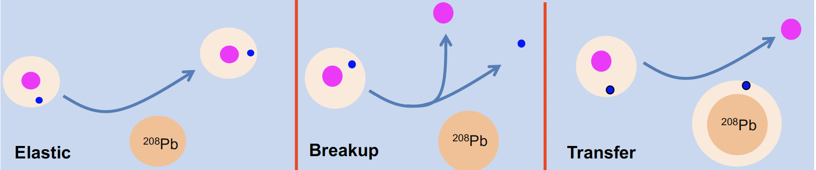
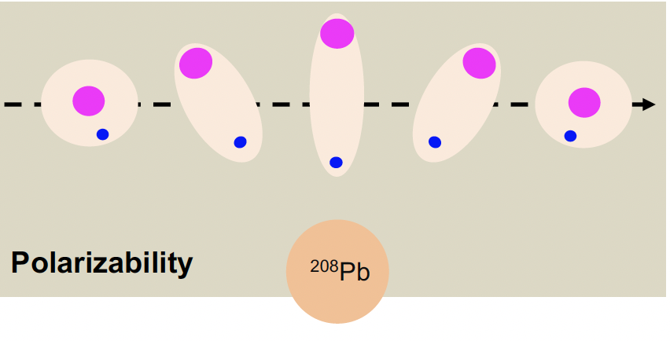
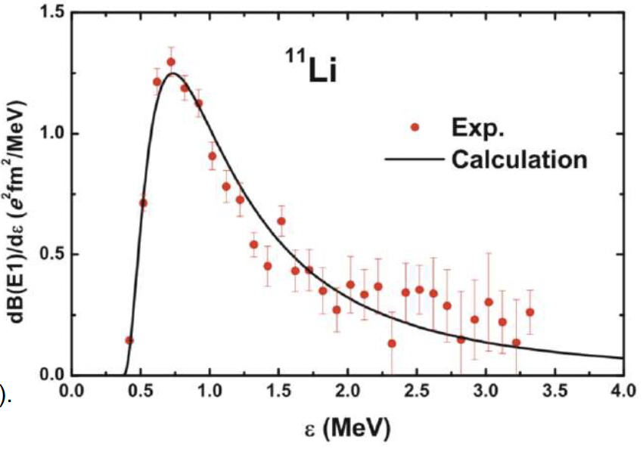
Scattering of Halo Nuclei @ Coulomb Barrier
Coupling between relative motion and internal degrees of freedom
  Elastic – inelastic – transfer – breakup – fusión + effects of the continuum
Strong absorption in elastic channel
Large cross section for fragmentation
Easy polarizable: distorsion of structure in vecinity of heavy target→ Coulomb dipole polarizability
Nakamura et al, PRL 96 (2006) 252502
Kim et al., J Kor Phys Soc 73 (2018)553

Slide 5
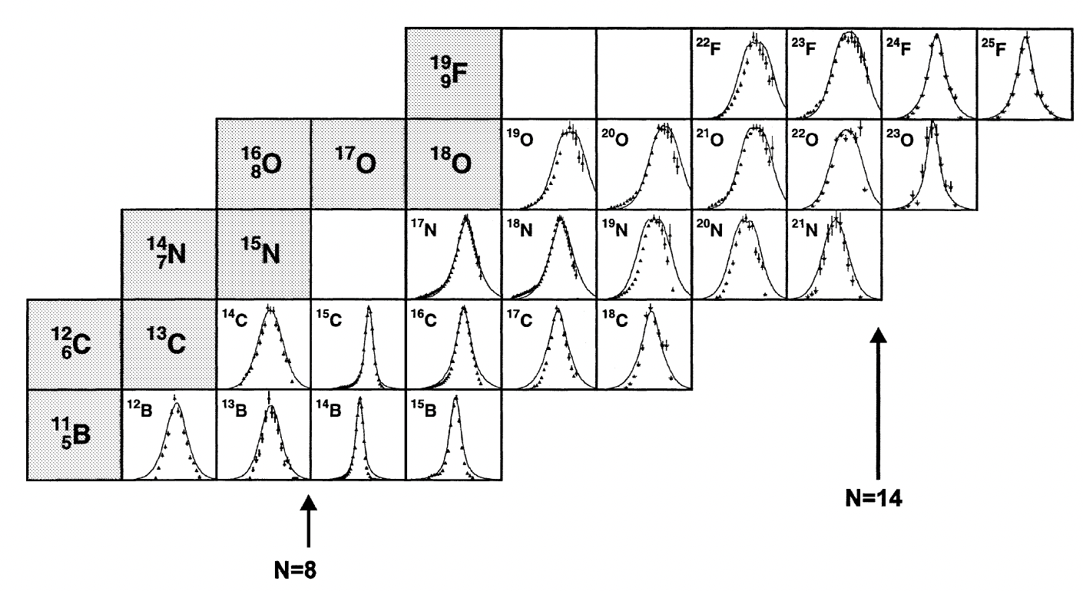
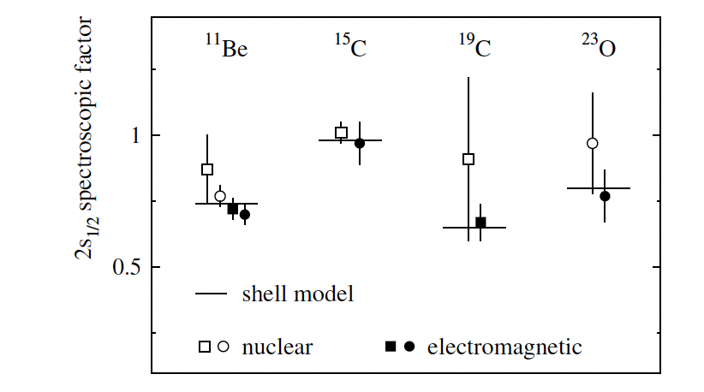
What makes ¹⁵C (T_{1/2} = 2.45s) Interesting ?
Realively weakly bound
S_{n} = 1.2 MeV; S_{2n} = 9.4 MeV
Relatively narrow longitudinal momentum distribution
First excited state (E = 740 keV)
Ground state 2s_{1/2} →
a s-wave 1n-halo coupled to ¹⁴C could explains these features,
62 MeV/c
Aumann et al., EPJA 26 (2005) 446
Spectroscopic Factor
Aumann et al., EPJA 26 (2005) 446
Ozawa. Nuc Phys A 738 38-44 (2004)
Notes:
The case of 15C is special since some high energy experiments have showed a large total interaction cross section and a very narrow distribution of the longitudinal component of the momentum of the fragments following breakup. This was reported by Ozawa in 2004 and this paper says that all these features would be consistent with a structure consisting of a 14C core plus a 1n in halo configuration with a pure s-wave as ground state, despite of having a relatively large separation energy above 1 MeV. Still the difference with the separation energy of 2 neutrons, which is closer to 10 MeV, is considerable.

Slide 6
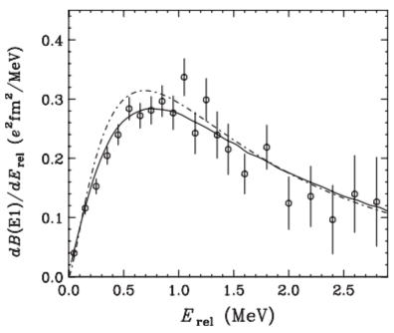
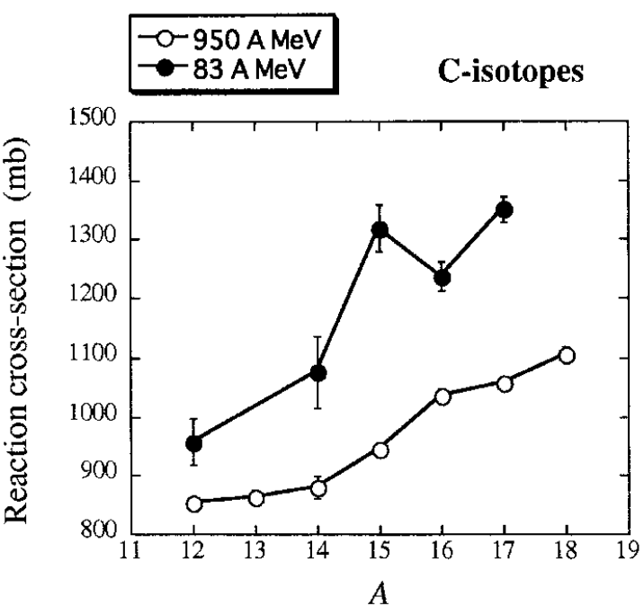
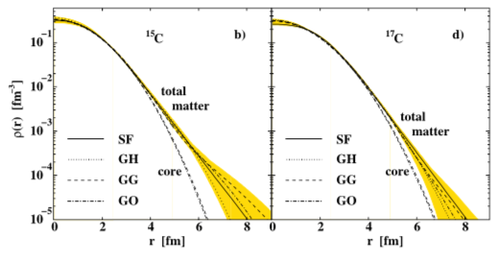
¹⁵C: Controversial 1n-halo
Reaction cross section larger than ^{14,16}C at intermediate energies, but not at higher energies
  It seems that coupling increases when energy decreases
B(E1) deduced from coulomb breakup of ¹⁵C on Pb longer tail than ¹¹Be and smaller value of mean square radius.
Nuclear matter radii and density recently revisited
R_{m} = 2.59(5) fm ; R_{p} = 2,37(3) fm
R_{c} = 2,41(5) fm ; R_{ν} = 4.36 (38) fm → κ = R_{ν} /R_{c} = 1.81 (halo κ > 2)
¹⁵C
R_{n} = 2,73(8) fm→ δ_{np} = 0.36(9) fm
Nakamura et al., PRC 79 (2009) 035805
Dobrovolsky et al., NP A 1008 (2021) 122154
Ozawa et al., NP A738 (2004) 38

Slide 7
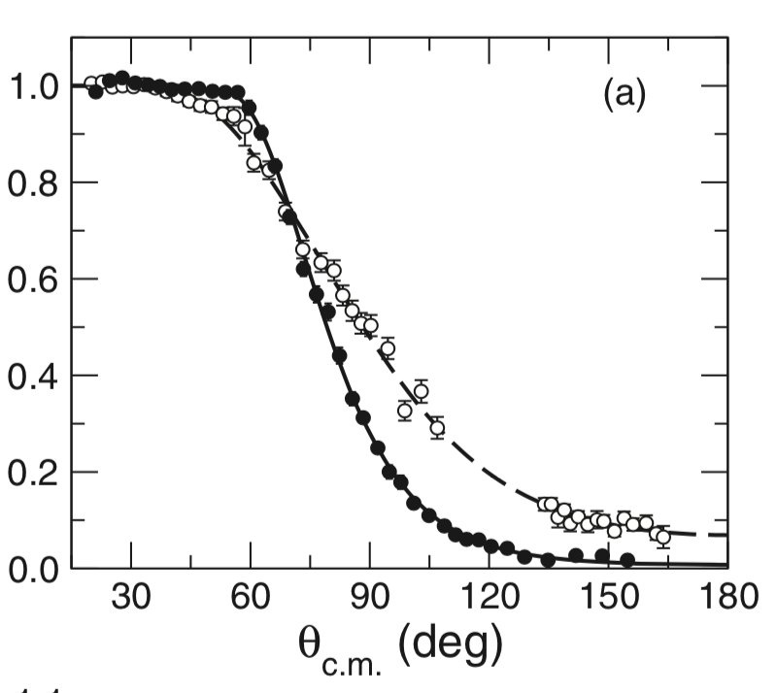
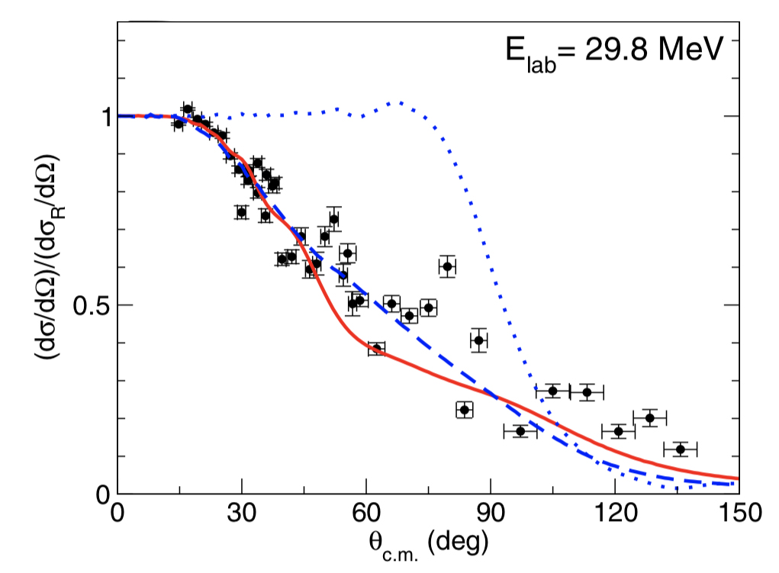
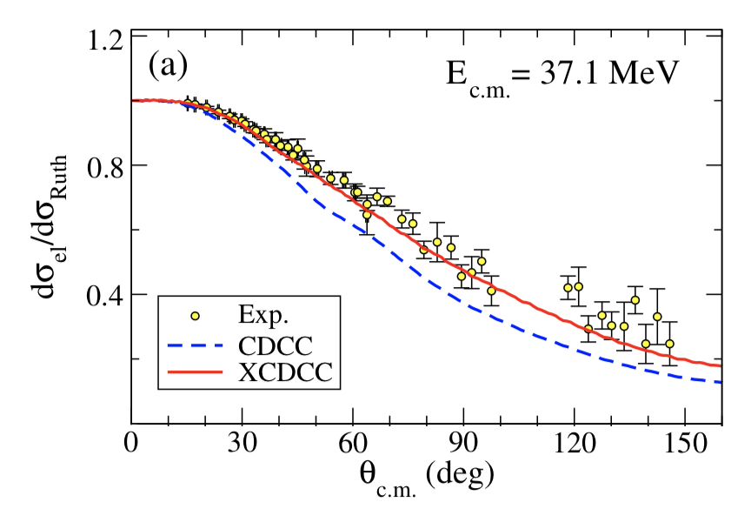
Elastic Scattering of halo/skin Nuclei
@ Coulomb Barrier
We have studied the halo effects on the elastic scattering on heavy targets at energies close to the Coulomb barrier
The scattering of loosely bound n-rich system in the strong electromagnetic field of the reaction target induces a dipole polarization in the projectile.
A strong absorption in the elastic channel and the suppression of the rainbow arising from the Fresnel interference in the Optical Model is found.
The structure effects manifest on the angular distribution of the elastic cross section.
⁶He→²⁰⁸Pb @ 22 MeV
⁸He→²⁰⁸Pb @ 22 MeV
¹¹Be→¹⁹⁷Au
¹¹Li→²⁰⁸Pb
Marquinez-Duran et al. P RC 94
064618 (2016)
Cubero et al. PRL109 (2012) 262701
Pesudo, PRL118 (2017)152502

Slide 8
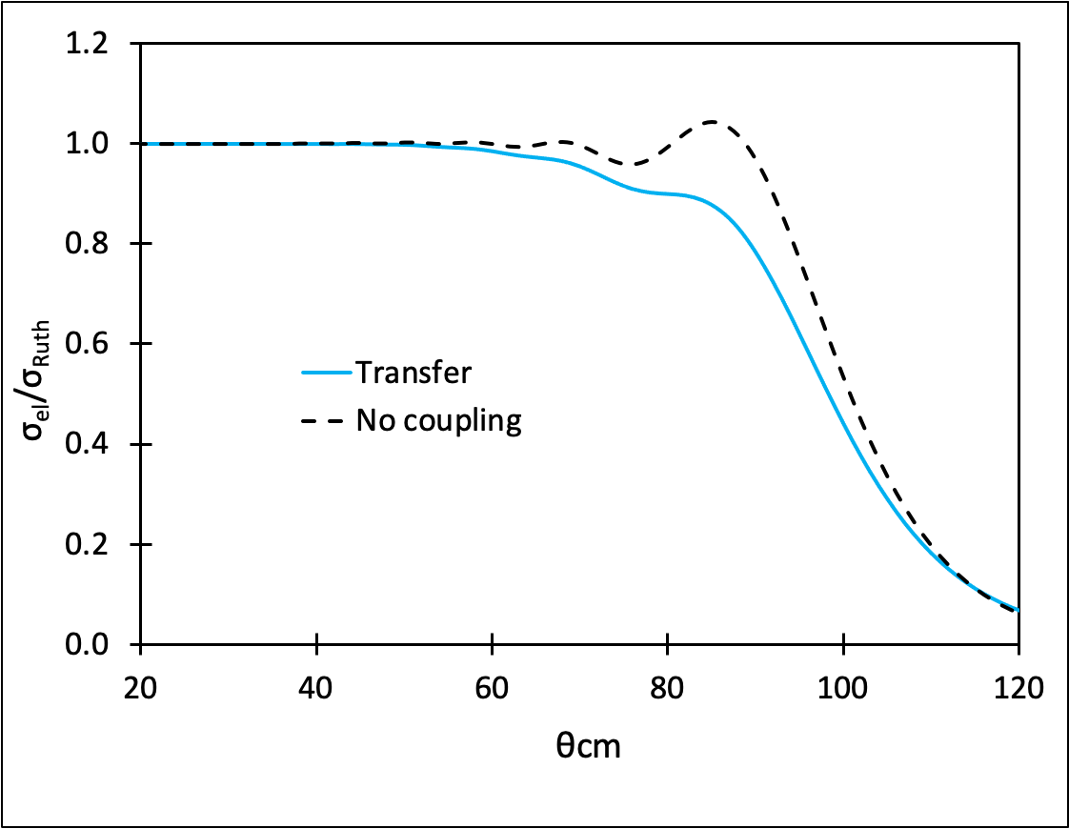
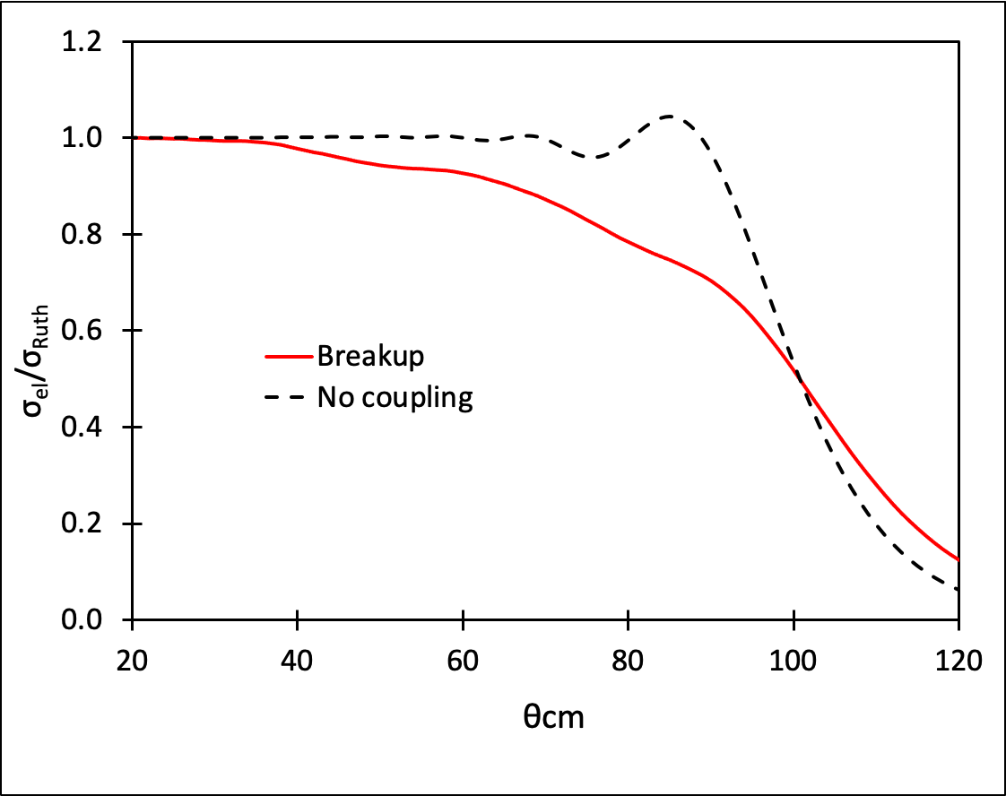
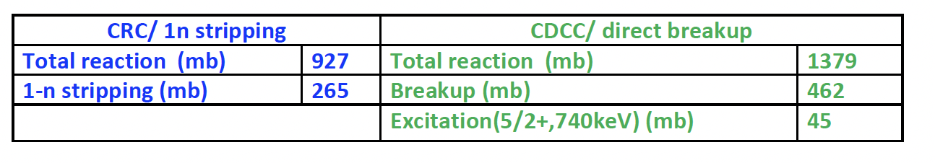
Coulomb Barrier Scattering of ¹⁵C + ²⁰⁸Pb
Reaction studies done at high energies all agree with a moderate halo structure for ¹⁵C → Which is the diferential elastic cross near Coulomb Barrier
Theoretical studies of ¹⁵C+²⁰⁸Pb at Coulomb Barrier exist for E = 65 MeV
1n-stripping:
Couple reaction channel (CRC)
1n-breakup:
Continuum discretized couple channel (CDCC)
Inelastic (1st excited @ 740 keV)
¹⁵C + ²⁰⁸Pb @ 65 MeV
¹⁵C + ²⁰⁸Pb @ 65 MeV
N. Keenley et al., PRC 75 (2007) 056610; EPJA 50 (2014) 145
Scattering dominated by the competition of 1n-stripping and breakup

Slide 9
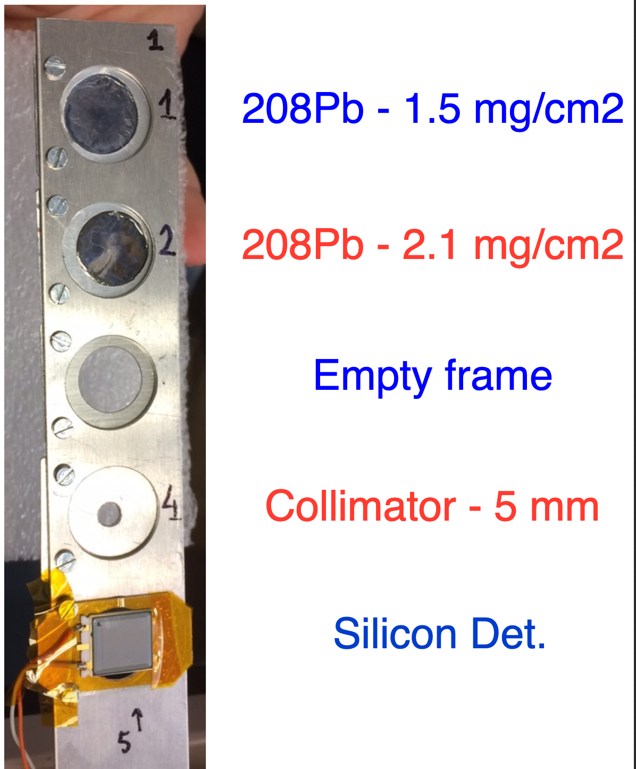
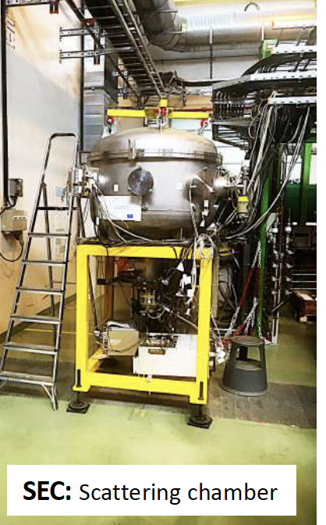
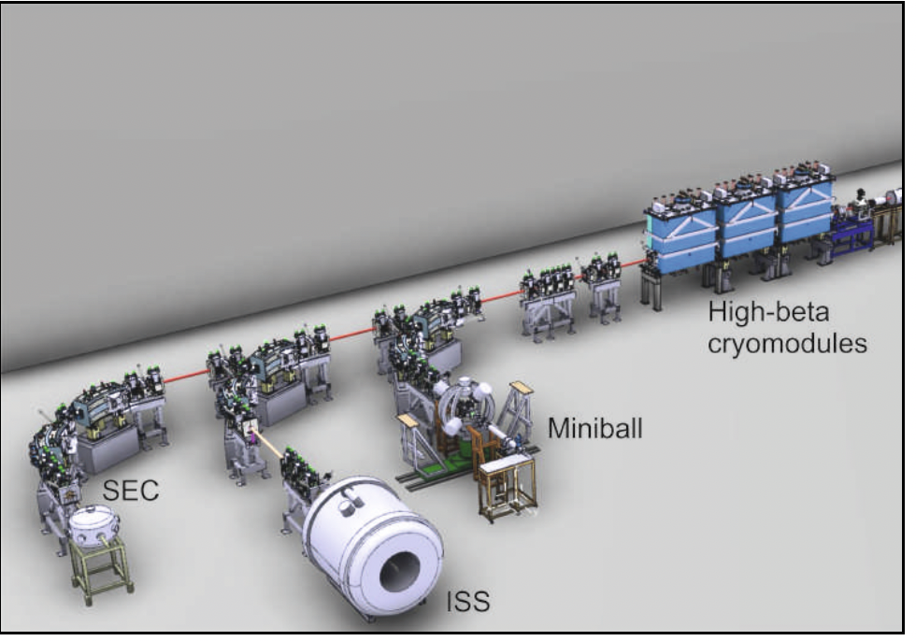
Coulomb barrier scattering of ¹⁵C + ²⁰⁸Pb
Experiment IS699 @ HIE-ISOLDE (CERN)
1 x 10³ pps average ¹⁵C at reaction point
E = 4.37 MeV/u incoming ¹⁵C (FWHM = 225 keV)
  65,43 MeV, after 75 μg/cm² stripping C-foil; 64,56(23) MeV in the middle of the ²⁰⁸Pb-foil Vc ~ 66,34 MeV
Cocktail beam of ¹⁵N + ¹⁵C: ¹⁵C/¹⁵N ≈ 1-3%
  ¹⁵N tightly bound @ this energy → use for monitoring and normalization
Notes:
The radioactive beam was produced from the impact of 1.4GeV proton pulses coming from the Psbooster on a CaO primary or production target, extracted, mass-separated and post-accelerated with A/q=3 up to 4.37 MeV/u; the coulomb barrier of the system 15C + 208 Pb.
15N was present as the unique contaminant after the 75ug/cm2 carbon stripping foil. This is a stable nucleus and at this energy is far from the Coulomb barrier, then it would follow a pure classic Rutherford scattering. The ratio between these two components in time fluctuated a little but was between 1 and 3%, meaning that the radioactive yield was one order of magnitude lower than requested.
We also could run with and stable cocktail beam made of 12C+15N+18º at the same energy per nucleon.

Slide 10
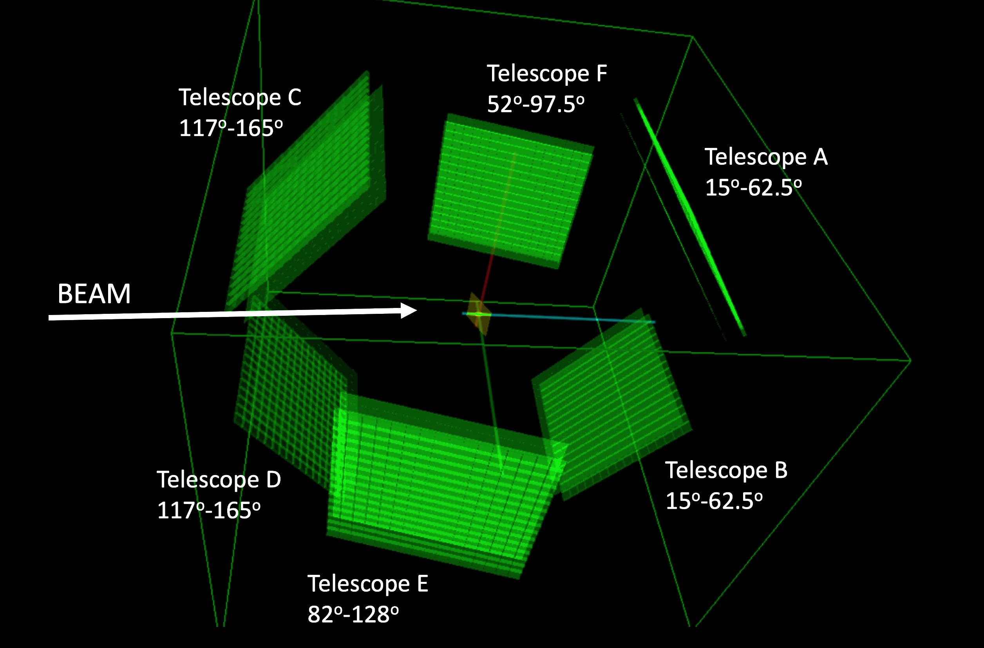
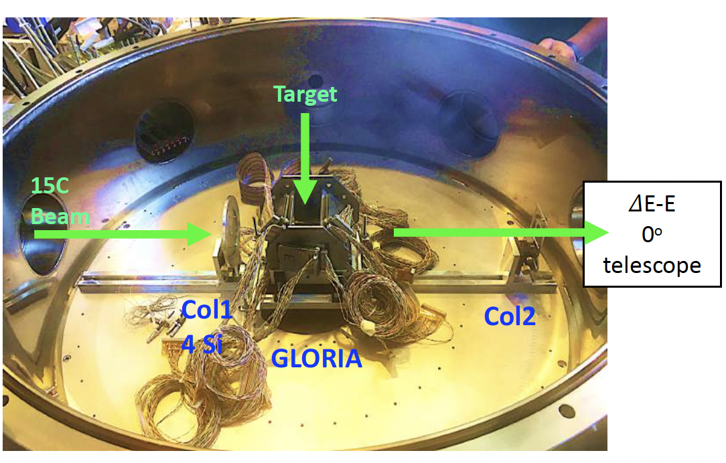
Experimental setup
Gobal Reaction Array GLORIA
  (NIM A 755 69-77 [2014]).
6 Si telescopes tangent to a 6 cm radius sphere.
40 µm (ΔE) + 1 mm (E) DSSDs in 256 pixels of 3x3 mm²
  2-3º angular ressolution
25% geometric eff.
Full angular coverage 𝛉_{LAB} =15º -165º
²⁰⁸Pb targets 2.1 and 1.2 mg/cm².
Notes:
For this purpose, the used experimental set-up was the global reaction array, also called GLORIA, which is an array of silicon detectors specially designed for scattering measurements. It consist of 6 silicon telescopes, all of them tangent to a 6 cm radius sphere in which center the reaction target is placed. All of the telescopes are made of a 40 um Delta E stage and a thicker 1 mm E stage. Both stages have 16x16 strips, which means they work as a set of 256 pixels each with an angular resolution between 2 and 3º. Dynamic ranges were adjusted to around 50 MeV to catch up the scattered 15C ions at ≈65 MeV lab. energy and the system has an angular coverage from 15 to 165º in a continous way with some overlapped intervals between pairs of telescopes. The geometric efficiency is 25%.
As reaction targets we had two available thicknesses of 208 Pb with a purity higher than 98%: 2.1 and 1.2 mg/cm2. They were placed on a target ladder with a 30º tilt respect to the beam direction, this avoids shadowing at 90º but also introduces an asymmetry in the energy losses through the phi azimutal angle.
With the thicker target the energy losses are enhanced but it also favors a higher reaction rate and more statistics. However, with the thin target we lose reaction rate but we avoid straggling and get a better energy resolution.
For beam tuning we also prepared an empty frame, a collimator and a silicon detector.

Slide 11
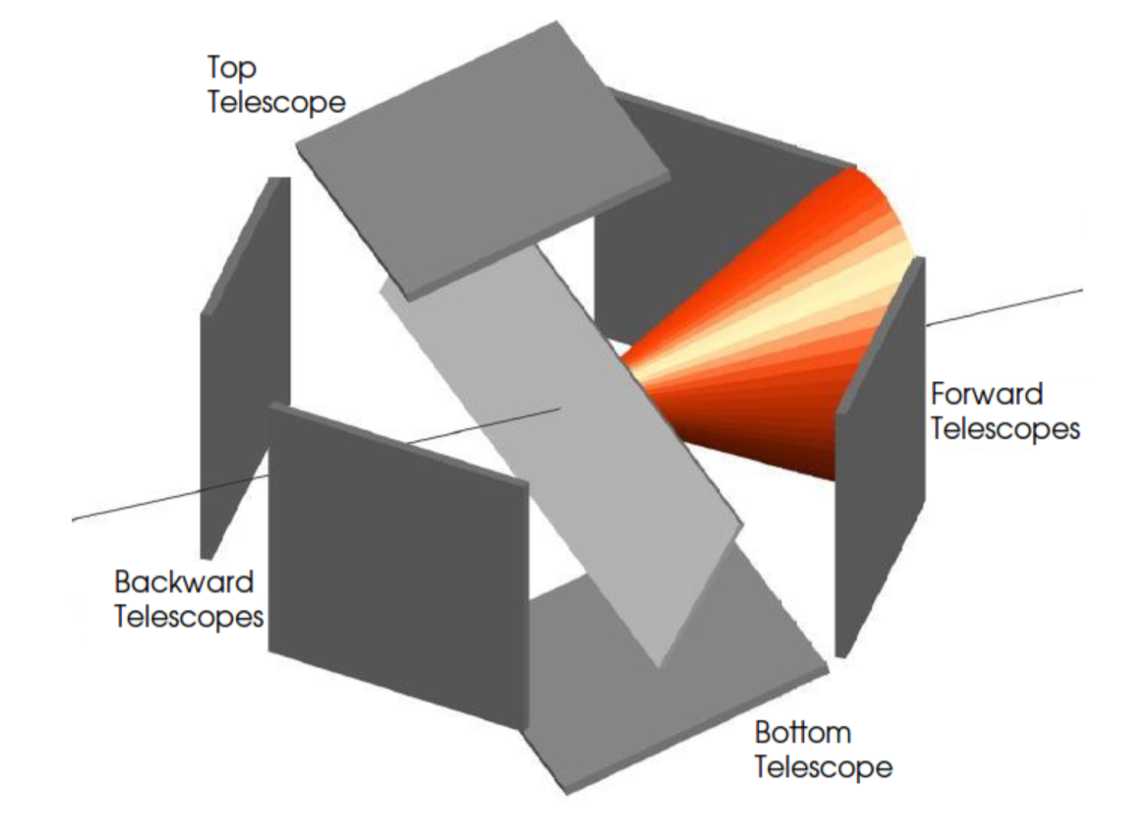
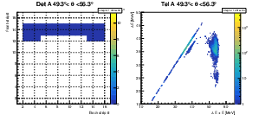
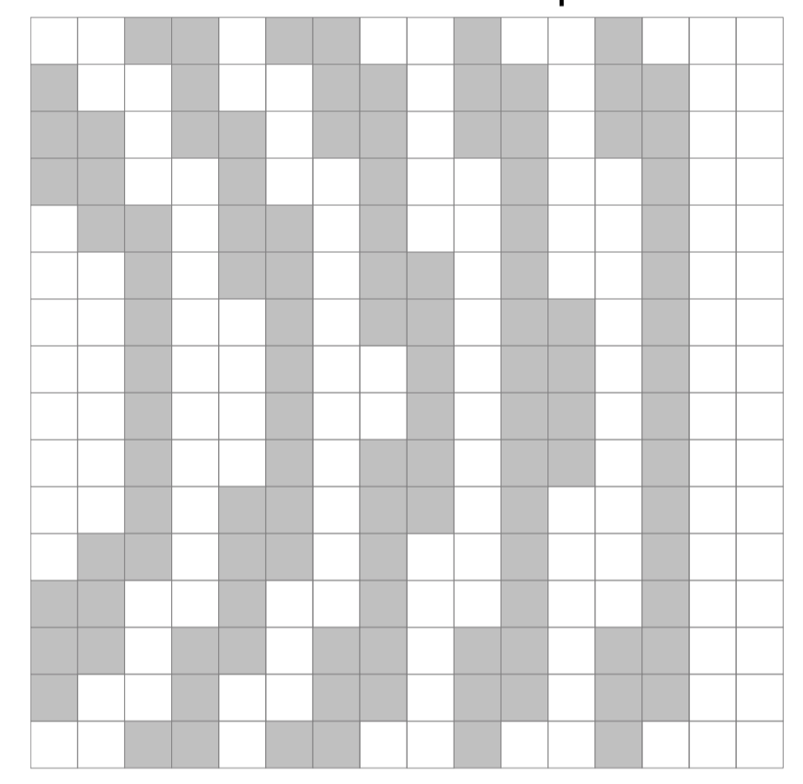
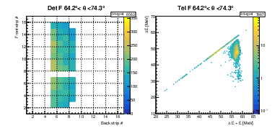
Data Analysis
Telescope configuration allows for particle identification from 2D (ΔE-E_{TOT}) plots.
High granularity of DSSDs allows for grouping together pixels within a Δ𝛉 range.
In the Δ𝛉 sectors the same physics are expected (non-polarized beam) and minor effects of different energy losses happen, maximizing the statistics and reducing the errorbars.
Tel A 49º < θ < 56º
Tel A 49º < θ < 56º
ΔE (MeV)
Front strip number
¹⁵N
target straggling
¹⁵C
¹⁵N
Back strip number
ΔE + E (MeV)
ΔE + E (MeV)
Tel F 64º < θ < 74º
Tel F 64º < θ < 74º
ΔE (MeV)
¹⁵N
Front strip number
¹⁵C
Back strip number
ΔE + E (MeV)
Notes:
dRegarding the analysis:
As for a non-polarised beam the reaction fragments follow axial symmetry, we expect the same physics to happen in the same scattering angle #theta, and this is a cone like the one shown, we divide our detectors angular intervals limited by the intersection between two cones of different angle and the detectors surfaces., This way, and despite of having an asymmetry in the energy losses, we can sum statistics keeping a reasonable resolution.
In the 2D/mass spectra plots from this angular sectors, we can appreciate several effects.
the two elastic scattered ions with some characteristic features such as the stragglin in the reaction target (that shows up as a long tail towards the left side), the channeling through the channels of the silicon lattice (as a tail downwards) or some charge charing events (hits in between strips).
On one hand, the presence of 15N is an advantage since it follows pure Rutherford scattering for being far from the Coulomb barrier and dividing the integral of the carbon elastic peak by the nitrogen one, one gets a point proportional to the carbon elastic cross-section normalized by Rutherford indpendent of the pixel angle and solid angle, since both are the exactly the same for the two isotoped. Apart of this one needs to know which angle is this so you put the corresponding cross section in the proper position of the angular distribution.

Slide 12
Angle and solid Angle Optimization

Slide 13
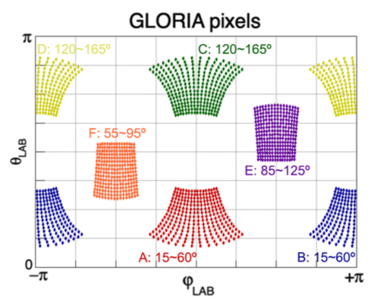
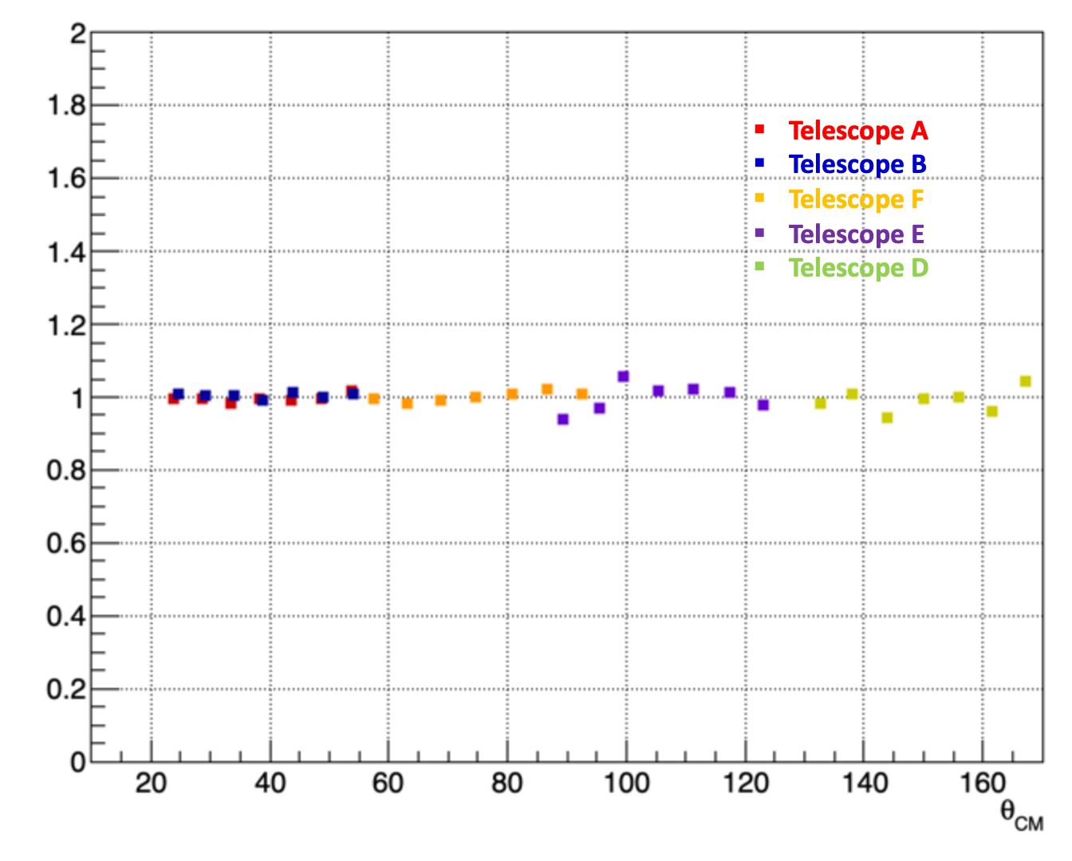
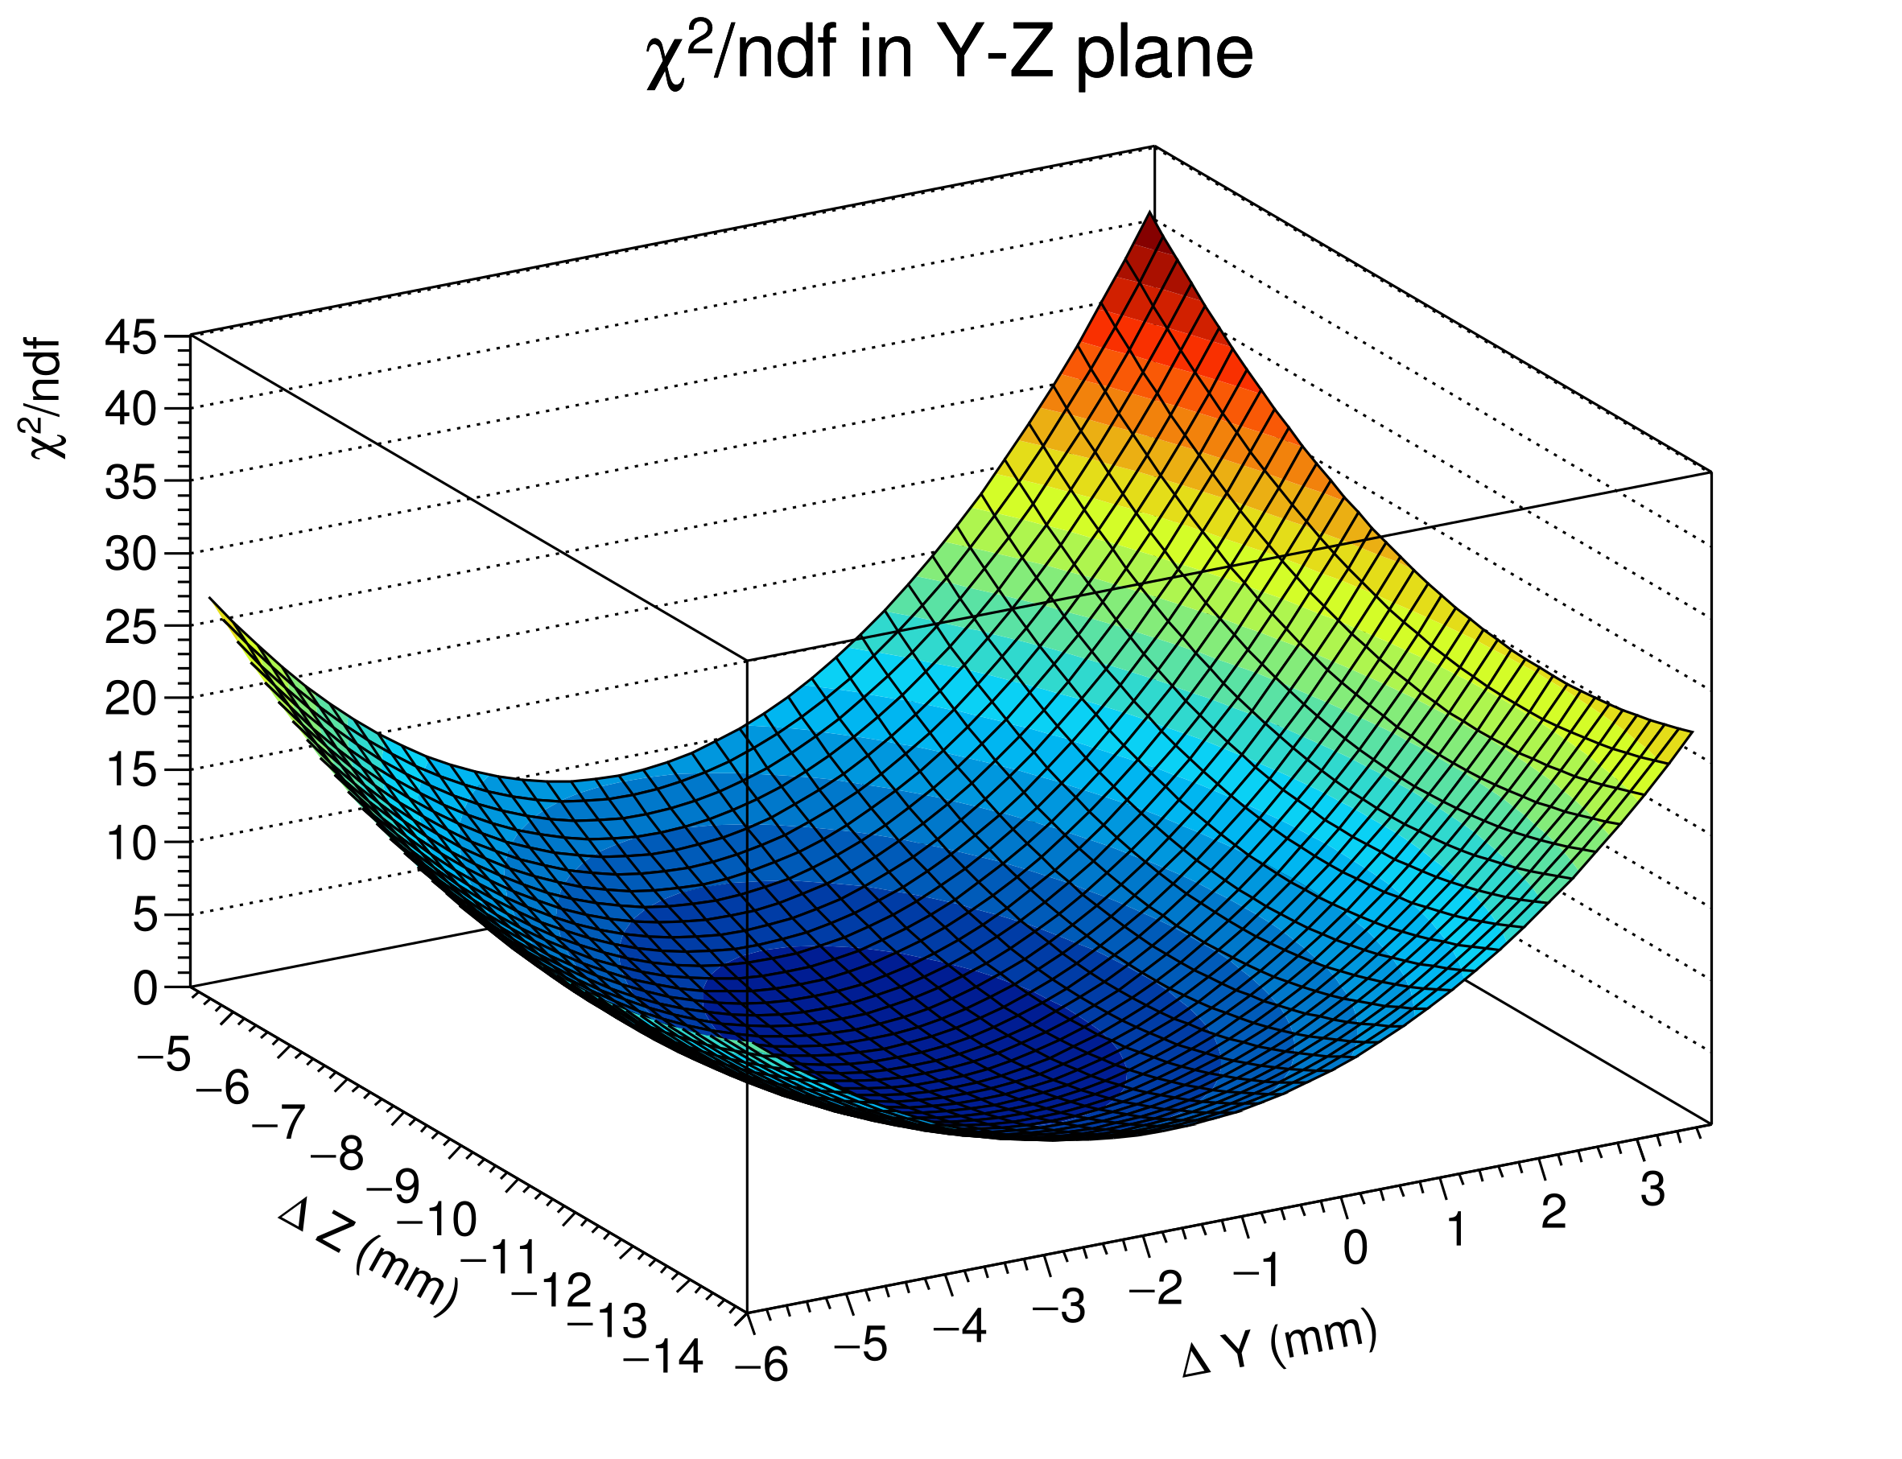



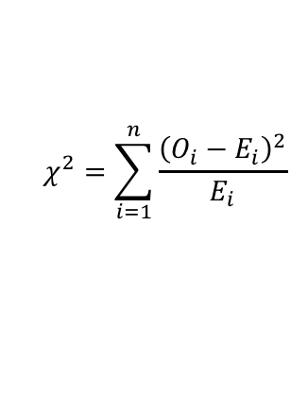

Solid Angle Optimization
Angle/solid angle determination is, determine geometrically for every pixel. Then the data from ¹⁵N is used as at the present energy the behaviour is Rutherford and it is optimized with a $χ^{2}$ test.
Optimal θ, φ and ΔΩ are chosen from the set of free parameters $(\vec{r_{RP}},I_{N})=\left(x_{RP},y_{RP},z_{RP},I_{N}\right)$ minimizing the $χ^{2}$/ndf when compared to the theoretical Rutherford cross section distribution.
The loop happens to converge for several sets $(z_{RP},I_{N})$, so the most feasible one is chosen according to the geometry and the intensity estimation by the ISOLDE beam team.
$$N_{Obs}=I_{beam}⋅t ⋅σ_{Pb}⋅\frac{dσ_{Ruth}}{dΩ}⋅ΔΩ$$
¹⁵N + ²⁰⁸Pb → ¹⁵N + ²⁰⁸Pb
$$\frac{dσ_{Ruth}}{dΩ}={\left(\frac{Z_{1}Z_{2}αℏc}{4ECM}\right)}^{2}\frac{1}{\sin^{4}{(θ_{CM}/2)}}$$
$$χ^{2}=\sum_{i=1}^{n}{\frac{{\left(O_{i}−E_{i}\right)}^{2}}{E_{i}}}$$
Unique Interaction Point
Notes:
R_rp = vector de las coordenadas el punto de reacción.
T is the time of measurement
Sigma_Pb = densidad superficial , SigmaPb = 3.29x1028m-3 x leff; donde leff = 1.32 x10-6 m /cos30º (=0.87) = 1,5 x10-6 m
Reaction symmetry axis
15N in telescopes A and B huge sensitivity due to [sin(thetaCM/2)]-4
Coordinates X_{RP} y Y_{RP} calculated for each angle, theta,phi and omega . Z_{RP} calculated by default
Νο τιλτ ιν τηε βεαμ αππρεχιατεδ.

Slide 14
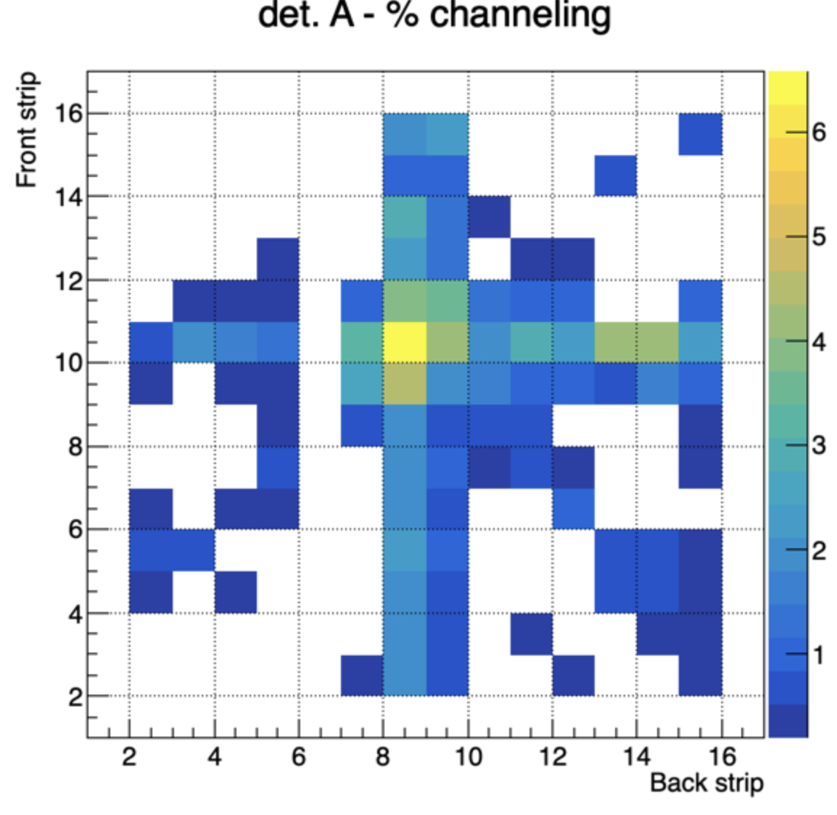
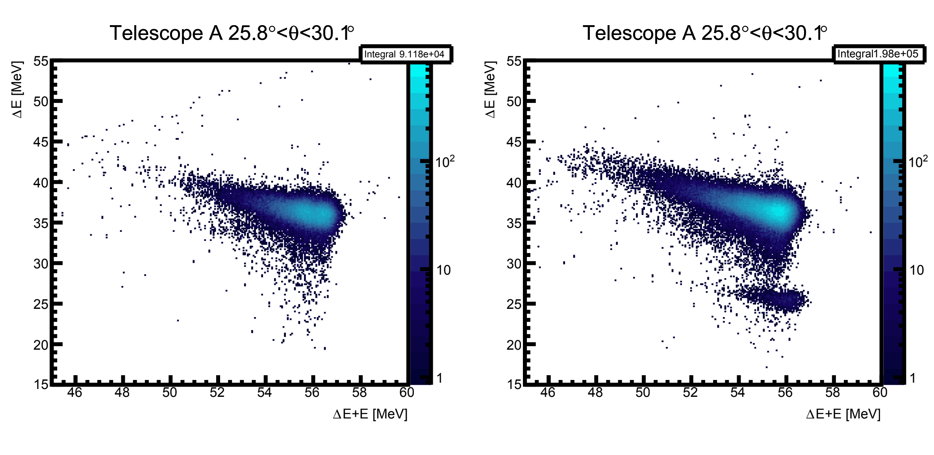
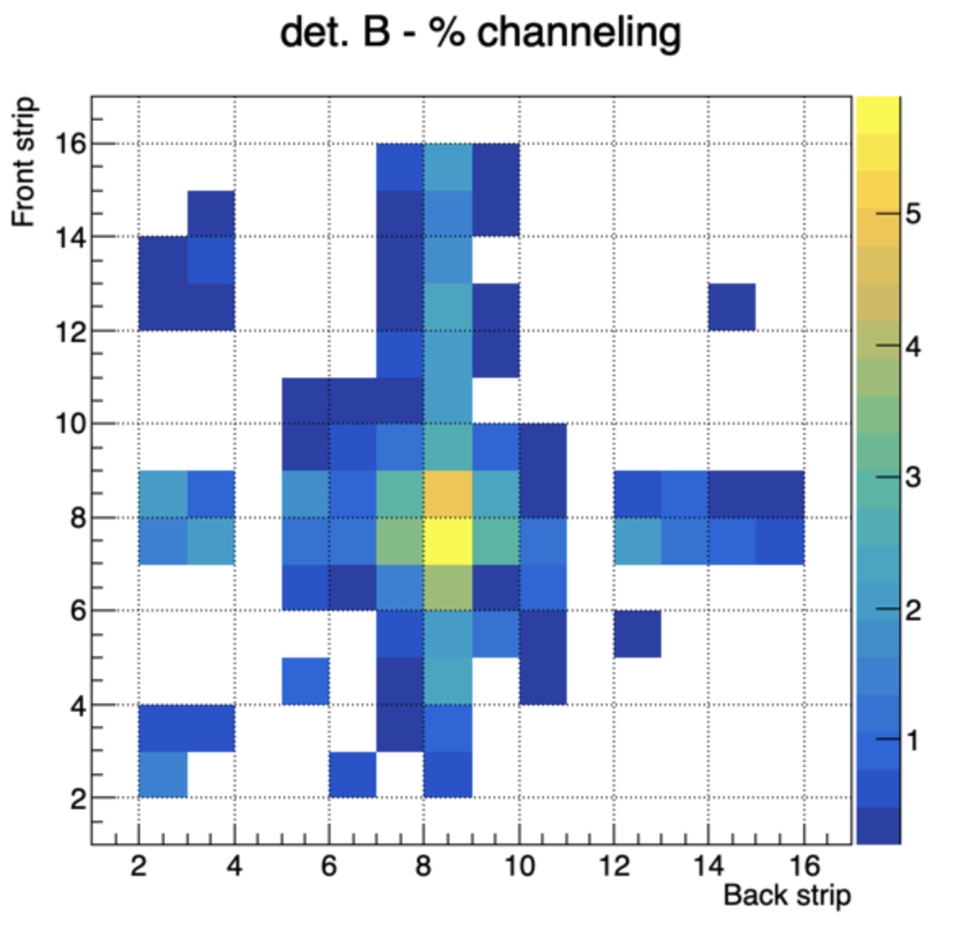
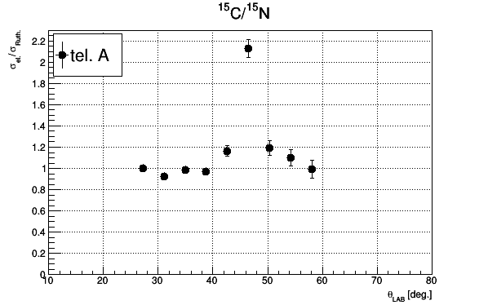
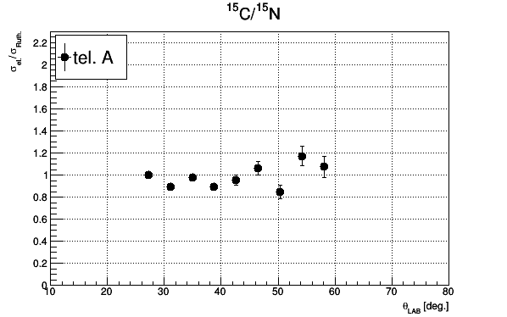
Channeling Effects
Channeling through Si lattice in ΔE detectors leads to a smaller energy deposition.
It happens in specific regions where the trajectory of the incident particle coincides with a channel of the detector wafer.
The channeling of ¹⁵N overlap with elastic of site of ¹⁵C
¹⁵N
¹⁵N
¹⁵C
Channeling corrected
Notes:
On the other hand, one sees in the mass spectra that the channeling tail of 15N overlaps the carbon region, so this effect has to be corrected by using files with only nitrogen and estimating the amount of channeling overlapping on every pixel and substracting it to the counts of 15C one integrates in the elastic cut.
We observe in the right side plots how if you do not consider this substraction, the ratio between the isotopes skyrockets at the points where the channeling is favored. This effect starts to be important in the moment where the amount of channeling is comparable to the amount of good C elastic events and we can see than at some points, we can even double the amount of carbon.
After substraction however the resulting trend is smoother and more realistic. Still the error introduced by this estimation needs to be calculated since in some regions the number of channeling counts is very small and, doing it pixel by pixel we can even get negative counts of carbon, which is clearly not possible, and by now, have been rejected.
The ffect is máximum in F10B8 reaching 6% of 15N events. Out of these two strips the effects is minor.. When reaches 6% is well above the 2% percentage of 15C versus 15N

Slide 15
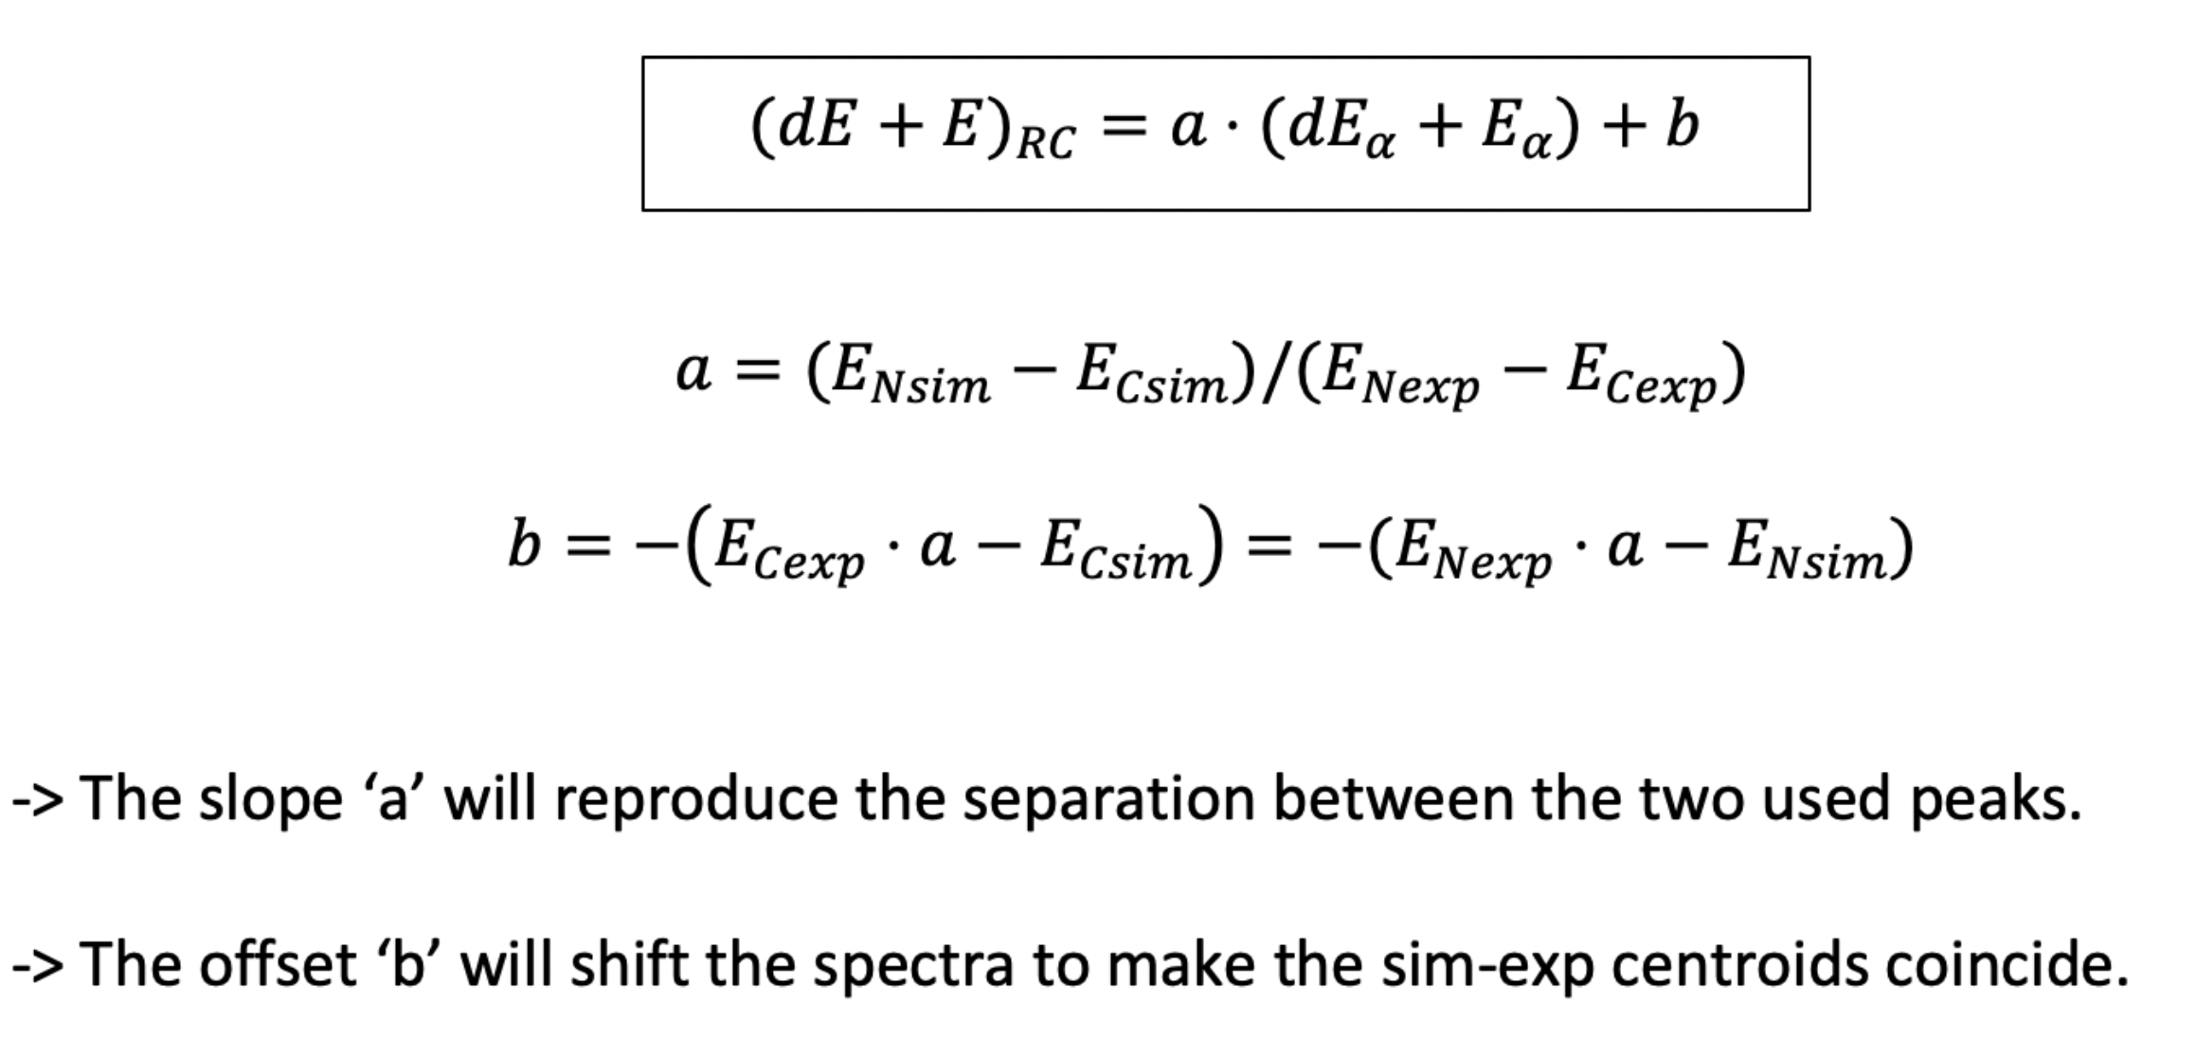
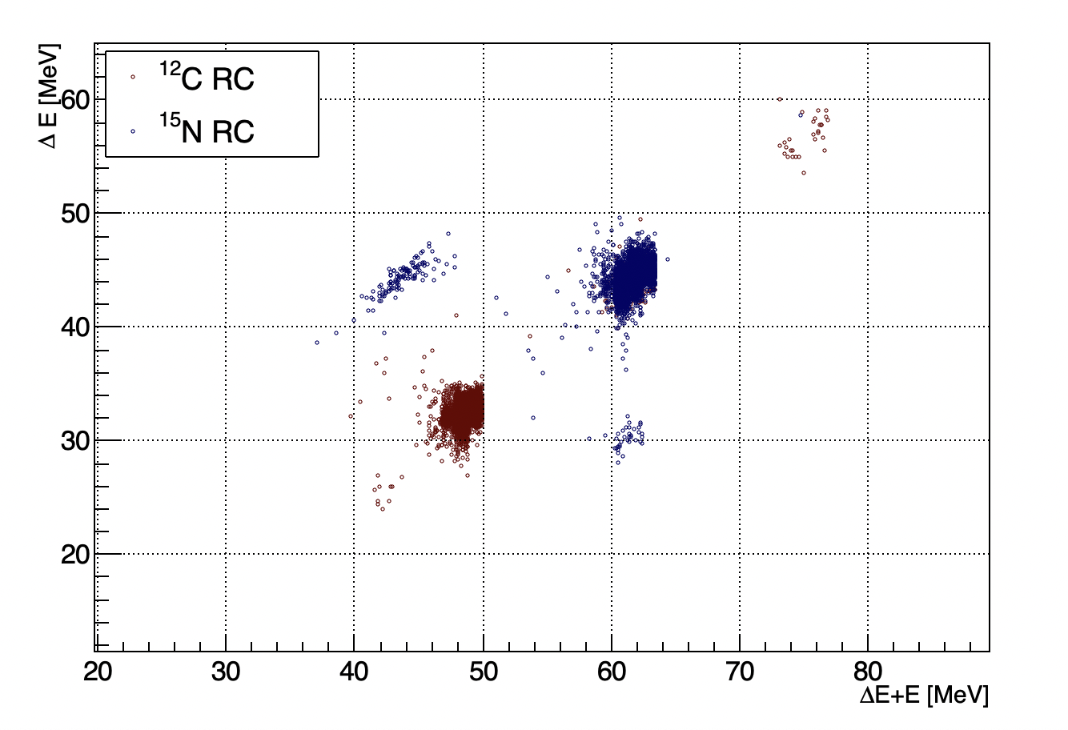
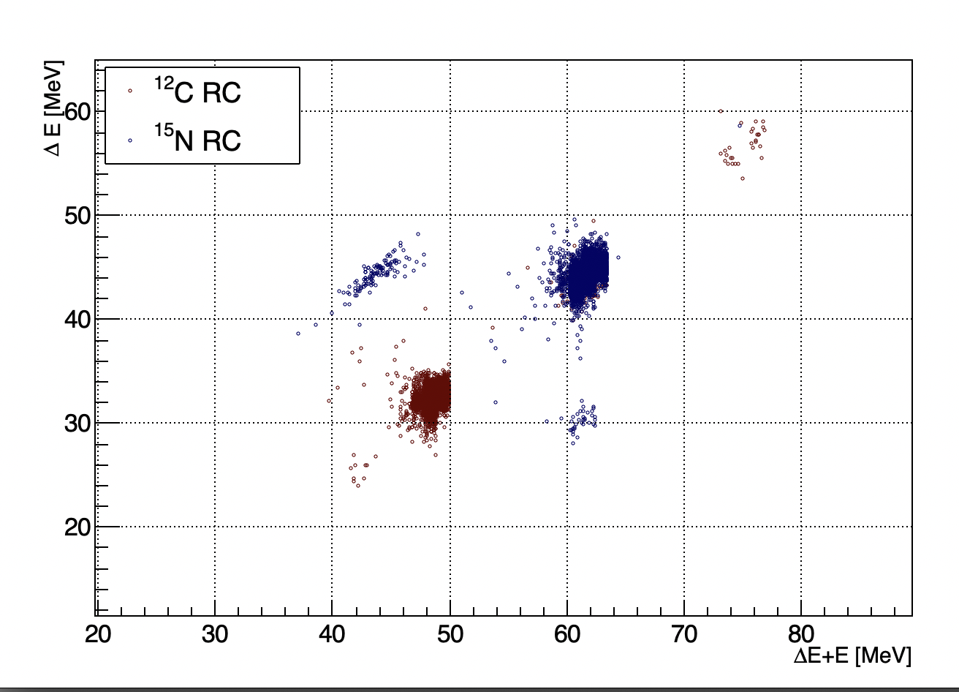
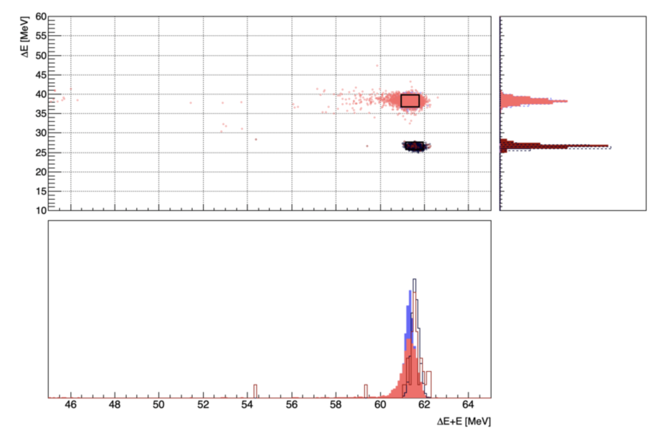
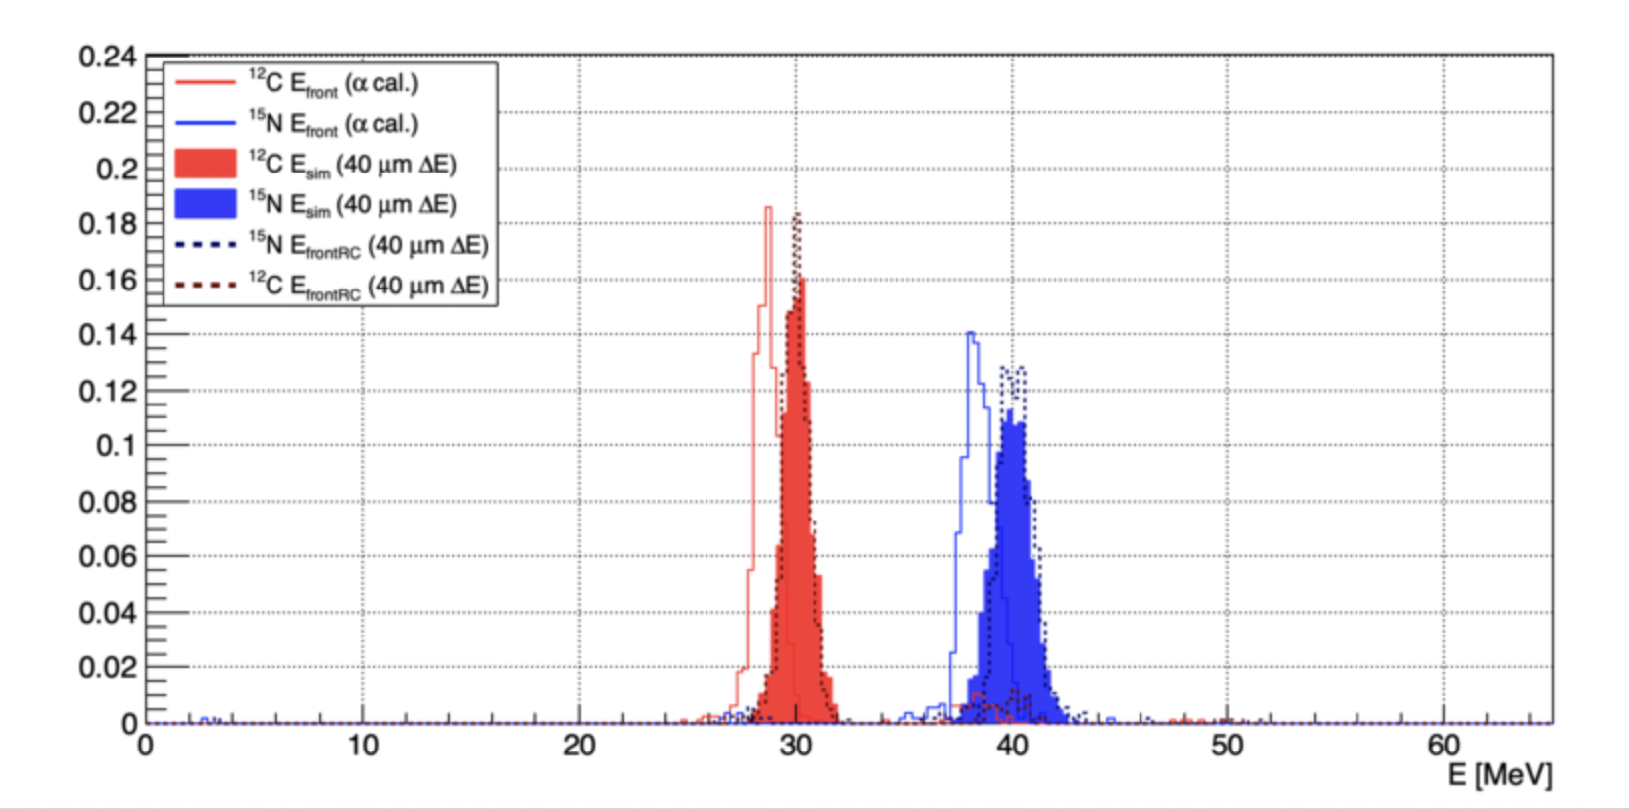
Calibration with α and heavy ions
Telescope A , pixel F2B2 = 26,7º
¹⁸O
¹⁵N
¹⁵C
¹²C
No sign of break up events

Slide 16
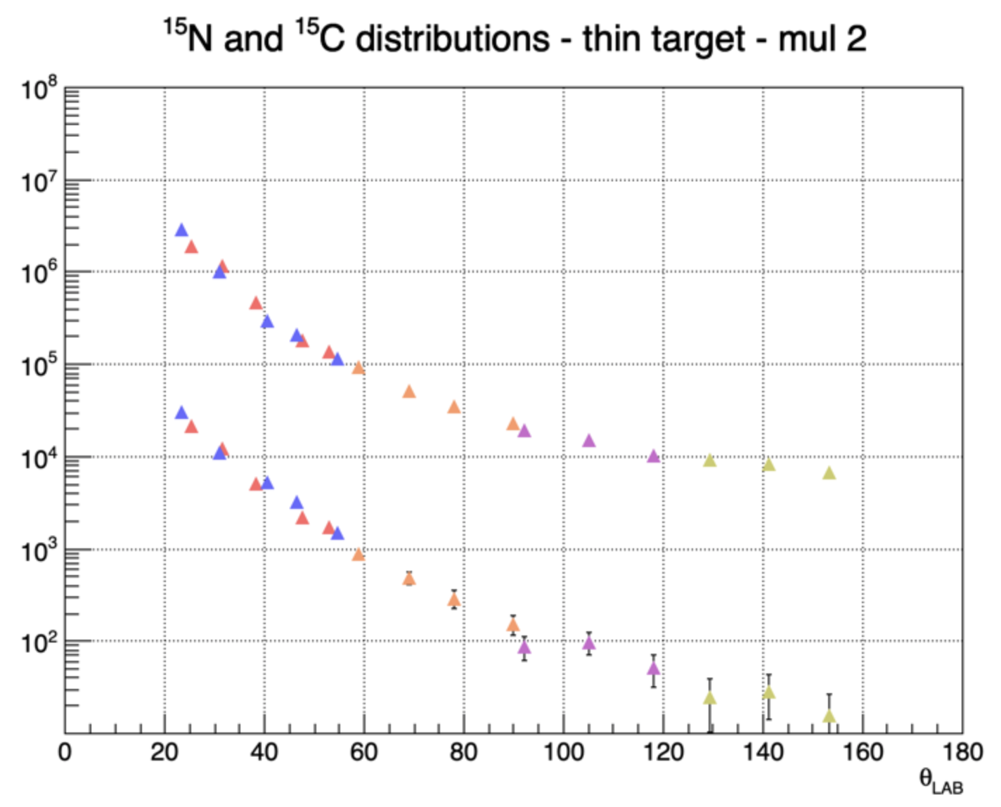
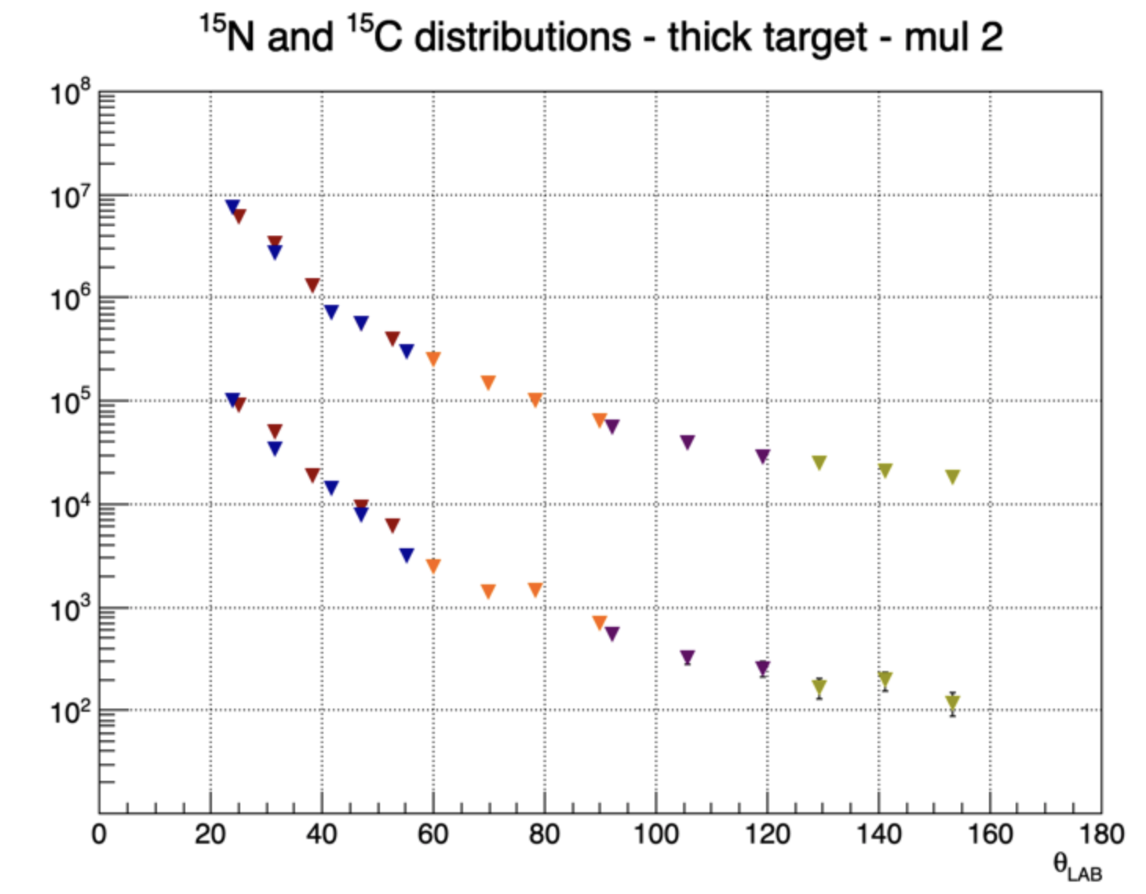
¹⁵N / ¹⁵C Distributions
θ_{LAB}
θ_{LAB}

Slide 17
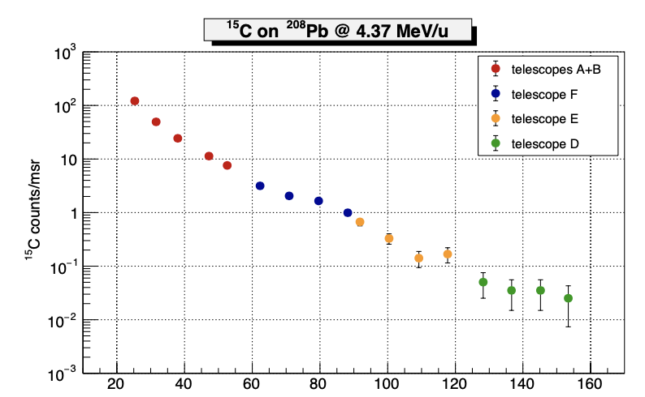
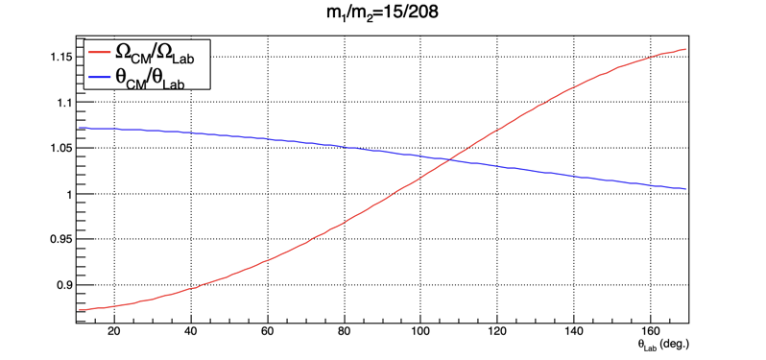
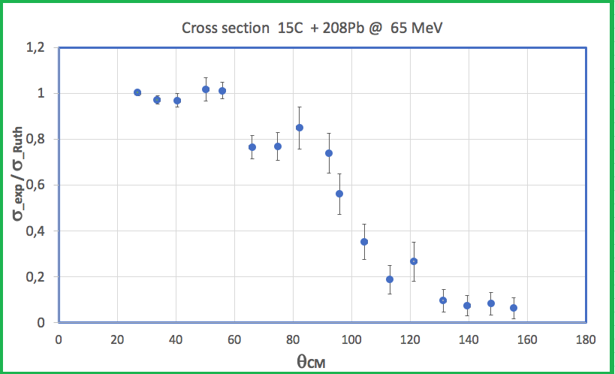
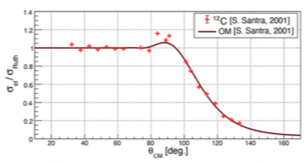
¹⁵C + ²⁰⁸Pb Cross Section
θ_{LAB}
Santra et al., PRC 64 (2001) 024602
¹²C+ ²⁰⁸Pb @ 65 MeV

Slide 18
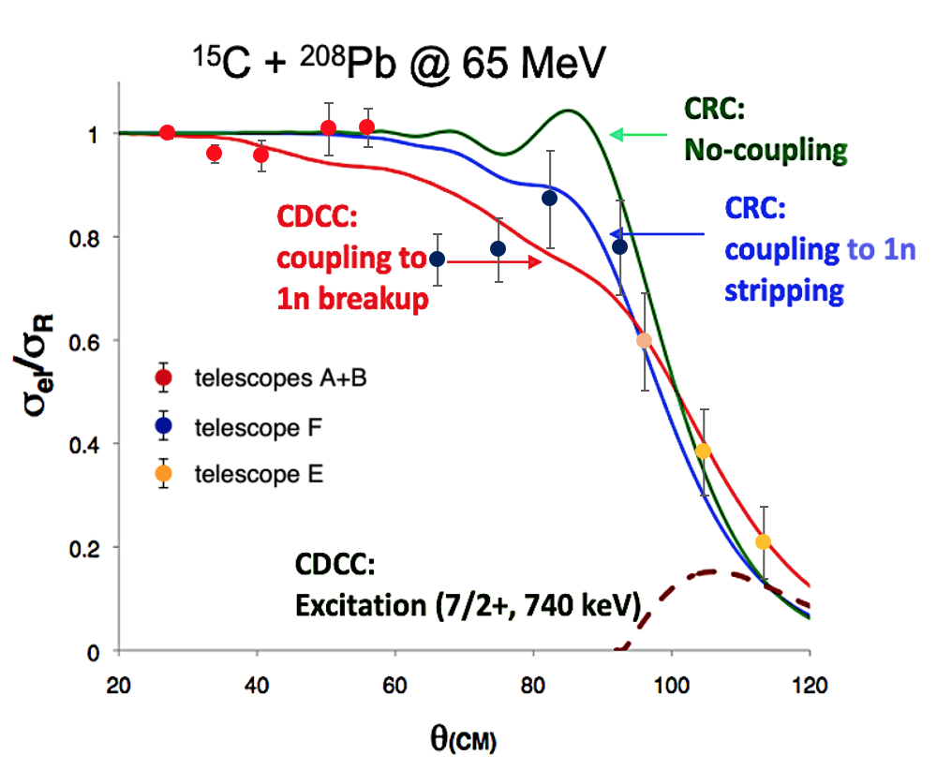
Comparison of Experimental results with Theory
The experimental angular distribution cross section of ¹⁵C + ²⁰⁸Pb @ 65 MeV are compared with the calculations done by Keenley et al., for the extreme case of no coupling and 1n-stripping within the coupled reaction channel and CDCC for no coupling and 1n breakup.
N. Keenley et al., PRC 75 (2007) 056610; EPJA 50 (2014) 145

Slide 19
Summary & Outlook
We have performed the first study of the angular distribution of the elastic cross section of ¹⁵C + ²⁰⁸Pb @ 65 MeV at HIE-ISOLDE (CERN).
¹⁵C nucleus is a border line halo case with relatively low binding energy, a moderate halo case,
It constitutes a unique case where the last neutron sits mainly in a 1S_{1/2}–wave state.
Predictions on the scattering of ¹⁵C + ²⁰⁸Pb @ 65 MeV were done by Keenley, Alamanos and Rusek in the framework of CRC including 1n-stripping and CDCC including breakup. 1n-stripping contribution wasexpected to be prominent as well as 1n-breakup
The experimental angular distribution of the elastic scattering near the Coulomb Barrier (~ 60 MeV ) shows strong couplings. The distribution favours the presence of 1n-stripping channel. Both the nuclear and Coulomb couplings as important as it the case of ¹¹Be and at difference of ⁶He and ¹¹Li where the Coulomb coupling dominates.
Hopefully the total cross section will support these conclusions

Slide 20
The IS699 collaboration
J.D. Ovejas , V.G. Tavora, O. Tengblad
Instituto de Estructura de la Materia, CSIC, Serrano 113-bis, E-28006 Madrid, Spain
I. Martel, A.M. Sánchez-Bení­tez
Departamento de Física Aplicada, Universidad de Huelva, E-21071, Huelva, Spain
Di Pietro, P. Figuera
INFN, Laboratori Nazionali del Sud, via S. Sofia 62, 1-95123, Catania, Italy
N. Keeley, K. Rusek
National Center for Nuclear Research, ul Andrzeja Soltana 7, 05-400 Otwock, Poland
L. Acosta
Dpto Física Experimental, Instituto de Física , UNAM (Mexico)
J. P. Fernández
Departamento de FAMN, Universidad de Sevilla, Seville, Spain
D. Galaviz
Faculty of Sciences, LIP, Lisbonne, Portugal
Thanks for Your Attention

Slide 21
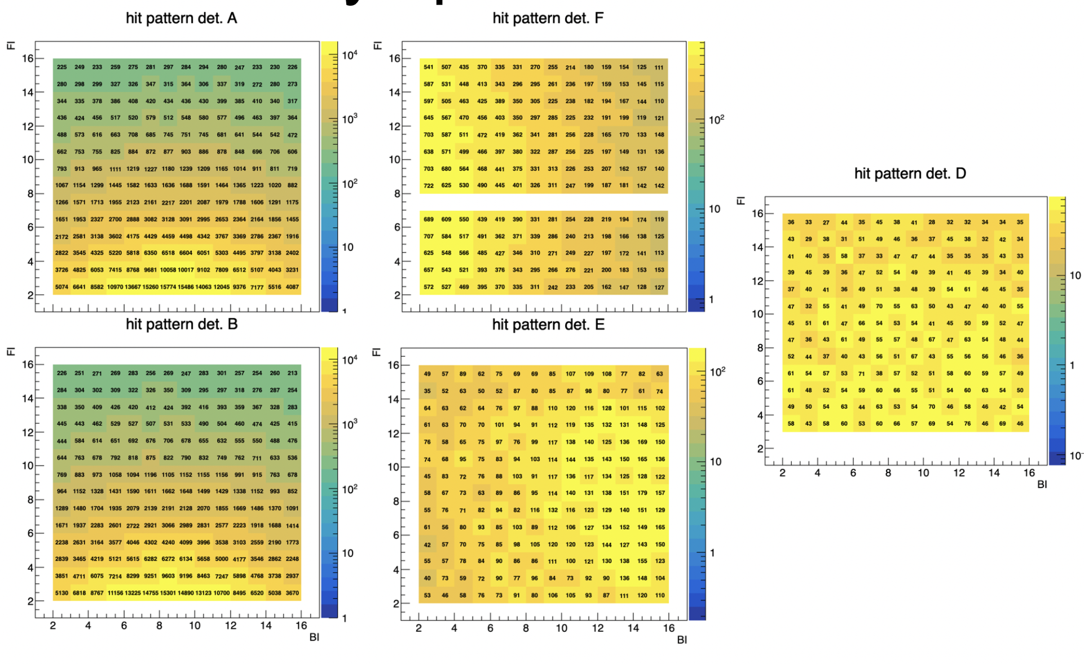
Geometry Optimization / Hit pattern

