Slide 1
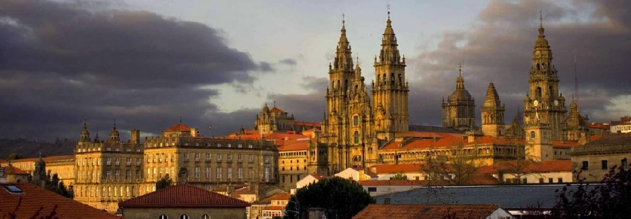
α-cluster structure of ¹⁸Ne
DREB 2022
Marina Barbui, Cyclotron Institute, Texas A&M University
July 1st, 2022

Slide 2
Motivation
¹⁸Ne has been studied only at the low excitation energies interesting for astrophysics (E_{x}< 8 MeV)
A lot of experimental work exists on ¹⁸O (up to E_{x} ≈15 MeV)
M. L. Avila et al., Phys. Rev. C 90, 024327 (2014)
S. Pirrie et al. Phys. Rev. C 102, 064315 (2020)
S. Pirrie et al. Eur. Phys. J A 57, 150 (2021)
E.D. Johnson et al., Eur. Phys. J. A 42, 135–139 (2009)
W. von Oertzen et al., Eur. Phys. J. A 43, 17–33 (2010)
B. Yang et al. Phys. Rev. C 99, 064315 (2019)
A. Cunsolo et al. Phys. Rev. C 24, 476 (1981)
A. Osman, A.A. Farra Il Nuovo Cimento, Vol 103 N12, 1693 (1990)
G.L Morgan et al. Nucl. Phys. A 148, 480 (1970)
G.L. Morgan et al. Phys. Lett. B 23, 353 (1970)
-¹⁸O studied at FSU with TTIK technique
-Resonant elastic scattering of ¹⁴C on ⁴He
-Excitation energy range 8-15 MeV
-High statistics
-Extensive R-matrix analysis
-Provides good starting parameters for the ¹⁸Ne analysis
W.R. Falk et al. Nucl. Phys. A 157, 241 (1970)
S.H. Park et al. Phys. Rev. C 59, 1182 (1999)
Changbo Fu et al., Phys. Rev. C 77, 064314 (2008)
D. R. Tilley et al. Nucl. Phys. A 595, 1-170 (1995)
A.V. Nero et al. Phys. Rev. C 24, 1864 (1981)
K.I. Hahn et al., Phys. Rev. C 54, 1999 (1996)
R. J. Charity et al., Phys. Rev. C 99, 044304 (2019)
J.J. He et al., Eur. Phys. J. A 47, 67 (2011)
B. Harss et al. Phys. Rev. C 65 035803 (2002)

Slide 3
Motivation
Due to isospin symmetry ¹⁸Ne and ¹⁸O should have similar structure, however differences might appear due to isospin-non-conserving interactions such as Coulomb.
Coupling with the continuum might be different in ¹⁸O and ¹⁸Ne due to their different alpha-decay threshold (6.227 and 5.115 MeV) and different Coulomb interaction in the alpha decay channel.
Comparison with shell model to classify α-cluster structures based on their particle-hole configuration and alpha decay channel.

Slide 4
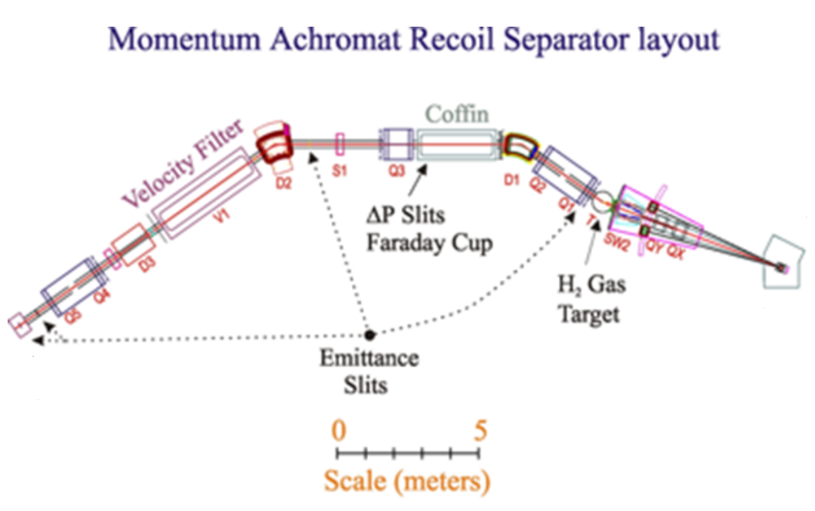
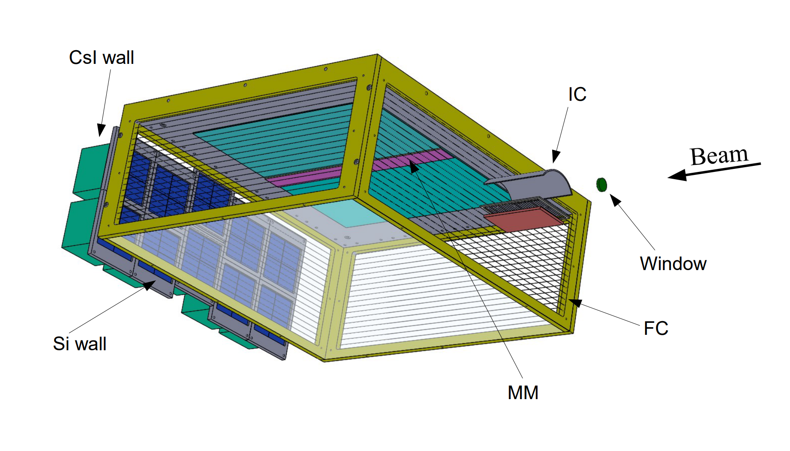
Experimental setup
¹⁴N(p, n)¹⁴O
TexAT active target
⁴He (96%) + CO₂ (4%) @ 580 Torr
Primary beam
¹⁴N @ 11 AMeV K500 Cyclotron
¹⁴O beam @ 61.8 MeV
10⁴ particles/s
(3.8 x 10⁸ total particles)
Excitation function of ¹⁸Ne from resonant elastic scattering of ¹⁴O on ⁴He
E. Koshchiy et al., NIM A 957, 163398 (2020)

Slide 5
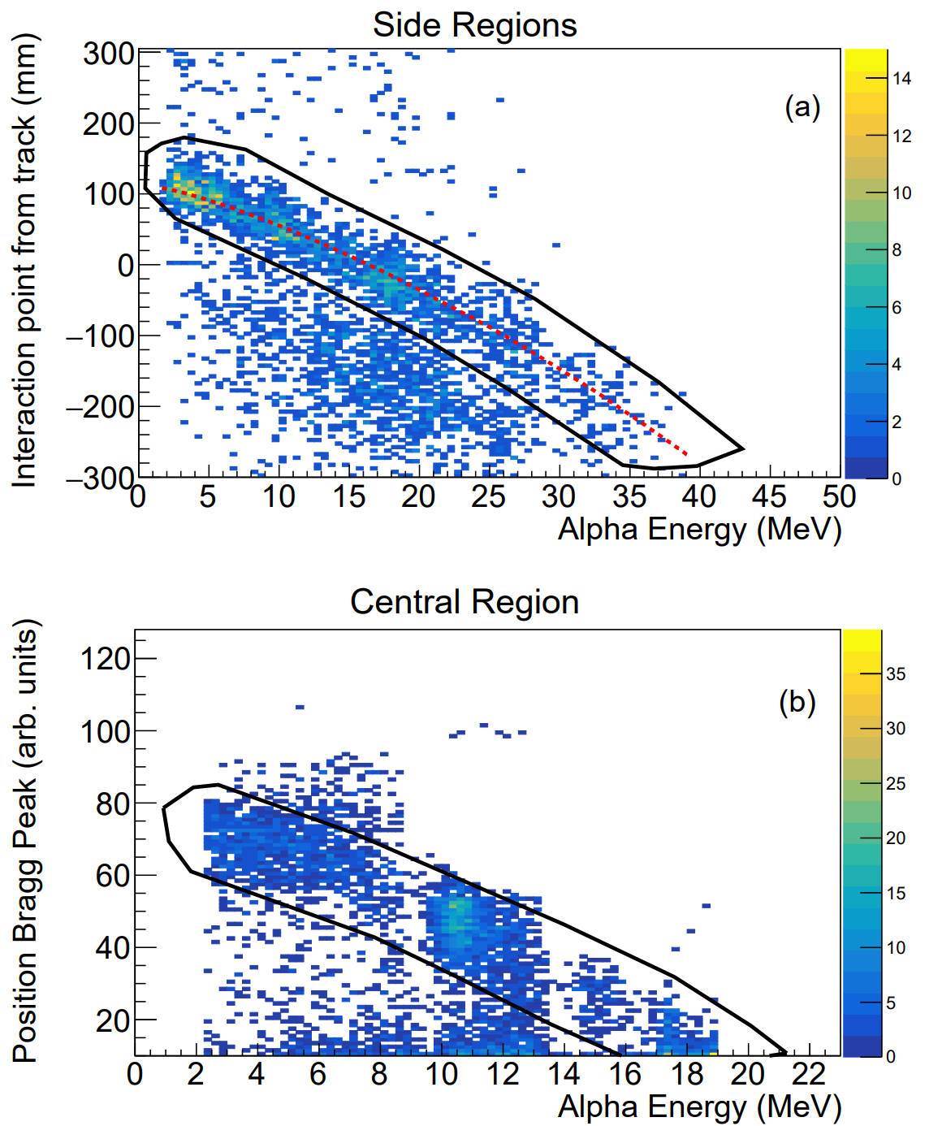
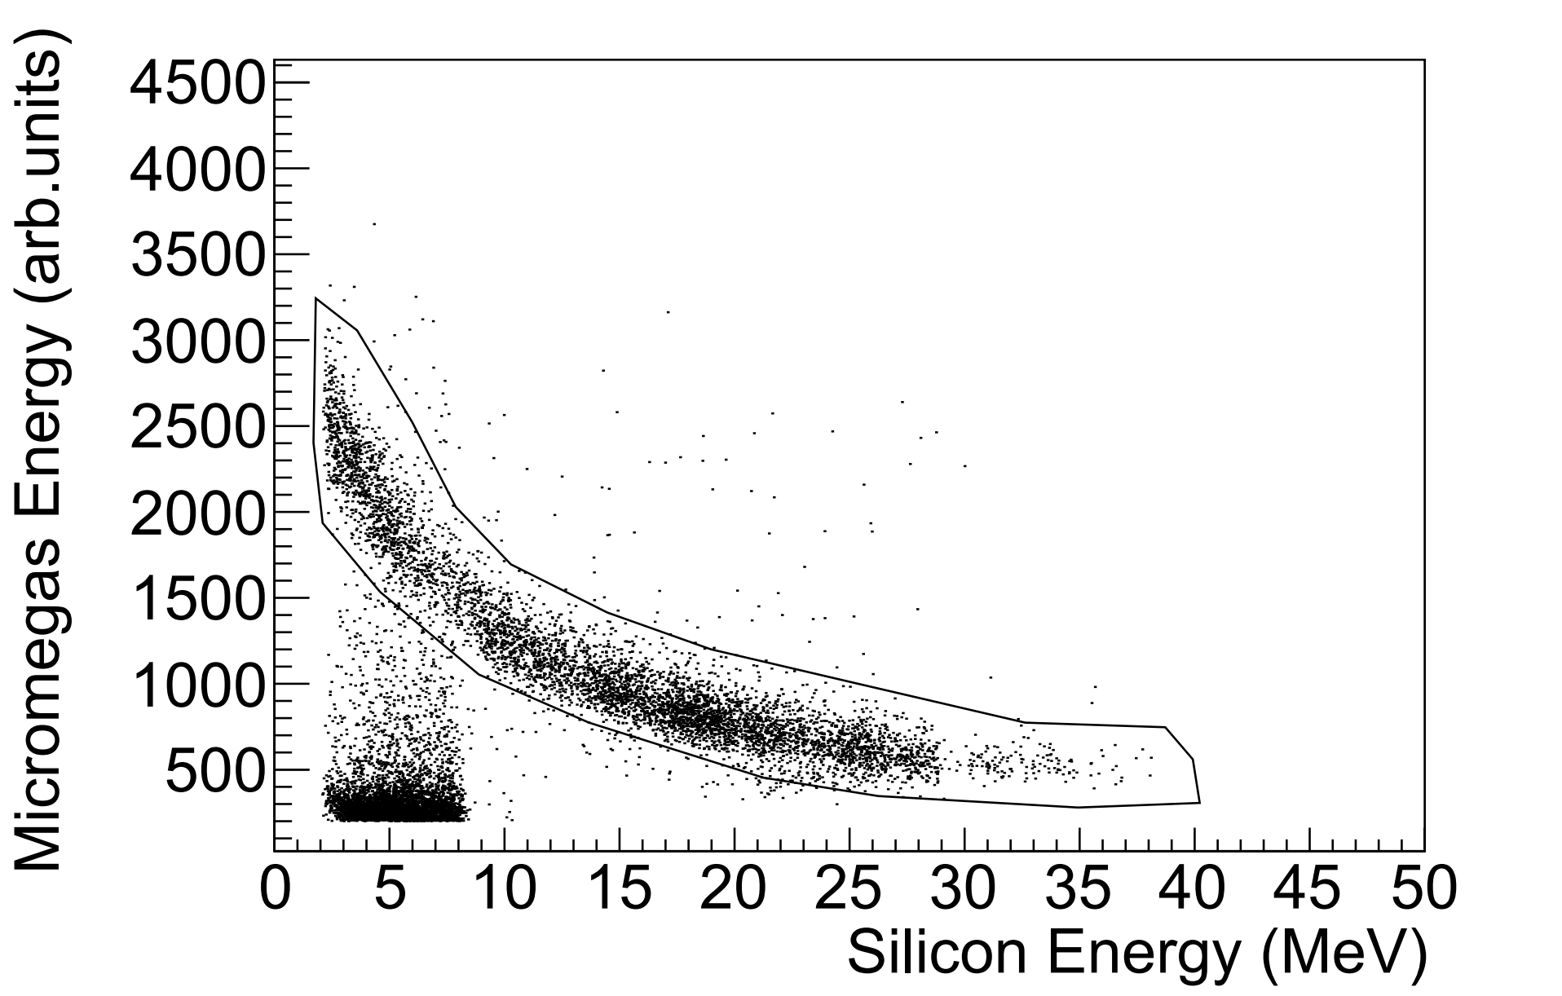
Particle identification and selection of elastic scattering events

Slide 6
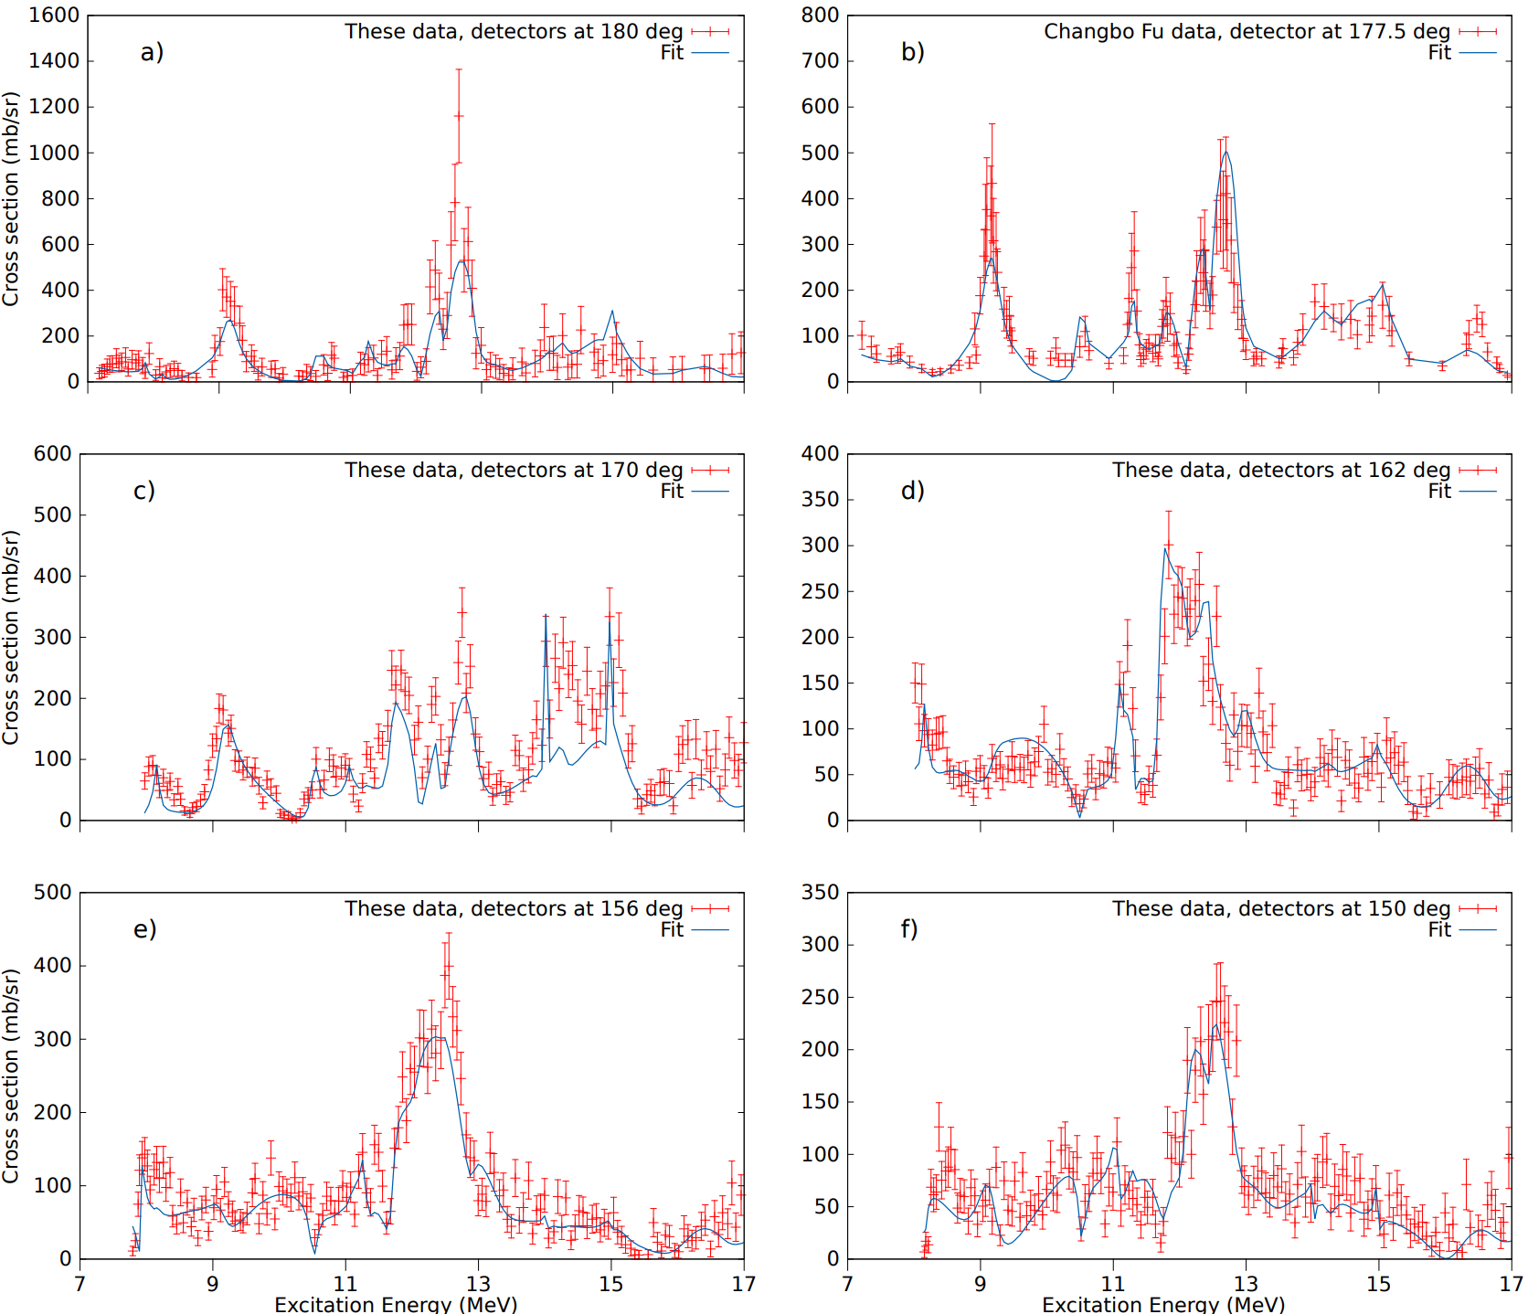
Excitation functions
R-matrix fit
MinRmatrix code, same used by Avlila et al. with the same number of decay channels:
alpha decay channel going to the ground state of ¹⁴O
proton decay channels going to the ¹⁷F ground state (5/2⁺) and to the ¹⁷F first excited state (at 495 keV with 1/2⁺).
Starting from the parameters from M. Avila et al. for ¹⁸O [Phys. Rev. C 90, 024327 (2014)].
29 states, Χ² = 2.7

Slide 7
Shell model calculation
Performed by A. Volya with the configuration interaction technique
FSU Hamiltonian (s, p, sd and fp valence shells) based on the harmonic oscillator and its basis to treat cluster configurations
Different particle-hole configurations are identified by the number of excitation quanta and the number of nodes in the alpha wave function.
Configuration mixing is not considered
The model is isospin-symmetric
K.Kravvaris and A. Volya Phys. Rev. C 100, 034321 (2019)

Slide 8
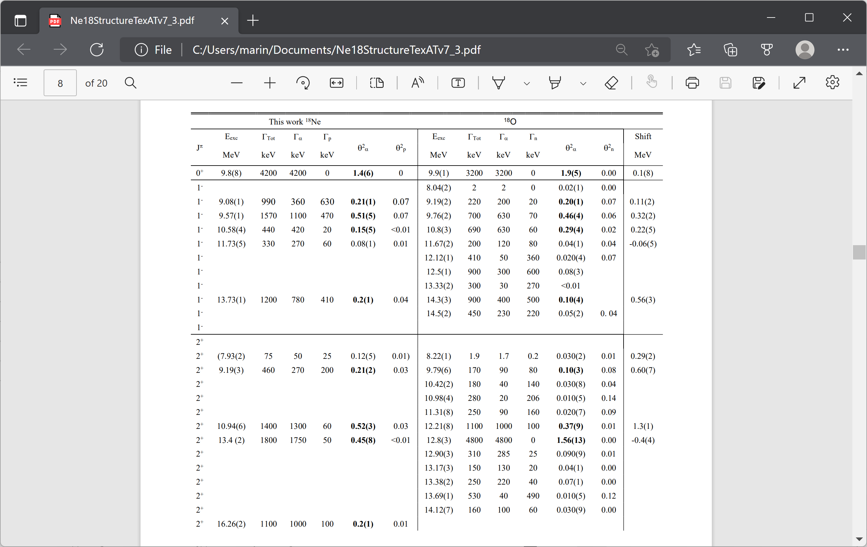
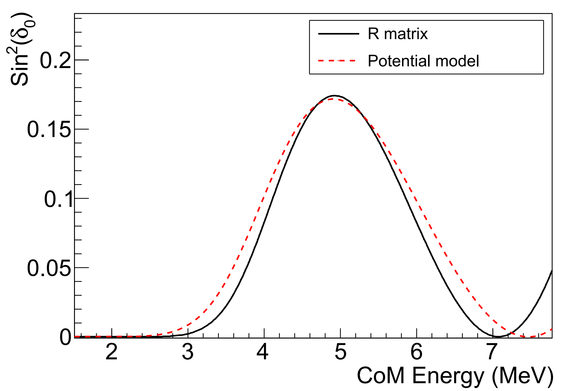
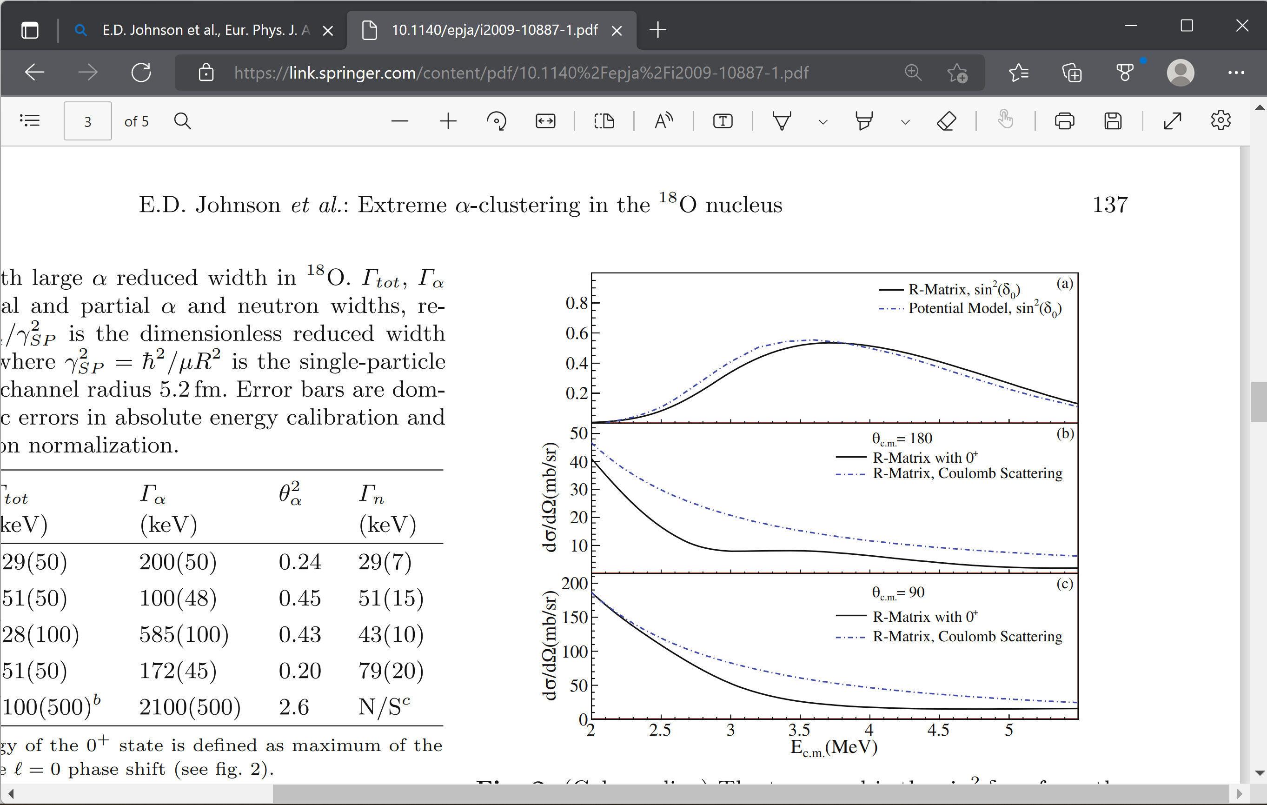
Comparison ¹⁸Ne-¹⁸O
J^{π} = 0⁺
Observed here for the first time
Predicted by OCM model to be shifted down by 500keV respect to ¹⁸O. M. Nakao et al., Phys. Rev. C 98, 054318 (2018)
Observed in ¹⁸O by
M. L. Avila et al., Phys. Rev. C 90, 024327 (2014)
E.D. Johnson et al., Eur. Phys. J. A 42, 135–139 (2009)
α+¹⁴O
The state is
described well
by
α + core with
n = 5 nodes
α+¹⁴C

Slide 9
Comparison with shell model, 0⁺ levels
 | Experiment |  |  | Shell Model
J^{π} | E_{exc} |  | θ²_{a} | E_{exc} |  |  | ℏ𝜔 | N | SF
 | (MeV) |  |  | (MeV)
0⁺ | 0^{[15,18]} |  |  | 0 |  |  | 0 | 3 | 0.74
0⁺ | 3.6^{[15,19]} |  |  | 3.4 |  |  | 2 | 4 | 0.62
0⁺ | 4.6^{[19-21]} |  |  | 4.6 |  |  | 0 | 3 | 0.2
0⁺ | 9.8(8) |  | 1.4(6) | 7.8, 11.8, 12.9, 13.3, 14.1 |  |  | 4 | 5 | <0.01, <0.01, <0.01, 0.02, 0.15
0⁺ |  |  |  | 7.9, 9.8, 10.4, 11.4,11.6, 12.2 |  |  | 2 | 4 | <0.01, 0.01, 0.05, <0.01, <0.01, 0.07
[15] W.R. Falk et al. Nucl. Phys. A 157, 241 (1970) [18] D. R. Tilley et al. Nucl. Phys. A 595, 1-170 (1995) [19] A.V. Nero et al. Phys. Rev. C 24, 1864 (1981) [20] K.I. Hahn et al., Phys. Rev. C 54, 1999 (1996) [21] R. J. Charity et al., Phys. Rev. C 99, 044304 (2019)

Slide 10
Comparison ¹⁸Ne-¹⁸O
J^{π} = 1⁻

Slide 11
Comparison with shell model, 1⁻ levels
 | Experiment |  |  | Shell Model
J^{π} | E_{exc} |  | θ²_{a} | E_{exc} |  |  | ℏ𝜔 | N |  | SF | SF
 | (MeV) |  |  | (MeV)
1⁻ | 4.5^{[20, 21]} |  |  | 4.5 |  |  | 1 | 3 |  | 0.22 | 0.22
1⁻ | 6.2^{[20, 21, 23]} |  | 0.2(1)^{[23]} | 6.7 |  |  | 1 | 3 |  | 0.12 | 0.12
1⁻ | 7.6^{[22, 23]} |  | 0.01^{[23]} | 7.4 |  |  | 1 | 3 |  | 0.39 | 0.39
1⁻ | 9.08(1) |  | 0.21(1) | 7.8, 9 |  |  | 1 | 3 |  | <0.01, 0.02 | <0.01, 0.02
1⁻ | 9.57(1) |  | 0.51(5) | 9.4, 9.8 |  |  | 3 | 4 |  | 0.47, <0.01 | 0.47, <0.01
1⁻ | 10.58(4) |  | 0.15(7) | 10.4, 10.9 |  |  | 3 | 4 |  | 0.13, <0.01 | 0.13, <0.01
1⁻ | 11.73(5) |  | 0.08(1) | 11.5, 11.9, 12.1,12.3,12.8 13.6 |  |  | 1 | 3 |  | <=0.01 | <=0.01
1⁻ |  |  |  | 12.4, 12.8, 13.2, 13.3 |  |  | 3 | 4 |  | <=0.01 | <=0.01
1⁻ | 13.73(1) |  | 0.2(1) | 13.2, 13.3 |  |  | 3 | 4 |  | <=0.01 | <=0.01
1⁻ | 13.73(1) |  | 0.2(1) | 11.8, 13.05 |  |  | 5 | 5 |  | N/A | N/A
[20] K.I. Hahn et al., Phys. Rev. C 54, 1999 (1996) [21] R. J. Charity et al., Phys. Rev. C 99, 044304 (2019) [22] J.J. He et al., Eur. Phys. J. A 47, 67 (2011) [23] B. Harss et al. Phys. Rev. C 65 035803 (2002)

Slide 12
J^{π} = 2⁺
Comparison ¹⁸Ne-¹⁸O

Slide 13
Comparison with shell model, 2⁺ levels
 | Experiment |  | Shell Model
J^{π} | E_{exc} | θ²_{a} | E_{exc} | ℏ𝜔 | N | SF
 | (MeV) |  | (MeV)
2⁺ | 1.9^{[15,19]} |  | 2.0 | 0 | 2 | 0.64
2⁺ | 3.6^{[15, 19]} |  | 4.4 | 0 | 2 | 0.15
2⁺ | 5.1^{[19, 20]} |  | 5.1 | 2 | 3 | 0.62
2⁺ | (7.93(2)) | (0.12(5)) | 9, 9.47, 9.51 | 2 | 3 | <0.01
2⁺ | 9.19(3) | 0.21(2) | 9.9, 11 | 0 | 2 | 0.08, 0.1
2⁺ | 10.94(6) | 0.52(3) | 9.1, 10.7, 10.8 | 4 | 4 | <0.01
2⁺ | 13.4(2) | 0.45(8) | 10.3, 10.5, 10.9, 10.94, 11.6, 11.7 | 2 | 3 | 0.03, 0.02, <0.01, 0.01, <0.01
2⁺ | 13.4(2) | 0.45(8) | 12.5, 12.8, 13.3, 13.8, 13.9, 14.4, 14.8 | 4 | 4 | <0.01
2⁺ | 16.26(2) | 0.2(1) | 16.2 | 0 | 2 | 0.03

Slide 14
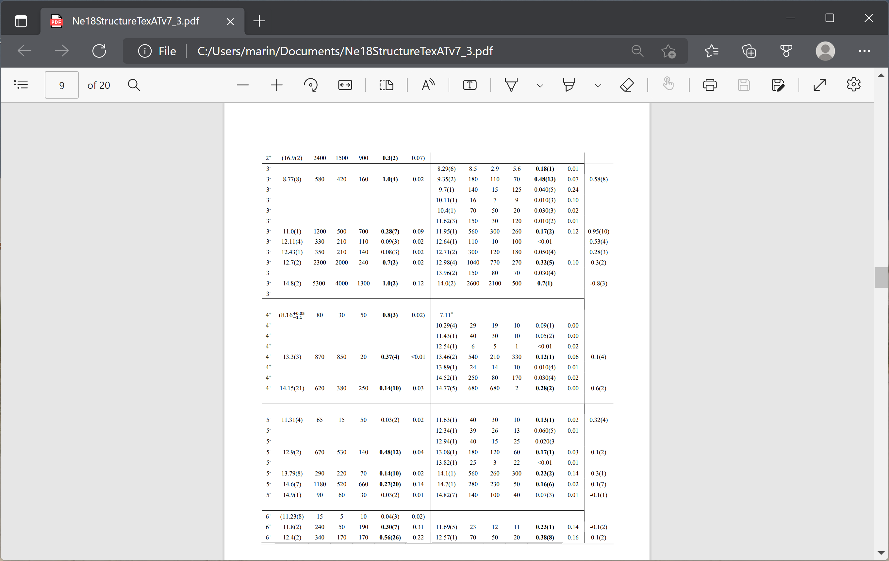
Comparison ¹⁸Ne-¹⁸O
J^{π} = 3⁻
could be added but it is not relevant to the fit

Slide 15
Comparison with shell model, 3⁻ levels
 | Experiment |  | Shell Model
J^{π} | E_{exc} | θ²_{a} | E_{exc} | ℏ𝜔 | N | SF
 | (MeV) |  | (MeV)
3⁻ | 5.1^{[18, 20, 21]} |  | 5.1 | 1 | 2 | 0.48
3⁻ | 6.3^{[20, 23]} | 0.02^{[23]} | 6.4 | 1 | 2 | 0.05
3⁻ | 8.29^{*[5]} | 0.18(1) | 7.8 | 1 | 2 | 0.13
3⁻ | 8.77(8) | 1.0(4) | 8.95 | 3 | 3 | 0.14
3⁻ | 8.77(8) | 1.0(4) | 8.98, 9.5, 9.9, 10.6 | 1 | 2 | 0.03, <0.01, 0.05, 0.06
3⁻ | 11.0(1) | 0.28(7) | 10.7 | 3 | 3 | 0.33
3⁻ |  |  | 10.9, 11.1, 11.5 | 1 | 2 | <0.01
3⁻ | 12.11(4) | 0.09(3) | 12.1 | 3 | 3 | 0.09
3⁻ | 12.43(1) | 0.08(5) | 12.3, 12.9, 13.44 | 3 | 3 | 0.01, 0.03, 0.01
3⁻ |  |  | 12.6, 12.9 | 1 | 2 | <0.01
3⁻ | 12.7(2) | 0.7(2) | 13.5, 13.7, 14.0 | 3 | 3 | 0.03, 0.02, <0.01
3⁻ | 12.7(2) | 0.7(2) | 13.1, 13.5, 14, 14.2 | 1 | 2 | 0.03, 0.02, <0.01, <0.01
3⁻ | 14.8(2) | 1.0(2) | 12.39 | 5 | 4 | N/A

Slide 16
Comparison ¹⁸Ne-¹⁸O
J^{π} = 4⁺
7.05(10) MeV with θ²_{α} = 0.5(2) [Harss et al.]
Could be added but it is not significant to the fit

Slide 17
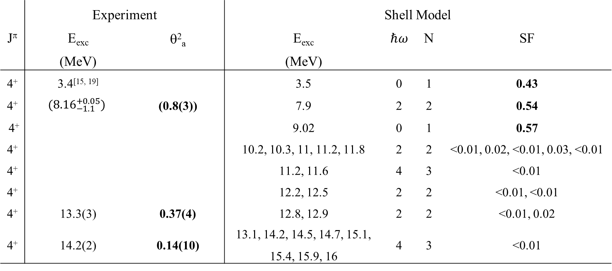
Comparison with shell model, 4⁺ levels
 | Experiment |  | Shell Model
J^{π} | E_{exc} | θ²_{a} | E_{exc} | ℏ𝜔 | N | SF
 | (MeV) |  | (MeV)
4⁺ | 3.4^{[15, 19]} |  | 3.5 | 0 | 1 | 0.43
4⁺ | $$({8.16}_{−1.1}^{+0.05})$$ | (0.8(3)) | 7.9 | 2 | 2 | 0.54
4⁺ |  |  | 9.02 | 0 | 1 | 0.57
4⁺ |  |  | 10.2, 10.3, 11, 11.2, 11.8 | 2 | 2 | <0.01, 0.02, <0.01, 0.03, <0.01
4⁺ |  |  | 11.2, 11.6 | 4 | 3 | <0.01
4⁺ |  |  | 12.2, 12.5 | 2 | 2 | <0.01, <0.01
4⁺ | 13.3(3) | 0.37(4) | 12.8, 12.9 | 2 | 2 | <0.01, 0.02
4⁺ | 14.2(2) | 0.14(10) | 13.1, 14.2, 14.5, 14.7, 15.1, 15.4, 15.9, 16 | 4 | 3 | <0.01

Slide 18
Comparison ¹⁸Ne-¹⁸O
J^{π} = 5⁻

Slide 19
Comparison with shell model, 5⁻ levels
 | Experiment |  | Shell Model
J^{π} | E_{exc} | θ²_{a} | E_{exc} | ℏ𝜔 | N | SF
 | (MeV) |  | (MeV)
5⁻ | 7.9*^{[9,18]} |  | 7.8 | 1 | 1 | 0.32
5⁻ | 8.1*^{[9,18]} |  | 8.4 | 1 | 1 | 0.36
5⁻ | 9.7*^{[18]} |  | 9.6 | 1 | 1 | <0.01
5⁻ | 11.31(4) | 0.03(2) | 11.8 | 3 | 2 | 0.02
5⁻ |  |  | 12.4, 12.7,13.3 | 1 | 1 | <=0.01
5⁻ | 12.9(2) | 0.5(1) | 13.8, 14.1 | 1 | 1 | 0.05, 0.02
5⁻ | 13.79(8), 14.6(7) | 0.14(1), 0.3(2) | 13.7, 14.3, 14.7,14.9 | 3 | 2 | 0.25, <0.01, 0.02, 0.04
5⁻ | 14.9(1) | 0.03(2) | 14.6, 14.7,15.2 | 1 | 1 | <0.01, 0.02,0.02
5⁻ |  |  | 13.9 | 5 | 3 | N/A
5⁻ |  |  | 15.2,15.3,15.5 | 3 | 2 | 0.01, <0.01, 0.08
[9] ¹⁸O, W. von Oertzen et al., Eur. Phys. J. A 43, 17–33 (2010)
[18] ¹⁸O, D. R. Tilley et al. Nucl. Phys. A 595, 1-170 (1995)

Slide 20
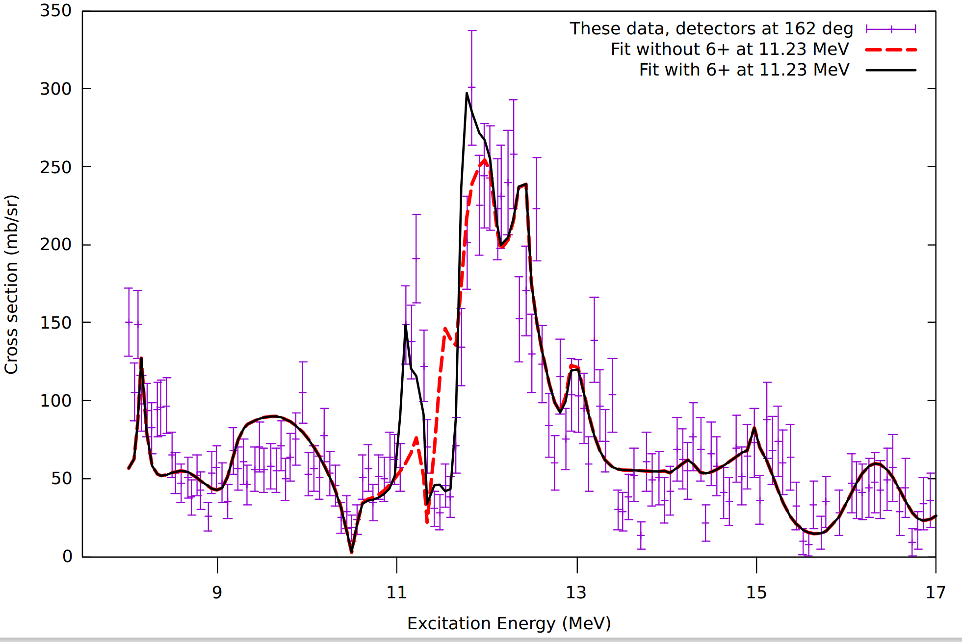
Comparison ¹⁸Ne-¹⁸O
J^{π} = 6⁺

Slide 21
Comparison with shell model, 6⁺ levels
 | Experiment |  | Shell Model
J^{π} | E_{exc} | θ²_{a} | E_{exc} | ℏ𝜔 | N | SF
 | (MeV) |  | (MeV)
6⁺ | (11.23) | (0.04(3)) | 12.1 | 0 | 0 | 0.07
6⁺ | 11.8(2) | 0.30(7) | 12.5 | 0 | 0 | 0.44
6⁺ | 12.4(2) | 0.6(3) | 13.5 | 2 | 1 | <0.01
6⁺ | 12.4(2) | 0.6(3) | 13.7 | 0 | 0 | 0.01
A paper about these results has been submitted to Phys.Rev. C
A preview is available on arXiv:2206.10659

Slide 22
Conclusions
Alpha clustering is strong in ¹⁸O and ¹⁸Ne.
The shell model reproduces the experimental levels well especially at energies lower than 10-11 MeV
Since the model used does not consider mixing this good agreement suggests that clustering inhibits particle-hole mixing
At higher energies the observed states are more clustered than predicted. This can be due to the limitations of the model.
However, the fact that, in the experiment, on each J^{π} group, one or two levels for each configuration absorb all the alpha strength going in that reaction channel suggests that these could be superradiant states.
More experimental and theoretical efforts are necessary to further investigate the role of superradiance in the formation of α-cluster states

Slide 23


Thank you for your attention!
M. Barbuiª, A. Volya^{a,e}, E. Aboud^{a,1}, S. Ahn^{a,2}, J. Bishopª, V.Z. Goldbergª, J. Hookerª, C.H. Hunt^{a,3}, H. Jayatissa^{a,4}, Tz. Kokalova^{d}, E. Koshchiyª, S. Pirrie^{d}, E. Pollacco^{b}, B.T. Roederª, A. Saastamoinenª, S. Upadhyayula^{a,5}, C. Wheldon^{d} and G.V. Rogachev^{a,c}
ª Cyclotron Institute, Texas A&M University, MS3366 College Station, TX, 77843, USA
^{b} IRFU, CEA, Saclay, Gif-sur-Yvette, France
^{c} Department of Physics &Astronomy, Texas A&M University, College Station, TX 77843, USA
^{d} School of Physics and Astronomy, University of Birmingham, Birmingham, United Kingdom
^{e} Department of Physics, Florida State University, Tallahassee, FL 32306-4350, USA
This work was supported by the United States Department of Energy under Grant No. DE-FG03- 93ER40773 and No. DE-SC0009883 and by the UK Science and Technology Facilities Council (STFC) under Grant No. ST/P004199/1

Slide 26
Comparison with AMD calculations on ¹⁸O
T. Baba and M. Kimura, Phys. Rev. C 100, 064311 (2019)
Geometrical alpha cluster configurations in ¹⁸O
They found 5 different types of cluster states
We can compare with the states in ¹⁸Ne
¹⁴C + α
¹⁴C + α higher nodal
Molecular state 1
Molecular state 2
4α linear-chain.
Alpha decay
Alpha decay
⁶He decay
⁶He decay
Alpha decay
Outside our energy range

Slide 27
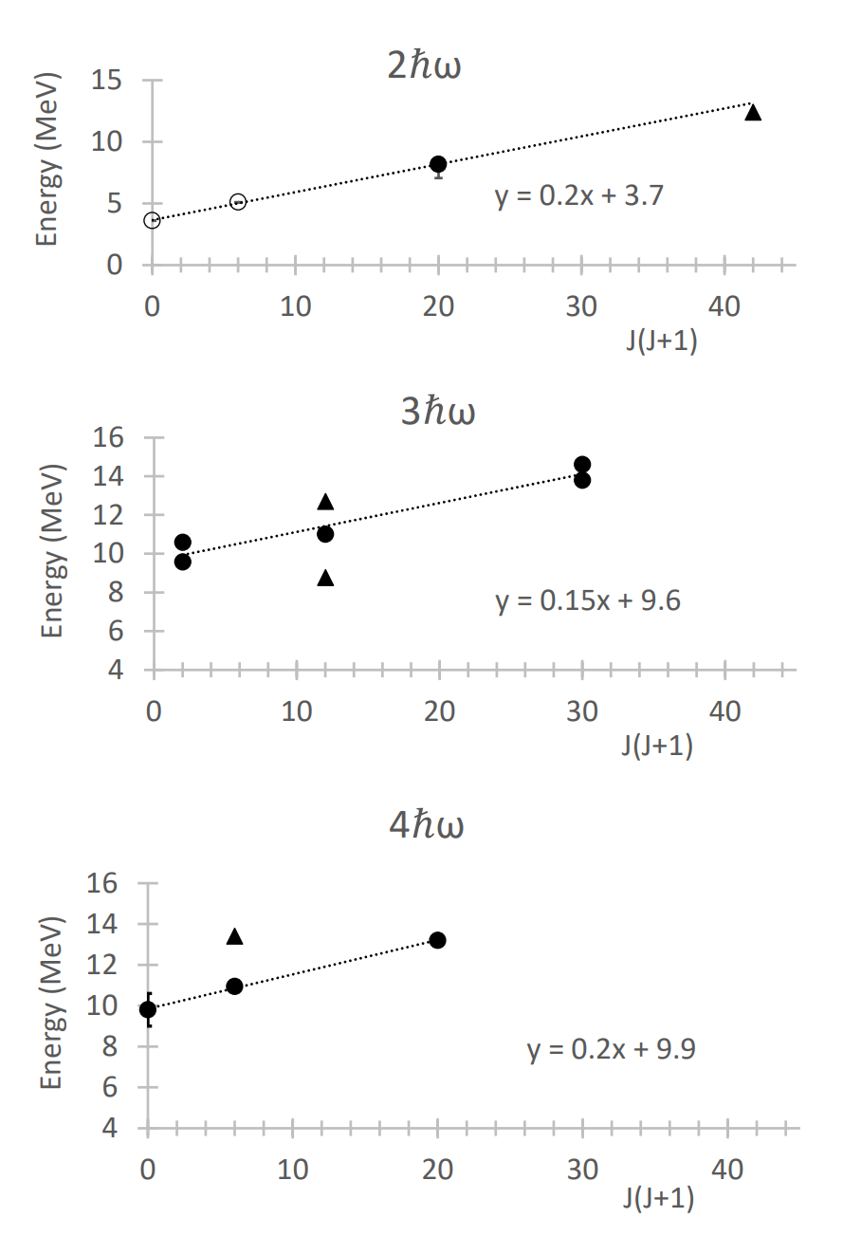
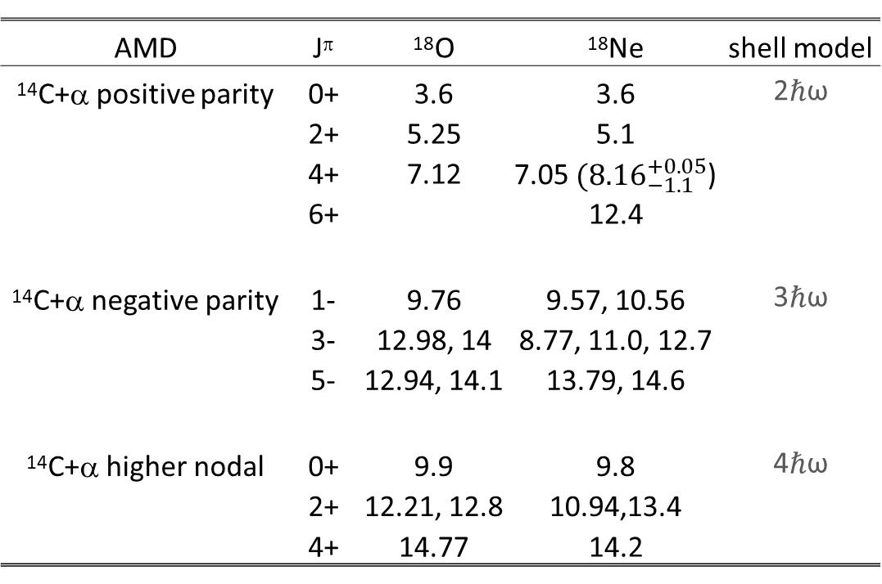
Comparison with AMD calculations on ¹⁸O
AMD | J^{π} | ¹⁸O | ¹⁸Ne | shell model
¹⁴C+α positive parity | 0+ | 3.6 | 3.6 | 2ℏω
 | 2+ | 5.25 | 5.1
 | 4+ | 7.12 | 7.05 $({8.16}_{−1.1}^{+0.05}$)
 | 6+ |  | 12.4
¹⁴C+α negative parity | 1- | 9.76 | 9.57, 10.56 | 3ℏω
 | 3- | 12.98, 14 | 8.77, 11.0, 12.7
 | 5- | 12.94, 14.1 | 13.79, 14.6
¹⁴C+α higher nodal | 0+ | 9.9 | 9.8 | 4ℏω
 | 2+ | 12.21, 12.8 | 10.94,13.4
 | 4+ | 14.77 | 14.2

Slide 28
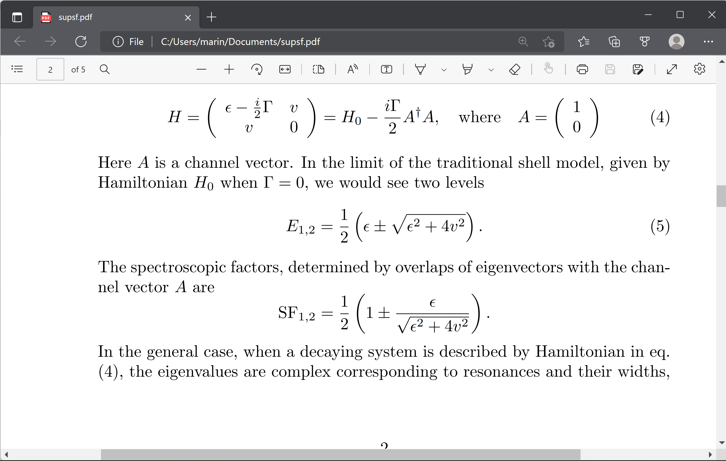
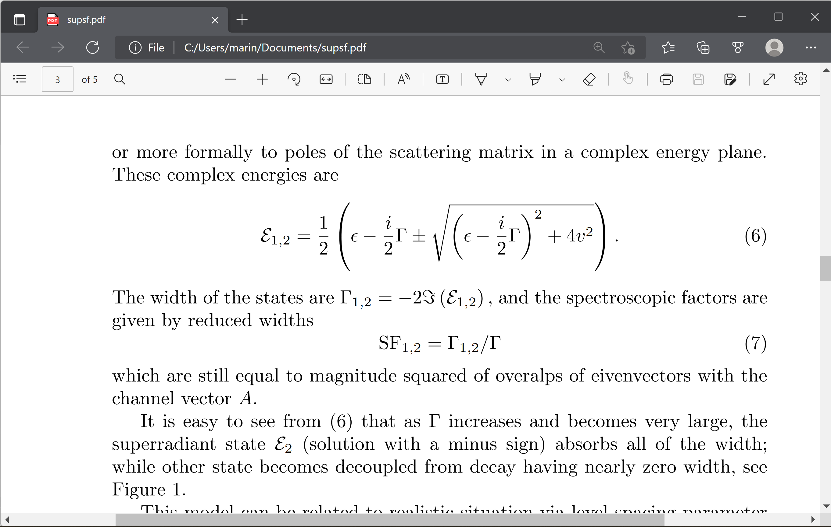
Speculations on superradiance
A.Volya and V. Zelevinsky, J. Opt. B: Quantum Semiclass. Opt. 5, S450 (2003)
N. Auerbach and V. Zelevinsky, Rep. Prog. Phys. 74 (2011) 106301.
Simple two-level model
If Γ = 0
In general

Slide 29
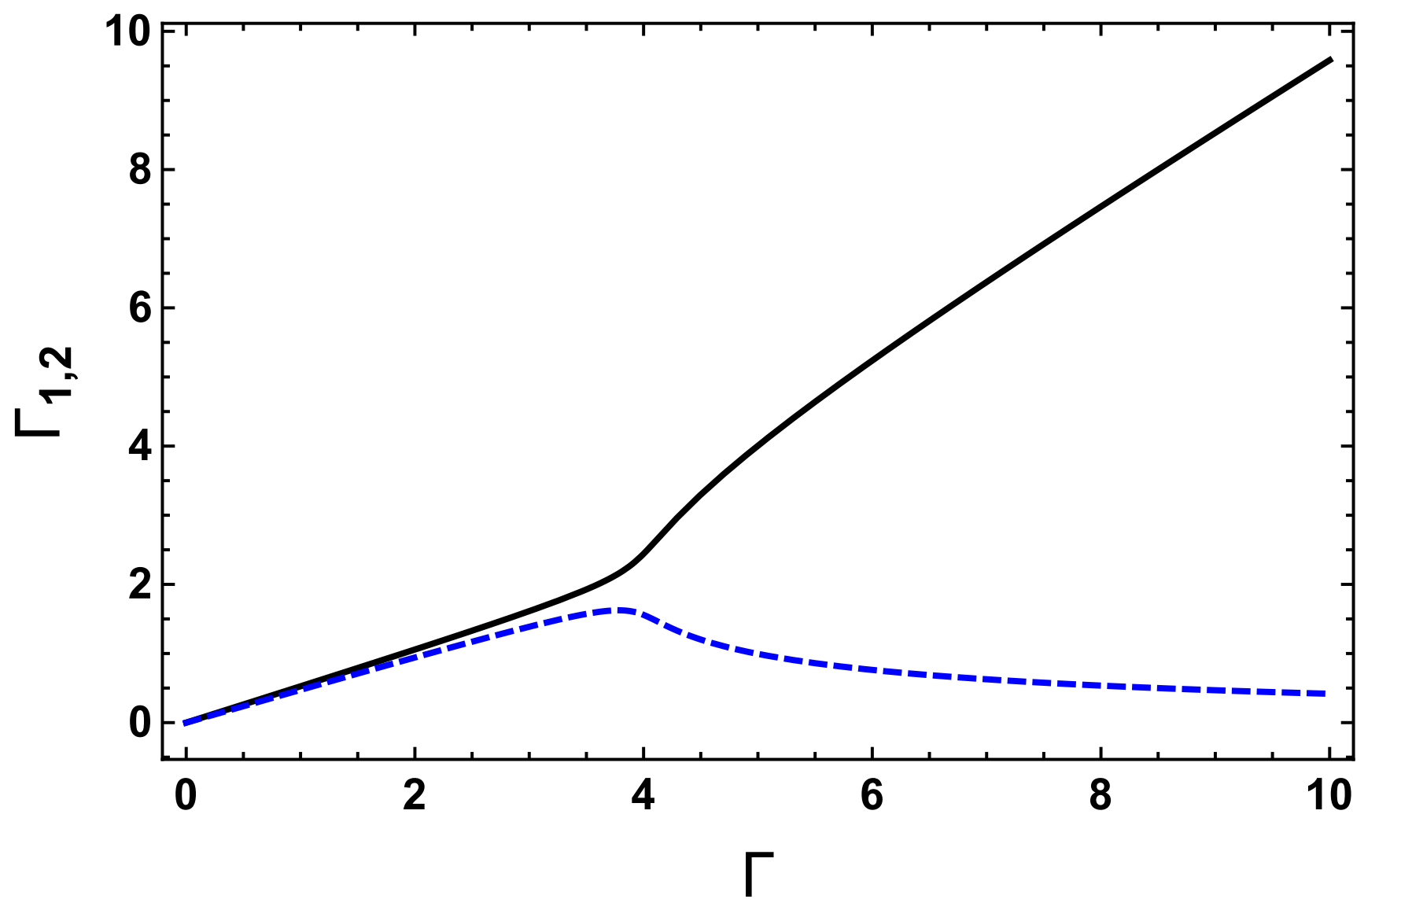
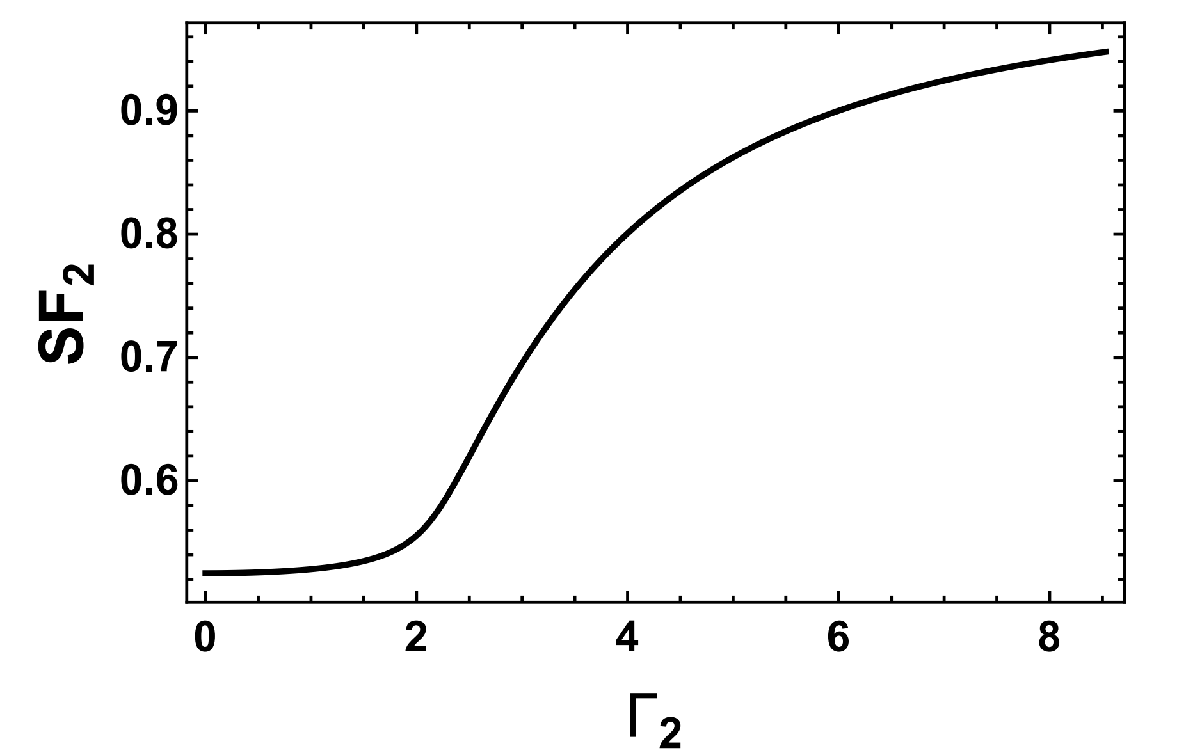
Speculations on superradiance

Slide 30
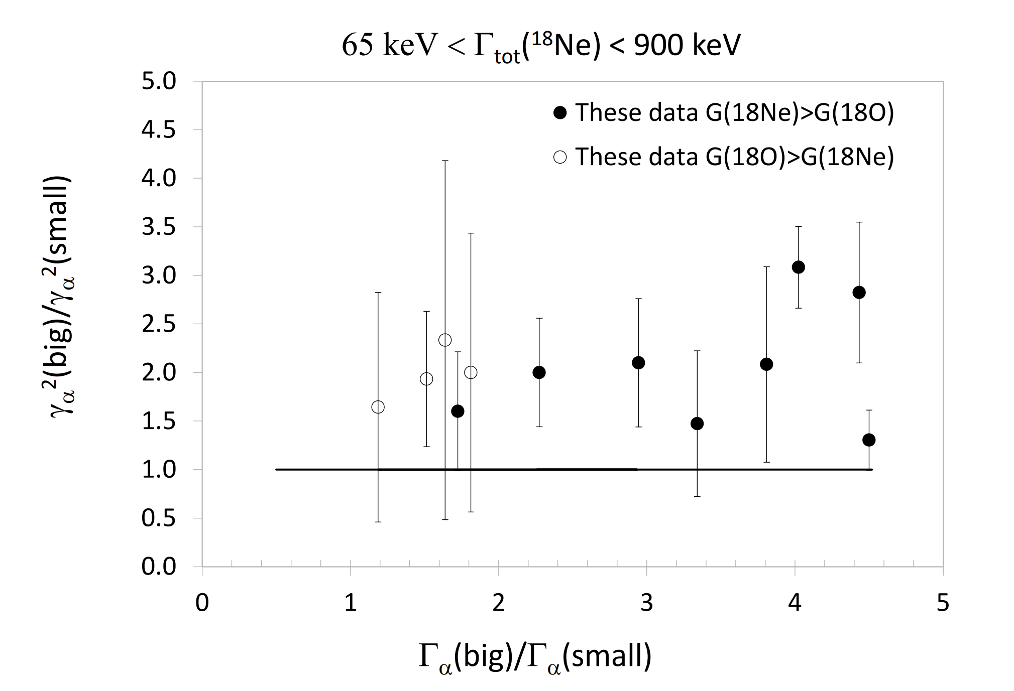
Speculations on superradiance

Slide 31
Conclusions
As expected from isospin-symmetry, there is good correspondence between the levels in the two mirror nuclei
α-clustering is strong in these nuclei
Good agreement between shell model calculation and experiment
Clustering seems to inibhit particle-hole mixing
The broad alpha-clustered states observed in the experiment account for most or the entire clustering strength in a particular channel, so that the strength of the corresponding particle-hole excitation levels is concentrated in one or few states.
The superradiance mechanisms could explain this observation.
More experimental and theoretical efforts are necessary to further investigate the role of superradiance in the formation of α-cluster states

