Slide 1
Direct Reactions studies with the AT-TPC
D. Bazin
Facility for Rare Isotope Beams
Michigan State University

Slide 2
Outline
Why Active Targets?
Preliminary results from recent AT-TPC experiments
  0d3/2 single-particle energy in ¹¹Be via the ¹⁰Be(d,p)¹¹Be transfer reaction
  Search for alpha cluster “Hoyle” state in ¹⁶O via inelastic scattering on ⁴He
  Transmission mode at high energy: charge exchange (d,²He) on ¹⁴O
Outlook and gallery

Slide 3
Why and when use an Active Target?
Target
Key experimental factors
  Any reaction with low energy recoils
  High luminosity (3 orders of magnitude gain)
    target thickness (2 orders of magnitude gain)
    solid angle (1 order of magnitude gain)
  No luminosity/resolution compromise
    No “dead” layer of material for low energy recoils to emerge from reaction site
    Vertex of reaction measured for each event, no kinematics broadening from large thickness
    Resolution limited by straggling effects and track localization
?
?
Detector
Beam
?
?
Beam
Recoils
Target = Detector

Slide 4
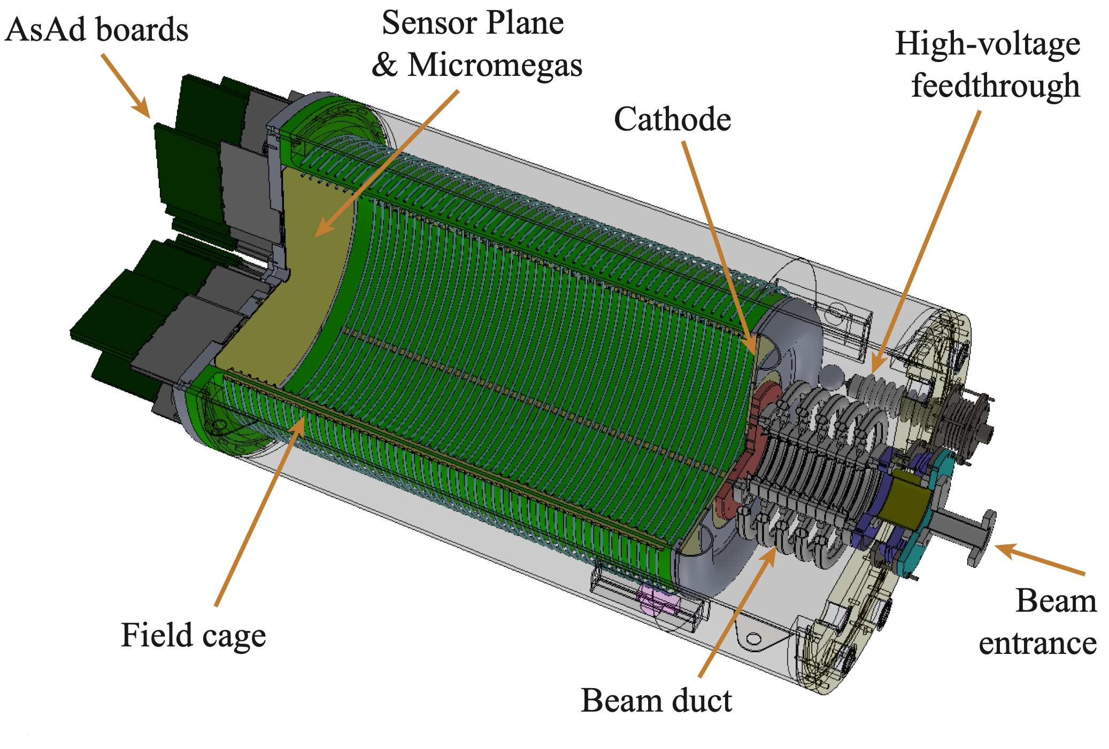
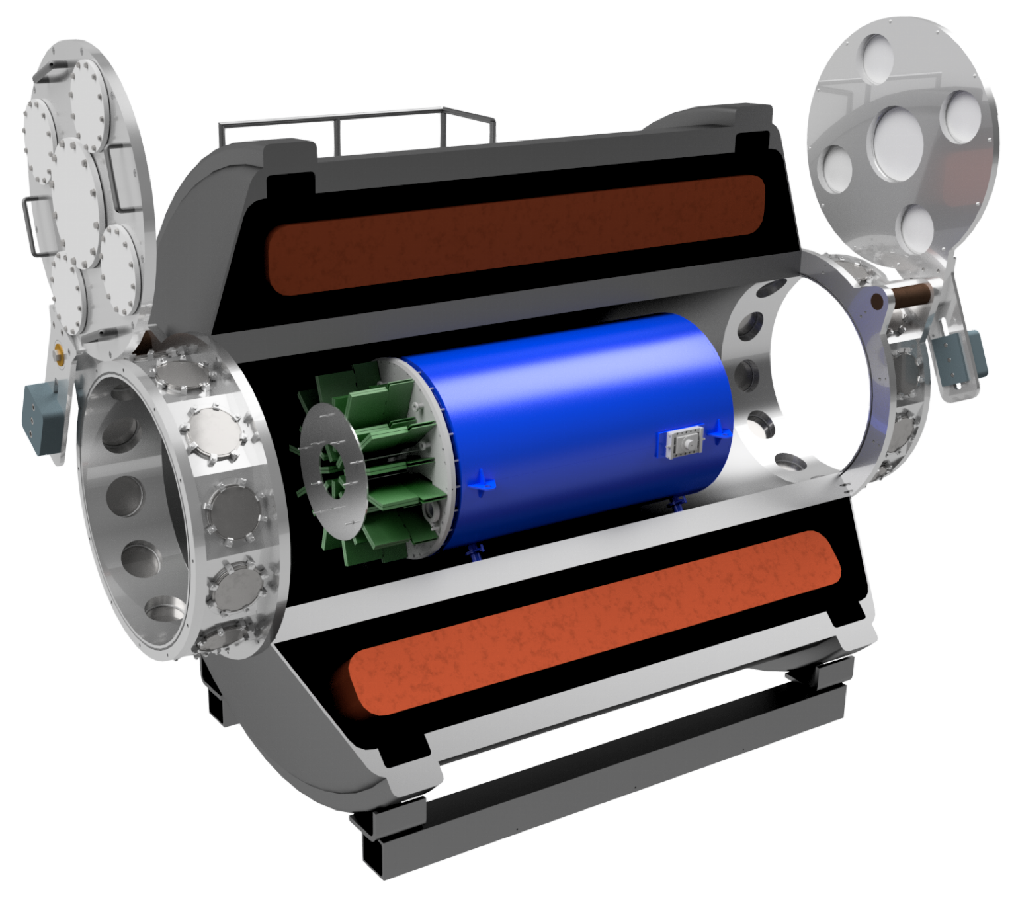
AT-TPC @ SOLARIS
Active Target Time Projection Chamber
Solenoidal Spectrometer Apparatus for Reaction Studies

Slide 5
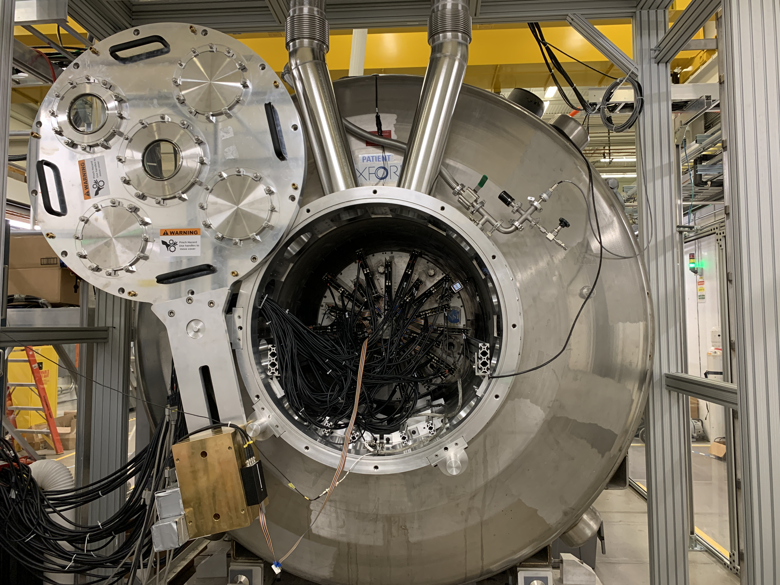
AT-TPC in SOLARIS
SOLARIS
AT-TPC

Slide 6
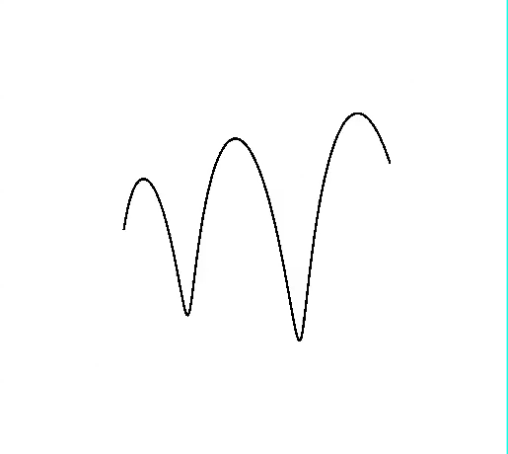
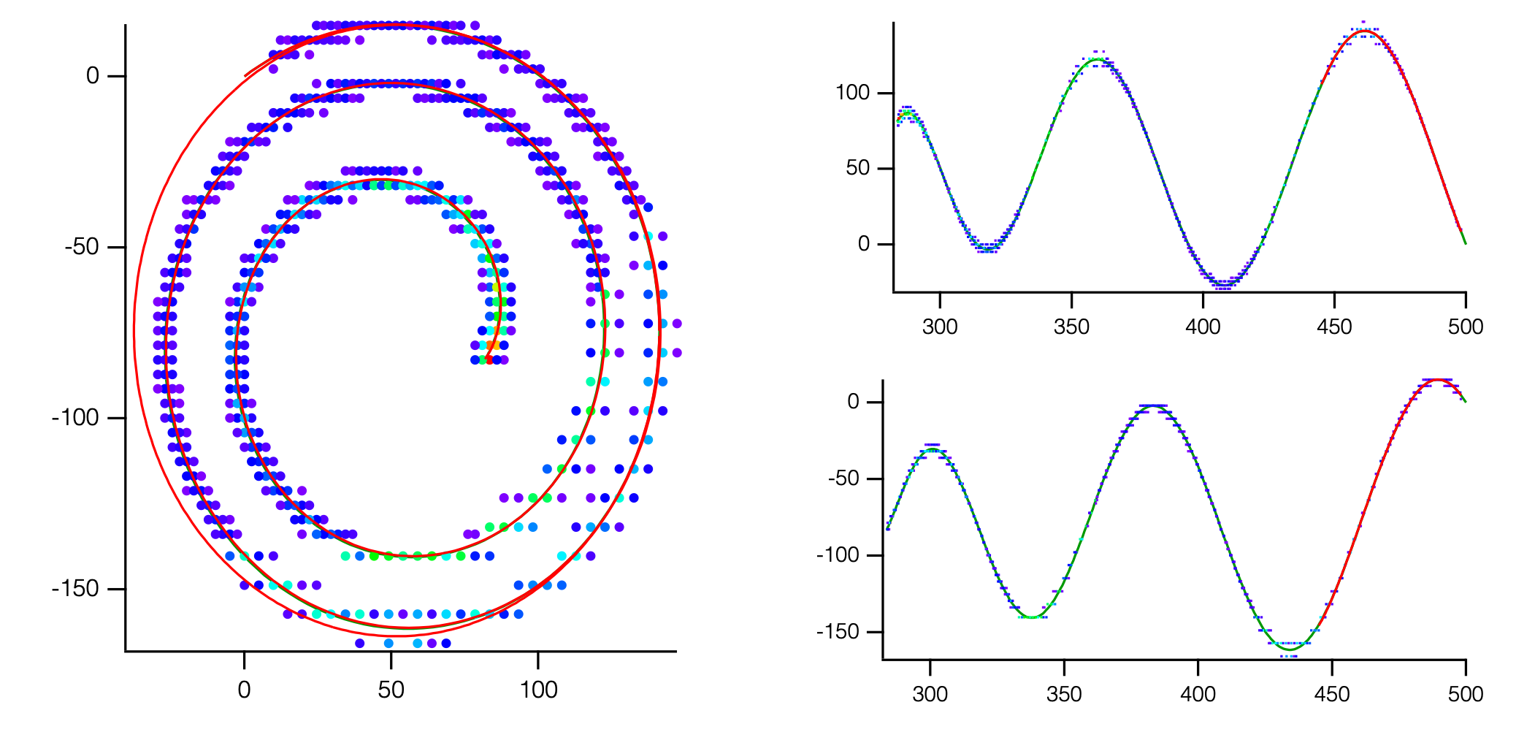
Three main challenges
Trigger on events of interest
  Most “events” are beam slowing down in gas
Noise and electric field deformation
  Beam region highly ionized
  Charge feedback on sensor plane
  Positive ions drift very slowly (~ ms)
Data analysis (in magnetic field)
  Recoil trajectories are 3D spirals
  Event classification to select reaction channel
  Clustering algorithms necessary
  Fitting without analytical model
Simulated event

Slide 7
Analysis of AT-TPC data
Several challenges
  Large volume (traces are recorded for each pad hit)
  Data reduction and clustering in tracks
  Fitting of tracks and extraction of physical quantities
  Event recognition and classification
Common effort by AT-TPC collaboration
  Several papers published on new methods
  Tools from particle physics community not readily applicable, have to be adapted
  Image processing and machine learning algorithms can help reduce the data processing time
Analysis from ATTPCRoot (Y. Ayyad)
Commissioning of the Active-Target Time Projection Chamber, J. Bradt et al., NIMA 875, 65 (2017)
Novel particle tracking algorithm based on the Random Sample Consensus Model for the Active Target Time Projection Chamber (AT-TPC), Y. Ayyad et al., NIMA 880, 166 (2018)
Automatic trajectory recognition in Active Target Time Projection Chambers data by means of hierarchical clustering, C. Dalitz et al., Comp. Phys. Comm. 235, 159 (2019)
Machine learning methods for track classification in the AT-TPC, M. P. Kuchera et al., NIMA 940, 156 (2019)
Unsupervised learning for identifying events in active target experiments, R. Solli et al., NIMA 1010, 165461 (2021)
Tracking algorithms for TPCs using consensus-based robust estimators, J. C. Zamora et al., NIMA 988, 164899 (2021)

Slide 8
Synopsis of analysis process
Machine Learning
Techniques
3D point cloud extraction from trace analysis
Grouping of points into clusters corresponding to individual tracks
Determination of track multiplicity and reaction vertex location
Fitting of individual tracks from modeled trajectories
Extraction of physical quantities
Identification and filtering of events of interest
Machine Learning
Techniques

Slide 9
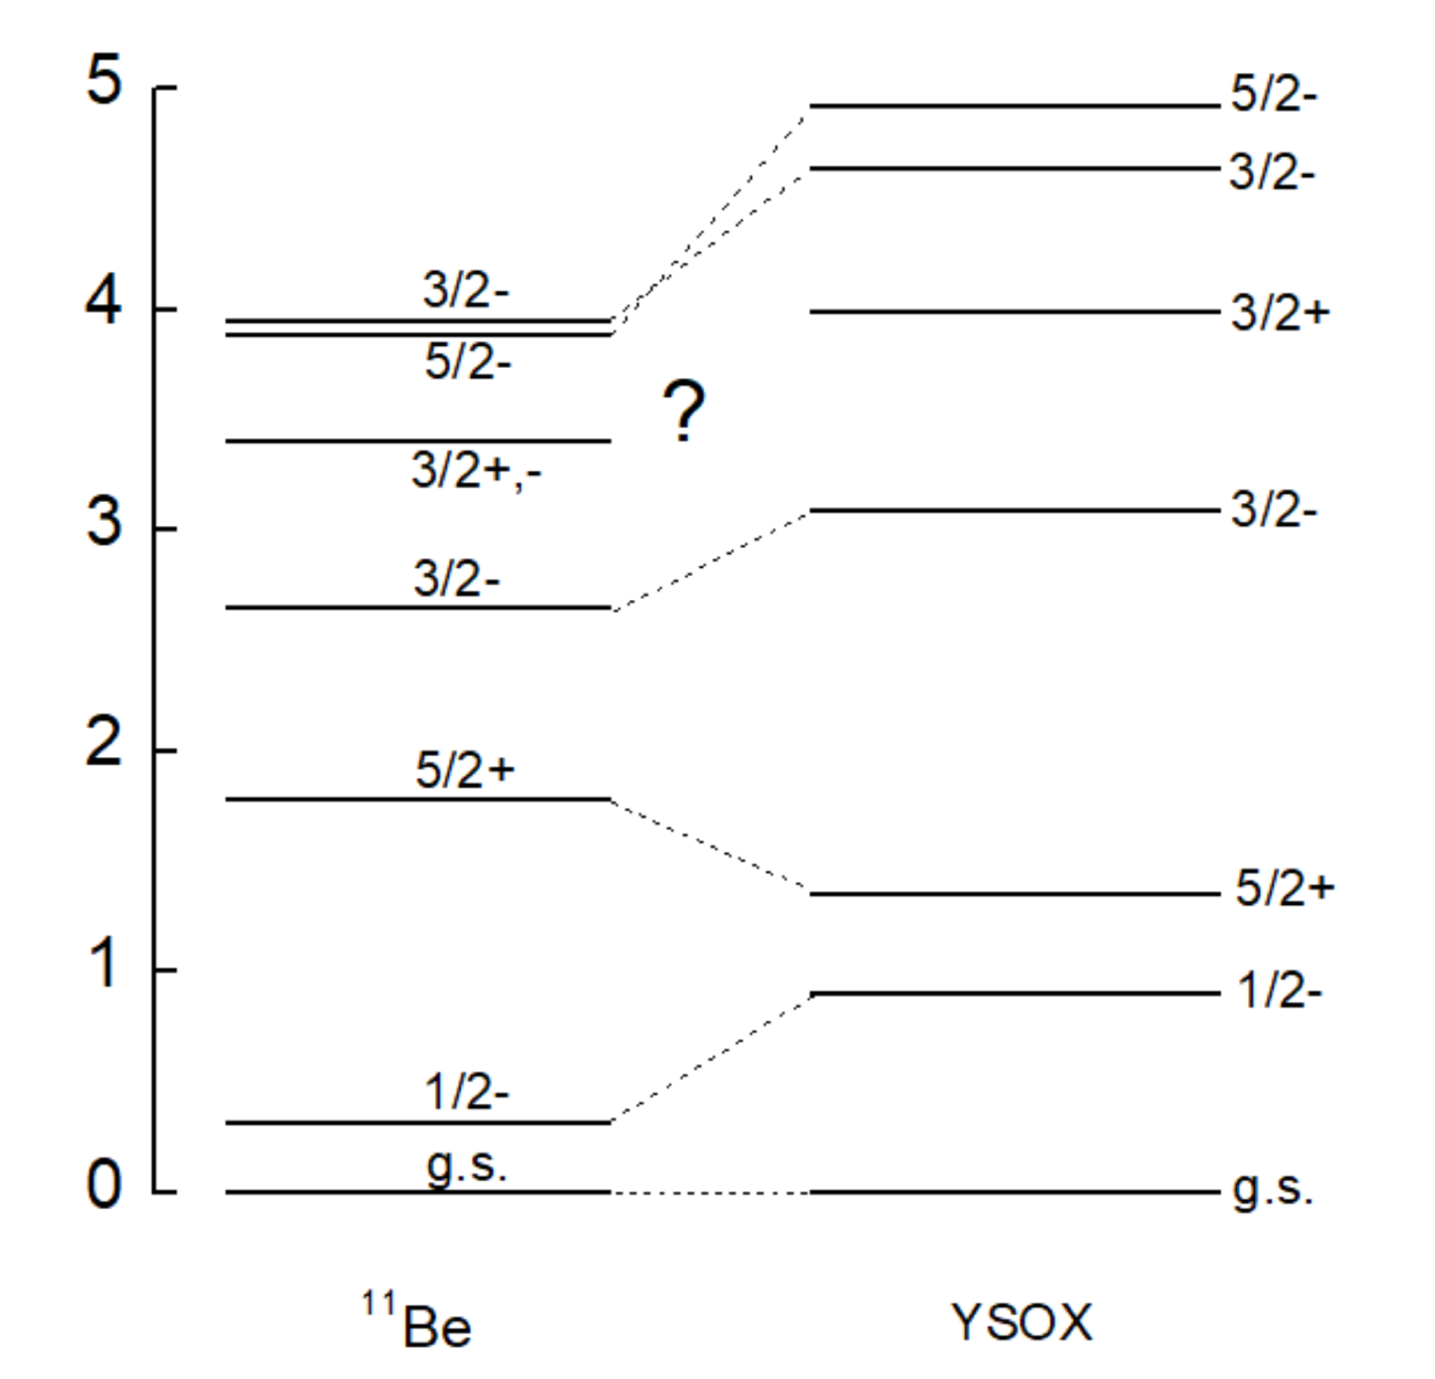

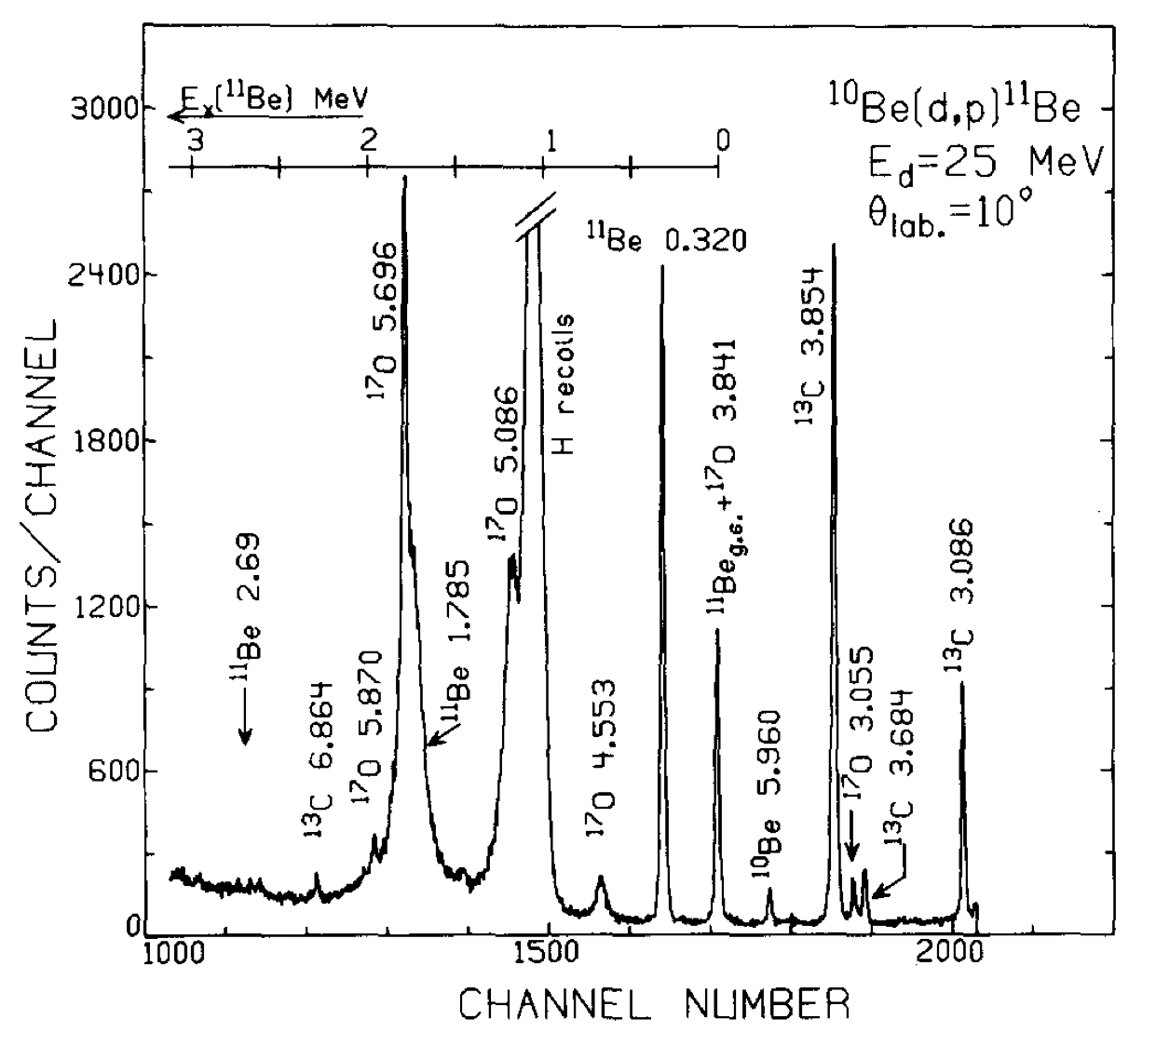

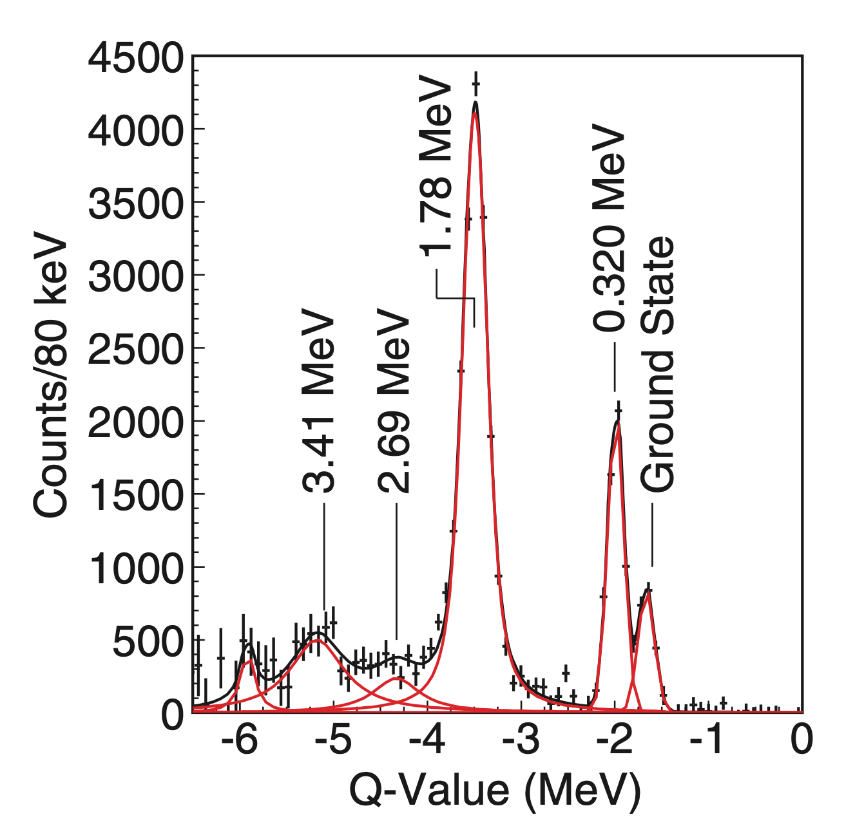
Transfer reaction commissioning of AT-TPC @ SOLARIS
Parity of 3/2 state at 3.41 MeV remains uncertain
  ⁹Be(t,p) and ß-decay support negative parity
  Inelastic scattering support positive parity
  Positive parity favored by ab-initio and Shell Model calculations using YSOX interaction
  If confirmed positive, 3.41 MeV state would determine 0d3/2 single-particle energy in ¹¹Be
¹⁰Be beam from ReA6 stand alone operation
B. Zwieglinski, W. Benenson et al., Nucl. Phys. A315, 124 (1979)
G.-B. Liu, H.T. Fortune, Phys. Rev. C 42, 167 (1990).
Y. Hirayama, T. Shimoda, H. Izumi, et al.,Physics Letters B 611, 239 (2005).
N. Fukuda et al., Phys. Rev. C 70, 054606 (2004).
Angelo Calci, Petr Navrátil, Robert Roth, et al.,Phys. Rev. lett. 117, 242501 (2016)
C. Yuan, T. Suzuki, T. Otsuka,et al., Phys. Rev. C 85 (2012) 064324.
K. T. Schmitt et al., Phys. Rev. C 88 (2013) 064612.

Slide 10
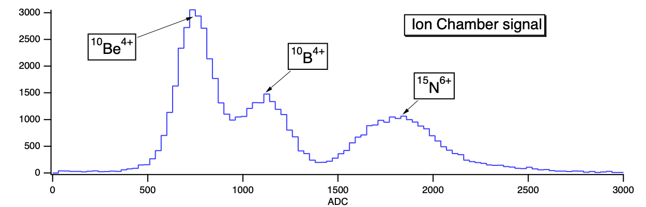
Experimental conditions
¹⁰Be beam from ReA6 linac
  ¹⁰B and ¹⁵N contaminants
  9.6 MeV/u and 1,000 pps
AT-TPC @ SOLARIS
  600 Torr of D2 gas (13 mg/cm²)
  Magnetic field 3 Tesla
  Trigger on mesh signal with beam region gain suppression
Recoiling proton
Beam region with reduced gain on Micromegas
Cross-talk from saturated pads outside beam region
Scattered ¹¹Be escapes from beam region
Example of ¹⁰Be(d,p)¹¹Be event

Slide 11
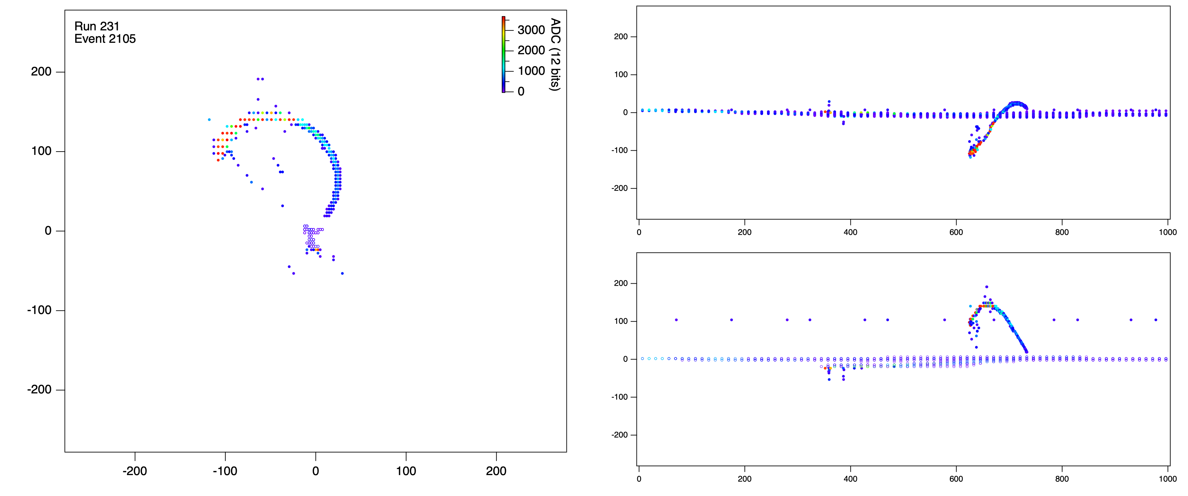
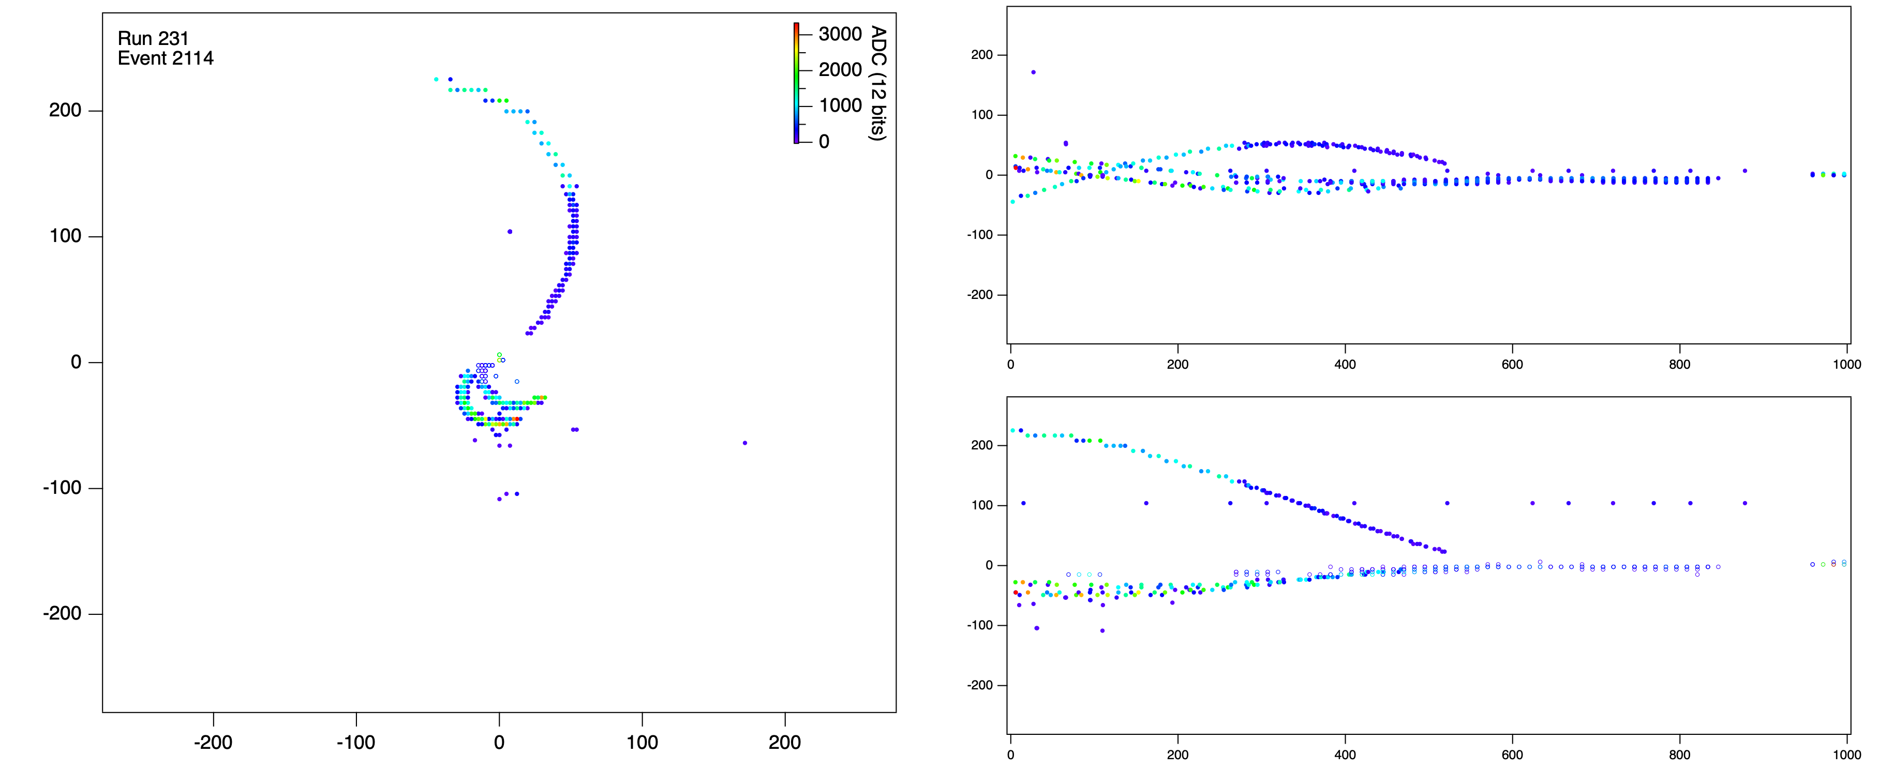
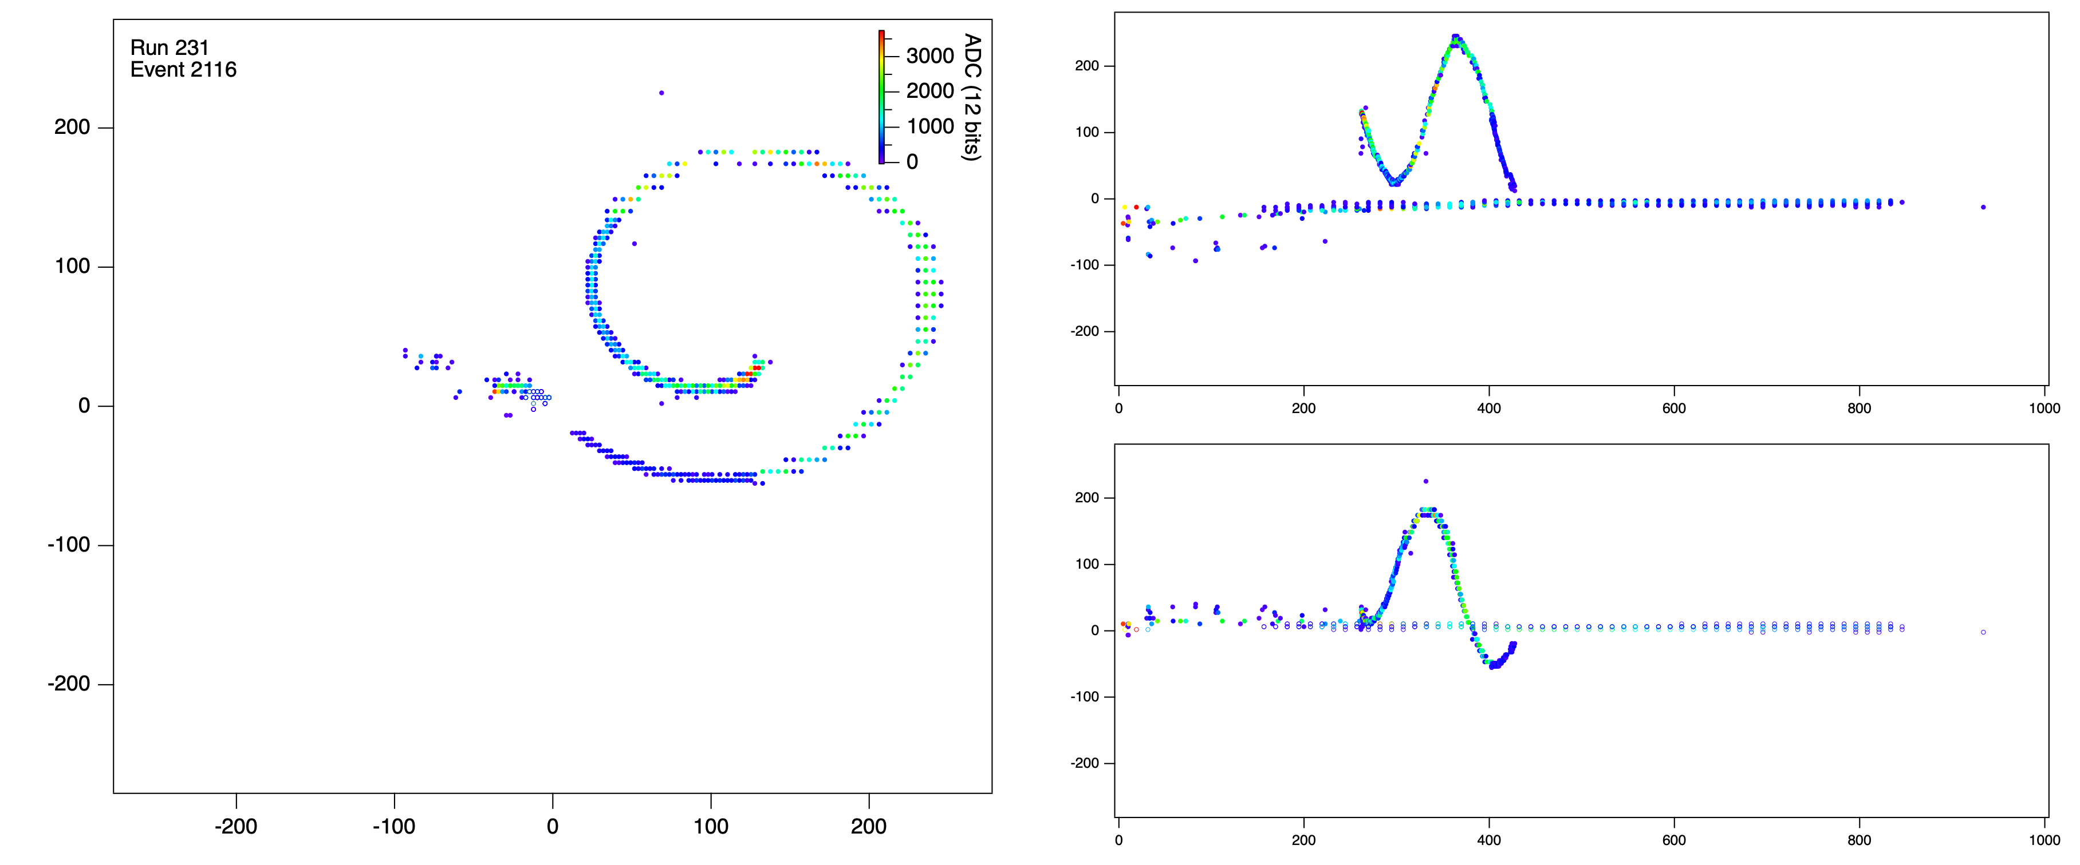
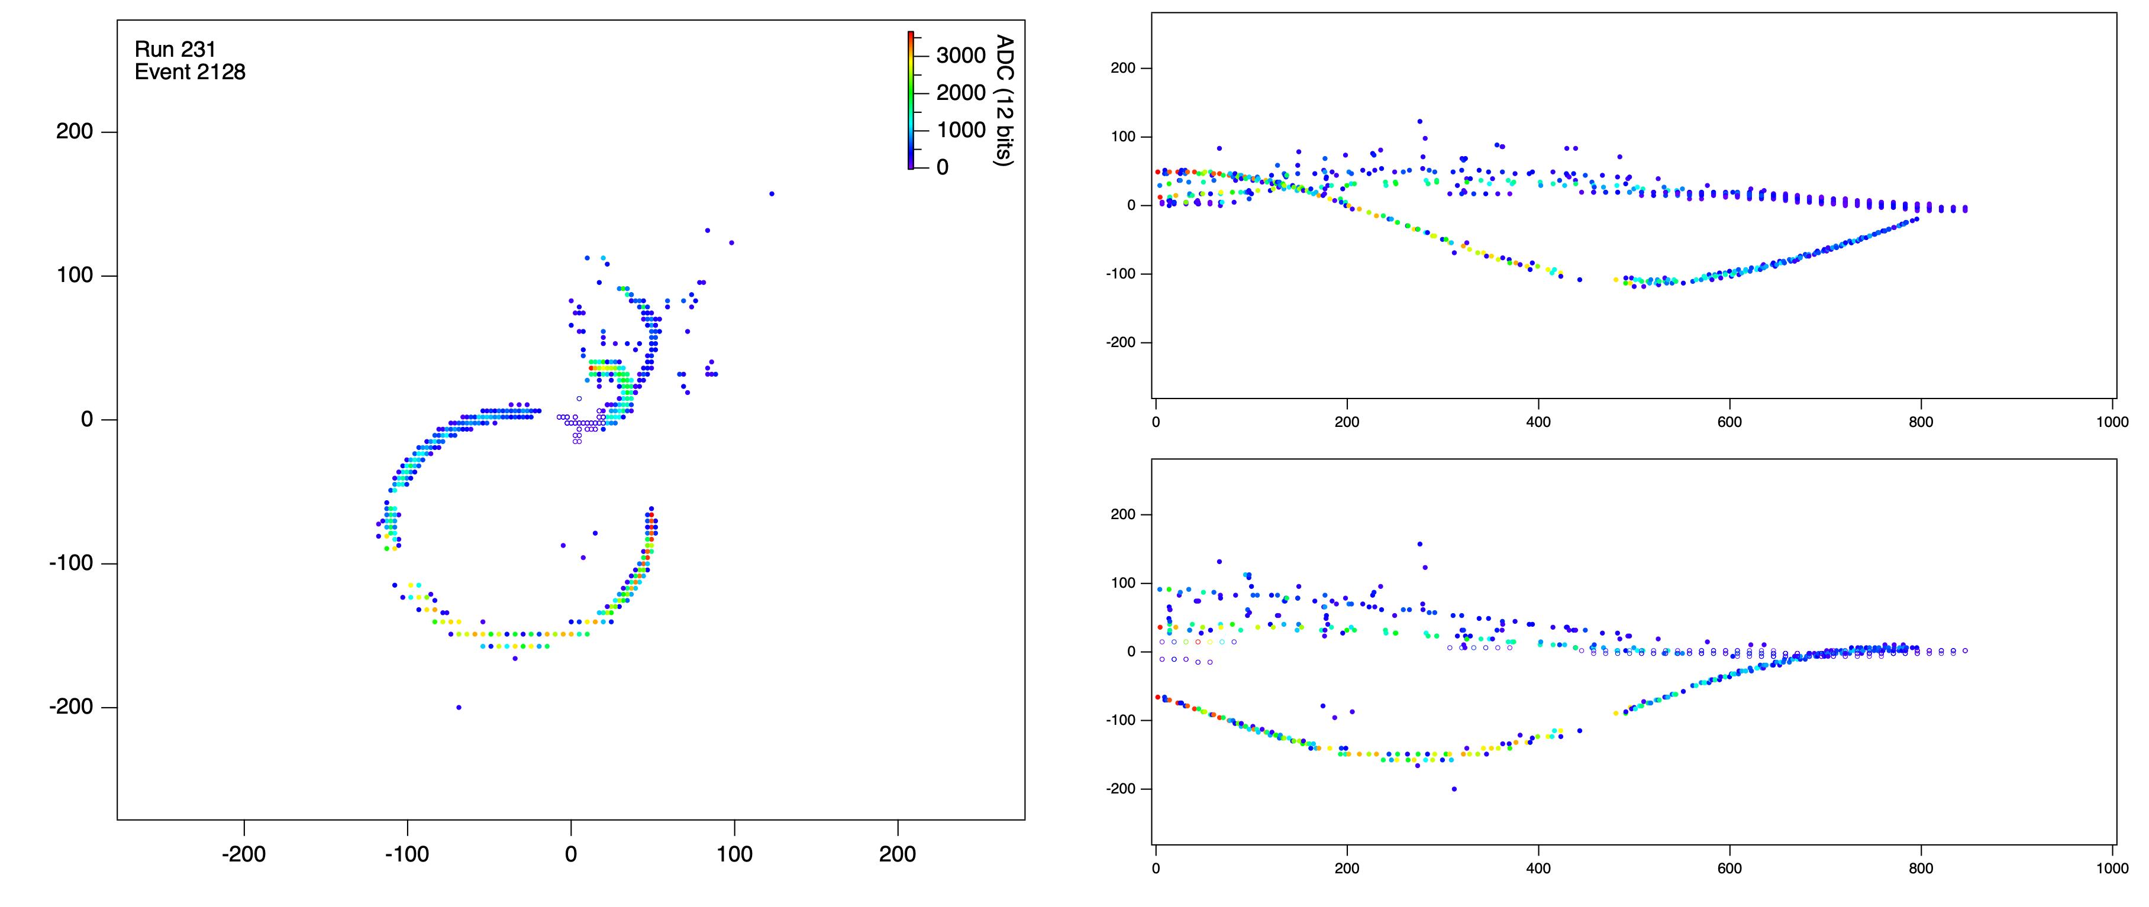
Online identification of (d,d’) events

Slide 12
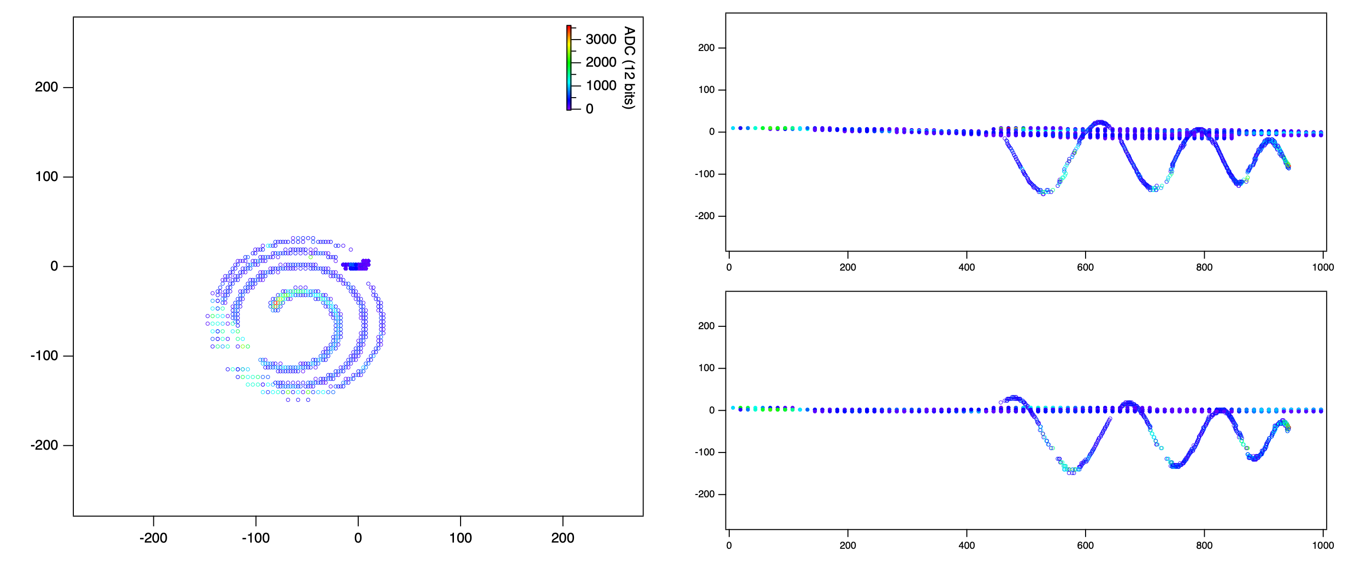
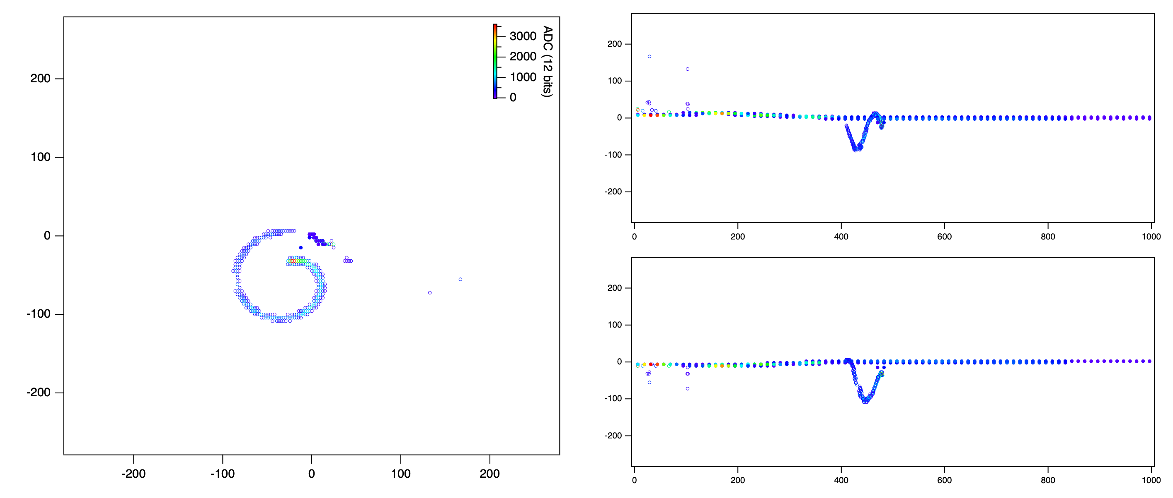
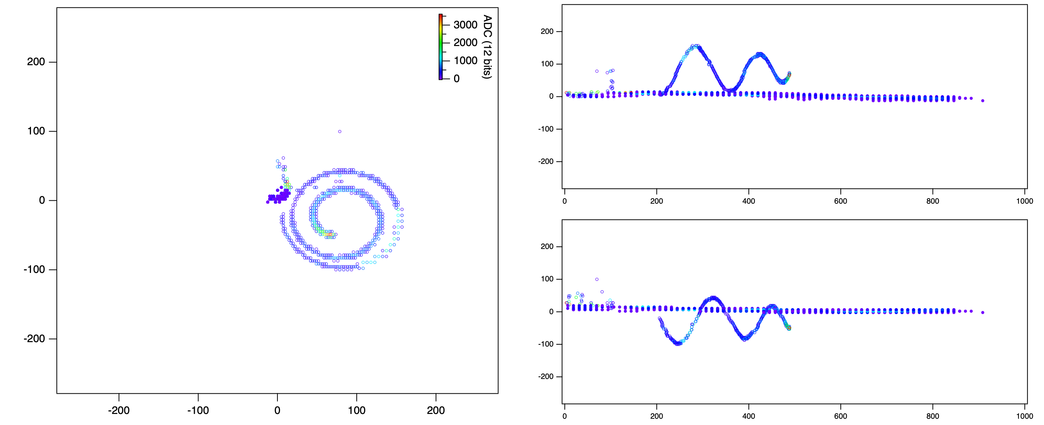
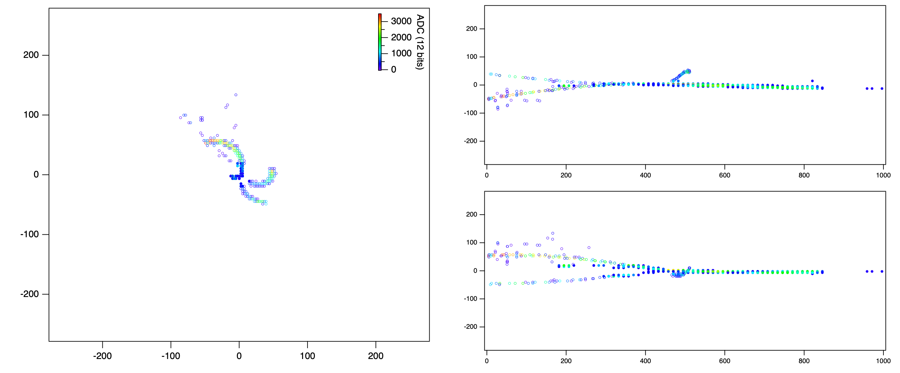
Online identification of (d,p) events
Run 231 Event 873
Run 231 Event 1640
Run 231 Event 1252
Run 231 Event 1990

Slide 13
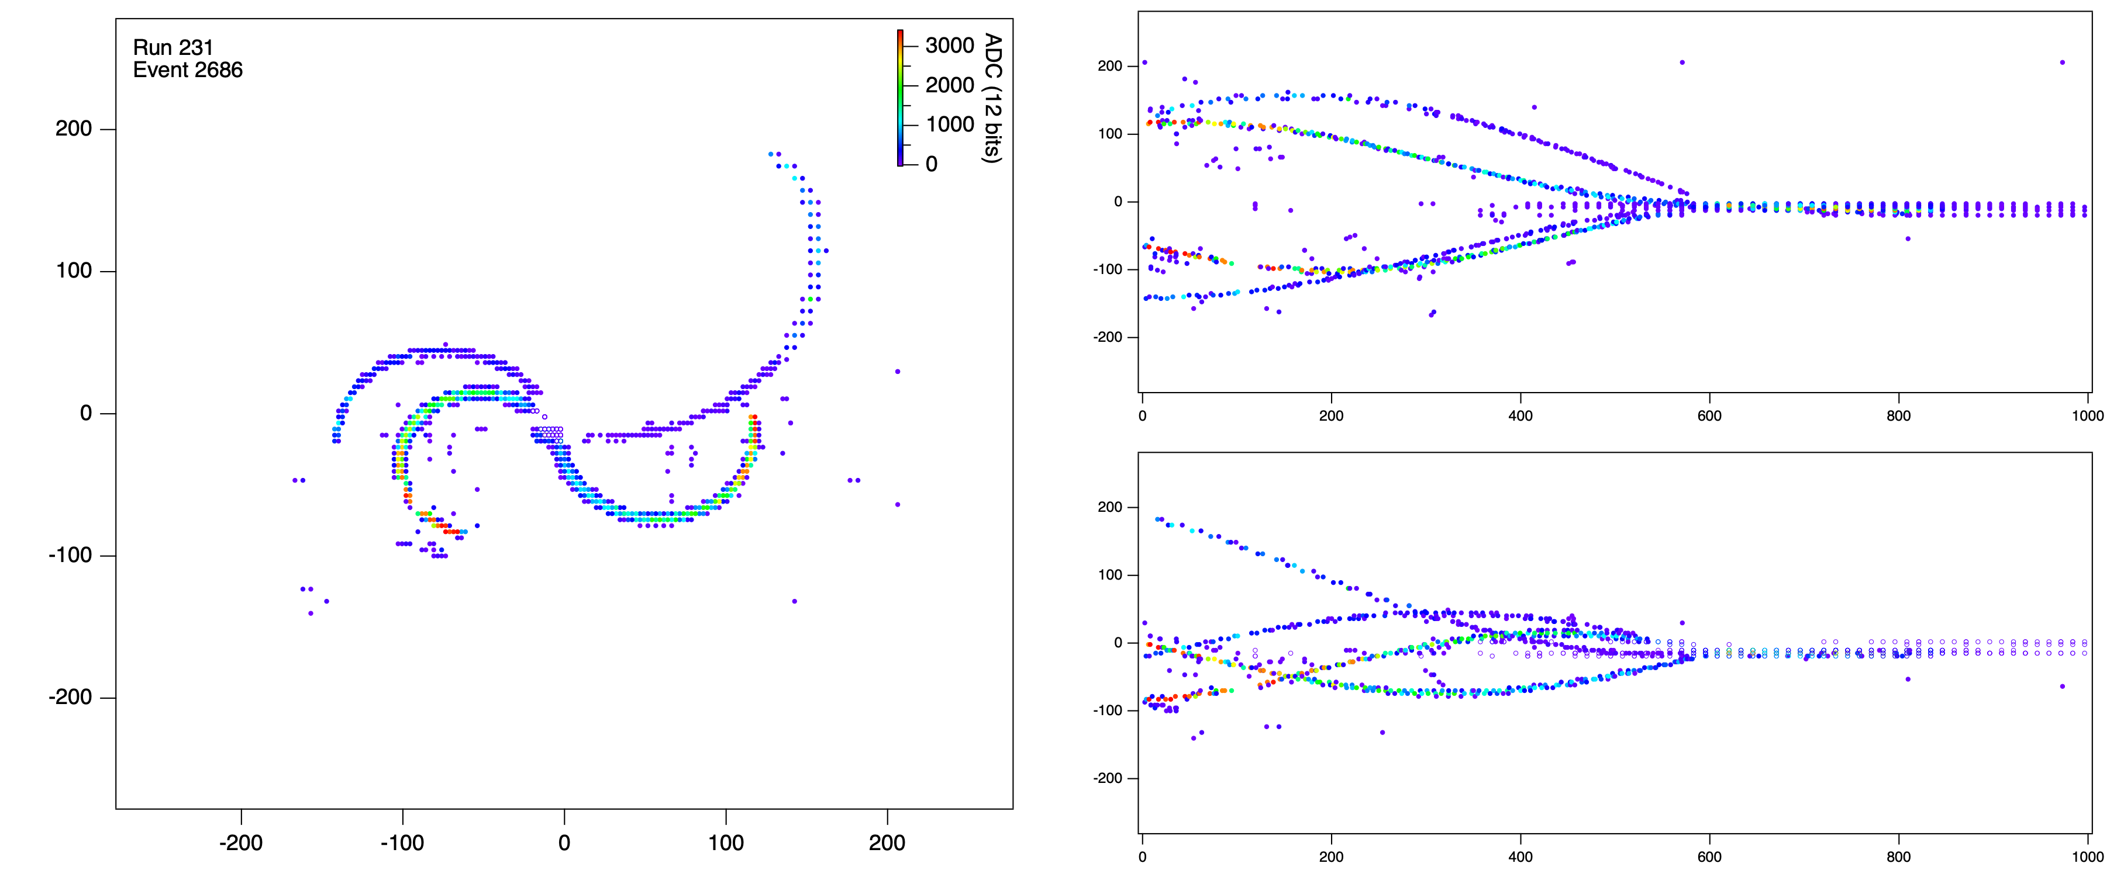
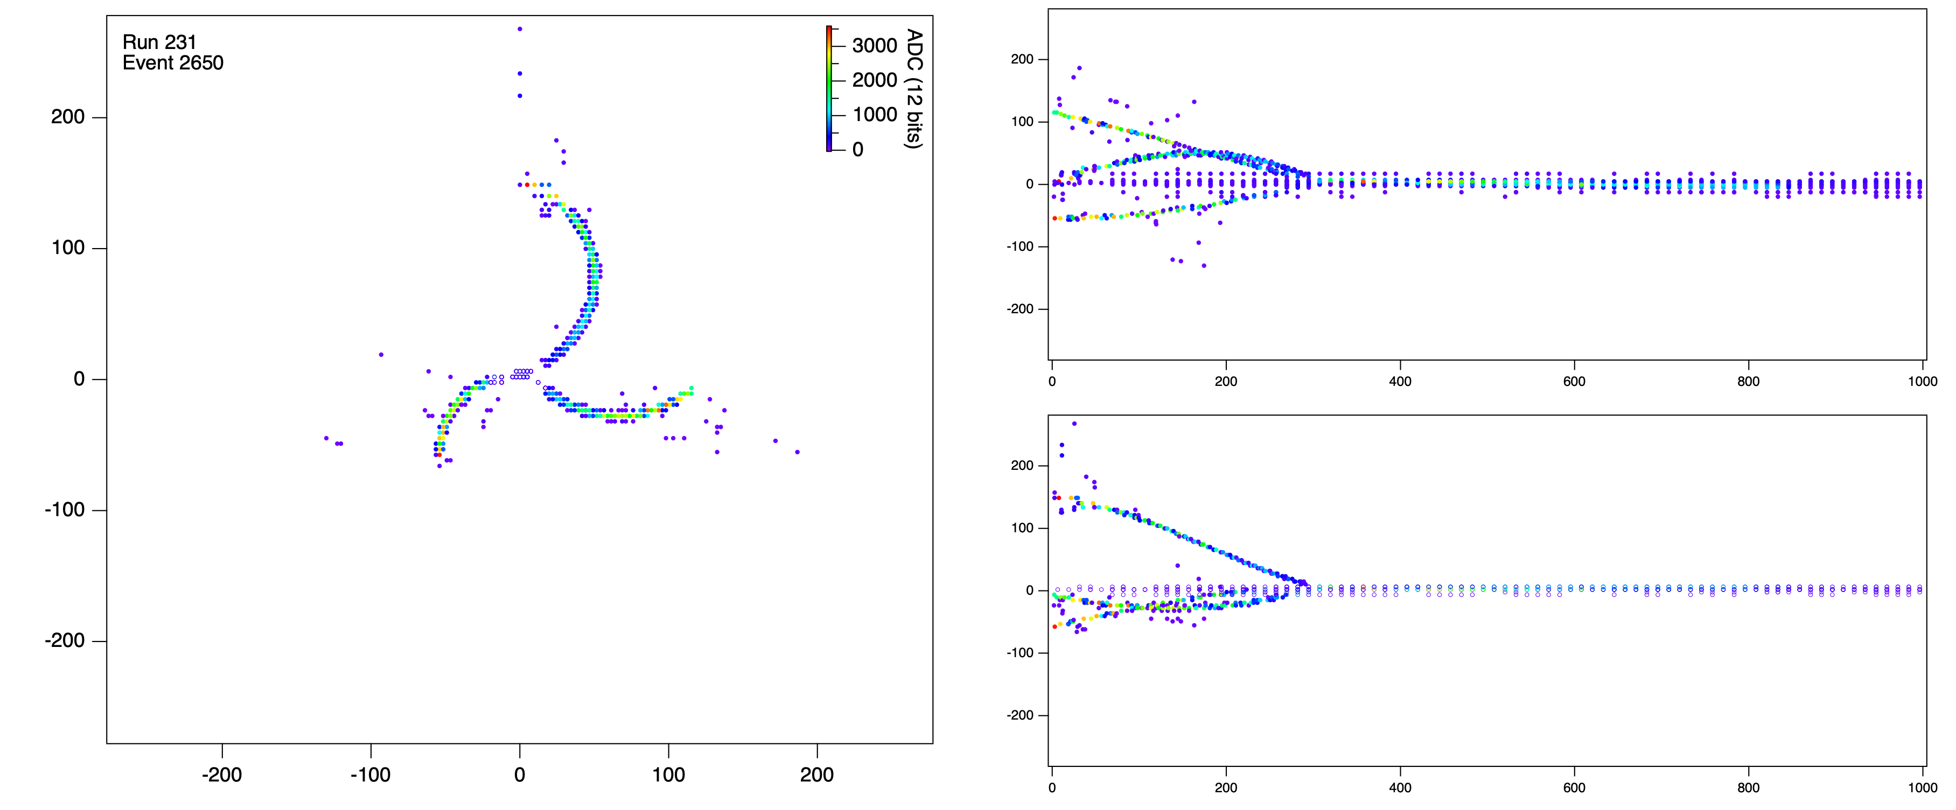
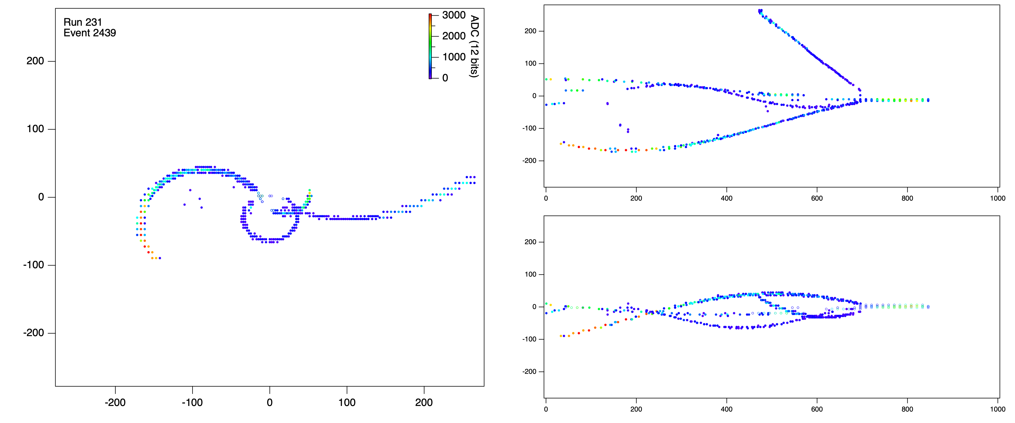
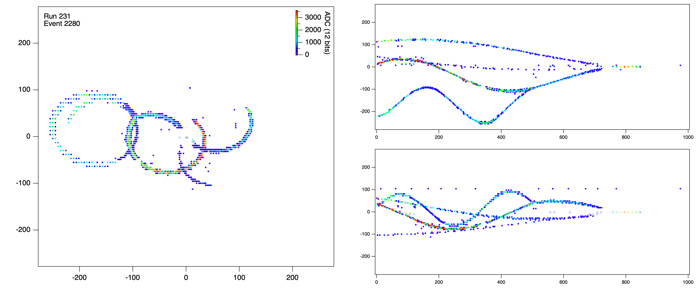
Other types of events (more central collisions)

Slide 14
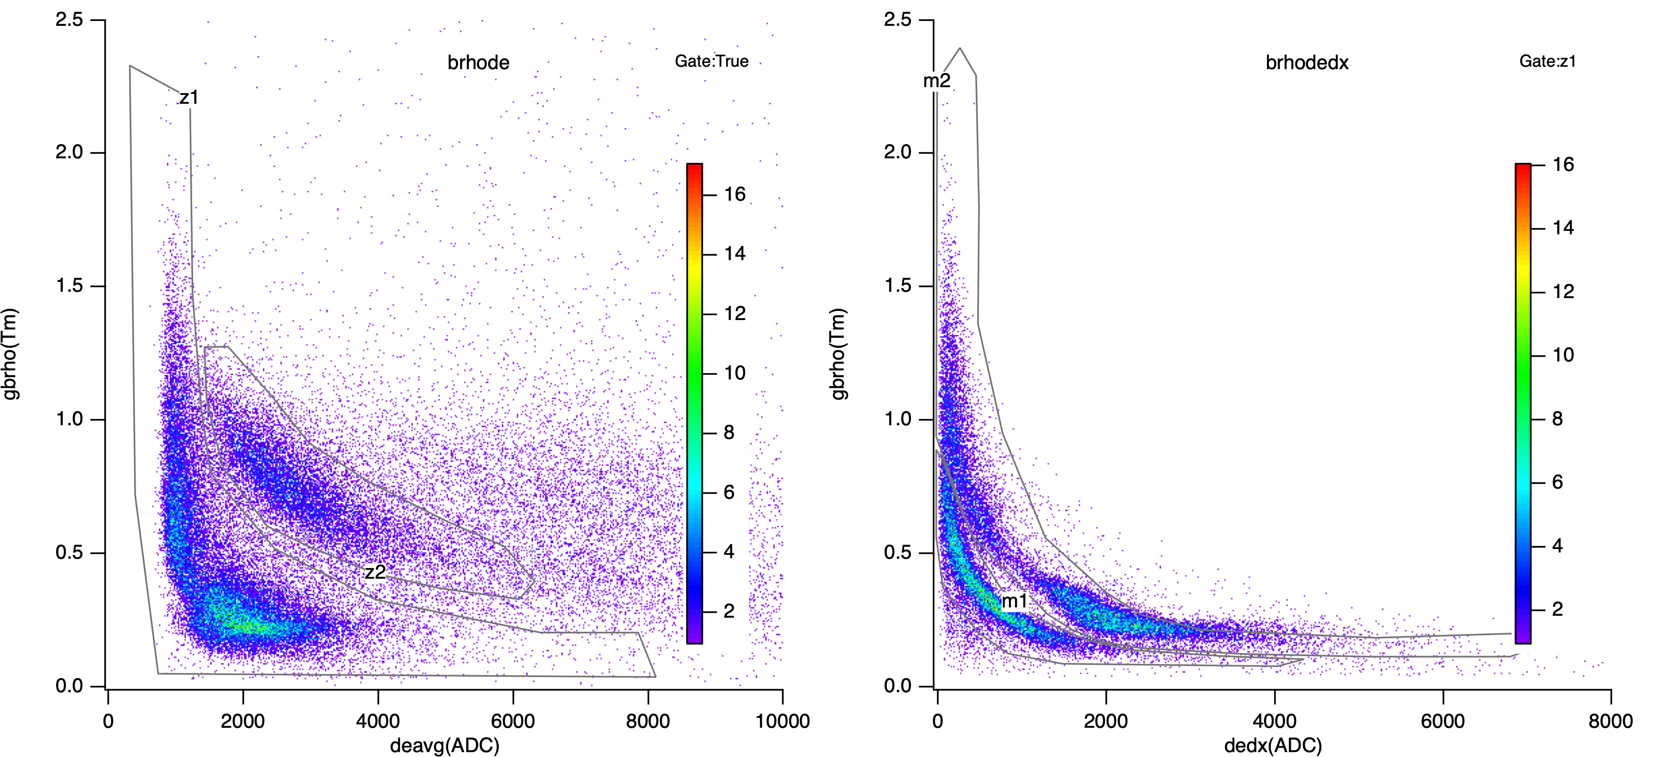

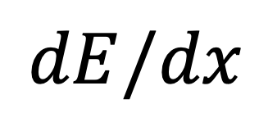
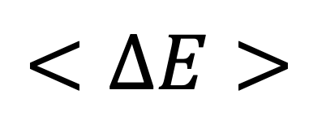

Particle identification
$$Bρ$$
$$Bρ$$
$$<ΔE>$$
$$dE/dx$$

Slide 15
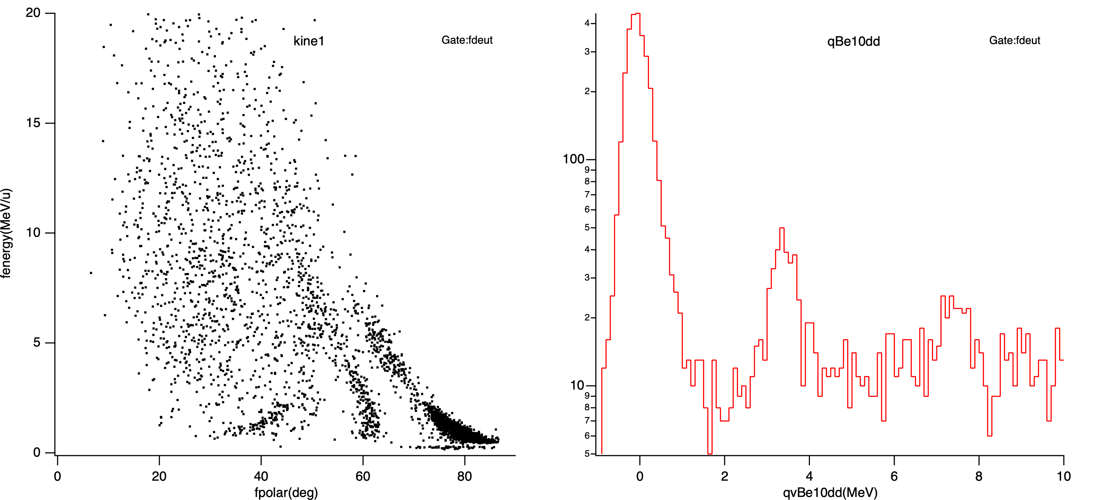
¹⁰Be(d,d) elastic and inelastic scattering
2 hours of data
@ 1000 pps…
2⁺1 (3.37 MeV)
2⁺3 (7.54 MeV)
Gated on incoming ¹⁰Be and scattered deuteron

Slide 16
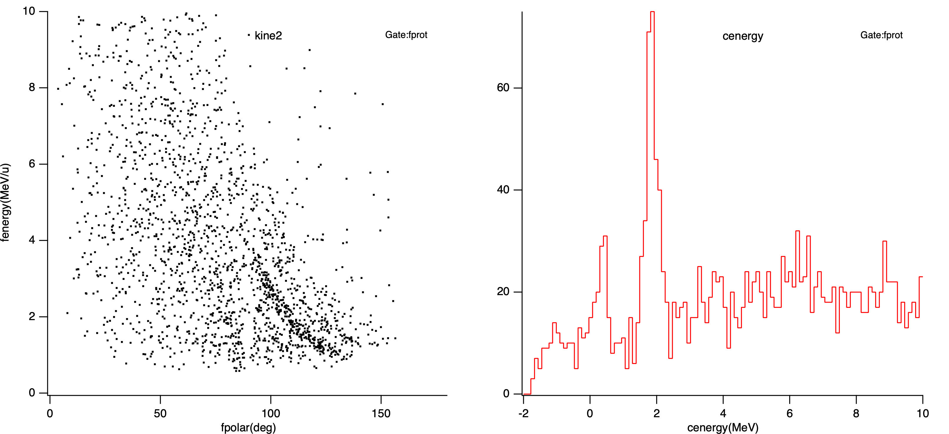
¹⁰Be(d,p)¹¹Be transfer
5/2⁺ (1.87 MeV)
2 hours of data
@ 1000 pps…
Resolution: 0.35 MeV (FWHM)
Contamination from ¹⁰B(d,p) pile-up
1/2⁻ (0.32 MeV)
Gated on incoming ¹⁰Be and scattered proton

Slide 17
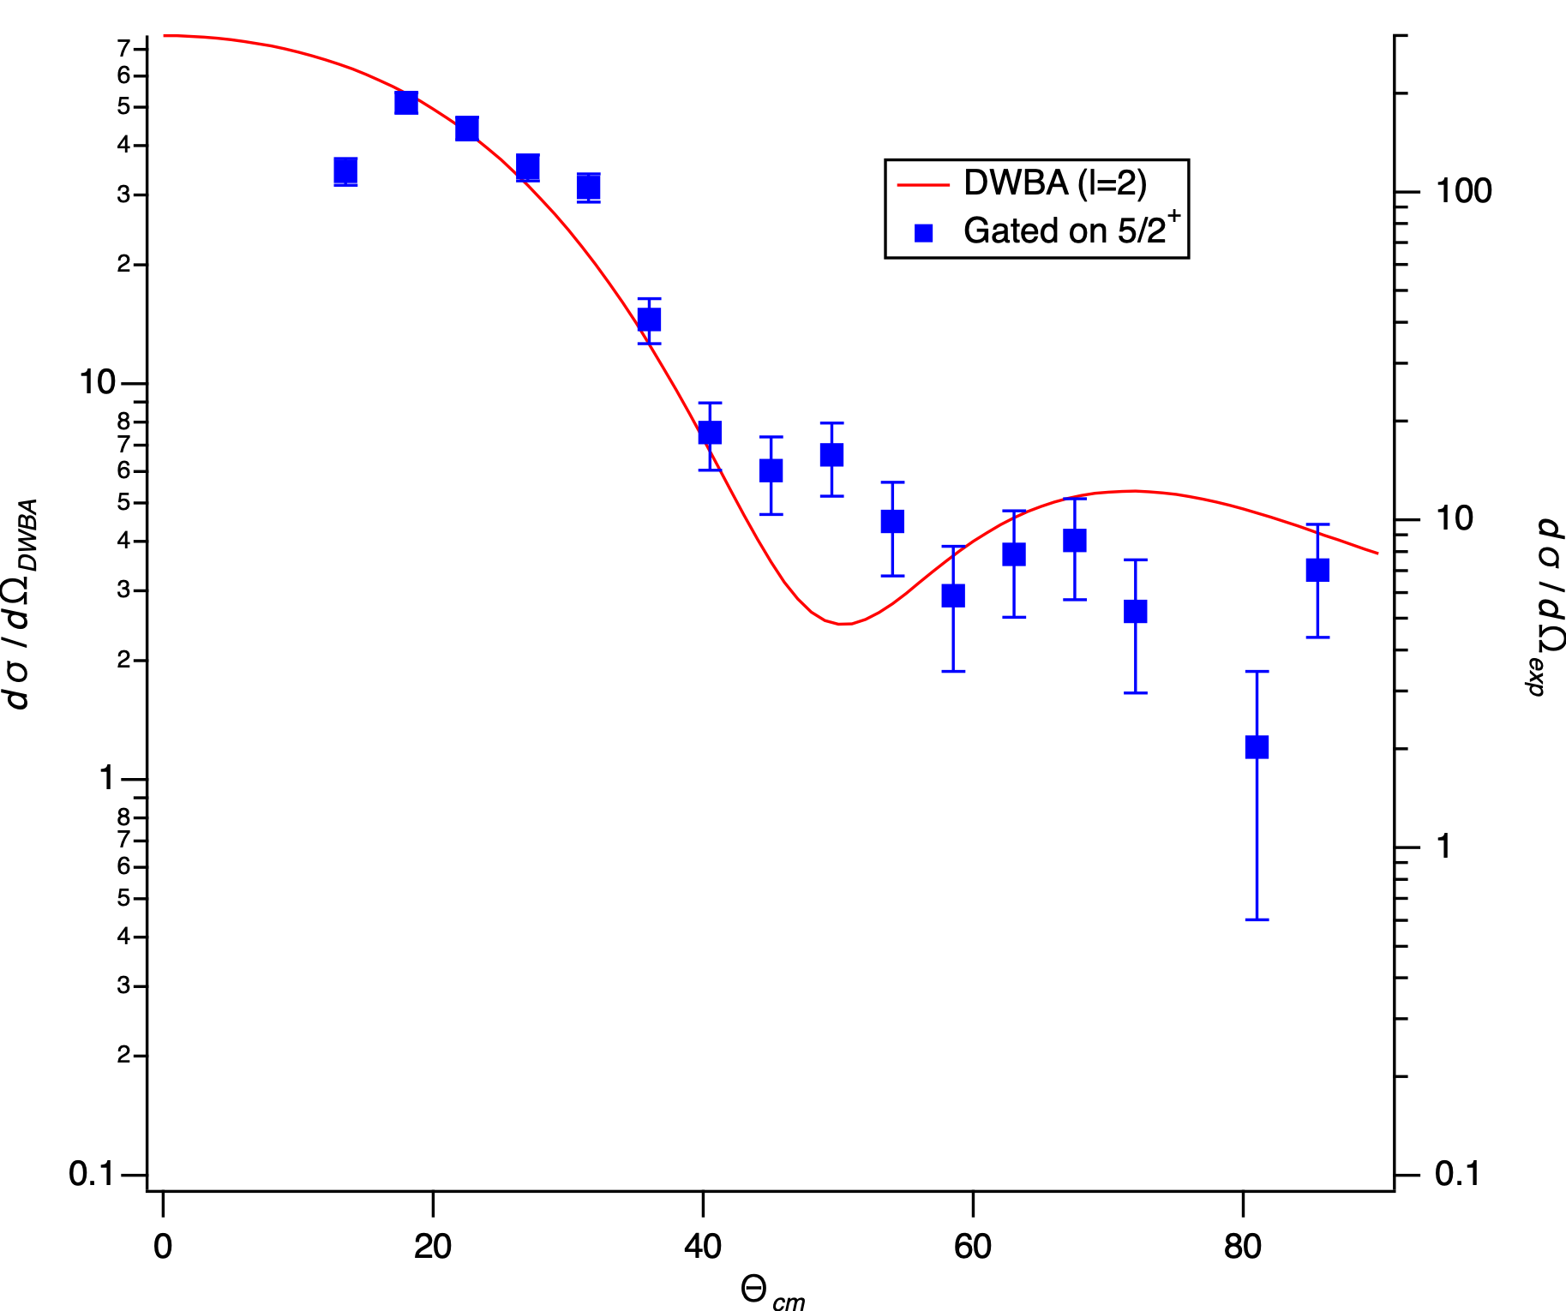
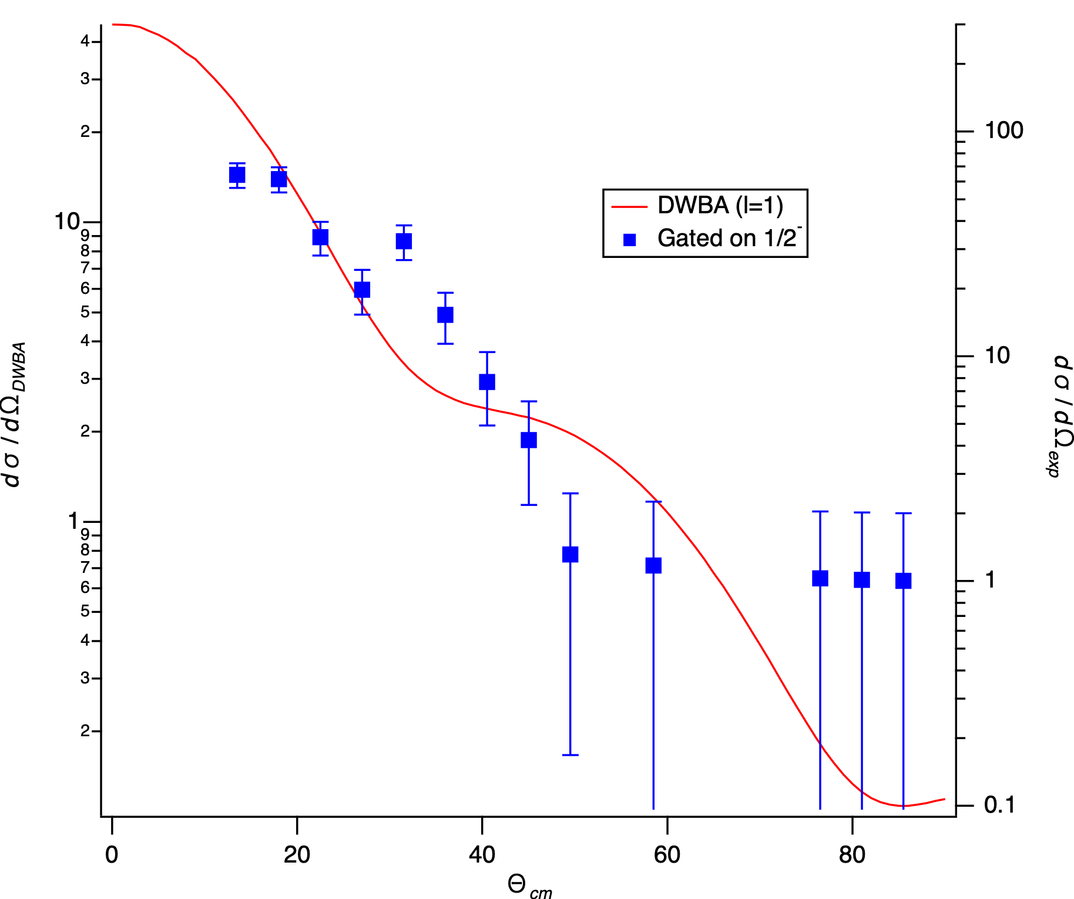
(Very preliminary) Angular distributions
2 hours of data
@ 1000 pps…

Slide 18
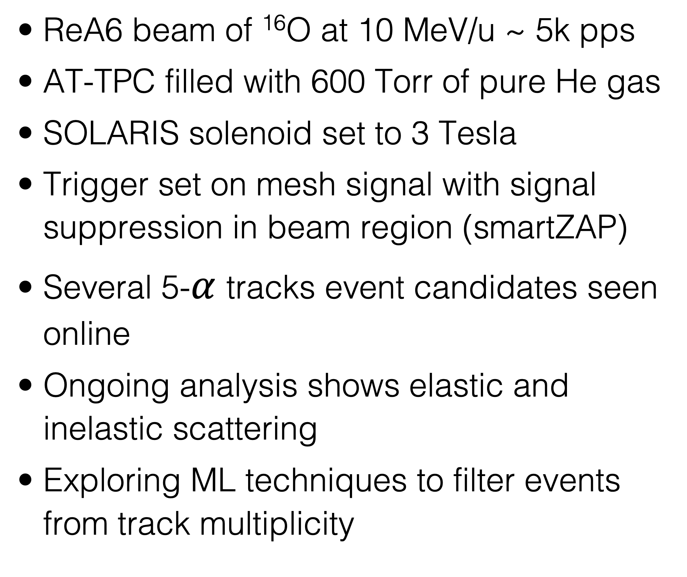
Study of $α$ cluster states in ¹⁶O
ReA6 beam of ¹⁶O at 10 MeV/u ~ 5k pps
AT-TPC filled with 600 Torr of pure He gas
SOLARIS solenoid set to 3 Tesla
Trigger set on mesh signal with signal suppression in beam region (smartZAP)
Several 5-$α$ tracks event candidates seen online
Ongoing analysis shows elastic and inelastic scattering
Exploring ML techniques to filter events from track multiplicity
ATTPCRoot

Slide 19
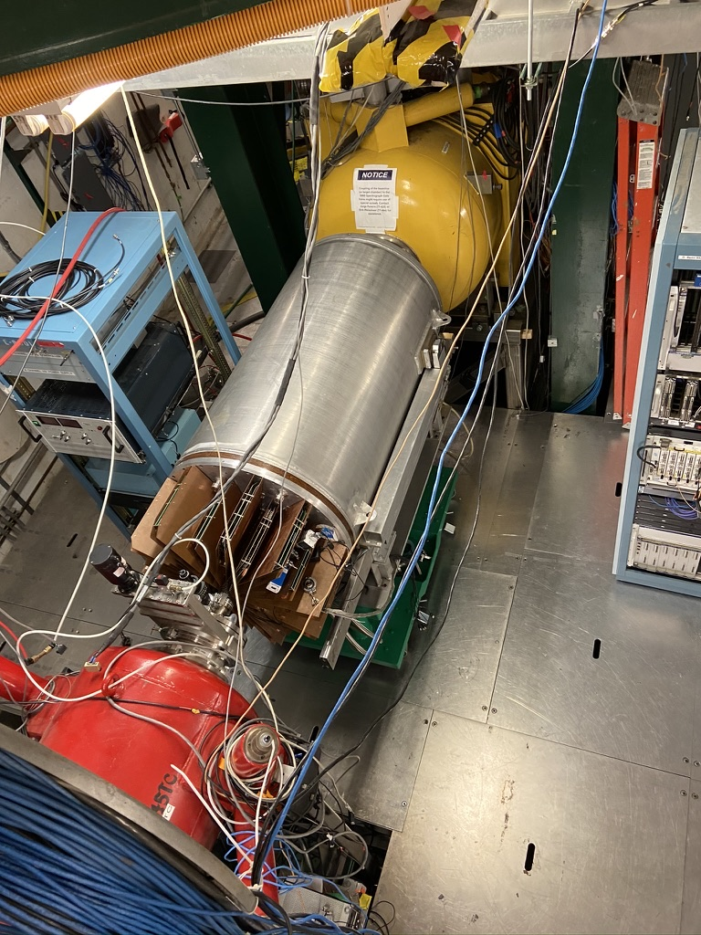
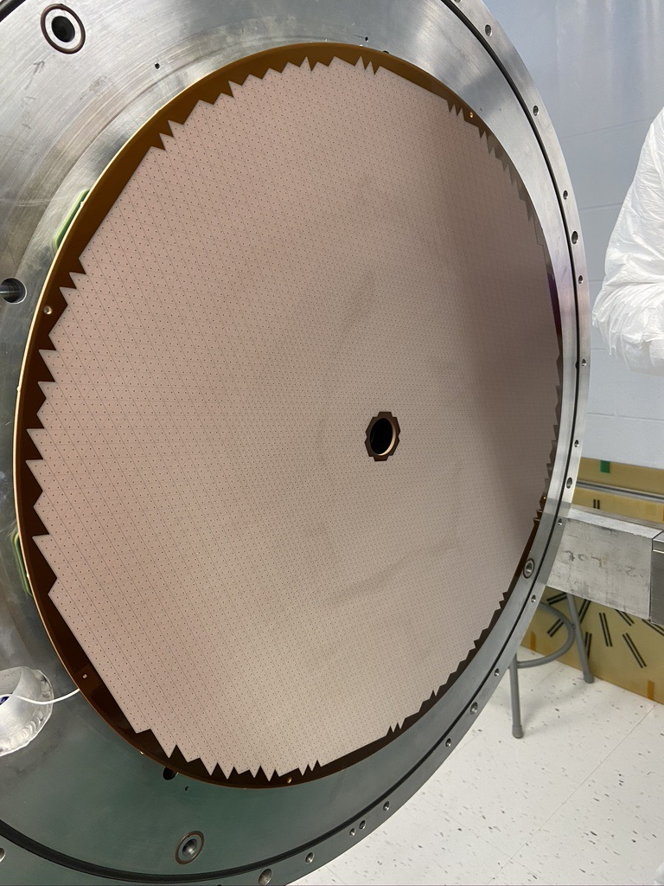
AT-TPC coupled to the S800
Use redesigned pad plane with 3cm hole in the middle to let radioactive beam in active volume
AT-TPC turned around with 4cm window on cathode end to let unreacted beam and beam residues in the S800
Rates up to 700,000 pps inside the blind beam region were achieved during experiment e18008
Beam
Residue
Recoil

Slide 20
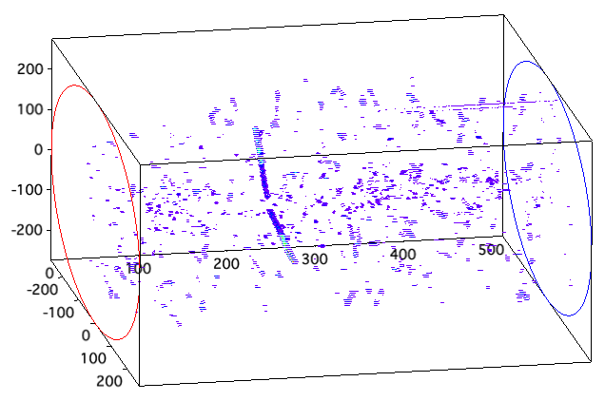
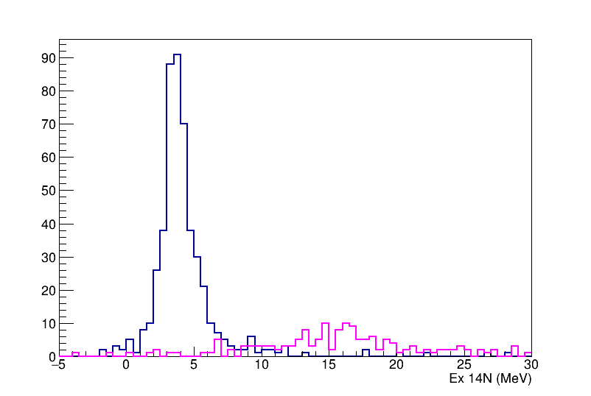
E18008: ¹⁴O(d,²He) charge exchange
Beam of ¹⁴O at ~ 100 MeV/u
AT-TPC filled with pure D2 gas at 530 Torr
Use of MTHGEM “electron preamplifier” installed on top of the Micromegas to raise gain to see proton signals
Trigger provided by the S800
Two-protons from ²He decay clearly visible
“Noise” tracks are actually delta electrons
Online spectrum gated on ¹⁴N residue clearly shows strong GT 1⁺ state populated
Analysis in progress (R. Zegers group)
Gated on ¹⁴N
Gated on ¹²C

Slide 21
Outlook
The AT-TPC is a versatile and powerful tool to measure direct reactions with weak intensity radioactive beams
High luminosity and good resolution can be achieved when combined with a solenoidal spectrometer such as SOLARIS
First transfer reaction commissioning experiment on ¹⁰Be(d,p)¹¹Be
  Preliminary resolution on Q-value: 350 keV
  Transfer reactions can be performed with intensities as low as ~ 100 pps
Operation of AT-TPC in transmission mode
  Can be coupled to spectrometer or Si-based recoil detector to measure heavy residues
  Higher intensities allow to reach smaller cross sections (tested up to 700,000 pps)

Slide 22

AT-TPC collaboration
(The ¹⁰Be sample was provided by the Paul Scherrer Institute)

Slide 23
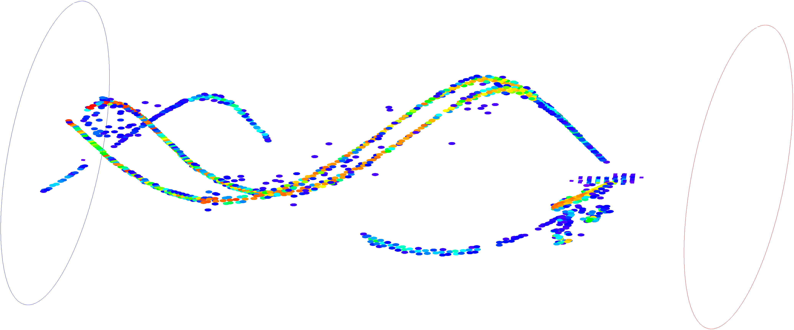
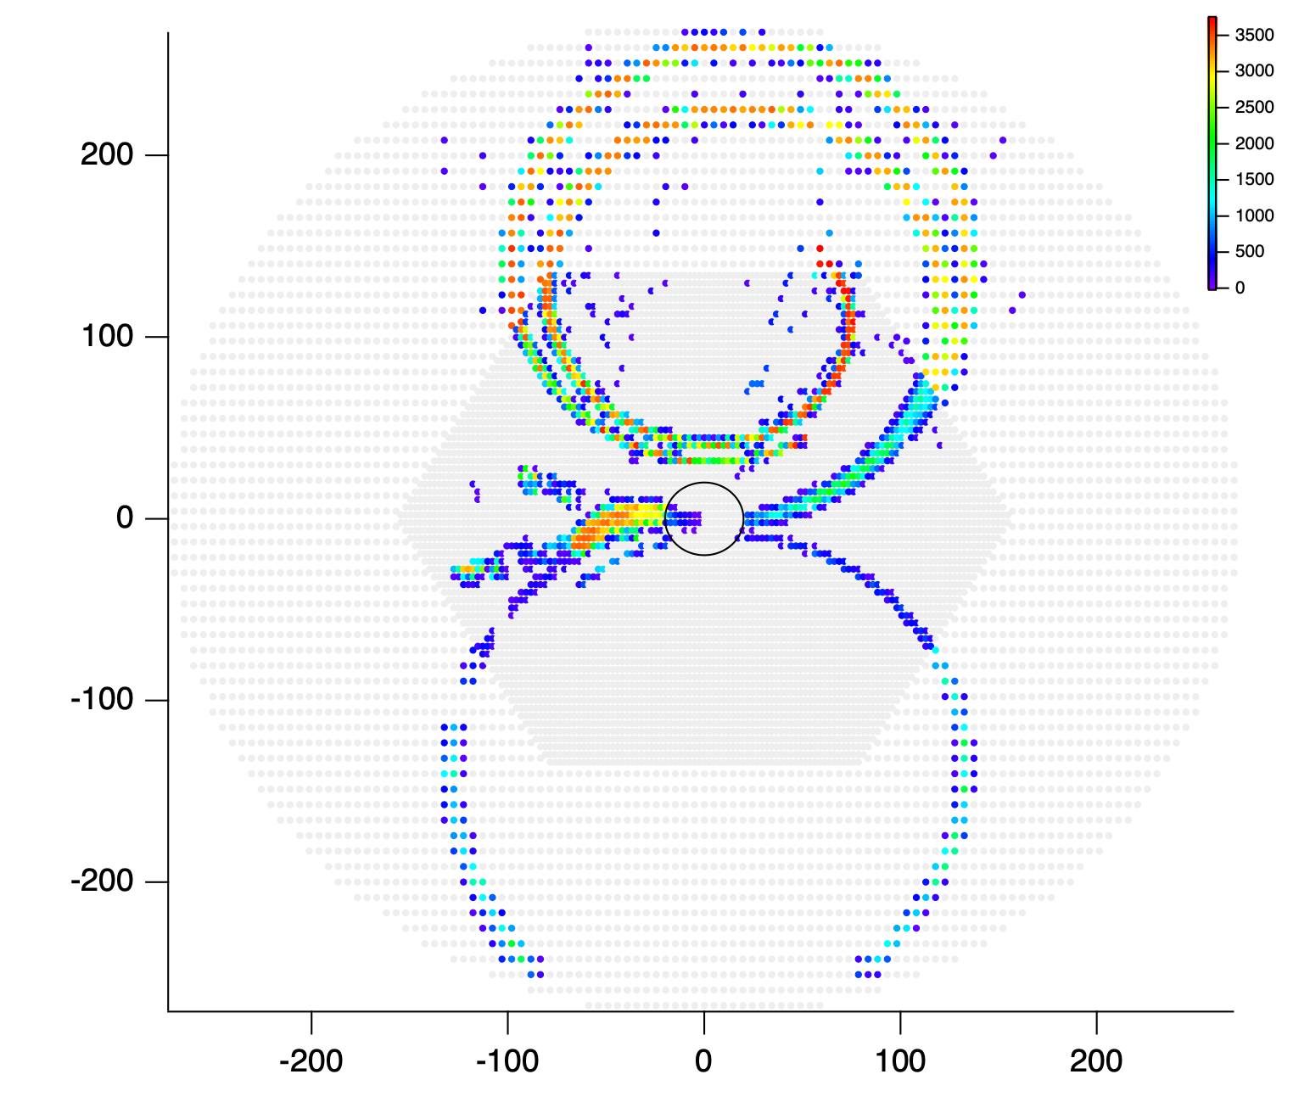
AT-TPC: an (art?) gallery
Shimmering electrons
Alphas pas de deux
¹⁰Be+d @ 10 MeV/u
¹⁴O(d,²He) @ 100 MeV/u
Cinnamon roll
The squid
¹⁶O+⁴He @ 10 MeV/u
¹⁰Be(d,p) @ 10 MeV/u

