Slide 1
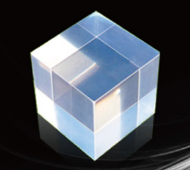
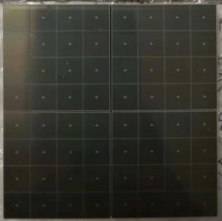

Ultra-high light yield solutions (from IHEP)
Low temperature CsI+SiPM+TPB solution
CsI, LY >100000 photons/MeV, 2.5 times better than CsI(Na)
SiPM, PDE 50%-60%, 2 times better than PMT
Expected ~50-60 p.e./keVee
SiPM
TPB（WLS）
CsI
Low temperature

Slide 2
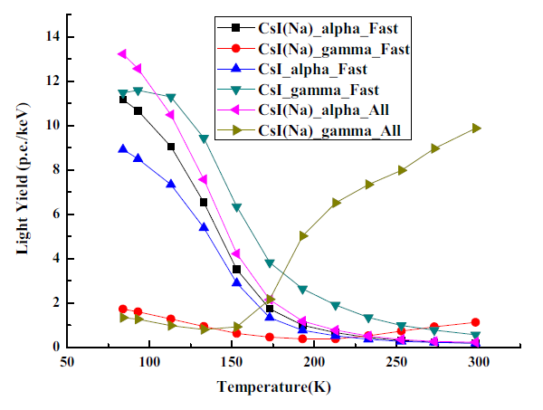
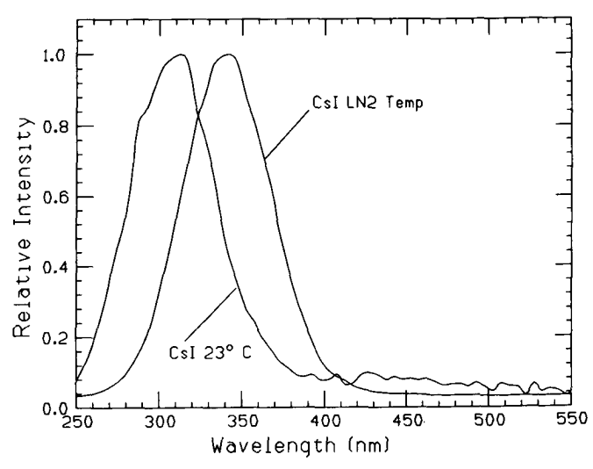
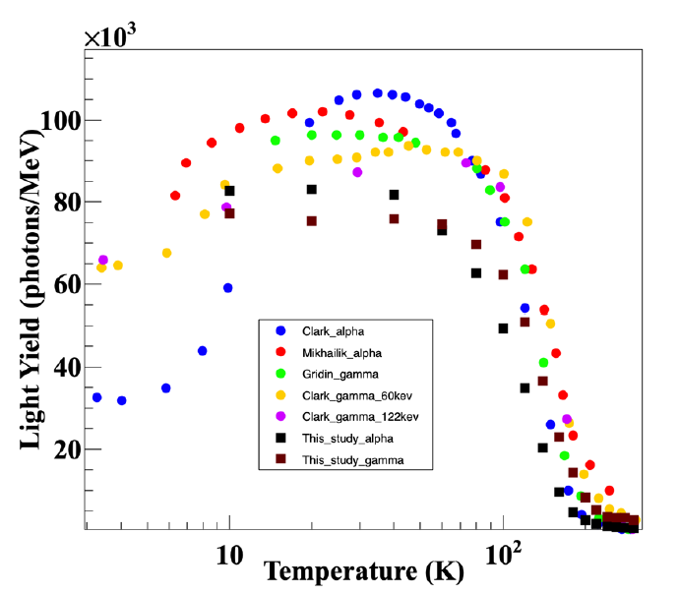
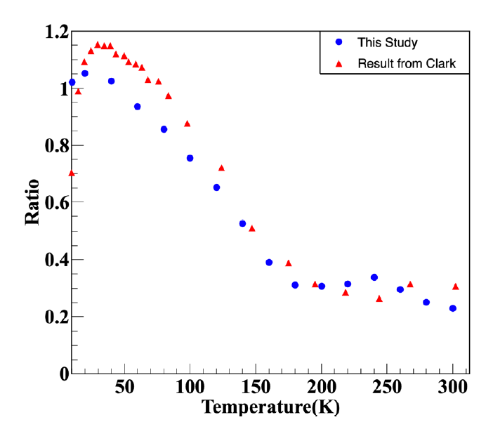
Pure CsI crystals
LY be significantly improved at LT
The brightest scintillator, 310-340 nm
QF>100% for alpha/gamma
QF for nuclear recoil/gamma 10%, 20%???
LY of CsI(Na), CsI(Tl) is reduced at LT
RDTM (2018) 2:15
IEEE TRANSACTIONS ON NUCLEAR SCIENCE, VOL. 37, NO. 2, APRIL 1990
New Physics: Sae Mulli,Vol. 71, No. 5, May 2021, pp. 469475

Slide 3
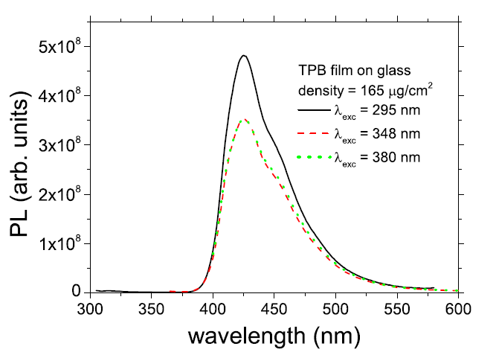
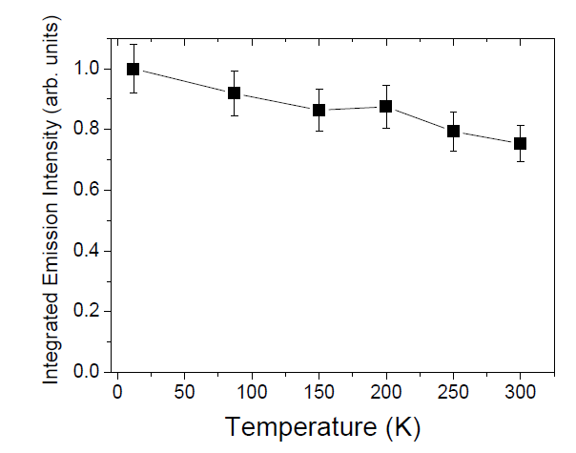
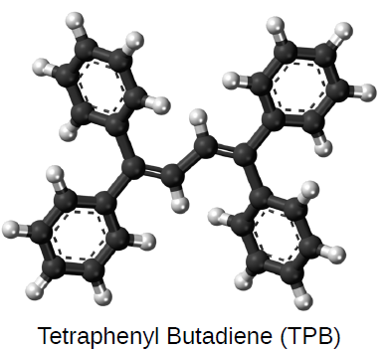
TPB wavelength shifter
Shift 340nm to 420 nm, match the SiPMs sensitive spectrum
Performance is enhanced at LT
Widely used in liquid argon detectors
R Francini et al 2013 JINST 8 P09006

Slide 4
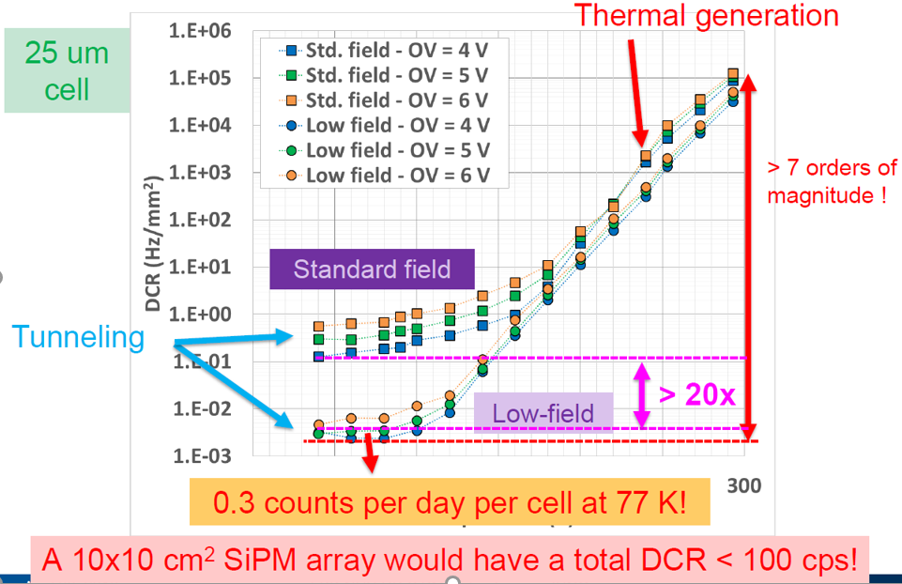
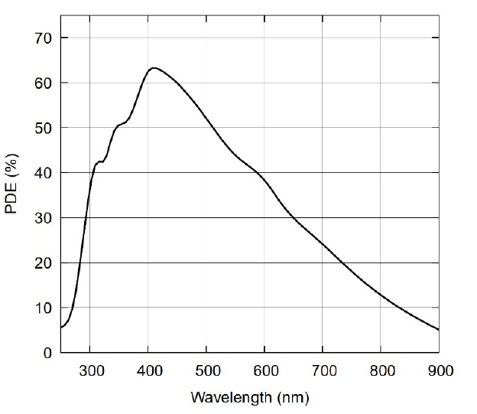
SiPMs Performance
PDE 50-60% at 420 nm
DCR reduced by 7 orders, < 0.01 CPS/mm² at 77K
Optical cross talk, acts as a photon amplifier
AFBR-S4N66P014M NUV-MT Silicon Photomultiplier
Alberto Gola FBK

Slide 5
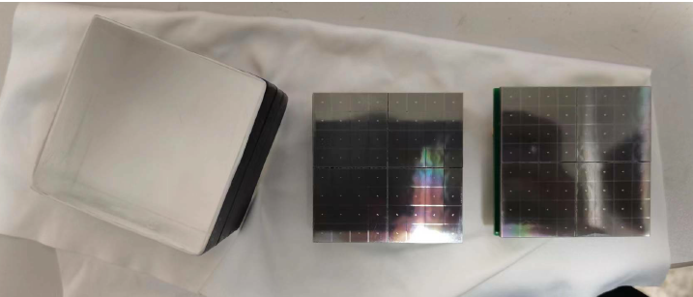
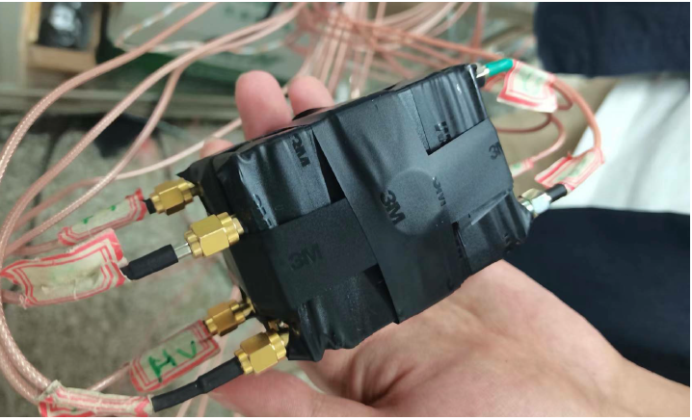
Prototype detector
CsI crystal 5x5x5 cm, 0.56kg, polished
Packaging with Teflon reflective film without TPB
SiPMs array, 5x5 cm, two end readout, with TPB
Cooling to 77 K with liquid nitrogen
Low temperature front-end amplifier circuit

Slide 6
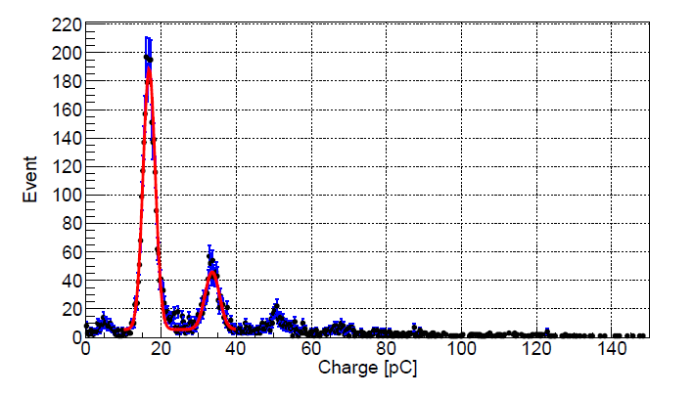
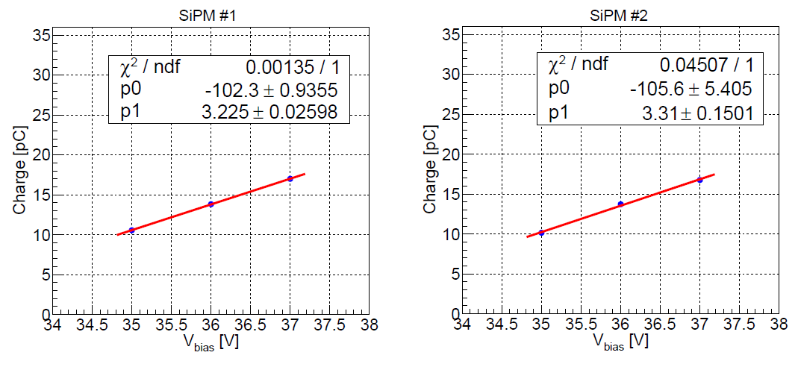
SiPMs array performance
SiPM and preamplifier run stably at low temperatures
Single photoelectron resolution is very good
Consistency of the two arrays is very good
DCR ~0.1 Hz/mm² @35V bisa
arXiv:2212.11515

Slide 7
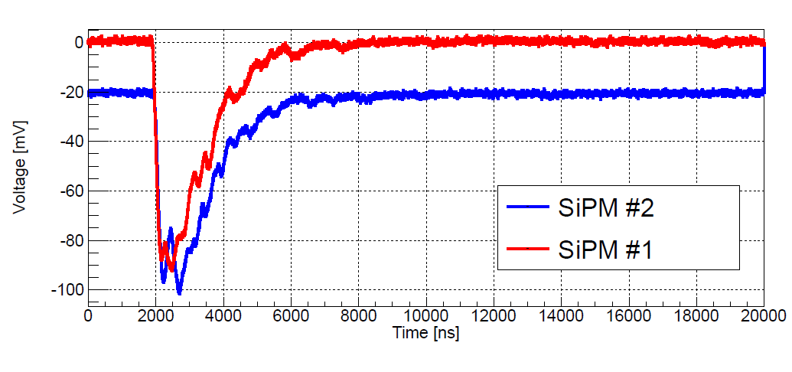
Waveform performance
Decay time ~1 µs, Pulse Width ~3 µs
Baseline width <5 mV

Slide 8
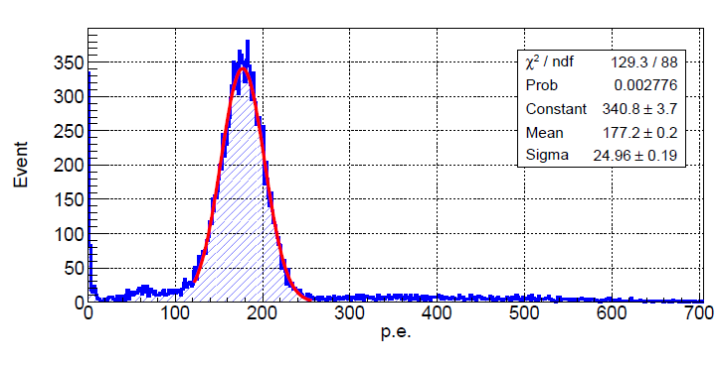
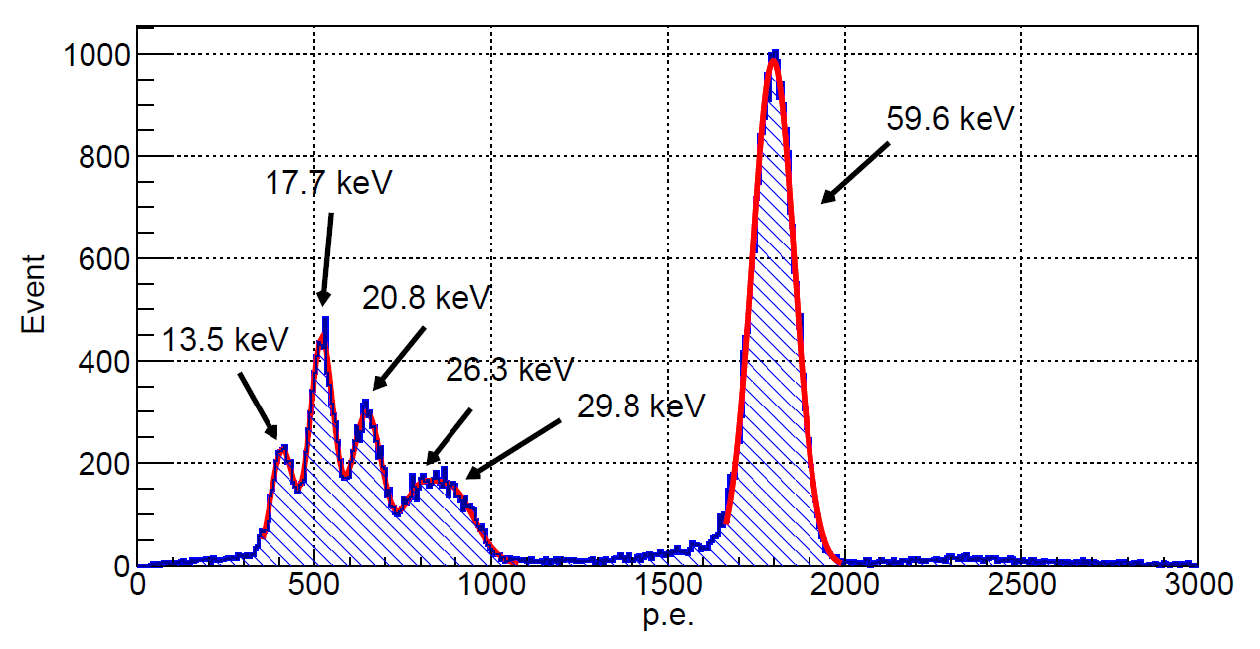
Energy spectrum
Test with ²⁴¹Am and ⁵⁵Fe
Excellent energy resolution,fine structures are clearly visible
arXiv:2212.11515

Slide 9
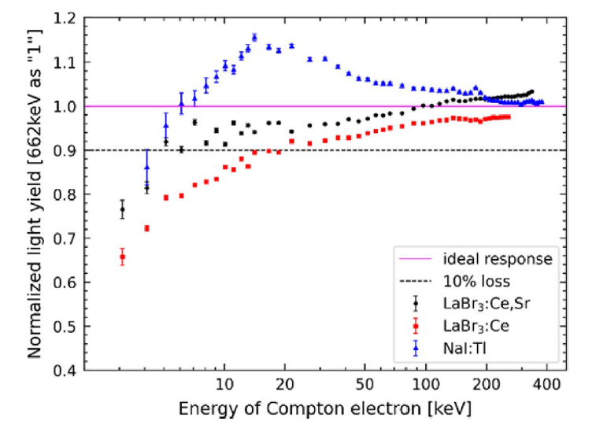
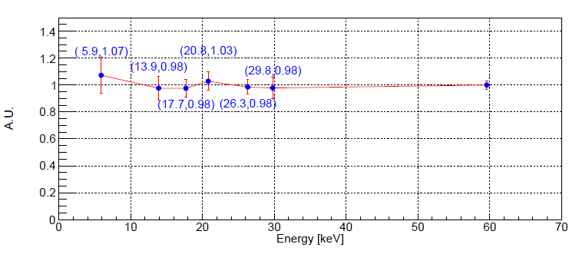
Luminescence linearity
Excellent luminescence linearity, no drop down below 10keV
Significantly better than LaBr₃, NaI:Tl
arXiv:2212.11515
Nuclear Science and Techniques (2024) 35:23

Slide 10
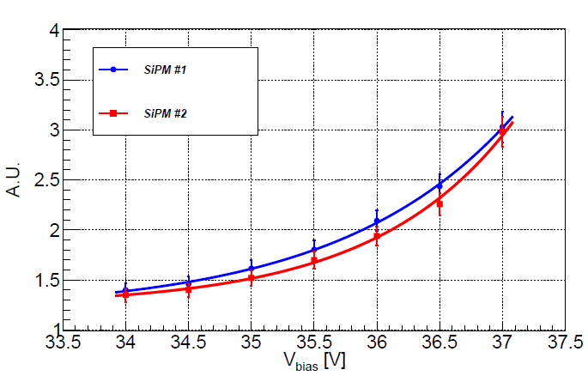
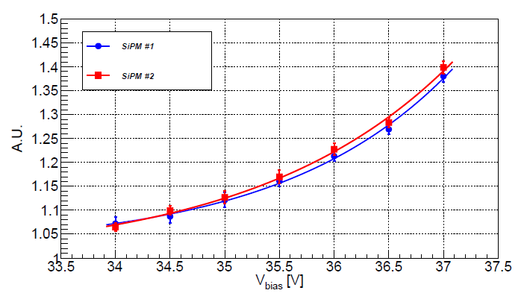
Influence of SiPMs Cross Talk and After Pulse
CT, AP significantly increasing the measured p.e. number
Internal CT, AP triples the number of p.e. at 37 V_{bias}
External CT 1.4 times the number of p.e. at 37 V_{bias}
arXiv:2212.11515

Slide 11
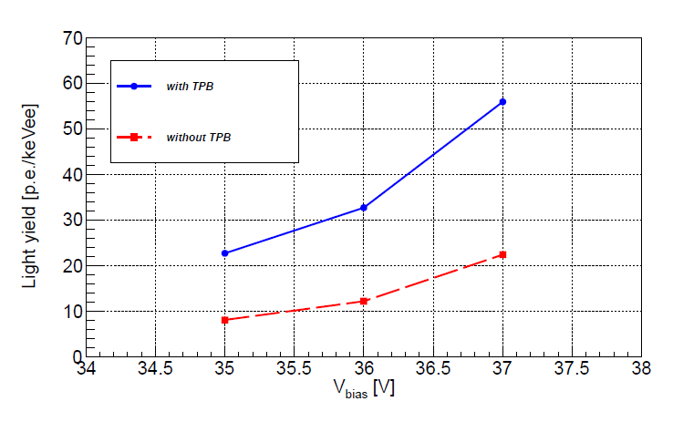
Influence of TPB
Photoelectrons number is doubled with TPB
arXiv:2212.11515

Slide 12
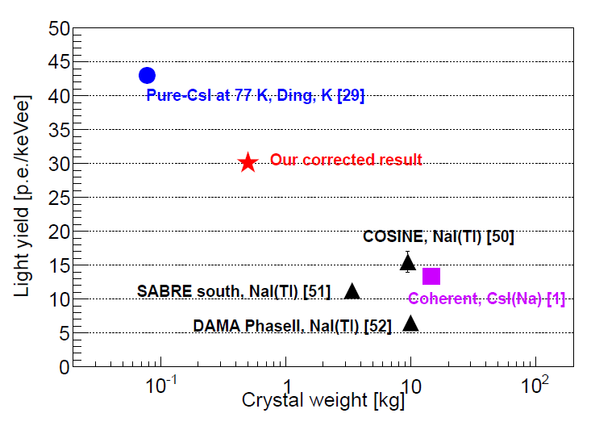
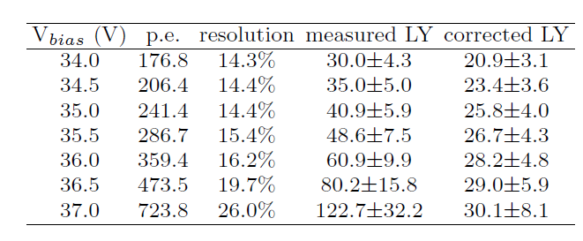
Light yield
The measured p.e. number increases significantly with increasing bias voltage, 30 to 122 p.e. /keVee
122.7 p.e./keVee, a world record
30.1 p.e./keVee, after CT subtract (50% PDE at LT?)
arXiv:2212.11515

Slide 13
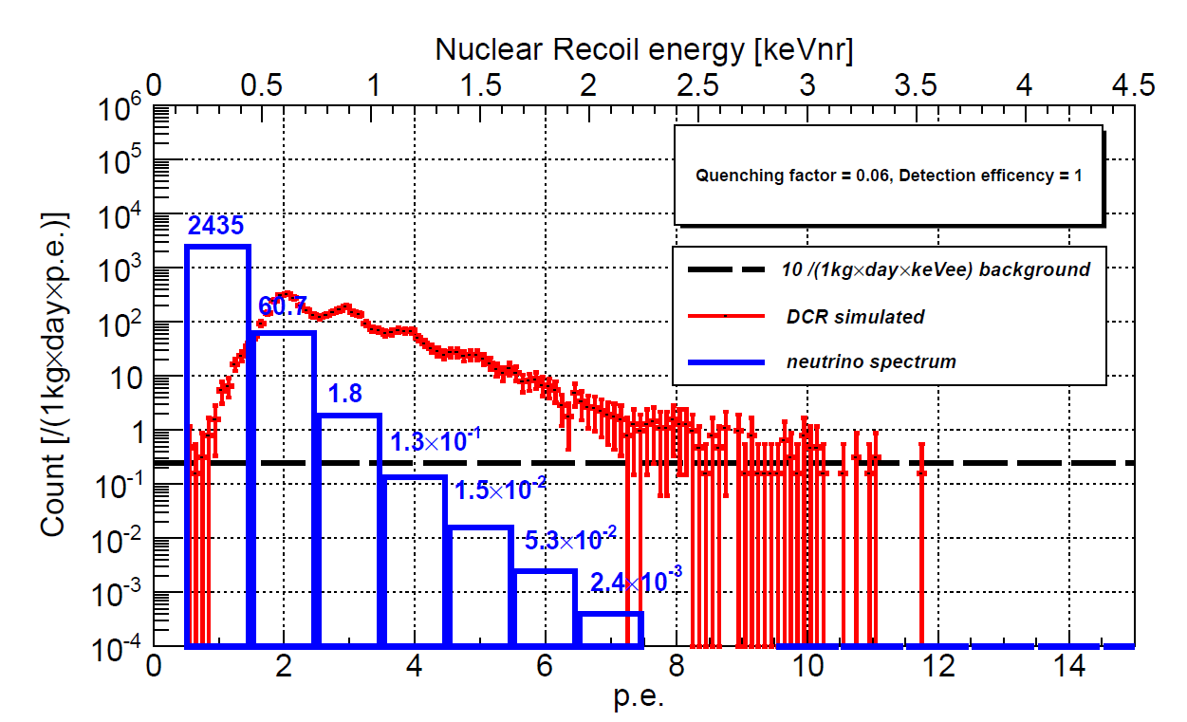
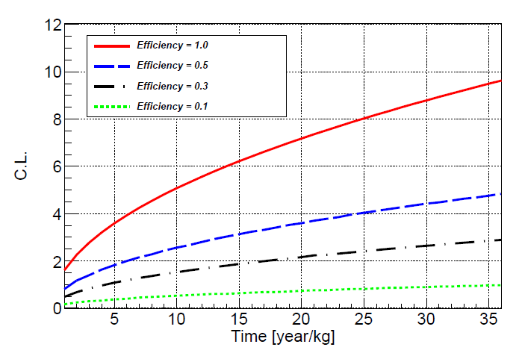
Potentials in the CEvNS detection
35 m distance to a 4.6 GW^{th} reactor
QF=0.06, DCR= 0.1 CPS/mm², DCR dominant background,
Threshold 2 p.e., good chance for reactor CEvNS observation
If QF ~15%?, DCR~0.01?, better sensitivity
arXiv:2212.11515

Slide 14
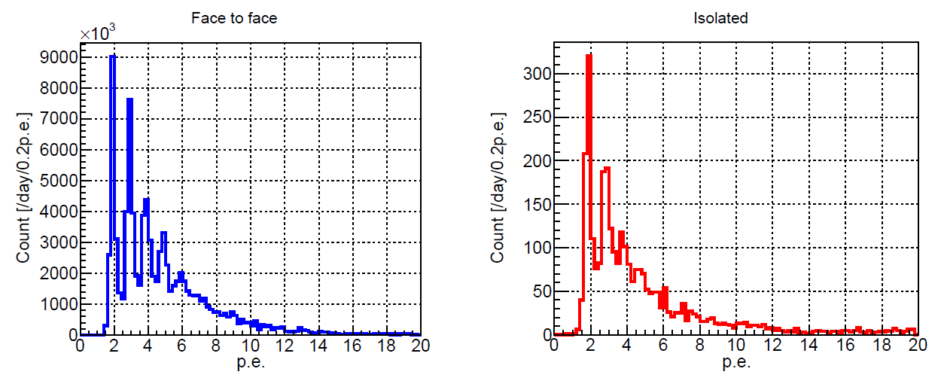
Issue of SiPMs eCT coincidence events
Events rate of eCT coincidence is very high
5 orders larger than accidental coincidence of DCR
Big issue for low threshold detectors
Need do further study, single-ended readout, correlation with iCT
arXiv:2212.11515

Slide 15
Summary
Ultra-high light yield solution is proposed by IHEP
The prototype detector works well
Good chance for reactor CEvNS detection
eCT issue need further study

