Slide 1
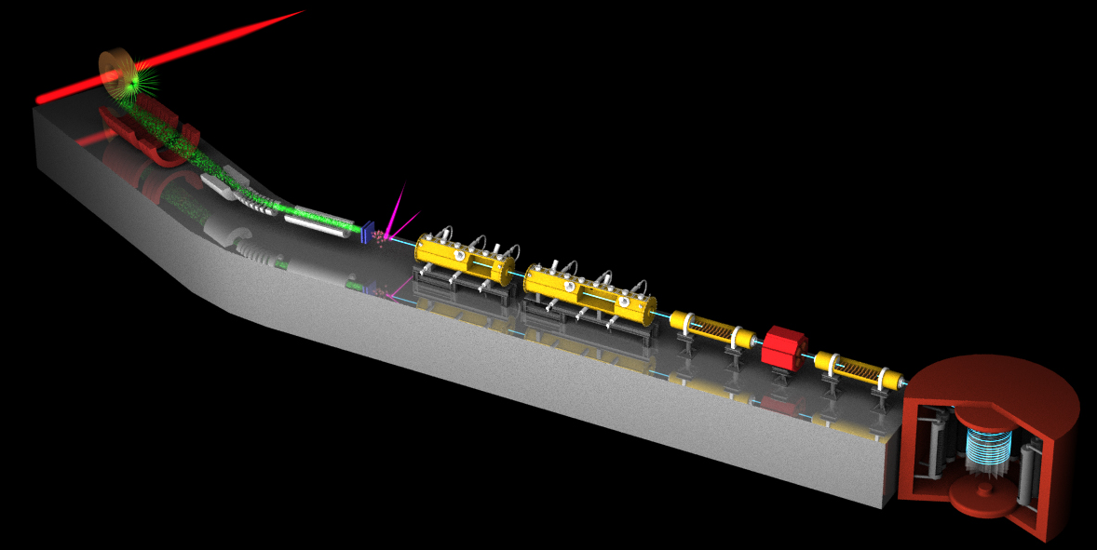
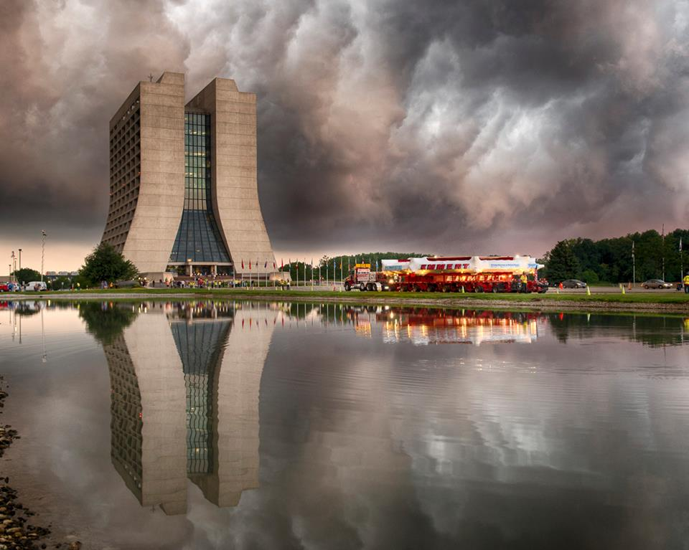
Experimental Prospects
on Muon g-2
Mark Lancaster
University College London

Slide 2
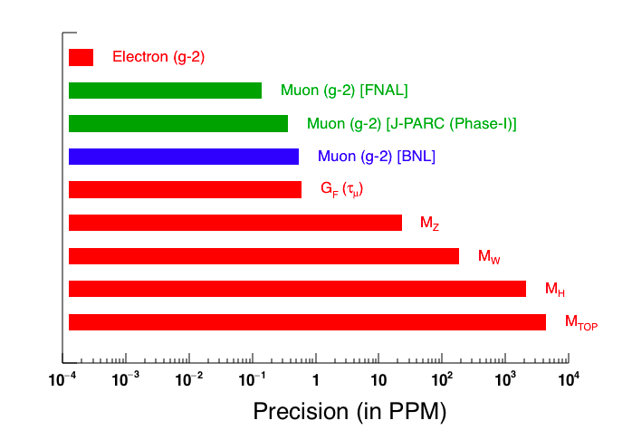
Aim
0.14 ppm
0.54 ppm

Slide 3
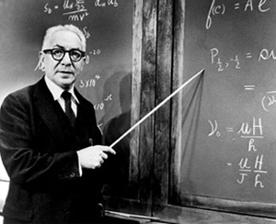
How to achieve 0.1 ppm
0.14 ppm
0.54 ppm
“Never measure anything but frequency”
I. Rabi

Slide 4

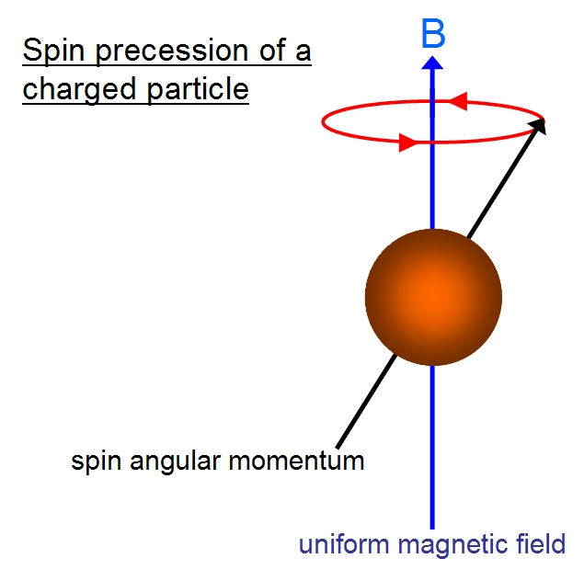


g-2 basics
Interaction between
magnetic moment (spin) with B-field.
Spin precesses around B at
a frequency determined by “g”
B field (photon)

Slide 5
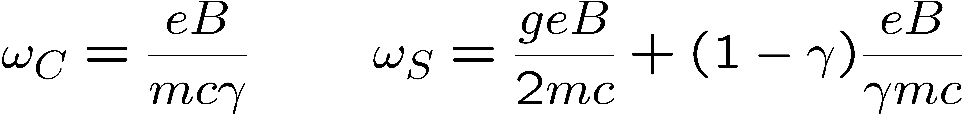
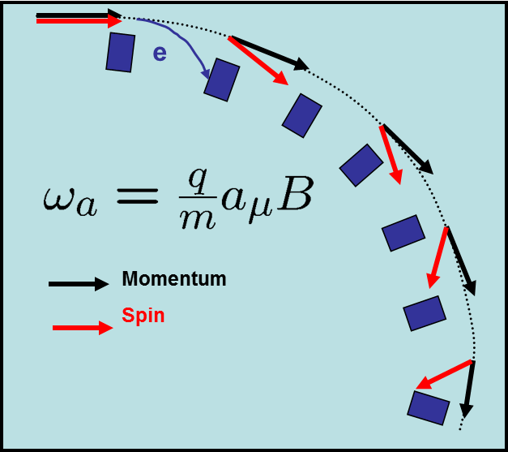
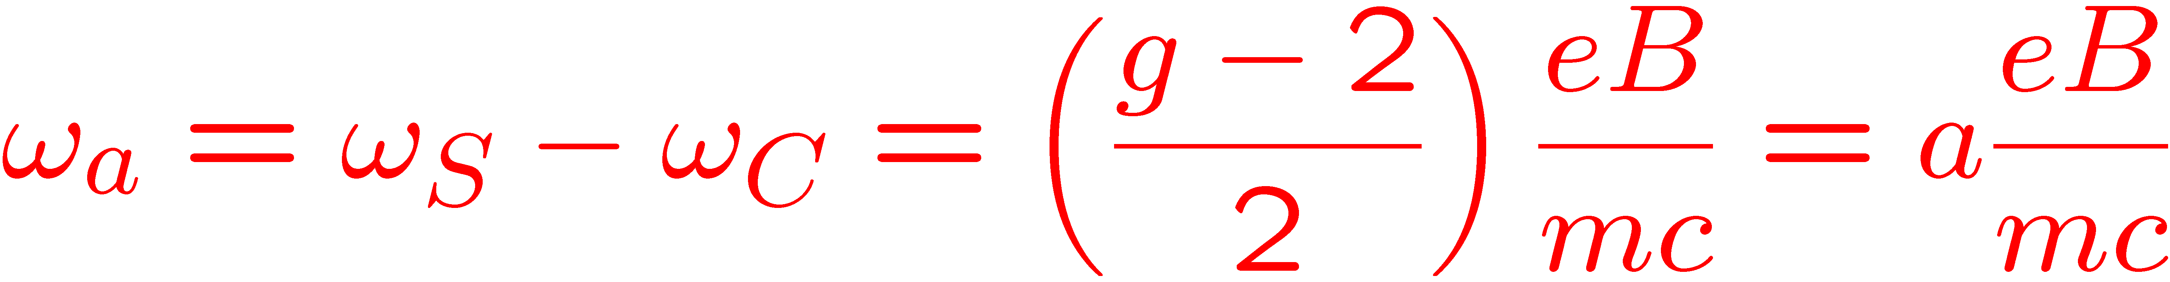

Motion in B-field storage ring
Particle in a circular storage ring (B-field): two frequencies:
Spin vector of muon rotates slightly quicker than Momentum vector.
For a 1.5T field spin rotates in 144ns and momentum in 149ns.

Slide 6
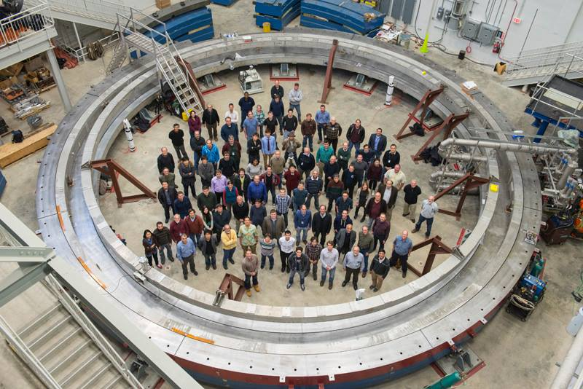
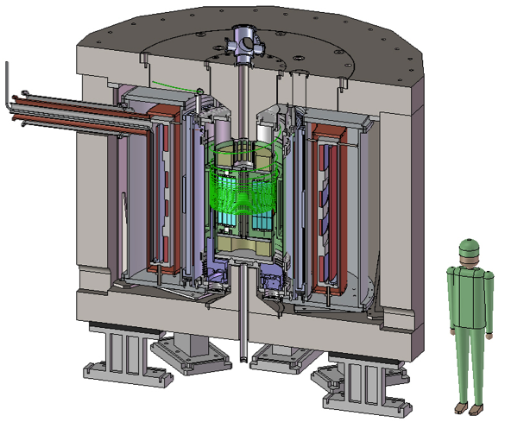
The real world
But real beams are not all on the same perfect circular orbit and can have a (small) transverse velocity component.
These imperfection causes beam to diverge vertically.
Two approaches:
- cancel the divergence with an electric quadrupole field (CERN,BNL, FNAL)
- minimise the divergence by reducing the beam p_{T} (J-PARC)
FNAL
J-PARC

Slide 7
Two very different experiments
FNAL
3.094 GeV muons
1.45 T, 14m bespoke magnet
Focussing quadrupoles
Kicker magnets
Emittance: 1000pimm
J-PARC
0.3 GeV muons
3T, 66cm MRI magnet
Δp_{T}/p_{T} = 1e-5
Apparatus and hence systematics are very different

Slide 8
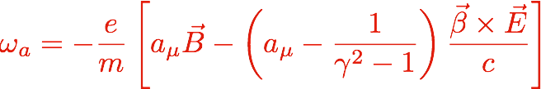

Addition of E-field
FNAL: MAKE ZERO BY
CHOOSING “MAGIC” 𝝲
J-PARC: MAKE ZERO
BY HAVING E=0
Both expts need to measure two quantities
- B field
- ω_{a}
To better than 0.1 ppm

Slide 9

Measure two quantities
B is measured using NMR in terms of the proton Larmor frequency : ω_{p}
λ₊ measured from muonium hyperfine structure
Uncertainty in a_{μ} determined by precision of ω_{p} and ω_{a} measurements

Slide 10
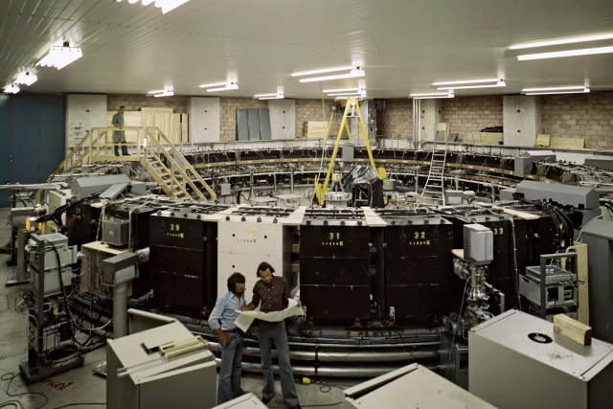
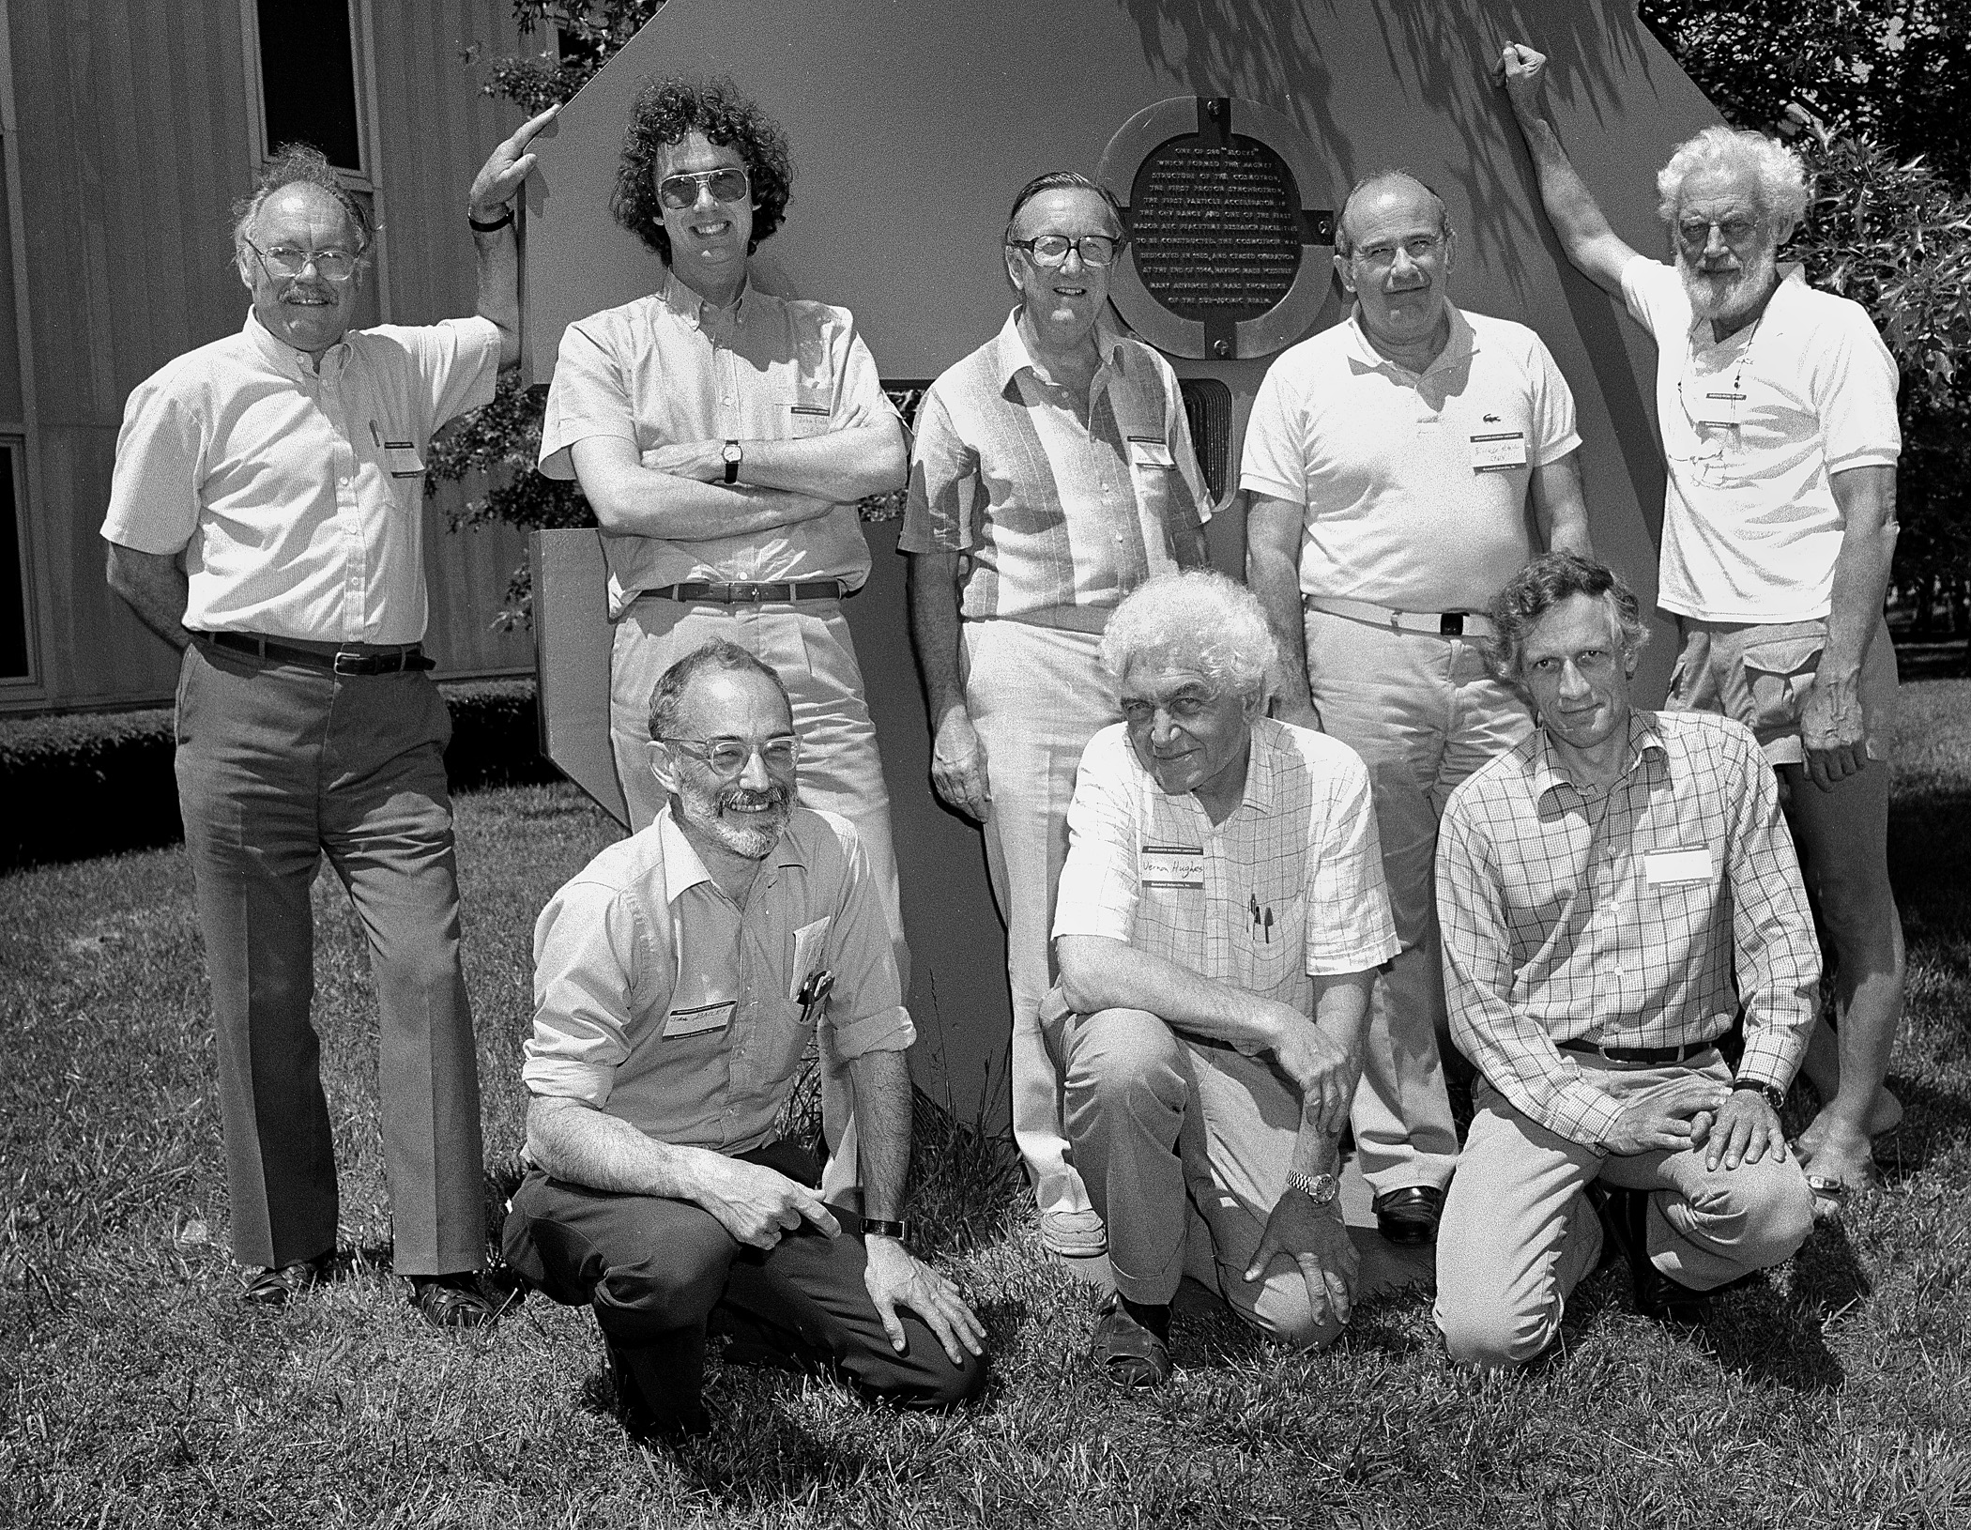
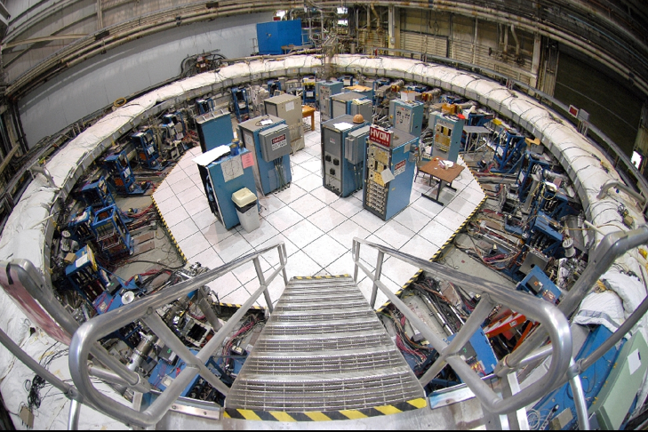
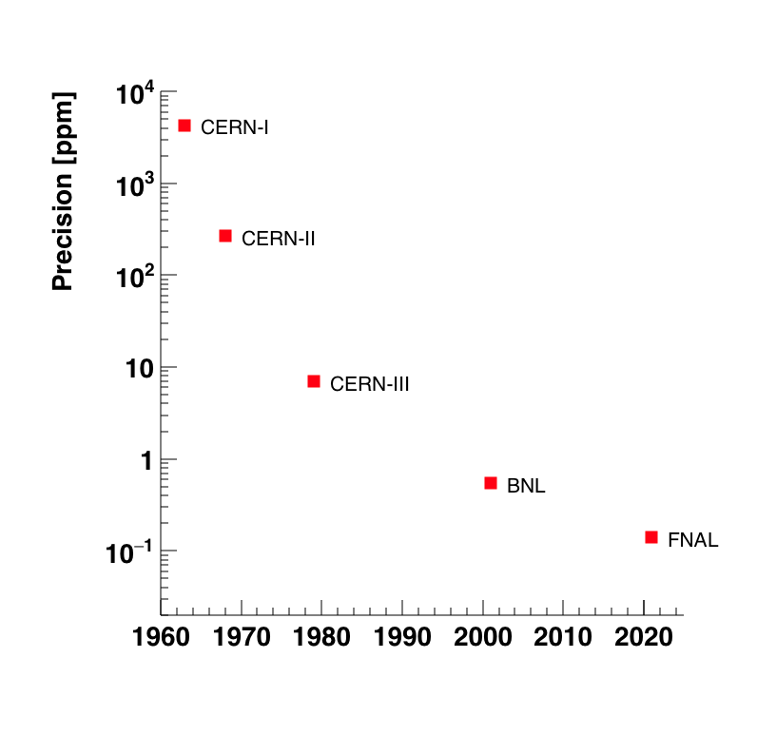
FNAL g-2 experiment

Slide 12
http://paperscape.org/

Slide 14
FNAL g-2
Inject 3.09 GeV muons into
a storage ring (B = 1.45 T)
Exploit property that direction
of e⁺ from μ⁺ decay is strongly
correlated with μ⁺ spin
for highest energy e⁺
24 calorimeters and 3 straw trackers measure e⁺ for O(1 ms) for spills
separated by 10ms.
16,000 stored 3.09 GeV muons from 10¹² protons per spill.

Slide 15
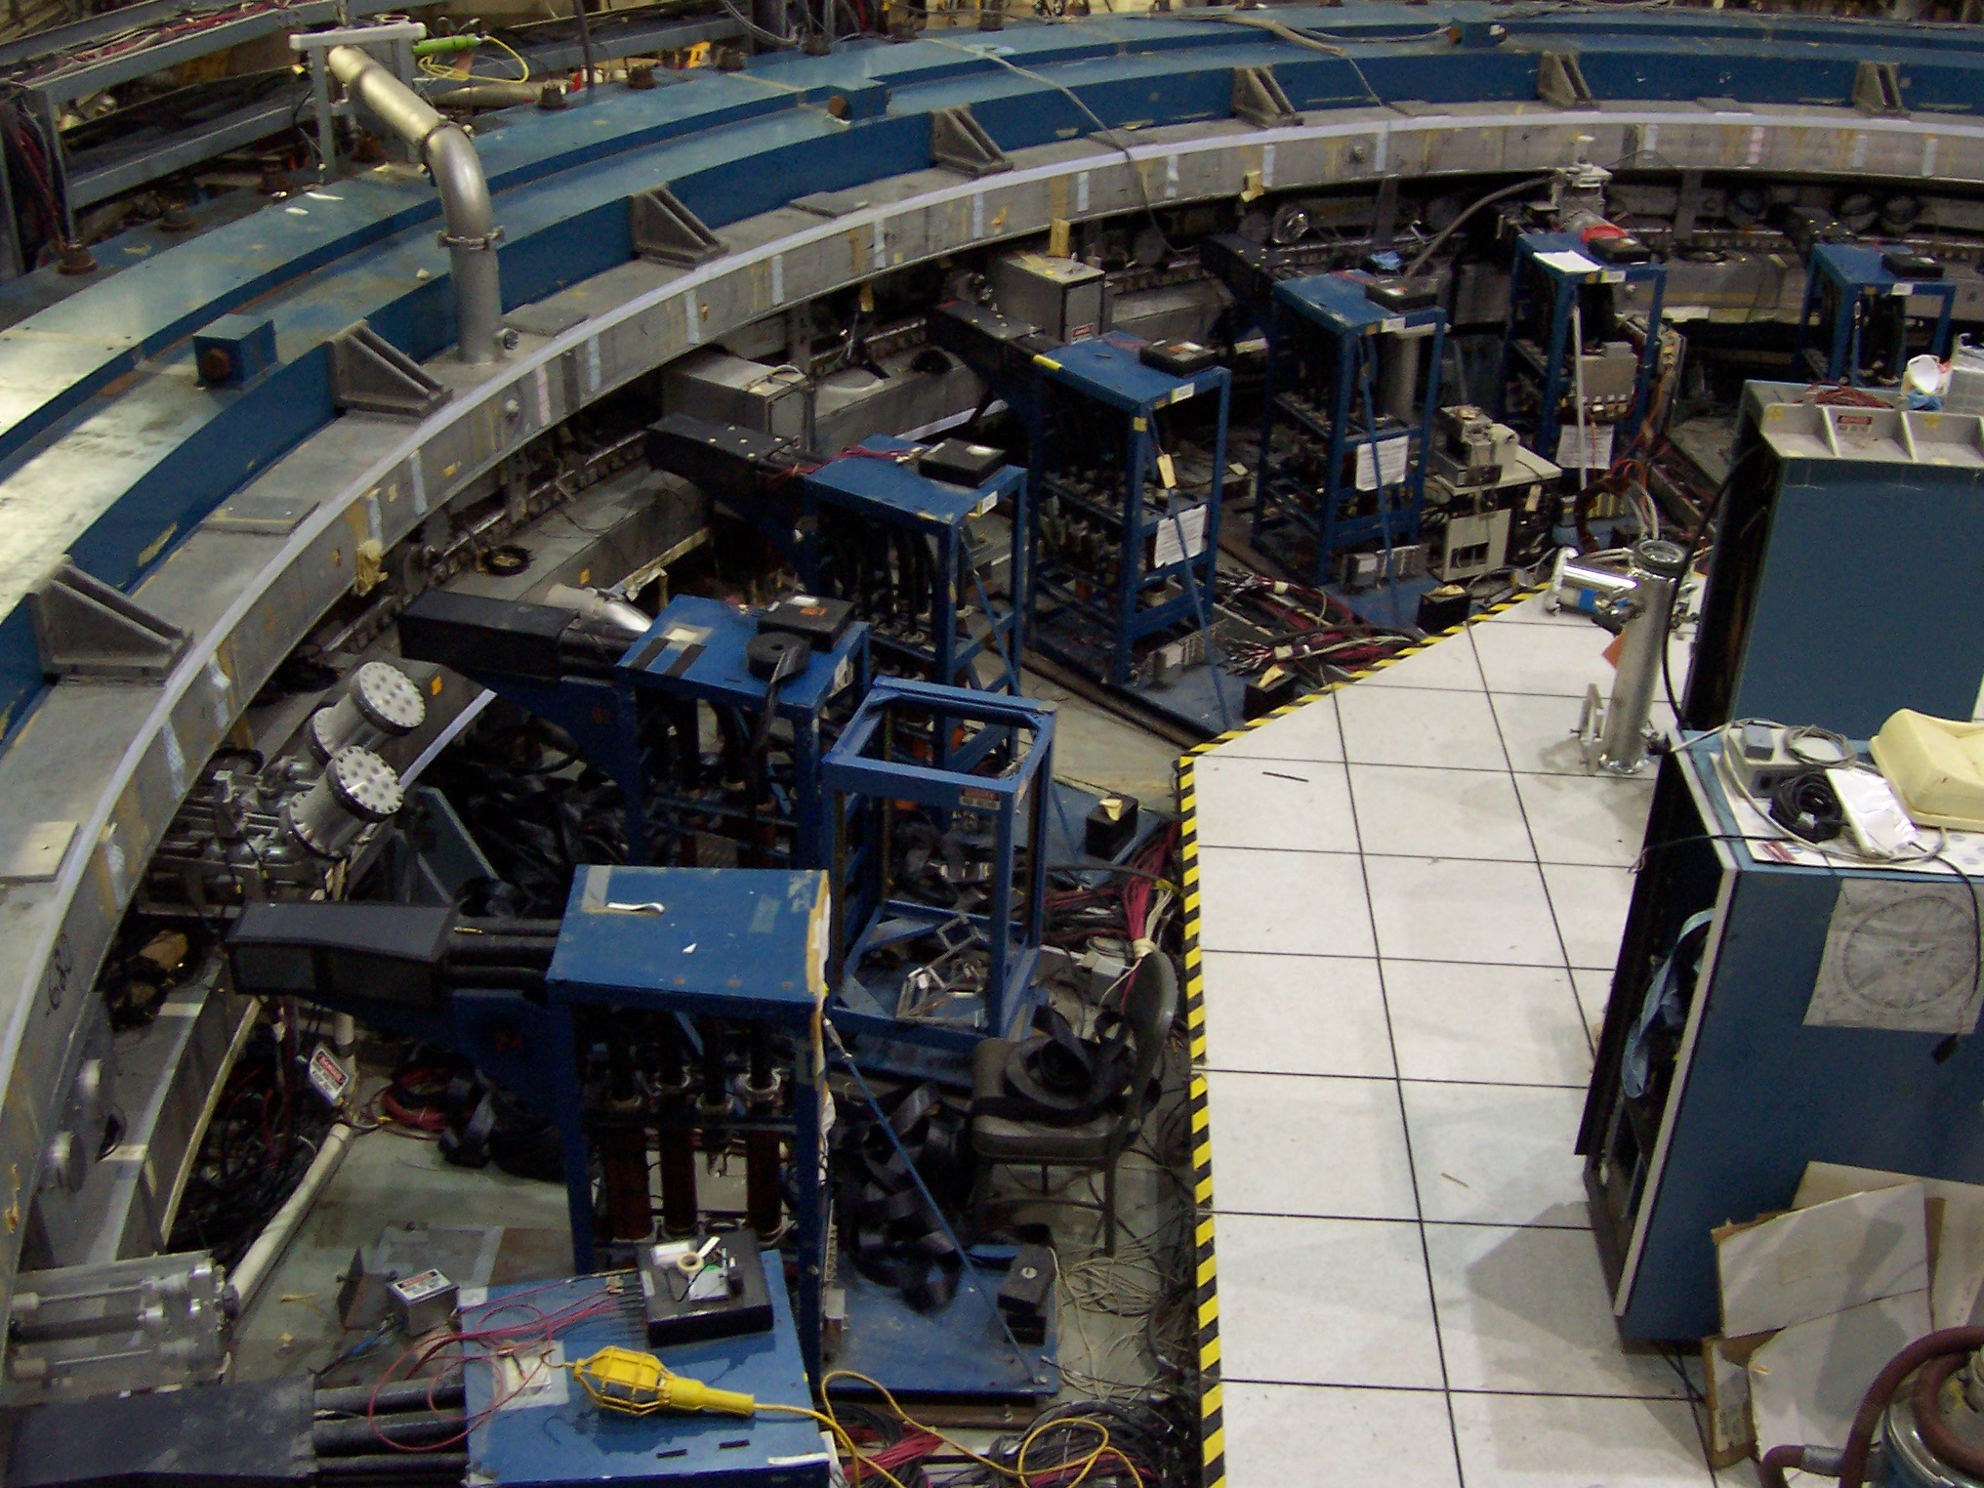
BNL calorimeters

Slide 16
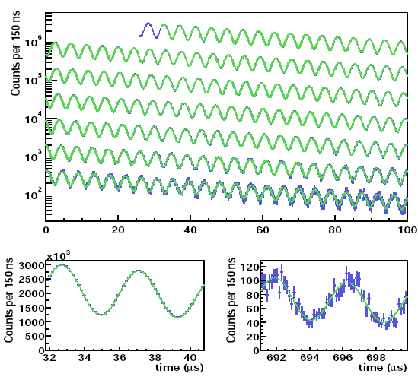
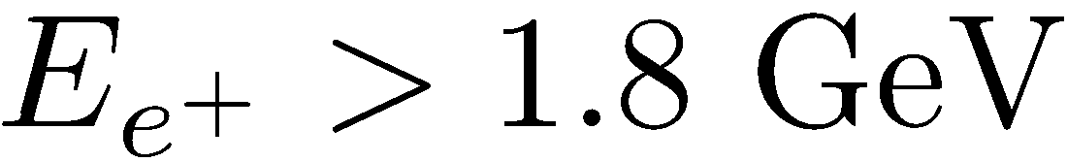
The Wiggle Plot
0 – 100 μs
100 – 200 μs
200 – 300 μs
300 – 400 μs
400 – 500 μs
500 – 600 μs
600 – 700 μs
Need approx
100B muons !

Slide 17
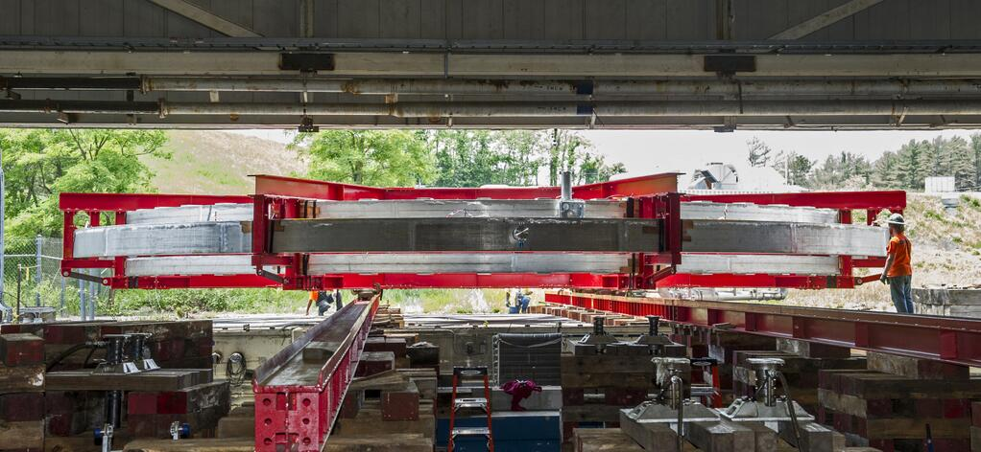
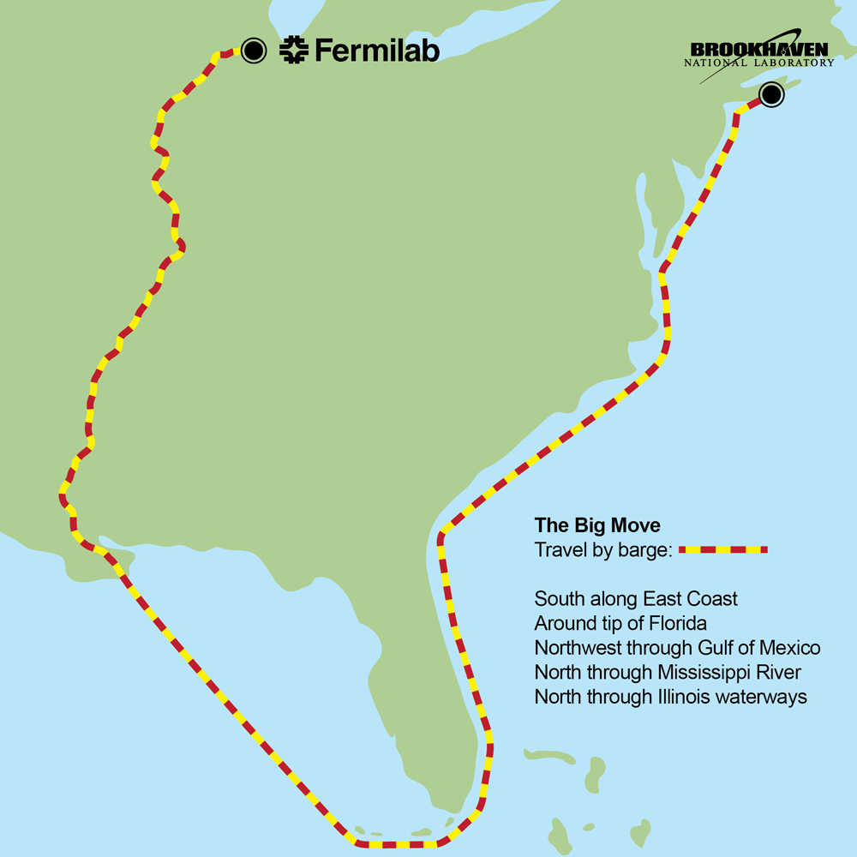
The Move

Slide 18
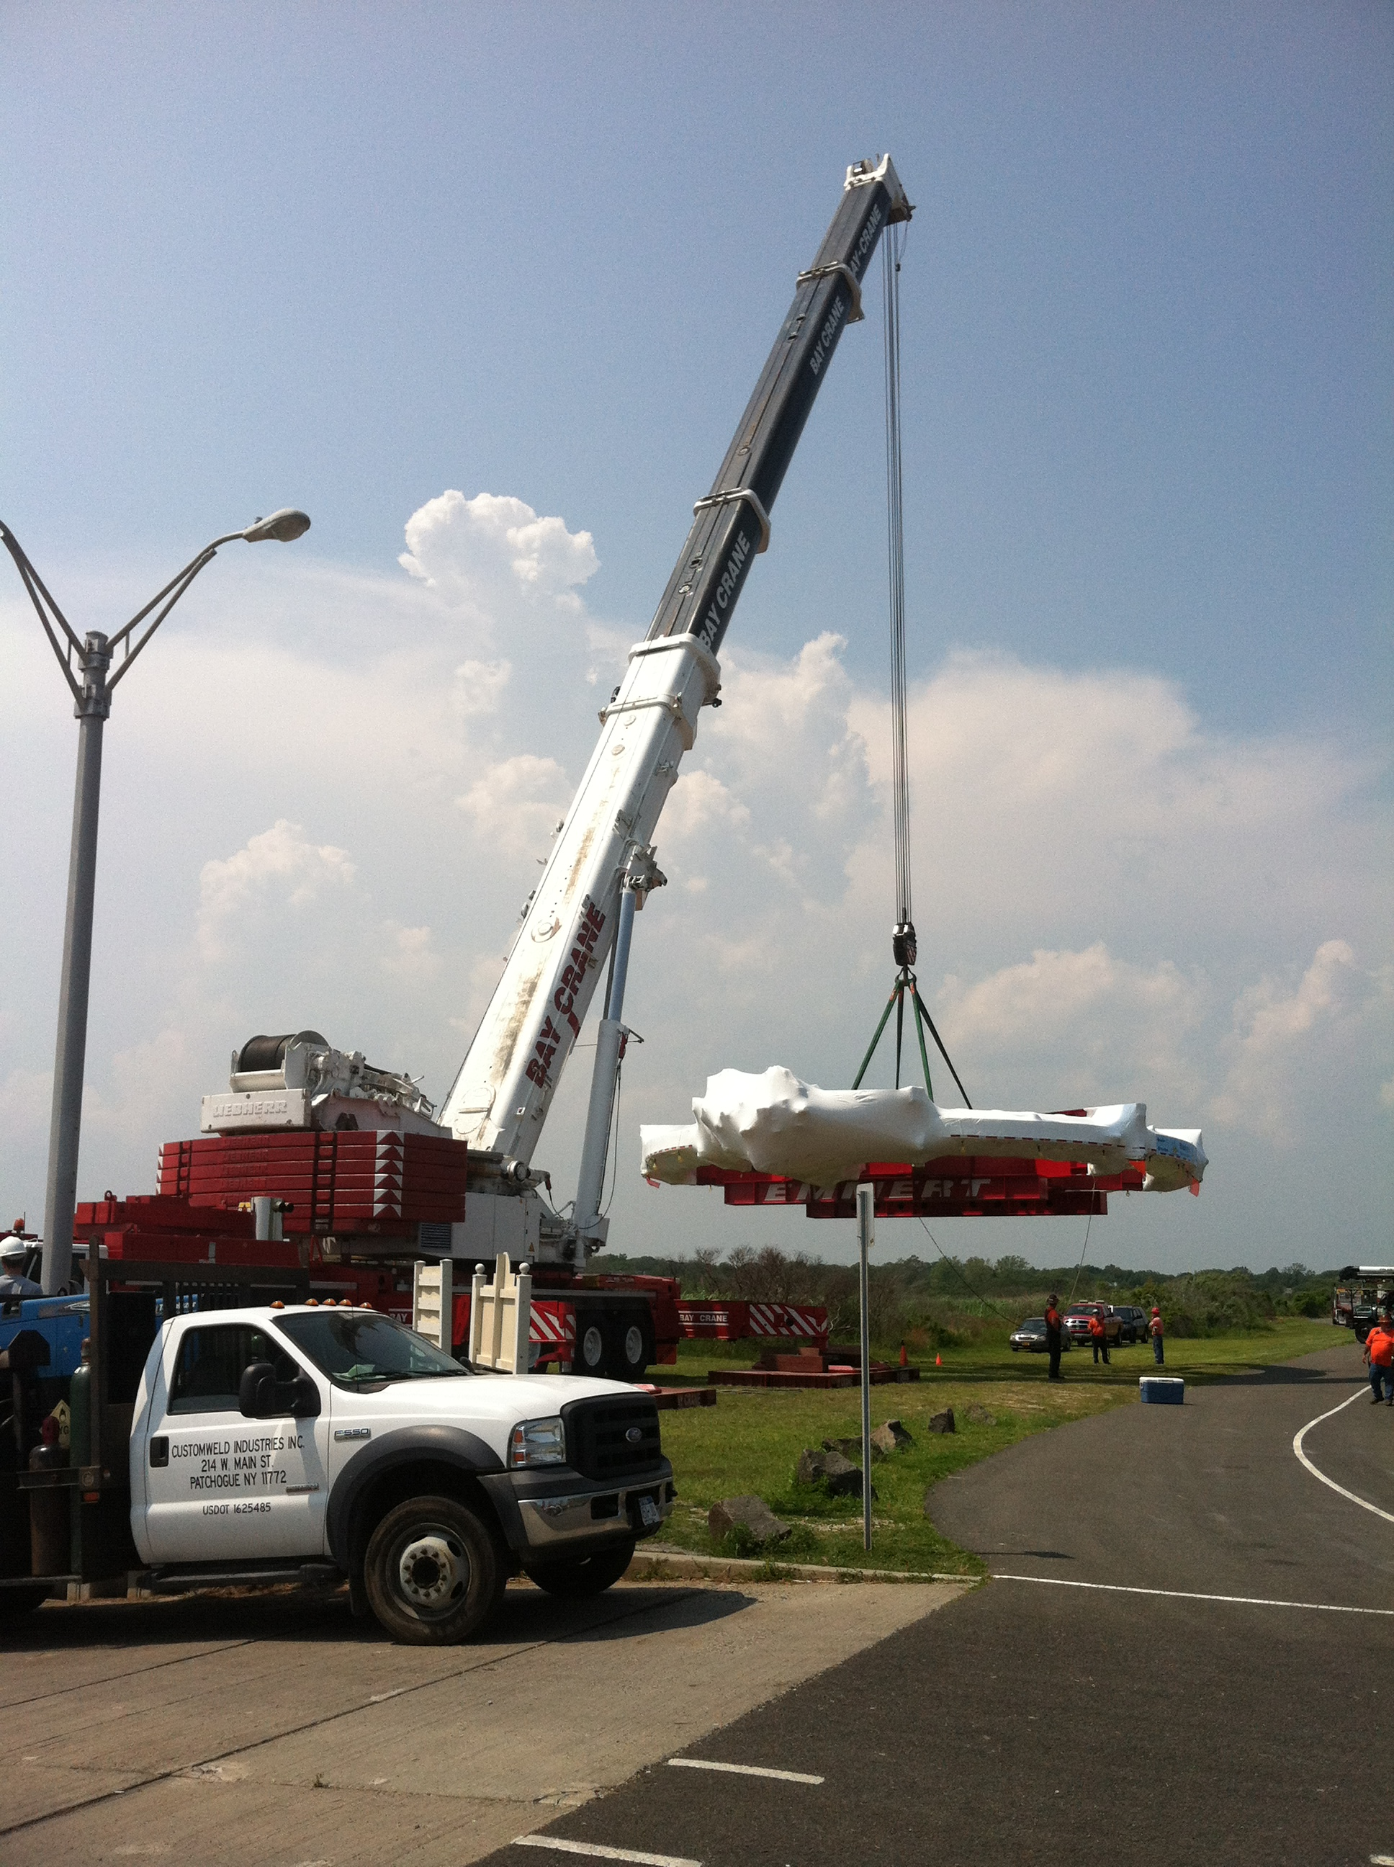
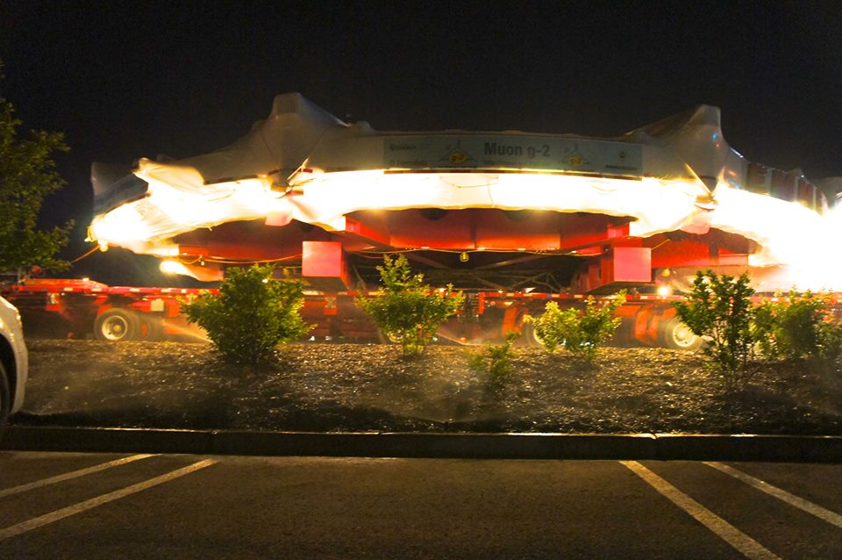
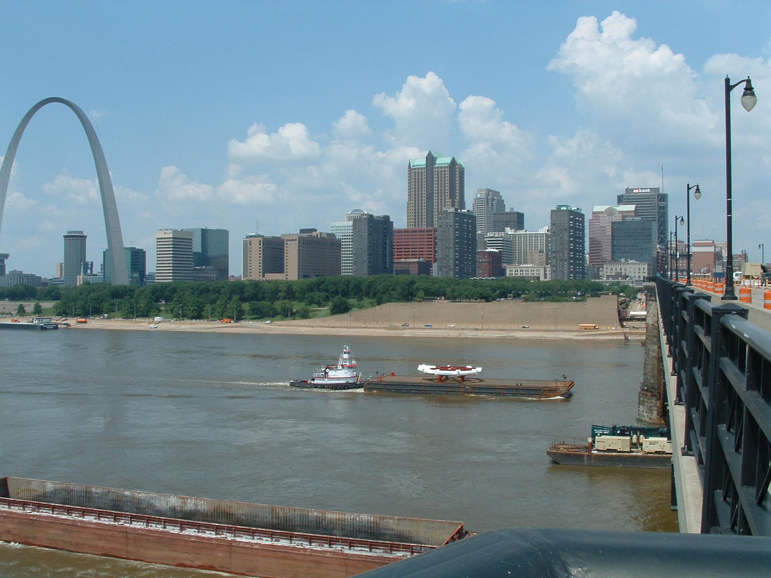
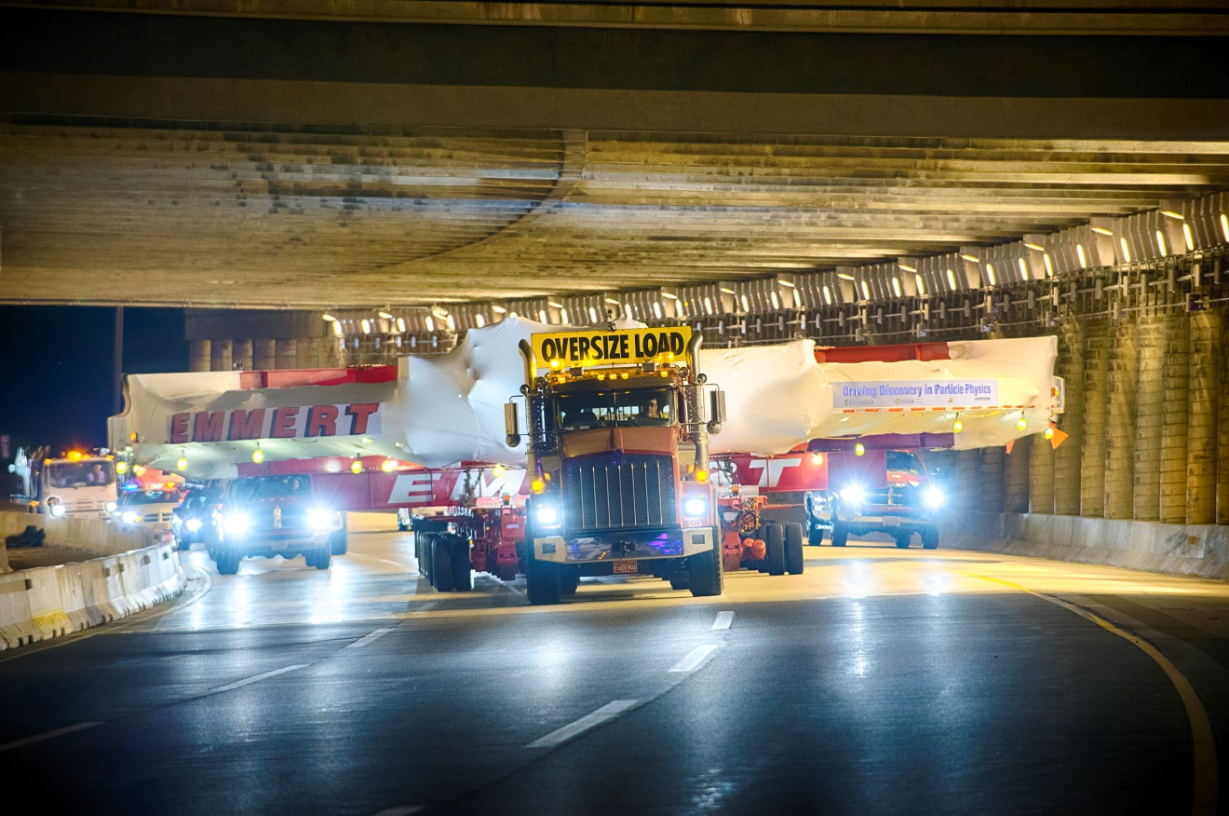
The Move

Slide 19
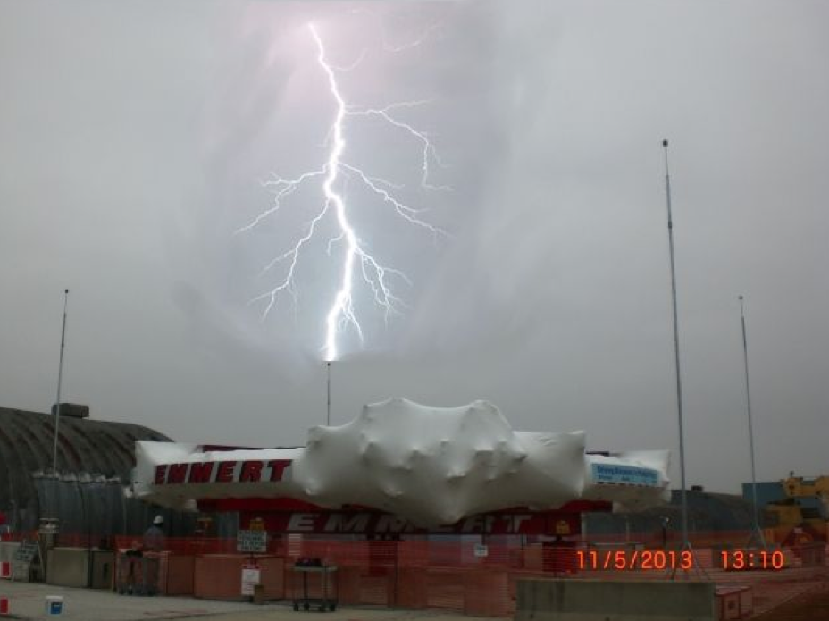
Long Live The Risk-Register
ENERGY
FRONTIER
Notes:
Back Row: Gordon Danby, John Field, Francis Farley, Emilio Picasso, and Frank Krienen.
Kneeling, from left:John Bailey, Vernon Hughes and Fred Combley.

Slide 20
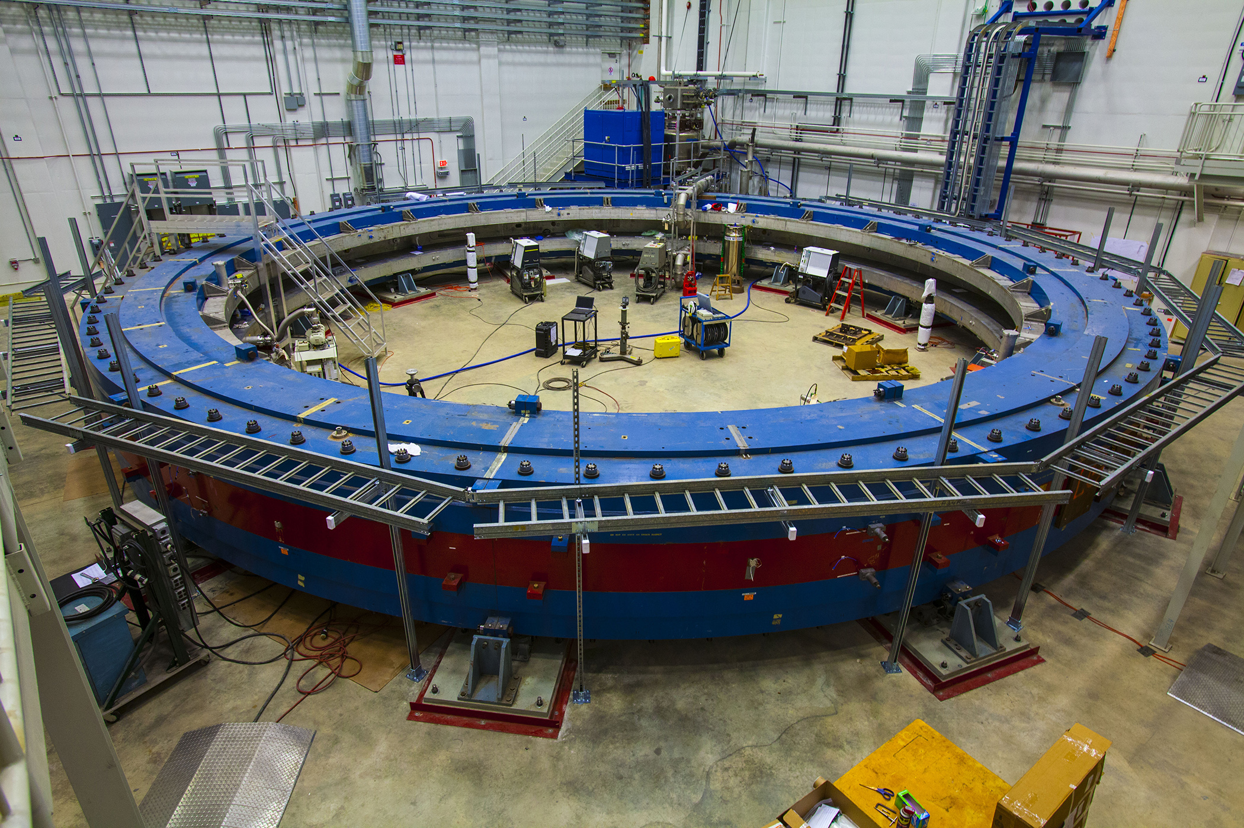
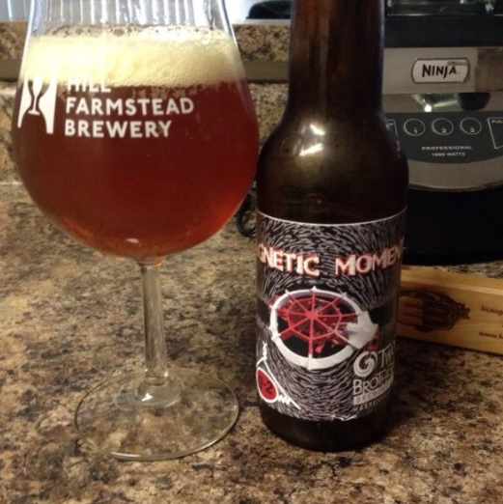

Slide 21
FNAL Improvements
Unique capabilities
of FNAL accelerators
More μ per proton
Lower inst. rate
Fewer pions
Improved detectors
Improved stored muon
beam dynamics
New / improved technologies
Additional collaborators
Building on wealth of experience
from BNL E821 & other expts
Improved field uniformity, field
measurement & calibration
Improved modeling of beam
& detectors

Slide 22
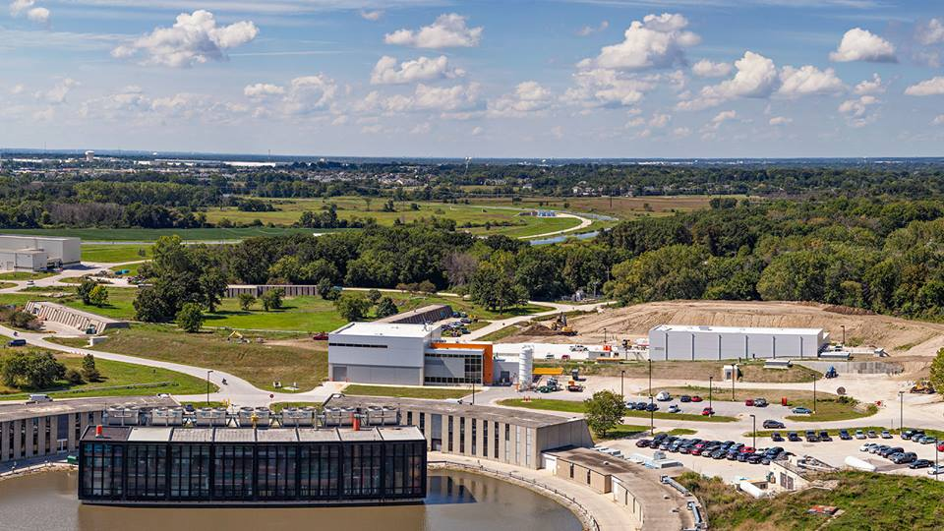
Accelerator modifications mostly complete at FNAL
RECYCLER
TARGET
DELIVERY
RING
g-2
Mu2e
MUONS
BOOSTER

Slide 23
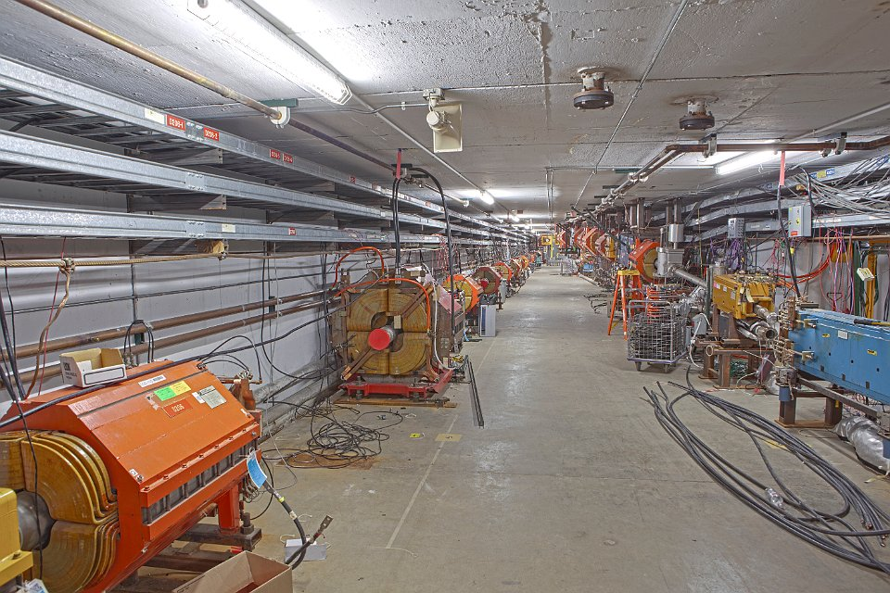
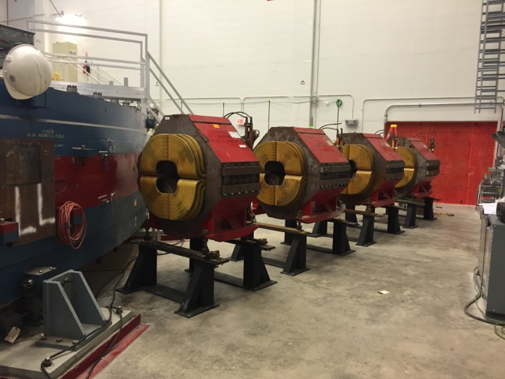
Beamlines
Beam infrastructure 90% complete
First beams (low muon intensity) from April 2017
AP30 Delivery Beamline
Beam Quads Into g-2 Ring

Slide 24
Beam Injection
Inflector Magnet
Beam doesn’t enter on the
correct orbit and needs a kick
to get there !
μ⁺
7 cm
7.1 m
Kicker magnets

Slide 25
Kicker
Ideal kicker pulse

Slide 26
Kicker Pulse
BNL kicker pulse
New FNAL (Cornell) kicker pulse

Slide 27
Improvements to injection system
Baseline: existing BNL inflector
but new design under R&D which
gives x2 stats
Inflector Magnet
μ⁺
7 cm
Q1
Q4
New with
improved kick
7.1 m
Kicker magnets
Using higher
voltage for
improved tune
Q3
Focussing quads
Q2
New and with
sensors
Collimators

Slide 28
Beamline simulation

Slide 29
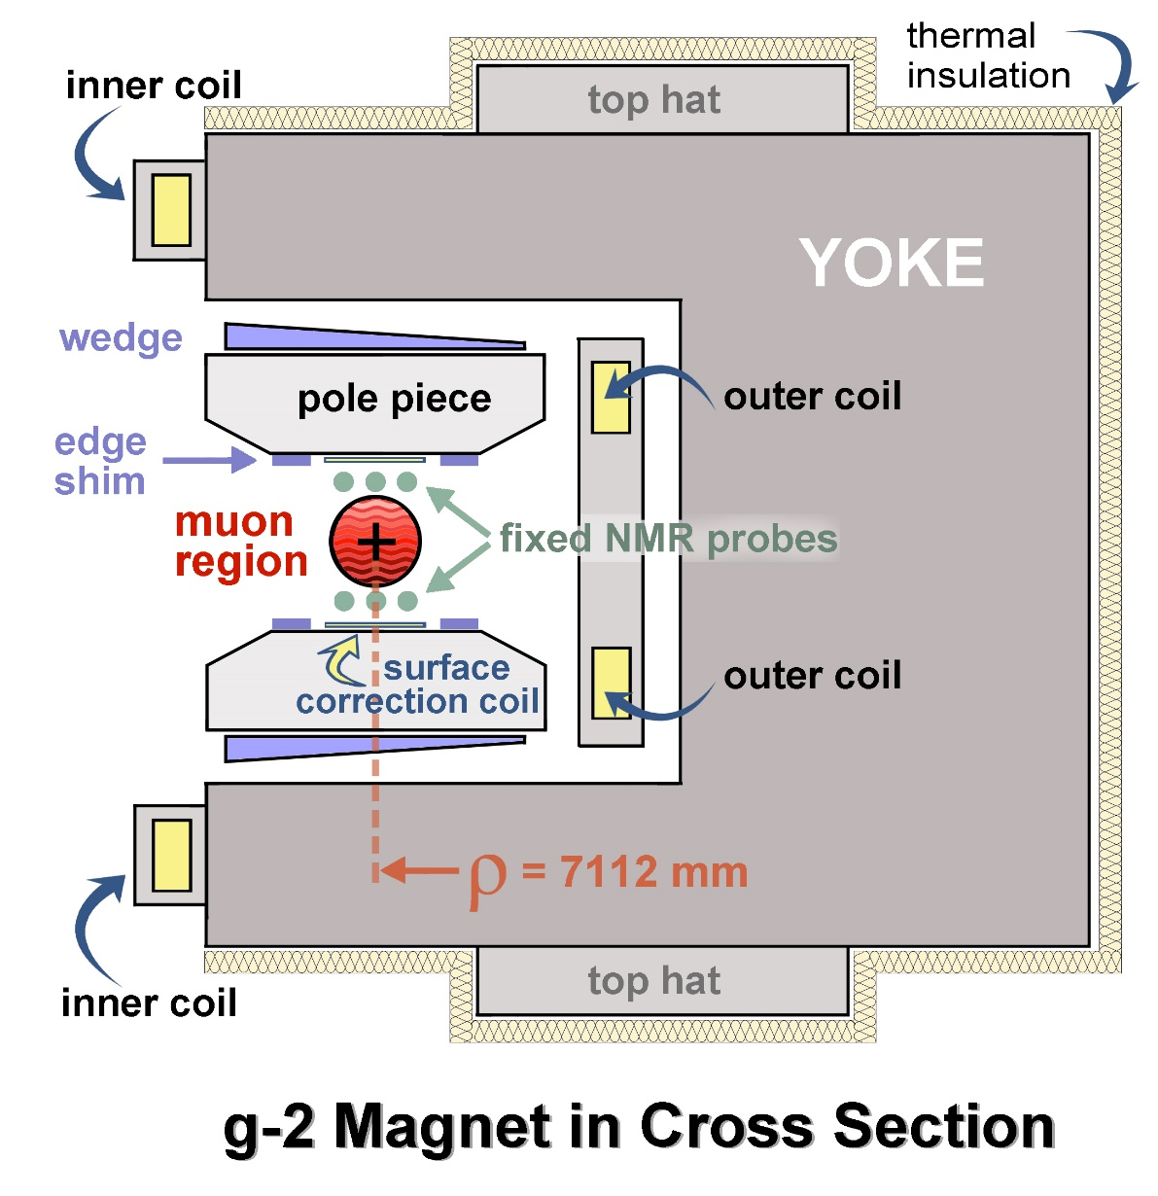
g-2 Magnet
72 pole pieces
864 wedges
48 iron “top hats”
144 edge shims
8000 surface iron foils
100 active surface coils
Yoke : 26 tons to 125 microns….

Slide 30
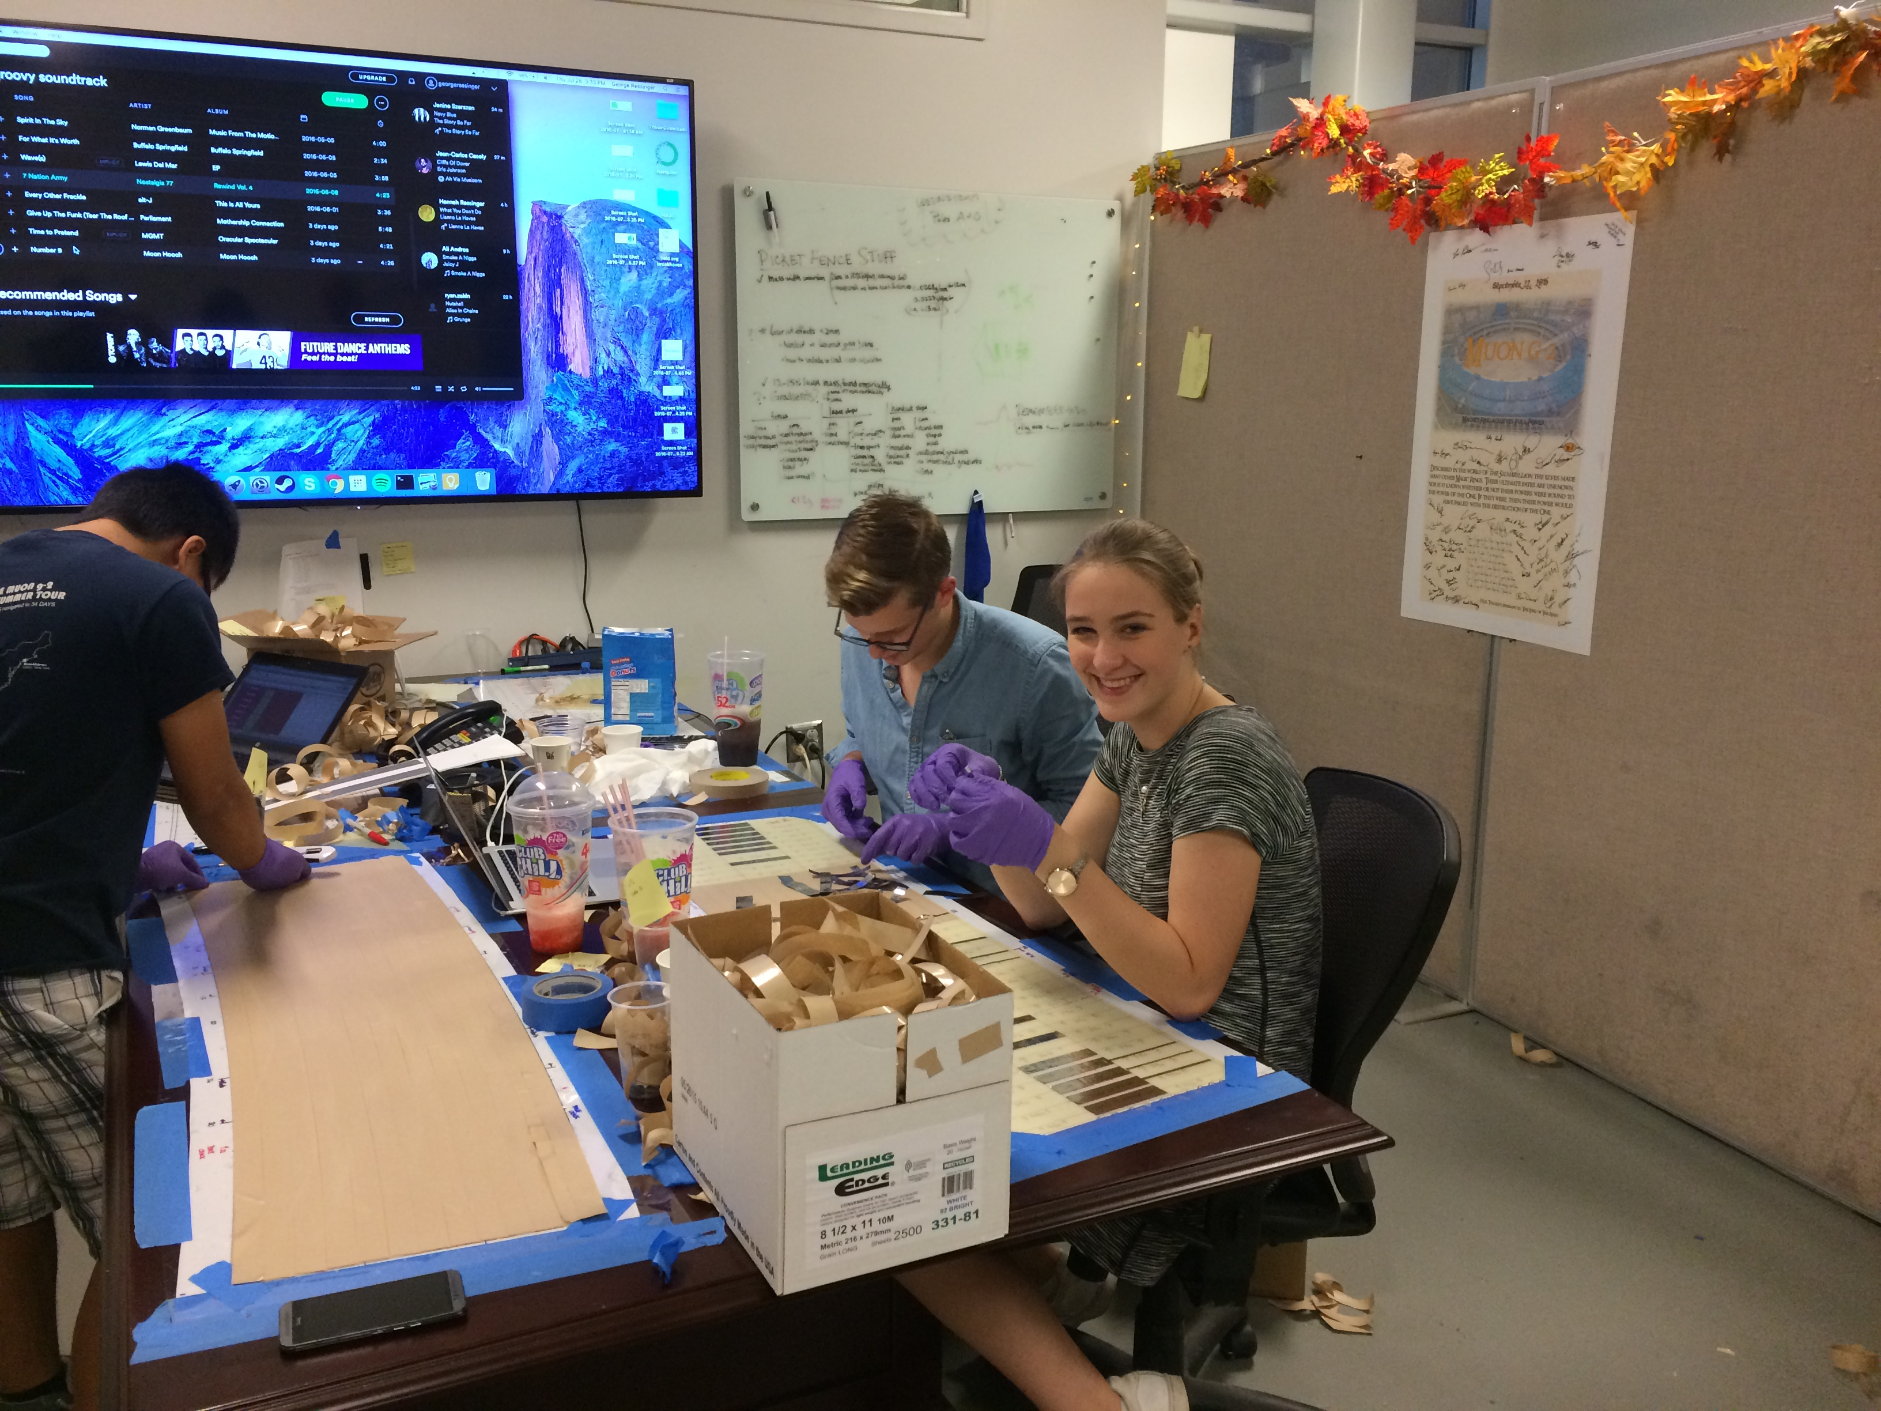
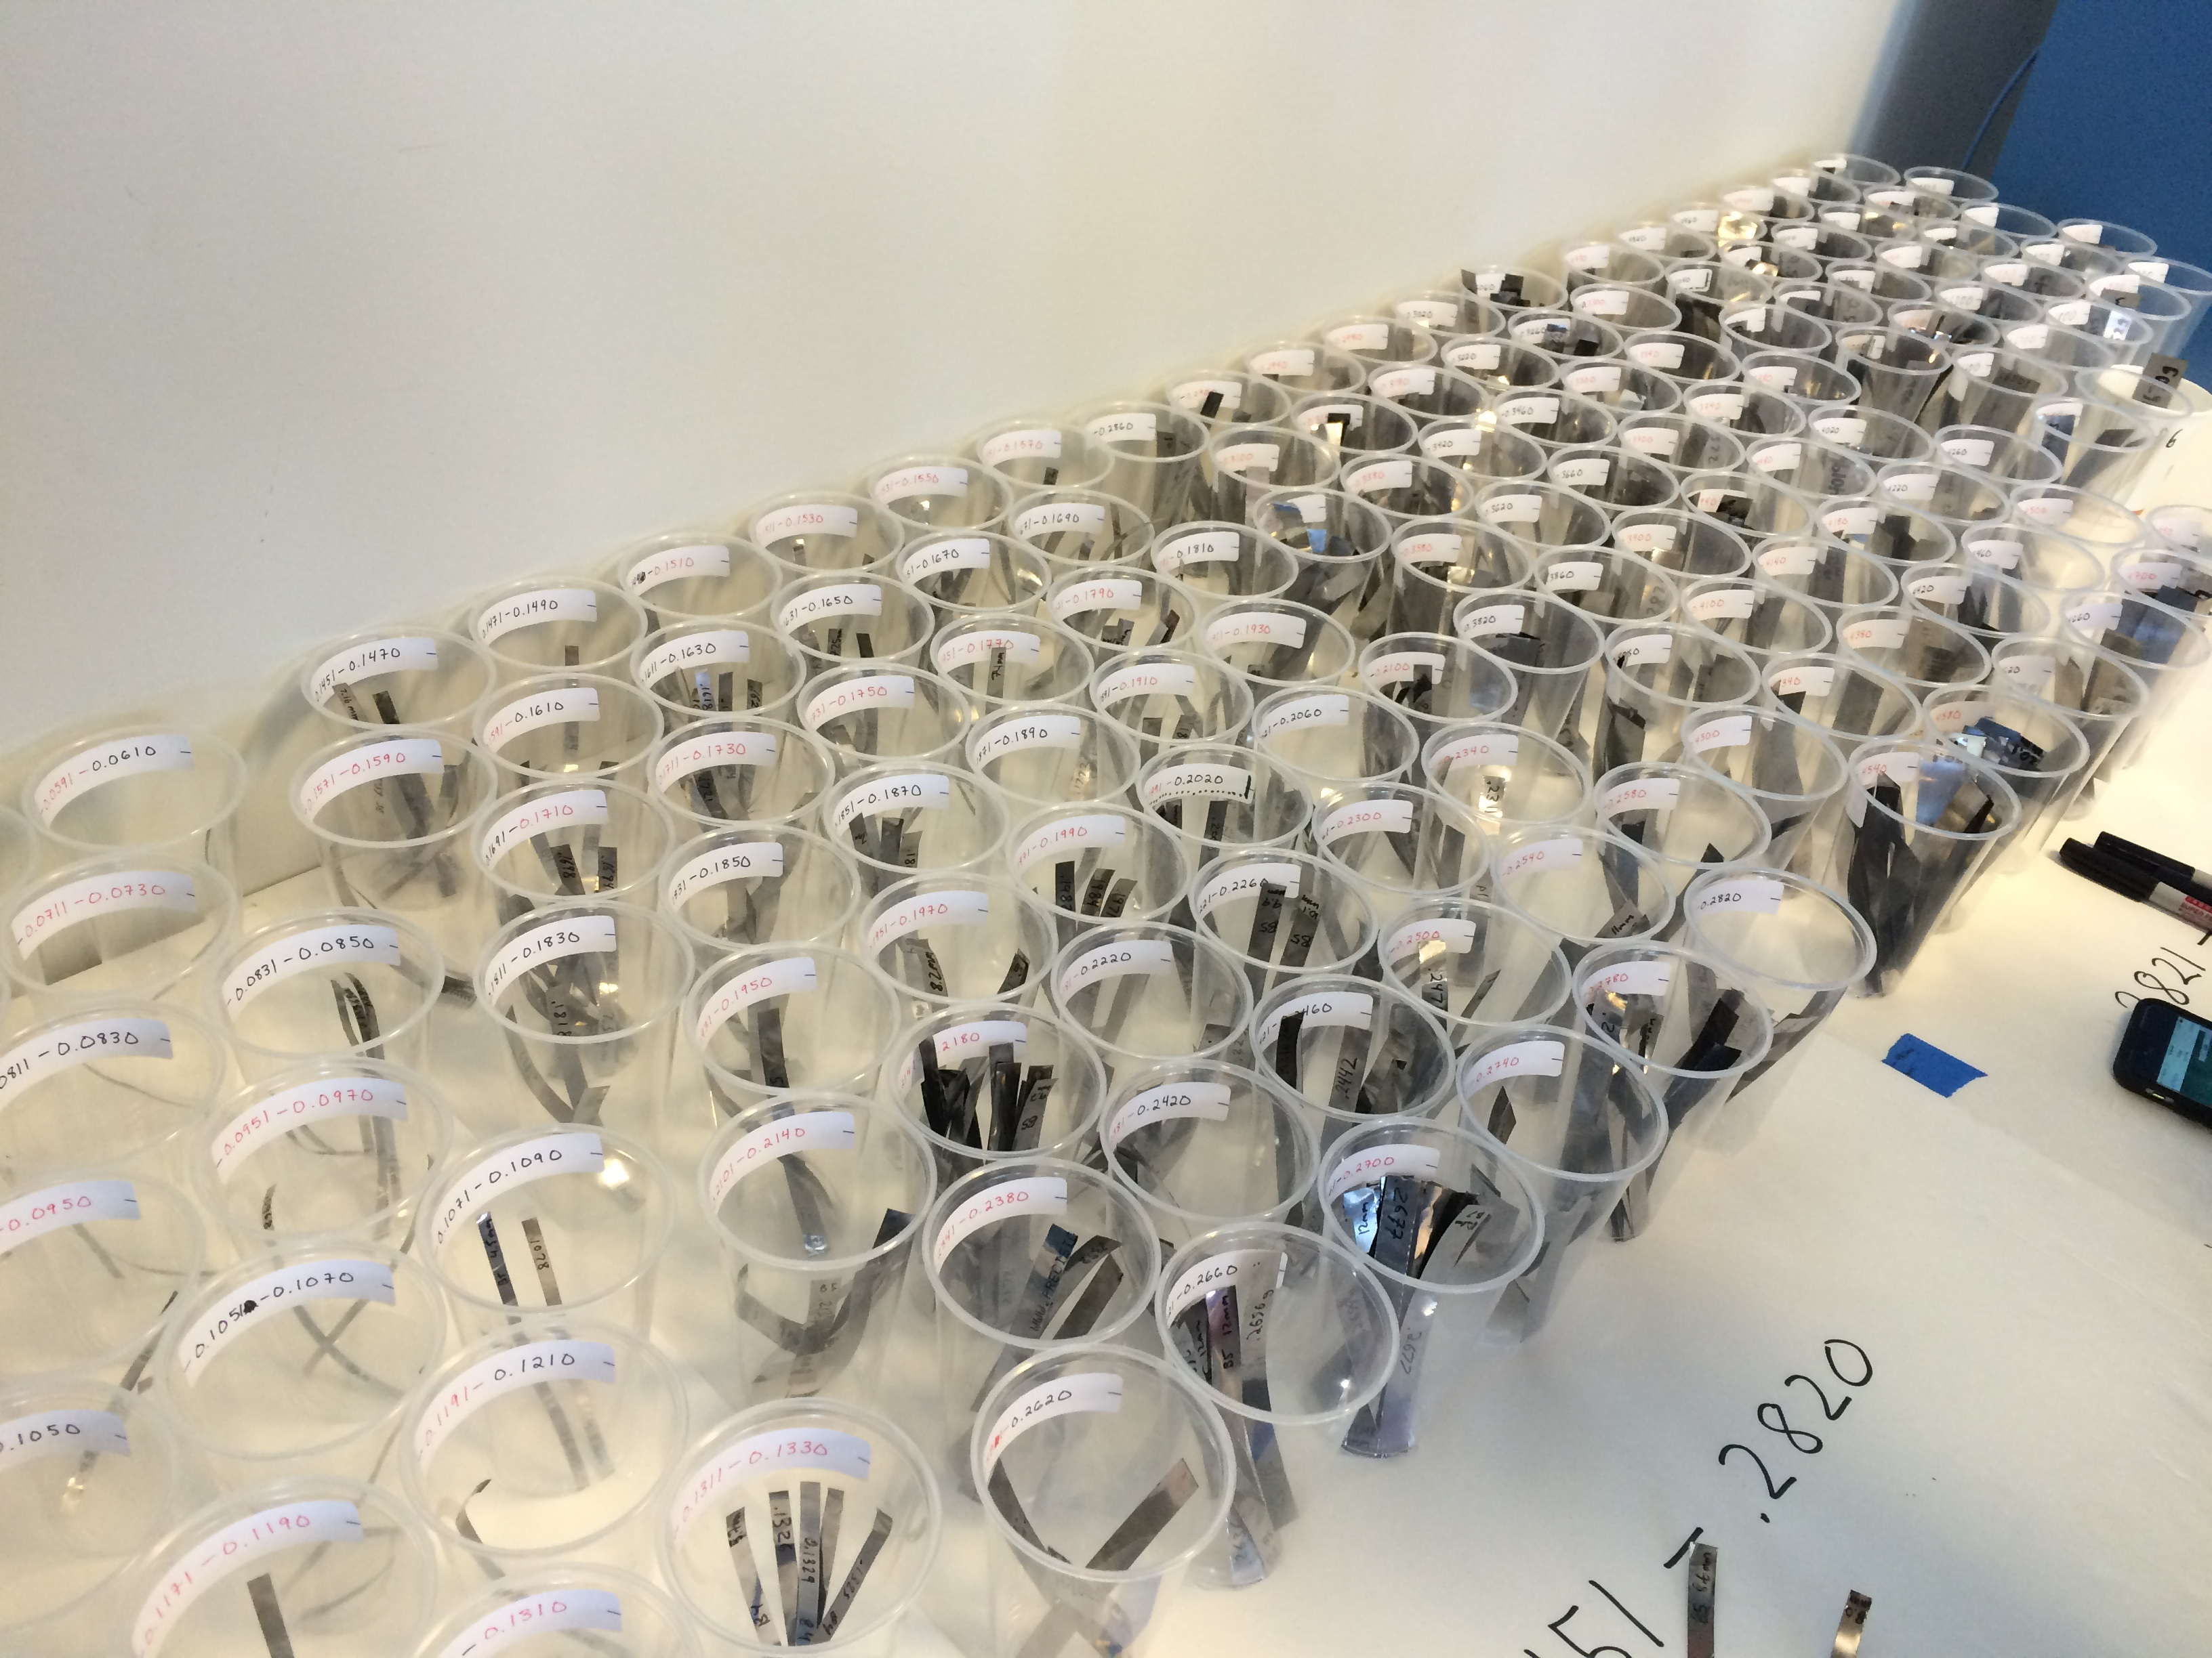
The laminators !

Slide 31
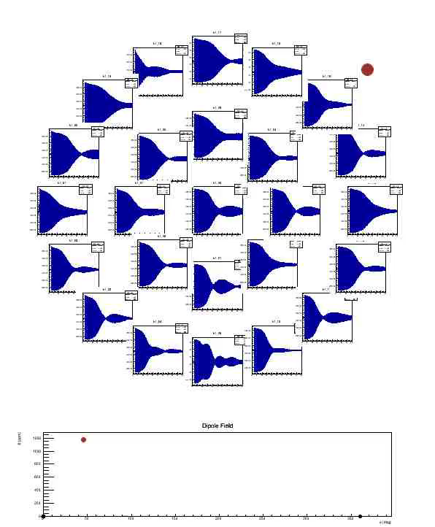
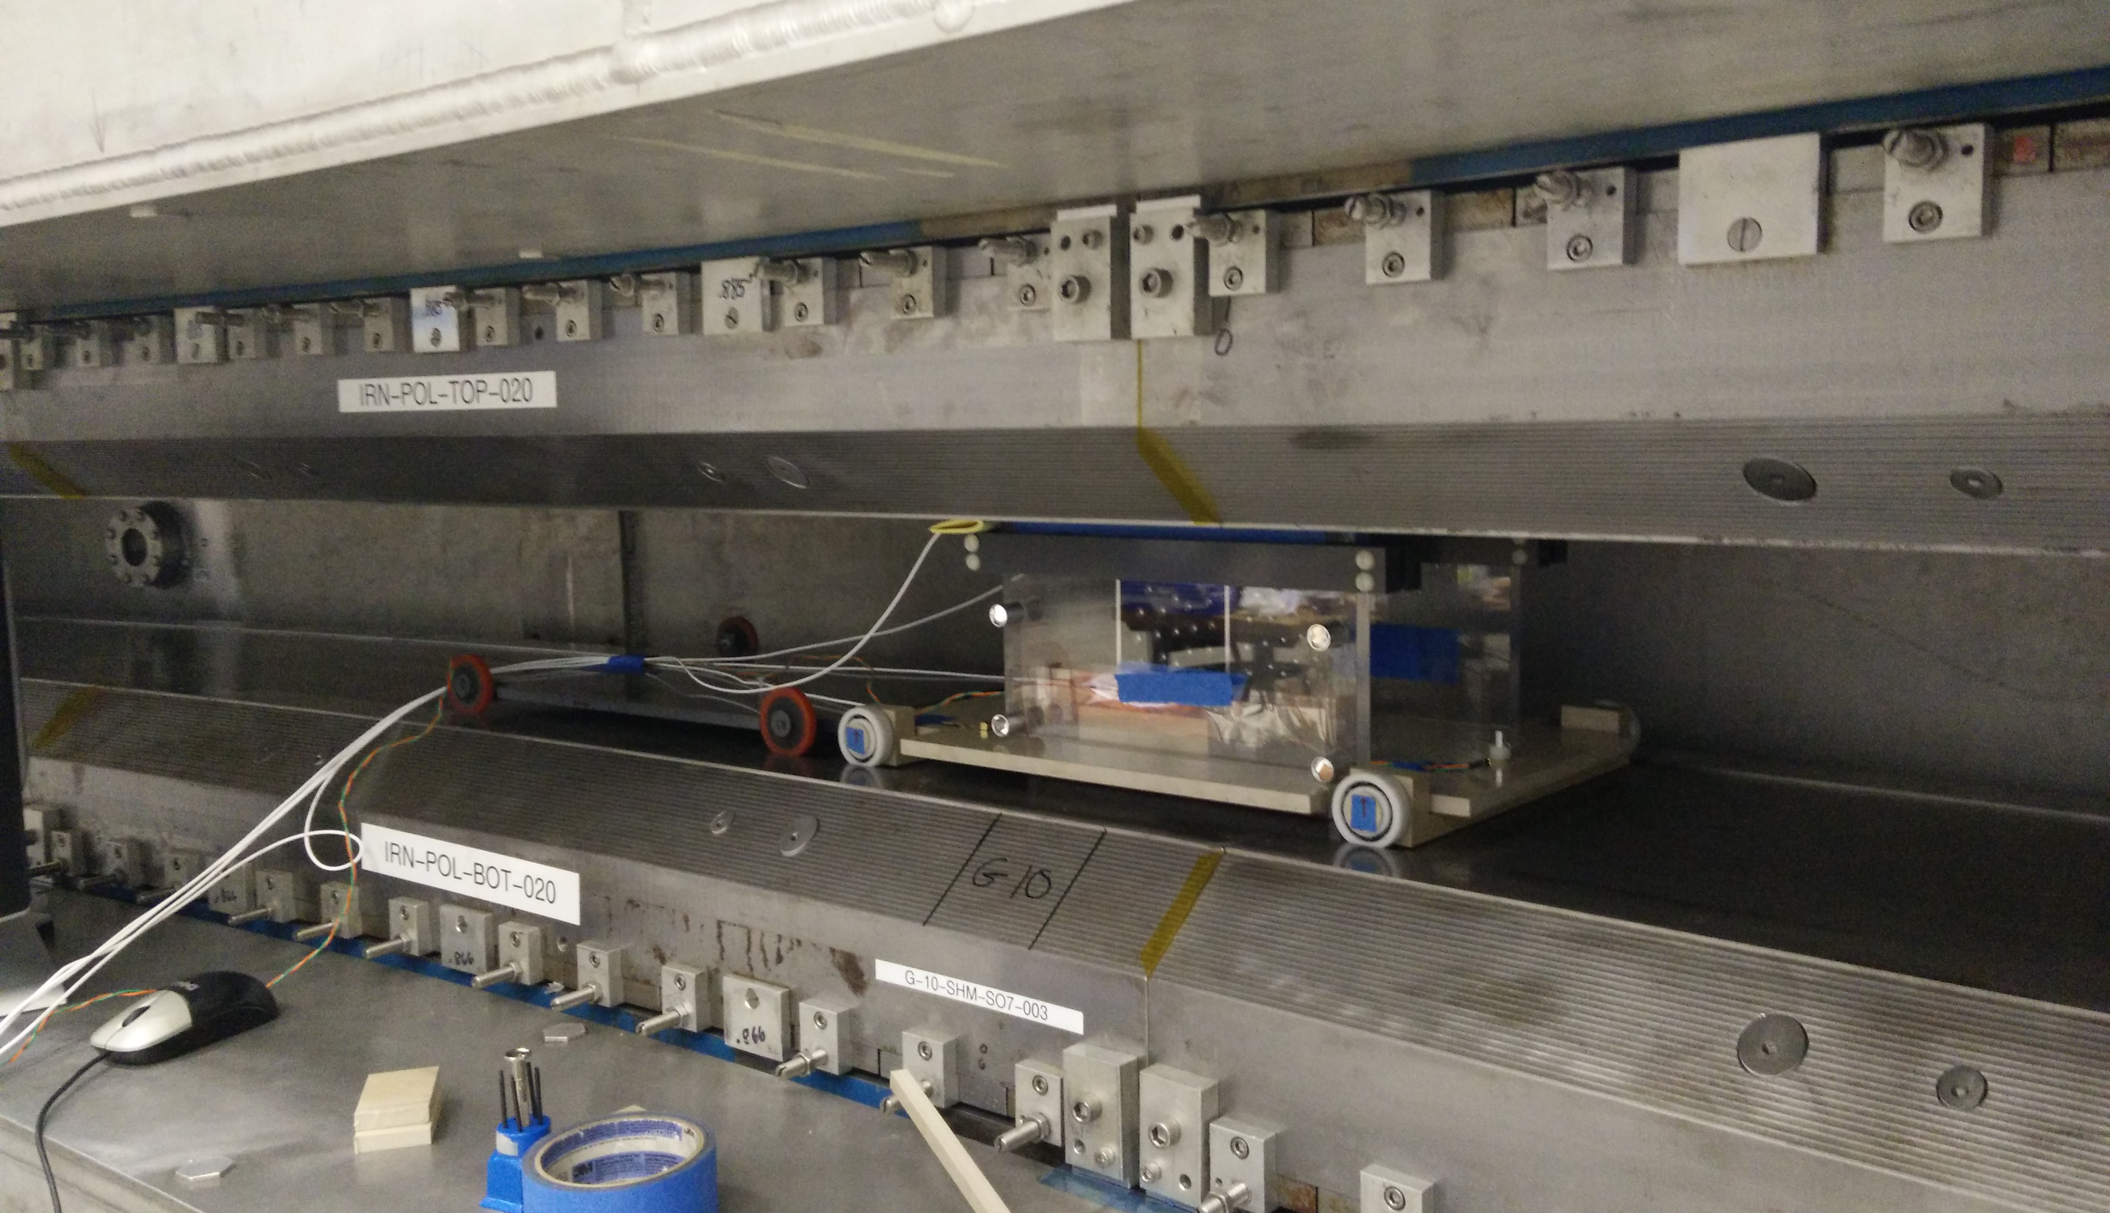
B-field been on for last 12 months

Slide 32
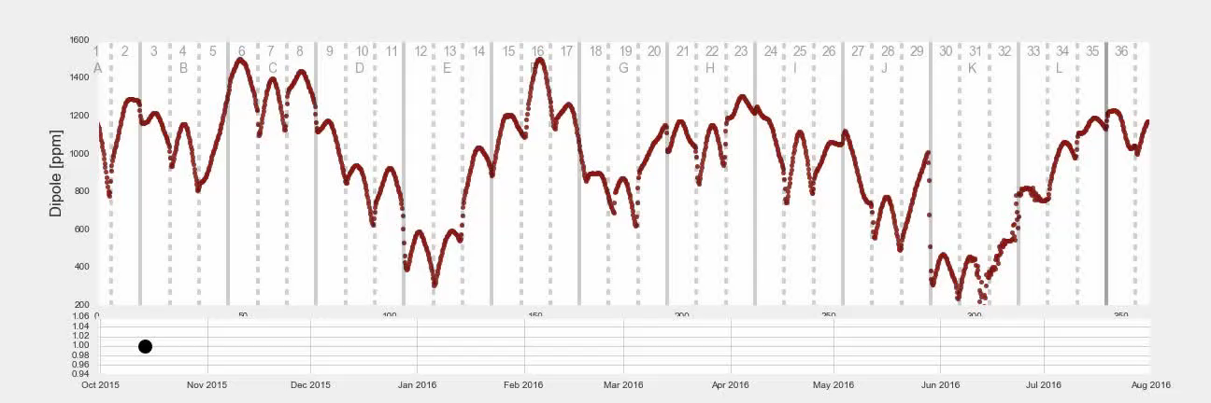
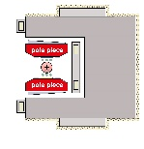
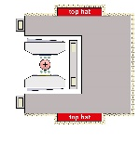
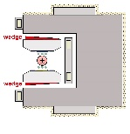
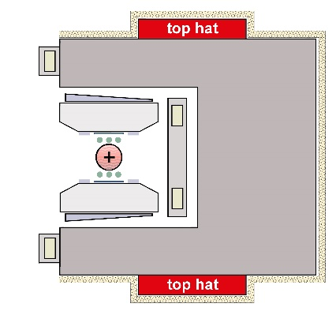
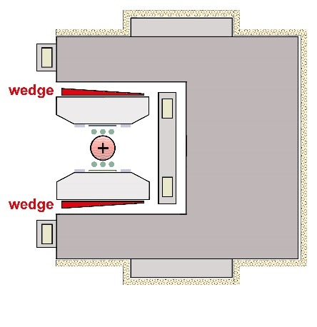
Shimming progress
+
Poles
Top hats & wedges
Surface foils

Slide 33
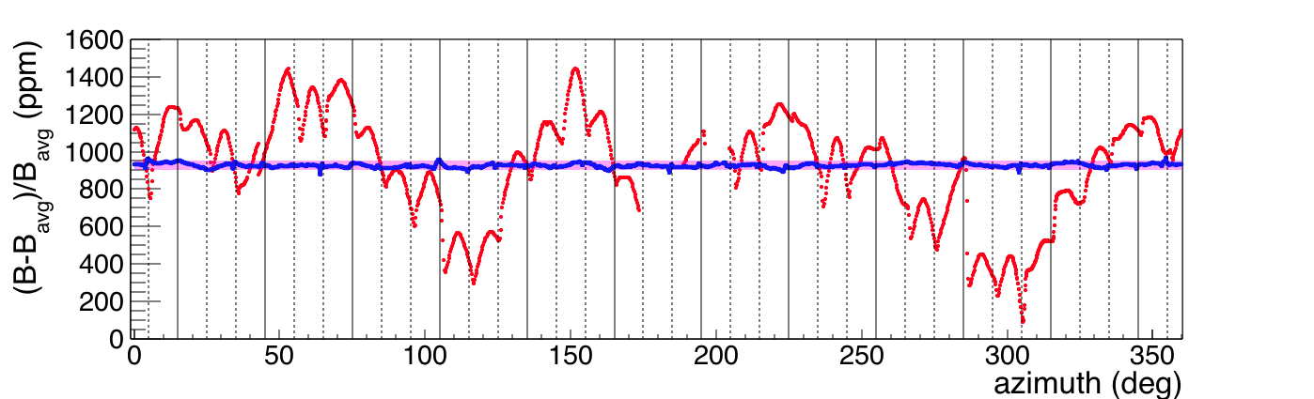
Field Uniformity
Field uniformity x30 improved in a year and now x4 better than
achieved at BNL after first shimming round.
50
ppm
Oct 2015 → Aug 2016
~1400
ppm

Slide 34
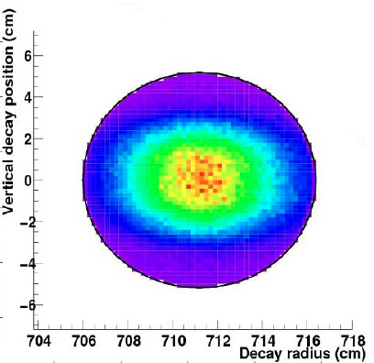
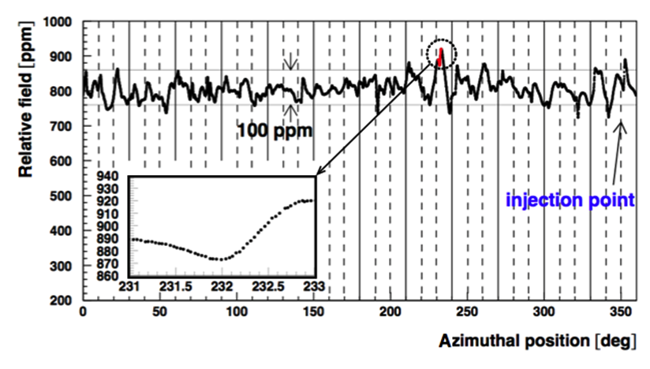
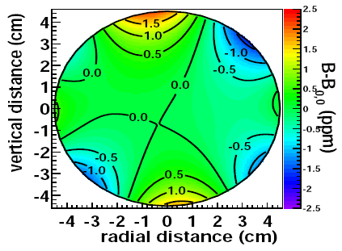
B-field map
Muons are distributed over storage volume
B-field is not uniform over this volume
Need to convolute the two.

Slide 35
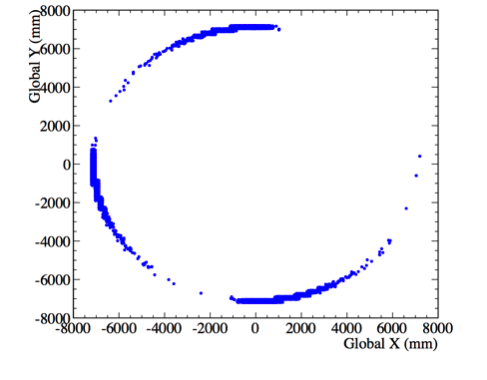
Straw tracking detectors
Measure beam profile
Identify pileup and muons lost from beam
Measure EDM
Trackers
Reconstructed decay position

Slide 36
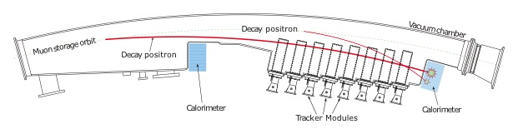
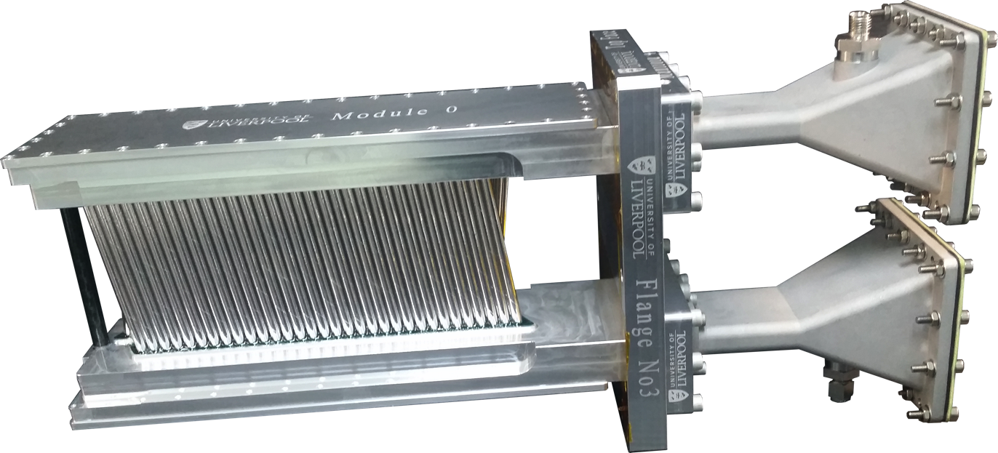
Straw tracking detectors

Slide 37
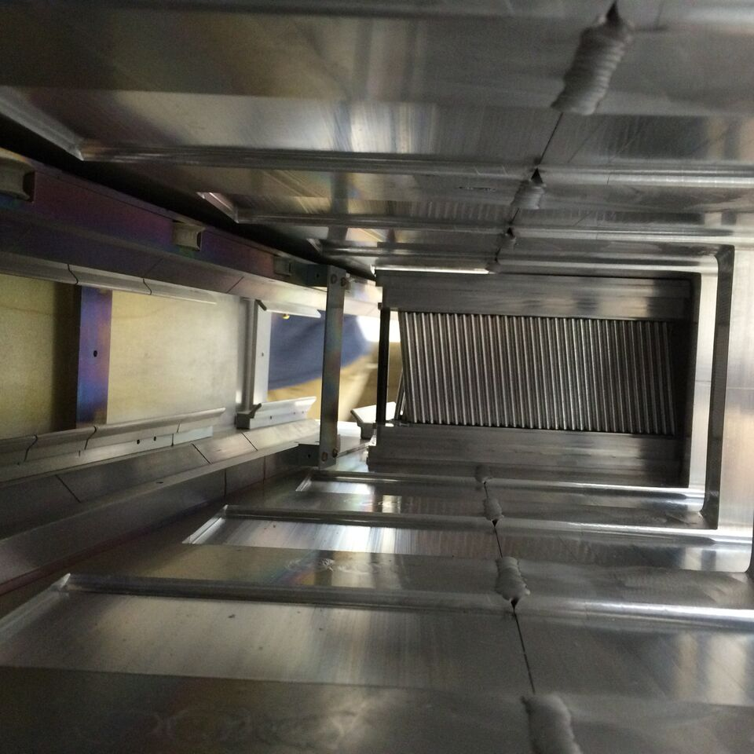
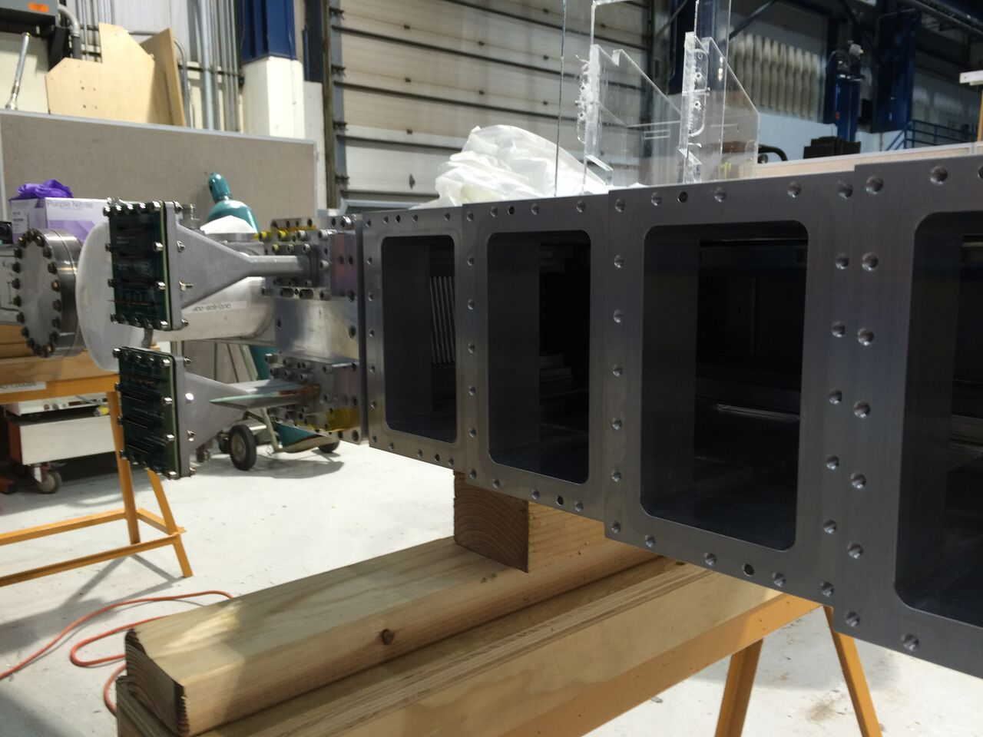
Position in vaccum chamber

Slide 38


Muon EDM
Essentially zero in SM : any observation is new physics
Expect several billion events in the
trackers and so reach 10-²¹
vs 2x10⁻¹⁹ at BNL
Needs non mass-scaling BSM effects to
be in expt’s reach given e⁻ EDM limit

Slide 39



PbF₂ calorimeter
50 MeV resolution at 2 GeV and pulse separation < 5ns.

Slide 40




Calorimeter testbeam results
Energy Resolution
NIM A 783 (2015),
Timing Resolution
σ_{t} ~ 25 ps
Electron pile-up
Position from Energy Deposit
Temporal separation at 5 ns

Slide 41

Status
1st beam is expected in April with first muon data to be
accumulated towards the end of 2017.
BNL-level statistics by mid-2018 and by 2020 x20 the statistics
Expectation is to publish 3 results with 100%, 50% and 25% of BNL
precision
Systematics: 3 missing pieces
That’s 3000ppm !!!

Slide 42
Systematics x 1/3
Systematics: 3 missing pieces
That’s 3000ppm !!!

Slide 43

Systematics x 1/3
132 “1000-piece” puzzles. If you lose just 1 piece it’s a 7 ppm error
The 1976 CERN result

Slide 44

Systematics x 1/3
7128 puzzles. Lose 1 piece : 140 ppb

Slide 45

J-PARC g-2 Experiment
Requires several innovations to achieve 10⁶ muons/sec
- production of sufficient muonium using special materials
- pulsed 100 μJ VUV lasers to ionise muonium
- muon linac keeping Δp_{T}/p_{T} < 1e-5 : world’s 1st muon accelerator !

Slide 46

MRI magnet and Si detectors
Very precise tracking using
Si detectors
Very uniform field (MRI magnet)
Spiral 3D beam injection !

Slide 47
First slow muons in beamline
Feb 2016

Slide 48
Acceleration progress
Tests of 1st two acceleration stages completed.

Slide 49
B-field uniformity / shimming

Slide 50
J-PARC STATUS
R&D phase being completed in next year
Funds for most of construction are secured.
Expect data taking to begin after FNAL g-2 i.e. 2020.
Initial sensitivity at 0.37 ppm (stat) reducing to 0.1 ppm (stat)
i.e. similar to FNAL 0.1 ppm (stat) [0.1 ppm (syst)]
This will provide a crucial measurement with completely different
systematic effects compared to the FNAL measurement.

Slide 51

Conclusion
“If you enjoy doing difficult experiments, you can do them, but it is a waste of time and effort because the result is already known” : Pauli
"No experiment is so dumb, that it should not be tried” : Gerlach

Slide 53

FNAL B-field / ω_{p} systematics

Slide 54

FNAL ω_{a} systematics

