Slide 1
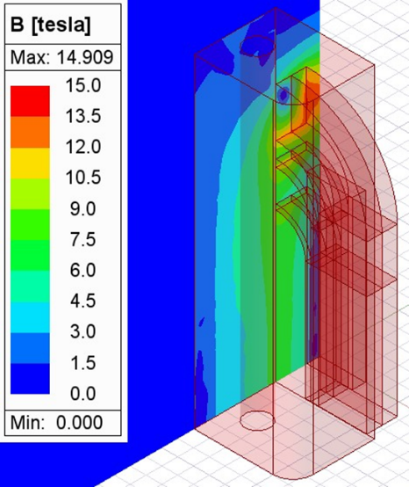
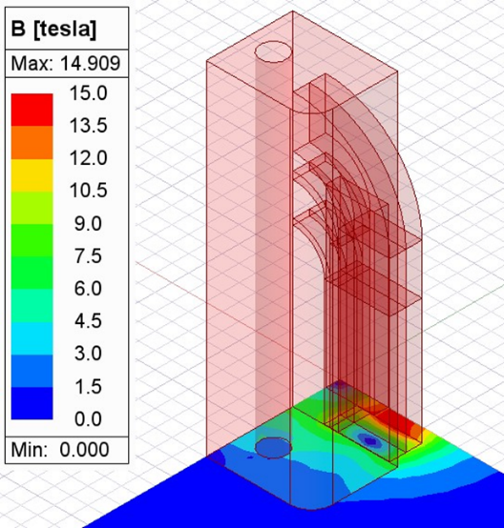
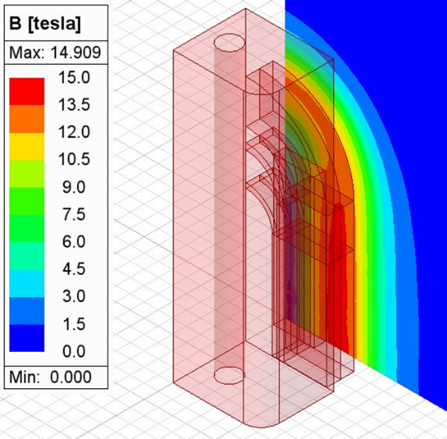
High field magnets for FCC
XZ
XY
YZ
J. García-Matos, C. Martins, F. Toral (CIEMAT)
FCC Day Spain – 7th Oct 2024

Slide 2
Outline
Introduction
High field magnets for FCC
High field magnets at CIEMAT
Conclusions

Slide 3
Introduction
There is a number of initiatives worldwide to build a large particle collider: ILC, CLIC, FCC-ee, FCC-hh, CEPC, SPPC.
High field magnets (>12T) are necessary for the high energy proton-proton colliders, that is, FCC-hh and SPPC.
This talk will focus on the high field magnets for FCC-hh.
CERN has organized a High Field Magnet (HFM) Programme in collaboration with other European Institutes (CEA, CIEMAT, INFN and PSI) to address this challenge. It is coordinated with the Magnet Development Program (MDP) in US.
Next slides are taken from the presentation made by Ezio Todesco (CERN) in the HFM forum meeting in July: https://indico.cern.ch/event/1430998/

Slide 4
Outline
Introduction
High field magnets for FCC
High field magnets at CIEMAT
Conclusions

Slide 5
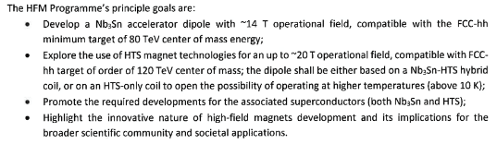
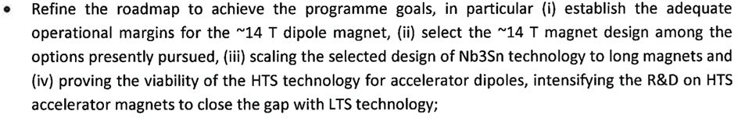
HFM Program targets
January 2024: revised mandate of HFM
  14 T is the operational field target for Nb₃Sn
    Shall be reached at 80% of short sample at 1.9 K, with “improved HL-LHC conductor” j_{c}=1200 A/mm² at 4.2 K
    Design (and mechanics, and protection …) shall be scalable to 15 m
  For HTS, we are not able to give today a target, but rather a 15-20 T range

Slide 6
Energy reach
March 2024, FCC steering board, energy reach
  The European Strategy has set a target for FCC-hh of 100 TeV or larger
  Even though it is well known that 100 TeV is not a hard threshold, all efforts should be done to approach this value as much as possible
  Dipole field (and tunnel length) is not the only parameter: there is also the arc length, and the filling factor of the arcs (80% for the LHC)
    The present optics, with cells three times longer than the LHC, allows to reduce the integrated quadrupole strength
HFM should also focus on the global optimization of the system
Setting target of 14 T operational field for FCC-hh Nb₃Sn option gives 85 TeV with present lattice (83% filling factor)
Further optimization can provide 90 TeV (87% filling factor)

Slide 7
Energy reach and roadmap
In February 2024 we had a request from top management of proposing an accelerated roadmap for Nb₃Sn option
  Results were presented in steering board of March
Main guidelines: (see next slides for details)
  FCC-hh with 14 T Nb₃Sn dipoles could start operation in 2055
  With further parallelization and involvement of the industry, and increased risk, as early as 2045-2050
  The main element of this strategy is the selection of one (or max two) cross-sections by the beginning of the HL-LHC operation (2028)
  The scaling in length will be applied to the final cross-section, at the horizon of end of RunIV
    Activities on 15-m-long magnets will start after HL-LHC installation and applied to the final dipole cross-section (and not applied to MQXF coils as in previous baseline)

Slide 8
Roadmap: Present stage
In the present stage, seven different types of magnets are being developed, and four designs for 14 T
  Three cosθ: two one-layer by INFN and CERN, and one four layer by INFN
  Two blocks: one two-layer by CERN and one four-layer by CEA with grading
  Two common coils: one from CIEMAT and one with stress management from PSI, both with grading
First magnet tests will not be before 2026
  The coherence of these initiatives will be discussed in the next steering board
Each program will produce 1-2 magnets of each type at the horizon of end of HL-LHC installation
Ongoing 12 T and 14 T short models (seven designs, 1 or 2 of each type)
These are the activities
in the 5-year plan of
HFM 2024-2028
2024
2025
2026
2027
2028
2029
2030
2031
2032
2033
2034
2035
2036
2037
2038
2039
2040
2041
LHC RunIII
HL-LHC RunIV
HL-LHC RunV
HL-LHC RunVI

Slide 9
Scaling to 15 m
During RunV, we shall launch the scaling to 15 m
  To be completed at the end of the decade, where we shall be ready for industrialization
  One could also involve industry already in this phase
15 m long prototypes (>5 of each type)
5 m long prototypes of one selected design
(>5 of each type)
Short model program on two selected designs
(>5 of each type)
Ongoing 12 T and 14 T short models (seven designs, 1 or 2 of each type)
Selection of final design
to start long magnets
2024
2025
2026
2027
2028
2029
2030
2031
2032
2033
2034
2035
2036
2037
2038
2039
2040
2041
LHC RunIII
HL-LHC RunIV
HL-LHC RunV
HL-LHC RunVI

Slide 10
Industrialization, production, and commissioning
At the end of HL-LHC, tender for the series
  Production and test over nine years
  Installation and commissioning in parallel
Installation and commissioning
Production and test
Industrialization (pre-series magnets)
Tender for the series
2040
2041
2042
2043
2044
2045
2046
2047
2048
2049
2050
2051
2052
2053
2054
2055
2056
2057
LHC RunVI

Slide 11
Open research lines
The temperature of operation of FCC-hh magnets is under study. Operation at 4.5 K could improve the energy efficiency, although the superconductor performance is not so good.
High critical temperature superconductors (HTS) properties are in constant development during the last years. HTS magnets could be used for FCC-hh collider in different ways: hybrid magnets, correctors…
There are ongoing efforts looking for strategies to shorten the timeline presented in the previous slides.

Slide 12
Outline
Introduction
High field magnets for FCC
High field magnets at CIEMAT
Conclusions

Slide 13
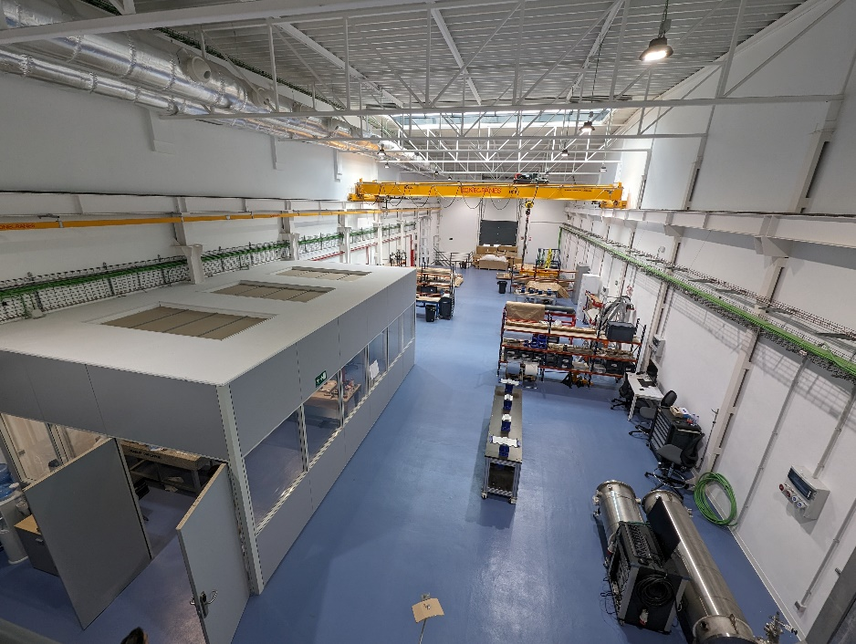
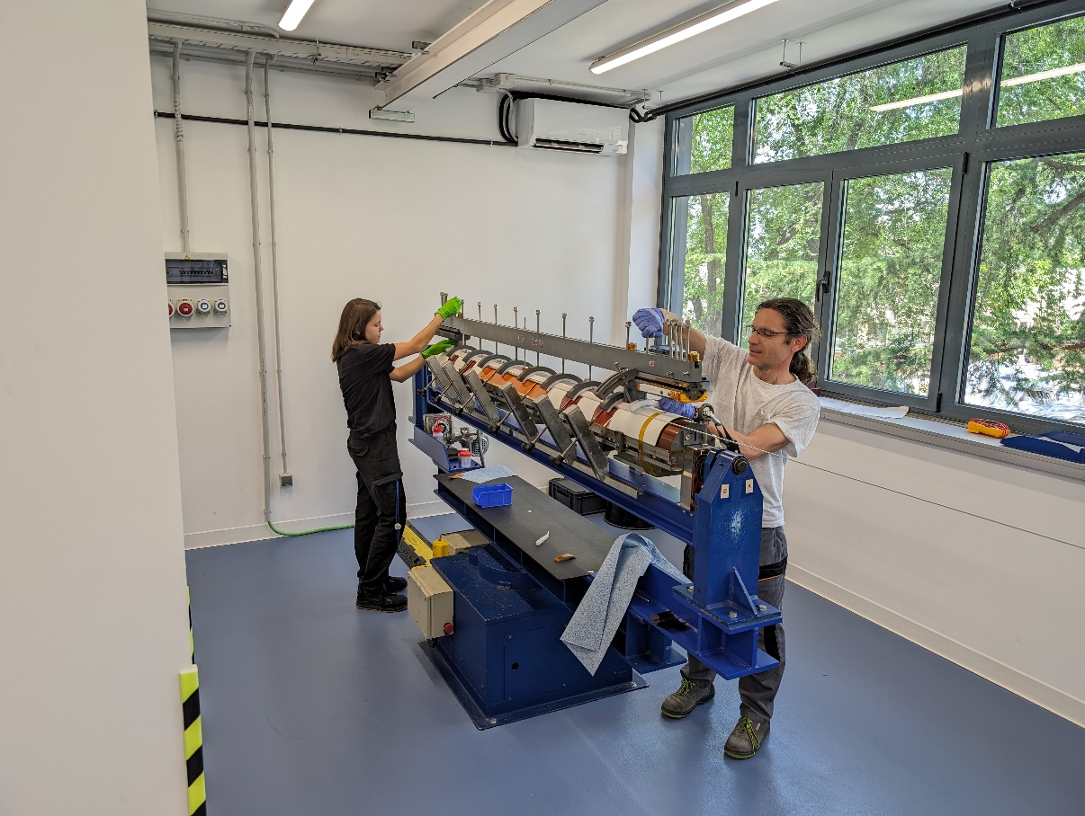
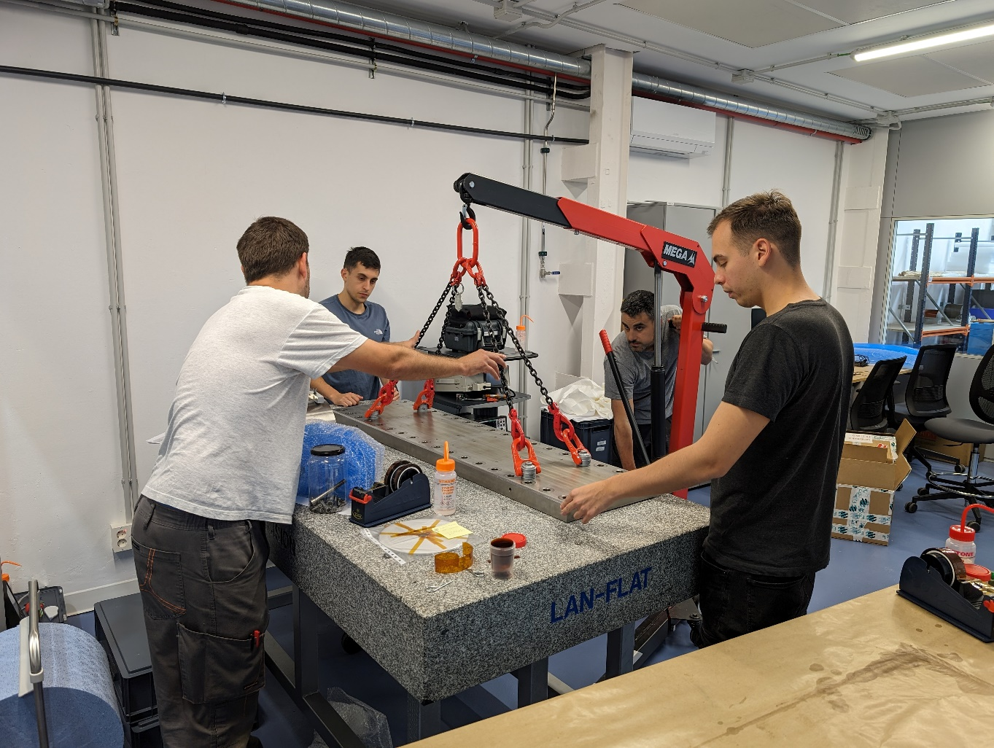
SMART-Lab: magnet laboratory
We are working on the commissioning of a new laboratory for prototyping magnets up to 2 m long and 10 ton: SMART-Lab (Superconducting MAgnet Research and Technology Laboratory).
Overall surface about 900 m², in three floors:
  Underground: mechanical workshop, laser cutting machine, storage
  Ground floor: winding area, reaction furnace, dimensional control room, collaring press, magnetic measurement bench, assembly
  First floor: offices

Slide 14
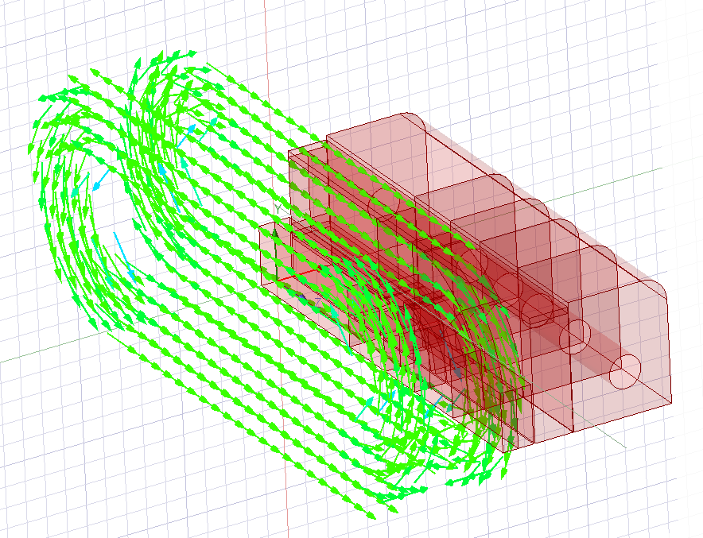
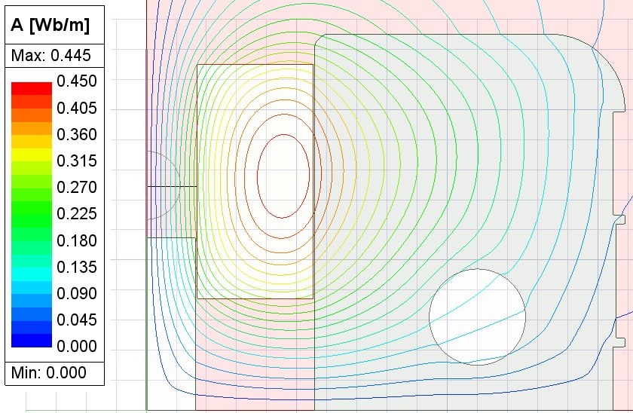
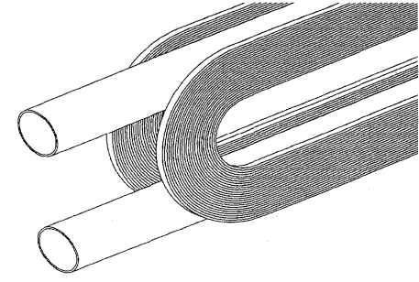
HFM at CIEMAT: Common Coil Configuration
Double aperture dipole based on 2 flat (racetrack) coils powered in opposite directions.
Simple geometry easier to produce, in principle, with brittle conductors like Nb₃Sn.
COIL
R. Gupta, ‘A common coil design for high field 2-in-1 accelerator magnets’, in Proceedings of the 1997 Particle Accelerator Conference (Cat. No.97CH36167), Vancouver, BC, Canada: IEEE, 1998, pp. 3344–3346. doi: 10.1109/PAC.1997.753203.

Slide 15
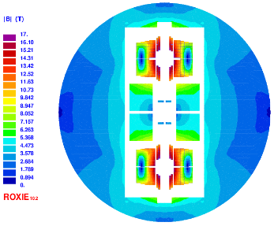
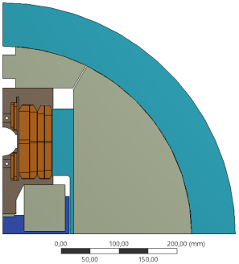
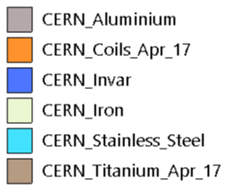
Background: EuroCirCol
Layout for a 16 T common coil magnet

Slide 16

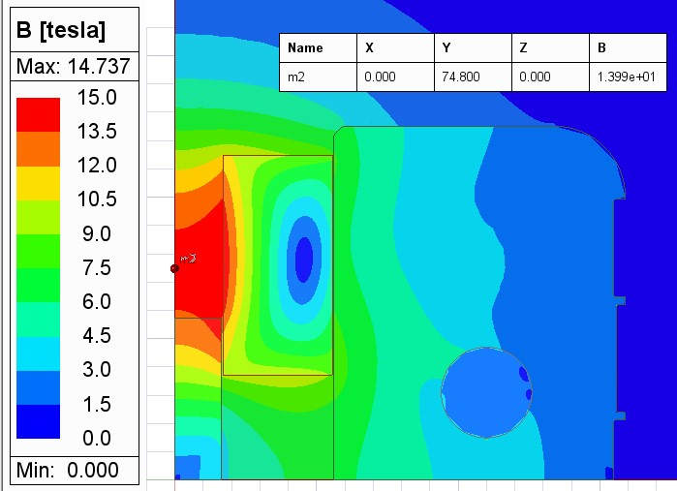
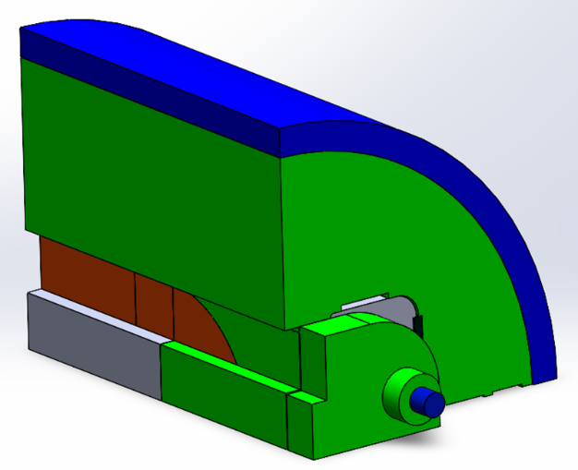
ISAAC: A first model magnet using existing coils
Motivation:
  The main challenge of high field common-coil dipoles is mechanics
  We can test different support structures with existing RMC coils
ISAAC: Investigating Superconducting Assembly to Address Common coil mechanics

Slide 17
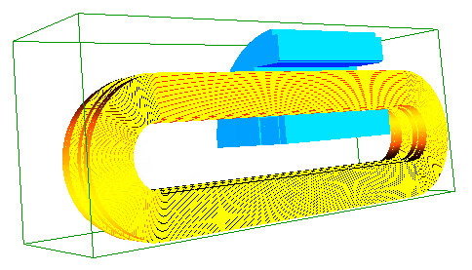
DAISY: a 14 T magnet demonstrator
The demonstrator is called DAISY: Demonstrator for Assembly Innovations in Superconducting common coil technologY. It honours Margarita Salas, an outstanding Spanish biologist (daisy is translated into Spanish as margarita).
It aims to create a 14 T dipole field in an aperture of 50 mm (FCC size).
In a first stage, the field quality will not be good enough for a particle collider, but it will be improved later.
It will be equipped with the first Nb₃Sn dipole coils produced in Spain.

Slide 18
Outline
Introduction
High field magnets for FCC
High field magnets at CIEMAT
Conclusions

Slide 19
Conclusions
High field magnets are necessary for FCC-hh.
CIEMAT is contributing to this effort by collaborating with the HFM program led by CERN.
CIEMAT is commissioning SMART-Lab, a new facility to prototype high field magnets.
CIEMAT is working on two high field magnets in common coil configuration:
  ISAAC: a model magnet using existing coils produced at CERN.
  DAISY: a 14 T magnet demonstrator with 50 mm aperture.
The previous magnets are based on Nb₃Sn coils, but parallel efforts are being organized to work also on high critical temperature superconductors (HTS).
CIEMAT has the committment to be part of the HFM Board research laboratories team, in a long-term collaboration, sharing the objectives for the ESPP with translational aims.

