Slide 1
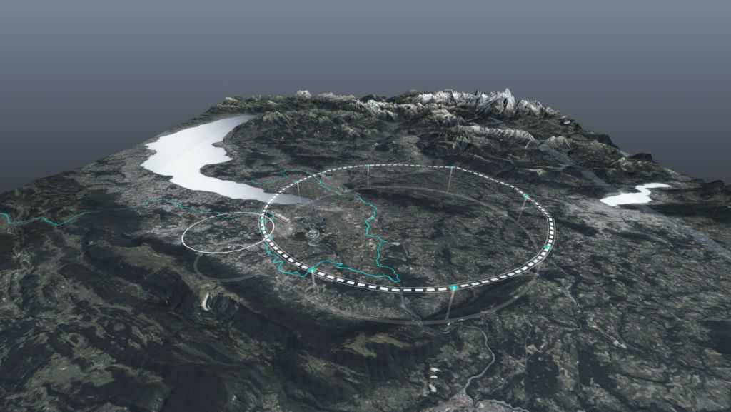









FCC Feasibility Study Status
FCC day Spain, 7 October 2024
Michael Benedikt, Frank Zimmermann, CERN
on behalf of FCC collaboration & FCCIS DS team
http://cern.ch/fcc
Work supported by the European Commission under the HORIZON 2020 projects EuroCirCol, grant agreement 654305; EASITrain, grant agreement no. 764879; iFAST, grant agreement 101004730, FCCIS, grant agreement 951754; E-JADE, contract no. 645479; EAJADE, contract number 101086276; and by the Swiss CHART program
photo: J. Wenninger

Slide 2

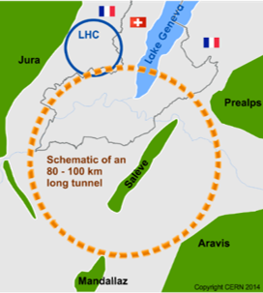
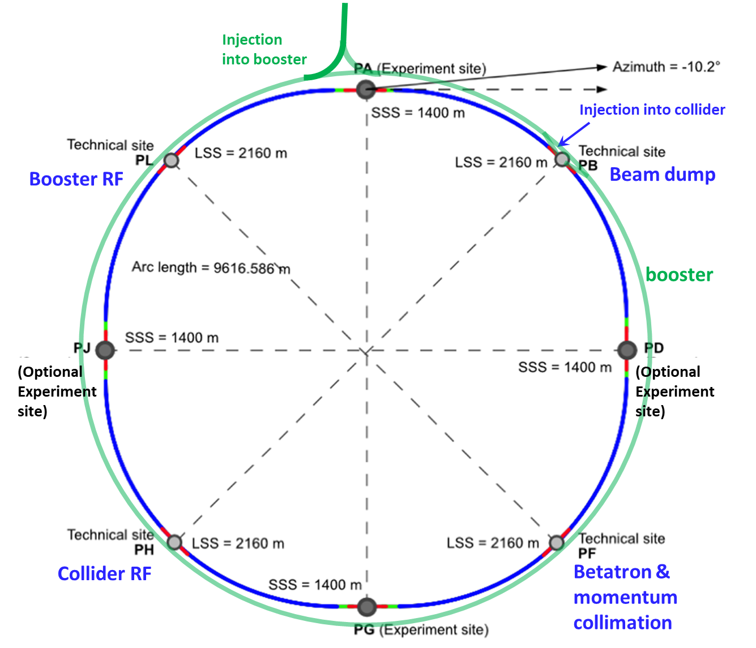
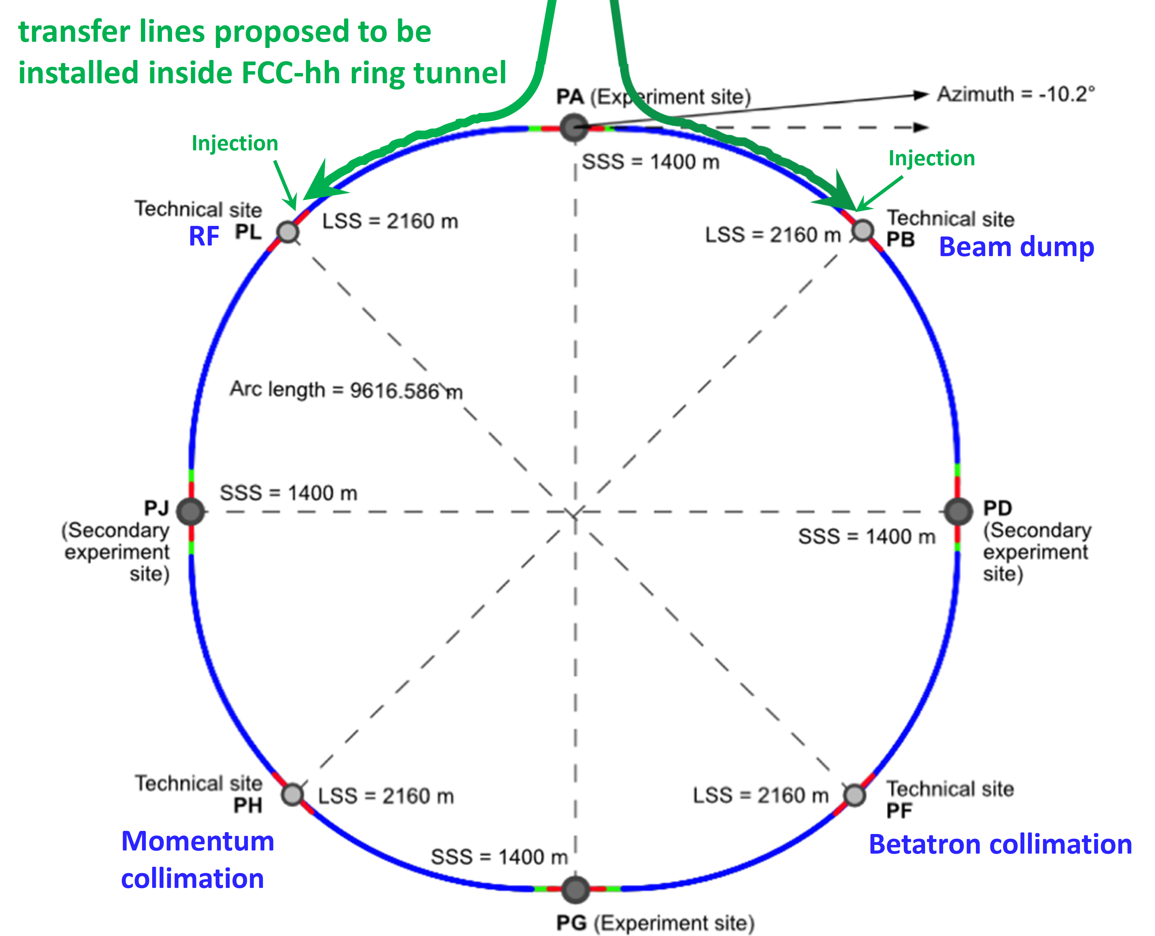
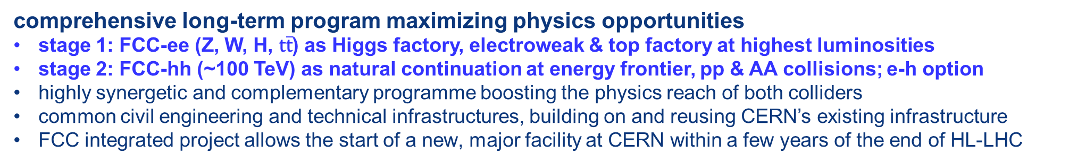
FCC integrated program
comprehensive long-term program maximizing physics opportunities
stage 1: FCC-ee (Z, W, H, $\text{t}\overline{\text{t}}$) as Higgs factory, electroweak & top factory at highest luminosities
stage 2: FCC-hh (~100 TeV) as natural continuation at energy frontier, pp & AA collisions; e-h option
highly synergetic and complementary programme boosting the physics reach of both colliders
common civil engineering and technical infrastructures, building on and reusing CERN’s existing infrastructure
FCC integrated project allows the start of a new, major facility at CERN within a few years of the end of HL-LHC
FCC-ee
FCC-hh
2020 - 2045
2045 - 2065
2070 -

Slide 3
FCC Feasibility Study (2021-2025): high-level objectives
demonstration of the geological, technical, environmental and administrative feasibility of the tunnel and surface areas and optimisation of placement and layout of the ring and related infrastructure;
pursuit, together with the Host States, of the preparatory administrative processes required for a potential project approval to identify and remove any showstopper;
optimisation of the design of the colliders and their injector chains, supported by R&D to develop the needed key technologies;
elaboration of a sustainable operational model for the colliders and experiments in terms of human and financial resource needs, as well as environmental aspects and energy efficiency;
development of a consolidated cost estimate, as well as the funding and organisational models needed to enable the project’s technical design completion, implementation and operation;
identification of substantial resources from outside CERN’s budget for the implementation of the first stage of a possible future project (tunnel and FCC-ee);
consolidation of the physics case and detector concepts for both colliders.
Results will be summarised in a Feasibility Study Report to be released by March 2025

Slide 4
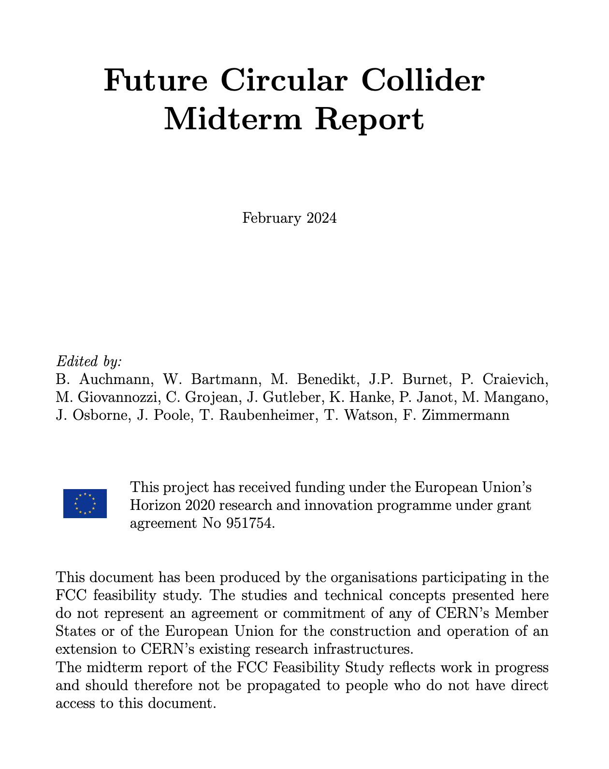
Feasibility Study Mid-Term Review passed !
The goal of the FCC FS mid-term review is to assess the progress of the Study towards the final report.
Deliverables approved by the Council in September 2022:
https://indico.cern.ch/event/1197445/contributions/5034859/attachments/2510649/4315140/spc-e-1183-Rev2-c-e-3654-Rev2_FCC_Mid_Term_Review.pdf
Full Report
8 Chapters/Deliverables
~ 700pp document
~ 16 editors
~ 500 contributors
Deliverables:
D1 : Definition of the baseline scenario
D2 : Civil engineering
D3 : Processes and implementation studies with the Host States
D4 : Technical infrastructure
D5 : FCC-ee accelerator
D6: FCC-hh accelerator
D7: Project cost and financial feasibility
D8: Physics, experiments and detectors
Many thanks to the SAC, CRP, SPC, FC and the Council for the very useful reviews!
Documents:
Mid-term report (all deliverables except D7)
Executive Summary of mid-term report
Updated cost assessment (D7)
Funding model (D7)
Review process:
Oct 2023: Scientific Advisory Committee (scientific and technical aspects)
and Cost Review Panel (ad hoc committee; cost and financial aspects)
Nov 2023: SPC and FC
2 Feb 2024: Council
All deliverables met, no technical showstoppers
→70-80 recommendations

Slide 5
Main goals for 2024/beginning 2025
Completion of technical work for Feasibility Study until end 2024
  Implementation of recommendations of the mid-term review
  Focus on “feasibility items” and items with important impact on cost/performance
  Develop a risk register
  Update cost estimate to reach cat 3 level on cost uncertainty (-20% / +30%).
  Further develop the funding model based on discussions with CERN Council
  Complete FS by March 2025 as input for ESPP update.
  In parallel, continue work with host states on project definition and responsibilities, authorization procedures, excavation material strategy and regional implementation development.

Slide 6




Feasibility Study Report for March 2025
Structure:Three Volumes
Vol. 1: Physics, Experiments and Detectors (~200 pages)
Vol. 2: Accelerators, Technical Infrastructures, Safety Concepts (~400 pages)
Vol. 3: Civil Engineering, Implementation & Sustainability (~200 pages)
- Executive Summary of the FCC Feasibility Study: ~40 pages
In addition:
a. Documentation on Cost Estimate – Funding Models
b. Environmental Report
Input for Update of European Strategy for Particle Physics
to be prepared with Overleaf & published by EPJ (Springer-Nature) – FCCIS members

Slide 7
Pre-TDR phase from April 2025 until end 2027
Main goal is to provide all information to Council to allow taking a decision on the project by end of 2027 or early 2028
Further develop the civil engineering and the technical design of all major systems and components, so as to provide a more detailed cost estimate with reduced uncertainties
Continuation of technical R&D activities
Work with host states on regional implementation development and authorization process definition to enable launch of environmental impact study in 2026
Continuation of site investigations and perform an overall integration study to specify requirements of technical infrastructure, accelerators and detectors
  Provision of input for civil engineering design if the project goes ahead.
→ Work with international partners to define roles and work packages

Slide 8




Expected time line till start of construction
2024 |  |  |  | 2025 |  |  |  | 2026 |  |  |  | 2027 |  |  |  | 2028 |  |  |  | 2029 |  |  |  | 2030 |  |  |  | 2031 |  |  |  | 2032 |  |  |  | 2033
Q1 | Q2 | Q3 | Q4 | Q1 | Q2 | Q3 | Q4 | Q1 | Q2 | Q3 | Q4 | Q1 | Q2 | Q3 | Q4 | Q1 | Q2 | Q3 | Q4
Feasibility Study
Pre-TDR Phase
TDR Phase
Construction →→→
FS Report
cost update
ESPPU
2025/26
pre TDR
cost update
TDR
cost update
Project Decision
accelerator design, technical infrastructure design, R&D, towards TDR
engineering design →
Environmental Impact study & Authorization Process
Phase 1 Site Investigations
Phase 2 Site Investigations
CE Concept Design update
CE Tender Design
Construction Design
Start construction
Detector EOI submissions
FC³ formation, call for CDRs
Detector CDRs submitted to FC³

Slide 9
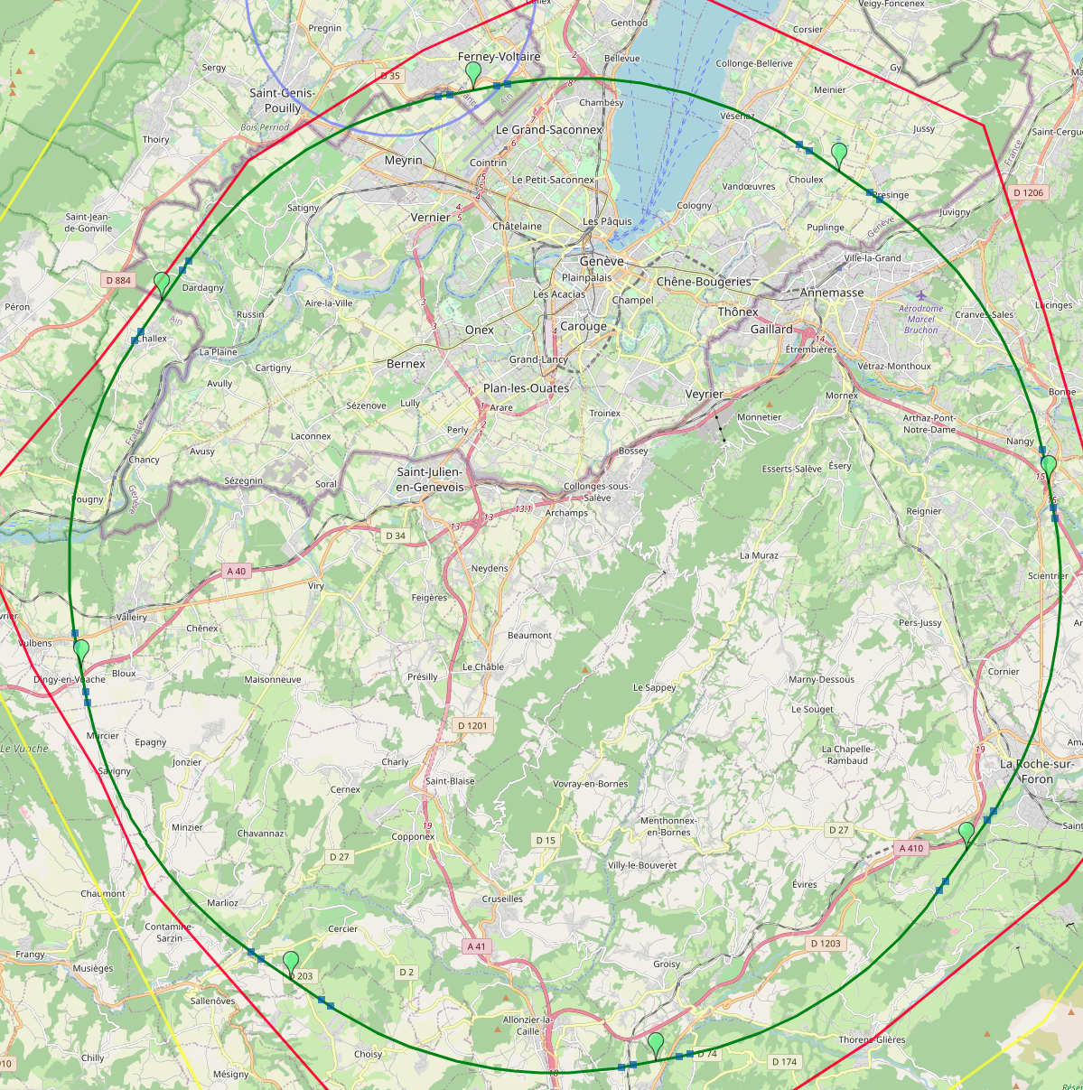
Reference layout and implementation: PA31 - 90.7 km
V. Mertens,
J. Gutleber
Layout chosen out of ~ 100 initial variants, based on geology and
surface constraints (land availability, access to roads, etc.), environment, (protected zones), infrastructure (water, electricity, transport), machine performance etc.
“Avoid-reduce-compensate” principle of EU and French regulations
PA: Experiment
PB: technical
PL: technical
Overall lowest-risk baseline: 90.7 km ring, 8 surface points,
4-fold symmetry
Number of surface sites | 8
Surface requirements | ~40 ha
LSS@IP (PA, PD, PG, PJ) | 1400 m
LSS@TECH (PB, PF, PH, PL) | 2032 m
Arc length | 9.6 km
Sum of arc lengths | 76.9 m
Total length | 90.7 km
PD: experiment
PJ: experiment
PF: technical
PH: technical
9
PG: experiment

Slide 10
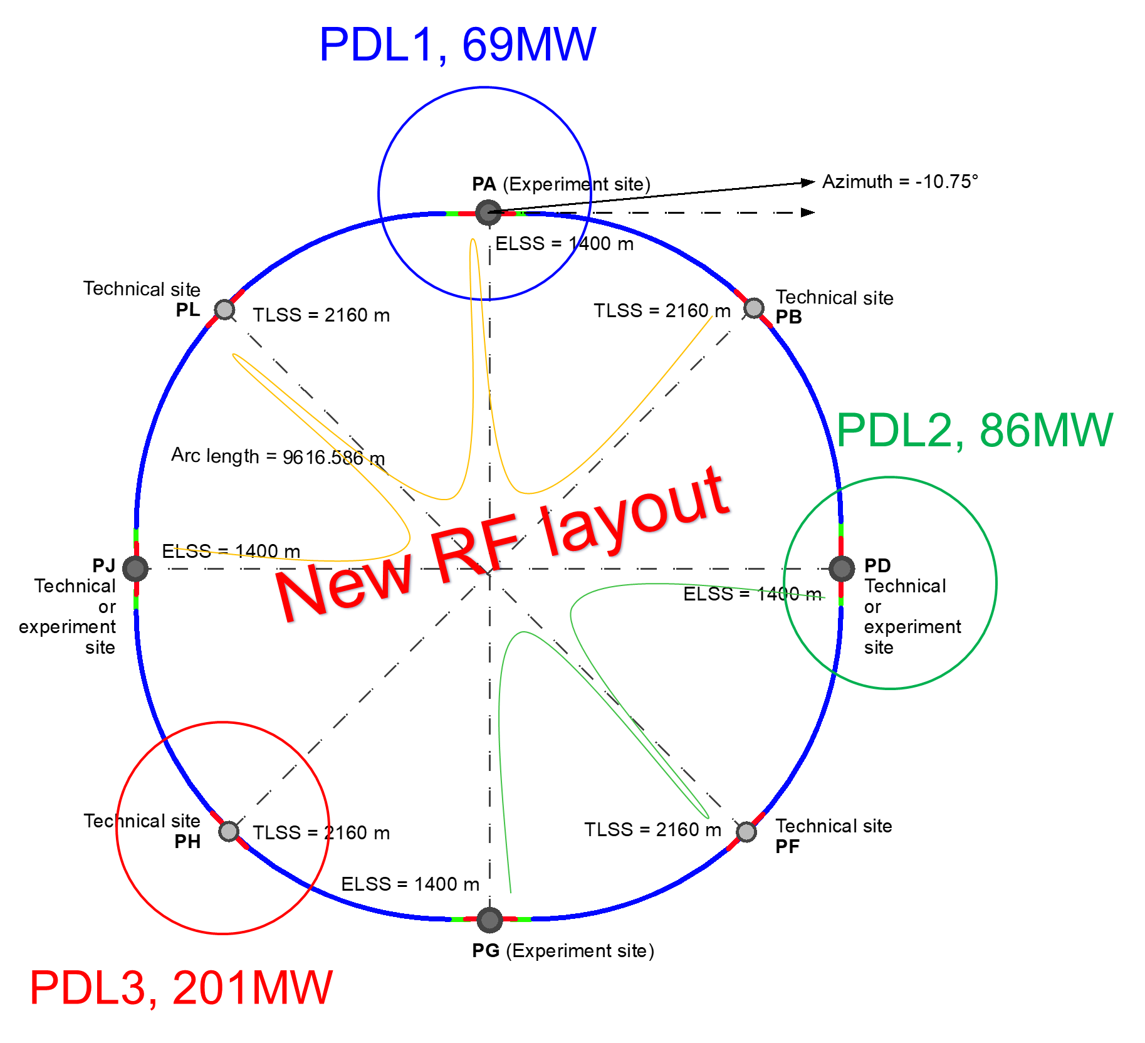
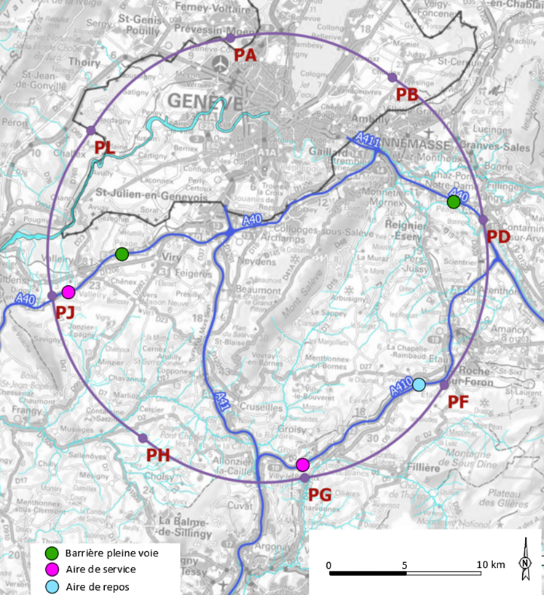
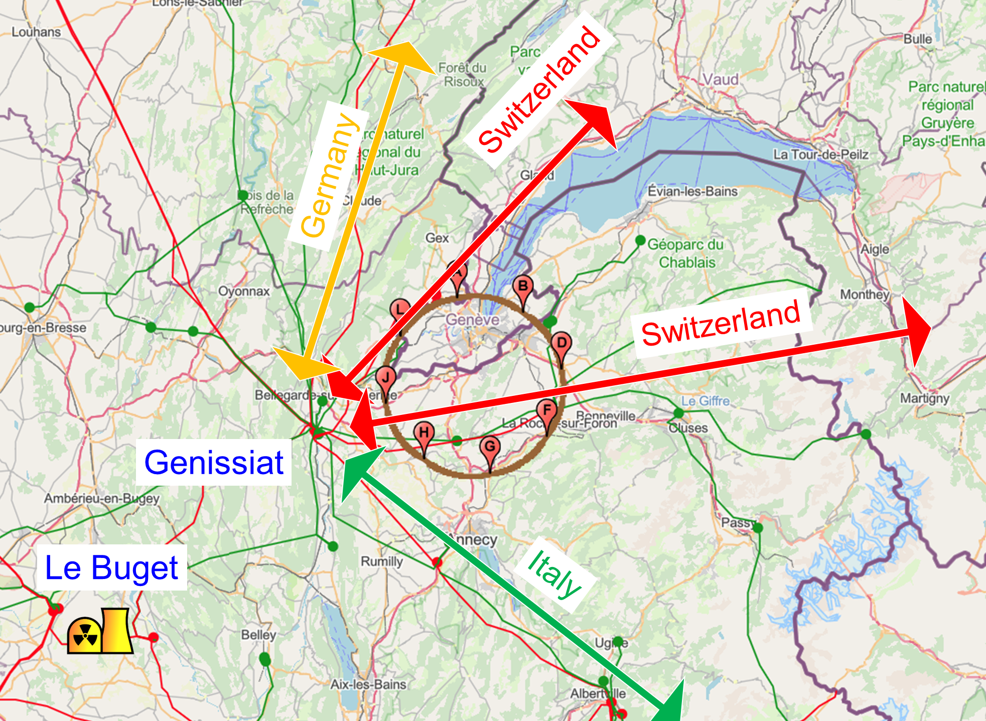
Integration with regional infrastructures
Road accesses developed for all 8 surface sites
Four possible highway connections defined
Less than 4 km of new roads required
Connections to
French electricity grid
connections with
highway network
Electrical connection concept developed with RTE (French electricity grid operator)
Three HV supply points, two new stations & CERN Prevessin
➔ requested loads have no significant impact on grid
R&D efforts aiming at reduction of the energy consumption of FCC-ee and FCC-hh

Slide 11
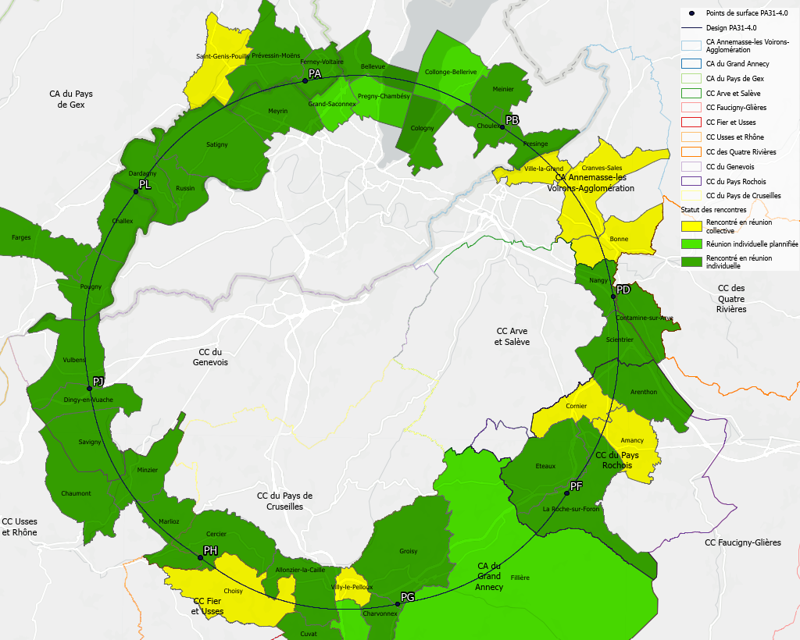
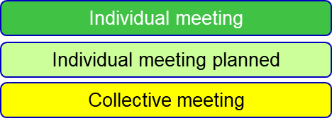
Regional implementation activities
Meetings with municipalities concerned
in France (31) and Switzerland (10)
PA – Ferney Voltaire (FR) – experiment site
PB – Présinge/Choulex (CH) – technical site
PD – Nangy (FR) – experiment site
PF – Roche sur Foron/Etaux (FR) – technical site
PG – Charvonnex/Groisy (FR) – experiment site
PH – Cercier (FR) – technical site
PJ – Vulbens/Dingy en Vuache (FR) experiment site
PL – Challex (FR) – technical site
Detailed work with municipalities and host states
identify land plots for surface sites
understand specific aspects for design
identify opportunities (waste heat, tec.)
reserve land plots until project decision
Status 1 June 2024
The support of the host states is greatly appreciated and essential for the study progress!

Slide 12
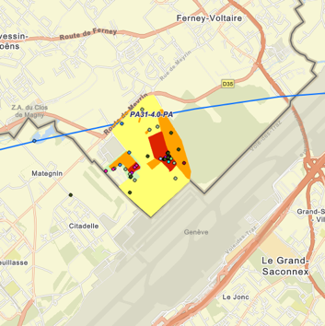
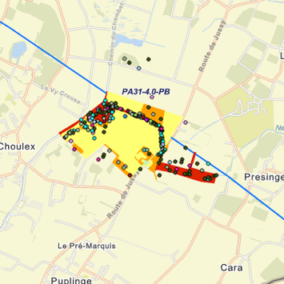
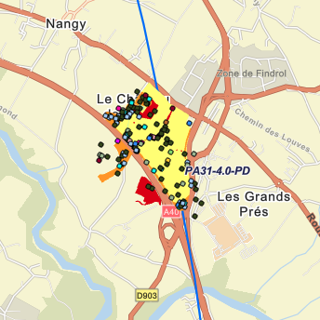
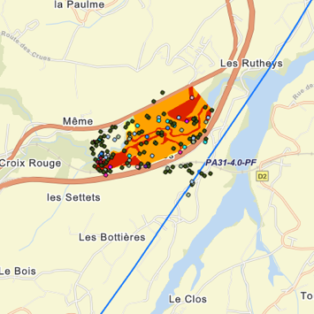
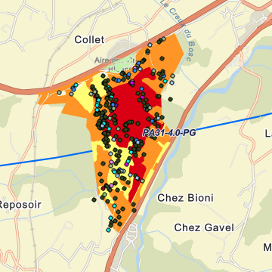
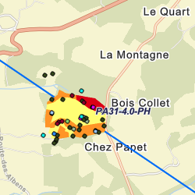
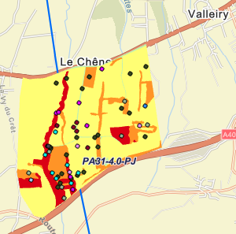
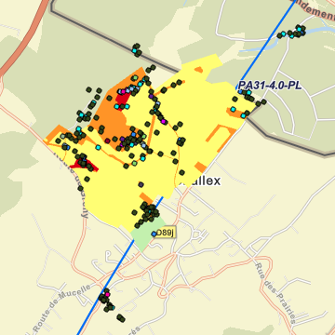
Environmental studies to document
present status of potential FCC surface site areas
PA
PB
PD
PF
Total area investigated in 2023/24: 585 ha over 4 seasons
PG
PH
PJ
PL

Slide 13
Environment report in progress: 2 volumes
Non-technical presentation of the FCC and the environment it would be embedded in.
In french for administrative services, the public and as basis for pre-project phase activities.
Volume: Environmental initial state
Environmental analysis of perimeter:
Climate, air, water, soil, geology, biodiversity, habitats, urbanism, mobility, economic activities, patrimony (cultural, architectural, archeological, natural), landscape, noise, vibration, artificial light pollution, radiation, natural risks, technical risks, potentially conflicting and synergetic projects.
Evolution of the territory without FCC.
Non-technical presentation of the FCC motivation, study and a potential project.
Volume: Environmental aspects
High level descriptions of all infrastructures, collider and experiment subsystems.
Identification of aspects that may lead to noteworthy environmental impacts as far as the current level of concepts allow (prioritisation).
Functional descriptions of surface sites and needed territorial developments.
Description of the construction activities.
Description of the installation activities.
Environmental strategy and guiding principles for Ecodesign to be considered by infrastructure and equipment designers in pre-TDR phase.

Slide 14
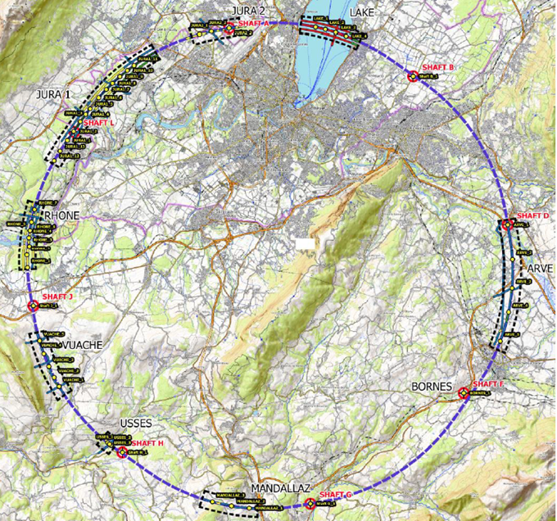
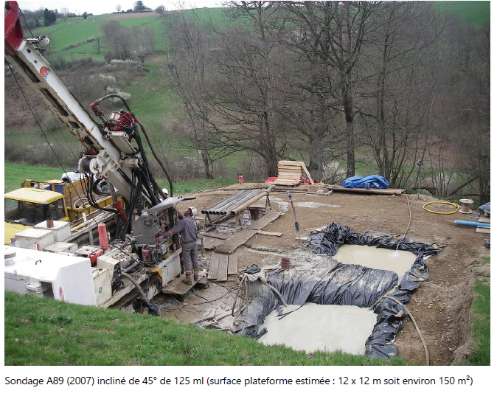
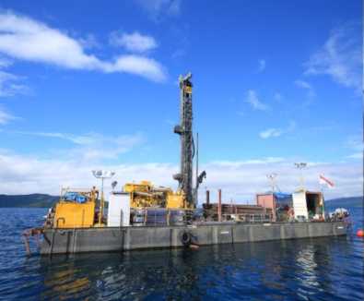
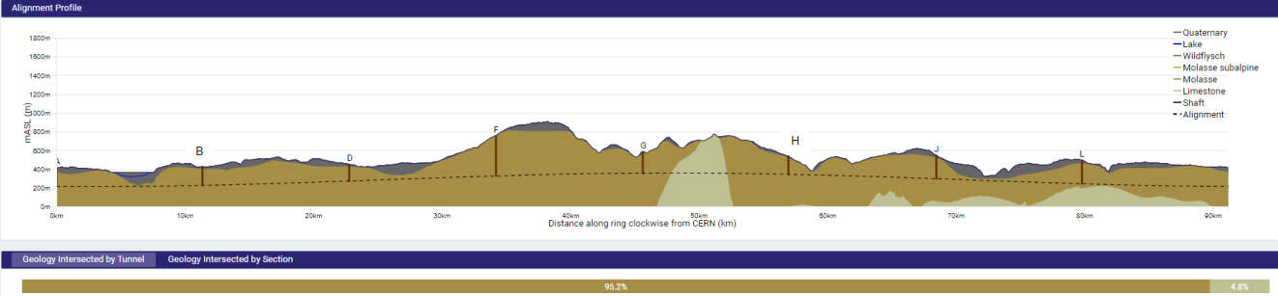
First series of site investigations
Site investigations to identify exact location of geological interfaces:
Molasse layer vs moraines/limestone
~30 drillings and ~100 km seismic lines
→ Vertical position and inclination of tunnel
Drilling works on the lake

Slide 15
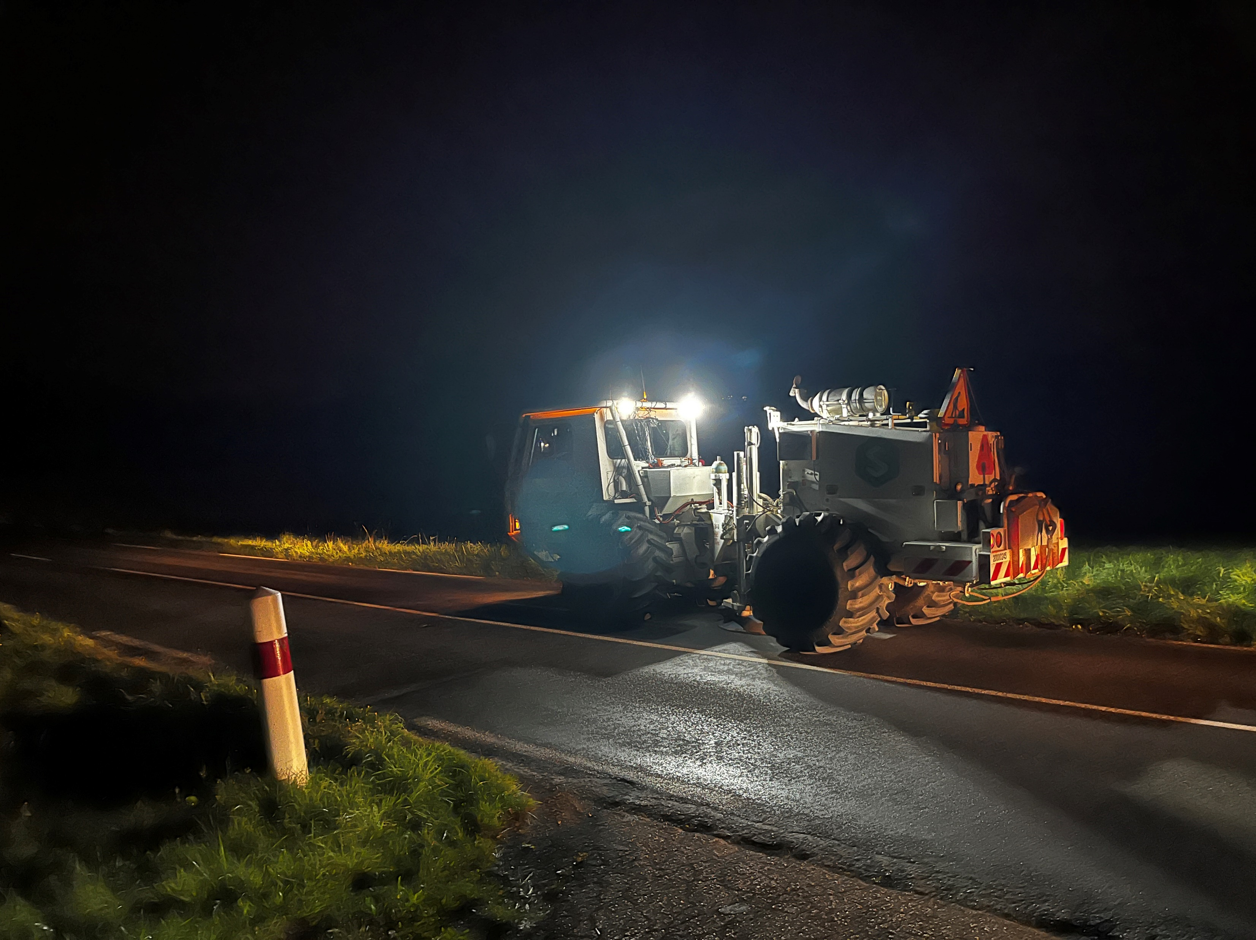
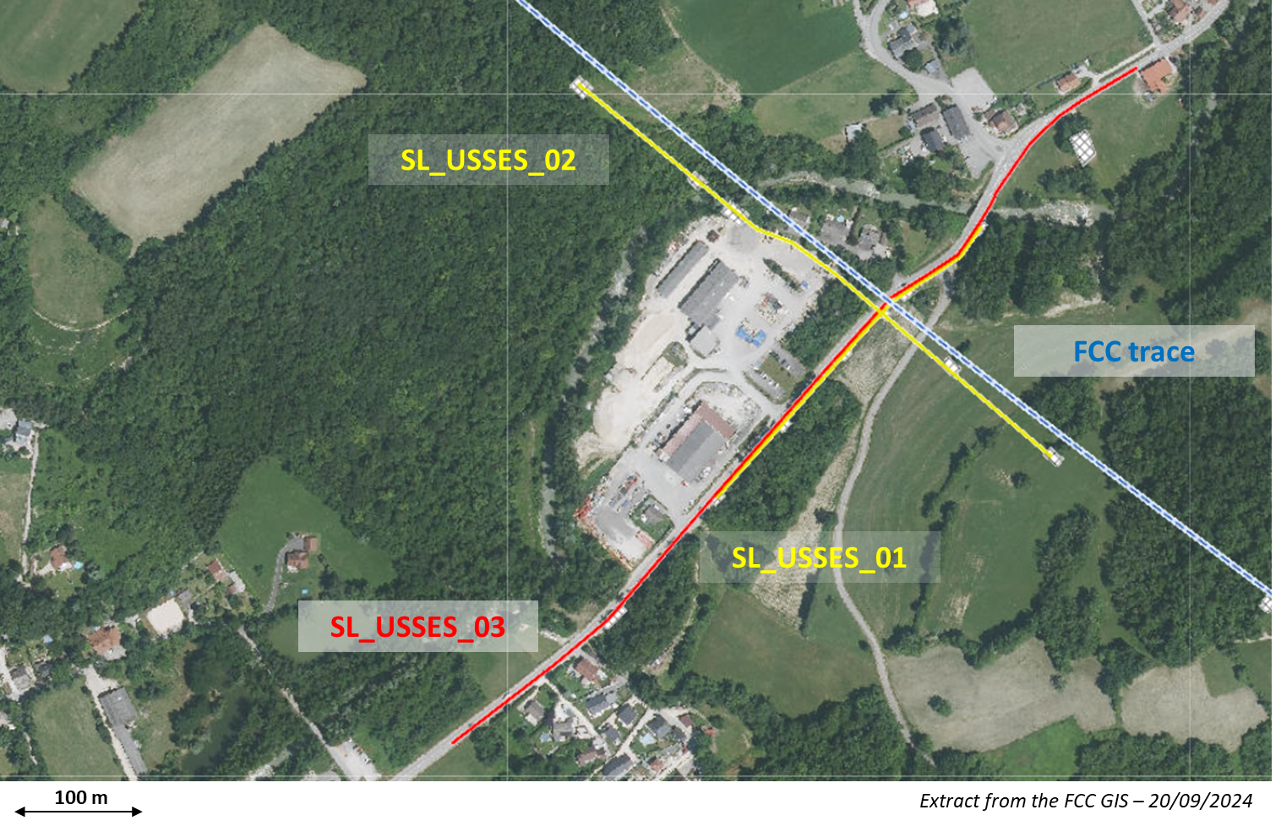
Start of site investigations – field work ongoing
First seismic line :
Second seismic line :
Seismic line SL_USSES_02 :
Acquisition date : 01/10/2024
Length : 480 meters
Method(s) : Explosive and Seismic gun
Geophones : 96 units (5 meters of spacing)
Shot points : 13 shot points in total
Seismic line SL_USSES_01 :
Acquisition date : 02/10/2024
Length : 300 meters
Method(s) : Weight drop
Geophones : 60 units (5 meters of spacing)
Shot points : 15 shot points in total

Slide 16
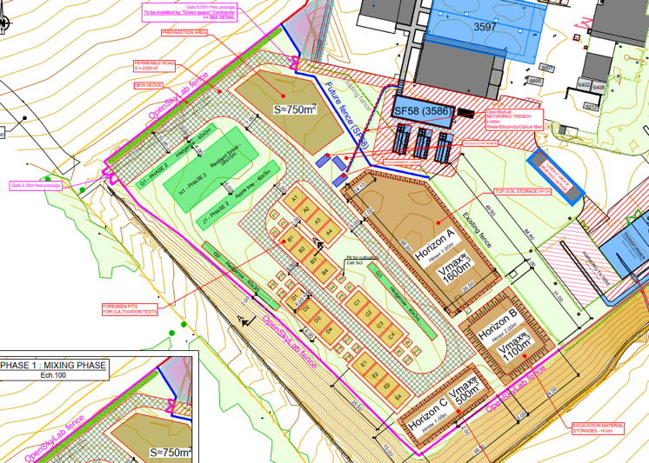









Development of excavation material re-use opportunities
OpenSkyLab: academic and industrial collaboration @LHC P5 CMS
Transformation of Molasse (FCC ~8 Mm³ volume) into fertile soil for agricultural and other uses
Materials: Molasse from the HL-LHC construction
Duration: 4+ years (2024 - )
Trials with 5 000 t molasse
  Soil fertilisation process (micro-organisms, mixing with fertile soil, etc.)
  Development of ferilisation mix products
  Development of quality managed processes
  Experimental phase with scientific protocol and field monitoring and control system support

Slide 17
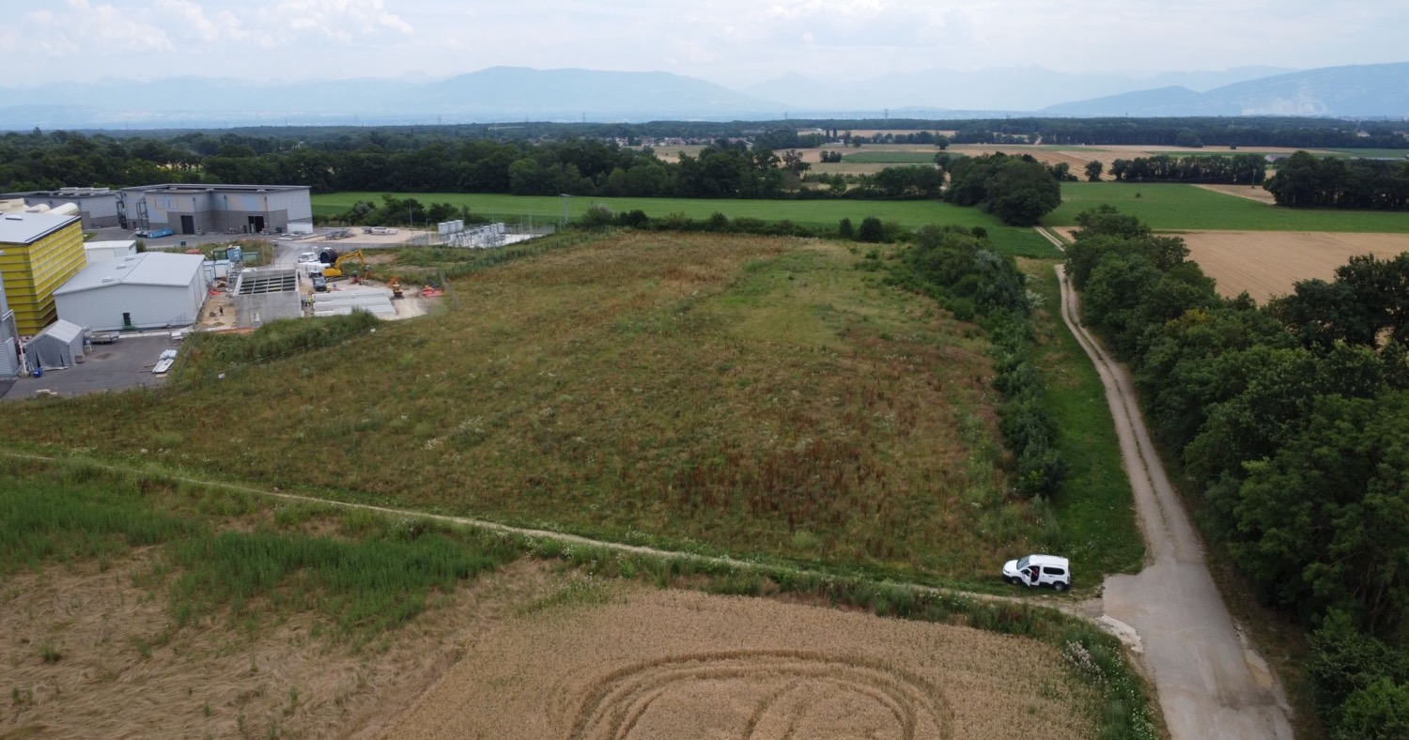
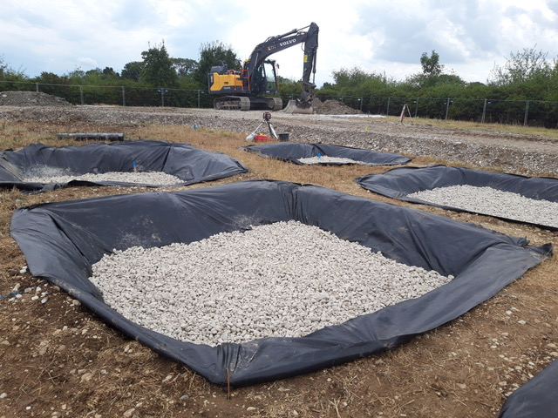
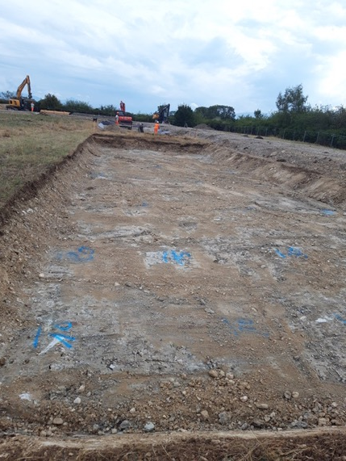
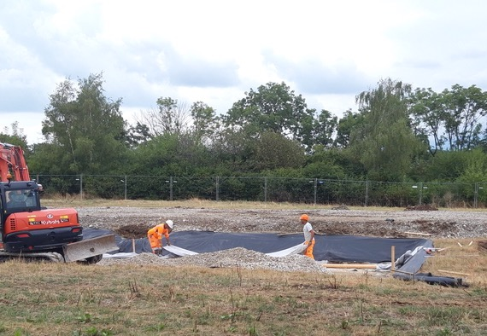
OpenSkyLab status and progress

Slide 18
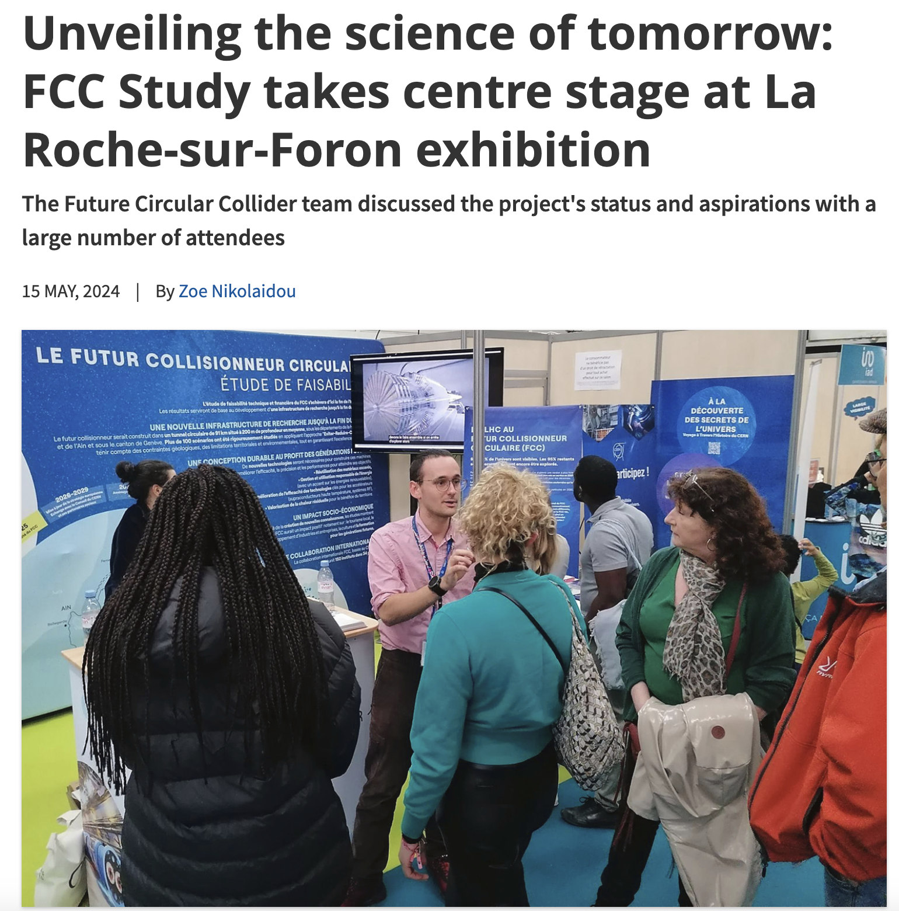
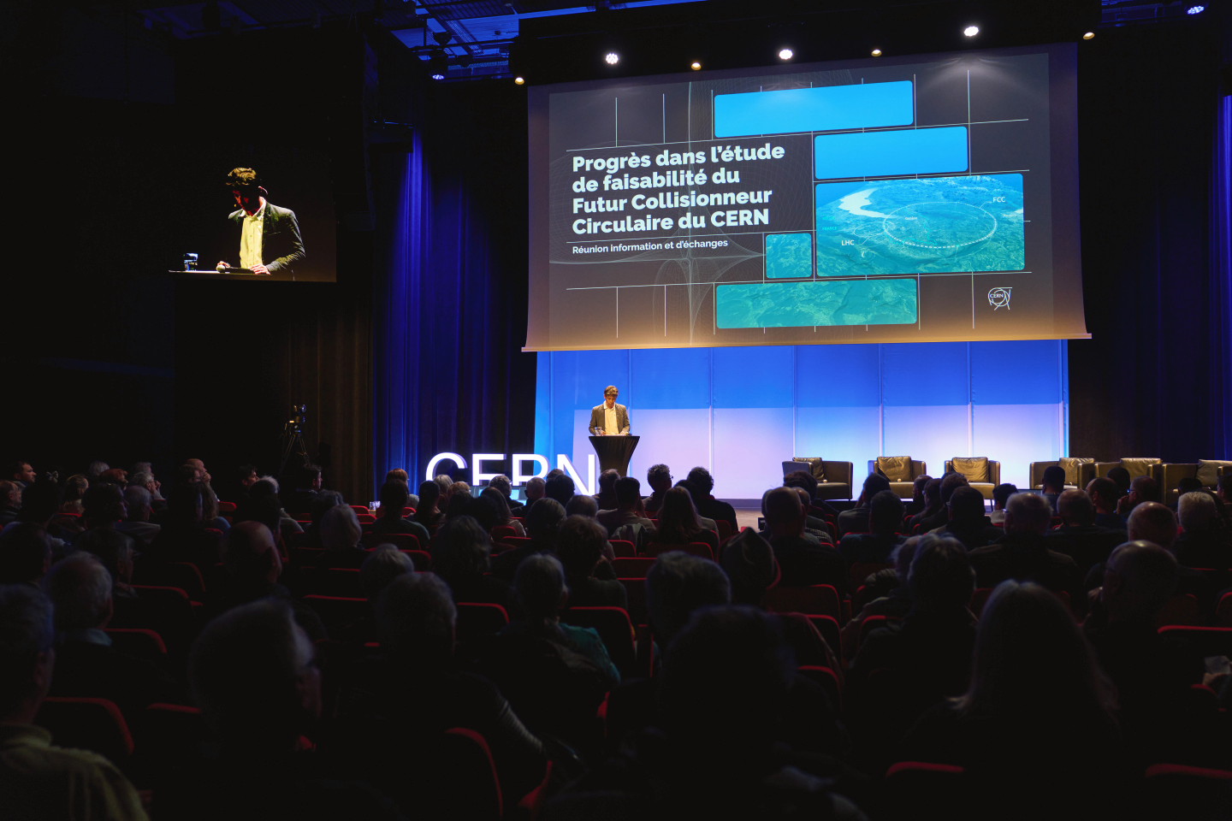
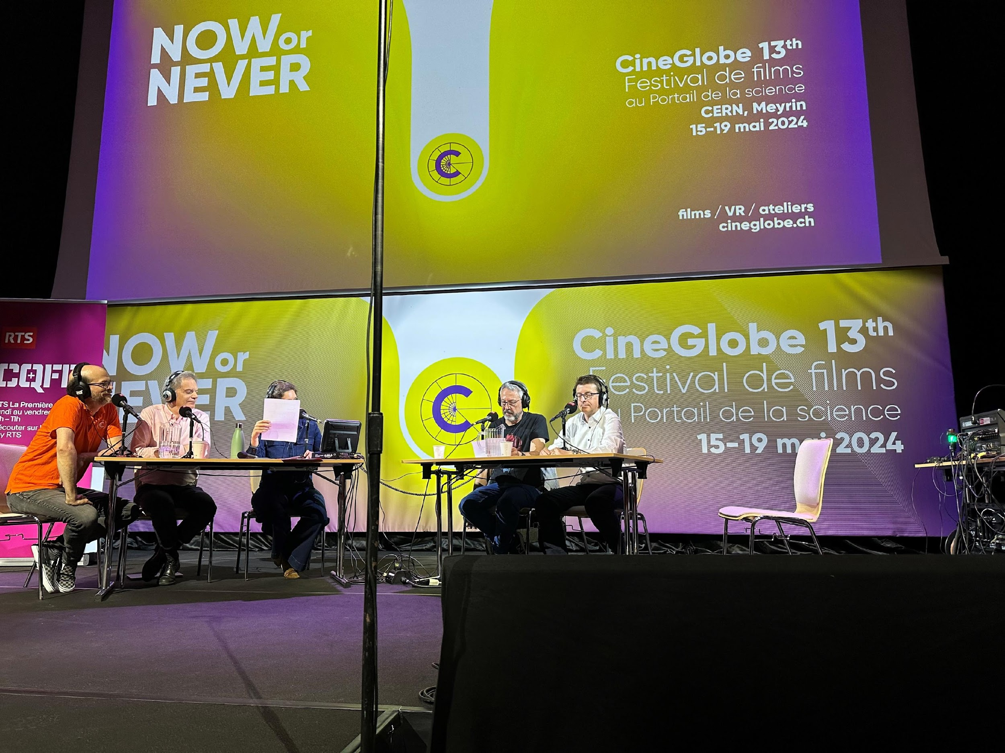
Start of public information & engagement sessions
First public information and discussion meeting at the Science Gateway on the 24th April at CERN.
The meeting was organised for the local community of our Host States, France and Switzerland, in the Science Gateway.
The "Progress of the feasibility study of the Future FCC circular collider" was followed by a discussion with the participants.
La Roche-sur-Foron - Haute Savoie international fare April 27 to May 6
CERN’s participation in the International Fair of Haute-Savoie/Mont Blanc, enhanced by the valuable help of volunteers from the FCC team, resulted in meaningful discussions with more than 2000 members of the local community on topics ranging from the required technological advancements to sustainability measures.
On 15 May, RTS (Radio Télévision Suisse) broadcasted a special program celebrating CERN’s 70th anniversary and hosted at CERN’s Science Gateway.
The event featured a comprehensive look at CERN's illustrious history, groundbreaking achievements, and future ambitions, including the prominently featured Future Circular Collider (FCC) project with study experts interacting with the audience.

Slide 19
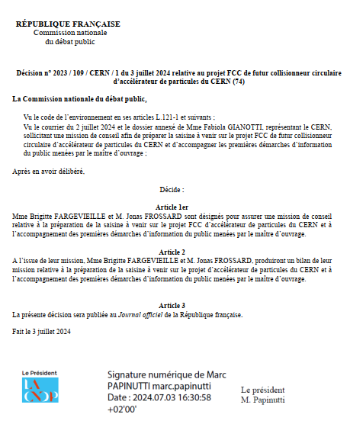
Commission Nationale de Debat Public (CNDP)
mission and public information meetings
The CNDP, created in 1995, is an independent French authority that ensures public participation in the definition and decision process of major projects in France, impacting the environment by providing a neutral and transparent framework for discussions between decision-makers and citizens.
On July 2, 2024, the CERN DG requested the CNDP to undertake an advisory mission on public participation for the FCC. On July 3, the president of the CNDP appointed two guarantors to:
Assist CERN in preparing the first information meetings on the ongoing studies in the region.
Provide non-binding advice to CERN on the next steps for public participation regarding the FCC.
Present status:
The FCC team, with the advice of the guarantors, is preparing the launch of information meetings on site investigations that are starting in the region.
Discussions regarding the legal framework of CERN, as International Organisation, and its compatibility with CNDP procedures are ongoing with the guarantors.
CNDP decision for the Advisory Mission

Slide 20
FCC-ee main machine parameters
Parameter | Z | WW | H (ZH) | ttbar
beam energy [GeV] | 45.6 | 80 | 120 | 182.5
beam current [mA] | 1270 | 137 | 26.7 | 4.9
number bunches/beam | 11200 | 1780 | 440 | 60
bunch intensity [10¹¹] | 2.14 | 1.45 | 1.15 | 1.55
SR energy loss / turn [GeV] | 0.0394 | 0.374 | 1.89 | 10.4
total RF voltage 400/800 MHz [GV] | 0.120/0 | 1.0/0 | 2.1/0 | 2.1/9.4
long. damping time [turns] | 1158 | 215 | 64 | 18
horizontal beta* [m] | 0.11 | 0.2 | 0.24 | 1.0
vertical beta* [mm] | 0.7 | 1.0 | 1.0 | 1.6
horizontal geometric emittance [nm] | 0.71 | 2.17 | 0.71 | 1.59
vertical geom. emittance [pm] | 1.9 | 2.2 | 1.4 | 1.6
vertical rms IP spot size [nm] | 36 | 47 | 40 | 51
beam-beam parameter ξ_{x} / ξ_{y} | 0.002/0.0973 | 0.013/0.128 | 0.010/0.088 | 0.073/0.134
rms bunch length with SR / BS [mm] | 5.6 / 15.5 | 3.5 / 5.4 | 3.4 / 4.7 | 1.8 / 2.2
luminosity per IP [10³⁴ cm⁻²s⁻¹] | 140 | 20 | ≥5.0 | 1.25
total integrated luminosity / IP / year [ab⁻¹/yr] | 17 | 2.4 | 0.6 | 0.15
beam lifetime rad Bhabha + BS [min] | 15 | 12 | 12 | 11
Design and parameters to maximise luminosity at all working points:
allow for 50 MW synchrotron radiation per beam.
Independent vacuum systems for electrons and positrons
full energy booster ring with top-up injection, collider permanent in collision mode
4 years
5 x 10¹² Z
LEP x 10⁵
2 years
> 10⁸ WW
LEP x 10⁴
3 years
2 x 10⁶ H
5 years
2 x 10⁶ tt pairs
x 10-50 improvements on all EW observables
up to x 10 improvement on Higgs coupling (model-indep.) measurements over HL-LHC
x10 Belle II statistics for b, c, τ
indirect discovery potential up to ~ 70 TeV
direct discovery potential for feebly-interacting particles over 5-100 GeV mass range
Up to 4 interaction points → robustness,
statistics, possibility of specialised detectors
to maximise physics output
F. Gianotti

Slide 21
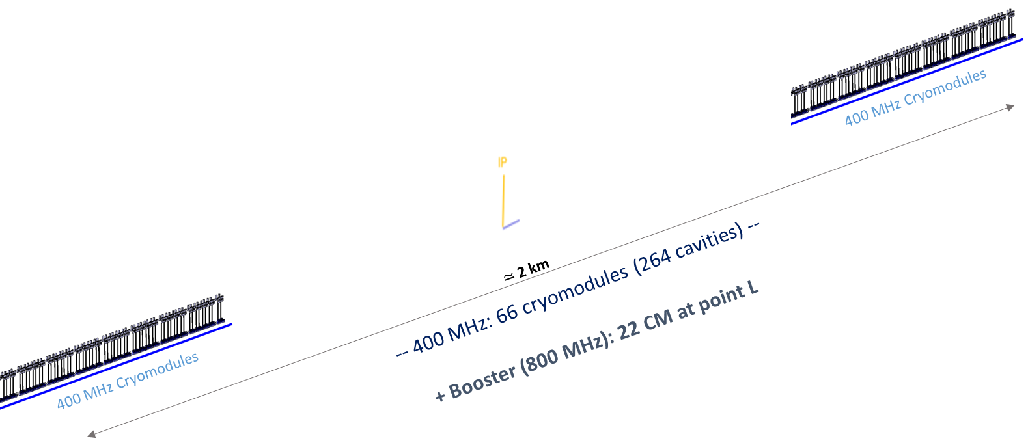
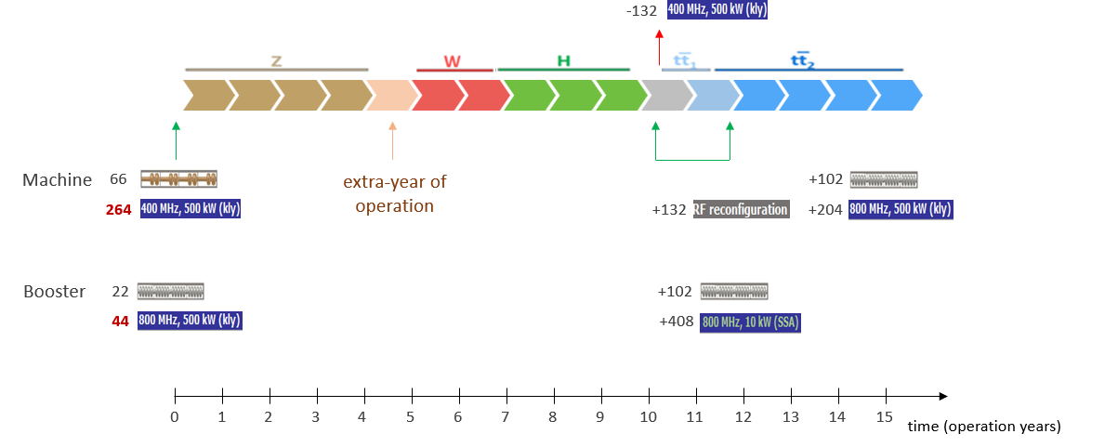
Optimisaion for operation: 400 MHz SRF and beam switchyard
Beam switching between (Z, W) and ZH operation
2-cell 400 MHz cavities for all three working points, identical configuration
ES separators + magnetic field for switching beams
Allows quasi “instantaneous” switching between Z, W, ZH
 | Energy (GeV) | Current (mA) | RF voltage (GV)
Z | 45.6 | 1280 | 0.08
W | 80 | 135 | 1
H | 120 | 26.7 | 2.08
ttb | 182.5 | 5 | 11.67
Collider RF integration at point H
(Z, WW and ZH operation)
Beam crossing and combination
at RF section in point H
Z, W
ZH
33 CM
33 CM
33 CM
33 CM
Beam 1
400 MHz
400 MHz
400 MHz
400 MHz
Beam 2
E&M
sep.1
E&M
sep. 2a
E& M
sep. 2b
extra year of operation thanks to single RF system

Slide 22
Optimized injector concept and parameters
Mid-term review recommendations to reduce gradients and repetition rate → new linac optimization in terms of cost and power density
  Overall power consumption (for linacs) is reduced by more than a factor 3 by means of:
    new accelerating structures with higher shunt impedance;
    lower gradient (29.5 MV/m → 22.5/20.5 MV/m);
    lower repetition rate (200/400 Hz → 100 Hz).
  Repetition rate of 100 Hz with 4 bunches per rf pulse
  New layout: Damping Ring at higher energy 2.86 GeV, no common linac with 2x repetition rate.

Slide 23
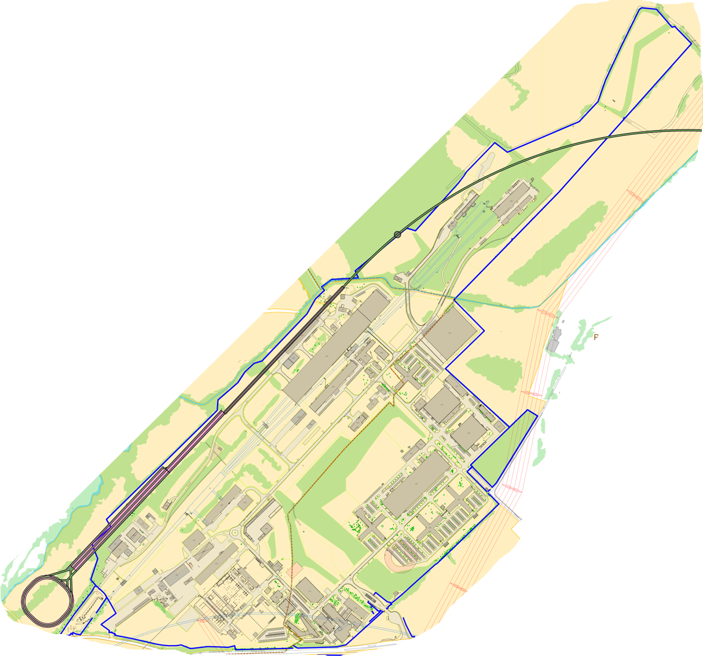
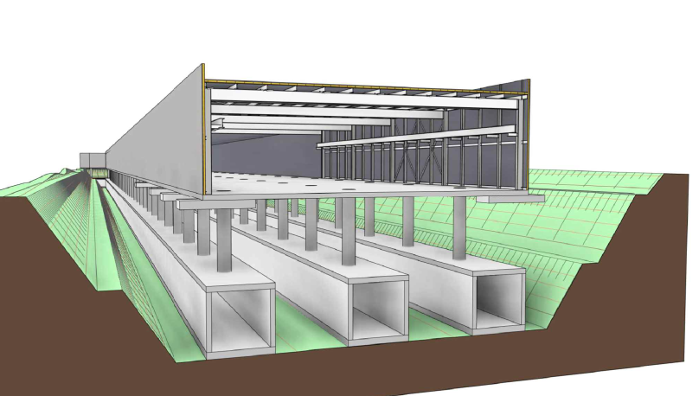
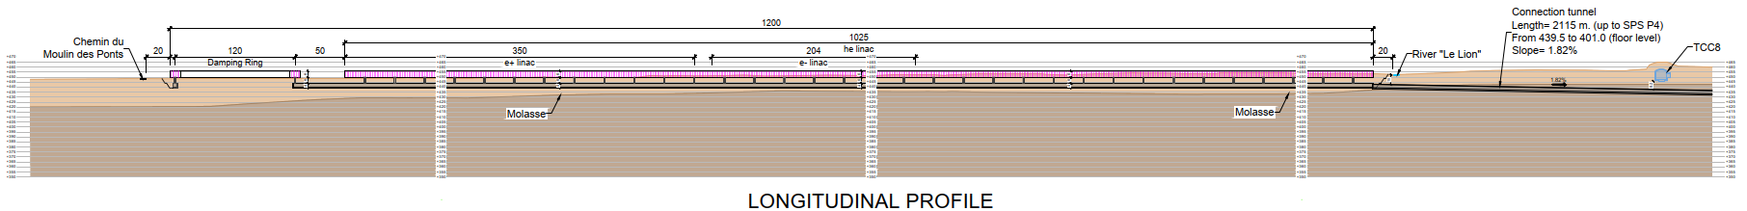
Optimised injector implementation at Prevessin site
Good integration with existing CERN Prevessin Site and strongly reduced visibility from outside.
Ideal connection to existing experimental halls.
Good conditions for construction.
High Energy LINAC
Damping
Ring
CERN Fenced Area
Entrance CERN Prevessin Site

Slide 24
FCC-hh main machine parameters
parameter | FCC-hh | HL-LHC | LHC
collision energy cms [TeV] | 81 - 115 | 14
dipole field [T] | 14 - 20 | 8.33
circumference [km] | 90.7 | 26.7
arc length [km] | 76.9 | 22.5
beam current [A] | 0.5 | 1.1 | 0.58
bunch intensity [10¹¹] | 1 | 2.2 | 1.15
bunch spacing [ns] | 25 | 25
synchr. rad. power / ring [kW] | 1020 - 4250 | 7.3 | 3.6
SR power / length [W/m/ap.] | 13 - 54 | 0.33 | 0.17
long. emit. damping time [h] | 0.77 – 0.26 | 12.9
peak luminosity [10³⁴ cm⁻²s⁻¹] | ~30 | 5 (lev.) | 1
events/bunch crossing | ~1000 | 132 | 27
stored energy/beam [GJ] | 6.1 - 8.9 | 0.7 | 0.36
Integrated luminosity/main IP [fb⁻¹] | 20000 | 3000 | 300
With FCC-hh after FCC-ee: significant amount of time for high-field magnet R&D,
aiming at highest possible collision energies
Target field range for cryo-magnet R&D
Formidable challenges:
high-field superconducting magnets: 14 - 20 T
power load in arcs from synchrotron radiation: 4 MW → cryogenics, vacuum
stored beam energy: ~ 9 GJ → machine protection
pile-up in the detectors: ~1000 events/xing
optimization of energy consumption: → R&D on cryo, HTS, beam current, …
Formidable physics reach, including:
Direct discovery potential up to ~ 40 TeV
Measurement of Higgs self to ~ 5% and ttH to ~ 1%
High-precision and model-indep (with FCC-ee input)
measurements of rare Higgs decays (𝛄𝛄, Z𝛄, µµ)
Final word about WIMP dark matter
F. Gianotti

Slide 25
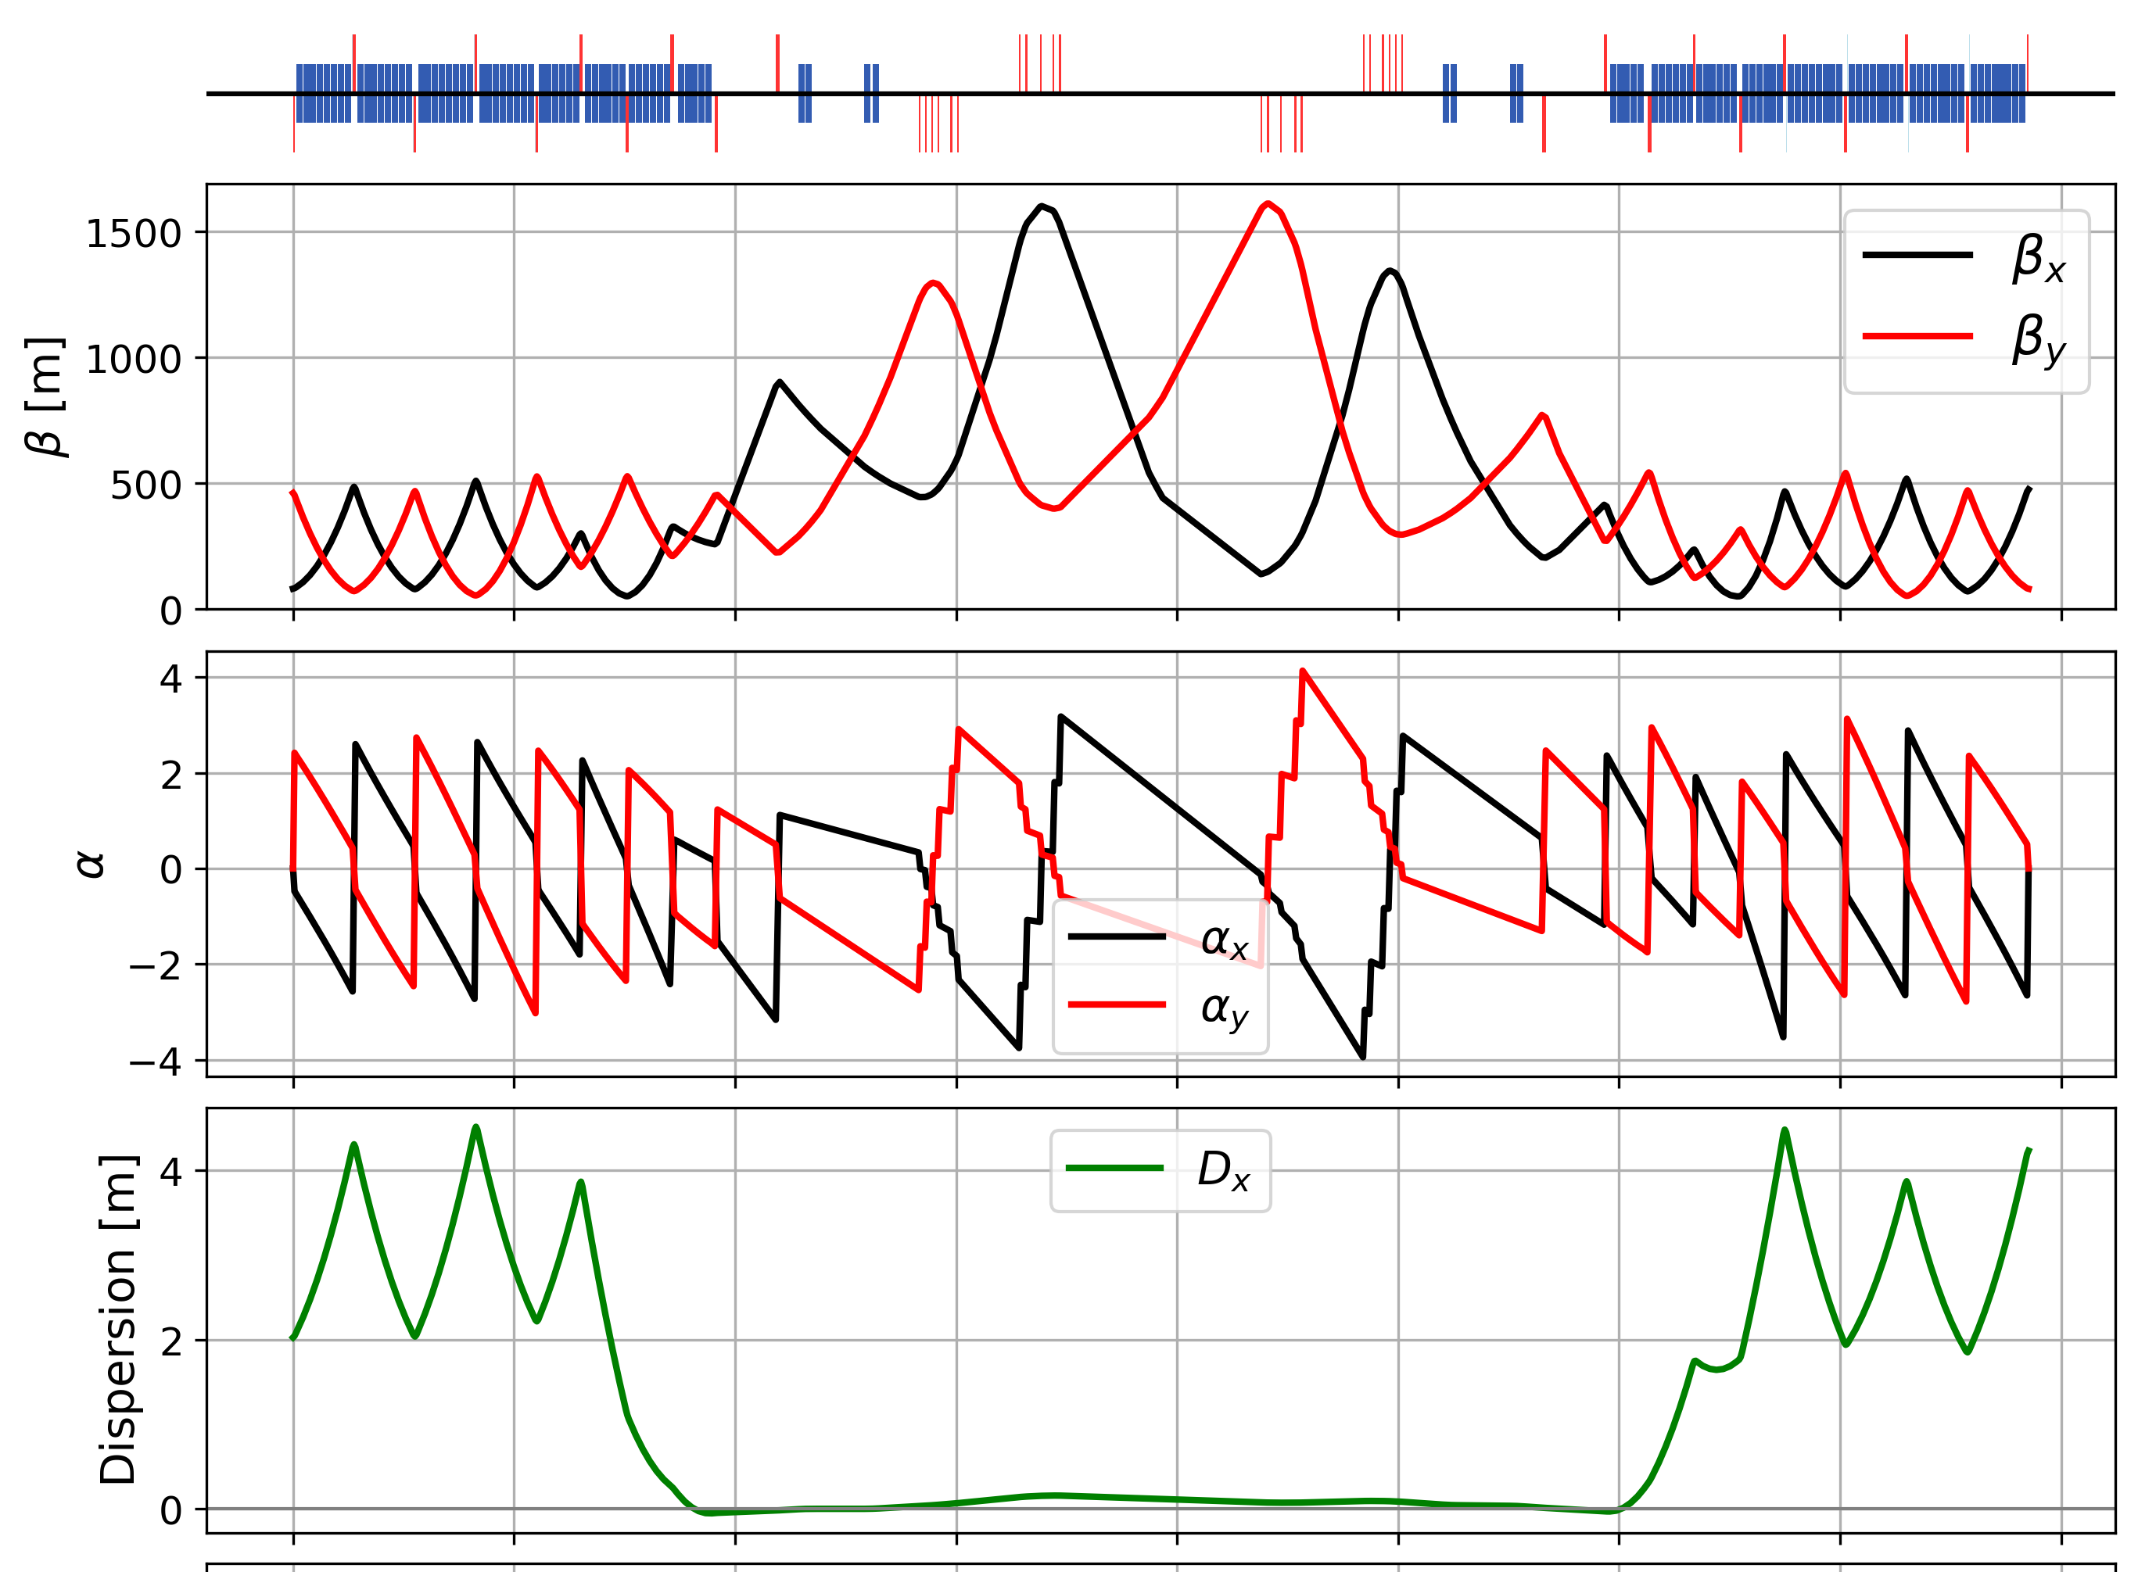
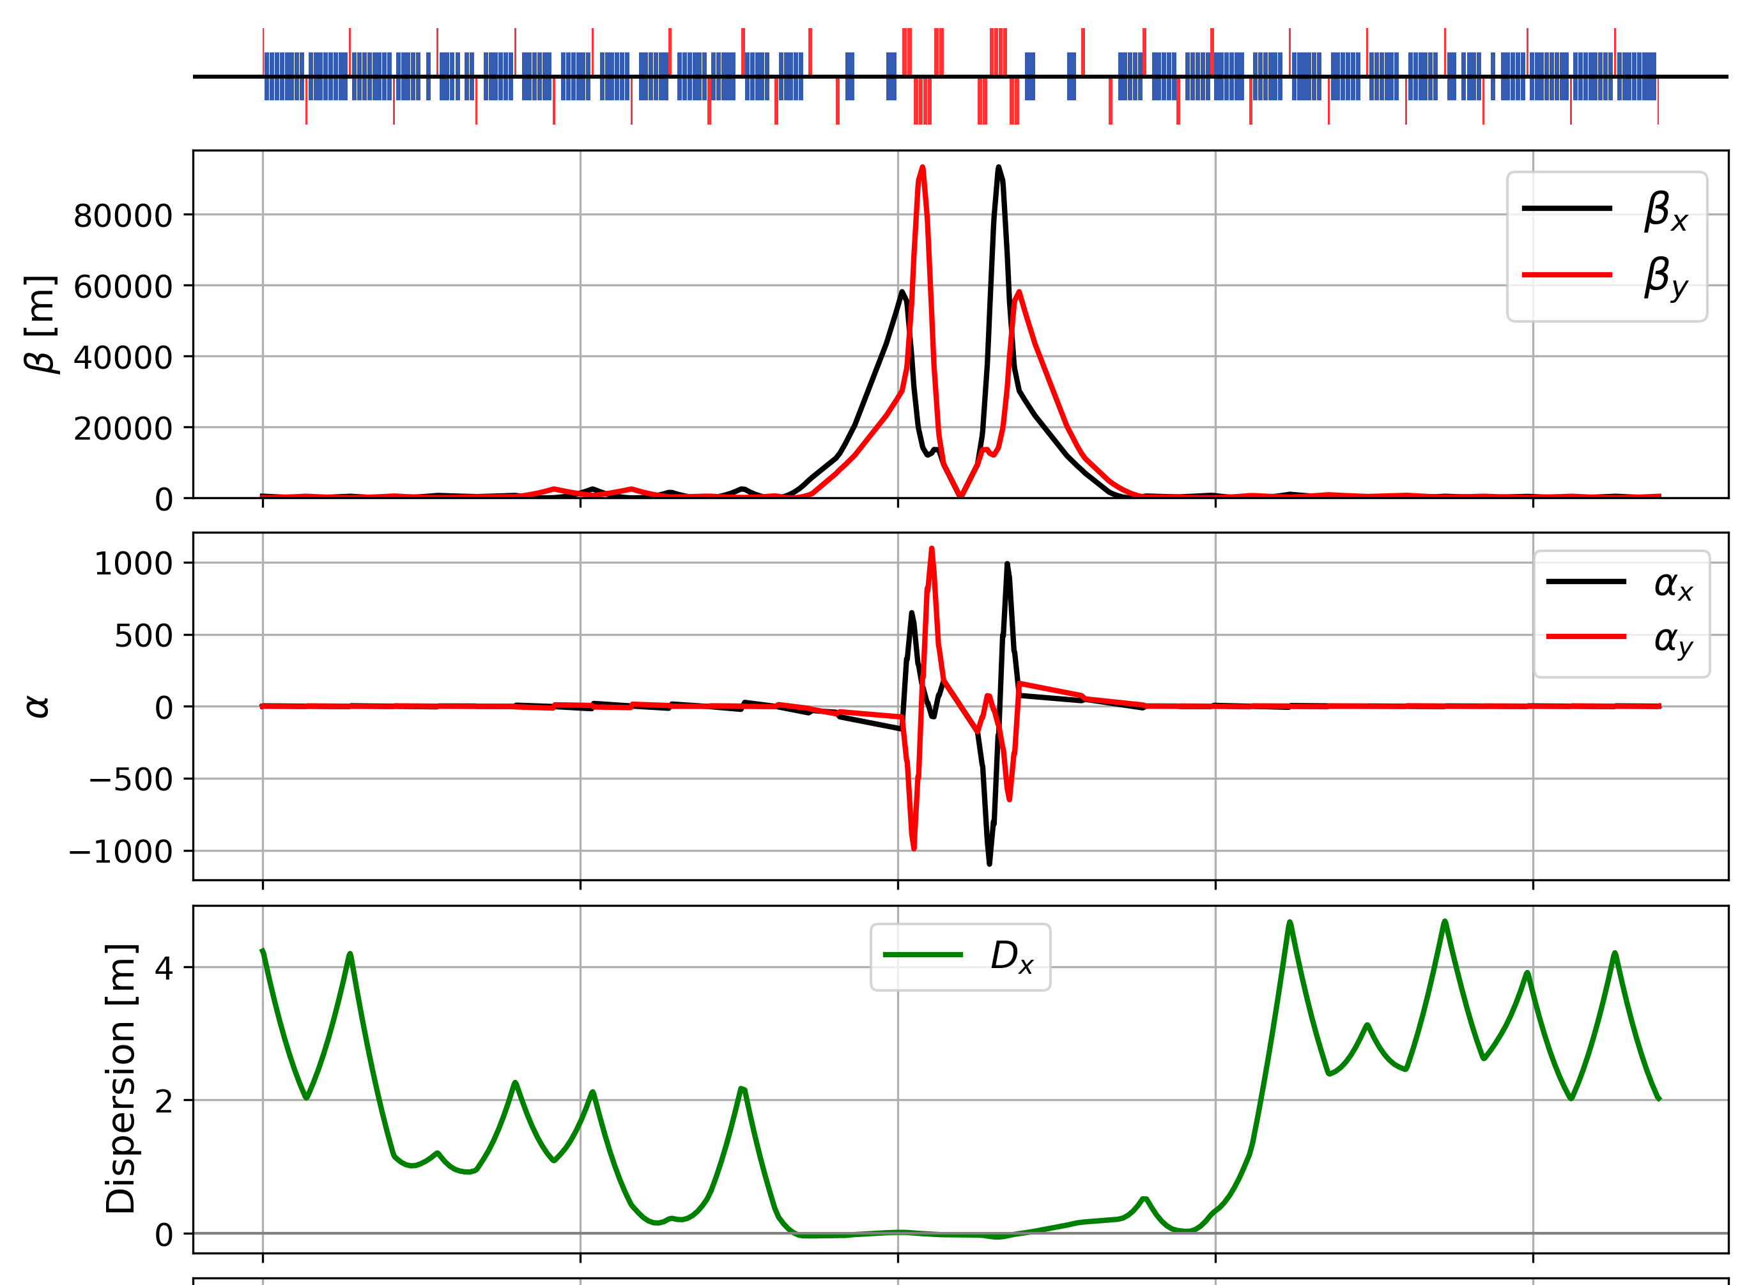
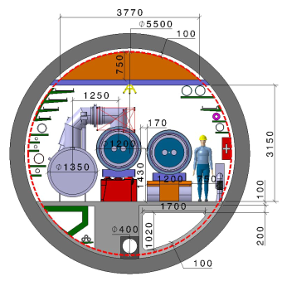
Key activities on FCC-hh: cryo magnet system, optics design
Optics design activities:
adaptation to new layout and geometry
shrink β collimation & extraction by ~30%
optics optimisation (filling factor etc.)
betatron collimation straight
experimental straight
M. Giovannozzi. G. Perez, T. Risselada
High-field cryo-magnet system design
Conceptual study of cryogenics concept and temperature layout for LTS and HTS based magnets, in view of electrical consumption.
Update of integration study for the ongoing HFM designs and scaling to preliminary HTS design.
  → Confirmation of tunnel diameter!
HFM R&D (LTS and HTS) on technology and magnet design, aiming also at bridging the TRL gap between HTS and Nb₃Sn.
Collider Center
F. Valchkova

Slide 26
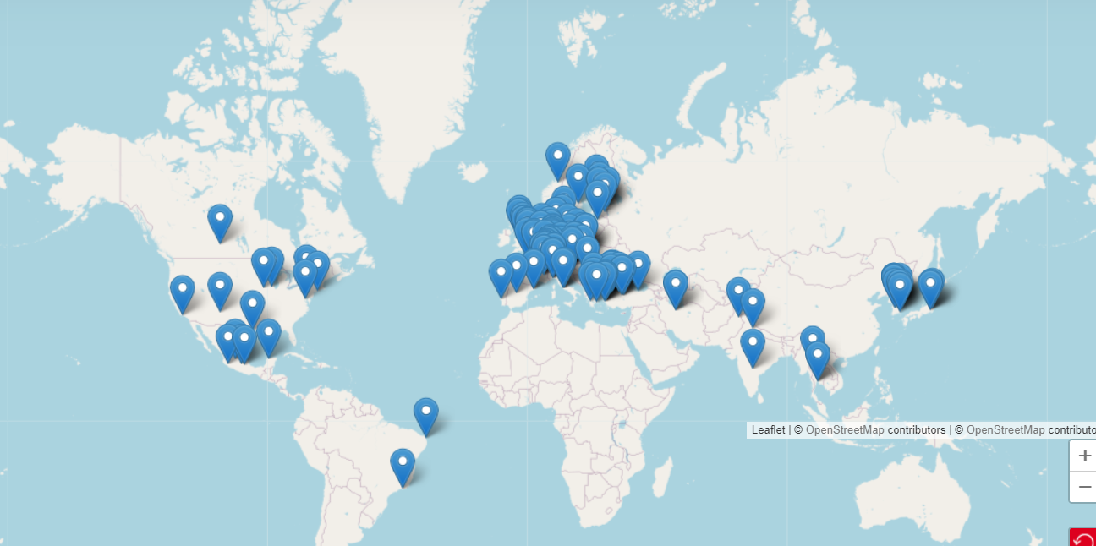


Status of FCC global collaboration
Increasing international collaboration as a prerequisite for success:
→links with science, research & development and high-tech industry will be essential to further advance and prepare the implementation of FCC
FCC Feasibility Study:
Aim is to increase further the collaboration,
on all aspects, in particular on
Accelerator and Particle/Experiments/Detectors
141 Institutes
32 countries
+
CERN

Slide 27

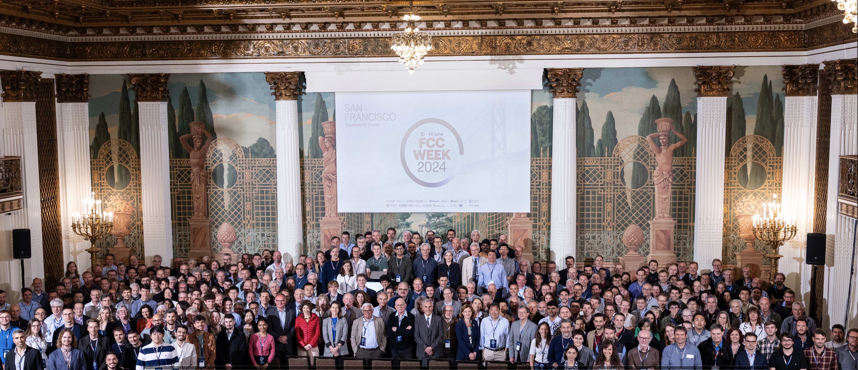
FCC Week 2024 - San Francisco – 10 to 14 June
449 participants, 50 public sessions, 216 oral presentations, 32 posters
US efforts getting organized, towards completing the FS by March 2025

Slide 28
FCC Main Goals for Coming Years
The first part of the FCC Feasibility Study has been successfully concluded with the mid-term review
Next milestone: completion of the FCC Feasibility Study by March 2025
By 2027-2028, possible FCC project approval, start of CE design contract:
  specifications to enable CE tender design by 2028
  refined input for environmental evaluation and project authorisation process
  requires overall integration study and designs based on technical pre-design of accelerators, technical infrastructure and detectors
By 2031-32, possible start of CE construction:
  CE groundbreaking
  TDR to enable prototyping, industrialization towards component production
Strong international collaboration is essential for success!

Slide 29

FCC Week 2025 - Vienna
Event Overview
Venue: Hofburg Palace, a historical and cultural landmark in Vienna, Austria.
Dates: Monday 19 to Friday 23 May 2025
Presentation of the Feasibility Study Report and review of its findings and opportunities for future R&D projects
Please save the date and join us in Vienna

