Slide 1
Where?
Restaurante ”La Sal Gorda”
Calle de Beatriz de Bobadilla, 9
Tlf: 915 53 95 06
When? at 20:30
How much? 40€ per person
What?

Slide 2
MENÚ
APPETIZERS
SALAD OF SARDINES, TOMATO AND IBERICO HAM and
ARTICHOKES FILLED WITH VEGETABLES and
OCTOPUS CROQUETTES
MAIN COURSES
BEEF TENDERLOIN or
ROASTED PORK KNUCKLE or
SEAFOOD CANNELLONI or
COD IN TEMPURA
DESSERT
CHOCOLATE CAKE or
“SACHER” CAKE
DRINKS
WATER, WINE AND COFFEE

Slide 3
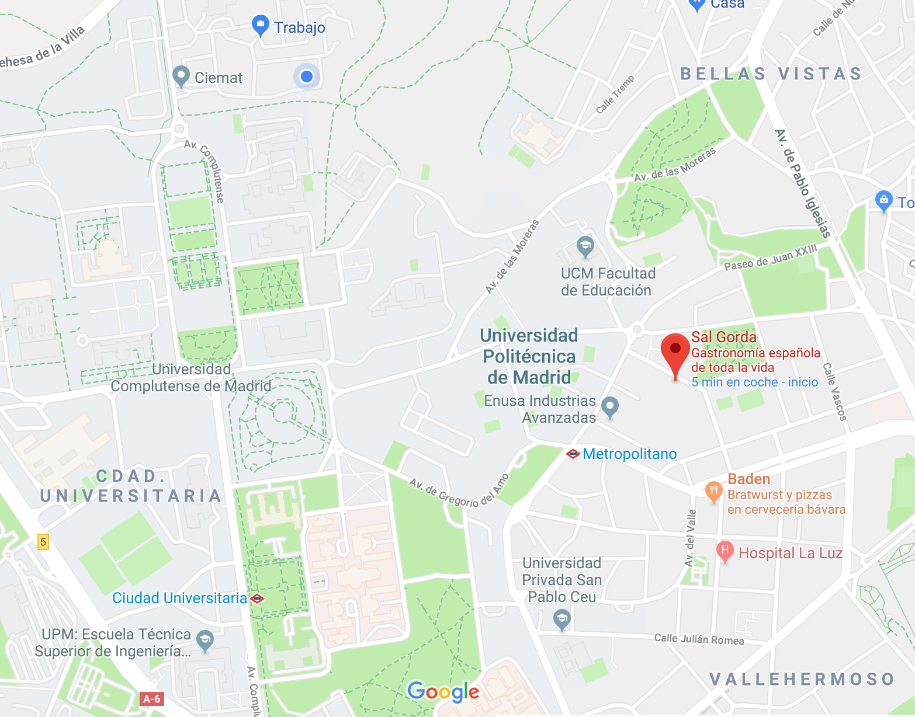
Restaurante ”La Sal Gorda”

Slide 4
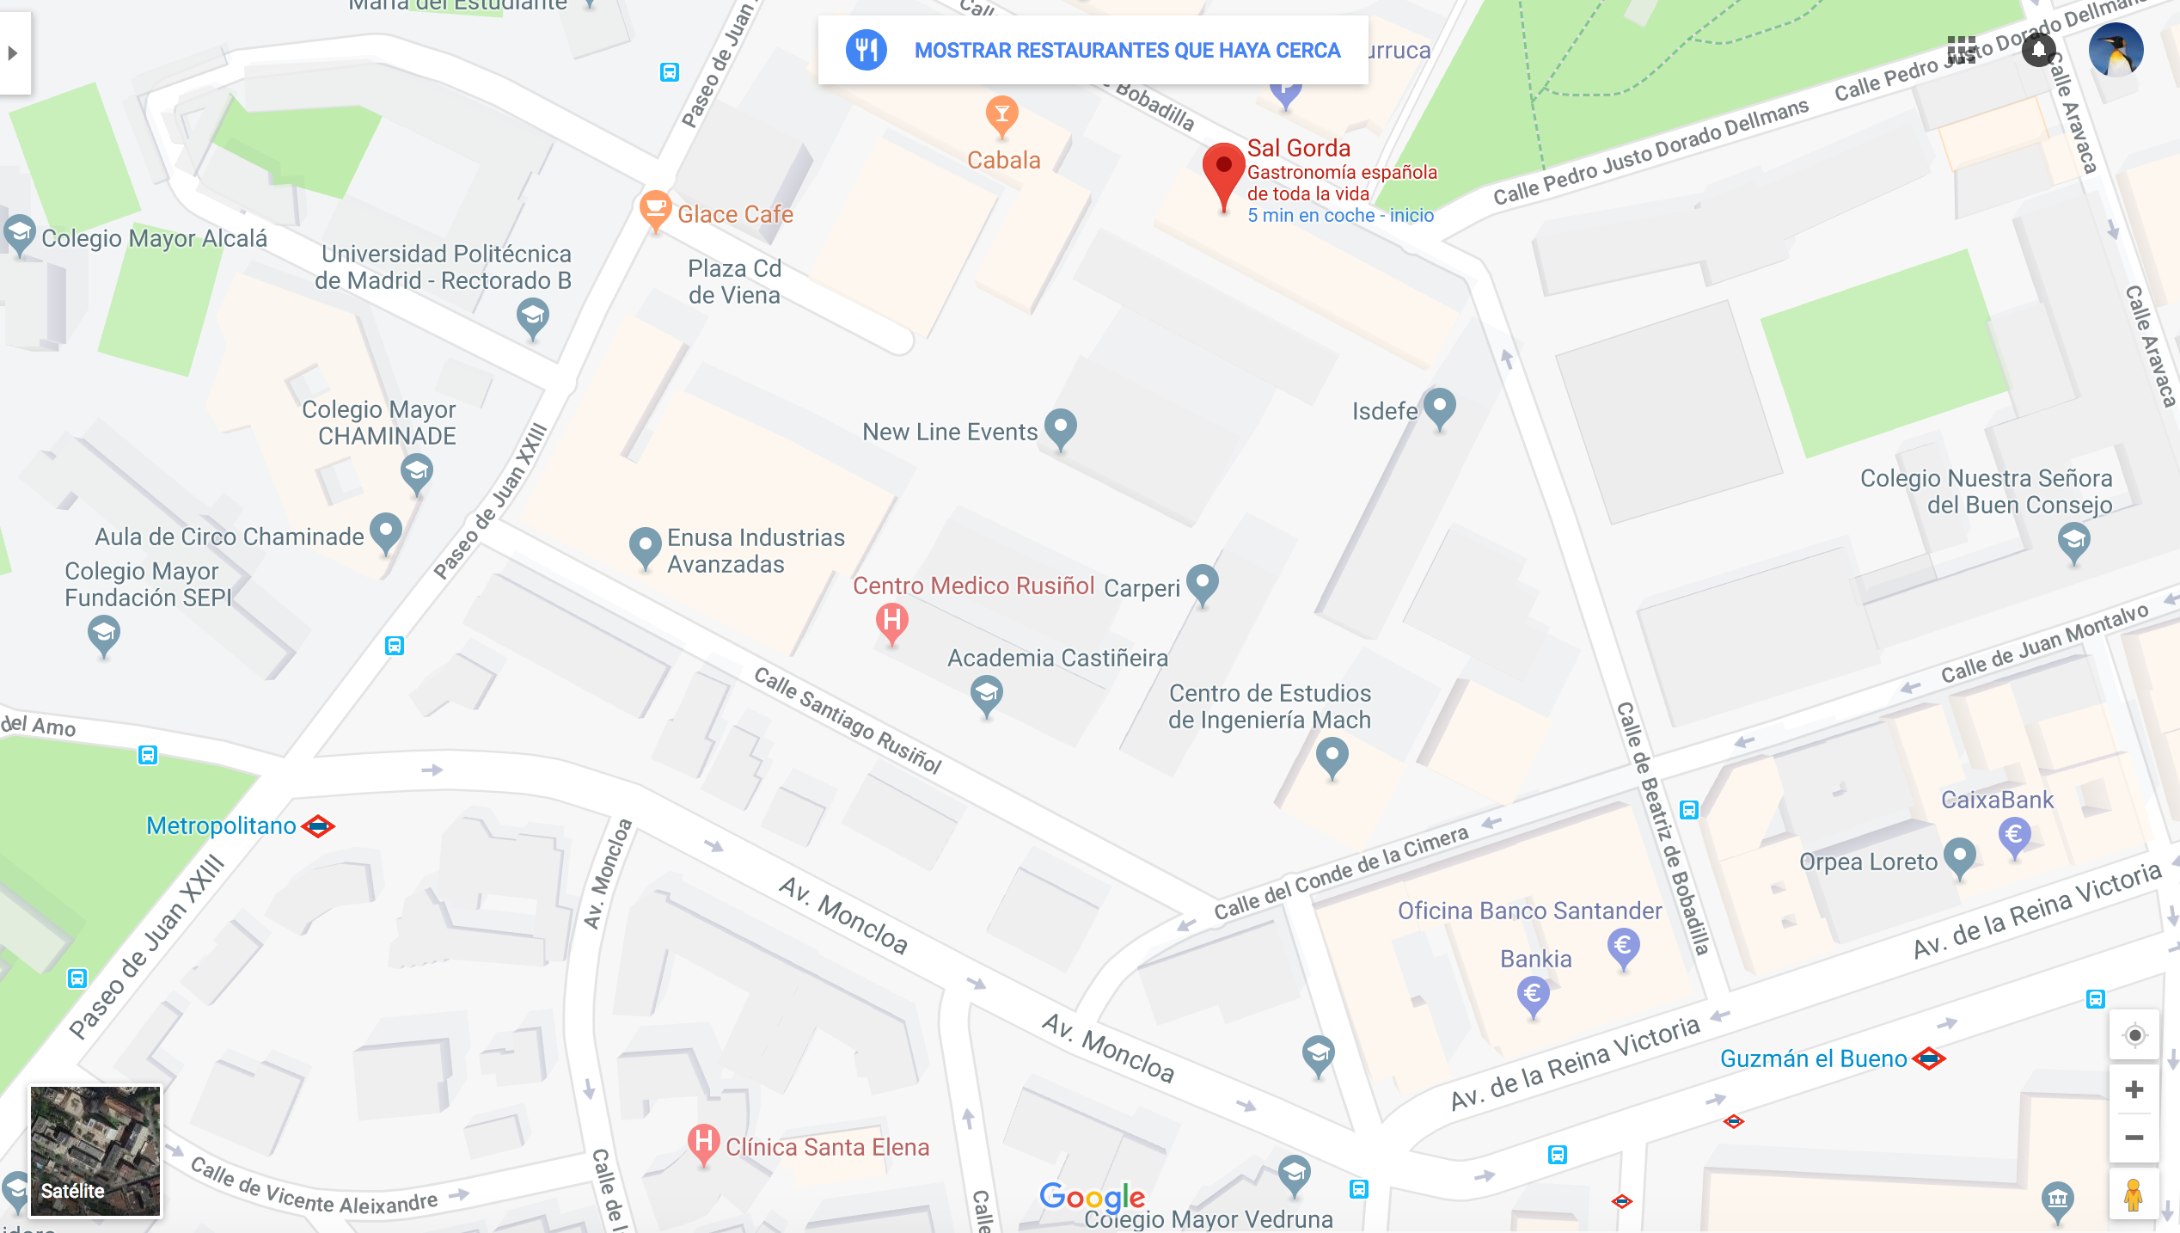

Slide 5
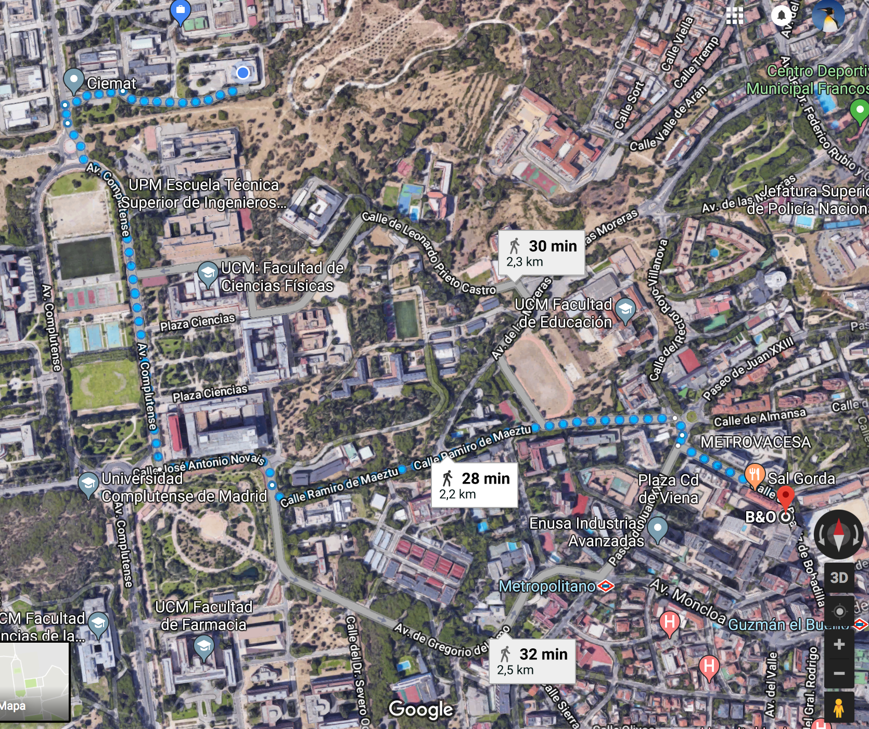

Slide 6
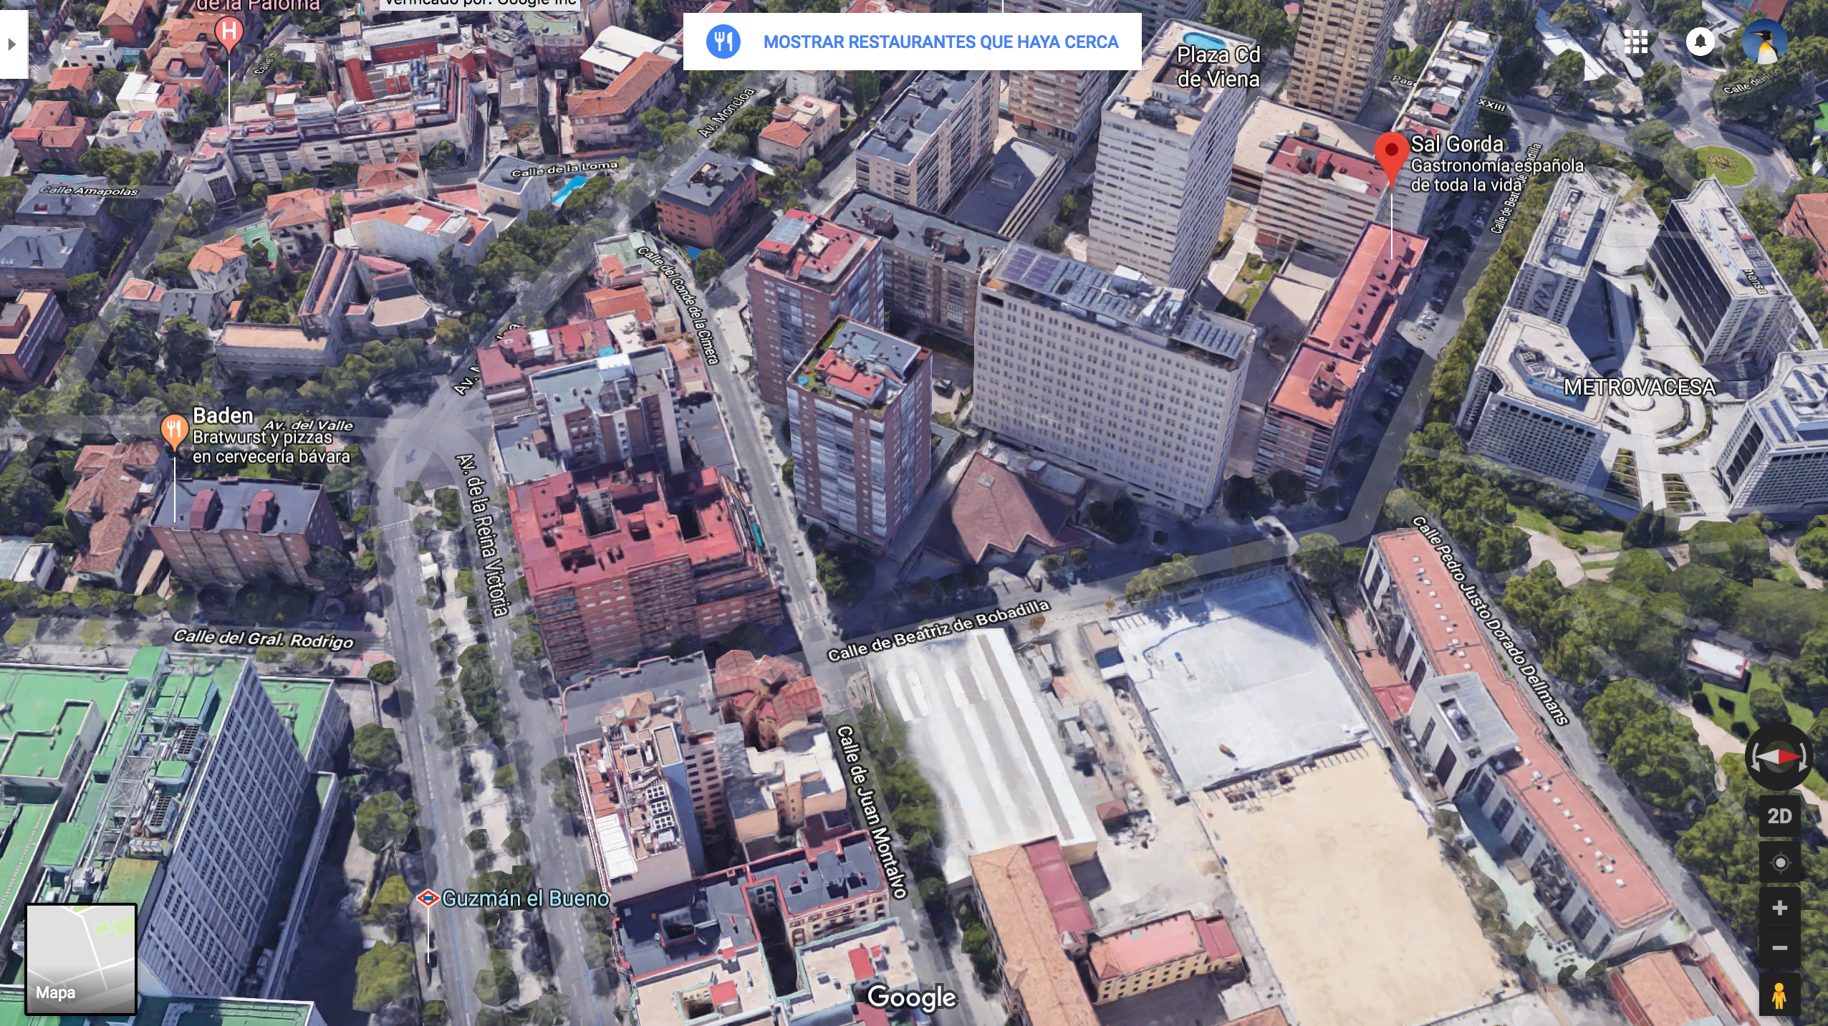

Slide 7
