Slide 1
A hybrid method calculating linear energy transfer for intensity modulated proton therapy
J. Lentz, X. Ding, M. Bues, W. Liu
ENSAR2 workshop: GEANT4 in nuclear physics
24 April 2019 – 26 April 2019 – CIEMAT Madrid, Spain

Slide 2
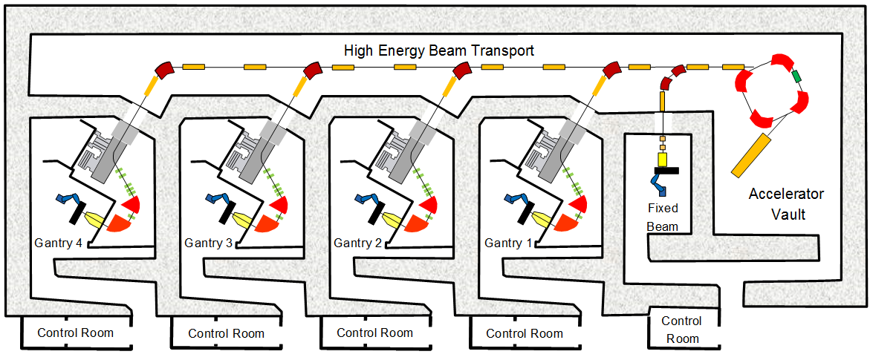
Facility Layout
G4
G3
G2
G1
Synchotron

Slide 3
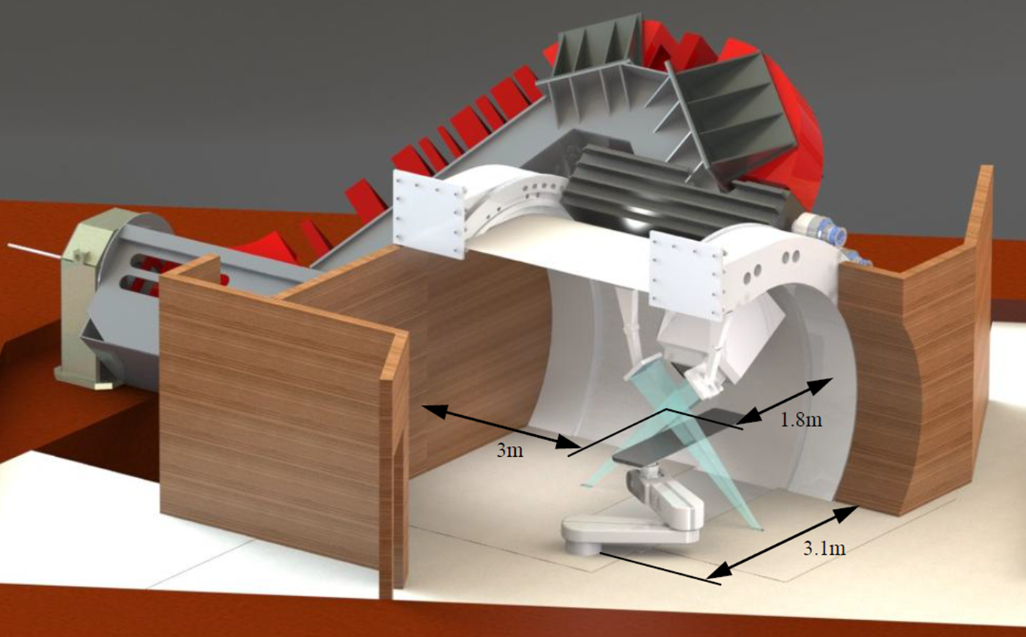
Treatment Room

Slide 4
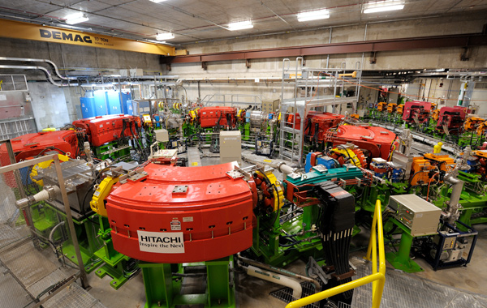
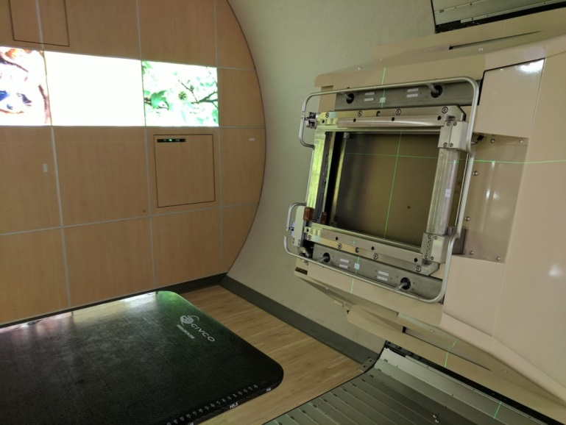
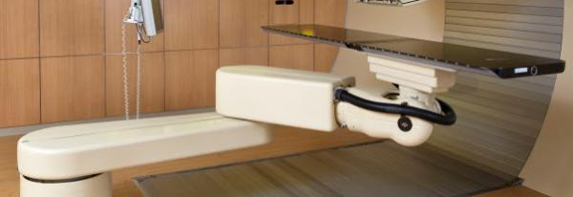
Daniel Robertson

Slide 5
Pencil Beam Scanning
Layer by layer (energy switching)
Spot by spot (magnetic deflection)

Slide 6
Linear Energy Transfer (LET) calculation
LET is one of the important factors in determining the biological effects of proton radiation therapy
No commercial Treatment Planning System (TPS) offers an LET calculation
We developed a hybrid method to calculate LET distributions in real patient geometries
The hybrid method was implemented in our in-house TPS and has been in routine clinical use for 2 years

Slide 7
Hybrid method to calculate LET
Developed a Geant4 MC code to model the proton therapy nozzle
Generated the LET kernels by the MC code
Incorporated the kernels into our in-house treatment planning system

Slide 8
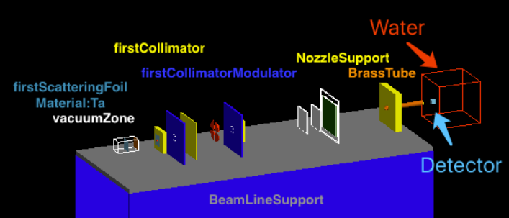
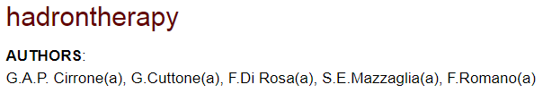
Developed a Geant4 MC code
Started from an example (hadrontherapy) from the Geant4 example set
Wrote the geometry (proton nozzle) based on the vendor’s documentation
Default physics model QGSF_BIC_EMY
Parameterized proton source (energy, momentum, position) to match measurement
Validated the MC code by measurement (IDD, profile, and FSF)

Slide 9
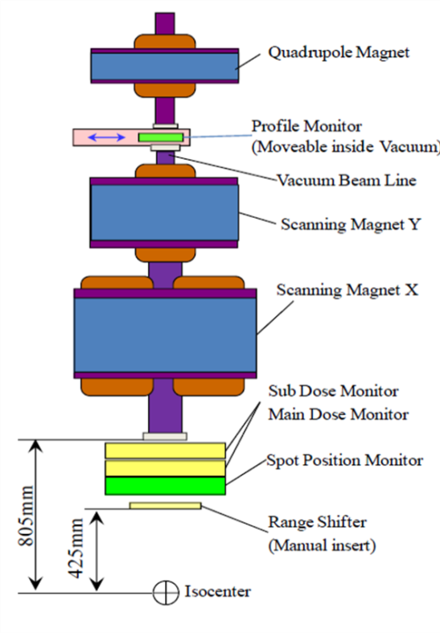
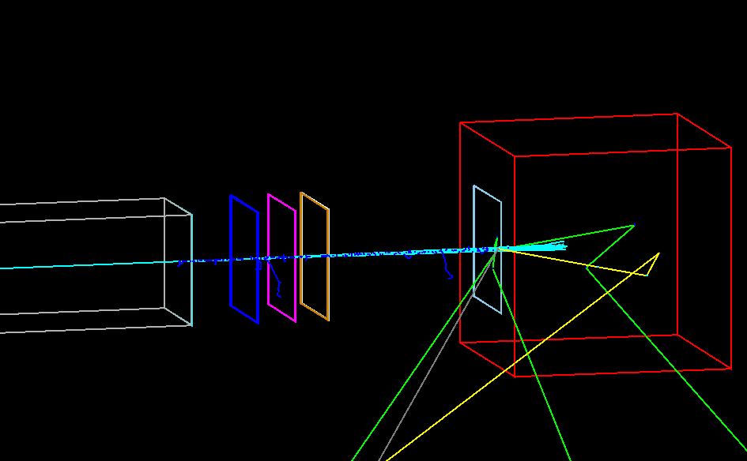
Mayo Clinic proton nozzle
[1] G.A. Pablo Cirrone, Giacomo Currone, Franceso Di Rosa, Santi E. Mazzaglia, Francesco Romano, Andrea Attili, Faiza
Bourhaleb, Germano Russo, Pekka Kataniemi, Aatos Heikkinen, Flavio Marchetto and Shin Jungwook. Hadrontherapy:
An open source, Geant4-based application for proton-ion therapy studies, 2009 IEEE nuclear Science Symposium Conference
Record

Slide 10
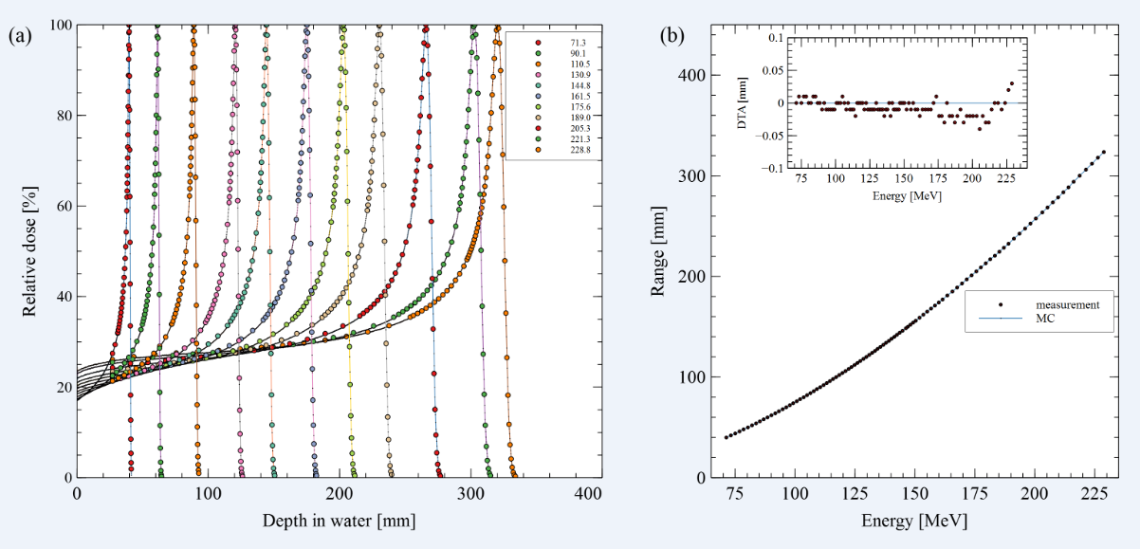
Validation by measurement:
(1) IDD comparison

Slide 11
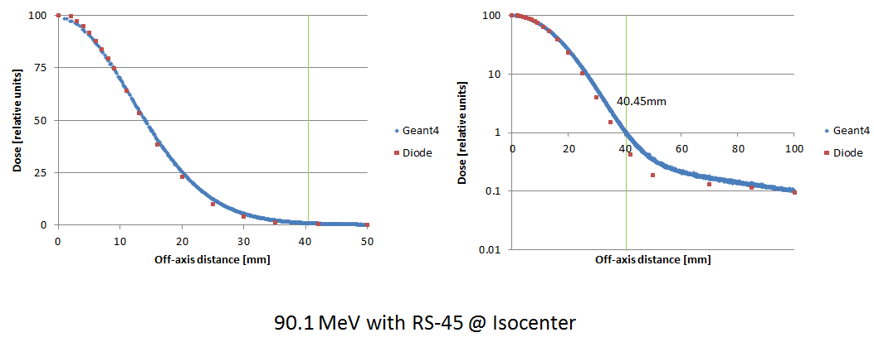
Validation by measurement:
(2) In-air profile comparison

Slide 12
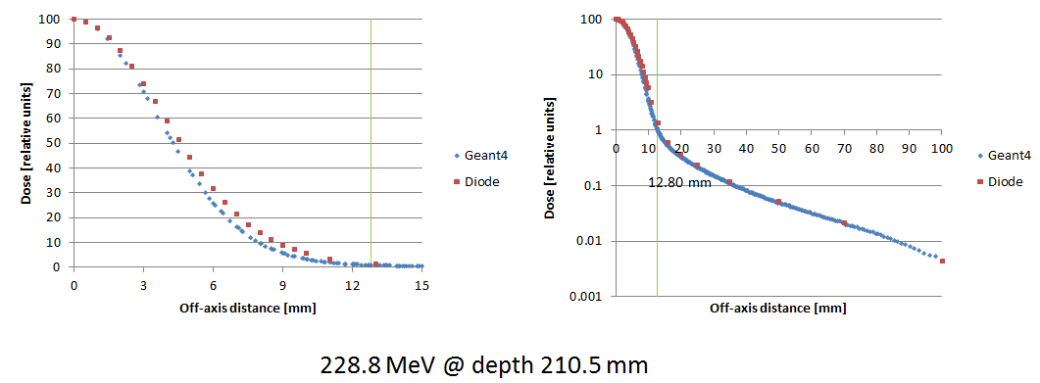
Validation by measurement:
(3) In-water profile comparison

Slide 13
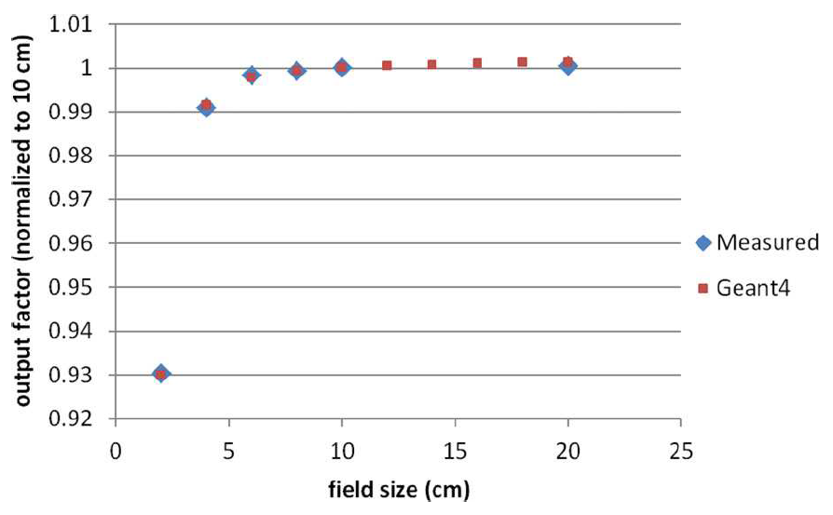
Validation by measurement:
(4) FSF comparison

Slide 14
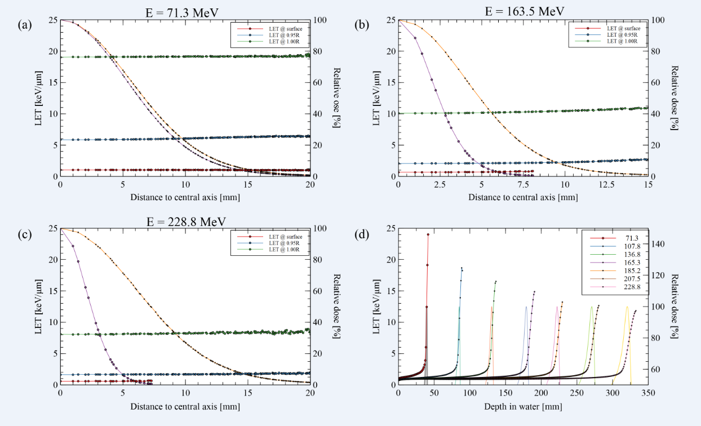

Generation of LET kernels (${LET}_{d}$)

Slide 15
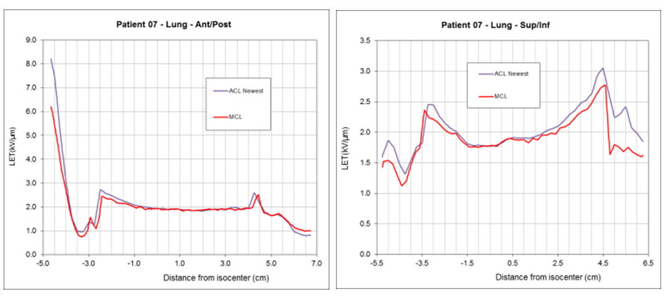
Comparison between hybrid and MC:
(1) Two lateral profiles through a lung tumor

Slide 16
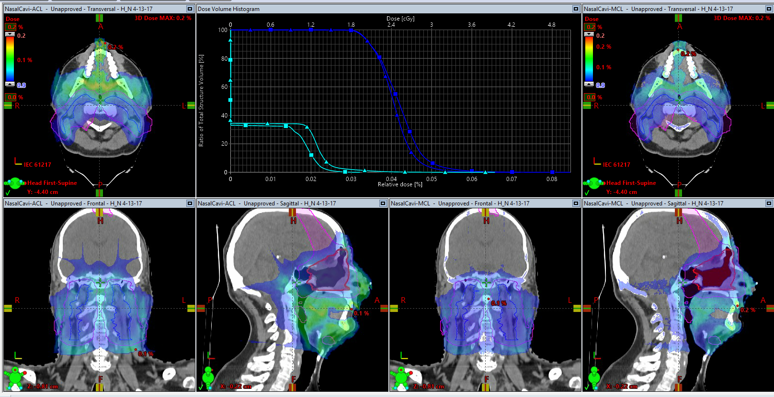
Comparison between hybrid and MC:
(2) LET deposition and LET-volume histograms for a H-N case

Slide 17
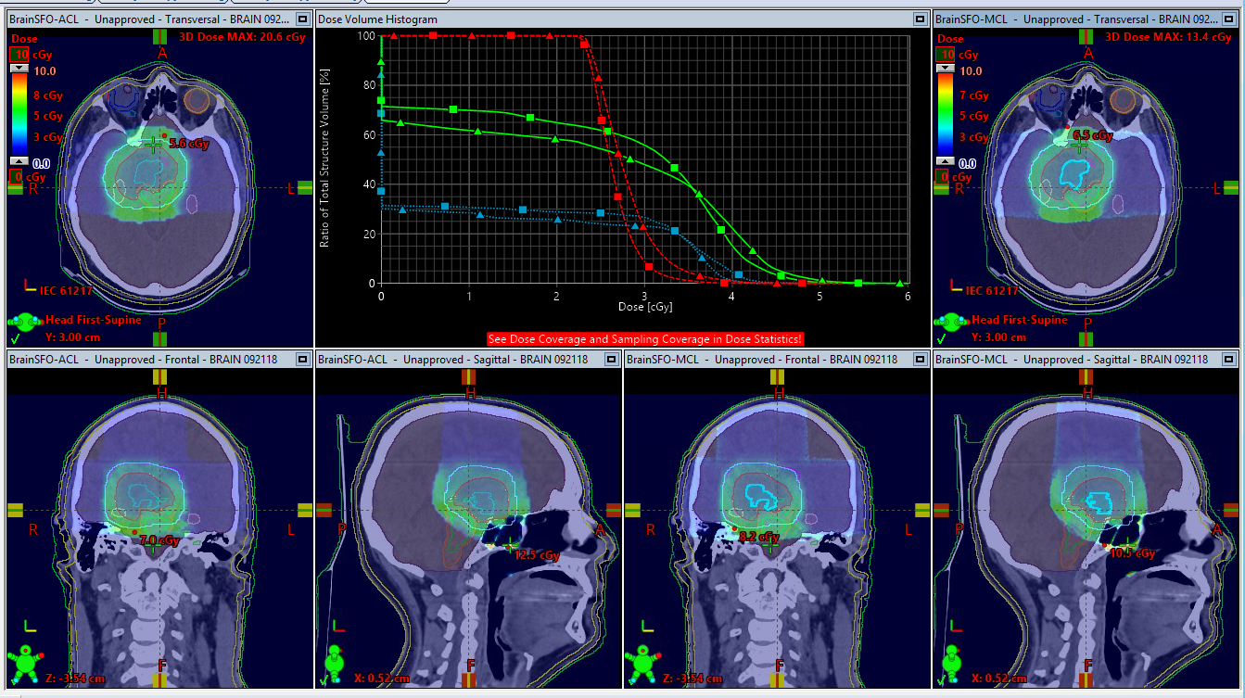
Comparison between hybrid and MC:
(3) LET deposition and LET-volume histograms for a Brain case

Slide 18
Conclusions
Geant4 MC code can be used to calculate LET data for proton radiation therapy
The hybrid method can be used to calculate LET distribution for real patient geometry accurately and efficiently

Slide 19
Questions & Discussion

