Slide 1
Adaptation of GEANT-4 to Criticality Calculations for Nuclear Reactors
ENSAR2 workshop: GEANT4 in nuclear physics 2018
Adriaan Buijs
McMaster University, Hamilton, Canada
Liam Russell, Wesley Ford (MASc)
Guy Jonkmans (AECL, DRDC)

Slide 2
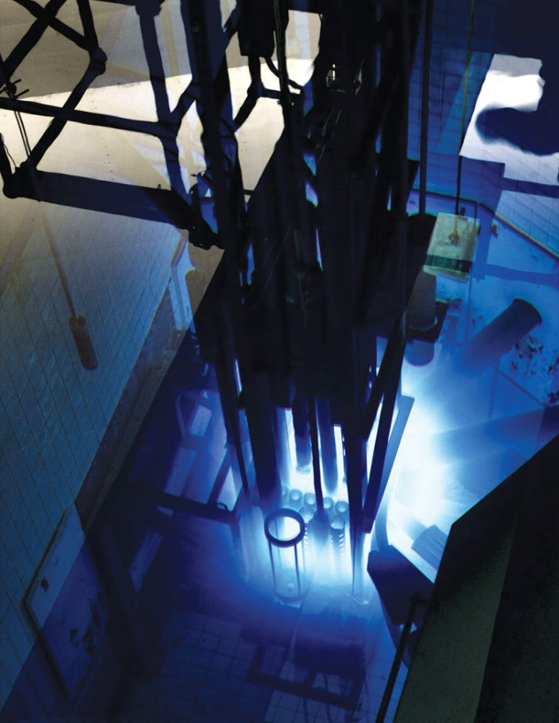
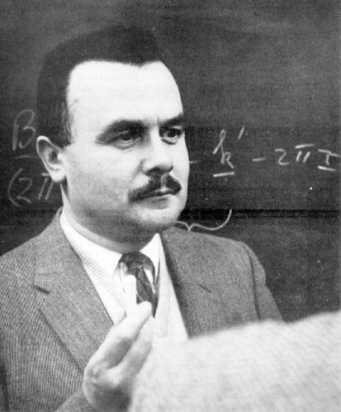
The Stage: McMaster
McMaster Nuclear Reactor Critical April 1959
(First RR at a Commonwealth University) (CERN:1952)
Bertram Brockhouse shared the 1994 Nobel Prize in Physics with American Clifford Shull for developing neutron scattering techniques for studying condensed matter.
Today: McMaster Research Funding about $400M – one of Canada’s most research intensive Universities
MNR:
Intense positron beam
Small-angle neutron scattering
Neutron activation analysis
Neutron radiography
MNR: Commercial production of radio-isotopes for medical purposes
(I-125, Lu-177, Re-186, …)
Accelerators (F-18), Hot cells, Sources.
https://nuclear.mcmaster.ca/

Slide 3
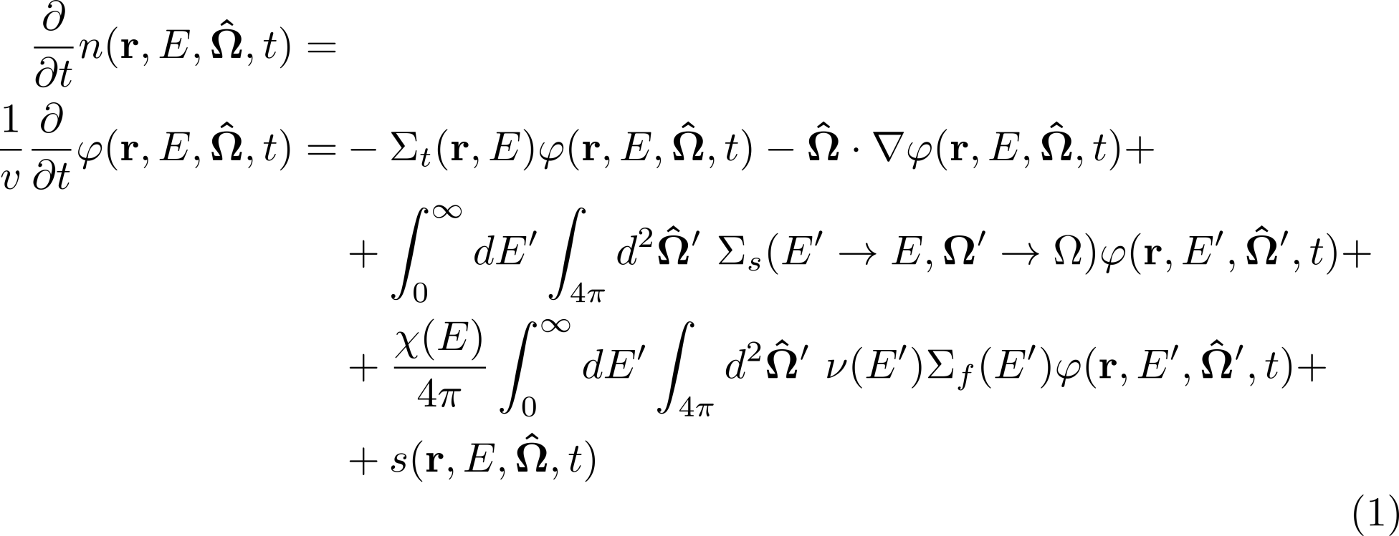
Analyzing Nuclear Reactors
Neutron transport equation describes the behaviour of neutrons in a reactor:
Total Absorption
Streaming
Scattering
Fission
External
source

Slide 4
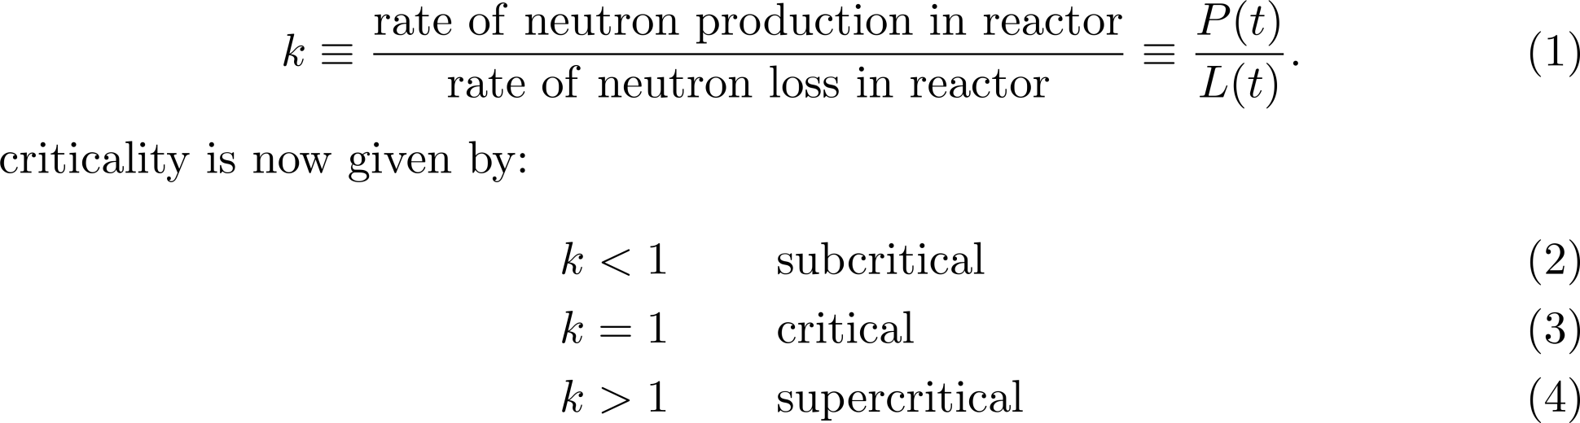
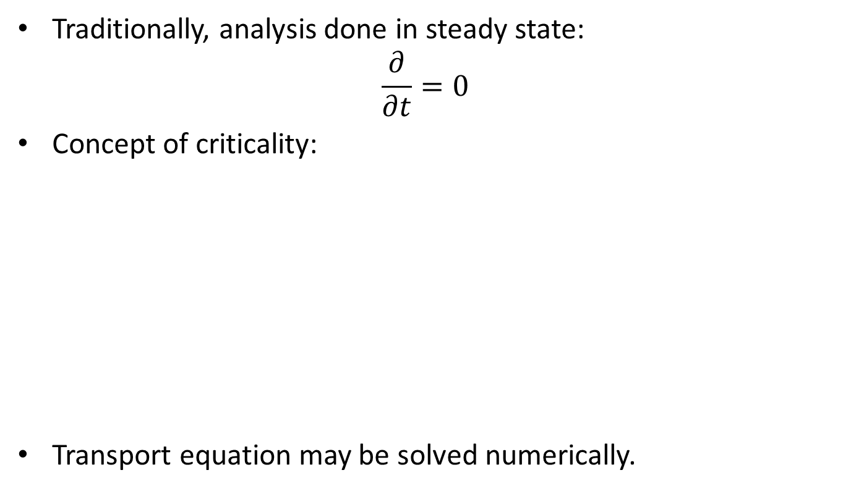
Steady State
Traditionally, analysis done in steady state:
$$\frac{∂}{∂t}=0$$
Concept of criticality:
Transport equation may be solved numerically.

Slide 5
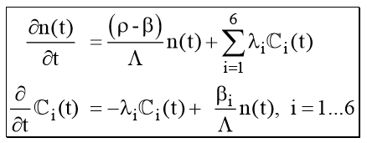
Kinetics
Dynamic changes in the reactor core are usually dealt with by Point Kinetics:
  Flux shape remains the same.
  Overall flux (neutron density) changes with time
  Reactors only work because of delayed neutrons!
β: delayed fraction
ρ: reactivity (1-1/k)
λ :decay constant
Λ: neutron generation
time

Slide 6
Numerical Methods
Direct solution of the transport equation;
  Through a variety of techniques.
  (WIMS, NEWT, DRAGON)
  Very time consuming, small geometries only (lattice cell)
  Accurate
Diffusion calculation;
  (NESTLE, PARCS, DONJON)
  Quick, but not always accurate
Monte Carlo techniques;
  (MCNP, KENO, SERPENT, OPENMC, SUPERMC)
  Very accurate, but slow
Common to all methods: need for nuclear data libraries

Slide 7
Monte Carlo
Follow neutrons (protons, electrons, gammas) through the geometry (core)
Submit them to physics:
  Scattering (elastic, inelastic)
  Absorption (n,gamma) → energy deposition
  Fission: creation of new neutrons
Account for material properties:
  Density
  Temperature (Doppler broadening of resonances)
  Population control (combing)
Accuracy determined by statistics

Slide 8
Monte Carlo Codes
Examples:
  Standard code is MCNP (developed originally for highly super-critical devices.)
  KENO (part of the SCALE package)
  SERPENT (European code)
Features:
  Need licence (half of your students can’t use half of these codes)
  Provided as executables only.
  Models are entered by input cards;

Slide 9
MCNP
KCODE calculation:
  Start with neutron source distribution (r,v)
  If absorbed by fissile material, create ν new source neutrons as result of fission.
  Follow neutrons until all have absorbed
  Obtain k_{eff} by new/old number of neutrons.
  Renormalize source (combing)
  Goto 1.
Variance reduction techniques (weighting)
Generation-based calculation:
no concept of time! (shakes)

Slide 10
Geant4 (G4-STORK)
No licence required
Hard-code the model
  Very detailed geometry
  Allows to change the geometry “on the fly”
  Allows for temperature change (feedback)
  On-the-fly Doppler broadening
  Many physics models
Simulation accounts for time!
Population control still needed
Need to think about k_{eff}.

Slide 11
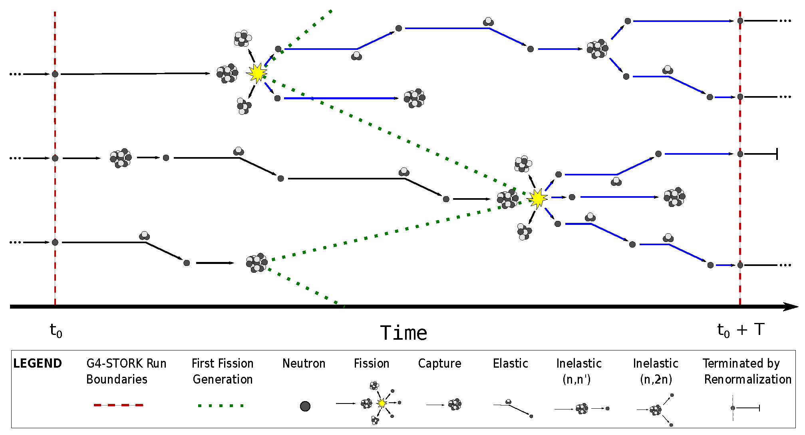
Show and Tell

Slide 12
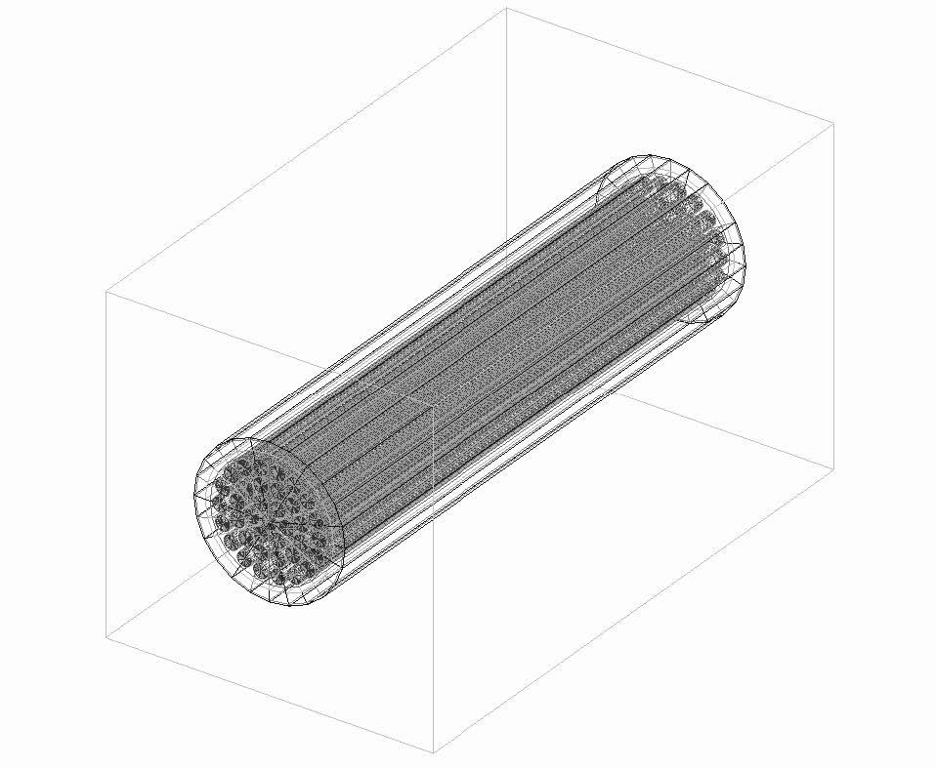
Benchmarking with
Transport Code
Test of flux distribution
Use CANDU reactor fuel bundle.
Fresh fuel (only U in the libraries)

Slide 13
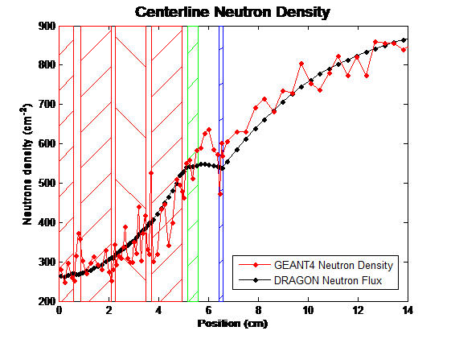
Compare to DRAGON

Slide 14
Simple Comparison to MCNP
Mono-chromatic beam on a U-235 slab.
Beam E = 0.0253 eV

Slide 15
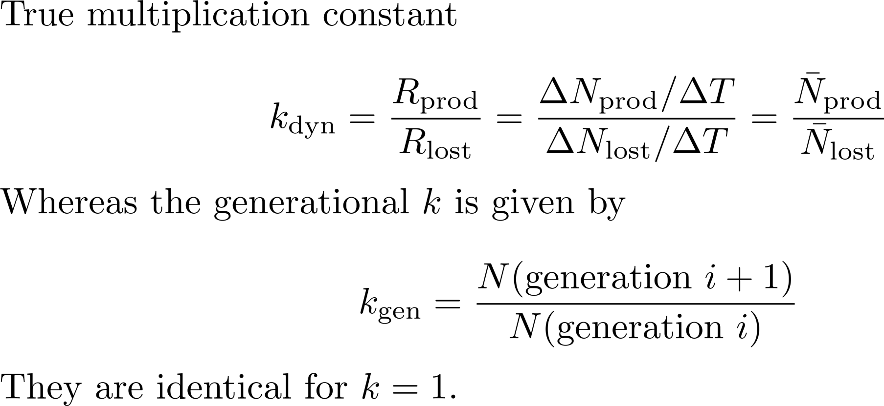
k_{eff}

Slide 16
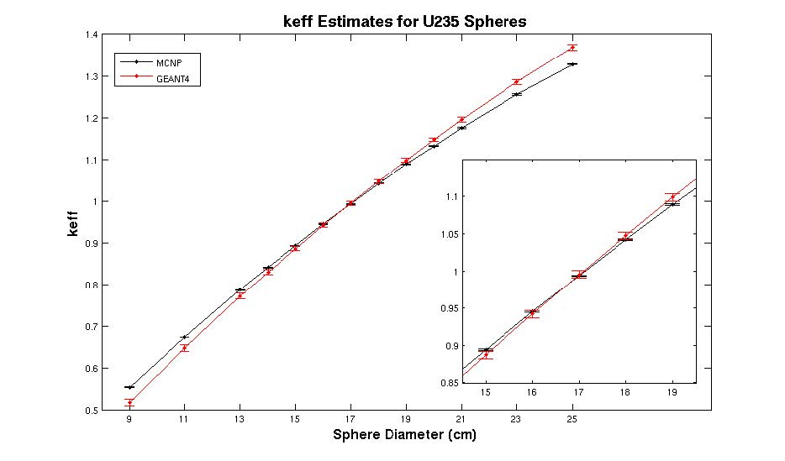
k_{eff}
Converged source (Shannon Entropy)

Slide 17
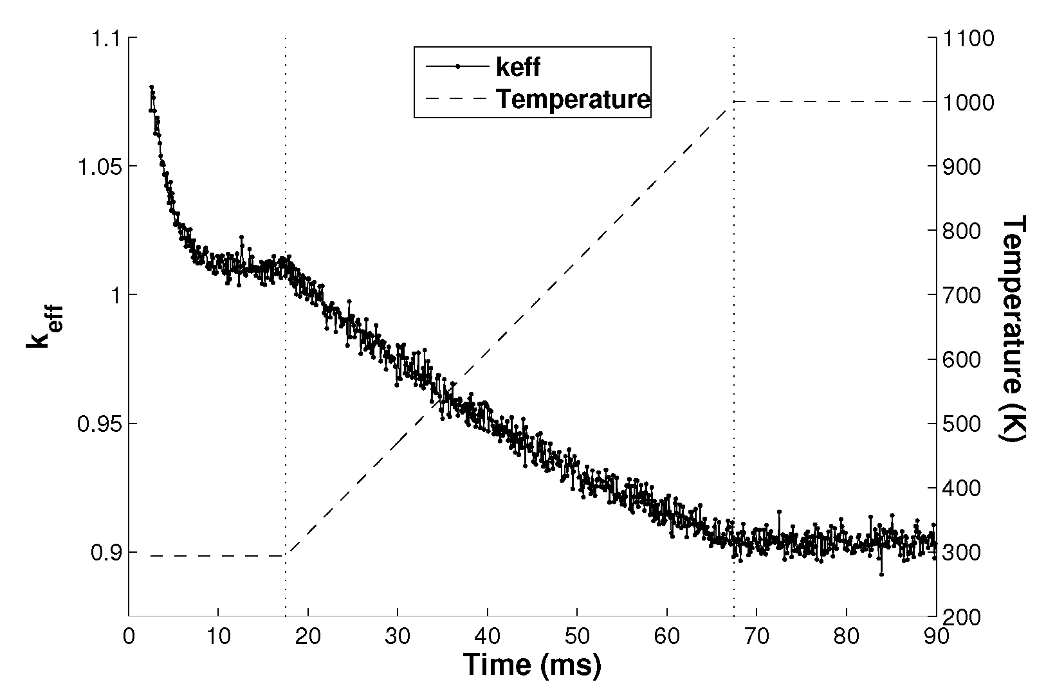
Time Evolution

Slide 18
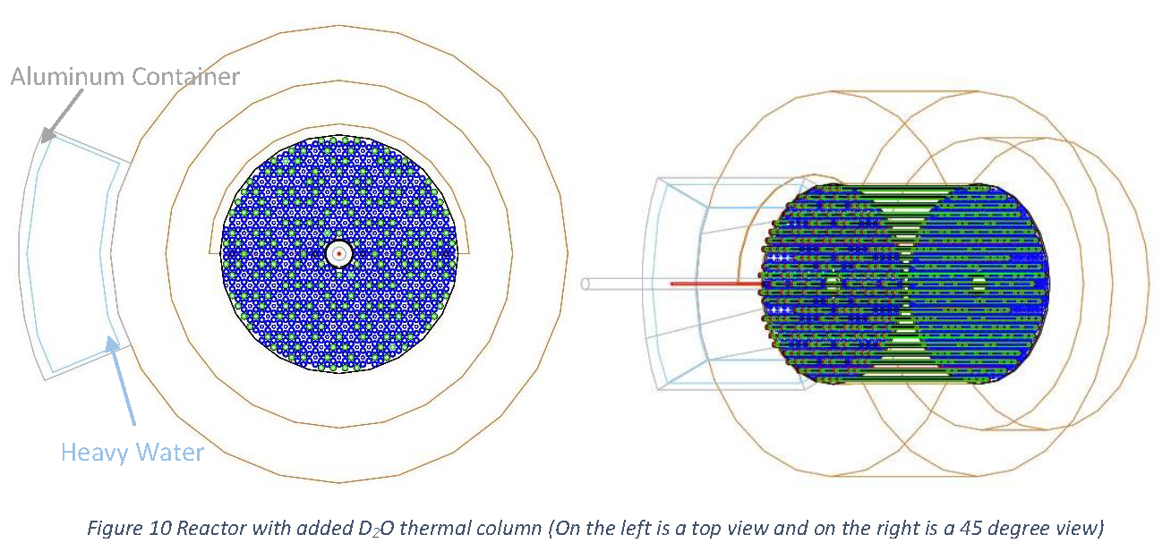
Validation with Reactor
SLOWPOKE

Slide 19
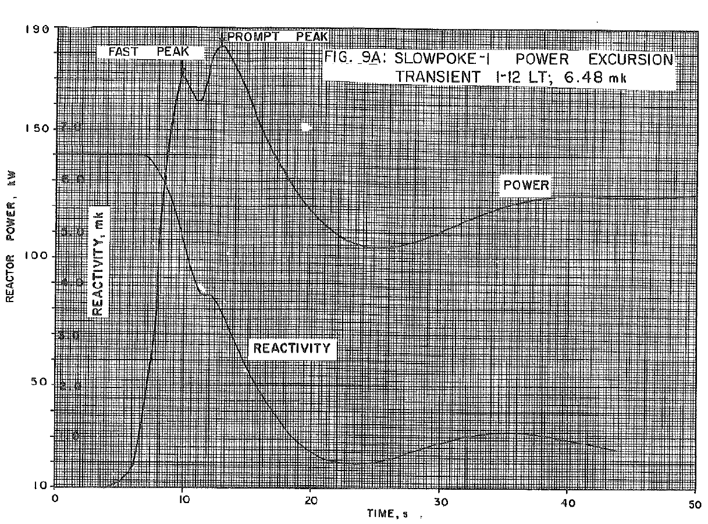
Transient

Slide 20
Delayed Neutrons
From delayed precursors (fission products)
Do not identify precursors, rather combine them in groups
Establish equilibrium concentration
Determine decay time.
Need to do population control as well

Slide 21
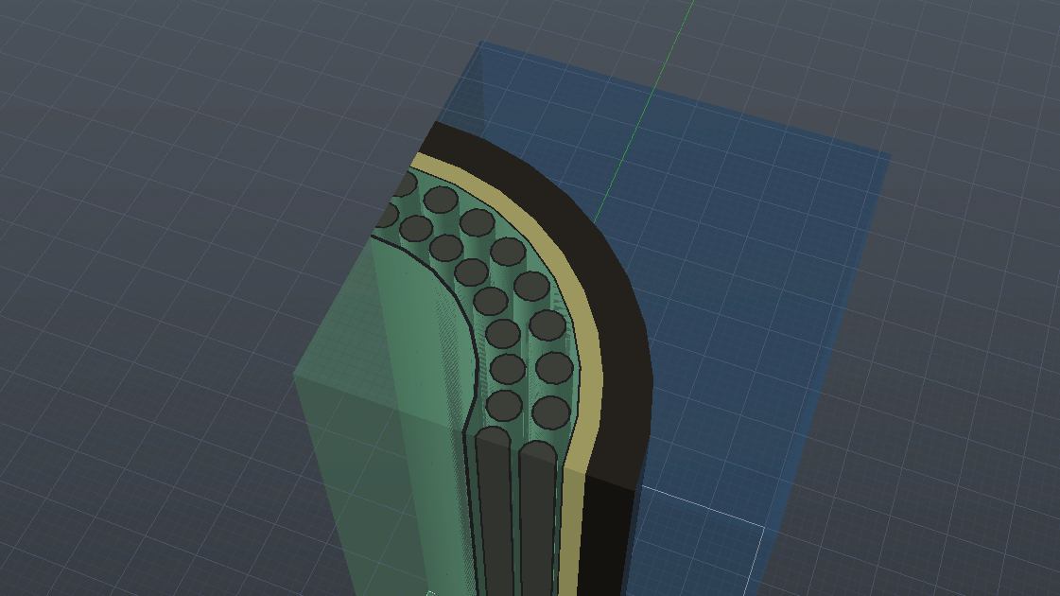
Detailed Benchmark with MCNP
Case: Super-critical water reactor
Crucial parameter: coolant void reactivity

Slide 22
G4-STORK-MCNP for SCWR
MCNP6.1 Settings:
Same as G4-STORK
Using thermal scattering
Using implicit absorption
Using unresolved resonance regime model
K_{inf} Cases | Fully Cooled | Void Inner Coolant | Void Outer Coolant | Void all Coolant | CVR (mk)
G4STORK | 1.253 ± 0.003 | 1.206 ± 0.001 | 1.258 ±0.003 | 1.215 ± 0.002 | -25.0±1.1
MCNP6.1 | 1.286 ± 0.0001 | 1.249 ± 0.0003 | 1.298 ± 0.0003 | 1.266 ± 0.0002 | -12.09±0.07

Slide 23
Apples-to-Apples
K_{inf} Cases | Fully Cooled | Void inner Coolant | Void Outer Coolant | Void all Coolant | CVR (mk)
G4-STORK | 1.2978±0.0007 | 1.2499±0.0007 | 1.3057±0.0008 | 1.2639±0.0006 | -20.7±0.61
MCNP 6.1 | 1.2979±0.0002 | 1.2562±0.0003 | 1.3085±0.0002 | 1.2708±0.0002 | -16.4±0.17
The generational criticality method has been implemented in G4-STORK;
in MCNP
  the thermal scattering data,
  unresolved resonance, and
  implicit capture models
  were turned off.

Slide 24
Summary
GEANT4 can be used to simulate
“neutron-multiplying systems”
Well-suited for transient calculations
Very much limited by speed.
Requests:
  General speed-up of the code, but especially
  Improve on-the-fly Doppler algorithm
  Provide the tool to create G4NDL

