Slide 1
Scoring Functionalities
Makoto Asai (SLAC)
ENSAR2 workshop: GEANT4 in nuclear physics
April 25, 2019

Slide 2
Contents
Introduction to sensitivity
Command-based scoring
Add a new scorer/filter
Define scorers in the tracking volume
Accumulate scores for a run
Sensitive detector vs. primitive scorer
Basic structure of detector sensitivity
Sensitive detector and hit
Touchable

Slide 3
Retrieving information from Geant4

Slide 4
Extract useful information
Given geometry, physics and primary track generation, Geant4 does proper physics simulation “silently”.
  You have to do something to extract information useful to you.
There are three ways:
  Built-in scoring commands
    Most commonly-used physics quantities are available.
  Use scorers in the tracking volume
    Create scores for each event
    Create own Run class to accumulate scores
  Assign G4VSensitiveDetector to a volume to generate “hit”.
    Use user hooks (G4UserEventAction, G4UserRunAction) to get event / run summary
You may also use user hooks (G4UserTrackingAction, G4UserSteppingAction, etc.)
  You have full access to almost all information
  Straight-forward, but do-it-yourself

Slide 5
Command-based scoring

Slide 6
Command-based scoring
Command-based scoring functionality offers the built-in scoring mesh and various scorers for commonly-used physics quantities such as dose, flux, etc.
  Due to small performance overhead, it does not come by default.
To use this functionality, access to the G4ScoringManager pointer after the instantiation of G4(MT)RunManager in your main().
  #include “G4ScoringManager.hh”
  int main()
  {
  G4RunManager* runManager = new G4MTRunManager;
  G4ScoringManager* scoringManager =
  G4ScoringManager::GetScoringManager();
  …
All of the UI commands of this functionality are in /score/ directory.
/examples/extended/runAndEvent/RE03

Slide 7
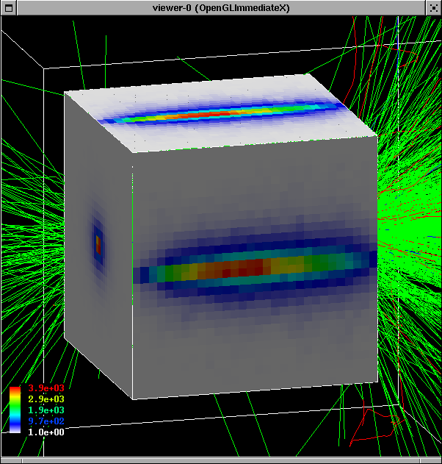
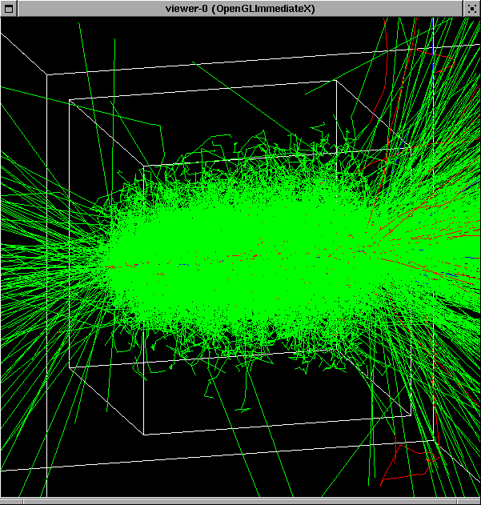
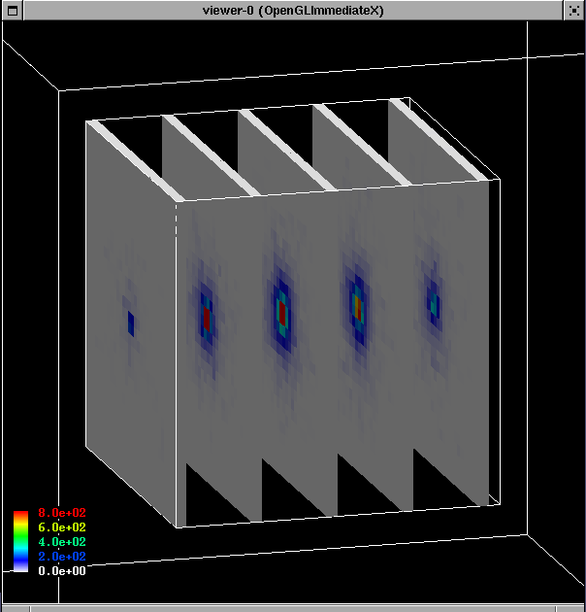
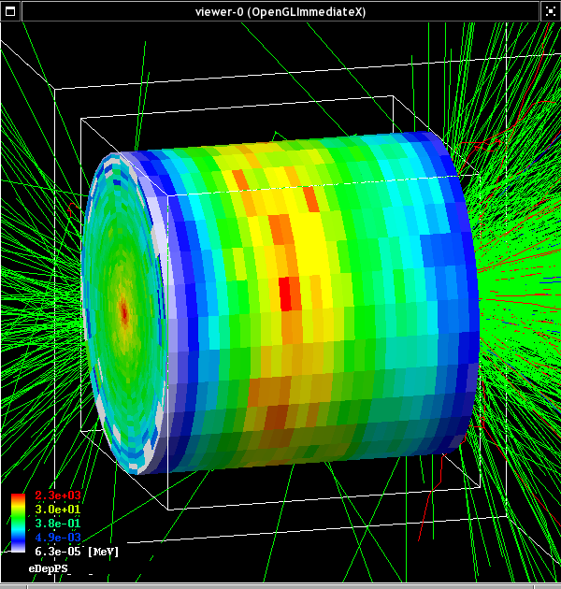
Command-based scorers

Slide 8
Define a scoring mesh
To define a scoring mesh, the user has to specify the followings.
  Shape and name of the 3D scoring mesh.
    Currently, box and cylinder are available.
  Size of the scoring mesh.
    Mesh size must be specified as "half width" similar to the arguments of G4Box / G4Tubs.
  Number of bins for each axes.
    Note that too many bins causes immense memory consumption.
  Specify position and rotation of the mesh.
    If not specified, the mesh is positioned at the center of the world volume without rotation.
    # define scoring mesh
    /score/create/boxMesh boxMesh_1
    /score/mesh/boxSize 100. 100. 100. cm
    /score/mesh/nBin 30 30 30
    /score/mesh/translate/xyz 0. 0. 100. cm
The mesh geometry can be completely independent to the real material geometry.

Slide 9
Scoring quantities
A mesh may have arbitrary number of scorers. Each scorer scores one physics quantity.
  energyDeposit * Energy deposit scorer.
  cellCharge * Cell charge scorer.
  cellFlux * Cell flux scorer.
  passageCellFlux * Passage cell flux scorer
  doseDeposit * Dose deposit scorer.
  nOfStep * Number of step scorer.
  nOfSecondary * Number of secondary scorer.
  trackLength * Track length scorer.
  passageCellCurrent * Passage cell current scorer.
  passageTrackLength * Passage track length scorer.
  flatSurfaceCurrent * Flat surface current Scorer.
  flatSurfaceFlux * Flat surface flux scorer.
  nOfCollision * Number of collision scorer.
  population * Population scorer.
  nOfTrack * Number of track scorer.
  nOfTerminatedTrack * Number of terminated tracks scorer.
/score/quantity/xxxxx <scorer_name> <unit>

Slide 10
List of provided primitive scorers
Concrete Primitive Scorers ( See Application Developers Guide 4.4.6 )
  Track length
    G4PSTrackLength, G4PSPassageTrackLength
  Deposited energy
    G4PSEnergyDepsit, G4PSDoseDeposit, G4PSChargeDeposit
  Current/Flux
    G4PSFlatSurfaceCurrent, G4PSSphereSurfaceCurrent,G4PSPassageCurrent, G4PSFlatSurfaceFlux, G4PSCellFlux, G4PSPassageCellFlux
  Others
    G4PSMinKinEAtGeneration, G4PSNofSecondary, G4PSNofStep
SurfaceFlux :
  Sum up 1/cos(angle) of injecting particles
  at defined surface
CellFlux :
  Sum of L / V of injecting particles
  in the geometrical cell.
SurfaceCurrent :
  Count number of
  injecting particles
  at defined surface.
angle
L : Total step length in the cell.
V : Volume

Slide 11
Filter
Each scorer may take a filter.
  charged * Charged particle filter.
  neutral * Neutral particle filter.
  kineticEnergy * Kinetic energy filter.
    /score/filter/kineticEnergy <fname> <eLow> <eHigh> <unit>
  particle * Particle filter.
    /score/filter/particle <fname> <p1> … <pn>
  particleWithKineticEnergy * Particle with kinetic energy filter.
        /score/filter/ParticleWithKineticEnergy
        <fname> <eLow> <eHigh> <unit> <p1> … <pn>
    /score/quantity/energyDeposit eDep MeV
    /score/quantity/nOfStep nOfStepGamma
    /score/filter/particle gammaFilter gamma
    /score/quantity/nOfStep nOfStepEMinus
    /score/filter/particle eMinusFilter e-
    /score/quantity/nOfStep nOfStepEPlus
    /score/filter/particle ePlusFilter e+
    /score/close
Same primitive scorers with different filters may be defined.
Close the mesh when defining scorers is done.

Slide 12
Drawing a score
Projection
  /score/drawProjection <mesh_name> <scorer_name> <color_map>
Slice
  /score/drawColumn <mesh_name> <scorer_name> <plane> <column> <color_map>
Color map
  By default, linear and log-scale color maps are available.
  Minimum and maximum values can be defined by /score/colorMap/setMinMax command. Otherwise, min and max values are taken from the current score.

Slide 13
Write scores to a file
Single score
  /score/dumpQuantityToFile <mesh_name> <scorer_name> <file_name>
All scores
  /score/dumpAllQuantitiesToFile <mesh_name> <file_name>
By default, values are written in CSV.
By creating a concrete class derived from G4VScoreWriter base class, the user can define his own file format.
  Example in /examples/extended/runAndEvent/RE03
  User’s score writer class should be registered to G4ScoringManager.

Slide 14
Energy spectrum?
One of most frequently asked questions is “How to get energy spectrum?”.
Create arbitrary number of flux scorers of same kind combined with particle and kinetic energy filters.
  /score/quantity/flatSurfaceFlux flux0
  /score/filter/particleWithKineticEnergy range0 10. 20. MeV e-
  /score/quantity/flatSurfaceFlux flux1
  /score/filter/particleWithKineticEnergy range1 20. 30. MeV e-
  /score/quantity/flatSurfaceFlux flux2
  /score/filter/particleWithKineticEnergy range2 30. 40. MeV e-
  /score/quantity/flatSurfaceFlux flux3
  /score/filter/particleWithKineticEnergy range3 40. 50. MeV e-

Slide 15
Alias
Alias can be defined by
  /control/alias [name] [value]
  It is also set with /control/loop and /control/foreach commands
  Aliased value is always treated as a string even if it contains numbers only.
Alias is to be used with other UI command.
  Use curly brackets, { and }.
  For example, frequently used lengthy command can be shortened by aliasing.
  /control/alias tv /tracking/verbose
  {tv} 1
  Aliases can be used recursively.
  /control/alias file1 /diskA/dirX/fileXX.dat
  /control/alias file2 /diskB/dirY/fileYY.dat
  /control/alias run 1
  /myCmd/getFile {file{run}}

Slide 16
Loop
/control/loop and /control/foreach commands execute a macro file more than once. Aliased variable name can be used inside the macro file.
/control/loop [macroFile] [counterName]
[initialValue] [finalValue] [stepSize]
  counterName is aliased to the number as a loop counter
/control/foreach [macroFile] [counterName] [valueList]
  counterName is aliased to a value in valueList
  valueList must be enclosed by double quotes (" ")
on UI terminal or other macro file
  /control/loop myRun.mac Ekin 10. 20. 2.
in myRun.mac
  /control/foreach mySingleRun.mac pname “p pi- mu-”
in mySingleRun.mac
  /gun/particle {pname}
  /gun/energy {Ekin} GeV
  /run/beamOn 100
Note: Simple math functions are also available
  E.g. /control/add y {x} 2. ⬅ y = x + 2.

Slide 17
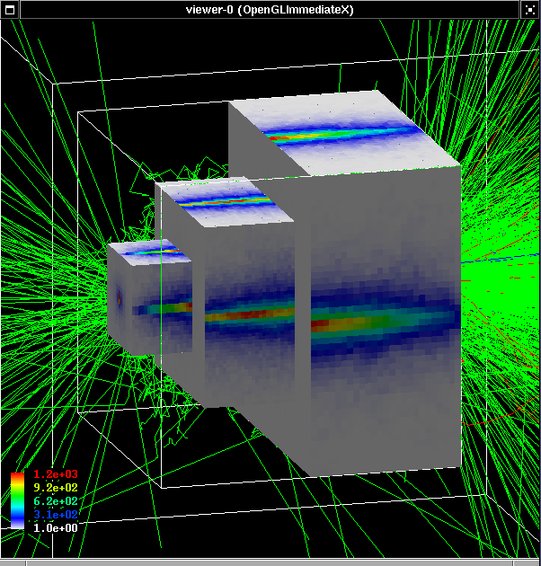
More than one scoring meshes
You may define more than one scoring mesh.
  And, you may define arbitrary number of primitive scorers to each scoring mesh.
Mesh volumes may overlap with other meshes and/or with mass geometry.
A step is limited on any boundary.
Please be cautious of too many meshes, too granular meshes and/or too many primitive scorers.
  Memory consumption
  Computing speed

Slide 18
Add a new scorer/filter to command-based scorers

Slide 19
Scorer base class
G4VPrimitiveScorer is the abstract base of all scorer classes.
To make your own scorer you have to implement at least:
  Constructor
  Initialize()
    Initialize G4THitsMap<G4double> map object
  ProcessHits()
    Get the physics quantity you want from G4Step, etc. and fill the map
  Clear()
  GetIndex()
    Convert three copy numbers into an index of the map
G4PSEnergyDeposit3D could be a good example.
Create your own messenger class to define /score/quantity/<your_quantity> command.
  Refer to G4ScorerQuantityMessengerQCmd class.

Slide 20
Creating your own scorer
Though we provide most commonly-used scorers, you may want to create your own.
  If you believe your requirement is quite common, just let us know, so that we will add a new scorer.
G4VPrimitiveScorer is the abstract base class.
  class G4VPrimitiveScorer
  {
  public:
  G4VPrimitiveScorer(G4String name, G4int depth=0);
  virtual ~G4VPrimitiveScorer();
  protected:
  virtual G4bool ProcessHits(G4Step*,
  G4TouchableHistory*) = 0;
  virtual G4int GetIndex(G4Step*);
  public:
  virtual void Initialize(G4HCofThisEvent*);
  virtual void EndOfEvent(G4HCofThisEvent*);
  virtual void clear();
  …
  };
Methods written in red will be discussed at “Scoring 2” talk.

Slide 21
Filter class
G4VSDFilter
  Abstract base class which you can use to make your own filter
  class G4VSDFilter
  {
  public:
  G4VSDFilter(G4String name);
  virtual ~G4VSDFilter();
  public:
  virtual G4bool Accept(const G4Step*) const = 0;
  …
Create your own messenger class to define /score/filter/<your_filter> command.
  Refer to G4ScorerQuantityMessenger class.

Slide 22
Define scorers to the tracking volume

Slide 23
Class diagram
Concrete class provided by G4
Abstract base class provided by G4
Template class provided by G4
G4LogicalVolume
G4Event
User’s class
has
1
0..1
G4HCofThisEvent
G4VSensitiveDetector
n
G4VHitsCollection
kind of
G4THitsCollection
G4MultiFunctionalDetector
userSensitiveDetector
n
n
G4VHit
G4VPrimitiveSensitivity
G4THitsMap
n
userHitsCollection
or userHitsMap
G4PSDoseScorer
hits map
G4PSDoseScorer
hits map
G4PSDoseScorer
hits map
n
G4PSDoseScorer
hits map
G4PSDoseScorer
hits map
userHit
1

Slide 24
Keys of G4THitsMap
All provided primitive scorer classes use G4THitsMap<G4double>.
By default, the copy number is taken from the physical volume to which G4MultiFunctionalDetector is assigned.
  If the physical volume is placed only once, but its (grand-)mother volume is replicated, use the “depth” argument of the constructor of the primitive scorer to indicate the level where the copy number should be taken.
    e.g. G4PSCellFlux(G4String name, G4String& unit, G4int depth=0)
    See exampleRE06
  If your indexing scheme is more complicated (e.g. utilizing copy numbers of more than one hierarchies), you can override the virtual method GetIndex() provided for all the primitive scorers.
Key should be taken from upper geometry hierarchy
Copy No 0
Copy No 1
Copy No 2
Scorer A
CopyNo
0
Copy No
0
CopyNo
0
Copy No
0
CopyNo
0
Copy No
0
Scorer B

Slide 25
G4VSDFilter
G4VSDFilter can be attached to G4VSensitiveDetector and/or G4VPrimitiveSensitivity to define which kinds of tracks are to be scored.
  E.g., surface flux of protons can be scored by G4PSFlatSurfaceFlux with a filter that accepts protons only.
G4VSensitiveDetector
G4VSDFilter
userSensitiveDetector
G4MultiFunctionalDetector
G4VPrimitiveSensitivity
G4SDParticleFilter
G4SDParticleFilter
G4SDParticleFilter
G4SDParticleFilter
G4PSDoseScorer
G4PSDoseScorer
G4SDParticleFilter
G4PSDoseScorer
G4SDParticleFilter
G4PSDoseScorer
userFilter
G4PSDoseScorer

Slide 26
example…
MyDetectorConstruction::ConstructSDandField()
{
  G4MultiFunctionalDetector* myScorer = new G4MultiFunctionalDetector(“myCellScorer”);
  G4VPrimitiveSensitivity* totalSurfFlux = new G4PSFlatSurfaceFlux(“TotalSurfFlux”);
  myScorer->Register(totalSurfFlux);
  G4VPrimitiveSensitivity* protonSufFlux = new G4PSFlatSurfaceFlux(“ProtonSurfFlux”);
  G4VSDFilter* protonFilter = new G4SDParticleFilter(“protonFilter”);
  protonFilter->Add(“proton”);
  protonSurfFlux->SetFilter(protonFilter);
  myScorer->Register(protonSurfFlux);
  G4SDManager::GetSDMpointer()->AddNewDetector(myScorer);
  SetSensitiveDetector(“myLogVol”,myScorer);
}

Slide 27
Accumulate scores for a run

Slide 28
Class diagram
Concrete class provided by G4
Abstract base class provided by G4
Template class provided by G4
G4LogicalVolume
G4Event
User’s class
has
1
0..1
G4HCofThisEvent
G4VSensitiveDetector
n
G4VHitsCollection
kind of
G4THitsCollection
G4MultiFunctionalDetector
userSensitiveDetector
n
n
G4VHit
G4VPrimitiveSensitivity
G4THitsMap
n
userHitsCollection
or userHitsMap
G4PSDoseScorer
hits map
G4PSDoseScorer
hits map
G4PSDoseScorer
hits map
n
G4PSDoseScorer
hits map
G4PSDoseScorer
hits map
userHit
1

Slide 29
Score == G4THitsMap<G4double>
At the end of successful event, G4Event has a vector of G4THitsMap as the scores.
Create your own Run class derived from G4Run, and implement two methods.
RecordEvent(const G4Event*) method is invoked in the worker thread at the end of each event. You can get all output of the event so that you can accumulate the sum of an event to a variable for entire run.
Merge(const G4Run*) method of the run object in the master thread is invoked with the pointer to the thread-local run object when an event loop of that thread is over. You should merge thread-local scores to global scores.
Your run class object should be instantiated in GenerateRun() method of your UserRunAction.
  This UserRunAction must be instantiated both for master and worker threads.

Slide 30
Customized run class
#include “G4Run.hh”
#include “G4Event.hh”
#include “G4THitsMap.hh”
Class MyRun : public G4Run
{
public:
MyRun();
virtual ~MyRun();
virtual void RecordEvent(const G4Event*);
virtual void Merge(const G4Run*);
private:
G4int nEvent;
G4int totalSurfFluxID, protonSurfFluxID, totalDoseID;
G4THitsMap<G4double> totalSurfFlux;
G4THitsMap<G4double> protonSurfFlux;
G4THitsMap<G4double> totalDose;
public:
… access methods …
};
Implement how you accumulate event data
Implement how you merge thread-local scores

Slide 31
Customized run class
MyRun::MyRun()
{
G4SDManager* SDM = G4SDManager::GetSDMpointer();
totalSurfFluxID = SDM->GetCollectionID("myCellScorer/TotalSurfFlux");
protonSurfFluxID = SDM->GetCollectionID("myCellScorer/ProtonSurfFlux");
totalDoseID = SDM->GetCollectionID("myCellScorer/TotalDose");
}
name of G4MultiFunctionalDetector object
name of G4VPrimitiveSensitivity object

Slide 32
Customized run class
void MyRun::RecordEvent(const G4Event* evt)
{
G4HCofThisEvent* HCE = evt->GetHCofThisEvent();
G4THitsMap<G4double>* eventTotalSurfFlux
= (G4THitsMap<G4double>*)(HCE->GetHC(totalSurfFluxID));
G4THitsMap<G4double>* eventProtonSurfFlux
= (G4THitsMap<G4double>*)(HCE->GetHC(protonSurfFluxID));
G4THitsMap<G4double>* eventTotalDose
= (G4THitsMap<G4double>*)(HCE->GetHC(totalDoseID));
totalSurfFlux += *eventTotalSurfFlux;
protonSurfFlux += *eventProtonSurfFlux;
totalDose += *eventTotalDose;
G4Run::RecordEvent(evt);
}
No need of loops.
+= operator is provided !
Don’t forget to invoke base class method!

Slide 33
Customized run class
void MyRun::Merge(const G4Run* run)
{
const MyRun* localRun = static_cast<const MyRun*>(run);
totalSurfFlux += *(localRun . totalSurfFlux);
protonSurfFlux += *(localRun . protonSurfFlux);
totalDose += *(localRun . totalDose);
G4Run::Merge(run);
}
Cast !
No need of loops.
+= operator is provided !
Don’t forget to invoke base class method!

Slide 34
RunAction with customized run
G4Run* MyRunAction::GenerateRun()
{ return (new MyRun()); }
void MyRunAction::EndOfRunAction(const G4Run* aRun)
{
const MyRun* theRun = static_cast<const MyRun*>(aRun);
if( IsMaster() )
{
// … analyze / record / print-out your run summary
// MyRun object has everything you need …
}
}
As you have seen, to accumulate event data, you do NOT need
  Event / tracking / stepping action classes
All you need are your Run and RunAction classes.
IsMaster() returns true for the RunAction object assigned to the master thread. (also returns true for sequential mode)

Slide 35
Sensitive detector vs. primitive scorer

Slide 36
Extract useful information
Given geometry, physics and primary track generation, Geant4 does proper physics simulation “silently”.
  You have to add a bit of code to extract information useful to you.
There are three ways:
  Built-in scoring commands
    Most commonly-used physics quantities are available.
  Use scorers in the tracking volume
    Create scores for each event
    Create own Run class to accumulate scores
  Assign G4VSensitiveDetector to a volume to generate “hit”.
    Use user hooks (G4UserEventAction, G4UserRunAction) to get event / run summary
You may also use user hooks (G4UserTrackingAction, G4UserSteppingAction, etc.)
  You have full access to almost all information
  Straight-forward, but do-it-yourself

Slide 37
Sensitive detector vs. primitive scorer
Sensitive detector
You have to implement your own detector and hit classes.
One hit class can contain many quantities. A hit can be made for each individual step, or accumulate quantities.
Basically one hits collection is made per one detector.
Hits collection is relatively compact.
Primitive scorer
Many scorers are provided by Geant4. You can add your own.
Each scorer accumulates one quantity for an event.
G4MultiFunctionalDetector creates many collections (maps), i.e. one collection per one scorer.
Keys of maps are redundant for scorers of same volume.
I would suggest to :
Use primitive scorers
  if you are not interested in recording each individual step but accumulating some physics quantities for an event or a run, and
  if you do not have to have too many scorers.
Otherwise, consider implementing your own sensitive detector.

Slide 38
Basic structure of detector sensitivity

Slide 39
Sensitive detector
A G4VSensitiveDetector object can be assigned to G4LogicalVolume.
In case a step takes place in a logical volume that has a G4VSensitiveDetector object, this G4VSensitiveDetector is invoked with the current G4Step object.
  You can implement your own sensitive detector classes, or use scorer classes provided by Geant4.
Stepping
Physics
Particle
Step
Track
Logical
Sensitive
Manager
Process
Change
Volume
Detector
GetPhysicalInteractionLength
SelectShortest
DoIt
Fill
Update
Update
IsSensitive
GenerateHits

Slide 40
Defining a sensitive detector
Basic strategy
  In your ConstructSDandField() method
  G4VSensetiveDetector* pSensetivePart
  = new MyDetector(“/mydet”);
  G4SDManager::GetSDMpointer()
  ->AddNewDetector(pSensetivePart);
  SetSensitiveDetector(“myLogicalVolume”,pSensetivePart);
Each detector object must have a unique name.
  Some logical volumes can share one detector object.
  More than one detector objects can be made from one detector class with different detector name.
  One logical volume cannot have more than one detector objects. But, one detector object can generate more than one kinds of hits.
    e.g. a double-sided silicon micro-strip detector can generate hits for each side separately.

Slide 41
Class diagram
Concrete class provided by G4
Abstract base class provided by G4
Template class provided by G4
G4LogicalVolume
G4Event
User’s class
has
1
0..1
G4HCofThisEvent
G4VSensitiveDetector
n
G4VHitsCollection
kind of
G4THitsCollection
G4MultiFunctionalDetector
userSensitiveDetector
n
n
G4VHit
G4VPrimitiveSensitivity
G4THitsMap
n
userHitsCollection
or userHitsMap
G4PSDoseScorer
hits map
G4PSDoseScorer
hits map
G4PSDoseScorer
hits map
n
G4PSDoseScorer
hits map
G4PSDoseScorer
hits map
userHit
1

Slide 42
Hits collection, hits map
G4VHitsCollection is the common abstract base class of both G4THitsCollection and G4THitsMap.
G4THitsCollection is a template vector class to store pointers of objects of one concrete hit class type.
  A hit class (deliverable of G4VHit abstract base class) should have its own identifier (e.g. cell ID).
  In other words, G4THitsCollection requires you to implement your hit class.
G4THitsMap is a template map class so that it stores keys (typically cell ID, i.e. copy number of the volume) with pointers of objects of one type.
  Objects may not be those of hit class.
    All of currently provided scorer classes use G4THitsMap with simple double.
  Since G4THitsMap is a template, it can be used by your sensitive detector class to store hits.

Slide 43
Sensitive detector and hit

Slide 44
Sensitive detector and Hit
Each Logical Volume can have a pointer to a sensitive detector.
  Then this volume becomes sensitive.
Hit is a snapshot of the physical interaction of a track or an accumulation of interactions of tracks in the sensitive region of your detector.
A sensitive detector creates hit(s) using the information given in G4Step object. The user has to provide his/her own implementation of the detector response.
Hit objects, which are still the user’s class objects, are collected in a G4Event object at the end of an event.

Slide 45
Hit class
Hit is a user-defined class derived from G4VHit.
You can store various types information by implementing your own concrete Hit class. For example:
  Position and time of the step
  Momentum and energy of the track
  Energy deposition of the step
  Geometrical information
  or any combination of above
Hit objects of a concrete hit class must be stored in a dedicated collection which is instantiated from G4THitsCollection template class.
The collection will be associated to a G4Event object via G4HCofThisEvent.
Hits collections are accessible
  through G4Event at the end of event.
    to be used for analyzing an event
  through G4SDManager during processing an event.
    to be used for event filtering.

Slide 46
Implementation of Hit class
#include "G4VHit.hh"
#include "G4Allocator.hh"
class MyHit : public G4VHit
{
public:
MyHit(some_arguments);
inline void*operator new(size_t);
inline void operator delete(void *aHit);
virtual ~MyHit();
virtual void Draw();
virtual void Print();
private:
// some data members
public:
// some set/get methods
};
#include “G4THitsCollection.hh”
typedef G4THitsCollection<MyHit> MyHitsCollection;
Notes:
Example of use of hit collections during event processing is its use in Event filtering.
Prompt particles can be simulated first, using the urgent stack.
When these are exhausted, the hits collection of a veto counter or trigger can be enquired to determine whether the full event should be simulated.

Slide 47
G4Allocator
Instantiation / deletion of an object is a heavy operation.
  It may cause a performance concern, in particular for objects that are frequently instantiated / deleted.
    E.g. hit, trajectory and trajectory point classes
G4Allocator is provided to ease such a problem.
  It allocates a chunk of memory space for objects of a certain class.
Please note that G4Allocator works only for a concrete class.
  It works only for “final” class.
  Do NOT use G4Allocator for abstract base class.
G4Allocator must be thread-local. Also, objects instantiated by G4Allocator must be deleted within the same thread.
  Such objects may be referred by other threads.

Slide 48
Use of G4Allocator
MyHit.hh
  #include "G4VHit.hh"
  #include "G4Allocator.hh"
  class MyHit : public G4VHit
  {
  public:
  MyHit(some_arguments);
  inline void*operator new(size_t);
  inline void operator delete(void *aHit);
  . . .
  };
  extern G4ThreadLocal G4Allocator<MyHit>* MyHitAllocator;
  inline void* MyHit::operator new(size_t)
  {
  if (!MyHitAllocator)
  MyHitAllocator = new G4Allocator<MyHit>;
  return (void*)MyHitAllocator->MallocSingle();
  }
  inline void MyHit::operator delete(void* aHit)
  { MyHitAllocator->FreeSingle((MyHit*)aHit); }
MyHit.cc
    #include ”MyHit.hh"
  G4ThreadLocal G4Allocator<MyHit>* MyHitAllocator = 0;

Slide 49
Sensitive Detector class
Sensitive detector is a user-defined class derived from G4VSensitiveDetector.
#include "G4VSensitiveDetector.hh"
#include "MyHit.hh"
class G4Step;
class G4HCofThisEvent;
class MyDetector : public G4VSensitiveDetector
{
public:
MyDetector(G4String name);
virtual ~MyDetector();
virtual void Initialize(G4HCofThisEvent*HCE);
virtual G4bool ProcessHits(G4Step*aStep,
G4TouchableHistory*ROhist);
virtual void EndOfEvent(G4HCofThisEvent*HCE);
private:
MyHitsCollection * hitsCollection;
G4int collectionID;
};

Slide 50
Sensitive detector
A tracker detector typically generates a hit for every single step of every single (charged) track.
  A tracker hit typically contains
    Position and time
    Energy deposition of the step
    Track ID
A calorimeter detector typically generates a hit for every cell, and accumulates energy deposition in each cell for all steps of all tracks.
  A calorimeter hit typically contains
    Sum of deposited energy
    Cell ID
You can instantiate more than one objects for one sensitive detector class. Each object should have its unique detector name.
  For example, each of two sets of detectors can have their dedicated sensitive detector objects. But, the functionalities of them are exactly the same to each other so that they can share the same class. See examples/basic/B5 as an example.

Slide 51
Step
Step has two points and also “delta” information of a particle (energy loss on the step, time-of-flight spent by the step, etc.).
Each point knows the volume (and material). In case a step is limited by a volume boundary, the end point physically stands on the boundary, and it logically belongs to the next volume.
Note that you must get the volume information from the “PreStepPoint”.
Boundary
Step
Post-step point
Pre-step point

Slide 52
Implementation of Sensitive Detector - 1
MyDetector::MyDetector(G4String detector_name)
:G4VSensitiveDetector(detector_name),
collectionID(-1)
{
collectionName.insert(“collection_name");
}
In the constructor, define the name of the hits collection which is handled by this sensitive detector
In case your sensitive detector generates more than one kinds of hits (e.g. anode and cathode hits separately), define all collection names.

Slide 53
Implementation of Sensitive Detector - 2
void MyDetector::Initialize(G4HCofThisEvent*HCE)
{
if(collectionID<0) collectionID = GetCollectionID(0);
hitsCollection = new MyHitsCollection
(SensitiveDetectorName,collectionName[0]);
HCE->AddHitsCollection(collectionID,hitsCollection);
}
Initialize() method is invoked at the beginning of each event.
Get the unique ID number for this collection.
  GetCollectionID() is a heavy operation. It should not be used for every events.
  GetCollectionID() is available after this sensitive detector object is constructed and registered to G4SDManager. Thus, this method cannot be invoked in the constructor of this detector class.
Instantiate hits collection(s) and attach it/them to G4HCofThisEvent object given in the argument.
In case of calorimeter-type detector, you may also want to instantiate hits for all calorimeter cells with zero energy depositions, and insert them to the collection.

Slide 54
Implementation of Sensitive Detector - 3
G4bool MyDetector::ProcessHits
(G4Step*aStep,G4TouchableHistory*ROhist)
{
MyHit* aHit = new MyHit();
...
// some set methods
...
hitsCollection->insert(aHit);
return true;
}
This ProcessHits() method is invoked for every steps in the volume(s) where this sensitive detector is assigned.
In this method, generate a hit corresponding to the current step (for tracking detector), or accumulate the energy deposition of the current step to the existing hit object where the current step belongs to (for calorimeter detector).
Don’t forget to collect geometry information (e.g. copy number) from “PreStepPoint”.
Currently, returning boolean value is not used.

Slide 55
Implementation of Sensitive Detector - 4
void MyDetector::EndOfEvent(G4HCofThisEvent*HCE)
{;}
This method is invoked at the end of processing an event.
  It is invoked even if the event is aborted.
  It is invoked before UserEndOfEventAction.

Slide 56
Touchable

Slide 57
Step point and touchable
As mentioned already, G4Step has two G4StepPoint objects as its starting and ending points. All the geometrical information of the particular step should be taken from “PreStepPoint”.
  Geometrical information associated with G4Track is identical to “PostStepPoint”.
Each G4StepPoint object has
  Position in world coordinate system
  Global and local time
  Material
  G4TouchableHistory for geometrical information
G4TouchableHistory object is a vector of information for each geometrical hierarchy.
  copy number
  transformation / rotation to its mother
Since release 4.0, handles (or smart-pointers) to touchables are intrinsically used. Touchables are reference counted.

Slide 58
Copy number
Suppose a calorimeter is made of 4x5 cells.
  and it is implemented by two levels of replica.
In reality, there is only one physical volume object for each level. Its position is parameterized by its copy number.
To get the copy number of each level, suppose what happens if a step belongs to two cells.
CopyNo = 0
0
1
2
3
4
CopyNo = 1
0
1
2
3
4
CopyNo = 2
0
1
2
3
4
CopyNo = 3
0
1
2
3
4
  Remember geometrical information in G4Track is identical to "PostStepPoint".
  You cannot get the correct copy number for "PreStepPoint" if you directly access to the physical volume.
Use touchable to get the proper copy number, transform matrix, etc.

Slide 59
Touchable
G4TouchableHistory has information of geometrical hierarchy of the point.
G4Step* aStep;
G4StepPoint* preStepPoint = aStep->GetPreStepPoint();
G4TouchableHistory* theTouchable =
(G4TouchableHistory*)(preStepPoint->GetTouchable());
G4int copyNo = theTouchable->GetVolume()->GetCopyNo();
G4int motherCopyNo
= theTouchable->GetVolume(1)->GetCopyNo();
G4int grandMotherCopyNo
= theTouchable->GetVolume(2)->GetCopyNo();
G4ThreeVector worldPos = preStepPoint->GetPosition();
G4ThreeVector localPos = theTouchable->GetHistory()
->GetTopTransform().TransformPoint(worldPos);

