Slide 1


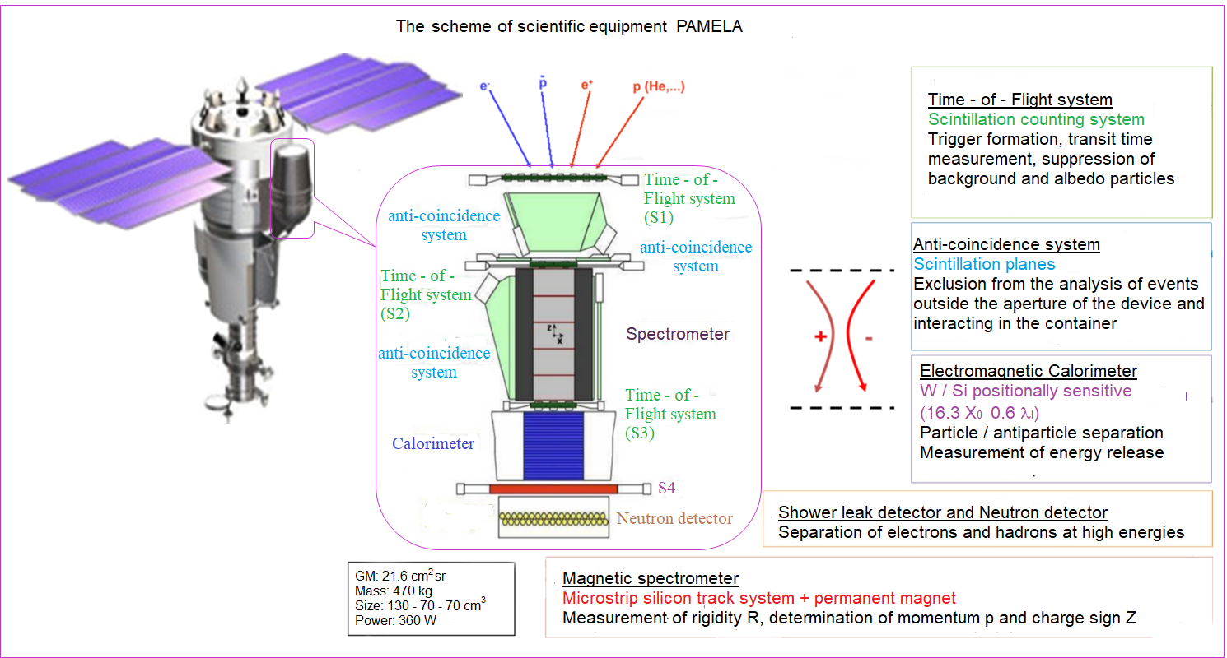

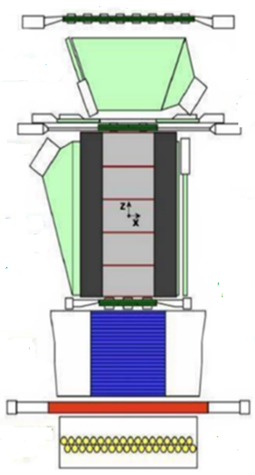
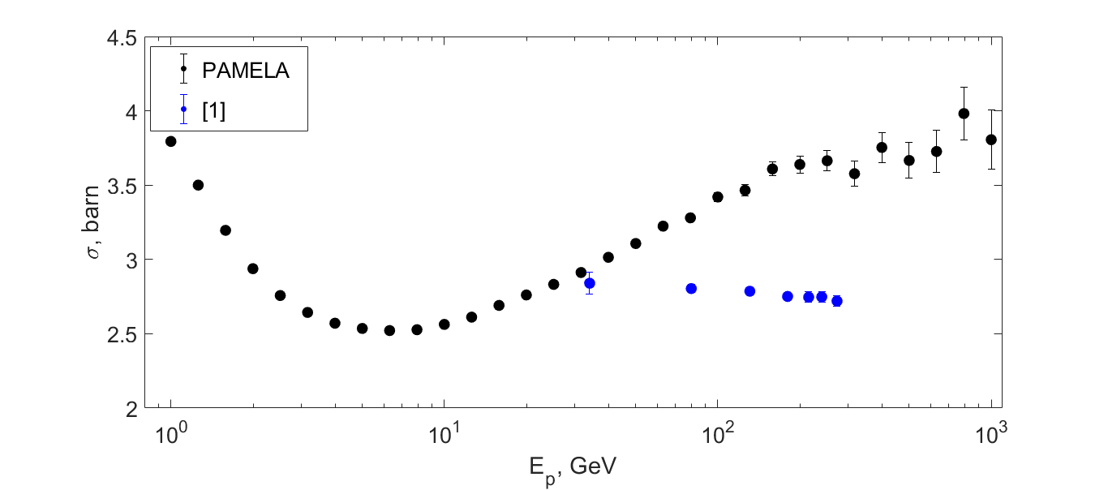
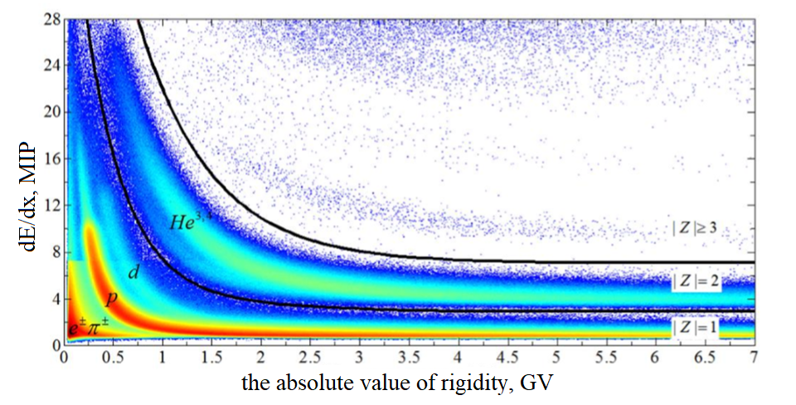
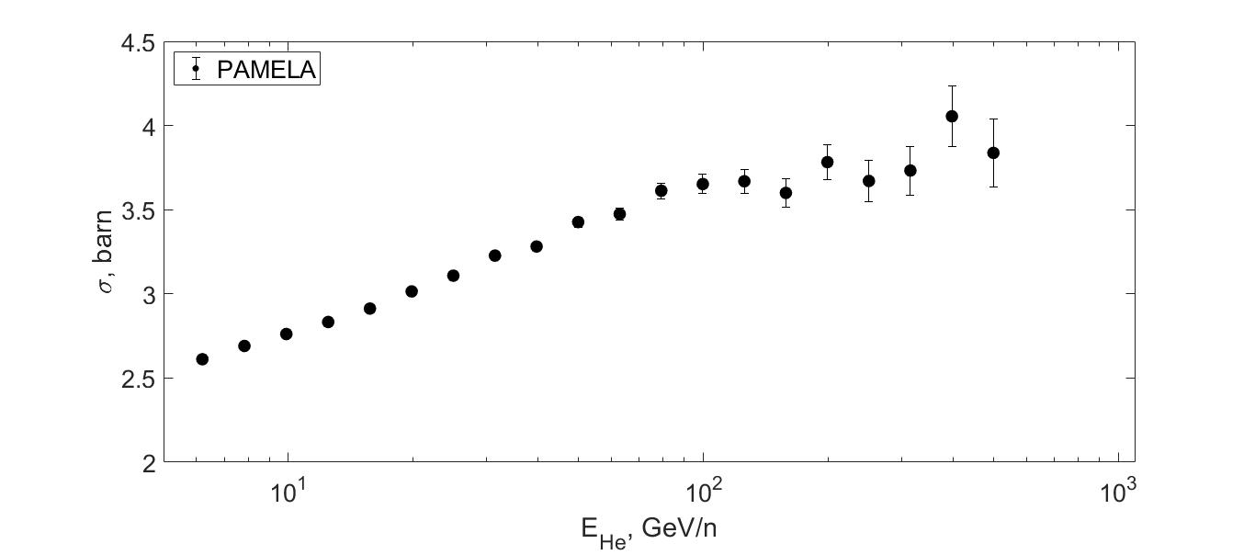
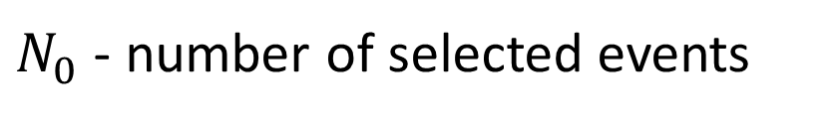
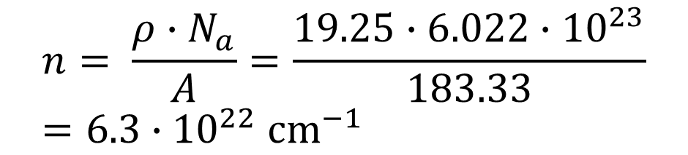
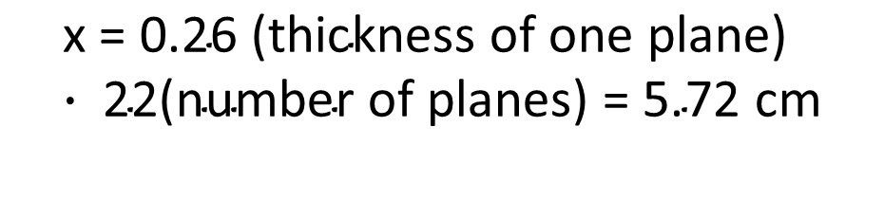
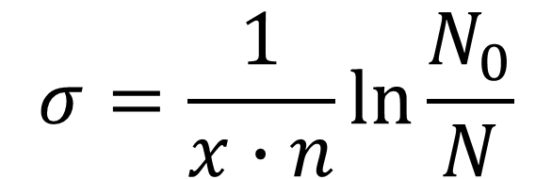
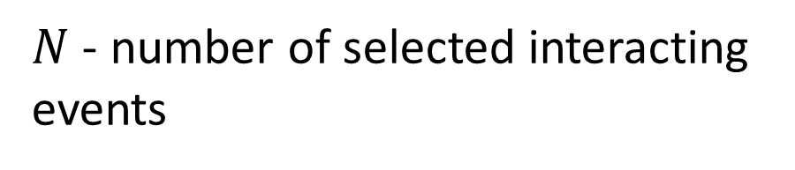
National Research Nuclear University MEPhI (Moscow Engineering Physics Institute)
The cross section of the inelastic interaction of protons and helium nuclei with the tungsten obtained with the PAMELA space experiment
Golub O.А.¹, Mayorov A.G.¹ on behalf of the PAMELA collaboration
¹ National Research Nuclear University MEPhI , 115409, Moscow, Kashirskoe highway, 31
Annotation.
We present the energy dependence of the cross section for the inelastic interaction of protons and helium nuclei with the tungsten in the energy range from a few hundred MeV to a hundred GeV using the data of the PAMELA space experiment. It was intended for the precision measurements of the cosmic ray fluxes of different nature and includes a set of detectors for the reliable determination of the particle characteristics (their type and energy). Identification of particles was carried out with the tracker system in magnetic field, time-of-flight and anticoincidence systems. A coordinate-sensitive calorimeter with a tungsten absorber, in turn, allows us to study the topology of the interaction of particles inside it, and calculate the cross-section of their inelastic interaction. We present the comparison of the obtained results with the measurements at accelerators and with existing theoretical models. The results of the work can be demanded for the development of numerical models describing particle’s interactions.
Additional selection criteria
Formula for cross section
Requirement for a particle to enter a calorimeter
The ratio of energy release within a radius of 8 strips to the total energy release is less than 0.95
$$σ=\frac{1}{x∙n}\ln{\frac{N_{0}}{N}}$$
$$\text{x}\text{ = 0.26 (}\text{thickness} \text{of} \text{one} \text{plane}\text{)}∙\text{ 22}\text{(}\text{number} \text{of} \text{planes}\text{)}\text{ = }\text{5.72 }\text{cm}$$
Number of events
Noninteracting particles
$$n= \frac{ρ∙N_{a}}{A}=\frac{19.25∙6.022∙{10}^{23}}{183.33}=6.3∙{10}^{22}{ cm}^{−1}$$
Resurs-DK 1
(15 June 2006 - 7 February 2016)
Interacting particles
$N_{0}$ - number of selected events
$N$ - number of selected interacting events
The ratio of energy release within a radius of 8 strips to the total energy release
Methodics
Results
Determination of the type of particle, energy and direction of arrival of the particle
Energy dependence of the inelastic proton-tungsten interaction cross section
Determination of the absolute value of charge
Preliminary
Selection of interacted particles
Energy dependence of the inelastic helium-tungsten interaction cross section
Basic selection criteria
  In the track system, one track is identified that does not touch the walls of the magnet
  The trajectory in the tracker is recovered using 4 or more points in the deflecting projection X, 3 or more points in the orthogonal projection Y
  No signals in all counters of the anti-coincidence system
  No more than the 1 hit scintillation strip In each of the 6 planes of the ToF
Preliminary
Conclusion
In this work the selection technique of protons and helium nuclei interacting in the PAMELA calorimeter was developed .
The obtained technique was applied to the experimental data of the PAMELA spectrometer collected during the period of work from September 29, 2006 to October 18, 2008.
Protons and helium nuclei, which interacted with the PAMELA calorimeter, were selected and the energy dependences of the cross section of their inelastic interaction with tungsten were obtained.
This technique allows to obtain data on the interaction of particles with tungsten in a wide energy range.
In the future it is planned :
Improve selection technique
Consider heavy nuclei
References
[1] P.V.R. Murthy, C.A. Ayre, Neutron total cross sections on nuclei at fermilab energies, 1975
[2] O. Adriani, G. Barbarino, G.A. Bazilevskaya et al, PAMELA - A Payload for Antimatter Matter Exploration and Light-nuclei Astrophysicsg, Astroparticle Physics,V.27, PP. 296–315,2007

