Slide 1

ExpertRoot. A GEANT4 and FairRoot based Sim and Reco framework for experiments at ACCULINNA2 and SuperFRS facilities
Mikhail Kozlov^{1,5}; Sergey Belogurov^{1,2}; Vratislav Chudoba^{1,3}; Andrey Fomichev¹; Elvira Gazeeva¹; Alexander Gorshkov¹; Sergey Krupko¹; Bakytbek Mauey¹; Ivan Muzalevskiy^{1,3}; Egor Ovcharenko^{1,4}; Anh Mai Quyn¹; Ilyas Saityshev¹; Vitaliy Schetinin^{1,5}
1 - JINR, Dubna; 2 - NRNU MEPhI, Moscow; 3- Silesian University, Opava; 4- Uni. Giessen; 5 - BMSTU, Moscow

Slide 2
Outlook
Introduction
Architecture
Event based workflow
Example of an experiment
Simulation “step by step”
Real data handling
Event reconstruction
Summary and plans
G4 feedback

Slide 3
Introduction
ExpertRoot is a FairRoot based framework for simulation of detector`s response, event reconstruction and real data analysis in low energy nuclear physics with radioactive beams
ExpertRoot is used for the EXPERT¹ project at SuperFRS@FAIR and for the experiments at ACCULINNA-2 fragment-separator in JINR
¹ EXPERT - EXotic Particle Emission and Radioactivity by Tracking
er.jinr.ru

Slide 4
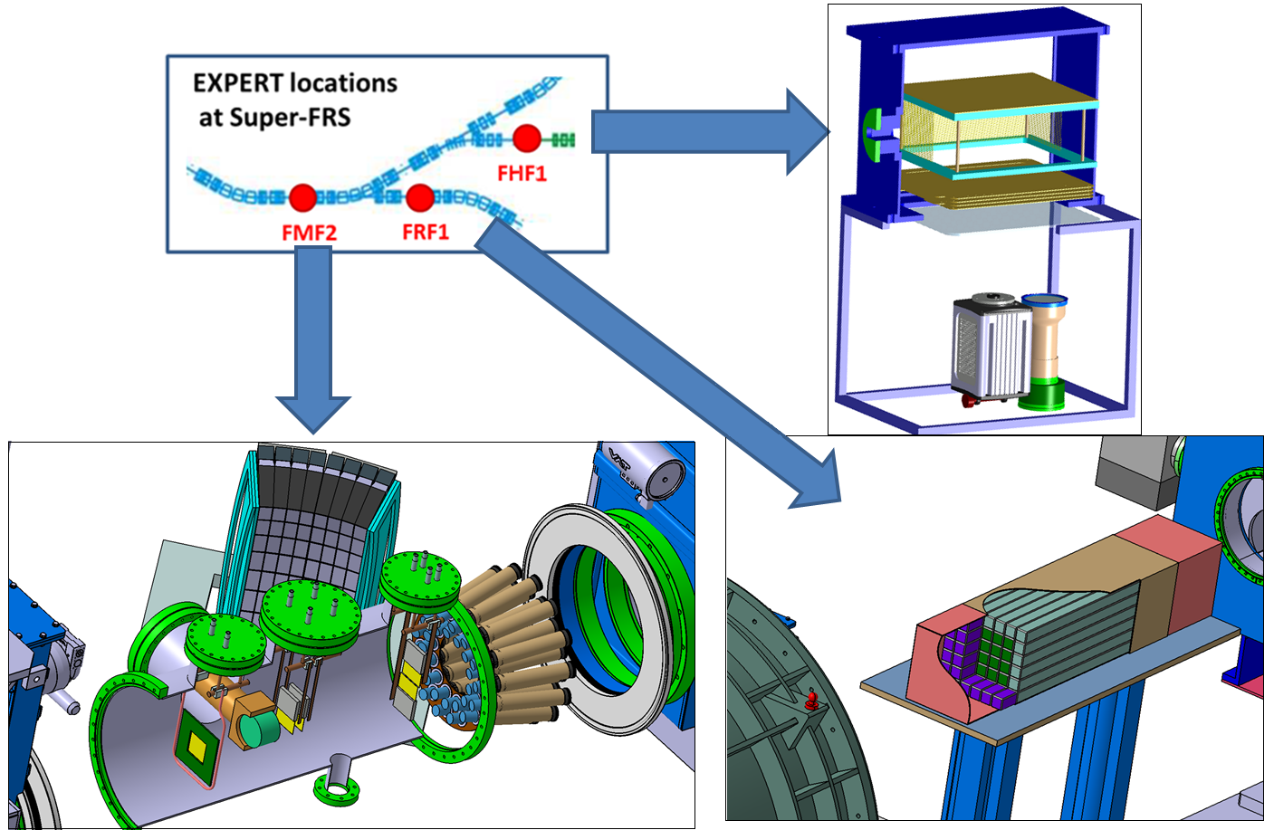
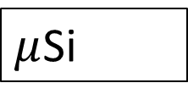
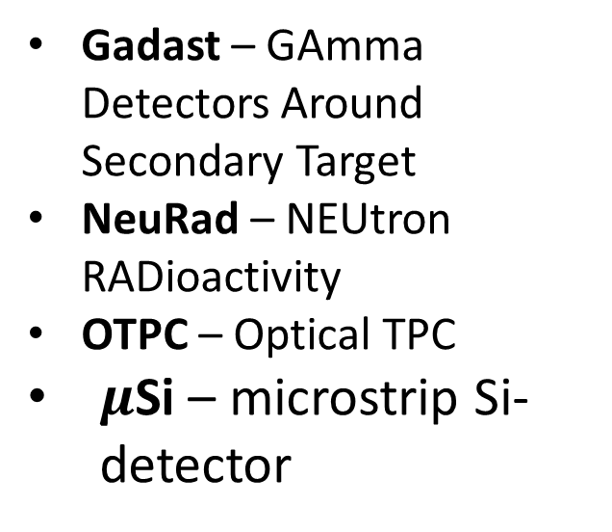
Introduction: EXPERT
Gadast – GAmma Detectors Around Secondary Target
NeuRad – NEUtron RADioactivity
OTPC – Optical TPC
$μ$Si – microstrip Si-detector
OTPC
Gadast
NeuRad
$μ$Si

Slide 5
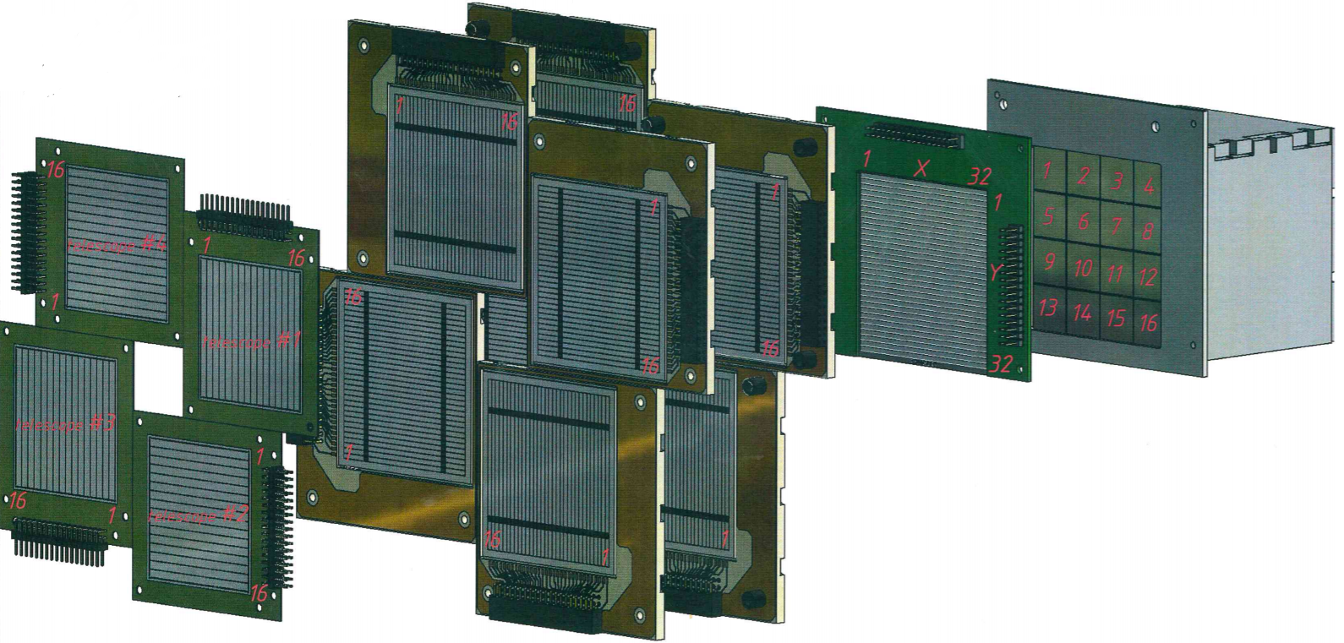
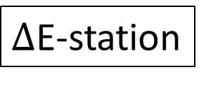
Introduction: ACCULINNA-2, part of the current setup
QTelescope
Veto-station
E-station
$Δ$E-station

Slide 6
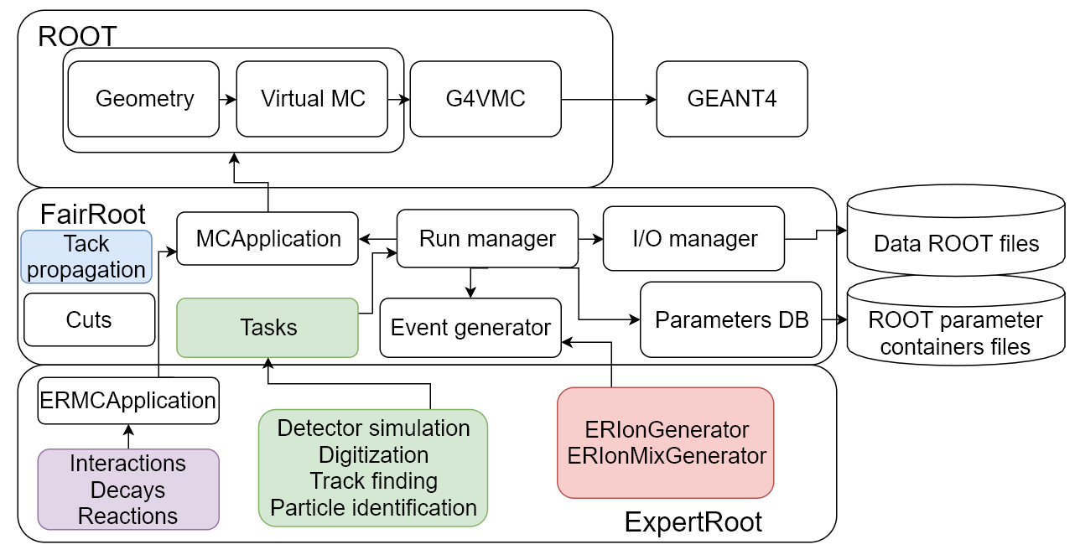
Architecture

Slide 7
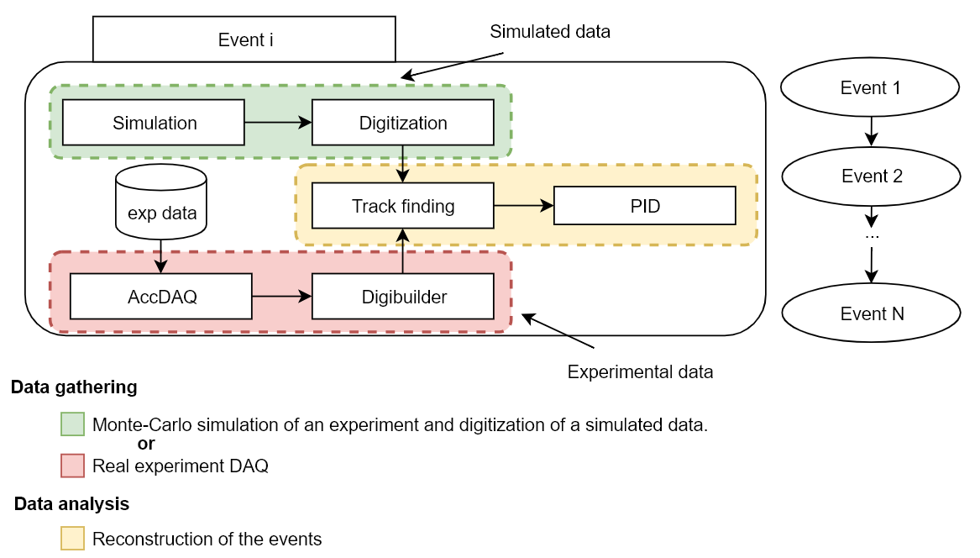
Event-based workflow
common format of the output data,
so the same reconstruction algorithms are used!

Slide 8
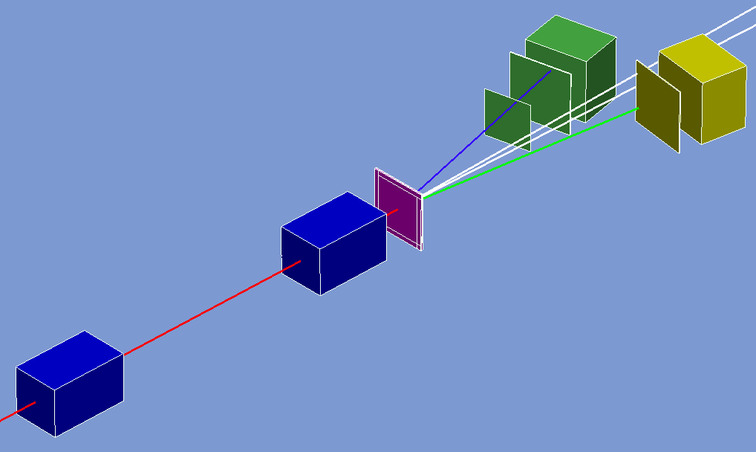
Example of an experiment
QTelescope-1
MWPC-2
QTelescope-2
Target
Tracks
MWPC-1
Helium-6
neutron
Helium-3
Triton
On each step in sensitive volume energy losses are summed up for every particle via ROOT interface to Geant methods
Information about generated primary tracks and daughter secondary particles are stored in MCTrack class object

Slide 9
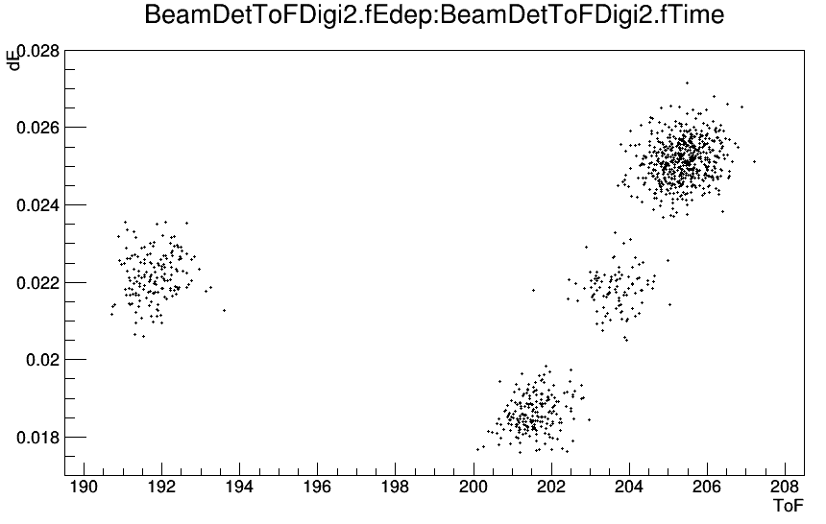
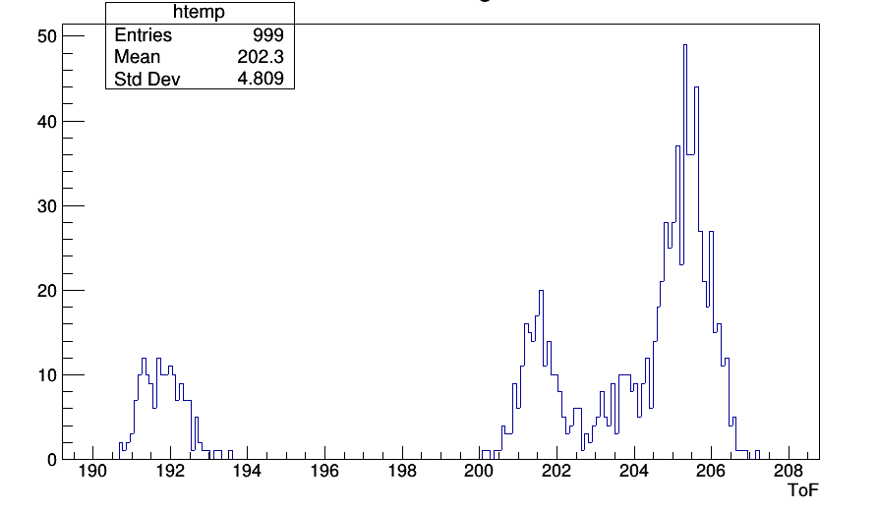








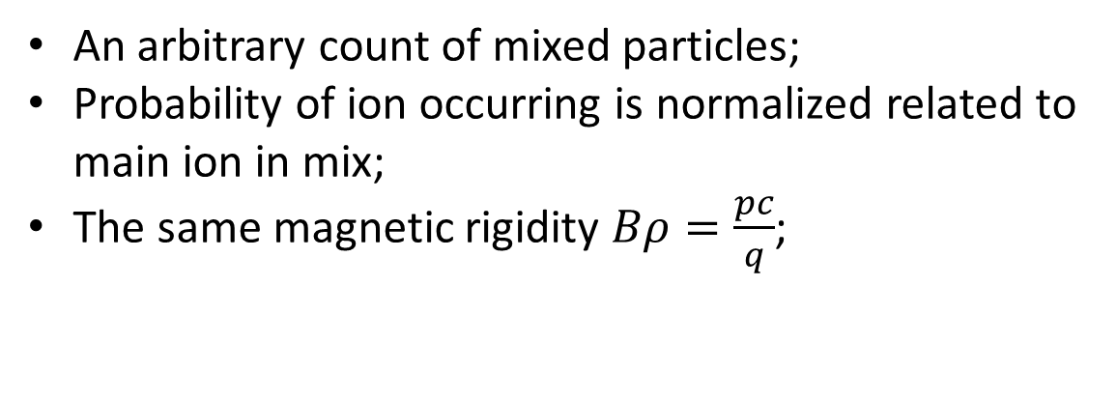

Ion mixture generator
ToF-dE
ToF
0.55
0.55
$${}_{}^{28}S$$
$${}_{}^{28}S$$
0.15
$${}_{}^{24}{Si}$$
0.1
0.1
$${}_{}^{26}P$$
0.15
0.2
$${}_{}^{26}P$$
$${}_{}^{24}{Si}$$
$${}_{}^{26}S$$
0.2
$${}_{}^{26}S$$
An arbitrary count of mixed particles;
Probability of ion occurring is normalized related to main ion in mix;
The same magnetic rigidity $Bρ=\frac{pc}{q}$;
Denomination:
Ion’s occurring probability
P
Ion
$${}_{}^{A}X$$

Slide 10
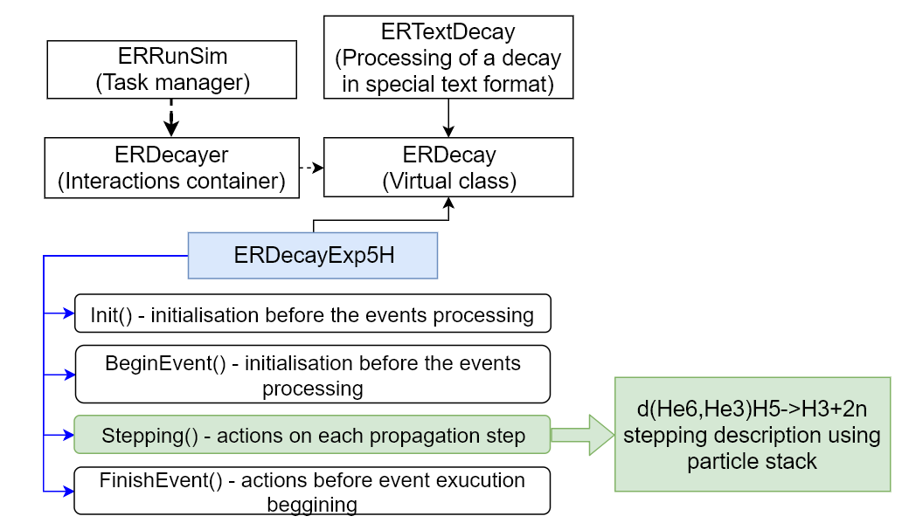
User defined interactions architecture

Slide 11
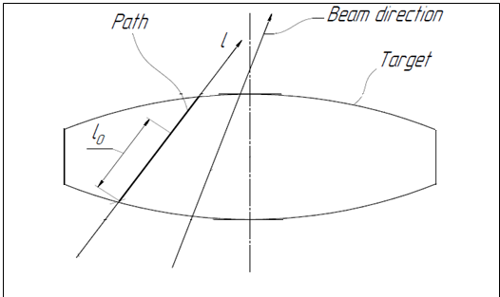
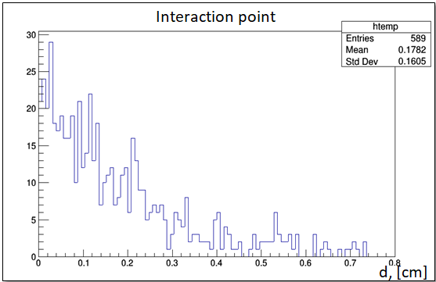
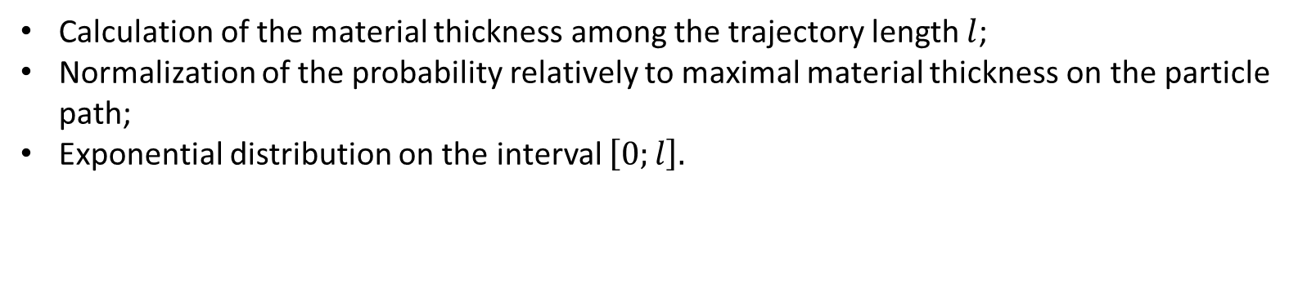
An interaction on the target
Calculation of the material thickness among the trajectory length $l$;
Normalization of the probability relatively to maximal material thickness on the particle path;
Exponential distribution on the interval $\left[0;l\right].$

Slide 12
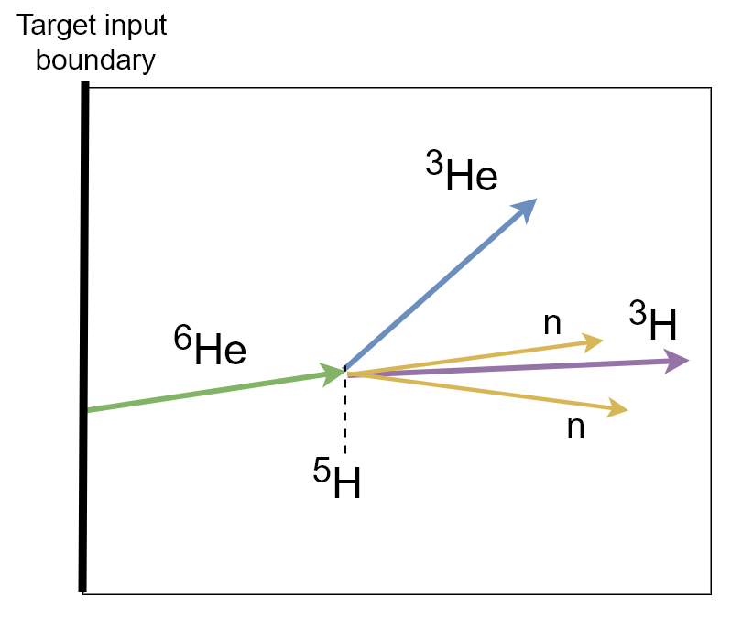
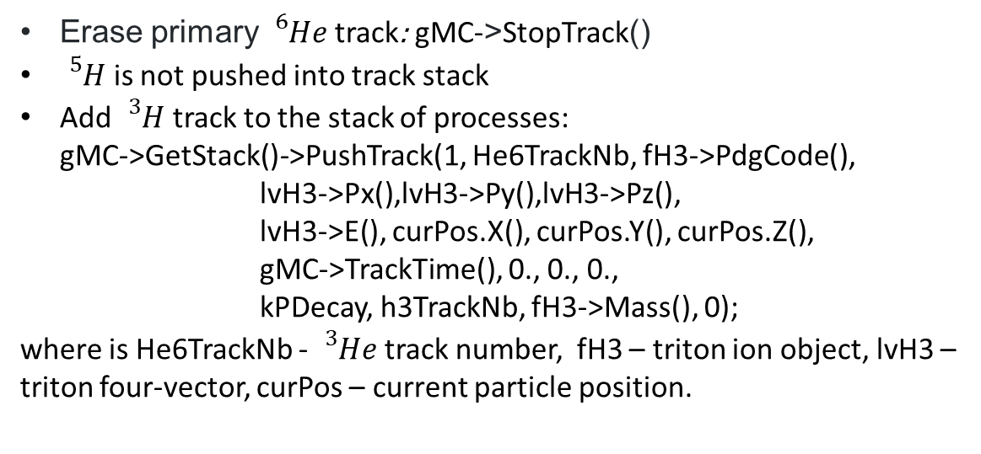
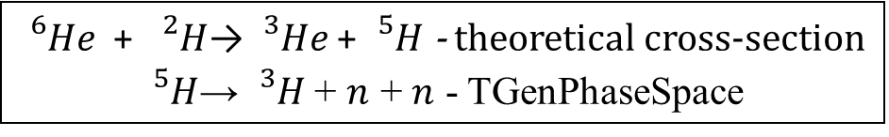
Work with process stack example
${}_{}^{6}{He}$ + ${}_{}^{2}H$→ ${}_{}^{3}{He}$+ ${}_{}^{5}H$ - theoretical cross-section
${}_{}^{5}H$→ ${}_{}^{3}H$+ $n$ + $n$ - TGenPhaseSpace
Erase primary ${}_{}^{6}{He}$ track: gMC->StopTrack()
${}_{}^{5}H$ is not pushed into track stack
Add ${}_{}^{3}H$ track to the stack of processes:
gMC->GetStack()->PushTrack(1, He6TrackNb, fH3->PdgCode(),
lvH3->Px(),lvH3->Py(),lvH3->Pz(),
lvH3->E(), curPos.X(), curPos.Y(), curPos.Z(),
gMC->TrackTime(), 0., 0., 0.,
kPDecay, h3TrackNb, fH3->Mass(), 0);
where is He6TrackNb - ${}_{}^{3}{He}$ track number, fH3 – triton ion object, lvH3 – triton four-vector, curPos – current particle position.

Slide 13
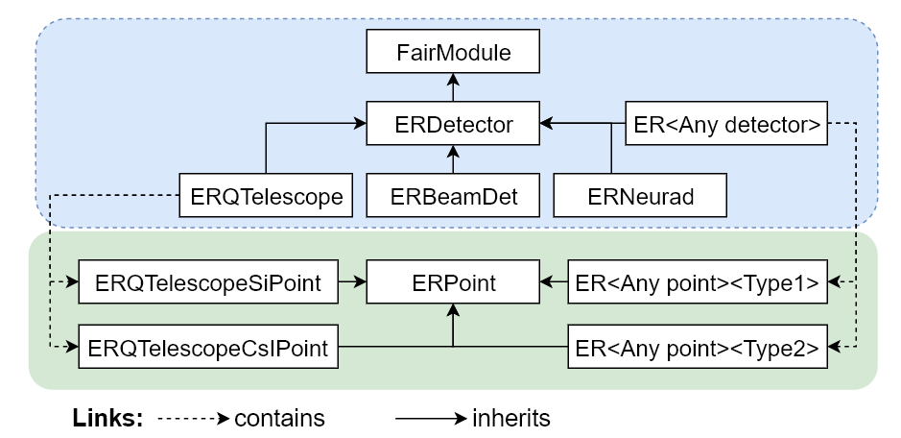
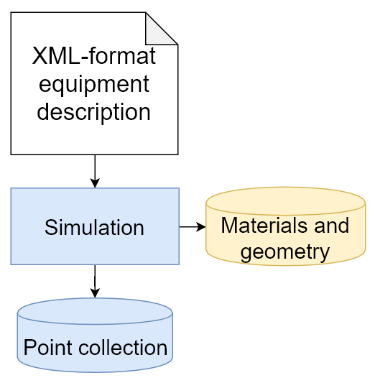
Detector simulation
Parameter
container
Point object is created for each particle in every sensitive volume:
“In” and “out” coordinates
“In” and “out” momentum
PDG,
“In” time
Other detector specific information.

Slide 14
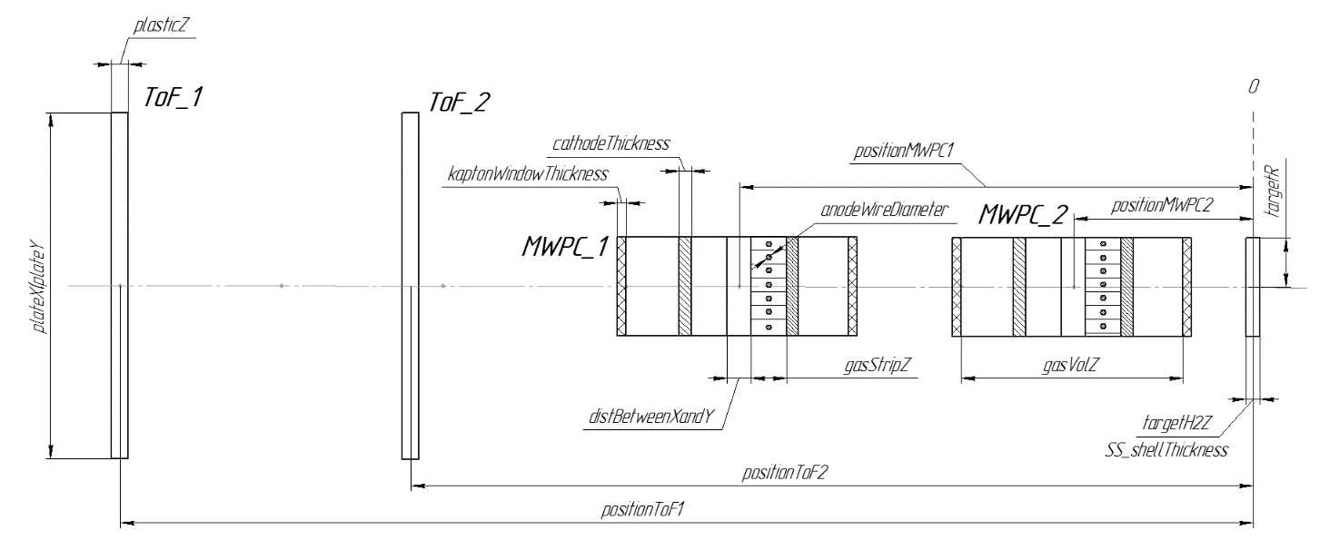
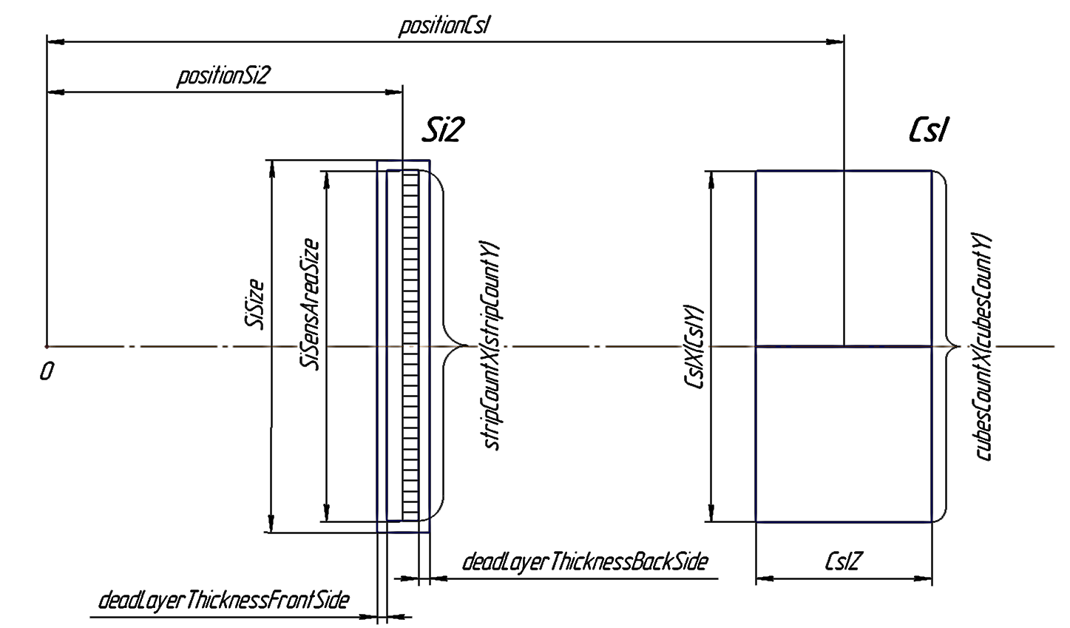
Detector geometry parameterization
BeamDet
QTelescope
Medium
BeamDet.xml
QTelescope.xml
Spreadsheets
(MS Excel at present time)

Slide 15
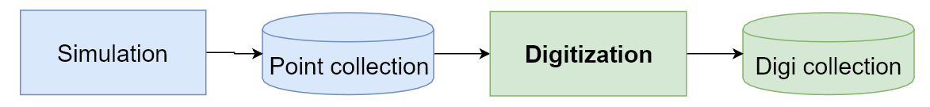
Digitization
Digitization – task consists of summing up energy deposited by all the particles in the sensitive volume, application of energy and time spread corresponding to the resolution of the detector, taking into account inefficiency of various nature (e.g. dead time) and discretization.
Digi – object contains the characteristics of the detector response.
Digi object is created for each particle in every sensitive volumes:
R/O channel number,
Energy response, recorded to the channel,
Timestamp
Other detector specific information.

Slide 16
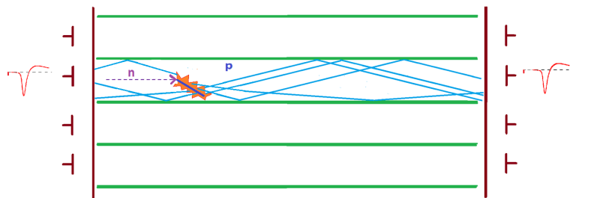
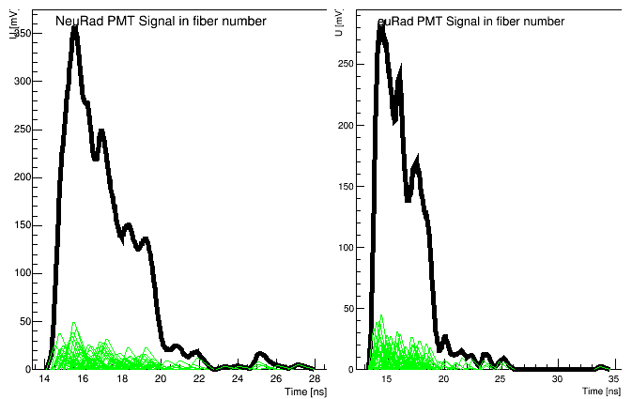
Digitization
Example: NeuRad - neutron detector with scintilating fibers along the path of neutron
  Birks quenching
  Position sensitivity obtained by limiting lengths of a point to 2 [cm],
  Exponential lighting emission kinetics
  light attenuation
  quantum efficiency
  dinode system modeling:
    using special distribution of photoelectron amplitude
    using user-defined function of photoelectron signal shape
    delay and jitter
    signal creation as a sum of signals from single electrons

Slide 17
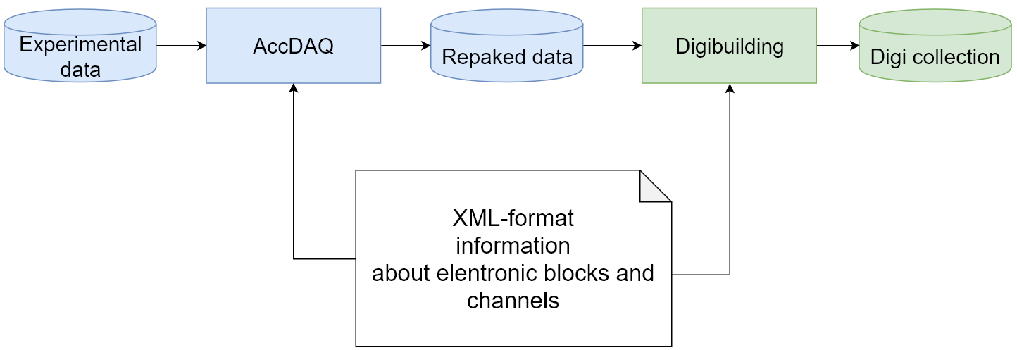
Real data handling

Slide 18
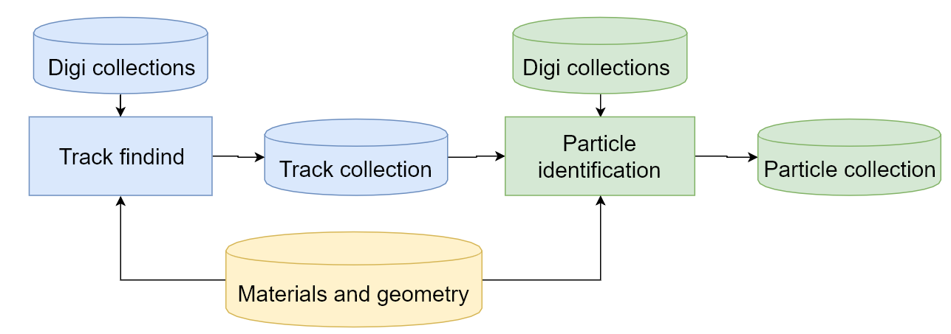
Event reconstruction
Coordinates
Angle distributions
Four-vectors

Slide 19
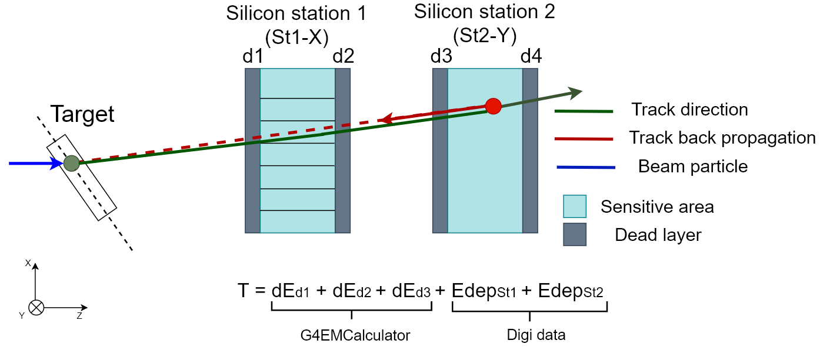
G4EMCalculator in reconstruction

Slide 20
Summary and plans
ExpertRoot framework is developed for simulation and reconstruction of the experiments with low energy exotic beams.
A full lifecycle functionality is implemented for the ⁵H and ⁷H experiments and can be easily extended to other examples.
The framework helps to combine efforts of physicists, detector experts and IT specialists
Plans:
Implement more usecases and make the framework more userfriendly
Develop a cloud service using Jupyter Notebook interface to Root
Extend interface to theoretical generators. In particular interpolate multiparticle output between the provided energies observing the momentum and energy conservation and phase space factor and introduce realistic background

Slide 21
G4 feedback
Limitation:
Calling G4EmCalculator->GetDeDx() requires full initialization of Geant4 in VMC:
TG4RunConfiguration initialization
TGeant4 initialization
Fake processing of first event for initialization of other environment
Desire:
Possibility to use the G4EmCalculator without initializing the entire Geant4 simulation would be extremely convenient.

