Slide 1

Extending GEANT4 “Radioactive Decay” for the Analysis of Complex Total Absorption Analysis Cases
A. Algora, E. Ganioglu, D. Jordán, E. Nácher
Instituto de Física Corpuscular, CSIC - UV

Slide 2

Use of G4 in Nuclear Physics
Design and Optimization
  Best geometry and materials, e.g. R³B-CALIFA
  Best configuration, e.g. PRESPEC / AGATA
Data Analysis
  Aid the data analysis process, e.g. particle ID plots
  Key factor in data analysis, e.g. efficiency calculation,
  data unfolding.

Slide 3
Outlook of the talk
Introduction: beta decay measurements
The TAS inverse problem
Beta decay of ¹⁸⁶Hg
Summary and Conclusions

Slide 4
Beta decay measurements
β-decay is an important source of nuclear structure information.
From direct measurements one can obtain half-lives, energy levels, Q_{β}-values (masses), beta intensity distributions (β feeding)…
Parent nucleus
Measuring the β feeding distribution is far from being trivial!!
T_{1/2}
β
E₄
γ
E₃
Q_{β}
E₂
γ
γ
γ
E₁
Daughter nucleus

Slide 5
Beta decay measurements
Medium mass and heavy nuclei: large level density at high energy.
^{A}Z
β⁺
real feeding
Very fragmented feeding distr. and γ-deexcitation pattern.
apparent feeding
γ
^{A}Z-1
HPGe arrays fail to detect systematically the upper part of the γ-cascade resulting in a wrong feeding and B(GT) distr.
HPGe
HPGe
γ₁’
γ₂
γ₁

Slide 6
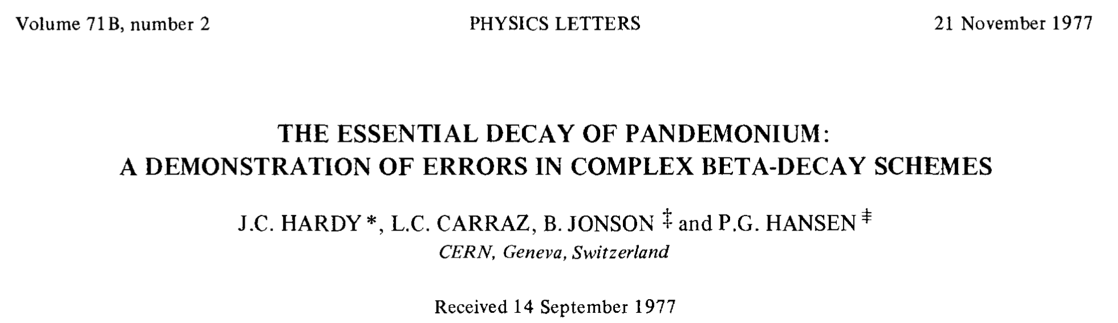
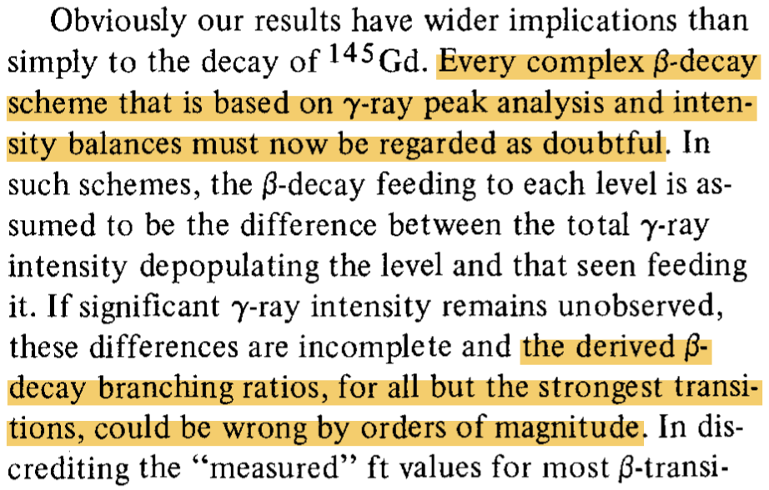
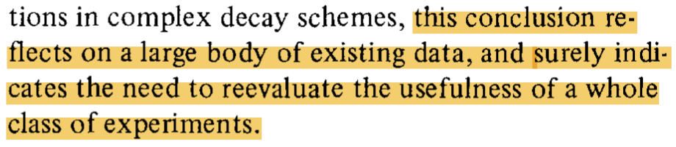

Slide 7
18/4/19
E. Nácher
7
Total Absorption Spectroscopy (TAS)
β feeding
NaI
E₂
γ2
E₁
γ1
γ1
γ2
β feeding
N
Ideal case
E₂
E

Slide 8
18/4/19
E. Nácher
8
Total Absorption Spectroscopy (TAS)
X-ray detector
N
NaI
EC
N
E₂
E
Positron detector
γ1
β⁺
γ2
E₂
E
2 photons (511 keV)
back to back
Unfolding
algorithm (EM)
I_{β}
Real case
E₂
E

Slide 9
The TAS Inverse Problem
The number of counts detected in channel j relates to the beta feeding to level i through the linear equation:
  f_{i} : Feeding to energy level “i”
  d_{j} : Counts in channel “j” of the spectrum
  R_{ij} : Response Function (matrix) to the decay

Slide 10
The TAS Inverse Problem
No way to measure R_{ij}!!
The only possibility is calculate it using MC simulations: Geant4
The number of counts detected in channel j relates to the beta feeding to level i through the linear equation:
We can then use the EM algorithm to unfold the data:
Calculation of R_{ij} from individual γ’s and β’s: D. Cano, J.L. Taín, NIM A430 (1999) 333
Study of the EM and others applied to TAS: J.L. Taín, D. Cano, NIM A571 (2007) 728

Slide 11
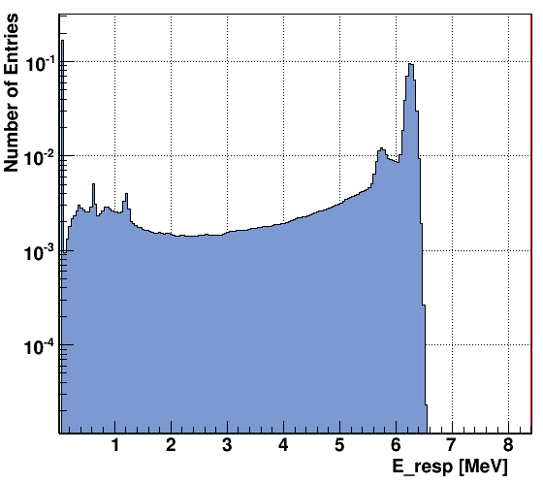
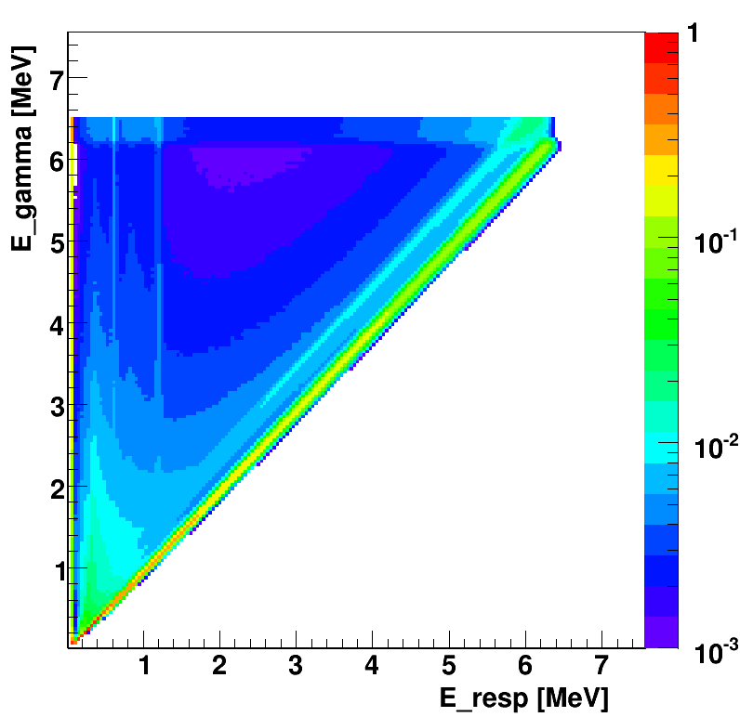
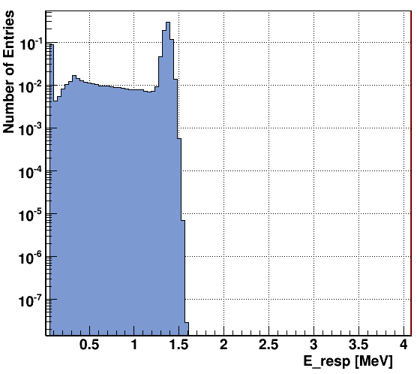
The Response Function

Slide 12
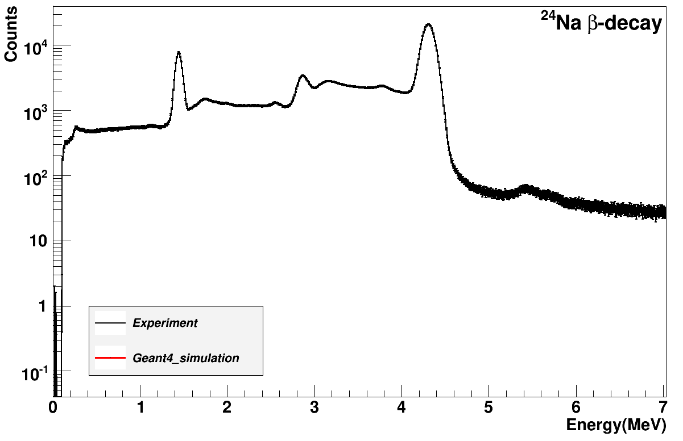
The Response Function
β-decay of ²⁴Na: test bench for our simulations

Slide 13
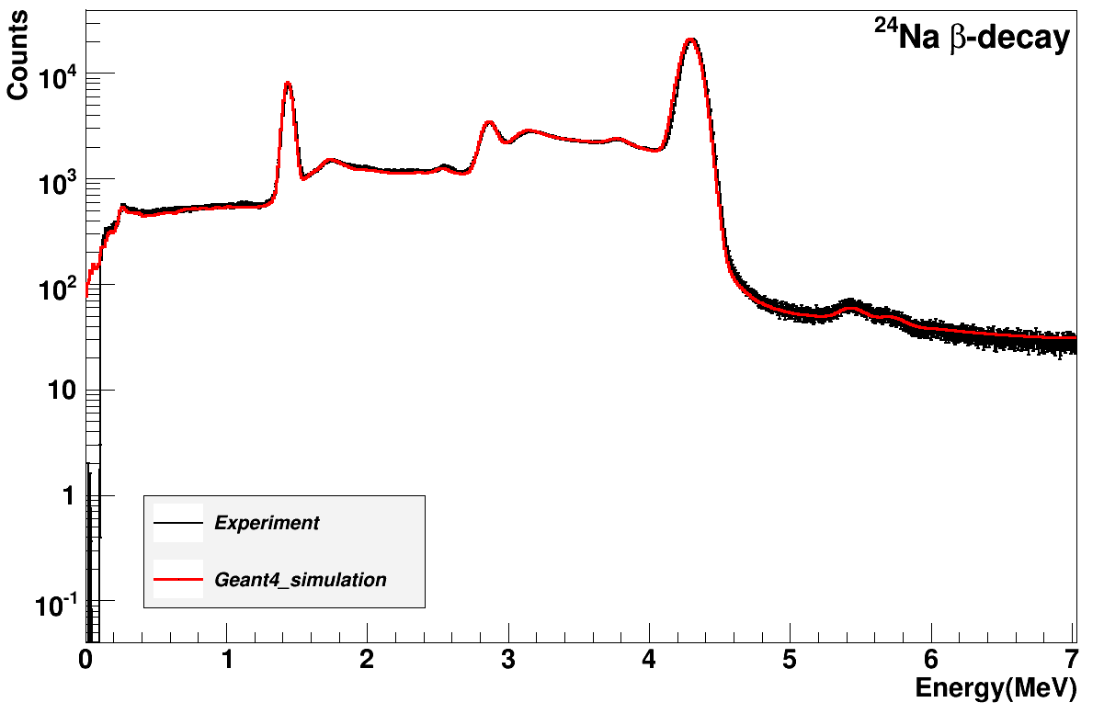
The Response Function
β-decay of ²⁴Na: test bench for our simulations

Slide 14
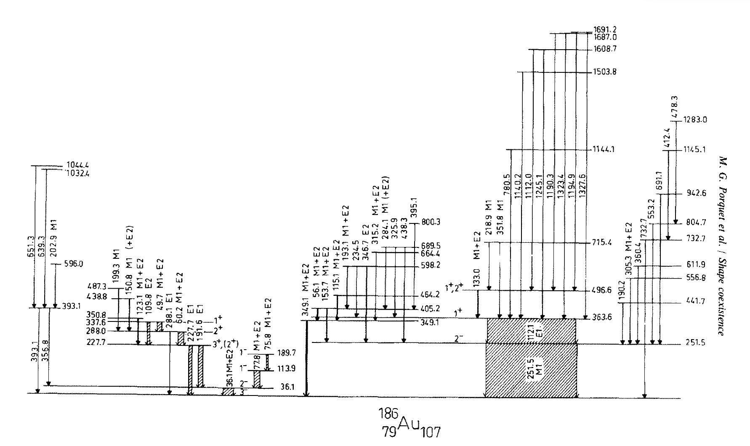
Study case: ¹⁸⁶Hg decay
Statistical model:
-Level densities: Goriely et al. Phys. Rev. C, 78 (2008)
HFB + combinatorial (RIPL3)
320 positive parity levels 1-3 MeV
-Gamma branchings: Axel-Brink hypothesis
E1, M1 & E2 from
giant resonances
?
0+
ENSDF → G4RadioactiveDecay
Event generator including the ‘unknown’ part: D. Jordán et al., NIM A828 (2016) 52

Slide 15
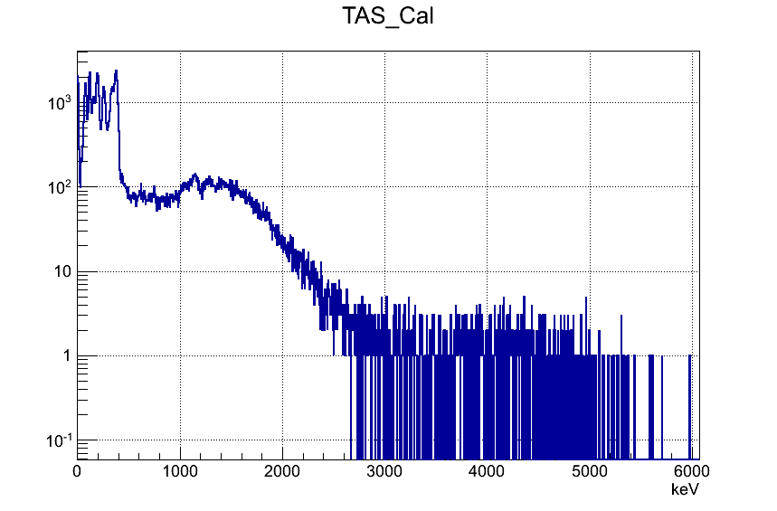
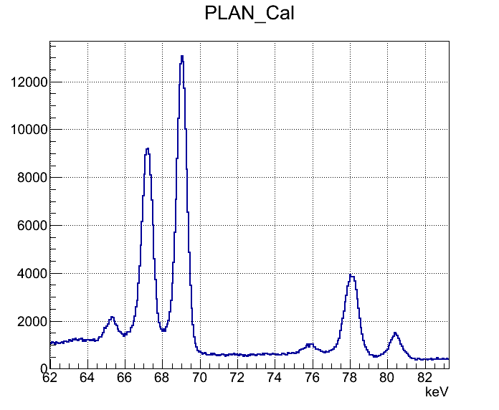
Study case: ¹⁸⁶Hg decay
Au X gate
Planar det.
Q = 3174 keV
E (keV)

Slide 16
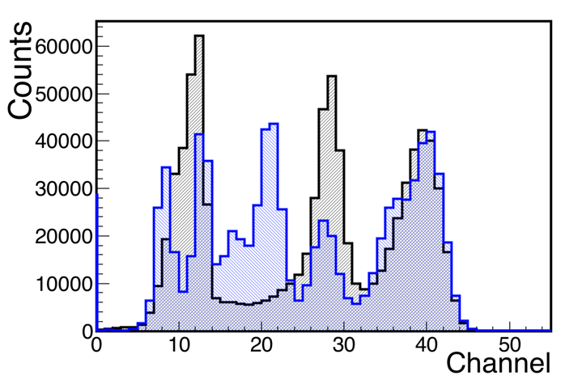
Study case: ¹⁸⁶Hg decay
0+
a)
b)
(G4RadioactiveDecay)
EC 74 %, β+ 6.8 %
1+
363.1
(High res.)
112.1
E1,α₁₁₂=0.315
2-
251.5
Response to the 363 level
112
112+X
a)
251.5
M1,α₂₅₂=0.558
251
363
251+X
b)
X
3-

Slide 17
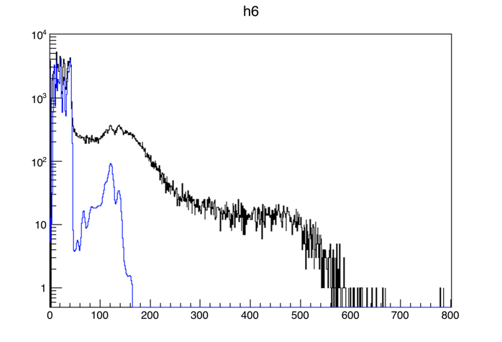
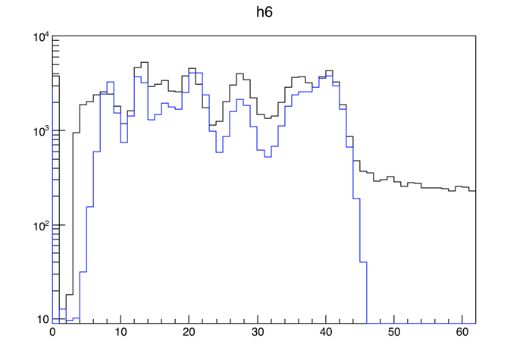
Study case: ¹⁸⁶Hg decay
E (10 keV / chan)
Comparison of the measured spectrum with the response to the level 363 (arbitrary normalization). Response calculated using G4RadioactiveDecay.

Slide 18
Study case: ¹⁸⁶Hg decay
We calculate the response of the detector to β-feeding, not from individual γ rays plus β particles but from the complete decay generated by G4RadioactiveDecay
We extend the ENSDF data tables included in RadioactiveDecay5.1.1 and PhotonEvaporation4.3.2 to include the unknown part of the decay / de-excitation (statistical model)
We analyze the data gated on Au x-rays making sure that this includes the EC component plus the β⁺ component. Both contain a proper treatment of CE and the generation of associated X-rays, which is crucial for the description of the experiment (penetration and summing of X-rays).

Slide 19
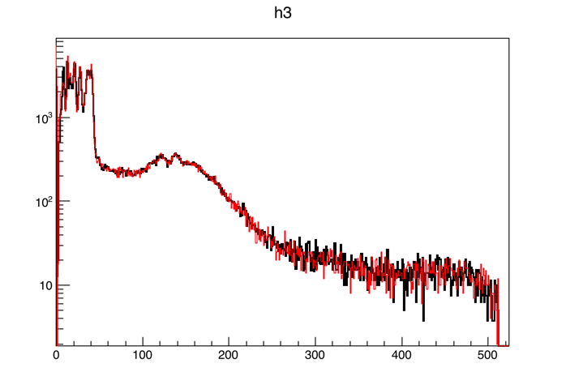
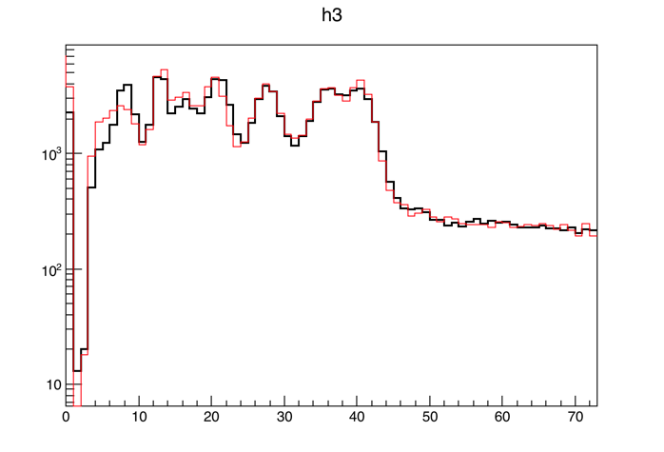
Study case: ¹⁸⁶Hg decay
Analysis: R_{ij} f_{j}
TAS in coinc with Xrays of Au
E (10 keV / chan)

Slide 20
Study case: ¹⁸⁶Hg decay
The results are consistent with a prolate ground state independent of the force used (SG2, SLy4). Better agreement with SG2
Calculations by P. Sarriguren
PRELIMINARY RESULTS
Error bands determined by the error in the Q_{EC} value and in the T_{1/2} and by the different possible solutions.

Slide 21
Summary & Conclusions
To calculate the R_{ij} we count on an event generator that includes the quasi-continuum part (missing in ENSDF). However it does not include the generation of conversion electrons and their subsequent x-ray emission (and some other 2nd order effects…)
The G4RadioactiveDecay class accounts for the aforementioned effects missing in our event generator. However it is based exclusively on ENSDF and therefore lacks of the quasi-continuum at the upper part of the decay scheme.
We have merged the two approaches extending the ENSDF data tables included in RadioactiveDecay5.1.1 and PhotonEvaporation4.3.2 using our event generator approach to include the unknown quasi-continuum part of the decay / de-excitation (statistical model).
We have analyzed the decay of ¹⁸⁶Hg gated on Au x-rays that was impossible to analyze with our event generator or with the G4RadioactiveDecay separately. The beta decay of ¹⁸⁶Hg shows a strong prolate signature as compared to QRPA calculations

Slide 22
Thanks for your attention!!

Slide 23
What is still missing… and highly desireble!
Beta-delayed particle emission: protons, neutrons and alphas.
Possibility to include broad resonances above S_{p} or S_{n} or S_{a} rather than discrete levels (e.g. beta decay of ⁸B in ⁸Be).

Slide 24
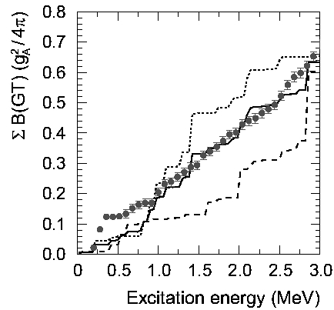
Some other TAS results
Shape of the g.s. of some N~Z nuclei in the A=70 region inferred from the β-decay
  E. Nácher, A. Algora et al, Phys. Rev. Lett. 92 (2004) 232501
  E. Poirier, F. Marechal et al, Phys. Rev. C69 (2004) 034307
Strong prolate
deformation of ⁷⁶Sr
Shape mixing in the g.s. of ⁷⁴Kr

Slide 25
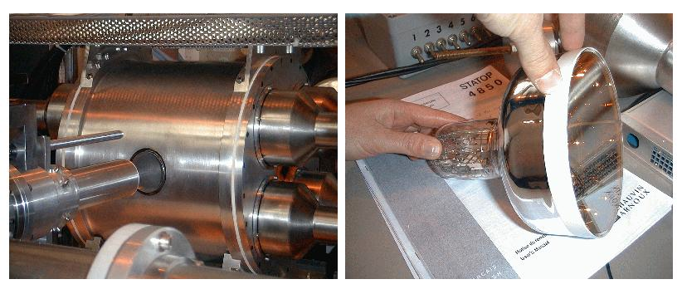
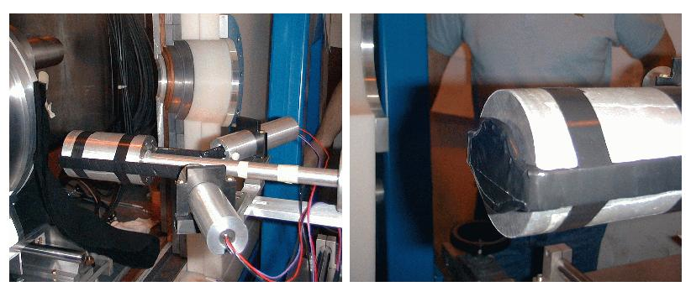
Some other TAS results
Shape of the g.s. of some N~Z nuclei in the A=70 region inferred from the β-decay
  E. Nácher, A. Algora et al, Phys. Rev. Lett. 92 (2004) 232501
  E. Poirier, F. Marechal et al, Phys. Rev. C69 (2004) 034307
Strong prolate
deformation of ⁷⁶Sr
Shape mixing in the g.s. of ⁷⁴Kr

Slide 26
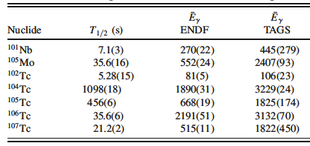
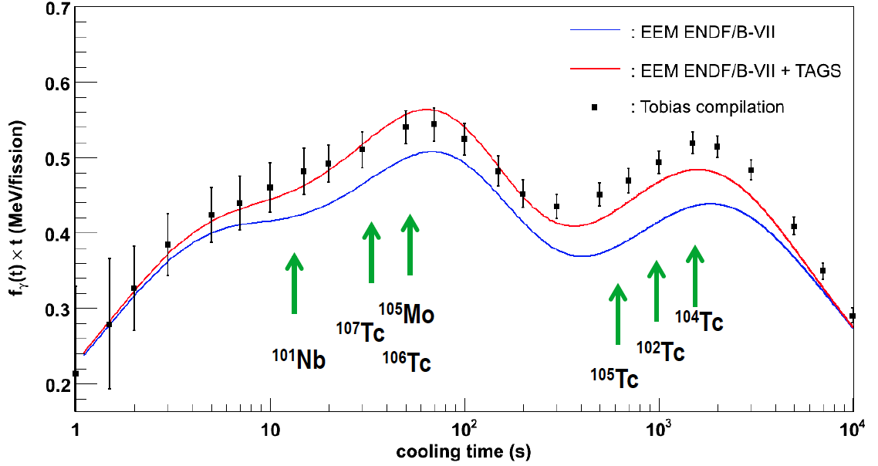
Some other TAS results
Reactor decay heat and related issues
  A. Algora, D. Jordan et al, Phys. Rev. Lett. 105 (2010) 202501

Slide 27
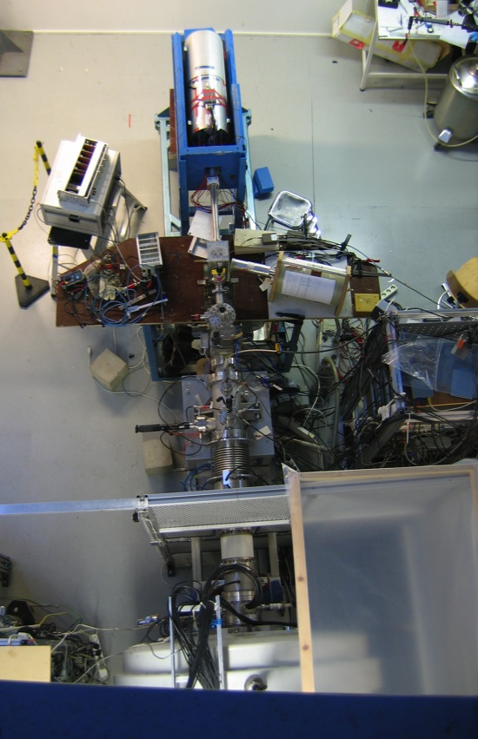
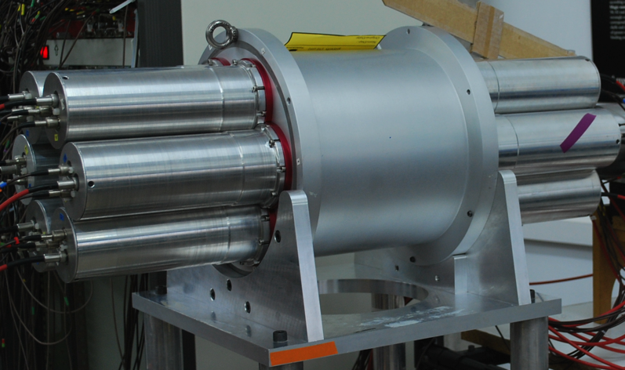
Some other TAS results
Reactor decay heat and related issues
  A. Algora, D. Jordan et al, Phys. Rev. Lett. 105 (2010) 202501
  A new scientific program on neutrino spectra determination is approved

Slide 28
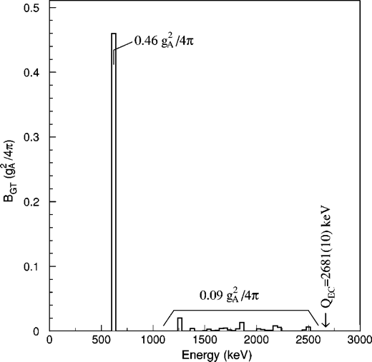
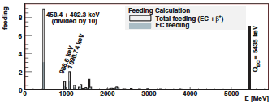
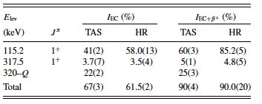
Some other TAS results
β-decay studies for a Monochromatic beam facility
  A. Algora, E. Nácher et al, Phys. Rev. C 70 (2004) 202501
  M.E. Estevez A. Algora et al, Phys. Rev. C 84 (2011) 034304
β-decay of ¹⁴⁸Dy
β-decay of ¹⁵²Yb

Slide 29
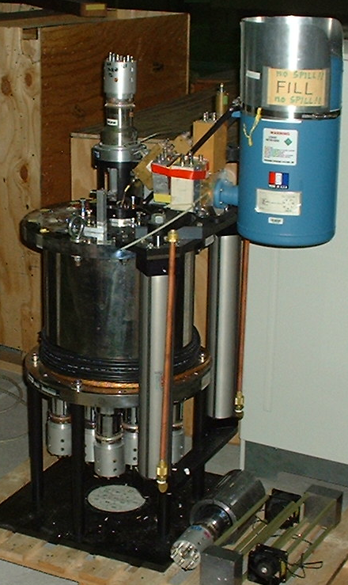
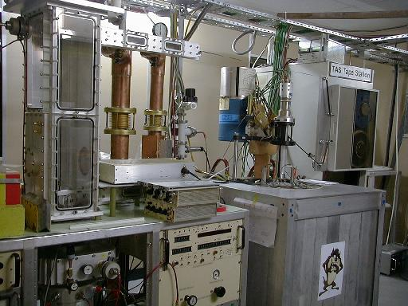
Some other TAS results
β-decay studies for a Monochromatic beam facility
  A. Algora, E. Nácher et al, Phys. Rev. C 70 (2004) 202501
  M.E. Estevez A. Algora et al, Phys. Rev. C 84 (2011) 034304
β-decay of ¹⁴⁸Dy
β-decay of ¹⁵²Yb

