Slide 1


DPhN
(Nuclear Science Department)
The Liège Intranuclear Cascade (INCL) model.
Its evolutions and capabilities.
Jean-Christophe David
ENSAR2 workshop: GEANT4 in nuclear physics
24 April 2019 - 26 April 2019 - CIEMAT Madrid, Spain

Slide 2
DPhN
(Nuclear Science Department)
The Liège Intranuclear Cascade (INCL) model.
Its evolutions and capabilities.
… And a few words about the de-excitation code Abla
Jean-Christophe David
ENSAR2 workshop: GEANT4 in nuclear physics
24 April 2019 - 26 April 2019 - CIEMAT Madrid, Spain

Slide 3
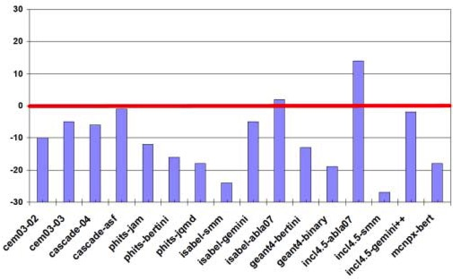
INCL (and Abla) has been developed for a long time now
So here only developments since ~2010 → the IAEA Benchmark
INCL-ABLA recognized as one the best combination to treat spallation reaction
(https://www-nds.iaea.org/spallations/)
Spallation reactions
n,p (π) + A - 150 MeV->2-3 GeV
INCL - ABLA
Perfect
Ex.:
residue production –
isotopic distributions
(https://www-nds.iaea.org/spallations/)
Very bad
The Liège Intranuclear Cascade
(INCL) model….

Slide 4
INCL
Main improvements
Cluster as projectile
Low-energy extension
← 150 MeV
Spallation reactions
n,p (π) + A - 150 MeV->2-3 GeV
INCL
High-energy extension
→ 10-20GeV
Cluster emission
Few-nucleon removal
The Liège Intranuclear Cascade
(INCL) model….

Slide 5
Cluster as projectile
Low-energy extension
← 150 MeV
Spallation reactions
n,p (π) + A - 150 MeV->2-3 GeV
INCL
High-energy extension
→ 10-20GeV
Cluster emission
Few-nucleon removal
The Liège Intranuclear Cascade
(INCL) model….

Slide 6
Cluster as projectile
Why?
Hadrontherapy ex.: C beam
He ~12% of the cosmic ray
Secondary reactions light nuclei produced and re-interacting
The Liège Intranuclear Cascade
(INCL) model….

Slide 7
Cluster as projectile
How?
Projectile must be prepared as the target (positions, momenta of nucleons…)
BUT two different treatments
  Target as usual with an INC X Projectile: Frozen, no Fermi motion
      no INC
Special care
  Some nucleons don’t interact
    either don’t enter the target (geometrical spectator)
    or don’t interact with any nucleons in the target (dynamical spectactor)
  Excitation energy of the projectile from a crude particle-hole model (no cascade)
  Low energy: Fusion accounted for (complete or not)
when one nucleon (projectile) below Fermi energy (target)
So, no symmetry projectile/target
  In Geant 4 what is done…
The Liège Intranuclear Cascade
(INCL) model….

Slide 8
Cluster as projectile
How?
According to what is measured,
Projectile or target
can be well treated
In Geant4
From D. Mancusi et al.
Phys. Rev. C 90 (2014) 054602.
The Liège Intranuclear Cascade
(INCL) model….

Slide 9
Cluster as projectile
Results
p
⁴He
¹²C + ¹²C
95 A.MeV
⁷Li
¹¹C
From D. Mancusi et al. Phys. Rev. C 90 (2014) 054602.
The Liège Intranuclear Cascade
(INCL) model….

Slide 10
Cluster as projectile
Results
⁸⁶Kr + ⁹Be
500 A.MeV
From D. Mancusi et al. Phys. Rev. C 90 (2014) 054602.
The Liège Intranuclear Cascade
(INCL) model….

Slide 11
Cluster as projectile
Low-energy extension
← 150 MeV
Spallation reactions
n,p (π) + A - 150 MeV->2-3 GeV
INCL
High-energy extension
→ 10-20GeV
Cluster emission
Few-nucleon removal
The Liège Intranuclear Cascade
(INCL) model….

Slide 12
Cluster as projectile
Low-energy extension
← 150 MeV
Spallation reactions
n,p (π) + A - 150 MeV->2-3 GeV
INCL
High-energy extension
→ 10-20GeV
Cluster emission
Few-nucleon removal
The Liège Intranuclear Cascade
(INCL) model….

Slide 13
Low-energy extension
← 150 MeV
Why?
Below 20 MeV, complete databases for n-induced reactions
But, 20 MeV< < 150 MeV
  not complete databases for n
  Few for protons
  Even fewer for light charged particles
  For A > 4 ???
And surprising not bad preliminary results
The Liège Intranuclear Cascade
(INCL) model….

Slide 14
Low-energy extension
← 150 MeV
How?
Nothing special, except special care for
  Separation energies (emitted particle)
  Coulomb deviation
  Energies of the particles (right interaction cross sections)
  Clusters: fusion (complete or incomplete)
The Liège Intranuclear Cascade
(INCL) model….

Slide 15
Low-energy extension
← 150 MeV
Results
n spectra
p spectra
(MeV)
From A. Boudard et al. Phys. Rev. C87 (2013) 014606
The Liège Intranuclear Cascade
(INCL) model….

Slide 16
Low-energy extension
← 150 MeV
Results
Geant4 Physics Reference Manual Release 10.5 (2018).
The Liège Intranuclear Cascade
(INCL) model….

Slide 17
Low-energy extension
← 150 MeV
Cluster as projectile
Spallation reactions
n,p (π) + A - 150 MeV->2-3 GeV
INCL
High-energy extension
→ 10-20GeV
Cluster emission
Few-nucleon removal
The Liège Intranuclear Cascade
(INCL) model….

Slide 18
Cluster as projectile
Low-energy extension
← 150 MeV
Spallation reactions
n,p (π) + A - 150 MeV->2-3 GeV
INCL
High-energy extension
→ 10-20GeV
Cluster emission
Few-nucleon removal
The Liège Intranuclear Cascade
(INCL) model….

Slide 19
High-energy extension
→ 10-20GeV
Why?
Set-up and Analysis of experiments in high-energy (TeV,~ 100 GeV) facilities
    (slow down, secondary particles)
Galactic Cosmic Ray
    peak ~GeV, but extends well beyond
J. A. Simpson, Ann. Rev. Nucl. Part. Sci. 33 , 323-381 (1983).
The Liège Intranuclear Cascade
(INCL) model….

Slide 20
High-energy extension
→ 10-20GeV
How?
Beyond 2-3 GeV, addition of
    Multipion production (instead of resonances, i.e., intermediate states)
    Other mesons (η, ω)
    Strange particles (K, Λ, Σ)
Main difficulties: getting all the involved cross sections!
    Ex.: strangeness → more than 400 channels
              (experimental data, symmetries, models, etc.)
The Liège Intranuclear Cascade
(INCL) model….

Slide 21
High-energy extension
→ 10-20GeV
Results
J.-C. David
NUFRA2013 Fourth International Conference on Nuclear Fragmentation
The Liège Intranuclear Cascade
(INCL) model….

Slide 22
High-energy extension
→ 10-20GeV
Results
J. Hirtz et al., EPJ Plus (2018) 133: 436
J. Hirtz et al., to be published in PRC
The Liège Intranuclear Cascade
(INCL) model….

Slide 23
High-energy extension
→ 10-20GeV
Cluster as projectile
Low-energy extension
← 150 MeV
Spallation reactions
n,p (π) + A - 150 MeV->2-3 GeV
INCL
Cluster emission
Few-nucleon removal
The Liège Intranuclear Cascade
(INCL) model….

Slide 24
Cluster as projectile
Low-energy extension
← 150 MeV
Spallation reactions
n,p (π) + A - 150 MeV->2-3 GeV
INCL
High-energy extension
→ 10-20GeV
Cluster emission
Few-nucleon removal
The Liège Intranuclear Cascade
(INCL) model….

Slide 25
Cluster emission
Few-nucleon removal
Why?
Cluster emission
    Production increases with energy (role in the mechanism!)
    Inducing secondary reactions
Few-nucleon removal
    (p,pn) OK
    (p,2p) Overestimated
The Liège Intranuclear Cascade
(INCL) model….

Slide 26
Cluster emission
How?
Not included in the INC hypotheses!!! dof: single hadrons (p, n, π , resonances)
    coalescence model needed
Scan of the phase-space around a leaving particle
to aggregate or not other particles
and to build-up a cluster
The Liège Intranuclear Cascade
(INCL) model….

Slide 27
Cluster emission
Results
p + ¹⁹⁷Au
1.2 GeV
From A. Boudard et al. Phys. Rev. C87 (2013) 014606
The Liège Intranuclear Cascade
(INCL) model….

Slide 28
Few-nucleon removal
How?
Putting quantum effects in the energy content (at the surface)
Classical picture
Nuclear-model picture
From D. Mancusi et al. Phys. Rev. C91, 034602 (2015)
The Liège Intranuclear Cascade
(INCL) model….

Slide 29
Few-nucleon removal
Results
p + A
1 GeV
From J.L. Rodriguez-Sanchez et al. Phys. Rev. C 96, 054602 (2017)
The Liège Intranuclear Cascade
(INCL) model….

Slide 30
Few-nucleon removal
Results
Also
interesting results on
the close-to-target
isotope production
From J.L. Rodriguez-Sanchez et al. Phys. Rev. C 96, 054602 (2017)
The Liège Intranuclear Cascade
(INCL) model….

Slide 31
Cluster emission
Few-nucleon removal
The Liège Intranuclear Cascade
(INCL) model….

Slide 32
Cluster emission
Few-nucleon removal
Cluster as projectile
Low-energy extension
← 150 MeV
Spallation reactions
n,p (π) + A - 150 MeV->2-3 GeV
INCL
High-energy extension
→ 10-20GeV
The Liège Intranuclear Cascade
(INCL) model….

Slide 33
ABLAV3 replaced by ABLA++ (i.e. ABLA07)
Cluster as projectile
Low-energy extension
← 150 MeV
Spallation reactions
n,p (π) + A - 150 MeV->2-3 GeV
ABLA
High-energy extension
→ 10-20GeV
Spallation reactions
p + A - 150 MeV-2-3 GeV
INCL
Cluster emission
Few-nucleon removal
Λ evaporation
Hyperfission (fission of hypernucleus)
The Liège Intranuclear Cascade
(INCL) model….

Slide 34
Spallation reactions
n,p (π) + A - 150 MeV->2-3 GeV
ABLA
Λ evaporation
Hyperfission (fission of hypernucleus)
The Liège Intranuclear Cascade
(INCL) model….

Slide 35
Λ evaporation
Hyperfission (fission of hypernucleus)
Why?
To produce hypernuclei!
The Liège Intranuclear Cascade
(INCL) model….

Slide 36
Λ evaporation
Hyperfission (fission of hypernucleus)
How?
Λ evaporation → similar to neutron evaporation
    Λ separation energies parametrized from experimental data
J. of Phys. G.: Nucl Part. Phys. 32, 363 (2006)
Hyperfission → similar to fission
    Fission barrier height modified to take into account the hyperenergy
Rev. Roum. Phys. 34, 461 (1989)
The Liège Intranuclear Cascade
(INCL) model….

Slide 37
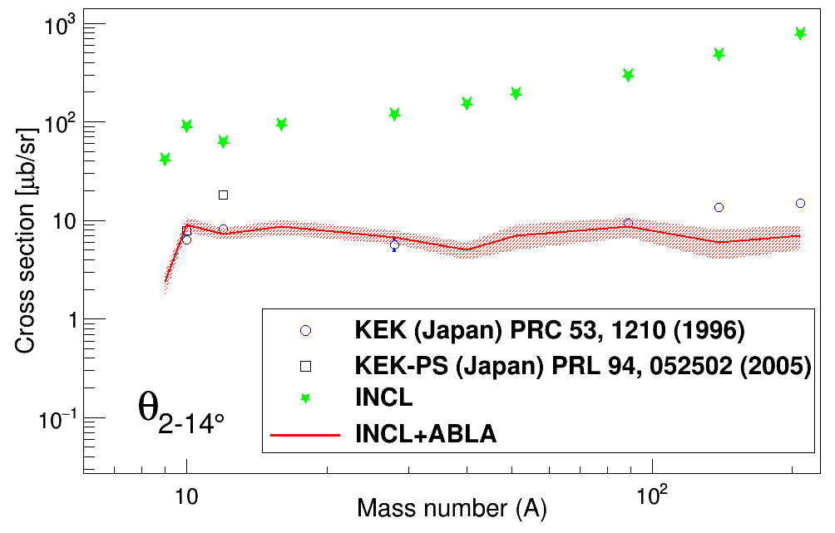
Λ evaporation
Hyperfission (fission of hypernucleus)
Results
V_{Λ} = 28 MeV
V_{Λ} fitted
J. L. Rodríguez-Sánchez et al., Phys. Rev. C 98, 021602(R) (2018)
The Liège Intranuclear Cascade
(INCL) model….

Slide 38
Λ evaporation
Hyperfission (fission of hypernucleus)
Results
The Liège Intranuclear Cascade
(INCL) model….

Slide 39

Conclusions
INCL - Abla
in GEANT4
Projectiles n, p, π, K, A $≤$ 18
Energies → 10-20 GeV
Emission p, n, π, Λ , Σ , K and clusters
Hypernuclei Yes! (NOT in GEANT4)
Future works
  New projectiles e⁻, μ, antiproton (thesis…)
Ξ added?
Study of uncertainties...
The Liège Intranuclear Cascade
(INCL) model….

Slide 40
Collaborators
Alain Boudard, Joseph Cugnon, Jason Hirtz,
Sylvie Leray, Davide Mancusi, Jose Luis Rodriguez Sanchez
The Liège Intranuclear Cascade
(INCL) model….

Slide 41
Thank you!
The Liège Intranuclear Cascade
(INCL) model….

Slide 42
The Liège Intranuclear Cascade
(INCL) model….

