Slide 1


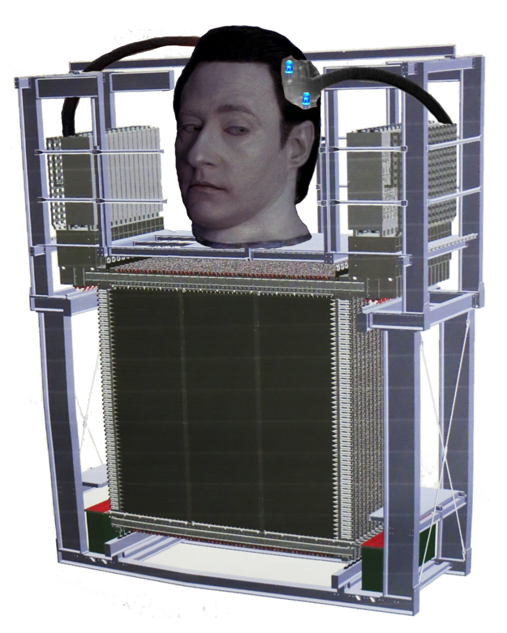
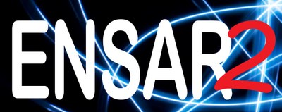


1/16
The use of Geant4 simulations for training a DNN to perform the NeuLAND data analysis
C. A. Douma
24 April 2019
28 Februari 2017

Slide 2
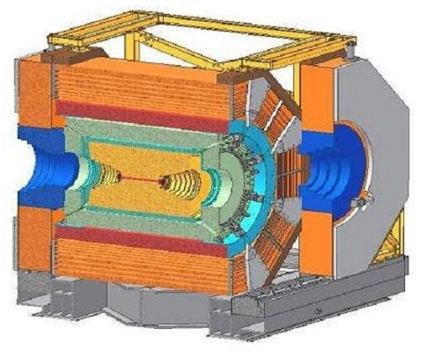
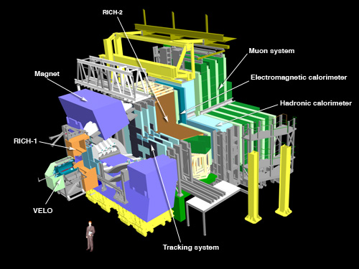
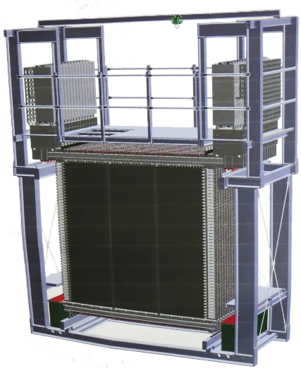
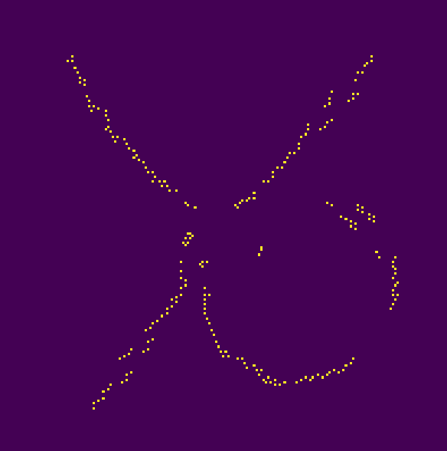
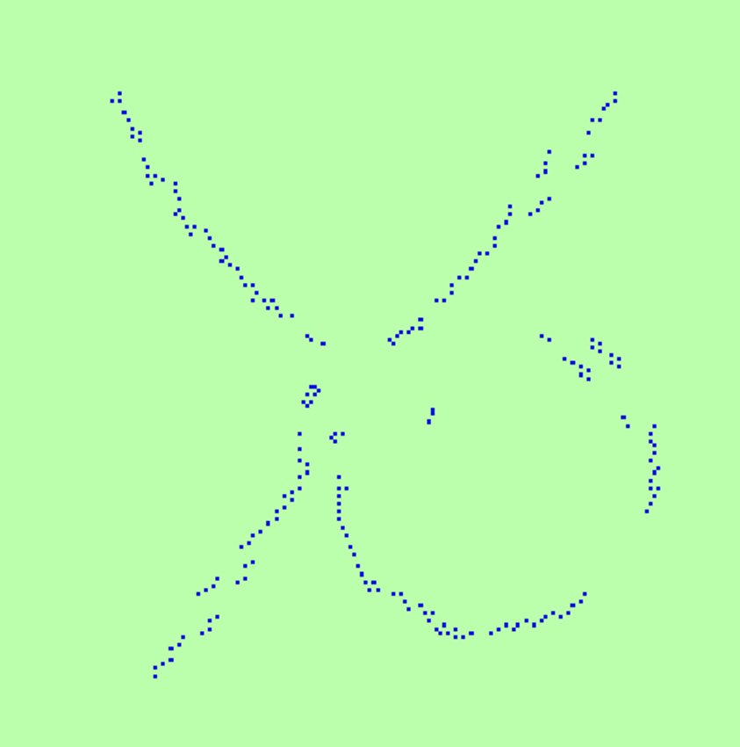
2/16
Machine Learning & DNNs
Deep artifical Neural Network (DNN) ➔ Can learn any math. function/alogorithm
if network is complex enough
➔ Ideal for complex data analysis
BES-III detector
Other applications…?
NeuLAND detector:
ID incoming neutrons
➔ Our case!
Resolve individual tracks in drift chamber in magnetic field.
H. de Vries, MSc thesis, RUG (upcoming).

Slide 3
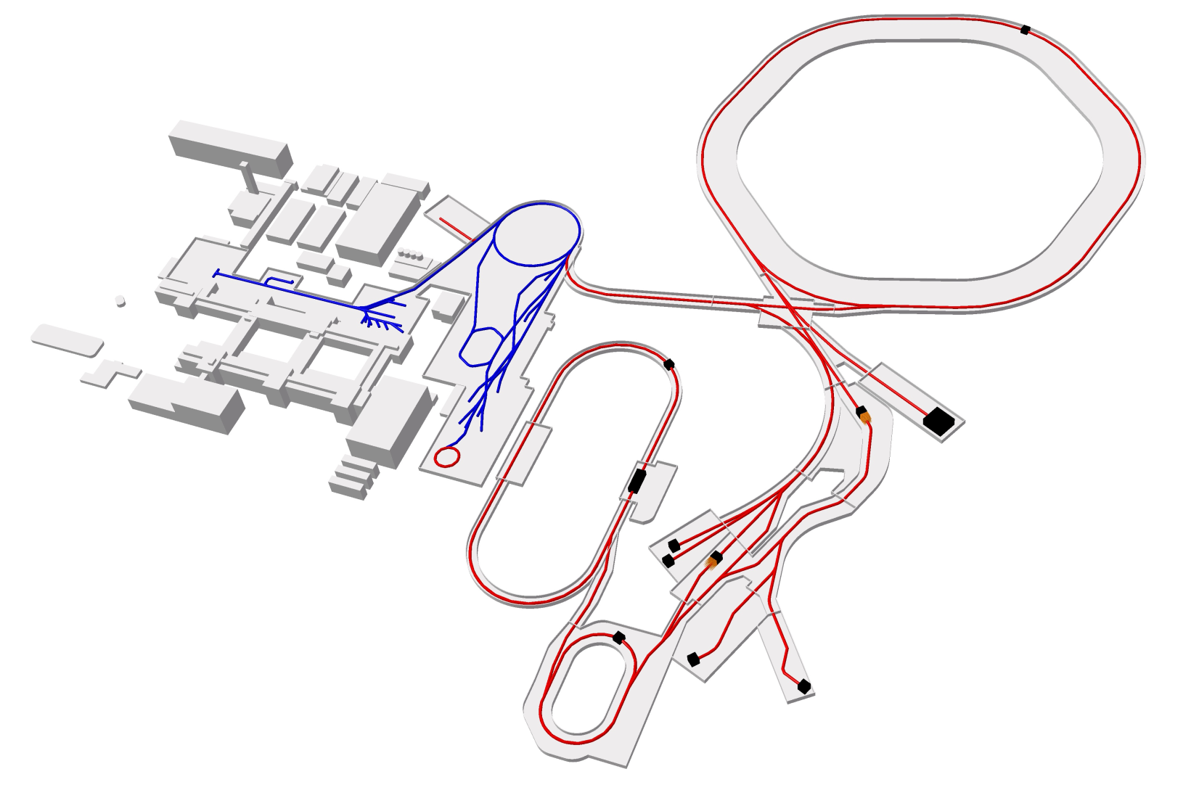

3/16
R3B Experiment in a nutshell
Primary accelerator
Pre-acceleration
Fixed primary target
Selection of exotic fragments
➔ Radioactive Beam
R3B experiment
➔ Measure nuclear structure of the beam

Slide 4

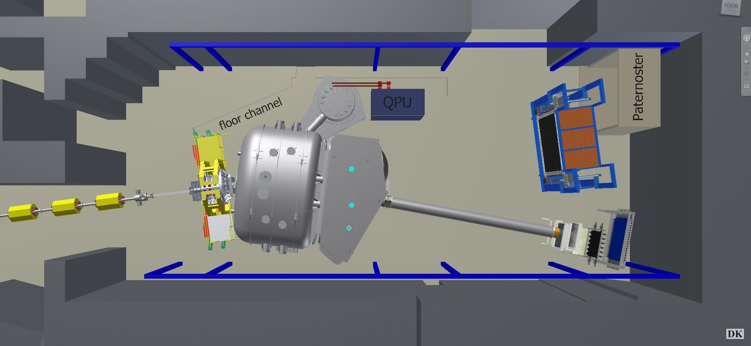
3/16
R3B Experiment in a nutshell
Full kinematic reconstruction of nuclear Reactions with Radioactive Relativistic Beams
Primary accelerator
Neutrons are detected by NeuLAND ➔ Neu(=new) Large Area Neutron Detector)
Pre-acceleration
In-beam detector for diagnostics
GLAD (bending magnet)
Vacuum chamber
neutrons
Fixed primary target
Selection of exotic fragments
➔ Radioactive Beam
Outgoing fragment
➔ Detected by TOF wall & wire chambers
Incoming radioactive
beam
Protons (detected inside chamber)
R3B experiment
➔ Measure nuclear structure of the beam
Fixed target + gamma spectrometer (CALIFA) & proton tracker
R³B phase 0

Slide 5
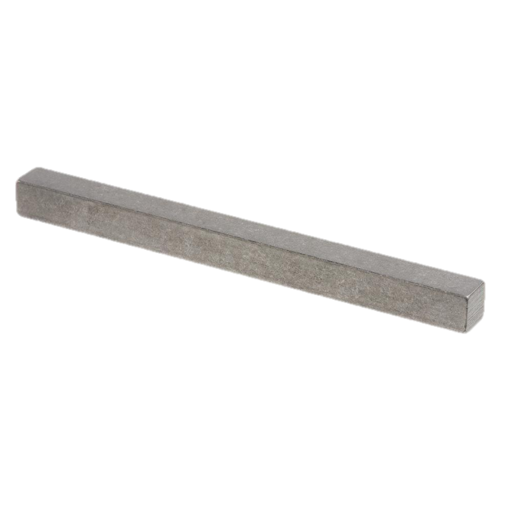
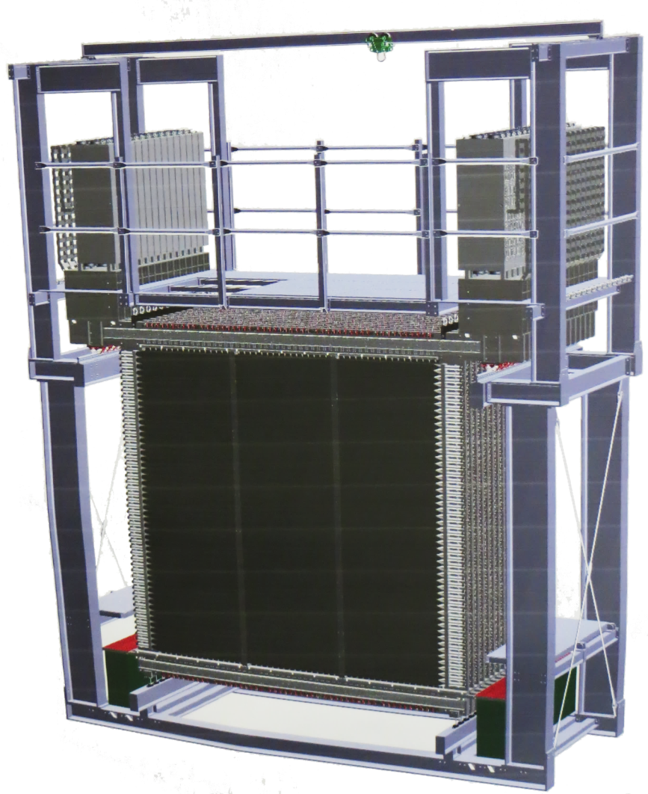
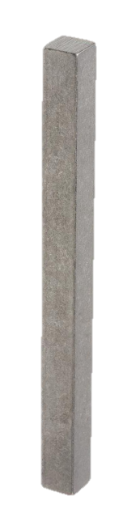
5/16
NeuLAND neutron detection
Scintillator bars: 50 bars per plane, 30 hor. planes & 30 vert. planes;
PMT on both ends of the bar
neutron

Slide 6
2/19
5/16
NeuLAND neutron detection
Scintillator bars: 50 bars per plane, 30 hor. planes & 30 vert. planes;
PMT on both ends of the bar
neutron

Slide 7
2/19
5/16
NeuLAND neutron detection
Measured PMT signals
Reconstruct (t,x,y,z,E) from TDC & QDC

Slide 8
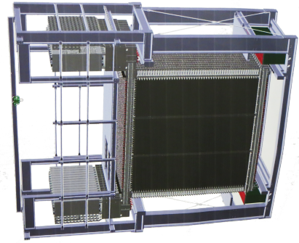
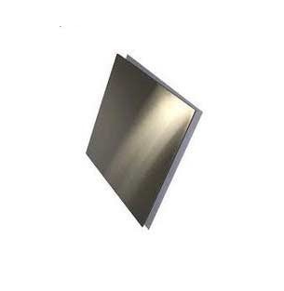
2/19
5/16
NeuLAND neutron detection
What we need:
Our data: NeuLAND digis:
(t,x,y,z,E) signals
Reaction (t,x,y,z): measured by tracking detectors
neutron
Beam
NeuLAND
Target
First hit (t,x,y,z)
of neutron
Reconstruct neutron momentum vector
From Reaction & First Hit.
Which one is the First hit?

Slide 9
2/19
5/16
NeuLAND neutron detection
What we need:
Our data: NeuLAND digis:
(t,x,y,z,E) signals
Reaction (t,x,y,z): measured by tracking detectors
neutron
Beam
NeuLAND
Target
First hit (t,x,y,z)
of neutron
Reconstruct neutron momentum vector
From Reaction & First Hit.
Or how about?

Slide 10
2/19
6/16
Use of Machine Learning
Given a set of (t,x,y,z,E)-signals:
How many first hits do they contain? (What is the multiplicity?)
Which of those signals are the first hits? (Which are the neutrons?)
Our data: NeuLAND digis:
(t,x,y,z,E) signals
Use Geant4 Monte Carlo simulations to generate data.
Feed it to a DNN for training.
But what if simulations do not represent reality?
We need accurate Geant4 physics lists!
neutrons

Slide 11
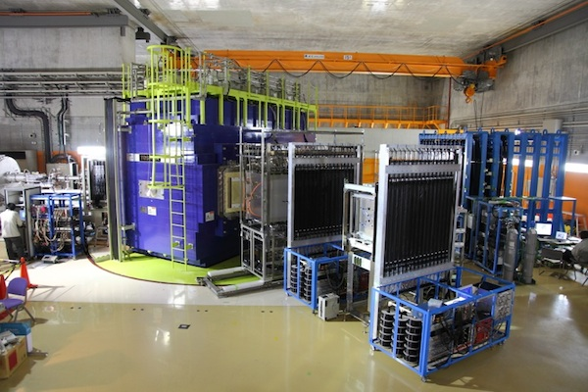
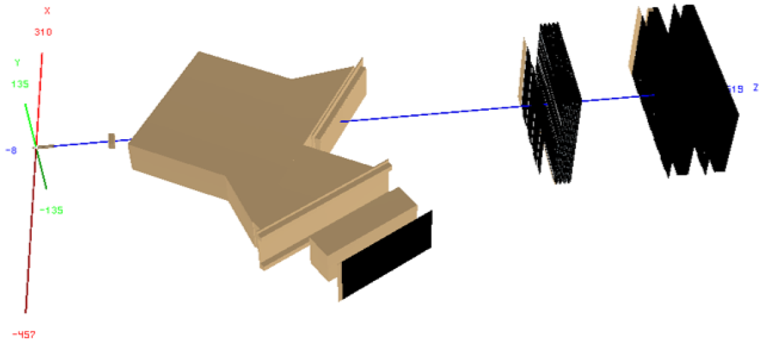
2/19
7/16
Benchmarking of Physics Lists
NEBULA detector
Ion-beam
Ion-beam
NeuLAND demonstrator
(8x50 bars, 4 double planes): K. Boretzky et al., MU-NUSTAR-NR-12,
GSI report 2014
SAMURAI dipole magnet
Ion TOF hodoscope
Simulation done by: J. Mayer, Ph.D. thesis, Universität zu Köln (2018)
SAMURAI setup: T. Kobayashi
et al., NIMB 317, 294 (2013)
➔ Benchmark single-neutron detection efficiency

Slide 12
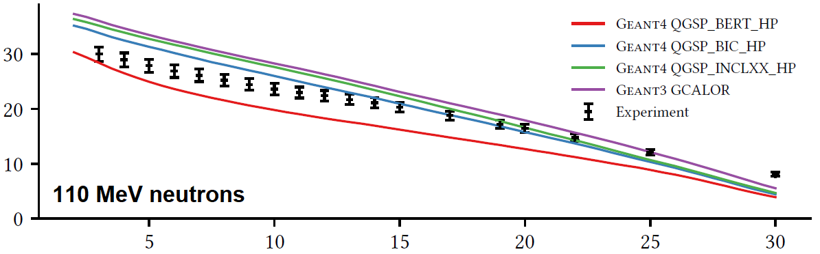
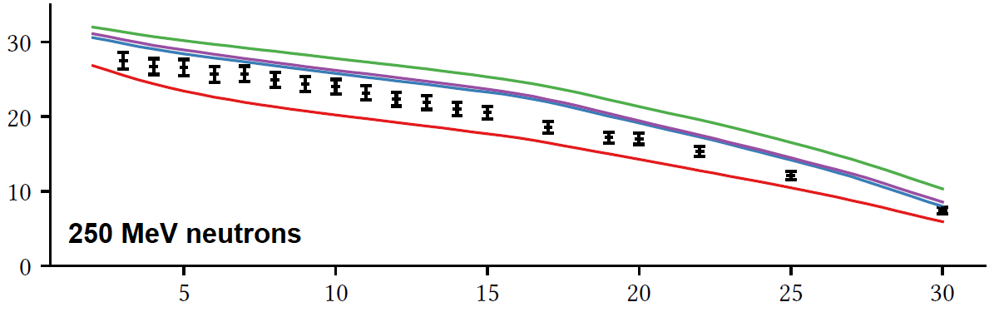
2/19
8/16
Benchmarking of Physics Lists
BERT: Bertini cascade model & quark-gluon string model with low E neutron physics
Single-neutron detection efficiency [%]
BIC: same, but uses Binary Cascade model
Energy deposition threshold in full NeuLAND [MeV]
INCL++: same, but uses Liege Intranuclear Cascade model & N-reactions A≤18
Our observation:
Exp ≈ ½ (BERT+INCL++)
What causes the diff. between phys. lists?
Consequences for DNN?

Slide 13
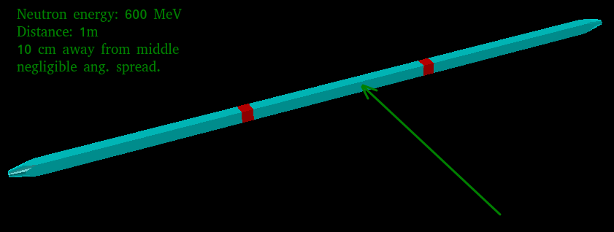
2/19
9/16
Shower developement
Phys. List | Interactions:
QGSP_INCLXX_HP | MC: 7.15% Det: 4.75%
QGSP_INCLXX | MC: 7.22% Det: 4.81%
FTFP_INCLXX_HP | MC: 7.20% Det: 4.79%
QGSP_BERT_HP | MC: 7.21% Det: 3.88%
QGSP_BIC_HP | MC: 7.21% Det: 4.48%
QBBC | MC: 7.15% Det: 4.45%
ShieldingM | MC: 7.17% Det: 3.89%
➔ Study in the simplest configuration
Study PDG & scat. angles of strictly sec. tracks
250 MeV neutrons
One single NeuLAND scintillator: 5x5x250 cm
CH2 material & Al-foil
10⁶ events simulated ➔ ≈0.1% stat. inaccuracy.
MC: #events where sec. tracks were created.
Det: #events where both PMTs fired.
Interaction rate is ≈ same.
Diff. in detection rate due to what?

Slide 14
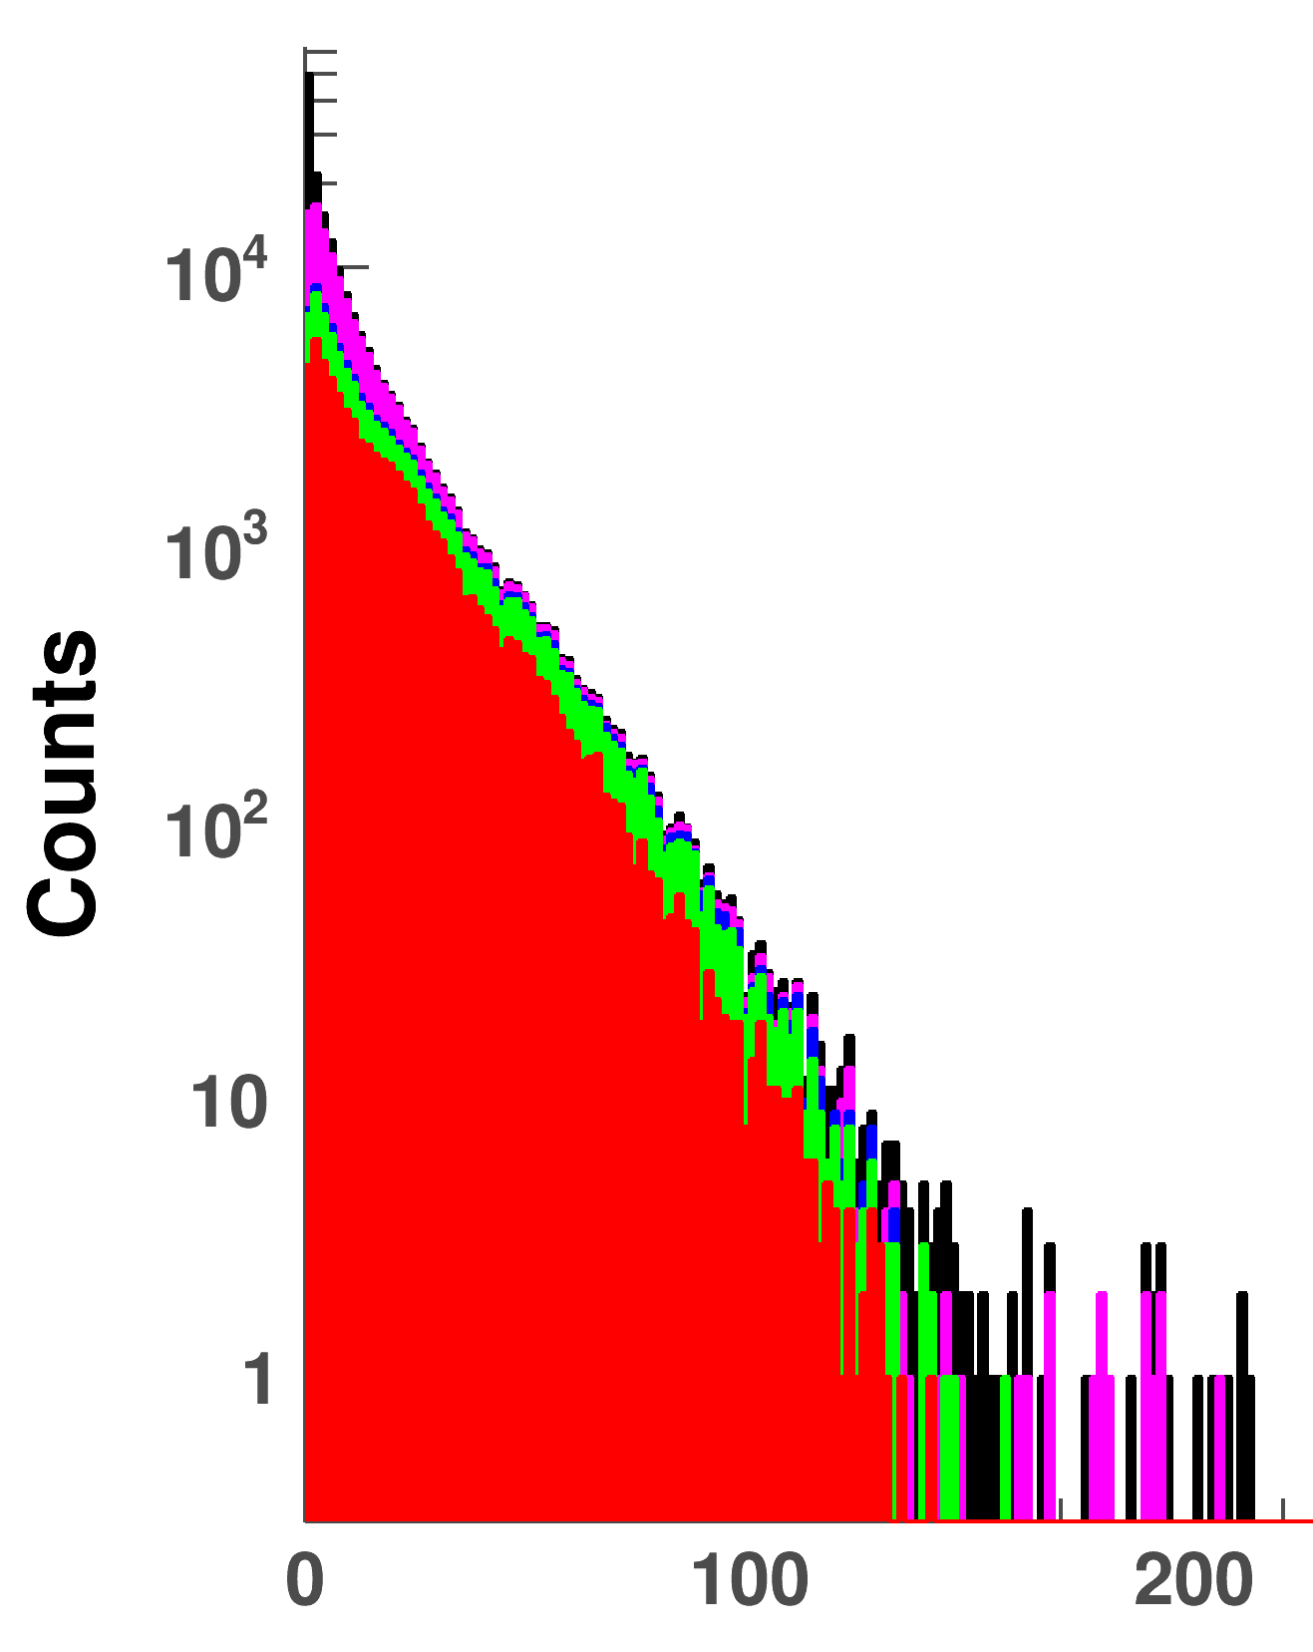
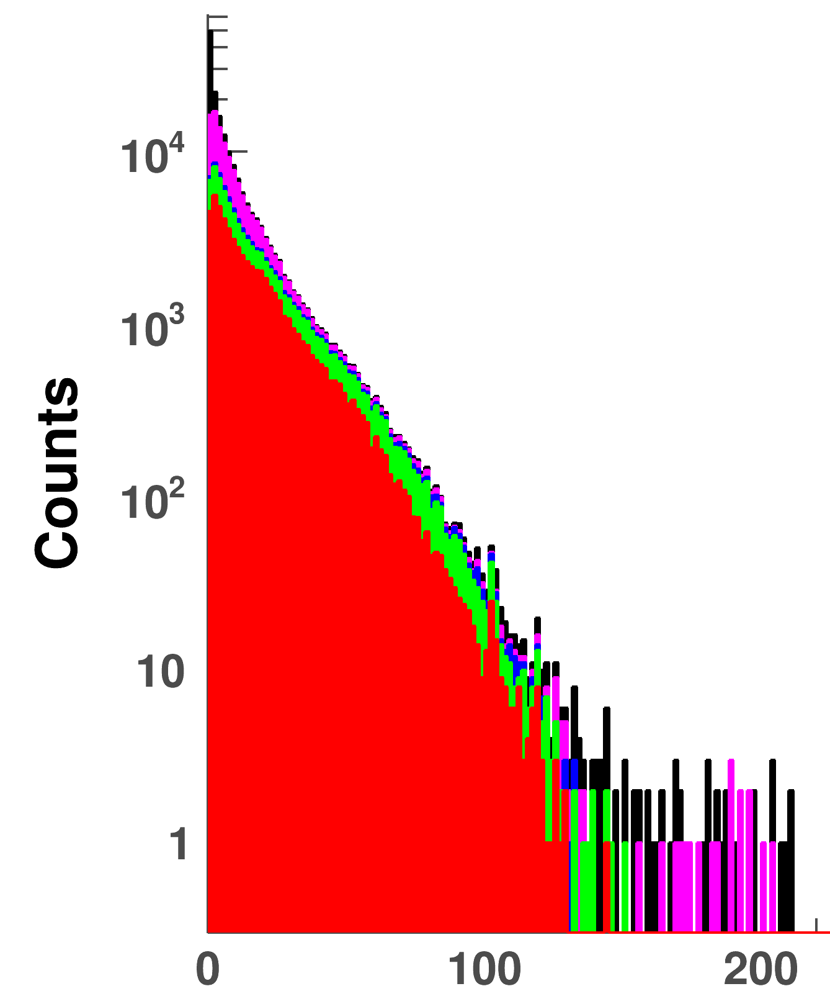
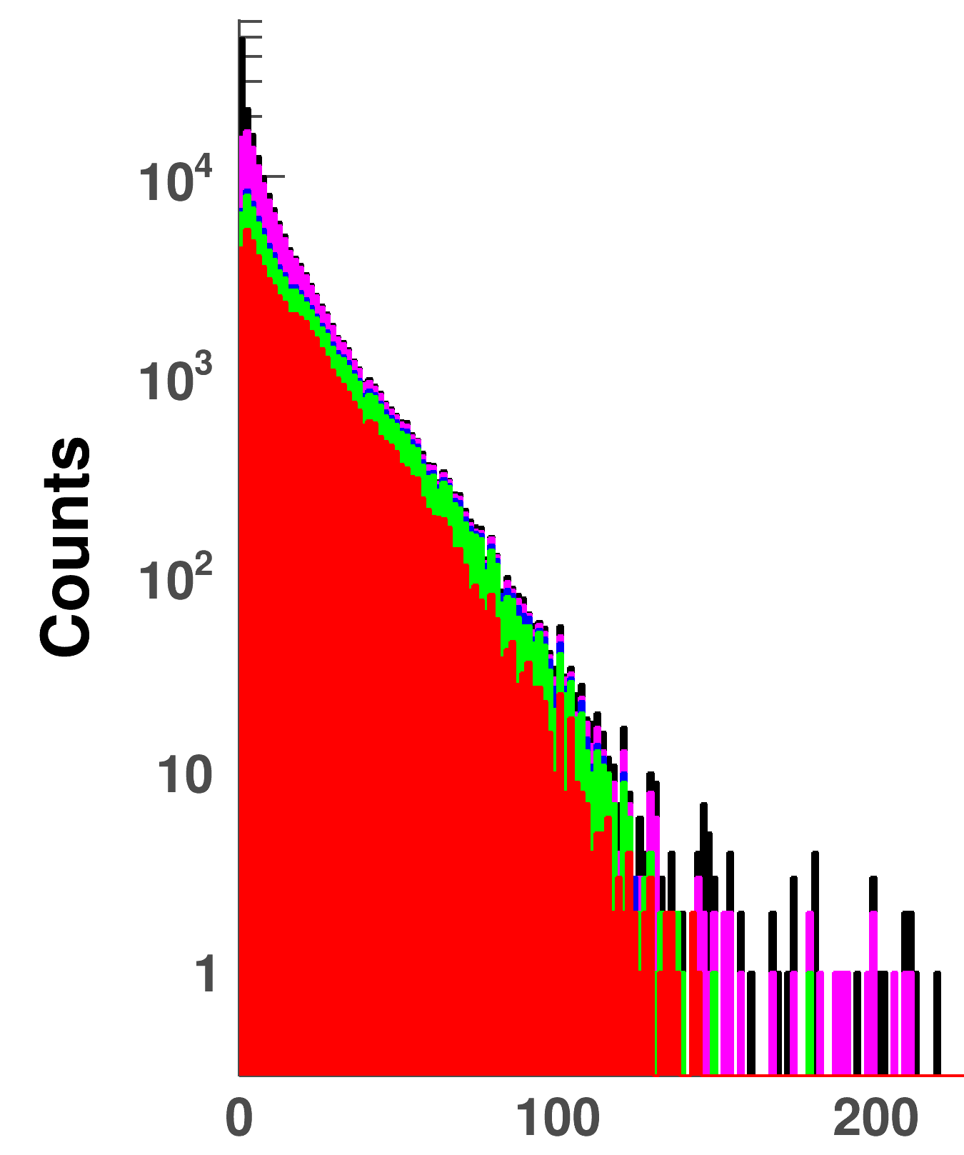
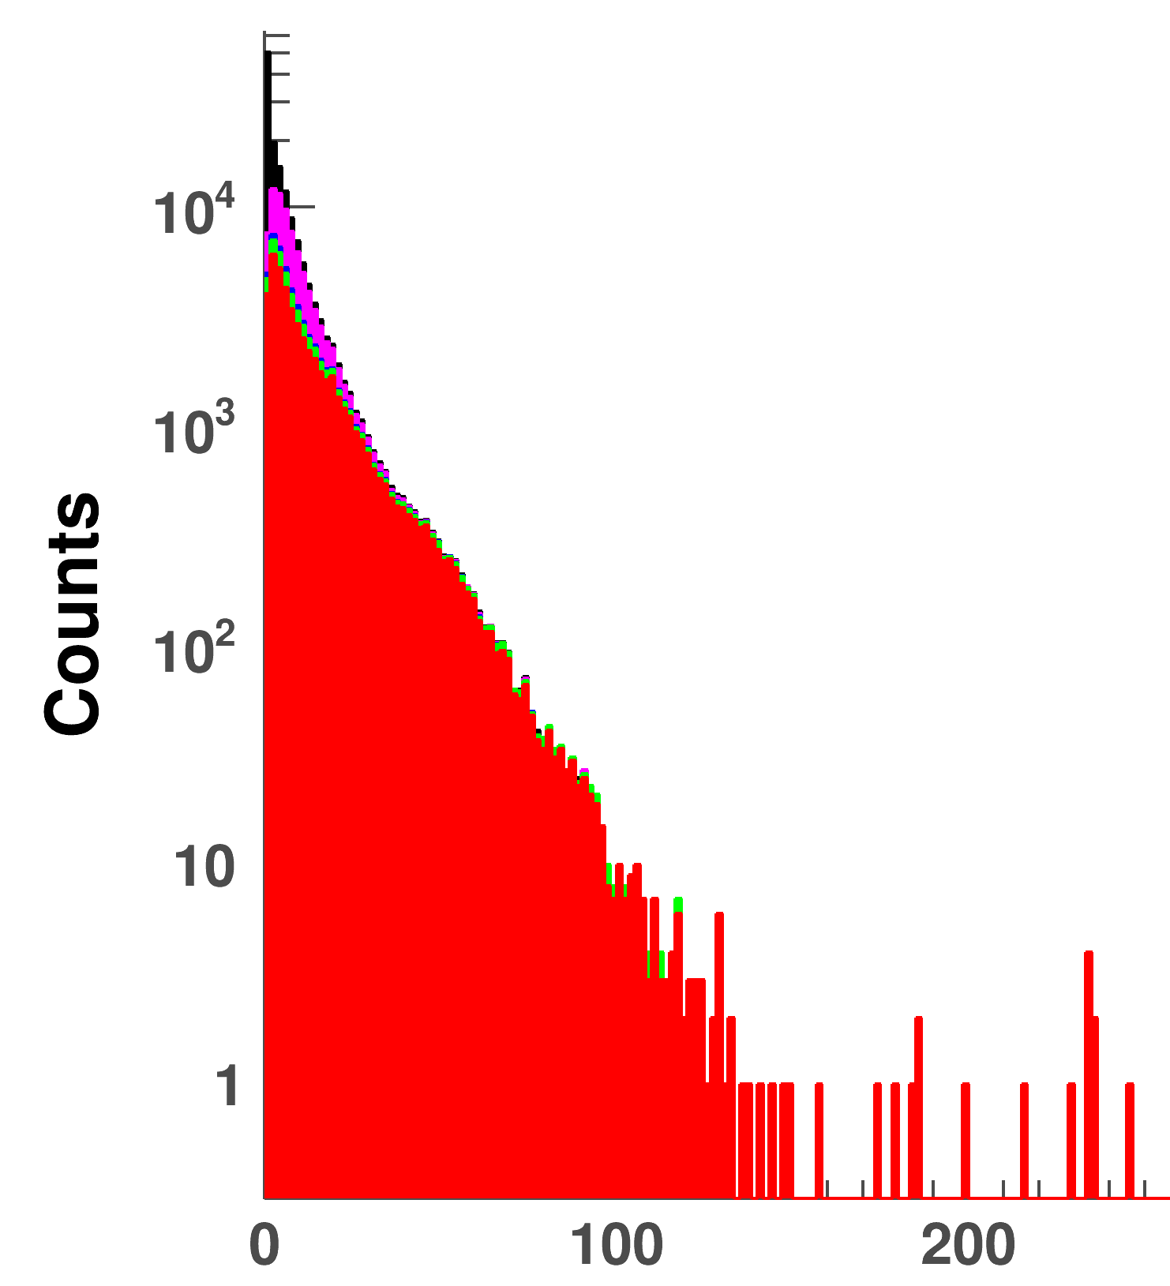
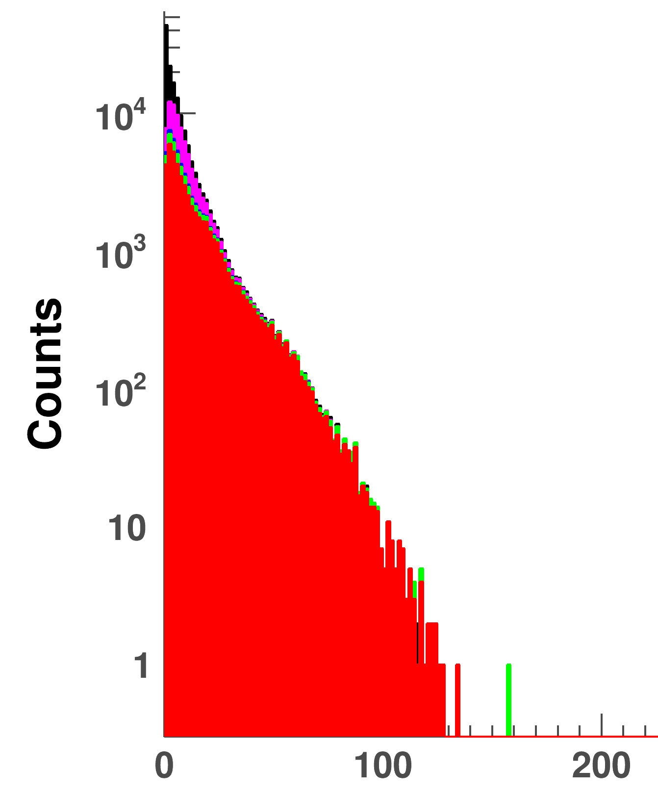
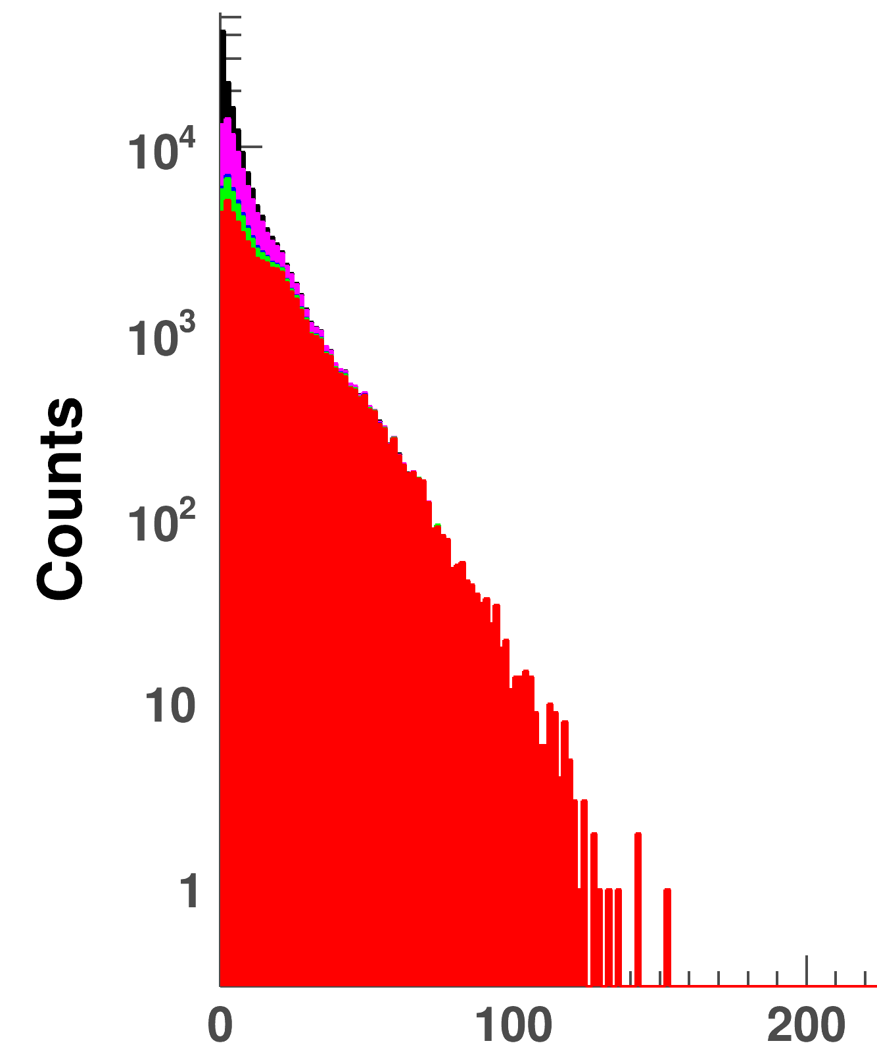
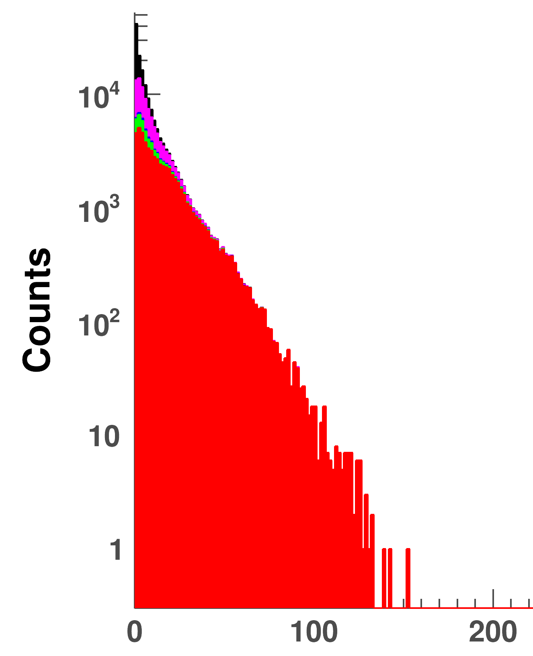
2/19
10/16
Energy deposition
Protons
Deuterons
QSGP_INCLXX_HP
QSGP_INCLXX
FTFP_INCLXX_HP
Tritons
Alphas
Other
ShieldingM
Deposited Energy [MeV]
Deposited Energy [MeV]
Deposited Energy [MeV]
QSGP_BERT_HP
QSGP_BIC_HP
QBBC
Deposited Energy [MeV]
Only INCL++ has significant (d,t,α) contributions
Deposited Energy [MeV]
Deposited Energy [MeV]
Deposited Energy [MeV]

Slide 15
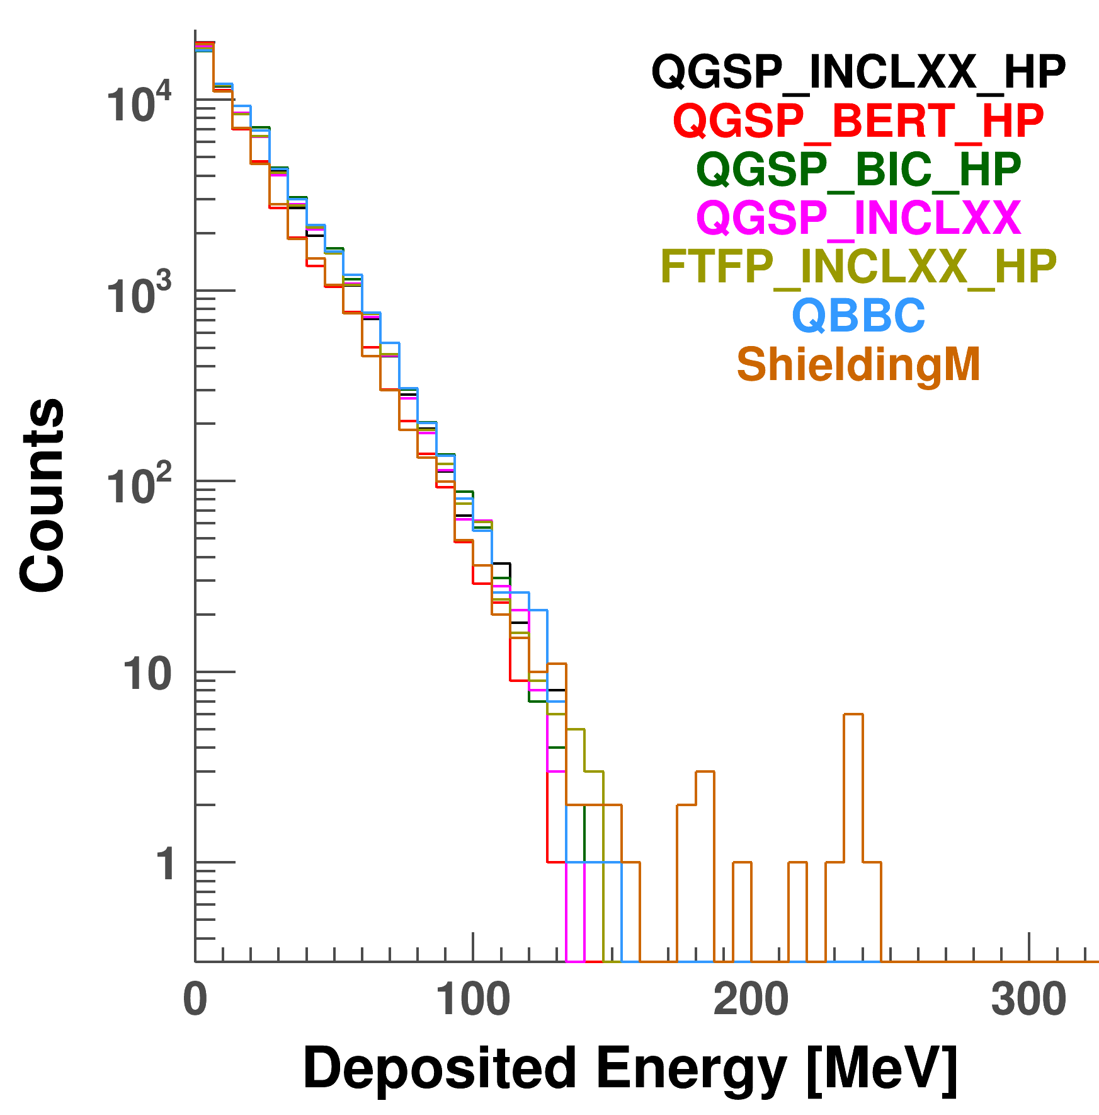
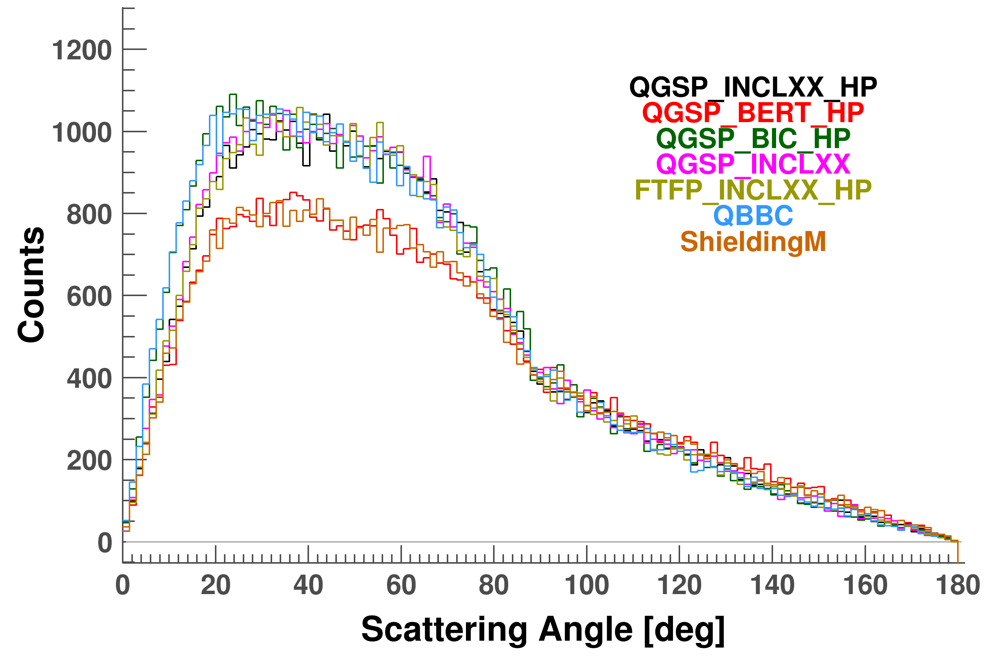
2/19
11/16
Particle tracks
Protons
ShieldingM & BERT produce less protons than the others
Scattering behaviour is ≈ same
Behaviour is ≈ same for all physics lists
Height is slightly different due to number of protons
➔ Differences are: nr. of produced protons & presence of (d,t,α) tracks.

Slide 16
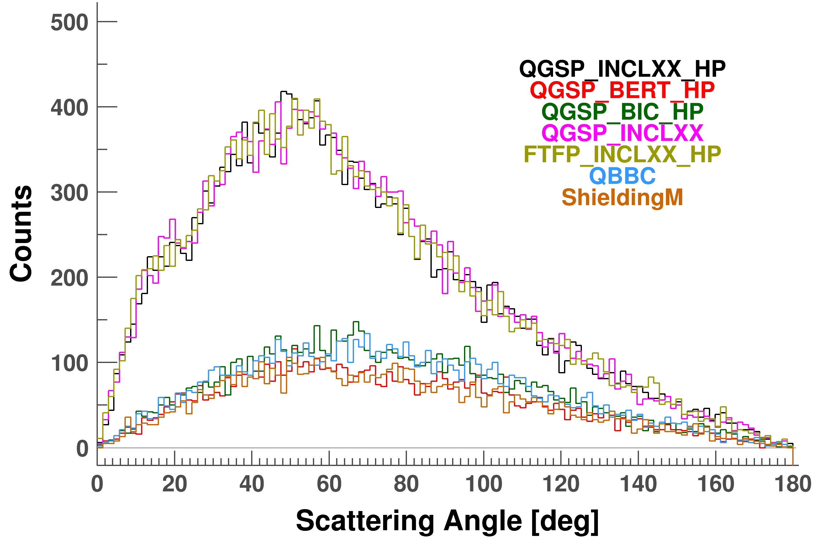
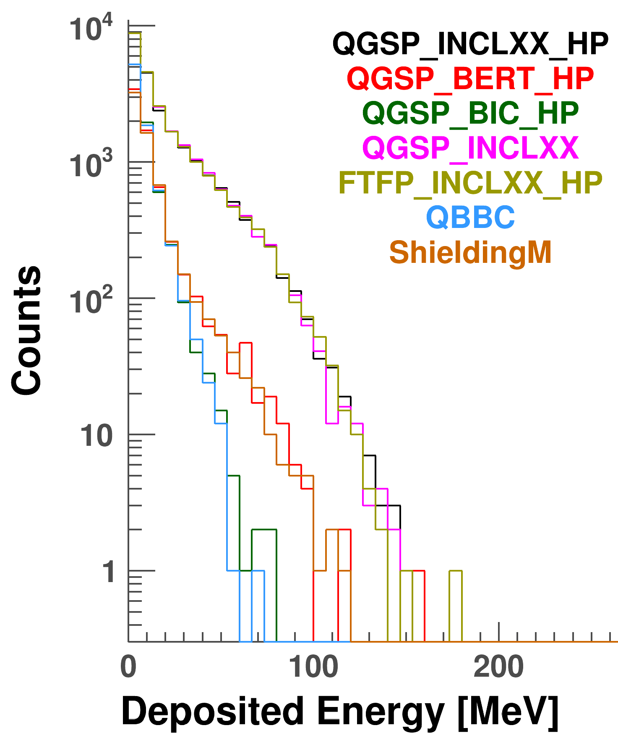
2/19
11/16
Particle tracks
Deuterons
INCL++ has more deuterons & they are slightly more forward boosted.
The produced deuterons also deposite (a lot) more energy for INCL++.

Slide 17
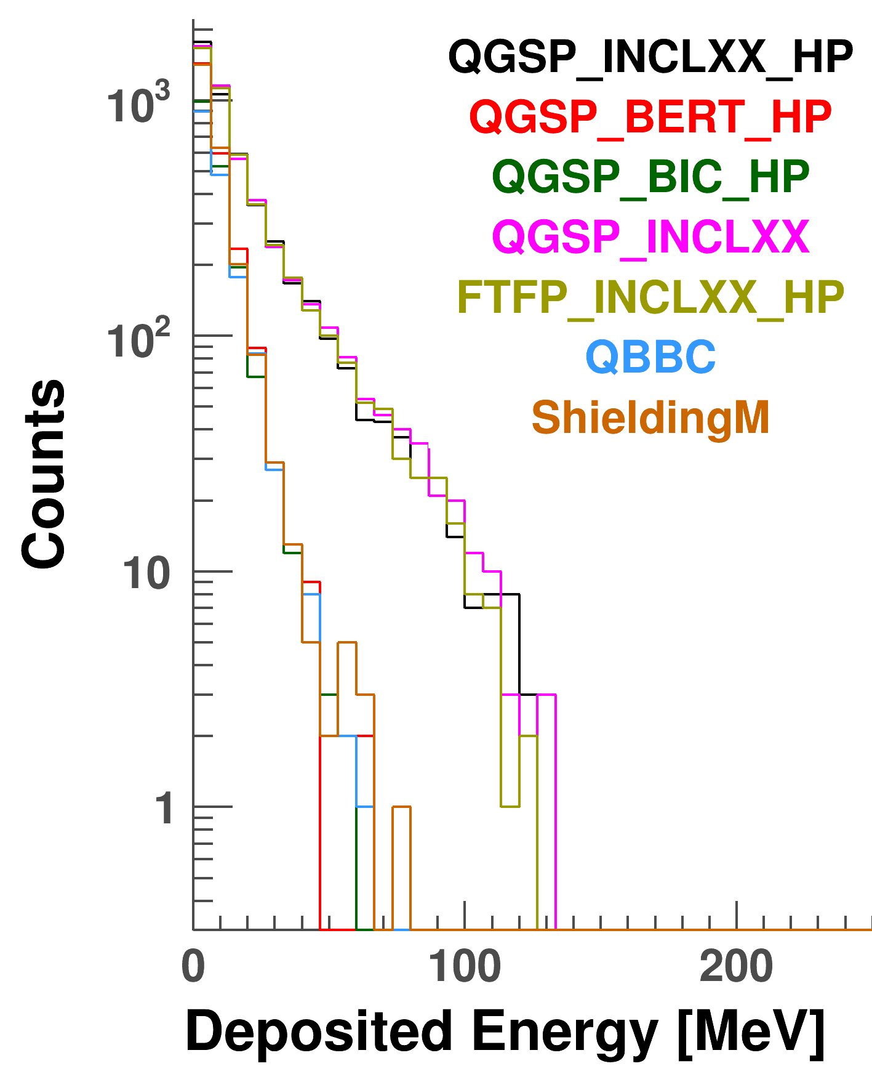
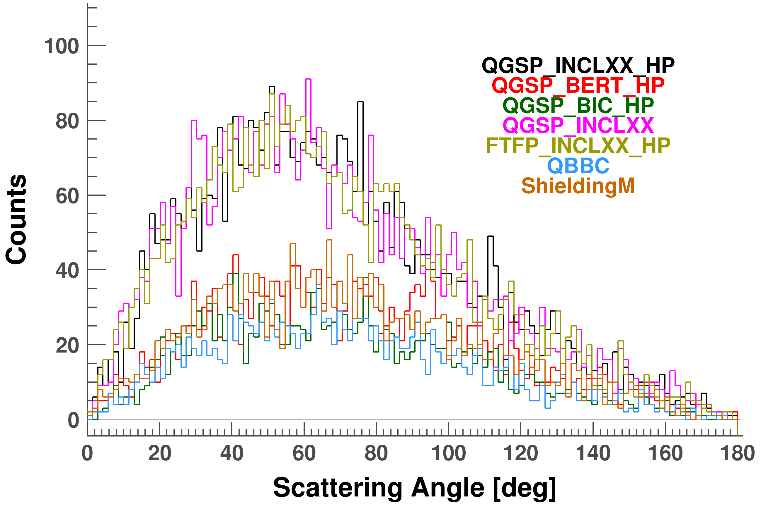
2/19
11/16
Particle tracks
Tritons
Scattering behaviour is ≈ same as for deuterons (just less particles).
E_{dep} is also ≈ same for non-INCL++ models

Slide 18
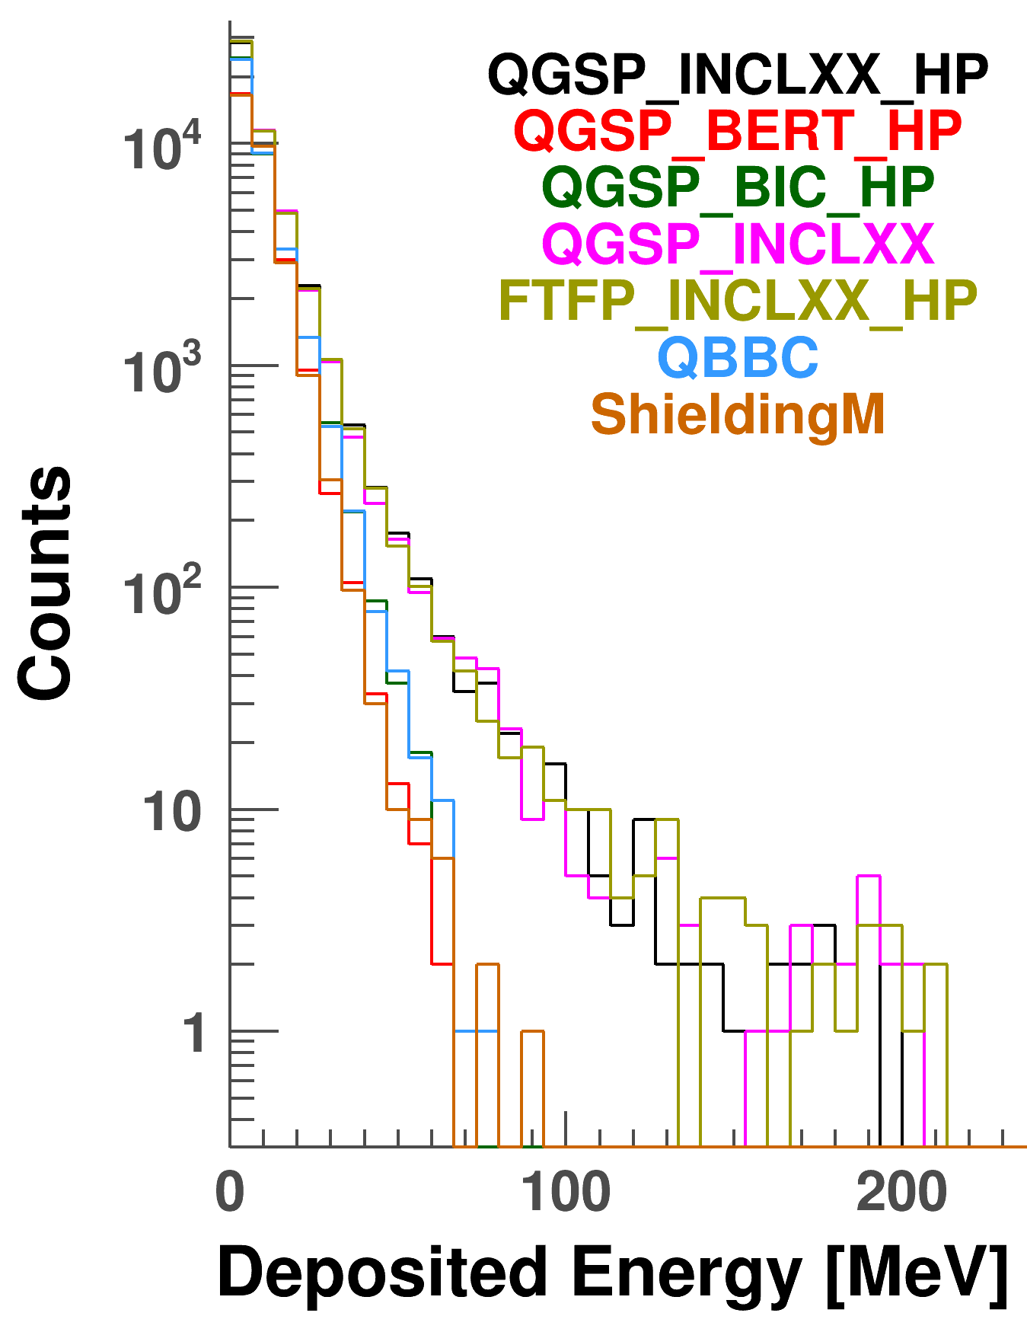
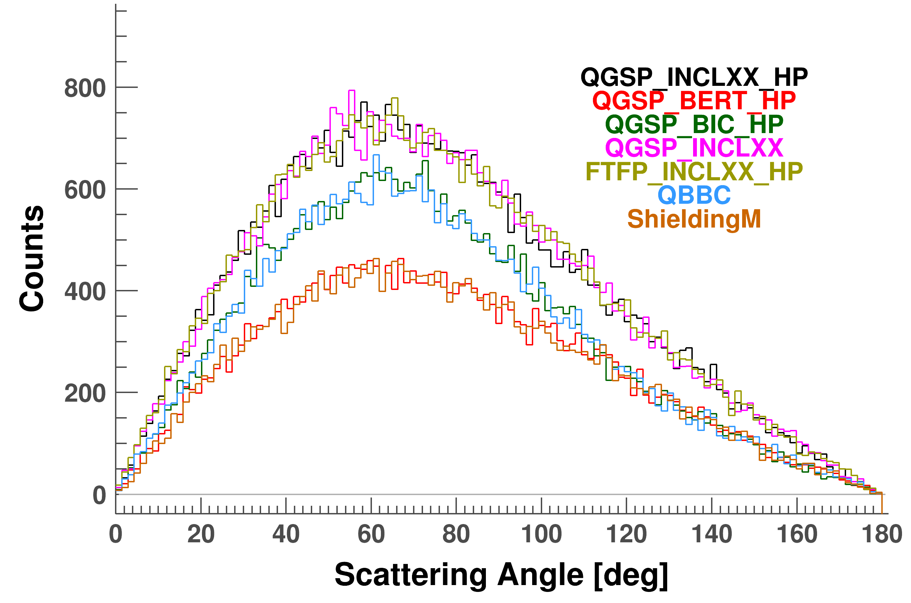
2/19
11/16
Particle tracks
Alphas
Number of α-particles differs.
Scattering behaviour is ≈ same.
Low energy deposition is ≈ same.
Few α-particles at higher energies, except for INCL++.

Slide 19
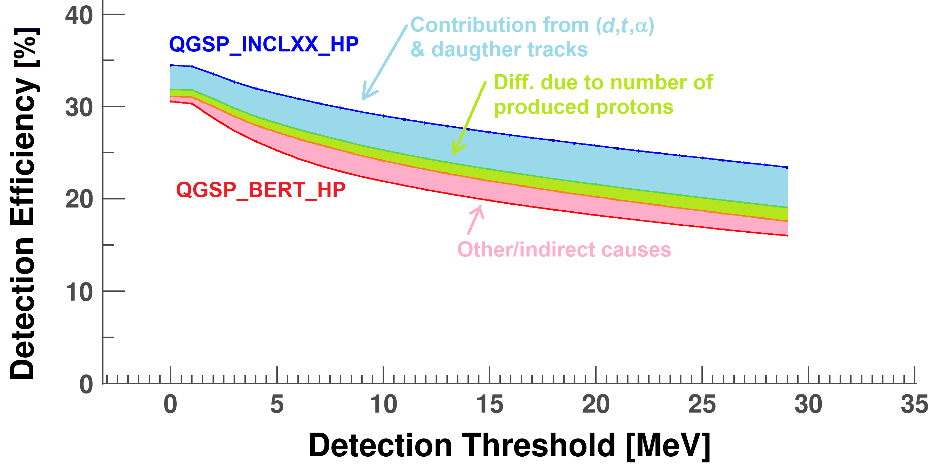
2/19
12/16
Comparing the contributions
250 MeV neutrons:
NeuLAND demonstrator
4 double planes @ 11m
NB: probably not realistic to have (almost) no (d,t,α) Energy deposition (CH₂ scintillators).
Geometry & event generator are slightly different from J. Mayer, Ph.D. Thesis
➔ So no benchmarking to exp. data (still working…)
We need: exp ≈ ½ (BERT + INCL++)
We see: |BERT – INCL++| = 50% due to (d,t,α) tracks
= 25% due to nr. of prod. protons
= 25% other/indirect causes

Slide 20
2/19
13/16
Physics list effects on DNN
Single neutron detection efficiency @ 250 MeV & 4 double planes:
20% – 32% (dep. on E_{thres}) & |BERT – INCL++| ≈ 8%
High neutron detection efficiency
Low neutron detection efficiency
DNN uses neighbouring relations to find primaries
M. Polleryd, M.Sc. thesis, Chalmers University (2017)
Physics list effects could be significant.
DNN is still under development
Use classical methods to estimate effects

Slide 21
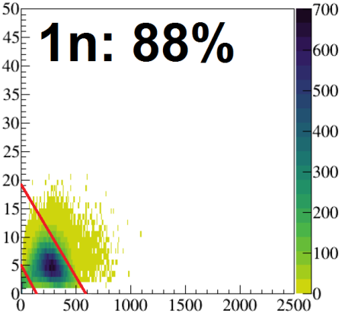
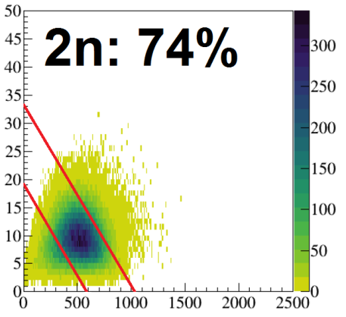
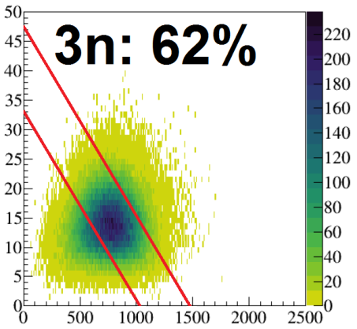
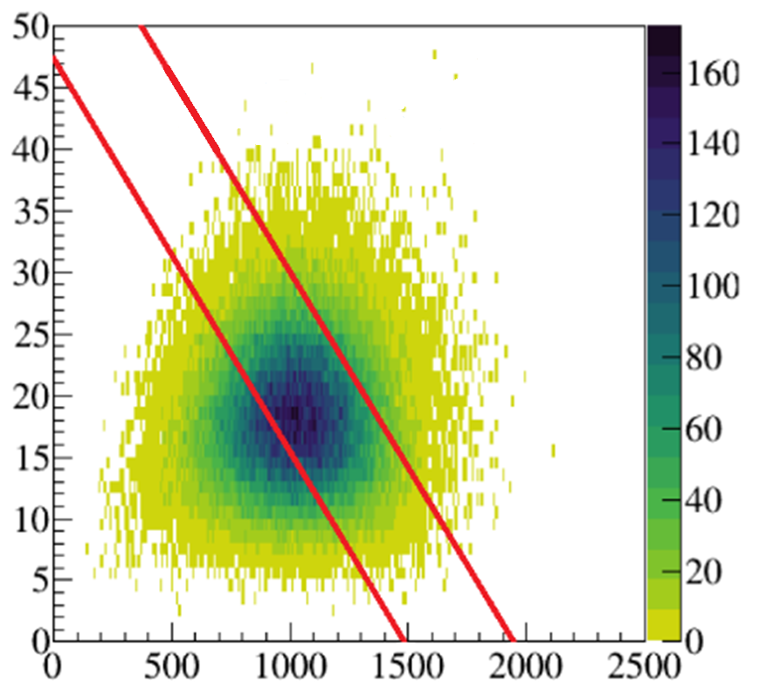
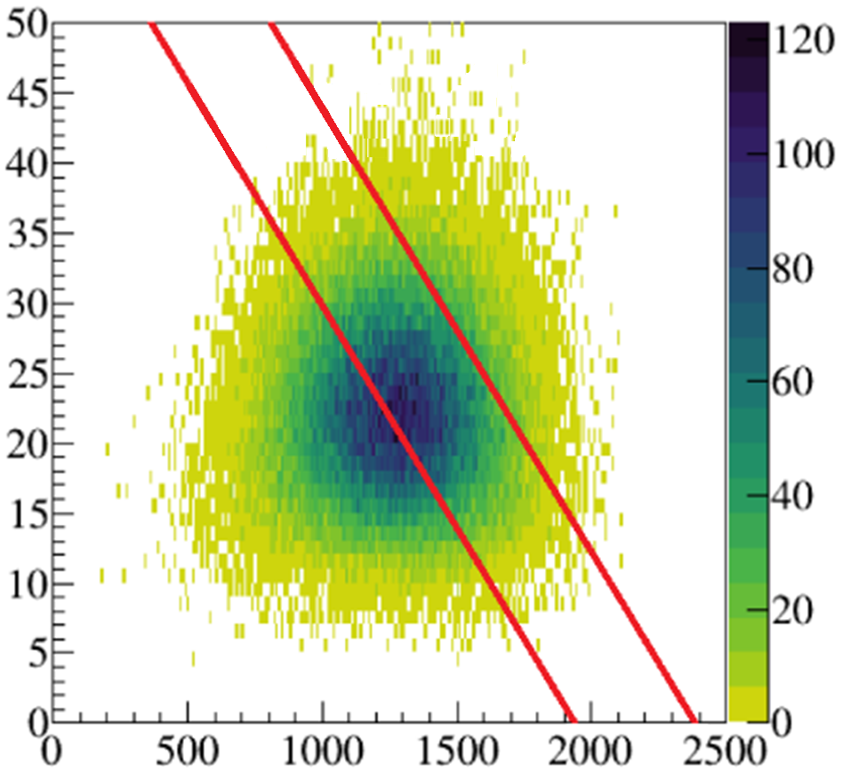
2/19
14/16
#clusters
Physics list effects
1n
2n
Traditional Method for multiplicity determination:
Simulate INCL++ & BERT
exp ≈ ½ (BERT + INCL++)
ΣE_{dep}
 | 200 MeV | 600 MeV | 1000 MeV
0n | 77±4% | 74±1% | 74±1%
1n | 73±8% | 79±2% | 80±1%
2n | 62±11% | 65±1% | 71±1%
3n | 58±10% | 56±1% | 61±1%
4n | 46±8% | 52±3% | 54±3%
5n | 57±8% | 61±2% | 62±4%
3n
4n
30 double planes
for NeuLAND @
14 m distance
5n
Physics lists errors are larger at lower energies
Relative errors: larger at higher multiplicities
NeuLAND is designed to detect high multiplicities

Slide 22
2/19
14/16
Full NeuLAND detector: 30 double planes
Physics list effects
Traditional Method for multiplicity determination:
Simulate INCL++ & BERT
exp ≈ ½ (BERT + INCL++)
Partial NeuLAND detector: 12 double planes
 | 200 MeV | 600 MeV | 1000 MeV
0n | 77±4% | 74±1% | 74±1%
1n | 73±8% | 79±2% | 80±1%
2n | 62±11% | 65±1% | 71±1%
3n | 58±10% | 56±1% | 61±1%
4n | 46±8% | 52±3% | 54±3%
5n | 57±8% | 61±2% | 62±4%
200 MeV | 600 MeV | 1000 MeV
82±2% | 82±1% | 83±1%
43±32% | 63±3% | 63±1%
57±5% | 51±1% | 52±1%
43±15% | 42±1% | 44±1%
49±12% | 41±2% | 37±1%
35±15% | 48±5% | 50±1%
Physics lists errors are larger at lower energies
Relative errors: larger at higher multiplicities
NeuLAND is designed to detect high multiplicities
Physics list errors grow when detector gets smaller.

Slide 23
2/19
15/16
Conclusion
NeuLAND detects fast neutrons: 100 MeV – 1000 MeV.
Benchmarking revealed: exp ≈ ½ (QGSP_BERT_HP + QGSP_INCLXX_HP)
for single-neutron detection efficiency.
Diff. = 50% due to (d,t,α) tracks, 25% due to nr. of prod. protons & 25% other.
Effects are <2% at higher energies, but very significant at lower energies.
These differences prevent us from properly training our DNN.
➔ A new physics list is needed with:
- E_{dep} from (d,t,α) tracks & nr. of prod. protons between BERT & INCL++.
- neutron detection eff. (E_{dep} in CH₂ scintillators): ½ (BERT + INCL++).
- implement with special attention at lower neutron energies.

Slide 24
16/16
Thank you!

