Slide 1


Development & maintenance of SCADA
(Supervisory Control And Data
Acquisition) based control systems
Isaac Pérez Sanz
18-01-2023 With the support of:

Slide 2
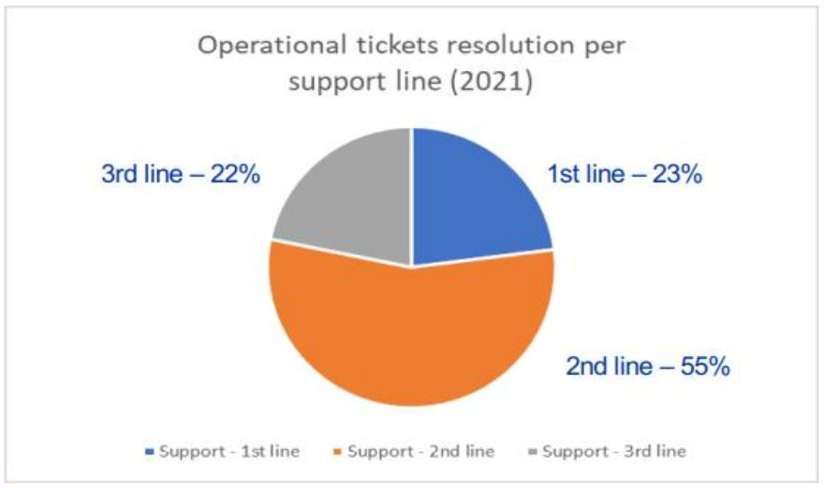



Prior context - The team & the job
• Supervisor: Lukasz Goralczyk (BE-ICS-CE)
• Colleagues:
• Alexandros Akostopos
• Marcin Bes
• Isaac Perez
• Jean-Charles Tournier (BE-ICS-FT)
Our job (2nd Line) is to keep up and running +200 SCADA applications that control
different systems at CERN. Meanwhile, improve the current infrastructure.
The technologies used are: WinCC OA 3.16, WinCC OA 3.19, UNICOS framework
CentOS 7, CentOS 9 stream, Docker, OpenSearch
18.01.23 Isaac Pérez | 15th FTEC Workshop

Slide 3
Project workload
Bi-weekly assignment to the 2nd Line
Compared to the previous year, it’s sometimes easy to spot the root cause
of an issue just by its description. Knowledge is gained just by experience
Some processes have been started to improve the existing documentation
Side projects:
wccdbase:
The project aims to create a WinCC DB of configurations for all the projects
and be able to retrieve all the DPs at once from an OpenSearch instance.
Advantages: Be able to easily compare configurations across all SAS projects
Other:
Little fixes or requests appear on the go. For example: UNICOS testing campaign or
small components creation
18.01.23 Isaac Pérez | 15th FTEC Workshop
3

Slide 4
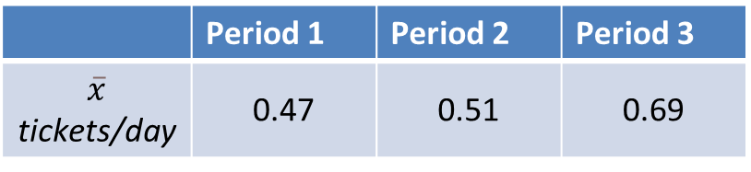
2nd Line Support
• In the next graphic we can see the evolution
on tickets interacted for three non-equalized
periods of time, and tickets directly solved.
Highlights:
• An evolution in performance can be seen when applying
the mean of tickets solved & assigned per effective day
 | Period 1 | Period 2 | Period 3
$$\overline{x}$$ tickets/day | 0.47 | 0.51 | 0.69
Evolution of ticket solving for three
periods of time not equalized
*30 days of vacation have been applied to the day calculus
18.01.23 Isaac Pérez | 15th FTEC Workshop
4
Notes:
Till 1st February: (184 days)
Number of tickets interacted: 184
Number of tickets solved: 44
Till July: 149 days
138: created >= "2022-02-01" and created < "2022-07-01" and (assignee = currentUser() OR reporter = currentUser() OR watcher = currentUser()) ORDER BY updated DESC
38: created >= "2022-02-01" and created < "2022-07-01" and (assignee = currentUser() and status = Resolved) ORDER BY updated DESC
From 1st July till 17th January:
*Days*: 200 days – 30 = 170
189: created >= "2022-07-01" and (assignee = currentUser() OR reporter = currentUser() OR watcher = currentUser()) ORDER BY updated DESC
59: created >= "2022-07-01" and (assignee = currentUser()) and status = Resolved ORDER BY updated DESC

Slide 5
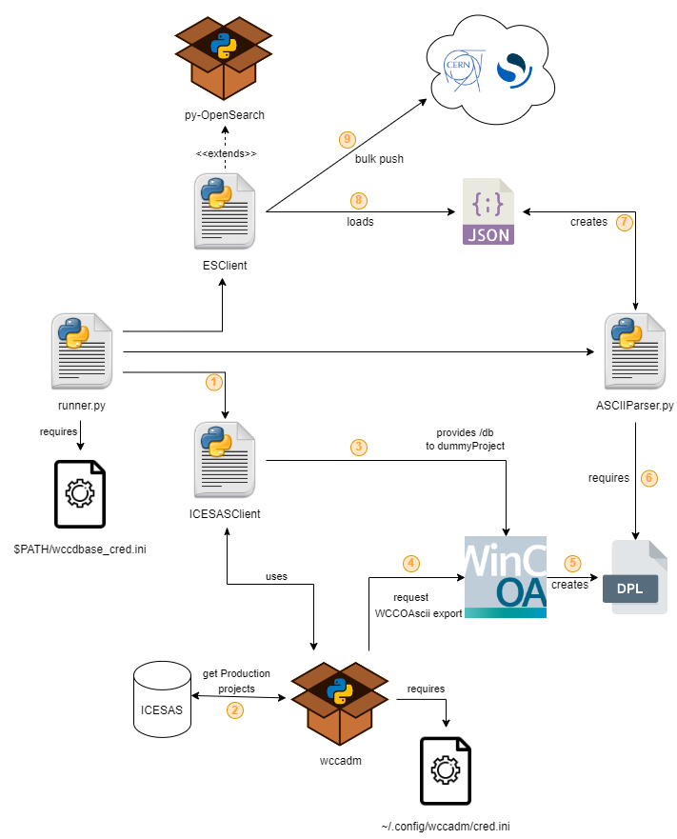
wccdbase – WinCC DBase?
It has been a challenge to reengineer an old implementation of wccdbase
The previous work (2y ago) was using ElasticSearch, but never
became production grade
From Proof of Concept (2021) to Production (2023)
18.01.23 Isaac Pérez | 15th FTEC Workshop
6

Slide 6
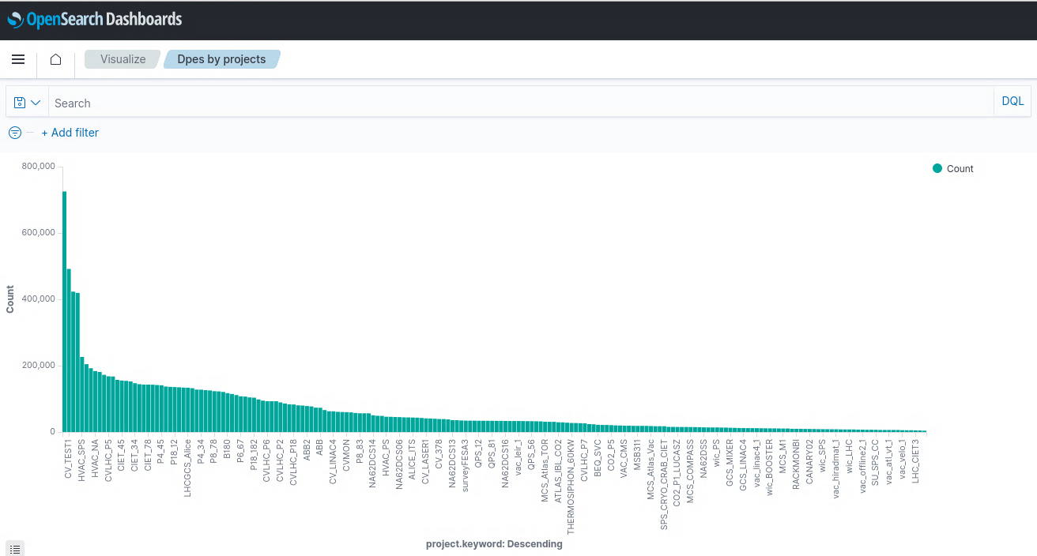
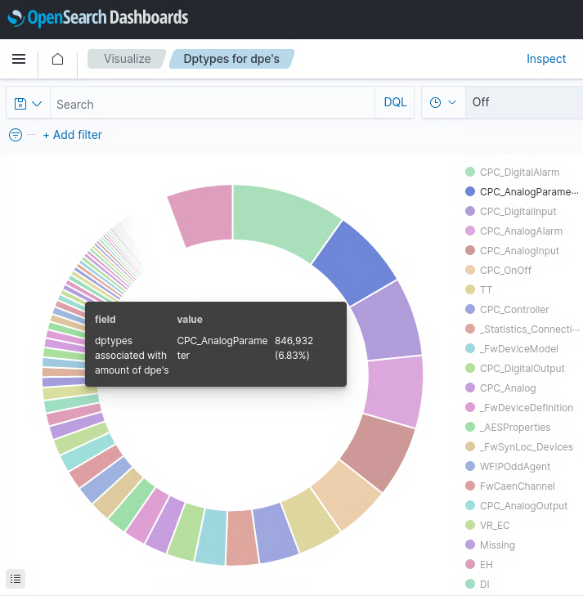
https://es-wccdbase.cern.ch/
Gitlab
wccdbase
18.01.23 Isaac Pérez | 15th FTEC Workshop
6

Slide 7



There’s more to come…
before finishing the contract
3.19
18.01.23 Isaac Pérez | 15th FTEC Workshop
6

Slide 8
Thank you
Questions?
18.01.23 Isaac Pérez | 15th FTEC Workshop
8

Slide 9

home.cern

