Slide 1


Characterisation of
Bunch-by-Bunch Tune Shift Effects in the CERN SPS
Ingrid Mases Solé (BE-ABP-INC)
Special thanks to: H. Bartosik and C. Zannini
FTEC Workshop 18/01/2023

Slide 2
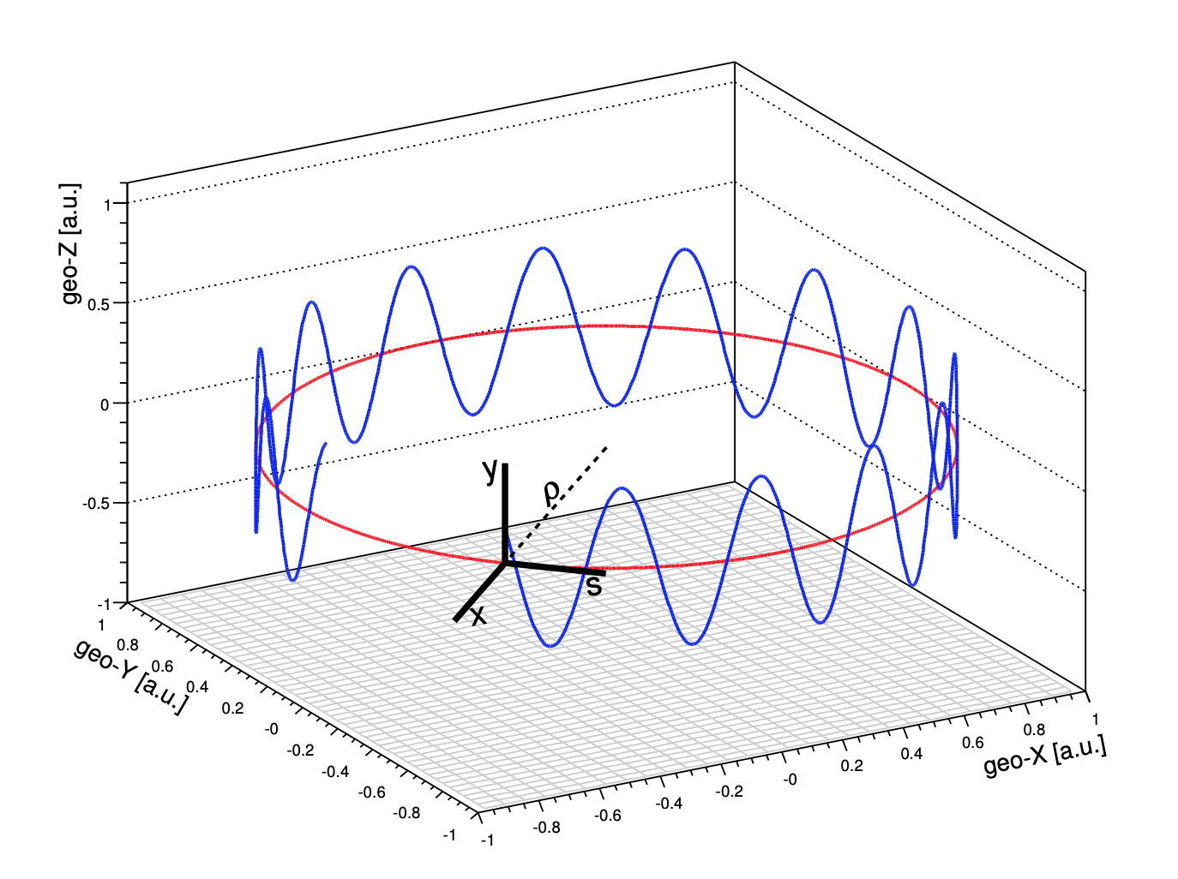
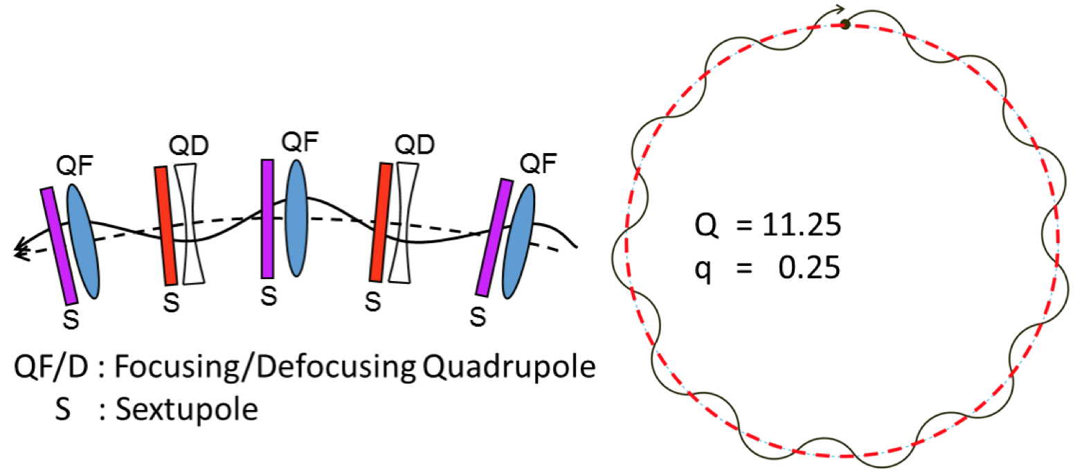
Motivation of the project
Definition of TUNE, Q
  Number of transverse oscillations that the particles describe during one revolution in the accelerator (frequency of the transverse oscillations)
Q_{x} = 20.13
Q_{y} = 20.18
Beam stability and beam losses depend on the tune
Avoid values of tune that make de beam unstable due to resonances

Slide 3
Motivation of the project
Why is bunch-by-bunch tune measurement and correction important?
LHC Injectors Upgrade, LIU [1]
High intensity of bunches in the SPS
Strong bunch-by-bunch tune shift effect from impedance
At injection the beam is more sensible to instabilities
Every time a train of bunches is injected in the SPS, a tune correction needs to be done such that
the measured tune of the last injected train is at the nominal value.
Horizontal and vertical tune correction in order to ensure:
    Beam stability
    Good beam transmission (reduce losses)

Slide 4
OUTLINE
Introduction
New experimental measurements and comparison to PyHT simulations
Transverse tails and beam profile measurements in the SPS (together with E. de la Fuente)
Growth rate measurements (together with E. de la Fuente)
Measurements of the Vertical coupled bunch instability in the SPS
Outlook

Slide 5
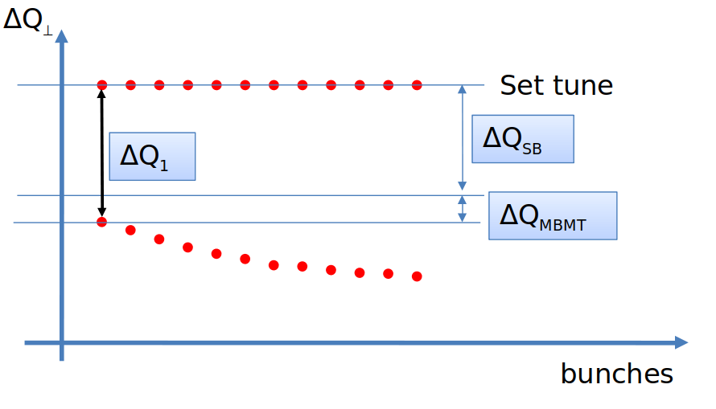
INTRODUCTION
SINGLE BUNCH TUNE SHIFT [2] due to narrowband impedances
MULTITURN TUNE SHIFT due to broadband impedances
The tune shift depends on:
The intensity per bunch
The total intensity of the beam, through:
  The number of bunches
  The number of trains of bunches (batches)
Tune shift grows for the trailing bunches as the wakefield builds up along the train

Slide 6
INTRODUCTION
OBJECTIVE
Obtain a method to predict the tune shift depending on the beam configuration (number of bunches, number of batches and intensity per bunch).
MEASUREMENTS
(at different intensities)
SIMULATIONS

Slide 7
OUTLINE
Introduction
New experimental measurements and comparison to simulations
Transverse tails and beam profile measurements in the SPS (together with E. de la Fuente)
Growth rate measurements (together with E. de la Fuente)
Measurements of the Vertical coupled bunch instability in the SPS
Outlook

Slide 8
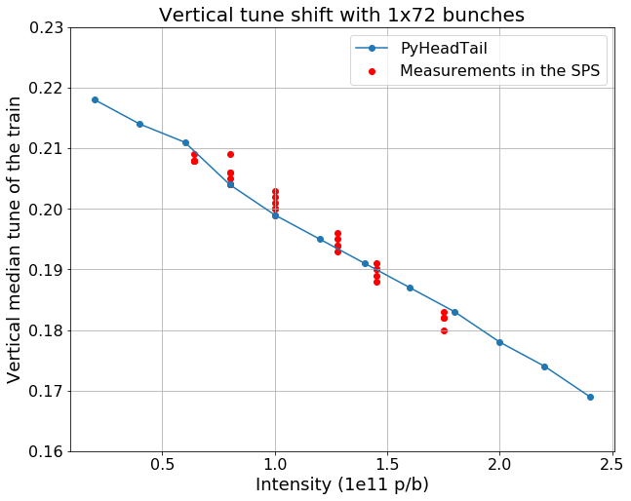
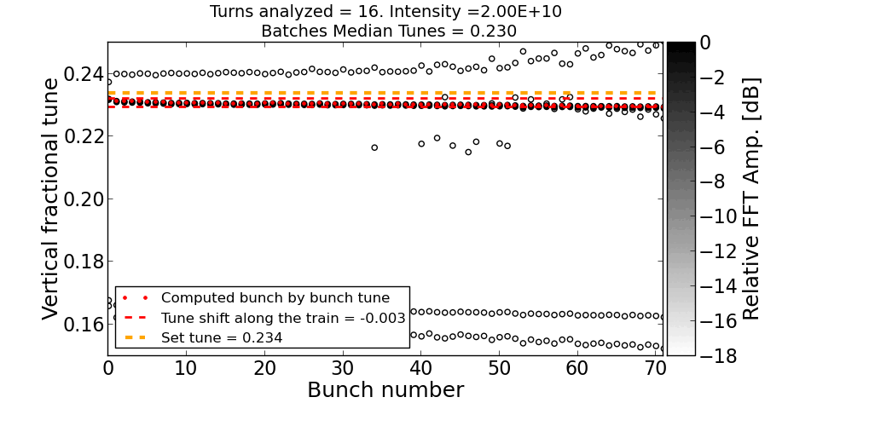
NEW MEASUREMENTS AND SIMULATIONS
PyHEADTAIL simulations of 1 train of 72 bunches
Measurements of 1 train of 72 bunches
Study how the tune changes when intensity
is increased from 0.2e11 p/b to 2.4e11 p/b
As intensity gets higher, tune is shifting down
Good agreement between measurements and simulations

Slide 9
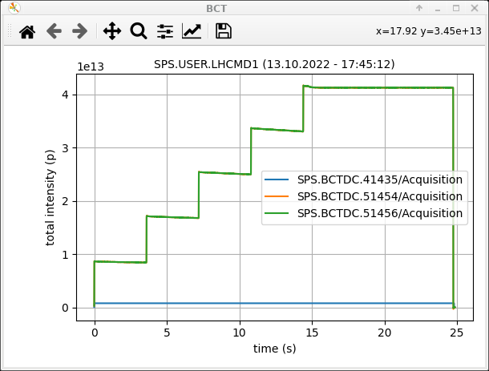
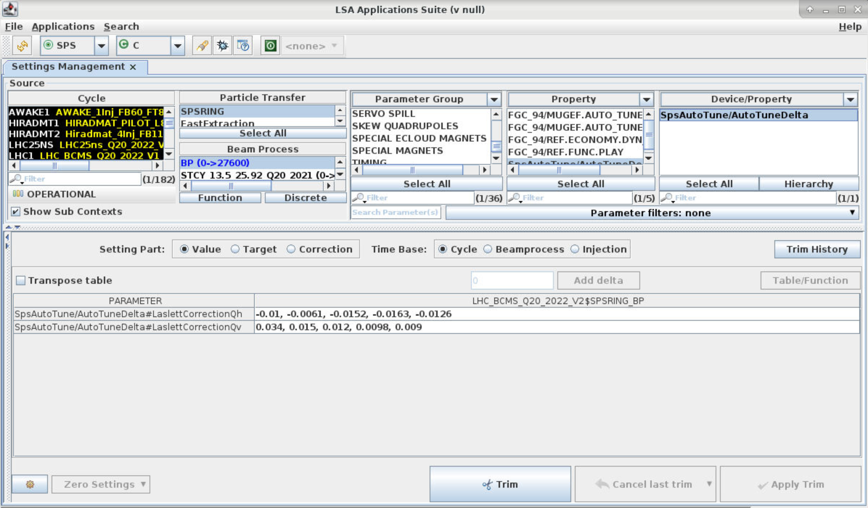
NEW MEASUREMENTS AND SIMULATIONS
Predictive model for the tune correction
(Laslett coefficients)
Measurements
with one train
Simulations with multiple trains
Until now, at each injection of a new train in the SPS, the tune is corrected manually.
We measure the tune and then we adjust the Laslett coefficients.
But this is very time-consuming.
With the new model, there will be no need of measuring the tune at every injection. The coefficients will be directly passed to the application.
Laslett coefficients

Slide 10
OUTLINE
Introduction
New experimental measurements and comparison to simulations
Transverse tails and beam profile measurements in the SPS (together with E. de la Fuente)
Growth rate measurements (together with E. de la Fuente)
Measurements of the Vertical coupled bunch instability in the SPS
Outlook

Slide 11
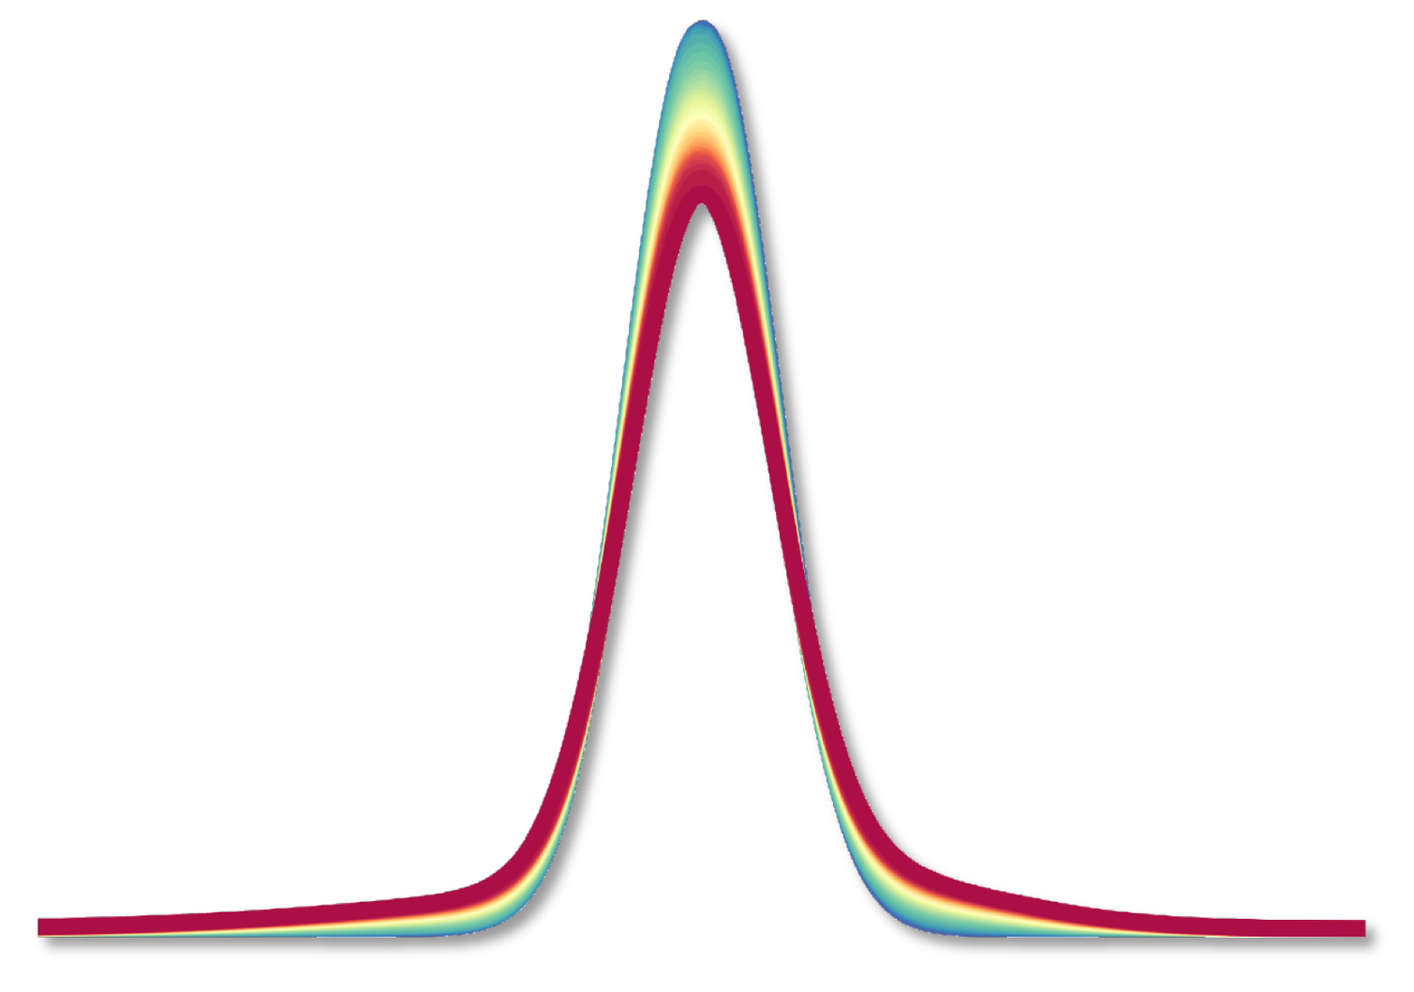
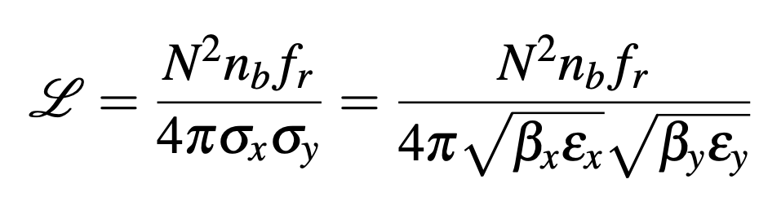


TRANSVERSE TAILS AND BEAM PROFILE
E. De la Fuente and I we have been involved in these measurements although is not part of our FTEC projects
Emittance is a key parameter for the overall performance of an accelerator.
Especially the luminosity depends on the transverse emittances.
For two Gaussian beams colliding head-on,
luminosity is expressed as:
$$σ$$
$$σ=\sqrt{βε}$$
Transverse profile of the proton beam
So we are interested in achieving small emittances in order to obtain higher luminosity

Slide 12
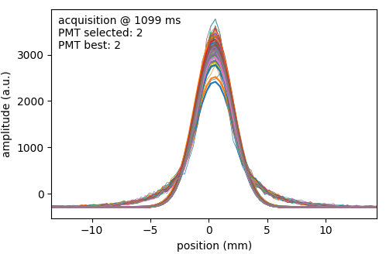
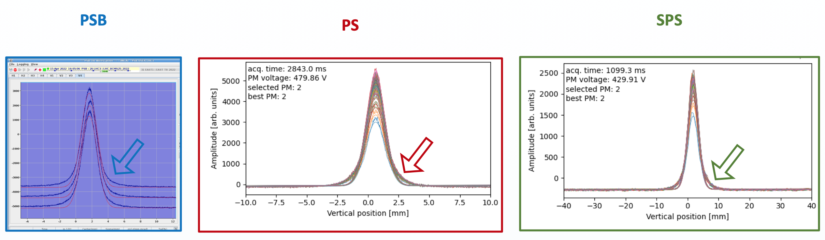
OVERPOPULATION OF TRANSVERSE TAILS
During 2022, heavy tails were observed for the transverse profiles in both planes, all along the injectors chain
Measured
profiles
The cause has not been identified yet
Gaussian fit
Measurements done with the SPS wire scanners
Courtesy of F. Asvesta
Protons in the tails will be removed by the LHC collimators.
So, we want the protons to be in the core of the beam.
This deviation from the Gaussian profile is an undesired phenomenon that will lower luminosity in the LHC
A lot of effort is being devoted in the PSB to solve this problem.

Slide 13
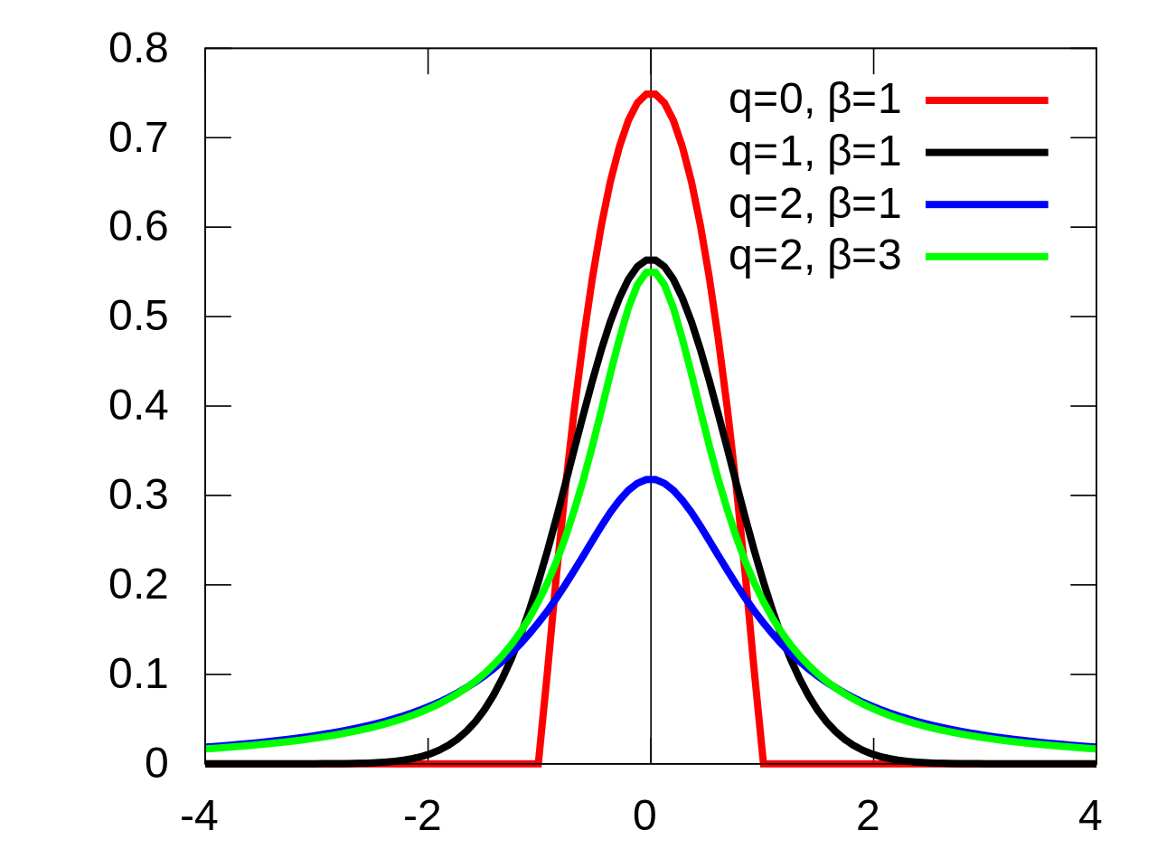
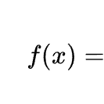
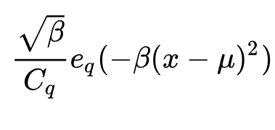
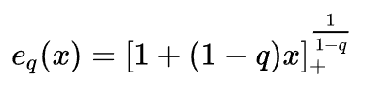
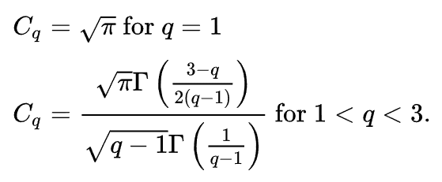
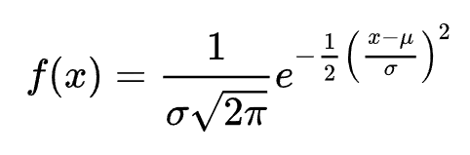
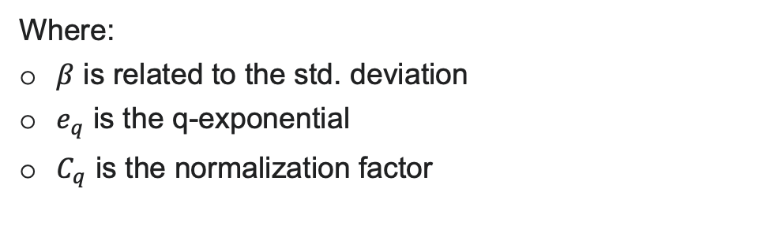
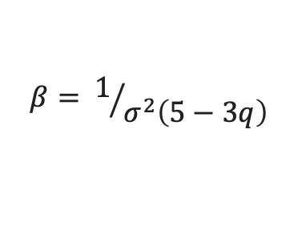
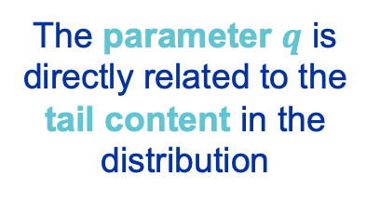
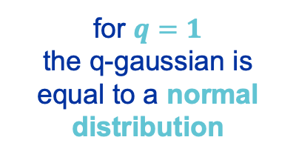
CHARACTERIZATION OF THE TAILS EVOLUTION
The standard q-Gaussian has the probability density function:
Comparison of different
q-Gaussian distributions
Where:
$β$ is related to the std. deviation
$e_{q}$ is the q-exponential
$C_{q}$ is the normalization factor
$$β= 1/{σ^{2}\left(5−3q\right)}$$
for $q=1$
the q-gaussian is equal to a normal distribution
The parameter $q$ is directly related to the tail content in the distribution
High q-values mean heavy tails
More details in INC section meeting 24/11/22

Slide 14
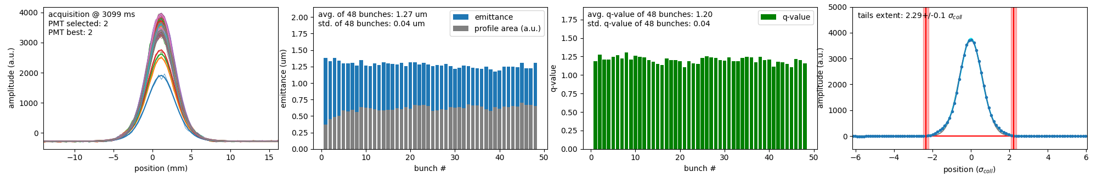
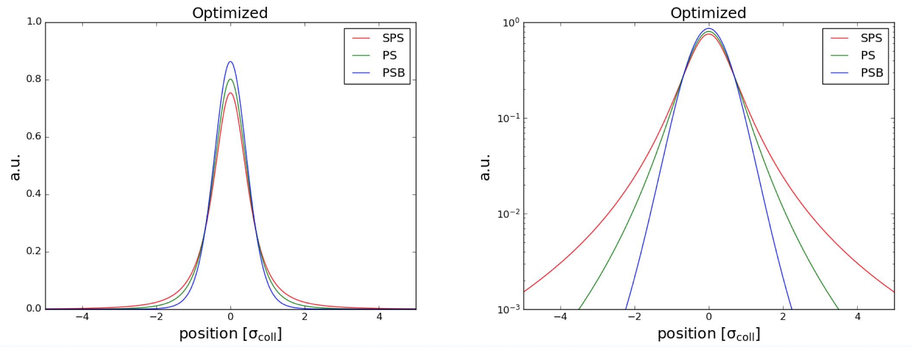
The emittance and q-value of each bunch is computed by postprocessing the data from the wire scanners measurements, updating for every cycle
Bunch profiles (measured)
emittances
q-values
tails width
RESULTS IN THE SPS
RESULTS ALONG THE INJECTORS CHAIN
Measurements have been preformed at different times along the cycle in the SPS
We have observed an increase of the tails population between injection and end of flat bottom

Slide 15
OUTLINE
Introduction
New experimental measurements and comparison to simulations
Transverse tails and beam profile measurements in the SPS (together with E. de la Fuente)
Growth rate measurements (together with E. de la Fuente)
Measurements of the Vertical coupled bunch instability in the SPS
Outlook

Slide 16
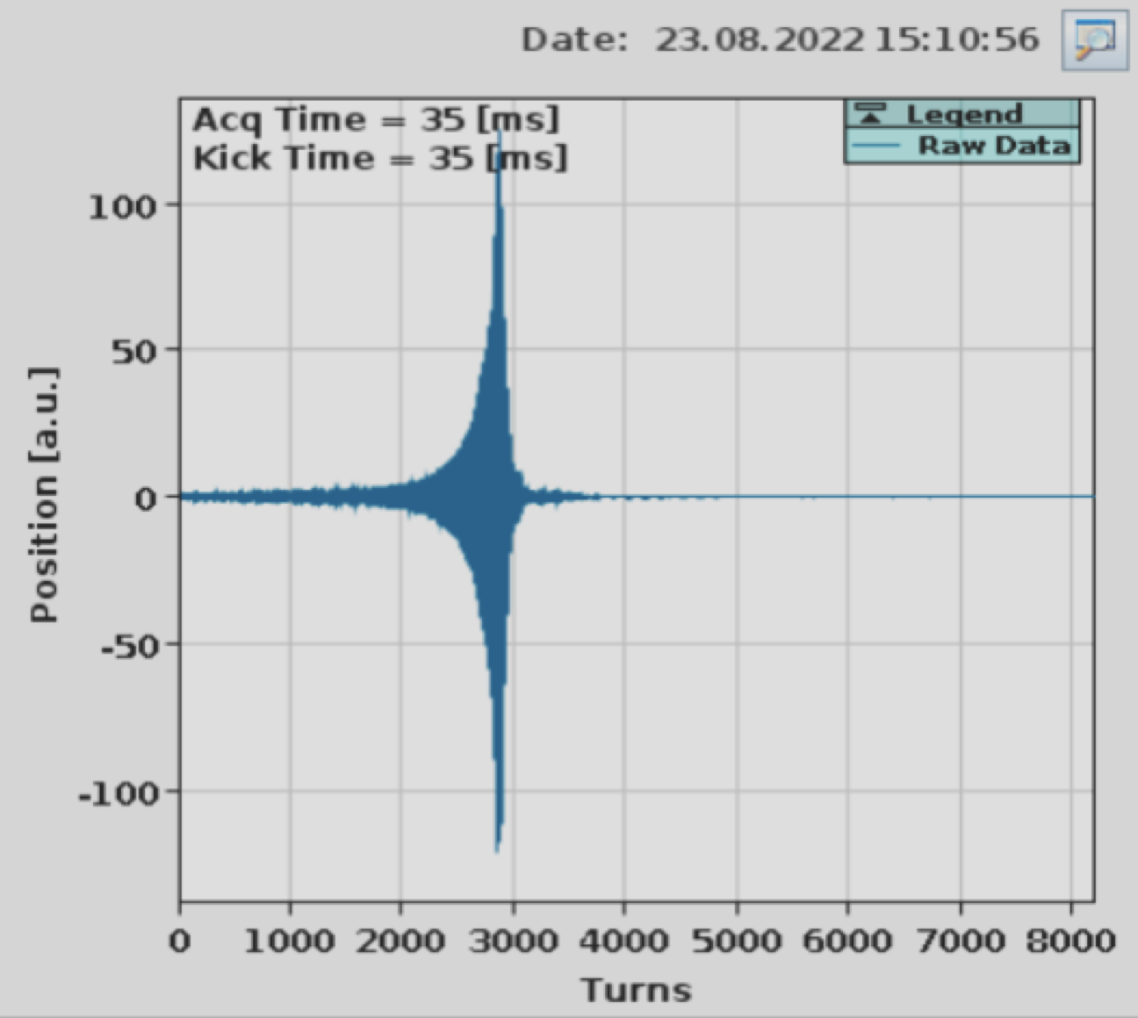
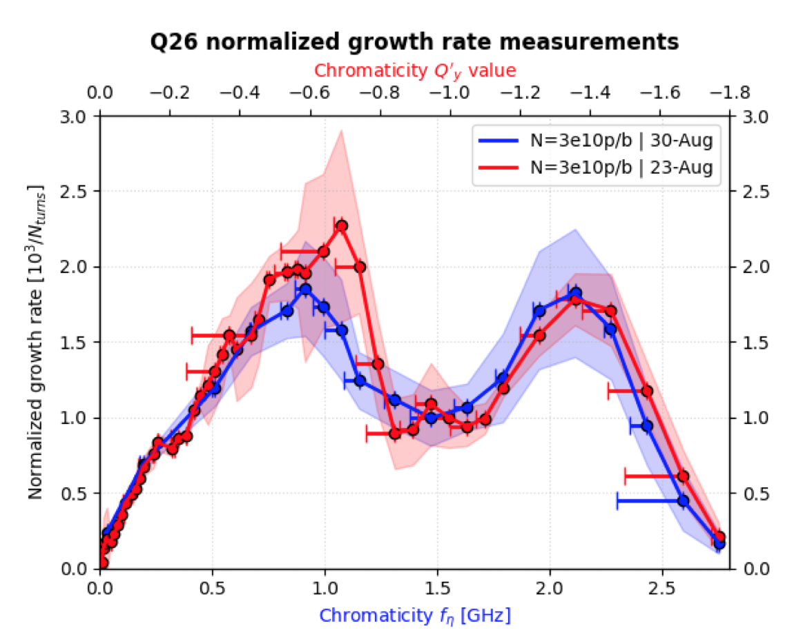
GROWTH RATE MEASUREMENTS OF MODE ZERO HEAD-TAIL INSTABILITY IN THE SPS (Q-26 OPTICS)
Objective: benchmark the impedance model of the SPS for Q-26 optics.
Measurements: Growth rate as function of chromaticty, for single bunch beam
E. De la Fuente and I we performed a lot of MD’s in the CCC in order to do these measurements
We had to overcome many unexpected difficulties
Great project between the two sections
(INC and CEI)
We developed tools for processing data in real time in the SPS
See E. de la Fuente presentation in
CIEMAT workshop 18/01/2023
and
Detailed presentation in
CEI section meeting 13/10/2022

Slide 17
OUTLINE
Introduction
New experimental measurements and comparison to simulations
Transverse tails and beam profile measurements in the SPS (together with E. de la Fuente)
Growth rate measurements (together with E. de la Fuente)
Measurements of the Vertical coupled bunch instability in the SPS
Outlook

Slide 18
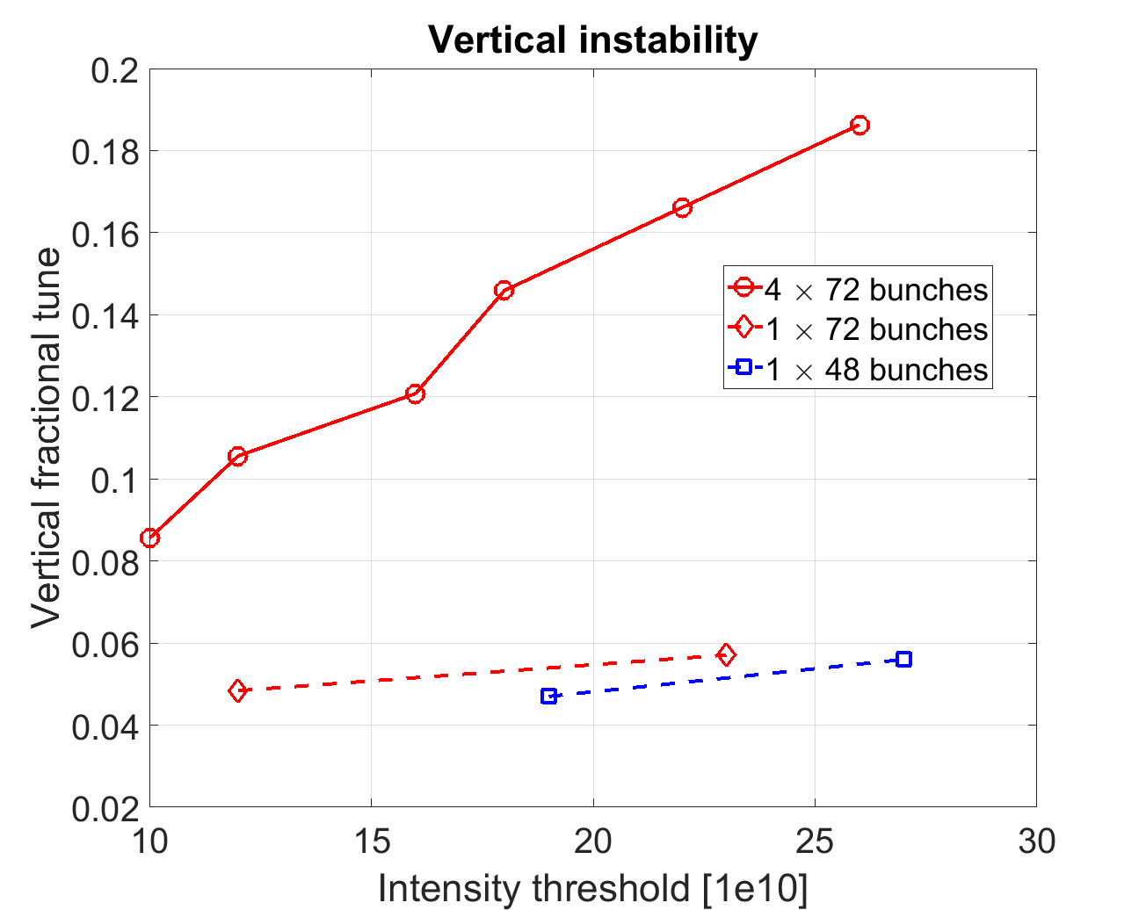
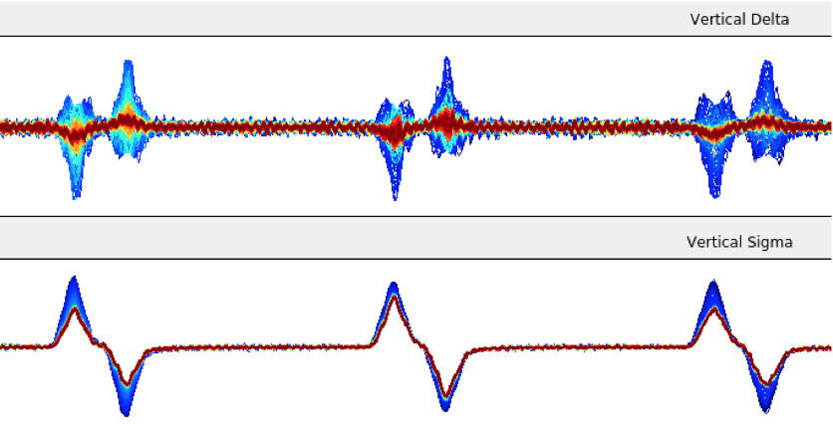
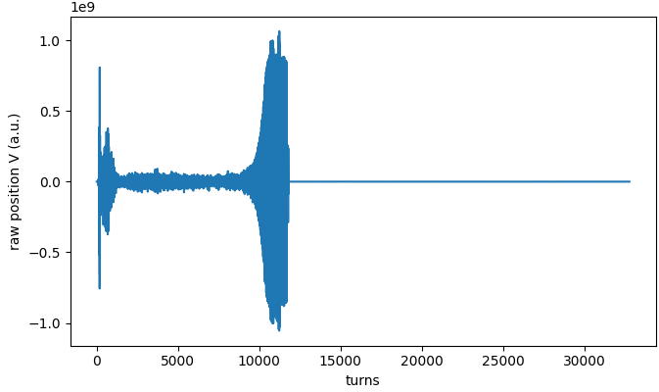
STUDIES OF THE COUPLED-BUNCH
VERTICAL INSTABILITY IN THE SPS
PYHEADTAIL SIMULATIONS
In good agreement with simulations, the instability was observed for Qv~0.05 at intensities:
N~1.8e11 p/b
(48 bunches)
N~1.2e11 p/b
(72 bunches)
For higher tunes the instability is not observed
OBSERVED INSTABILITY
C. Zannini and I.Mases

Slide 19
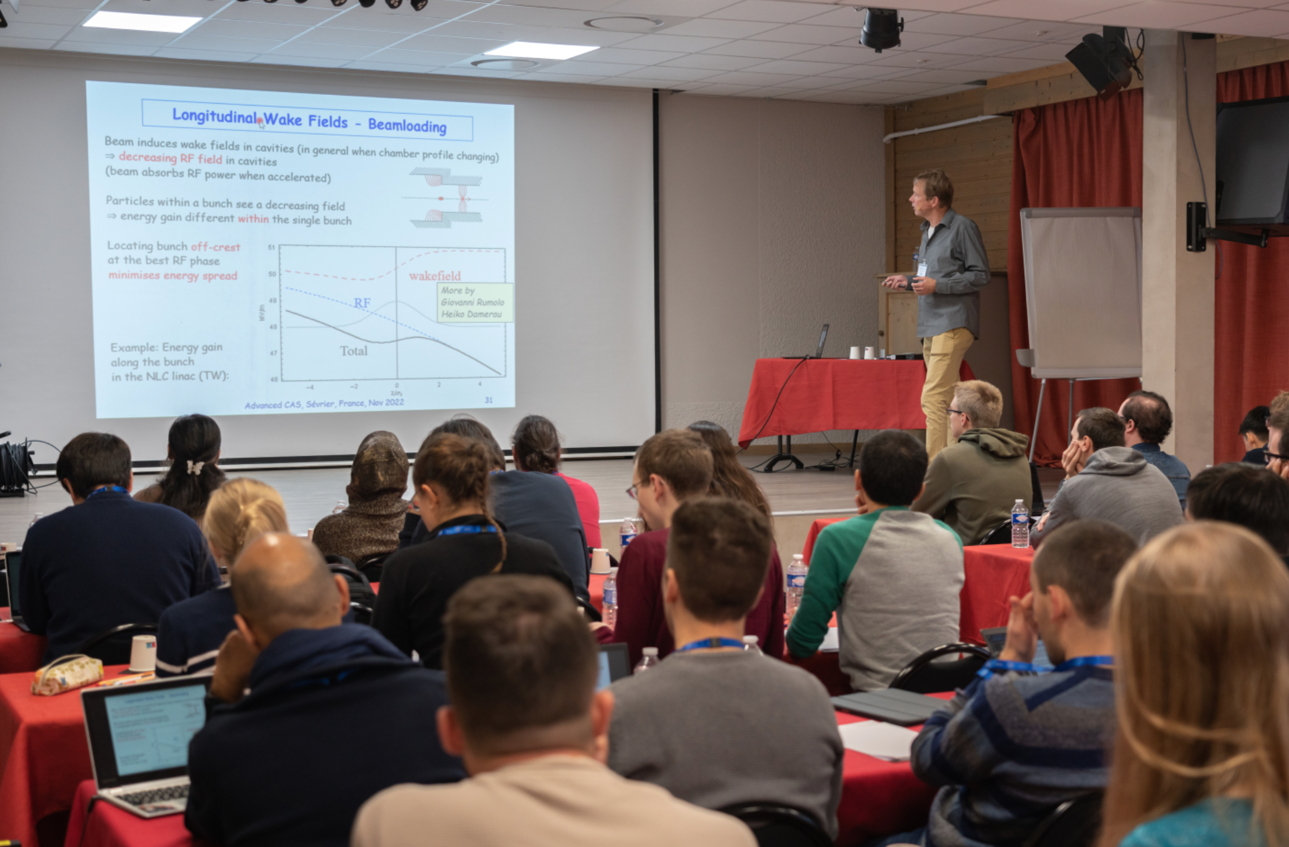



ADVANCED CAS COURSE on Accelerator Physics, in Sévrier (November 2022)
Beam Instrumentation
hands-on
Lessons
Meeting
people
Hikes

Slide 20
OUTLINE
Introduction
New experimental measurements and comparison to simulations
Transverse tails and beam profile measurements in the SPS (together with E. de la Fuente)
Growth rate measurements (together with E. de la Fuente)
Measurements of the Vertical coupled bunch instability in the SPS
Outlook

Slide 21
OUTLOOK
Perform multi-train tune shift measurements (2, 3 and 4 trains of 48/72 bunches).
Finish and test the tune shift predictive model during the SPS scrubbing run 2023.
Perform more beam profile measurements in the SPS, together with the PSB and PS to continue the tails studies.

Slide 22
References
[1] J. Coupard et al., “LHC Injectors Upgrade, Technical Design Report, Vol. I: Protons”, LIU Technical Design Report (TDR), CERN-ACC-2014-0337.
[2] C. Zannini, H. Bartosik, G. Iadarola, G. Rumolo, and B. Salvant, “Benchmarking the CERN-SPS Transverse Impedance Model with Measured Headtail Growth Rates”, in Proc. IPAC’15, Richmond, VA, USA, May 2015, pp. 402–405. doi:10.18429/JACoW-IPAC2015-MOPJE049

Slide 23
THANK YOU VERY MUCH FOR YOUR ATTENTION!

