Slide 1
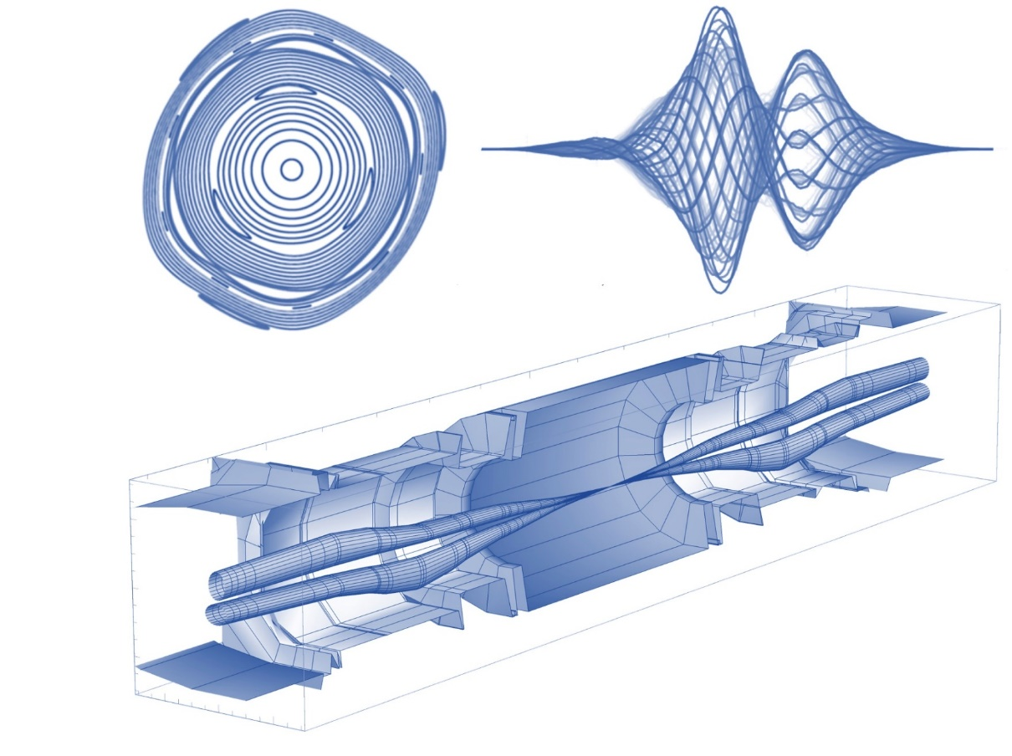
Beam Coupling Impedance From Pre-Computed Fields
(FTEC2020 - 03)
FTEC Workshop 18th January 2023
Speaker: Elena de la Fuente García (BE–ABP–CEI)
Supervisor: Carlo Zannini (BE–ABP–CEI)
CEI

Slide 2
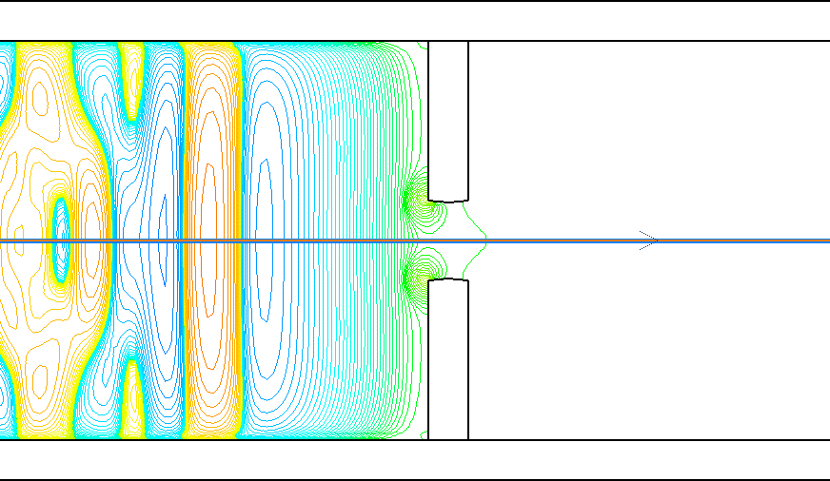
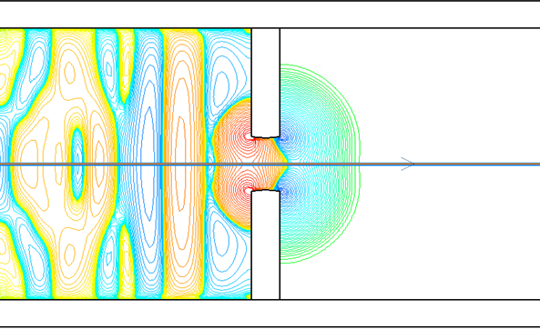

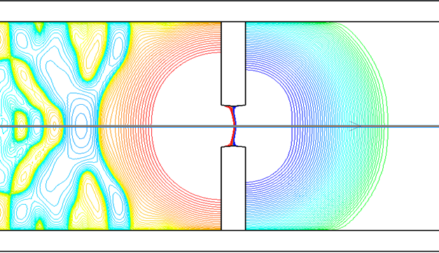
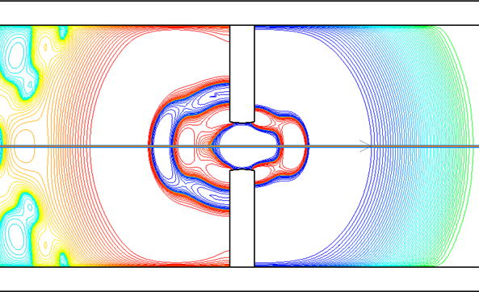




Introduction
3D Time domain simulation of a smooth pipe with obstacle with a passing proton beam (1-4)
t=0
t=1
isolines $E_{z}$
p+ bunch
$$y$$
$$z$$
t=1
t=4
☹
$$1/{ 10}$$

Slide 3
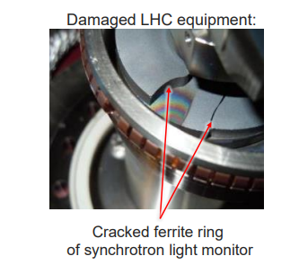
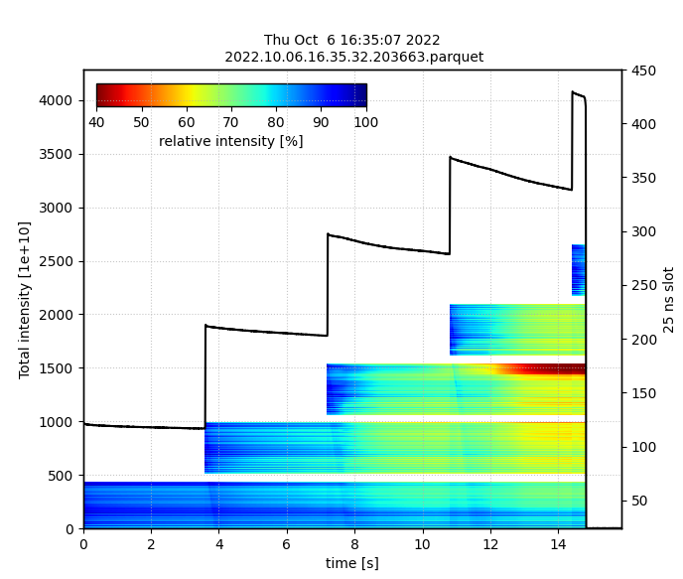


Introduction
Why is it important to characterize Wakefields (in$t)$ / Impedance (in $f$) ?
Beam Induced Heating
Beam Instabilities
[1] courtesy of B. Salvant
[2] Intensity losses in the CERN SPS
E. de la Fuente & I. Mases
$$2/{ 10}$$

Slide 4
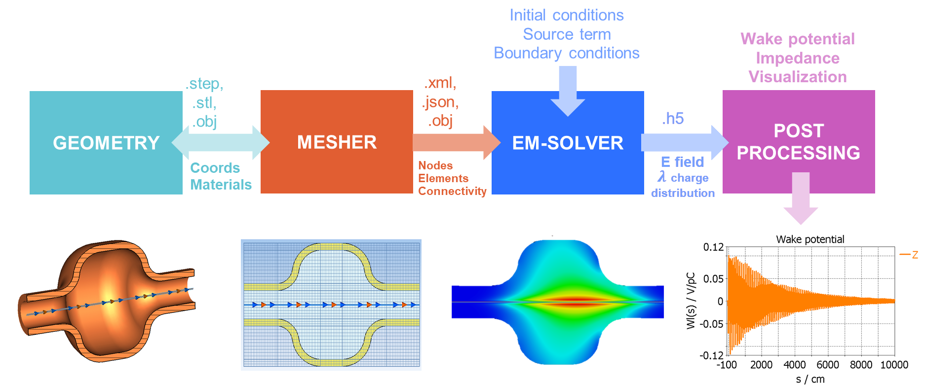



Wake Solver How-To
Currently, only non open-source tools (i.e., CST, GdfidL) can perform the integration of the Wake Potential in time domain for 3d geometries
But CERN ♡ open-source…
$$3/{ 10}$$
Notes:
We want to simulate the electromagnetic response of different structures with a passing beam

Slide 5





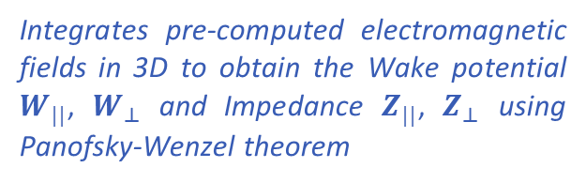

Wake Solver How-To (II)
EM solver
Wake solver
WarpX EM solver
WAKIS
(Wake and Impedance Solver)
3D Electromagnetic time-domain solver using mesh refinement (AMReX), parallel computing and GPU, based on Particle-In-Cell (PIC) + FDTD method. Developed by:
Integrates pre-computed electromagnetic fields in 3D to obtain the Wake potential $W_{||}$, $W_{⊥}$ and Impedance $Z_{||}$, $Z_{⊥}$ using Panofsky-Wenzel theorem
$$4/{ 10}$$
Notes:
We want to simulate the electromagnetic response of different structures with a passing beam

Slide 6
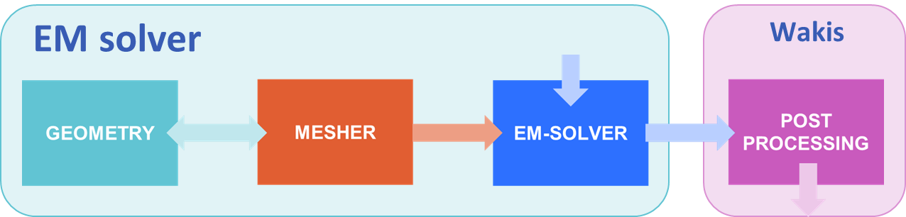
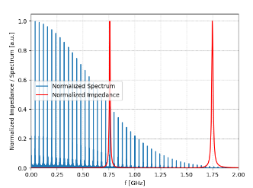
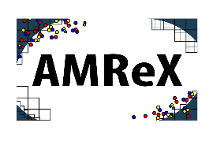


Main improvements
BIHC
Collaboration with LBNL to develop a CAD geometry importer (.stl) for WarpX geometry & mesh AMReX
Collaboration with univ. Darmstadt to test their (non-open source) code PBCI and compare it with CST Studio
Added a new package for Beam Induced Heating Computation (BIHC) from the Impedance and Wakefield data, also paired with CERN’s Timber database.
w/ Leonardo Sito (ABP-CEI)
$$5/{ 10}$$
Notes:
We want to simulate the electromagnetic response of different structures with a passing beam

Slide 7
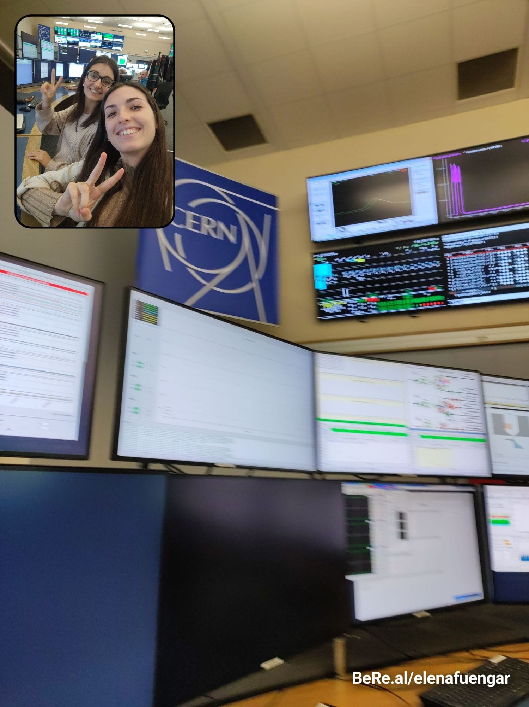



CCC Studies
Abstracts approved ☺
Growth rate measurements vs Chromaticity
Emittance measurements and Beam Tails analysis
High Intensity studies in CERN SPS for BCMS and 8b4e beams
+ presented in JAP workshop by F. Asvesta
Presented in JAPC workshop by C. Zannini
+100h spent in the Control Room (16 MDs)
Lots of measuring, programming & post-processing data
w/ Ingrid Mases Sole (ABP-INC)
$$6/{ 10}$$

Slide 8
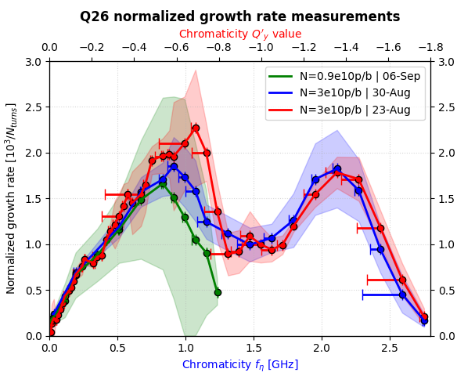
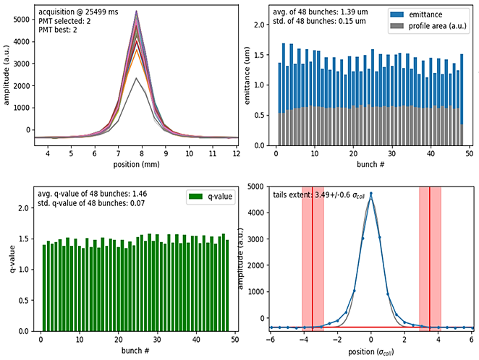
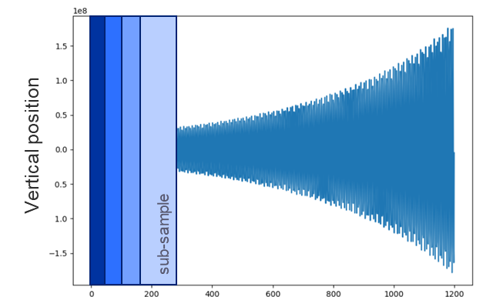

CCC Studies (II)
Emittance & profile tails online measurement
Measurement results have been very well received and have been presented at
section (CEI) & section (INC)
w/ Ingrid Mases Sole (ABP-INC)
$$7/{ 10}$$

Slide 9
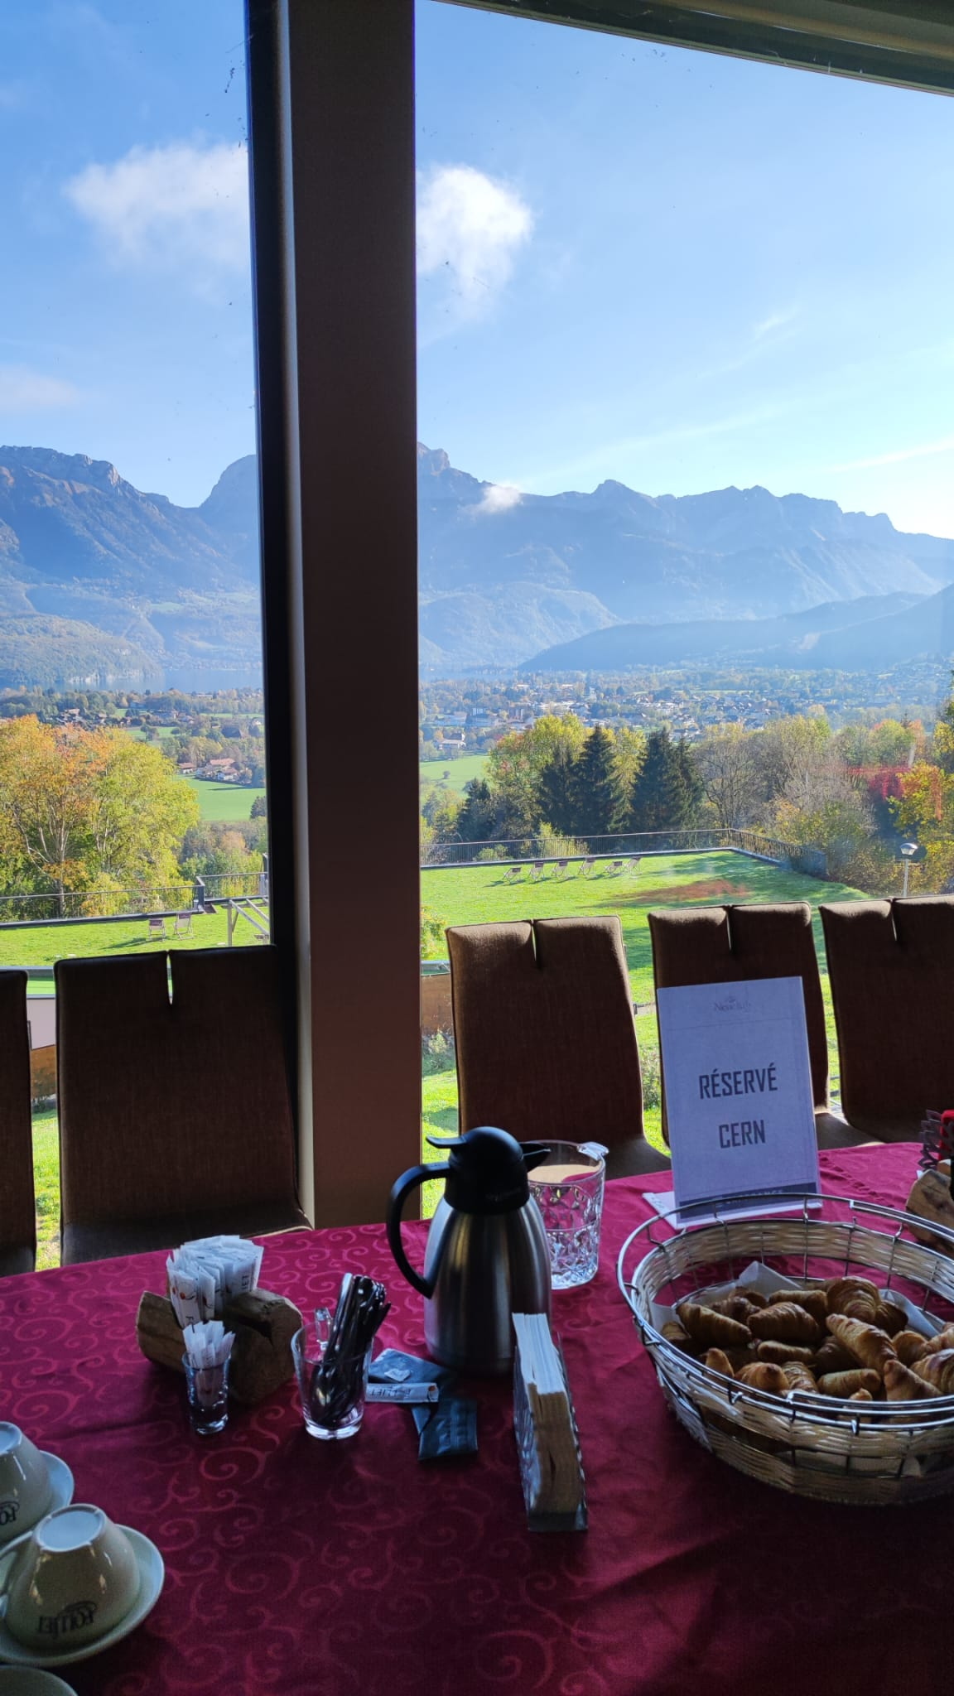
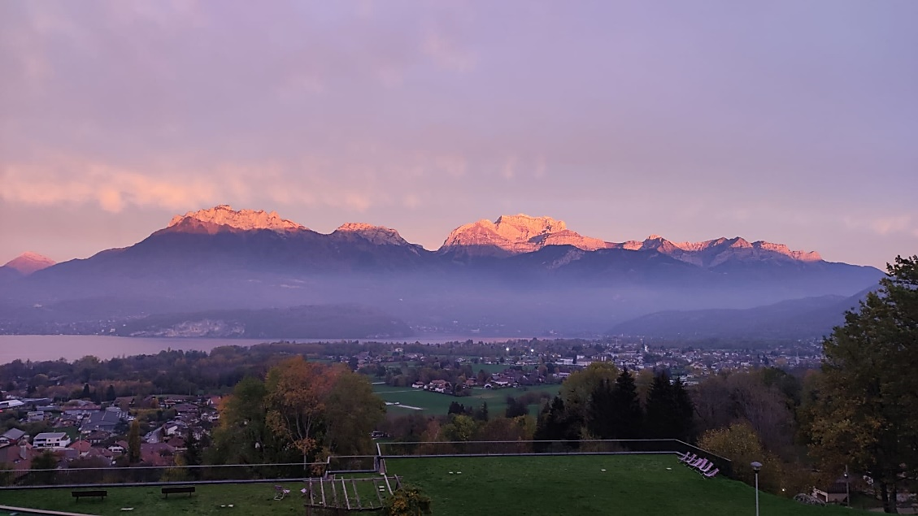
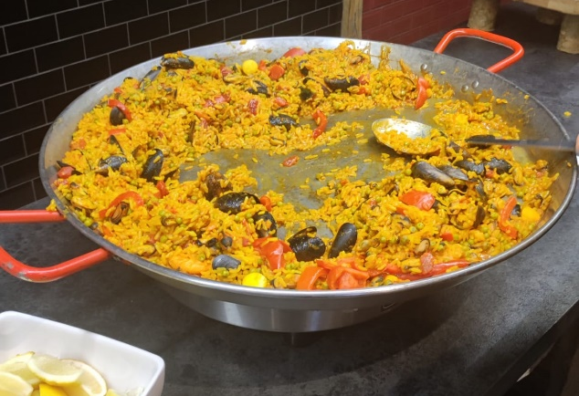

Advanced CERN Accelerator School
Amazing views & Lectures…
Hotel Balcons du lac d’Annecy
But French paella ☹
$$8/{ 10}$$

Slide 10
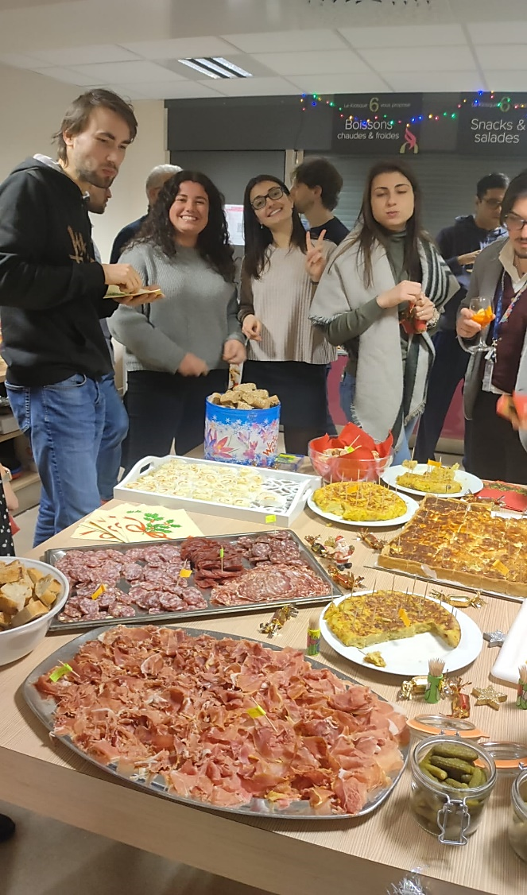
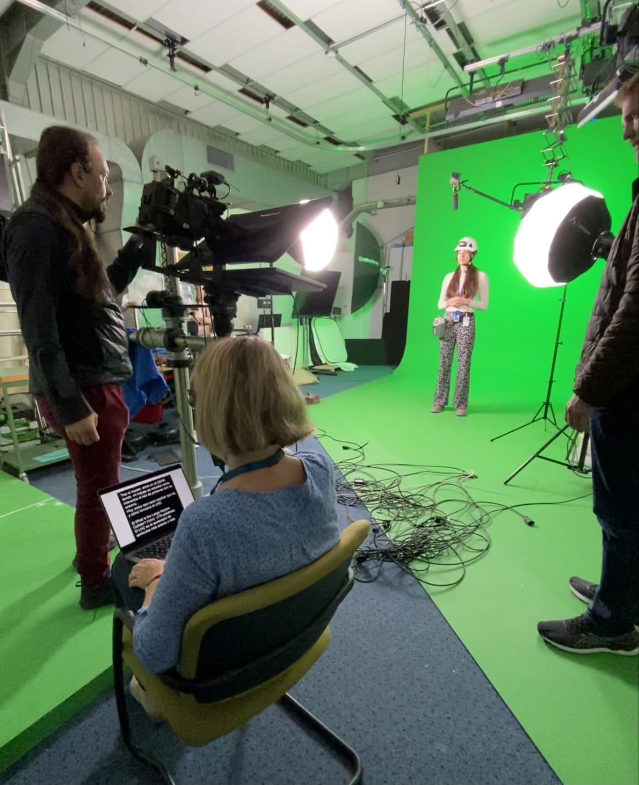

Other (very cool) activities
Video recording for Science Gateway´s LHC explanation
CERN ABP Christmas dinner organization
w/ INC Section
$$9/{ 10}$$

Slide 11

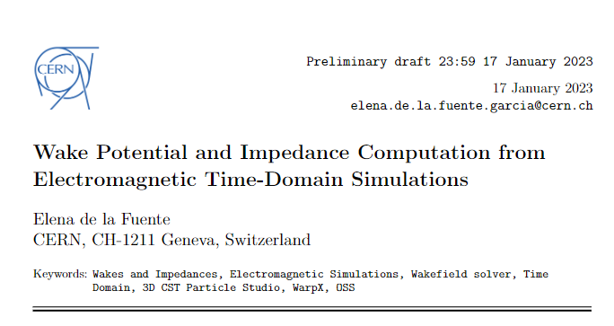

Summary & Outlook
Development of open-source Wake Solver
Berkeley collab to develop CAD importer
Done
Darmstadt collab to assess PBCI
Coupled Beam Induced Heating with Wake Solver with new package BIHC
CERN ATS Note
Improve WarpX boundary conditions (PMLs)
To Do
CCC measurements on Growth rate and Emittance
Growth rate measurements vs chromaticity
Done
x 2
Emittance and beam tails studies
$${10}/{ 10}$$

Slide 12
Thank you for your attention ☺
Beam Coupling Impedance From Pre-Computed Fields (FTEC2020 - 03)
Elena de la Fuente García (BE–ABP–CEI)

