Slide 1
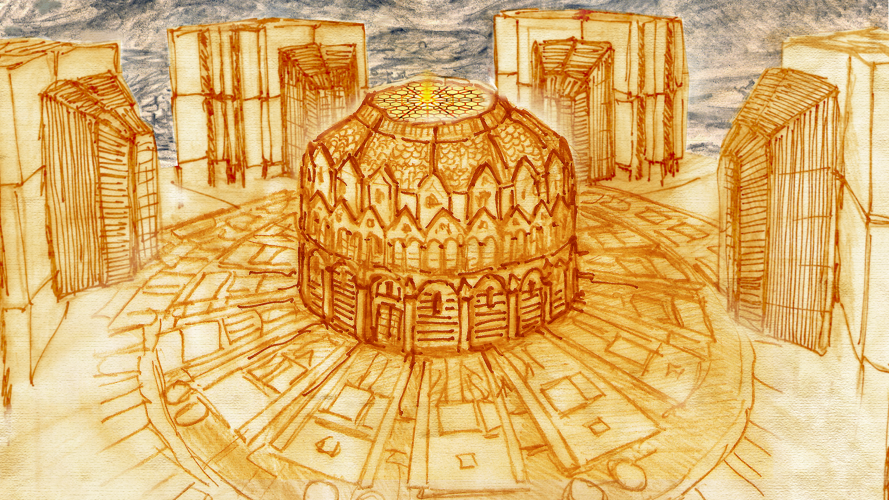

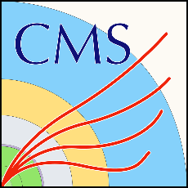

Engineering and design of interface systems to integrate the new 250-tonne high-granularity calorimeter into the CMS detector
FTEC-2021-09
Workshop 18/01/2023
Speaker: Diego García Robles (EP-CMX-SCI)
Supervisor: Tristan Loiseau (EP-CMX-SCI)

Slide 2
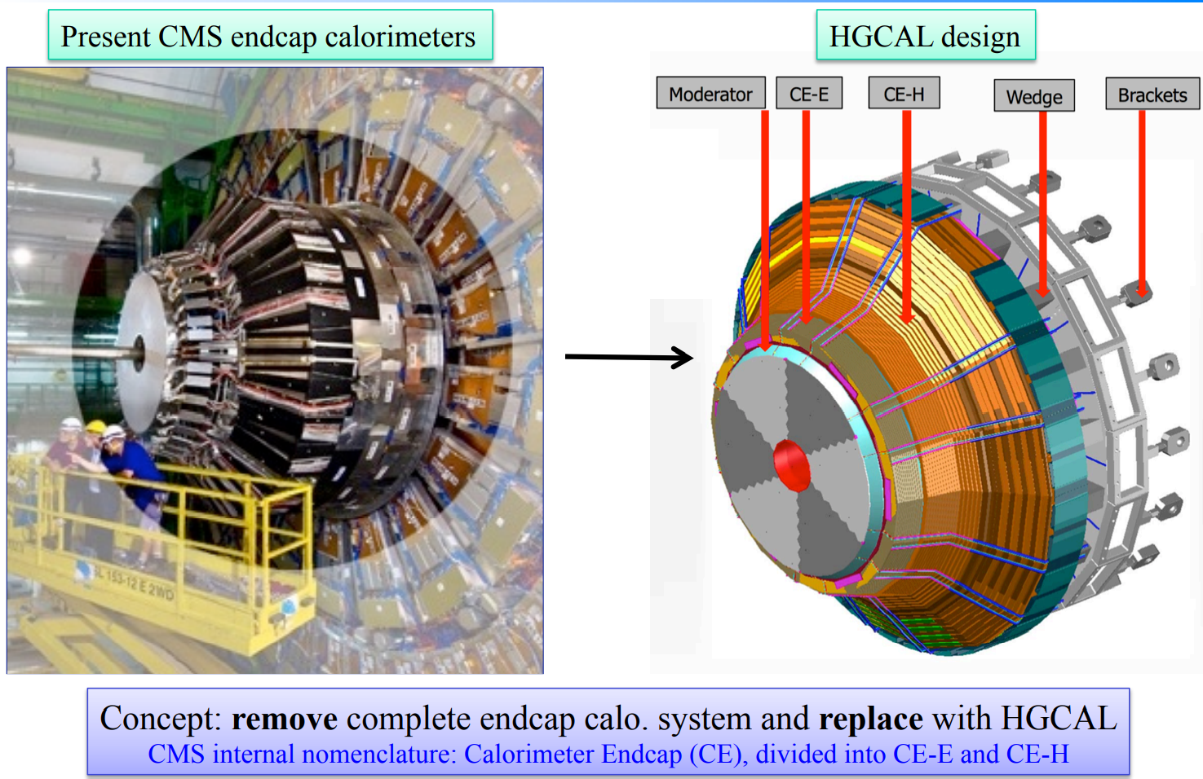
Introduction
Present endcap calorimeter
HGCAL design
Integrate a brand-new calorimeter in an existing 20-year-old structure
Need to design interface systems and components.
Diego G. Robles

Slide 3
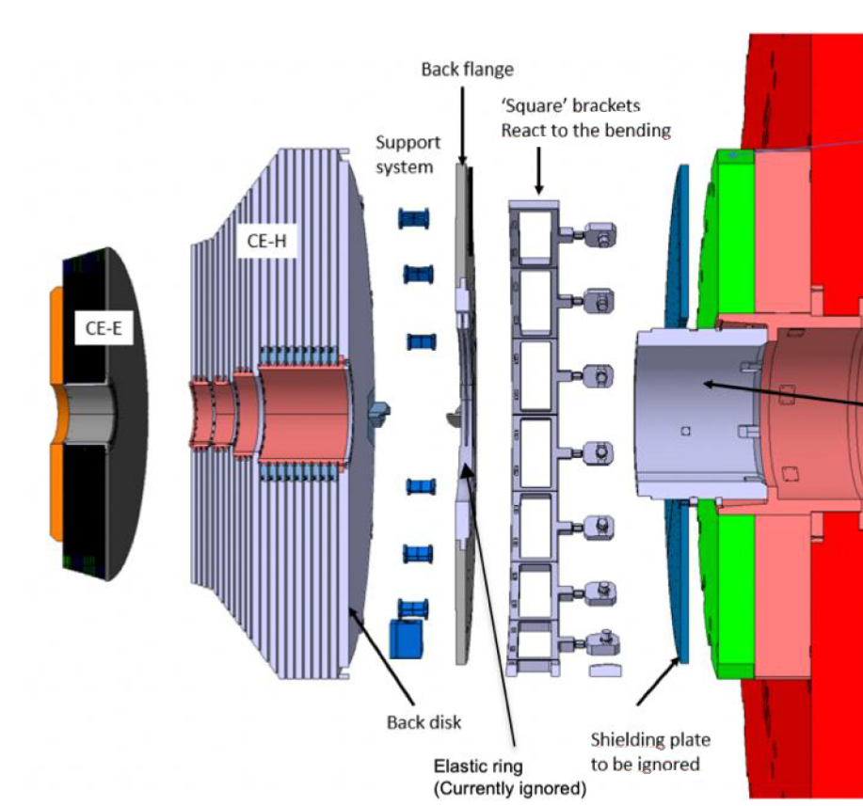
Introduction. Components for HGCAL
New elements
Existing elements
New components for HGCAL
designed by me:
  Back flange
  ME0 shielding
  ME1/1 shielding
Diego G. Robles

Slide 4
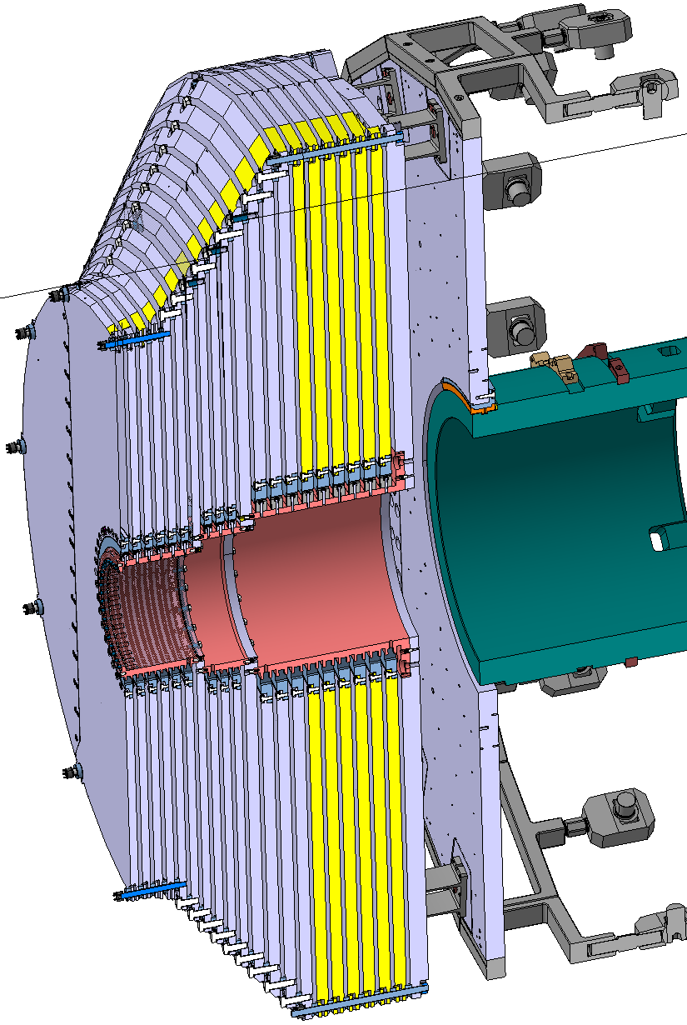
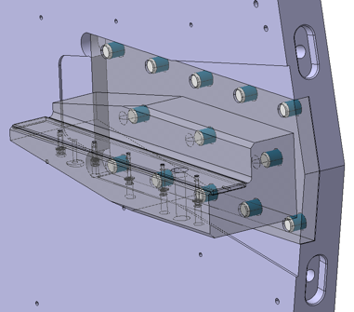
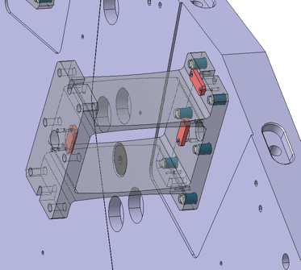
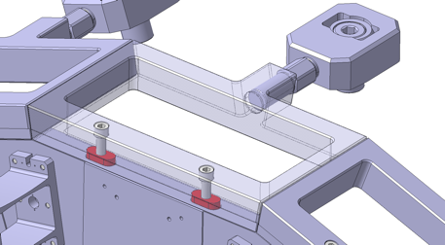
Back flange - Introduction
Brackets
The function of the back flange is to be the direct link between HGCAL and the detector’s structure.
The back flange is mounted on the support tube, which rests the whole weight of HGCAL (250 tons) and connected by 18 brackets all around to withstand the moment created by the cantilevered calorimeter.
Back flange
Wedges interface:
Support
Tube
Brackets interface:
Absorbers
Wedges
Diego G. Robles

Slide 5
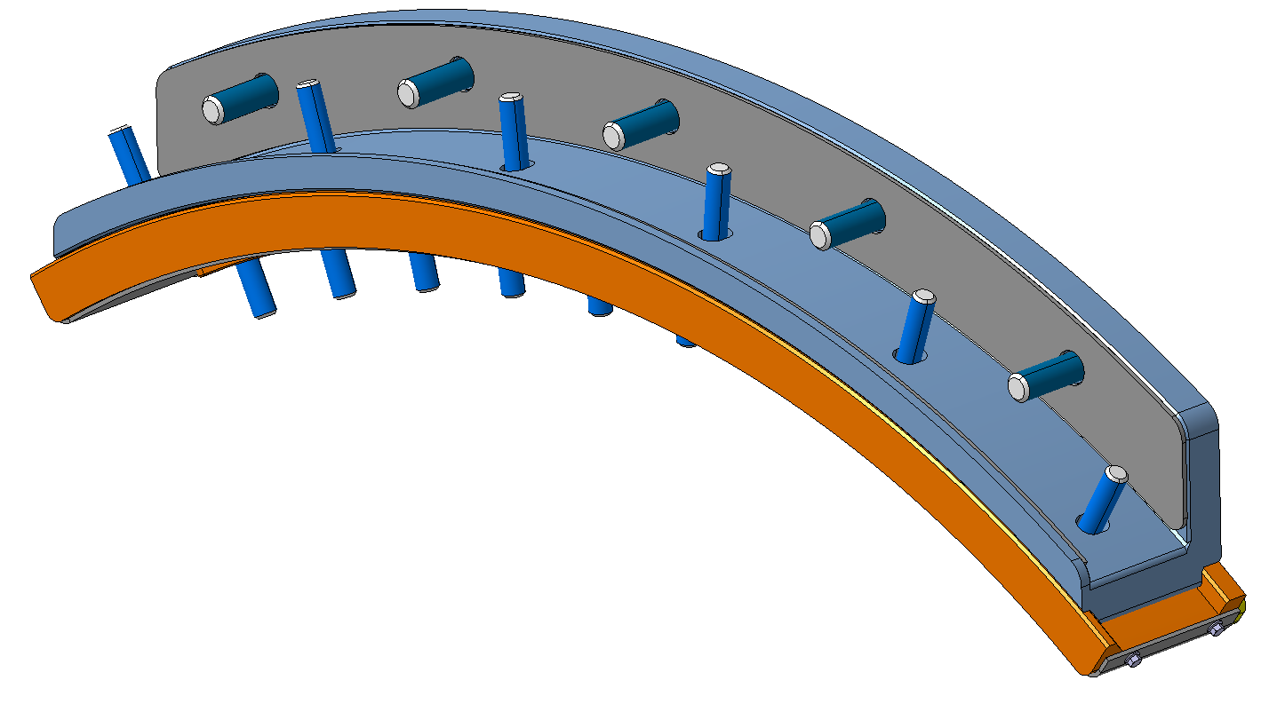
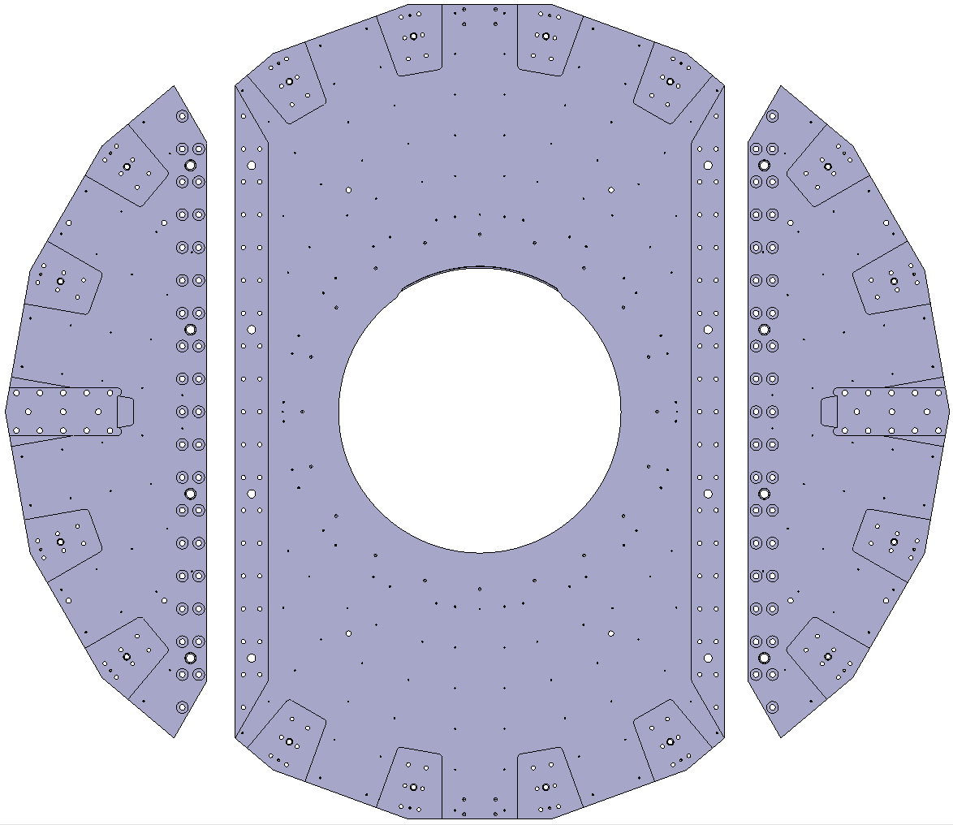
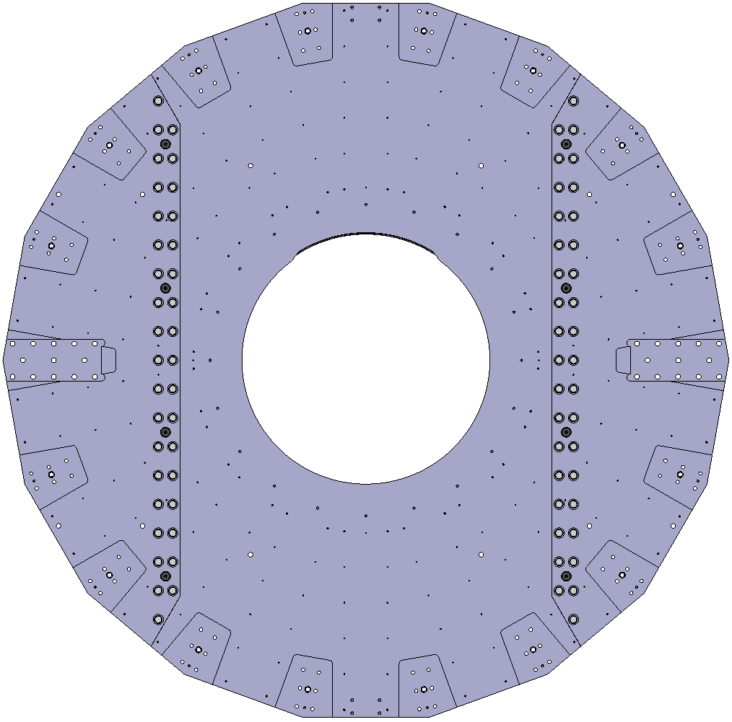
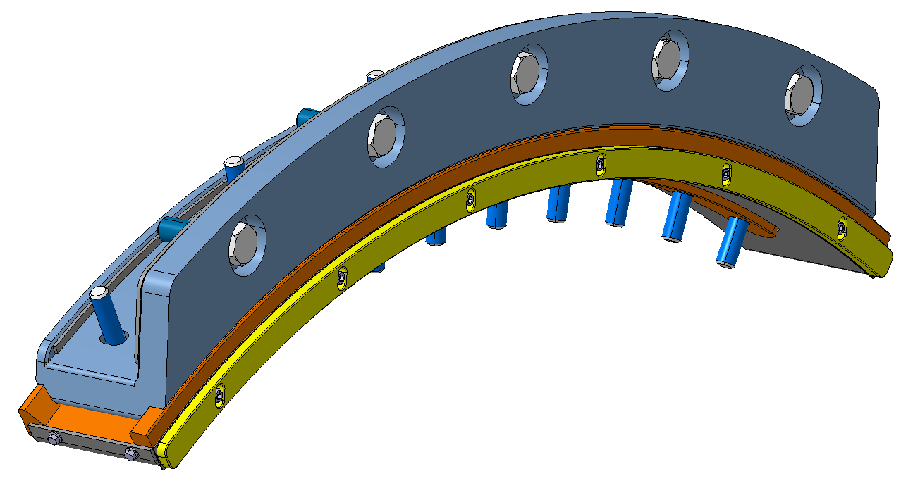
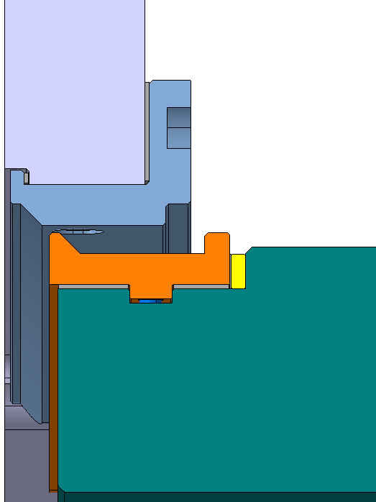
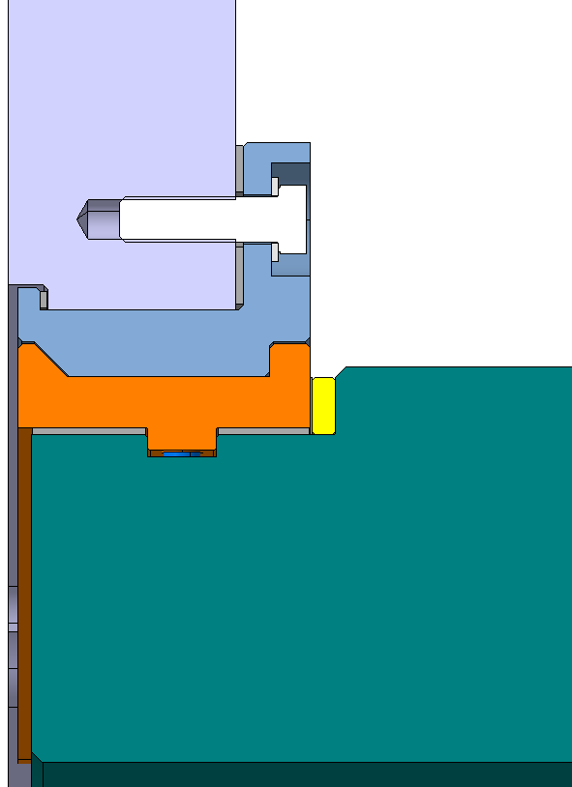
Back flange - Design
The design was done considering the Eurocode 3 standard for structural components.
72 Screws M30x70 [BUMAX 88]
72 Washers 30x56 [BUMAX 88]
8 Pins D50 [INCONEL 718]
Central
section
~8.4t
Assembly:
~13.2t
Installation
Left
section
~2.3t
Right
section
~2.3t
Diego G. Robles

Slide 6
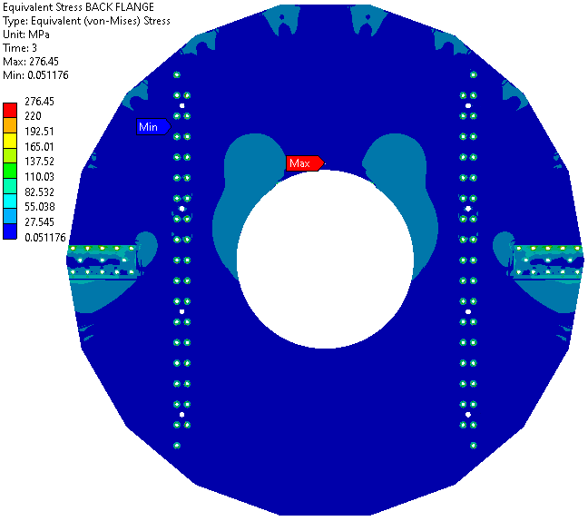
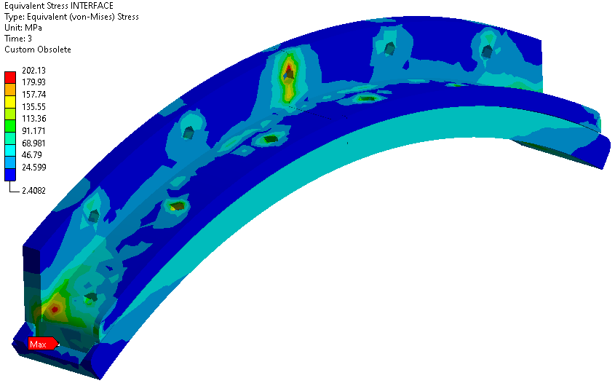
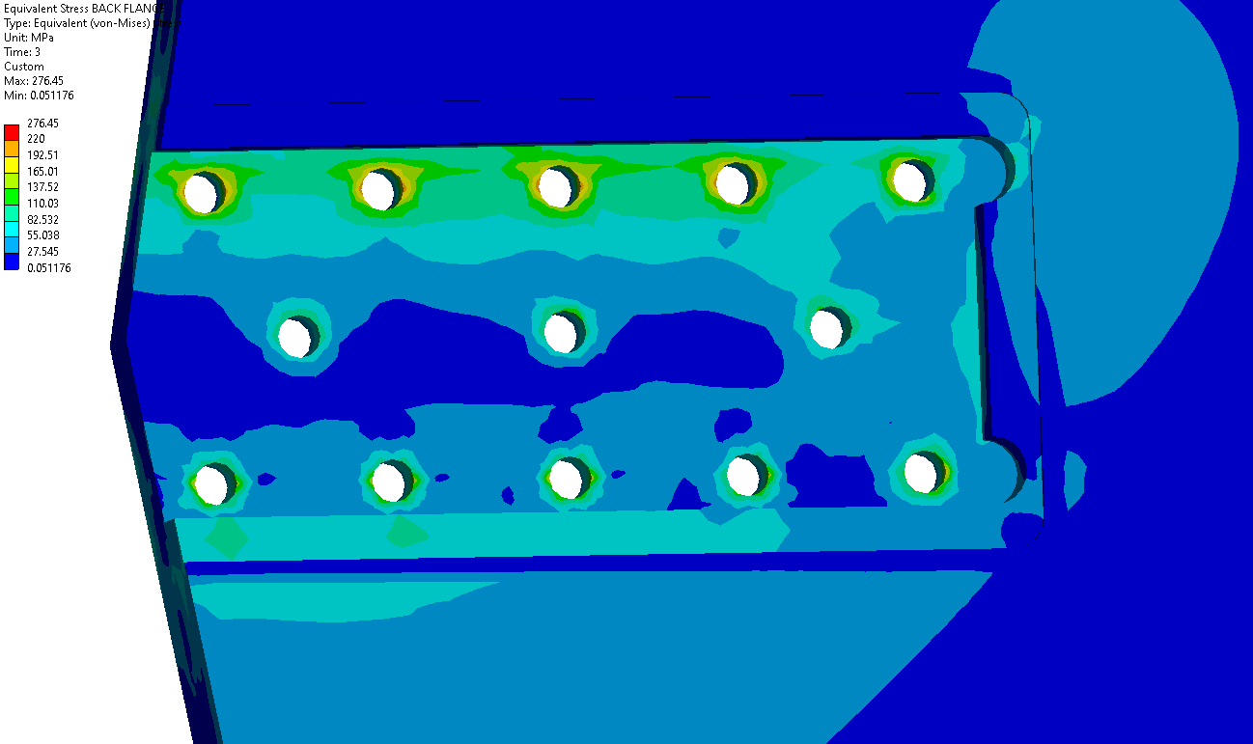
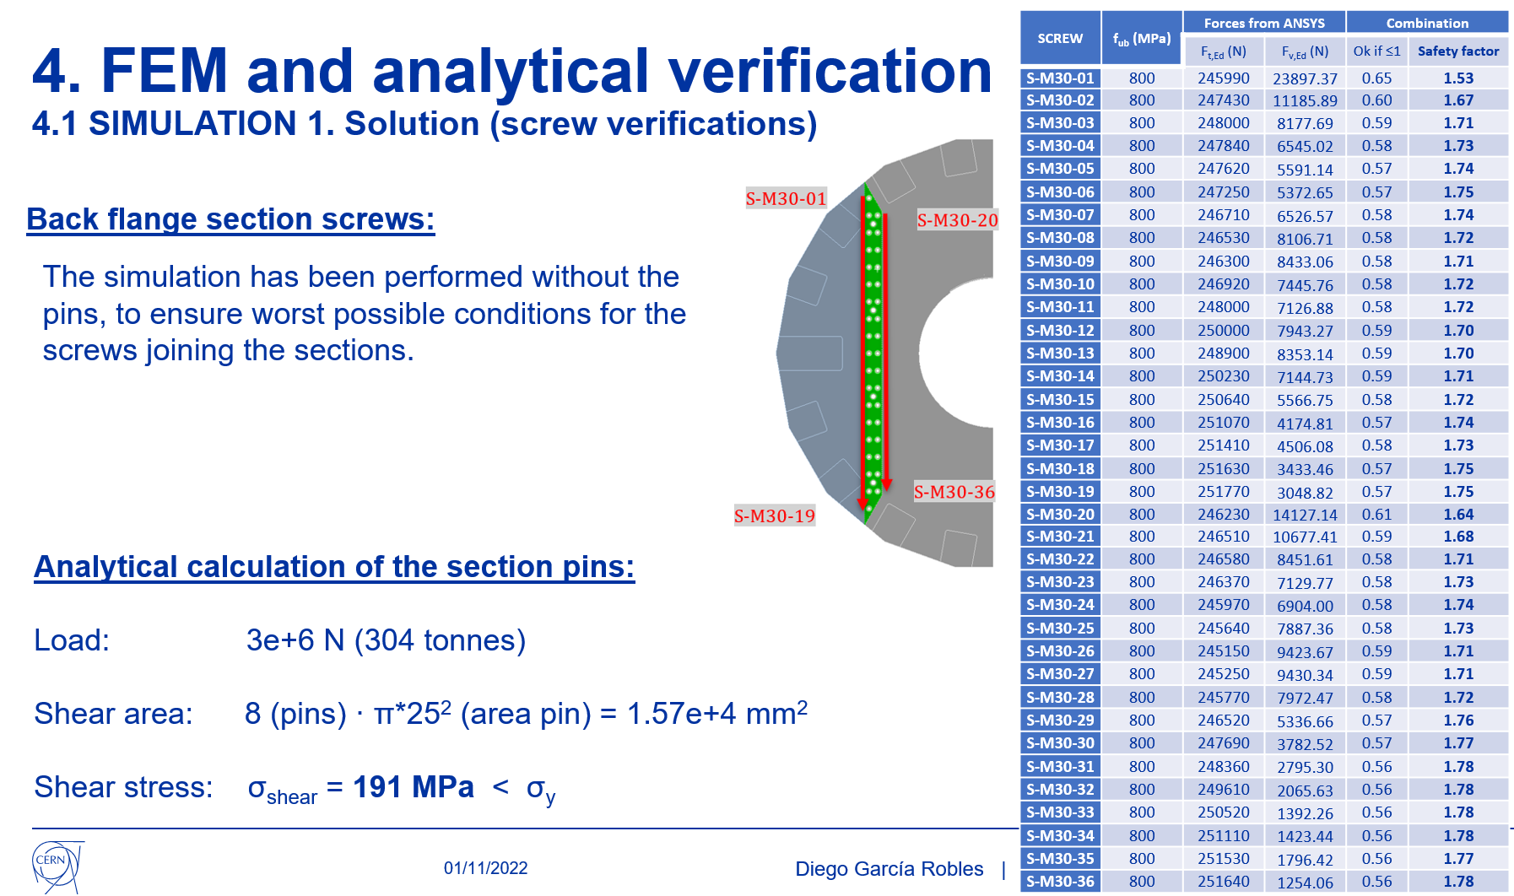
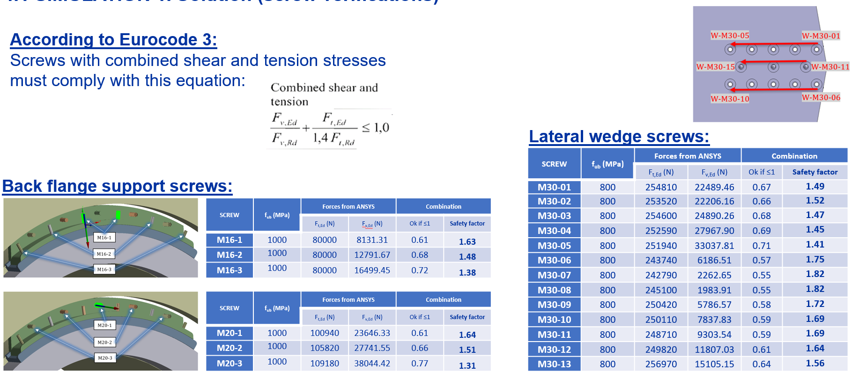
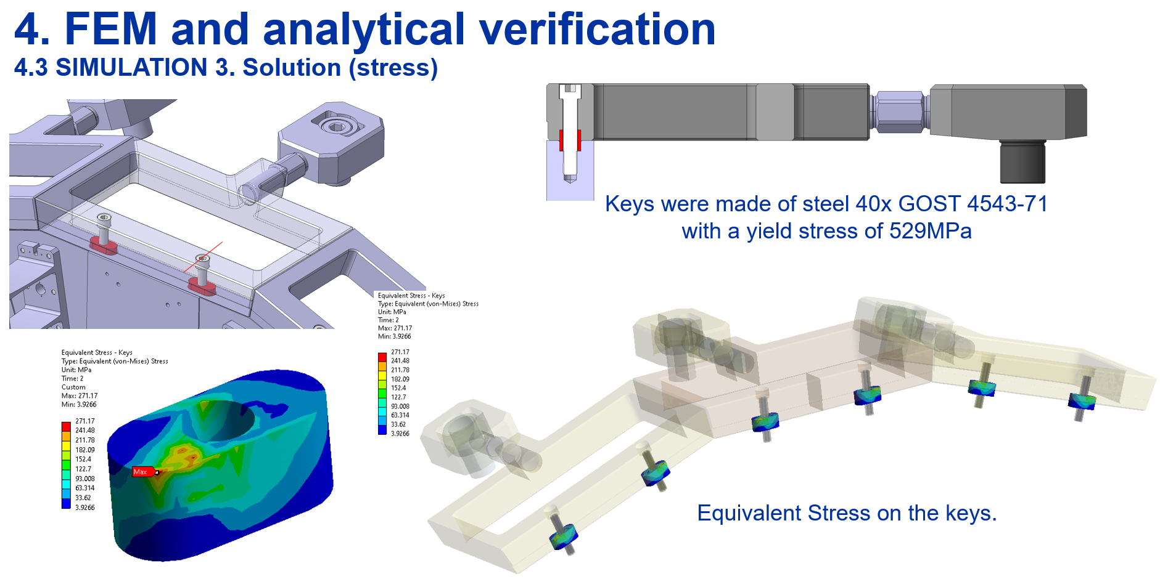
Back flange - Calculations
All components of the back flange were analyzed using FEM.
All the screws and pins were verified according to Eurocode 3 requirements.
EDMS: 2741425
Diego G. Robles

Slide 7
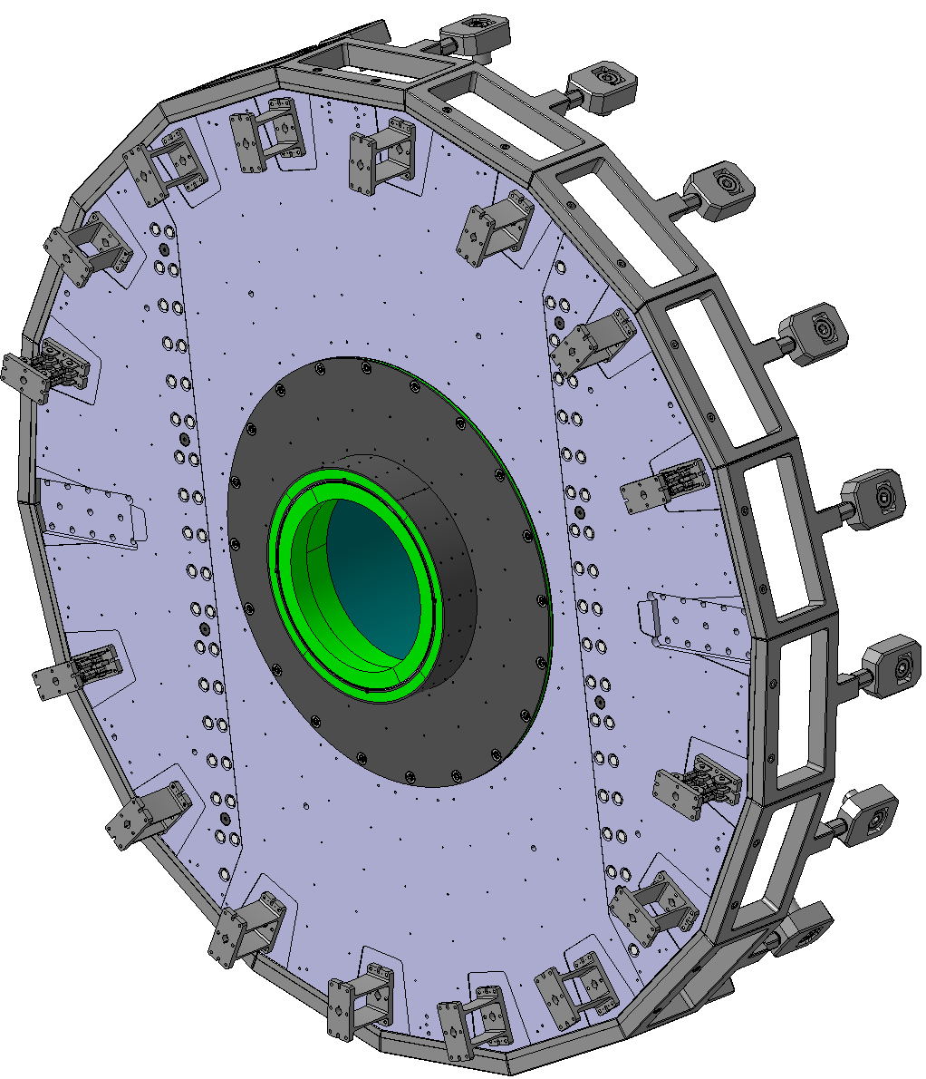
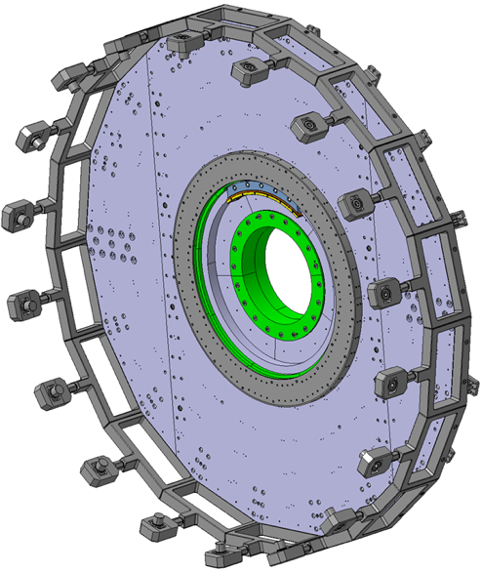
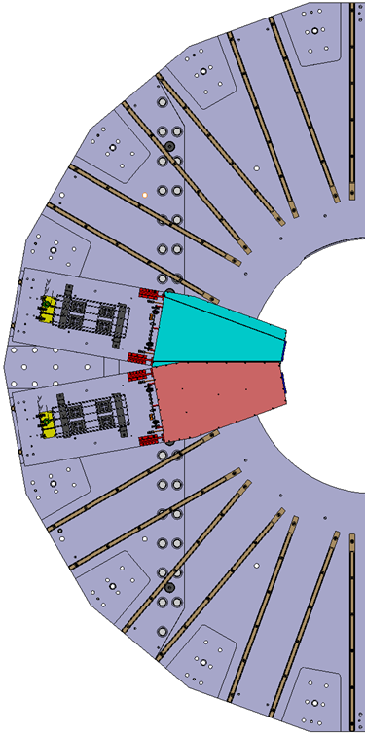
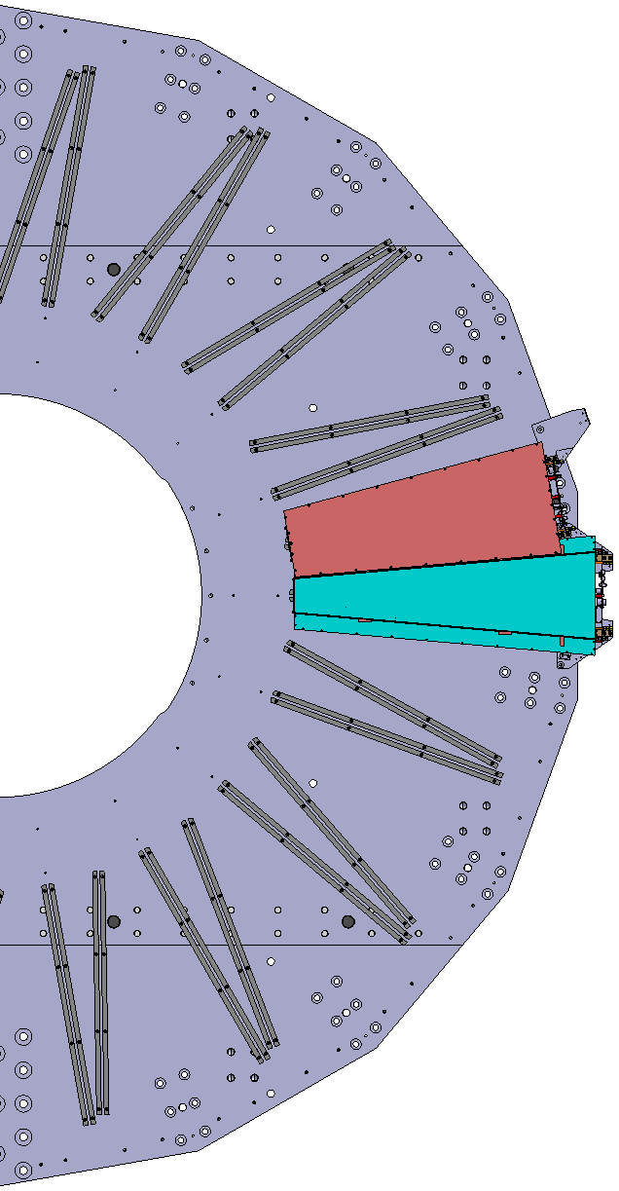
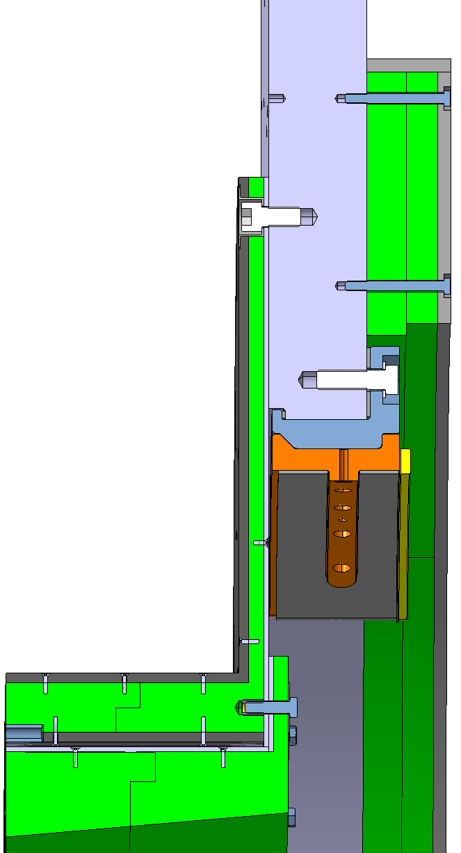
Radiation shielding
Radiation shieldings
Muon chambers
ME0
GEM
ME0
ME1/1
IP
NIP
IP
NIP
Diego G. Robles
7

Slide 8
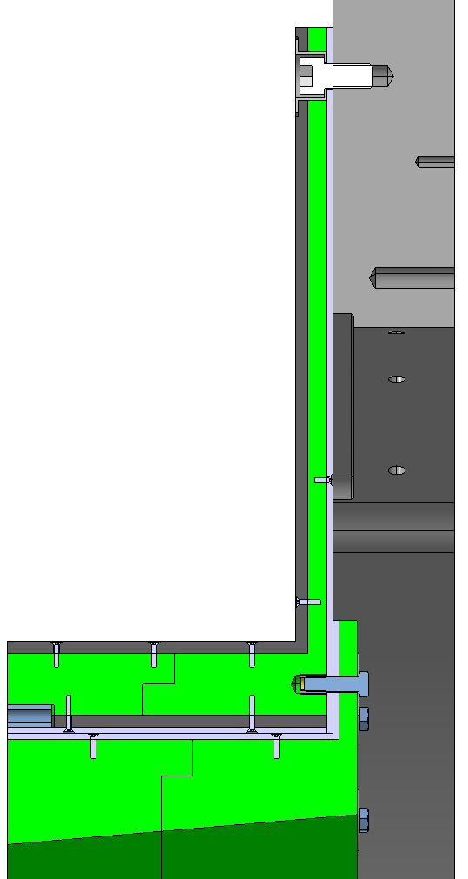
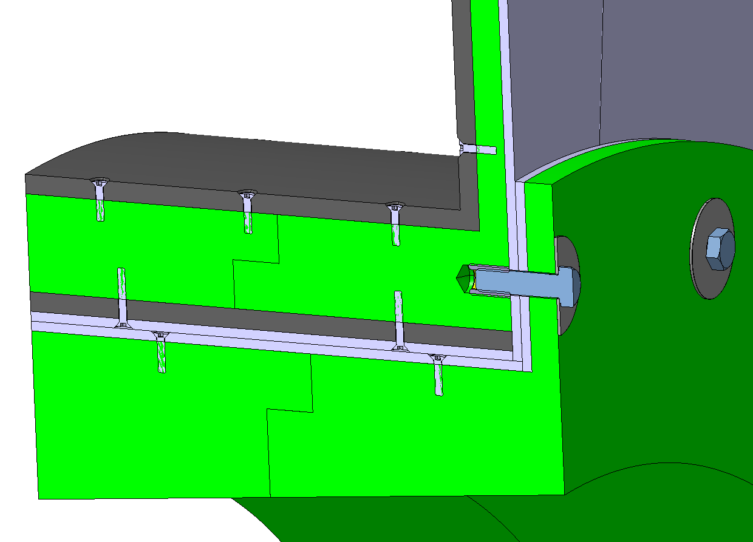
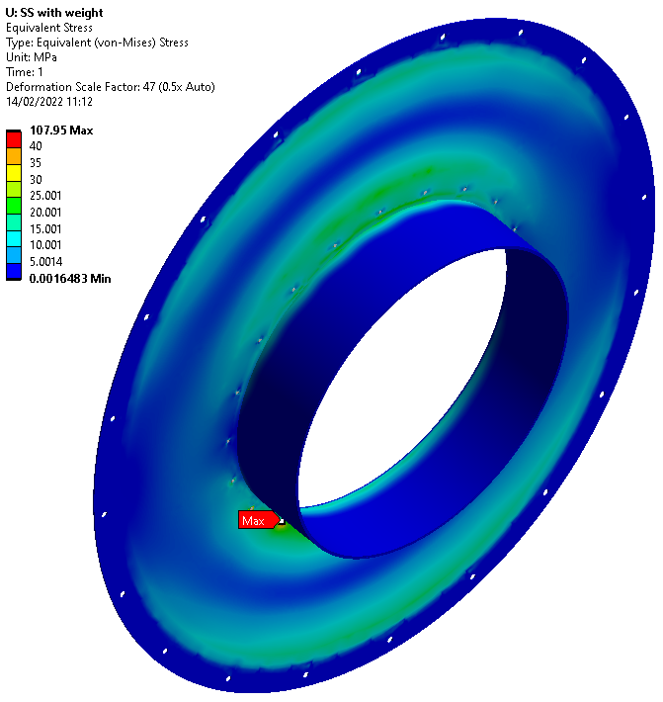
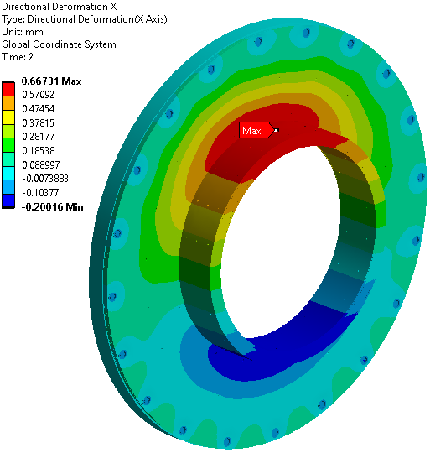
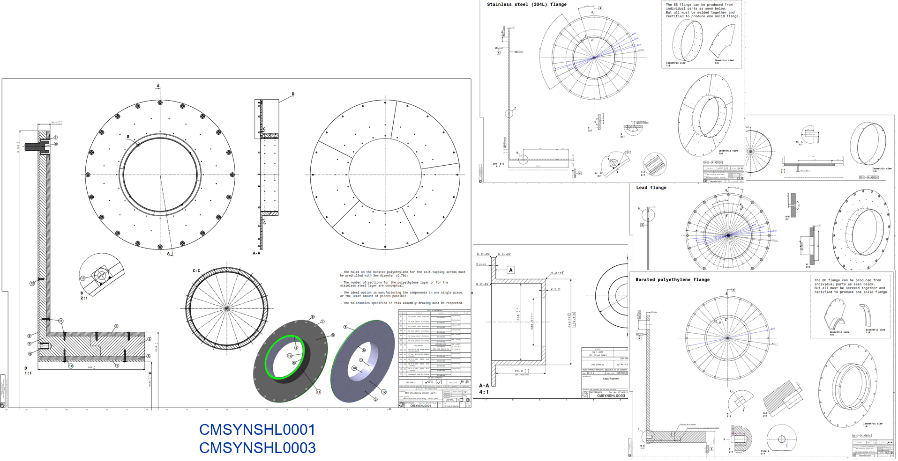
Radiation shielding
The design for the radiation shielding consists in different layers of lead and borated polyethylene.
The layers are joined together with screws.
The shielding is fixed to the back flange by bolts.
The design was done considering the corresponding safety standards (for lead and polyethylene).
And Eurocode 3 standard for structural components.
All the FEM studies and analytical calculations show satisfactory results.
The manufacturing drawings are finished.
EDMS: 2723199
Diego G. Robles

Slide 9
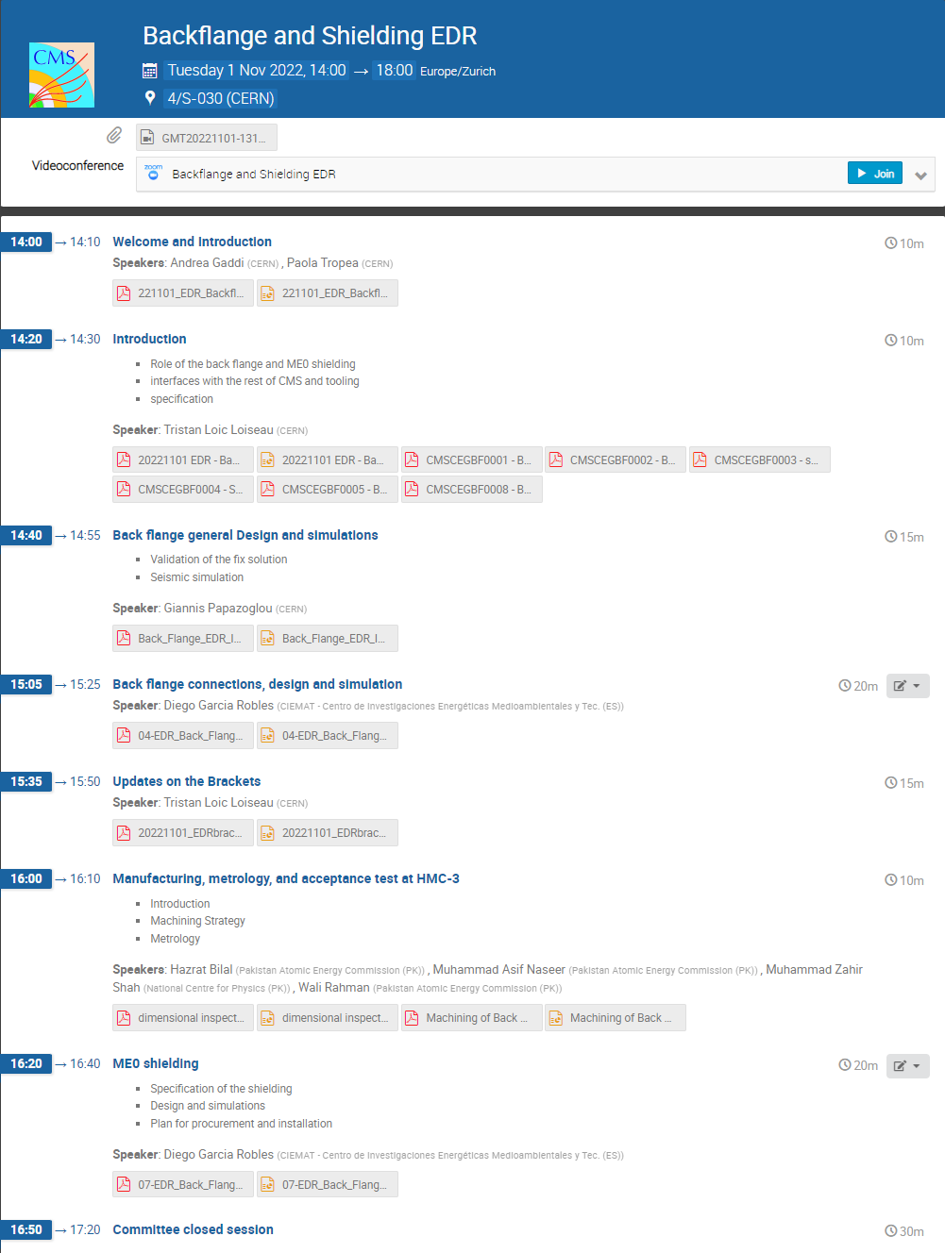
Project status
Design is finished.
Calculations are finished.
Manufacturing drawings are ready.
November 1st
Engineering Design Review (EDR)
Committee of experts at CERN
Approved the design
(very good feedback)
Ready for manufacturing
https://indico.cern.ch/event/1210794/
Diego G. Robles

Slide 10
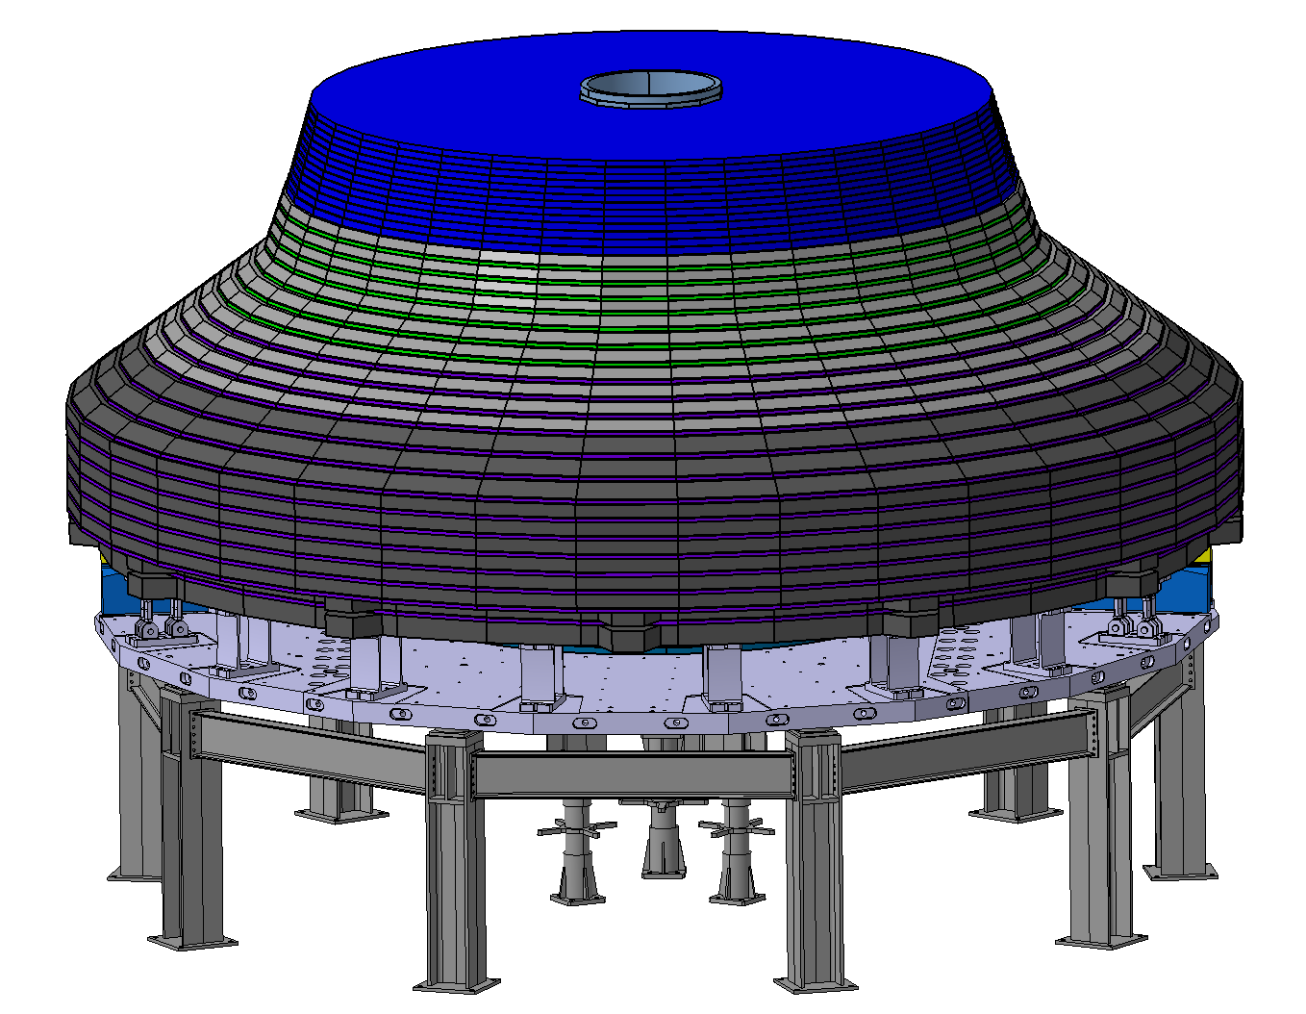
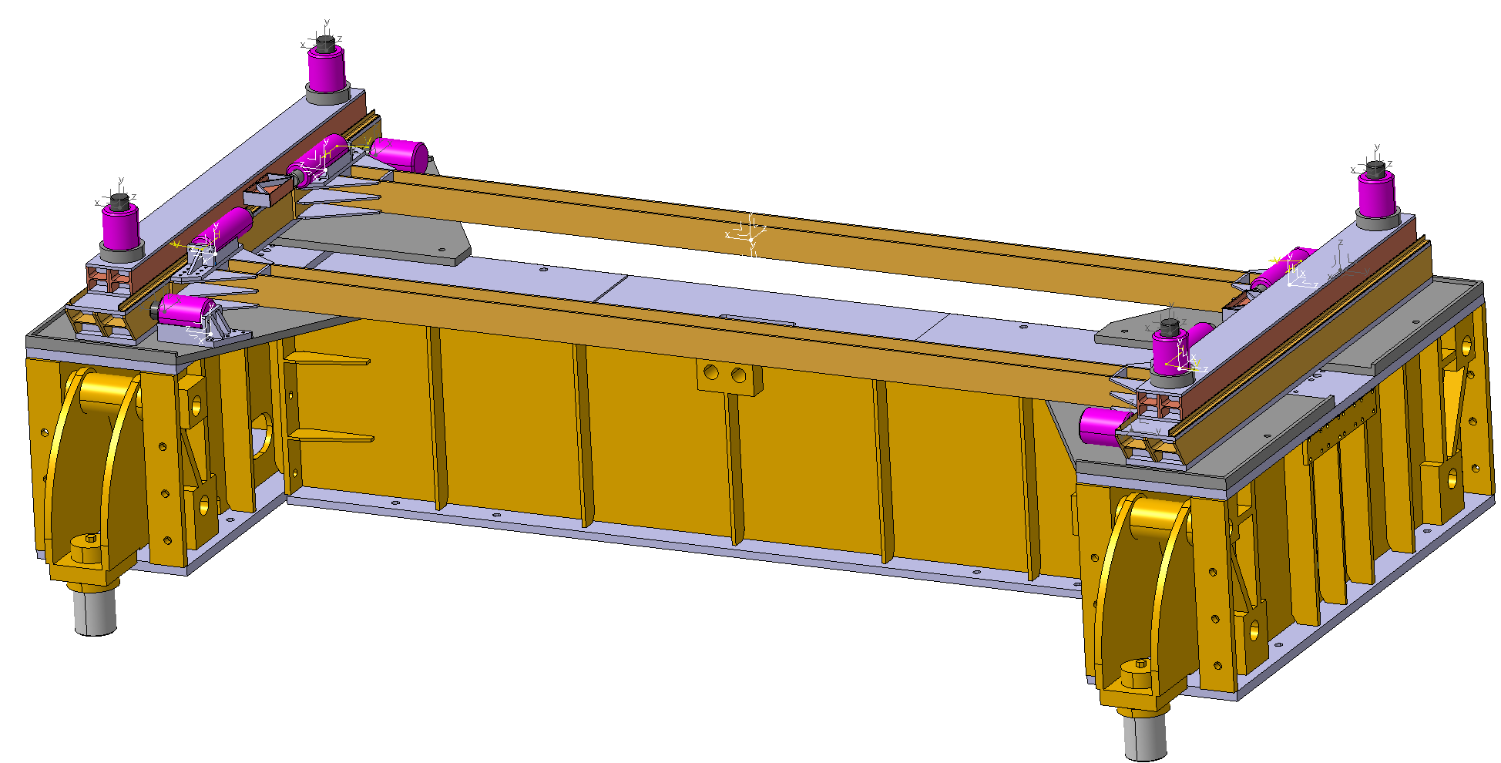
New projects I’m working on:
Assembly table for HGCAL
Adjustment table for Tooling C
Diego G. Robles

Slide 11
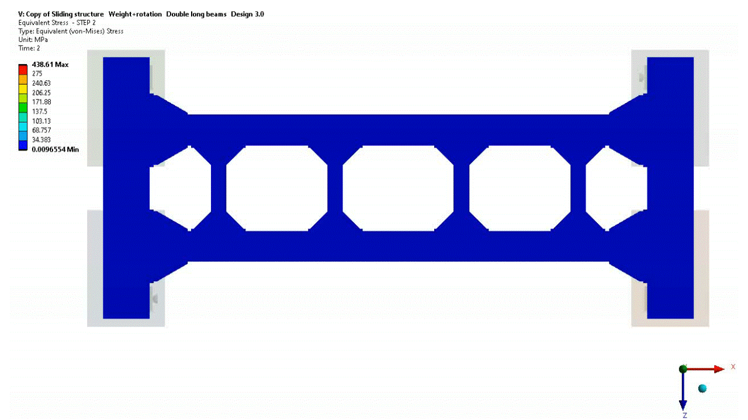
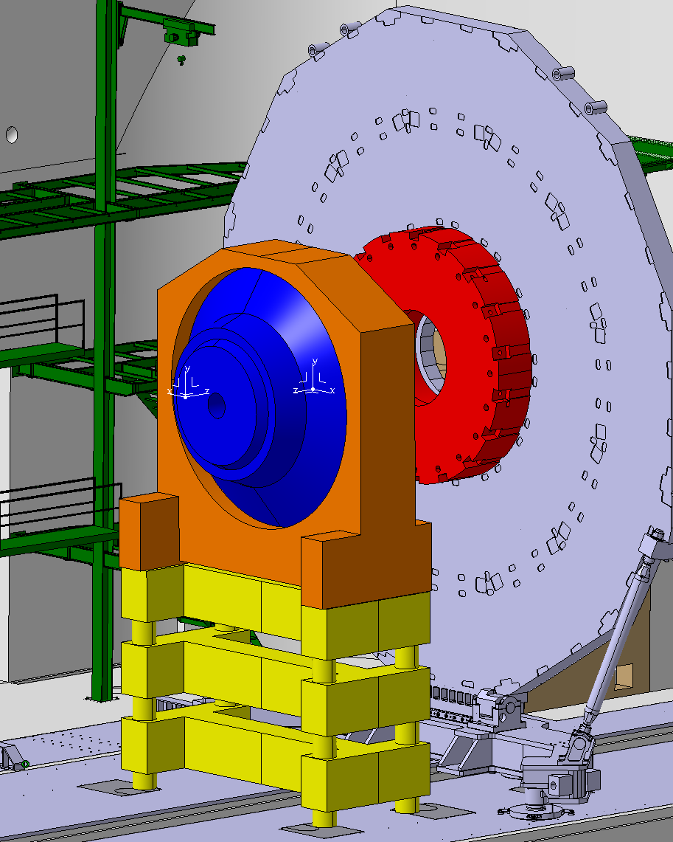
Adjustment table for Tooling C
50mm
± 2.5⁰
50mm
Adj. table
Riser
This table will have 6 degrees of freedom.
Allowing movements and rotations in all 3 axis.
Diego G. Robles

Slide 12
Thank you
for your attention
Diego G. Robles

