Slide 1



Engineering/design of tooling for installation of 250-tonne fragile calorimeter from surface to the CMS detector, 100m underground.
15th FTEC Workshop - January 18, 2023
CMS Endcap Upgrade. HGCAL project
Speaker: Victorio Sanchis Ortolá (EP-CMX-SCI)
Supervisor: Tristan Loiseau (EP-CMX-SCI)

Slide 2
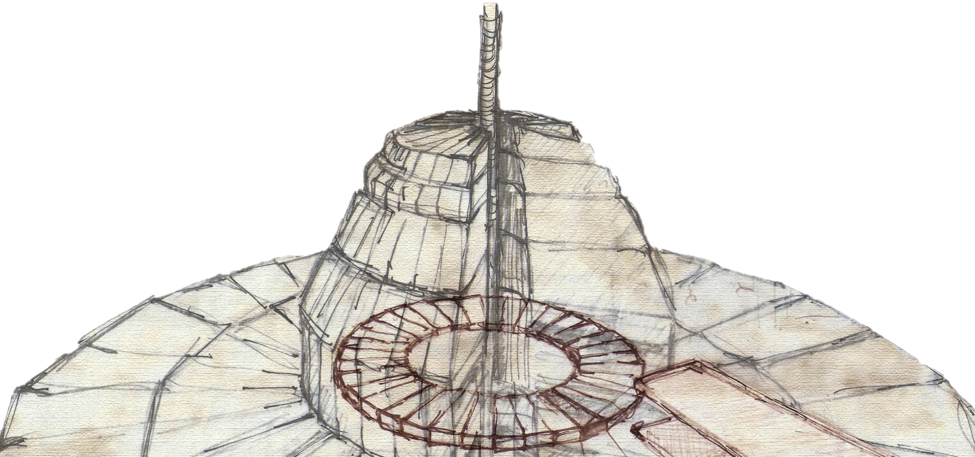
Summary
03
03
04
05
06
06
07
08
09
09
10
11
1. Context ...…………………………………………………………………………….......
1.1. Endcap upgrade at CMS. HGCAL Project ………………………………………......
1.2. Load Cases ……………………………………………………………………………………….
1.3. ANSYS Simulations …………………………………………………………………………..
2. Design Updates ………………………………………………………………………….
2.1. Cradle layout & Lifting Supports …………………………………………………………
2.2. Transport Units re-design ……………………………………………………………………
2.3. Bottom cut of Cradle Frame ………………………………………………………………..
3. Testing ………………………………………………………………………………………
3.1. Vertical Testbench ………………………………………………………………………………
3.2. Horizontal Testbench …………………………………………………………………………..
4. Project progress & next steps ……………………………………………………….

Slide 3
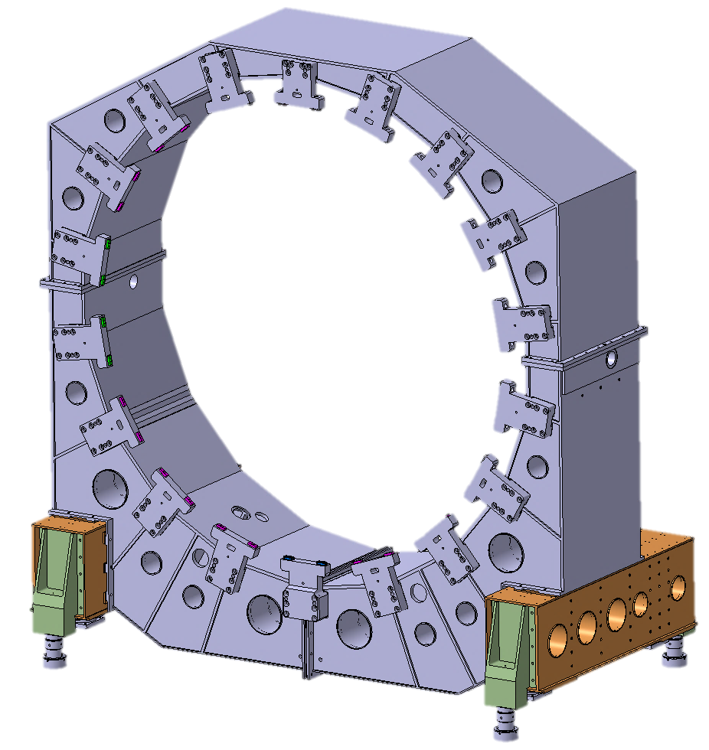
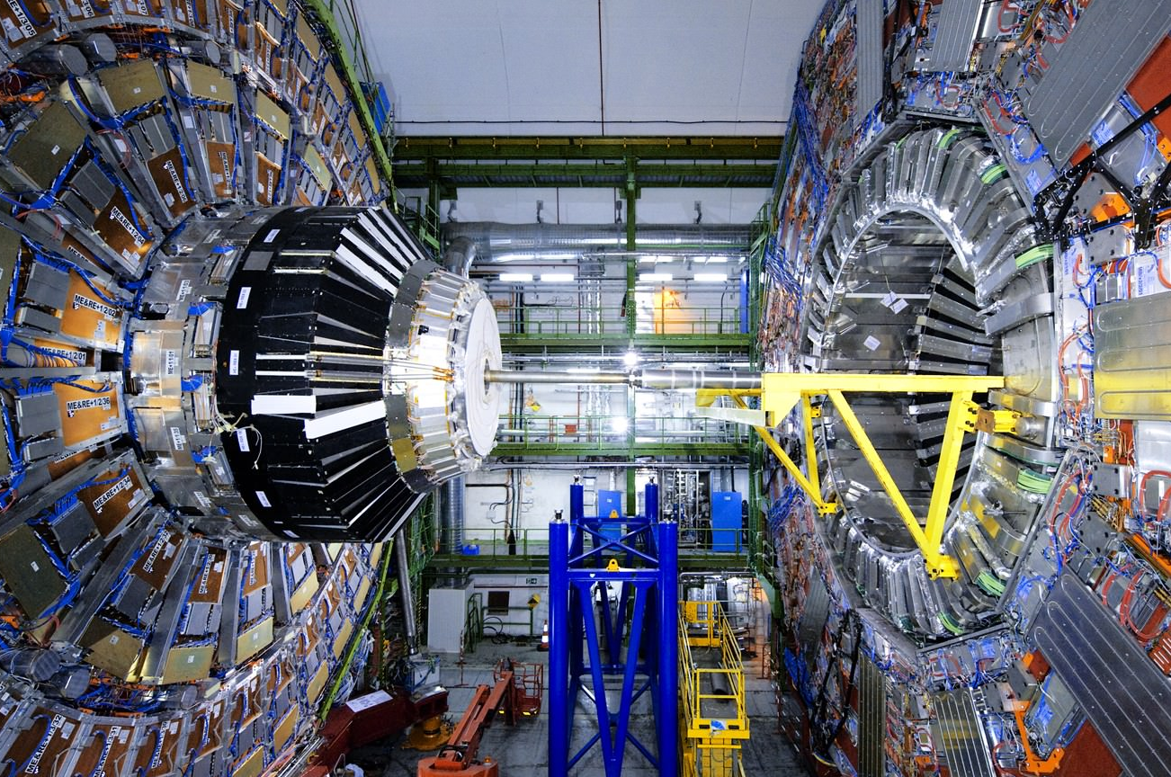
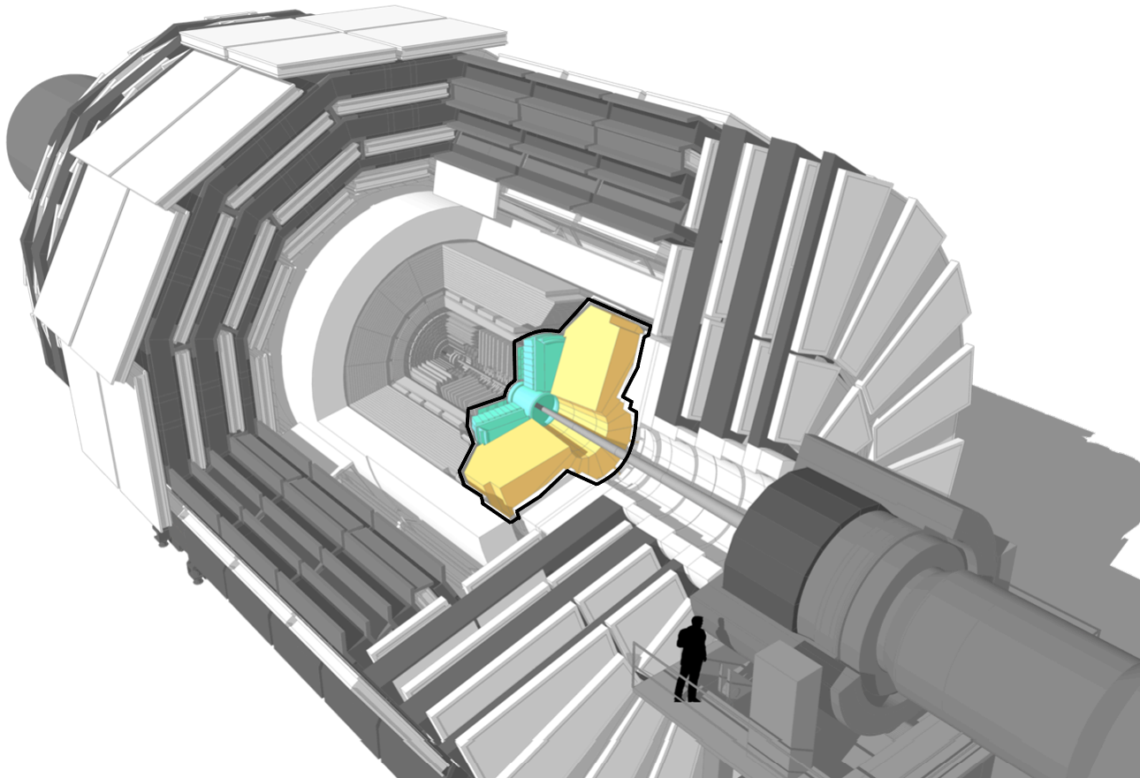
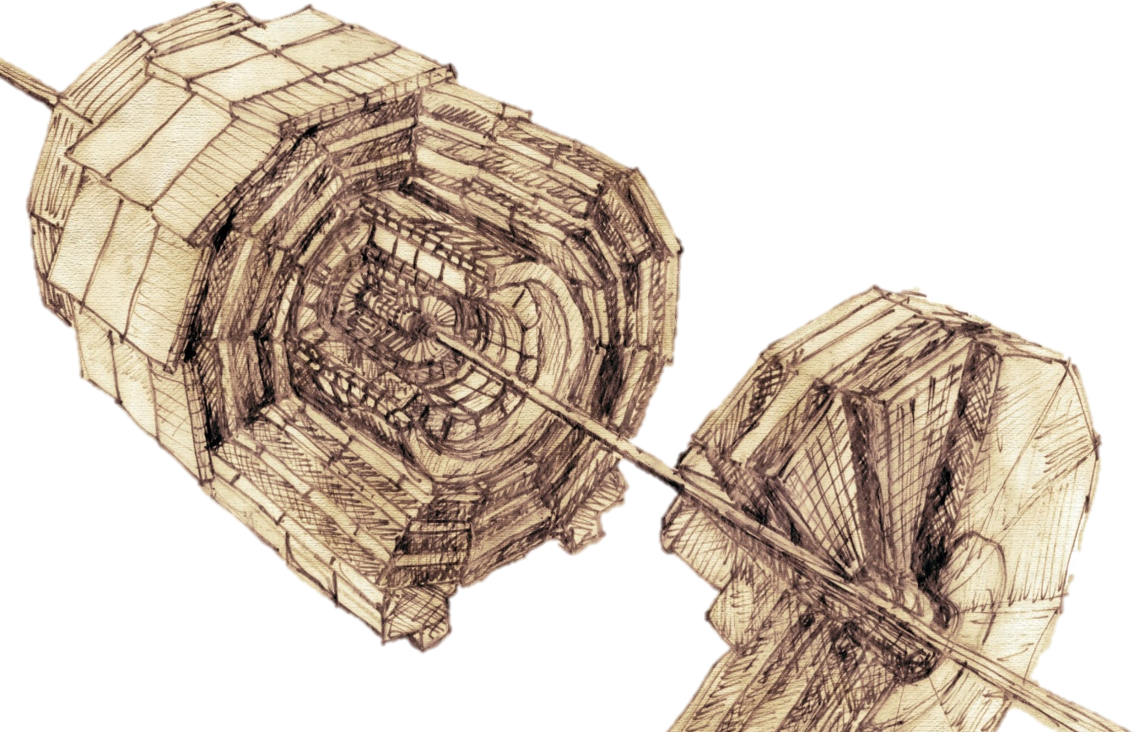



1.1. Context: Endcap upgrade at CMS. HGCAL Project
Tooling C Support Cradle
CMS Experiment, P5
Endcap Calorimeter
$\sim$3 $\sim$
15th FTEC Workshop – January 2023
Sanchis Ortolá, Victorio

Slide 4
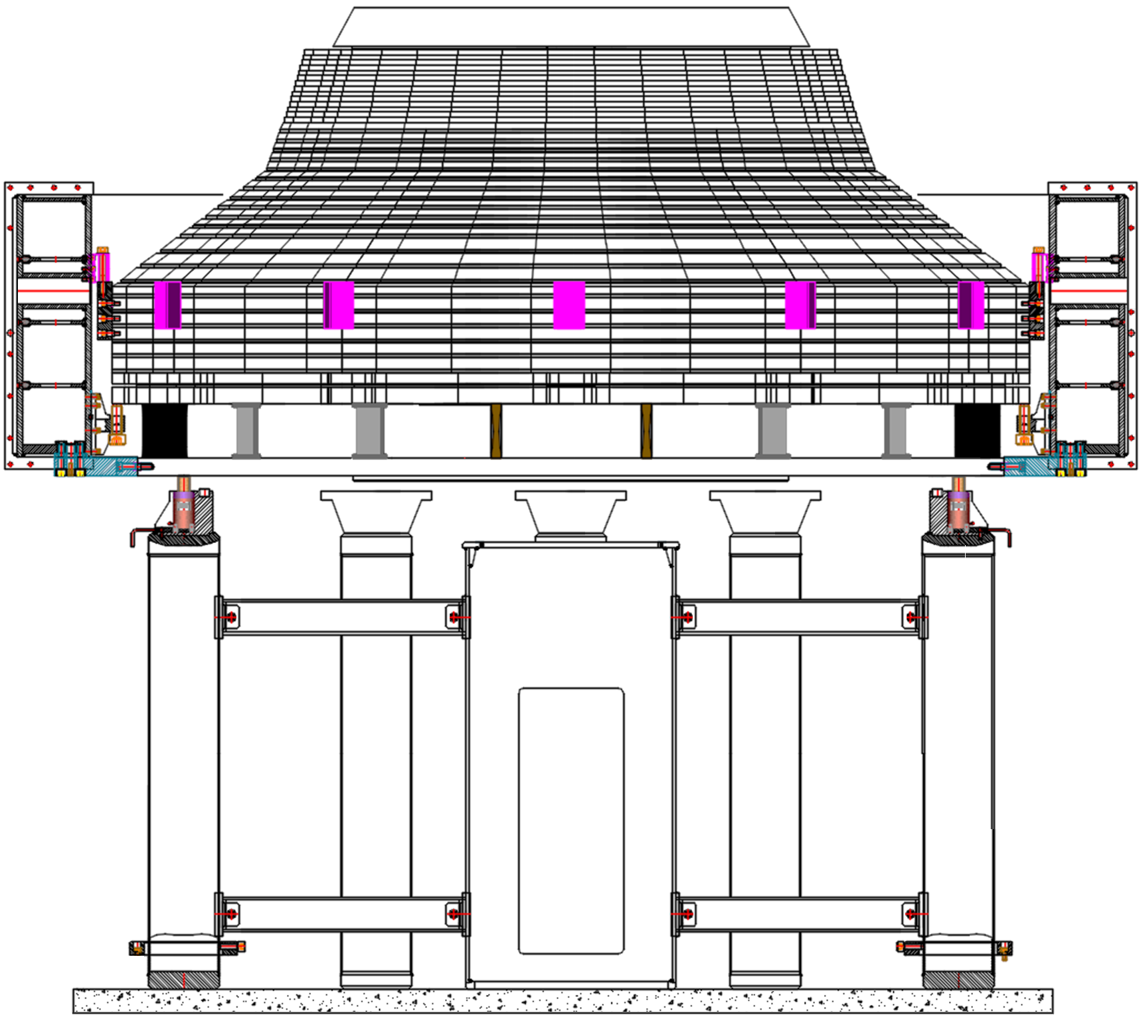
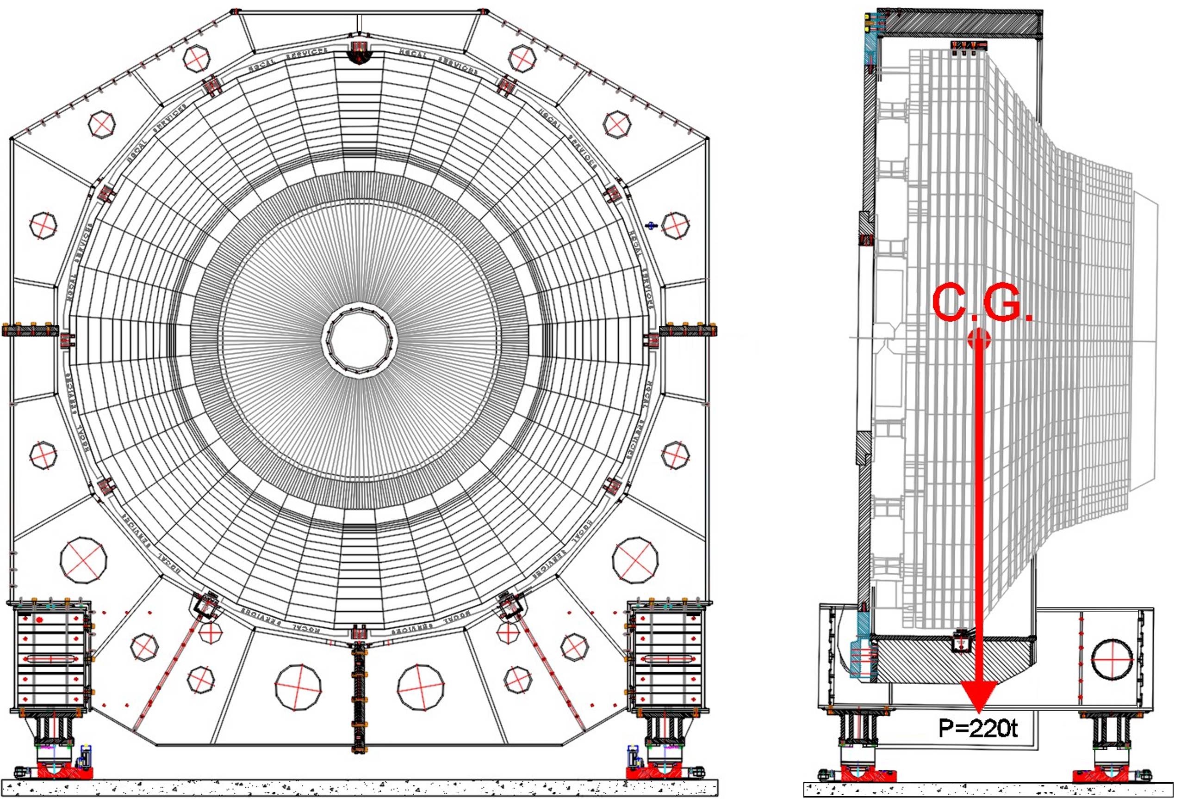
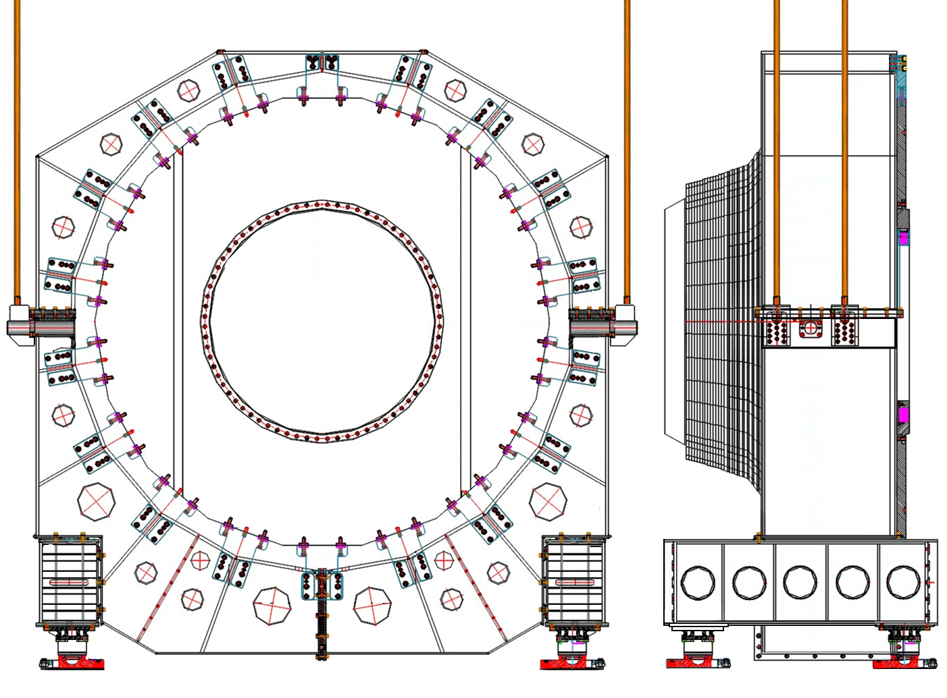
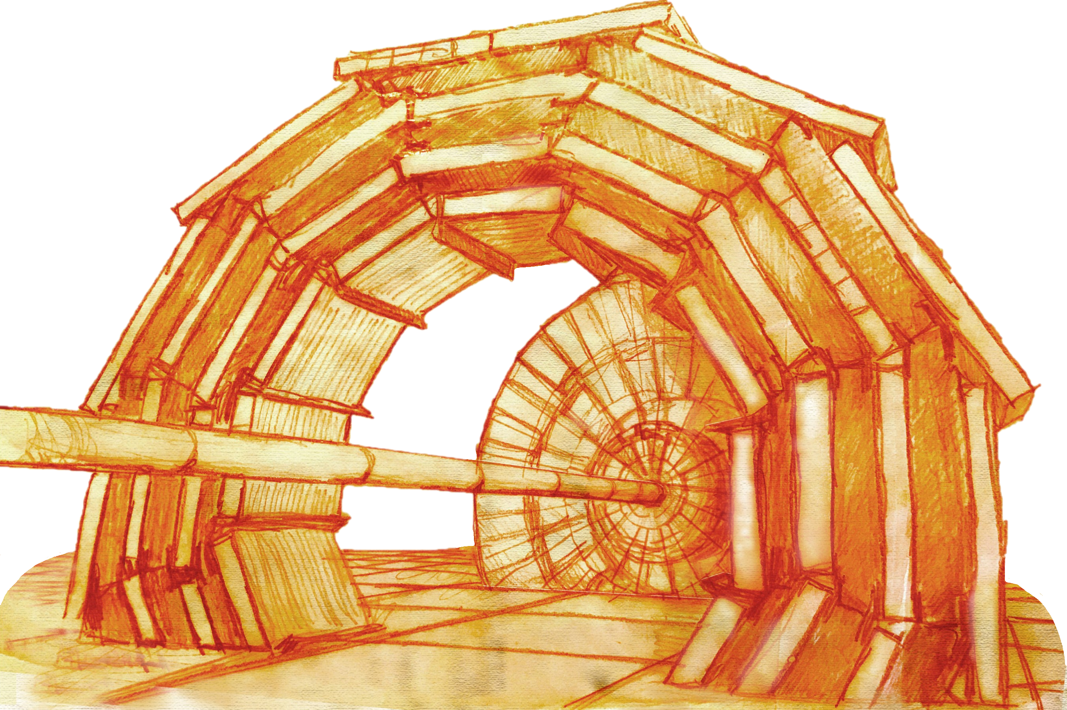

1.2. Context: Load Cases
With preliminary design finished, the iterative process of Finite Elements Analysis is started.
The worst case scenarios are identified from all the installation procedure:
Tooling in HORIZONTAL position, HANGING from lifting supports
Tooling in VERTICAL position,
SITTING on TU supports
Tooling in VERTICAL position,
HANGING from lifting supports
$\sim$4 $\sim$
15th FTEC Workshop – January 2023
Sanchis Ortolá, Victorio

Slide 5
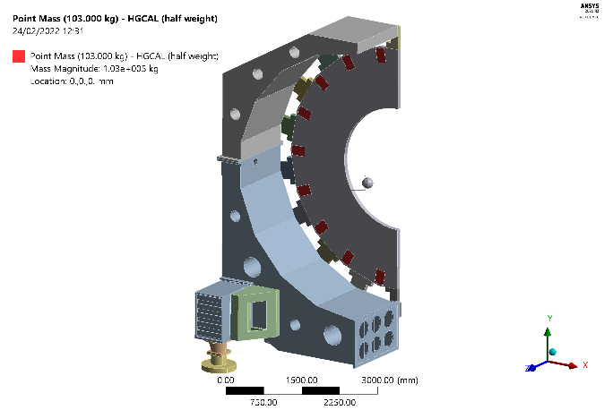
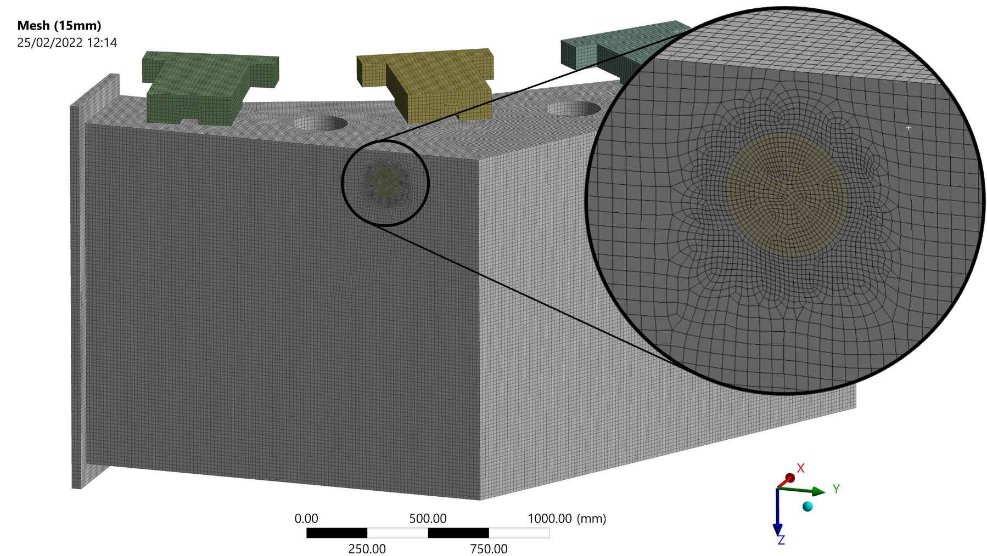
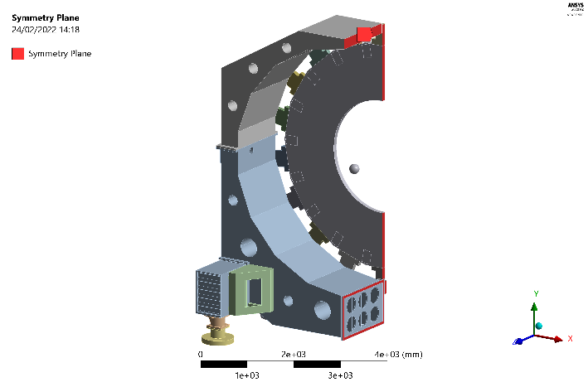
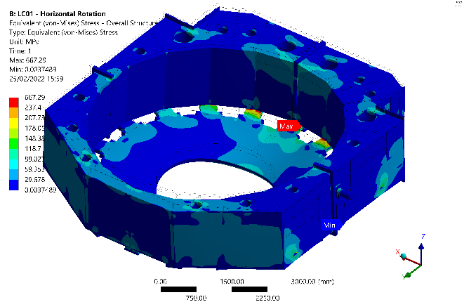
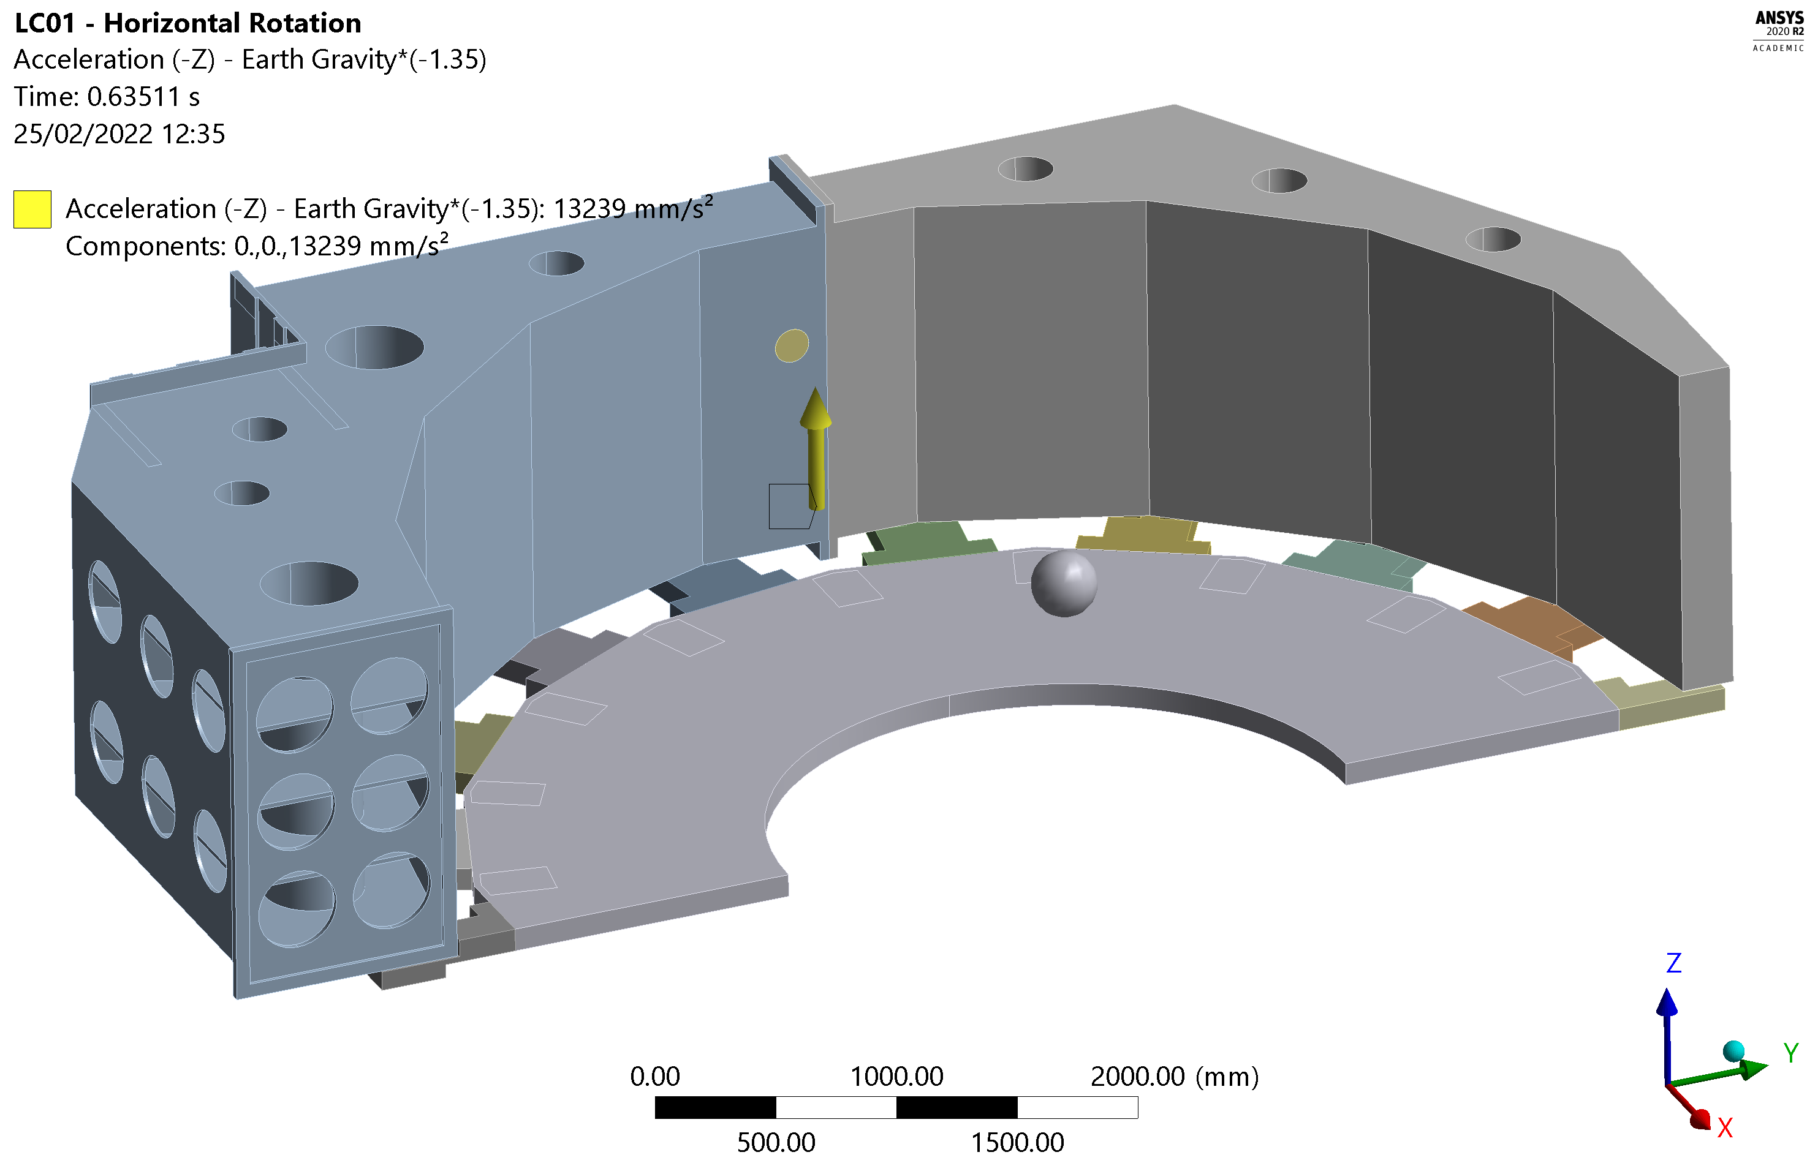

1.3. Context. ANSYS Simulations
Geometry, modified with SpaceClaim plug-in
Connections,
contacts & joints
Meshing
Boundary Conditions, following Eurocode
Symmetry condition
Results: Deformation & Stress
$\sim$5 $\sim$
15th FTEC Workshop – January 2023
Sanchis Ortolá, Victorio

Slide 6
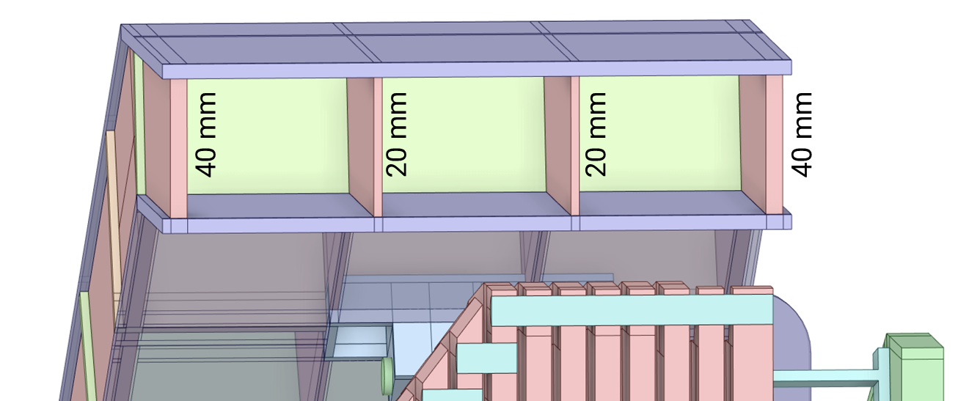
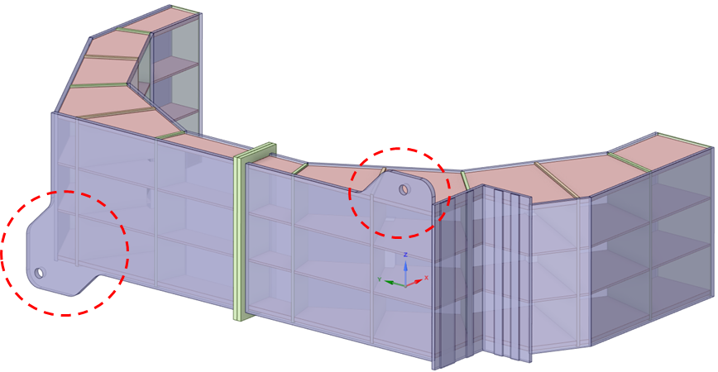
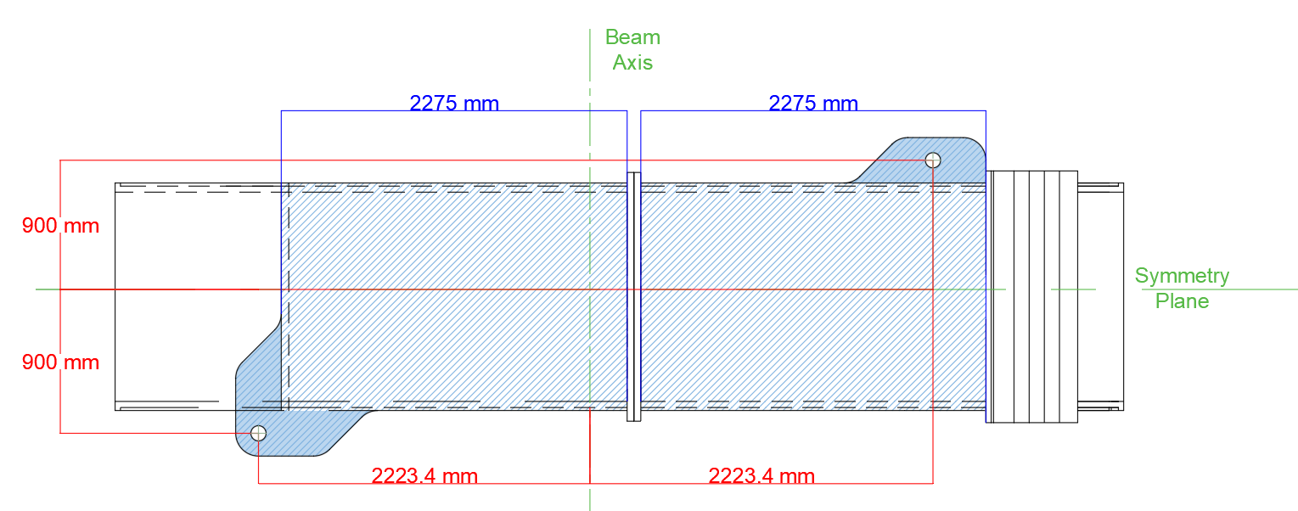
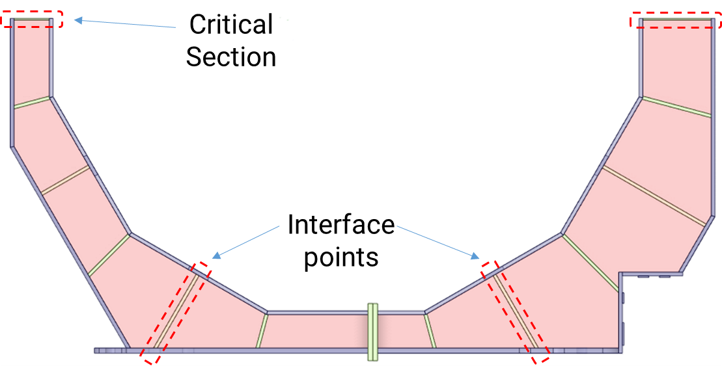

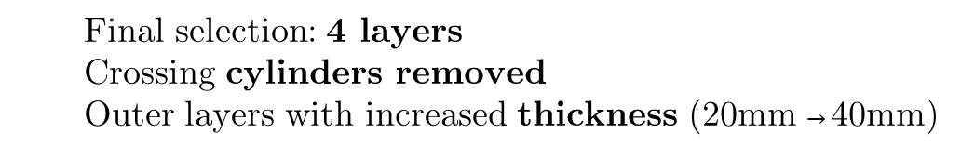
2.1. Design Updates: Cradle layout & Lifting Supports
Updated Lifting Supports, to center the HGCAL CG (both in V & H positions)
Now merged with external plates
  Final selection: 4 layers
  Crossing cylinders removed
  Outer layers with increased thickness (20mm $→$40mm)
  Added radial plates on critical points of the Frame
$\sim$6 $\sim$
15th FTEC Workshop – January 2023
Sanchis Ortolá, Victorio

Slide 7
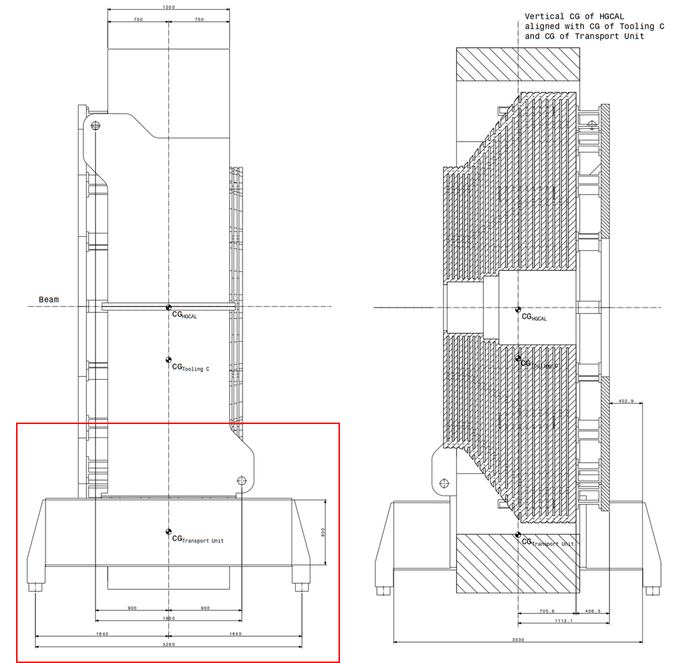
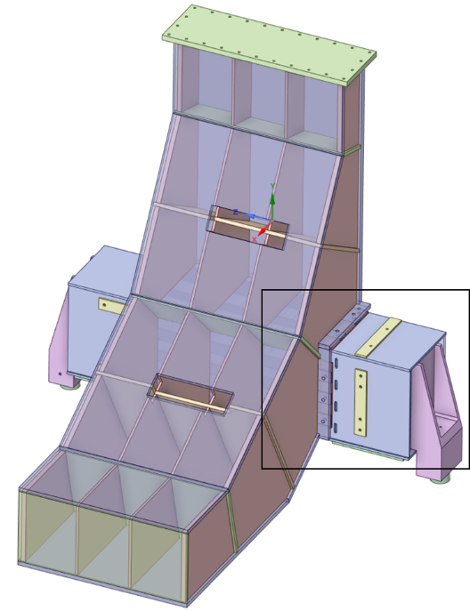


2.2. Design Updates: Transport Units re-design
The transport units that carry all the weight of the Tooling + HGCAL have been redesigned by adapting their height to the available space (using HEB-800 beams)
The design tries to unify the transport units used for Tooling B (removal of the current calorimeter) and Tooling C (insertion of the new calorimeter).
The transport units (CF-TU interface) and the Interface Blocks (CF-HGCAL interface) are moved longitudinally in order to align the vertical component of the CoG of the 3 main bodies, to increase the stability of the structure.
$\sim$7 $\sim$
15th FTEC Workshop – January 2023
Sanchis Ortolá, Victorio

Slide 8
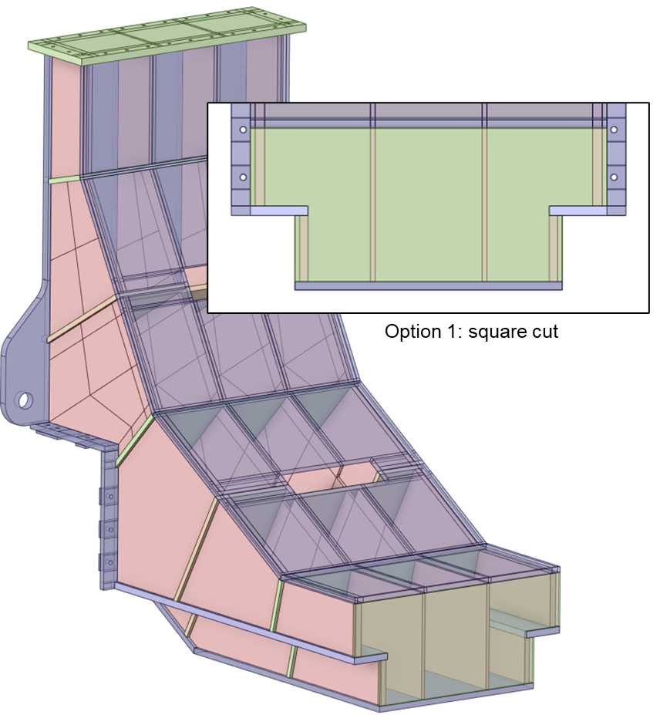
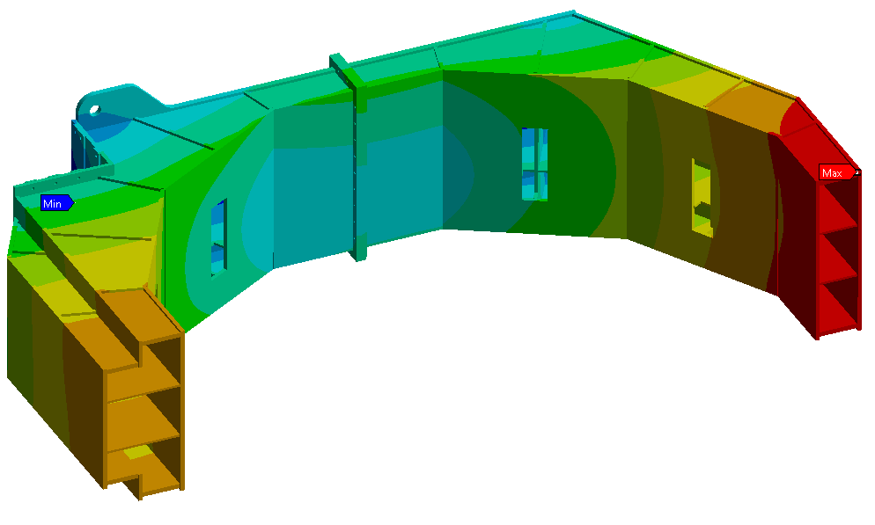
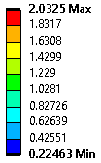

2.3. Design Updates: Bottom cut of Cradle Frame
Modification of the lower part of the Cradle Frame to allow the insertion of a skidding system for the movement of the tooling inside CMS.
$\sim$8 $\sim$
15th FTEC Workshop – January 2023
Sanchis Ortolá, Victorio

Slide 9
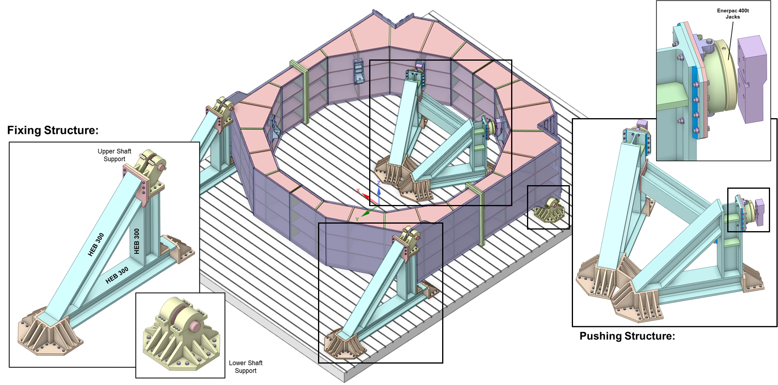

Testing: Vertical Testbench for Tooling
$\sim$9 $\sim$
15th FTEC Workshop – January 2023
Sanchis Ortolá, Victorio

Slide 10
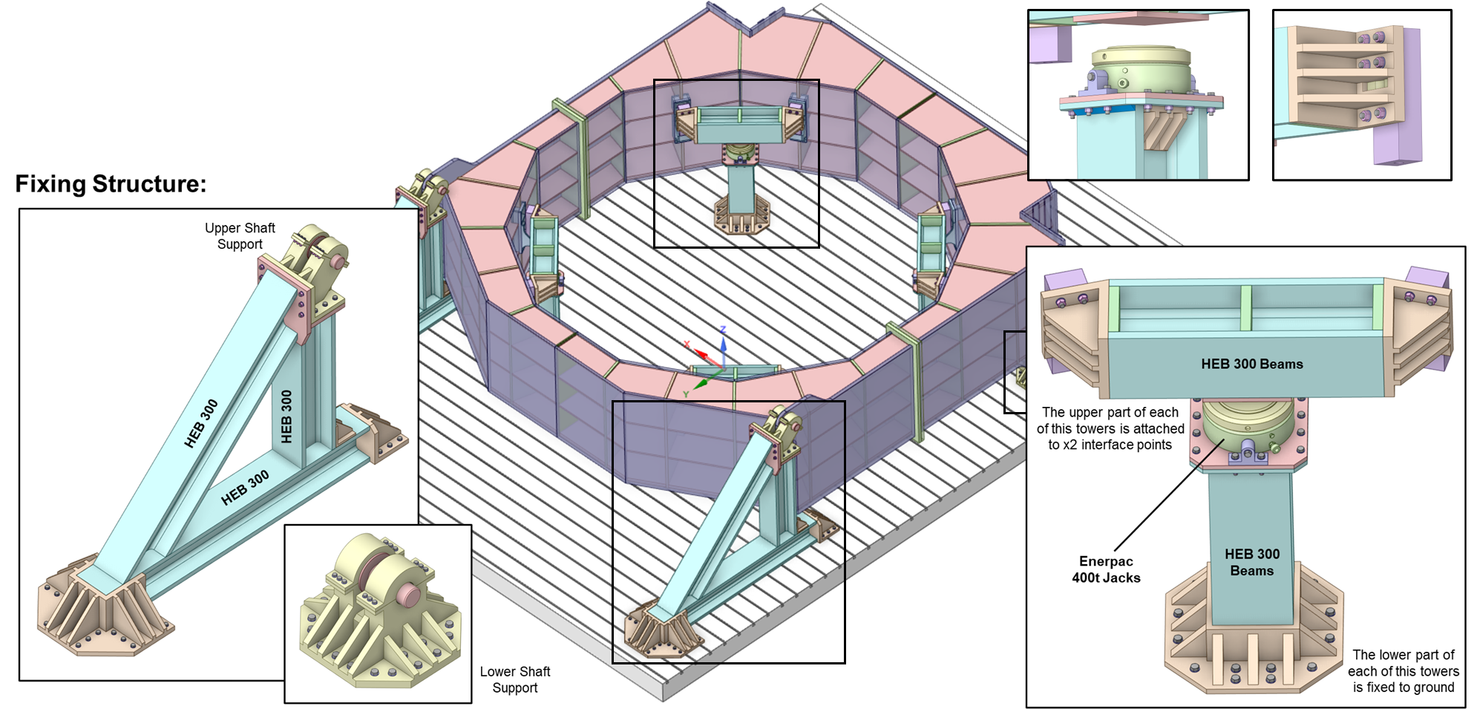

Testing: Horizontal Testbench for Tooling
$\sim$10 $\sim$
15th FTEC Workshop – January 2023
Sanchis Ortolá, Victorio

Slide 11

Project progress & Next steps
D O N E
D O I N G
T O D O
Interface modifications & design improvement
Parametric Study of the layout of layers for the Cradle Frame
Redaction of final Technical Report
Simulation of Testbench
Final master ANSYS Simulation
Engineering Design Review (EDR) before manufacturing
$\sim$11 $\sim$
15th FTEC Workshop – January 2023
Sanchis Ortolá, Victorio

Slide 12

Thank you
Engineering/design of tooling for installation of 250-tonne fragile calorimeter
from surface to the CMS detector, 100m underground.
15th FTEC Workshop
$\sim$12 $\sim$
15th FTEC Workshop - January 2023
Sanchis Ortolá, Victorio

