Slide 1


High Field Magnet short models' development and construction
FTEC-2021-16
Joan Rico Orero
Supervisor: Juan Carlos Pérez
TE-MSC-SMT
15th FTEC Workshop - 18/01/2023

Slide 2
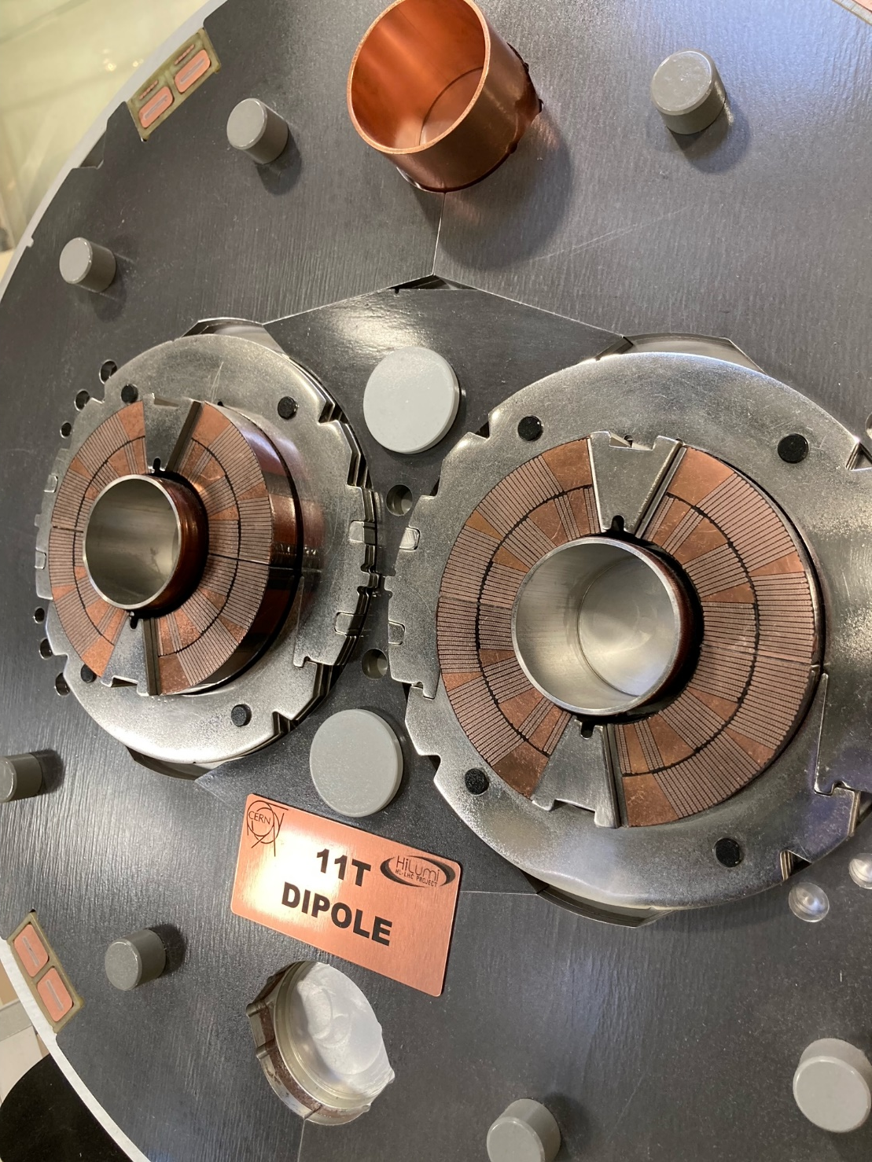
Outline
TE-MSC-SMT section
Building 927: Short Model Magnet Laboratory
SMC 11T 2G coils
10-stack measurements
FAROArm
Fig. 1: HL-LHC 11T dipole cross-section
Notes:
Dimensional control and quality assesment

Slide 3


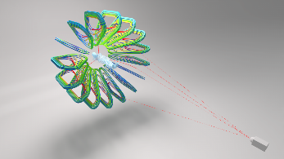
1. TE-MSC-SMT section
Technology (TE) Department
Magnets, Superconductors and Cryostats (MSC) Group
Superconducting Magnet Technology (SMT) Section
Develop innovative high-field superconducting electromagnets
  LHC upgrades →
  Future accelerators →
  Associated technologies →
  Other applications →
Notes:
Overview of Section in CERN’s organigram
belongs to…
Mission/Mandate: Develop innovative high-field superconducting electromagnets
LHC upgrades → 1st of the 3 stages in design/manufacturing of superconducting magnets: Short Model Magnet, Prototype and Series Magnet.
R&D in technologies for future accelerators: flat race-track coils: RMM, eRMC, SMC…
Other applications: medical applications: GaToroid…

Slide 4
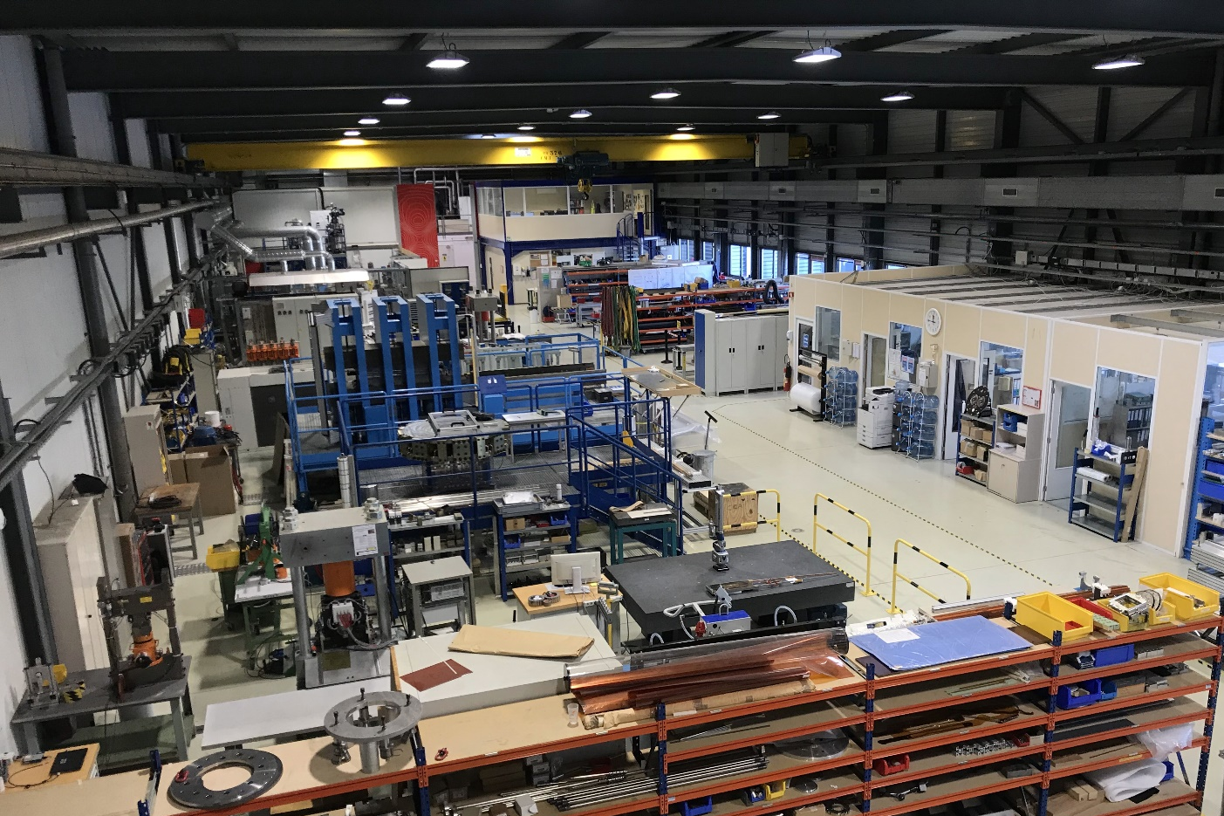
2. Building 927: Short Model Magnet Laboratory
Accelerator magnets
Short Model Magnet
Prototype
Series Magnet
Manufacturing stages
  Winding
  Reaction
  Instrumentation
  Impregnation
  Electrical testing
  Magnet assembly
Coil
Fig. 2: Building 927
Notes:
Main activity → development of 1st version of accelerator magnets → reason why it’s often called SMML
For each project, same manufacturing stages:
1st stages: just manufacturing of coil
Last: assembly of the magnet
Picture of the laboratory

Slide 5
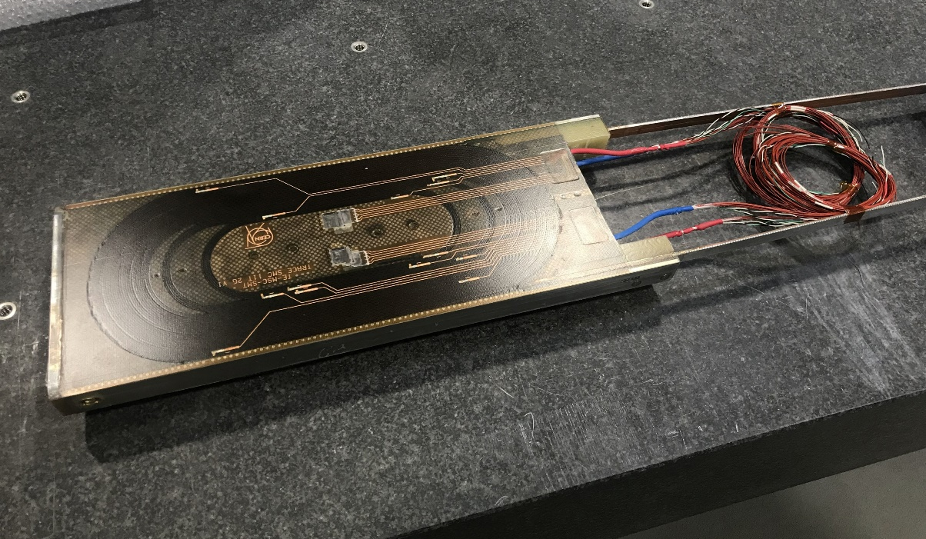
3. SMC 11T 2G coils (I)
2nd generation of SMC 11T flat race-track coils
  Simplified coil geometry
Test innovative superconductor magnets technology
  Nb₃Sn superconductor
Tasks
  Dimensional control of winding procedure
  Monitoring of every manufacturing stage
    Update the manufacturing procedures
    ↑ magnetic fields
    successor to NbTi
Fig. 3: SMC 11T 2G #101 impregnated coil

Slide 6
3. SMC 11T 2G coils (II)
Winding
Nb₃Sn heat treatment
Instrumentation
Impregnation
Impregnated coil
Reacted coil
Instrumentation

Slide 7
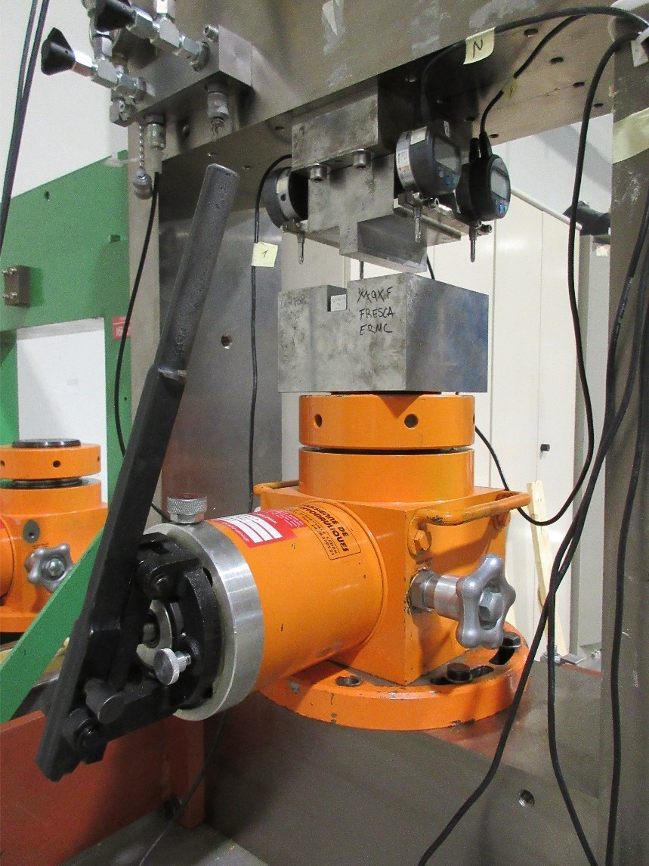
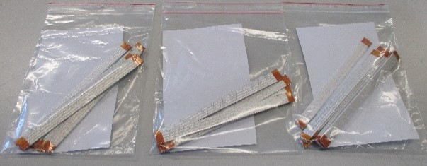
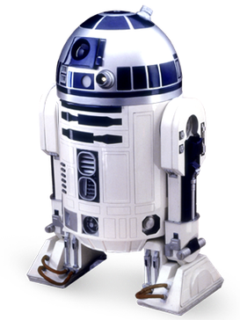
10 Stacks Measurements
Quality assessment to control the electrical insulation thickness of superconducting cables.
One of the most important quality control tests in the coil manufacturing. Critical before winding.
Figure 5. 3 samples of MQXF ready to be prepared and tested.
The measured samples are from:
MCBXF
MQXF
Figure 4. 10-stack press with the MQXF tooling mounted.
11T
R2D2
D2
Notes:
If it does not comply, we would have a dielectric resistance problem.
It also influences the azimuth size of the coils.
MCBXF – 8 different models
MQXF - 11
R2D2 – 3

Slide 8
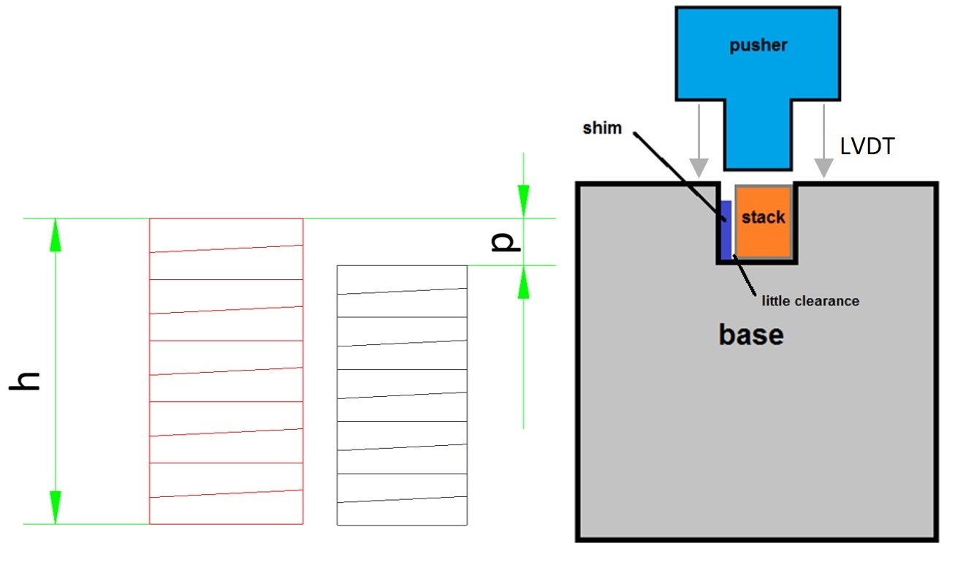
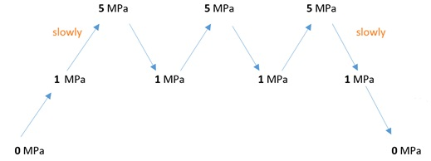
10 Stacks Measurements
Relative measurement of the thickness of the insulation layer
Absolute measurement of the mid-thickness of a single cable
Very simple and effective test
  Zero
  Calibration
  Insulated cycle @ target stress
  Bare cycle @ target stress
Figure 6. 10-stack of insulated cable samples (red) and a 10-stack of bare cable samples (black). Draft of the press setup (right)
Figure 5. Typical experimental course for a 10-Stack test
Notes:
p is the difference in height at the target stress
20 is the number of layers of insulation (two per cable sample)

Slide 9
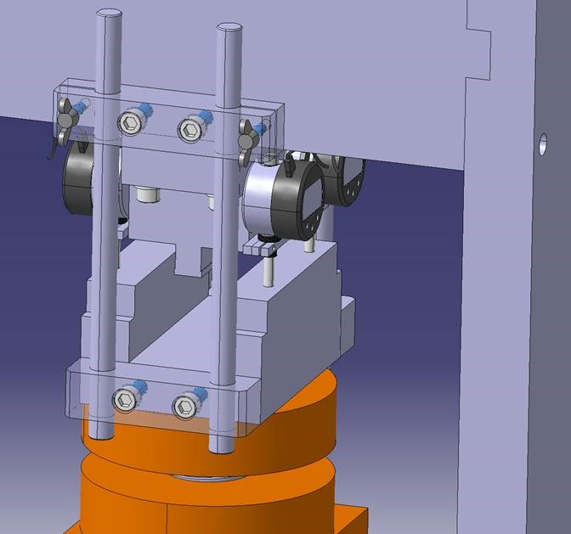
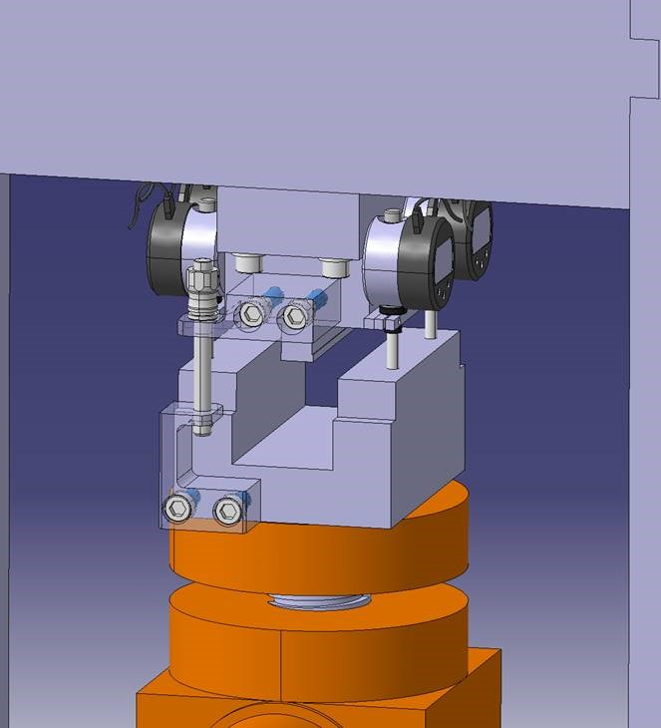
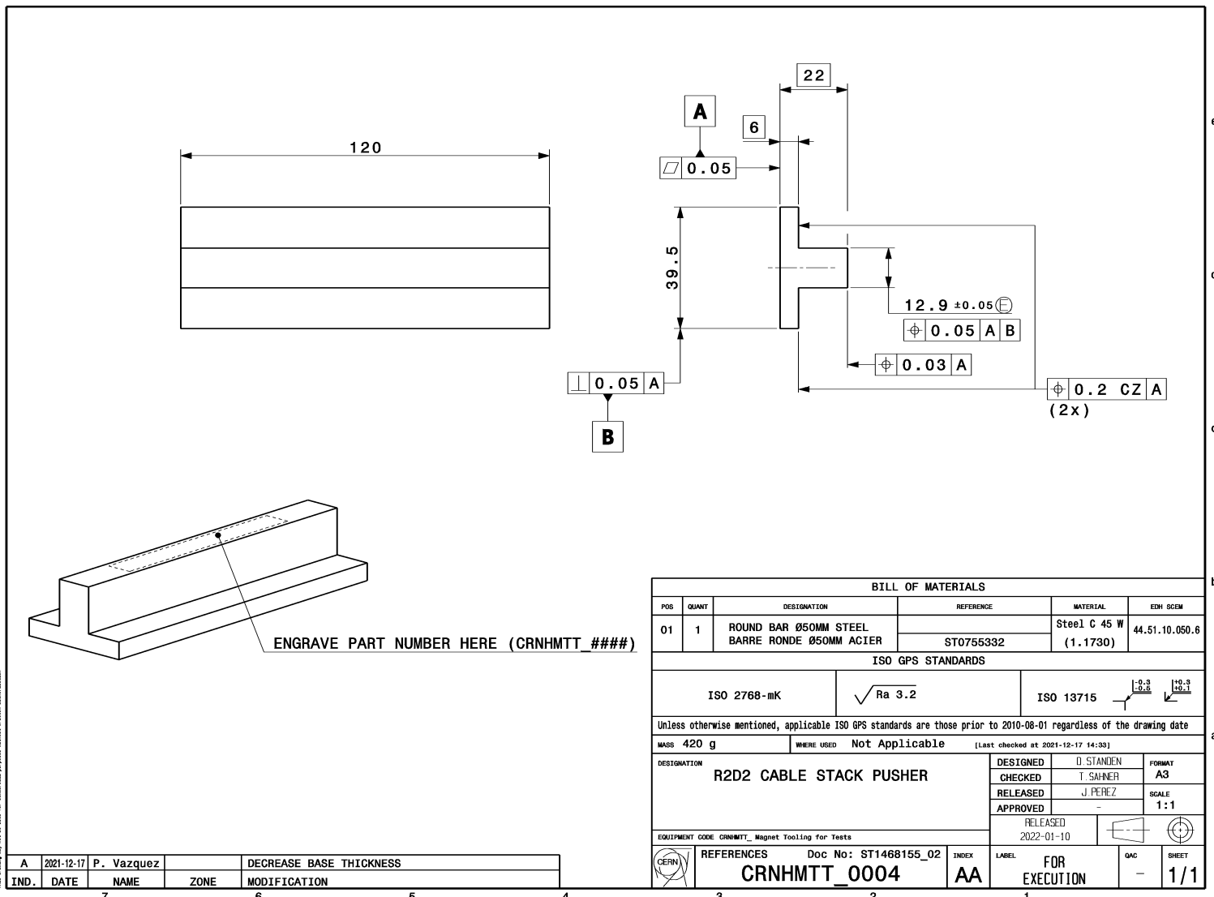
10 Stacks Press Improvements
Automatization of the data importing and handling
Differentiation of the tooling
Repeatability of the tests
DRAFTS
Figure 7. Pusher design.
Figure 8. Two conceptual designs to reduce the degrees of freedom on the 10 Stack press.
Notes:
Study different solutions to restrict degrees of freedom on the test support

Slide 10
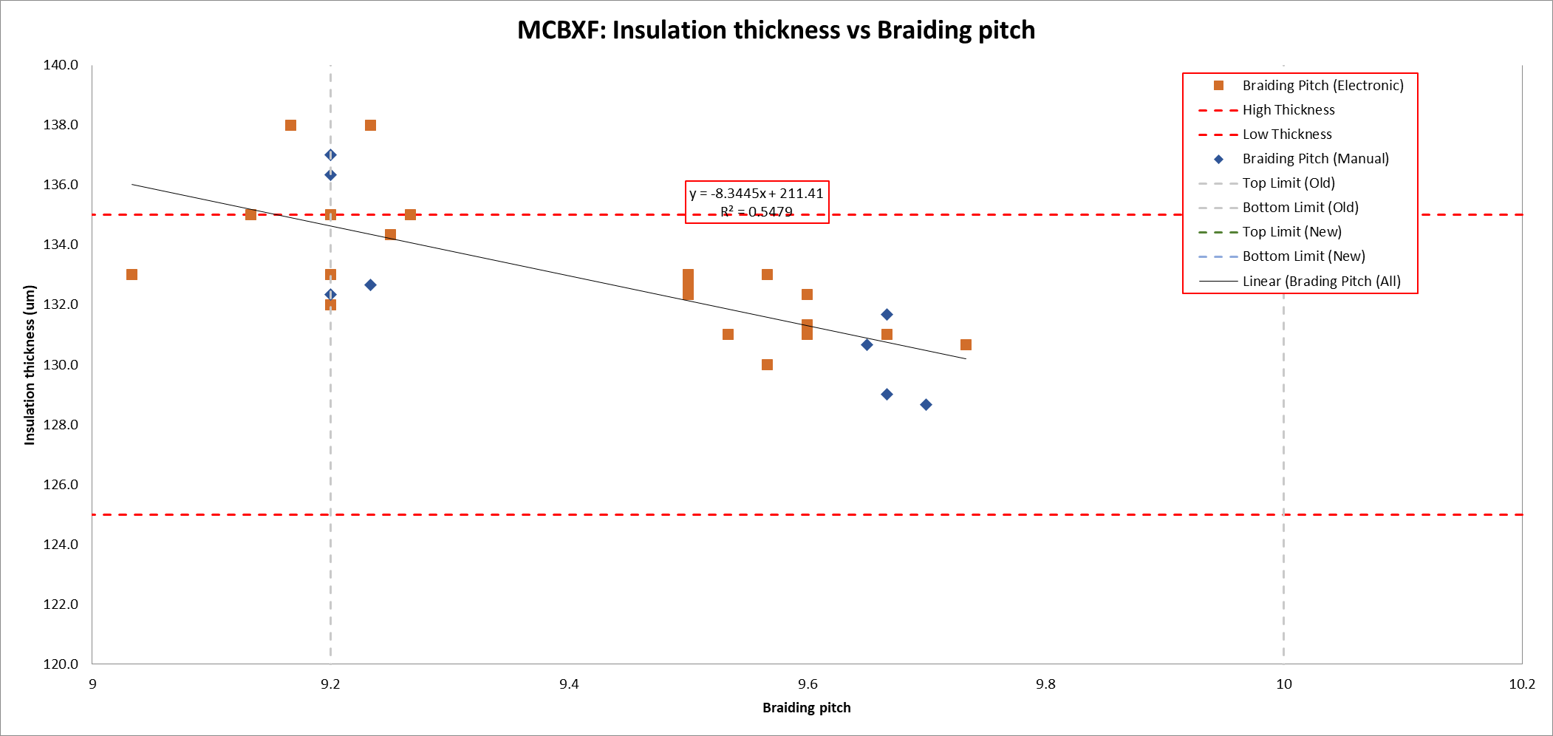
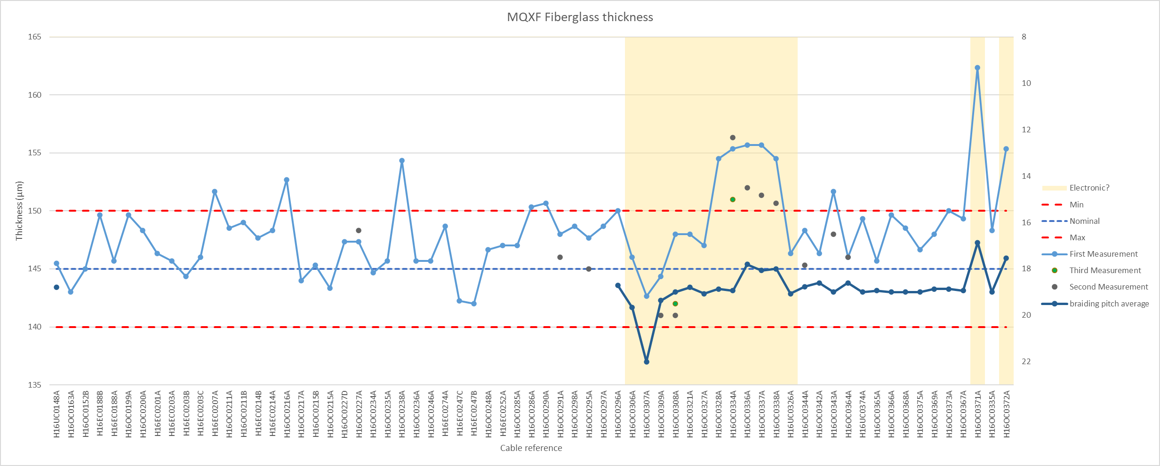
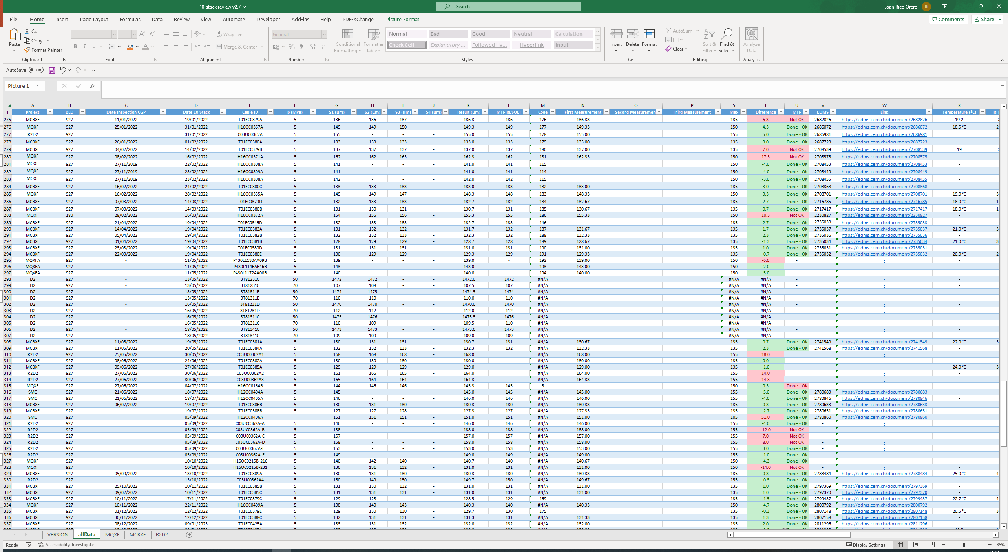
10 Stacks Press Improvements
Creation of an extensive database with all historic measurements
Identification of trends and iteration with manufacturer
Zero non-conformities in the last 8 months

Slide 11
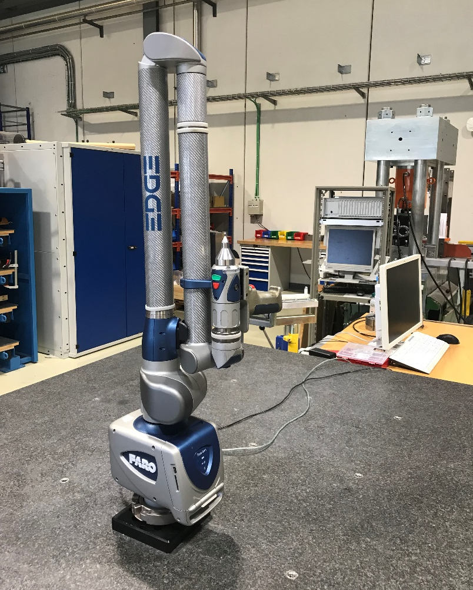
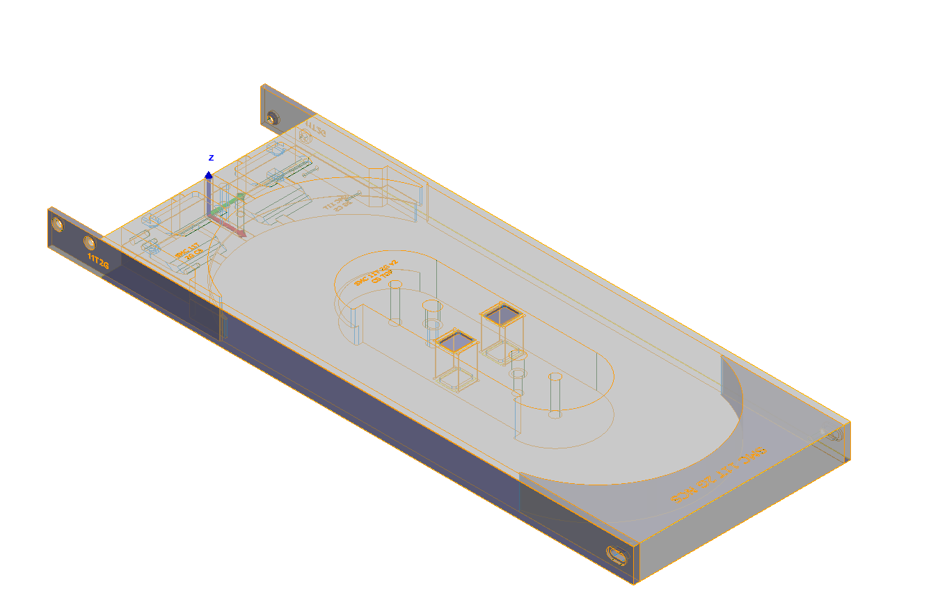
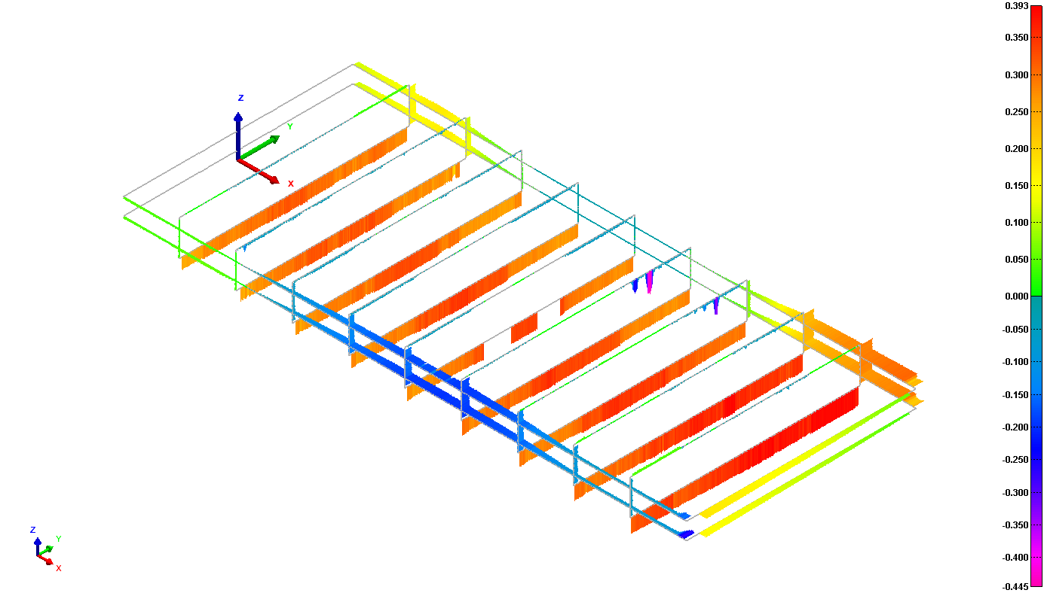
4. FAROArm
Coordinate Measuring Machine (CMM)
Dimensional control of SMT section projects
Postprocessing with Polyworks software
components
assemblies
Fig. 9: FAROArm measuring device
Fig. 10: Coil model and measurements performed at Polyworks environment
Notes:
Used for the metrology and dimensional control of … the projects in which the section is involved.

Slide 13
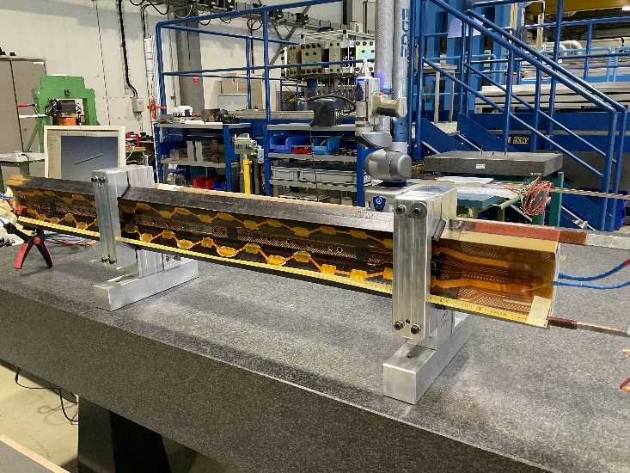
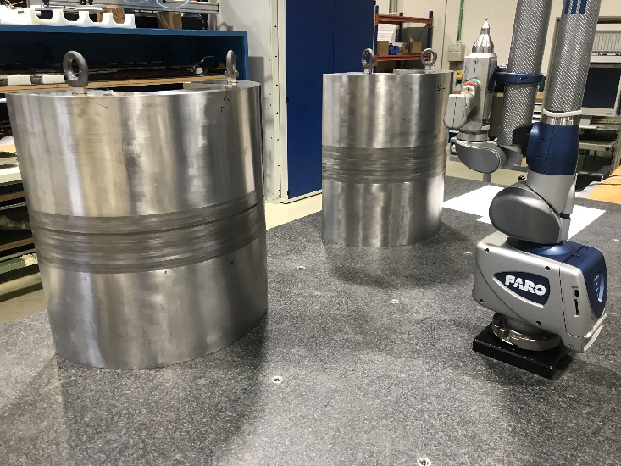
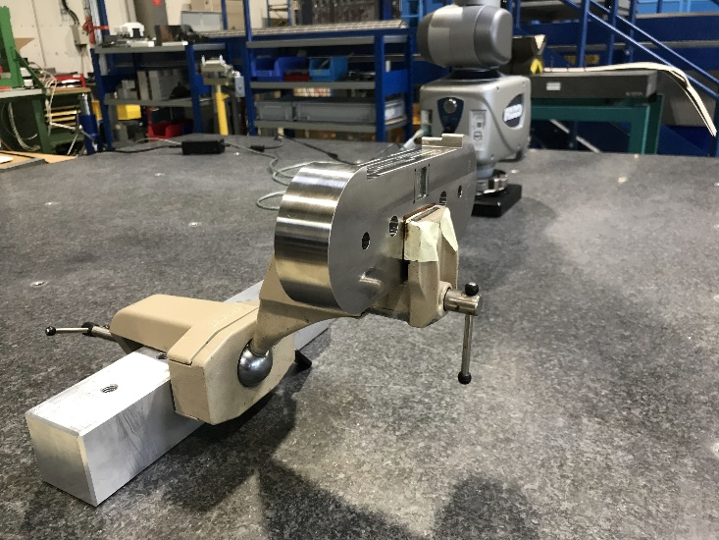
4. FAROArm
Measurements performed
  MQXF & 11T Dipole coils
  Yoke assembly for the SMC magnet structure
  SMC 11T 2G central posts and spacers
Fig. 11: Measurement setups for an MQXF coil, the yoke assembly and the central post

Slide 14
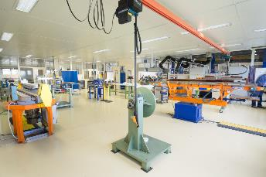
Superconductive Magnets Technology (SMT) section
Technology (TE) Department
Magnets, Superconductors and Cryostats (MSC) Group
Superconductive Magnets Technology (SMT) Section
Develop innovative superconducting electromagnets:
LHC upgrades
Future accelerators
Associated technologies
Winding
Heat treatment
Instrumentation
Impregnation
Electrical testing
Assembly
Figure 1. Winding Laboratory in b. 927
Notes:
From functional specifications to the construction of short models

Slide 15
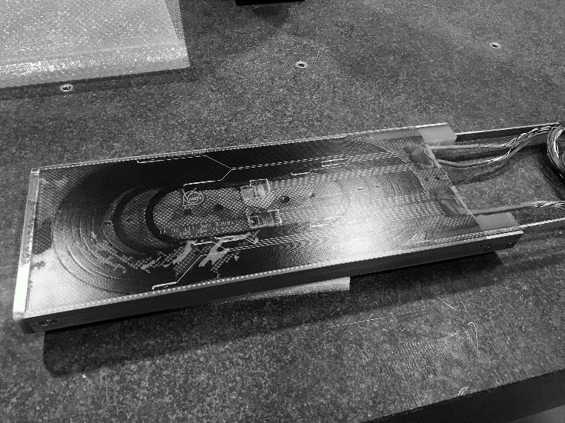
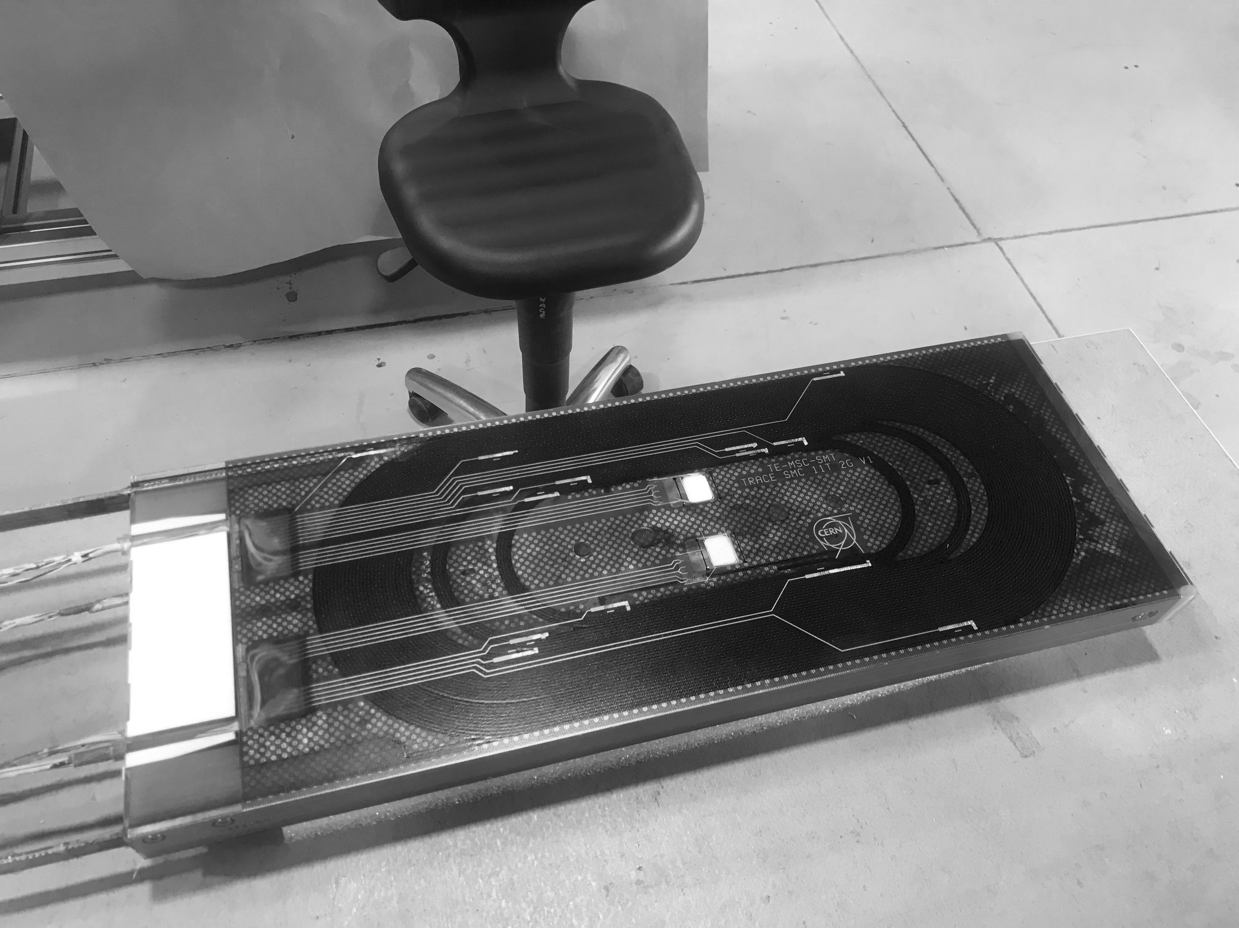
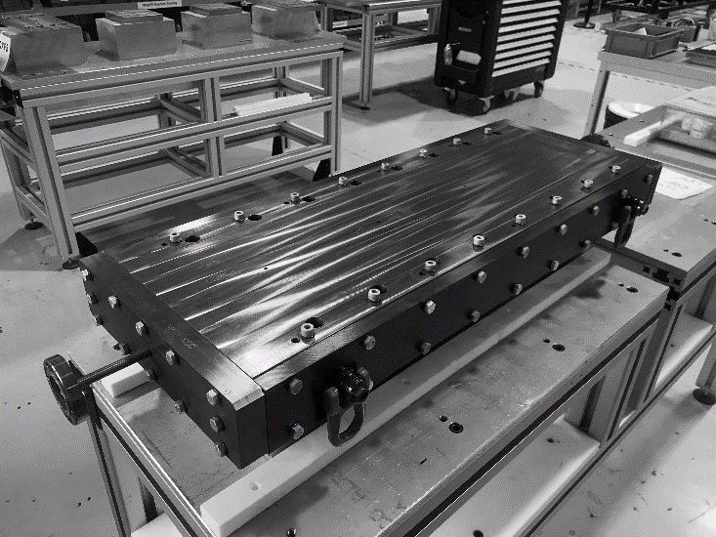
3. SMC 11T 2G coils (III)
Coil #101
Post-impregnation
Coil #102
Post-impregnation
Coil #103
Post-reaction

Slide 16
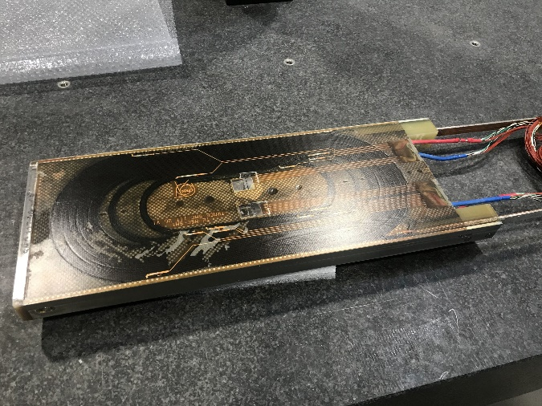
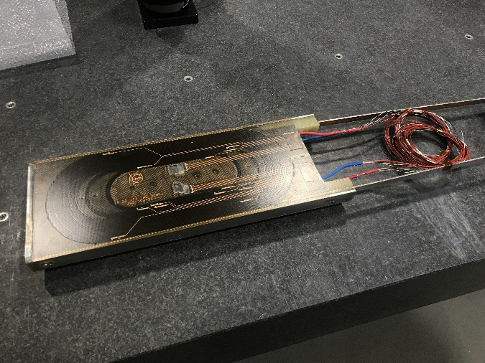
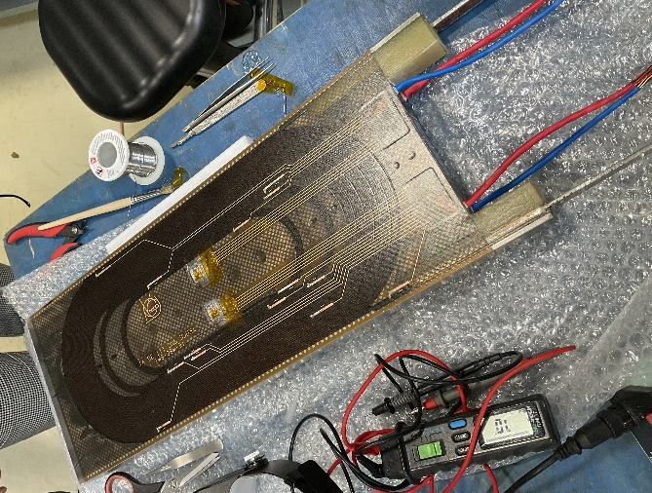
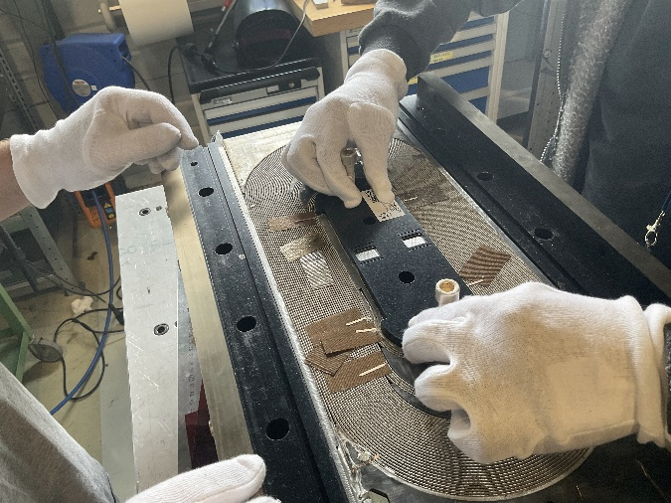
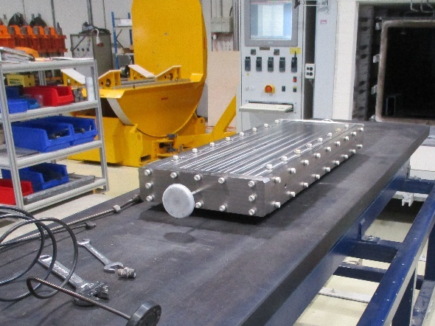
3. SMC 11T 2G coils (IV)
Coil #101
Finished
Coil #102
Finished
Coil #103
Finished
Coil #105
Instrumentation
Coil #104
Reaction

Slide 17
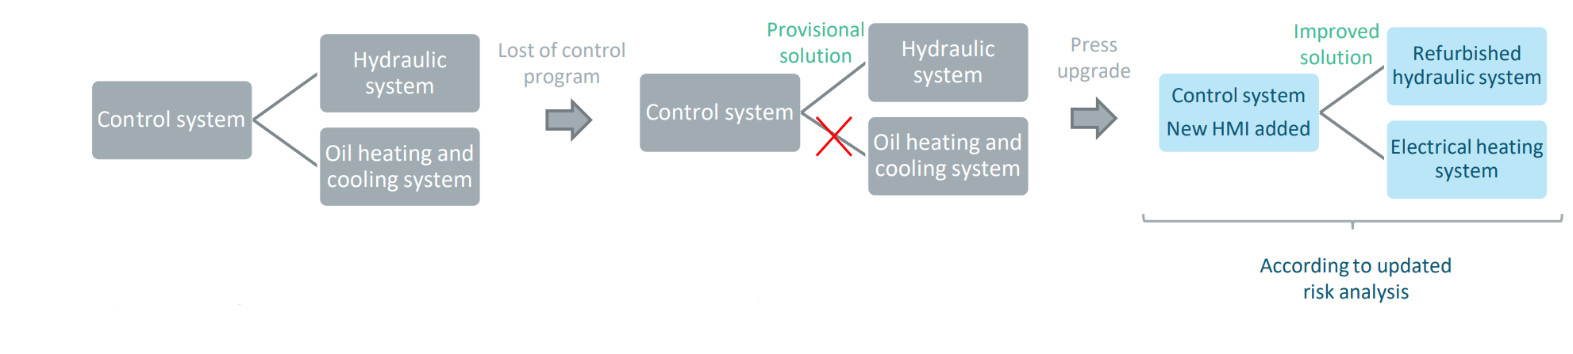
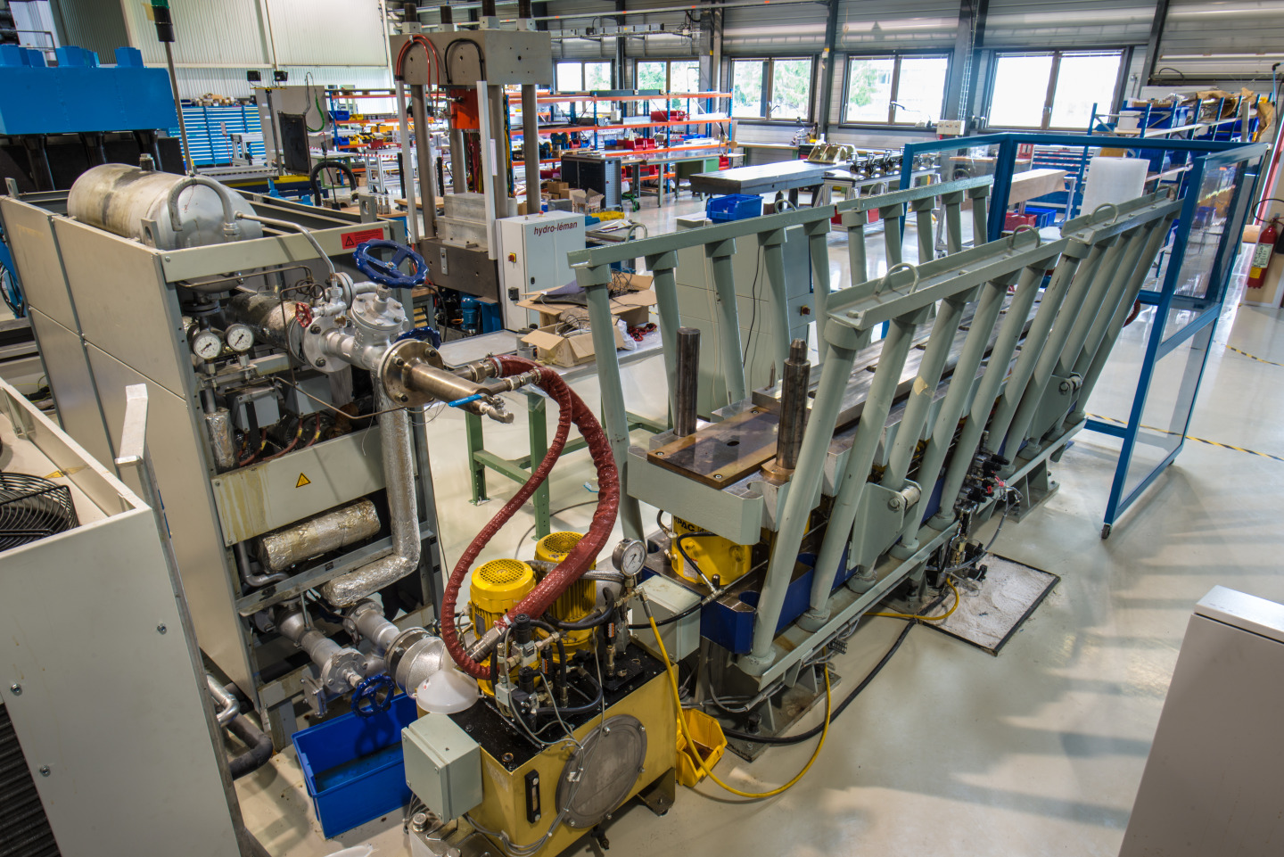
Curing press upgrade
Figure 8. Curing press in b. 927, with the heating system on the left
Notes:
UNICOS course in the BEAMS department for a month

Slide 18
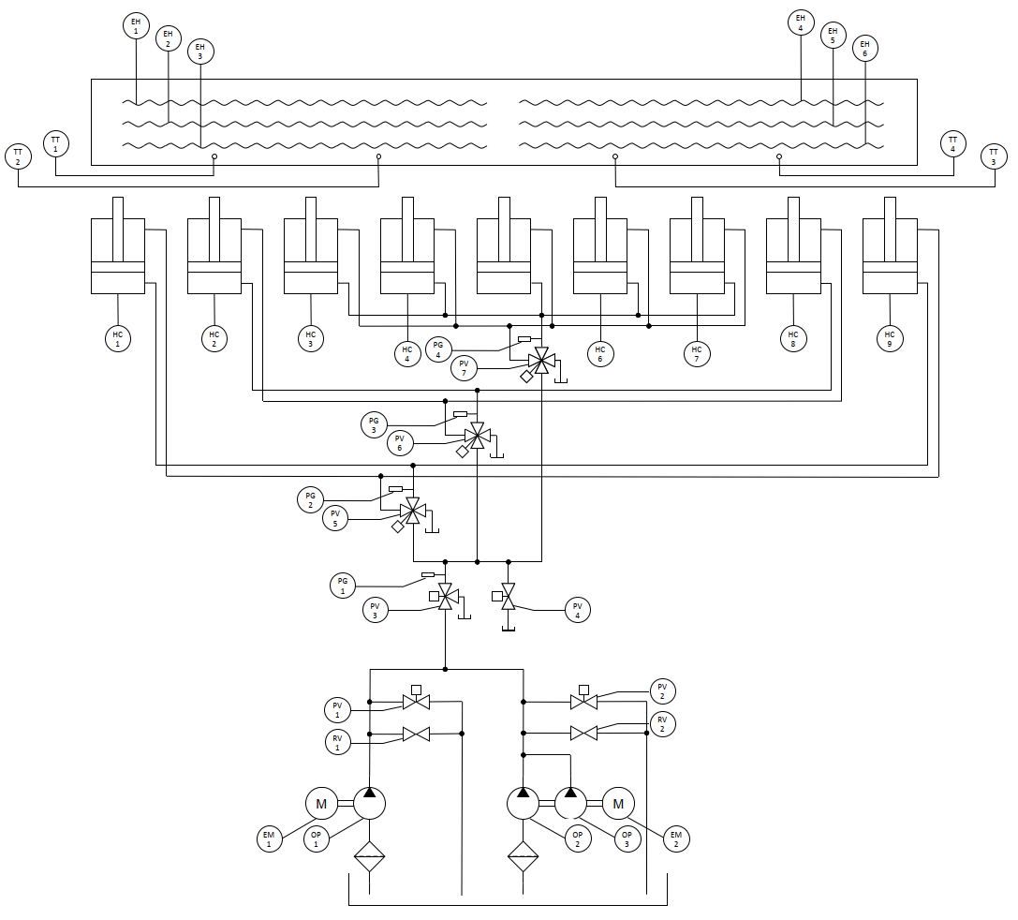
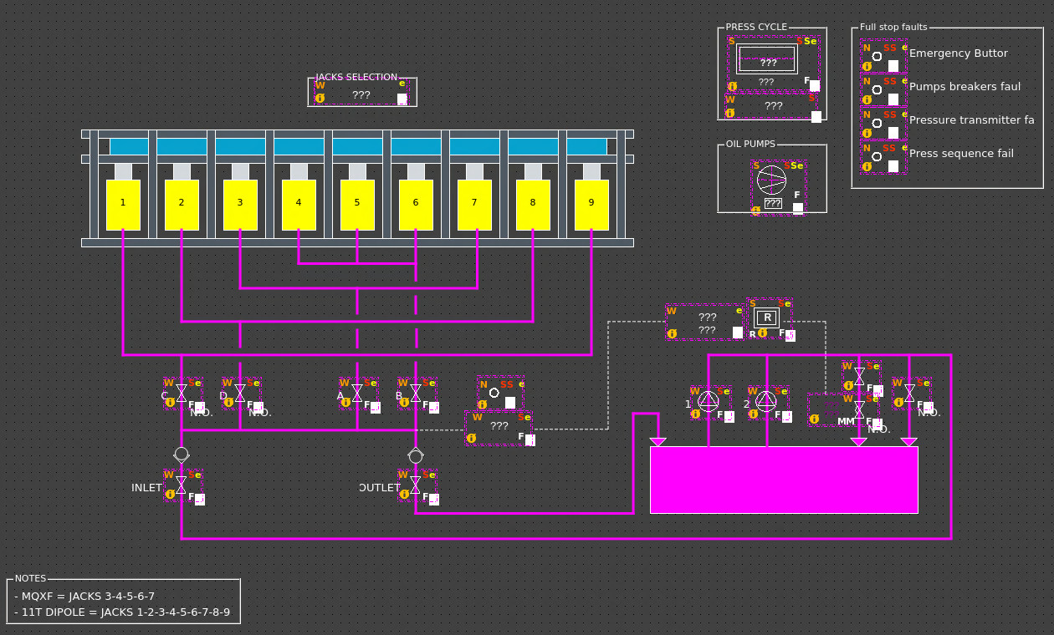

Curing press upgrade
Figure 9. Upgraded hydraulic system in the curing press
Figure 10. Schematic design of the new hydraulic system, on WinCCOA
Notes:
Using WinCC OA as a commercial SCADA
About UNICOS | UNICOS (cern.ch)
Migration from the CCM BE application to a ROG (Remote Operation Gateway) based in a FastX cluster. (faster and safer environment)

Slide 19
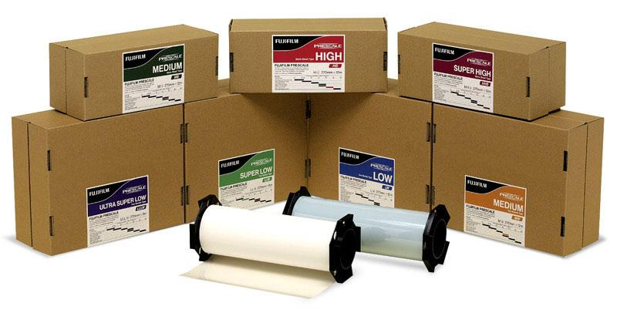
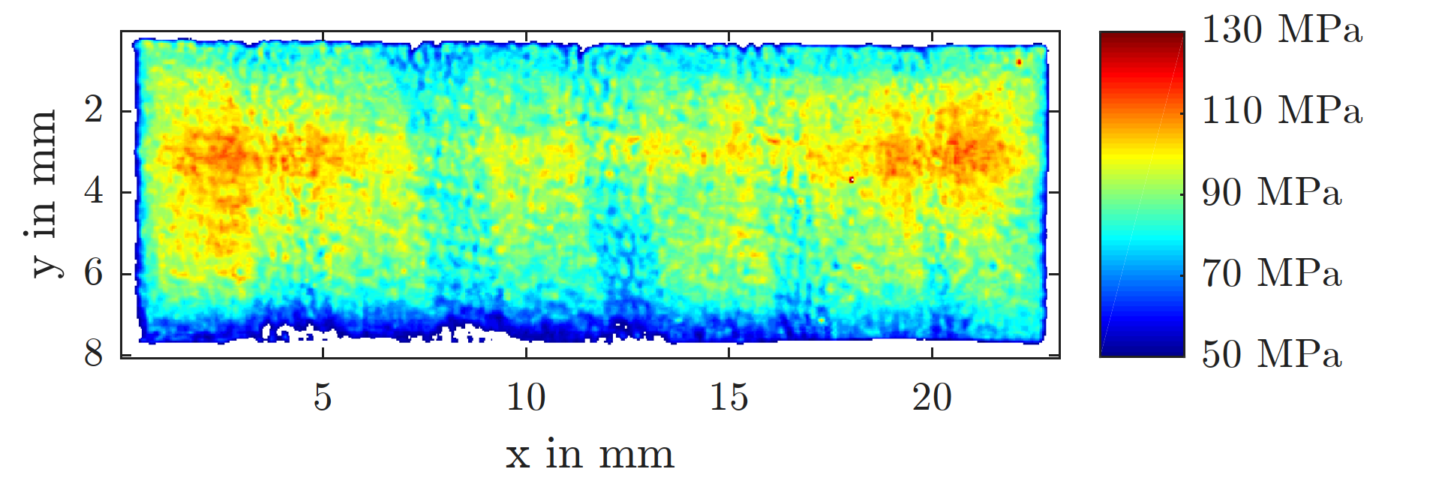
FUJI prescale film – how it works
Double-sheet
  LLLW 0.2-0.5 MPa
  LLW 0.5-2.5 MPa
  LW 2.5-10 MPa
  MW 10-50 MPa
Mono-sheet
  MS 10 – 50 MPa
  HS 50 – 130 MPa
  HHS 130 – 300 MPa
Figure 13. Complete offer of FUJI prescale films [1]
Polyester base
Color-developing layer
Micro-encapsulated color-forming layer
Figure 11. Analysed Prescale film similar to ANSYS stress plot
Figure 12. Layout of a Mono-sheet Prescale Film. [1]
[1] FUJIFILM Prescale Instruction Manual
Notes:
Stress range can be extended by stacking different types of prescale film

Slide 20
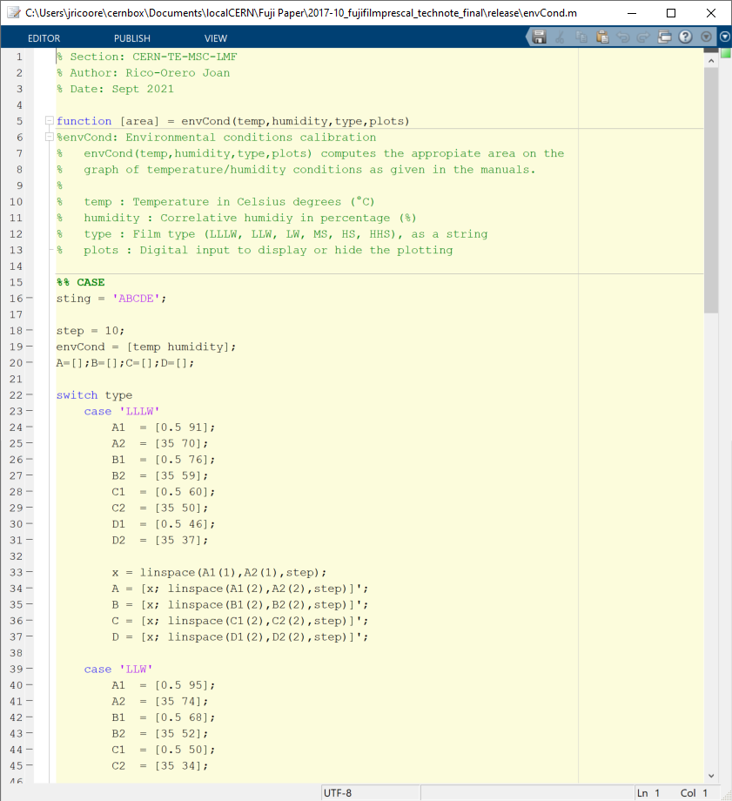
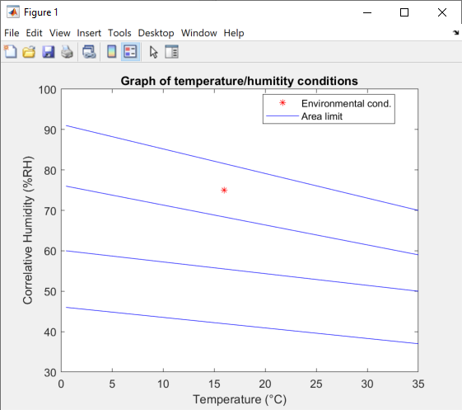
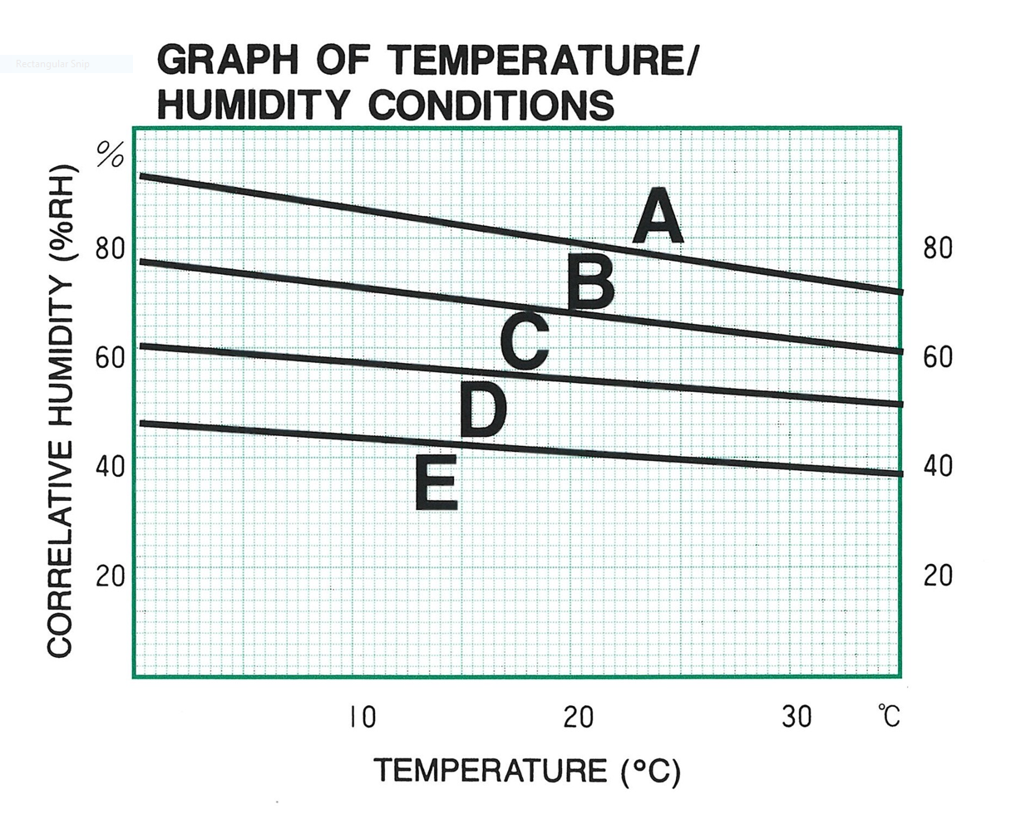
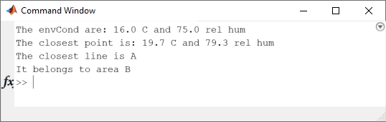
FUJI prescale film – analysis EDMS 1885552 /2
Areas analysis
Figure 14. Code for analysis in the MATLAB environment.
Figure 15. Output from the code

Slide 21
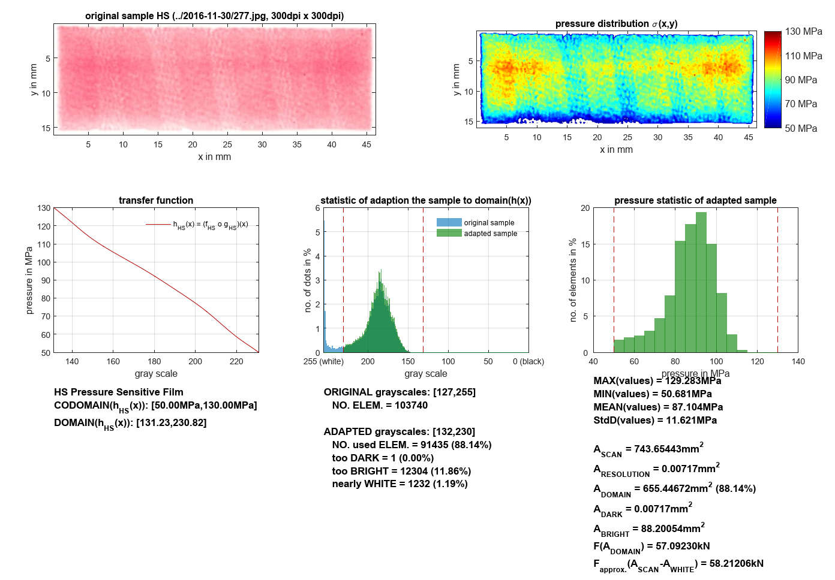
FUJI prescale film – analysis EDMS 1885552 /2
… Total scanned area
… Resolution of the scanner
.. . Area in the pressure domain
… Area above the pressure domain
… Area below the pressure domain
… Total integrated force
Note:
Stress values below or above the stress domain are interpretated equal 0MPa.

