Slide 1

Studies on kicker magnets
FTEC project 2021
Miguel DIAZ
Advisor: Mike BARNES

Slide 2
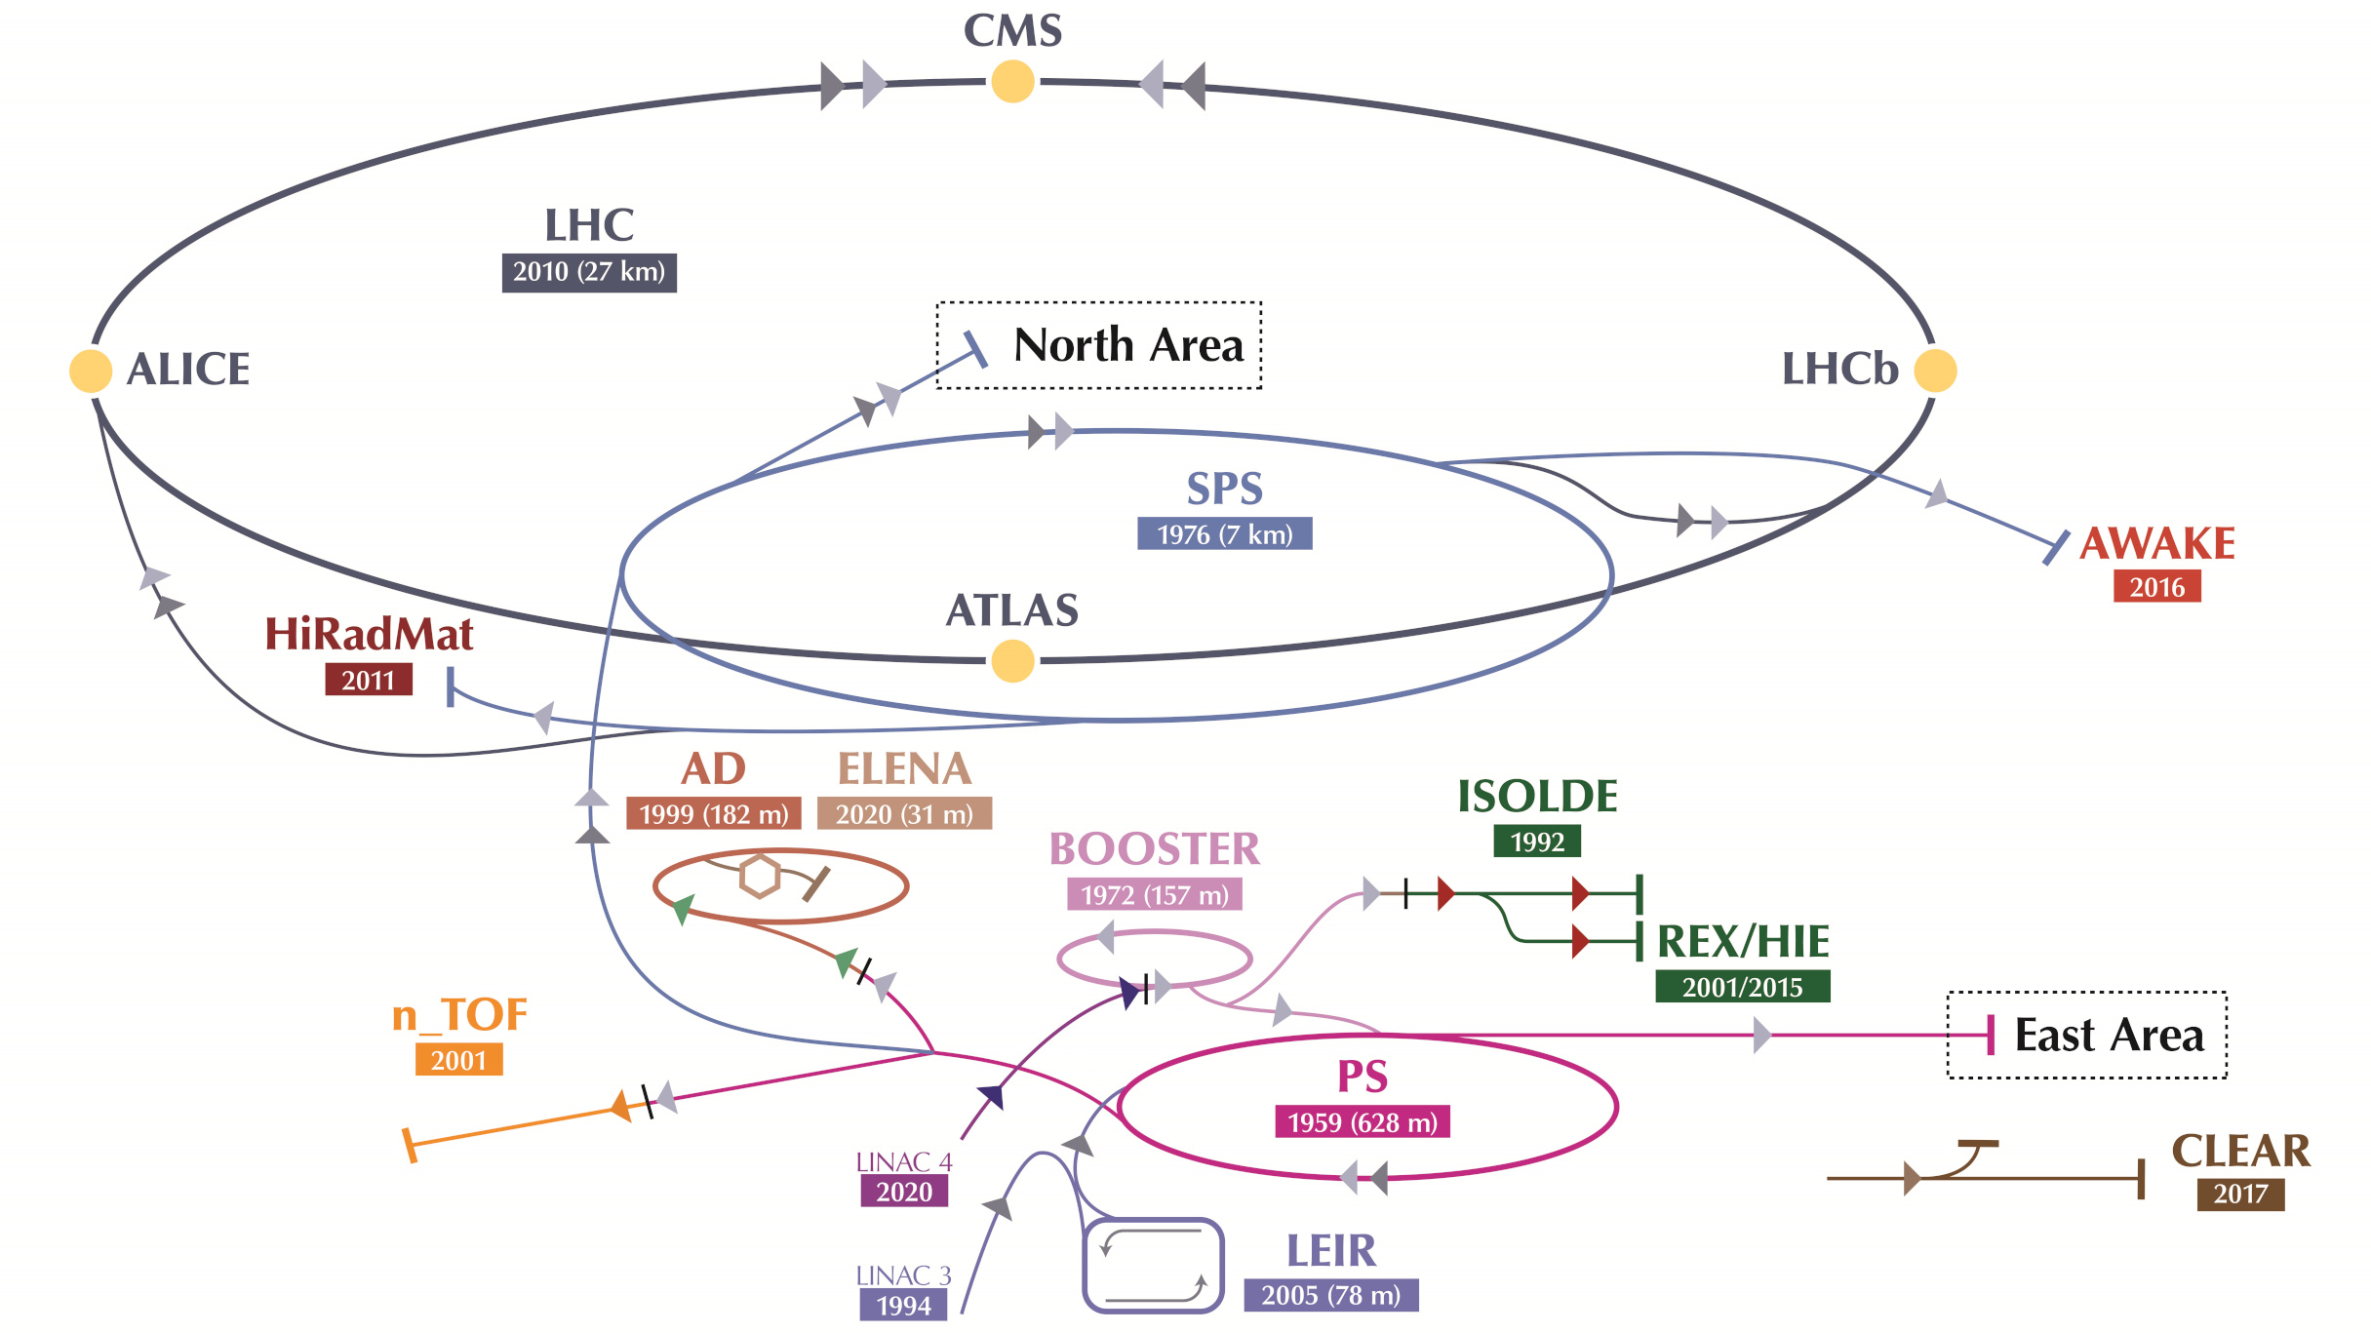
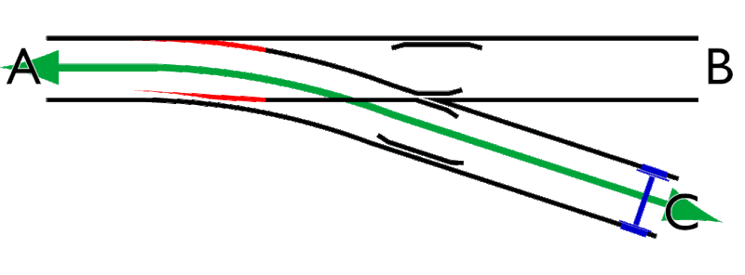
Introduction: Role of the kicker magnets in the accelerators
They inject or extract beam from the accelerators, by momentarily deflecting the particles (typically several μs)
That allows beam to be transferred between accelerators
MKP
(injector for the SPS)
MKI
(injector for the LHC)
Circulating beam remains untouched
Kicker magnet (injector)
Injected beam
Septum
(does not deflect circulating beam)

Slide 3
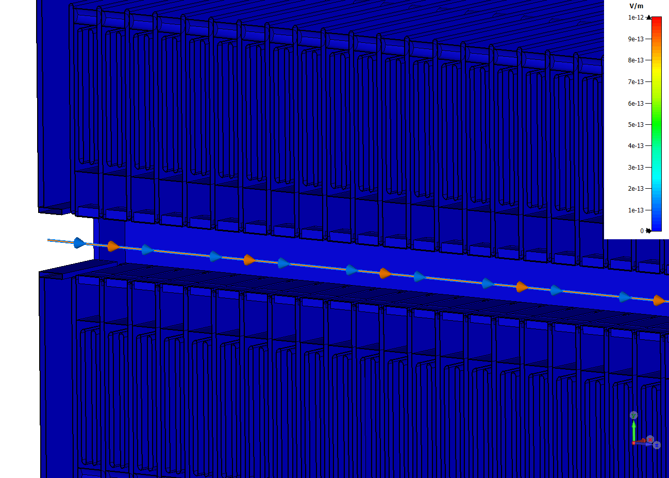
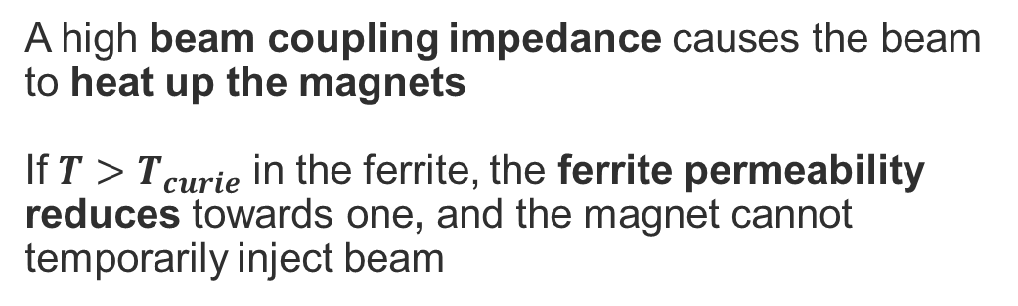
Context: campaign to lower the beam impedance of the magnets
A high beam coupling impedance causes the beam to heat up the magnets
If $T>T_{curie}$ in the ferrite, the ferrite permeability reduces towards one, and the magnet cannot temporarily inject beam
Actions:
Predicting the magnet heating for the different beam types
Simulate magnet design to support modifications, aiming to reduce impedance, and therefore heating
Wakefield simulation, showing electric fields generated by passage of the beam

Slide 4

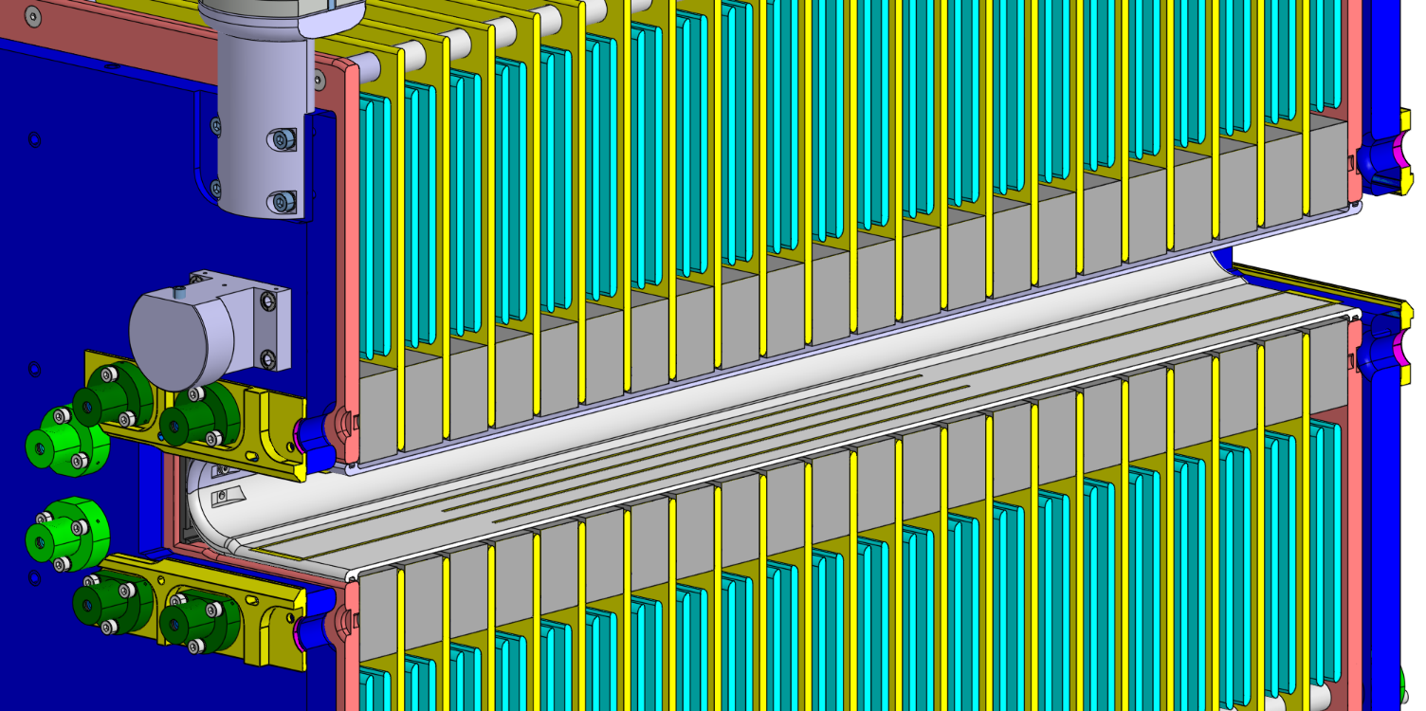
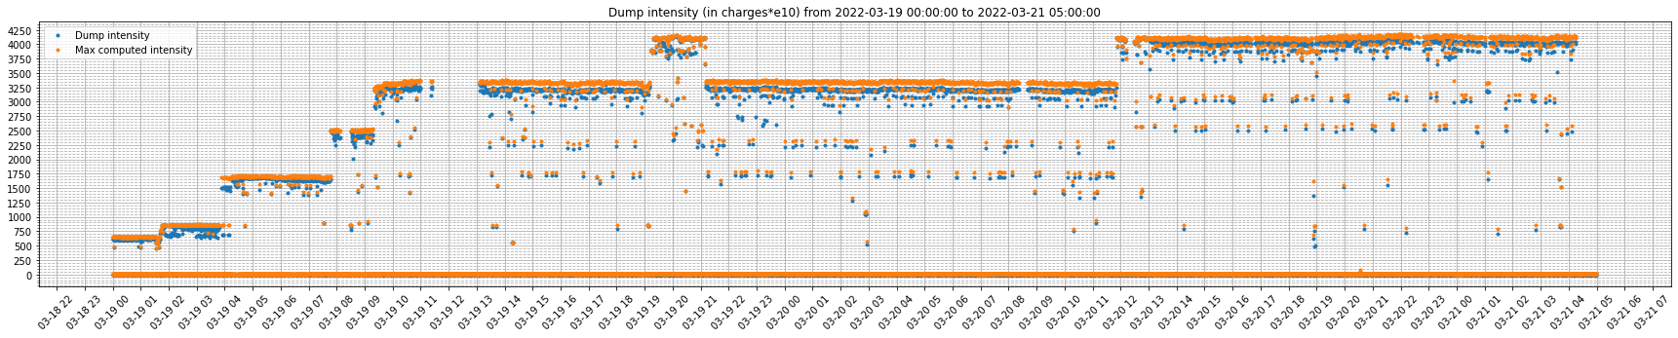
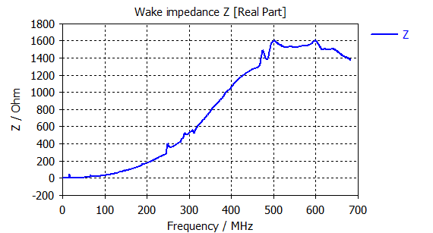
1. Beam induced heating computations
3D model of magnet,
with realistic material properties
NXcals
Beam parameters:
Intensity
Injection scheme
Bunch length
Bunch spacing
get_beam_parameters.py
Beam parameters along time
Wakefield simulation
(CST Studio)
Only intensity shown here
Longitudinal real impedance (Ω), as function of frequency
impedance_to_power.py

Slide 5

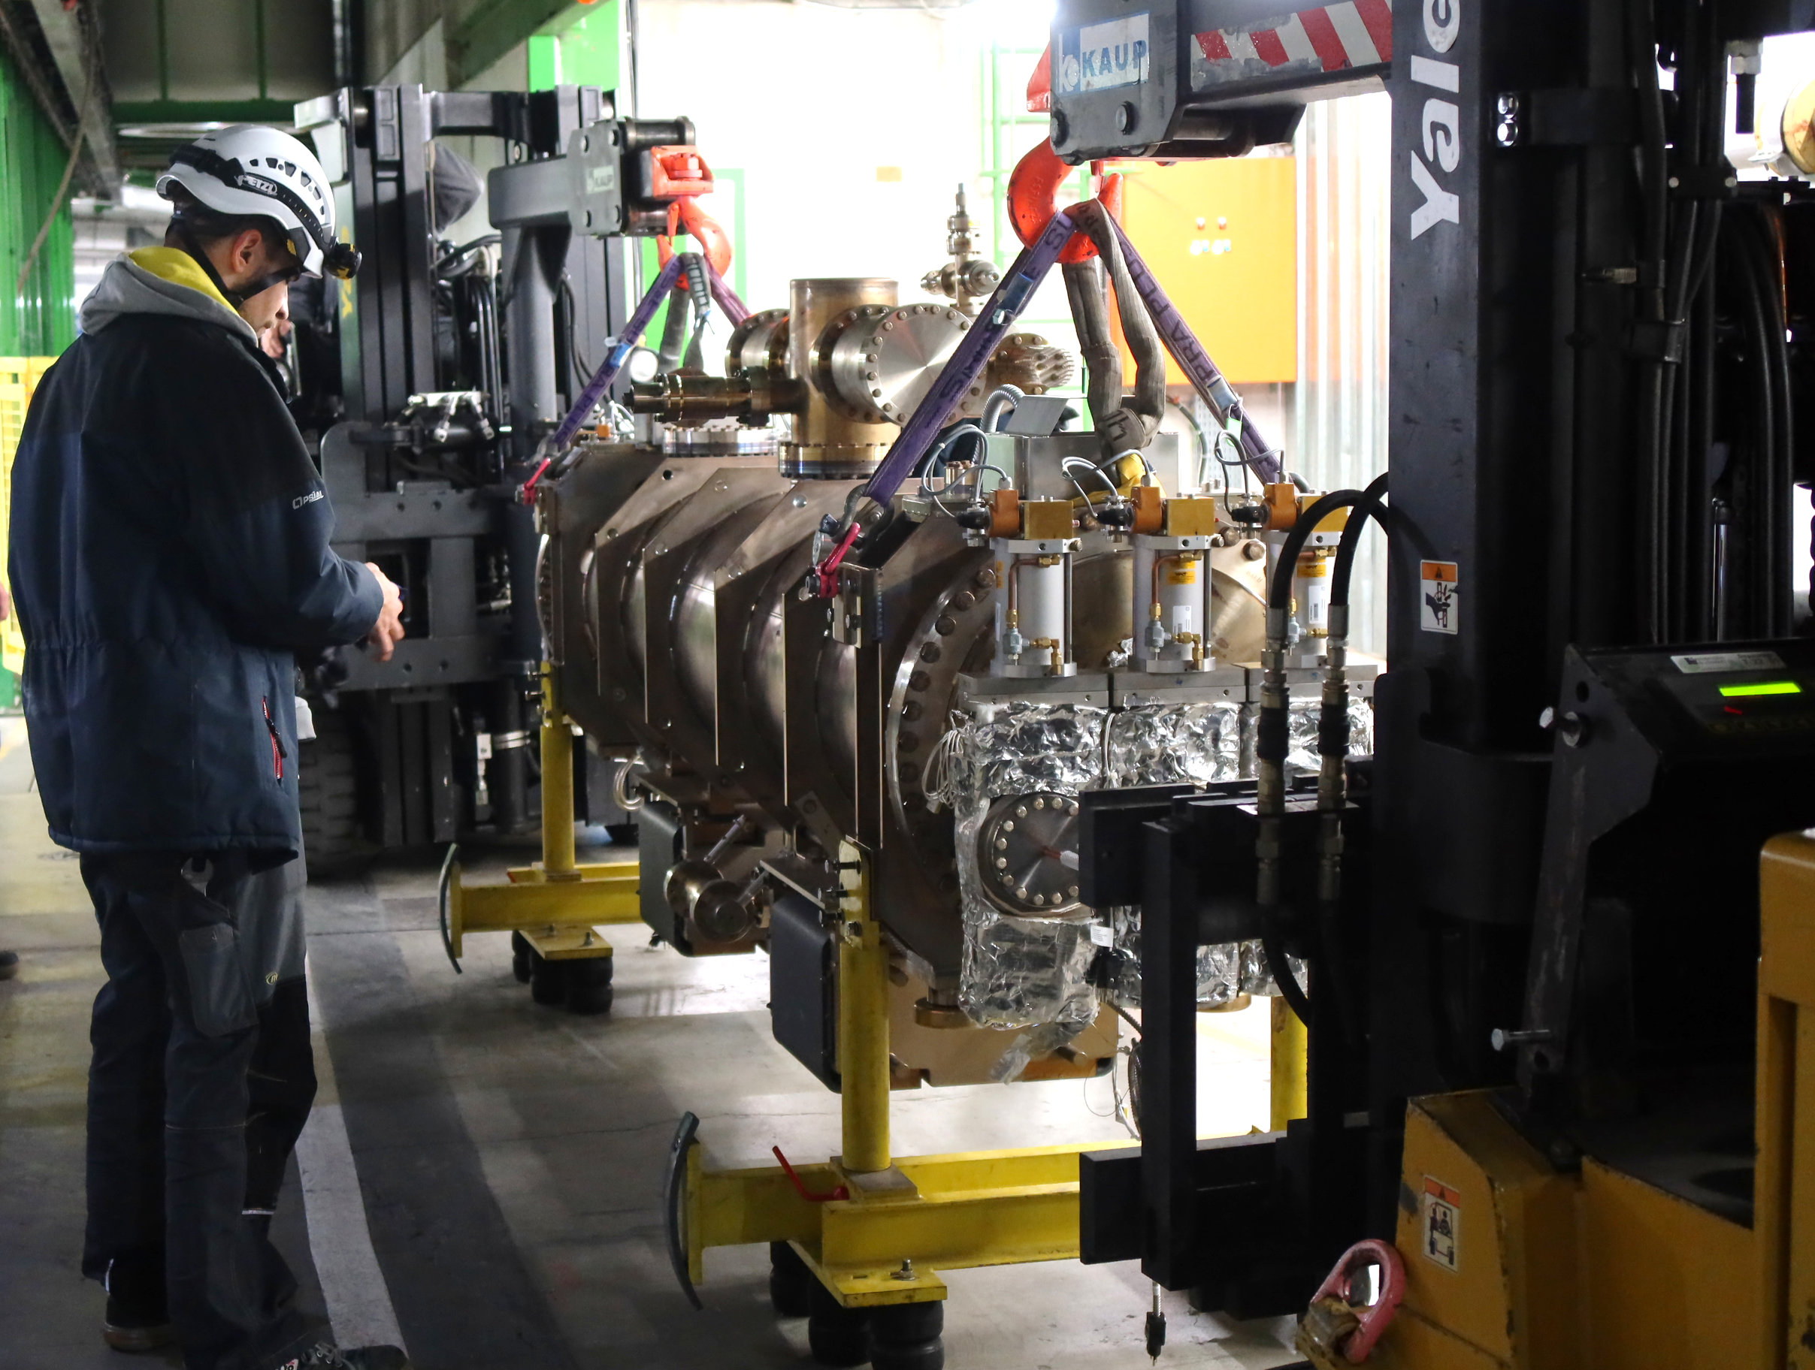
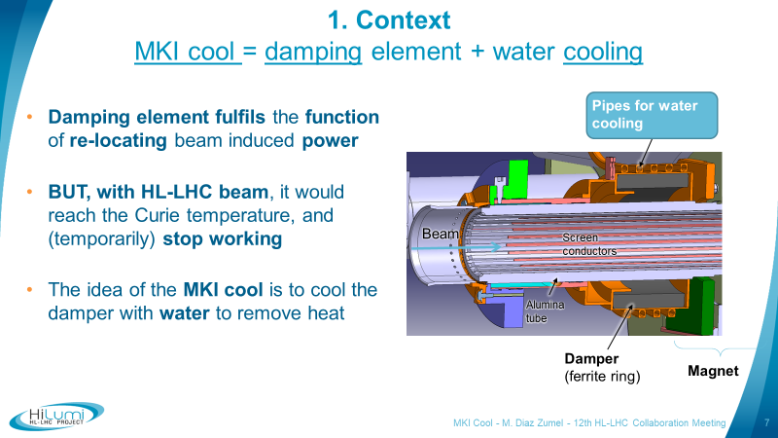
2. Work on MKI-Cool (upgraded injector kicker for LHC)
It is planned to replace all the 8 LHC injector kickers (MKIs) by MKI-Cools before HL-LHC
The MKI-Cool incorporates a water-cooled ferrite cylinder, on the upstream end, that absorbs a part of the beam induced heating (very high heating expected for Hi-Lumi LHC)
The first MKI-Cool has been successfully installed in point 8 of LHC this YETS
During the HL-LHC Collaboration Meeting, in Uppsala (Sweden), in September 2022, I presented an update of the MKI-Cool project
MKI-Cool installation in LHC

Slide 6
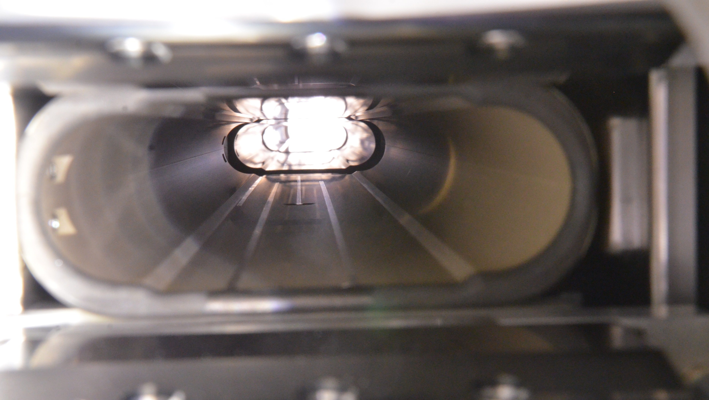
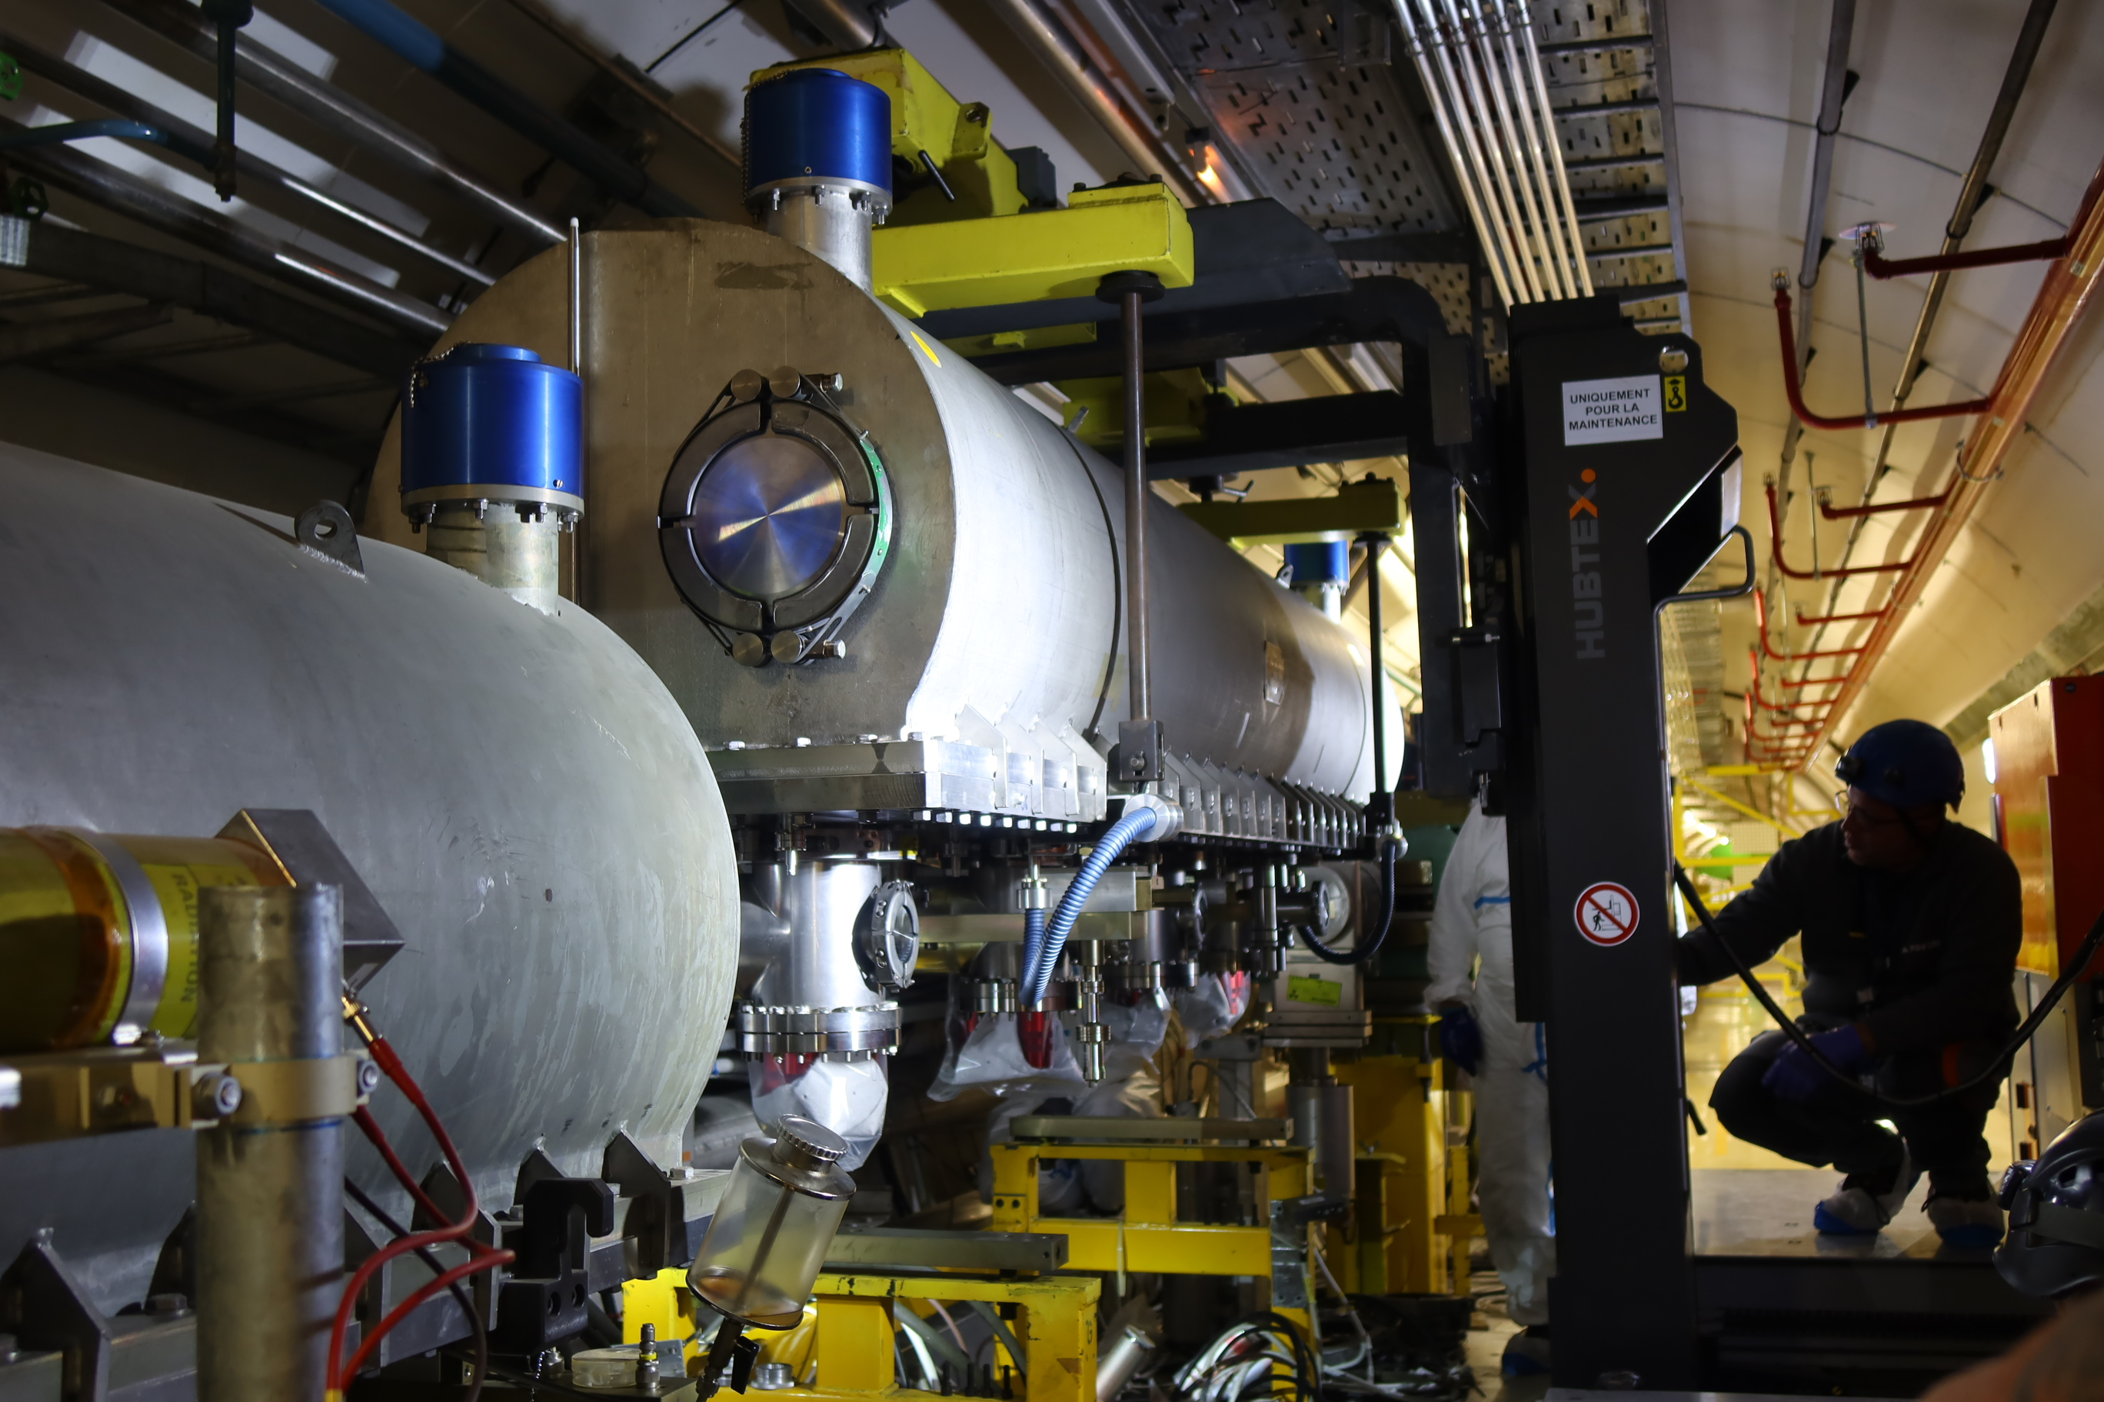
3. Low impedance MKP-L (injector kicker for the SPS)
The new low impedance magnet includes a ceramic chamber with serigraphy fingers on it
Serigraphy fingers create a path for the image current of the beam, reducing the electromagnetic fields, created by the beam, which couple into the ferrite yoke
Tests in lab allowed us to define its final design, constrained by:
  eventual electric discharges when pulsing
  achieving low beam coupling impedance
The magnet has been installed in the SPS during this YETS
4-modules MKP-L magnet in lab
MKP-L magnet installation in SPS

Slide 7
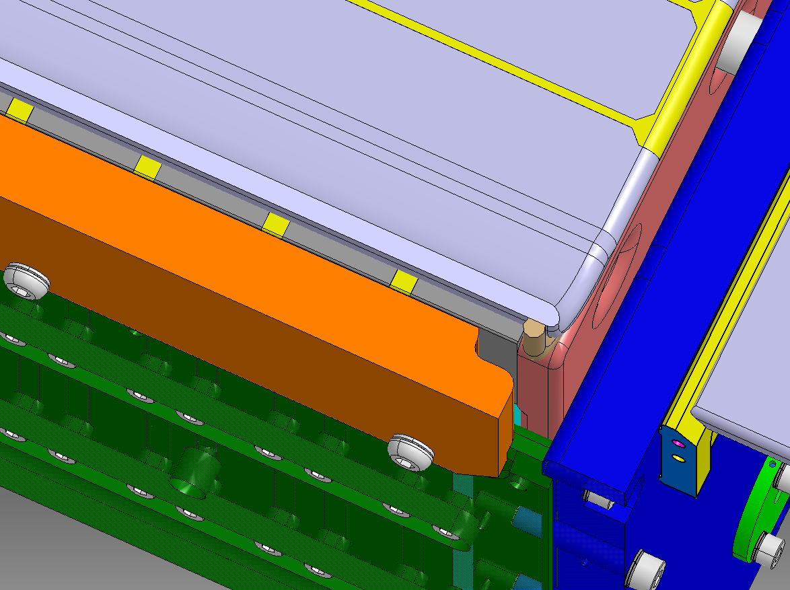
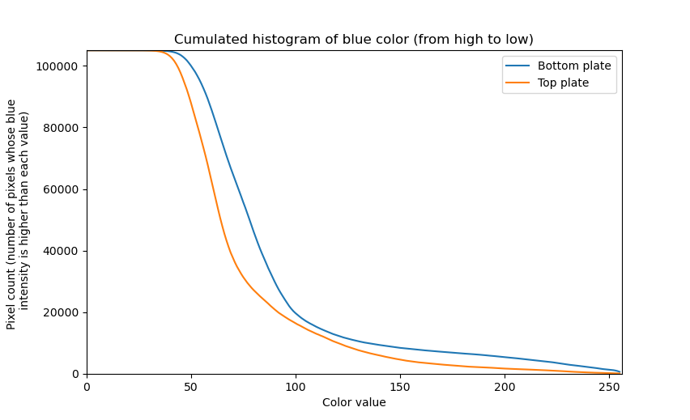

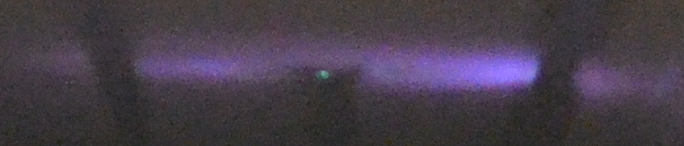
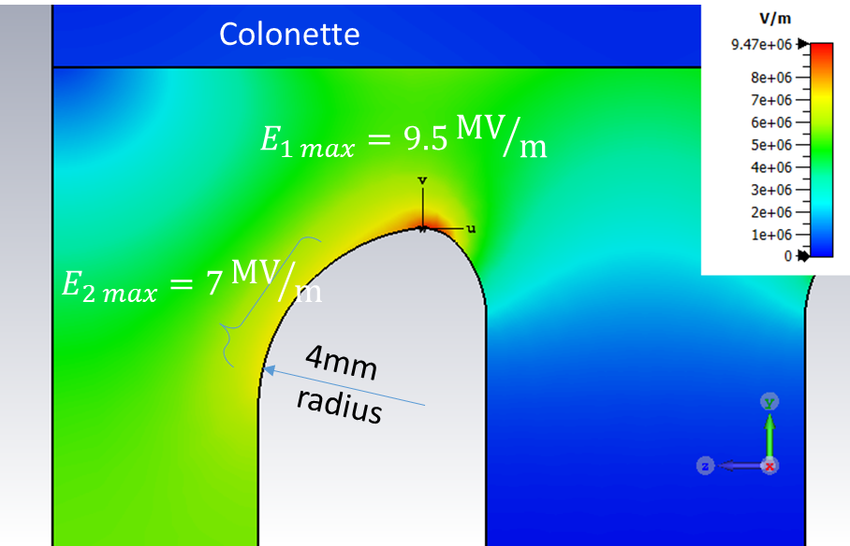
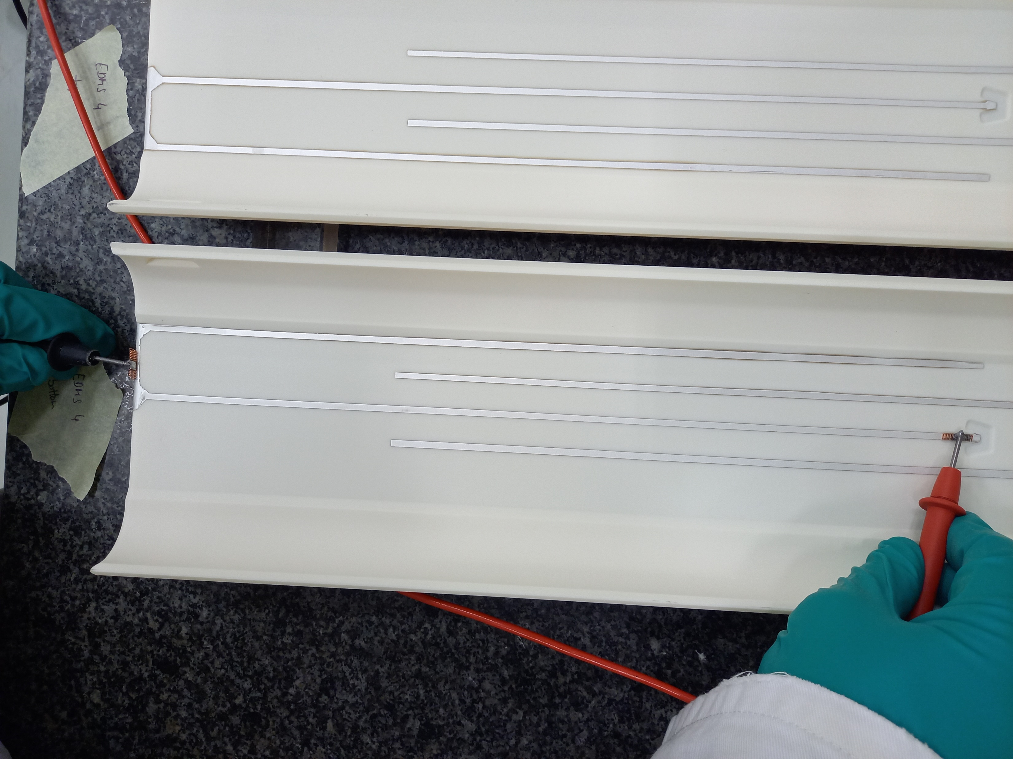

3. Work carried out for MKP-L
Photographs and histograms to evaluate intensity of corona effect in magnet
Development of prototype design
Bypass (high voltage)
Intensities higher than 150 are clearly due to the discharges, not to background light
Electrostatic simulations to support modifications
Busbar (ground)
Bottom (slot)
Cutout distance
Top (groove)
Participation in high voltage tests
Poster for conference
Resistance measurements of serigraphy

Slide 8
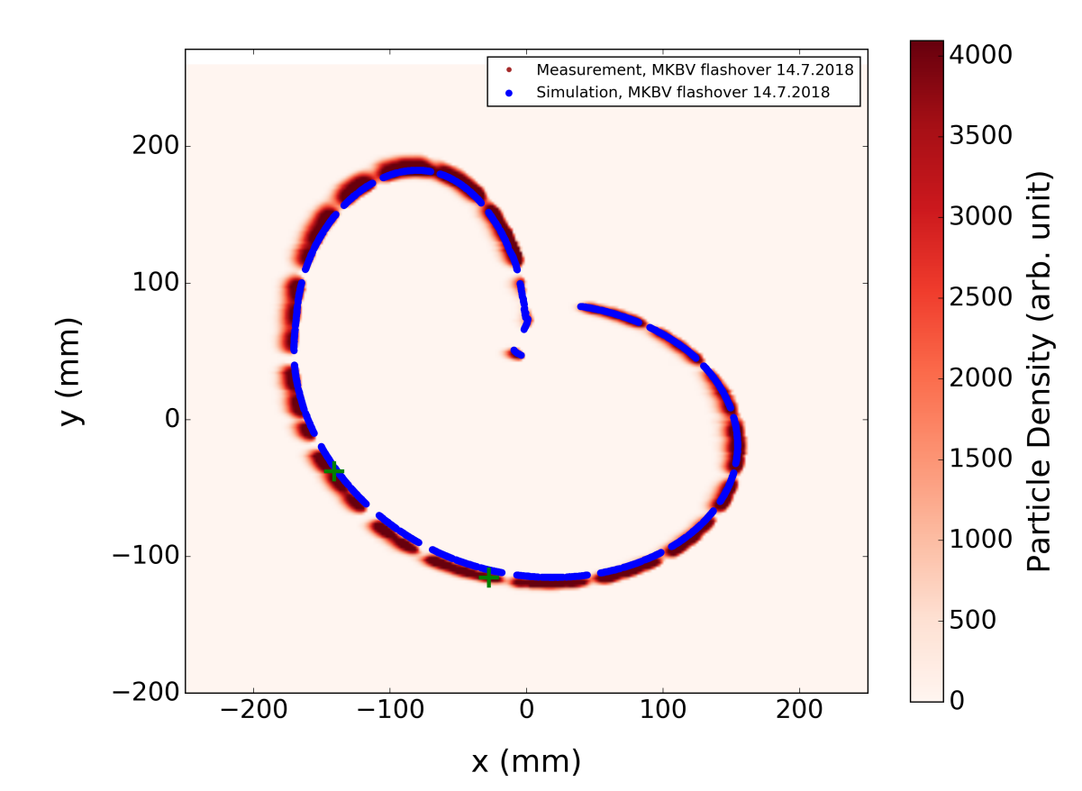
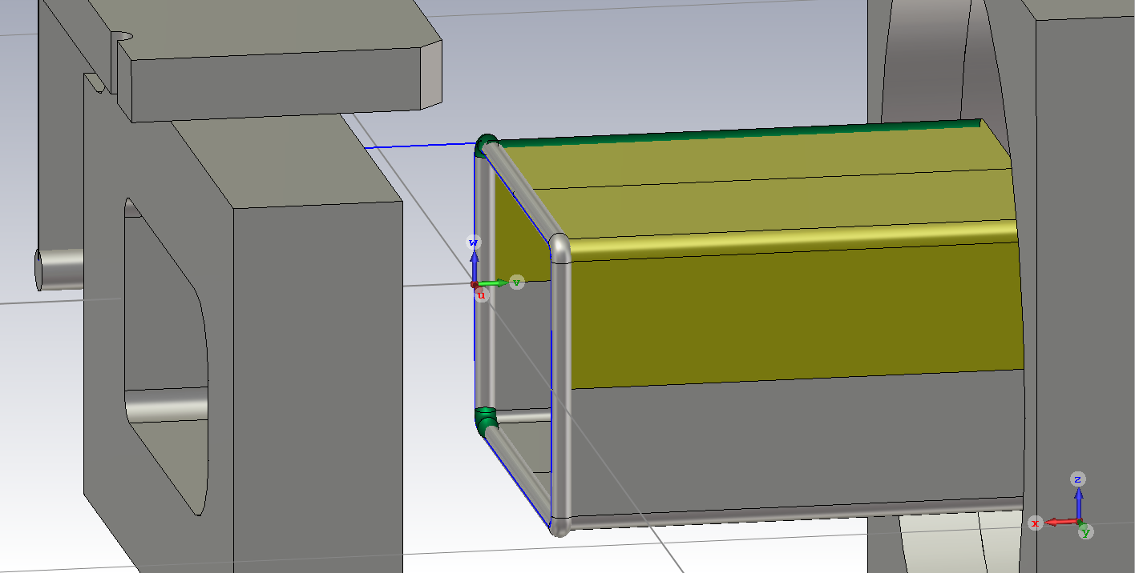
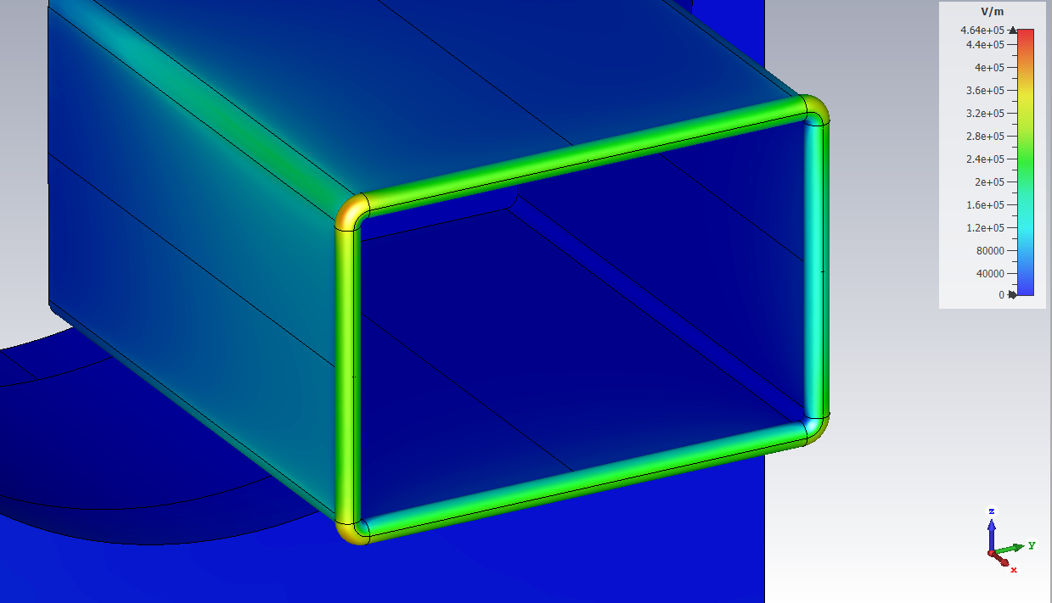
4. Screen box for MKBV
The MKBV is a vertical dilutor for the LHC beam dump system
Dilution magnets deflect the beam on a pre-defined shape, so it doesn’t hit the block in the same point
A so-called “beam screen” inside the magnet was redesigned to make it less susceptible to electric breakdowns
Electrostatic simulations were done to optimize:
  Radius of the end
  Distance to the magnet
The new screen box was installed during YETS
Solution: Ø4 mm metal pipe surrounding edge of box
Generic dilution pattern on the dumper block
Electric field overview
16000 V
1900 V
0 V

Slide 9
Spare slides

Slide 10
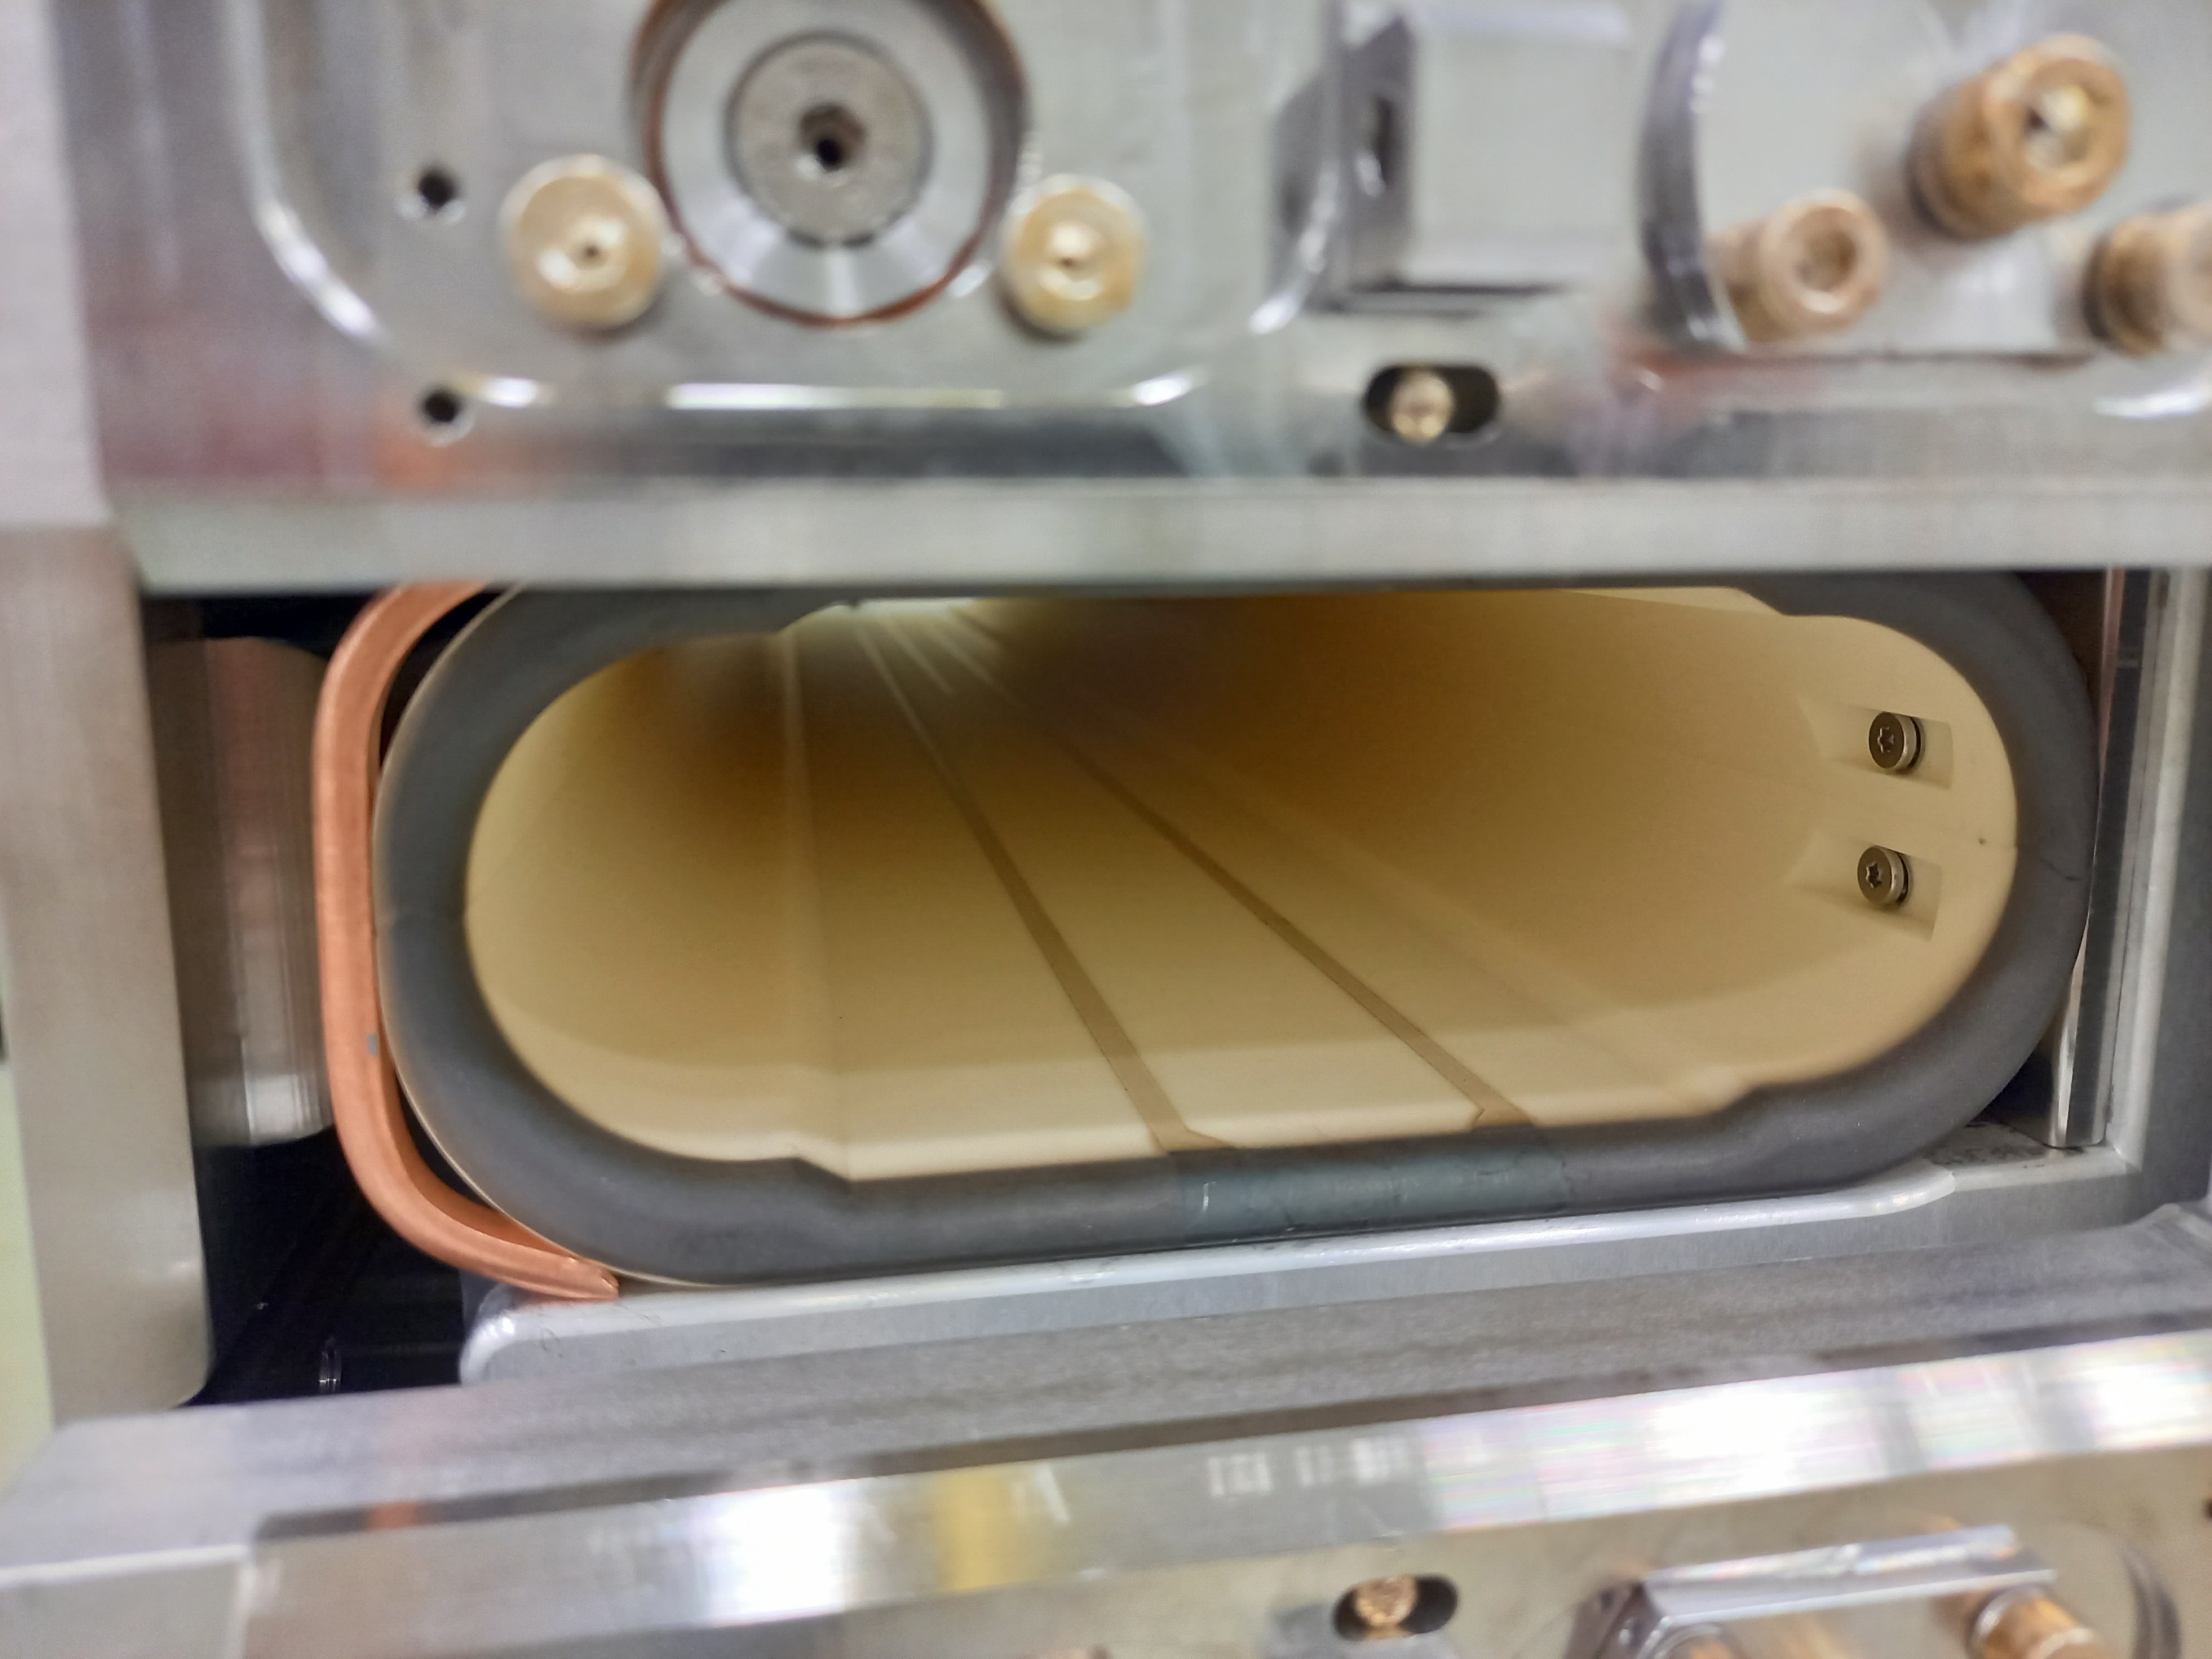
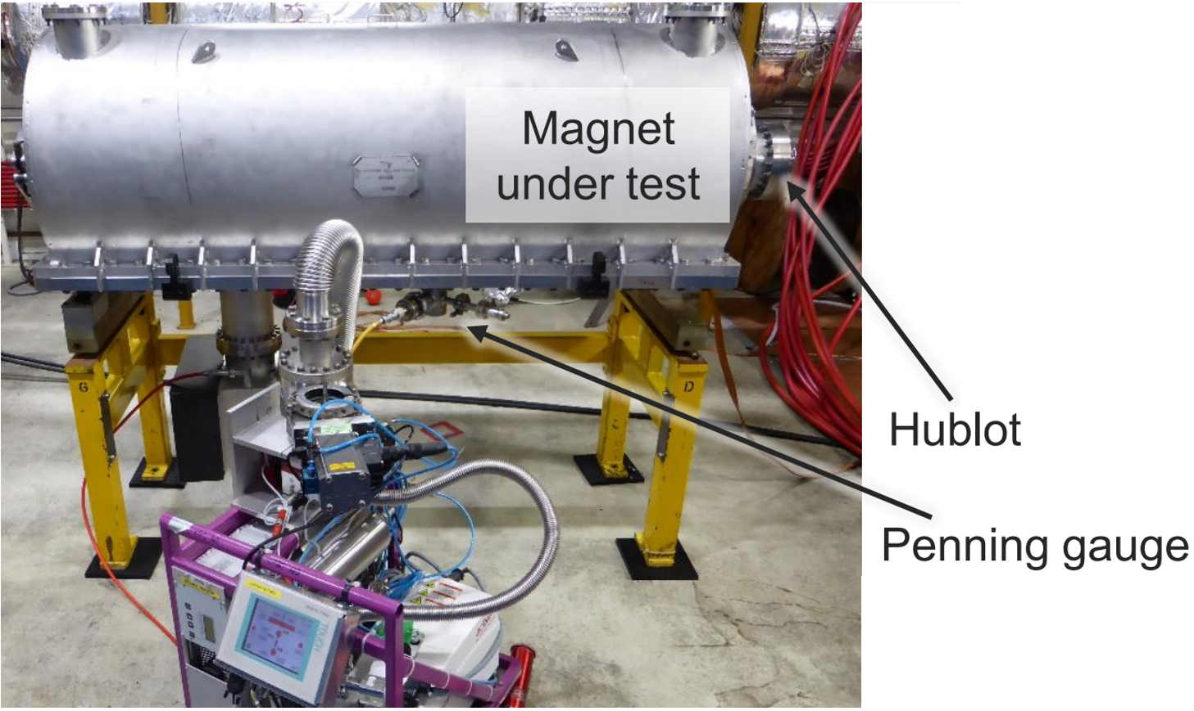
2. Low impedance MKP-L (injector for the SPS)
The future low impedance magnet will include a ceramic chamber with serigraphy fingers on it
Serigraphy fingers create a path for the image current of the beam, compensating the electromagnetic fields created by the beam
Design evolved through different prototype versions
High voltage tests carried out to check high voltage behavior

Slide 11
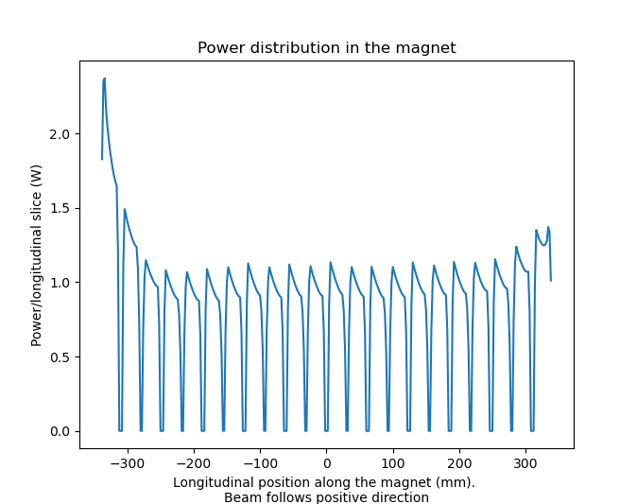
1. Beam coupling impedance computations
3D model of magnet,
with realistic material properties
Longitudinal impedance (Ω),
as function of frequency
Wakefield simulation
(CST Studio)
Total deposited power (Wats)
Power distribution inside magnet
Beam direction
Beam parameters:
Intensity
Injection scheme
Bunch length
Bunch spacing

Slide 12
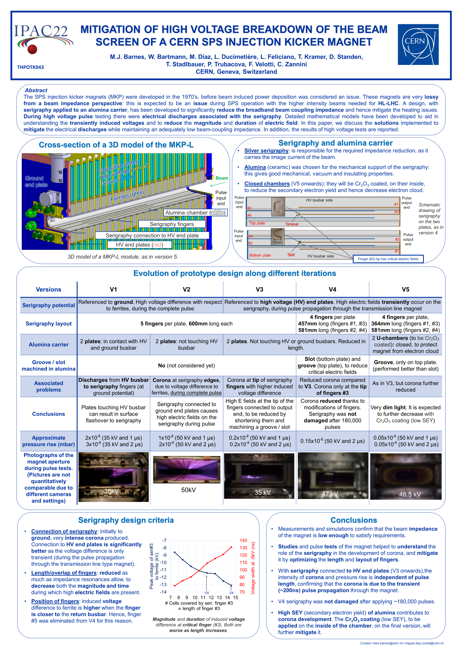
Thanks for your attention

