Slide 1
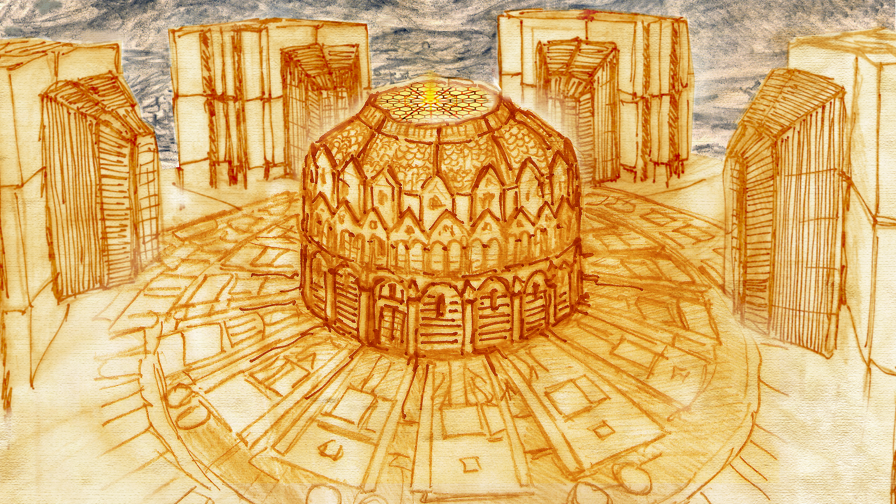

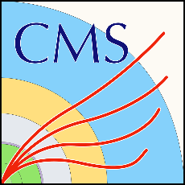

Engineering and design of interface systems to integrate the new 250-tonne high-granularity calorimeter into the CMS detector
FTEC-2021-09
Workshop 22/06/2022
Speaker: Diego García Robles (EP-CMX-SCI)
Supervisor: Tristan Loiseau (EP-CMX-SCI)

Slide 2
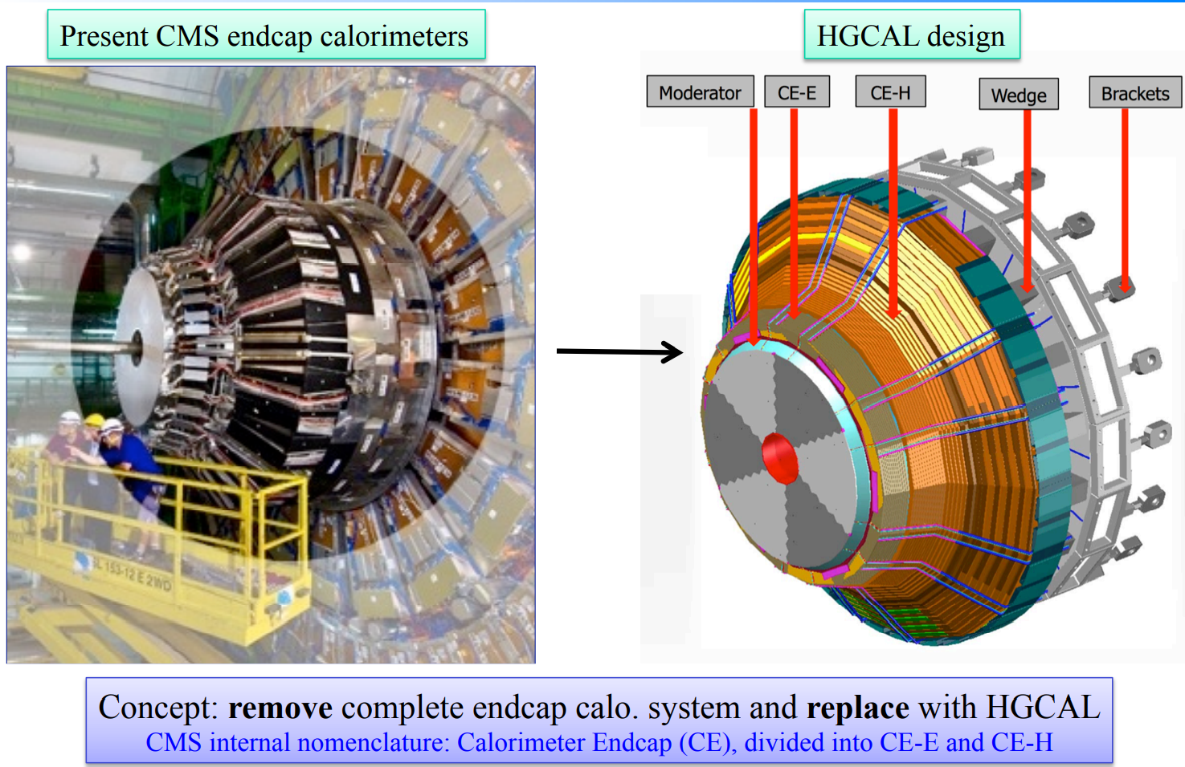
Introduction
Present endcap calorimeter
HGCAL design
Integrate a brand-new calorimeter in an existing 20-year-old structure
Need to design interface systems and components.
Diego G. Robles

Slide 3
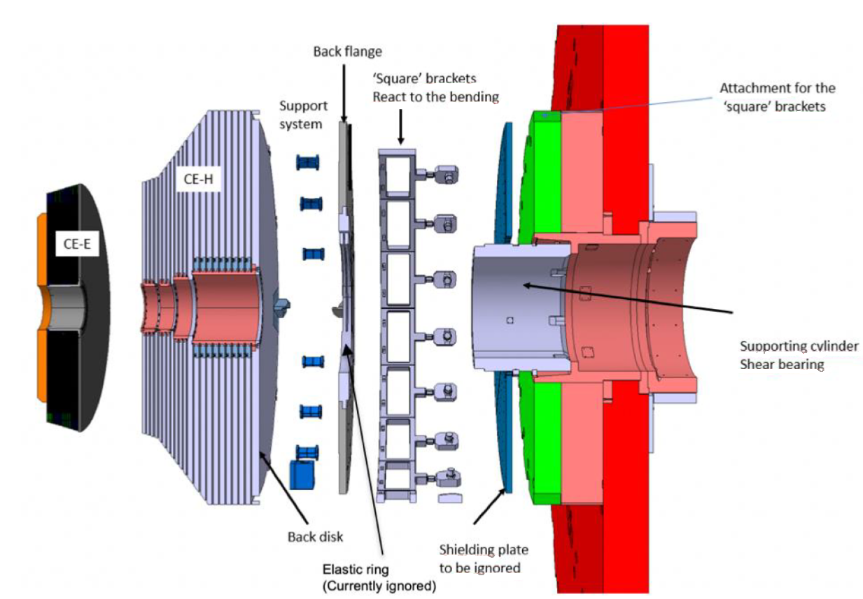
Back flange. Introduction
New elements
Existing elements
The function of the back flange is to be the direct link between HGCAL and the detector’s structure.
The back flange is mounted on the support tube, which rests the whole weight of HGCAL (250 tons) and connected by 18 brackets all around to withstand the moment created by the cantilevered calorimeter.
Diego G. Robles

Slide 4
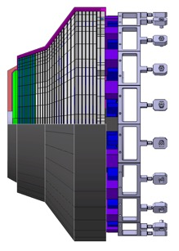
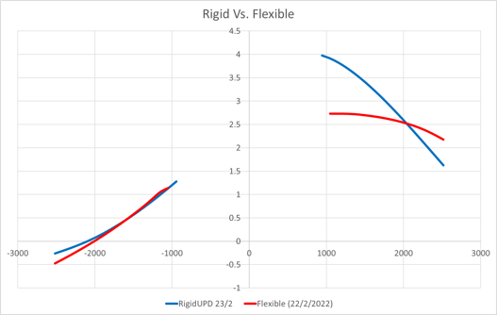
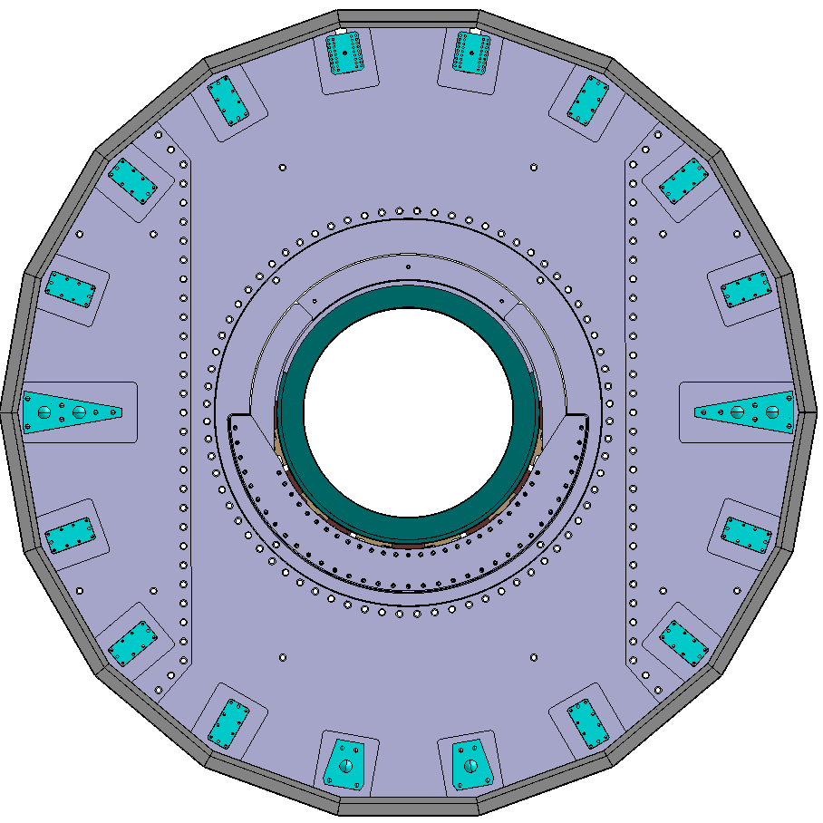
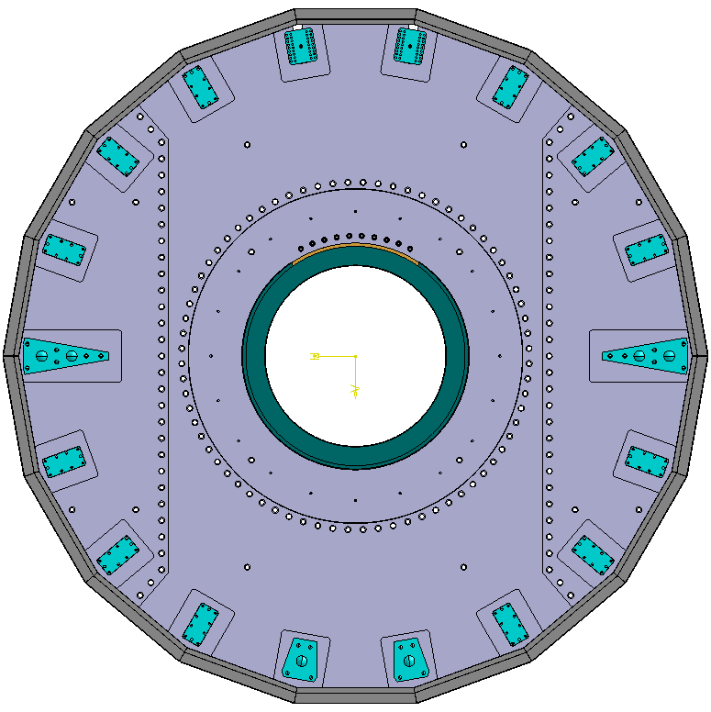
Back flange. Design decision.
Top
Previously, 2 design options
Multilayer Elastic Ring
Fixed solution
1.18 mm
Elastic solution reduce the displacement on the top area compared to the fixed solution by around 1mm.
Tilting of the HGCAL assembly is higher with the flexible solution.
Elastic ring solution induce a drop of 2.4 mm in Y direction compared to the fixed solution.
Bottom
Decision taken in internal CMS reviews
Diego G. Robles

Slide 5
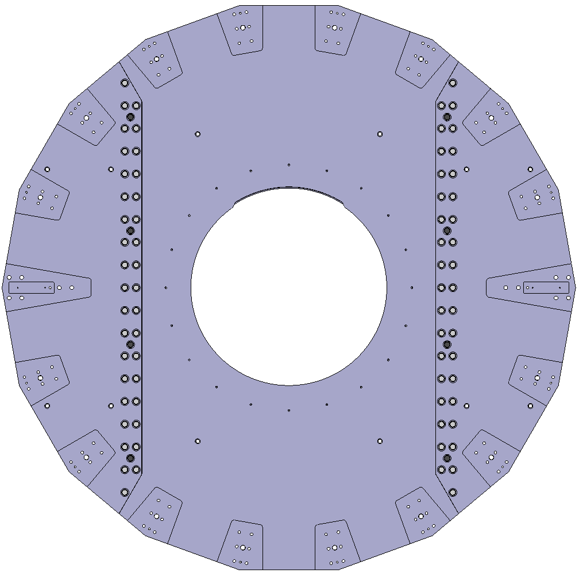
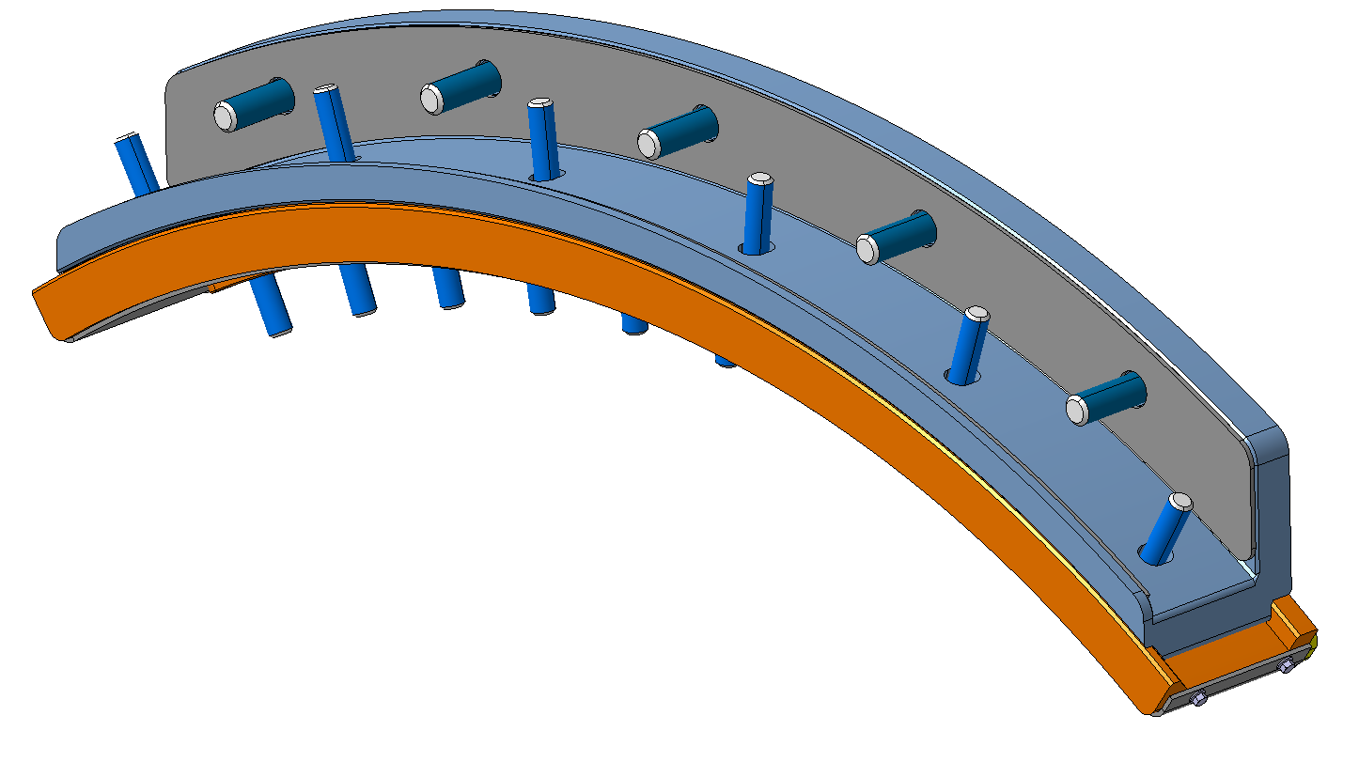
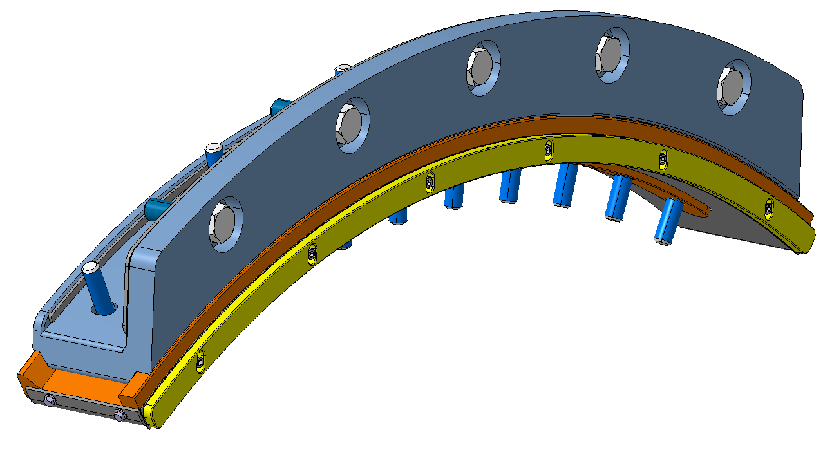
Back flange. Final design
The 3 sections of the back flange will be assembled by 8 pins and 72 screws:
The back flange will be attached to the support tube by the fixed interface:
Diego G. Robles

Slide 6
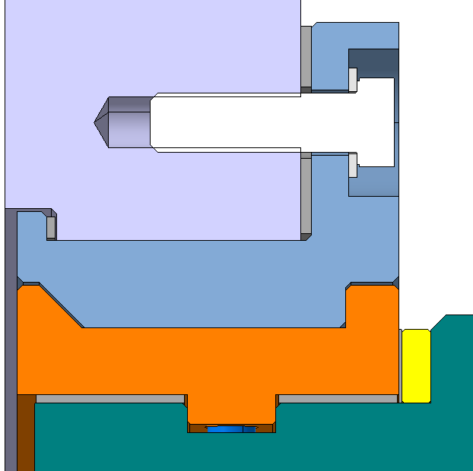
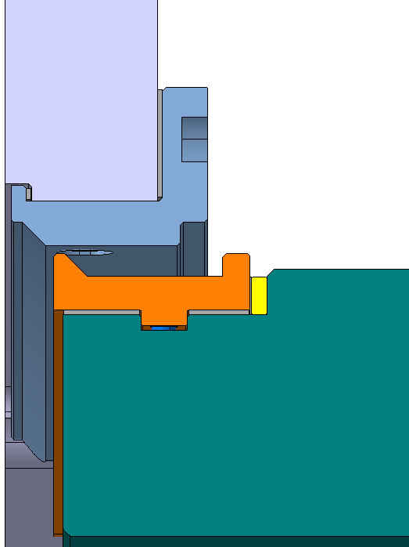
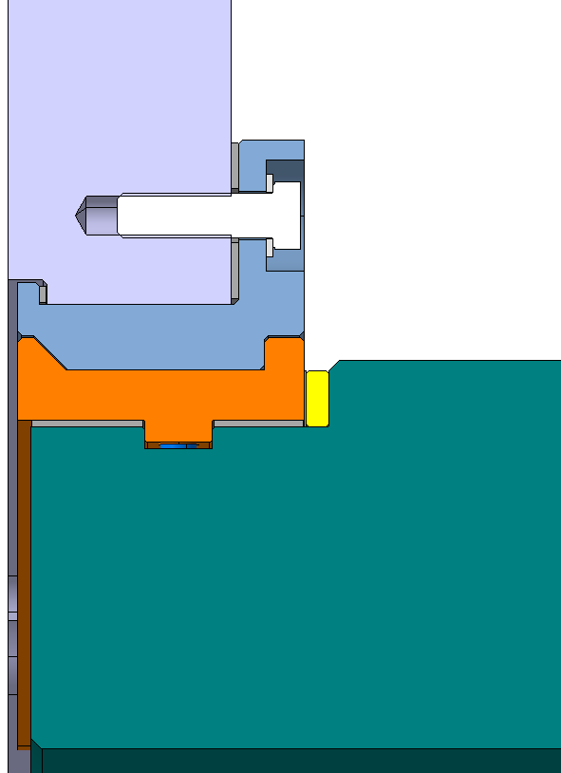
Back flange. Installation of HGCAL on the detector
Installation
Shimming system
Z axis shims for compensation
(+3.5mm/-3.5mm)
Shims for filling gap
Back pusher piece to receive the displacement of the support tube
Y axis shims (+5mm/-3mm)
Diego G. Robles

Slide 7
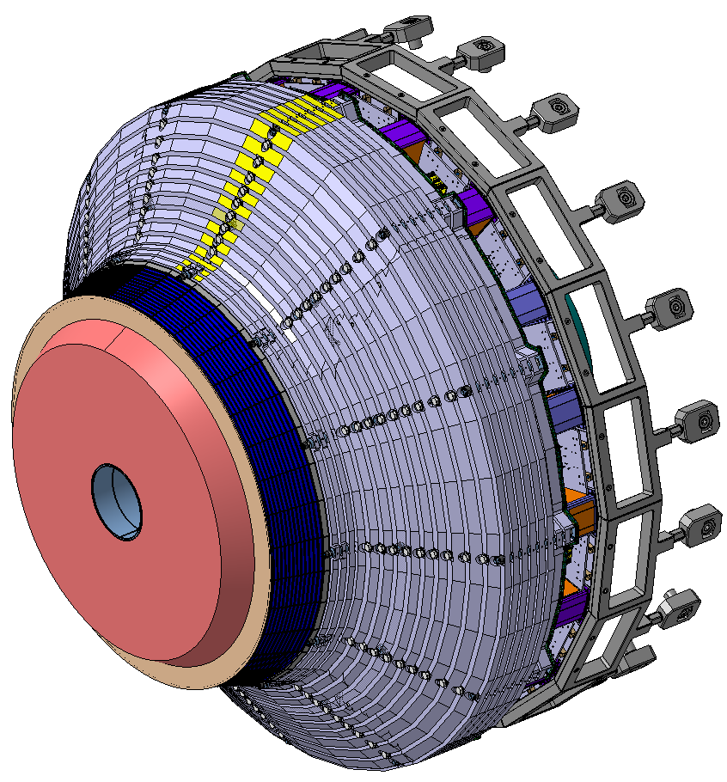
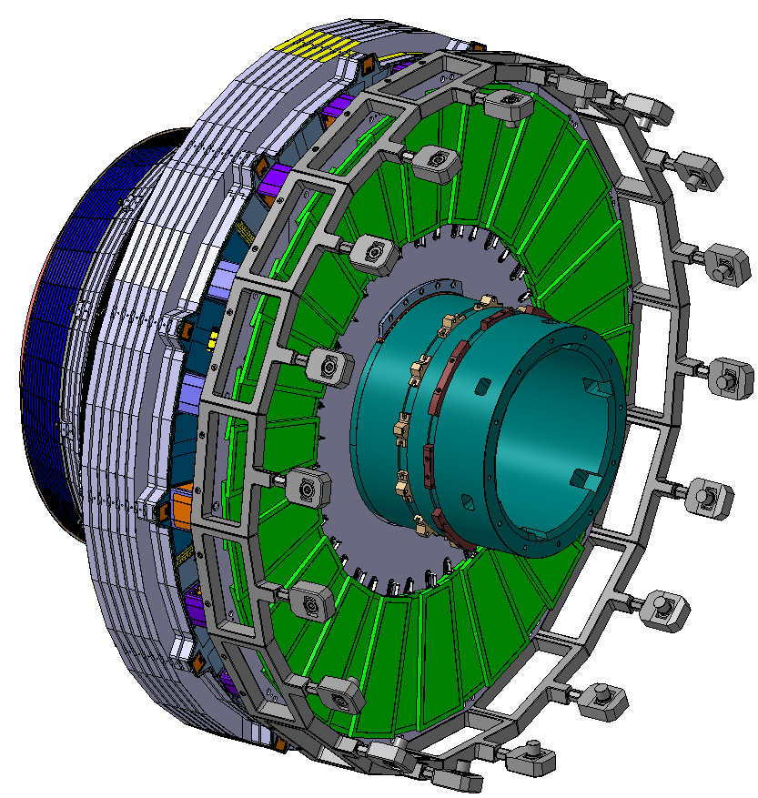
Brackets
18 brackets
The brackets will be reused.
Stresses on the brackets are recalculated considering the new load case.
We are studying the brackets in detail, and we will probably manufacture some new ones for the most solicitated positions.
Diego G. Robles

Slide 8
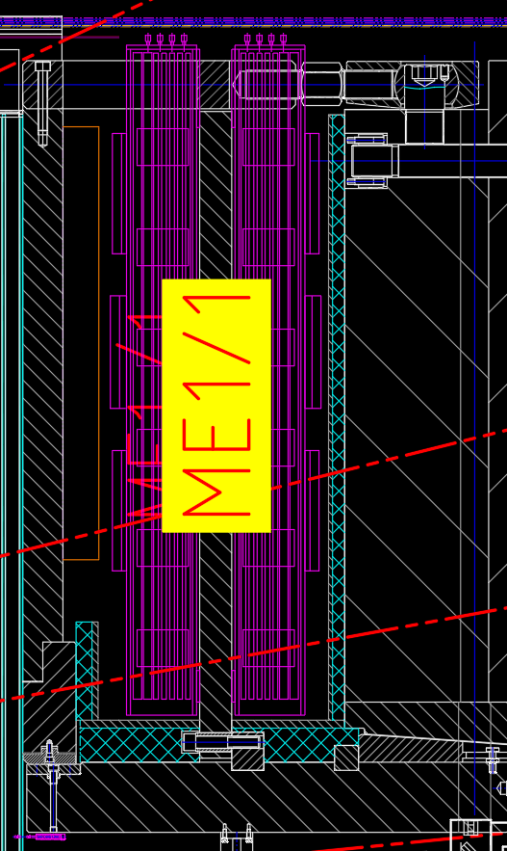
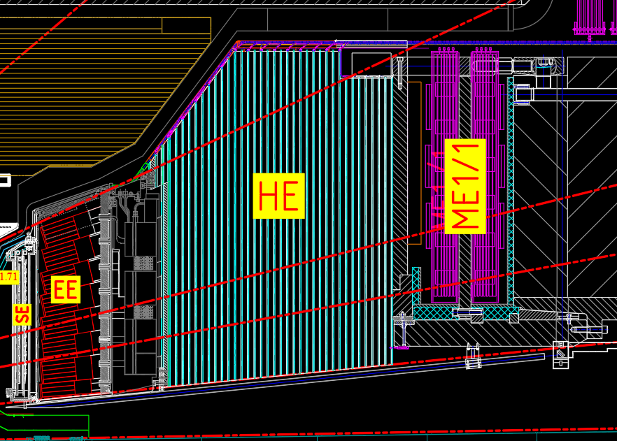
ME1/1 shielding
ME1/1
Back flange
The radiation shielding is located around ME1/1, attached to the interface tube, YN1 and the bottom part of the back flange.
Consisting of lead and borated polyethylene.
The old shielding fixed to the back flange
will be removed in the extraction of the calorimeter.
New back flange has different design.
Need to design a new shielding piece.
Nose YN1
Shielding
Interface tube
Diego G. Robles

Slide 9
Project status
Back flange status:
Next steps:
3D models finalized including the fixed interface and shimming system
Manufacturing 2D drawings on going
drawings
General check with HSE
Overall simulation completed
simulation
Check of the interface with support tube completed
ME1/1 shielding status:
ME1/1 team doing radiation simulations
Design of the new shielding
Brackets status:
Test the material of the brackets in the detector to identify it.
Overall simulations completed
Searching for an adequate material
Decide how many manufacture
Diego G. Robles

Slide 10
Thank you
for your attention
Diego G. Robles

