Slide 1


Characterisation of
Bunch-by-Bunch Tune Shift Effects in the CERN SPS
Ingrid Mases Solé (BE-ABP-INC)
Special thanks to: H. Bartosik, C. Zannini and M. Schenk
22/06/2022

Slide 2
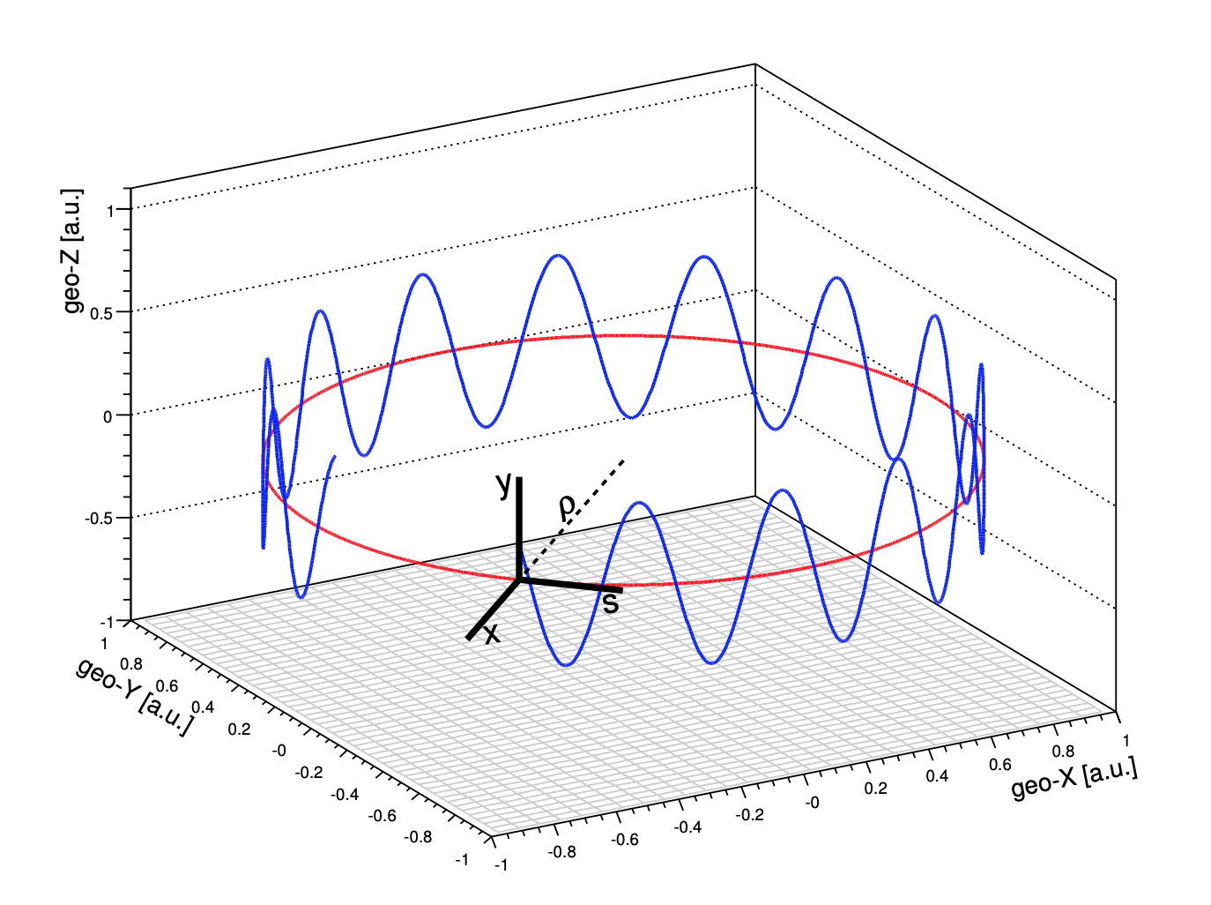
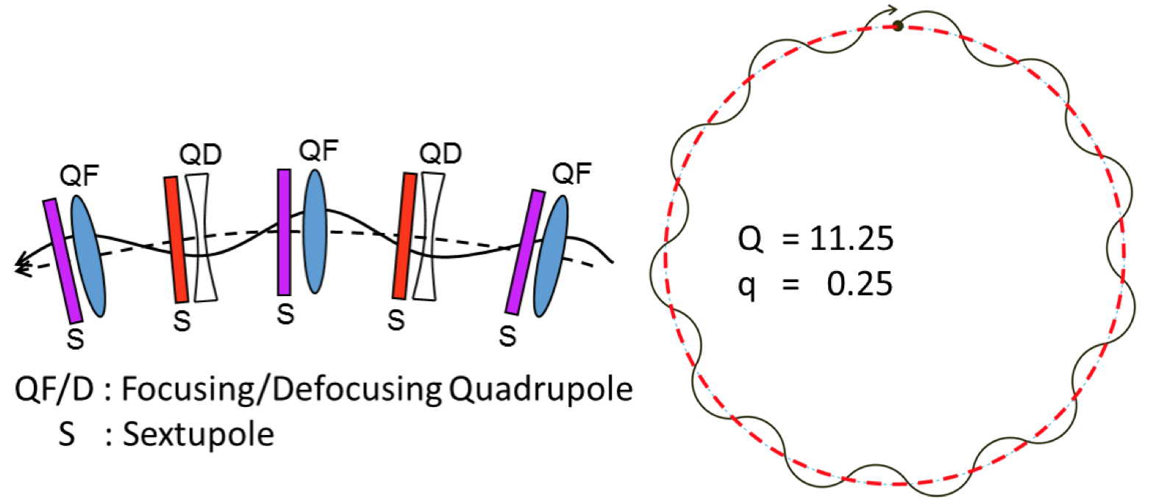
Motivation of the project
Definition of TUNE, Q
  Number of transverse oscillations that the particles describe during one revolution in the accelerator (frequency of the transverse oscillations)
Q_{x} = 20.13
Q_{y} = 20.18
Beam stability and beam losses depend on the tune
Avoid values of tune that make de beam unstable due to resonances

Slide 3
Motivation of the project
Why is bunch-by-bunch tune measurement and correction important?
LHC Injectors Upgrade, LIU [1]
High intensity of bunches in the SPS
Strong bunch-by-bunch tune shift effect from impedance
It is necessary to measure the horizontal and vertical bunch-by-bunch tunes and correct the average tunes in order to:
    Stabilise the beam
    Ensure good beam transmission (reduce losses)

Slide 4
OUTLINE
Introduction
Experimental measurements
PyHEADTAIL simulations
Comparison of measurements and simulations
Additional tasks and IPAC 2022
Outlook

Slide 5
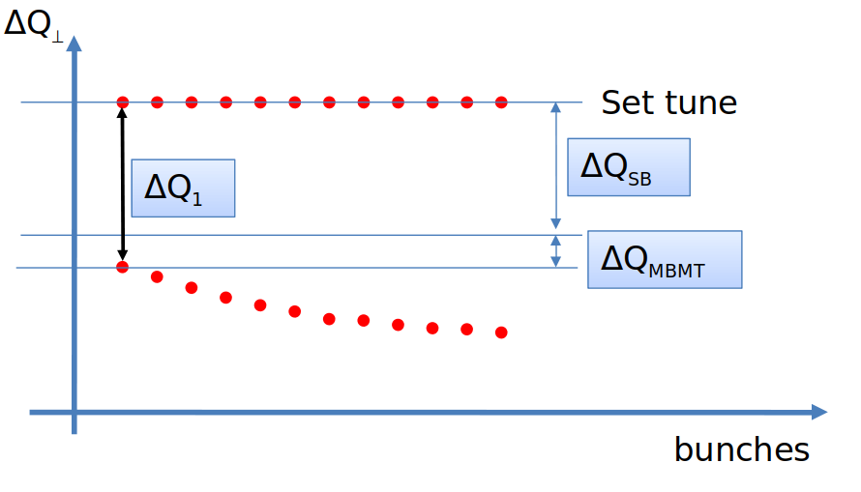
INTRODUCTION
SINGLE BUNCH TUNE SHIFT [2] due to narrowband impedances
MULTITURN TUNE SHIFT due to broadband impedances
The tune shift depends on:
The intensity per bunch
The total intensity of the beam, through:
  The number of bunches
  The number of trains of bunches (batches)
Tune shift grows for the trailing bunches as the wakefield builds up along the train

Slide 6
INTRODUCTION
OBJECTIVE
Obtain a method to predict the tune shift depending on the beam configuration (number of bunches, number of batches and intensity per bunch).
MEASUREMENTS
(at different intensities)
SIMULATIONS
(For both single-bunch and multi-bunch beams)

Slide 7
OUTLINE
Introduction
Experimental measurements
PyHEADTAIL simulations
Comparison of measurements and simulations
Additional tasks and IPAC 2022
Outlook

Slide 8
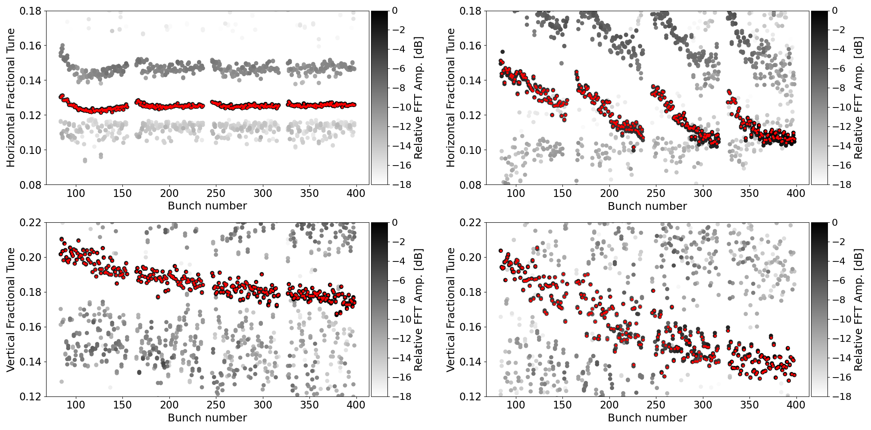
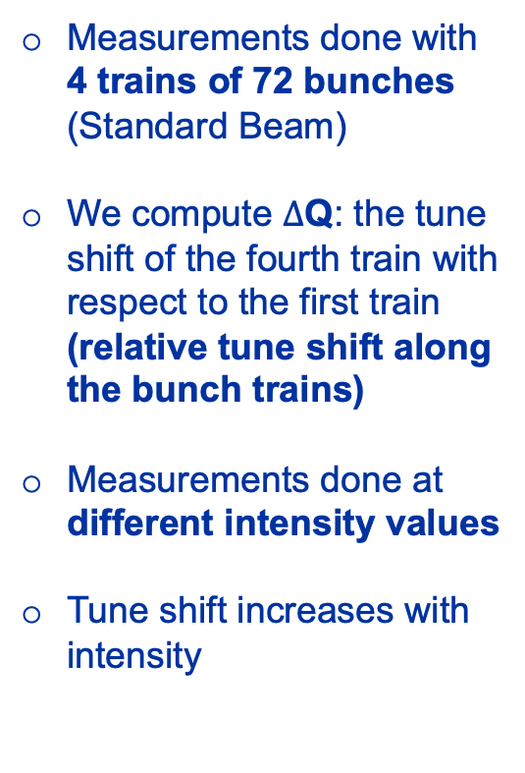


RESULTS FROM MUTLI-BUNCH MEASUREMENTS
LOW INTENSITY
HIGH INTENSITY
Measurements done with 4 trains of 72 bunches (Standard Beam)
We compute $∆$Q: the tune shift of the fourth train with respect to the first train (relative tune shift along the bunch trains)
Measurements done at different intensity values
Tune shift increases with intensity
$∆$Q
$∆$Q
Horizontal (top) and vertical (bottom) bunch-by-bunch tunes measured through the LHC prototype Beam Position Monitors (LHCBPMs) in the SPS, for low intensity of 0.8 x 10¹¹ p/b (left) and high intensity of 2.0 x 10¹¹ p/b (right).

Slide 9
OUTLINE
Introduction
Experimental measurements
PyHEADTAIL simulations
Comparison of measurements and simulations
Additional tasks and IPAC 2022
Outlook

Slide 10
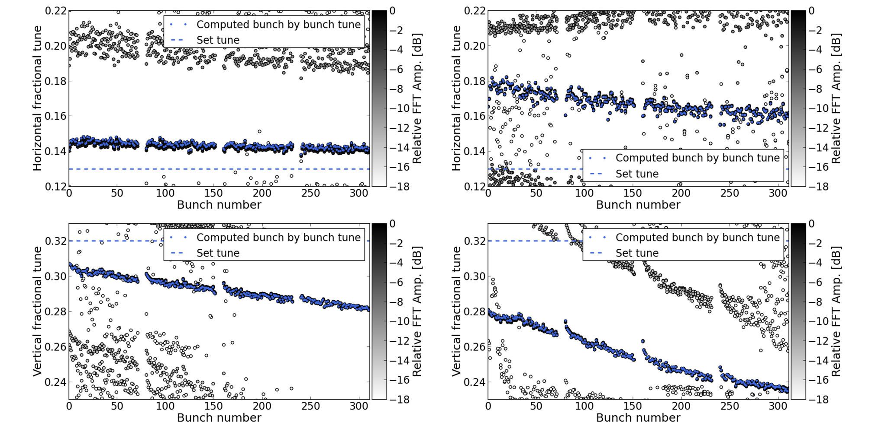


PyHEADTAIL SIMULATIONS
LOW INTENSITY
HIGH INTENSITY
Impedance induced tune shifts are simulated with the PyHEADTAIL [3] macroparticle tracking code
SPS impedance model with wall and kickers contributions
Simulations done under the same conditions as the measurements
Electron cloud effects are NOT included in the simulations
$∆$Q
$∆$Q
Horizontal (top) and vertical (bottom) bunch-by-bunch tunes obtained with PyHEADTAIL, for low intensity of 0.8 x 10¹¹ p/b (left) and high intensity of 2.0 x 10¹¹ p/b (right).

Slide 11
OUTLINE
Introduction
Experimental measurements
PyHEADTAIL simulations
Comparison of measurements and simulations
Additional tasks and IPAC 2022
Outlook

Slide 12
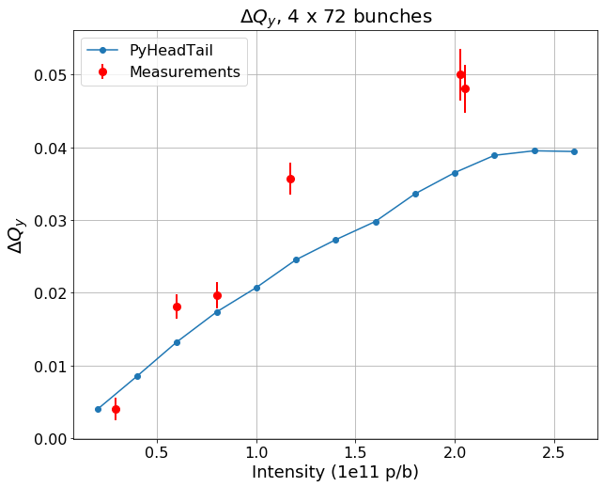
COMPARISON MEASUREMENTS AND SIMULATIONS
 | Vertical Plane | Horizontal Plane
Single-Bunch Beams
Multi-Bunch Beams | Low intensities High intensities
For single-bunch beams, simulations are successfully benchmarked with measurements
For multi-bunch beams:
  More impedance contributions need to be included in the simulations model to solve the discrepancies at high intensities in the V plane
  E-cloud effects are needed to solve discrepancies in the H plane
Relative tune shift of the fourth train with respect to the first train comparing measurements with simulations (vertical plane).

Slide 13
OUTLINE
Introduction
Experimental measurements
PyHEADTAIL simulations
Comparison of measurements and simulations
Additional tasks and IPAC 2022
Outlook

Slide 14
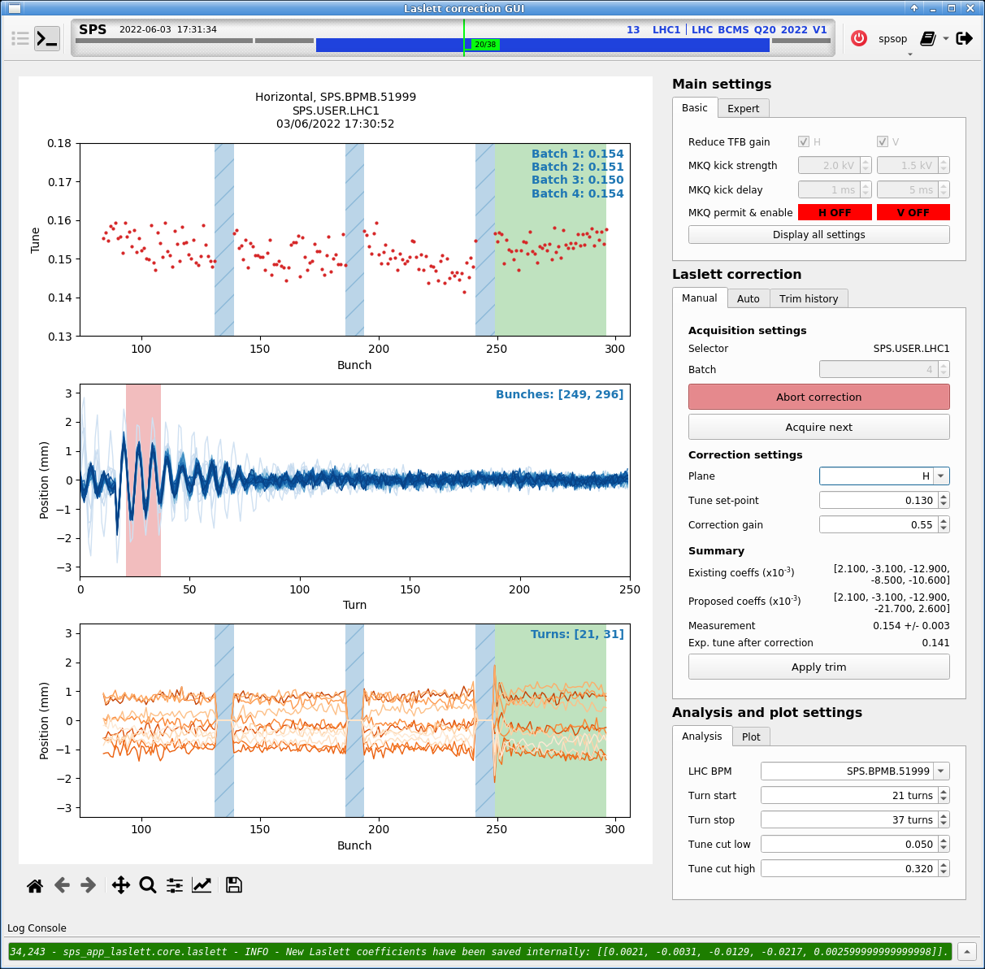
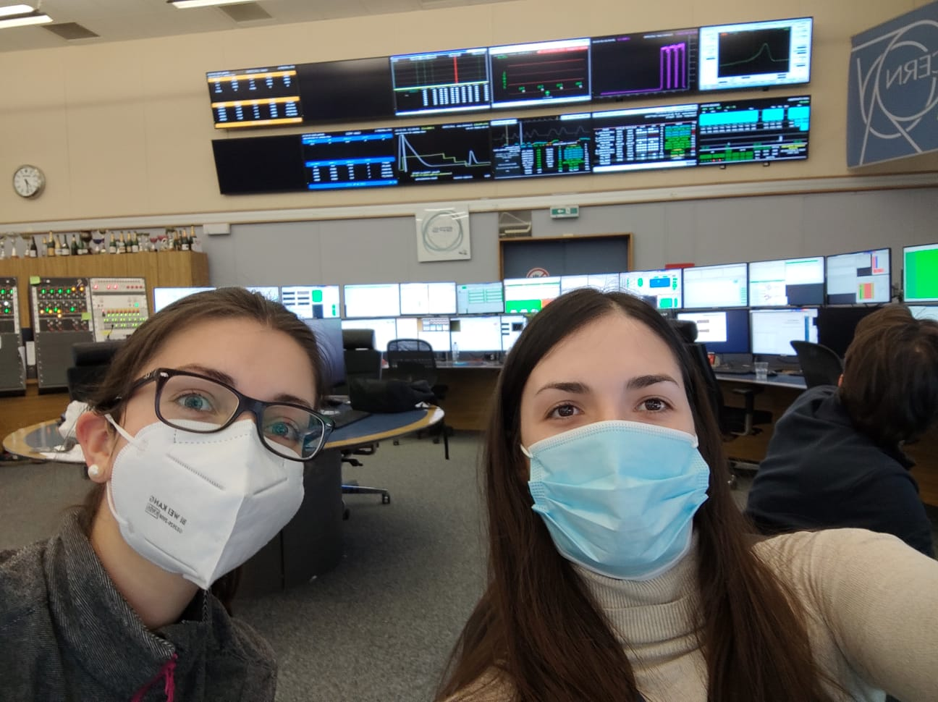
COMPLEMENTARY WORK
APPLICATION FOR TUNE MEASUREMENT AND CORRECTION IN THE SPS (CCC)
PARTICIPATION IN THE
SPS SCRUBBING RUN
From 19.03.2022 to 10.04.2022
After a long shutdown, scrubbing is needed to reduce electron cloud inside the beampipe [4]
M. Schenk (BE-OP) maintainer of the app.

Slide 15
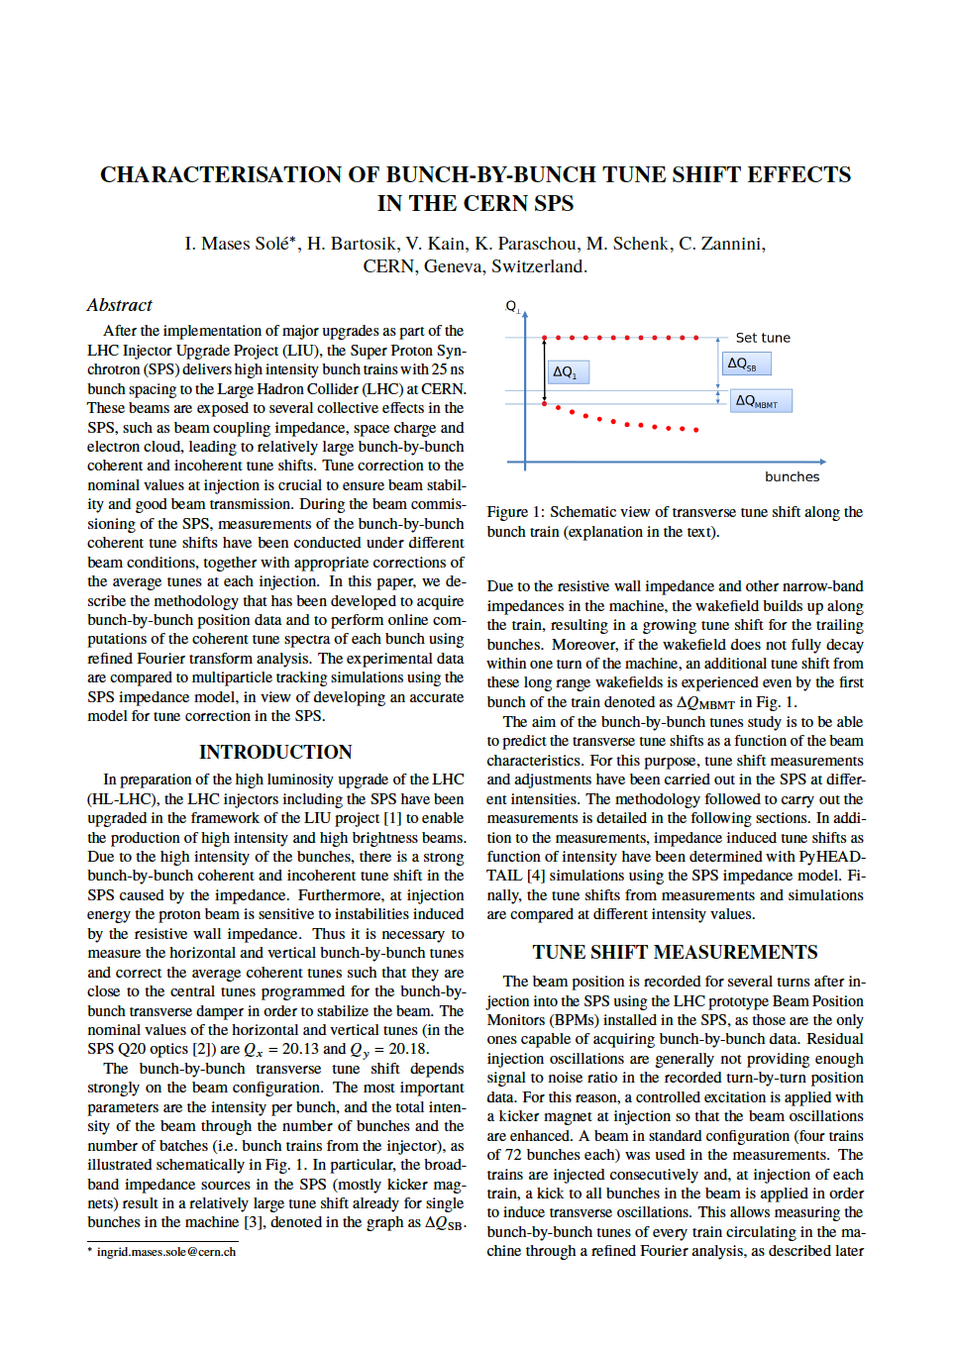
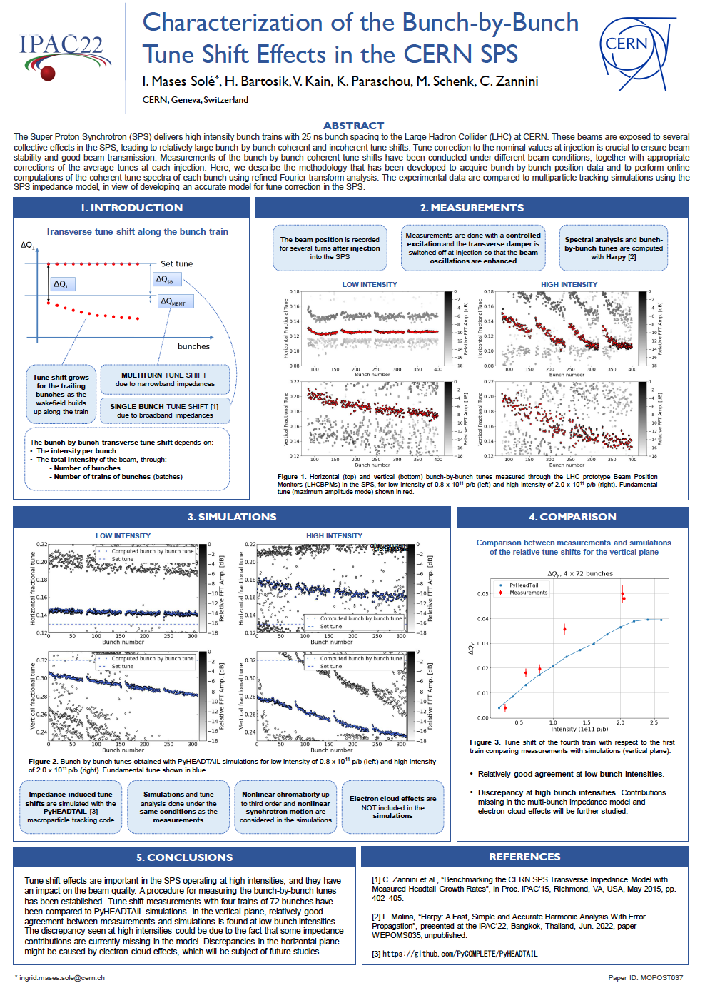
Contribution to IPAC 2022
(International Particle Accelerator Conference, from 12-17 June, ipac22.org)
PAPER PUBLICATION
POSTER PRESENTATION
Link to paper
Link to poster

Slide 16
OUTLINE
Introduction
Experimental measurements
PyHEADTAIL simulations
Comparison of measurements and simulations
Additional tasks and IPAC 2022
Outlook

Slide 17
FUTURE WORK
Include electron cloud effects in the PyHEADTAIL simulations
Include more contributions to the SPS multi-bunch impedance model
Perform more measurements to have more experimental data
Study the impact of the tune shift on the emittance and losses

Slide 18
References
[1] J. Coupard et al., “LHC Injectors Upgrade, Technical Design Report, Vol. I: Protons”, LIU Technical Design Report (TDR), CERN-ACC-2014-0337.
[2] C. Zannini, H. Bartosik, G. Iadarola, G. Rumolo, and B. Salvant, “Benchmarking the CERN-SPS Transverse Impedance Model with Measured Headtail Growth Rates”, in Proc. IPAC’15, Richmond, VA, USA, May 2015, pp. 402–405. doi:10.18429/JACoW-IPAC2015-MOPJE049
[3] https://github.com/PyCOMPLETE/PyHEADTAIL
[4] G. Iadarola et al., “Detailed Studies of Beam Induced Scrubbing in the CERN-SPS”, in Proc. IPAC'15, Richmond, VA, USA, May 2015, pp. 3908-3910. doi:10.18429/JACoW-IPAC2015-THPF091

Slide 19
THANK YOU VERY MUCH FOR YOUR ATTENTION!

Slide 20
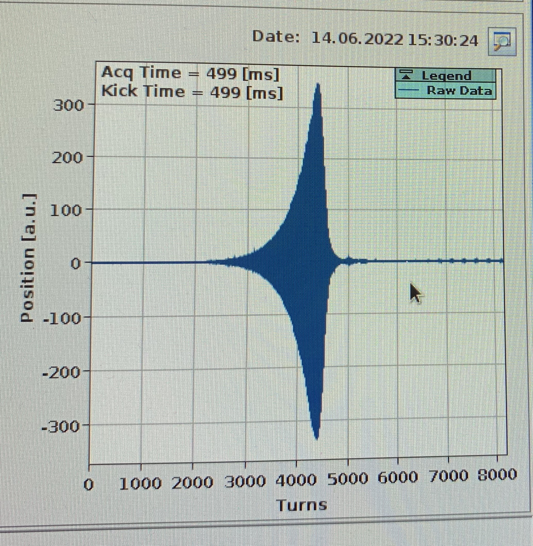
EXTRA SLIDES: COMPLEMENTARY WORK
Q-26 OPTICS
SINGLE BUNCH REFERENCE MEASUREMENTS
IN THE SPS
Headtail mode 0 instability GROWTH RATE as function of chromaticity [5]
Together with E. de la Fuente
19th, 20th May and 13th, 14th June
PARTICIPATION IN THE
SPS LIU MD’s
(Machine Development sessions)
Check the high-intensity beams that will be delivered to the LHC during Run3:
  Standard Beam (trains of 72 bunches)
  BCMS Beam (trains of 48 bunches)
Emittance measurements

Slide 21
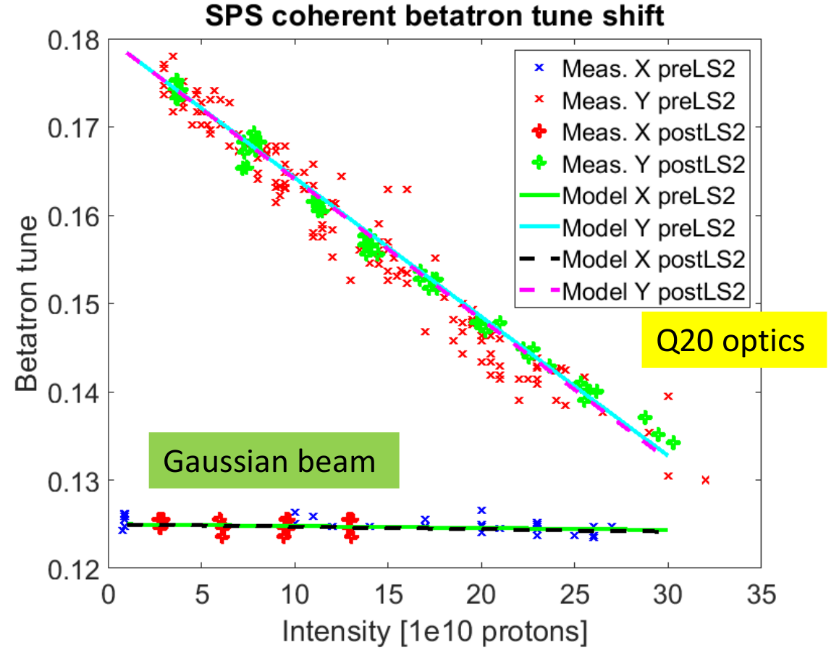
EXTRA SLIDES
Single-bunch tune shift measurements in the SPS
Good agreement of
measurements
and simulations

