Slide 1


Laser treatment for electron cloud
Ana Karen Reascos Portilla TE-VSC
Supervisors:
Marcel Himmerlich TE-VSC
Mauro Taborelli TE-VSC
Ana Karen Reascos Portilla
20/01/2022
1
1

Slide 2
Summary
Laser installation
LHC visit
Laser long test
Hardware implementation
Software implementation
Ana Karen Reascos Portilla
20/01/2022
2

Slide 3
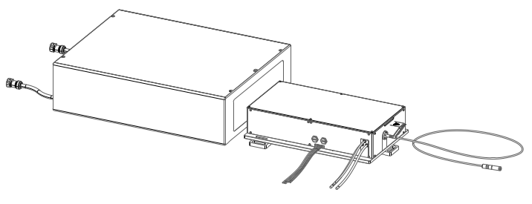
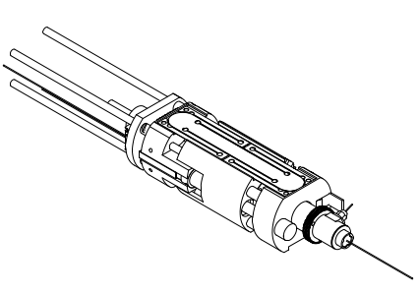
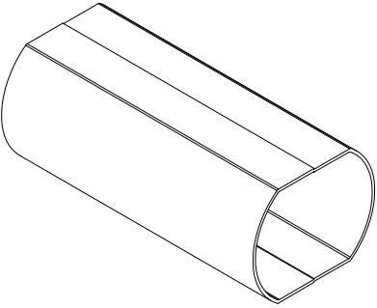
Experimental setup for laser treatment
Interface
cable
Hyper-Rapid Laser
N2 pipe
BDS
Vacuum pump
Chiller
Ana Karen Reascos Portilla
20/01/2022
3

Slide 4
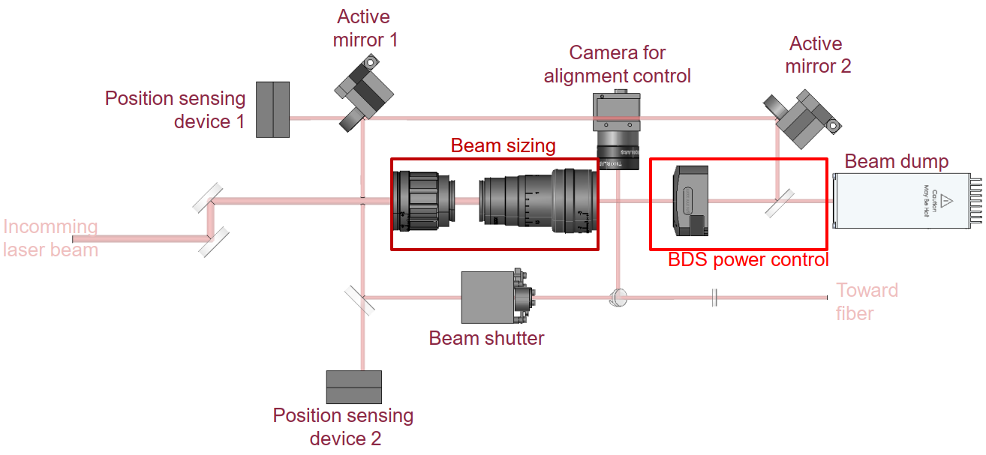

Optical principle of working – Beam Delivery System
Laser output power
Optical fibre
Power meter
Ana Karen Reascos Portilla
20/01/2022
4

Slide 5
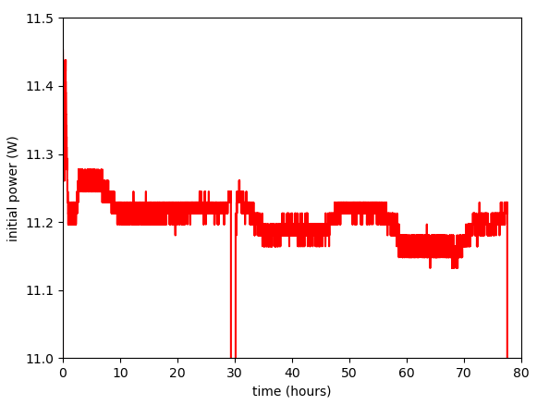
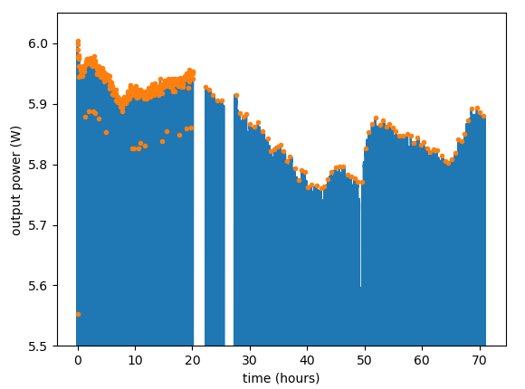
Laser long test
22/11 - 9:29
25/11 - 13:59
22/11 - 12:34
23/11 - 15:20
Laser output power (initial power)
77h30
BDS output power (final power)
73h25
Pressure
46h39
Laser output power
BDS output power (Power meter)
Ana Karen Reascos Portilla
20/01/2022
5

Slide 6
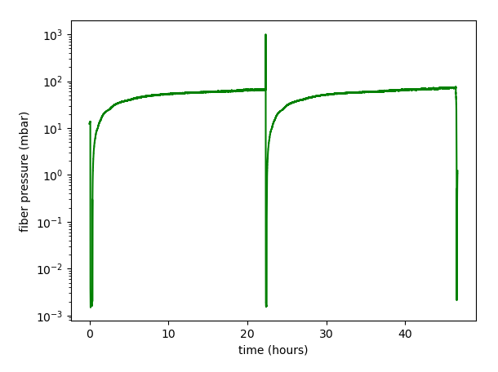
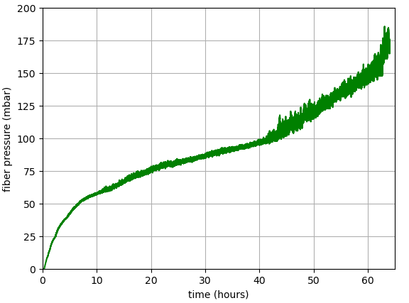
Laser long test
22/11 - 9:29
25/11 - 13:59
22/11 - 12:34
23/11 - 15:20
77h30
Laser output power (initial power)
BDS output power (final power)
73h25
Pressure
46h39
Vacuum gauge
Vacuum gauge – Weekend test
Pump the fiber before starting the laser
Maintain static vacuum
Pump the fiber
Maintain static vacuum
Ana Karen Reascos Portilla
20/01/2022
6

Slide 7





New hardware implementation
Vacuum gauge
Monitor fiber pressure
Power meter
Stabilization system
BDS Output power
Monitor the alignment
Chillers
Half-wave plate
Check list of errors
Shutter (BDS)
Change the angle
On / off
Ana Karen Reascos Portilla
20/01/2022
7

Slide 8
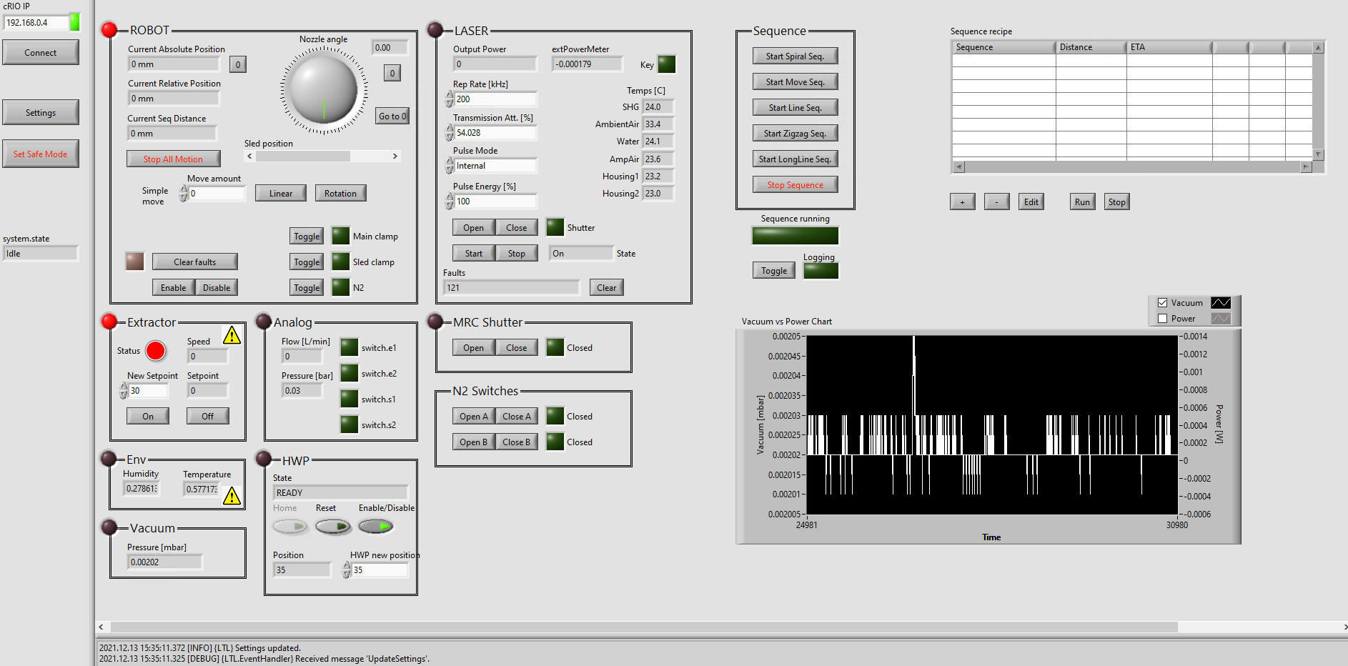
Ana Karen Reascos Portilla
20/01/2022
8

Slide 9
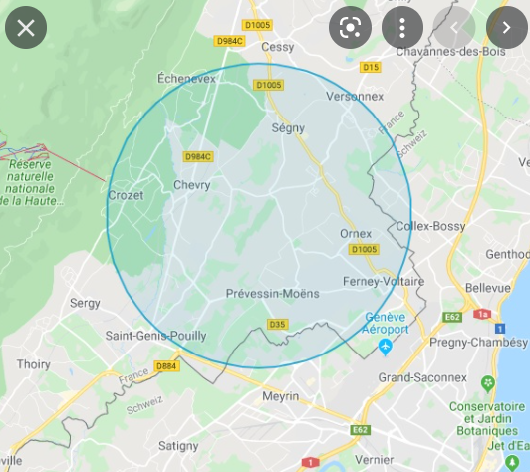
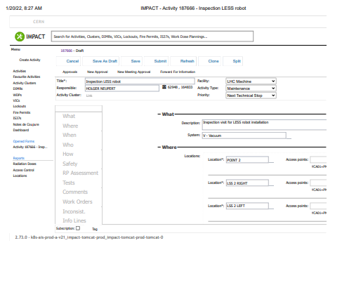
LHC visit
Impact order
Point 2
Point 8
impact.cern.ch
Ana Karen Reascos Portilla
20/01/2022
9

Slide 10
What’s next?
Eliminate the leak
Finish the stabilization system integration
Test the laser functionalities from the CRio interface
Align the optics in the robot
START TO TREAT SAMPLES
Ana Karen Reascos Portilla
20/01/2022
10

Slide 11
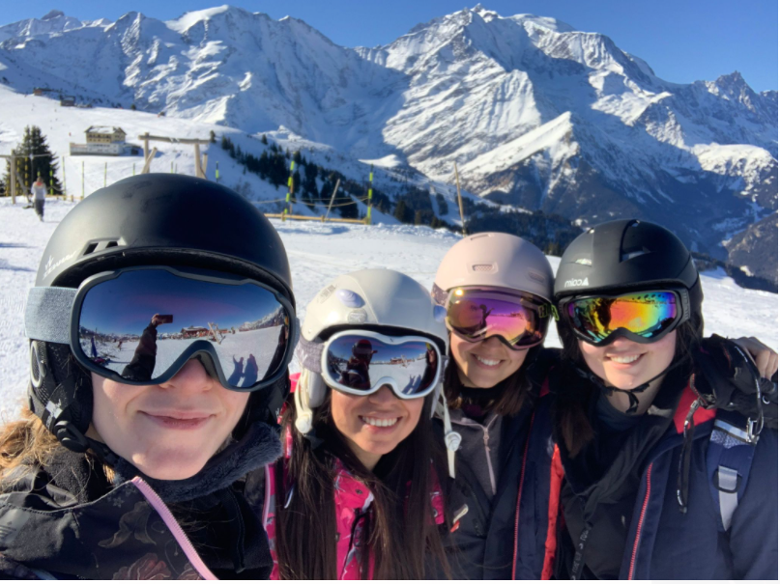


FTEC PROGRAM
Gran oportunidad internacional
Centro de investigacion de alto nivel
Mas contacto con la industria
Plan de retorno mas espeficico
Ana Karen Reascos Portilla
20/01/2022
11

