Slide 1
13th FTEC Workshop
Design and manufacturing of normal conducting copper structures (FTEC2019-09)
Pedro Morales Sanchez Sup: Nuria Catalan Lasheras
20/01/2022

Slide 2
Summary of the jobs
Structures
Collaborations
Integrations
Brazing
KCLIC G
Personal

Slide 3
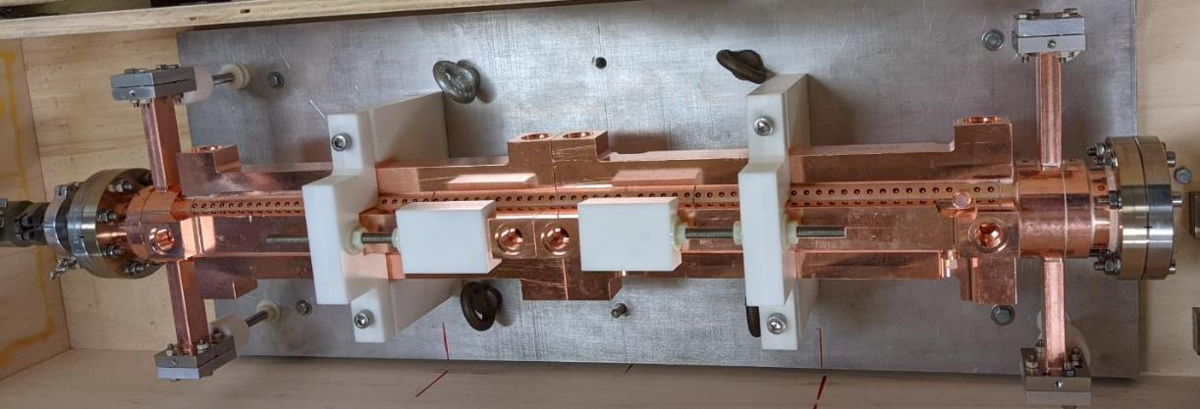
PSI Linearizer
Notes:
One of the last structures we are building is this PSI Linearizer. This Project manufacturing started before I arrived CERN with the disc manufacturing outside CERN.

Slide 4
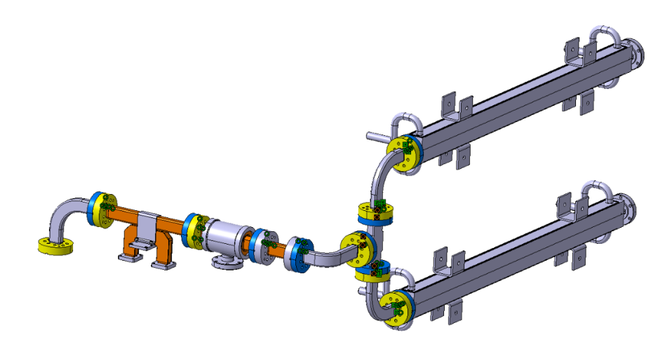
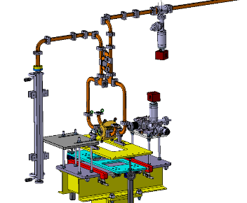
Integrations Xbox 1 & 3
Xbox1
Italy
Xbox3

Slide 5
Halves

Slide 6
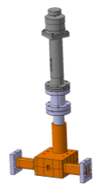
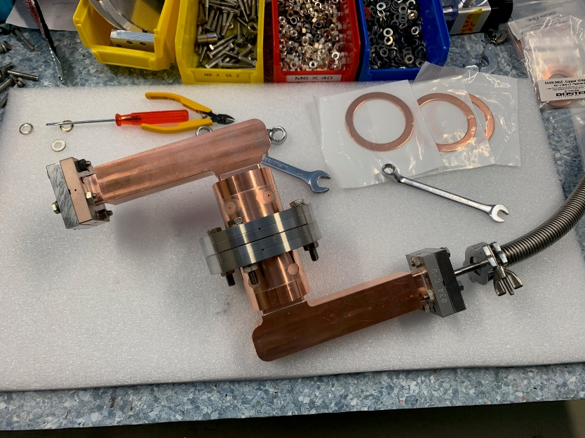
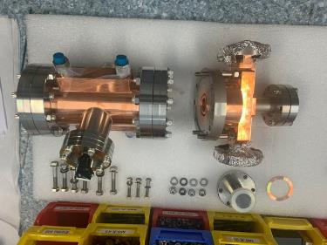
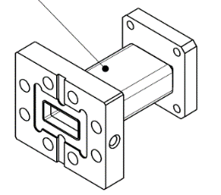
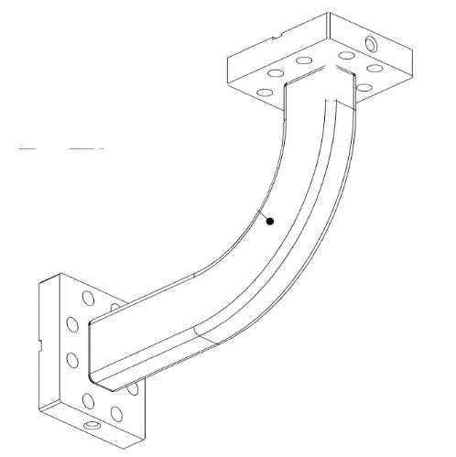
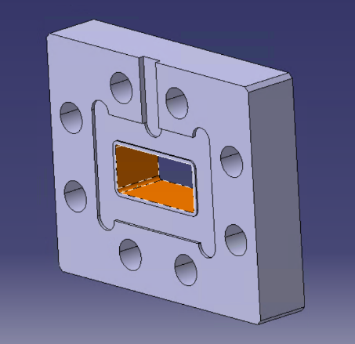
Components

Slide 7
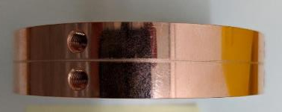
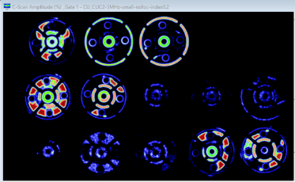
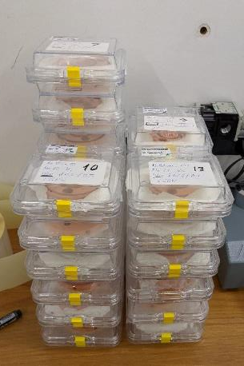
Brazing implementation for CLIC G

Slide 8
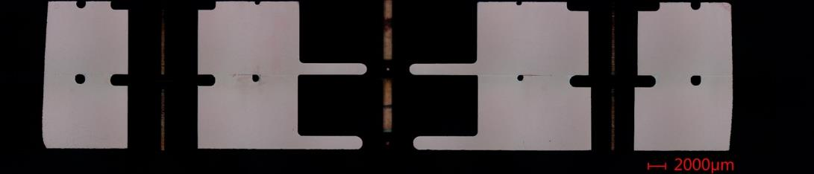
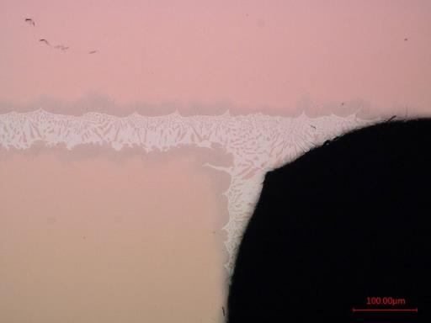
Metallographic evaluation
#7
Another outcome we can see from this study is that the BFM stop as soon is reaching the end of the channels generating a rounding in the corners and a flat area in the straights surfaces
Brazing tests (15 September 2021) · Indico (cern.ch)
20/01/2022
Pedro Morales Sanchez | 13th FTEC Workshop

Slide 9
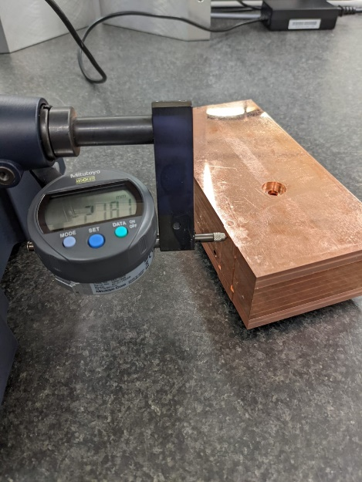
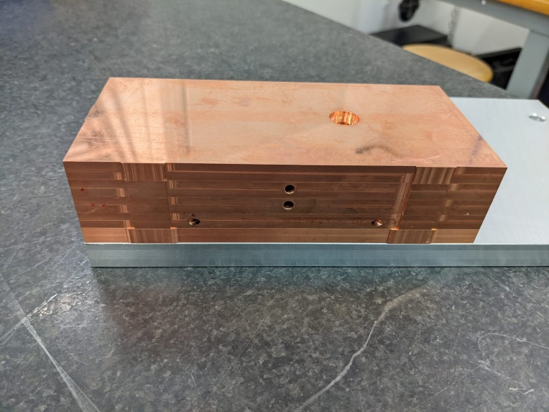
KCLIC G
#7
20/01/2022
Pedro Morales Sanchez | 13th FTEC Workshop

Slide 10
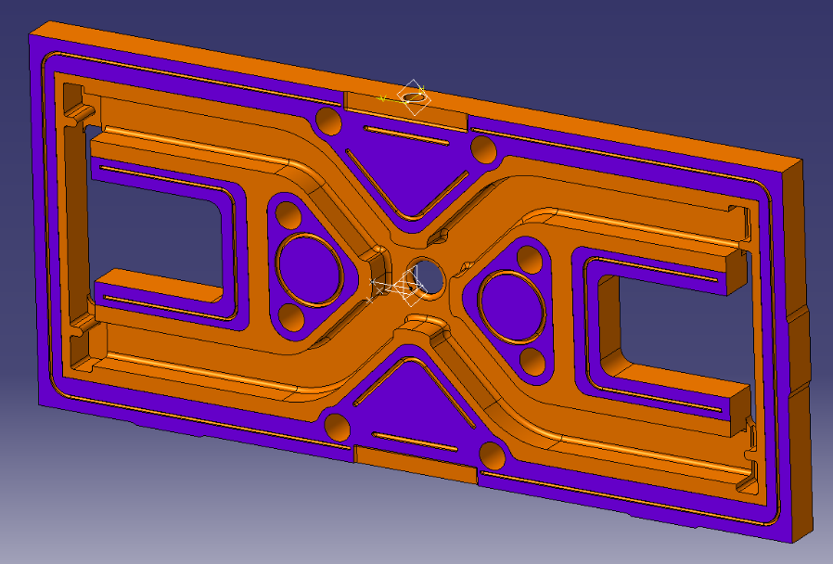
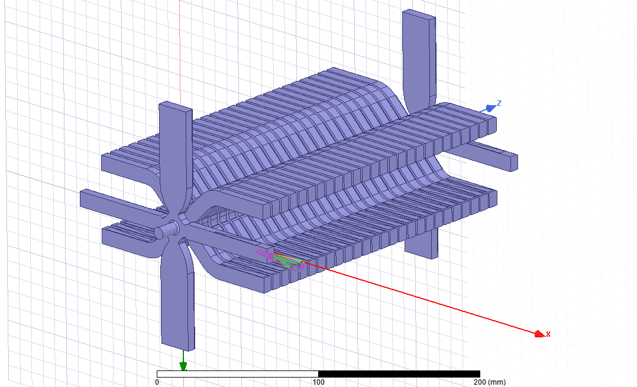
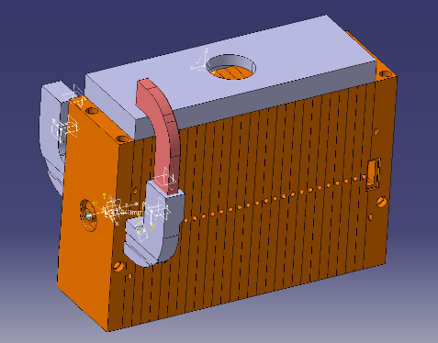
KCLIC G
CATIA Design
RF Design

Slide 11


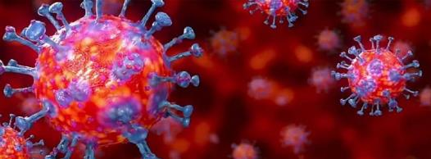
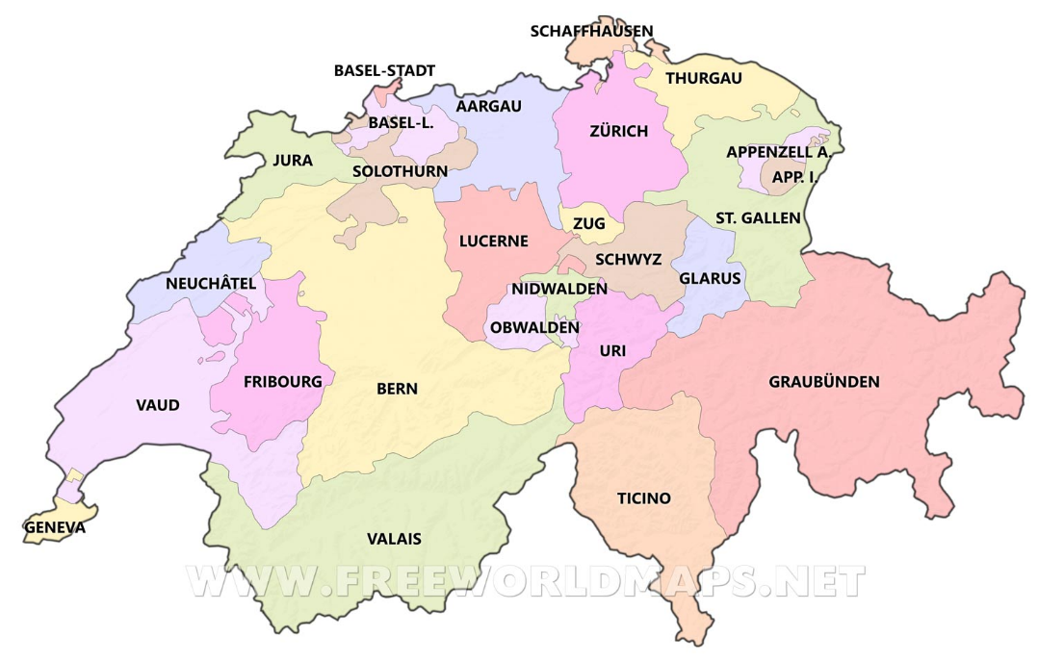


Personal

Slide 12

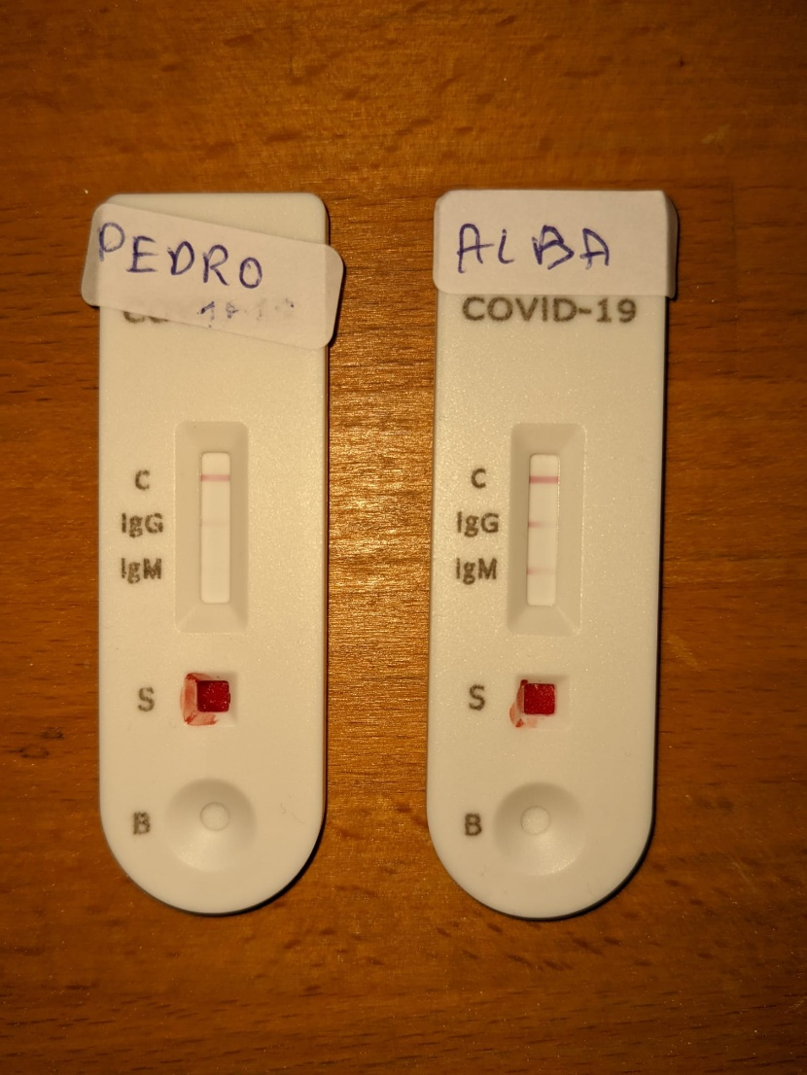


Personal

Slide 13
Personal

Slide 14
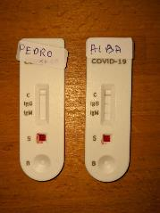
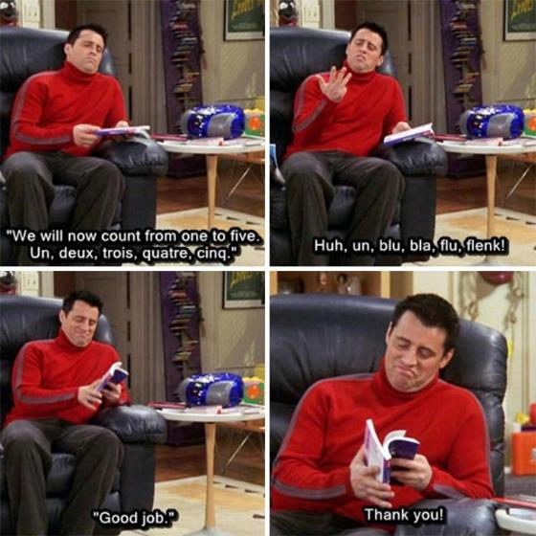
Personal

Slide 15
Personal

Slide 16
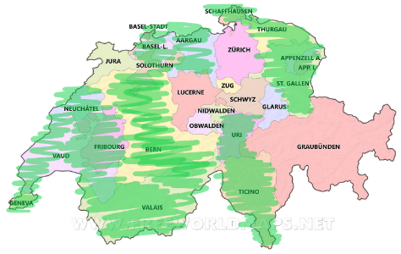
Personal

Slide 17
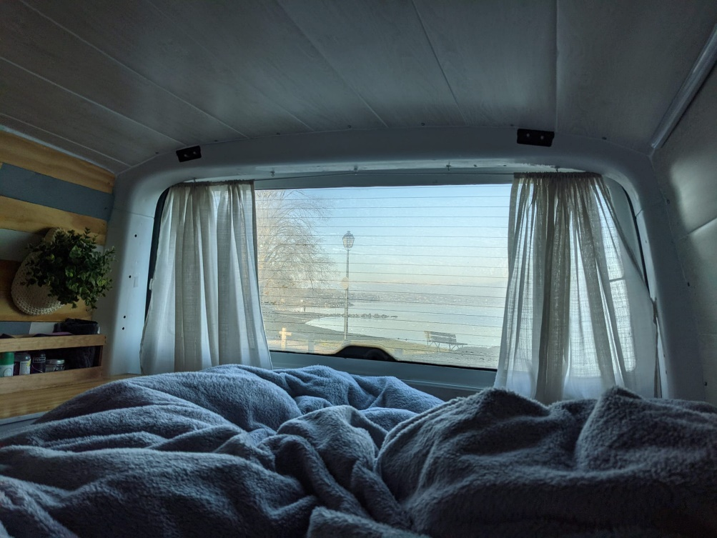
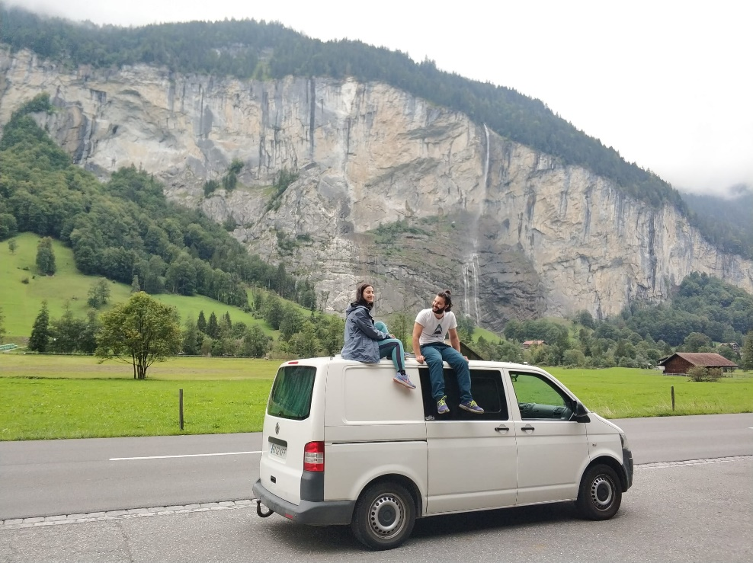
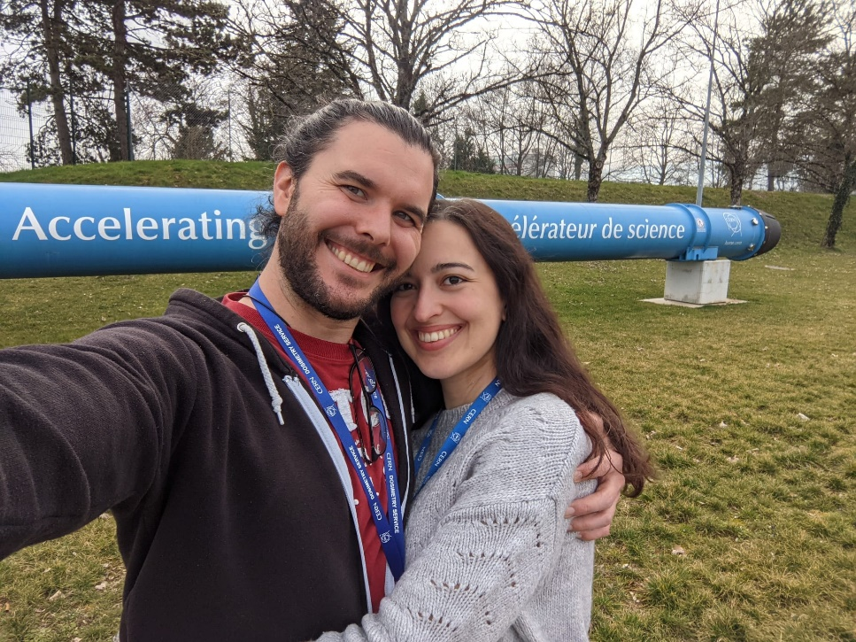
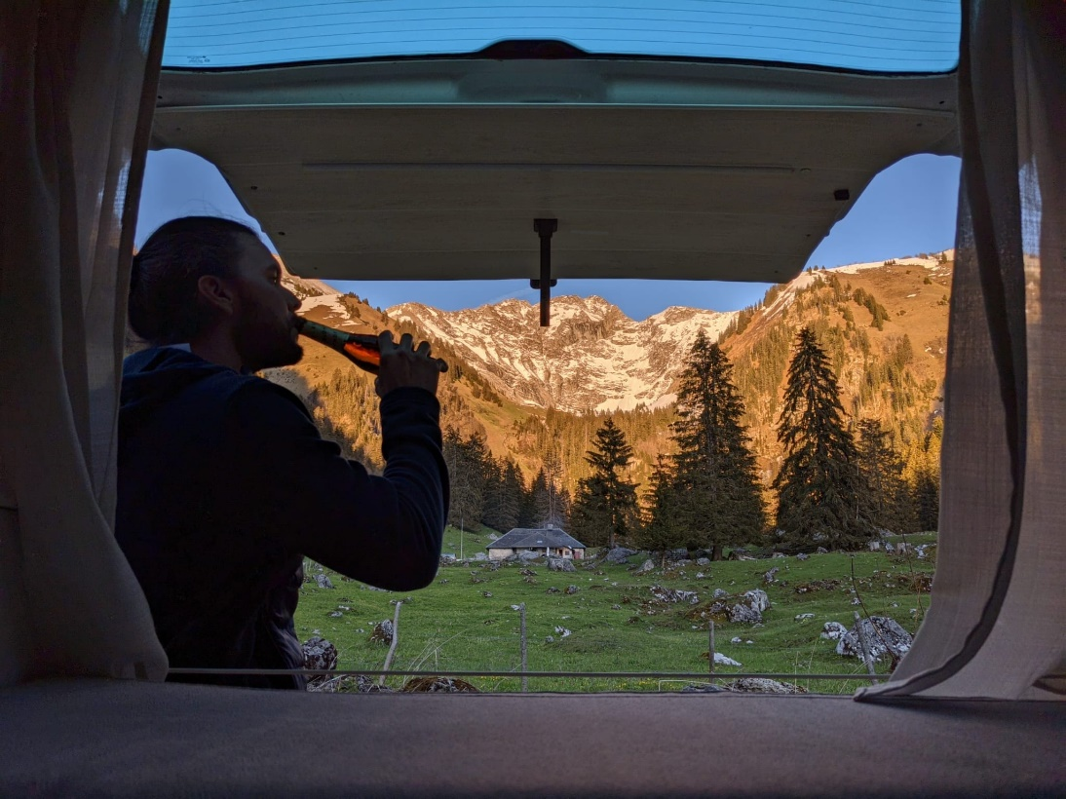
Personal

