Slide 1
12th FTEC Workshop
Design and manufacturing of normal conducting copper structures (FTEC2019-09)
Pedro Morales Sanchez Sup: Nuria Catalan Lasheras
21/05/2021

Slide 2
Brief Remind
PSI Linearizer
Integration Xbox1
Halves
Spiral load
Brazing
New projects
CLIC G
CIEMAT collaboration
Integration Xbox3
Personal

Slide 3
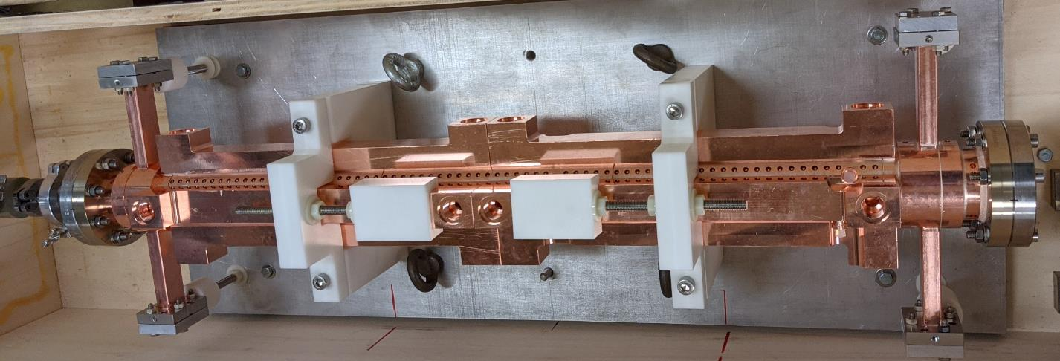
PSI Linearizer
During last months we have been going on with this structure fabrication.
Pin tunning and cooling system brazing
Bakeout
EBW of the antennas
Cooling system pipes order
Notes:
One of the last structures we are building is this PSI Linearizer. This Project manufacturing started before I arrived CERN with the disc manufacturing outside CERN.

Slide 4
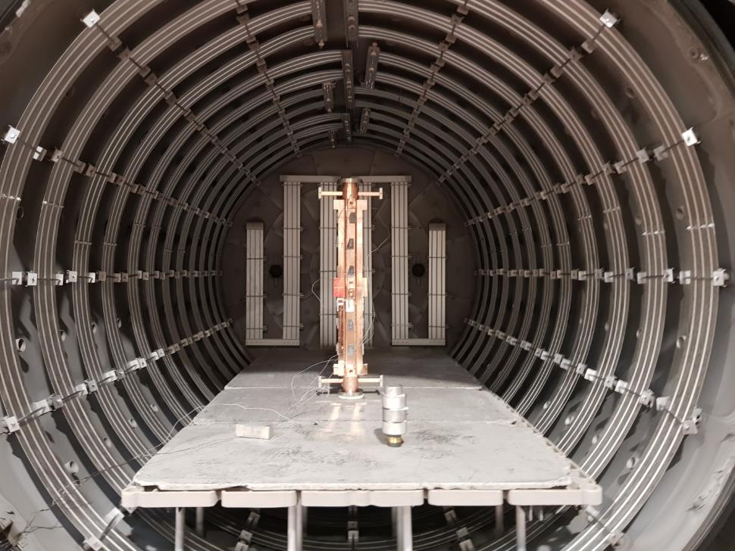
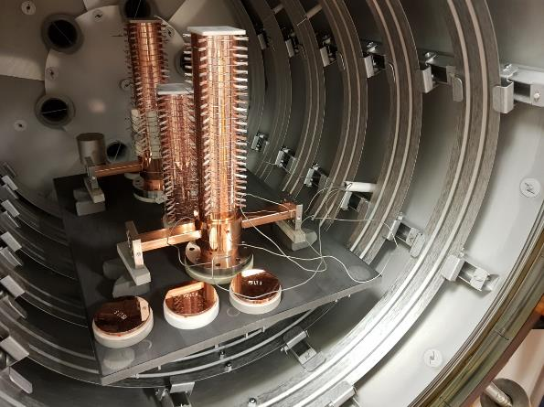
PSI Linearizer
Pin tunning and cooling system brazing

Slide 5
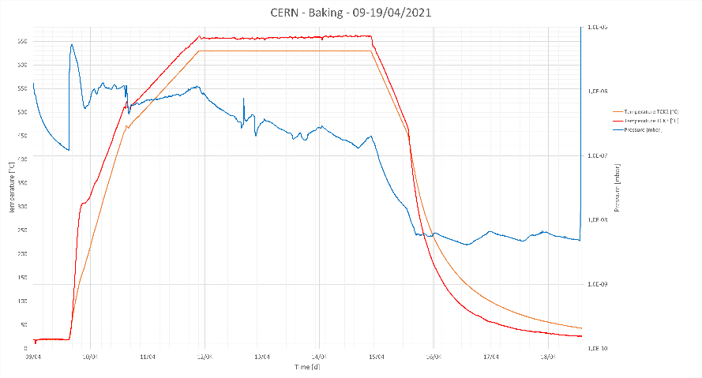
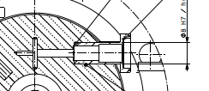
PSI Linearizer
Bakeout
EBW of the antennas
Performed at COMEB. It consist in doing a furnace cycle to remove all the H2 acumulated during the previous cycles
Done this week (17-18/05/2021) at main workshop

Slide 6
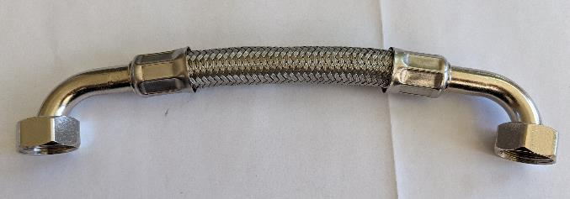
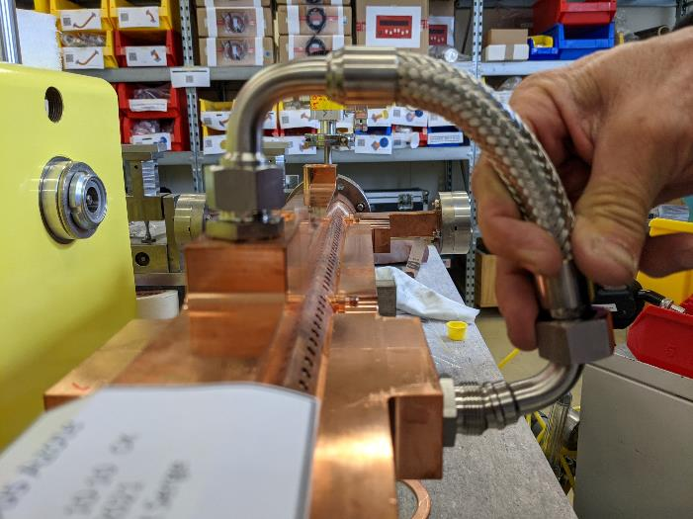
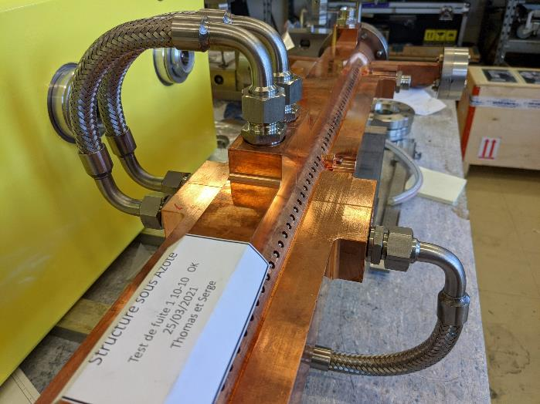
PSI Linearizer
Cooling system pipes order
Fabricated in Spain. There was an error/misunderstanding and the parts was shorter than needed but we could solve it even before to finish the final structure.

Slide 7
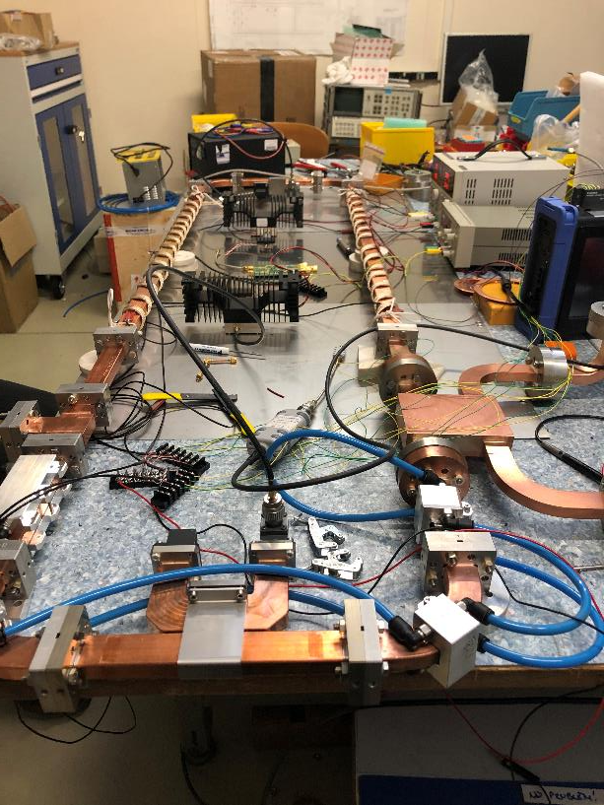
Integration Xbox1

Slide 8
Halves

Slide 9
Spiral Load 3D print
3D design
Back flange
Vacuum Flange solution
Cooling system

Slide 10

Spiral Load 3D print
3D design
Back flange
Vacuum Flange solution
Cooling system

Slide 11
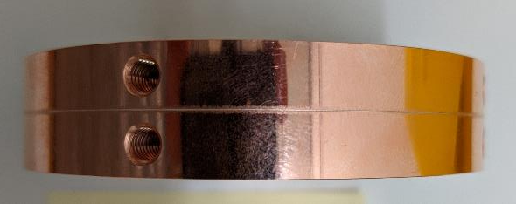
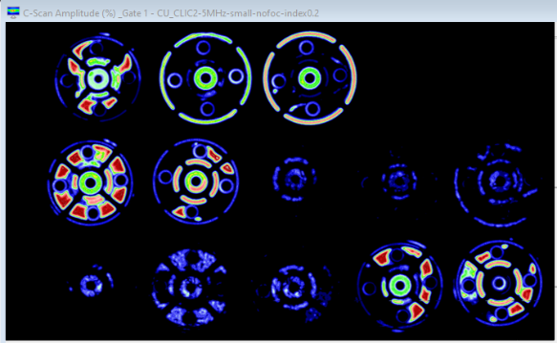
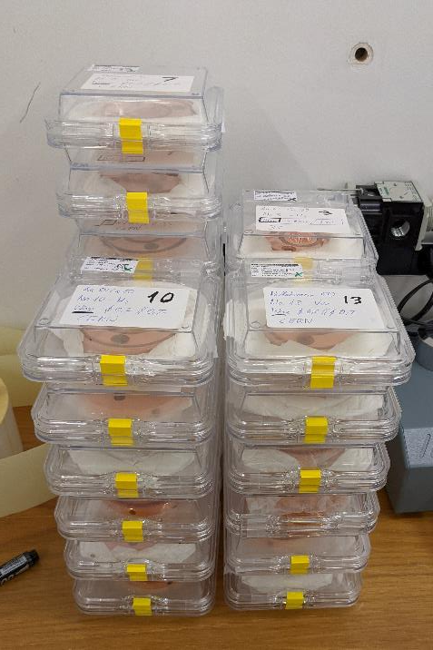
Brazing implementation for CLIC G

Slide 12
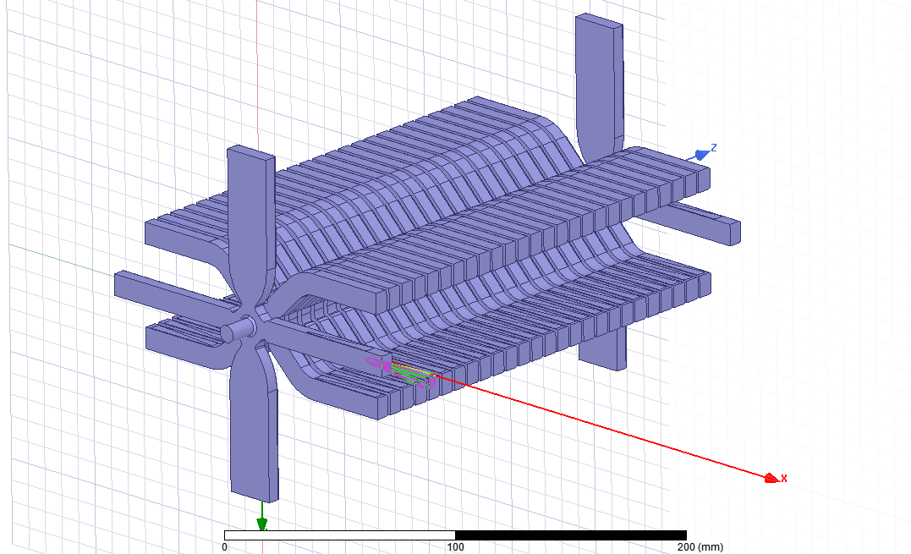
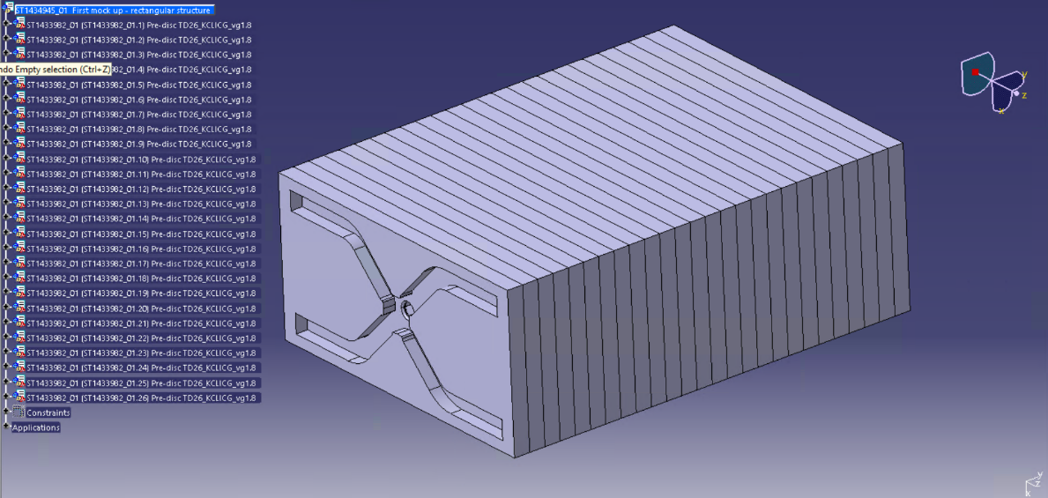
CLIC G
CATIA Design
RF Design

Slide 13
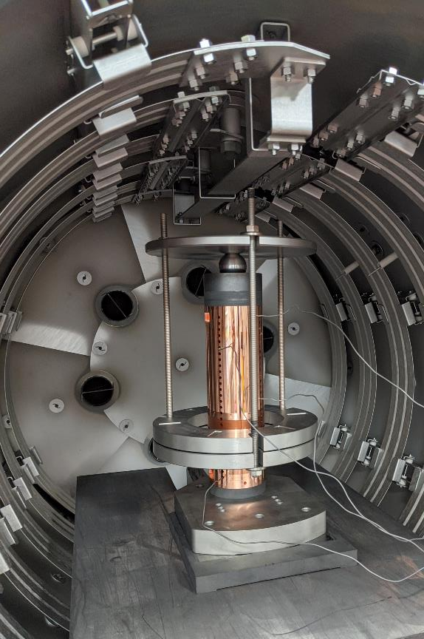
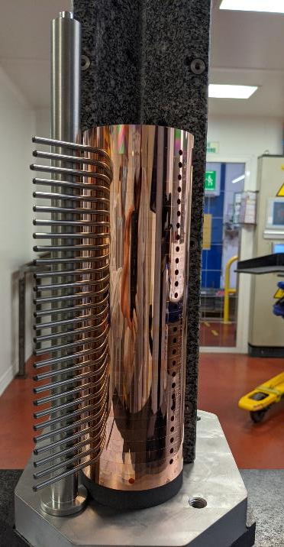
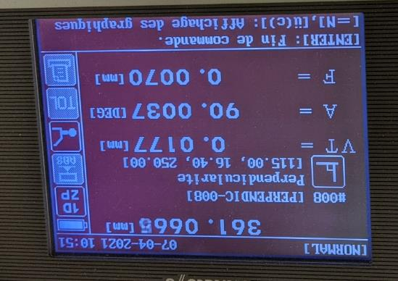
CIEMAT collaboration
Done the first bonding at Bodycote achieving an alignment between 3-5 µm

Slide 14
Integration Xbox3
SINAP structure
CRAB Cavity

Slide 15
Integration Xbox3
SINAP structure
CRAB Cavity

Slide 16
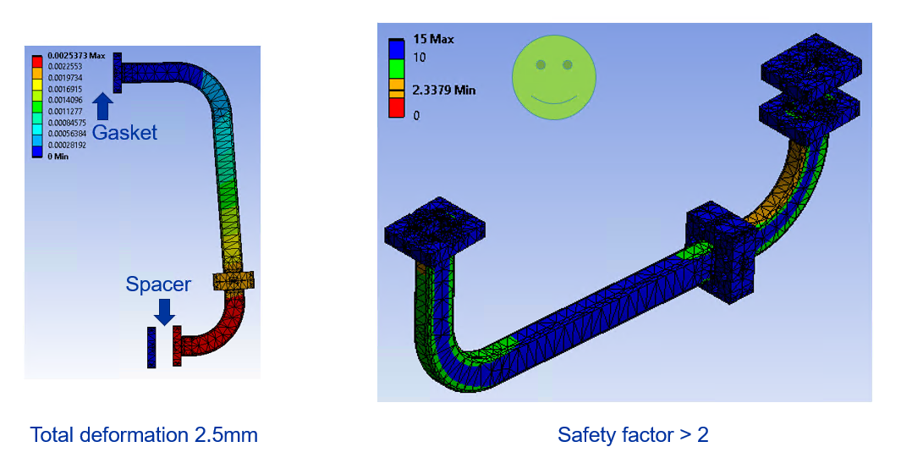
Integration Xbox3
CRAB Cavity – Gap study
Error in the previous files uploaded to the system so we have swich to another integration

Slide 17
Integration Xbox3
SINAP structure
RF window

Slide 18
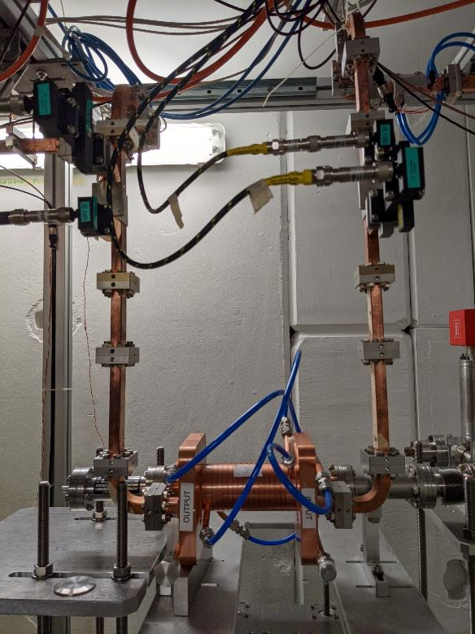
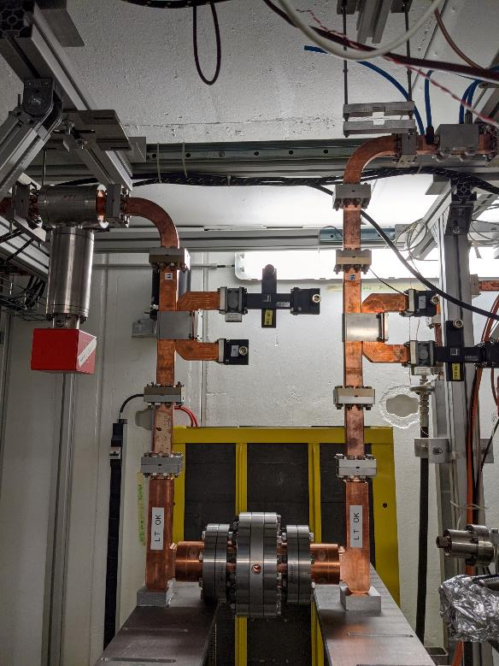
Integration Xbox3
SINAP structure
RF window

Slide 19

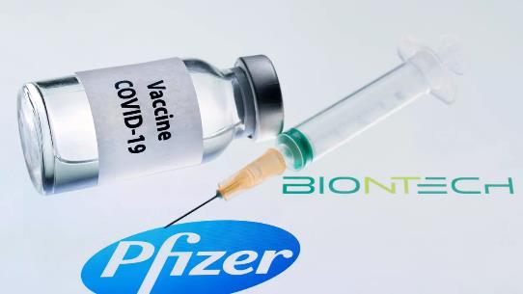

Personal
- miniCAS – Mechanical
- BASIC CAS
7h → 9h

