Slide 1


Laser treatment for electron cloud mitigation
Workshop 21/05/2020
Ana Karen Reascos Portilla TE-VSC
Supervisors:
Marcel Himmerlich TE-VSC
Mauro Taborelli TE-VSC
Ana Karen Reascos Portilla
21/05/2021
1
1

Slide 2
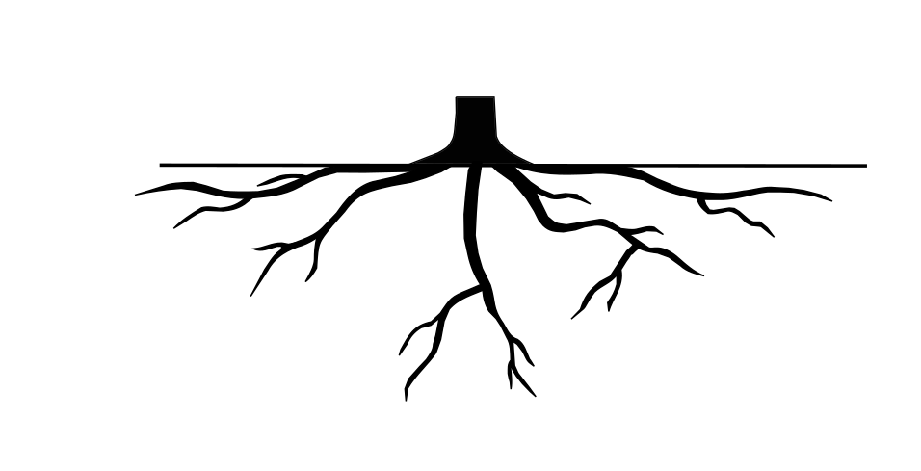
OVERVIEW OF THE PROJECT
Duplicate the system
Robot problems
Cable Management
Cabling
Electronic valves
Laser
Breadboard
Extension
Hose
System
Ana Karen Reascos Portilla
21/05/2021
2

Slide 3
OVERVIEW OF THE PROJECT
Duplicate the system
Robot problems
Cable Management
Cabling
Electronic valves
Laser
Breadboard
Extension
Hose
System
Ana Karen Reascos Portilla
21/05/2021
2

Slide 4
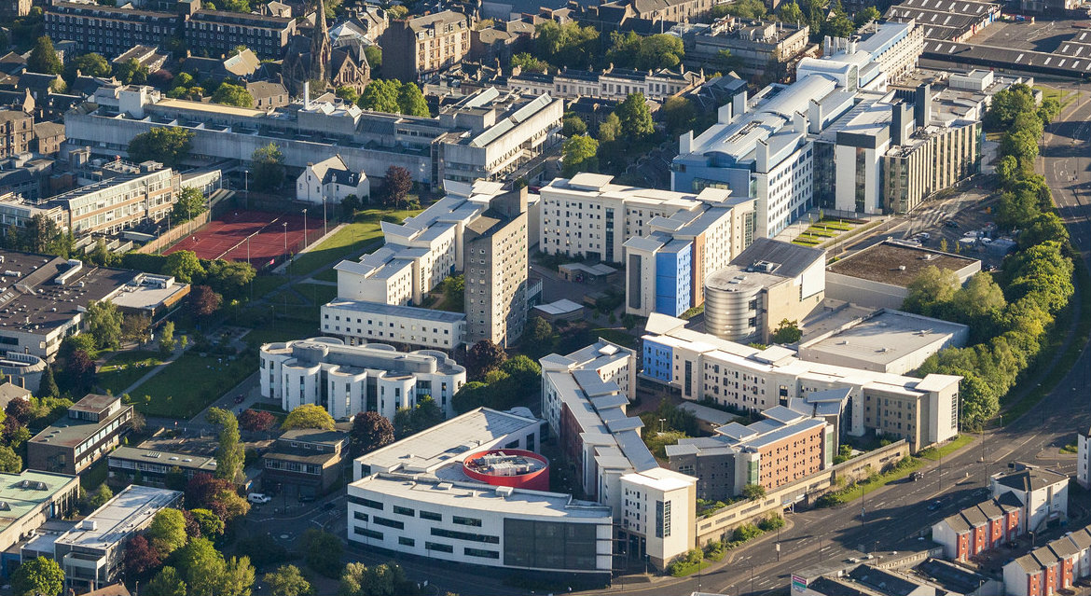

DUPLICATE THE SYSTEM
Agreement with University of Dundee
They want to apply the laser surface treatment.
CERN will send all the elements to control the robot:
Hardware
Software
Documentation
Ana Karen Reascos Portilla
21/05/2021
3

Slide 5
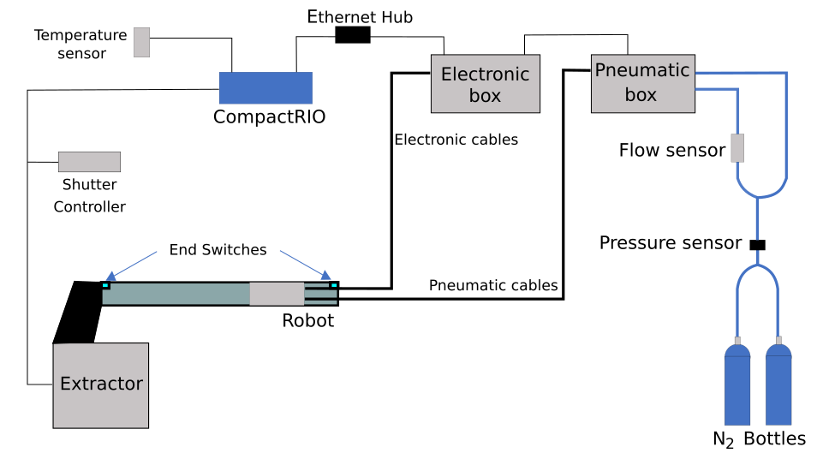
DUPLICATE THE SYSTEM
Ana Karen Reascos Portilla
21/05/2021
4

Slide 6


DUPLICATE THE SYSTEM
Hardware:
Documentation
Software
Compact RIO
Robot
Electronic box
Pneumatic box
Flow sensor
Hardware installation document
Software user manual
Modify some functionalities
Send the software.
Ana Karen Reascos Portilla
21/05/2021
5

Slide 7
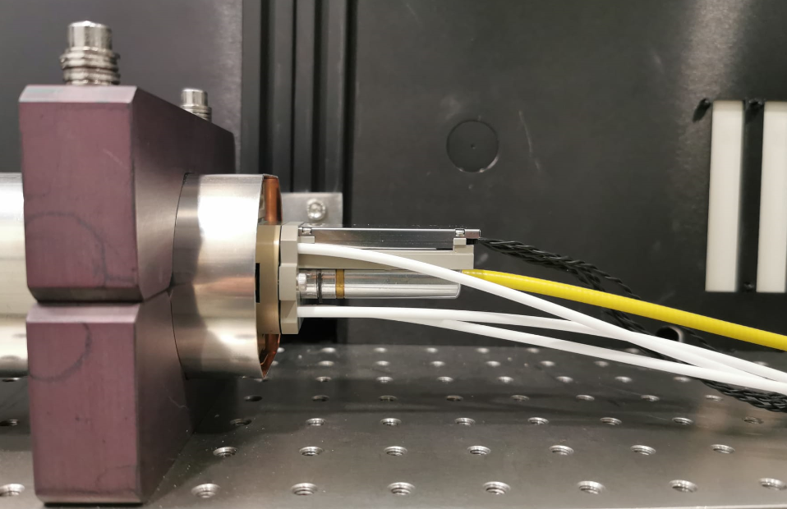
CABLE EXTENSION
15 cm
15 m –20 m
Robot + Cables
Electronics
Optical fiber
Nitrogen
Stainless steel
Ana Karen Reascos Portilla
21/05/2021
6

Slide 8



CABLE EXTENSION
15 cm
15 m –20 m
Stainless steel
Nitrogen flow
Electronics
Number of cables: 4
Diameter: 0.8 mm
Polymer covering
Polypropylene tubing
Number: 3
Number of cores: 12
Area: 0.25mm2
Ana Karen Reascos Portilla
21/05/2021
7

Slide 9
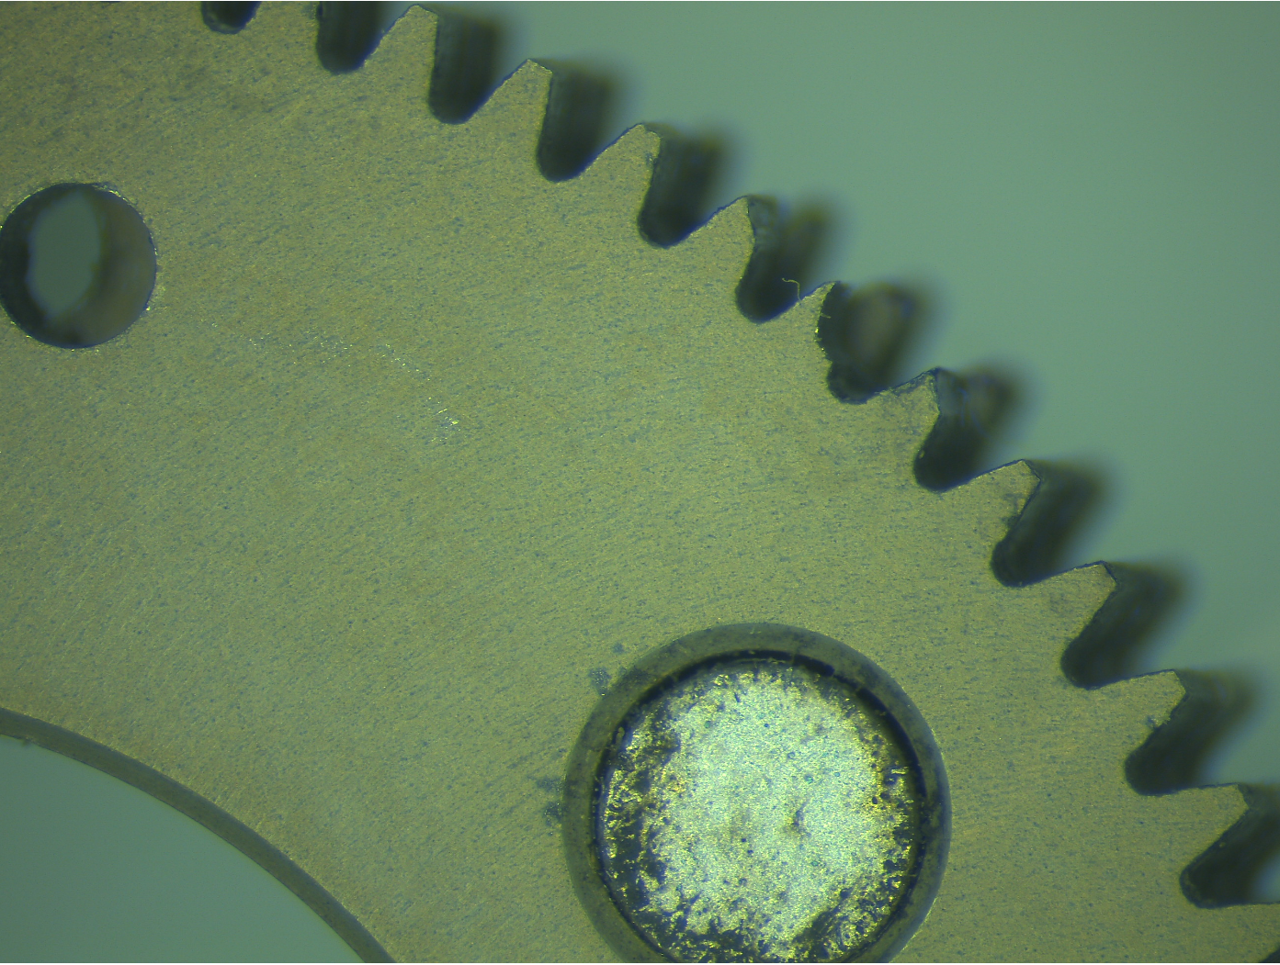
PROBLEMS WITH THE ROBOT
Connectivity problem
Broken part
Identify the problem
Robot electronic card
Dismounting the robot
Send the robot to the company
Ana Karen Reascos Portilla
21/05/2021
8

Slide 10
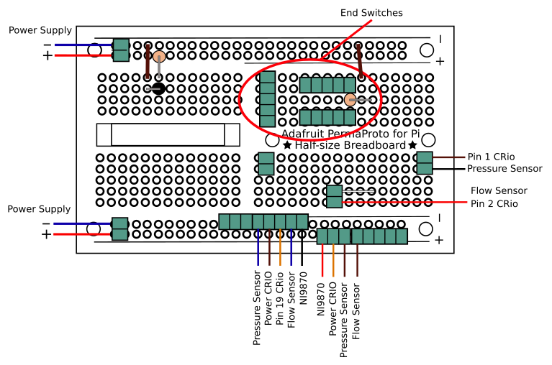
BREADBOARD
Ana Karen Reascos Portilla
21/05/2021
9

Slide 11
ACTIONS PLANNED
Install the laser with the beam delivery system (BDS).
Integrate in the system two electronic valves to control the nitrogen flow. This also allow us to know when we need to change the bottles.
Find a cable management system to insert and extract 20 m of cables.
Ana Karen Reascos Portilla
21/05/2021
10

Slide 12
OVERVIEW OF THE PROJECT
Duplicate the system
Robot problems
Cable Management
Cabling
Electronic valves
Laser
Breadboard
Extension
Hose
System
Ana Karen Reascos Portilla
21/05/2021
11

Slide 13
Laser treatment for electron cloud mitigation
3rd Workshop 28/05/2020
Ana Karen Reascos Portilla TE-VSC
Supervisors:
Marcel Himmerlich TE-VSC
Mauro Taborelli TE-VSC
Ana Karen Reascos Portilla
21/05/2021
1
1

