Slide 2

TE-CRG-CE
Controls and Electrical Support for cryogenics
SPS BA6
Cryoplant Refurbishment
for CPC6-UNICOS process control system
Sergio VILLANUEVA
Supervisor: Marco PEZZETTI
12th FTEC Workshop

Slide 3
Summary
Introduction
SPS BA6 Cryoplant status
Ongoing projects.
Conclusion.

Slide 4
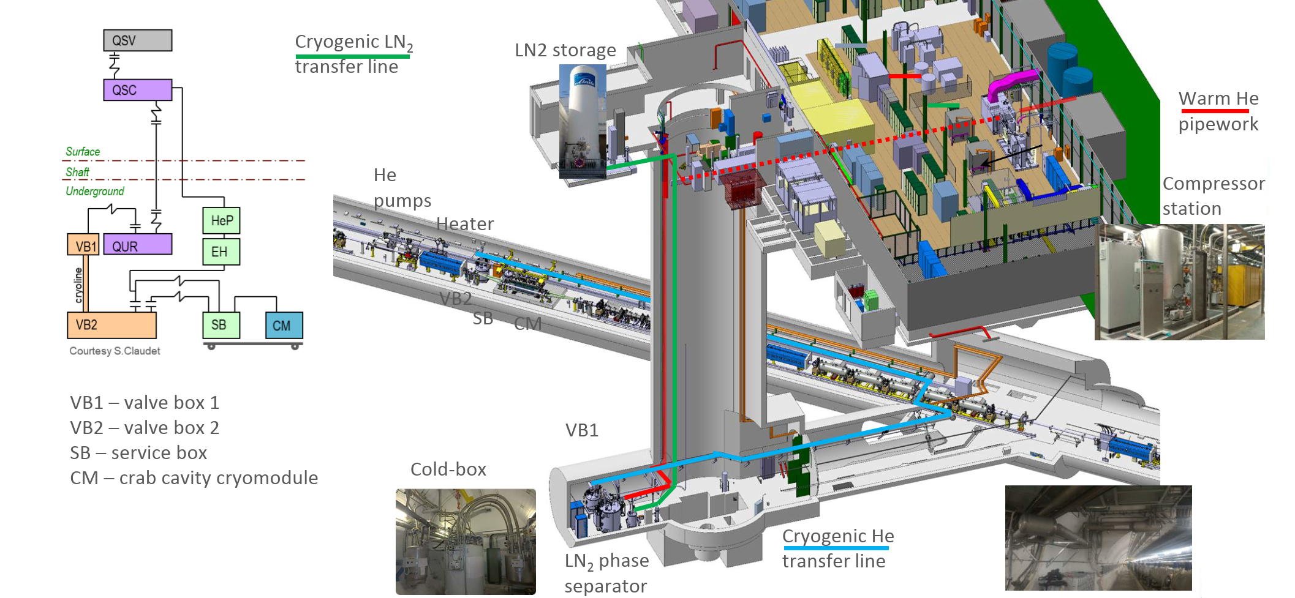

SPS BA6 Layout
Refurbishment of the CFB_BA6_QACR Cryoplant
(HW + SW) to be integrated in UNICOS
Warm He

Slide 5

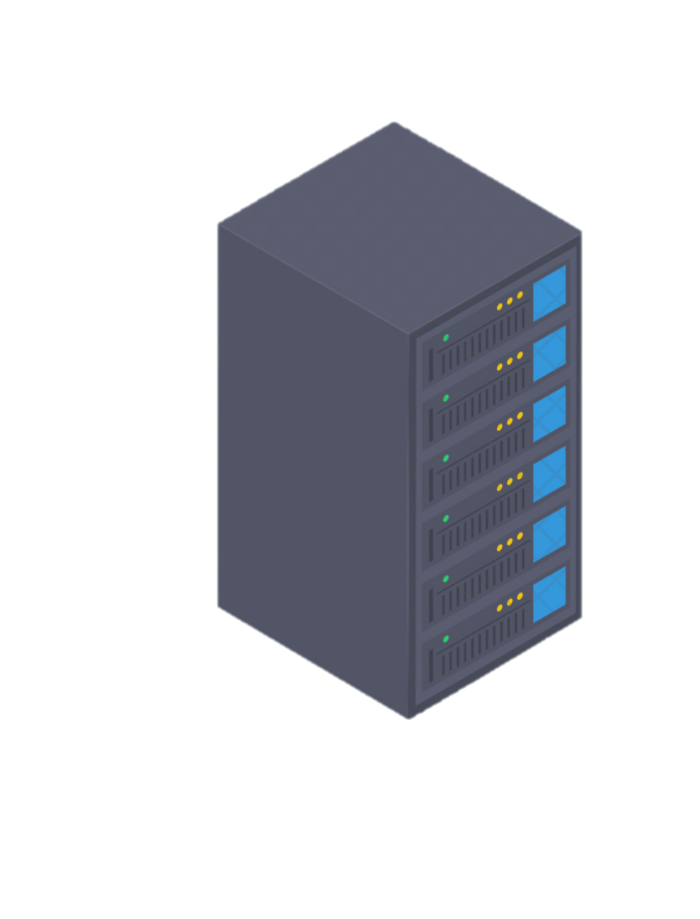
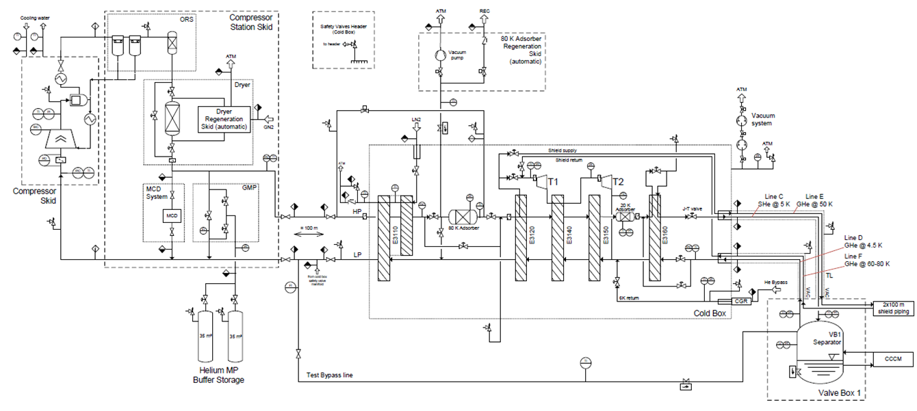
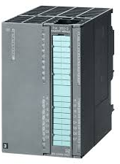

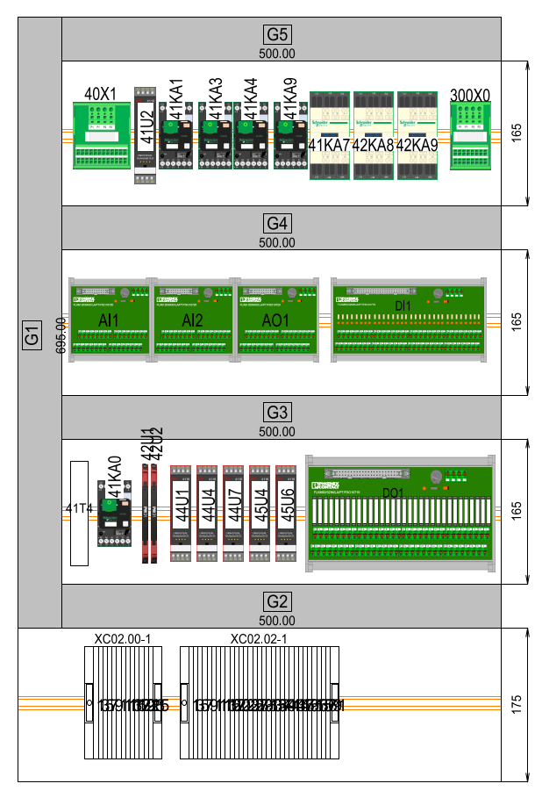
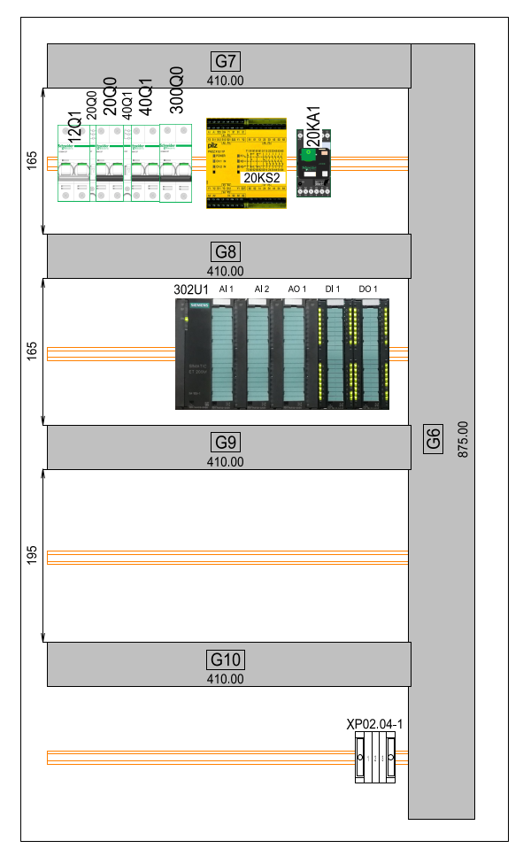
SPS BA6 Control Architecture
After the integration, an UNICOS PLC software will control the cryoplant
CS-CCR-COCA
Full control/diagnose of all equipments
New supervision
Data Server
Communication
CFP-BA6_QAICC
PLC
CFP-BA6-QACR
PLC
New Safety Chain
+ Compressor I/O

Slide 6
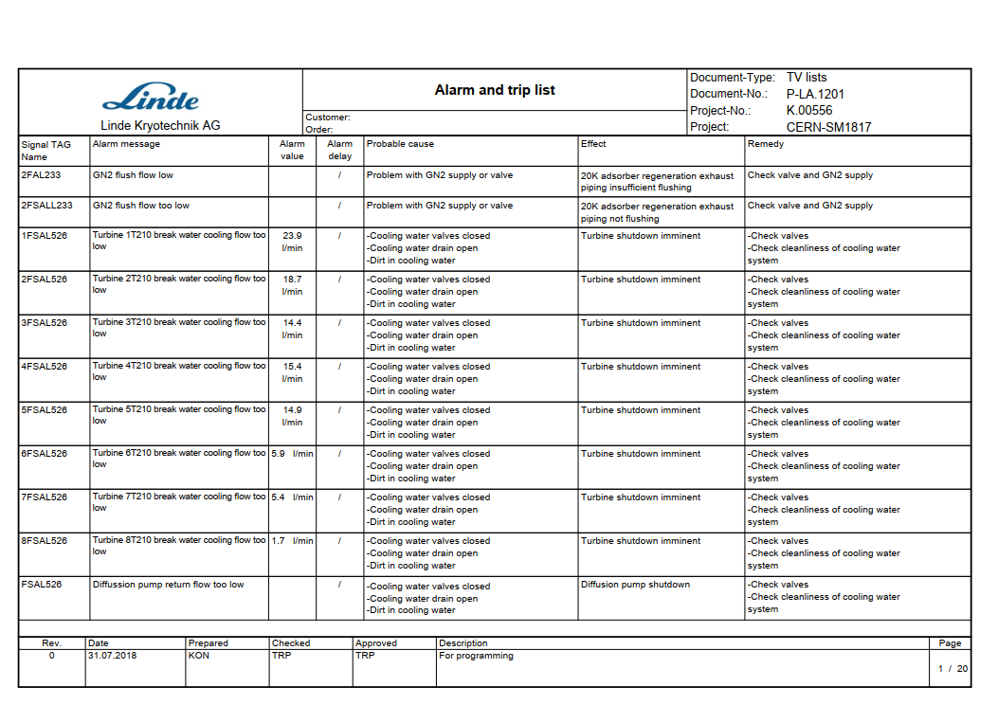
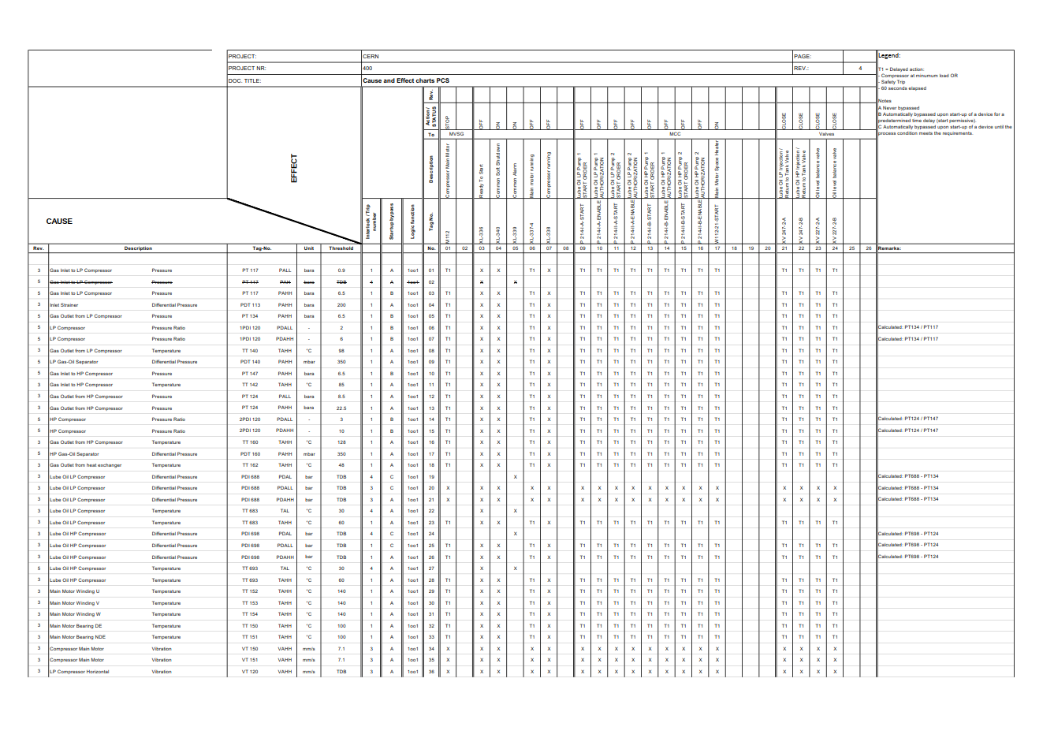
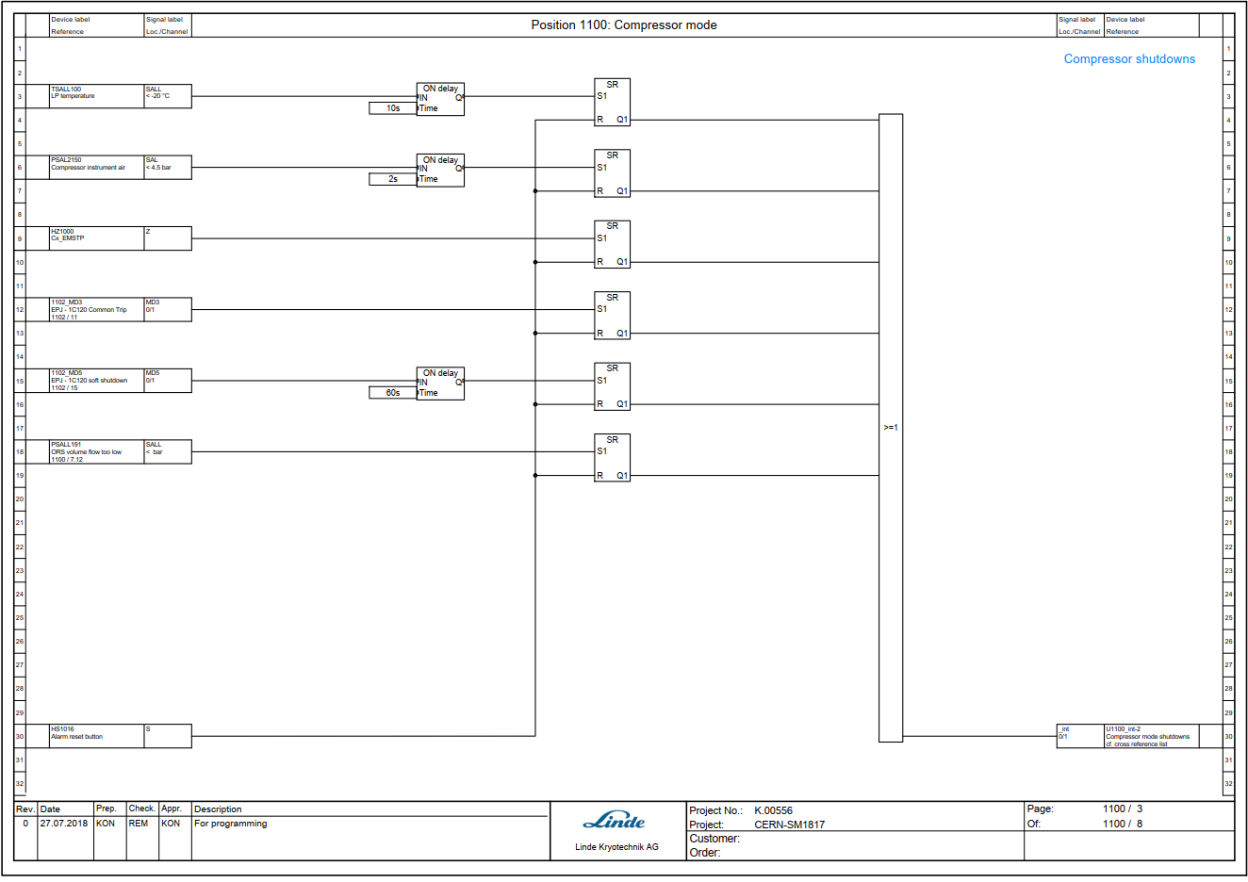
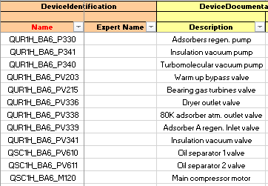
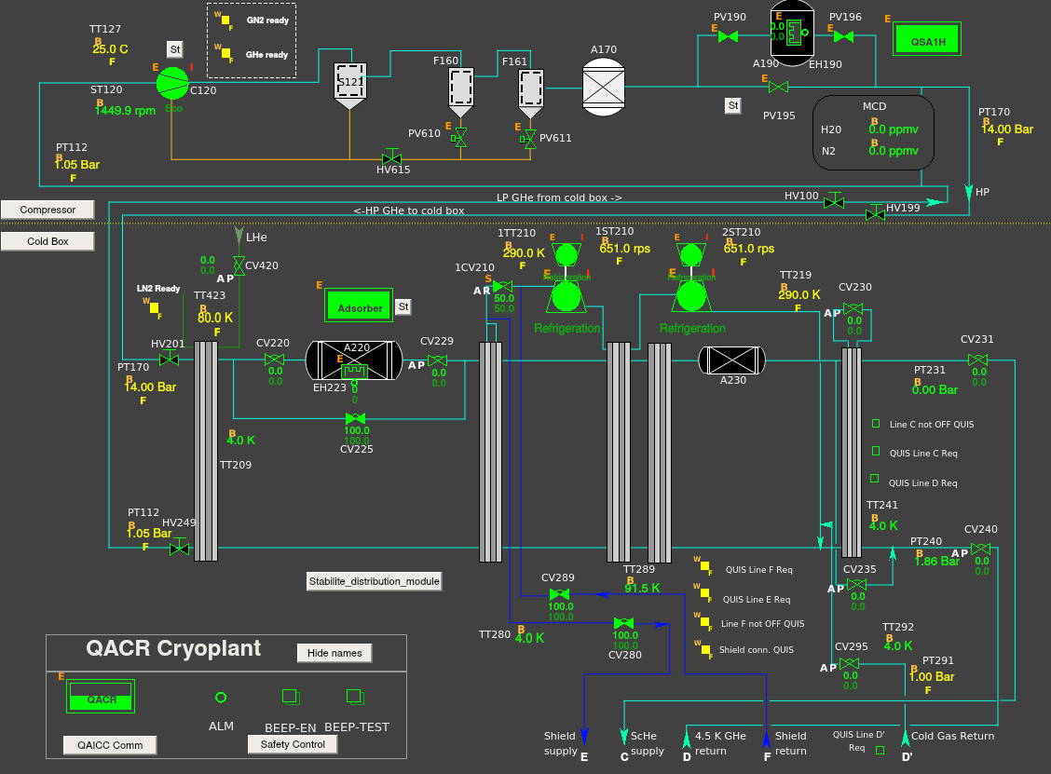

SBS BA6 Software Continuous Integration
The following procedure has been followed during the development
Validation in progress
(ends June-2021)
Database + Logic definition
Unicos
generation
Mirror tests
WinCC OA / SW Ready to download
- LINDE documentation
  Alarm list
  Functional Plan
  Siemens Software
  P&ID
  Electrical drawing
Logic Spec.
SPS BA6 Compressor station
+
Cold Box
Logic Spec. Draft
(TE-CRG-OP)
SW validated after
mirror test
- SM18 35 g/s experience
Documentation
and software update
- TE-CRG-CE standards
-TE-CRG-OP / TE-CRG-ML process expertise
Once the validation is finished, the software should be tested on site:
Equipment protection and safeties.
Alarms and interlocks.
Control logic (paying special attention in compressor/turbine system).

Slide 7
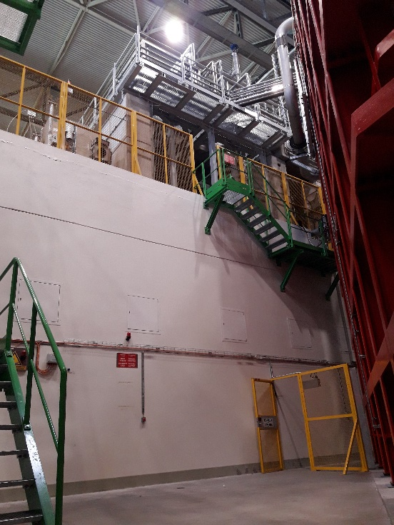
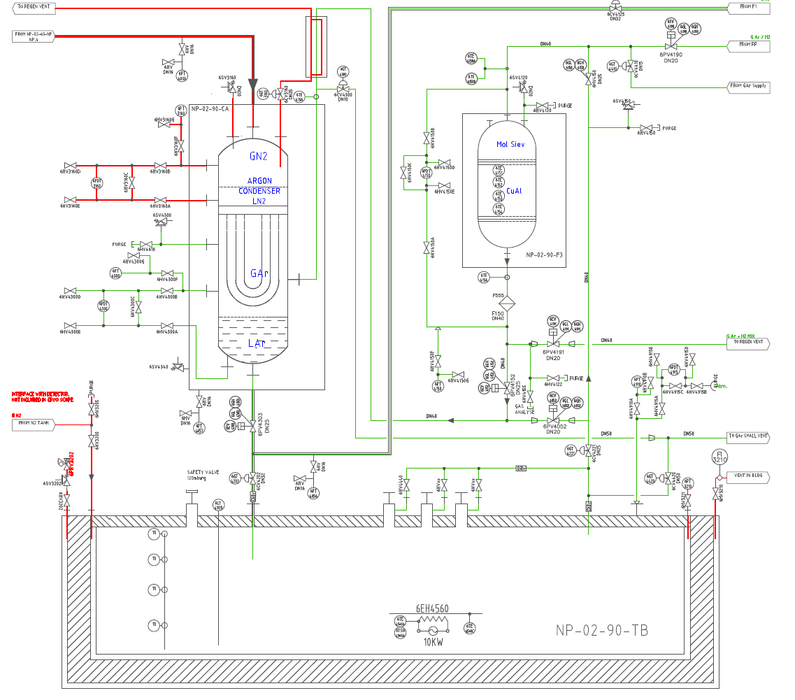
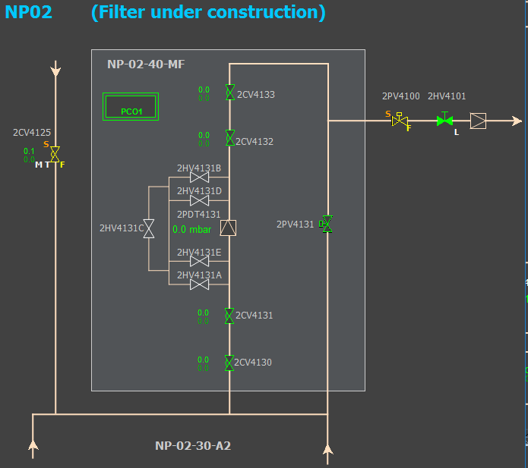
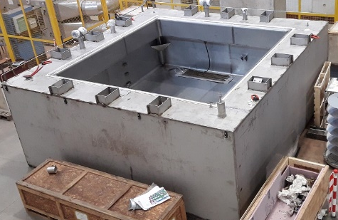
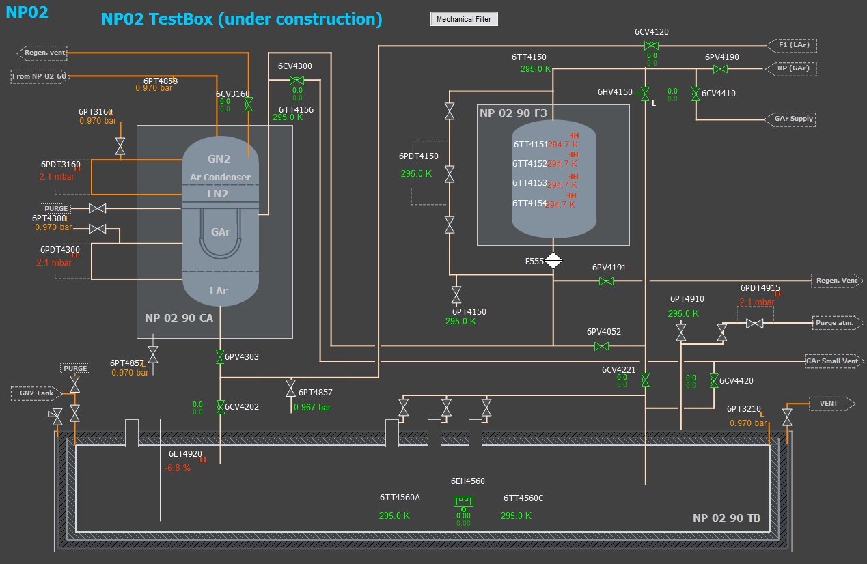
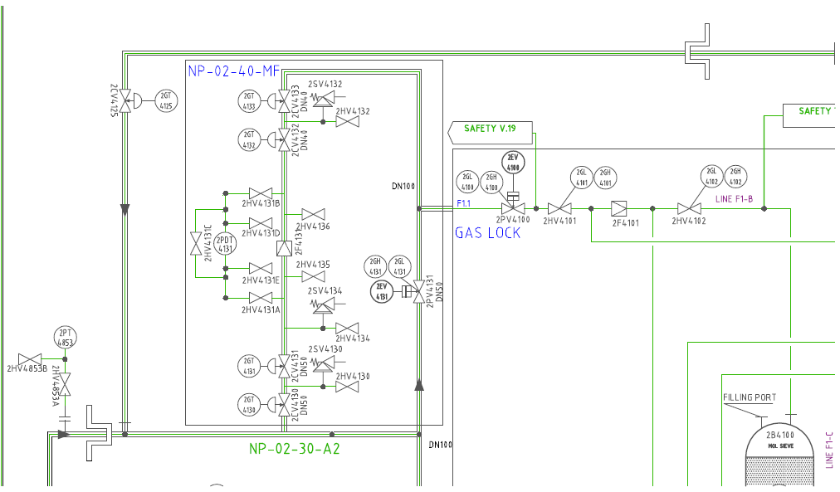
Ongoing Projects. NP02 Test box
The existing NP02 PLC Program will be modified.
- 3 Electrical proposals already presented.
- Cabinets spare I/O channels will be used for this project
- Control preparation will start soon
- Commissioning in August 2021.
Level 1/2
Level S/R
Purifier
New NP02 Test box will be located in the pit on 3 levels
Condenser
Filter
Level S2
Test box
NP02 new Test box instrumentation (56 I/O)
NP02 new filter instrumentation (12 I/O)

Slide 8
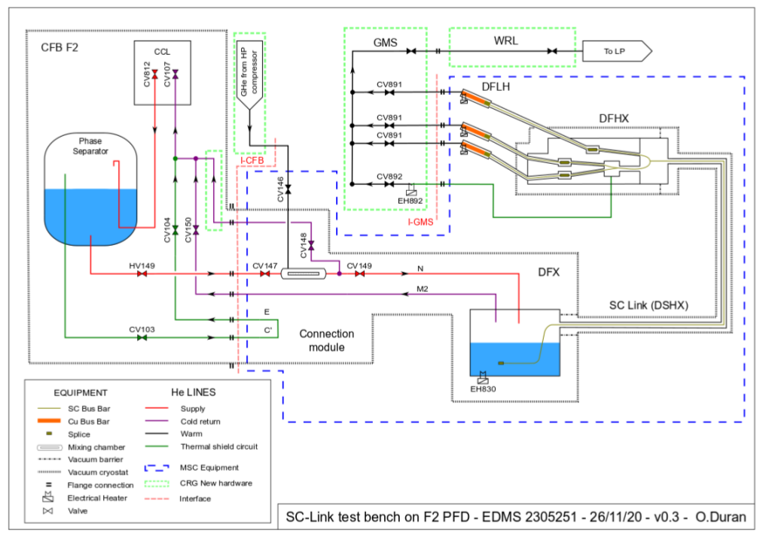
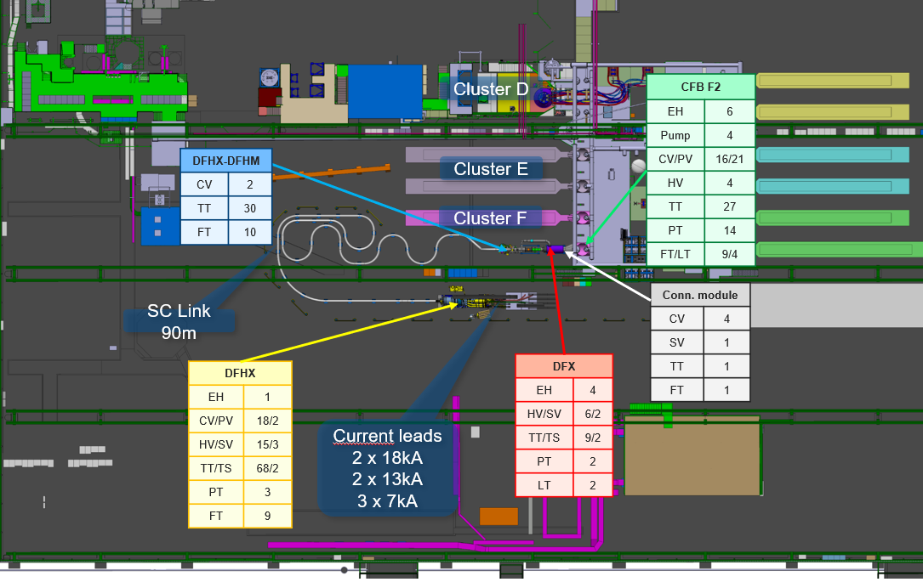
Ongoing Projects. SM18 SC-Link
Electrical design and control of the new SC-Link current leads test bench.
Brand new CPU S7-1500 for the control system.
Planning 2021:
May-June Electrical schemas
Aug-Sept Cabinet construction
Oct-Nov Electrical installation +
Control / SW preparation
Dec 2021 Commissioning

Slide 9
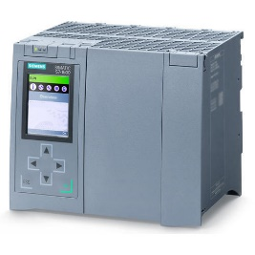
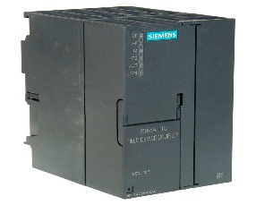
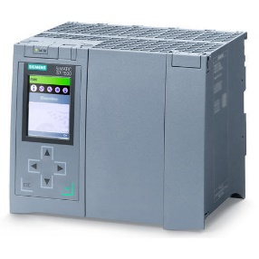
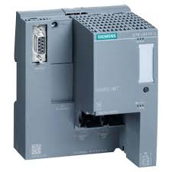
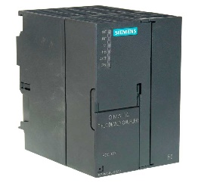
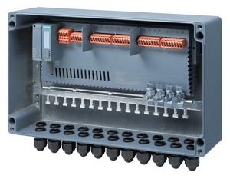
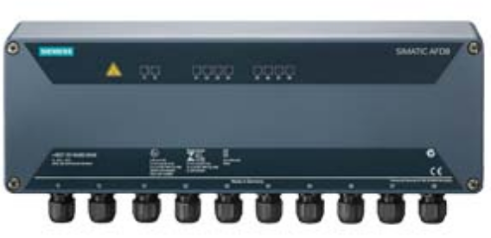
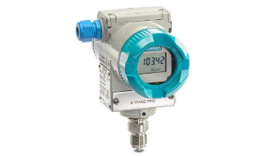
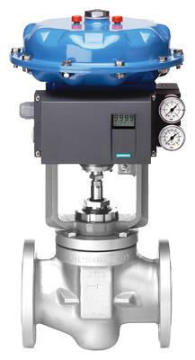

Ongoing Projects. PN-PA new architecture
IE/PB link + 2x FDC157 PA
Simatic Compact Field Unit (CFU)
S7-1500 CPU
Profinet PN
Profinet PN
Profibus DP
2 different architectures
(up to 8 PA slaves per module)
Simatic CFU
Distributor AFD8
Profibus PA
Profibus PA
IE/PB Link PN-PB Gateway | 870.00 €
FDC157 PA Coupler | 2x 800.00 €
AFD8 Distributor PA | 860.00 €
 | 3330.00 €
Simatic CFU (with housing) | 2000.00 €
Simatic CFU (without housing) | 1700.00 €
Profibus ring redundancy
Faster speed + ring redundancy
Extra Hardware in the topology (Gateway + coupler)
Integration in 1 single module
Profibus configured in S7 HW Config (not TIA)
Easy HW and mapping in TIA Portal
PDM Configuration and diagnose
PDM Configuration and diagnose
Better price as the PA devices increases ( >24xPA)
Cheaper for small networks

Slide 10
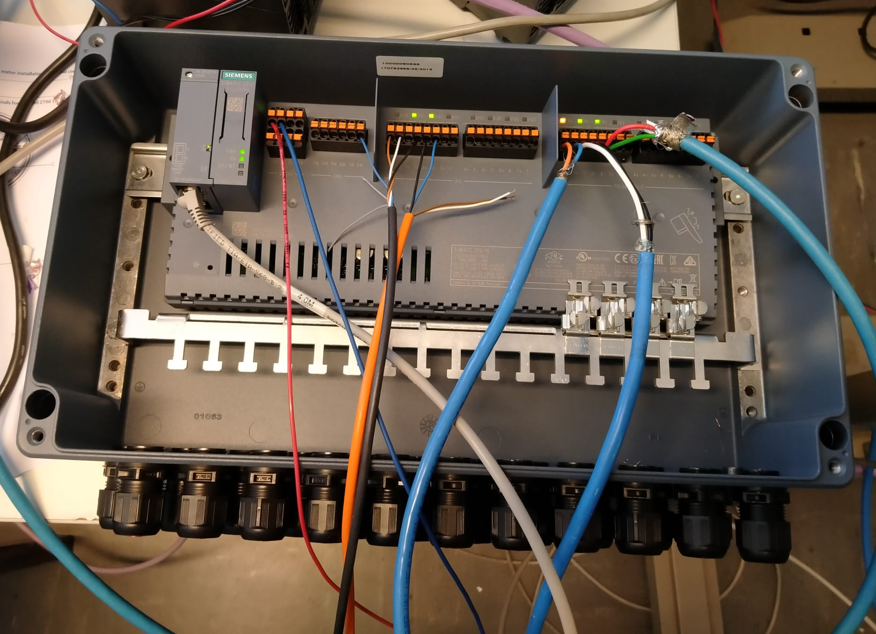
Ongoing Projects. PN-PA new architecture
SC-Link will be the first cryogenic project built with TIA Portal (CPU S7-1500).
Simatic Compact Field Unit (CFU)
Many field devices (valve positioners and instruments) with be in a Profibus PA Network.
S7-1500 CPU
Profinet PN
Simatic CFU
Currently, a new distributor (SIMATIC CFU) is being tested to be integrated in future TIA Portal projects.
Profibus PA
Simatic CFU (with housing) | 2000.00 €
Simatic CFU (without housing) | 1700.00 €
Faster speed + ring redundancy
Integration in 1 single module
Easy HW and mapping in TIA Portal
PDM Configuration and diagnose
Cheaper for small networks

Slide 11
Conclusion
SPS-BA6 cryoplant software is nearly validated and will be ready to test on site soon with minor electrical modifications (depending on operation schedule)
Neutrino Platform NP02 test box electrical design, software and SCADA preparation has already started (Commissioned in August 2021)
SM18 SC-Link Electrical schemas design is ongoing. Control will be prepared soon (October 2021) This testbench should be commissioned in December 2021.

Slide 12
Thank you for your attention!

