Slide 1


Consolidation and Redesign of the CERN Industrials Controls Frameworks (FTEC2019-10)
BE-ICS-FT
Juan Manuel Pablo Rodríguez
Supervisors: Fernando Varela Rodríguez, Piotr Golonka
Date: 21/05/2021

Slide 2
Outline
      UNICOS Human Machine Interface (HMI)
      Infor EAM Integration Prototype
      Future Work

Slide 3
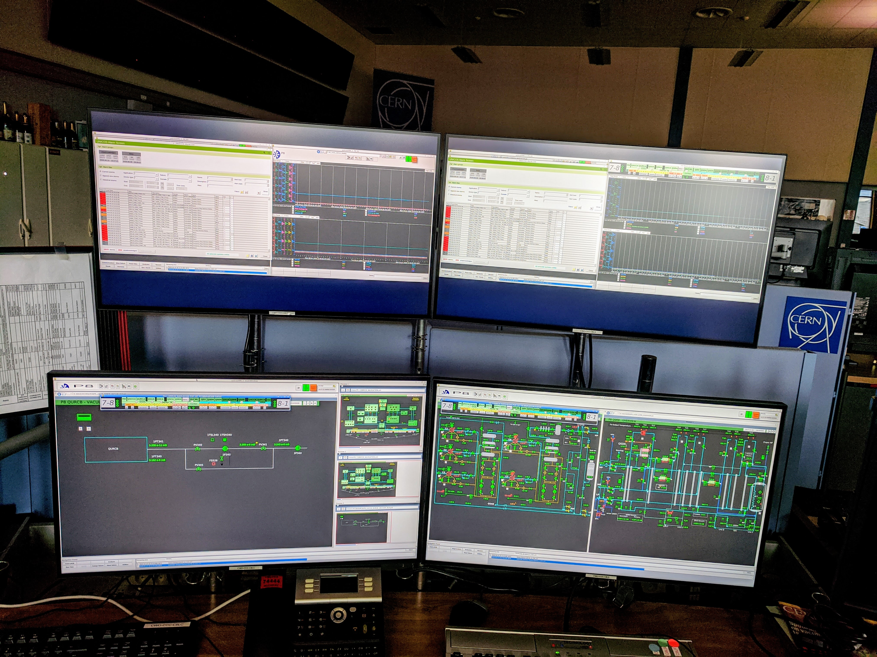
UNICOS Human Machine Interface (HMI)
  Supervise the control systems of experiments and projects.
  Used by the Cryogenics group in the CERN Control Center (CCC) with large screen resolution.
  Recently adopted by operators in the Magnet workshops with touchpad smaller screens.

Slide 4
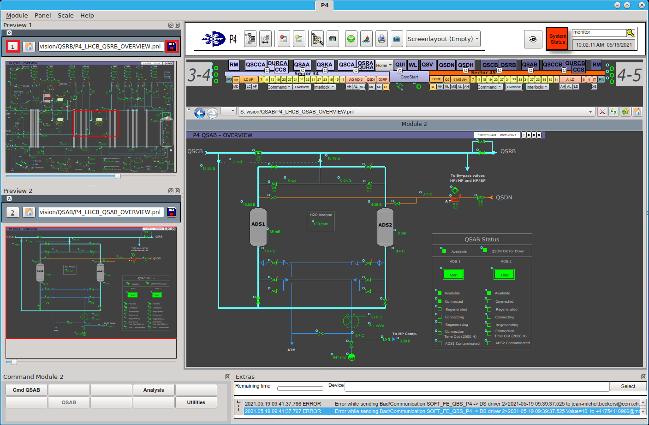
UNICOS Human Machine Interface (HMI)
  Release of version 1.1.1 including:
  New detailed User Manual and Reference Guide.
  Save/load view port zoom and position functionality.
  ALT+number keyboard open module shortcut.
  Mouse-wheel zoom in/out.
  Preview modules hidden automatically in split mode.

Slide 5
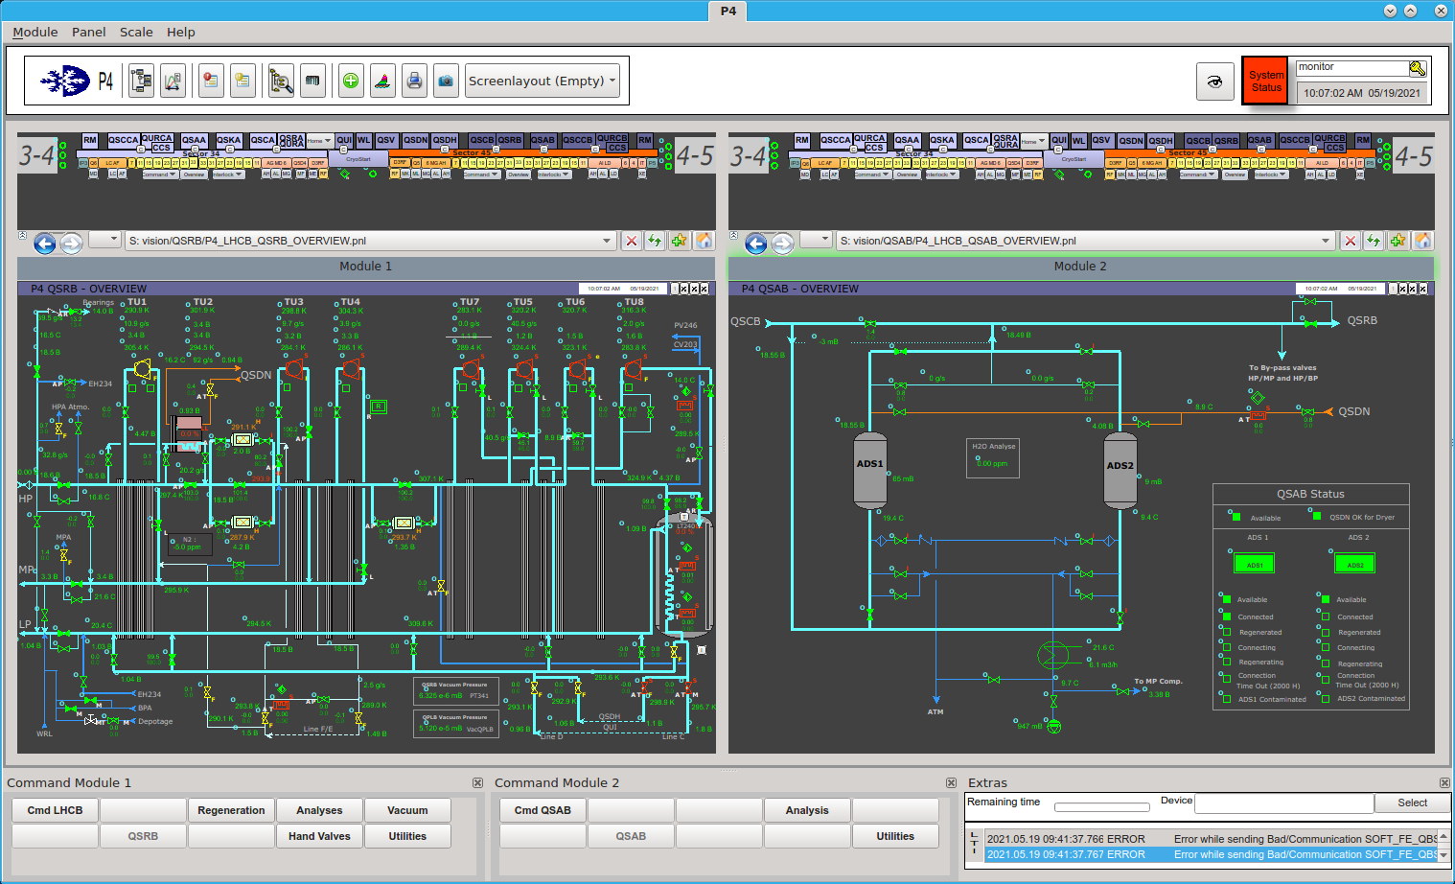
UNICOS Human Machine Interface (HMI)
  Other tasks:
  Cryogenics’ feedback consideration from previous HMI version deployed.
  Communication about required improvements with Magnet workshops.
  Research and compatibility tests against ETM WinCC OA 3.18 software recently released.

Slide 6
Infor EAM Integration Prototype
  Software for managing materials and assets in operation and production, and for maintenance.
  Used to keep track of equipment installed in the experiments.
  Critical and detailed information introduced in Infor EAM databases automatically (bar code scan). Other additional data inserted by operators.
  Main goal: Develop a prototype that integrates Infor EAM database information into the UNICOS framework.

Slide 7



Infor EAM Integration Prototype
1. SQL query request
UNICOS Application
Infor EAM Database
2. SQL query response
5. Final Result
3. REST API request
4. REST API response
Infor EAM Web Services

Slide 8
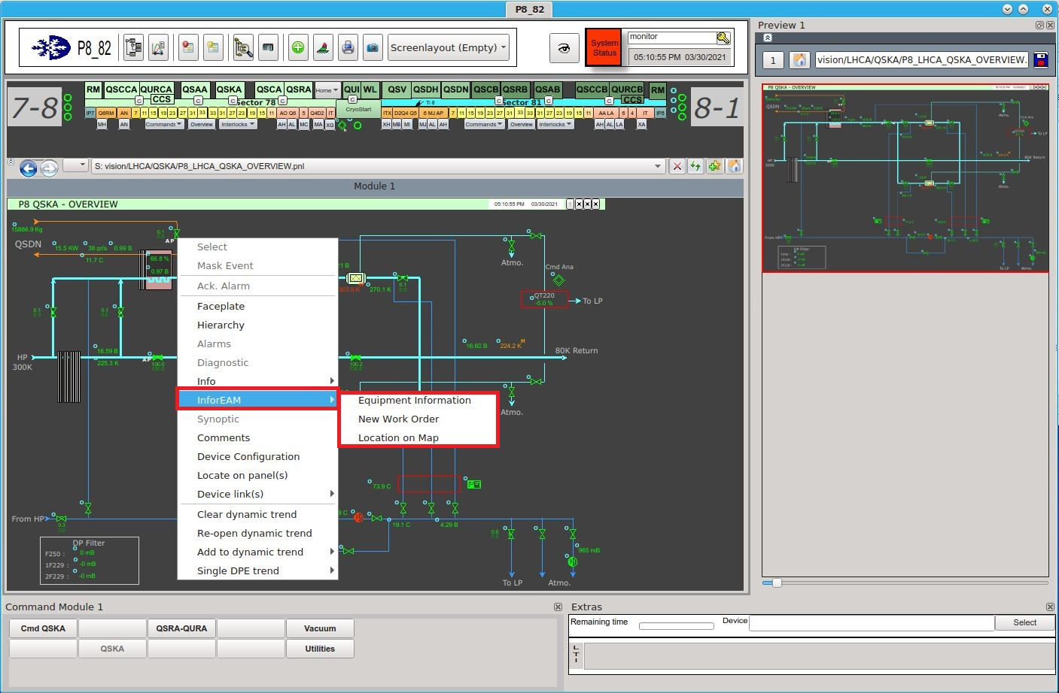
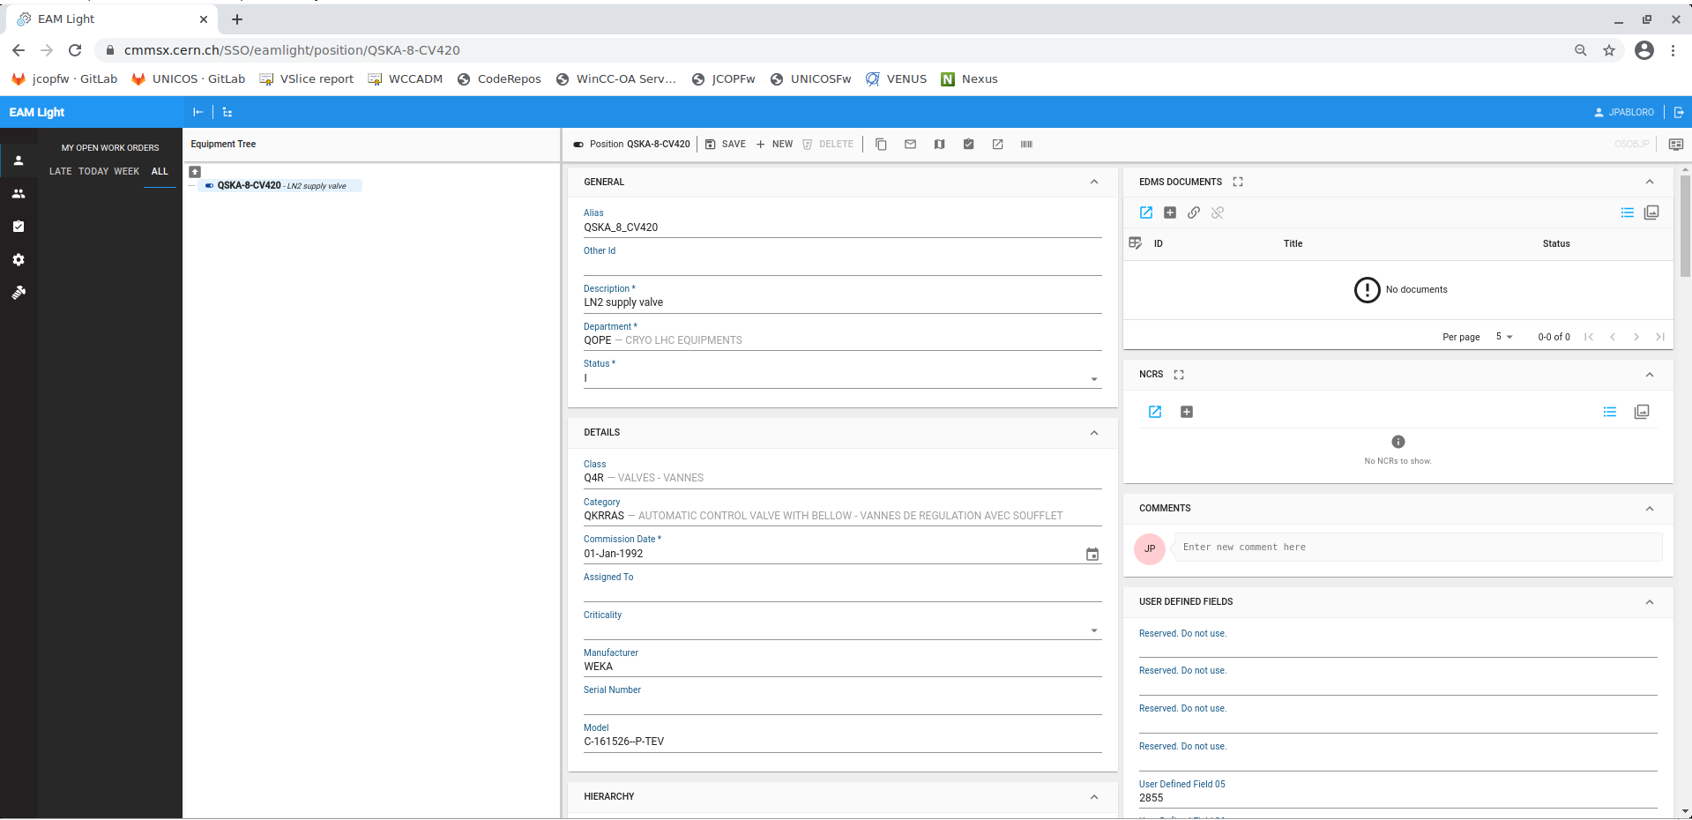
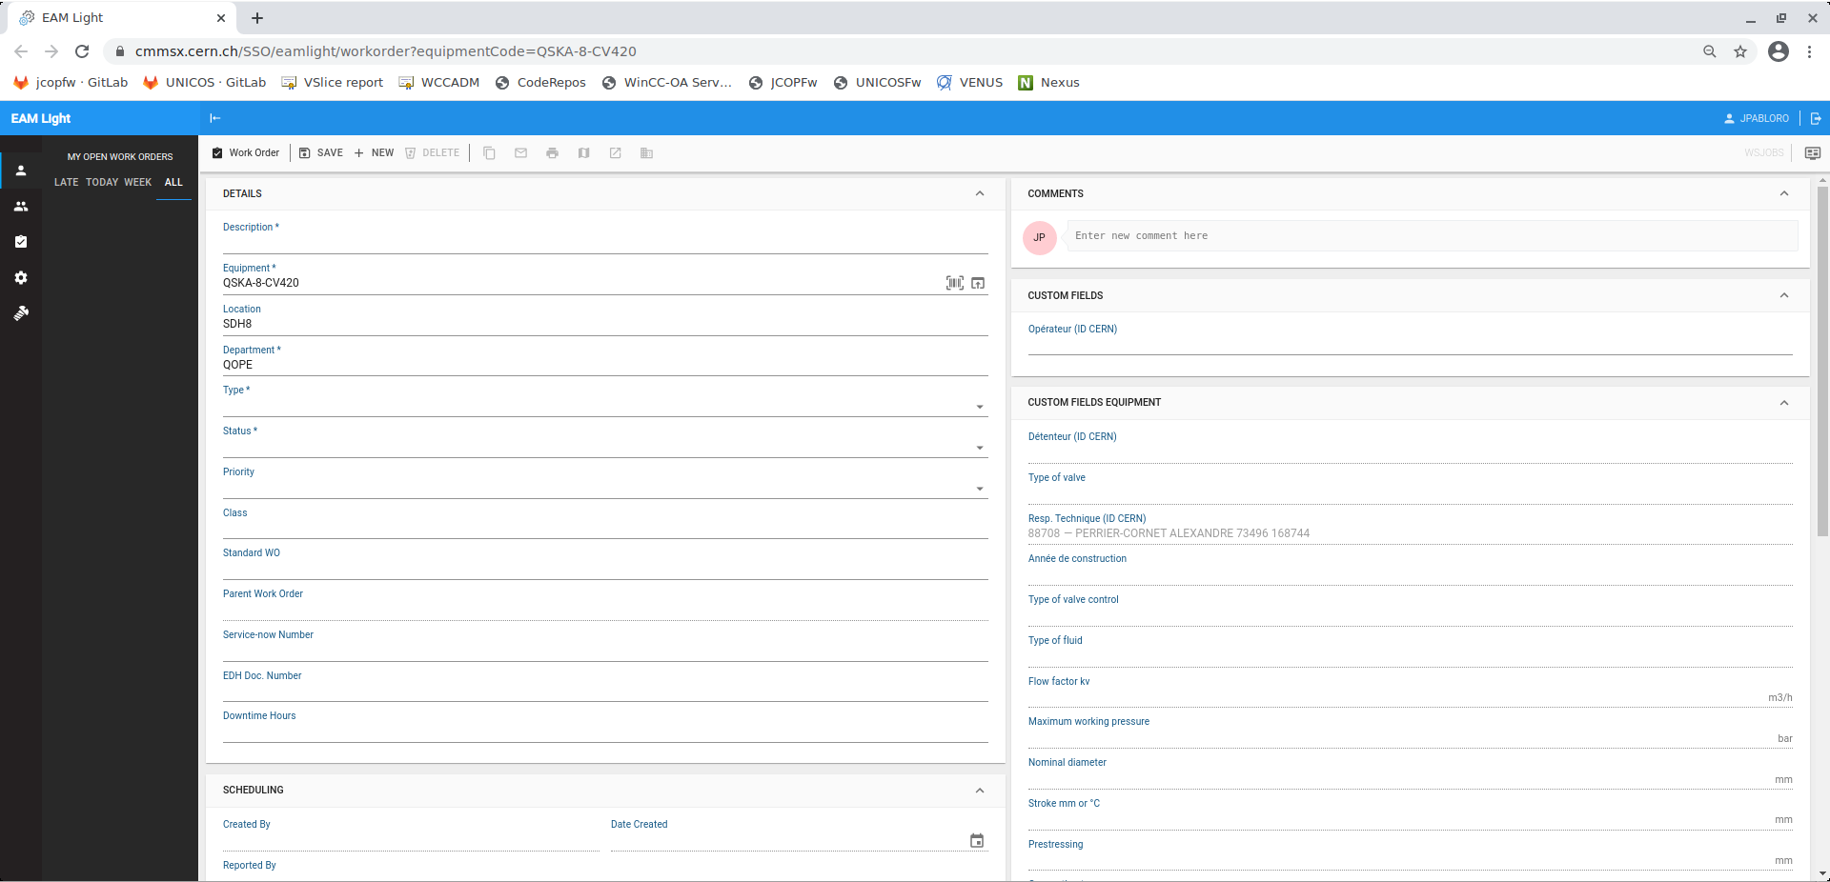
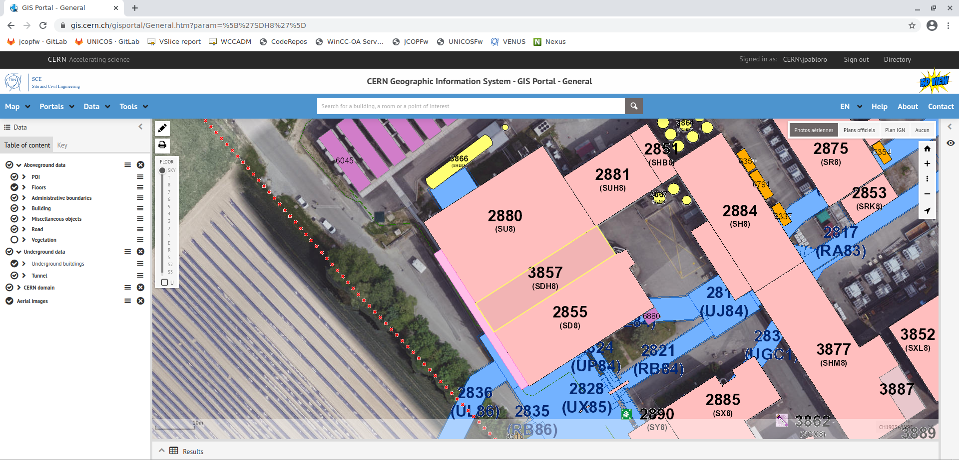
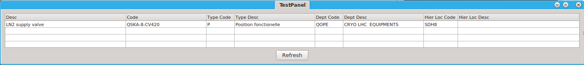
Infor EAM Integration Prototype

Slide 9
Future work
  Provide support for the HMI, implement features requested by clients, release new incremental versions, and research functionalities included in WinCC OA 3.18.
  Show the current state of the Infor EAM prototype to the UNICOS users, and explain the many possibilities that this project presents for the future.
  Consolidate and deploy in production the Infor EAM integration code.
  Discuss and collect ideas from users and developers for future considerations.

Slide 10

Thanks for your attention
Questions?

